Slide 1
PLEASE STANDBY
OUR LIVESTREAM
WILL BEGIN SOON

Slide 2
WELCOME
THANKS FOR JOINING US!

Slide 3
Songs of
Praise to God

Slide 4
Opening PRAYER

Slide 5
Songs of
Praise to God

Slide 6
THE REVELATION OF JESUS CHRIST
“WHO IS ABLE TO STAND?”
REVELATION 6:17 (NKJV)

Slide 7
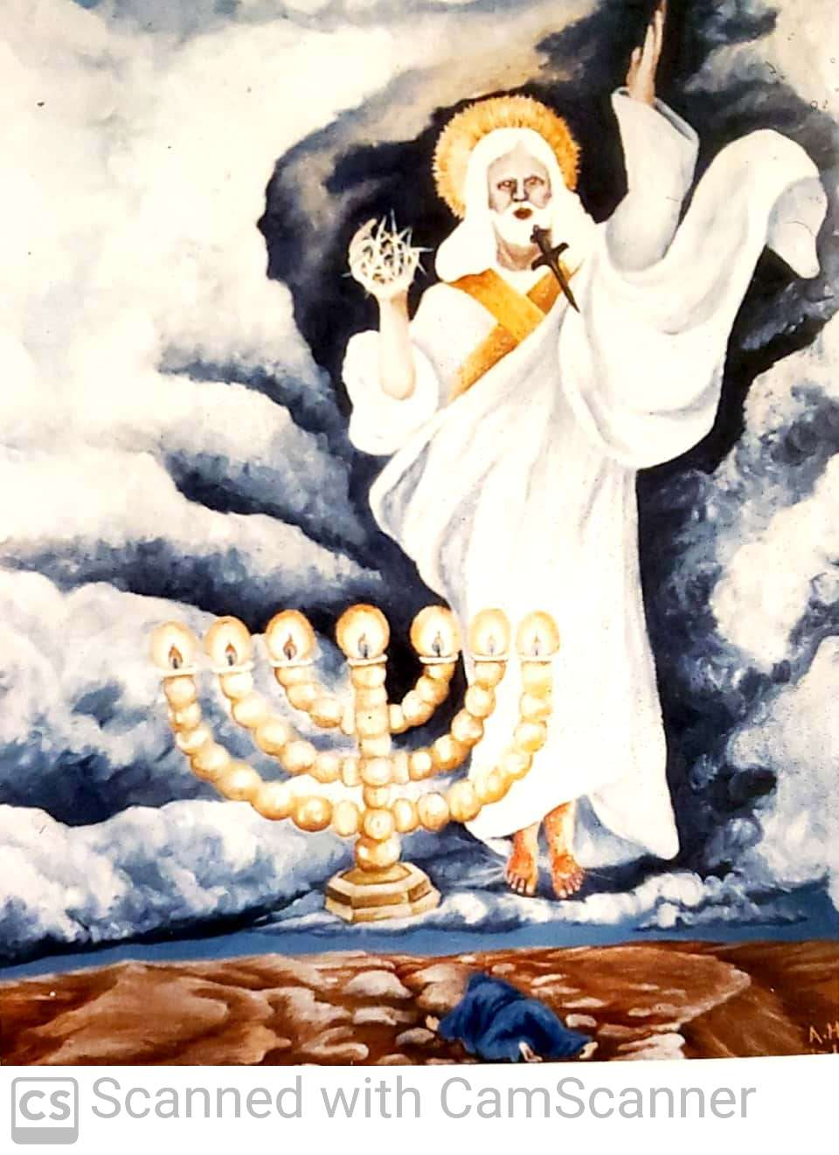

Slide 8
First Seal Opened
Rev. 6:1-2

Slide 9
First Seal Opened
Rev. 6:1-2
Man on a White Horse
Given a Bow → Sent to Conquer
Gal. 5:4, Heb. 12:15, 2 Pet. 3:17

Slide 10
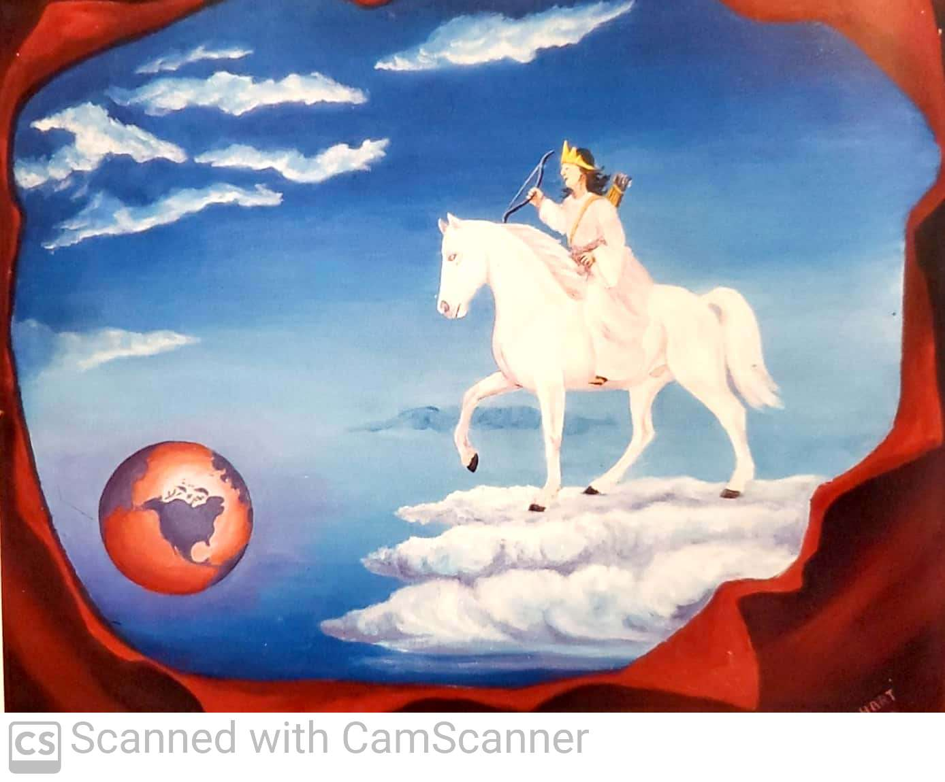

Slide 11
Second Seal Opened
Rev. 6:3-4

Slide 12
Second Seal Opened
Rev. 6:3-4
Man on a Red Horse
Given a Sword → Takes Peace Away
Gal. 5:4, Heb. 12:15, 2 Pet. 3:17

Slide 13
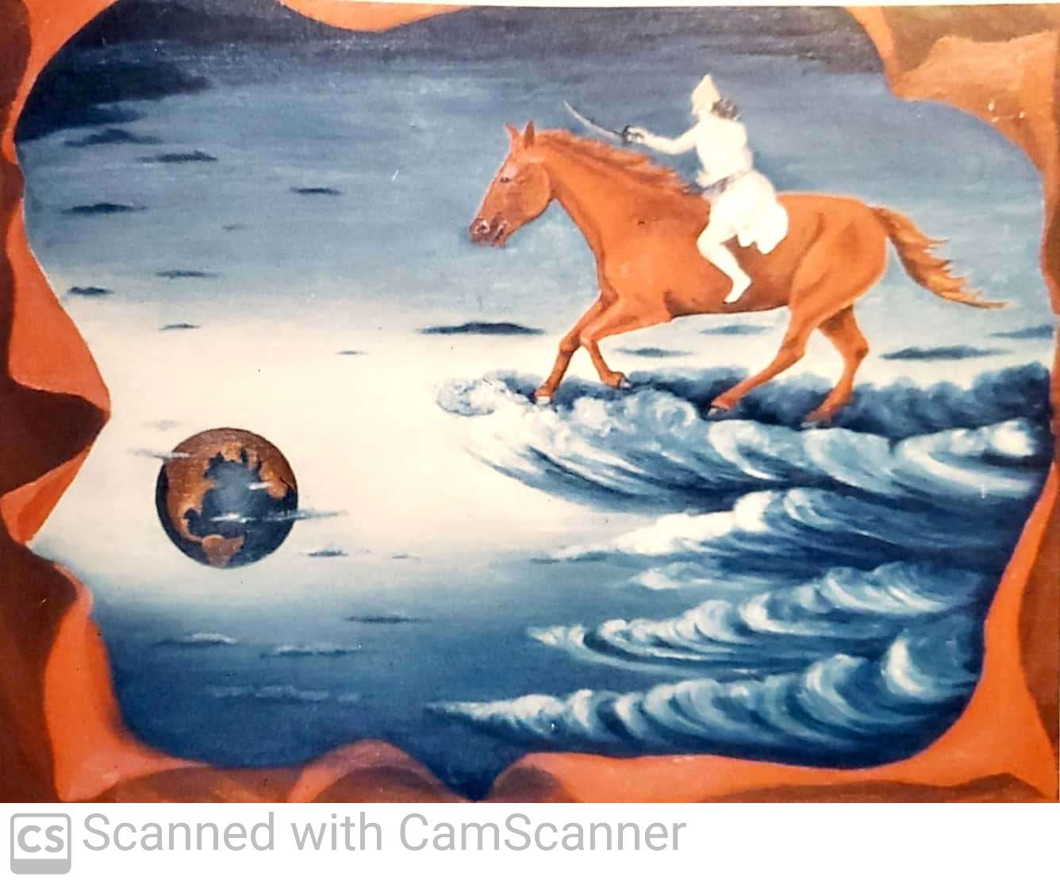

Slide 14
Third Seal Opened
Rev. 6:5-6

Slide 15
Third Seal Opened
Rev. 6:5-6
Man on a Black Horse
Given a pair of Scales → Famine
Gal. 5:4, Heb. 12:15, 2 Pet. 3:17

Slide 16
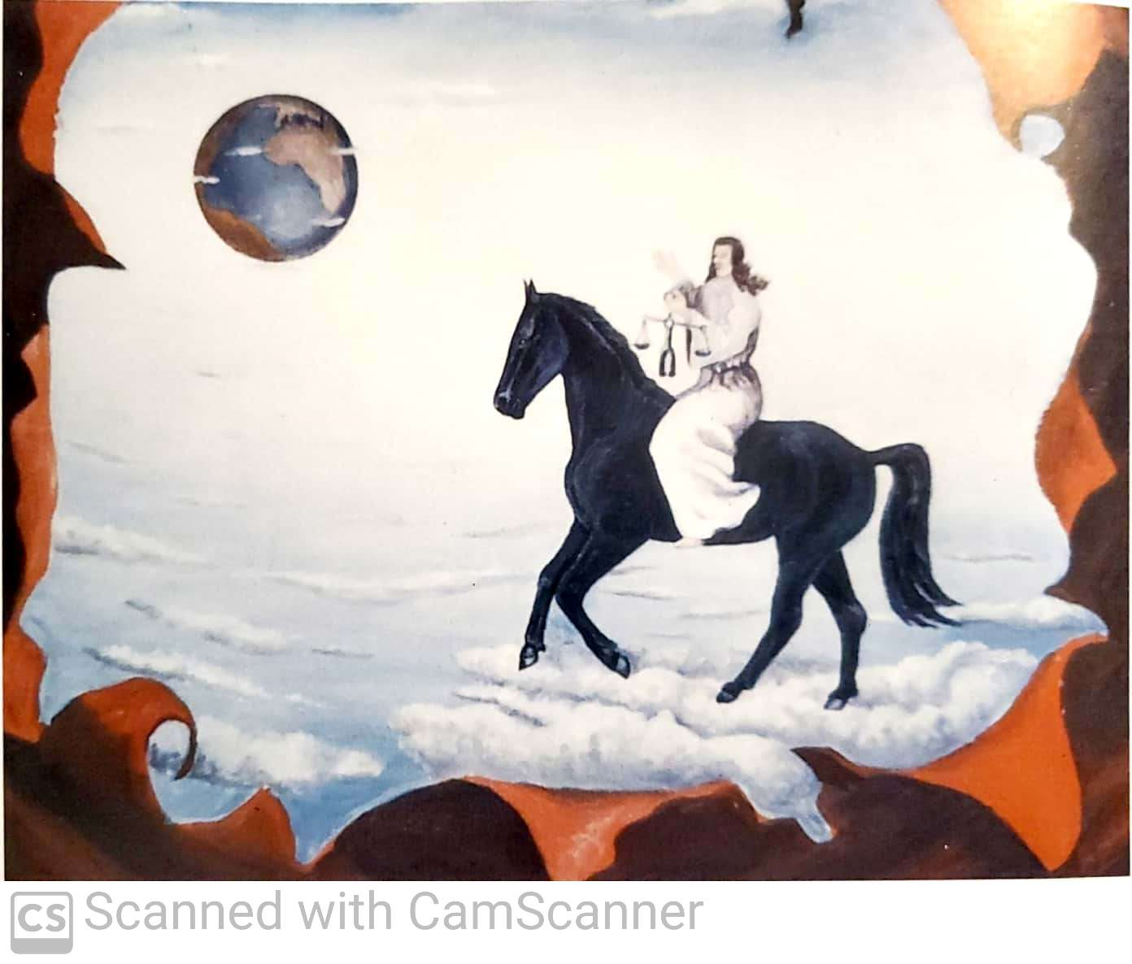

Slide 17
Fourth Seal Opened
Rev. 6:7-8

Slide 18
Fourth Seal Opened
Rev. 6:7-8
Man on a Pale Horse
Named “Death”→ Power to Kill
Gal. 5:4, Heb. 12:15, 2 Pet. 3:17

Slide 19
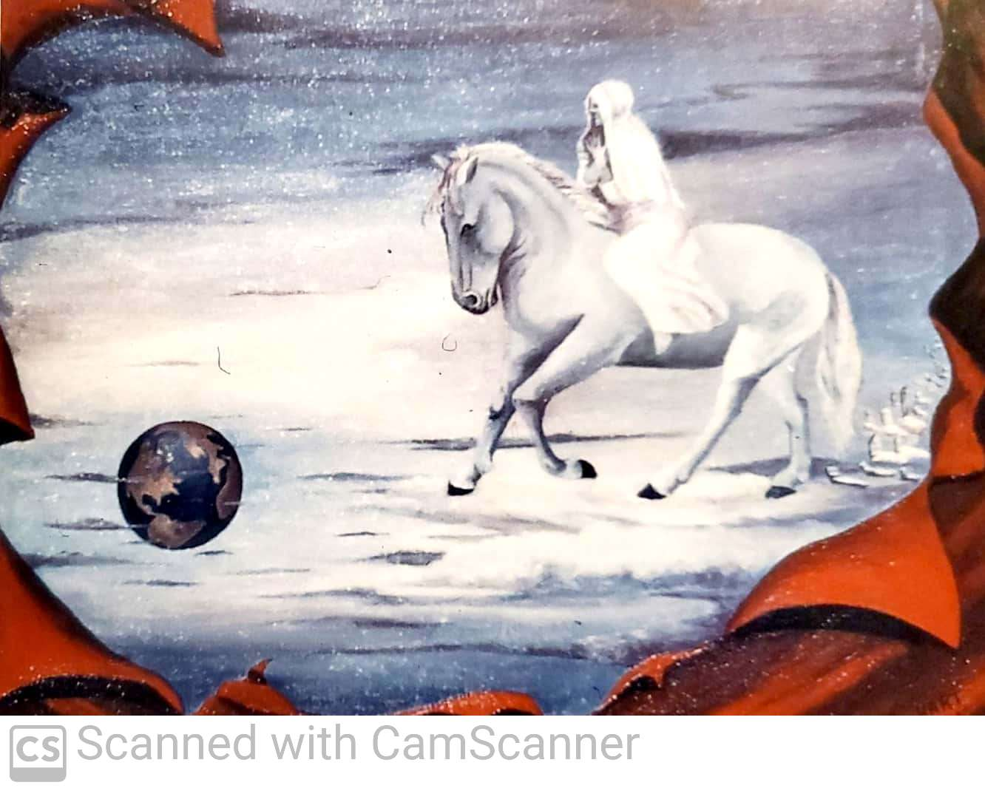

Slide 20
Fifth Seal Opened
Rev. 6:9-11

Slide 21
Fifth Seal Opened
Rev. 6:9-11
Souls of the Martyrs
Under the Altar → Crying out, “How long…?”

Slide 22
Fifth Seal Opened
Rev. 6:9-11
Souls of the Martyrs
Under the Altar → Crying out, “How long…?”
Answer in v. 11

Slide 23
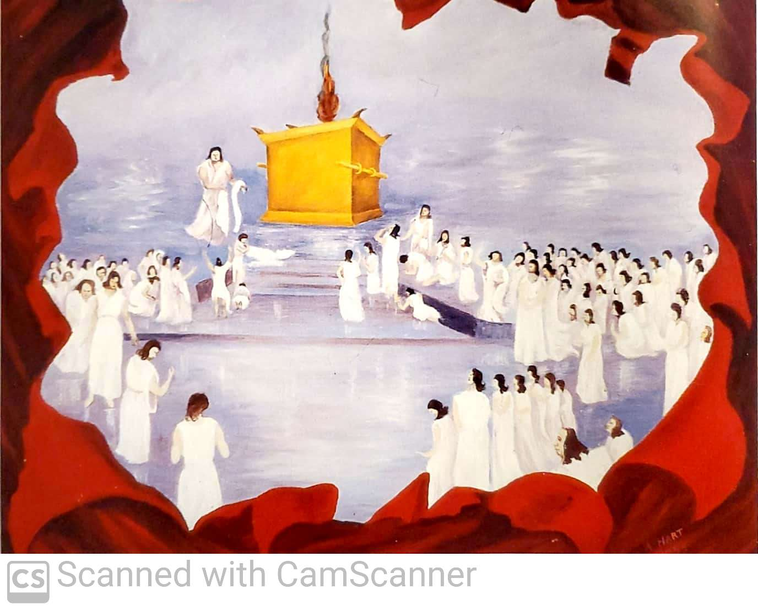

Slide 24
Sixth Seal Opened
Rev. 6:12-17
Seven Signs:
Earthquake
Sun turned black
Moon turned to blood
Stars fall to earth
Sky rolls back
Mountains/Islands Moved
Mankind Hides

Slide 25
Sixth Seal Opened
Rev. 6:12-17
Seven Signs:
Earthquake
Sun turned black
Moon turned to blood
Stars fall to earth
Sky rolls back
Mountains/Islands Moved
Mankind Hides
Judgment Language

Slide 26
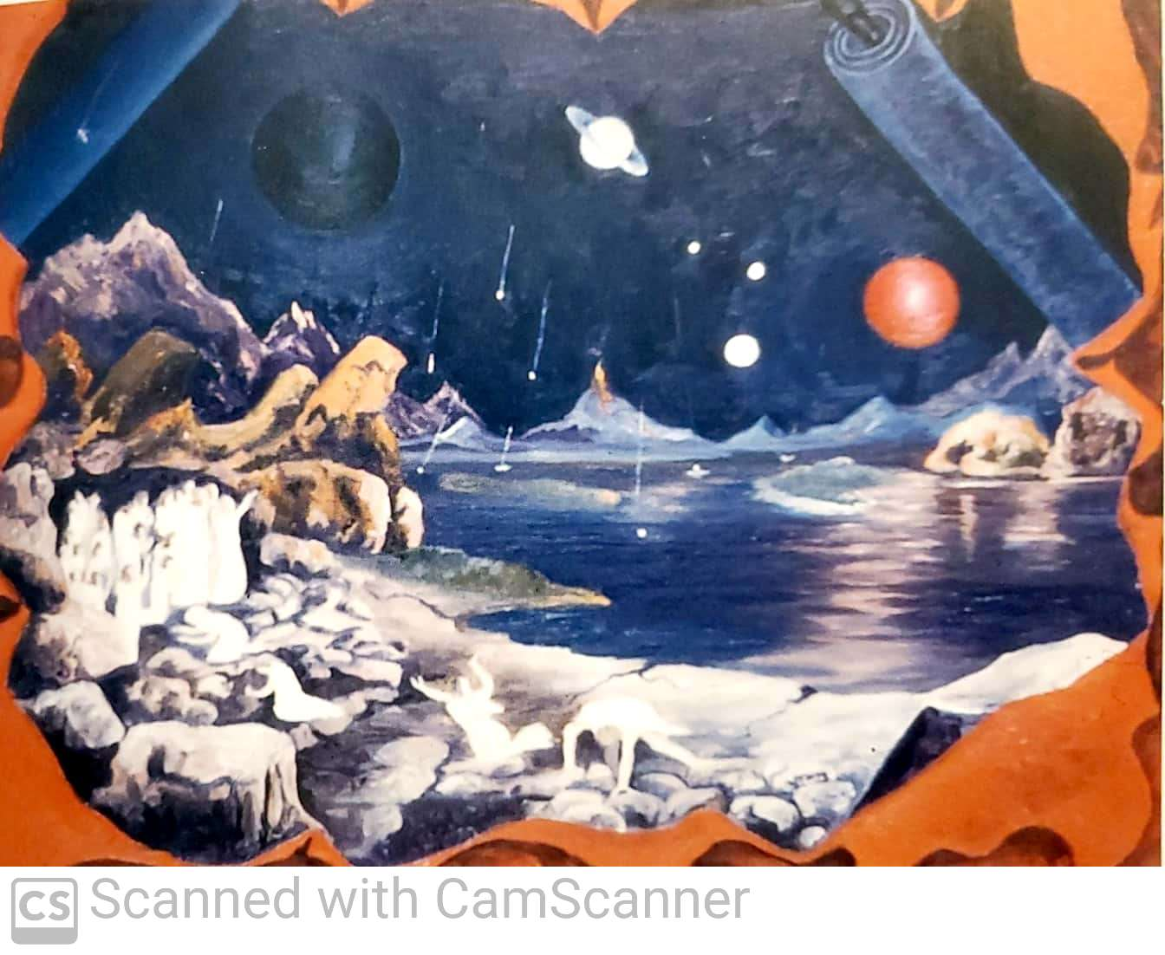

Slide 27
Sixth Seal Opened
Rev. 6:12-17

Slide 28
Sixth Seal Opened
Rev. 6:12-17
They ask “…Who is able to stand?

Slide 29
Sixth Seal Opened
Rev. 6:12-17
They ask “…Who is able to stand?
Deut. 9:2 – “who can stand”

Slide 30
Sixth Seal Opened
Rev. 6:12-17
They ask “…Who is able to stand?
Deut. 9:2 – “who can stand”
1 Sam. 6:20 – “who is able to stand”

Slide 31
Sixth Seal Opened
Rev. 6:12-17
They ask “…Who is able to stand?
Deut. 9:2 – “who can stand”
1 Sam. 6:20 – “who is able to stand”
Job 41:10 – “who then is able to stand against Me?”

Slide 32
Sixth Seal Opened
Rev. 6:12-17
They ask “…Who is able to stand?
Deut. 9:2 – “who can stand”
1 Sam. 6:20 – “who is able to stand”
Job 41:10 – “who then is able to stand against Me?”
Psa. 147:17 – “who can stand before His cold?”

Slide 33
Sixth Seal Opened
Rev. 6:12-17
They ask “…Who is able to stand?
Deut. 9:2 – “who can stand”
1 Sam. 6:20 – “who is able to stand”
Job 41:10 – “who then is able to stand against Me?”
Psa. 147:17 – “who can stand before His cold?”
Nah. 1:6 – “who can stand before His indignation?”

Slide 34
Sixth Seal Opened
Rev. 6:12-17
They ask “…Who is able to stand?
Deut. 9:2 – “who can stand”
1 Sam. 6:20 – “who is able to stand”
Job 41:10 – “who then is able to stand against Me?”
Psa. 147:17 – “who can stand before His cold?”
Nah. 1:6 – “who can stand before His indignation?”
Mal. 3:2 – “who can stand when He appears?”

Slide 35
The Answer
Rev. 7:1-15

Slide 36
The Answer
Rev. 7:1-15
Q: Who is able to stand?
A: The Faithful of God’s People!

Slide 37
The Twelve Tribes of Israel
Judah
Reuben
Gad
Asher
Naphtali
Manasseh
Simeon
Dan
Issachar
Zebulun
Ephraim
Benjamin

Slide 38
The Sealed of Israel
Judah
Reuben
Gad
Asher
Naphtali
Manasseh
Simeon
Dan
Issachar
Zebulun
Ephraim
Benjamin

Slide 39
The Sealed of Israel
Judah
Reuben
Gad
Asher
Naphtali
Manasseh
Simeon
Dan
Issachar
Zebulun
Ephraim
Benjamin

Slide 40
The Sealed of Israel
Judah
Reuben
Gad
Asher
Naphtali
Manasseh
Simeon
Dan
Issachar
Zebulun
Ephraim
Benjamin

Slide 41
The Sealed of Israel
Judah
Reuben
Gad
Asher
Naphtali
Manasseh
Simeon
Levi
Issachar
Zebulun
Joseph
Benjamin

Slide 42
The Answer
Rev. 7:1-15
Q: Who is able to stand?
A: The Faithful of God’s People!
Rev. 7:3-4, 9, 14-15, 14:1

Slide 43
Seventh Seal Opened
Rev. 8:1

Slide 44
Seventh Seal Opened
Rev. 8:1
Silence for 30 minutes
7 Trumpets Sound – Ch. 8-11
Announcing God’s Wrath on Rome

Slide 45
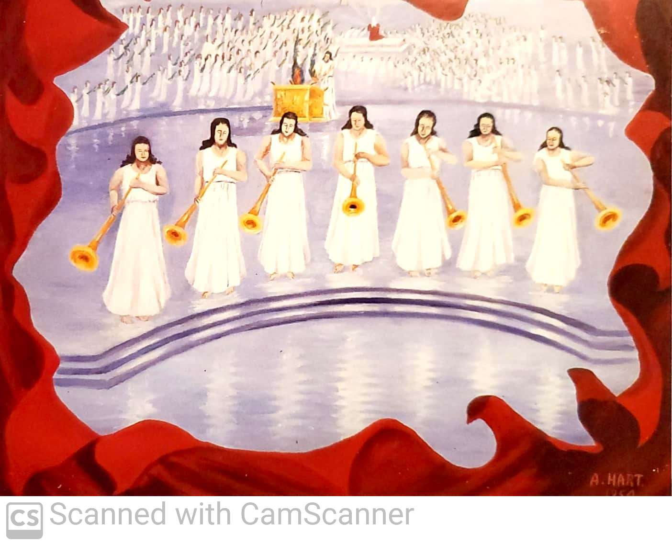

Slide 46
The Reality
Rev. 20:12
We will all be “standing before God…”
Psa. 1:5-6

Slide 47
Will You Stand?

Slide 48
Songs of
Praise to God

Slide 49
Closing PRAYER

Slide 50
Songs of
Praise to God

Slide 51
WEDNESDAY @ 6:30 pm
JOIN US
HOPE TO SEE YOU THERE!

