Slide 1
1-1 I Am Thine O Lord
I Am Thine, O Lord
666

Slide 2
1-2 I Am Thine O Lord
I Am Thine, O Lord
666

Slide 3
C-1 I Am Thine O Lord
I Am Thine, O Lord
666

Slide 4
C-2 I Am Thine O Lord
I Am Thine, O Lord
666

Slide 5
4-1 I Am Thine O Lord
I Am Thine, O Lord
666

Slide 6
4-2 I Am Thine O Lord
I Am Thine, O Lord
666

Slide 7
C-1 I Am Thine O Lord
I Am Thine, O Lord
666

Slide 8
C-2 I Am Thine O Lord
I Am Thine, O Lord
666

Slide 9
RESTORE REBUILD RENEW
welcome
we are glad to
Have you with us
IN 2022
WHEELER
CHURCH
OF
CHRIST

Slide 10
Song:
I Know Whom I Have Believed
#524

Slide 11
1-1 I Know Whom I have Believed
I Know Whom I Believed
524

Slide 12
1-2 I Know Whom I have Believed
I Know Whom I Believed
524

Slide 13
C-1 I Know Whom I have Believed
I Know Whom I Believed
524

Slide 14
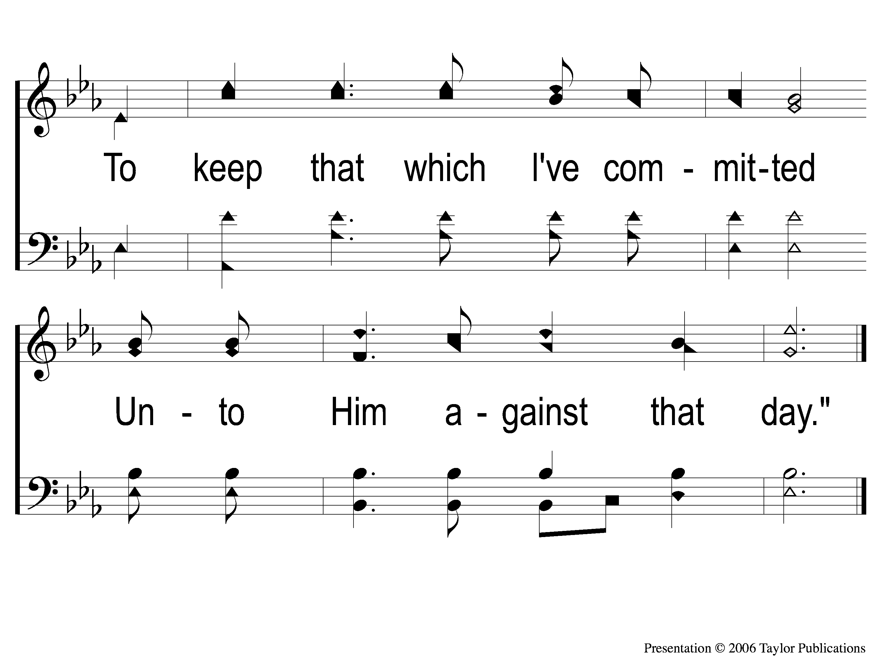
C-2 I Know Whom I have Believed
I Know Whom I Believed
524

Slide 15
2-1 I Know Whom I have Believed
I Know Whom I Believed
524

Slide 16
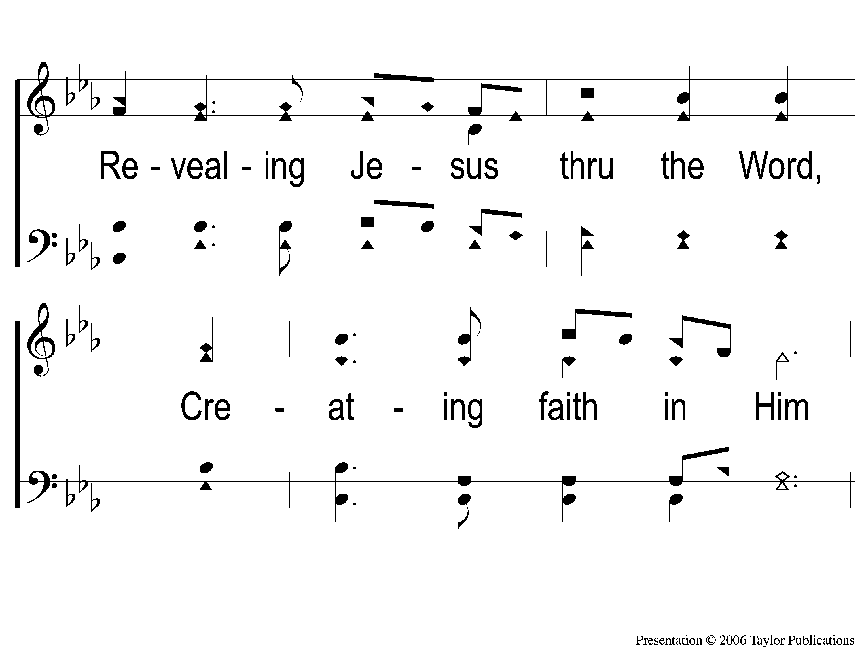
2-2 I Know Whom I have Believed
I Know Whom I Believed
524

Slide 17
C-1 I Know Whom I have Believed
I Know Whom I Believed
524

Slide 18
C-2 I Know Whom I have Believed
I Know Whom I Believed
524

Slide 19
4-1 I Know Whom I have Believed
I Know Whom I Believed
524

Slide 20
4-2 I Know Whom I have Believed
I Know Whom I Believed
524

Slide 21
C-1 I Know Whom I have Believed
I Know Whom I Believed
524

Slide 22
C-2 I Know Whom I have Believed
I Know Whom I Believed
524

Slide 23
Song:
Whispering Hope
#497

Slide 24
1-1 Whispering Hope
Whispering Hope
497

Slide 25
1-2 Whispering Hope
Whispering Hope
497

Slide 26
1-3 Whispering Hope
Whispering Hope
497

Slide 27
C-1 Whispering Hope
Whispering Hope
497

Slide 28
C-2 Whispering Hope
Whispering Hope
497

Slide 29
3-1 Whispering Hope
Whispering Hope
497

Slide 30
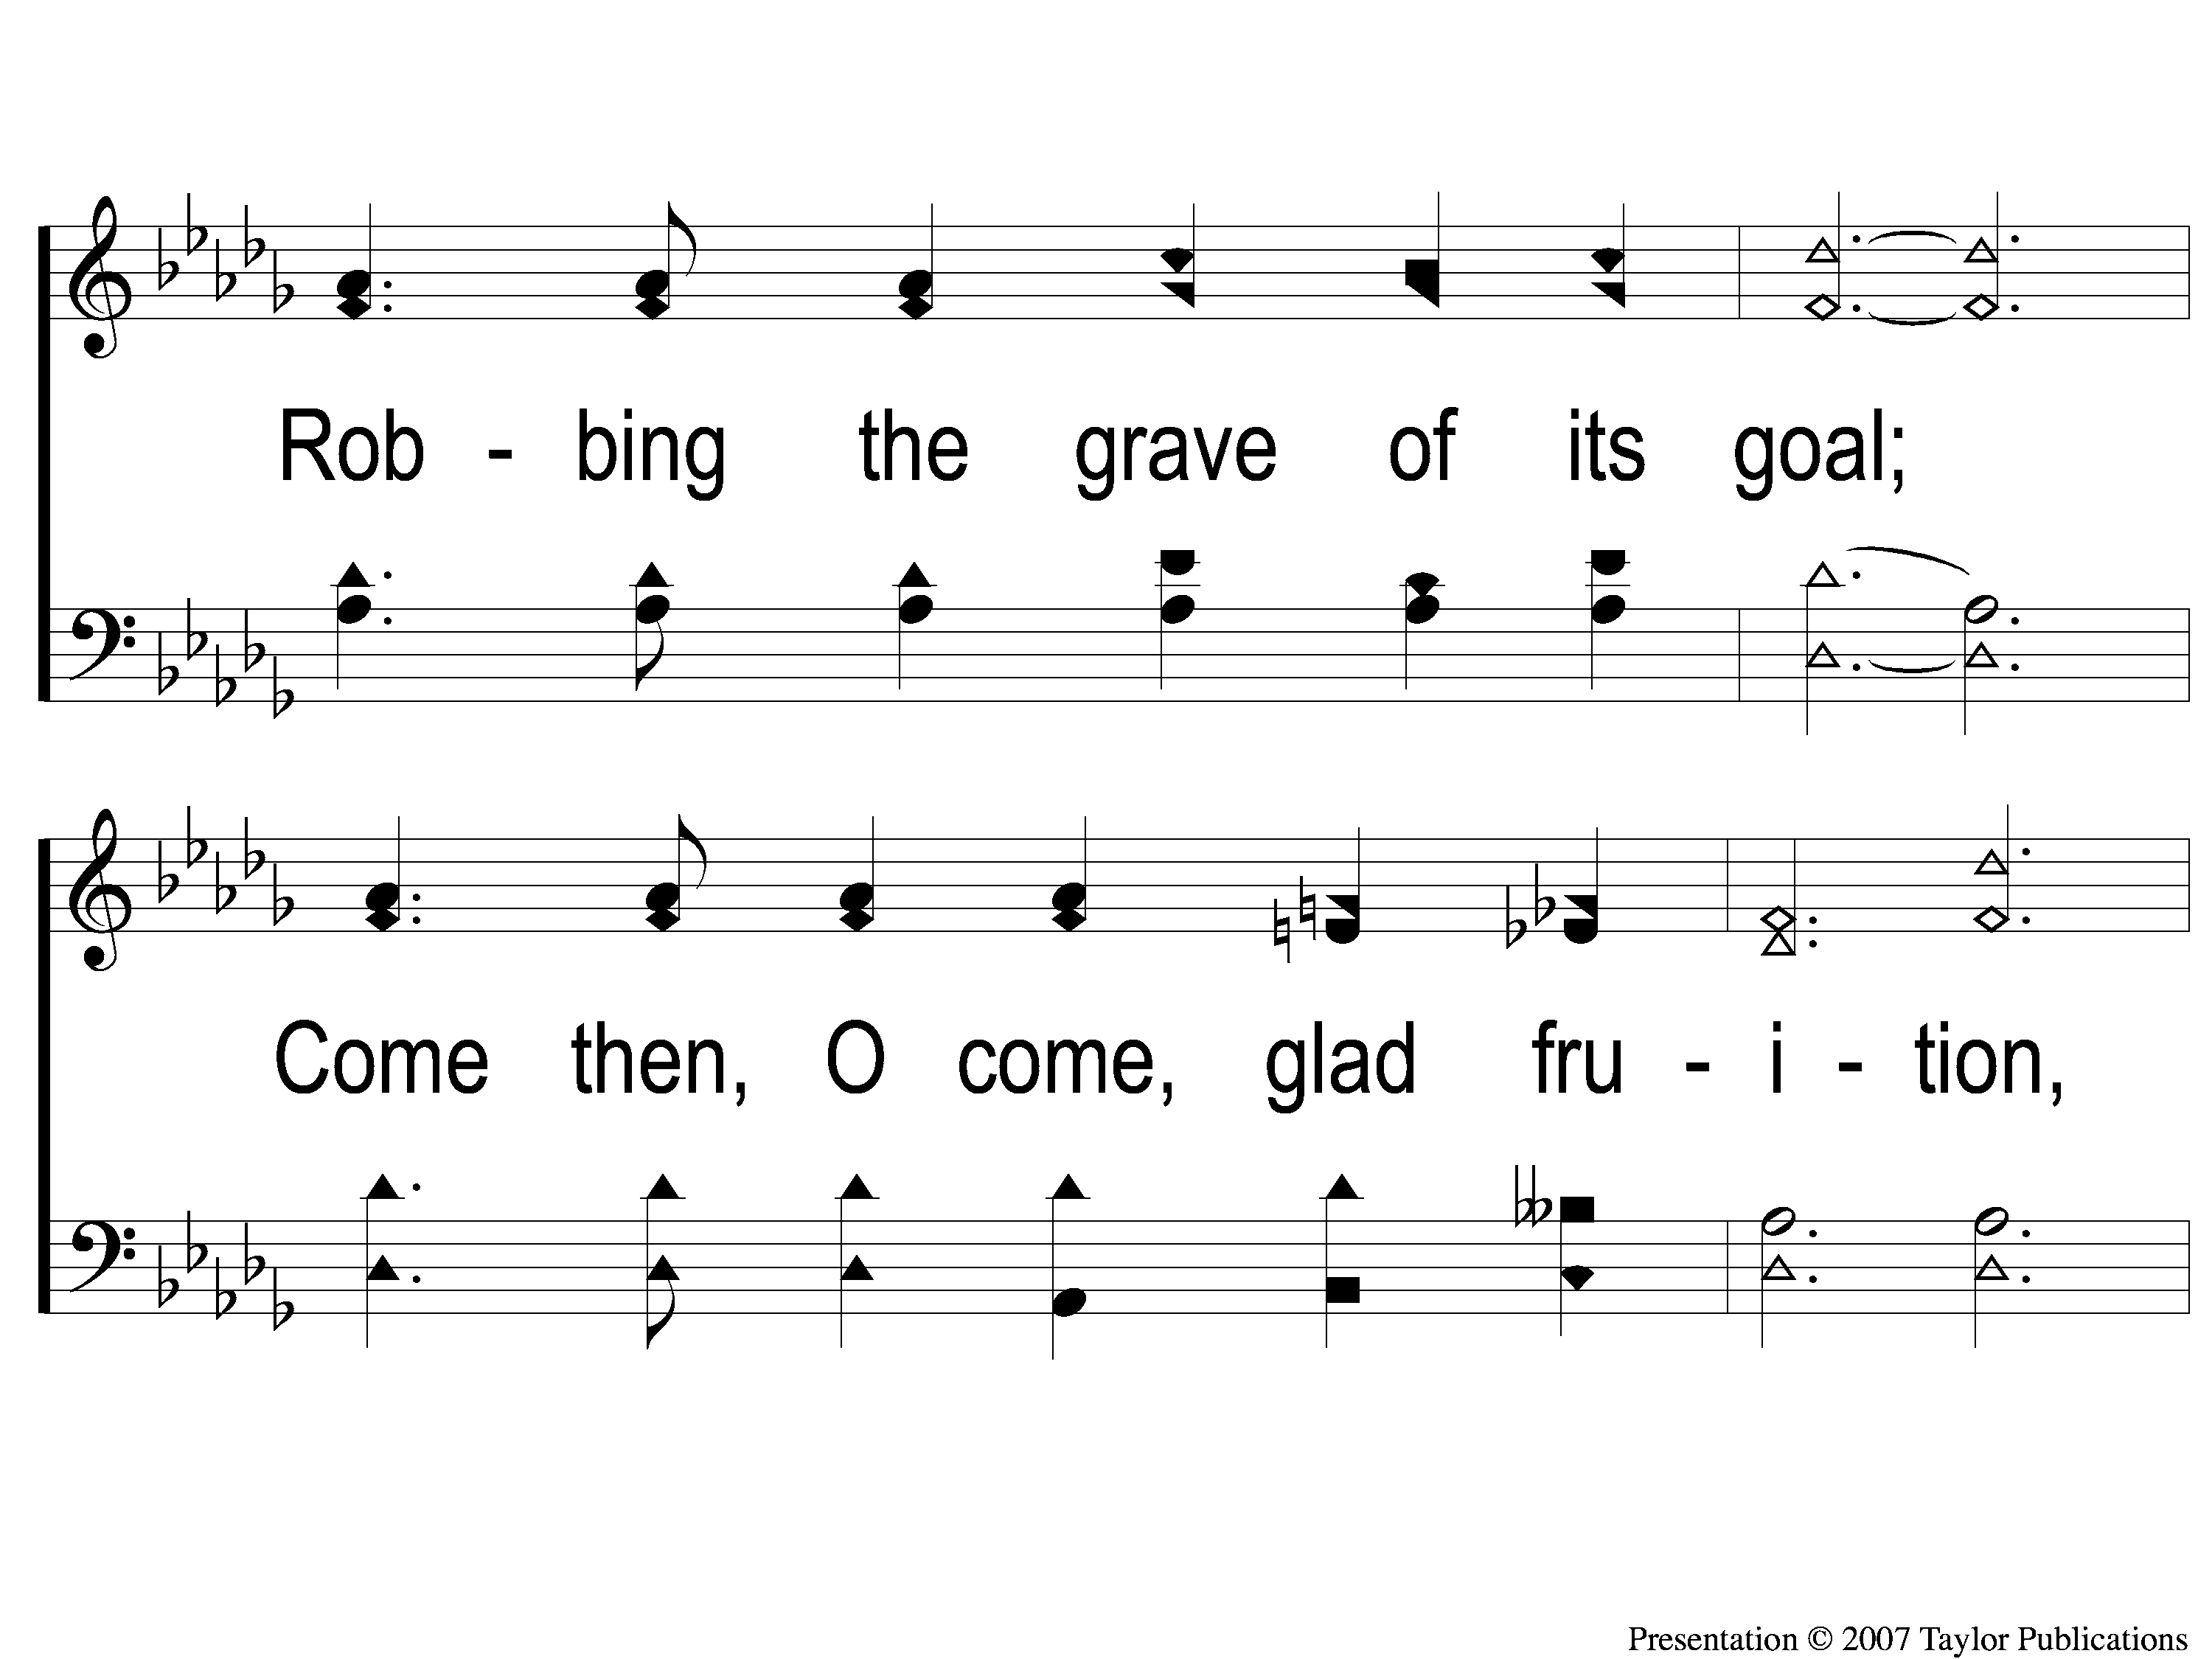
3-2 Whispering Hope
Whispering Hope
497

Slide 31
3-3 Whispering Hope
Whispering Hope
497

Slide 32
C-1 Whispering Hope
Whispering Hope
497

Slide 33
C-2 Whispering Hope
Whispering Hope
497

Slide 34
Opening Prayer

Slide 35
Song:
Shine, Jesus, Shine
#290

Slide 36
1-1 Shine Jesus Shine
Shine, Jesus, Shine
290

Slide 37
1-2 Shine Jesus Shine
Shine, Jesus, Shine
290

Slide 38
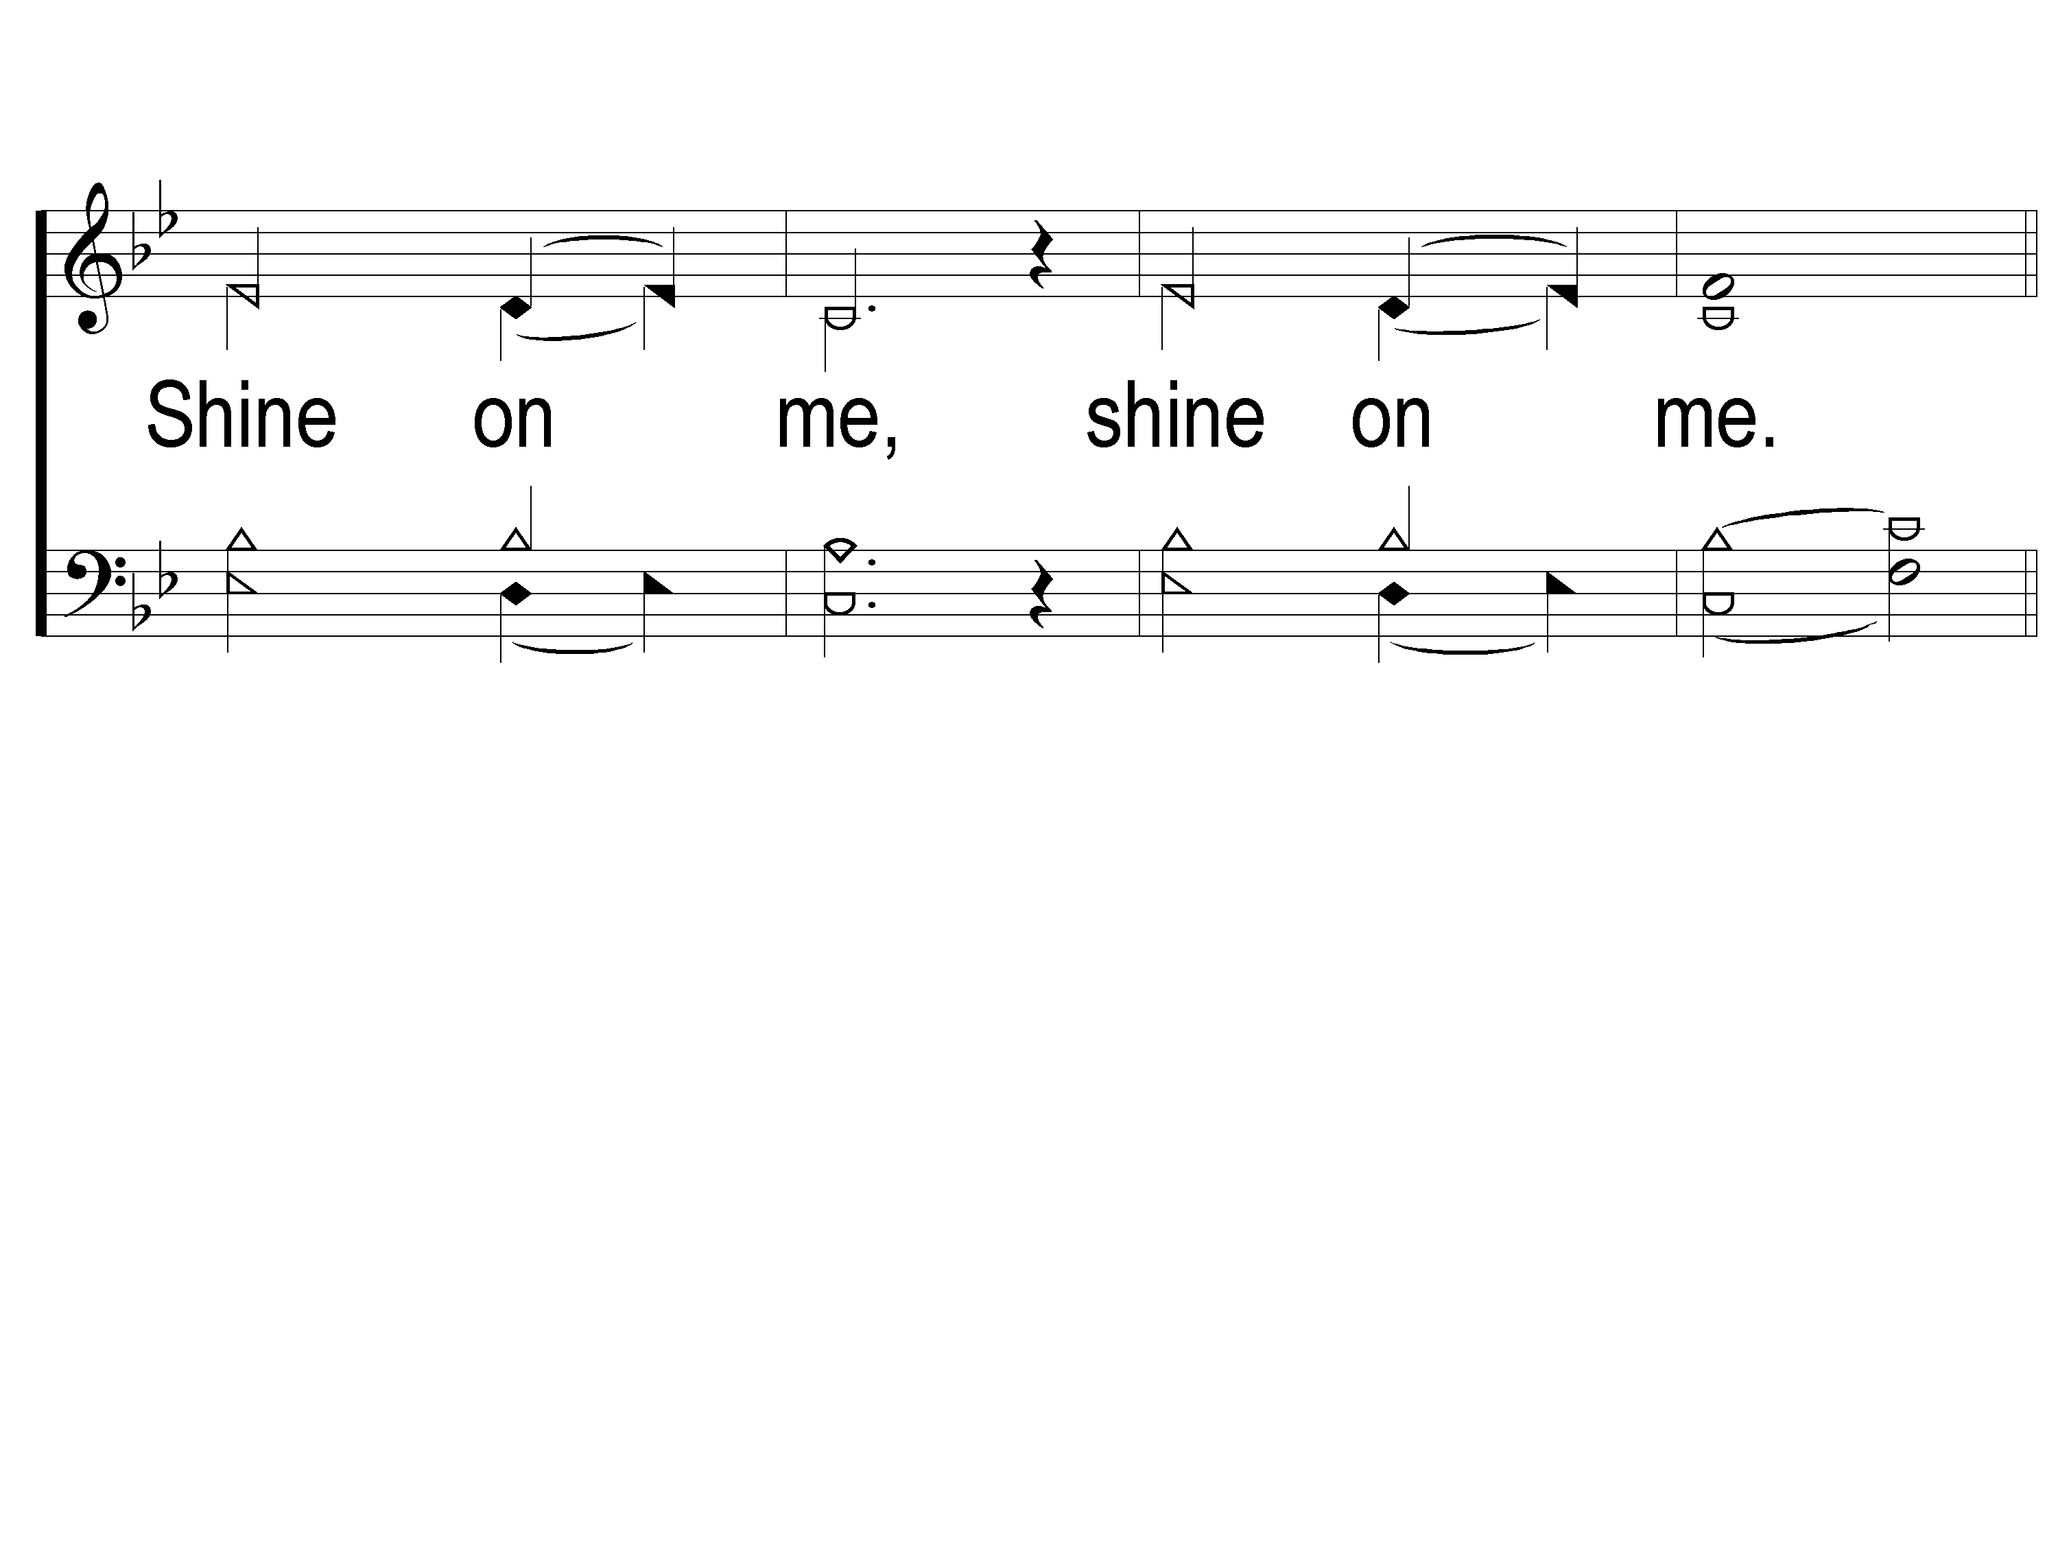
1-3 Shine Jesus Shine
Shine, Jesus, Shine
290

Slide 39
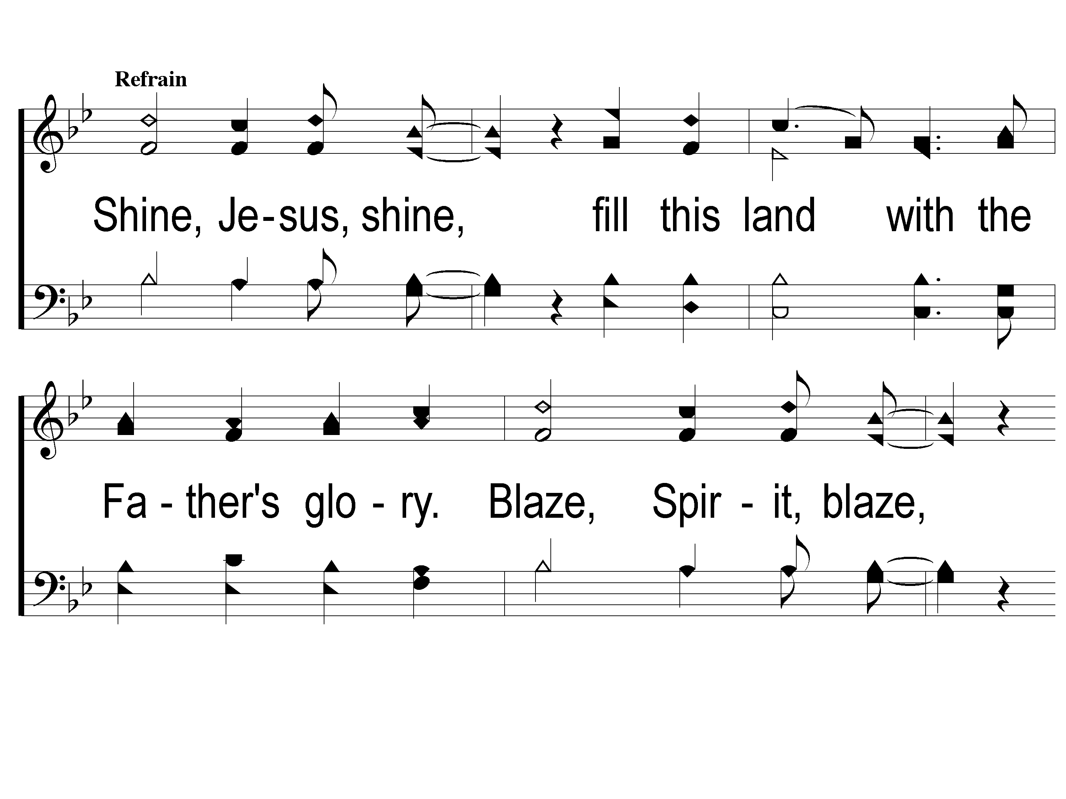
C-1 Shine Jesus Shine
Shine, Jesus, Shine
290

Slide 40
C-2 Shine Jesus Shine
Shine, Jesus, Shine
290

Slide 41
C-3 Shine Jesus Shine
Shine, Jesus, Shine
290

Slide 42
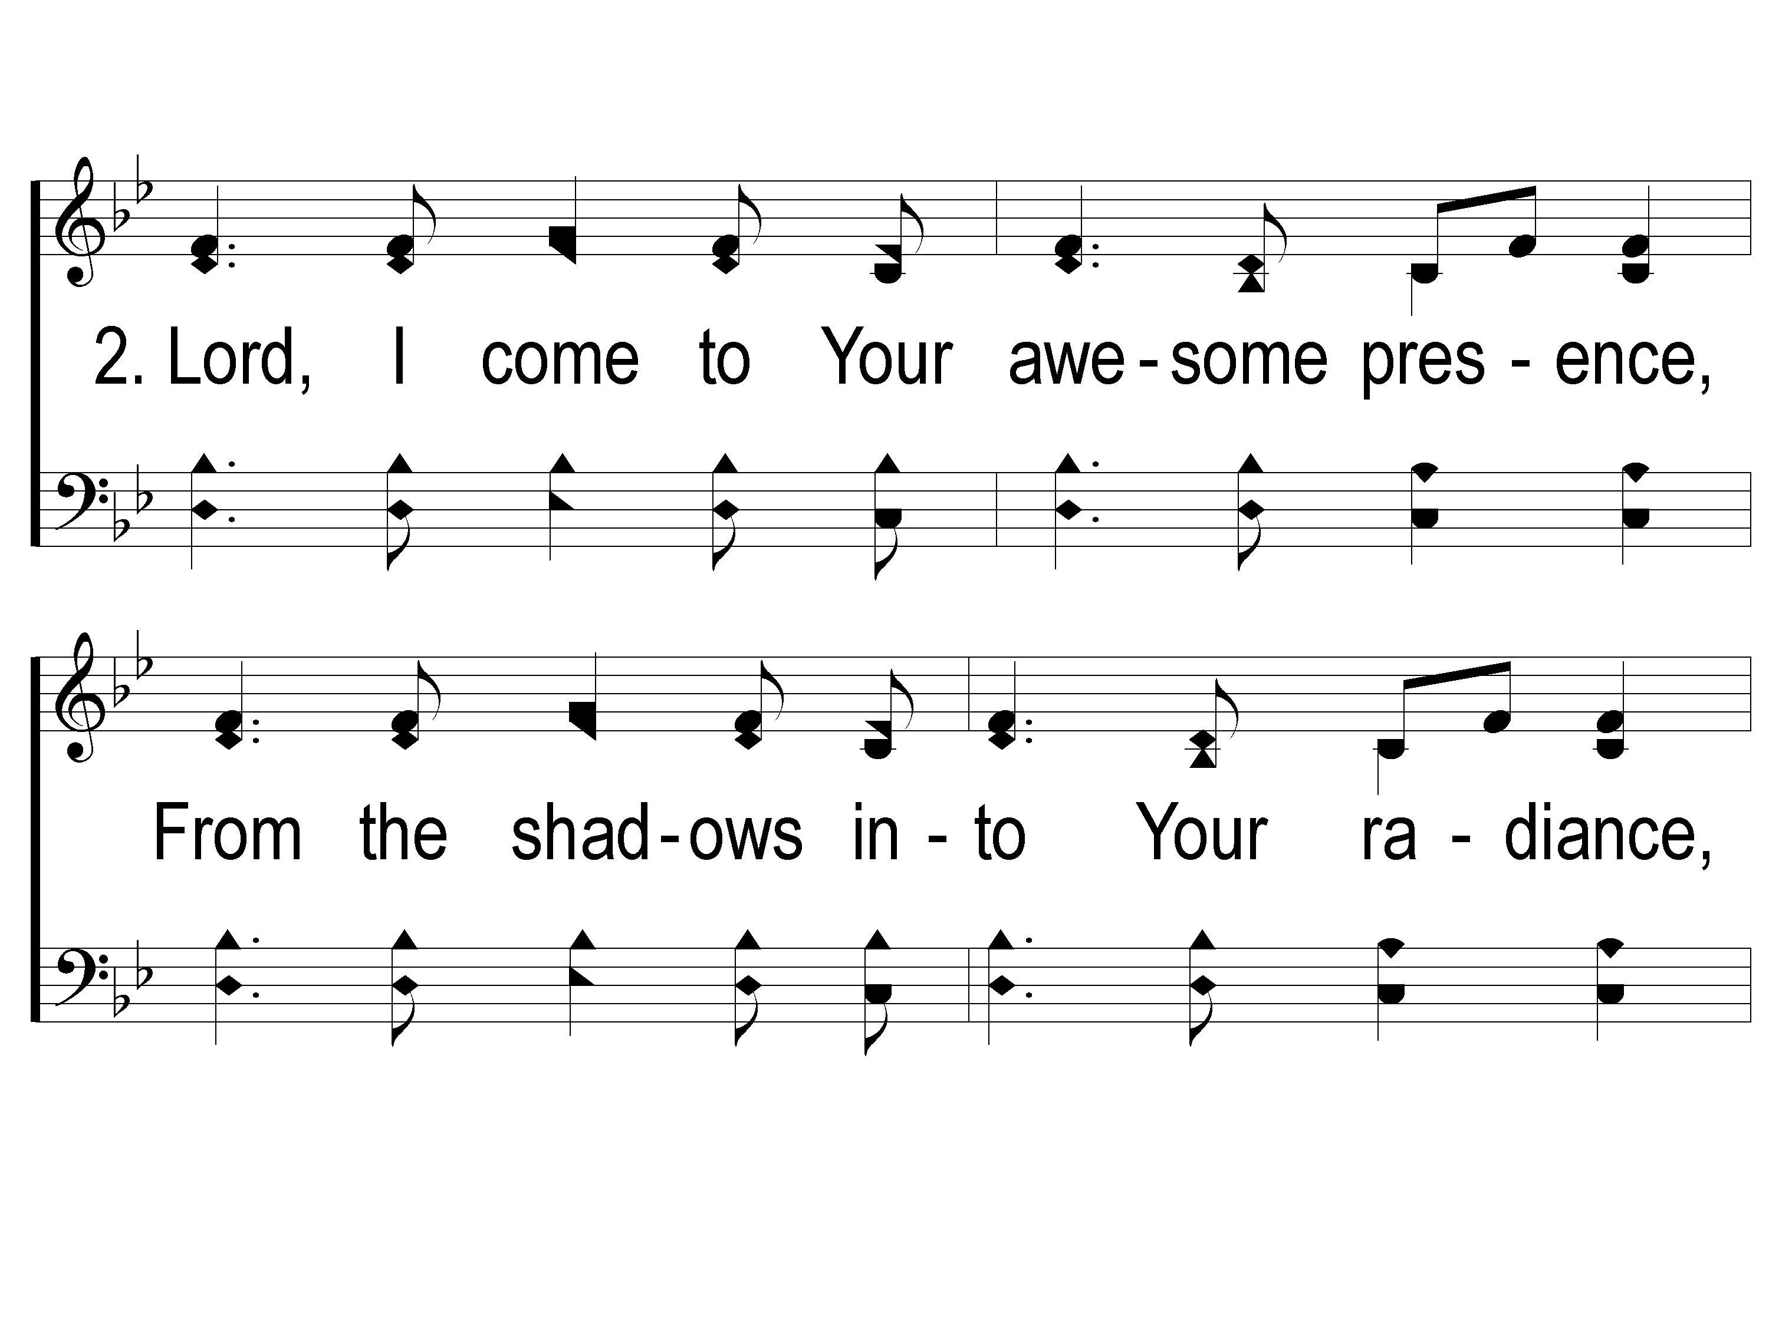
2-1 Shine Jesus Shine
Shine, Jesus, Shine
290

Slide 43
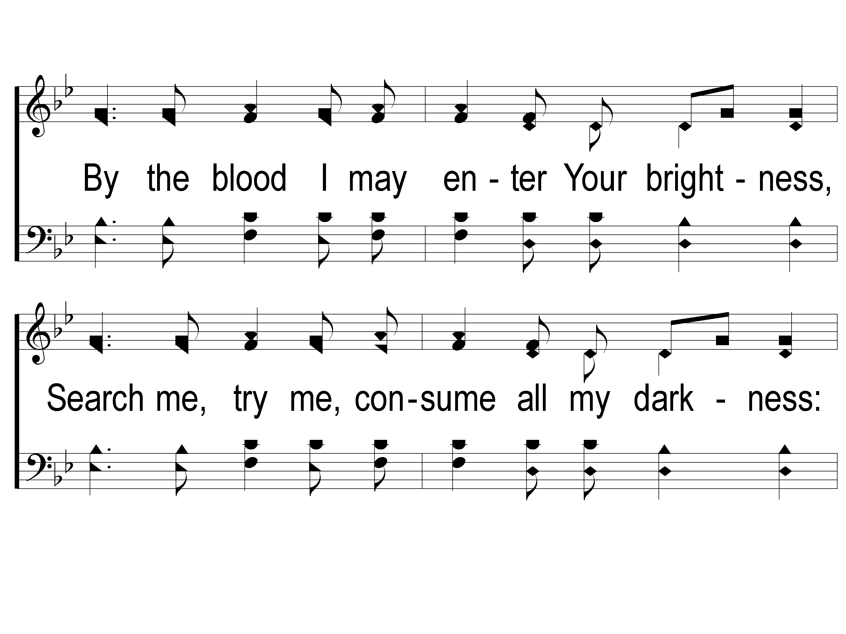
2-2 Shine Jesus Shine
Shine, Jesus, Shine
290

Slide 44
2-3 Shine Jesus Shine
Shine, Jesus, Shine
290

Slide 45
C-1 Shine Jesus Shine
Shine, Jesus, Shine
290

Slide 46
C-2 Shine Jesus Shine
Shine, Jesus, Shine
290

Slide 47
C-3 Shine Jesus Shine
Shine, Jesus, Shine
290

Slide 48
Song:
Sing To Me Of Heaven
#716

Slide 49
1-1 Sing to Me of Heaven
Sing To Me of Heaven
716

Slide 50
1-2 Sing to Me of Heaven
Sing To Me of Heaven
716

Slide 51
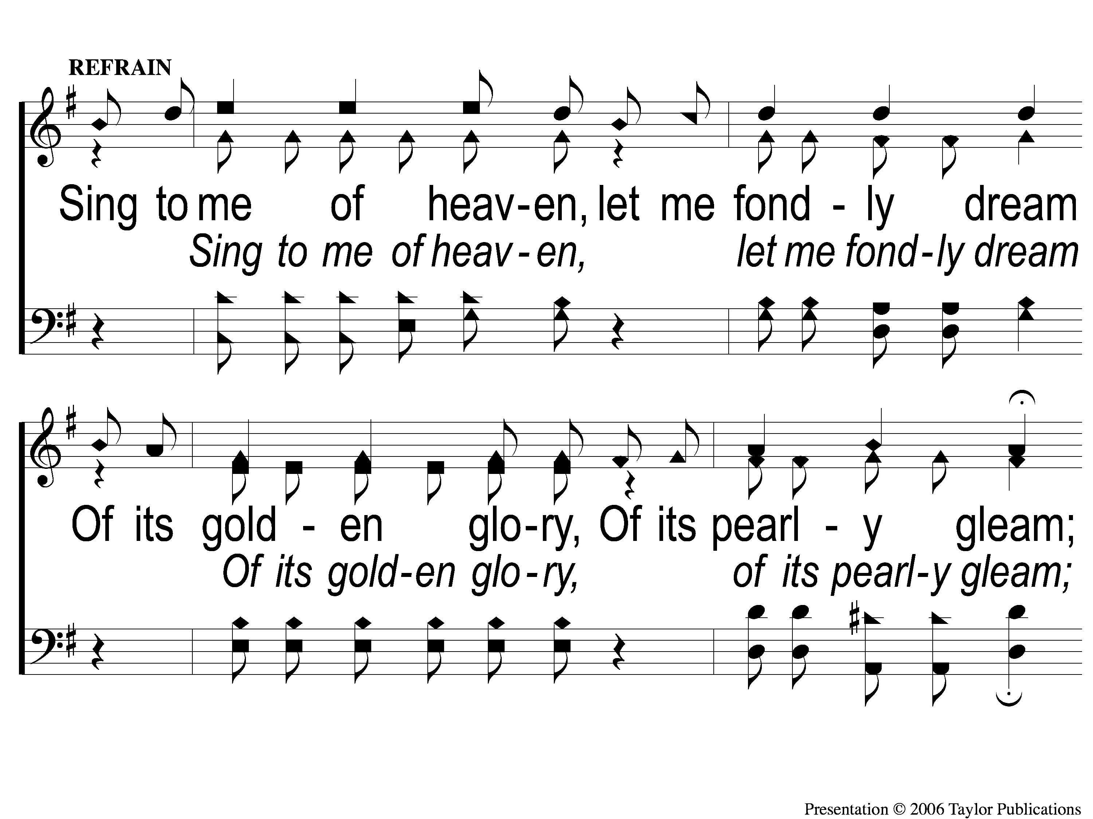
C-1 Sing to Me of Heaven
Sing To Me of Heaven
716

Slide 52
C-2 Sing to Me of Heaven
Sing To Me of Heaven
716

Slide 53
2-1 Sing to Me of Heaven
Sing To Me of Heaven
716

Slide 54
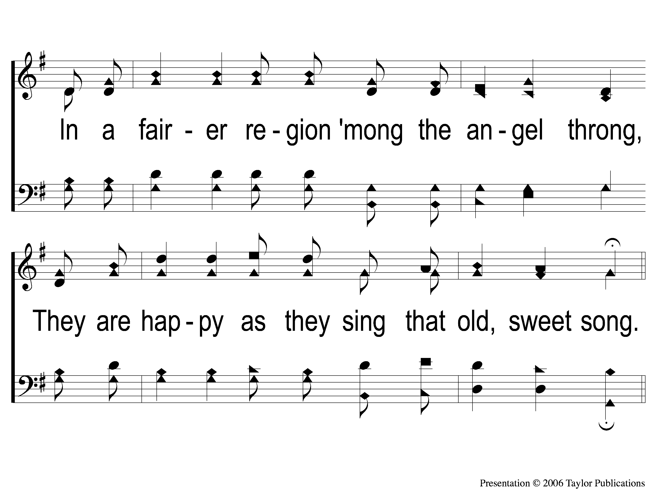
2-2 Sing to Me of Heaven
Sing To Me of Heaven
716

Slide 55
C-1 Sing to Me of Heaven
Sing To Me of Heaven
716

Slide 56
C-2 Sing to Me of Heaven
Sing To Me of Heaven
716

Slide 57
3-1 Sing to Me of Heaven
Sing To Me of Heaven
716

Slide 58
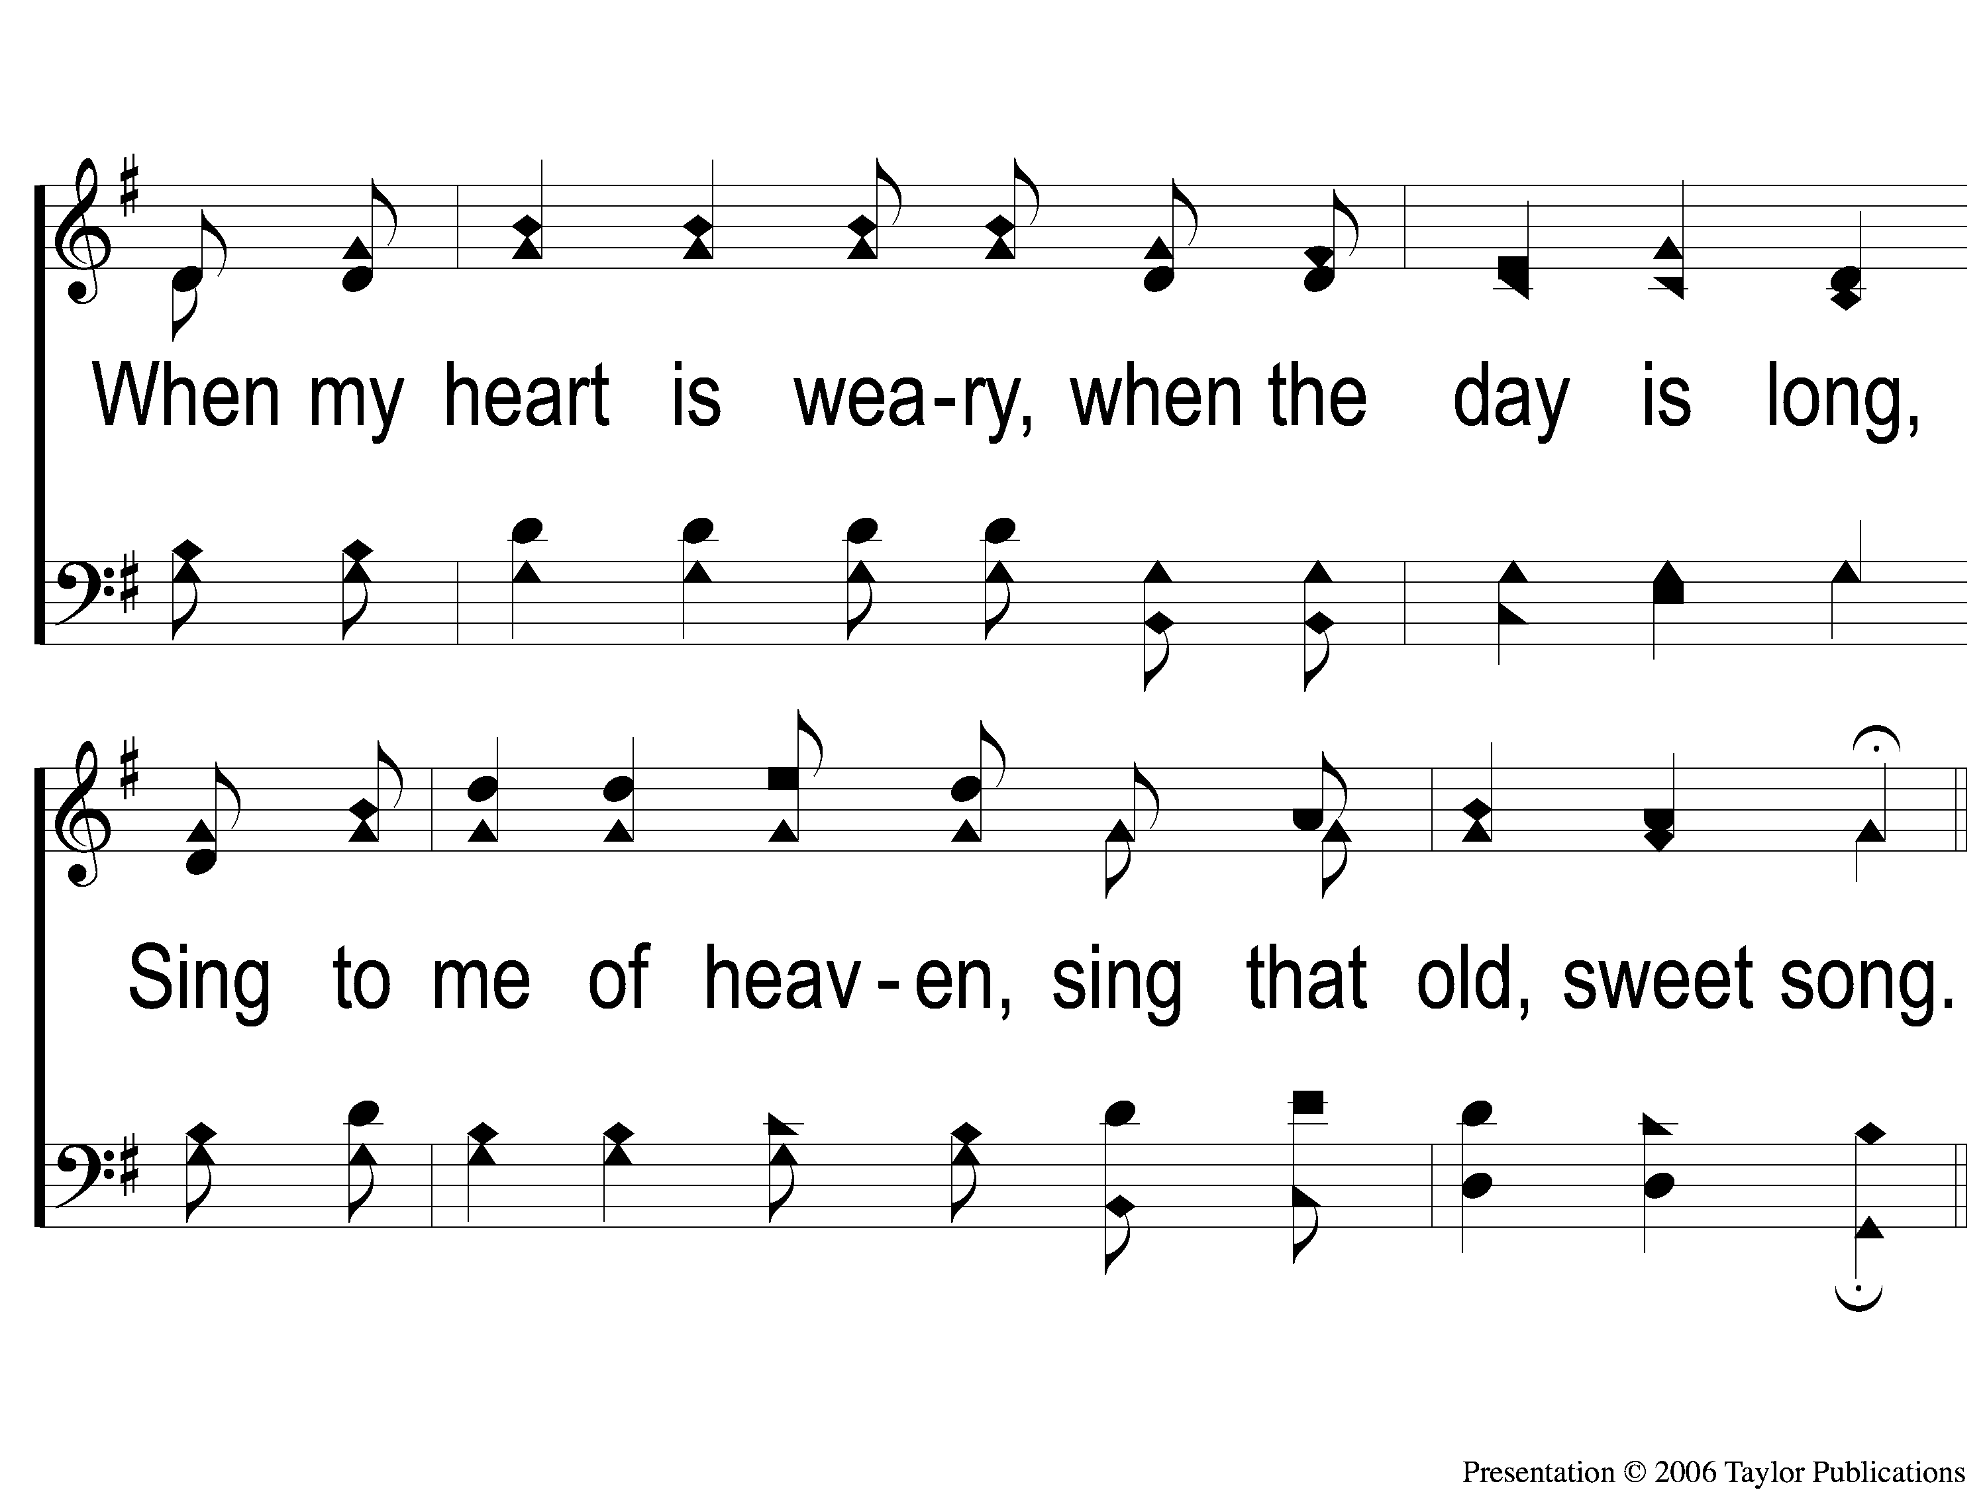
3-2 Sing to Me of Heaven
Sing To Me of Heaven
716

Slide 59
C-1 Sing to Me of Heaven
Sing To Me of Heaven
716

Slide 60
C-2 Sing to Me of Heaven
Sing To Me of Heaven
716

Slide 61
Scripture Reading:
Genesis 29:1-14

Slide 62
RESTORE
OUR
FOUNDATIONS
JANUARY - APRIL

Slide 63
Tonight @ 6pm:
&
war Peace

Slide 64
&
Sowing Reaping

Slide 65
&
Sowing Reaping
The Soils & Sower – Mk. 4:3-8

Slide 66
&
Sowing Reaping
The Soils & Sower – Mk. 4:3-8
The Wheat & Tares – Matt. 13:24

Slide 67
&
Sowing Reaping
The Soils & Sower – Mk. 4:3-8
The Wheat & Tares – Matt. 13:24
The Mustard Seed – Matt. 13:31

Slide 68
&
Sowing Reaping
Genesis 1:11-12
“According to its Kind”

Slide 69
The Law Of
&
Sowing Reaping

Slide 70
&
Sowing Reaping
Galatians 6:6-10
Sowing to the Flesh → Corruption
Sowing to The Spirit → Everlasting Life

Slide 71
&
Sowing Reaping
Jacob Sowed to the Flesh
Gen. 25:29-34 & 27:18-24

Slide 72
&
Sowing Reaping
Jacob Received According to the Flesh
Gen. 27:41, 29:15-25

Slide 73
&
Sowing Reaping
EVERY Work of the Flesh produces Corruption
Gal. 5:19-21

Slide 74
&
Sowing Reaping
Jacob Sowed to The Spirit
Gen. 32:22-30

Slide 75
&
Sowing Reaping
The Fruit of The Spirit
Produces Everlasting Life
Gal. 5:22-23, 25

Slide 76
What Are You
Sowing to
?

Slide 77
Invitation
Song:
I Am Resolved
#948

Slide 78
1-1 I Am Resolved
I Am Resolved
948

Slide 79
1-2 I Am Resolved
I Am Resolved
948

Slide 80
C-1 I Am Resolved
I Am Resolved
948

Slide 81
C-2 I Am Resolved
I Am Resolved
948

Slide 82
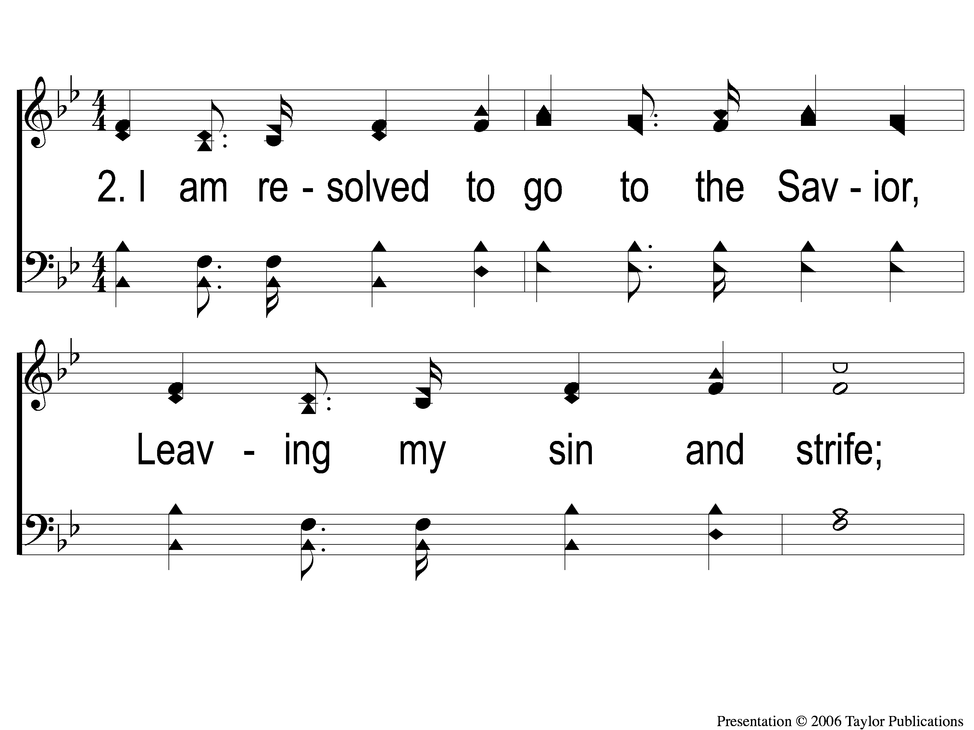
2-1 I Am Resolved
I Am Resolved
948

Slide 83
2-2 I Am Resolved
I Am Resolved
948

Slide 84
C-1 I Am Resolved
I Am Resolved
948

Slide 85
C-2 I Am Resolved
I Am Resolved
948

Slide 86
4-1 I Am Resolved
I Am Resolved
948

Slide 87
4-2 I Am Resolved
I Am Resolved
948

Slide 88
C-1 I Am Resolved
I Am Resolved
948

Slide 89
C-2 I Am Resolved
I Am Resolved
948

Slide 90
The Contribution:
1 John 3:16-17
“By this we know love, because He laid down His life for us. And we also ought to lay down our lives for the brethren. But whoever has this world’s goods, and sees his brother in need, and shuts up his heart from him, how does the love of God abide in him?”

Slide 91
Song:
He Paid A Debt
#376

Slide 92
1-1 He Paid a Debt
He Paid A Debt
376

Slide 93
1-2 He Paid a Debt
He Paid A Debt
376

Slide 94
c He Paid a Debt
He Paid A Debt
376

Slide 95
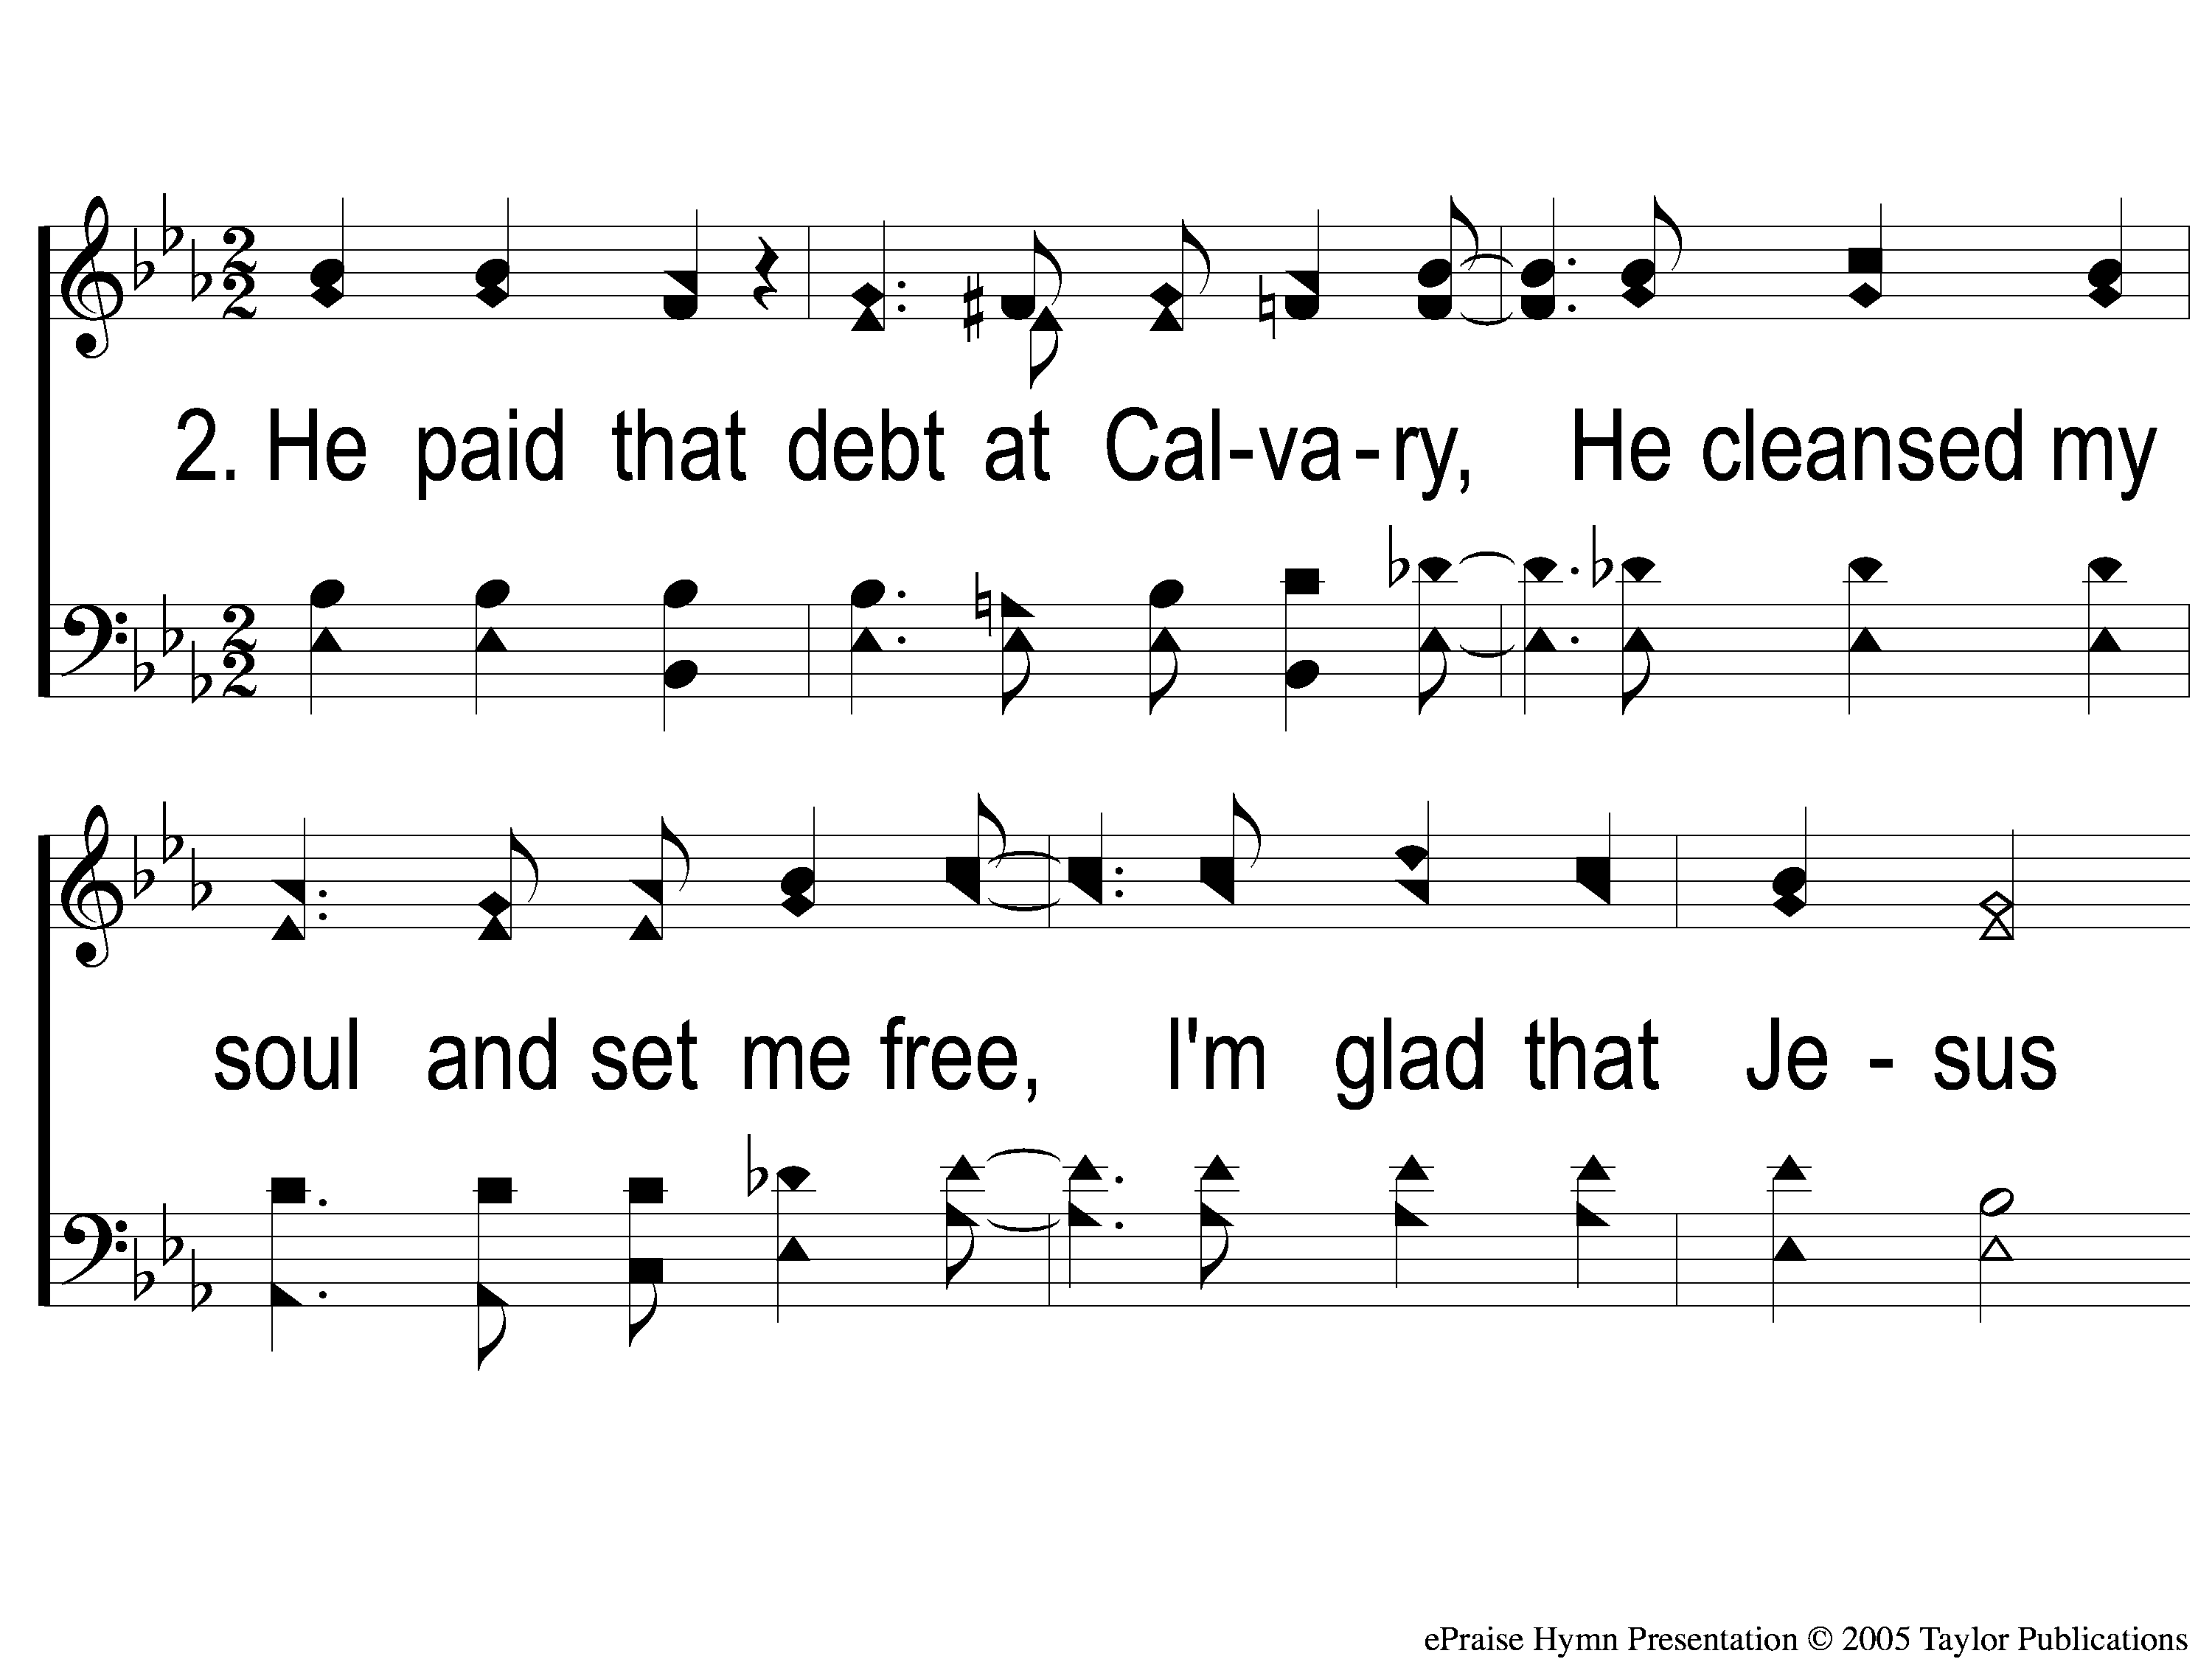
2-1 He Paid a Debt
He Paid A Debt
376

Slide 96
2-2 He Paid a Debt
He Paid A Debt
376

Slide 97
c He Paid a Debt
He Paid A Debt
376

Slide 98
3-1 He Paid a Debt
He Paid A Debt
376

Slide 99
3-2 He Paid a Debt
He Paid A Debt
376

Slide 100
c He Paid a Debt
He Paid A Debt
376

Slide 101
The Unleavened Bread
Revelation 1:17-18
“And when I saw Him, I fell at His feet as dead. But He laid His right hand on me, saying to me, ‘Do not be afraid; I am the First and the Last. I am He who lives, and was dead, and behold, I am alive forevermore.’ ”

Slide 102
The Fruit
of the Vine
Revelation 5:9-10
“And they sang a new song, saying: ‘You are worthy to take the scroll, And to open its seals; For You were slain, And have redeemed us to God by Your blood Out of every tribe and tongue and people and nation, And have made us kings and priests to our God; And we shall reign on the earth.’ ”

Slide 103
Closing Prayer

Slide 104
Song:
To Christ Be True
#736

Slide 105
1-1 To Christ Be True
To Christ Be True
736

Slide 106
1-2 To Christ Be True
To Christ Be True
736

Slide 107
C-1 To Christ Be True
To Christ Be True
736

Slide 108
C-2 To Christ Be True
To Christ Be True
736

Slide 109
3-1 To Christ Be True
To Christ Be True
736

Slide 110
3-2 To Christ Be True
To Christ Be True
736

Slide 111
C-1 To Christ Be True
To Christ Be True
736

Slide 112
C-2 To Christ Be True
To Christ Be True
736

Slide 113
Tonight
Worship @ 6:00 pm
Monday
Bible Study @ 6:30 pm
Wednesday
Worship/Classes @ 6:30 pm
RESTORE REBUILD RENEW
IN 2022
WHEELER
CHURCH
OF
CHRIST

Slide 114
Sowing to the Wind
Reaping the Whirlwind
&

Slide 115
Envy’s
Empty Promises

