Slide 1
PLEASE STANDBY
OUR LIVESTREAM
WILL BEGIN SOON

Slide 2
WELCOME
THANKS FOR JOINING US!

Slide 3
#63
SONG:
I Will Call Upon The Lord

Slide 4
1 I Will Call Upon the Lord
I Will Call Upon the Lord
63

Slide 5
2 I Will Call Upon the Lord
I Will Call Upon the Lord
63

Slide 6
3 I Will Call Upon the Lord
I Will Call Upon the Lord
63

Slide 7
4 I Will Call Upon the Lord
I Will Call Upon the Lord
63

Slide 8
DC1 I Will Call Upon the Lord
I Will Call Upon the Lord
63

Slide 9
DC2 I Will Call Upon the Lord
I Will Call Upon the Lord
63

Slide 10
DC3 I Will Call Upon the Lord
I Will Call Upon the Lord
63

Slide 11
DC4 I Will Call Upon the Lord
I Will Call Upon the Lord
63

Slide 12
tag I Will Call Upon the Lord
I Will Call Upon the Lord
63

Slide 13
SONG:
Here I Am To Worship

Slide 14
1-1 Here I Am To Worship
Here I Am To Worship

Slide 15
1-2 Here I Am To Worship
Here I Am To Worship

Slide 16
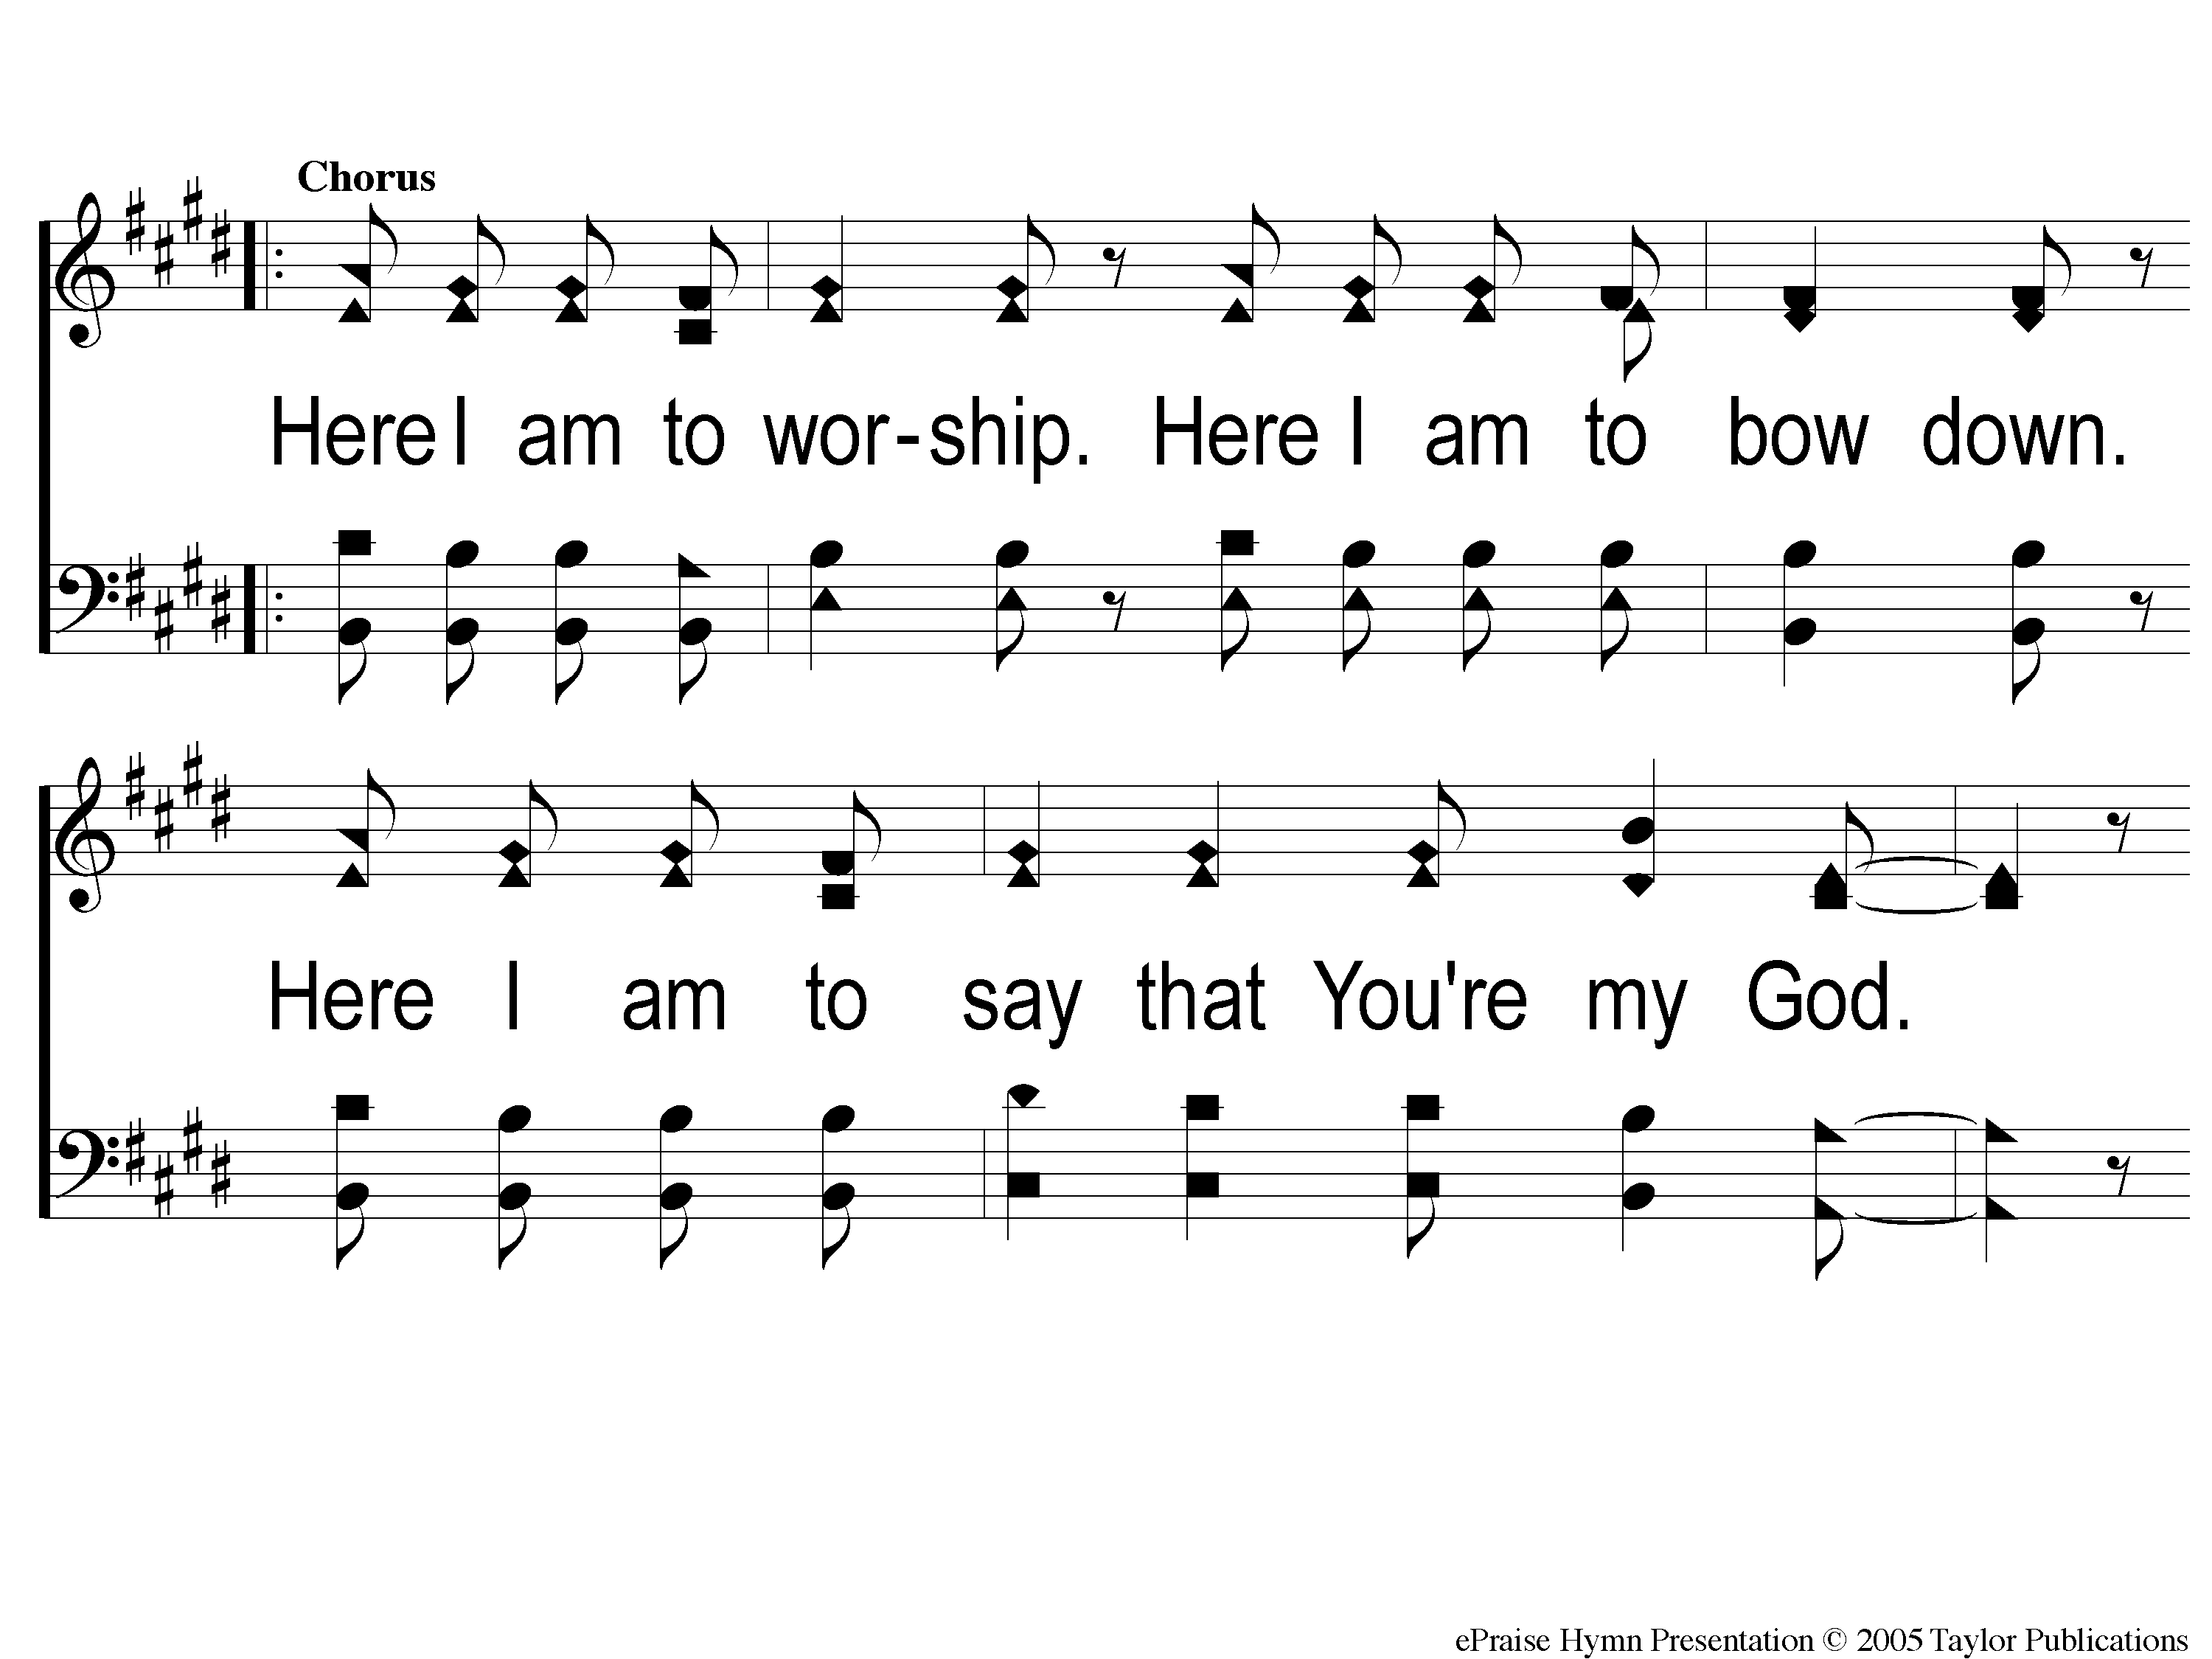
C-1 Here I Am To Worship
Here I Am To Worship

Slide 17
C-2 Here I Am To Worship
Here I Am To Worship

Slide 18
2-1 Here I Am To Worship
Here I Am To Worship

Slide 19
2-2 Here I Am To Worship
Here I Am To Worship

Slide 20
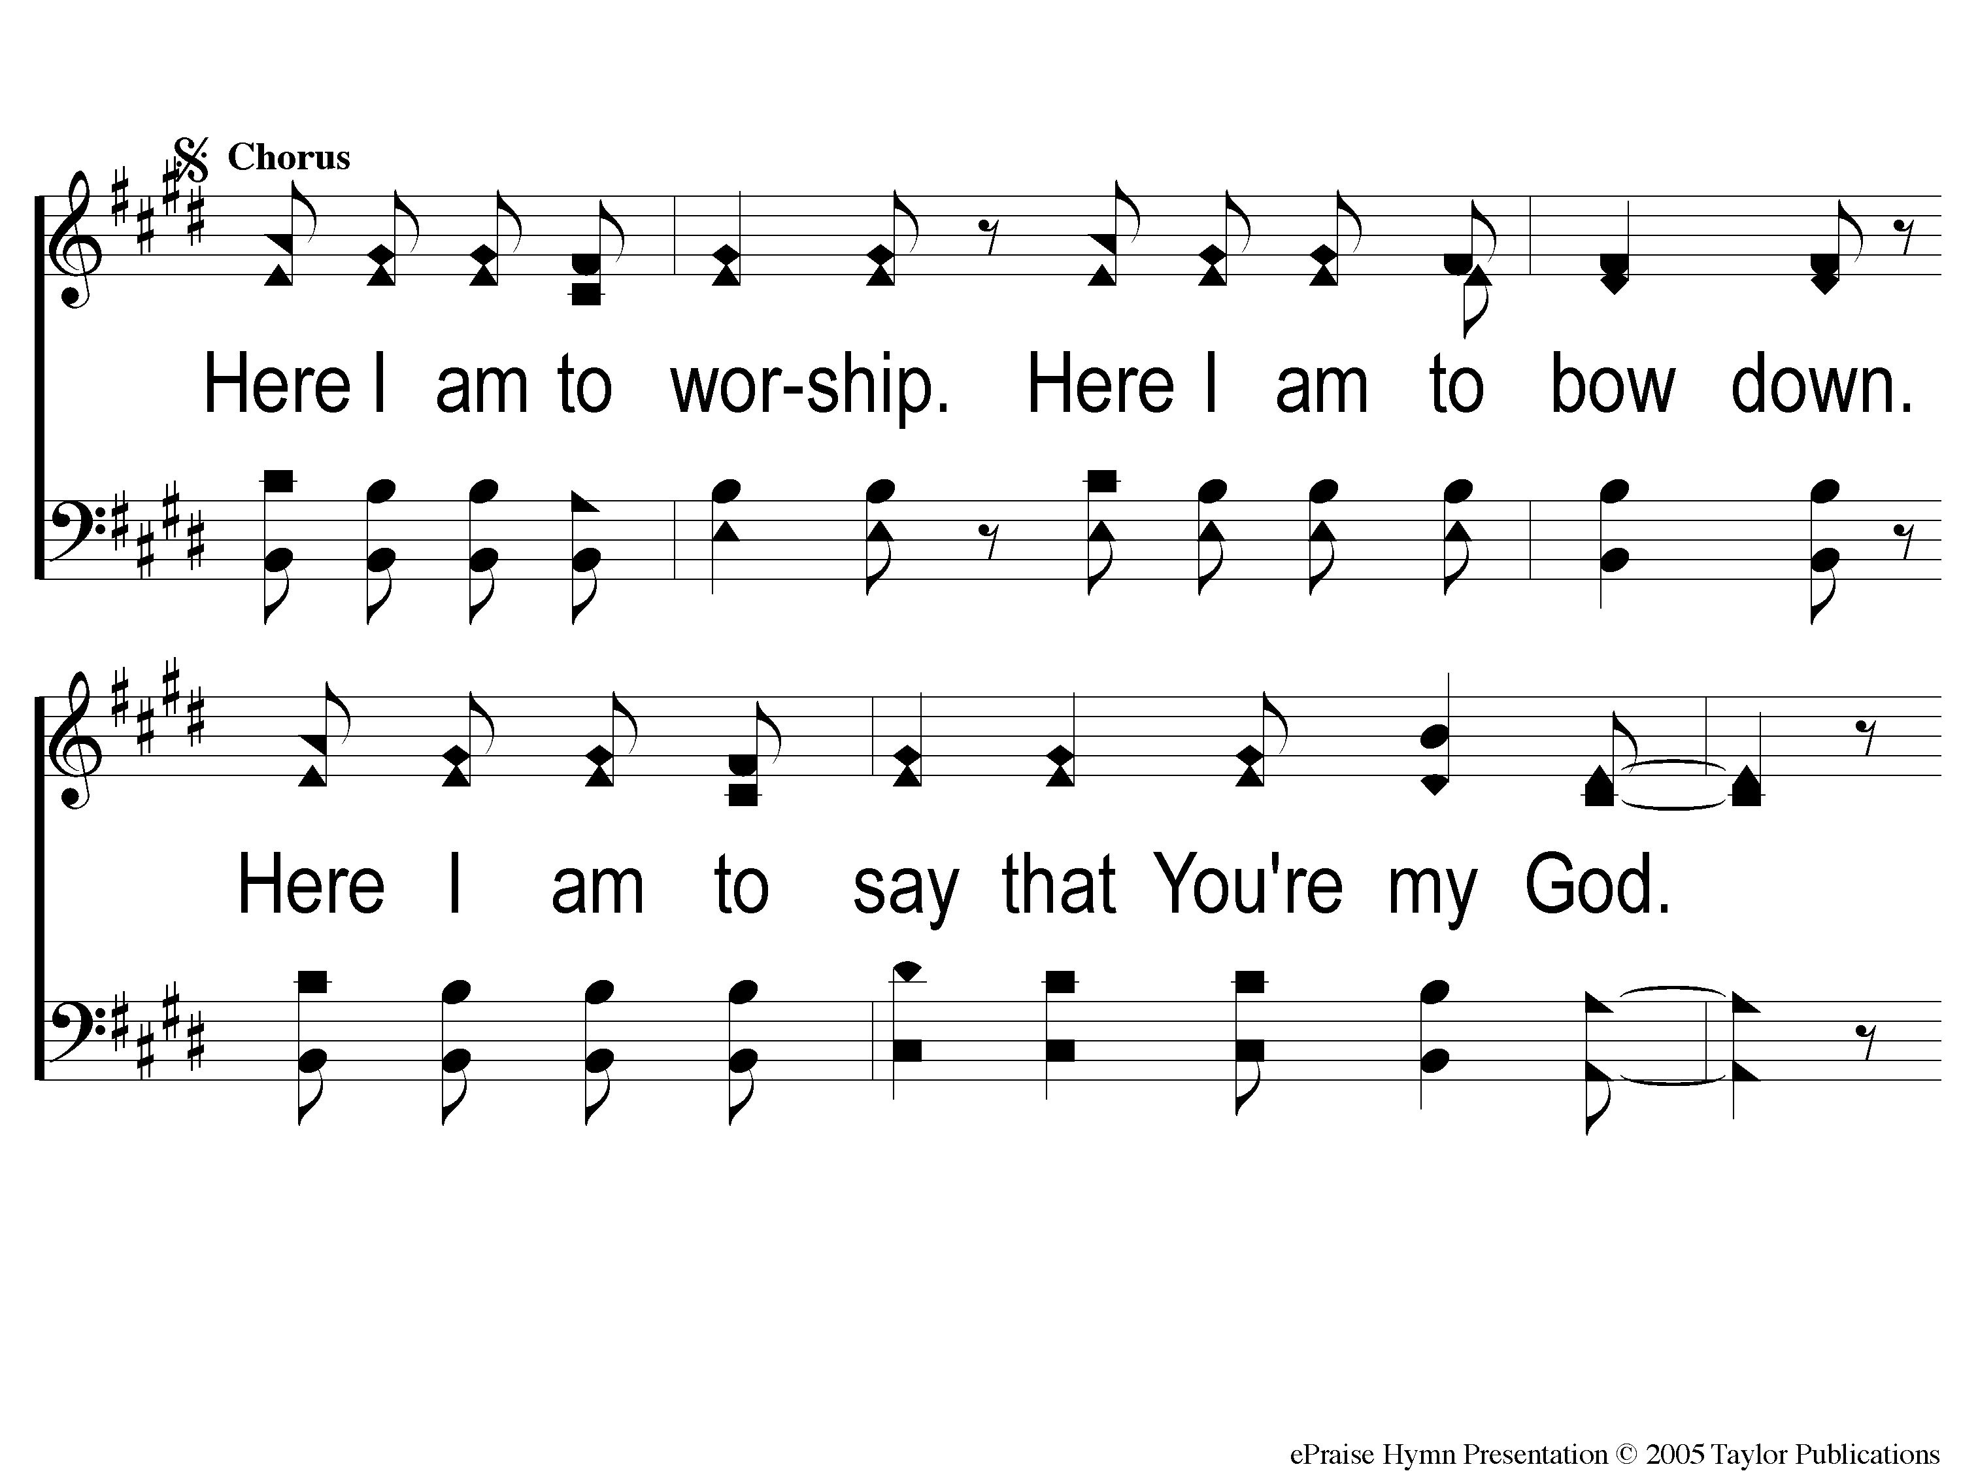
C2-1 Here I Am To Worship
Here I Am To Worship

Slide 21
C2-2 Here I Am To Worship
Here I Am To Worship

Slide 22
Bridge1 Here I Am To Worship
Here I Am To Worship

Slide 23
Bridge2 Here I Am To Worship
Here I Am To Worship

Slide 24
C2-1 Here I Am To Worship
Here I Am To Worship

Slide 25
C2-2 Here I Am To Worship
Here I Am To Worship

Slide 26
tag Here I Am To Worship
Here I Am To Worship

Slide 27
Opening PRAYER

Slide 28
SONG:
10,000 Reasons

Slide 29
Intro1 10,000 Reasons (Bless the Lord)
10,000 Reasons (Bless the Lord)

Slide 30
Intro2 10,000 Reasons (Bless the Lord)
10,000 Reasons (Bless the Lord)

Slide 31
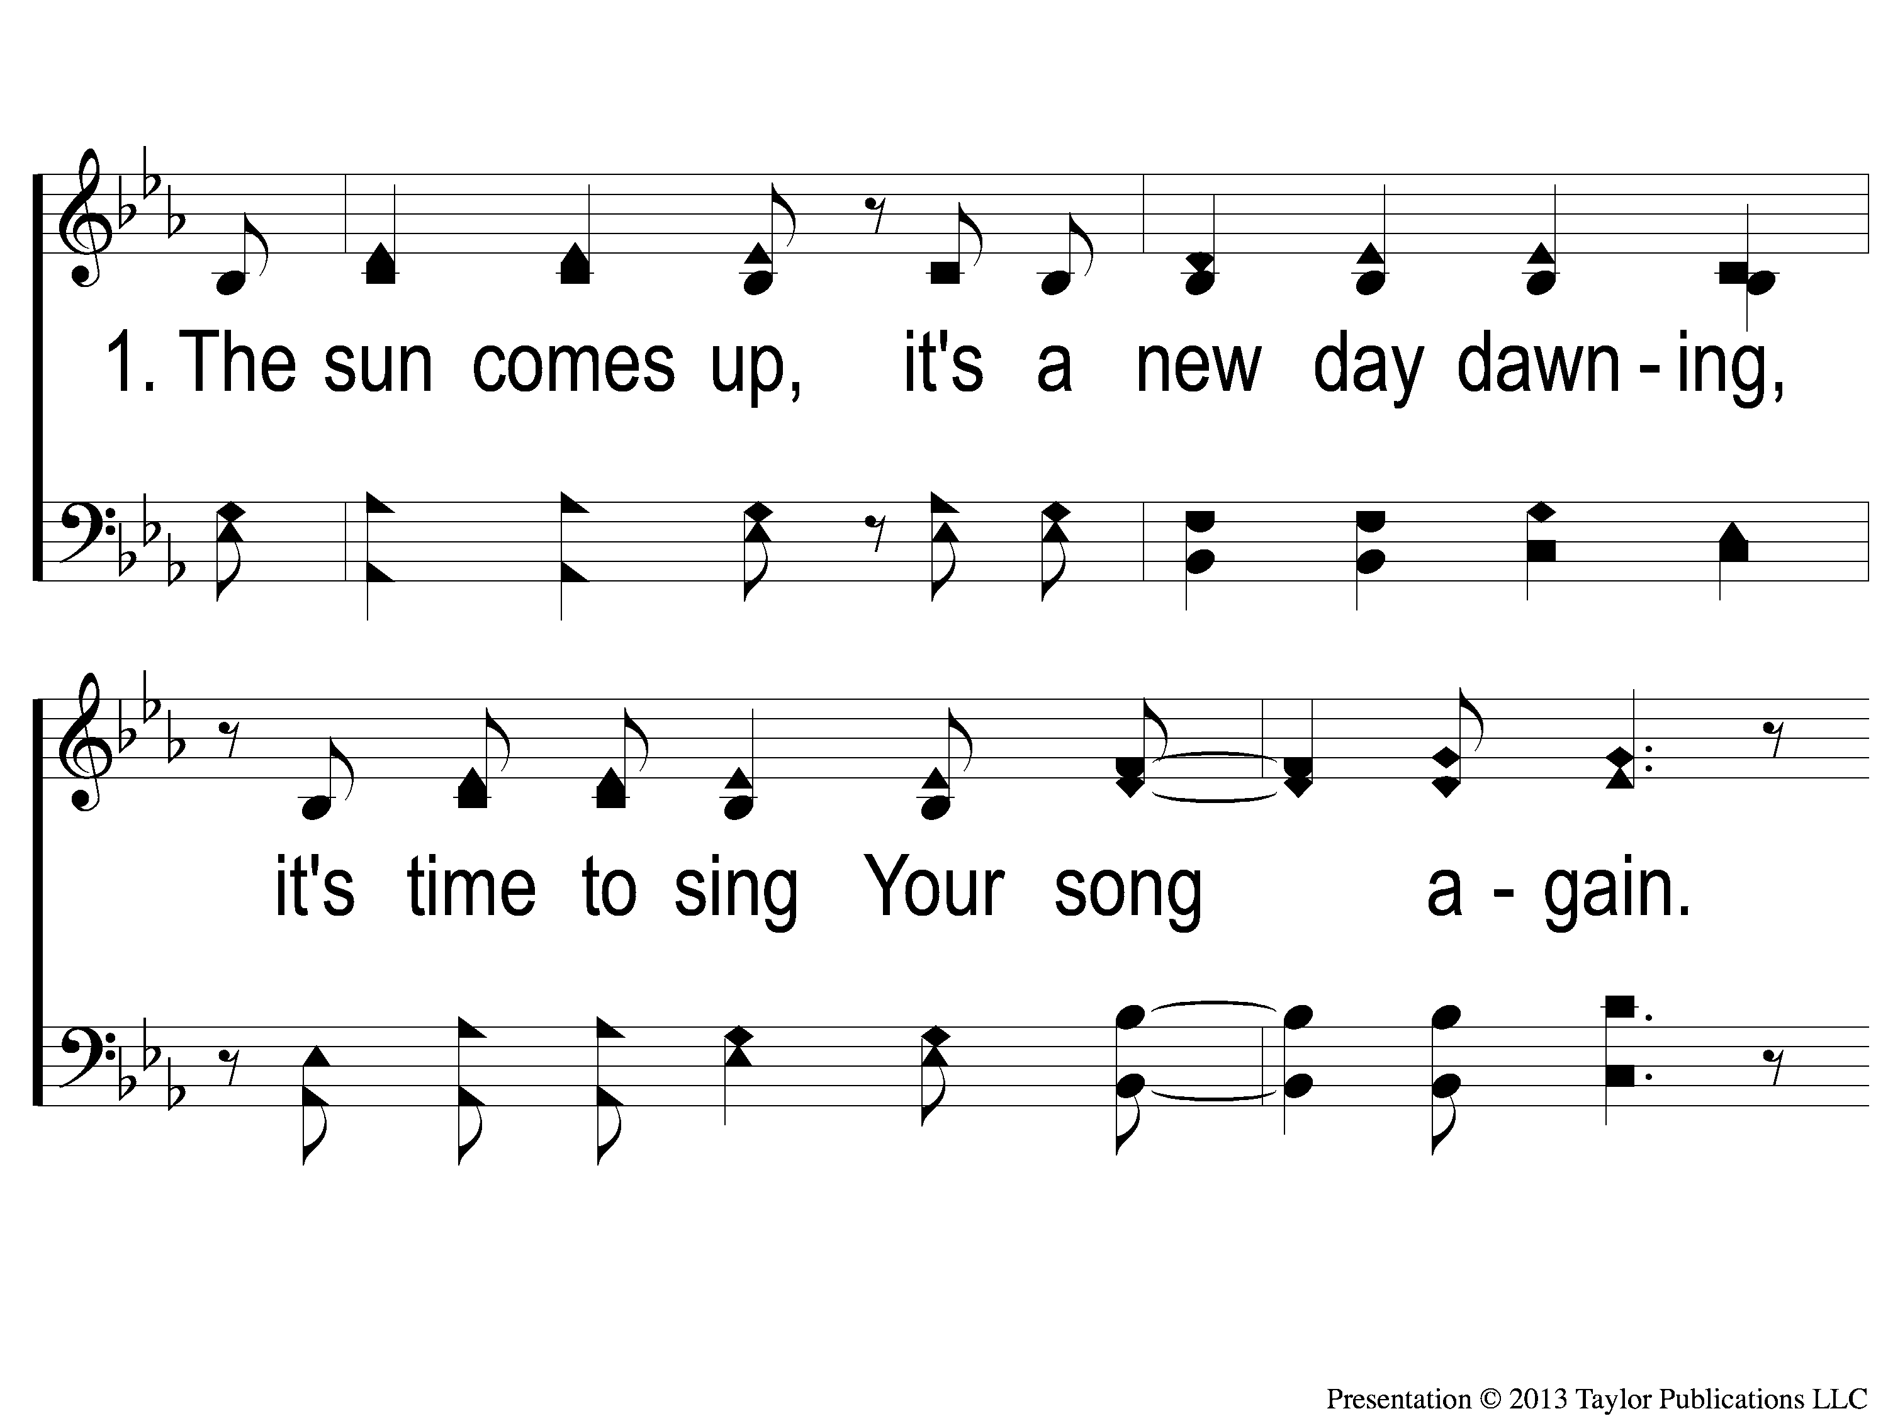
1-1 10,000 Reasons (Bless the Lord)
10,000 Reasons (Bless the Lord)

Slide 32
1-2 10,000 Reasons (Bless the Lord)
10,000 Reasons (Bless the Lord)

Slide 33
1c-1 10,000 Reasons (Bless the Lord)
10,000 Reasons (Bless the Lord)

Slide 34
1c-2 10,000 Reasons (Bless the Lord)
10,000 Reasons (Bless the Lord)

Slide 35
2-1 10,000 Reasons (Bless the Lord)
10,000 Reasons (Bless the Lord)

Slide 36
2-2 10,000 Reasons (Bless the Lord)
10,000 Reasons (Bless the Lord)

Slide 37
2c-1 10,000 Reasons (Bless the Lord)
10,000 Reasons (Bless the Lord)

Slide 38
2c-2 10,000 Reasons (Bless the Lord)
10,000 Reasons (Bless the Lord)

Slide 39
3-1 10,000 Reasons (Bless the Lord)
10,000 Reasons (Bless the Lord)

Slide 40
3-2 10,000 Reasons (Bless the Lord)
10,000 Reasons (Bless the Lord)

Slide 41
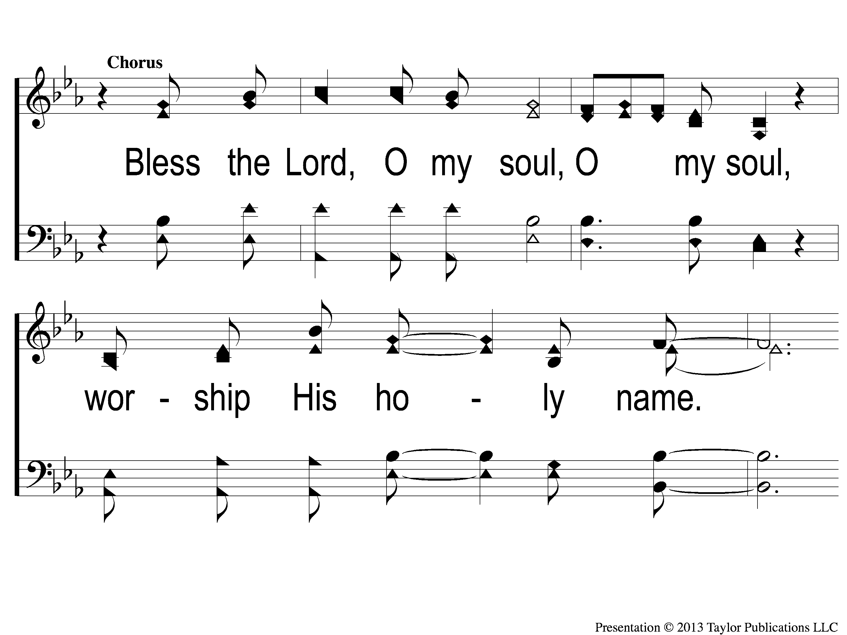
3c-1 10,000 Reasons (Bless the Lord)
10,000 Reasons (Bless the Lord)

Slide 42
3c-2 10,000 Reasons (Bless the Lord)
10,000 Reasons (Bless the Lord)

Slide 43
#916
SONG:
What A Day
That Will Be

Slide 44
1-1 What a Day That Will Be
What a Day That Will Be
916

Slide 45
1-2 What a Day That Will Be
What a Day That Will Be
916

Slide 46
1-3 What a Day That Will Be
What a Day That Will Be
916

Slide 47
C-1 What a Day That Will Be
What a Day That Will Be
916

Slide 48
C-2 What a Day That Will Be
What a Day That Will Be
916

Slide 49
C-3 What a Day That Will Be
What a Day That Will Be
916

Slide 50
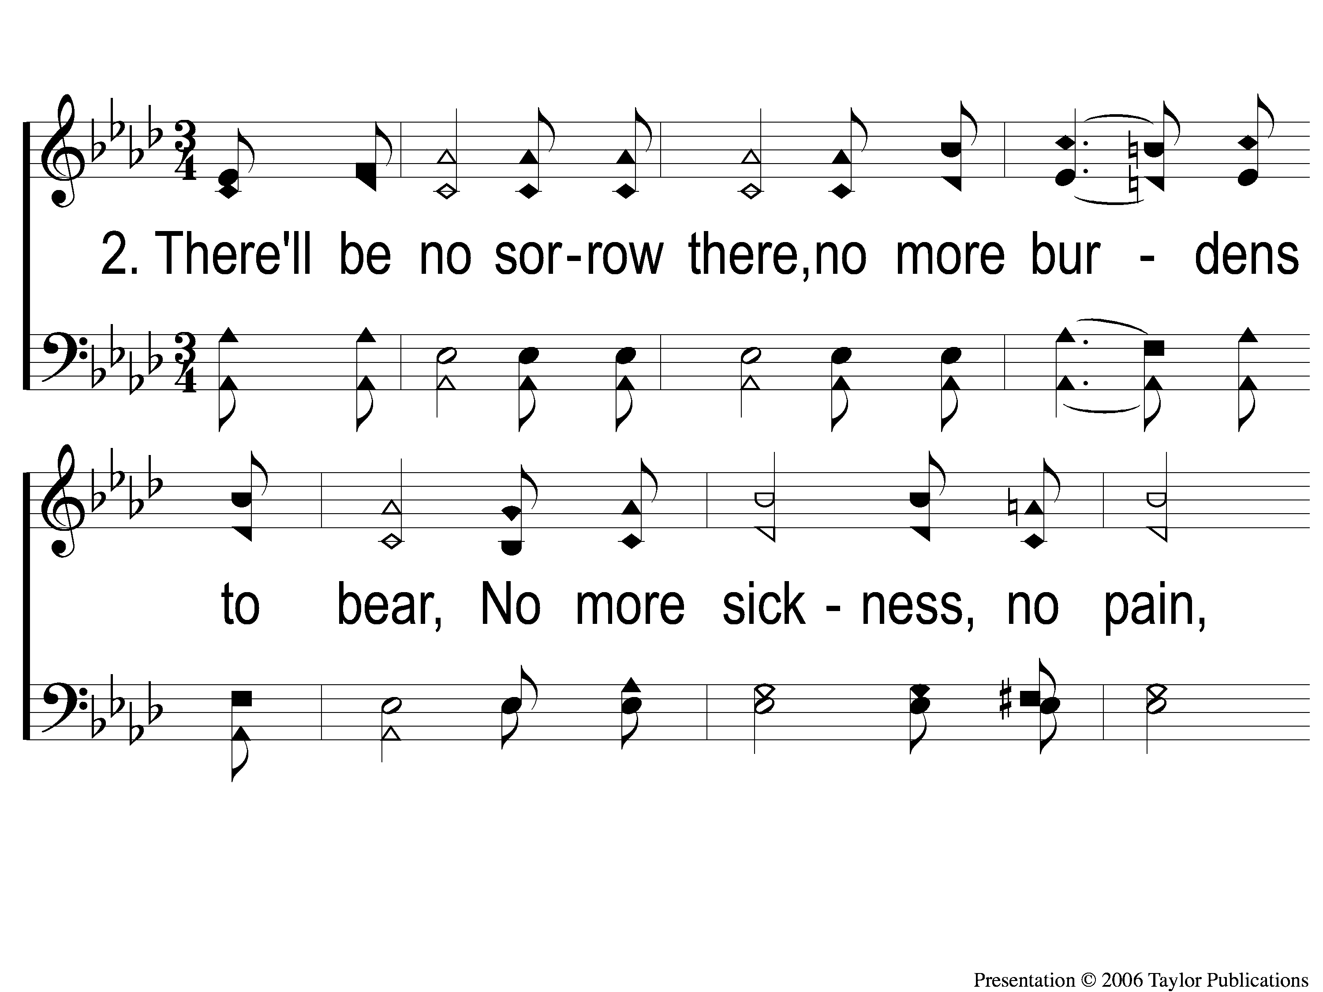
2-1 What a Day That Will Be
What a Day That Will Be
916

Slide 51
2-2 What a Day That Will Be
What a Day That Will Be
916

Slide 52
2-3 What a Day That Will Be
What a Day That Will Be
916

Slide 53
C-1 What a Day That Will Be
What a Day That Will Be
916

Slide 54
C-2 What a Day That Will Be
What a Day That Will Be
916

Slide 55
C-3 What a Day That Will Be
What a Day That Will Be
916

Slide 56
SCRIPTURE:
Revelation 8:1-6

Slide 57
THE REVELATION OF JESUS CHRIST
“THE 7 ANGELS WHO HAD THE 7 TRUMPETS”
REVELATION 8:6 (NKJV)

Slide 58
Two Challenges:
Read through all of the book
Write a one-sentence summary of the book

Slide 59
REVIEW
Ch. 1 – Setting: John’s Exile
Ch. 2-3 – Jesus’ Messages to the 7 Churches
Ch. 4-7 – The 7 Seals Opened

Slide 60
Seventh Seal Opened
Rev. 8:1
Silence for 30 minutes

Slide 61
Seventh Seal Opened
Rev. 8:1
Silence for 30 minutes
7 Trumpets Sound – Ch. 8-11
Announcing God’s Wrath on Rome

Slide 62
The First Trumpet
Rev. 8:7

Slide 63
The First Trumpet
Rev. 8:7
Hail, Fire, & Blood → Earth
1/3 of trees burned up
All of the green grass burned up

Slide 64
The Second Trumpet
Rev. 8:8-9

Slide 65
The Second Trumpet
Rev. 8:8-9
Mountain → Sea
1/3 of the sea → Blood
1/3 of creatures died
1/3 of ships destroyed

Slide 66
The Third Trumpet
Rev. 8:10-11

Slide 67
The Third Trumpet
Rev. 8:10-11
Star from Heaven → Springs & Rivers
1/3 of the water → Bitter

Slide 68
The Fourth Trumpet
Rev. 8:12-13

Slide 69
The Fourth Trumpet
Rev. 8:12-13
1/3 Sun
1/3 of Moon
1/3 of Stars
3-Fold “Woe” Pronounced

Slide 70
The Fifth Trumpet
Rev. 9:1-12

Slide 71
The Fifth Trumpet
Rev. 9:1-12
Star falls from Heaven → Earth
Given key to bottomless pit / abyss
Locusts sent out to harm → w/o seal of God!

Slide 72
The Sixth Trumpet
Rev. 9:13-21

Slide 73
The Sixth Trumpet
Rev. 9:13-21
Voice heard from the altar of God
4 Angels released to kill 1/3 of mankind
Released from the Euphrates River

Slide 74
The Interlude
Rev. 10:1-11

Slide 75
The Interlude
Rev. 10:1-11
John told to “eat the little book”
Similar visions:
Ezek. 3:1
Jer. 15:16

Slide 76
The Interlude
Rev. 11:1-14

Slide 77
The Interlude
Rev. 11:1-14
The 2 Witnesses
Prophesied (v. 1-6)
Killed (v. 7-10)
Resurrected (v. 11-14)

Slide 78
The Seventh Trumpet
Rev. 11:15-19

Slide 79
The Seventh Trumpet
Rev. 11:15-19
Loud Praise in Heaven
“Kingdoms of Earth → Kingdoms of the Lord”
Reward for the Saints
Temple Opened

Slide 80
The Application
1. The 7 Trumpets were Signs of Partial Judgment
For Rome & Persecutors of Christians
NOT signs in our future of Judgment Day

Slide 81
The Application
2. The Message of the Gospel is either:
Bitter
Sweet

Slide 82
How Do I Respond to
God’s Call to Repentance?

Slide 83
#712
SONG:
Jesus Is Coming Soon

Slide 84
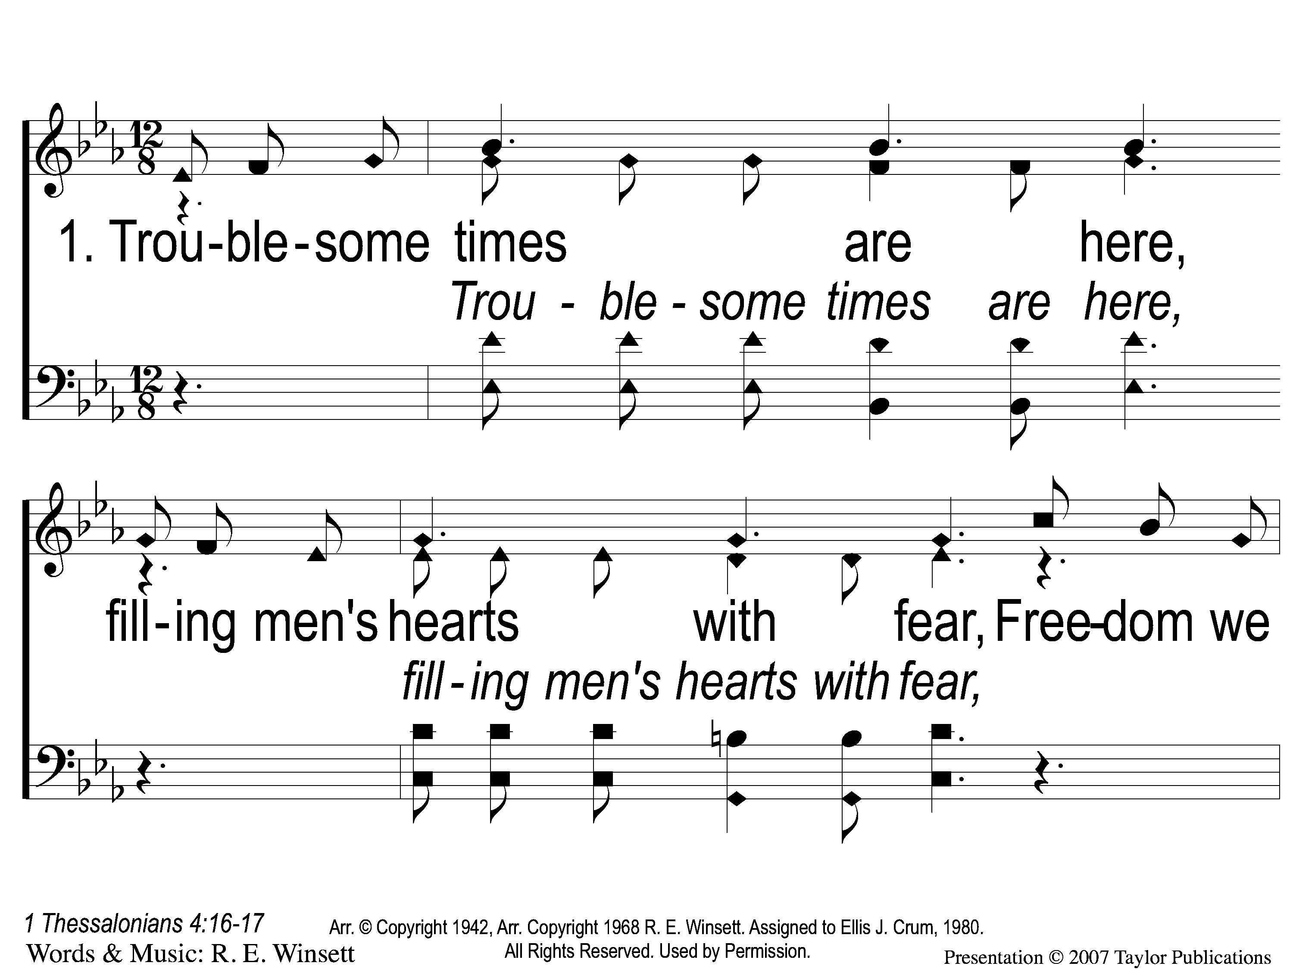
1-1 Jesus is Coming Soon
Jesus is Coming Soon
712

Slide 85
1-2 Jesus is Coming Soon
Jesus is Coming Soon
712

Slide 86
1-3 Jesus is Coming Soon
Jesus is Coming Soon
712

Slide 87
C-1 Jesus is Coming Soon
Jesus is Coming Soon
712

Slide 88
C-2 Jesus is Coming Soon
Jesus is Coming Soon
712

Slide 89
C-3 Jesus is Coming Soon
Jesus is Coming Soon
712

Slide 90
C-4 Jesus is Coming Soon
Jesus is Coming Soon
712

Slide 91
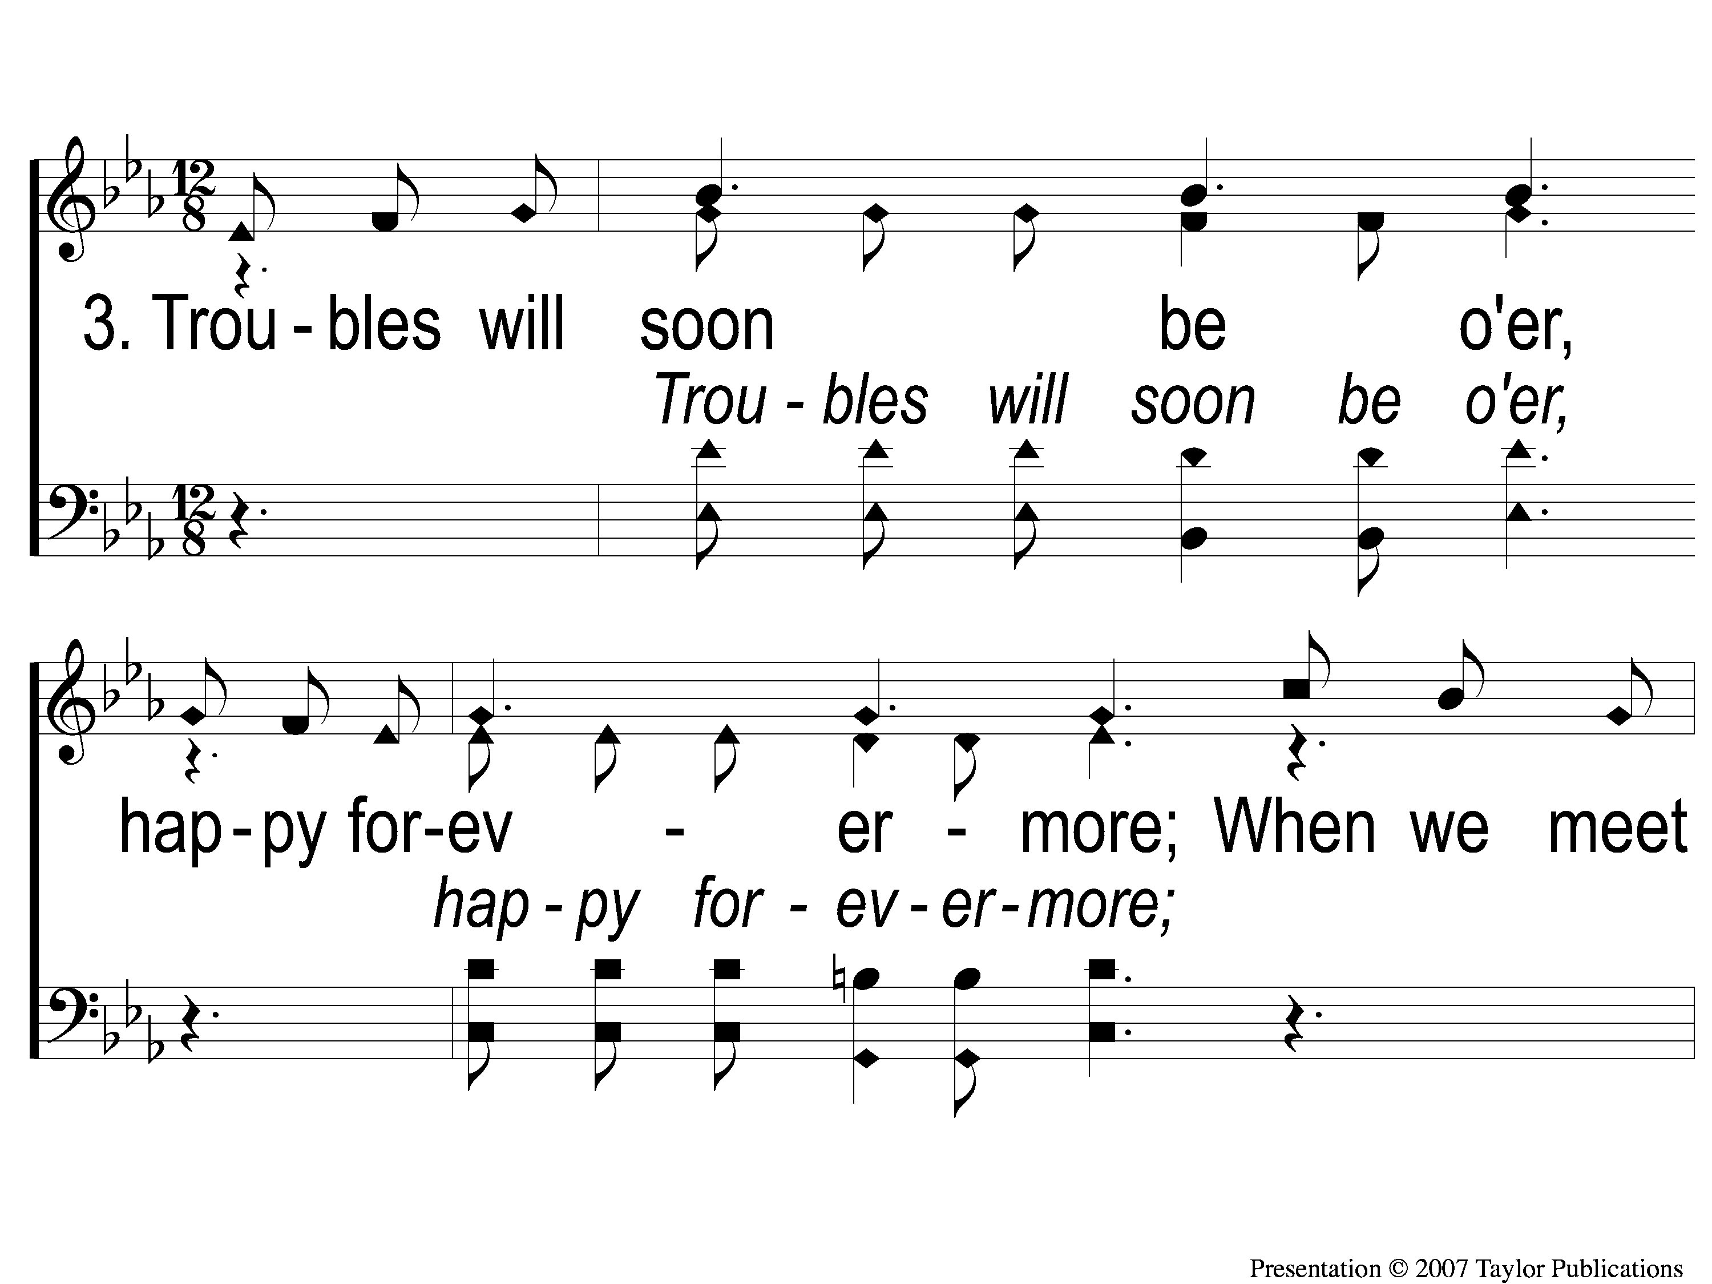
3-1 Jesus is Coming Soon
Jesus is Coming Soon
712

Slide 92
3-2 Jesus is Coming Soon
Jesus is Coming Soon
712

Slide 93
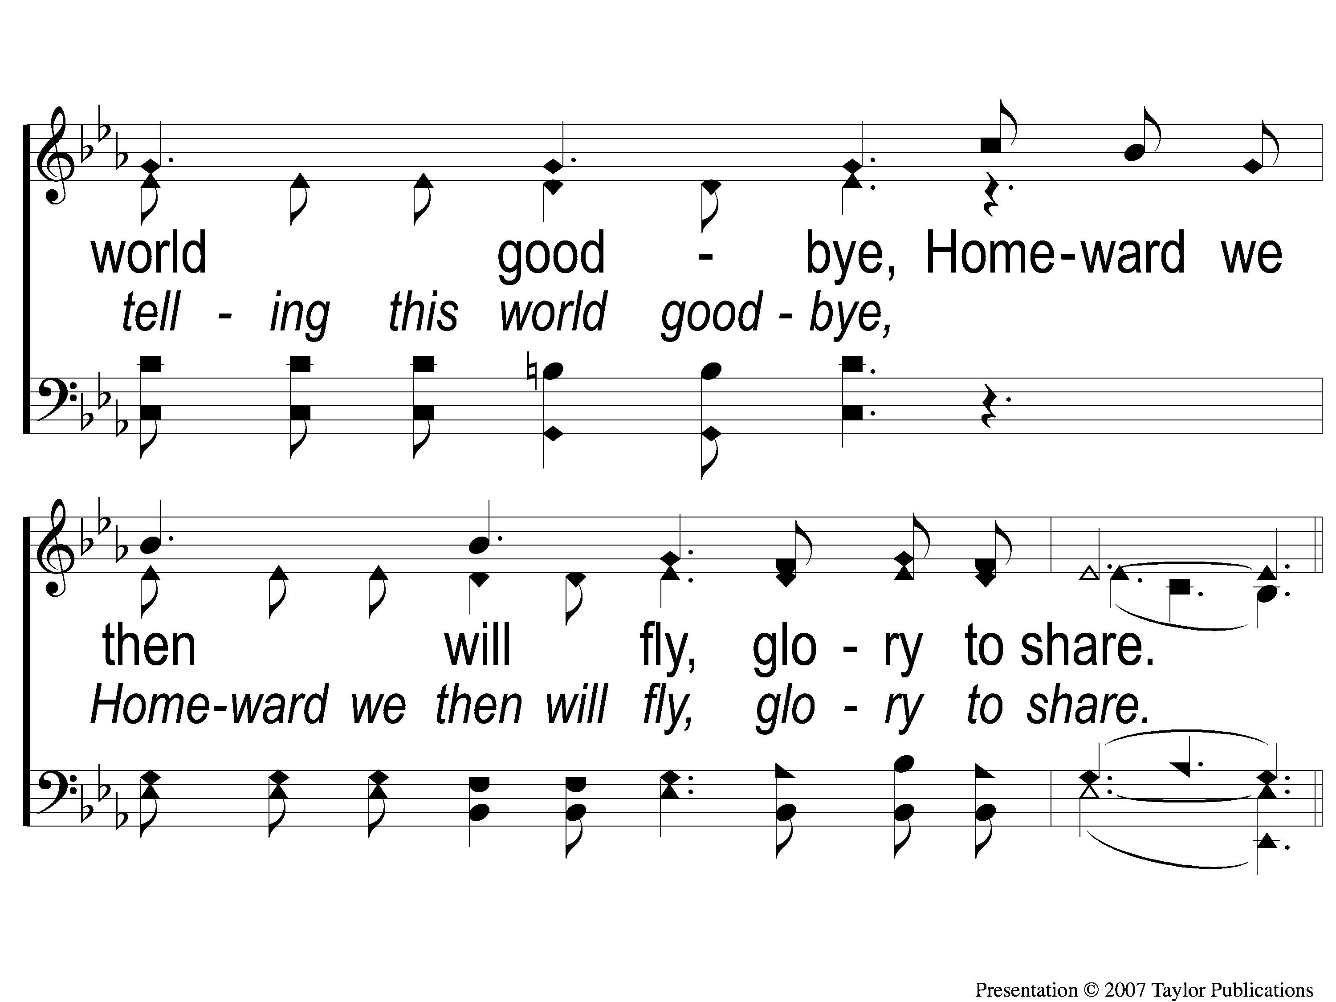
3-3 Jesus is Coming Soon
Jesus is Coming Soon
712

Slide 94
C-1 Jesus is Coming Soon
Jesus is Coming Soon
712

Slide 95
C-2 Jesus is Coming Soon
Jesus is Coming Soon
712

Slide 96
C-3 Jesus is Coming Soon
Jesus is Coming Soon
712

Slide 97
C-4 Jesus is Coming Soon
Jesus is Coming Soon
712

Slide 98
SONG:
In Christ Alone

Slide 99
1-1 In Christ Alone
In Christ Alone

Slide 100
1-2 In Christ Alone
In Christ Alone

Slide 101
1-3 In Christ Alone
In Christ Alone

Slide 102
1-4 In Christ Alone
In Christ Alone

Slide 103
2-1 In Christ Alone
In Christ Alone

Slide 104
2-2 In Christ Alone
In Christ Alone

Slide 105
2-3 In Christ Alone
In Christ Alone

Slide 106
2-4 In Christ Alone
In Christ Alone

Slide 107
3-1 In Christ Alone
In Christ Alone

Slide 108
3-2 In Christ Alone
In Christ Alone

Slide 109
3-3 In Christ Alone
In Christ Alone

Slide 110
3-4 In Christ Alone
In Christ Alone

Slide 111
4-1 In Christ Alone
In Christ Alone

Slide 112
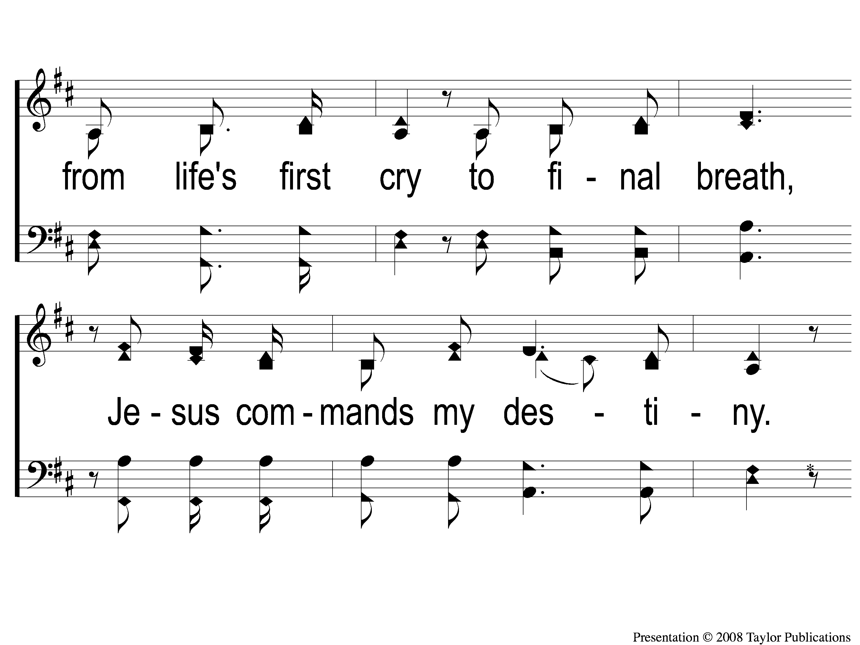
4-2 In Christ Alone
In Christ Alone

Slide 113
4-3 In Christ Alone
In Christ Alone

Slide 114
4-4 In Christ Alone
In Christ Alone

Slide 115
LORD’S SUPPER
The
Matt. 26:26-29

Slide 116
Unleavened Bread
LORD’S SUPPER
¹ Who has believed our report? And to whom has the arm of the Lord been revealed?
² For He shall grow up before Him as a tender plant, And as a root out of dry ground. He has no form or comeliness; And when we see Him, There is no beauty that we should desire Him.
³ He is despised and rejected by men, A Man of sorrows and acquainted with grief. And we hid, as it were, our faces from Him; He was despised, and we did not esteem Him.
Isaiah 53:1-3

Slide 117
Fruit of the Vine
LORD’S SUPPER
Surely He has borne our griefs
And carried our sorrows;
Yet we esteemed Him stricken,
Smitten by God, and afflicted.
⁵ But He was wounded for our transgressions,
He was bruised for our iniquities;
The chastisement for our peace was upon Him,
And by His stripes we are healed.
Isaiah 53:4-5

Slide 118
2 Corinthians 8:12
OFFERING
¹² For if there is first a willing mind, it is accepted according to what one has, and not according to what he does not have.

Slide 119
Closing PRAYER

Slide 120
#851
SONG:
I’ll Fly Away

Slide 121
1-1 I’ll Fly Away
I’ll Fly Away
851

Slide 122
1-2 I’ll Fly Away
I’ll Fly Away
851

Slide 123
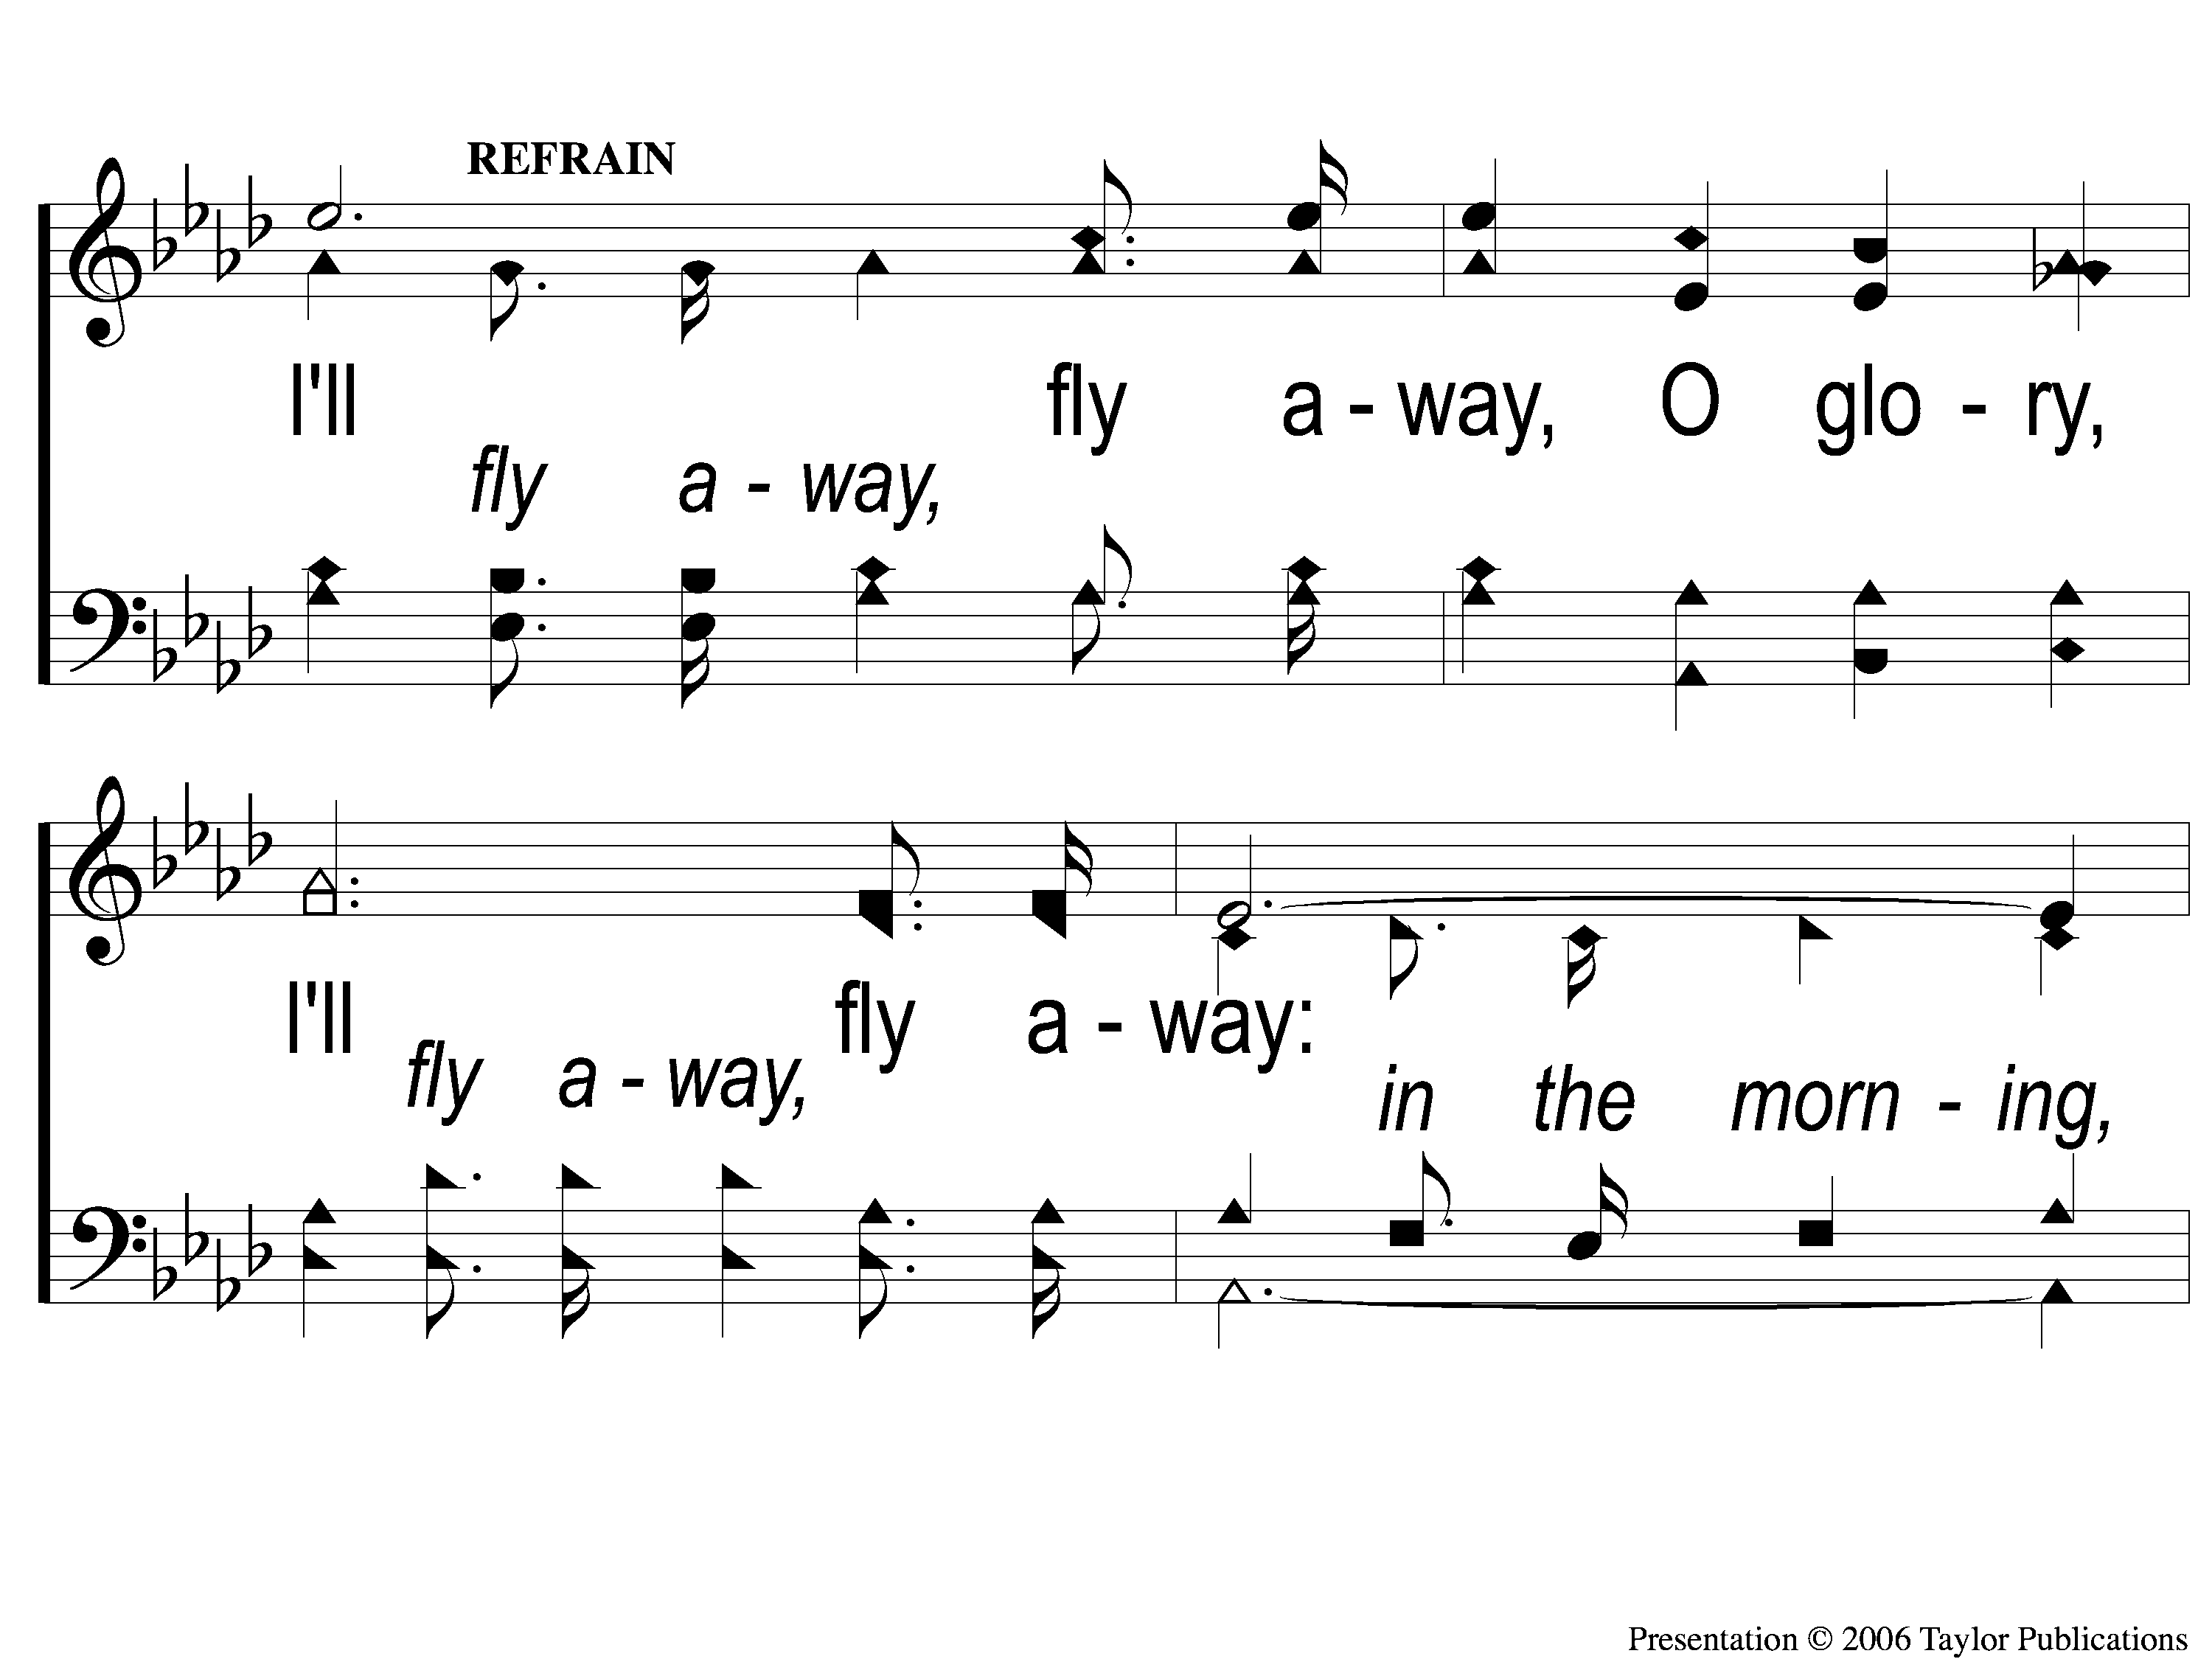
C-1 I’ll Fly Away
I’ll Fly Away
851

Slide 124
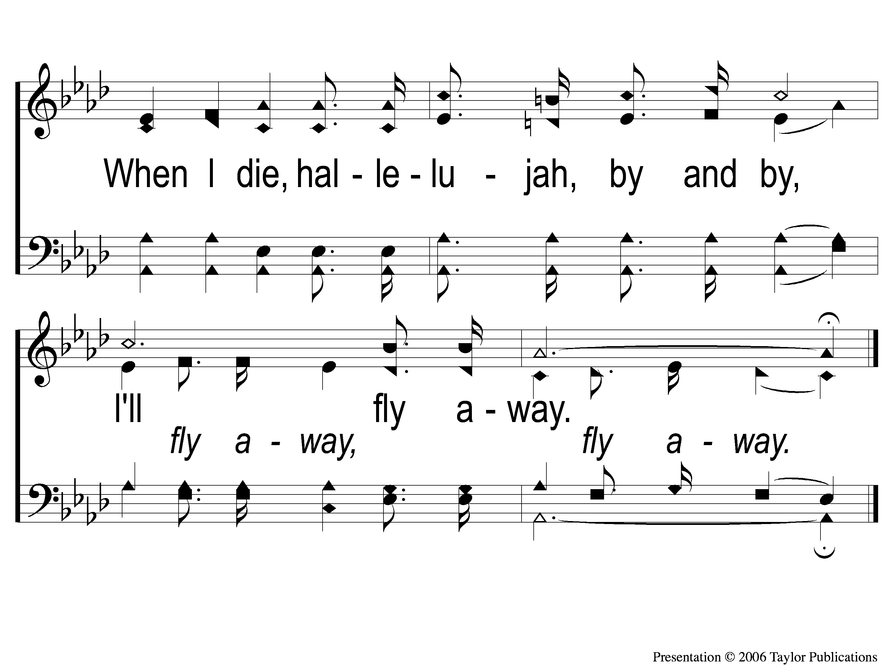
C-2 I’ll Fly Away
I’ll Fly Away
851

Slide 125
2-1 I’ll Fly Away
I’ll Fly Away
851

Slide 126
2-2 I’ll Fly Away
I’ll Fly Away
851

Slide 127
C-1 I’ll Fly Away
I’ll Fly Away
851

Slide 128
C-2 I’ll Fly Away
I’ll Fly Away
851

Slide 129
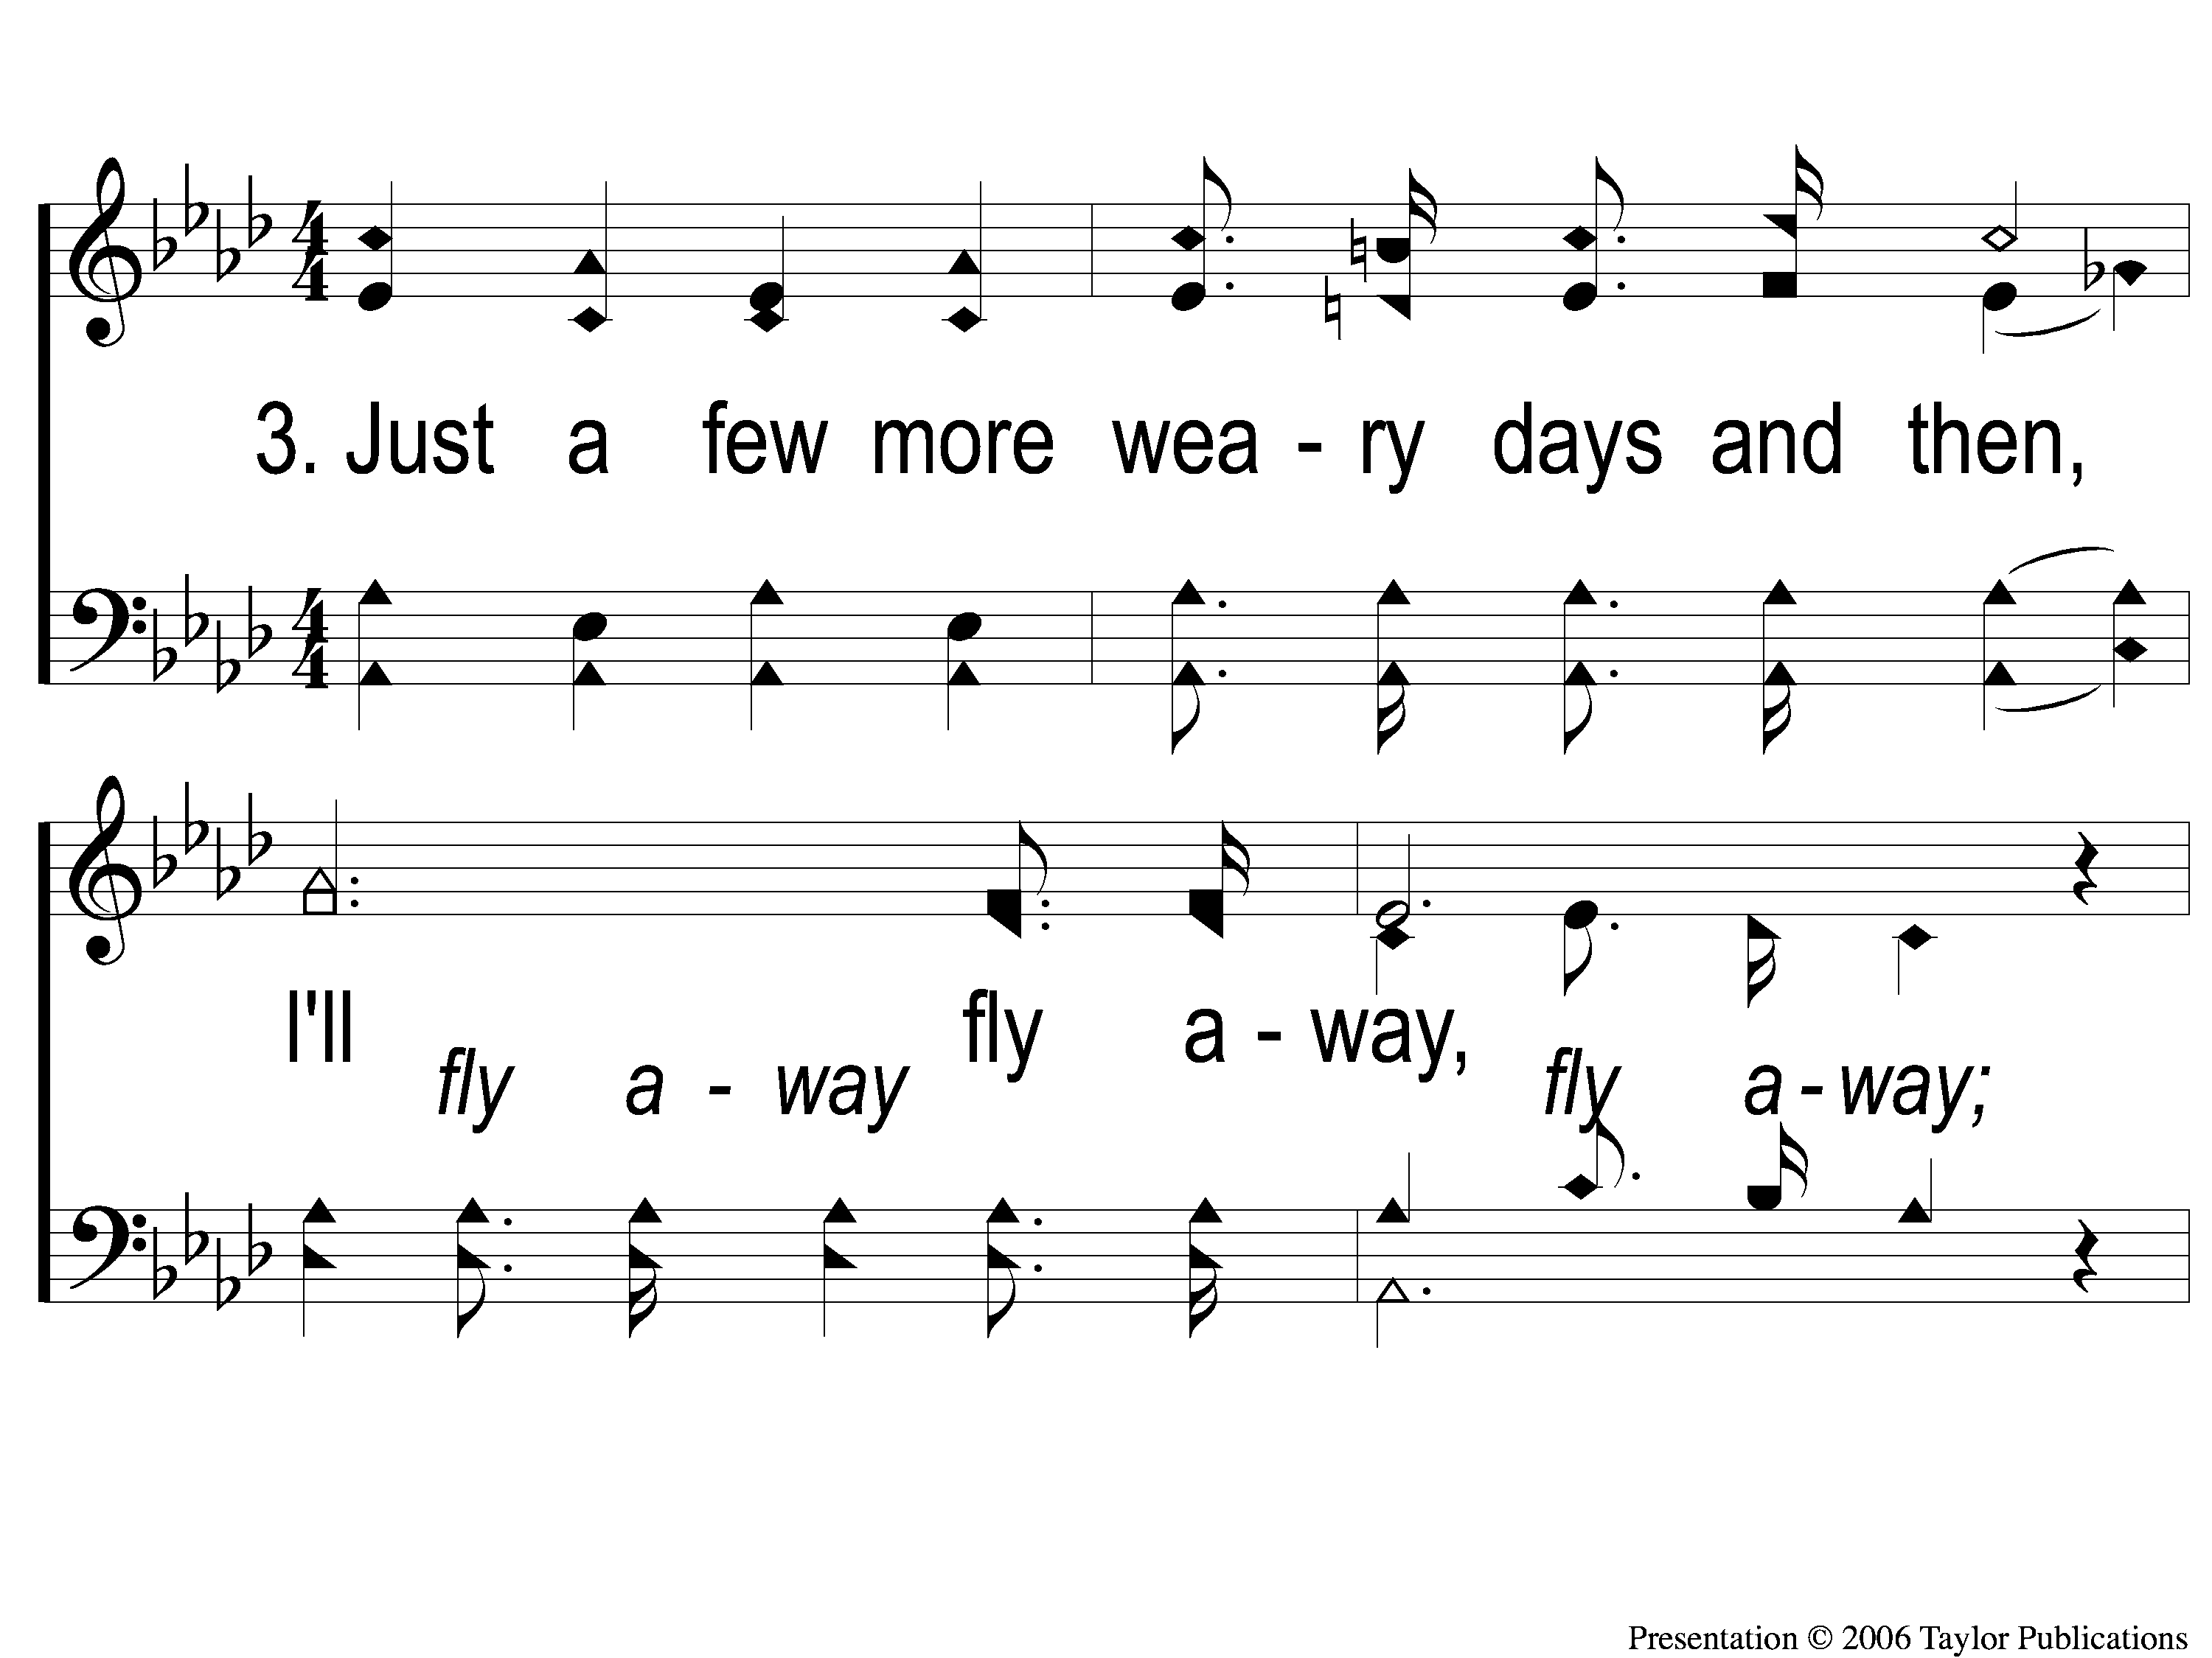
3-1 I’ll Fly Away
I’ll Fly Away
851

Slide 130
3-2 I’ll Fly Away
I’ll Fly Away
851

Slide 131
C-1 I’ll Fly Away
I’ll Fly Away
851

Slide 132
C-2 I’ll Fly Away
I’ll Fly Away
851

Slide 133
TONIGHT @ 6:00 pm
JOIN US
HOPE TO SEE YOU THERE!

