Slide 1
PLEASE STANDBY
OUR LIVESTREAM
WILL BEGIN SOON

Slide 2
WELCOME
THANKS FOR JOINING US!

Slide 3
Songs of
Praise to God

Slide 4
Opening PRAYER

Slide 5
Songs of
Praise to God

Slide 6
THE REVELATION OF JESUS CHRIST
“NOW A GREAT SIGN APPEARED IN HEAVEN”
REVELATION 12:1 (NKJV)

Slide 7
Past, Present, & Future
Ch. 12 – The Past
Ch. 13 – The Present
Ch. 14 – The Future

Slide 8
Important Note
1,260 Days = 42 Months = 3 ½ Years
= “time and times and half a time” (12:14)

Slide 9
Ch. 12 – The Past
The Plotting (v. 1-6)
The Plummeting & The Praising (v. 7-12)
The Persecuting (v. 13-17)

Slide 10
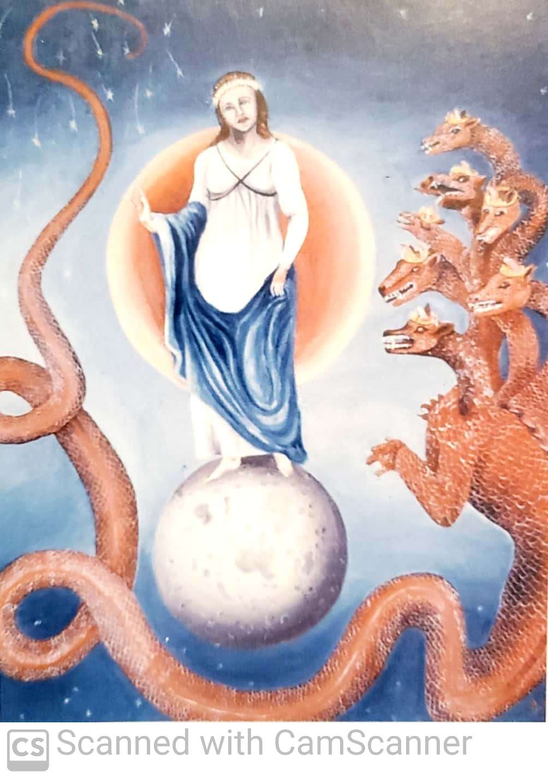

Slide 11
Ch. 13 – The Present
The Sea Beast (v. 1-10)
The Land Beast (v. 11-18)

Slide 12
Ch. 13 – The Present
The Sea Beast (v. 1-10)

Slide 13
Ch. 13 – The Present
The Sea Beast (v. 1-10)
Seems Perfect (v. 1-2)
Given Power from Dragon (v. 3)
Given Worship (v. 4, 8)
Prideful (v. 5-6)
Made war with God’s people (v. 7-8)
Will reap what they have sown (v. 9-10)

Slide 14
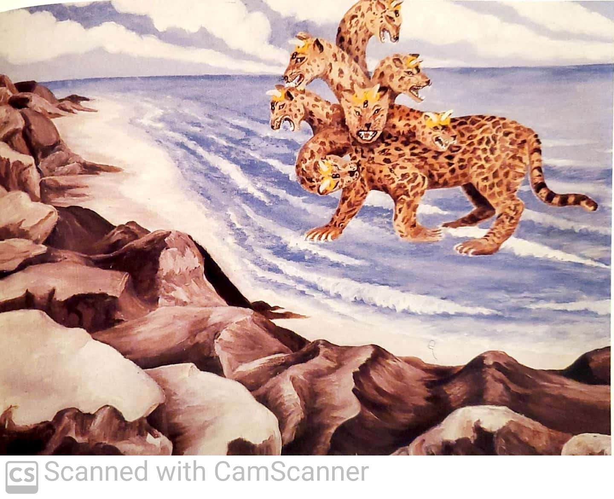

Slide 15
Ch. 13 – The Present
The Land Beast (v. 11-18)

Slide 16
Ch. 13 – The Present
The Land Beast (v. 11-18)
Looked like a lamb with 2 Horns
Spoke like the Dragon
Caused people to worship the Sea Beast
Deceptive (v. 13-14)
Destructive (v. 15-17)
Those who follow are unwise (v. 18)

Slide 17
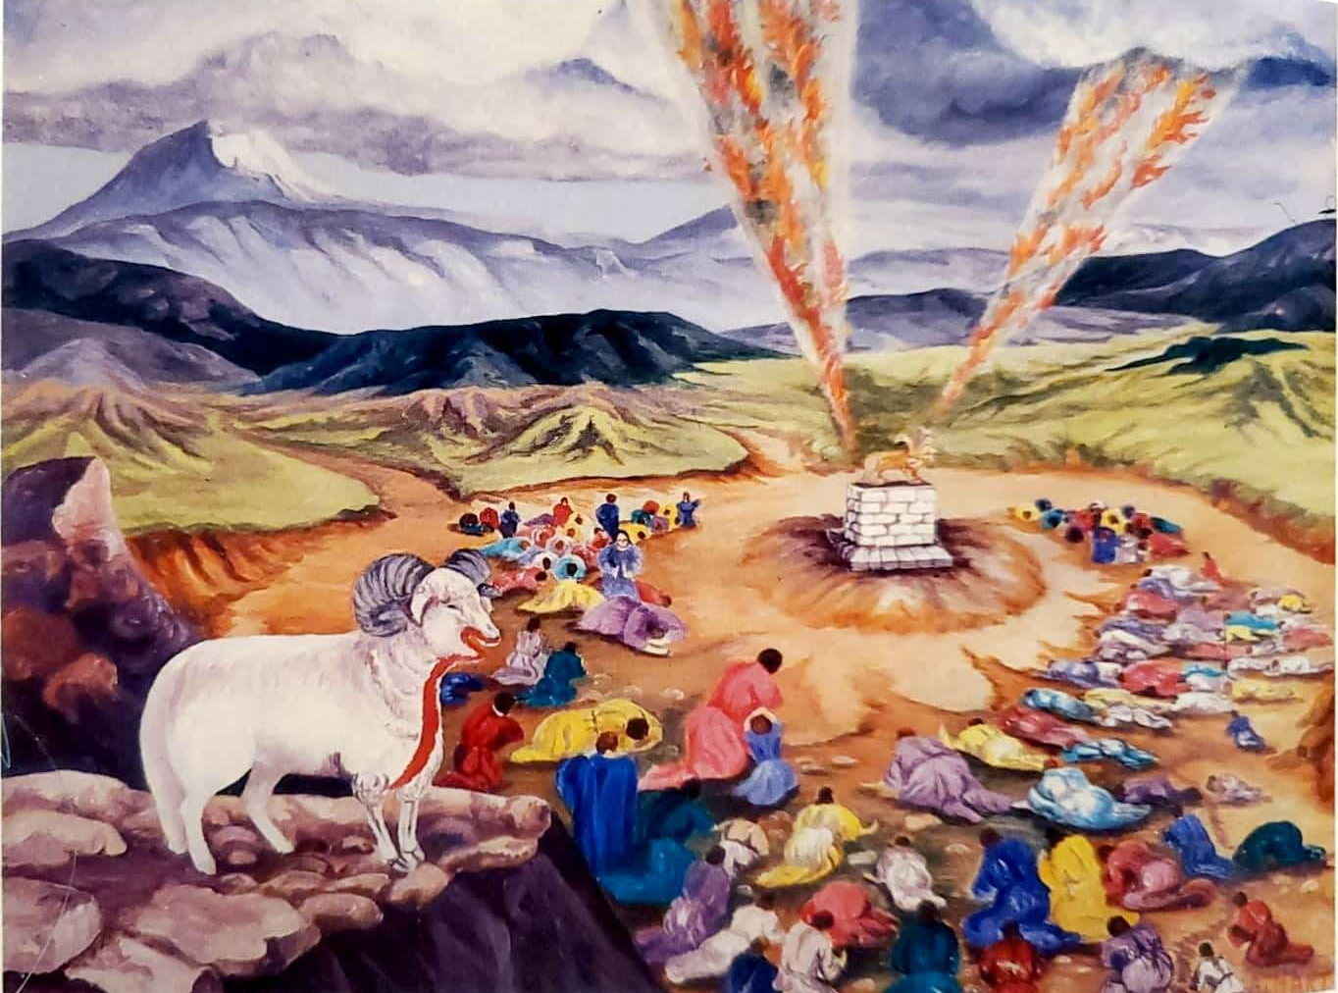

Slide 18
Ch. 14 – The Future
The Redeemed & The Lamb (v. 1-5, 12-13)

Slide 19
Ch. 14 – The Future
The Redeemed & The Lamb (v. 1-5, 12-13)
Sang a “new song”

Slide 20
Ch. 14 – The Future
The Redeemed & The Lamb (v. 1-5, 12-13)
Sang a “new song”
“Blessed” → patient, enduring ones (v. 12)
At Rest → from labors, works (v. 12)

Slide 21
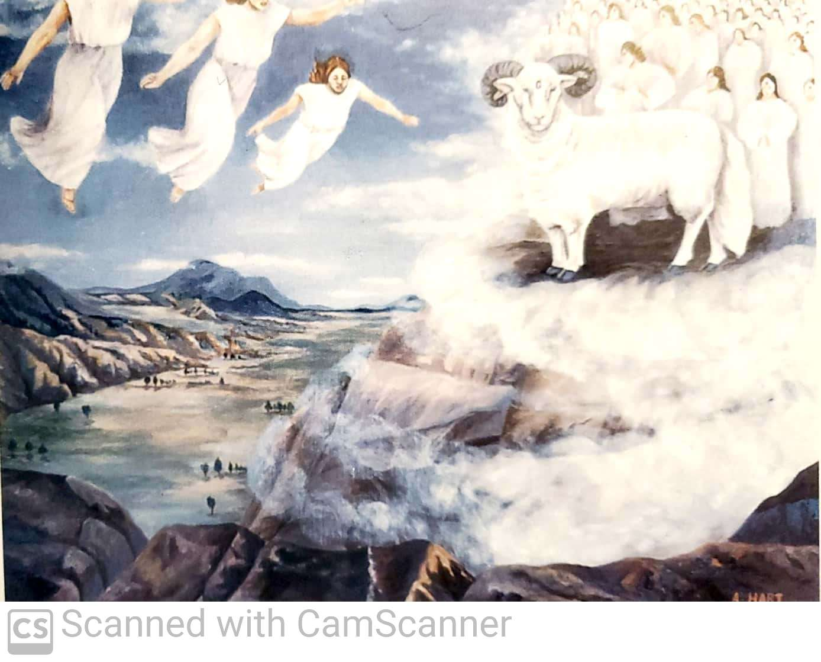

Slide 22
Ch. 14 – The Future
Warning to Those Not Redeemed (v. 1-5, 12-13)

Slide 23
Ch. 14 – The Future
Warning to Those Not Redeemed (v. 1-5, 12-13)
1st Angel → proclaiming the Gospel

Slide 24
Ch. 14 – The Future
Warning to Those Not Redeemed (v. 1-5, 12-13)
1st Angel → proclaiming the Gospel
2nd Angel → “Babylon is fallen”

Slide 25
Ch. 14 – The Future
Warning to Those Not Redeemed (v. 1-5, 12-13)
1st Angel → proclaiming the Gospel
2nd Angel → “Babylon is fallen”
3rd Angel → Do not worship the Beast!

Slide 26
“Redeemed!”
Do I Love to Proclaim It?

Slide 27
Songs of
Praise to God

Slide 28
Closing PRAYER

Slide 29
Songs of
Praise to God

Slide 30
WEDNESDAY @ 6:30 pm
JOIN US
HOPE TO SEE YOU THERE!

