Slide 1
1-1 Holy, Holy, Holy
Holy, Holy, Holy
47

Slide 2
1-2 Holy, Holy, Holy
Holy, Holy, Holy
47

Slide 3
4-1 Holy, Holy, Holy
Holy, Holy, Holy
47

Slide 4
4-2 Holy, Holy, Holy
Holy, Holy, Holy
47

Slide 5
RESTORE REBUILD RENEW
welcome
we are glad to
Have you with us
IN 2022
WHEELER
CHURCH
OF
CHRIST

Slide 6
Song:
Faithful Love

Slide 7
1-1 Faithful Love
Faithful Love

Slide 8
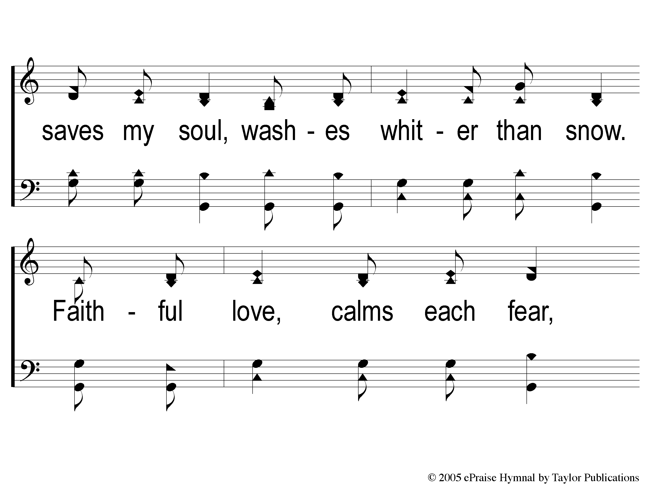
1-2 Faithful Love
Faithful Love

Slide 9
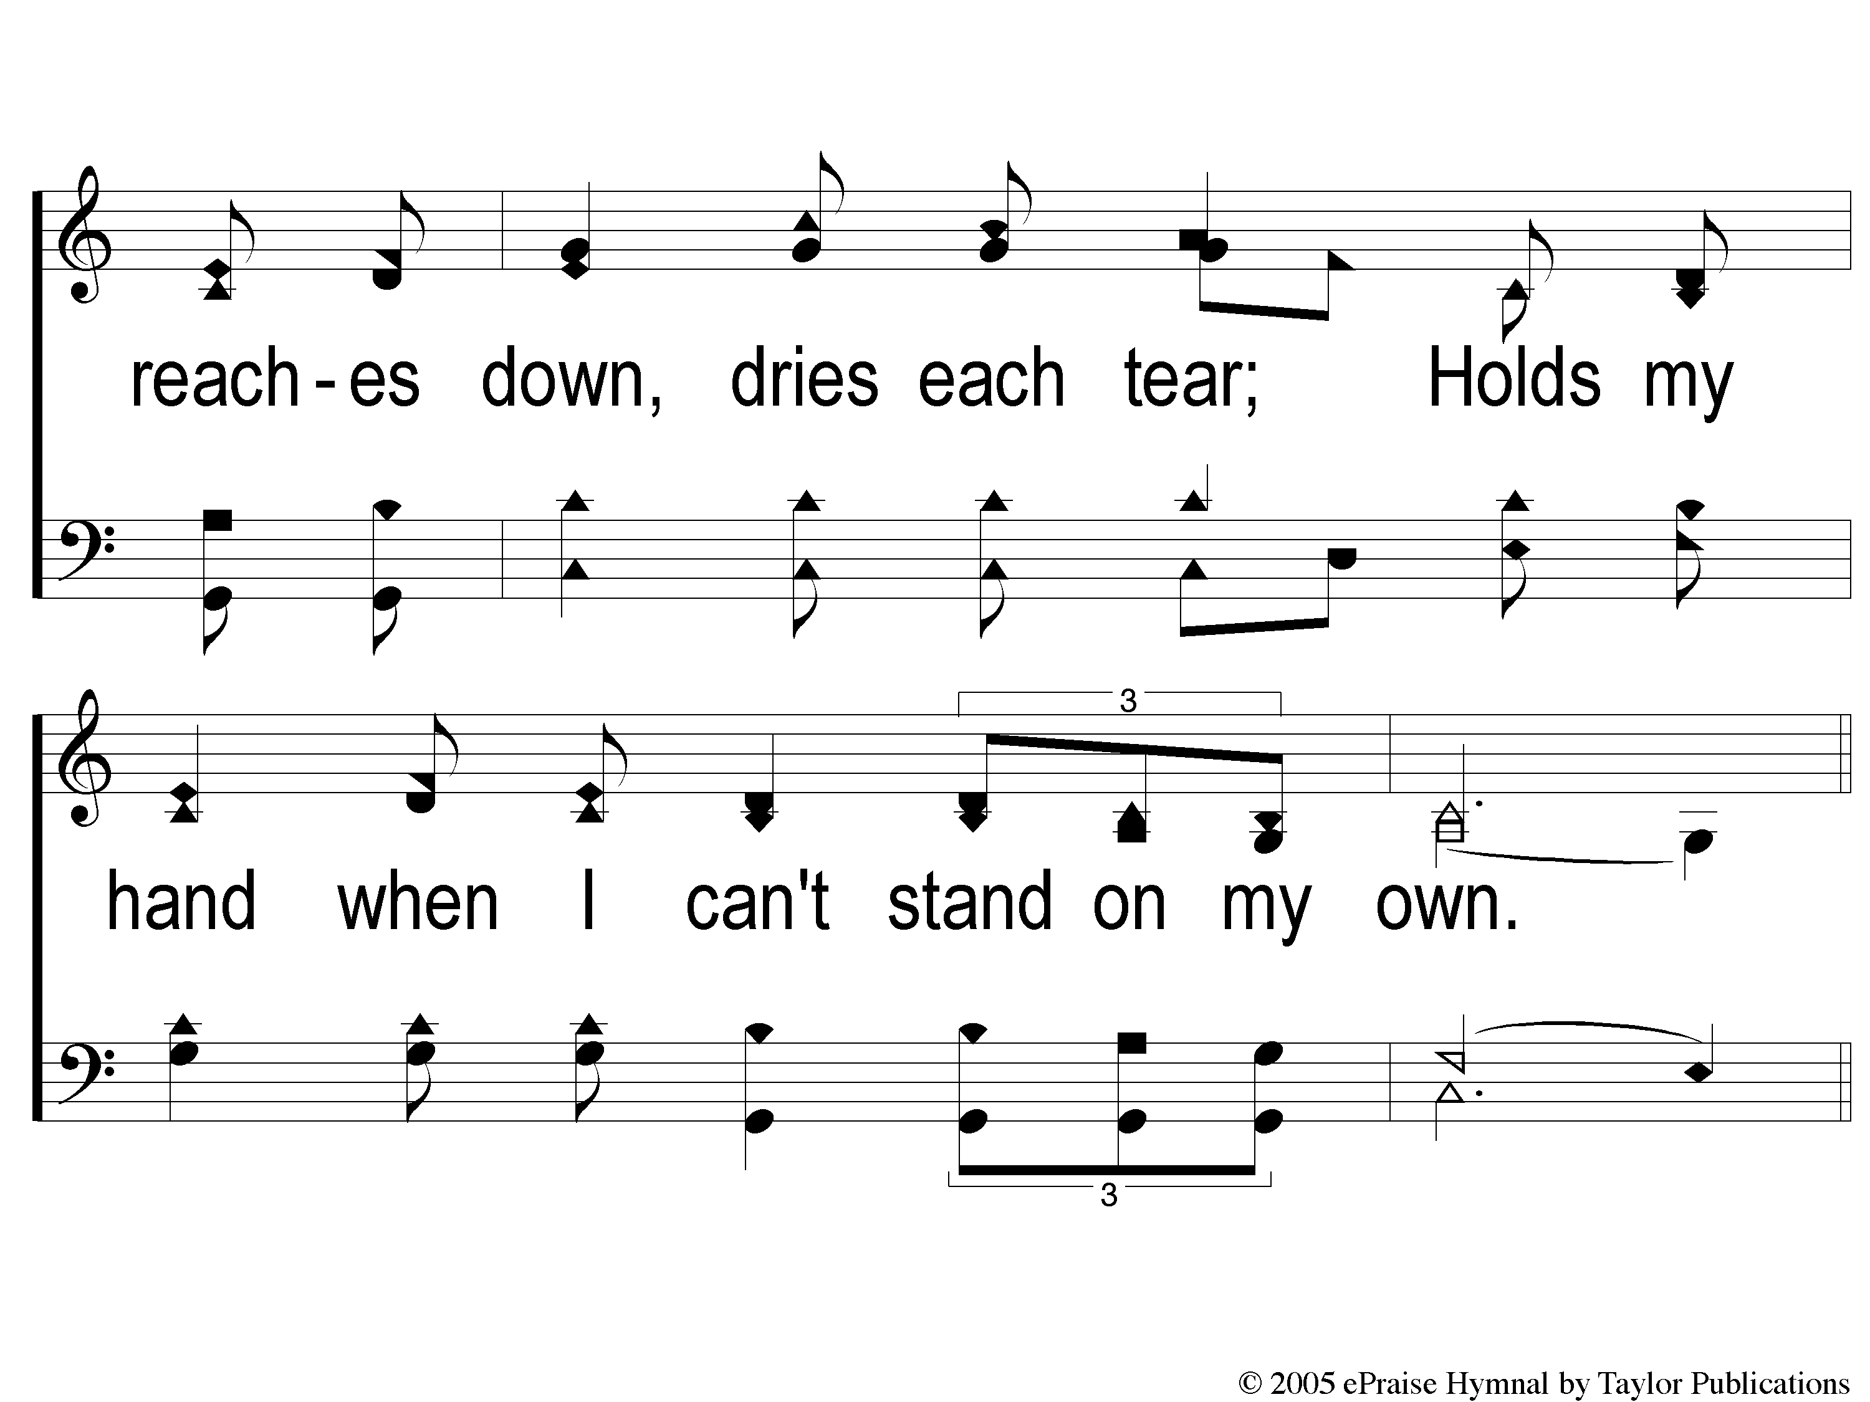
1-3 Faithful Love
Faithful Love

Slide 10
C-1 Faithful Love
Faithful Love

Slide 11
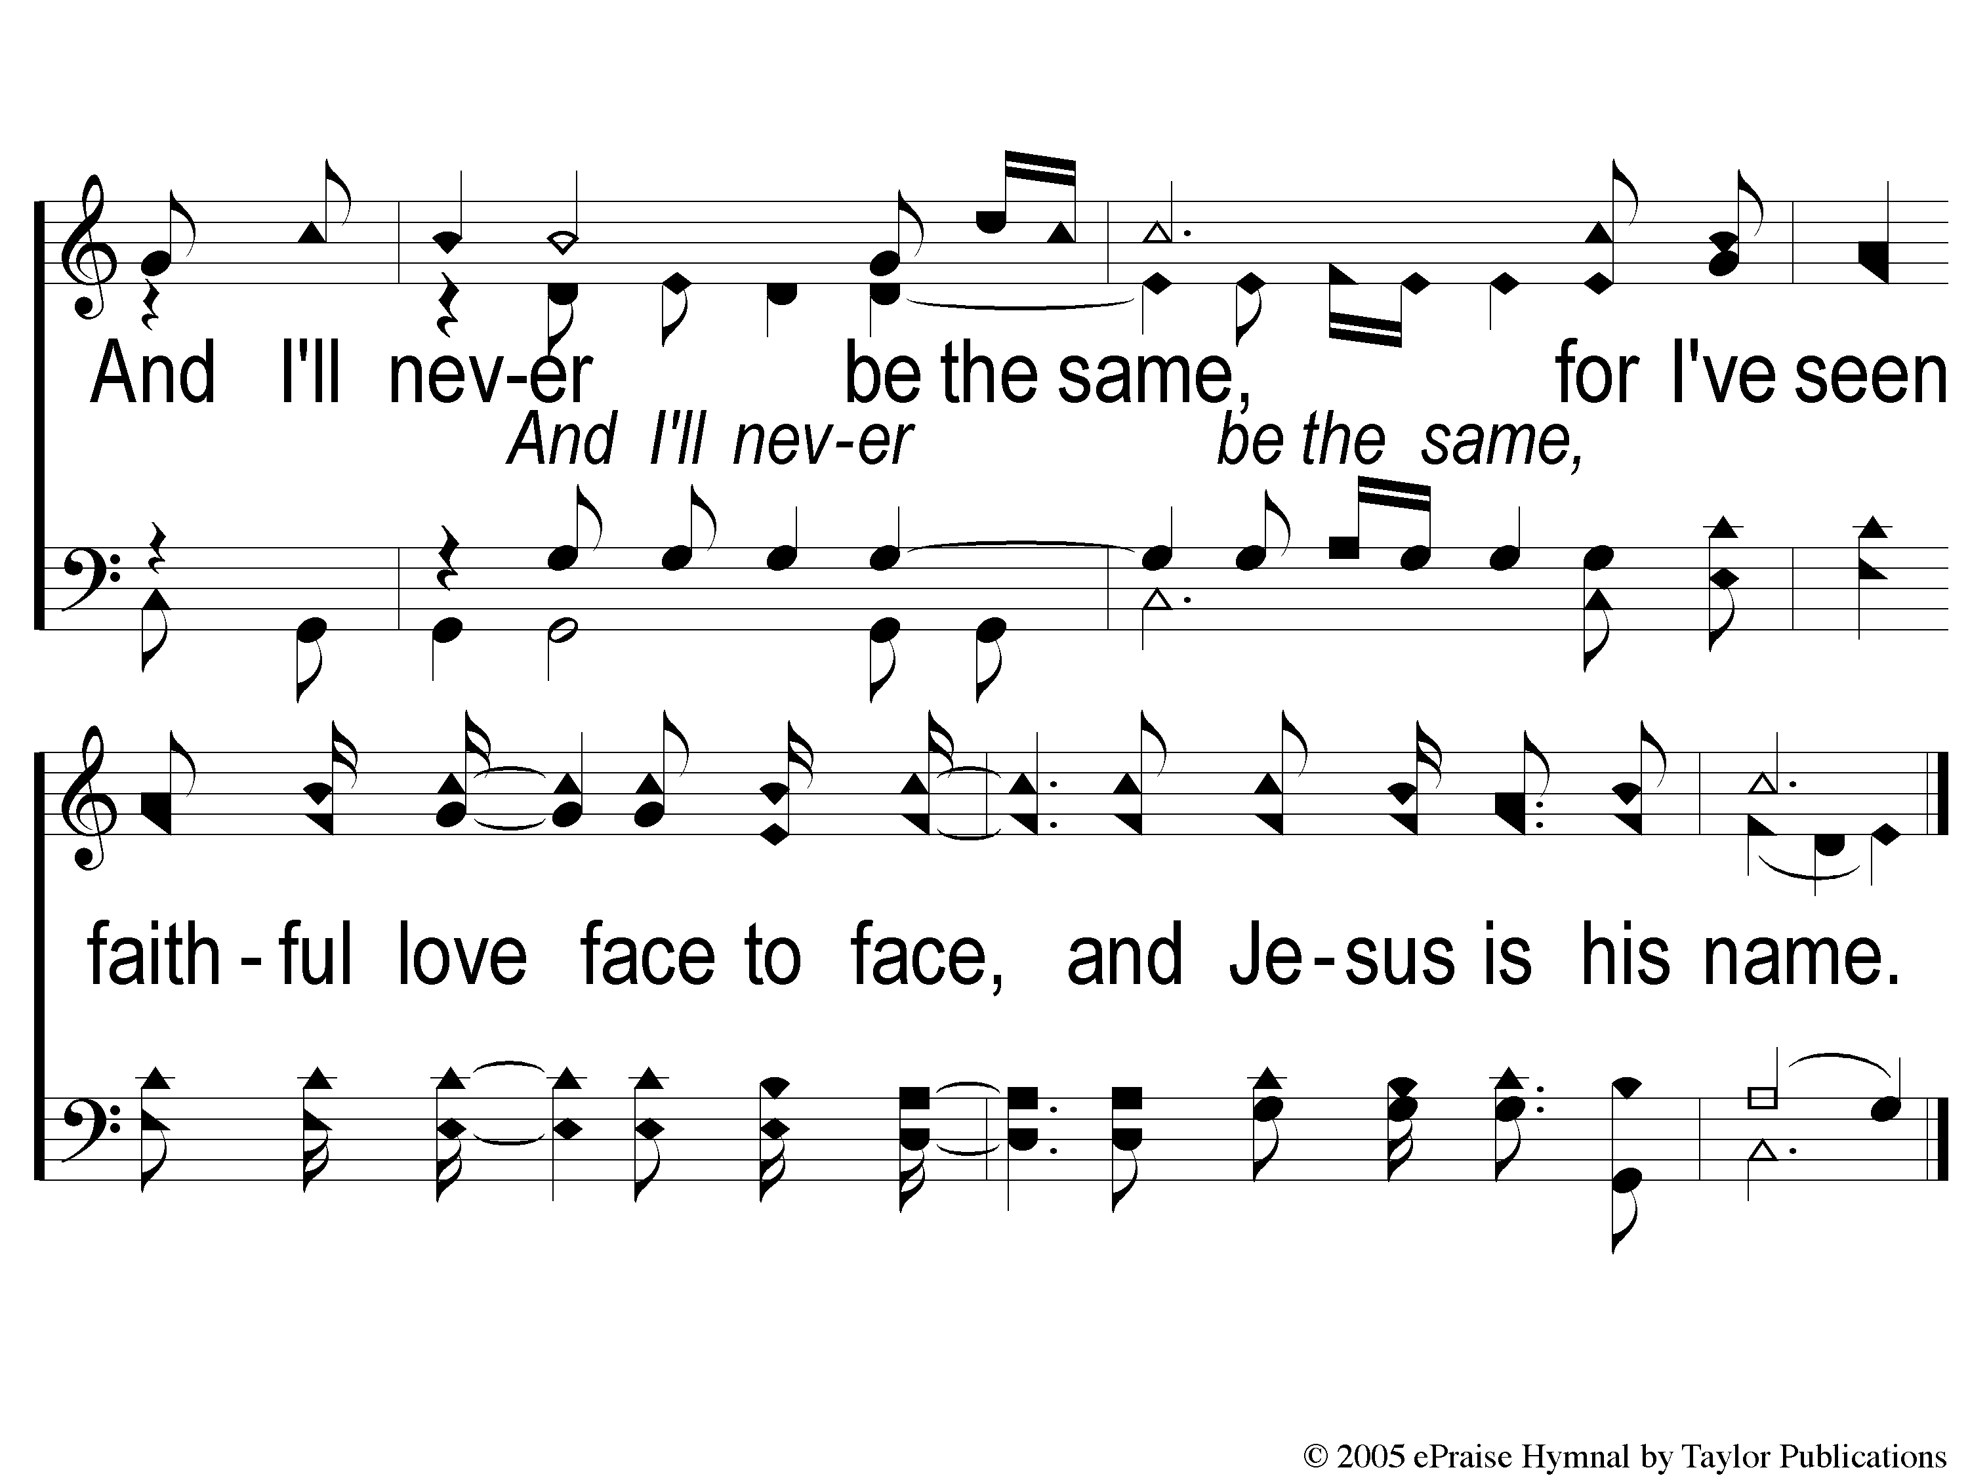
C-2 Faithful Love
Faithful Love

Slide 12
2-1 Faithful Love
Faithful Love

Slide 13
2-2 Faithful Love
Faithful Love

Slide 14
2-3 Faithful Love
Faithful Love

Slide 15
C-1 Faithful Love
Faithful Love

Slide 16
C-2 Faithful Love
Faithful Love

Slide 17
Song:
Sweet Hour Of Prayer
#827

Slide 18
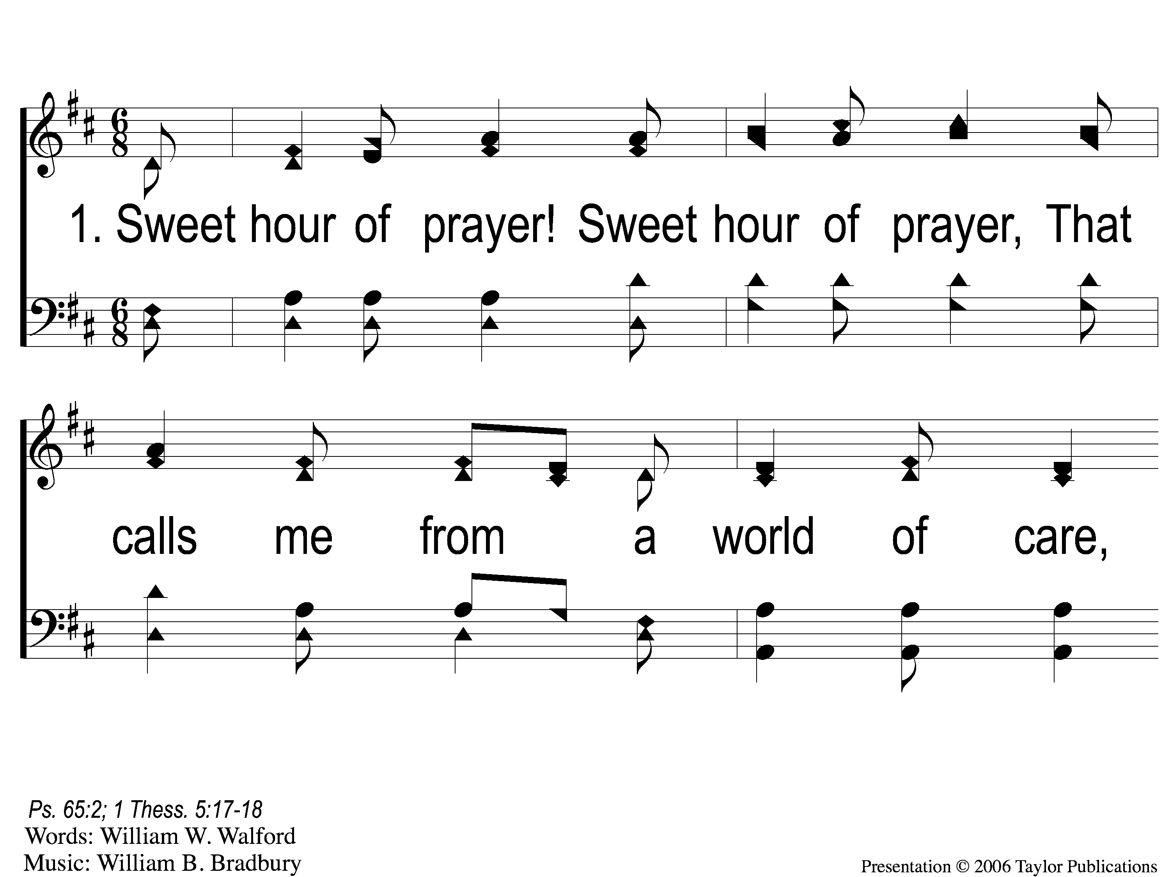
1-1 Sweet Hour of Prayer
Sweet Hour of Prayer
827

Slide 19
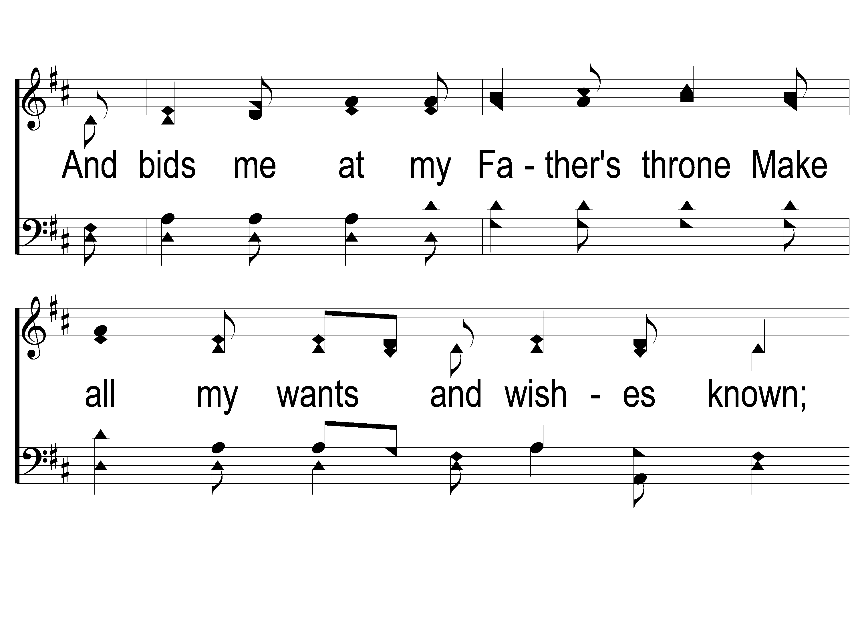
1-2 Sweet Hour of Prayer
Sweet Hour of Prayer
827

Slide 20
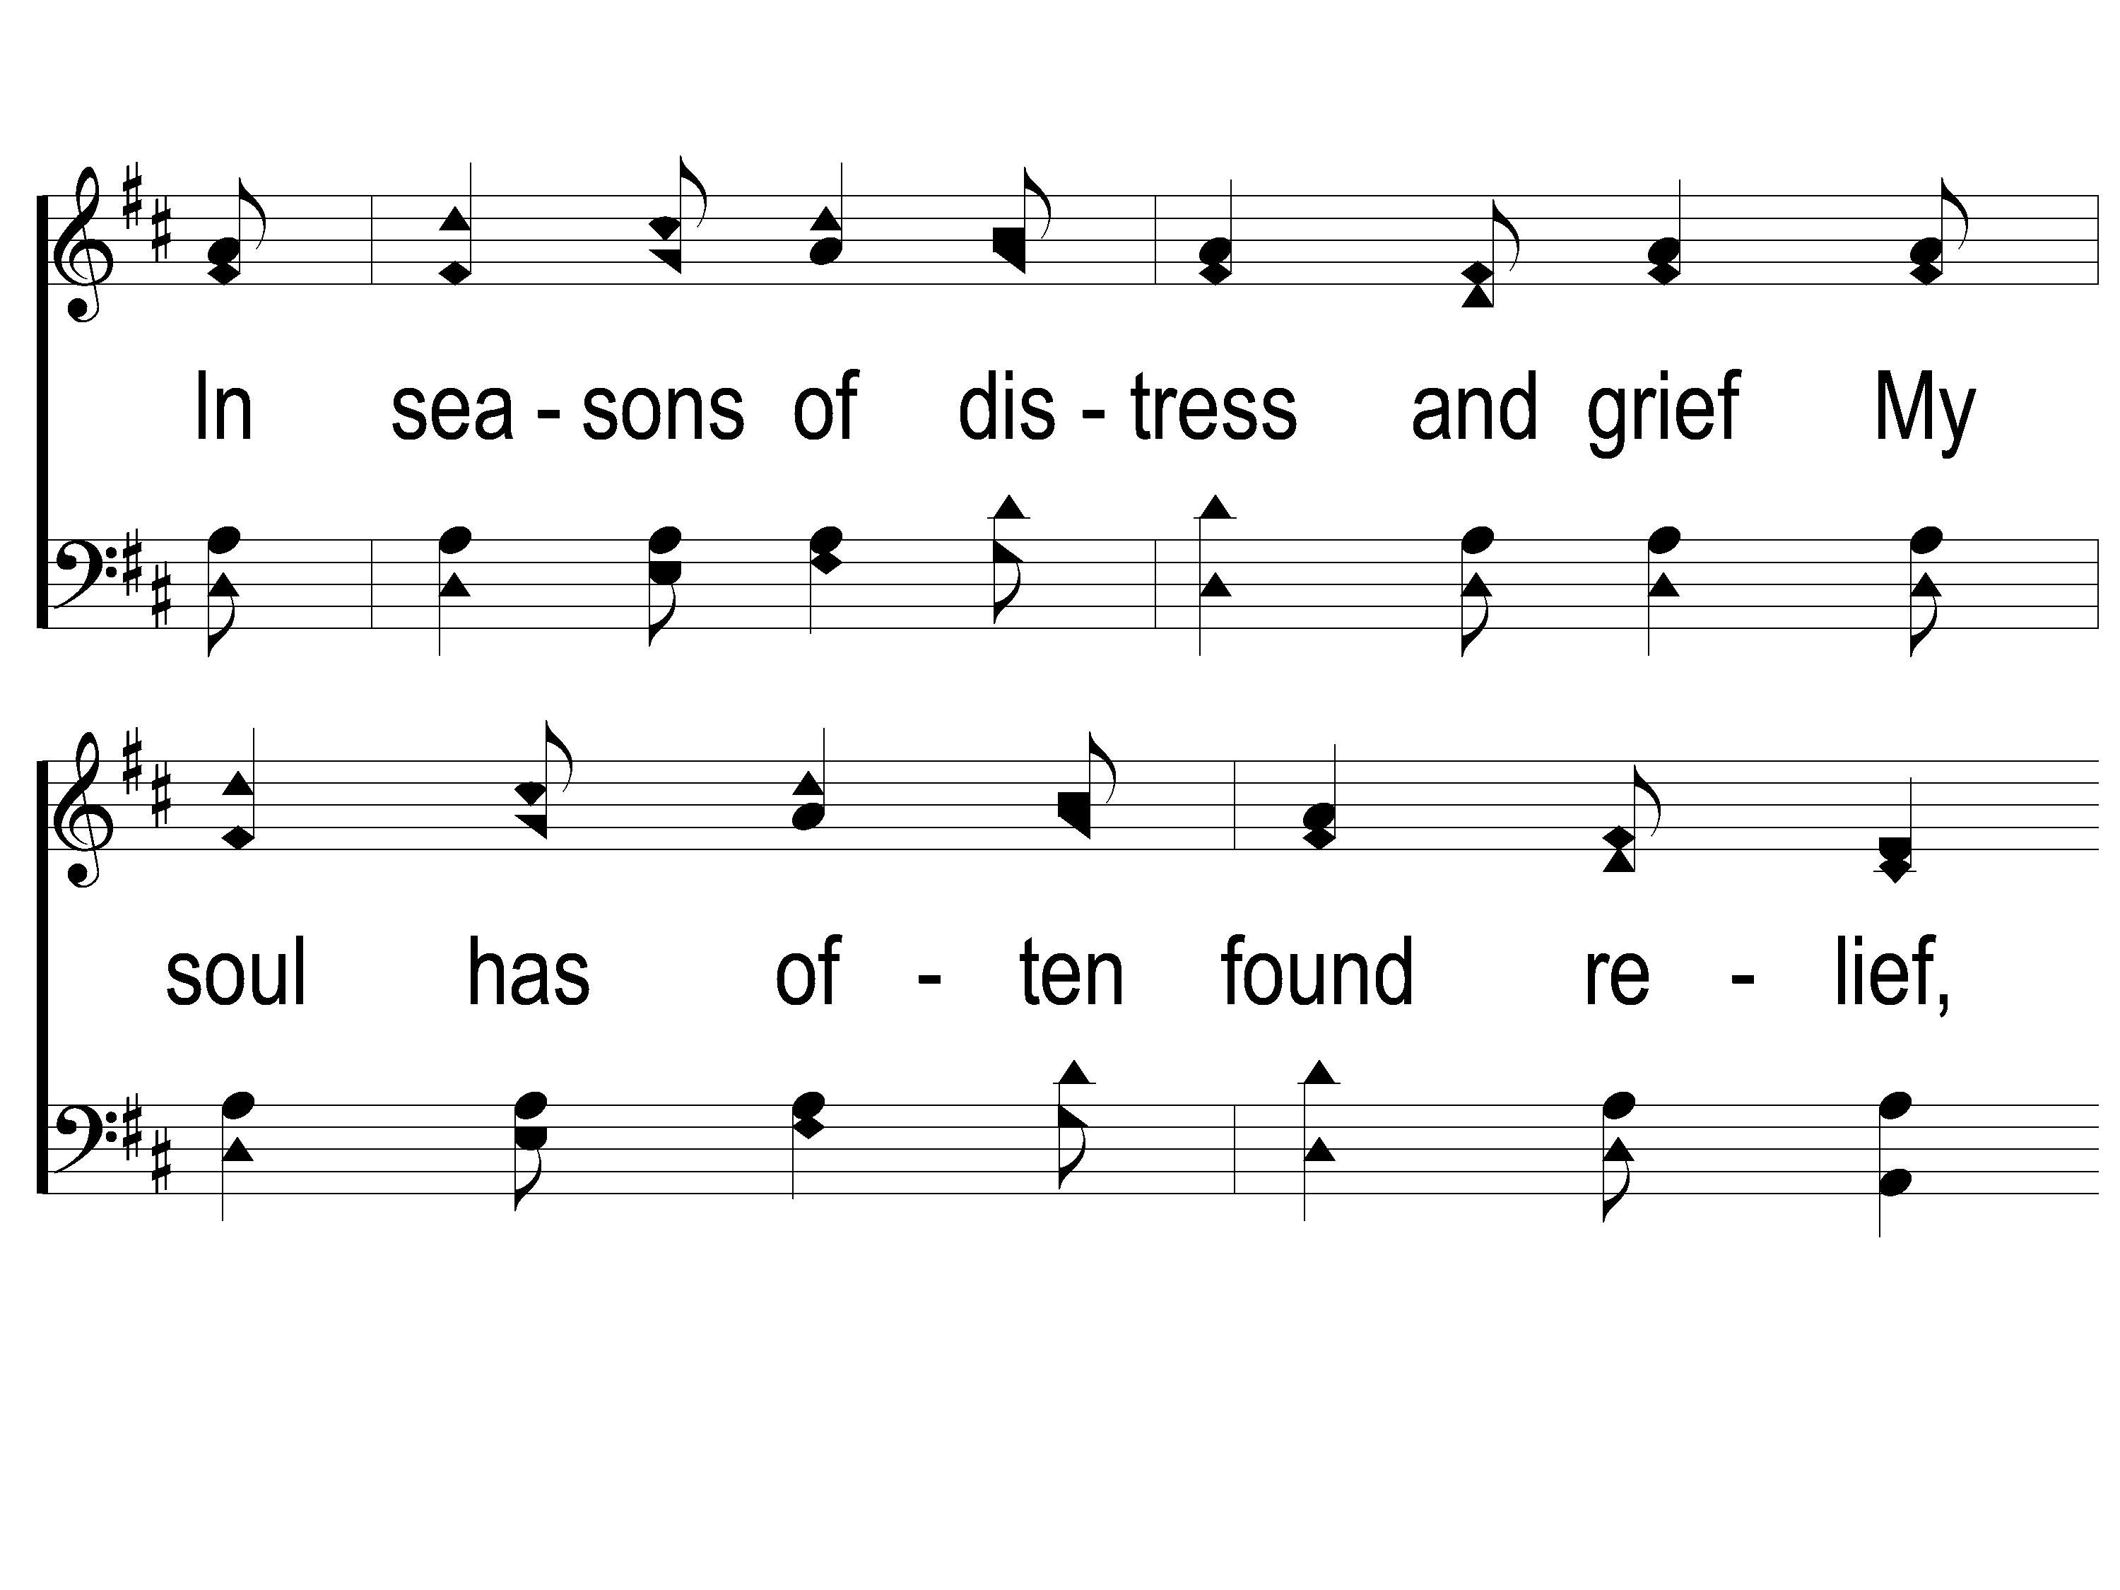
1-3 Sweet Hour of Prayer
Sweet Hour of Prayer
827

Slide 21
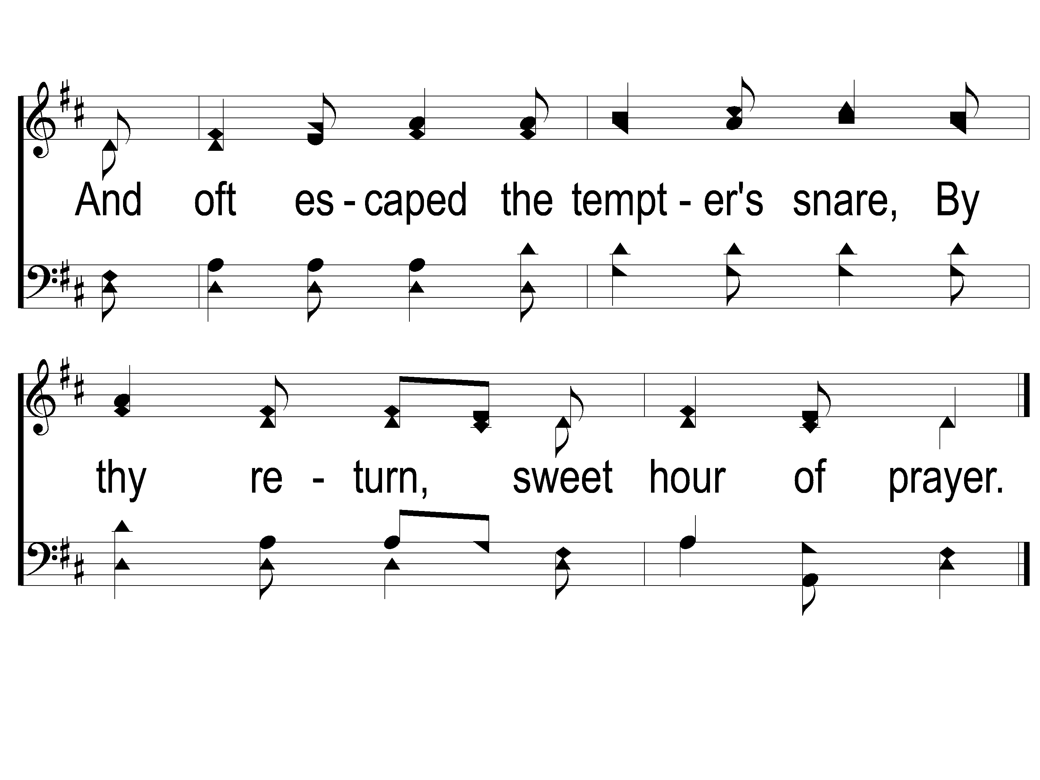
1-4 Sweet Hour of Prayer
Sweet Hour of Prayer
827

Slide 22
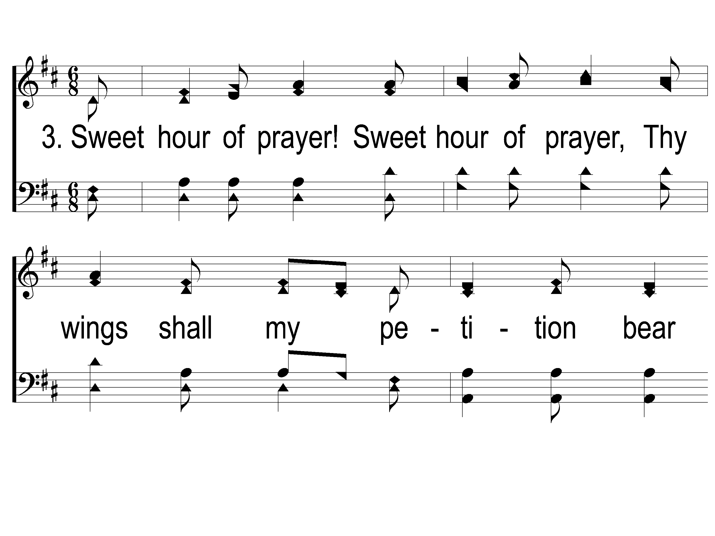
3-1 Sweet Hour of Prayer
Sweet Hour of Prayer
827

Slide 23
3-2 Sweet Hour of Prayer
Sweet Hour of Prayer
827

Slide 24
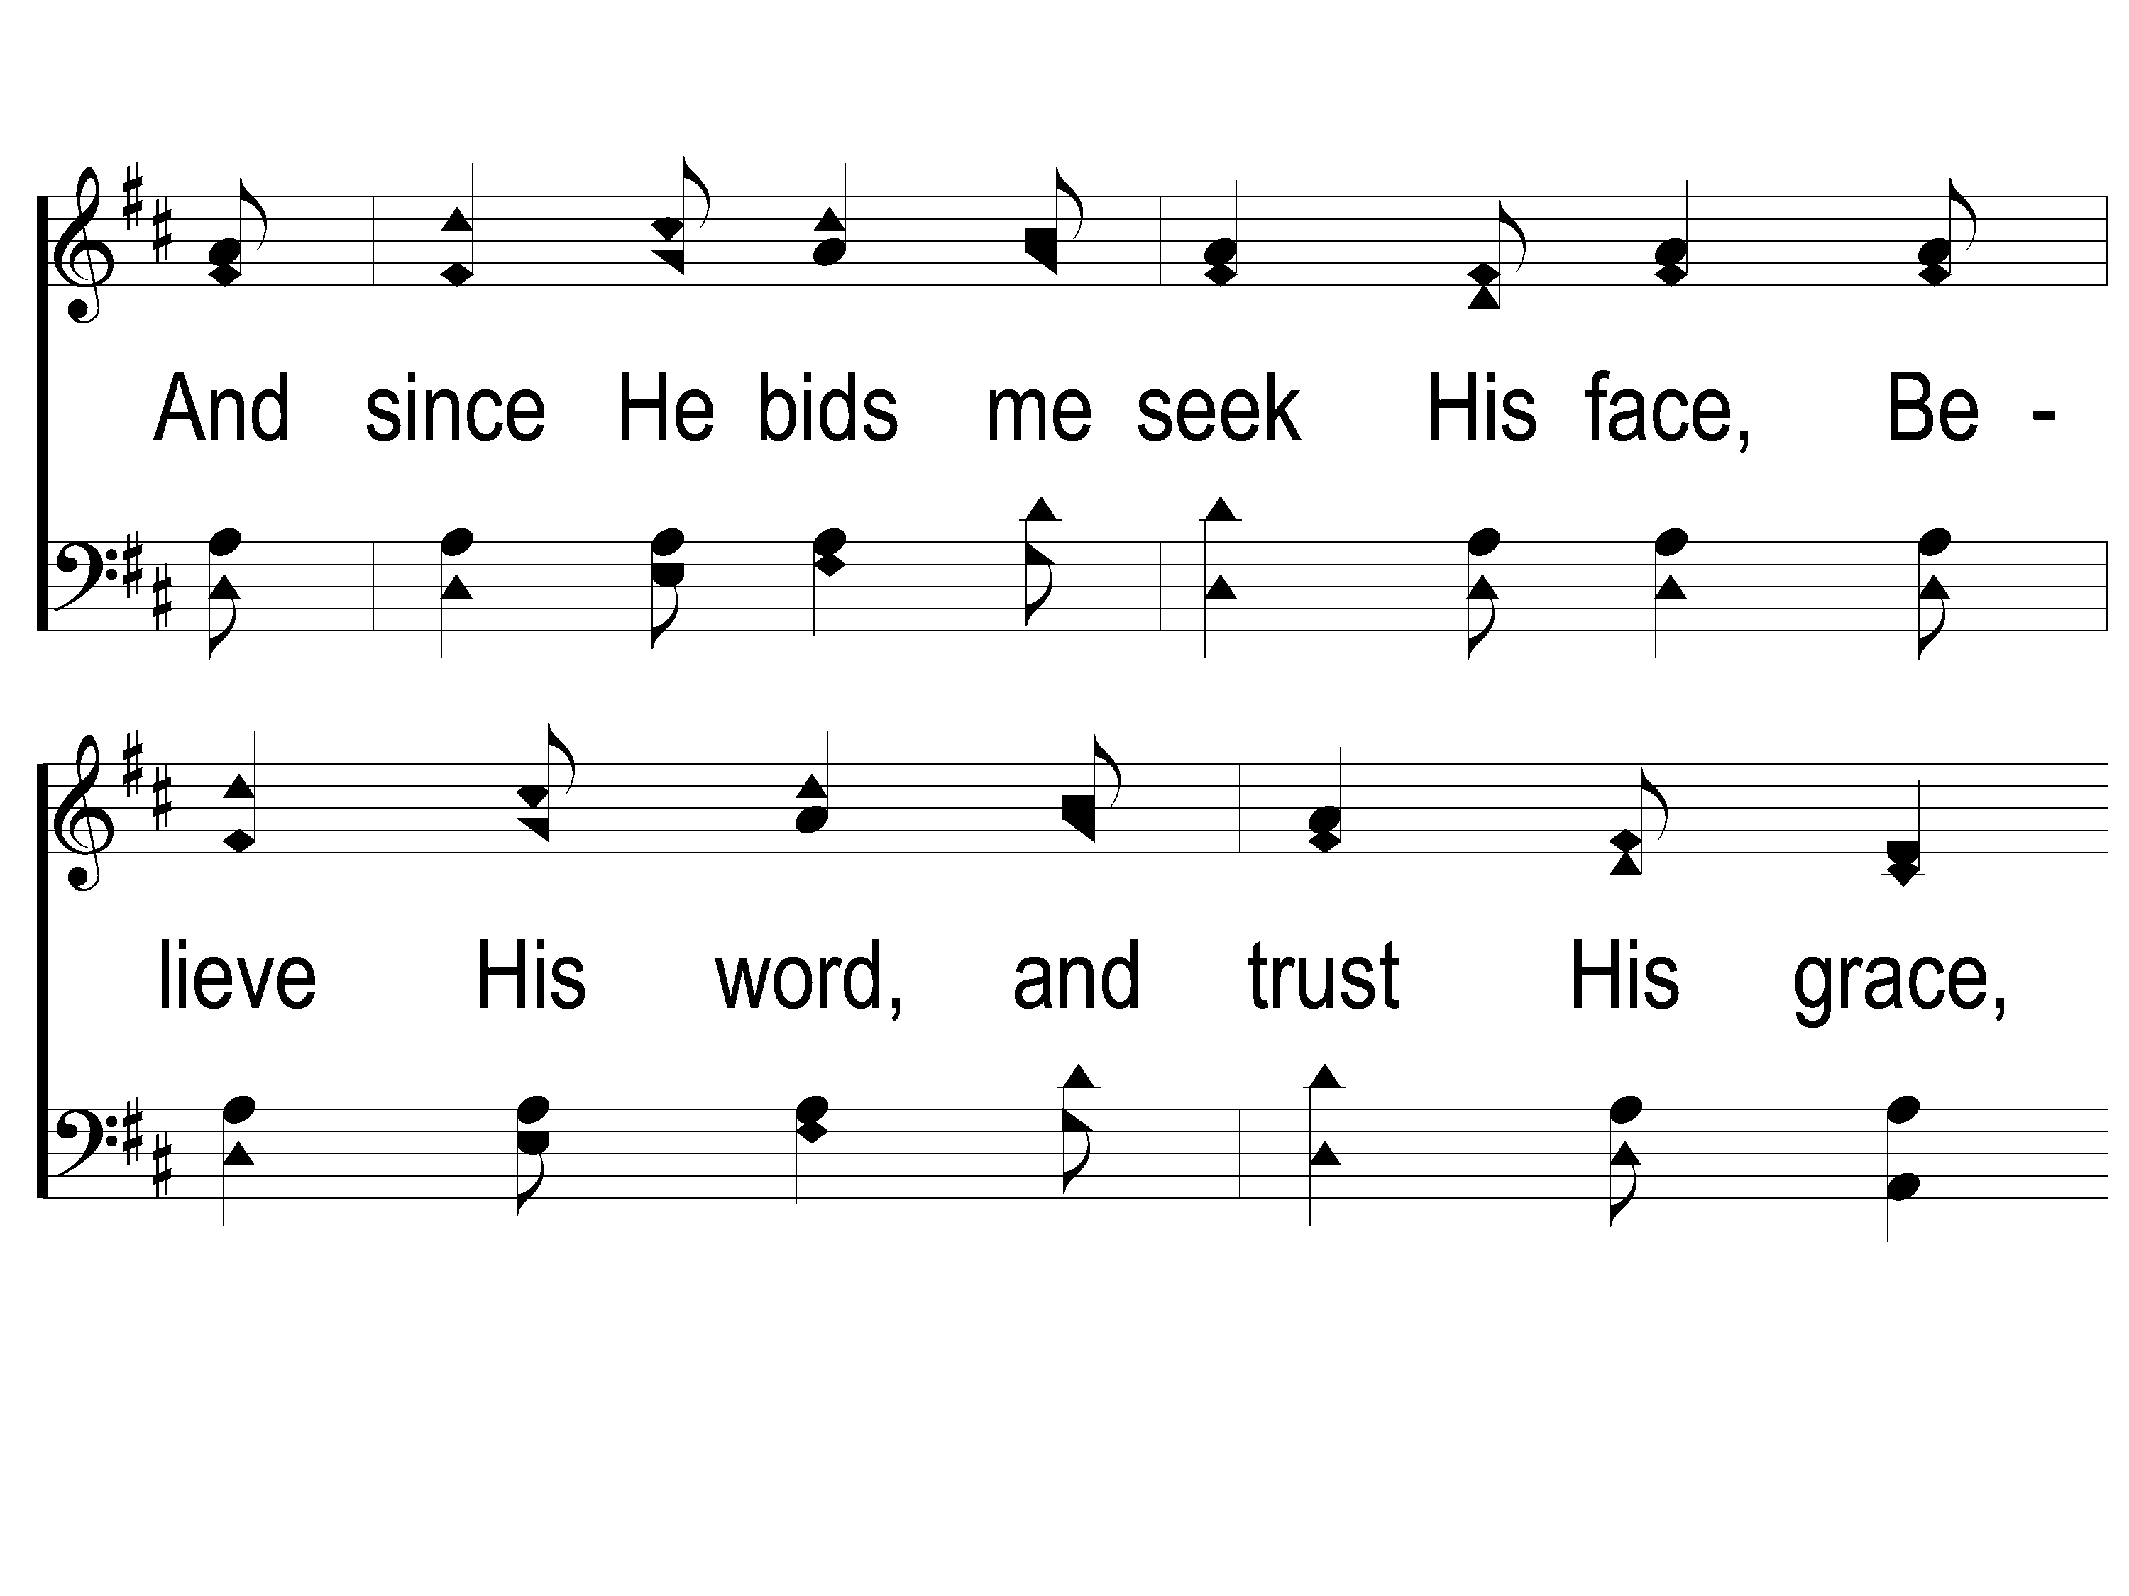
3-3 Sweet Hour of Prayer
Sweet Hour of Prayer
827

Slide 25
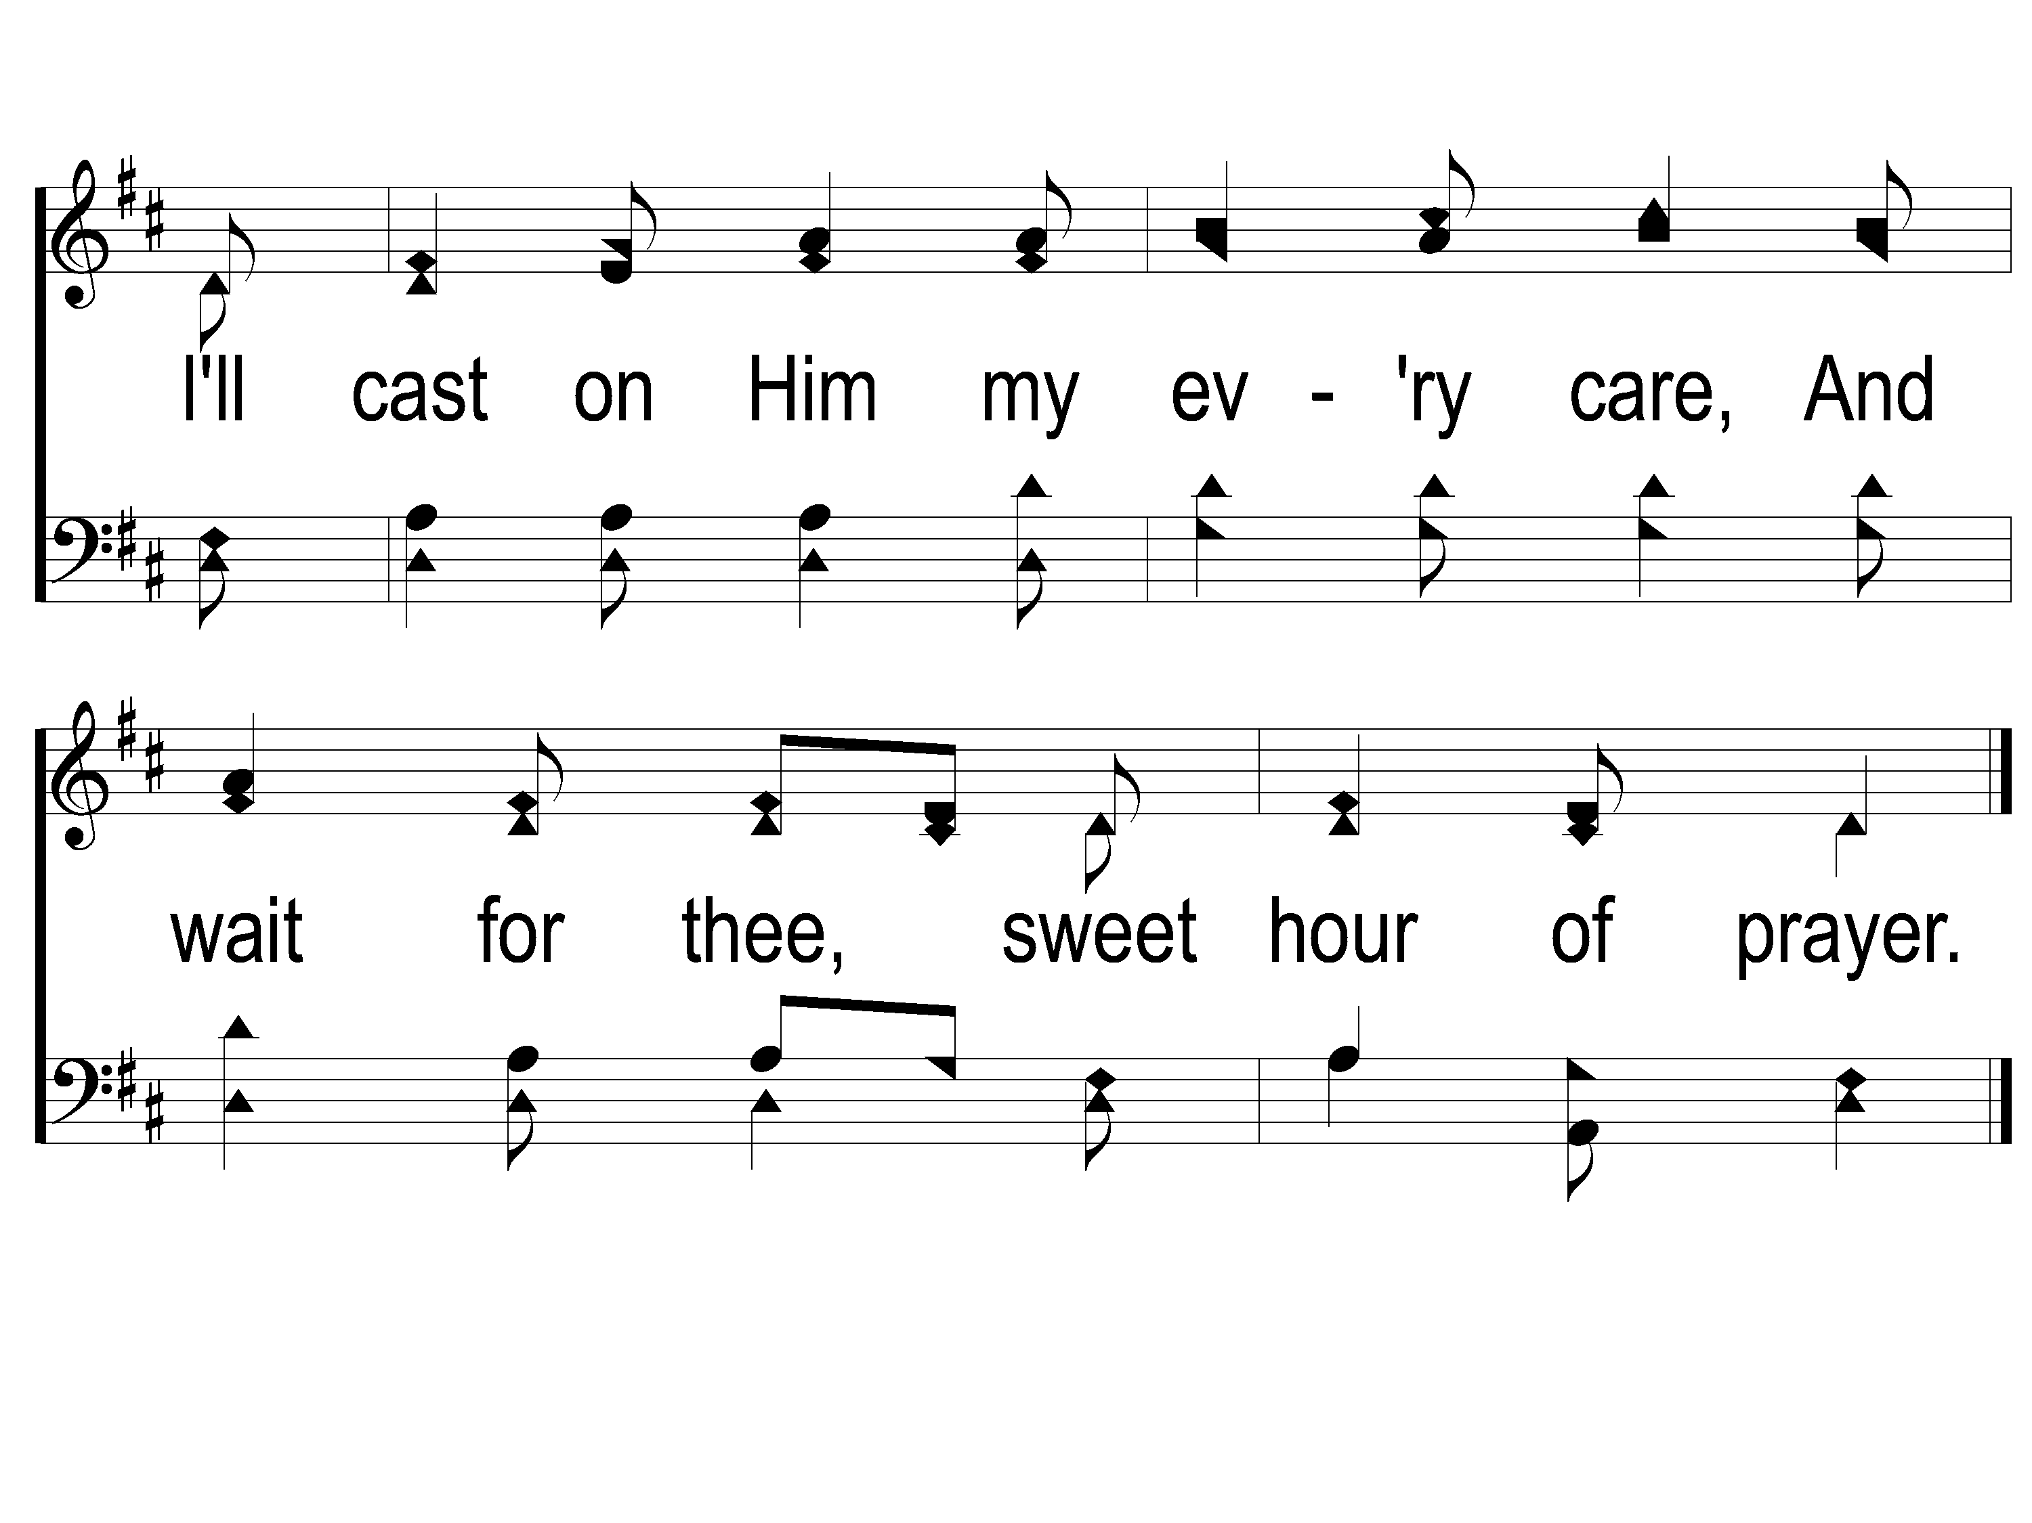
3-4 Sweet Hour of Prayer
Sweet Hour of Prayer
827

Slide 26
Opening Prayer

Slide 27
Song:
Victory In jesus
#470

Slide 28
1-1 Victory in Jesus
Victory in Jesus
470

Slide 29
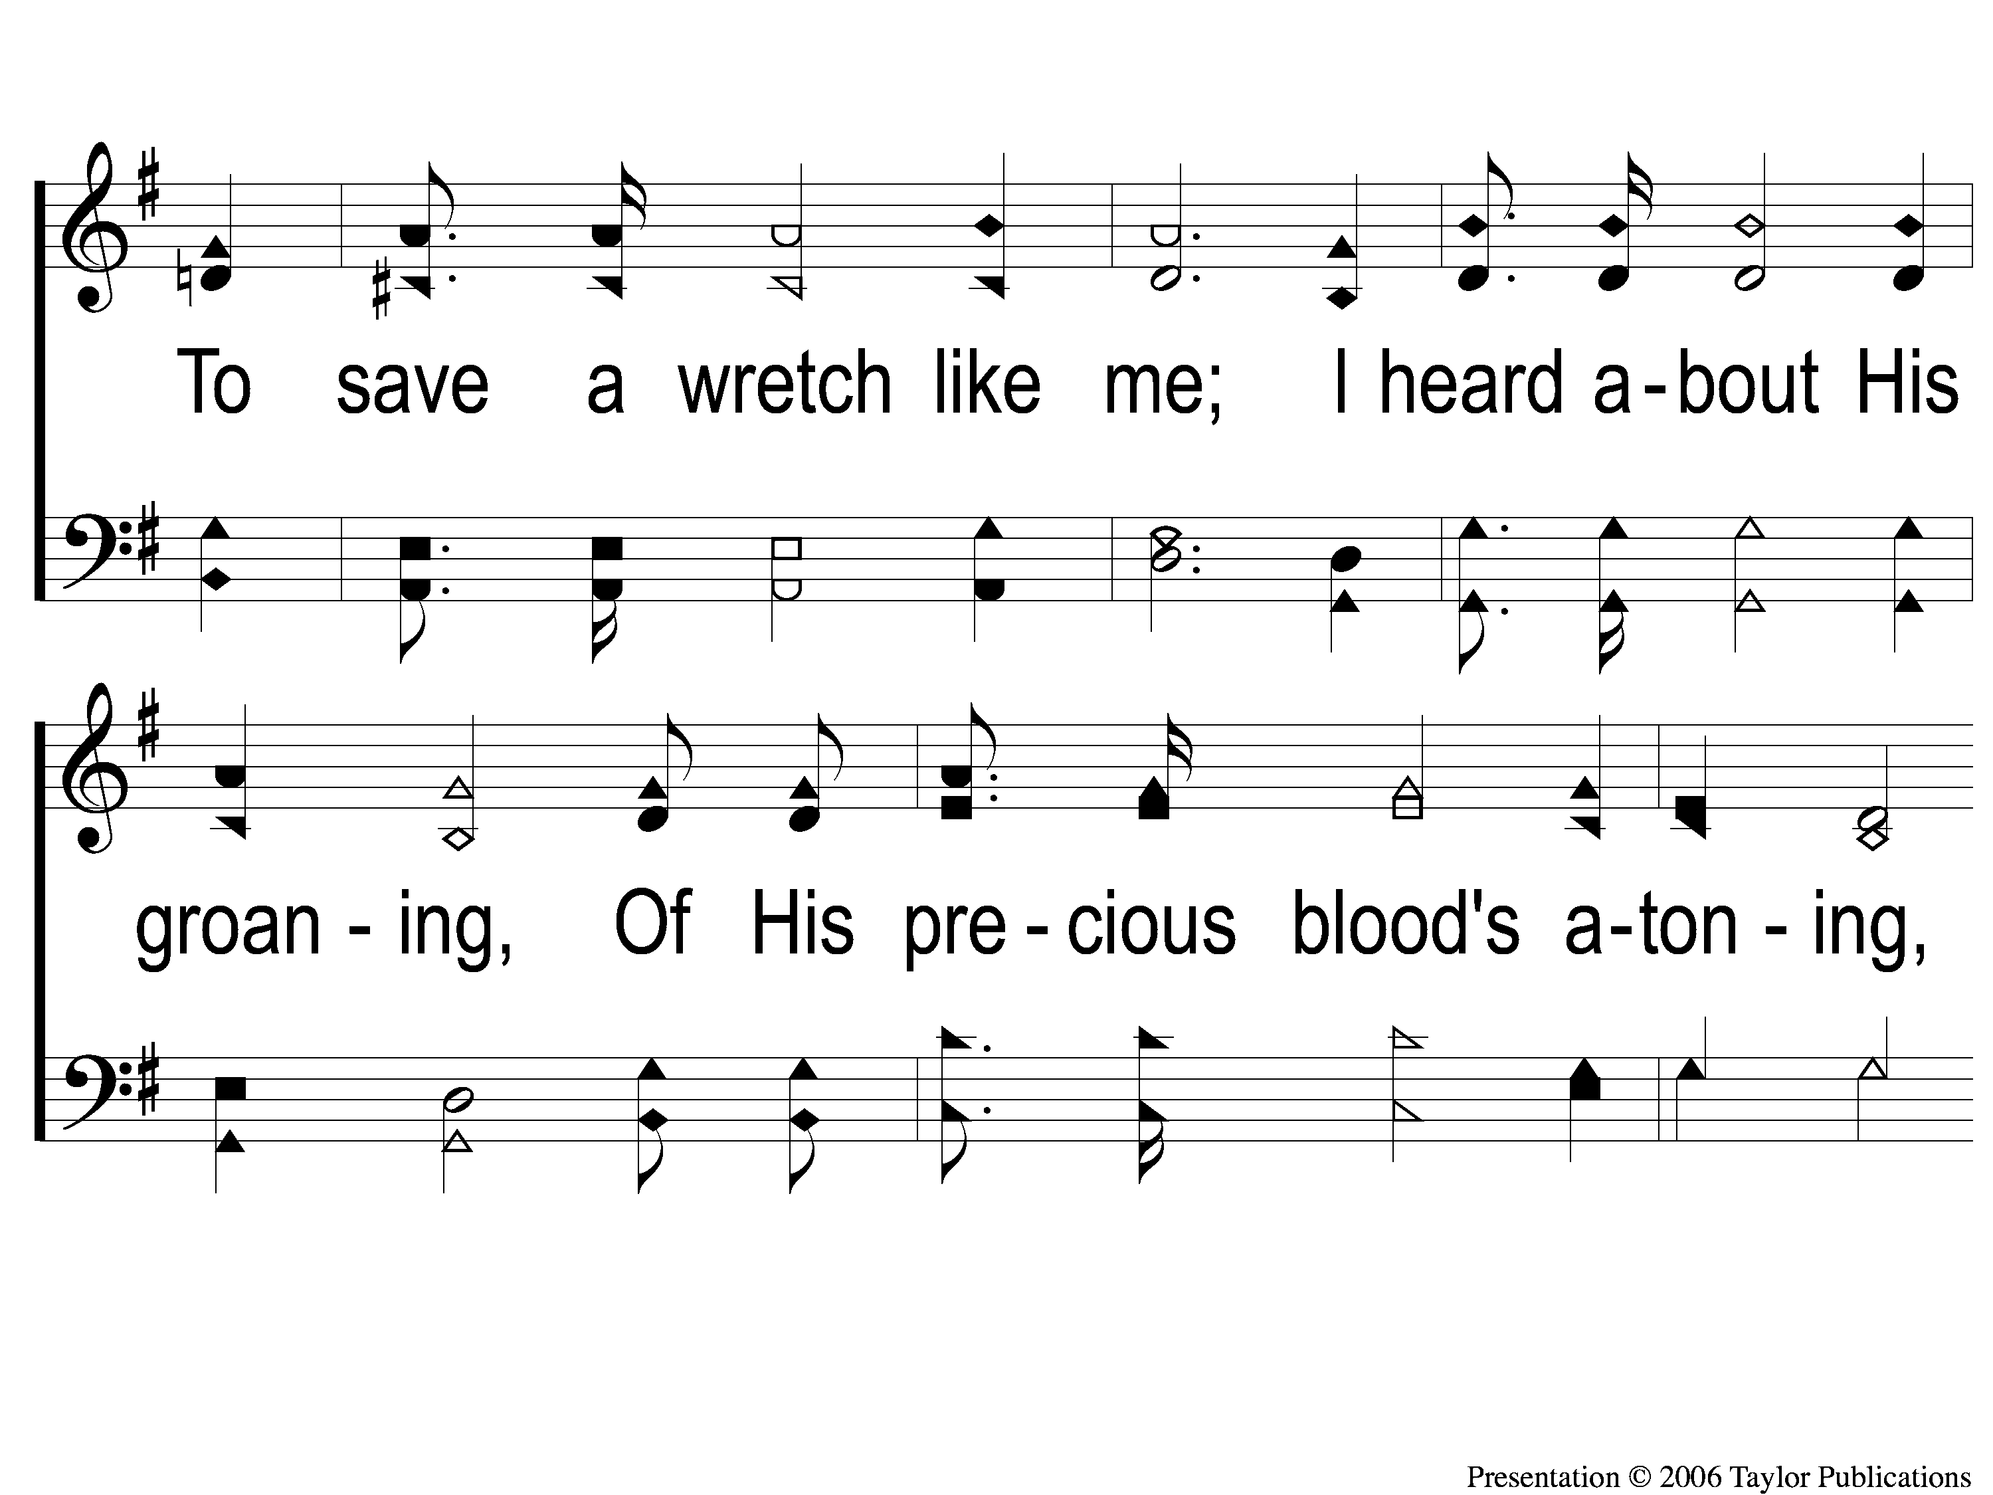
1-2 Victory in Jesus
Victory in Jesus
470

Slide 30
1-3 Victory in Jesus
Victory in Jesus
470

Slide 31
C-1 Victory in Jesus
Victory in Jesus
470

Slide 32
C-2 Victory in Jesus
Victory in Jesus
470

Slide 33
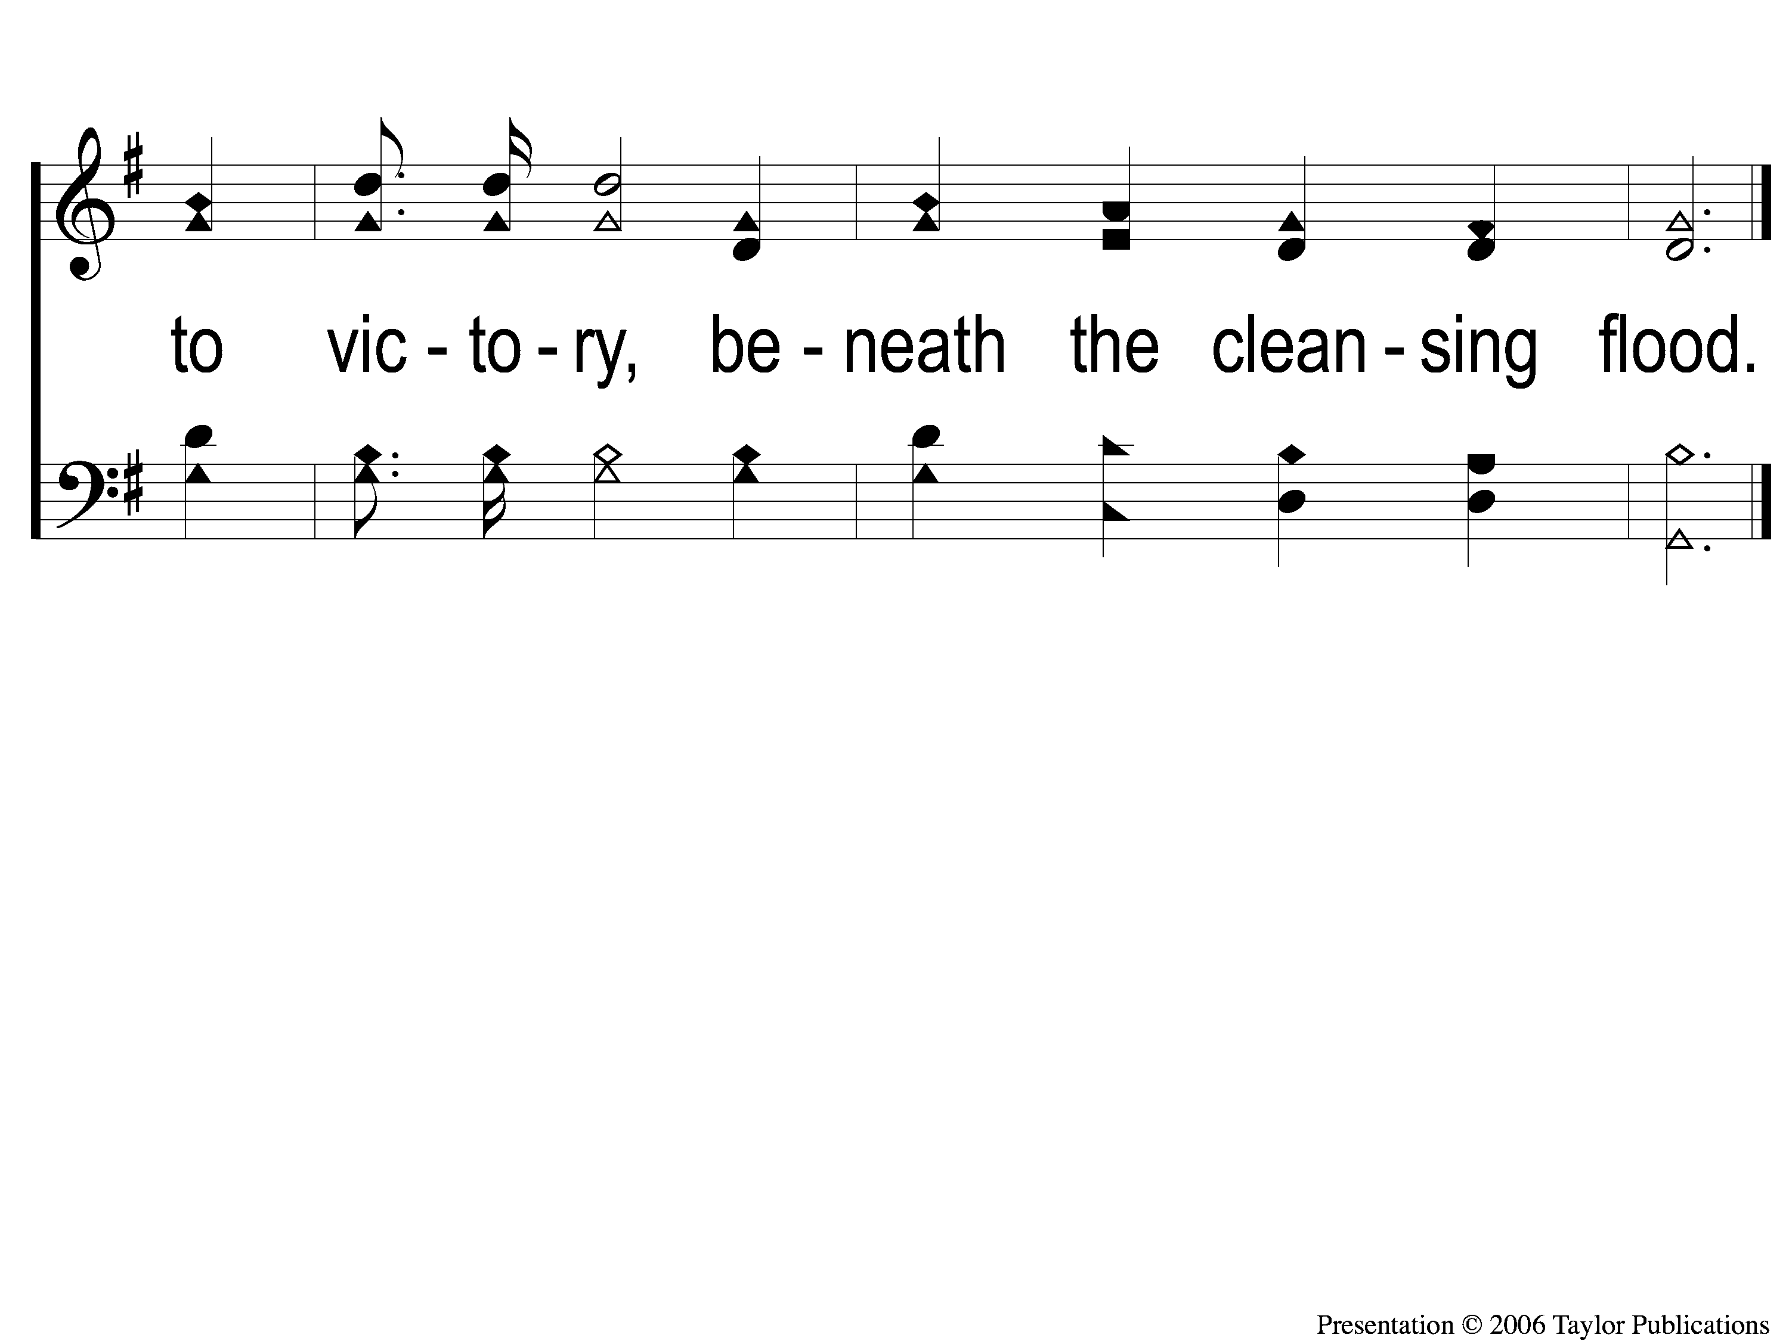
C-3 Victory in Jesus
Victory in Jesus
470

Slide 34
2-1 Victory in Jesus
Victory in Jesus
470

Slide 35
2-2 Victory in Jesus
Victory in Jesus
470

Slide 36
2-3 Victory in Jesus
Victory in Jesus
470

Slide 37
C-1 Victory in Jesus
Victory in Jesus
470

Slide 38
C-2 Victory in Jesus
Victory in Jesus
470

Slide 39
C-3 Victory in Jesus
Victory in Jesus
470

Slide 40
3-1 Victory in Jesus
Victory in Jesus
470

Slide 41
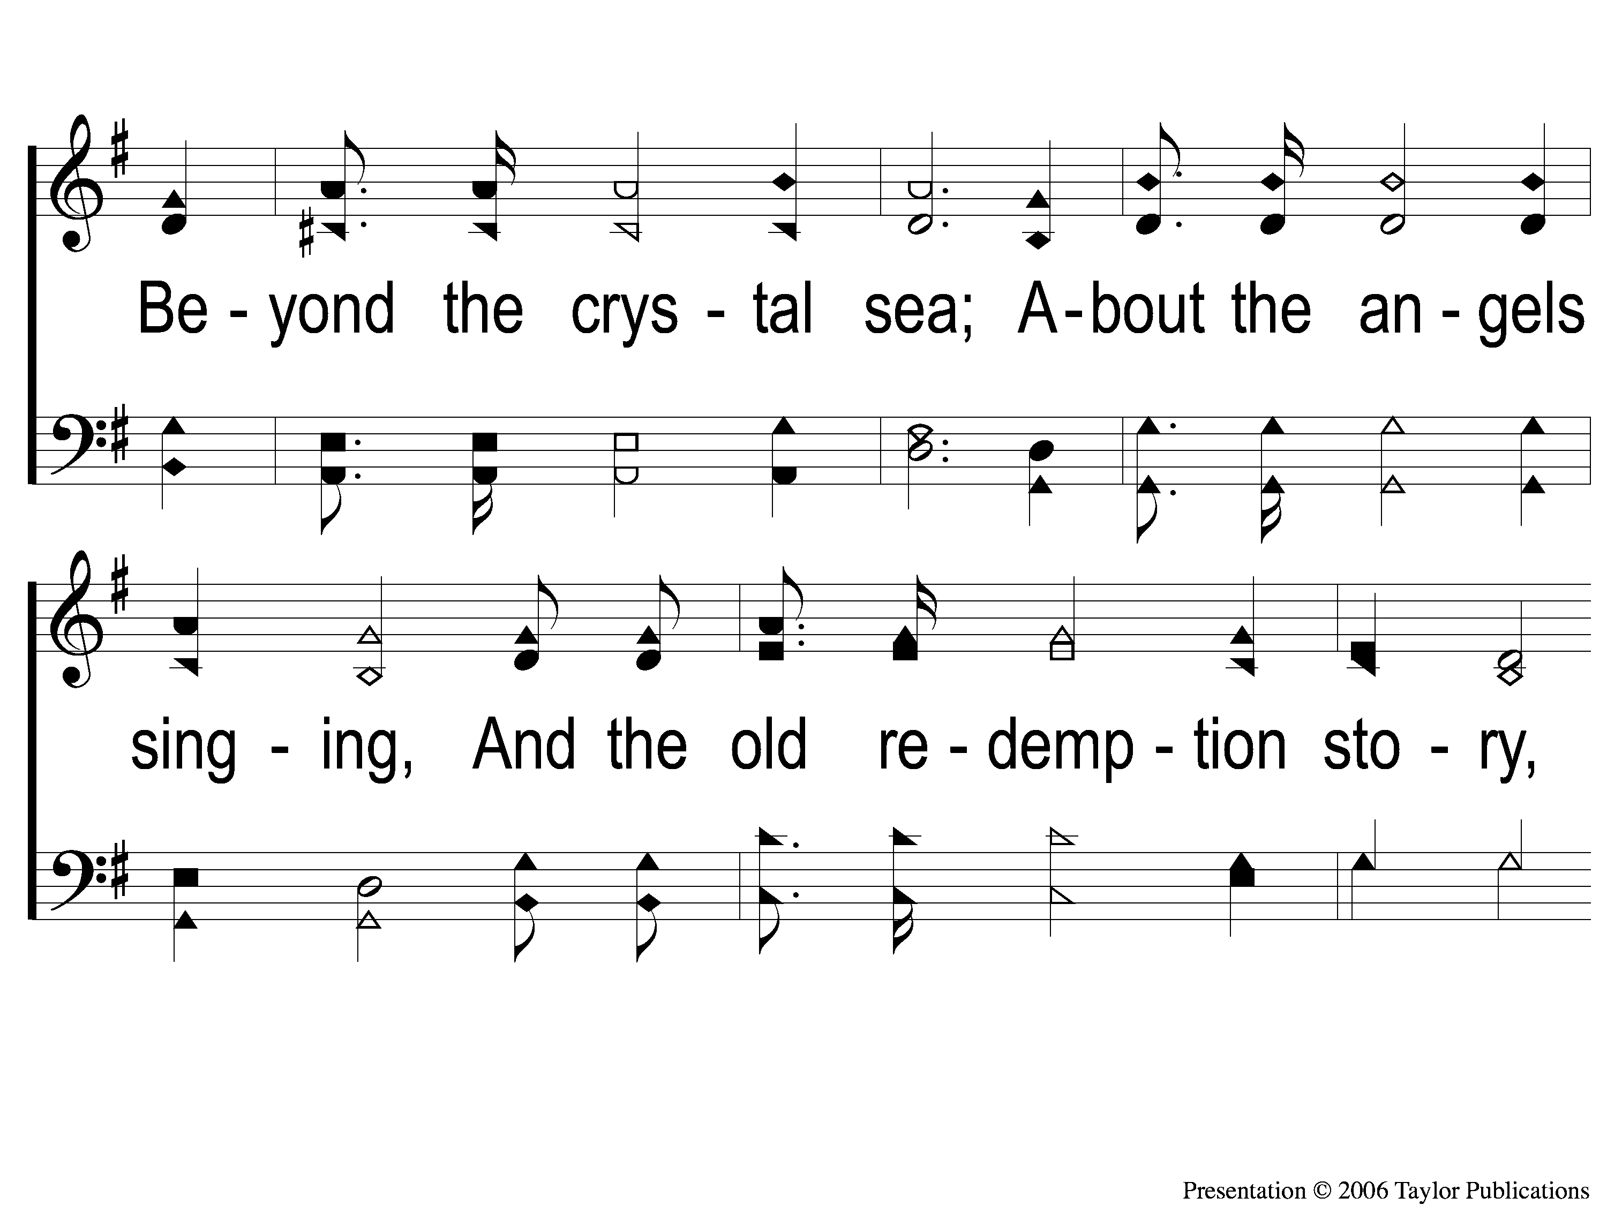
3-2 Victory in Jesus
Victory in Jesus
470

Slide 42
3-3 Victory in Jesus
Victory in Jesus
470

Slide 43
C-1 Victory in Jesus
Victory in Jesus
470

Slide 44
C-2 Victory in Jesus
Victory in Jesus
470

Slide 45
C-3 Victory in Jesus
Victory in Jesus
470

Slide 46
Song:
Teach Me Lord To Wait
#764

Slide 47
1-1 Teach Me Lord to Wait
Teach Me Lord, To Wait
764

Slide 48
1-2 Teach Me Lord to Wait
Teach Me Lord, To Wait
764

Slide 49
C-1 Teach Me Lord to Wait
Teach Me Lord, To Wait
764

Slide 50
C-2 Teach Me Lord to Wait
Teach Me Lord, To Wait
764

Slide 51
2-1 Teach Me Lord to Wait
Teach Me Lord, To Wait
764

Slide 52
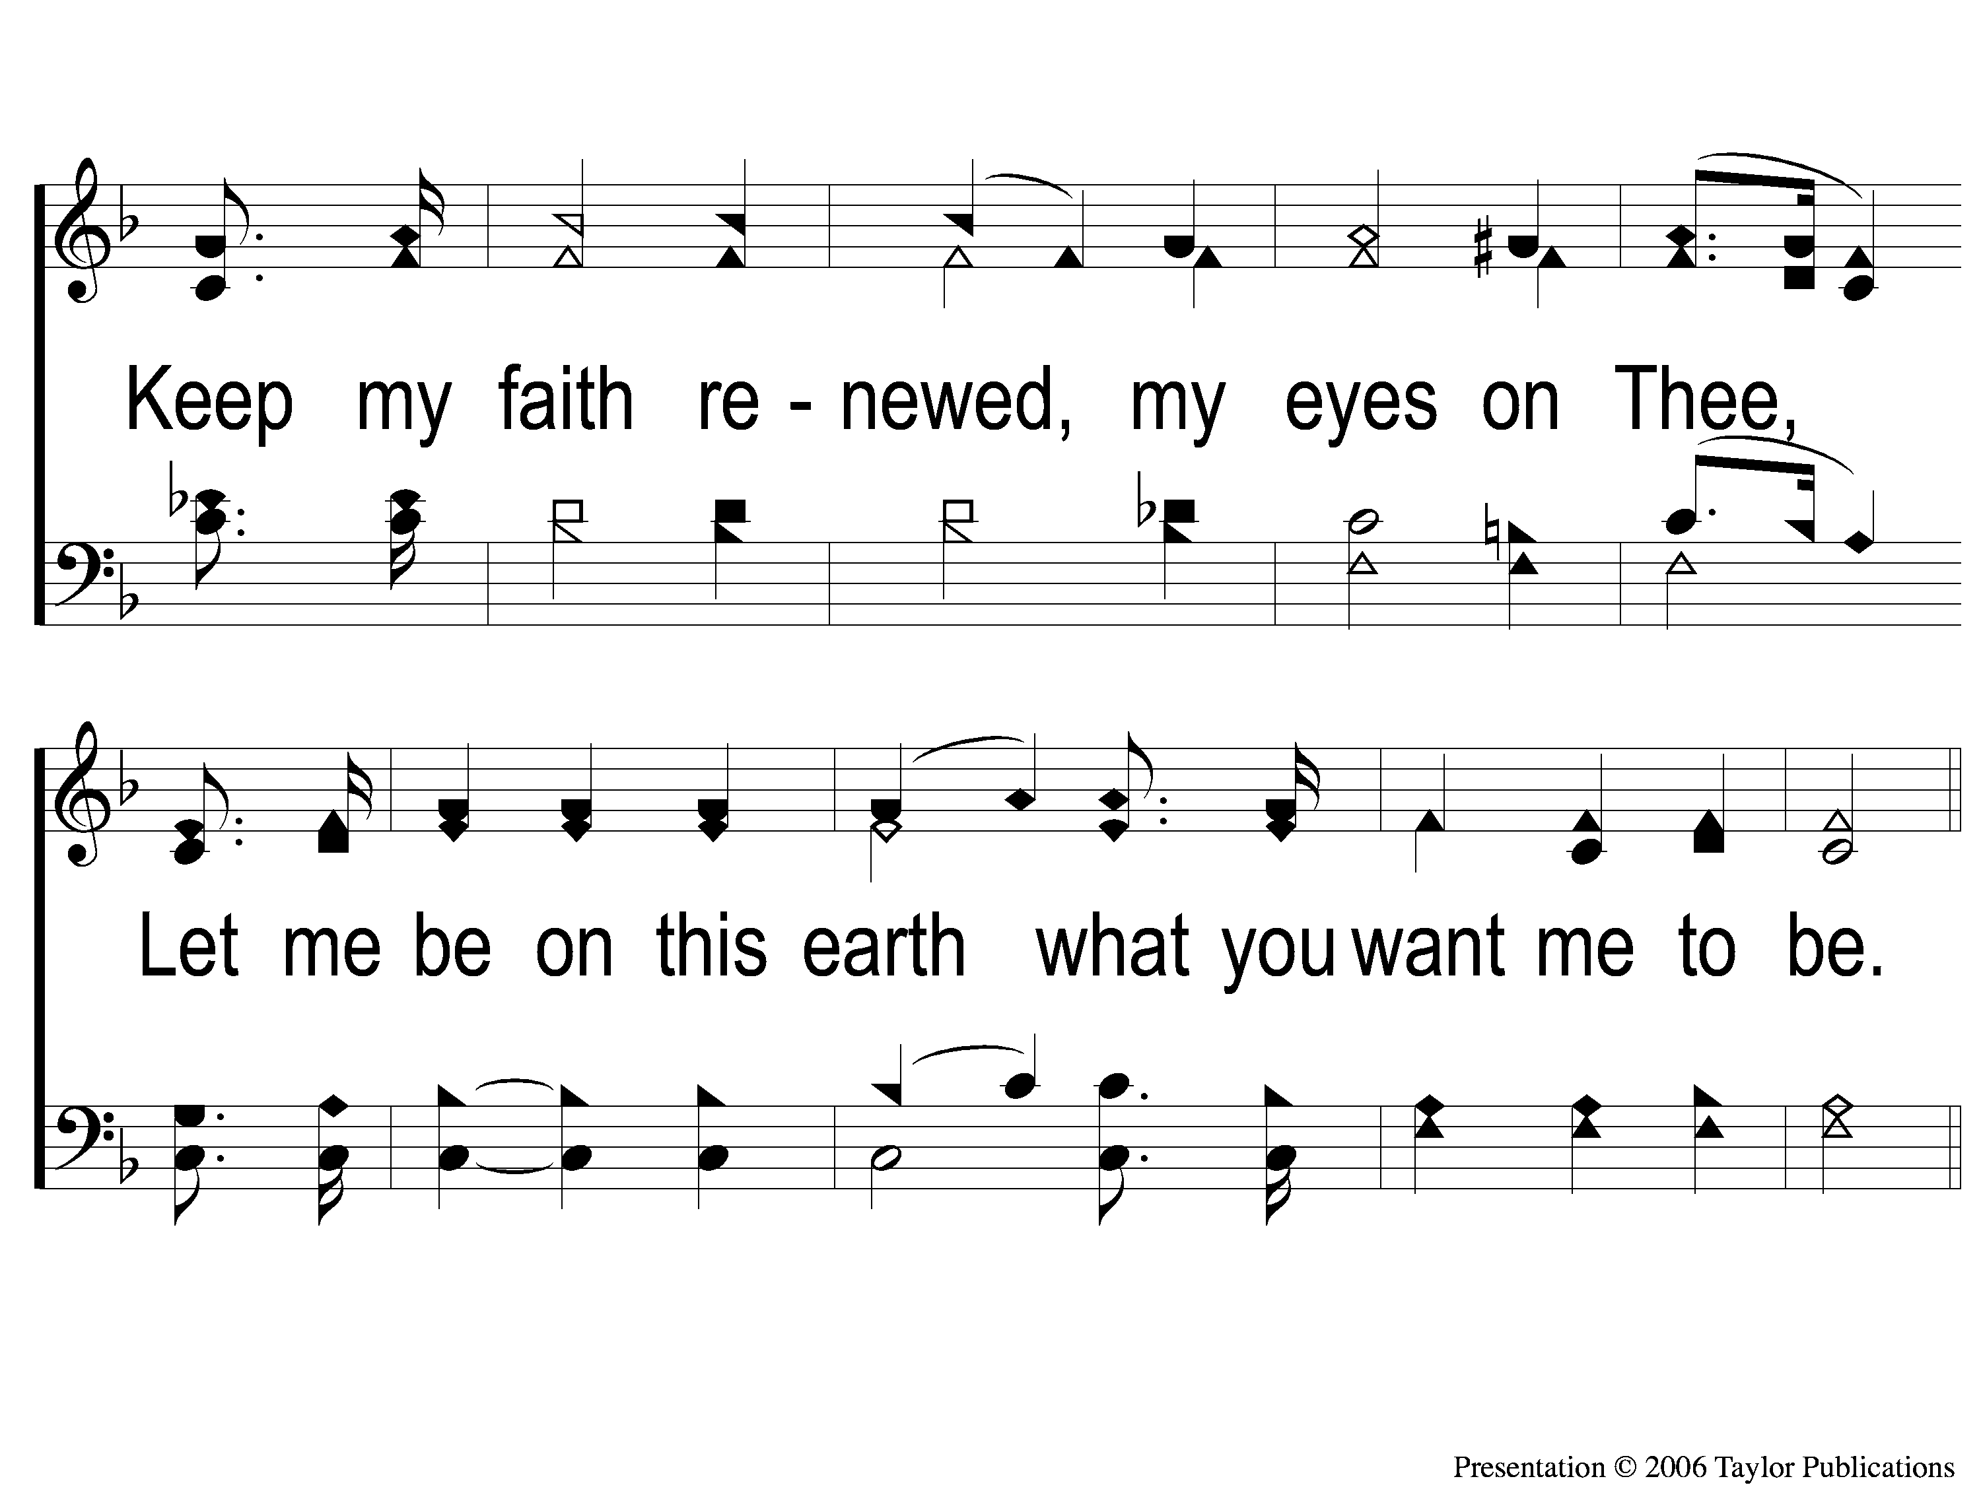
2-2 Teach Me Lord to Wait
Teach Me Lord, To Wait
764

Slide 53
C-1 Teach Me Lord to Wait
Teach Me Lord, To Wait
764

Slide 54
C-2 Teach Me Lord to Wait
Teach Me Lord, To Wait
764

Slide 55
Scripture Reading:
Genesis 2:18-22

Slide 56
RESTORE
OUR
FOUNDATIONS
JANUARY - APRIL

Slide 57
When Looking For A Spouse:
Look for a “Help-meet”

Slide 58
Look For A “Help-Meet”
Gen. 24:4

Slide 59
Look For A “Help-Meet”
Gen. 24:4
Isaac was a Man / Male

Slide 60
Look For A “Help-Meet”
Gen. 24:4
Isaac was a Man / Male
Isaac needed a woman / female

Slide 61
Look For A “Help-Meet”
Animals were not comparable

Slide 62
Look For A “Help-Meet”
Animals were not comparable
Another man was not comparable

Slide 63
Look For A “Help-Meet”
Animals were not comparable
Another man was not comparable
God does not support polygamy

Slide 64
When Looking For A Spouse:
Look for a “Help-meet”
Look for a child of God

Slide 65
Look For A Child Of God
Gen. 24:3-4, 28:1-2

Slide 66
Look For A Child Of God
In the OT, God Forbids Marriage
Outside the Family of God
Gen. 26:35, 27:46 – Ex. 34:11-16

Slide 67
When Looking For A Spouse:
Look for a “Help-meet”
Look for a child of God
Look for a follower / Leader

Slide 68
Look For A Follower / Leader
Gen. 24:5-8, 57-58

Slide 69
Look For A Follower / Leader
Gen. 24:5-8, 57-58
Rebekah Willingly Followed

Slide 70
Look For A Follower / Leader
Wives, Love & Follow like the Church
Eph. 5:22-24

Slide 71
Look For A Follower / Leader
Husbands, Lead & Love like Jesus
Eph. 5:25-29

Slide 72
Are You Married to Christ?

Slide 73
Invitation
Song:
Softly And Tenderly
#909

Slide 74
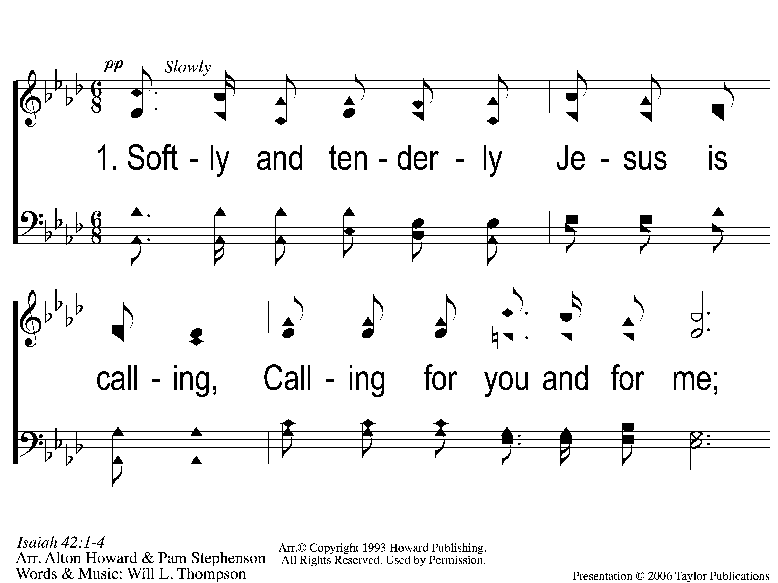
1-1 Softly and Tenderly
Softly and Tenderly
934

Slide 75
1-2 Softly and Tenderly
Softly and Tenderly
934

Slide 76
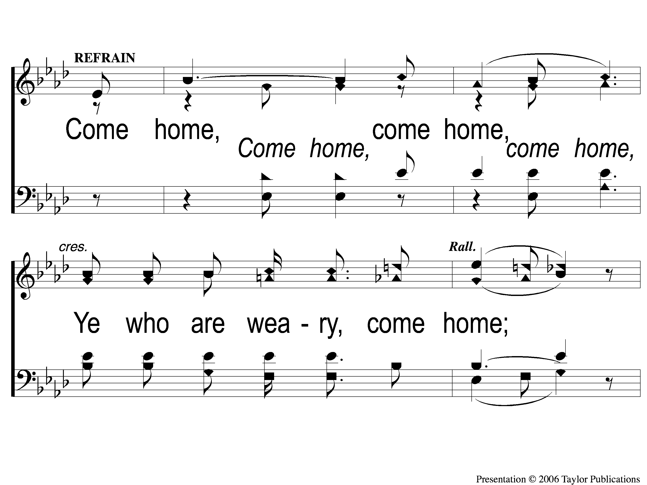
C-1 Softly and Tenderly
Softly and Tenderly
934

Slide 77
C-2 Softly and Tenderly
Softly and Tenderly
934

Slide 78
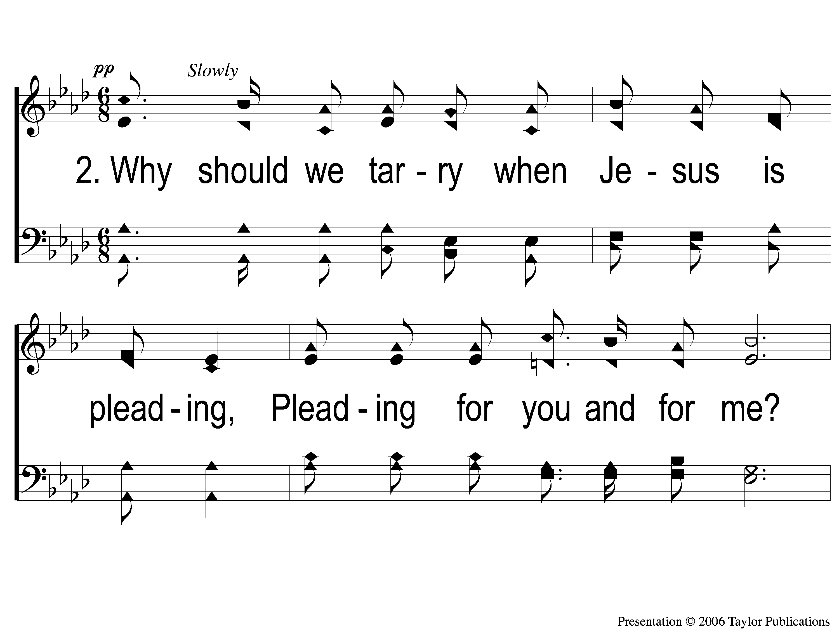
2-1 Softly and Tenderly
Softly and Tenderly
934

Slide 79
2-2 Softly and Tenderly
Softly and Tenderly
934

Slide 80
C-1 Softly and Tenderly
Softly and Tenderly
934

Slide 81
C-2 Softly and Tenderly
Softly and Tenderly
934

Slide 82
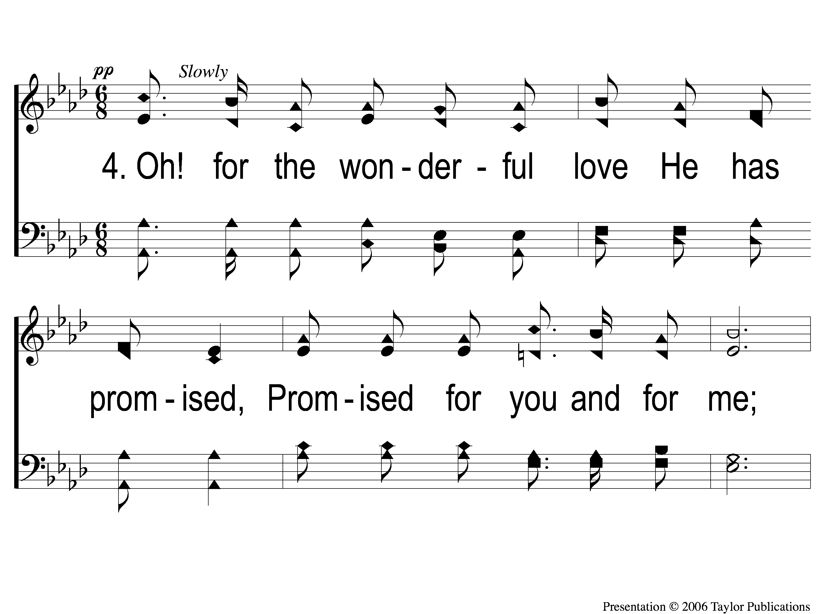
4-1 Softly and Tenderly
Softly and Tenderly
934

Slide 83
4-2 Softly and Tenderly
Softly and Tenderly
934

Slide 84
C-1 Softly and Tenderly
Softly and Tenderly
934

Slide 85
C-2 Softly and Tenderly
Softly and Tenderly
934

Slide 86
The Contribution:
Romans 9:6-8
“The point is this: whoever sows sparingly will also reap sparingly, and whoever sows bountifully will also reap bountifully. Each one must give as he has decided in his heart, not reluctantly or under compulsion, for God loves a cheerful giver. And God is able to make all grace abound to you, so that having all sufficiency in all things at all times, you may abound in every good work.”

Slide 87
Song:
By Christ Redeemed
#366

Slide 88
s
The Old Rugged Cross
313

Slide 89
1-2 The Old Rugged Cross
The Old Rugged Cross
313

Slide 90
C-1 The Old Rugged Cross
The Old Rugged Cross
313

Slide 91
C-2 The Old Rugged Cross
The Old Rugged Cross
313

Slide 92
2-1 The Old Rugged Cross
The Old Rugged Cross
313

Slide 93
2-2 The Old Rugged Cross
The Old Rugged Cross
313

Slide 94
C-1 The Old Rugged Cross
The Old Rugged Cross
313

Slide 95
C-2 The Old Rugged Cross
The Old Rugged Cross
313

Slide 96
4-1 The Old Rugged Cross
The Old Rugged Cross
313

Slide 97
4-2 The Old Rugged Cross
The Old Rugged Cross
313

Slide 98
C-1 The Old Rugged Cross
The Old Rugged Cross
313

Slide 99
C-2 The Old Rugged Cross
The Old Rugged Cross
313

Slide 100
The Unleavened Bread
Romans 5:18-19
“Therefore, as through one man’s offense judgment came to all men, resulting in condemnation, even so through one Man’s righteous act the free gift came to all men, resulting in justification of life. For as by one man’s disobedience many were made sinners, so also by one Man’s obedience many will be made righteous.”

Slide 101
The Fruit
of the Vine
Romans 5:9-11
“Since, therefore, we have now been justified by his blood, much more shall we be saved by him from the wrath of God. For if while we were enemies we were reconciled to God by the death of his Son, much more, now that we are reconciled, shall we be saved by his life. More than that, we also rejoice in God through our Lord Jesus Christ, through whom we have now received reconciliation.”

Slide 102
Closing Prayer

Slide 103
Song:
When We All Get To Heaven
#853

Slide 104
1-1 Home of the Soul
Home of the Soul
875

Slide 105
1-2 Home of the Soul
Home of the Soul
875

Slide 106
C-1 Home of the Soul
Home of the Soul
875

Slide 107
C-2 Home of the Soul
Home of the Soul
875

Slide 108
C-3 Home of the Soul
Home of the Soul
875

Slide 109
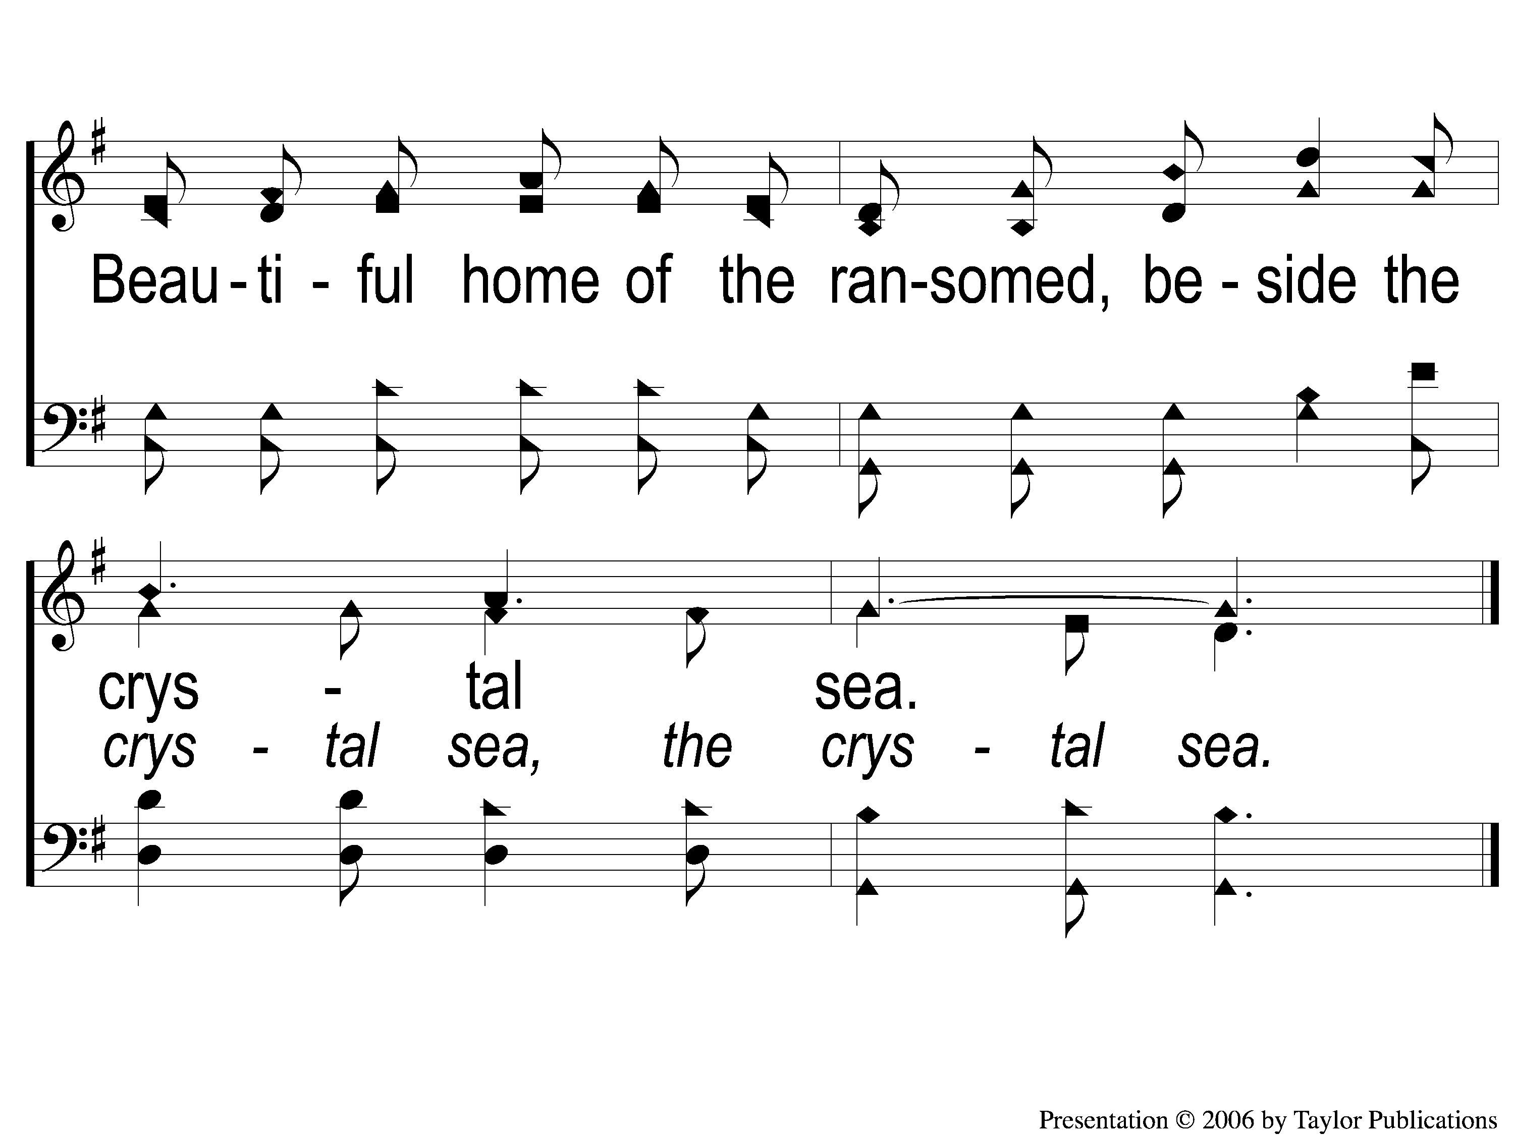
C-4 Home of the Soul
Home of the Soul
875

Slide 110
3-1 Home of the Soul
Home of the Soul
875

Slide 111
3-2 Home of the Soul
Home of the Soul
875

Slide 112
C-1 Home of the Soul
Home of the Soul
875

Slide 113
C-2 Home of the Soul
Home of the Soul
875

Slide 114
C-3 Home of the Soul
Home of the Soul
875

Slide 115
C-4 Home of the Soul
Home of the Soul
875

Slide 116
RESTORE REBUILD RENEW
JOIN US
IN THE MPB FOR
A FELLOWSHIP MEAL
& DEVO @ NOON
IN 2022
WHEELER
CHURCH
OF
CHRIST

Slide 117
Tonight
WORSHIP @ 6:00 pm
Wednesday
WORSHIP @ 6:30 pm
Bible classes @ 7:00 pm
RESTORE REBUILD RENEW
IN 2022
WHEELER
CHURCH
OF
CHRIST

