Slide 1
PLEASE STANDBY
OUR LIVESTREAM
WILL BEGIN SOON

Slide 2
WELCOME
THANKS FOR JOINING US!

Slide 3
#166
SONG:
He’s My King

Slide 4
1-1 He’s My King
He’s My King
166

Slide 5
1-2 He’s My King
He’s My King
166

Slide 6
C-1 He’s My King
He’s My King
166

Slide 7
C-2 He’s My King
He’s My King
166

Slide 8
3-1 He’s My King
He’s My King
166

Slide 9
3-2 He’s My King
He’s My King
166

Slide 10
C-1 He’s My King
He’s My King
166

Slide 11
C-2 He’s My King
He’s My King
166

Slide 12
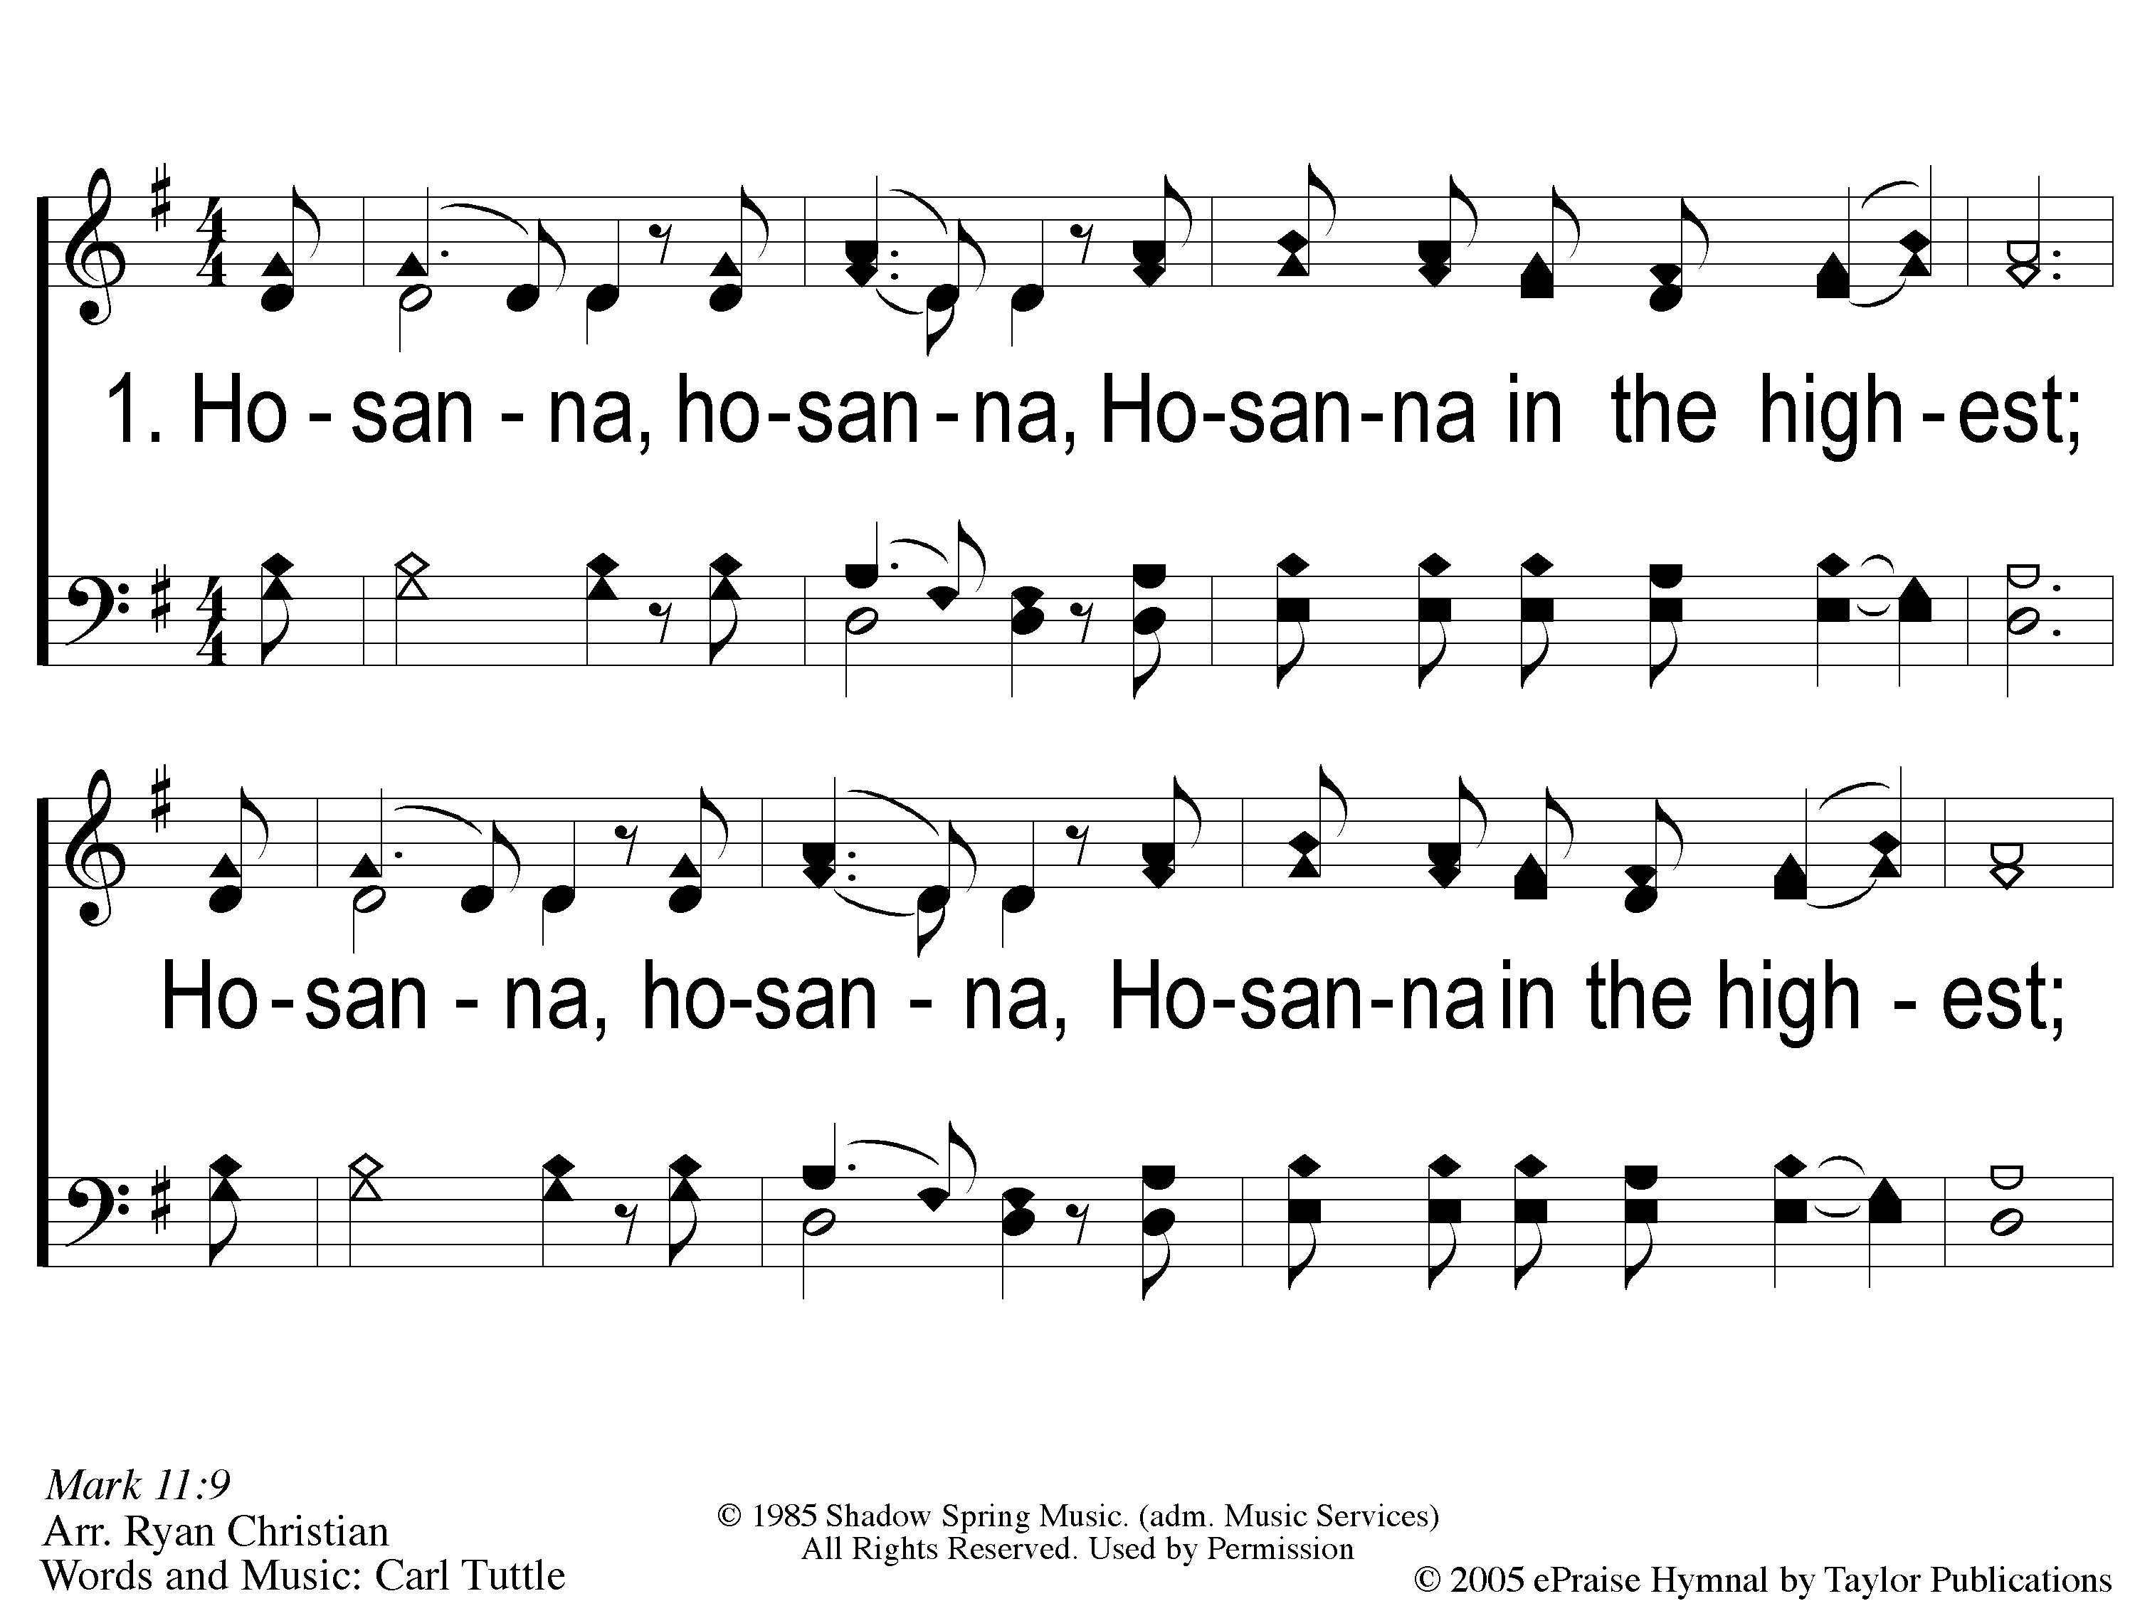
1 Hosanna
Hosanna
167

Slide 13
C-1 Hosanna
Hosanna
167

Slide 14
C-2 Hosanna
Hosanna
167

Slide 15
2 Hosanna
Hosanna
167

Slide 16
C-1 Hosanna
Hosanna
167

Slide 17
C-2 Hosanna
Hosanna
167

Slide 18
#764
SONG:
Teach Me Lord,
To Wait

Slide 19
1-1 Teach Me Lord to Wait
Teach Me Lord, To Wait
764

Slide 20
1-2 Teach Me Lord to Wait
Teach Me Lord, To Wait
764

Slide 21
C-1 Teach Me Lord to Wait
Teach Me Lord, To Wait
764

Slide 22
C-2 Teach Me Lord to Wait
Teach Me Lord, To Wait
764

Slide 23
2-1 Teach Me Lord to Wait
Teach Me Lord, To Wait
764

Slide 24
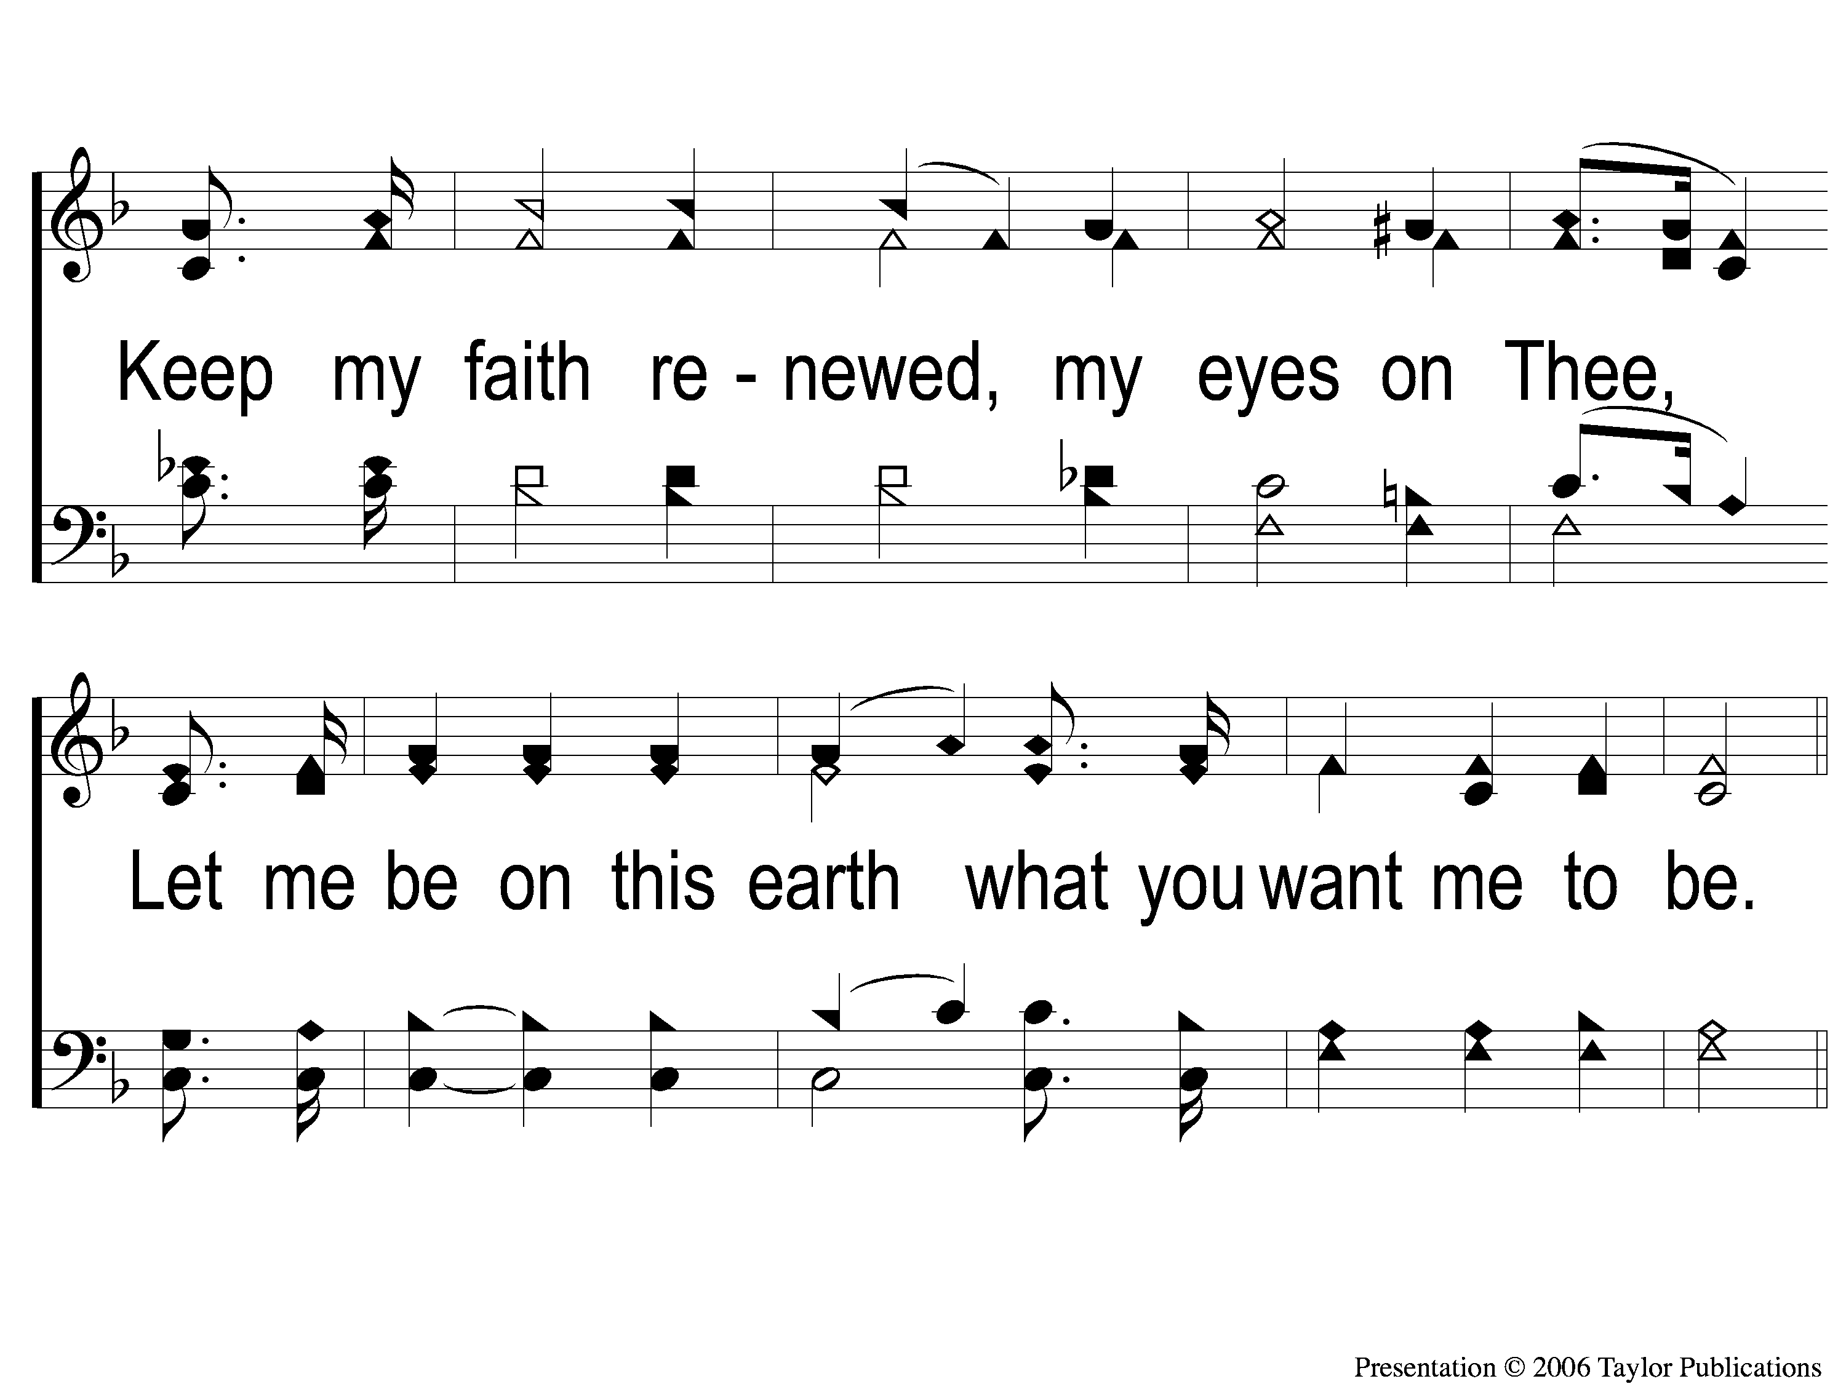
2-2 Teach Me Lord to Wait
Teach Me Lord, To Wait
764

Slide 25
C-1 Teach Me Lord to Wait
Teach Me Lord, To Wait
764

Slide 26
C-2 Teach Me Lord to Wait
Teach Me Lord, To Wait
764

Slide 27
Opening PRAYER

Slide 28
#577
SONG:
We Bow Down

Slide 29
1-1 We Bow Down
We Bow Down
577

Slide 30
1-2 We Bow Down
We Bow Down
577

Slide 31
1-3 We Bow Down
We Bow Down
577

Slide 32
1-4 We Bow Down
We Bow Down
577

Slide 33
2-1 We Bow Down
We Bow Down
577

Slide 34
2-2 We Bow Down
We Bow Down
577

Slide 35
2-3 We Bow Down
We Bow Down
577

Slide 36
2-4 We Bow Down
We Bow Down
577

Slide 37
1-1 We Will Glorify
We Will Glorify
578

Slide 38
1-2 We Will Glorify
We Will Glorify
578

Slide 39
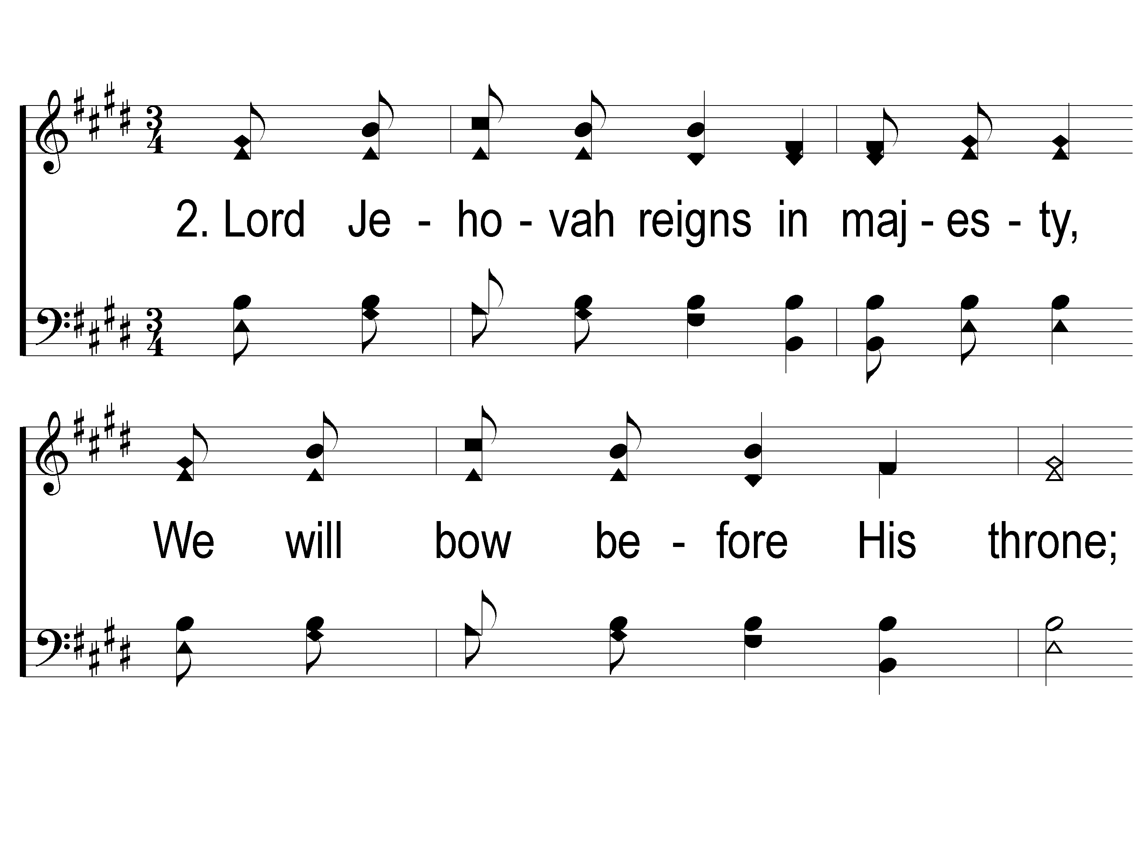
2-1 We Will Glorify
We Will Glorify
578

Slide 40
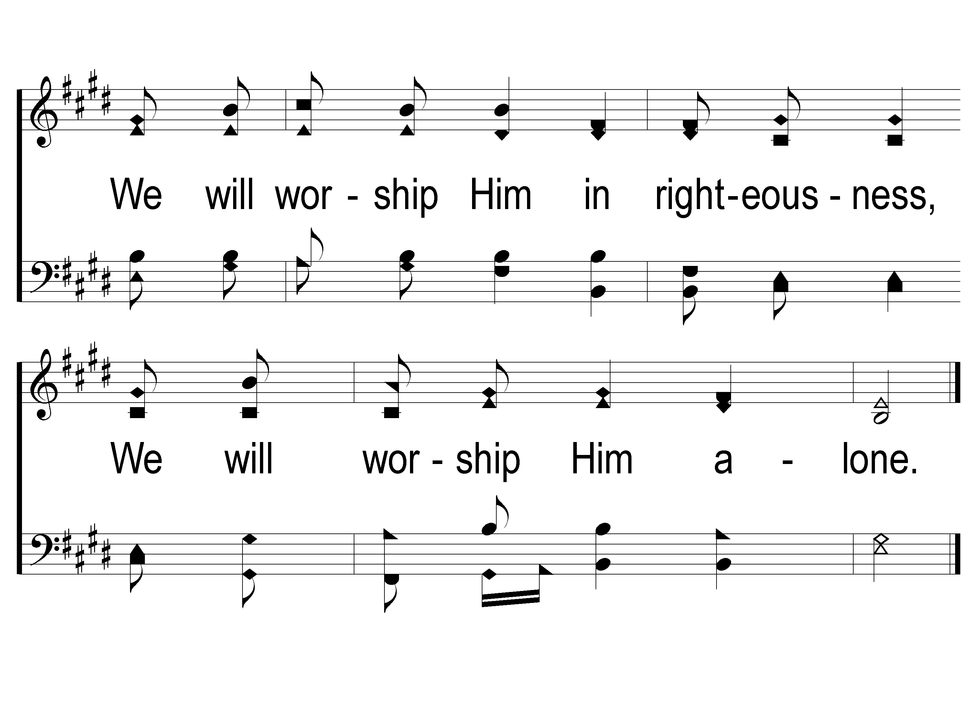
2-2 We Will Glorify
We Will Glorify
578

Slide 41
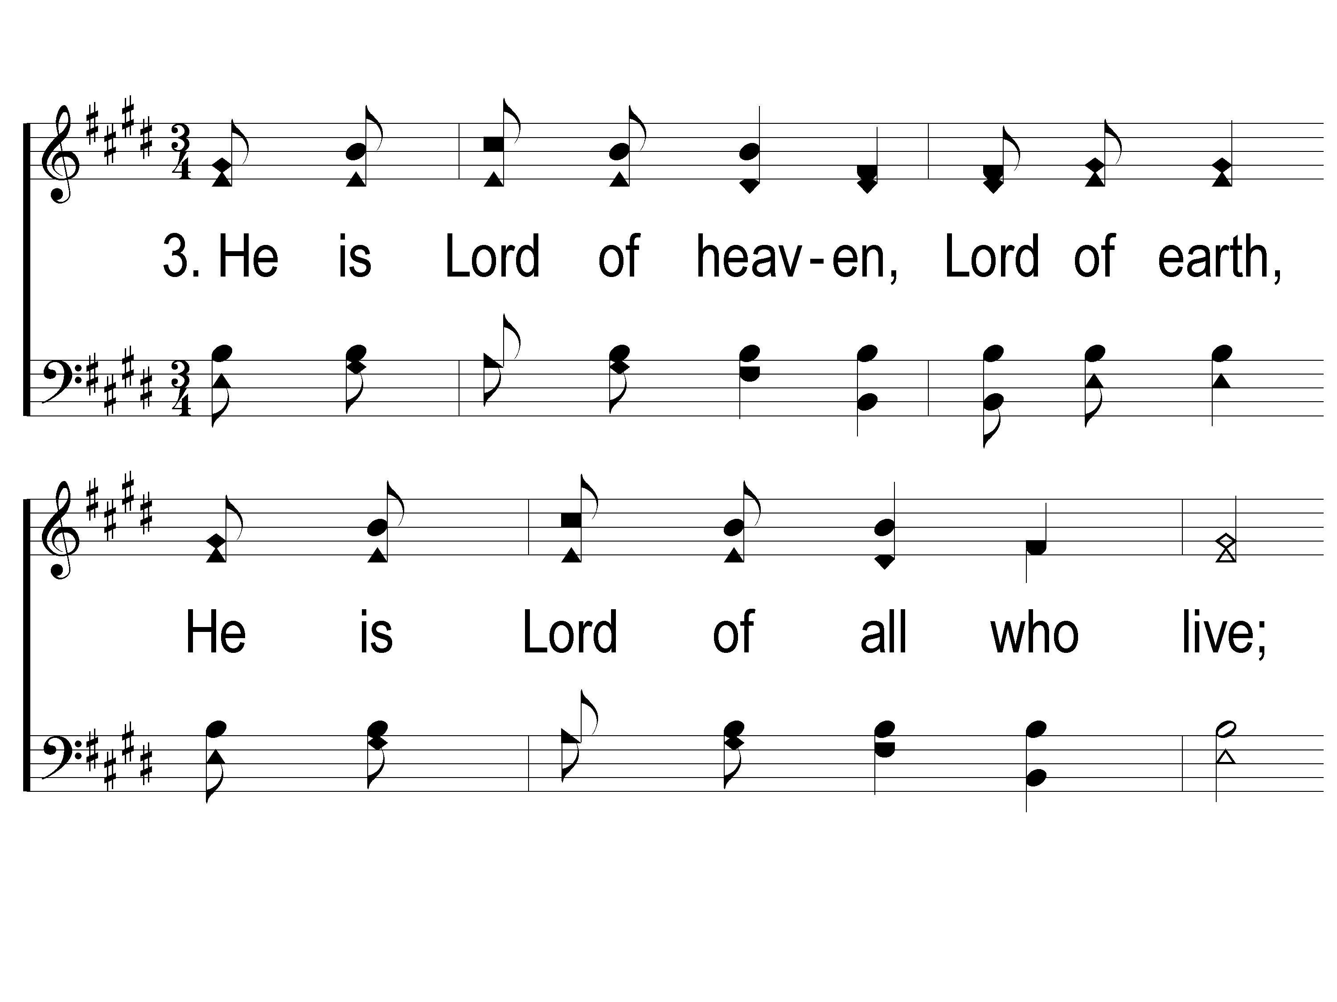
3-1 We Will Glorify
We Will Glorify
578

Slide 42
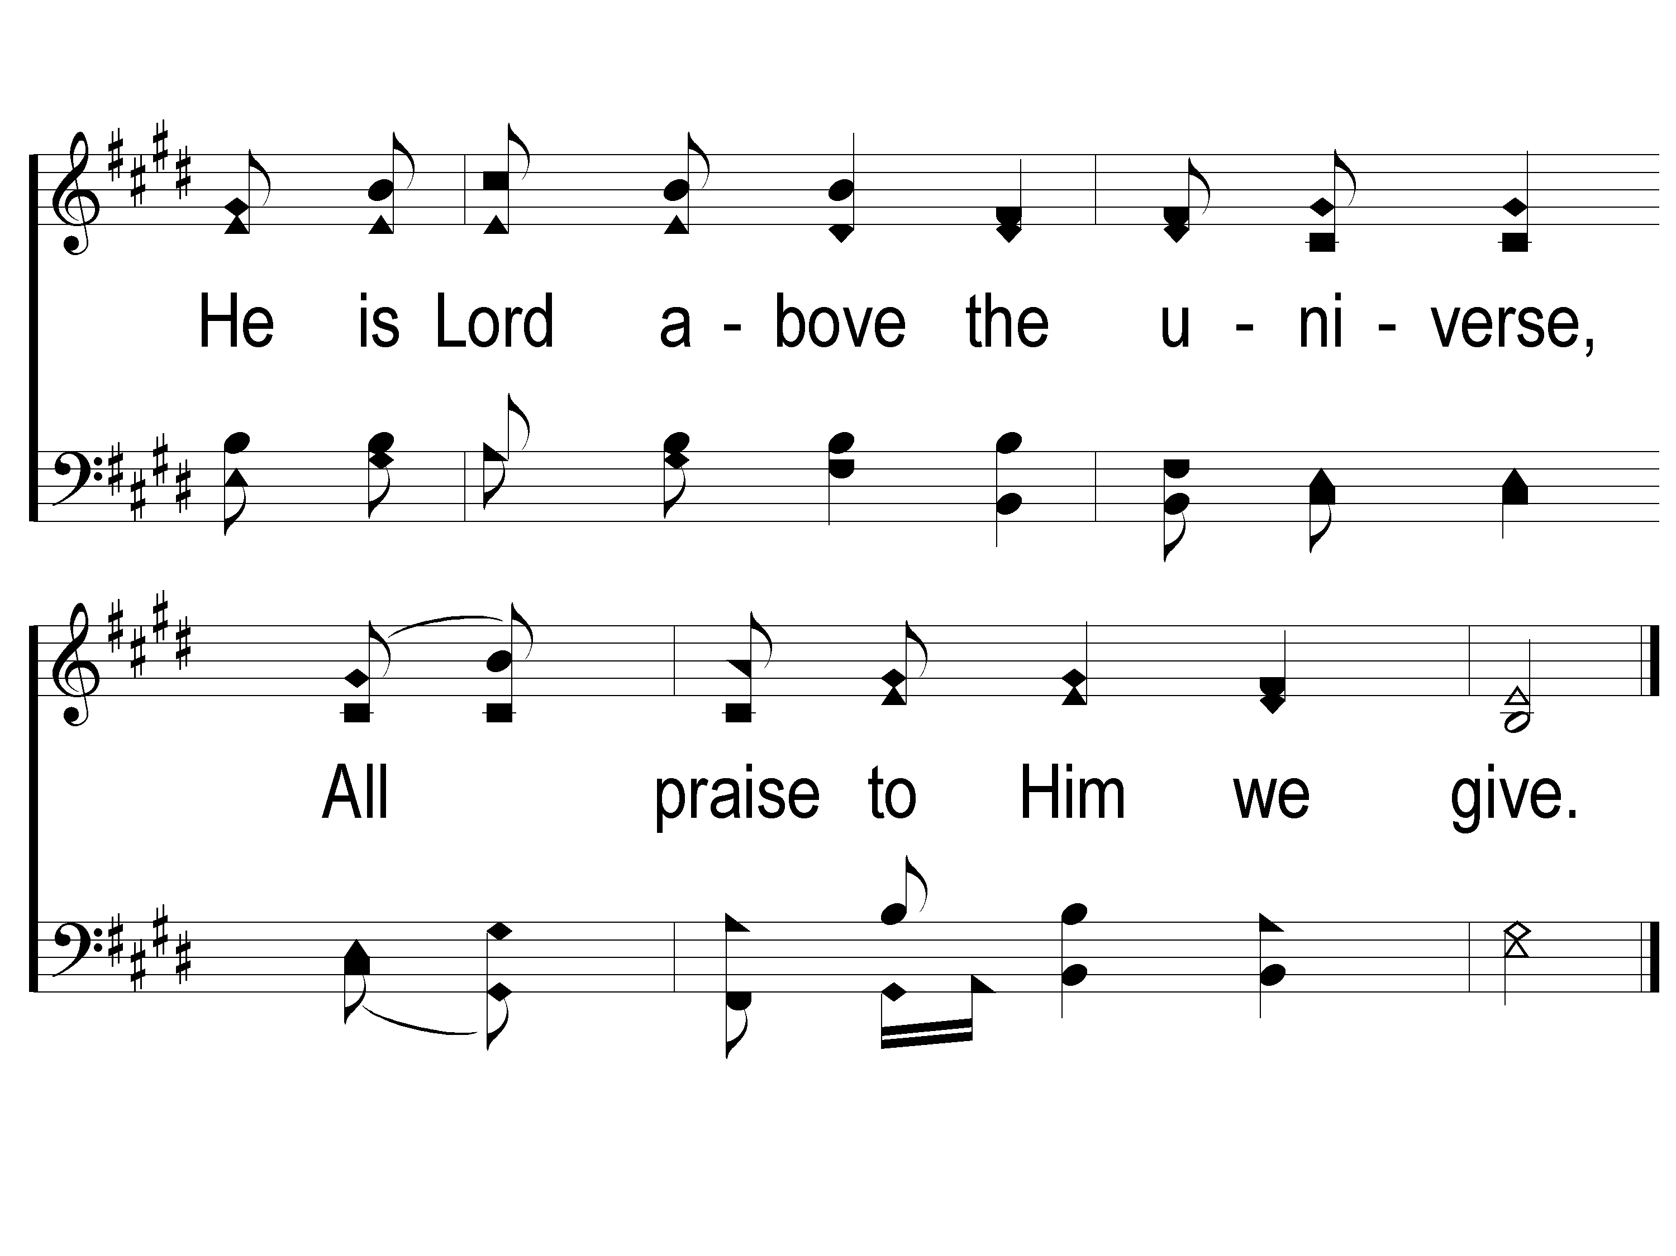
3-2 We Will Glorify
We Will Glorify
578

Slide 43
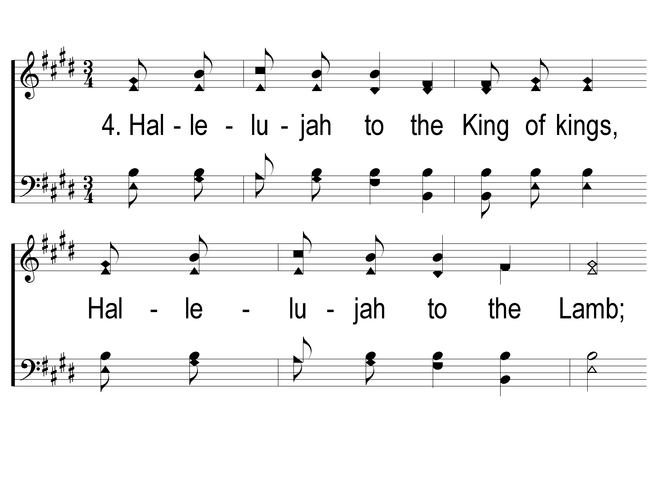
4-1 We Will Glorify
We Will Glorify
578

Slide 44
4-2 We Will Glorify
We Will Glorify
578

Slide 45
SCRIPTURE:
Revelation 1:1-3

Slide 47
STAND STILl

Slide 48
WHO IS ABLE TO STAND?
WHO IS ABLE TO STAND?

Slide 49
THE REVELATION OF JESUS CHRIST
“WHO IS ABLE TO STAND?”
REVELATION 6:17 (NKJV)

Slide 50
THE REVELATION OF JESUS CHRIST
“THINGS WHICH MUST SHORTLY TAKE PLACE”
REVELATION 1:1 (NKJV)

Slide 51
Two Challenges:

Slide 52
Two Challenges:
Read through all of the book

Slide 53
Two Challenges:
Read through all of the book
Write a one-sentence summary of the book

Slide 54
Summary Sentence:
“Behold, God is on His throne and the Lamb has overcome the Devil and all the nations.”

Slide 55
Summary Sentence:
“Behold, God is on His throne and the Lamb has overcome the Devil and all the nations.”

Slide 56
Classify the Book
What is its Genre of Literature?

Slide 57
Classify the Book
What is its Genre of Literature?
A Letter

Slide 58
Classify the Book
What is its Genre of Literature?
A Letter
A Prophecy

Slide 59
Classify the Book
What is its Genre of Literature?
A Letter
A Prophecy
Apocalyptic

Slide 60
Classify the Book
What is its Genre of Literature?
A Letter
A Prophecy
Apocalyptic
Apokalypsis = to unveil, to reveal

Slide 61
Revelation Chapter 1
The Scope (v. 1-3)

Slide 62
THE SCOPE (v. 1-3)
The Author
John → The Apostle (Mk. 1:19ff)

Slide 63
THE SCOPE (v. 1-3)
The Author
John → The Apostle (Mk. 1:19ff)
Mk. 3:17 – one of the “Sons of Thunder”

Slide 64
THE SCOPE (v. 1-3)
The Author
John → The Apostle (Mk. 1:19ff)
Mk. 3:17 – one of the “Sons of Thunder”
“the disciple whom Jesus loved” – Jn. 13:23, 19:26

Slide 65
THE SCOPE (v. 1-3)
The Author
Exiled on the Island of Patmos (v. 9, 2:10)

Slide 66
THE SCOPE (v. 1-3)
The Author
Exiled on the Island of Patmos (v. 9, 2:10)
By Emperor Domitian (81-96 AD)

Slide 67
THE SCOPE (v. 1-3)
The Author
Exiled on the Island of Patmos (v. 9, 2:10)
By Emperor Domitian (81-96 AD) – Why?
Empire-wide persecution
No mention of persecution in Ephesians

Slide 68
THE SCOPE (v. 1-3)
The Aim
To Reveal the Near Future (v. 1a, 3)

Slide 69
THE SCOPE (v. 1-3)
The Aim
To Reveal the Near Future (v. 1a, 3)
“shortly” – 22:7a, Acts 25:4
“near” – 22:10, Lk. 21:31, Matt. 26:18

Slide 70
THE SCOPE (v. 1-3)
The Aim
To Bless those who Read, Hear, & Do (v. 3)
Rev. 22:7b

Slide 71
Revelation Chapter 1
The Scope (v. 1-3)

Slide 72
Revelation Chapter 1
The Scope (v. 1-3)
The Salutation (v. 4-8)

Slide 73
THE SALUTATION (v. 4-8)
The Audience
The 7 churches of Asia Minor
Modern-day Turkey

Slide 74
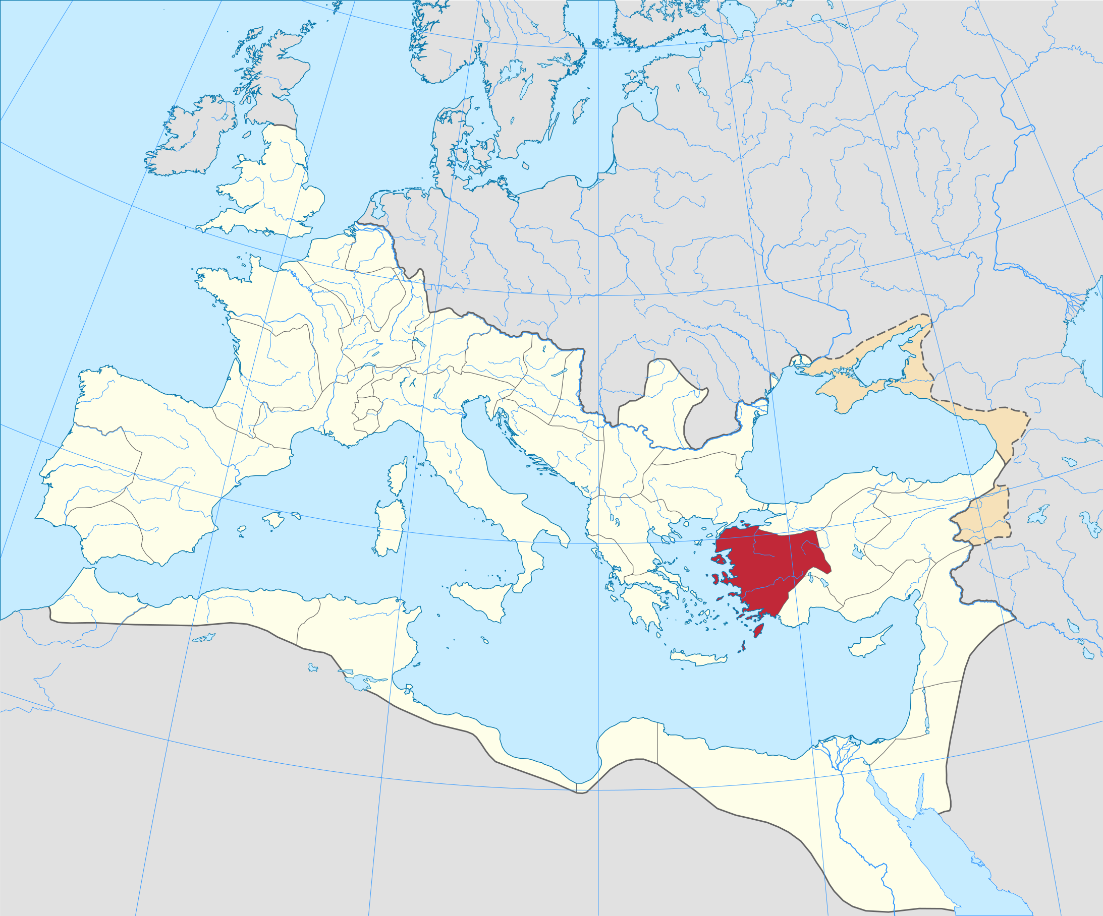

Slide 79
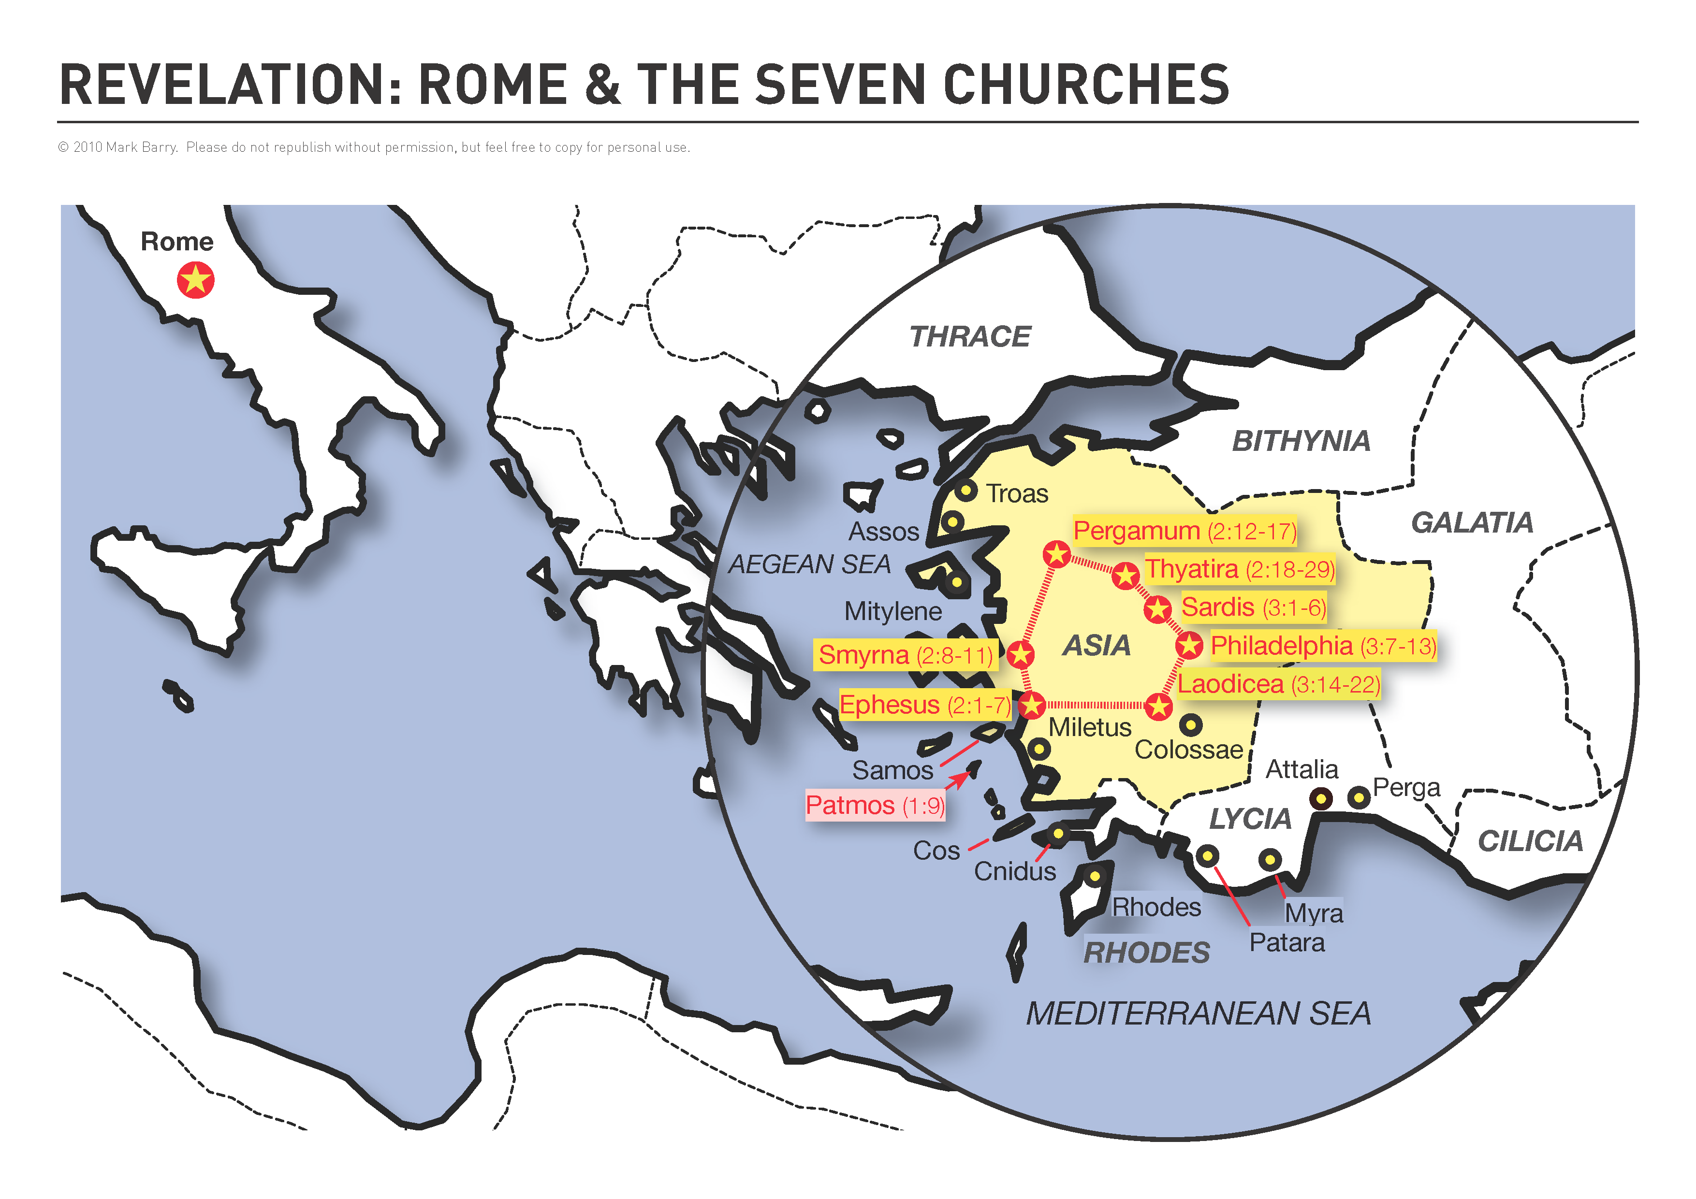

Slide 81
THE SALUTATION (v. 4-8)
The Authority
The Father (v. 4)
Deut. 33:27, Psa. 90:2

Slide 82
THE SALUTATION (v. 4-8)
The Authority
Jesus Christ (v. 5-6)

Slide 83
THE SALUTATION (v. 4-8)
The Authority
Jesus Christ (v. 5-6)
“Faithful Witness” – Prov. 14:5, Isa. 55:4, Jn. 5:36

Slide 84
THE SALUTATION (v. 4-8)
The Authority
Jesus Christ (v. 5-6)
“Faithful Witness” – Prov. 14:5, Isa. 55:4, Jn. 5:36
“Firstborn from the dead” – 1 Cor. 15:20, Col. 1:18

Slide 85
THE SALUTATION (v. 4-8)
The Authority
Jesus Christ (v. 5-6)
“Faithful Witness” – Prov. 14:5, Isa. 55:4, Jn. 5:36
“Firstborn from the dead” – 1 Cor. 15:20, Col. 1:18
“Ruler over the kings of the earth” – 11:15, 17:14, 19:16

Slide 86
Revelation Chapter 1
The Scope (v. 1-3)
The Salutation (v. 4-8)

Slide 87
Revelation Chapter 1
The Scope (v. 1-3)
The Salutation (v. 4-8)
The Signs (v. 9-20)

Slide 88
THE SIGNS (v. 9-20)
To the Servant (v. 9-11)
A sign of assurance! – “The Alpha & The Omega”

Slide 89
THE SIGNS (v. 9-20)
To the Servant (v. 9-11)
A sign of assurance! – “The Alpha & The Omega”
Jn. 16:33
1 Thess. 1:6
2 Tim. 3:12

Slide 90
THE SIGNS (v. 9-20)
Of the Sovereign (v. 12-20)
The Description (v. 12-16)
The Reaction (v. 17a)
The Motivation (v. 17b-20)

Slide 91
SUMMARY

Slide 92
SUMMARY
Revelation is a Letter & a Prophecy

Slide 93
SUMMARY
Revelation is a Letter & a Prophecy
Revelation was revealed to John in Visions

Slide 94
SUMMARY
Revelation is a Letter & a Prophecy
Revelation was revealed to John in Visions
Revelation is a book of HOPE for Christians

Slide 95
How will you respond to Jesus?

Slide 96
#912
SONG:
Burdens Are Lifted

Slide 97
1-1 Burdens Are Lifted At Calvary
Burdens Are Lifted At Calvary
912

Slide 98
1-2 Burdens Are Lifted At Calvary
Burdens Are Lifted At Calvary
912

Slide 99
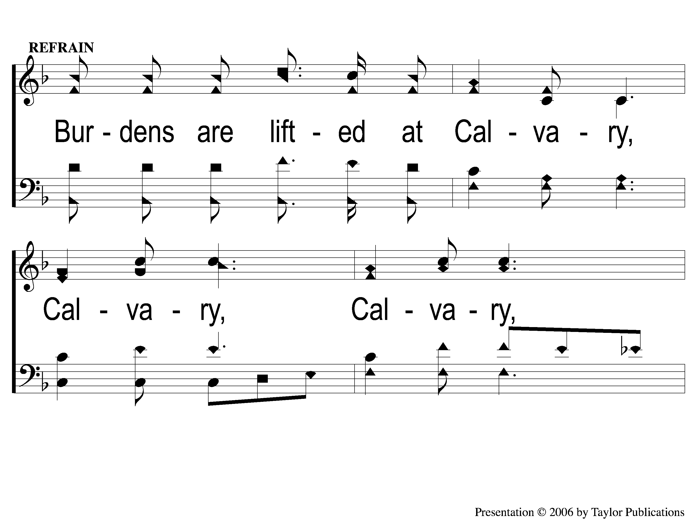
C-1 Burdens Are Lifted At Calvary
Burdens Are Lifted At Calvary
912

Slide 100
C-2 Burdens Are Lifted At Calvary
Burdens Are Lifted At Calvary
912

Slide 101
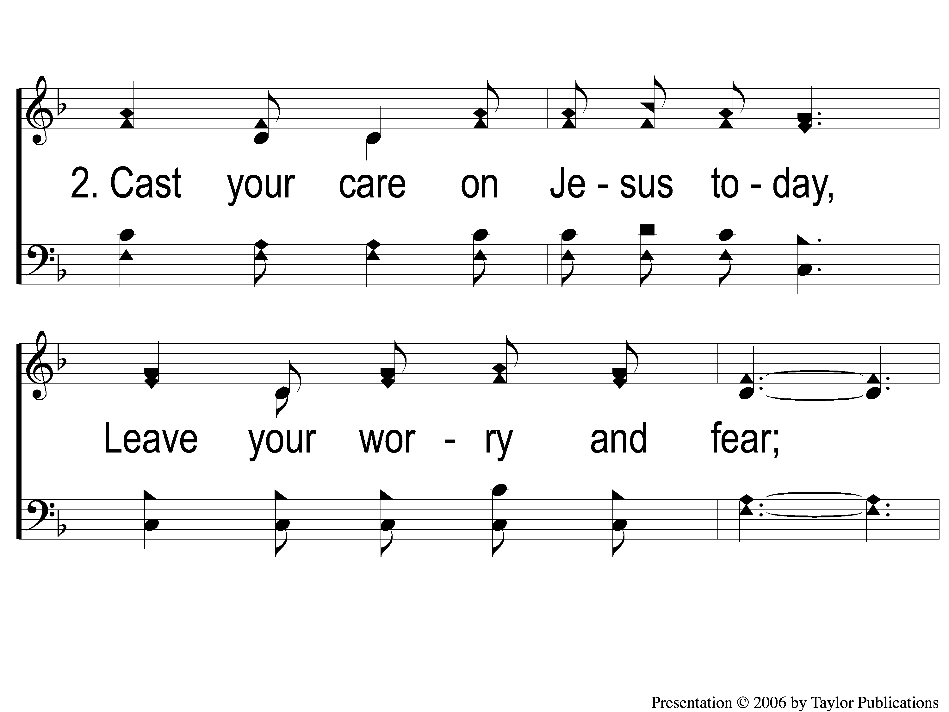
2-1 Burdens Are Lifted At Calvary
Burdens Are Lifted At Calvary
912

Slide 102
2-2 Burdens Are Lifted At Calvary
Burdens Are Lifted At Calvary
912

Slide 103
C-1 Burdens Are Lifted At Calvary
Burdens Are Lifted At Calvary
912

Slide 104
C-2 Burdens Are Lifted At Calvary
Burdens Are Lifted At Calvary
912

Slide 105
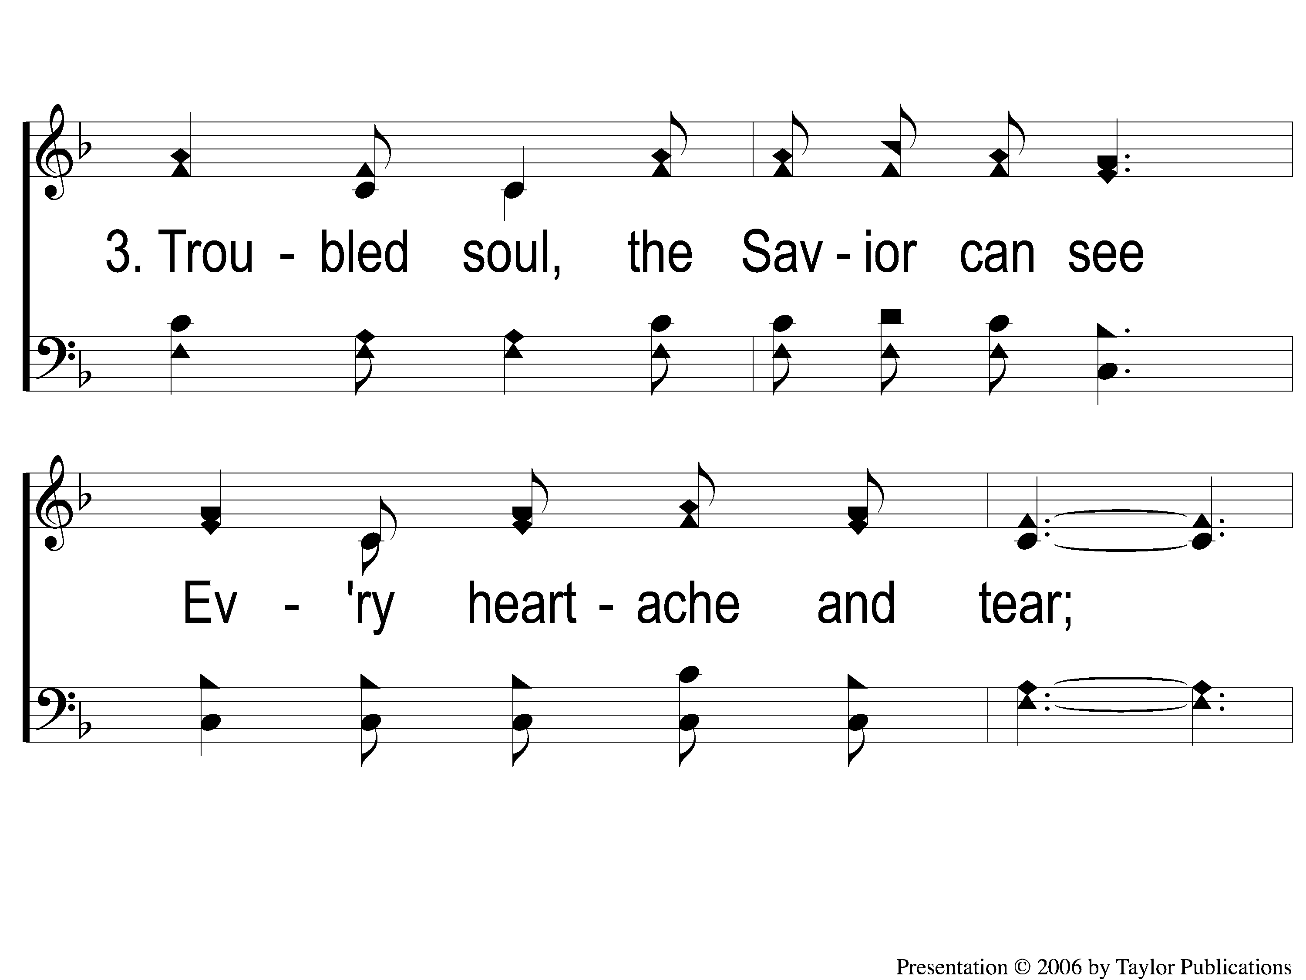
3-1 Burdens Are Lifted At Calvary
Burdens Are Lifted At Calvary
912

Slide 106
3-2 Burdens Are Lifted At Calvary
Burdens Are Lifted At Calvary
912

Slide 107
C-1 Burdens Are Lifted At Calvary
Burdens Are Lifted At Calvary
912

Slide 108
C-2 Burdens Are Lifted At Calvary
Burdens Are Lifted At Calvary
912

Slide 109
SONG:
Create In Me

Slide 110
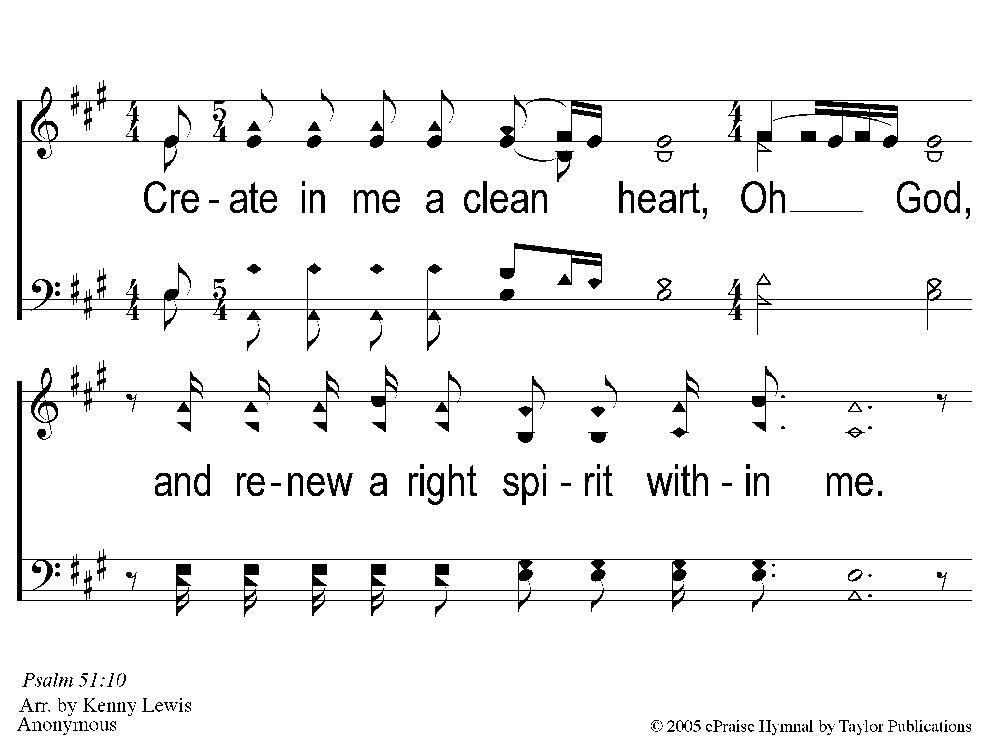
1 Create in Me
Create In Me A Clean Heart

Slide 111
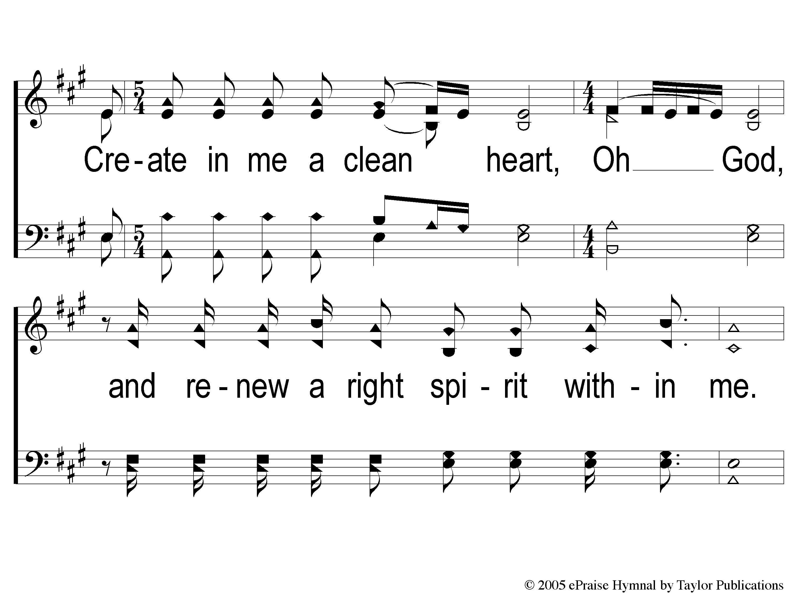
2 Create in Me
Create In Me A Clean Heart

Slide 112
3 Create in Me
Create In Me A Clean Heart

Slide 113
4 Create in Me
Create In Me A Clean Heart

Slide 114
LORD’S SUPPER
The
Matt. 26:26-29

Slide 115
Unleavened Bread
LORD’S SUPPER
⁴⁸ I am the bread of life. ⁴⁹ Your fathers ate the manna in the wilderness, and are dead. ⁵⁰ This is the bread which comes down from heaven, that one may eat of it and not die. ⁵¹ I am the living bread which came down from heaven. If anyone eats of this bread, he will live forever; and the bread that I shall give is My flesh, which I shall give for the life of the world.
John 6:48-51

Slide 116
Fruit of the Vine
LORD’S SUPPER
⁵³ Then Jesus said to them, “Most assuredly, I say to you, unless you eat the flesh of the Son of Man and drink His blood, you have no life in you. ⁵⁴ Whoever eats My flesh and drinks My blood has eternal life, and I will raise him up at the last day. ⁵⁵ For My flesh is food indeed, and My blood is drink indeed. ⁵⁶ He who eats My flesh and drinks My blood abides in Me, and I in him. ⁵⁷ As the living Father sent Me, and I live because of the Father, so he who feeds on Me will live because of Me.
John 6:53-57

Slide 117
Luke 12:15
OFFERING
“And He said to them, ’Take heed and beware of covetousness, for one’s life does not consist in the abundance of the things he possesses.’”

Slide 118
Closing PRAYER

Slide 119
#288
SONG:
Fairest Lord Jesus

Slide 120
1-1 Fairest Lord Jesus
Fairest Lord Jesus
288

Slide 121
1-2 Fairest Lord Jesus

Slide 122
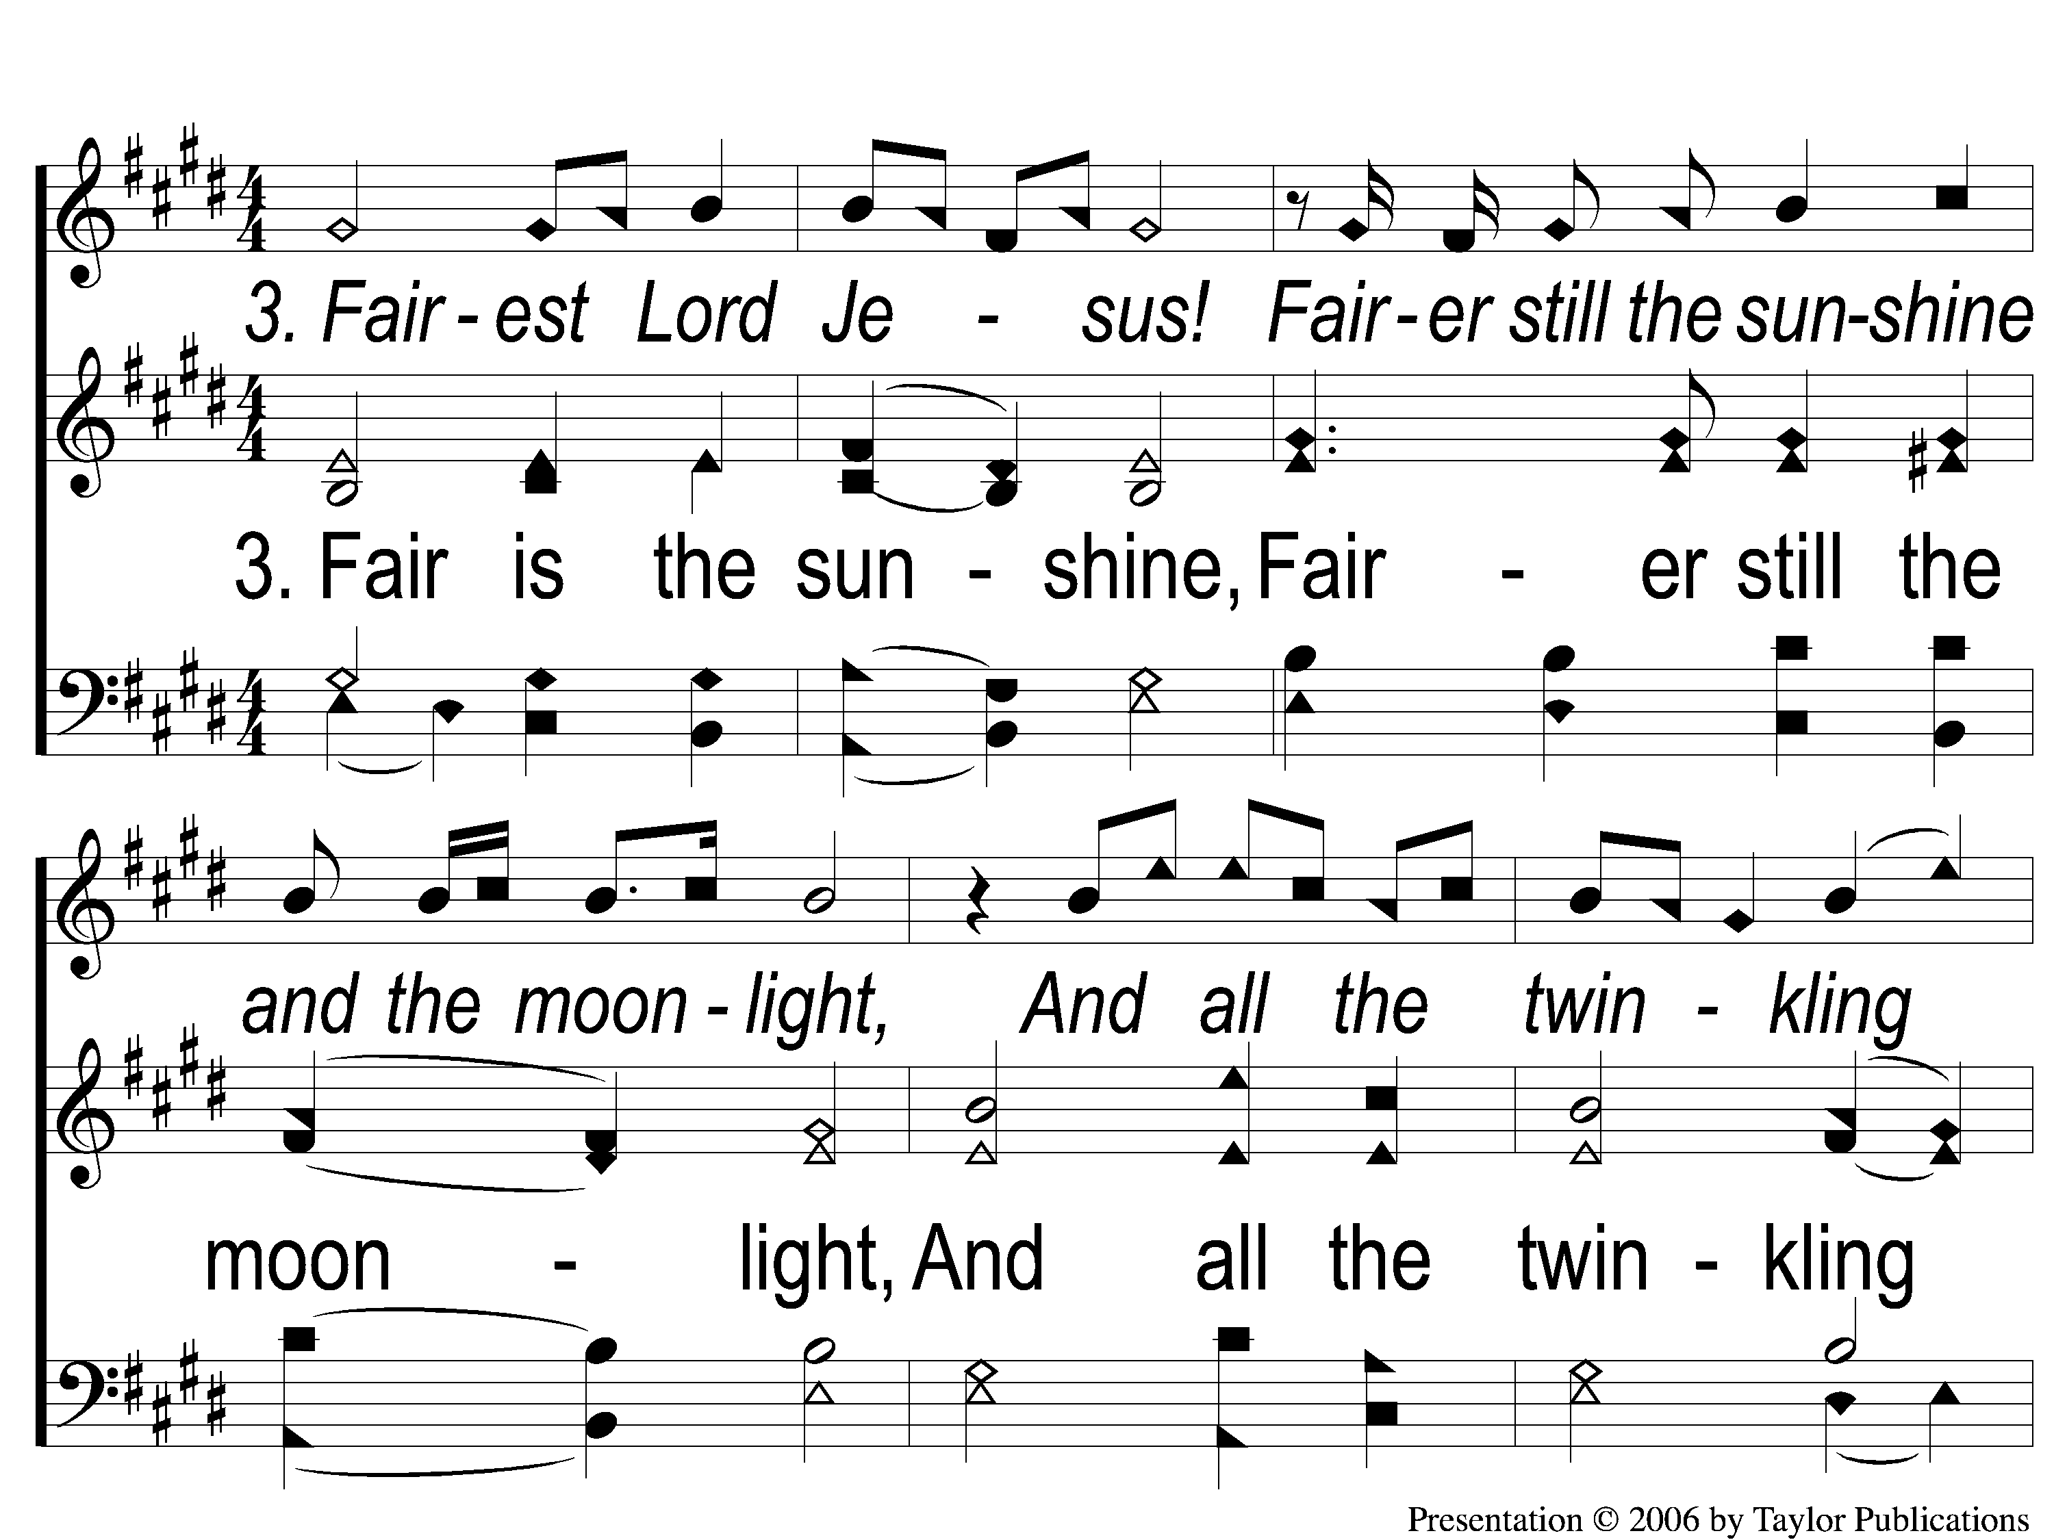
Opt Descant 3-1 Fairest Lord Jesus
Fairest Lord Jesus
288

Slide 123
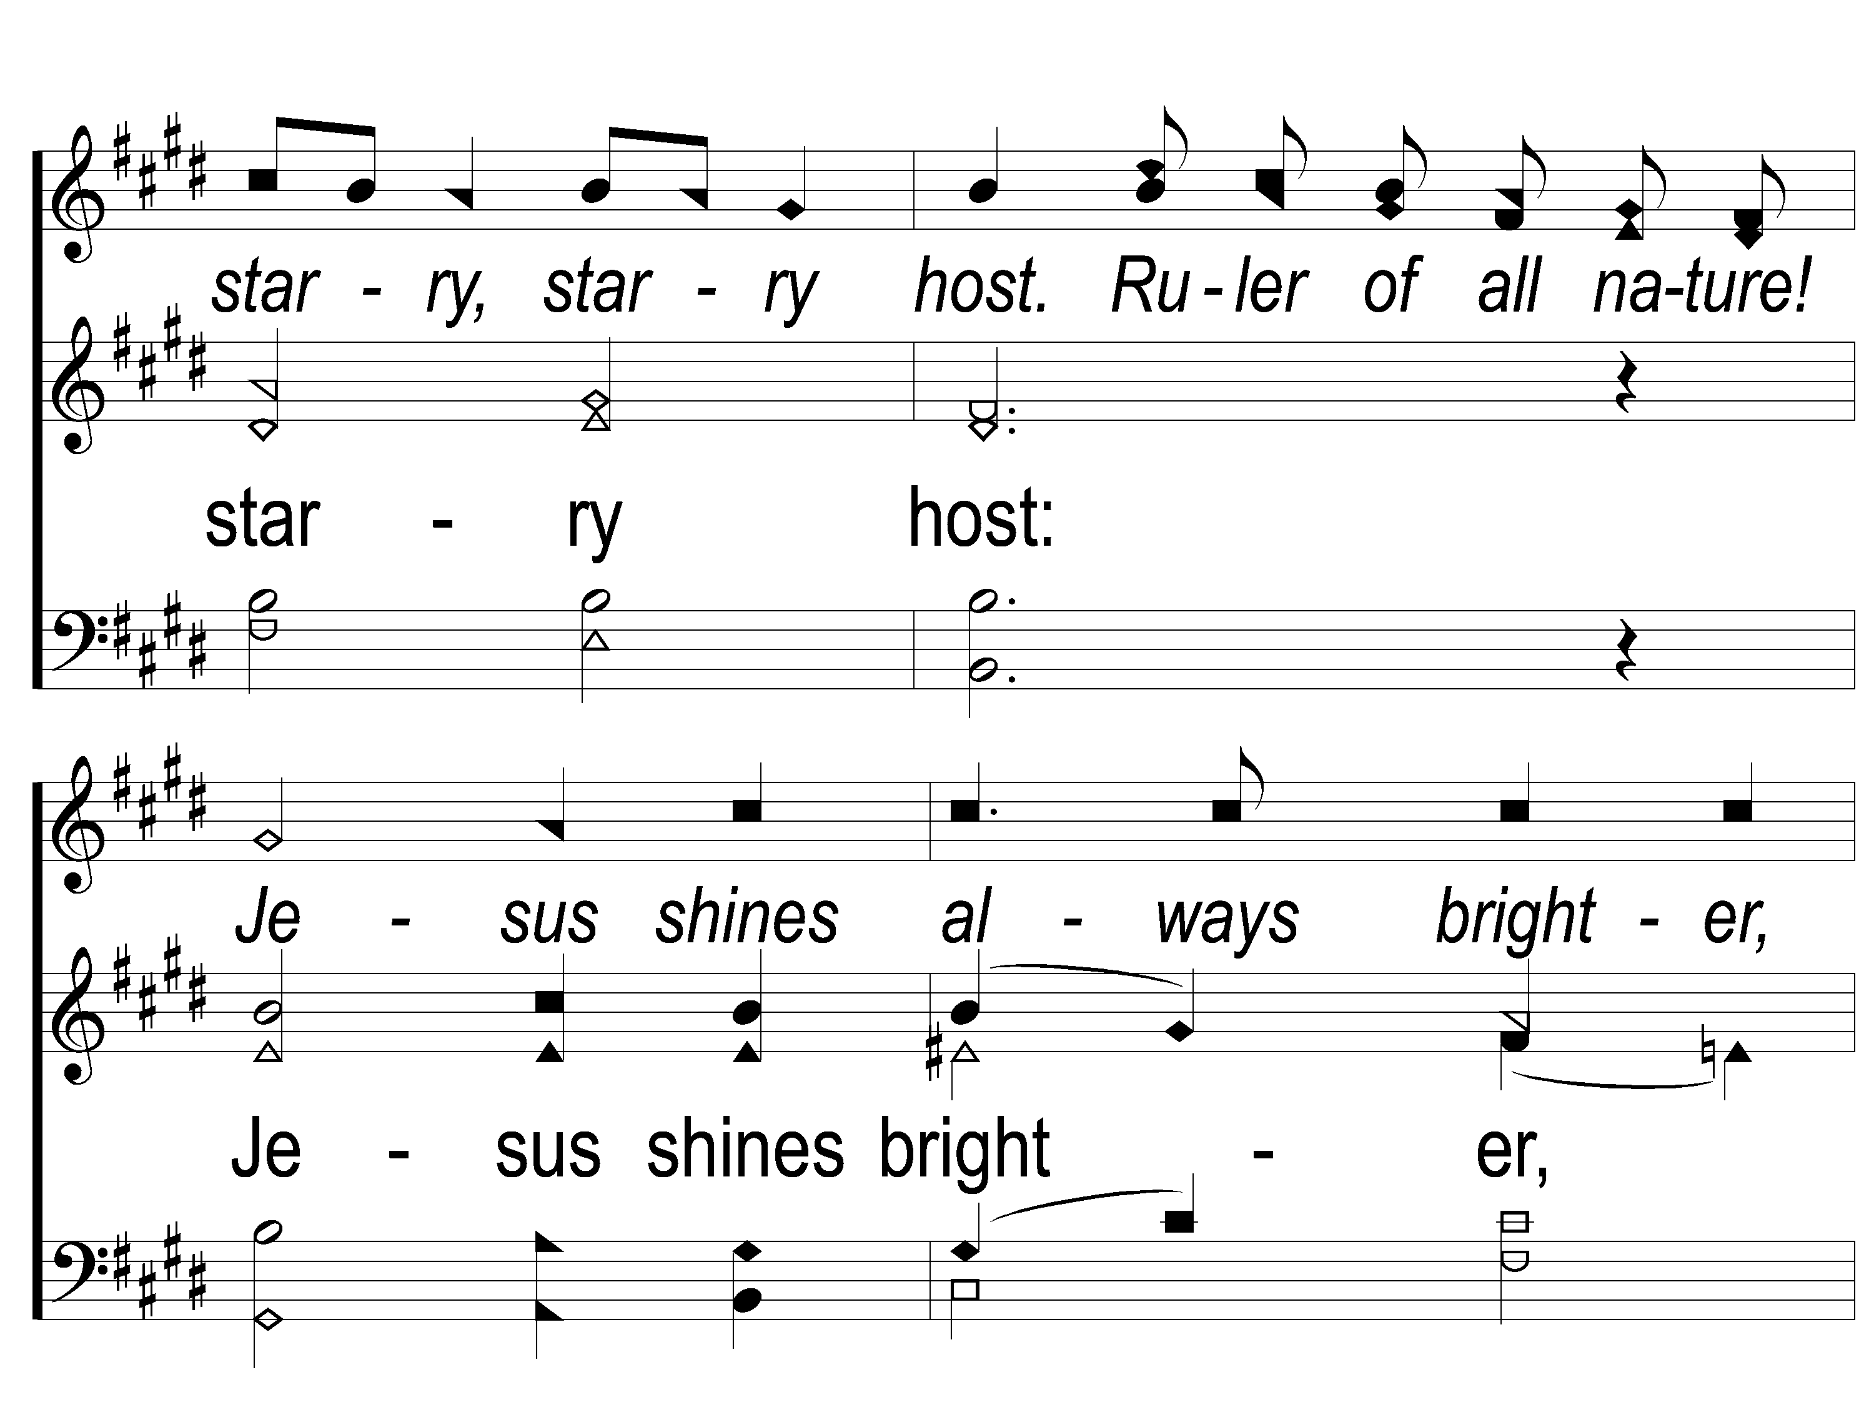
Opt Descant 3-2 Fairest Lord Jesus
Fairest Lord Jesus
288

Slide 124
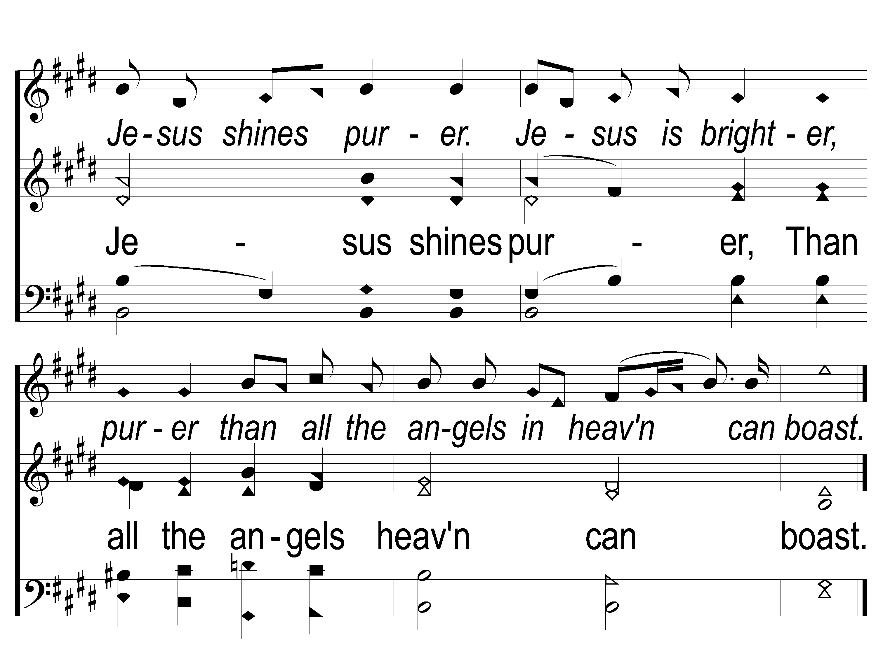
Opt Descant 3-3 Fairest Lord Jesus
Fairest Lord Jesus
288

Slide 125
TONIGHT @ 6:00 pm
JOIN US
HOPE TO SEE YOU THERE!

