Slide 1
PLEASE STANDBY
OUR LIVESTREAM
WILL BEGIN SOON

Slide 2
WELCOME
THANKS FOR JOINING US!

Slide 3
Songs of
Praise to God

Slide 4
Opening PRAYER

Slide 5
Songs of
Praise to God

Slide 6
THE REVELATION OF JESUS CHRIST
“WHO IS ABLE TO STAND?”
REVELATION 6:17 (NKJV)

Slide 7
THE REVELATION OF JESUS CHRIST
“THINGS WHICH MUST SHORTLY TAKE PLACE”
REVELATION 1:1 (NKJV)

Slide 8
THE REVELATION OF JESUS CHRIST
“HEAR WHAT THE SPIRIT SAYS TO THE CHURCHES”
REVELATION 2:7 (NKJV)

Slide 9
THE REVELATION OF JESUS CHRIST
7 WARNINGS FROM 7 CHURCHES
PART ONE

Slide 10
LEARNING FROM THE PAST
“For whatever things were written before were written for our learning, that we through the patience and comfort of the Scriptures might have hope.” – Rom. 15:4

Slide 11
THE 7 CHURCHES OF ASIA MINOR:
Ephesus
Smyrna
Pergamos
Thyatira
Sardis
Philadelphia
Laodicea

Slide 12
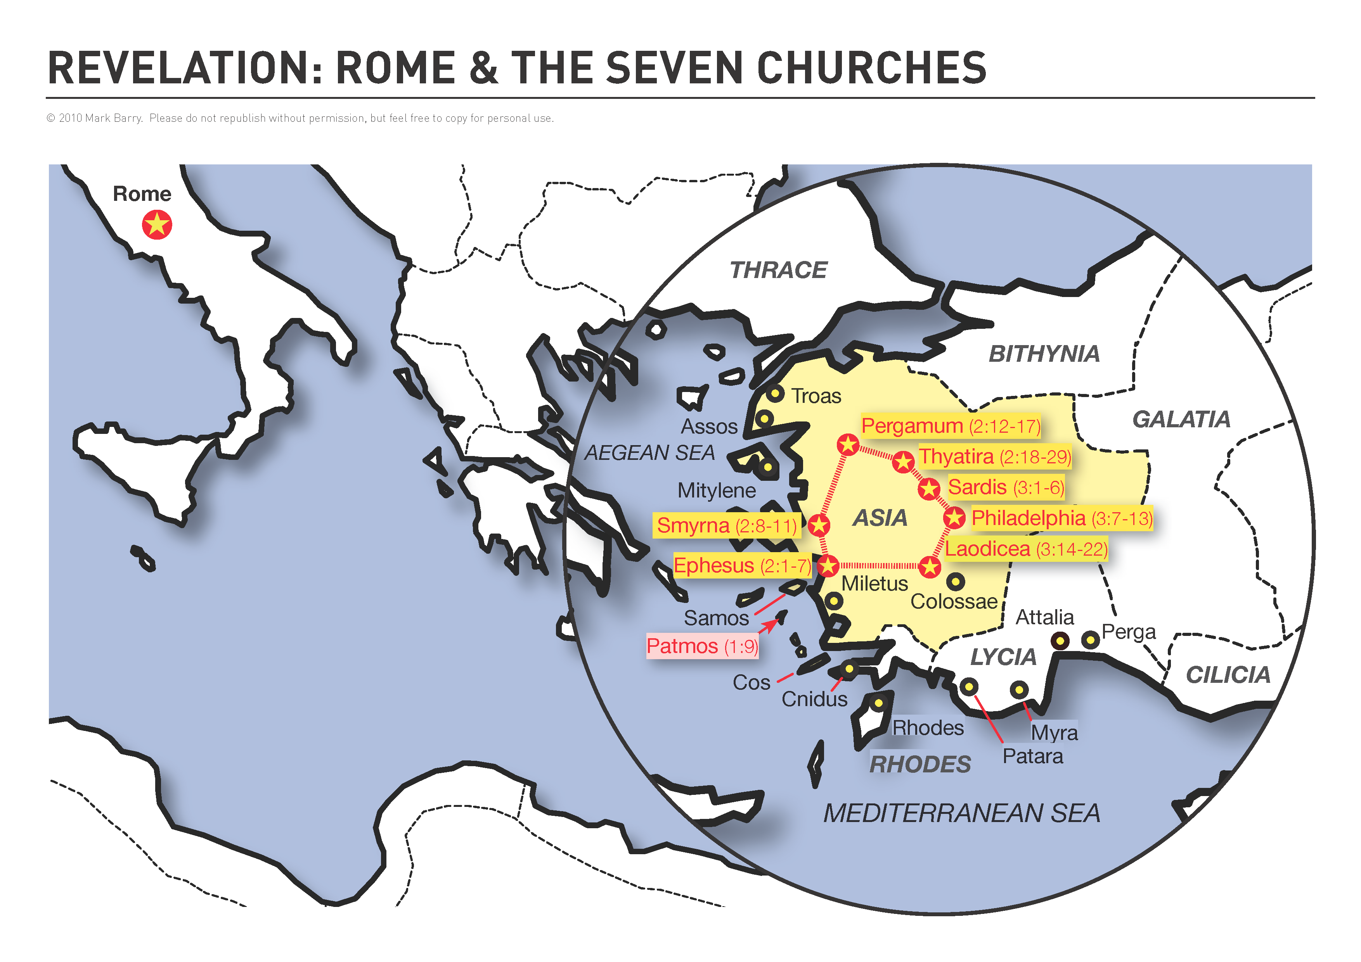

Slide 22
THE 7 CHURCHES OF ASIA:
Estranged Ephesus
Steadfast Smyrna
Permissive Pergamos
Tolerant Thyatira
Sleeping Sardis
Faithful Philadelphia
Lukewarm Laodicea

Slide 23
THE 7 CHURCHES OF ASIA:
Estranged Ephesus
Steadfast Smyrna
Permissive Pergamos
Tolerant Thyatira
Sleeping Sardis
Faithful Philadelphia
Lukewarm Laodicea
Ch. 2

Slide 24
THE 7 CHURCHES OF ASIA:
Estranged Ephesus
Steadfast Smyrna
Permissive Pergamos
Tolerant Thyatira
Sleeping Sardis
Faithful Philadelphia
Lukewarm Laodicea
Ch. 2
Ch. 3

Slide 25
WE LEARN FROM…
…Ephesus → We CAN fall from God’s Grace

Slide 26
EPHESUS: We CAN fall from Grace
Rev. 2:1-7

Slide 27
EPHESUS: We CAN fall from Grace
Rev. 2:1-7
Commended for: Works, Labor, & Patience

Slide 28
EPHESUS: We CAN fall from Grace
Rev. 2:1-7
Commended for: Works, Labor, & Patience
Warned for: Leaving “their first love”

Slide 29
EPHESUS: We CAN fall from Grace
Rev. 2:1-7
Commended for: Works, Labor, & Patience
Warned for: Leaving “their first love”
Gal. 5:4, Heb. 12:15, 2 Pet. 3:17

Slide 30
WE LEARN FROM…
…Ephesus → We CAN fall from God’s Grace
…Smyrna → We CAN face the “Second Death”

Slide 31
SMYRNA: We CAN face the “Second Death”
Rev. 2:8-11

Slide 32
SMYRNA: We CAN face the “Second Death”
Rev. 2:8-11
Commended for: Works, Tribulation, Poverty

Slide 33
SMYRNA: We CAN face the “Second Death”
Rev. 2:8-11
Commended for: Works, Tribulation, Poverty
Warning: “Be faithful until death…”

Slide 34
SMYRNA: We CAN face the “Second Death”
Rev. 2:8-11
Commended for: Works, Tribulation, Poverty
Warning: “Be faithful until death…”
Rev. 20:6, 21:8, 2 Pet. 3:7, 12

Slide 35
WE LEARN FROM…
…Ephesus → We CAN fall from God’s Grace
…Smyrna → We CAN face the “Second Death”
…Pergamos → We Can be affected by False Doctrine

Slide 36
PERGAMOS: We CAN be affected by False Doctrine
Rev. 2:12-17

Slide 37
PERGAMOS: We CAN be affected by False Doctrine
Rev. 2:12-17
Commended for: Works, Perseverance, Faith

Slide 38
PERGAMOS: We CAN be affected by False Doctrine
Rev. 2:12-17
Commended for: Works, Perseverance, Faith
Warned for: Permitting false doctrines

Slide 39
PERGAMOS: We CAN be affected by False Doctrine
Rev. 2:12-17
Commended for: Works, Perseverance, Faith
Warned for: Permitting false doctrines
2 John 9-10

Slide 40
WE LEARN FROM…
…Ephesus → We CAN fall from God’s Grace
…Smyrna → We CAN face the “Second Death”
…Pergamos → We Can be affected by False Doctrine
…Thyatira → We CAN run out of time to Repent

Slide 41
THYATIRA: We CAN run out of time to Repent
Rev. 2:18-29

Slide 42
THYATIRA: We CAN run out of time to Repent
Rev. 2:18-29
Commended for: “Works, love, service, faith, & patience” (v. 19)

Slide 43
THYATIRA: We CAN run out of time to Repent
Rev. 2:18-29
Commended for: “Works, love, service, faith, & patience” (v. 19)
Warned for: Tolerating Sin (v. 20)

Slide 44
THYATIRA: We CAN run out of time to Repent
Rev. 2:18-29
Commended for: “Works, love, service, faith, & patience” (v. 19)
Warned for: Tolerating Sin (v. 20)
2 Pet. 3:9, Acts 17:30

Slide 45
WE LEARN FROM…
…Ephesus → We CAN fall from God’s Grace
…Smyrna → We CAN face the “Second Death”
…Pergamos → We Can be affected by False Doctrine
…Thyatira → We CAN run out of time to Repent

Slide 46
Have you fallen from God’s grace?

Slide 47
Songs of
Praise to God

Slide 48
Closing PRAYER

Slide 49
Songs of
Praise to God

Slide 50
WEDNESDAY @ 6:30 pm
JOIN US
HOPE TO SEE YOU THERE!

