Slide 1
1 A Common Love
A Common Love
705

Slide 2
2 A Common Love
A Common Love
705

Slide 3
3 A Common Love
A Common Love
705

Slide 4
RESTORE REBUILD RENEW
welcome
we are glad to
Have you with us
IN 2022
WHEELER
CHURCH
OF
CHRIST

Slide 5
Song:
I Walk With The King
#550

Slide 6
1-1 I Walk With the King
I Walk With The King
550

Slide 7
1-2 I Walk With the King
I Walk With The King
550

Slide 8
1-3 I Walk With the King
I Walk With The King
550

Slide 9
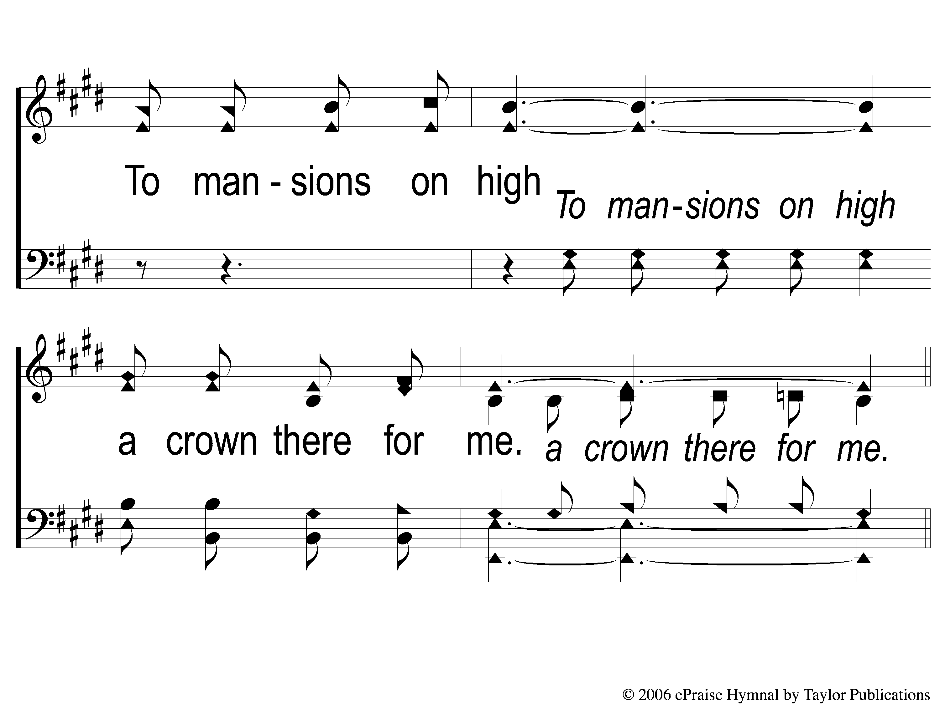
1-4 I Walk With the King
I Walk With The King
550

Slide 10
C-1 I Walk With the King
I Walk With The King
550

Slide 11
C-2 I Walk With the King
I Walk With The King
550

Slide 12
C-3 I Walk With the King
I Walk With The King
550

Slide 13
C-4 I Walk With the King
I Walk With The King
550

Slide 14
3-1 I Walk With the King
I Walk With The King
550

Slide 15
3-2 I Walk With the King
I Walk With The King
550

Slide 16
3-3 I Walk With the King
I Walk With The King
550

Slide 17
3-4 I Walk With the King
I Walk With The King
550

Slide 18
C-1 I Walk With the King
I Walk With The King
550

Slide 19
C-2 I Walk With the King
I Walk With The King
550

Slide 20
C-3 I Walk With the King
I Walk With The King
550

Slide 21
C-4 I Walk With the King
I Walk With The King
550

Slide 22
Song:
In Moments Like These
#239

Slide 23
1-1 In Moments Like These
In Moments Like These
239

Slide 24
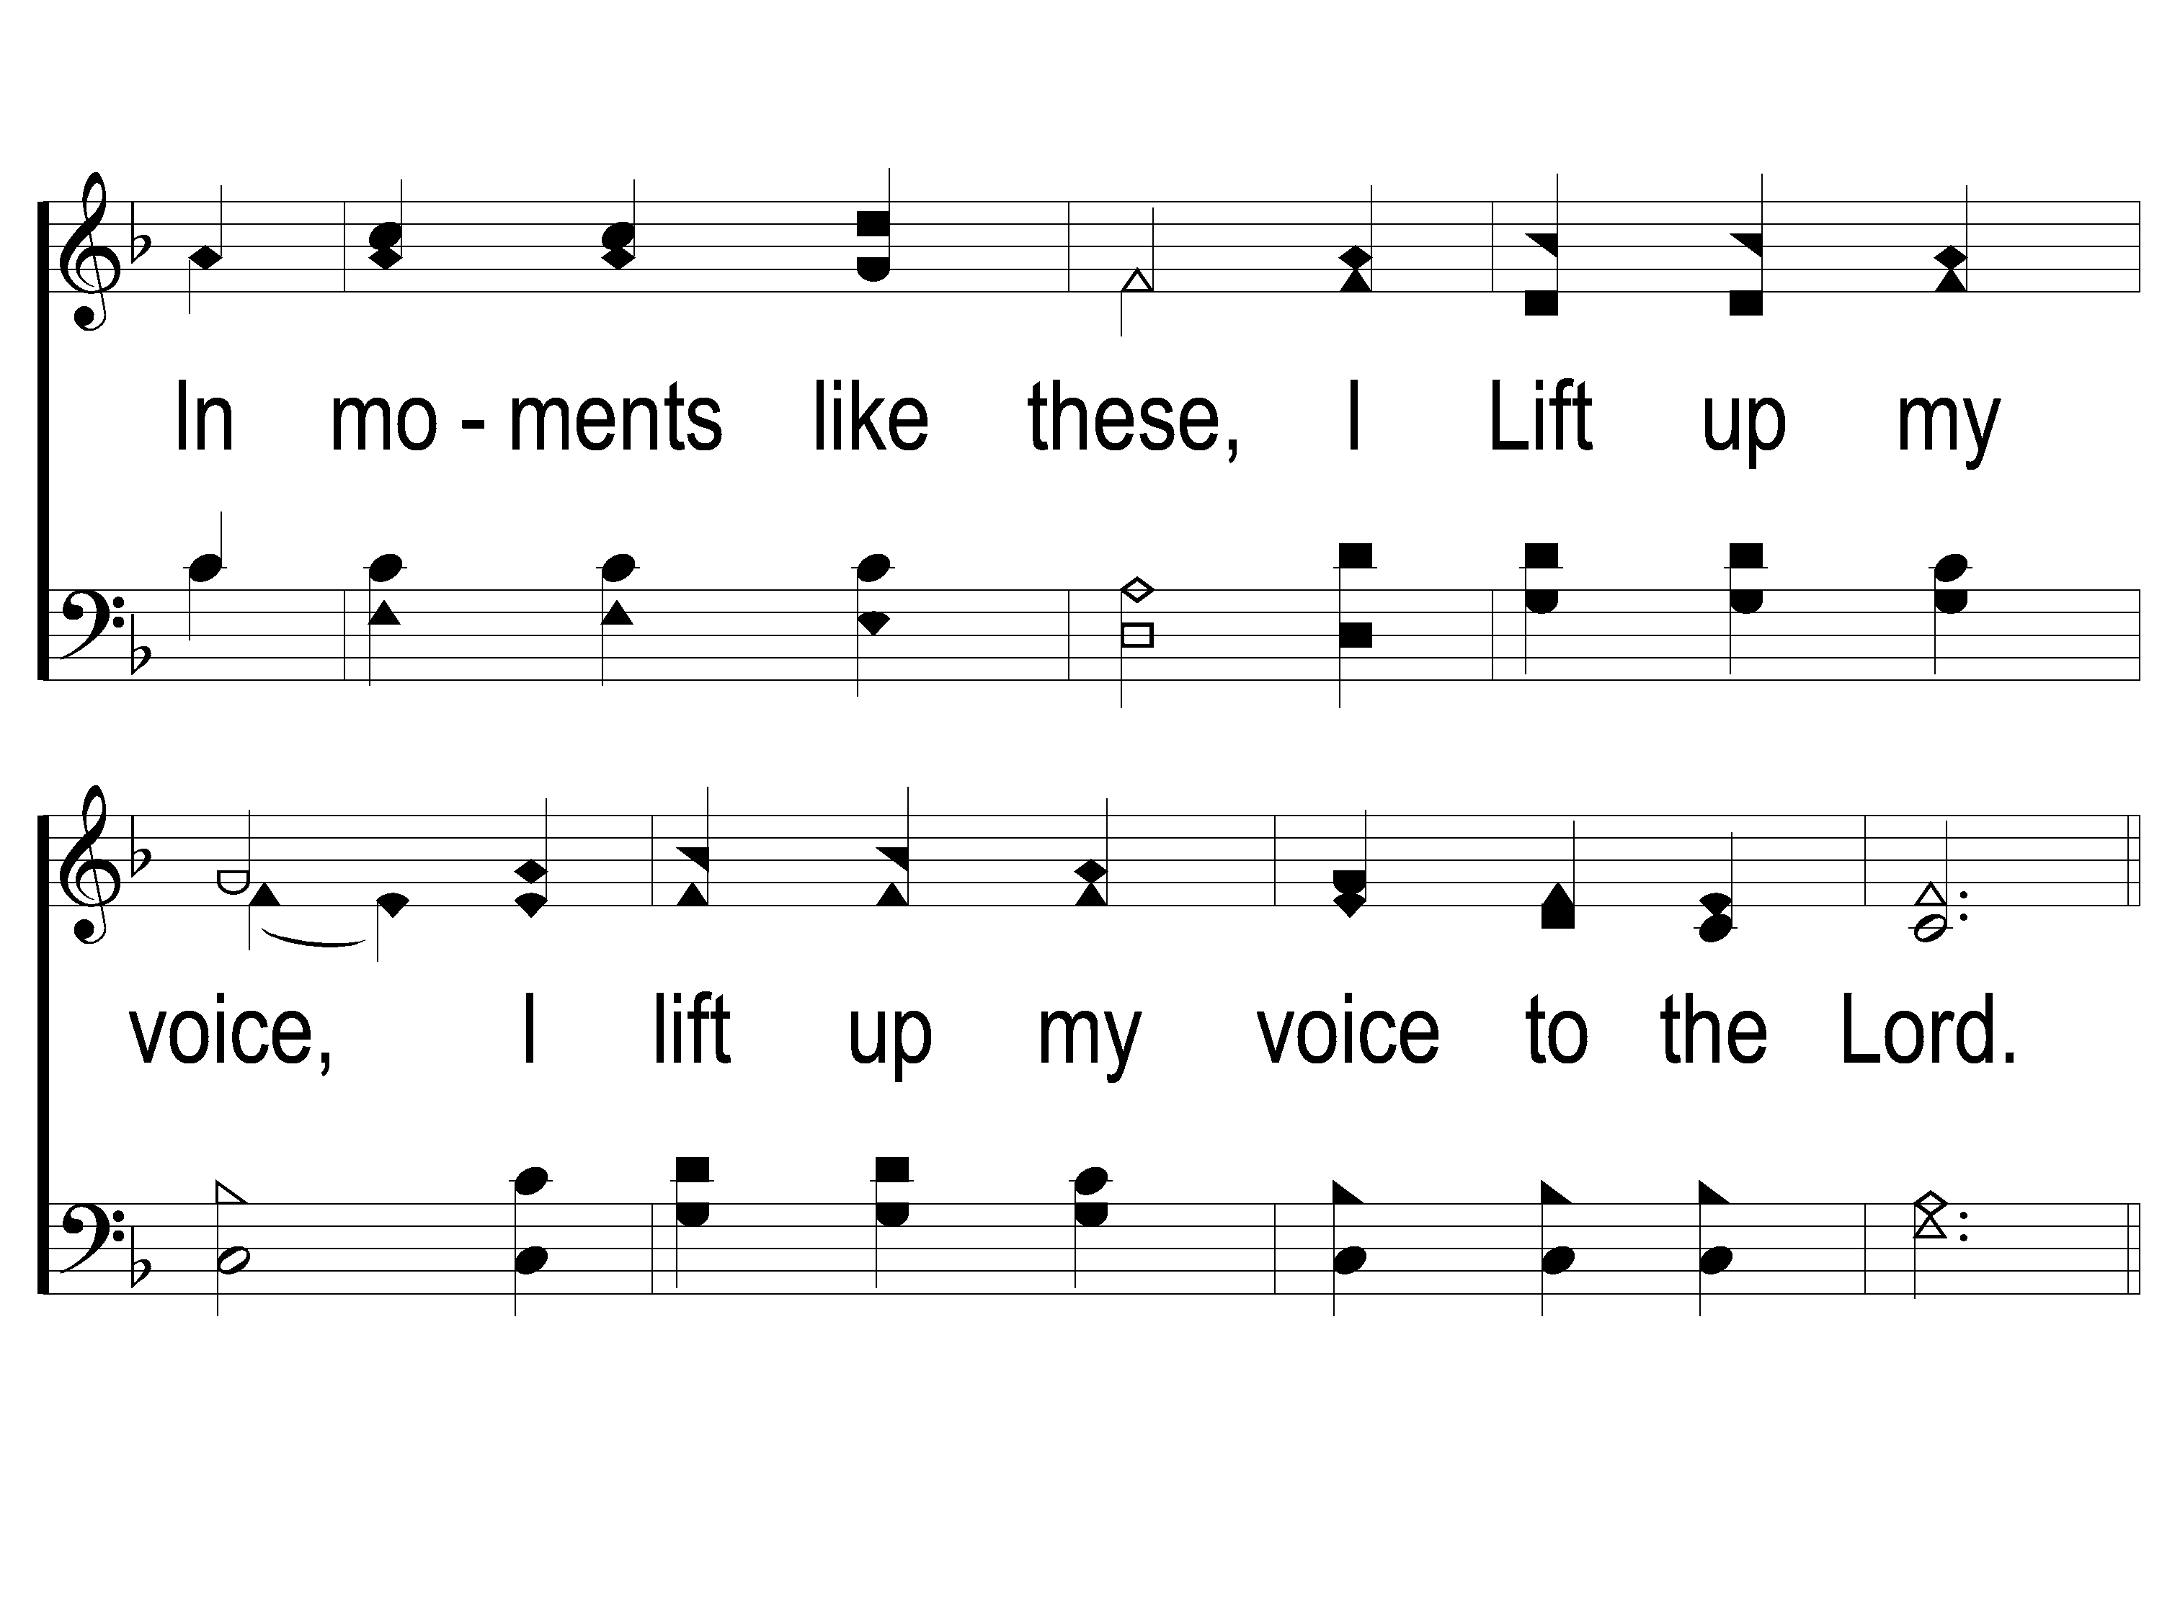
1-2 In Moments Like These
In Moments Like These
239

Slide 25
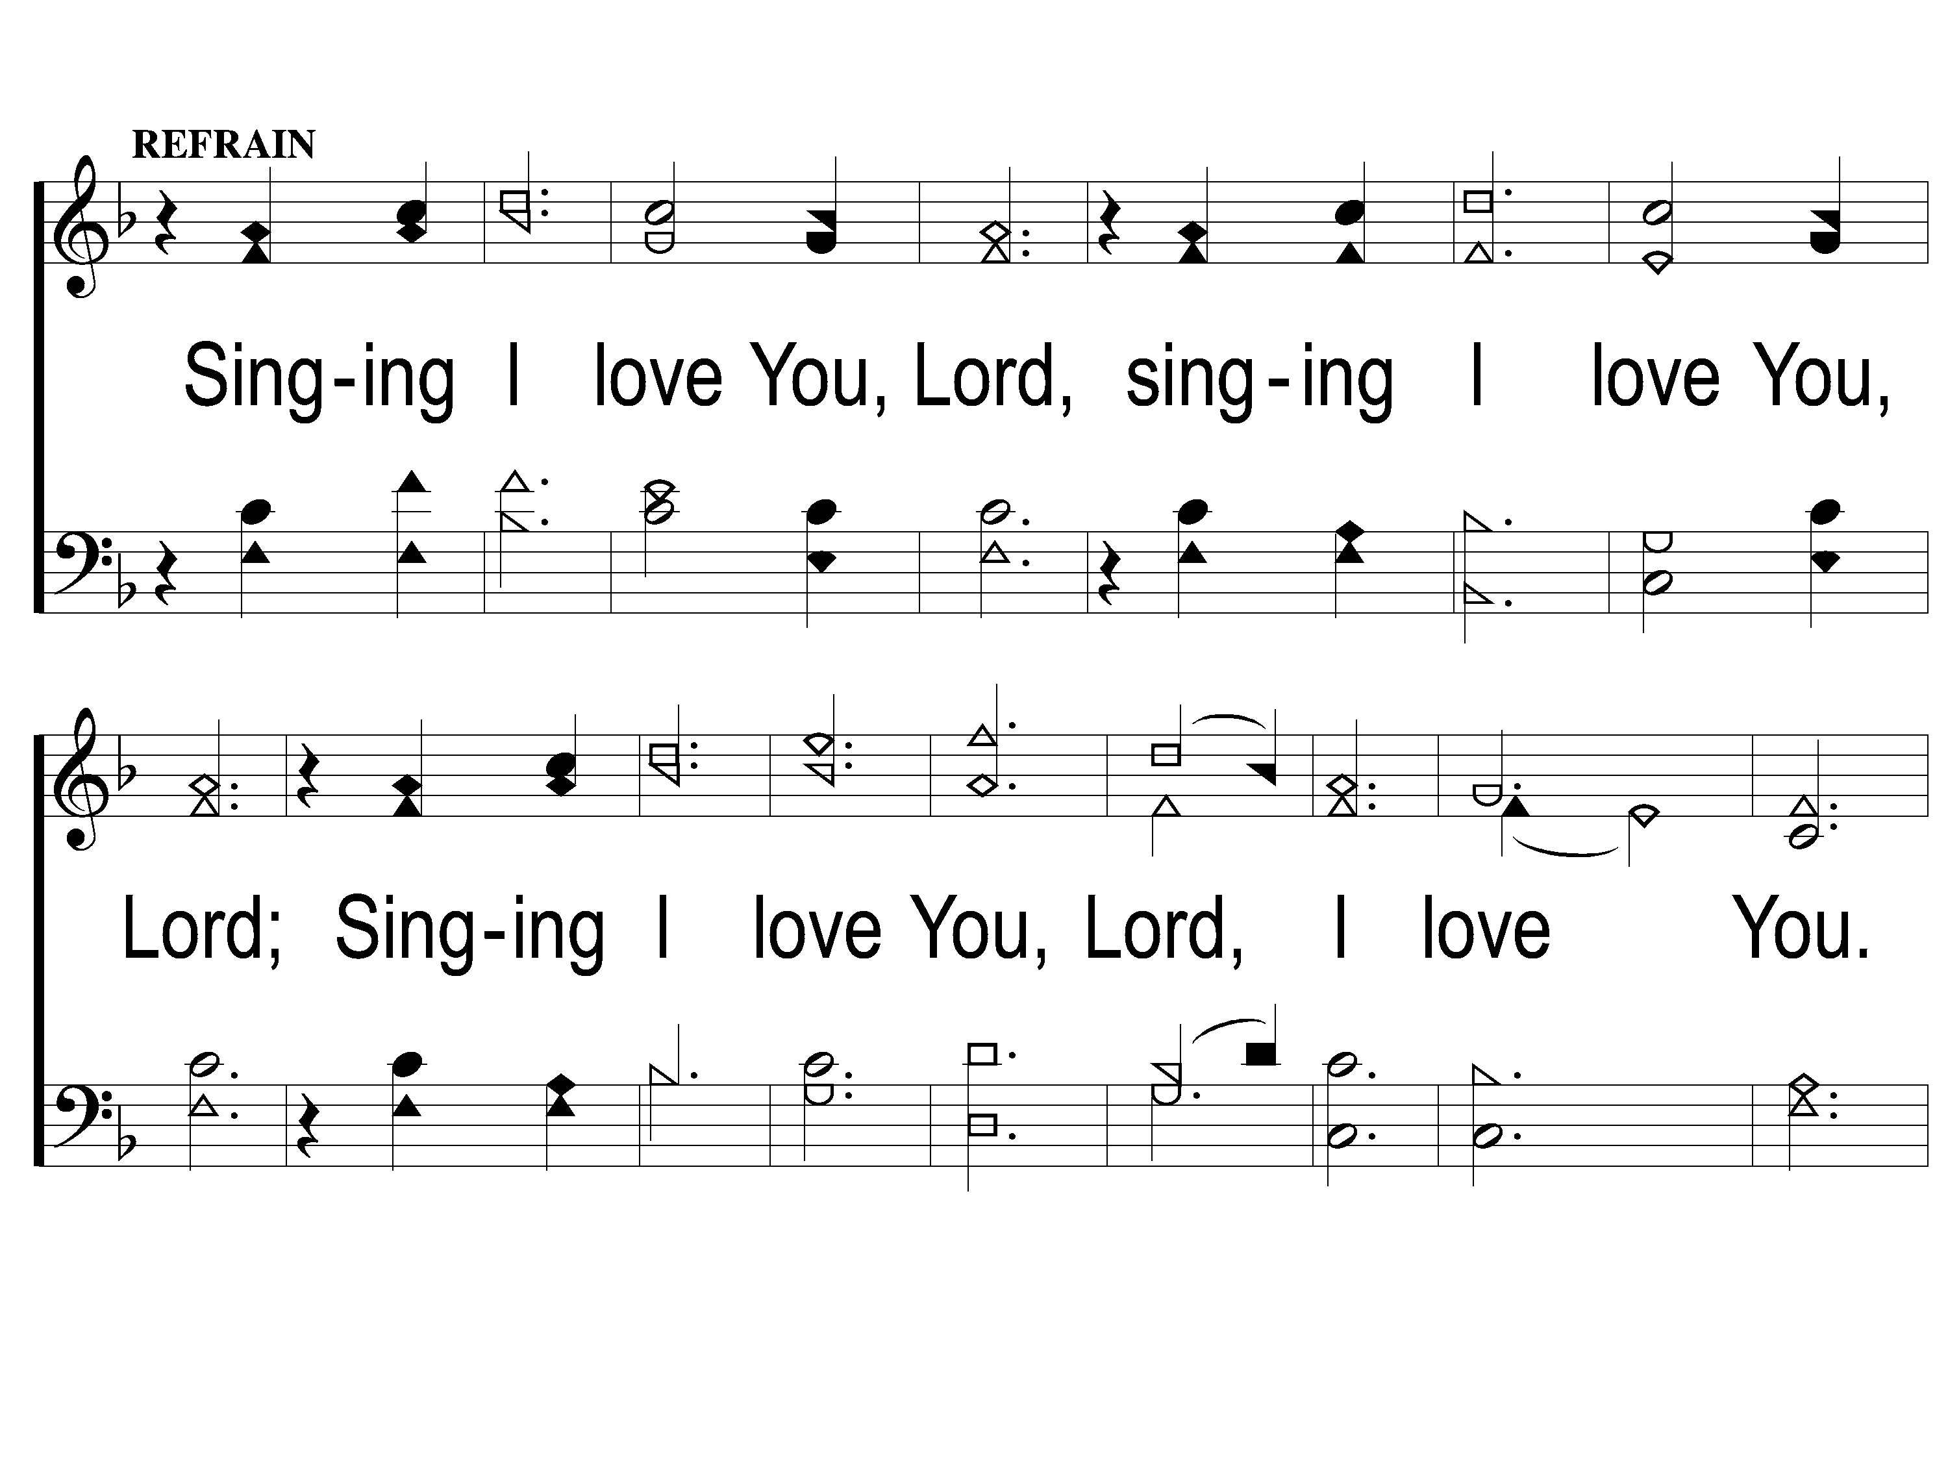
C-1 In Moments Like These
In Moments Like These
239

Slide 26
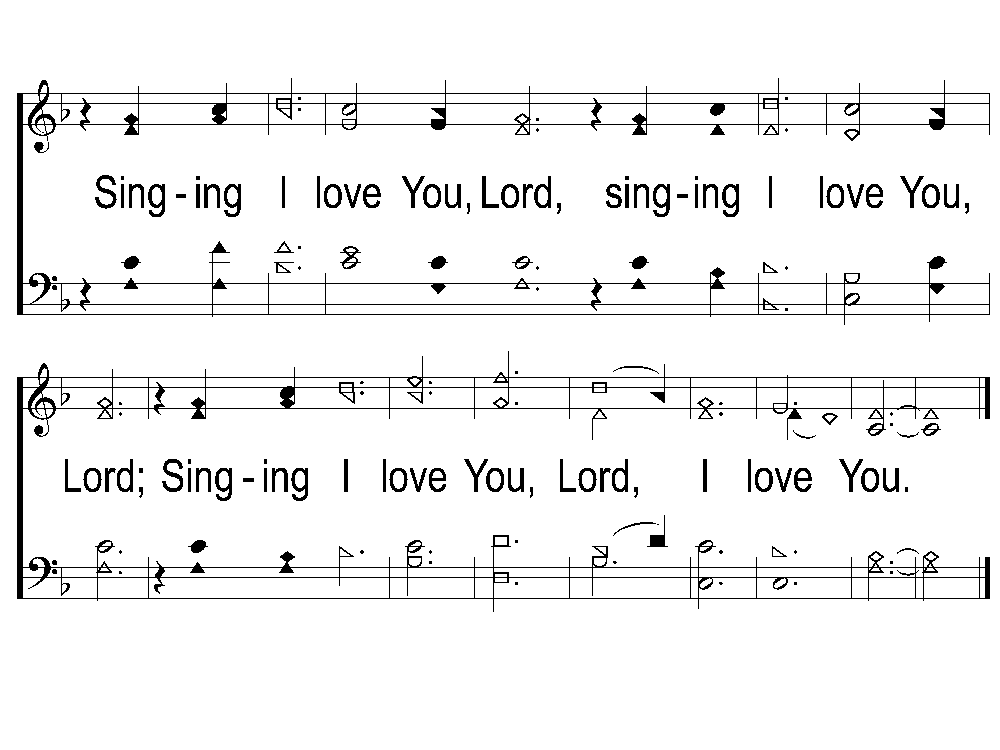
C-2 In Moments Like These
In Moments Like These
239

Slide 27
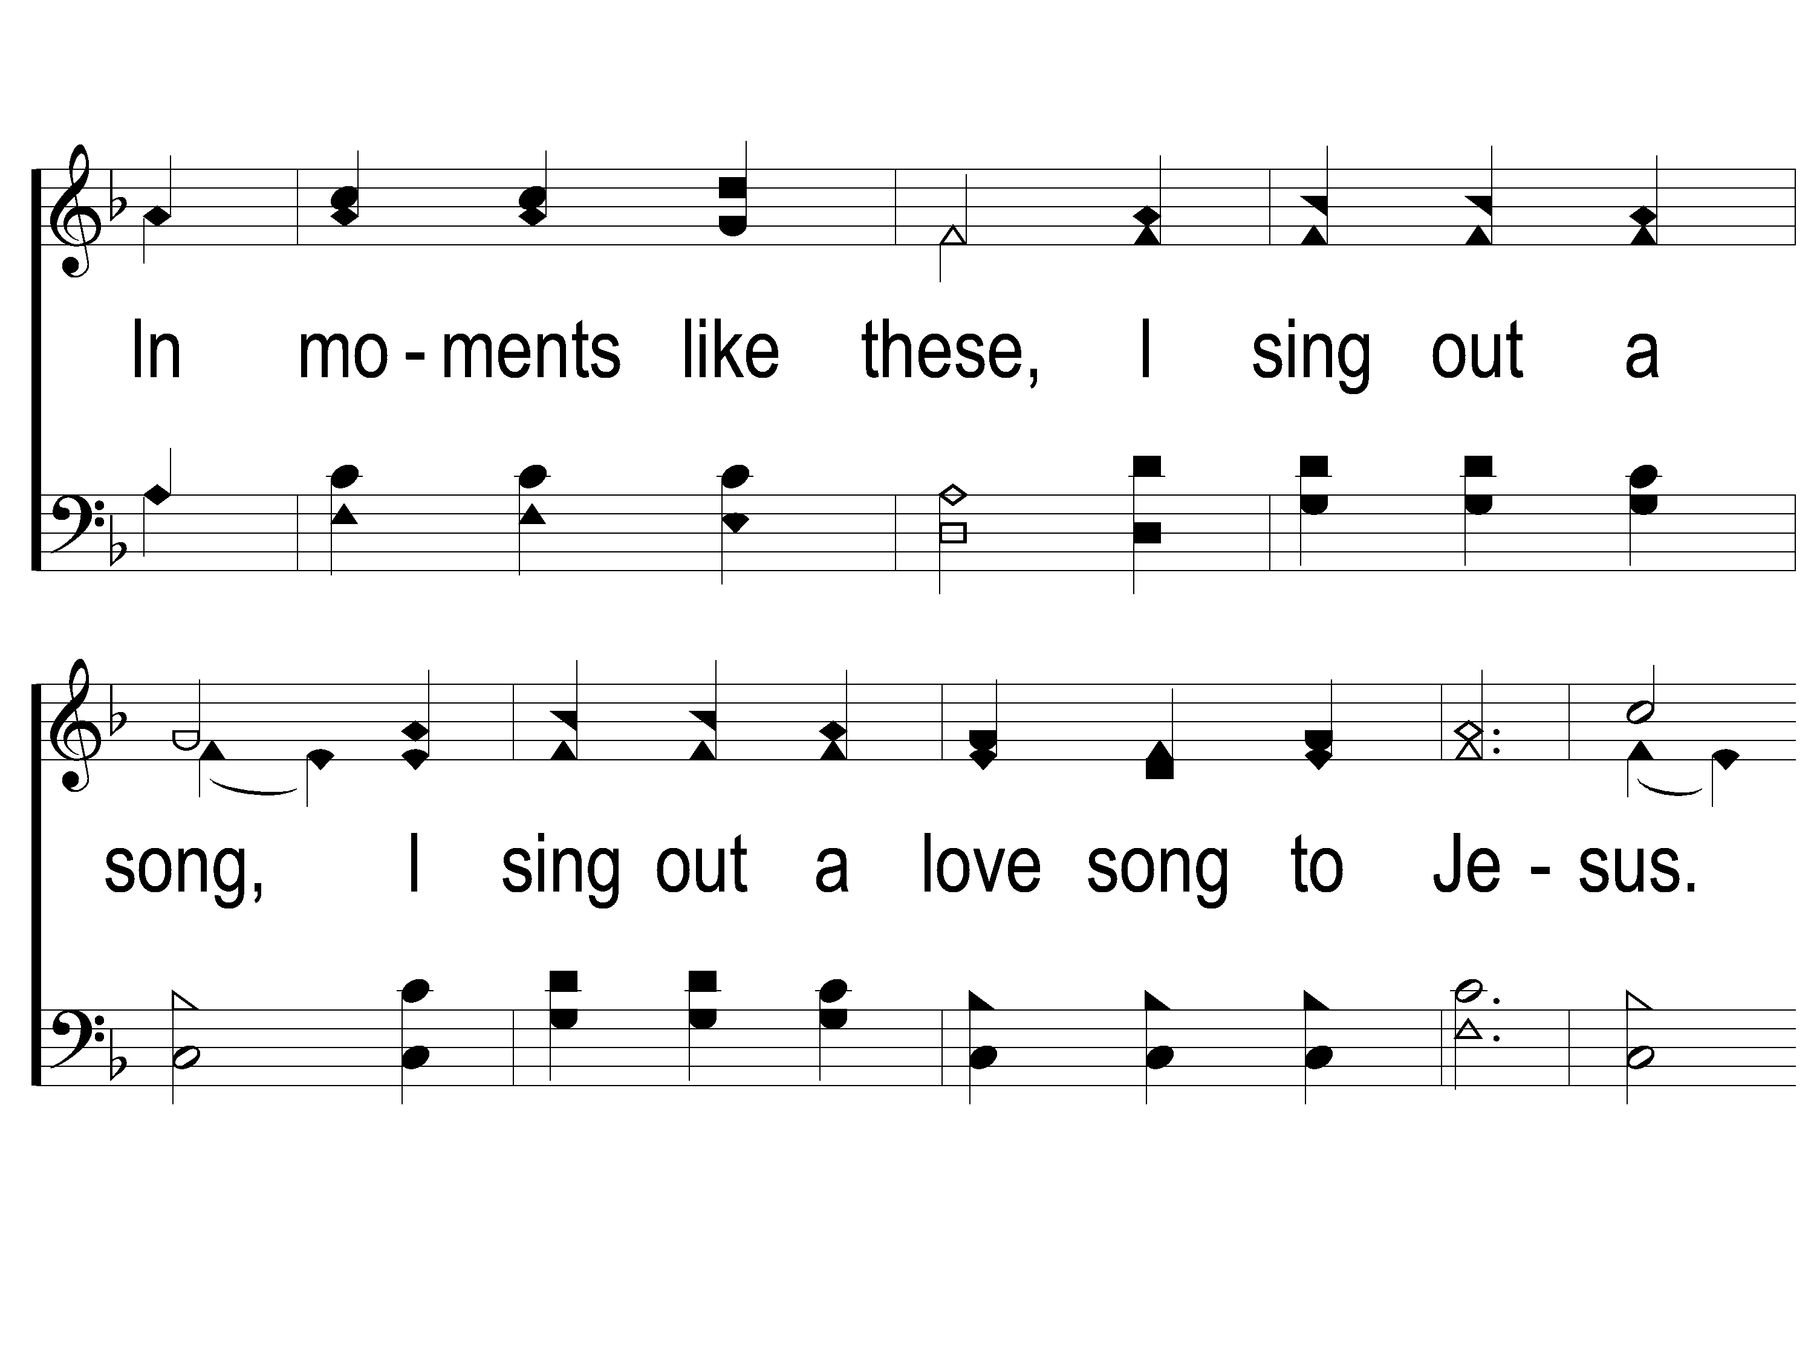
2-1 In Moments Like These
In Moments Like These
239

Slide 28
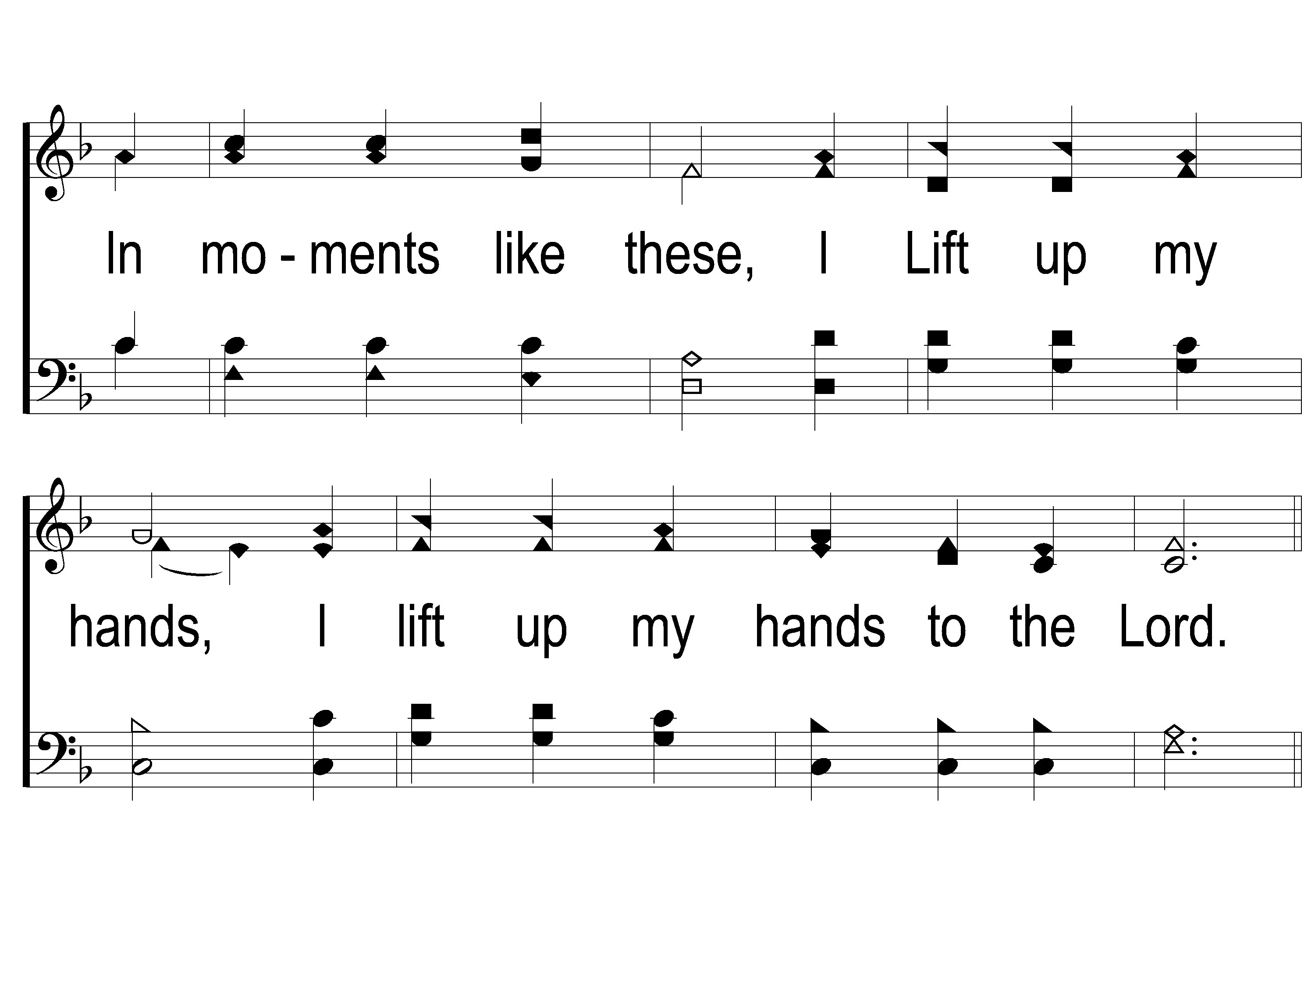
2-2 In Moments Like These
In Moments Like These
239

Slide 29
C-1 In Moments Like These
In Moments Like These
239

Slide 30
C-2 In Moments Like These
In Moments Like These
239

Slide 31
Opening Prayer

Slide 32
Song:
You’re The One
#294

Slide 33
1-1 You’re the One
You’re the One
294

Slide 34
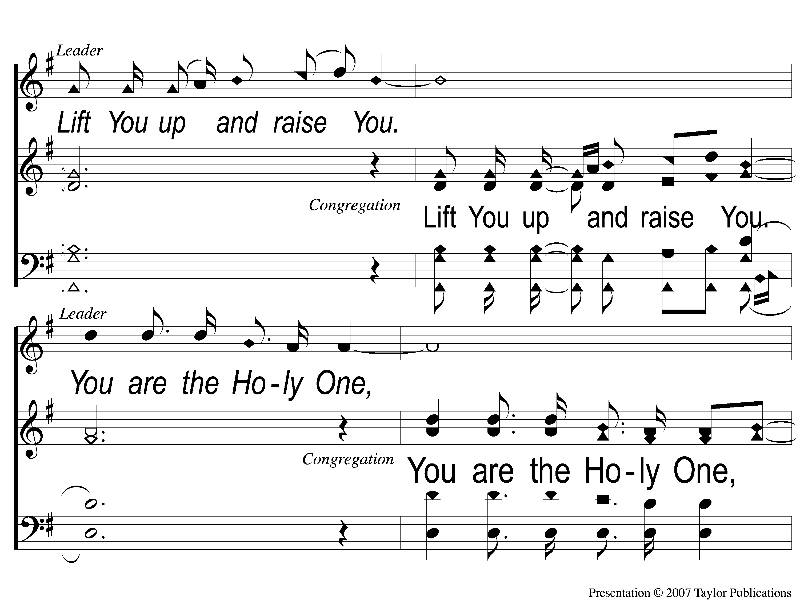
1-2 You’re the One
You’re the One
294

Slide 35
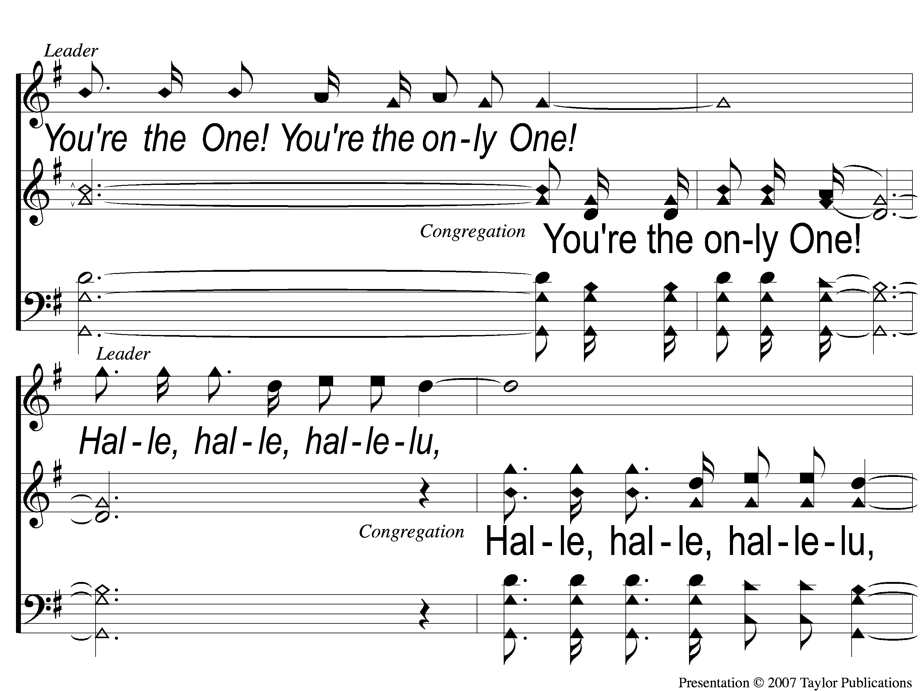
1-3 You’re the One
You’re the One
294

Slide 36
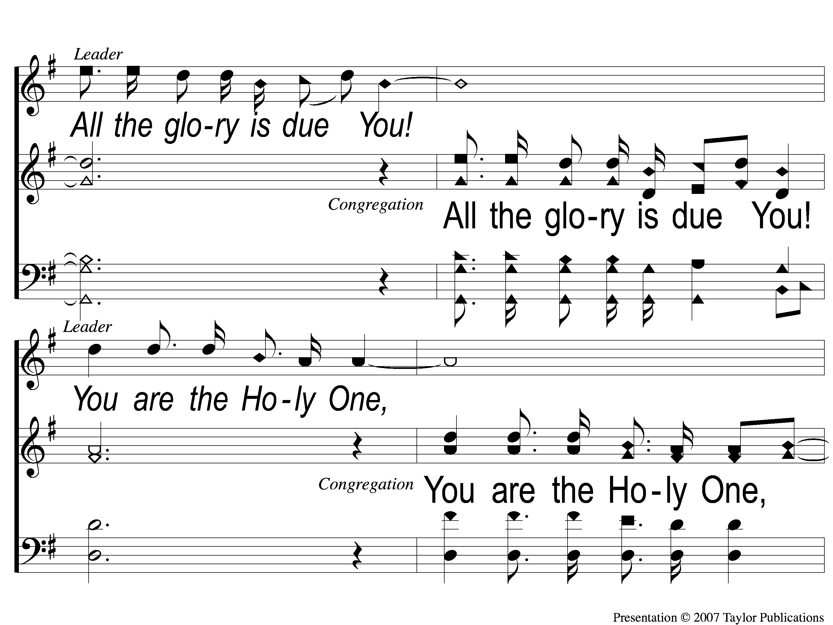
1-4 You’re the One
You’re the One
294

Slide 37
1-5 You’re the One
You’re the One
294

Slide 38
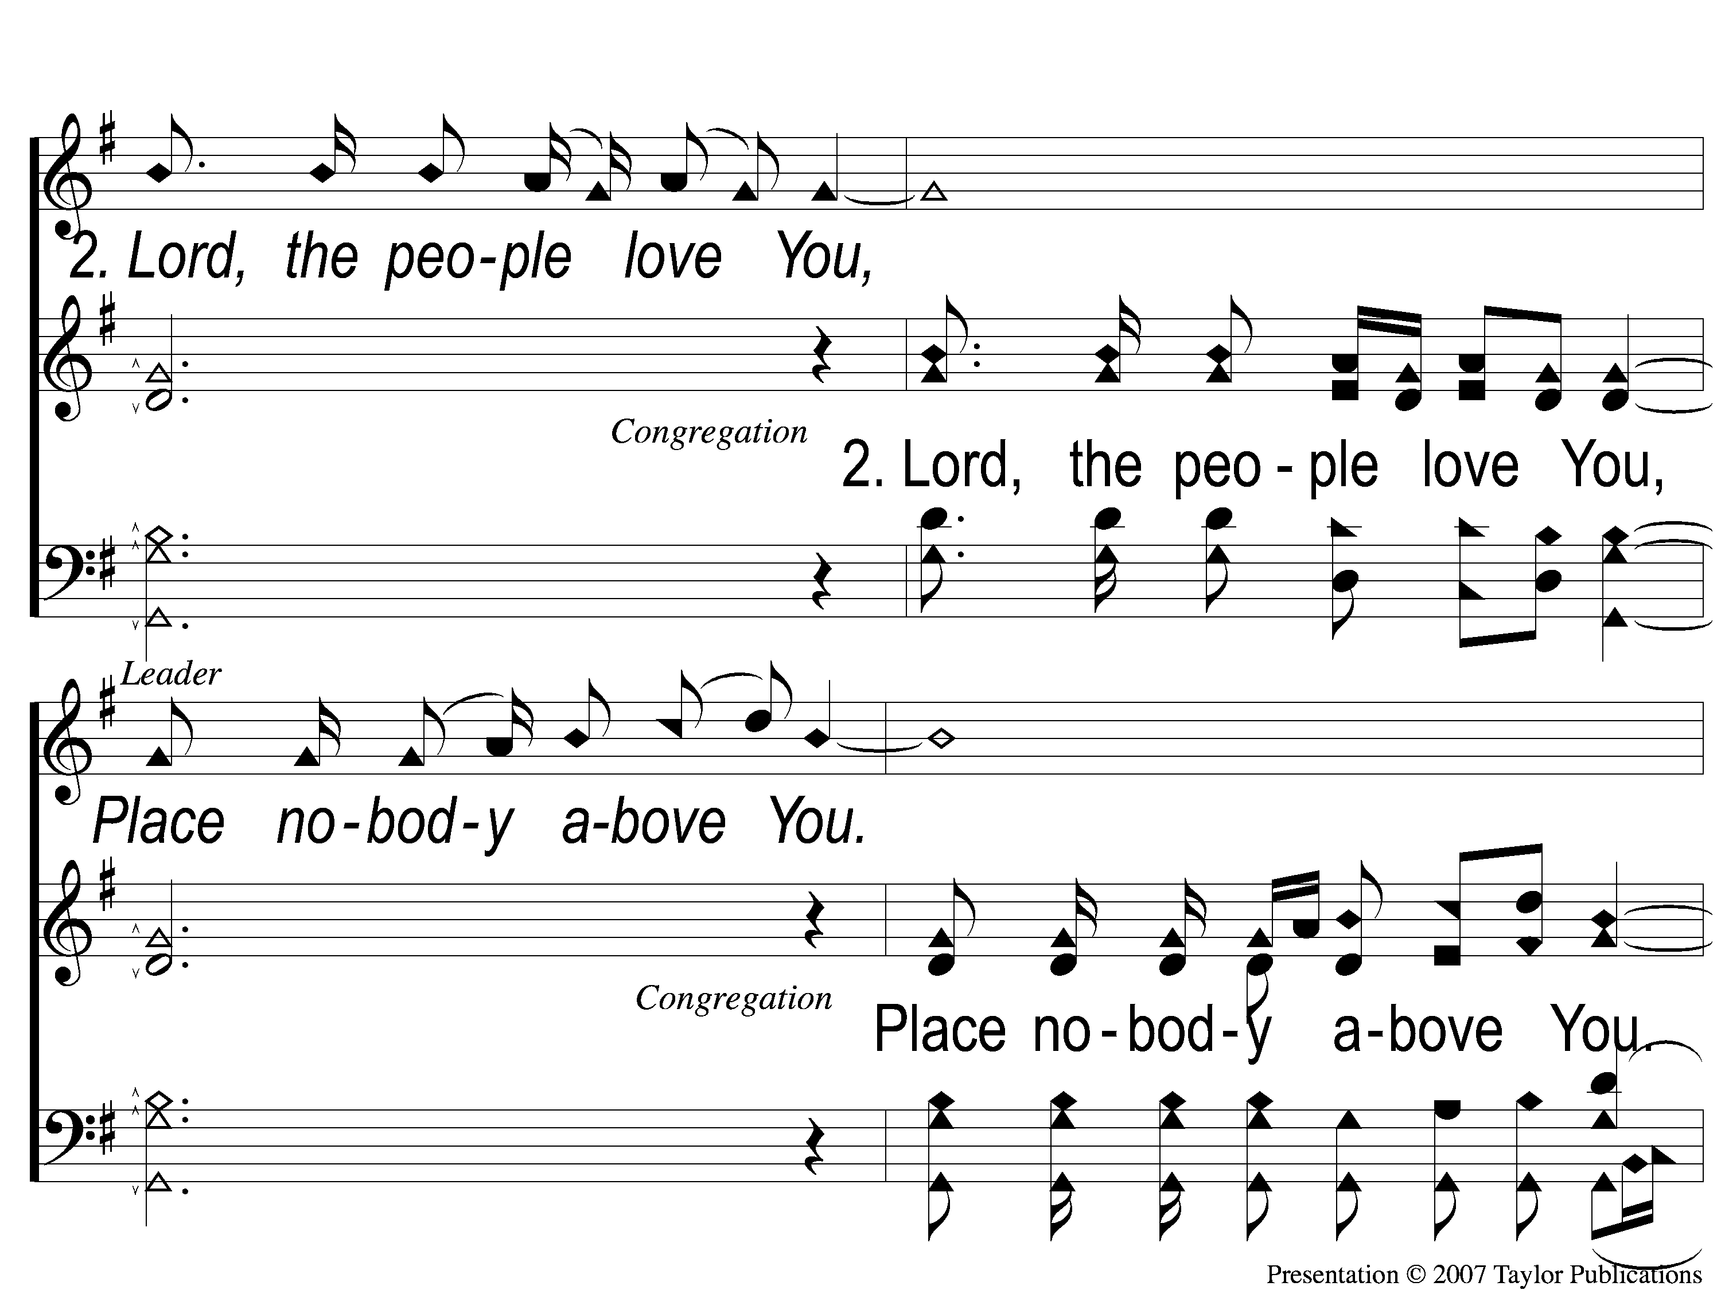
2-1 You’re the One
You’re the One
294

Slide 39
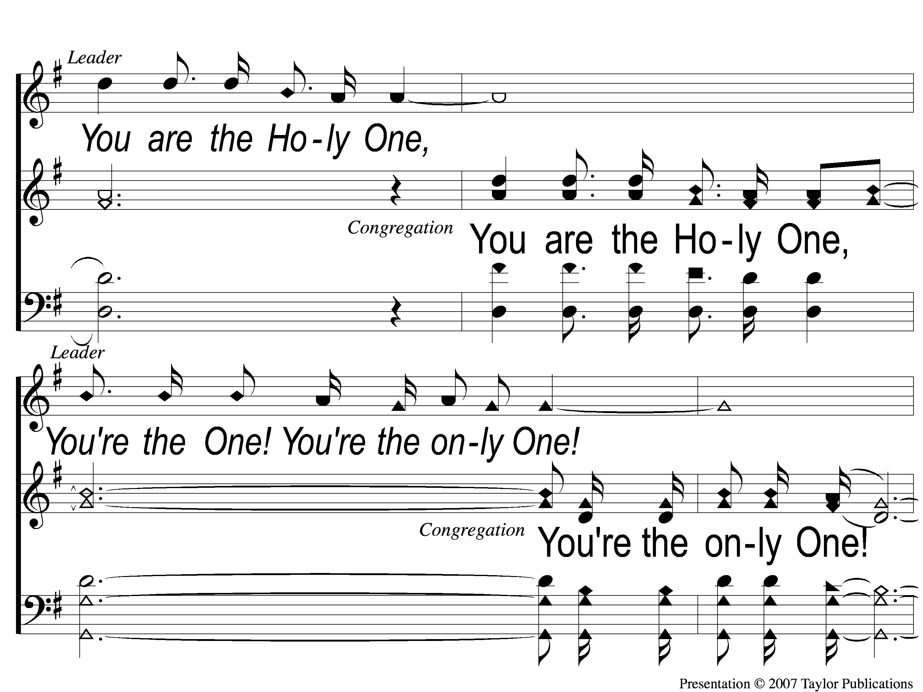
2-2 You’re the One
You’re the One
294

Slide 40
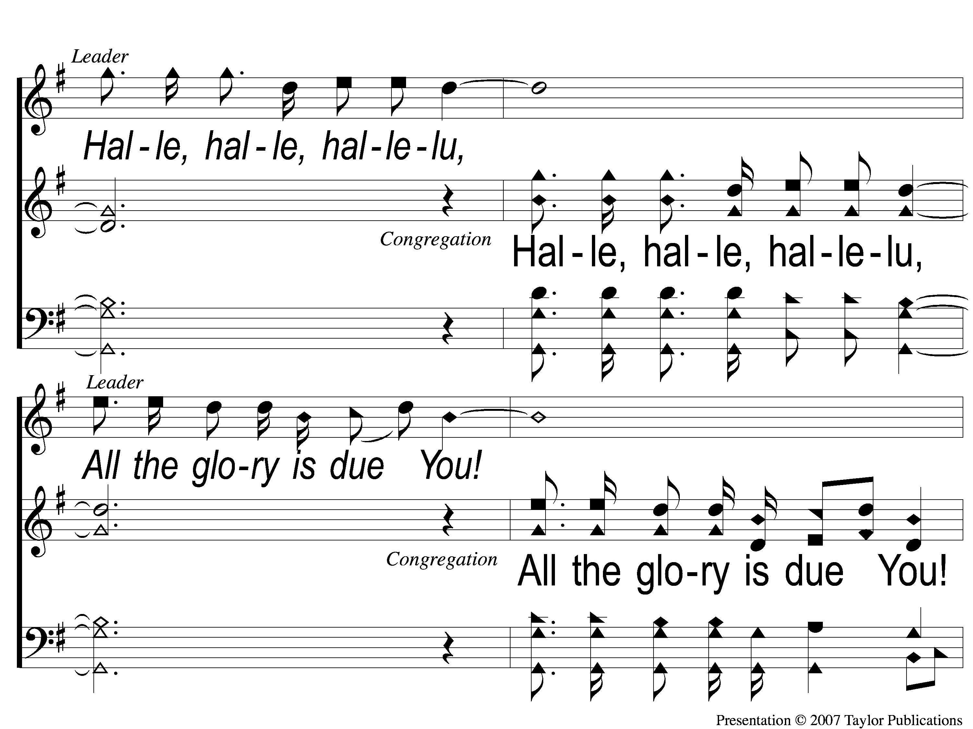
2-3 You’re the One
You’re the One
294

Slide 41
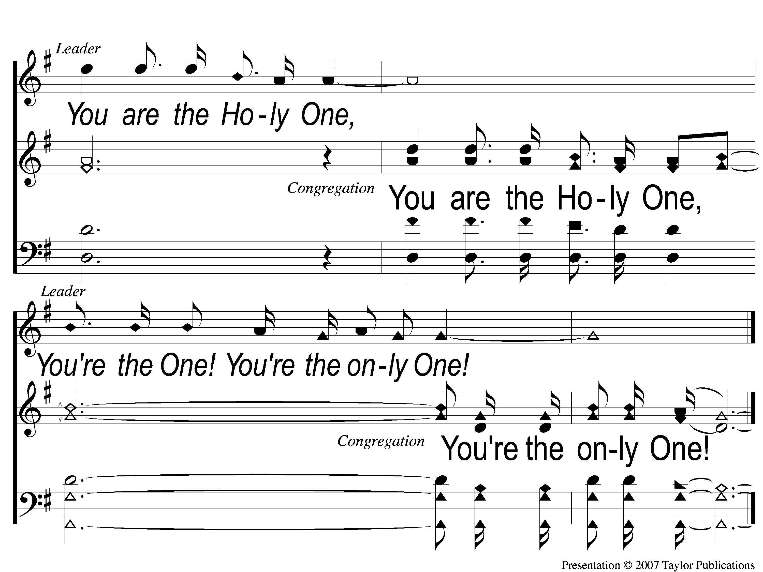
2-4 You’re the One
You’re the One
294

Slide 42
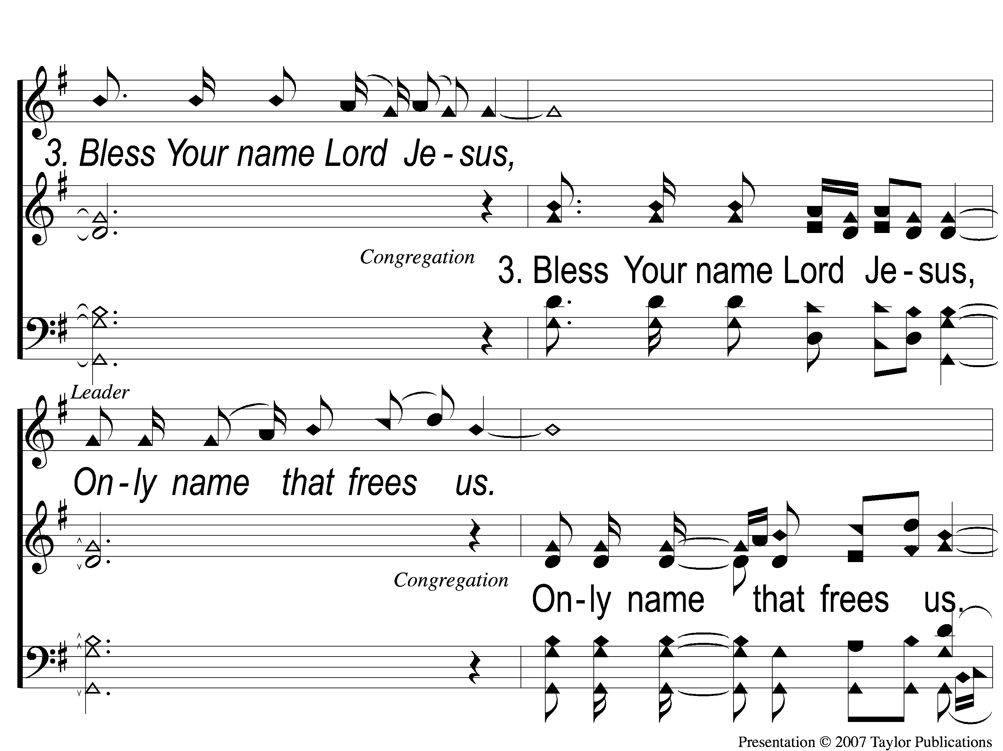
3-1 You’re the One
You’re the One
294

Slide 43
3-2 You’re the One
You’re the One
294

Slide 44
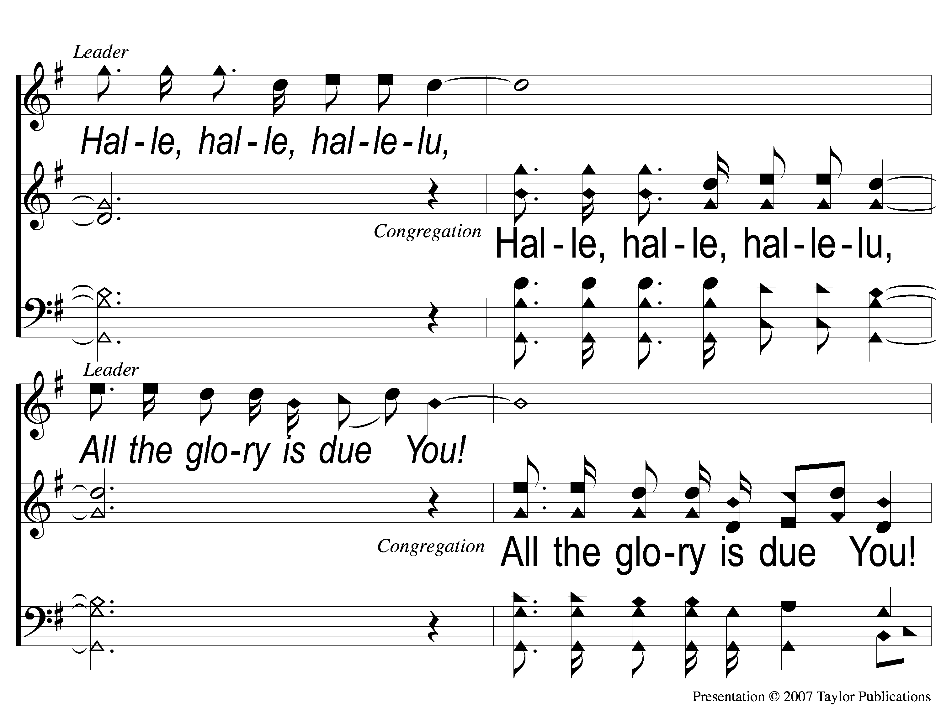
3-3 You’re the One
You’re the One
294

Slide 45
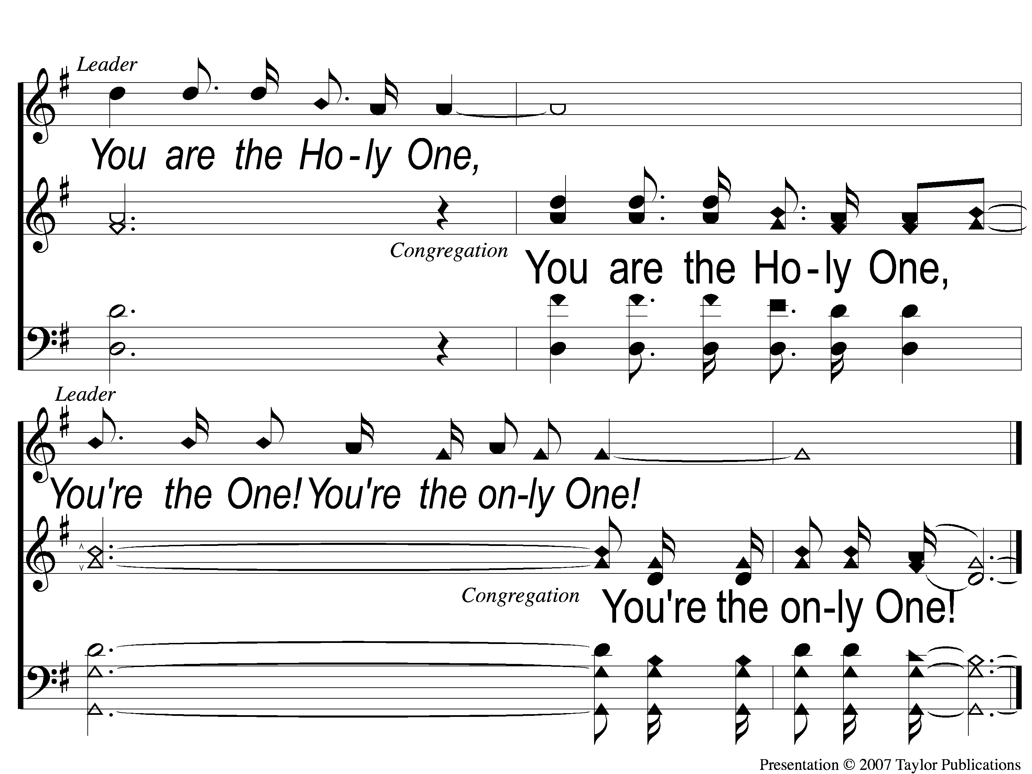
3-4 You’re the One
You’re the One
294

Slide 46
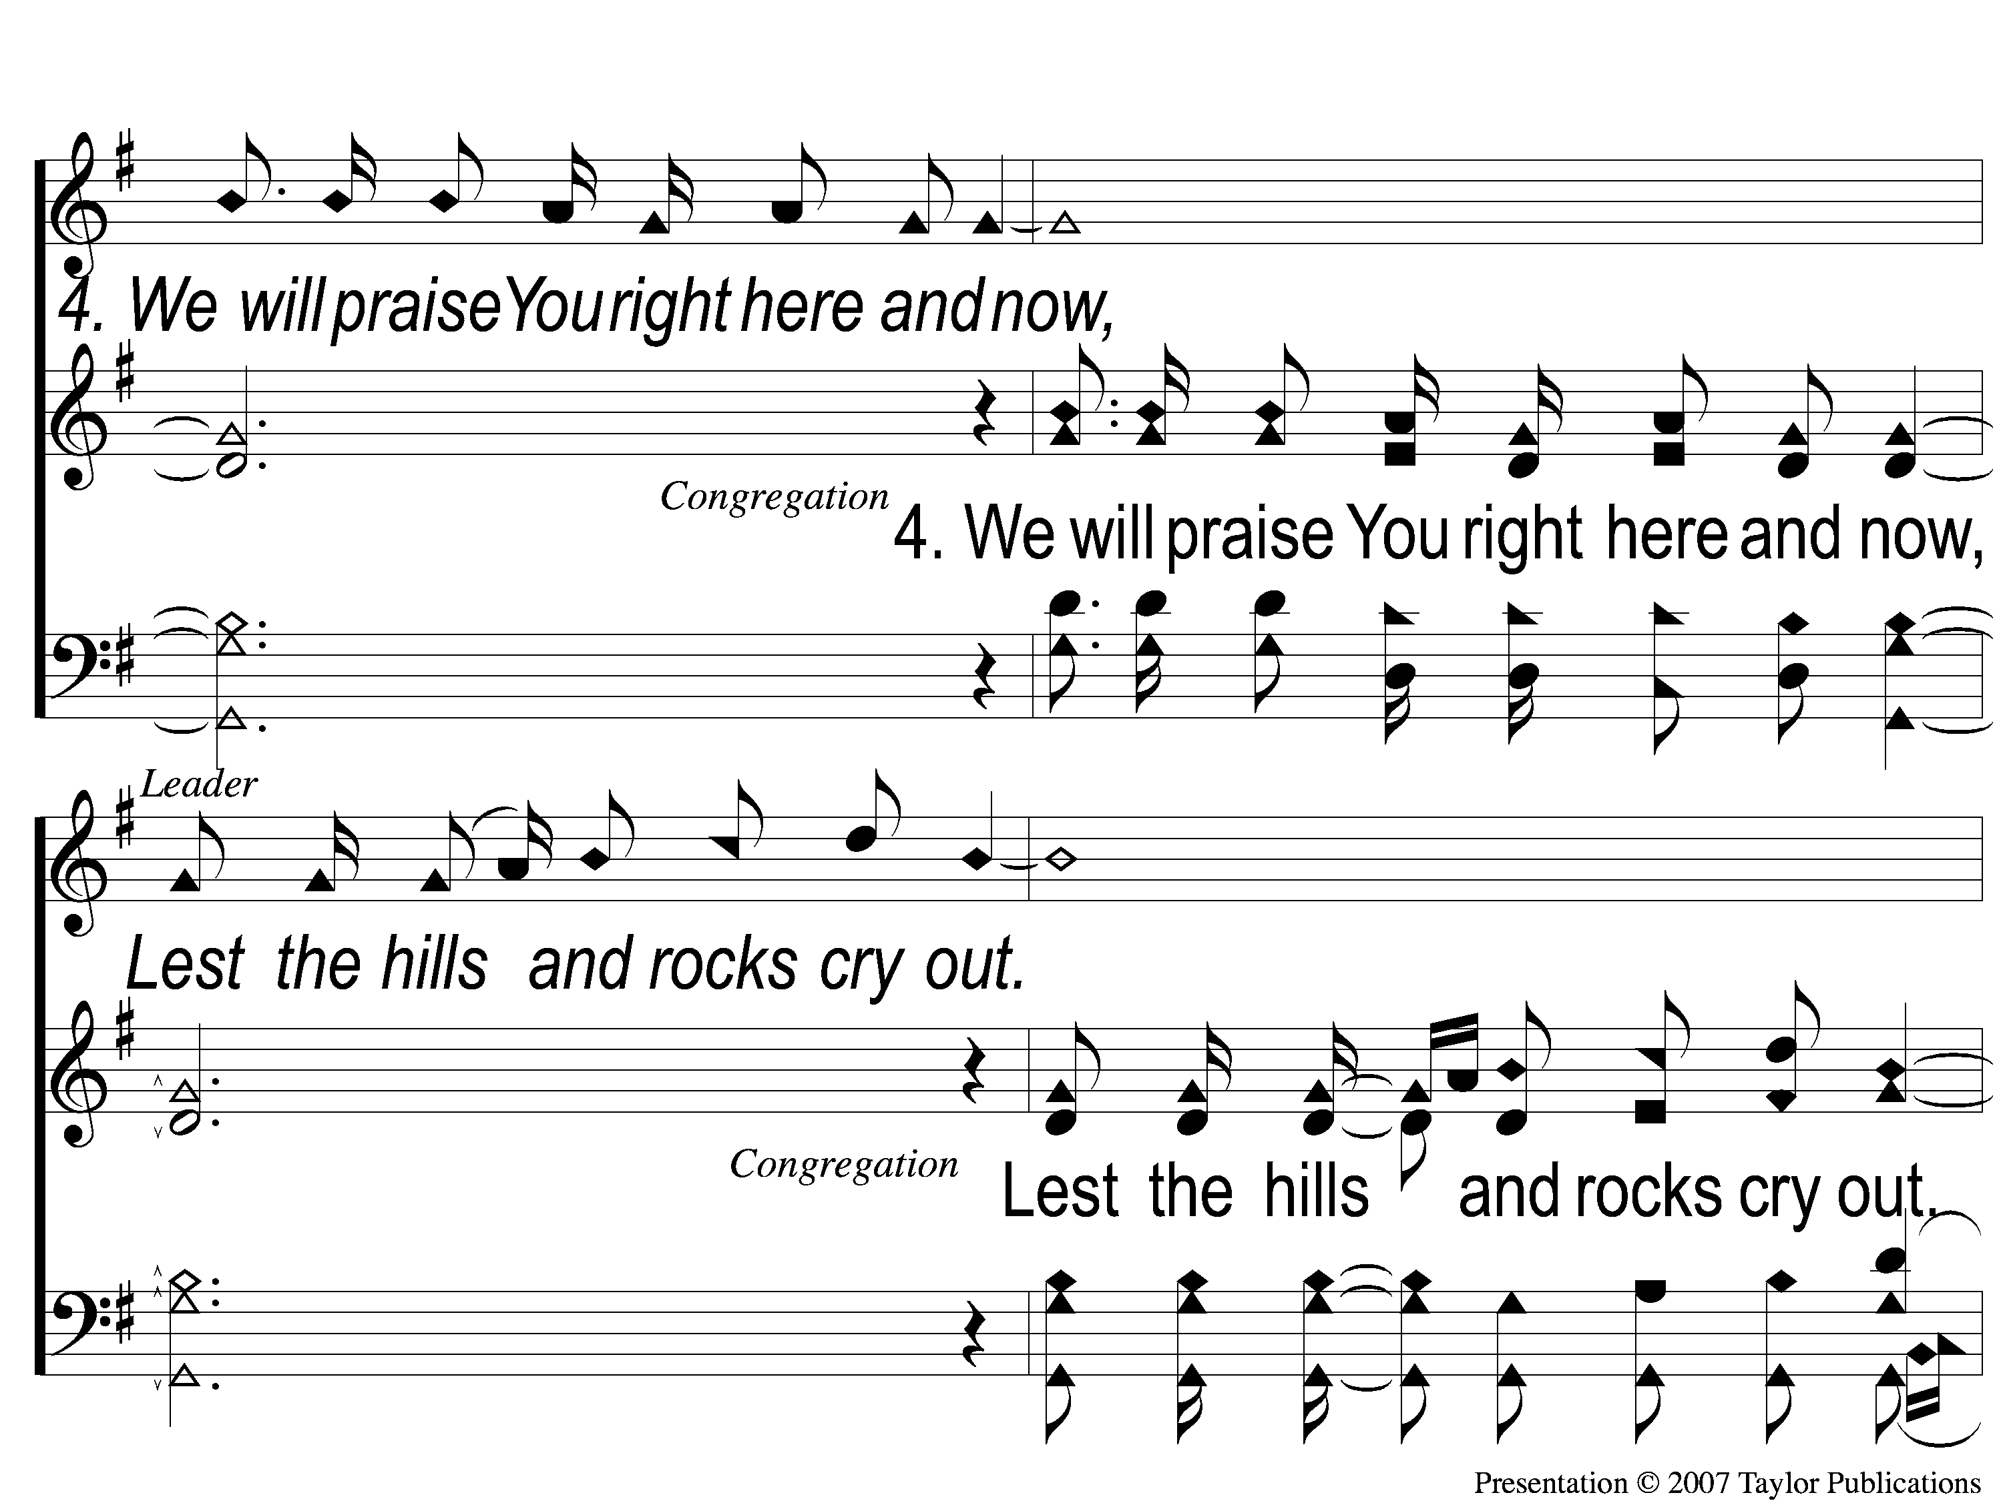
4-1 You’re the One
You’re the One
294

Slide 47
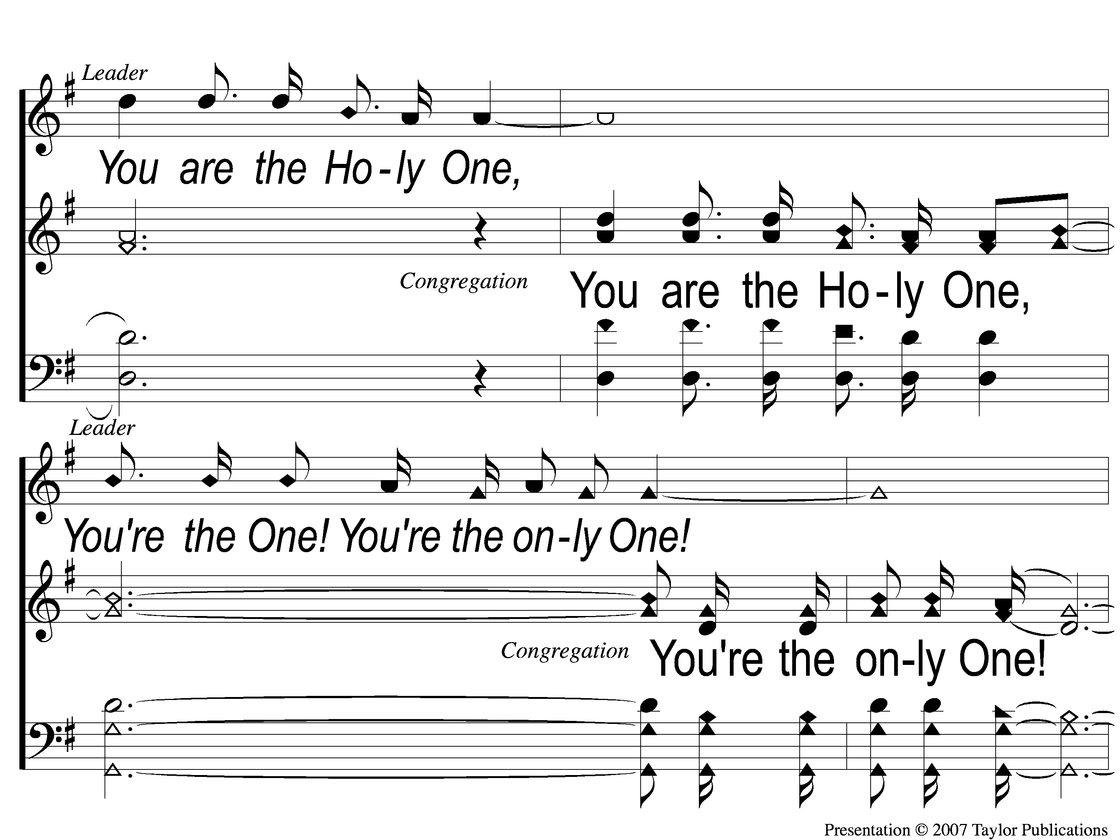
4-2 You’re the One
You’re the One
294

Slide 48
4-3 You’re the One
You’re the One
294

Slide 49
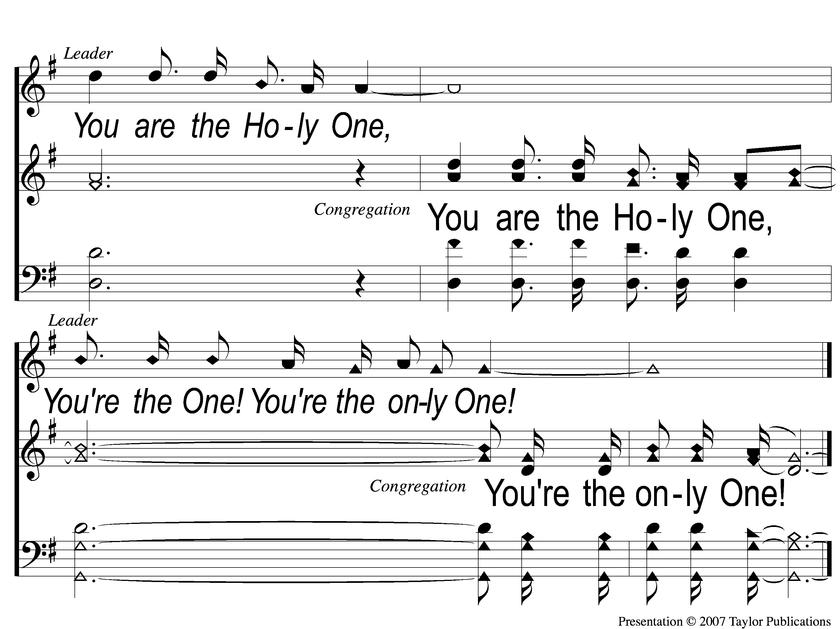
4-4 You’re the One
You’re the One
294

Slide 50
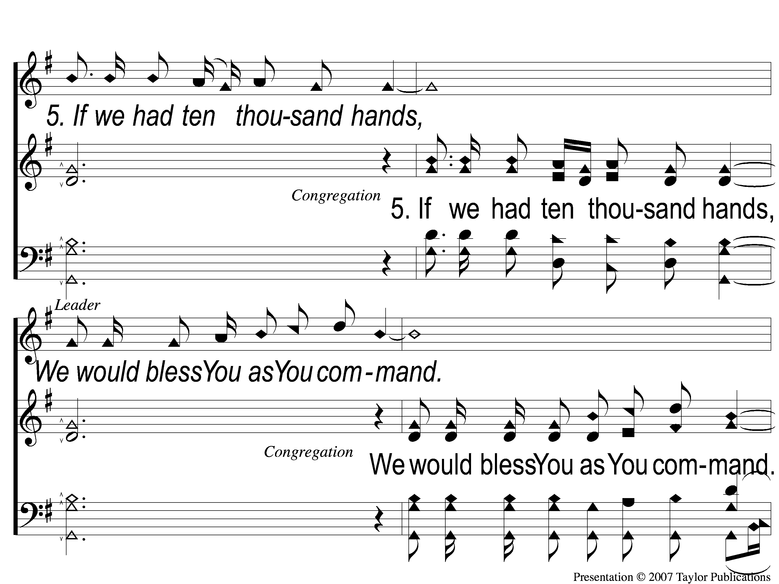
5-1 You’re the One
You’re the One
294

Slide 51
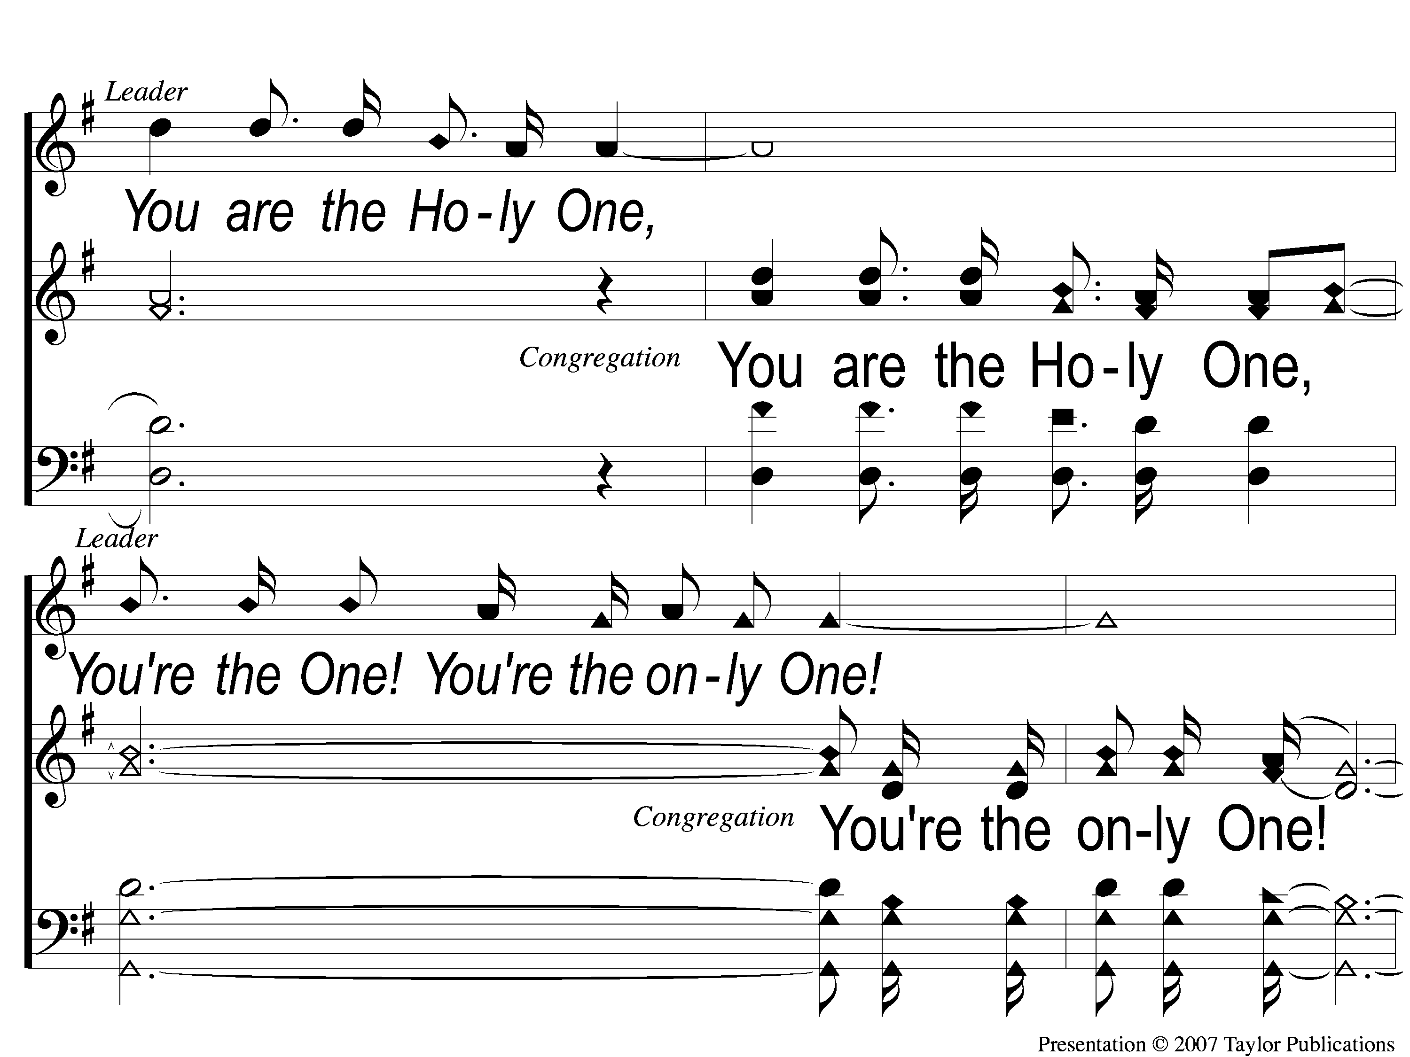
5-2 You’re the One
You’re the One
294
You’re the One

Slide 52
5-3 You’re the One
You’re the One
294

Slide 53
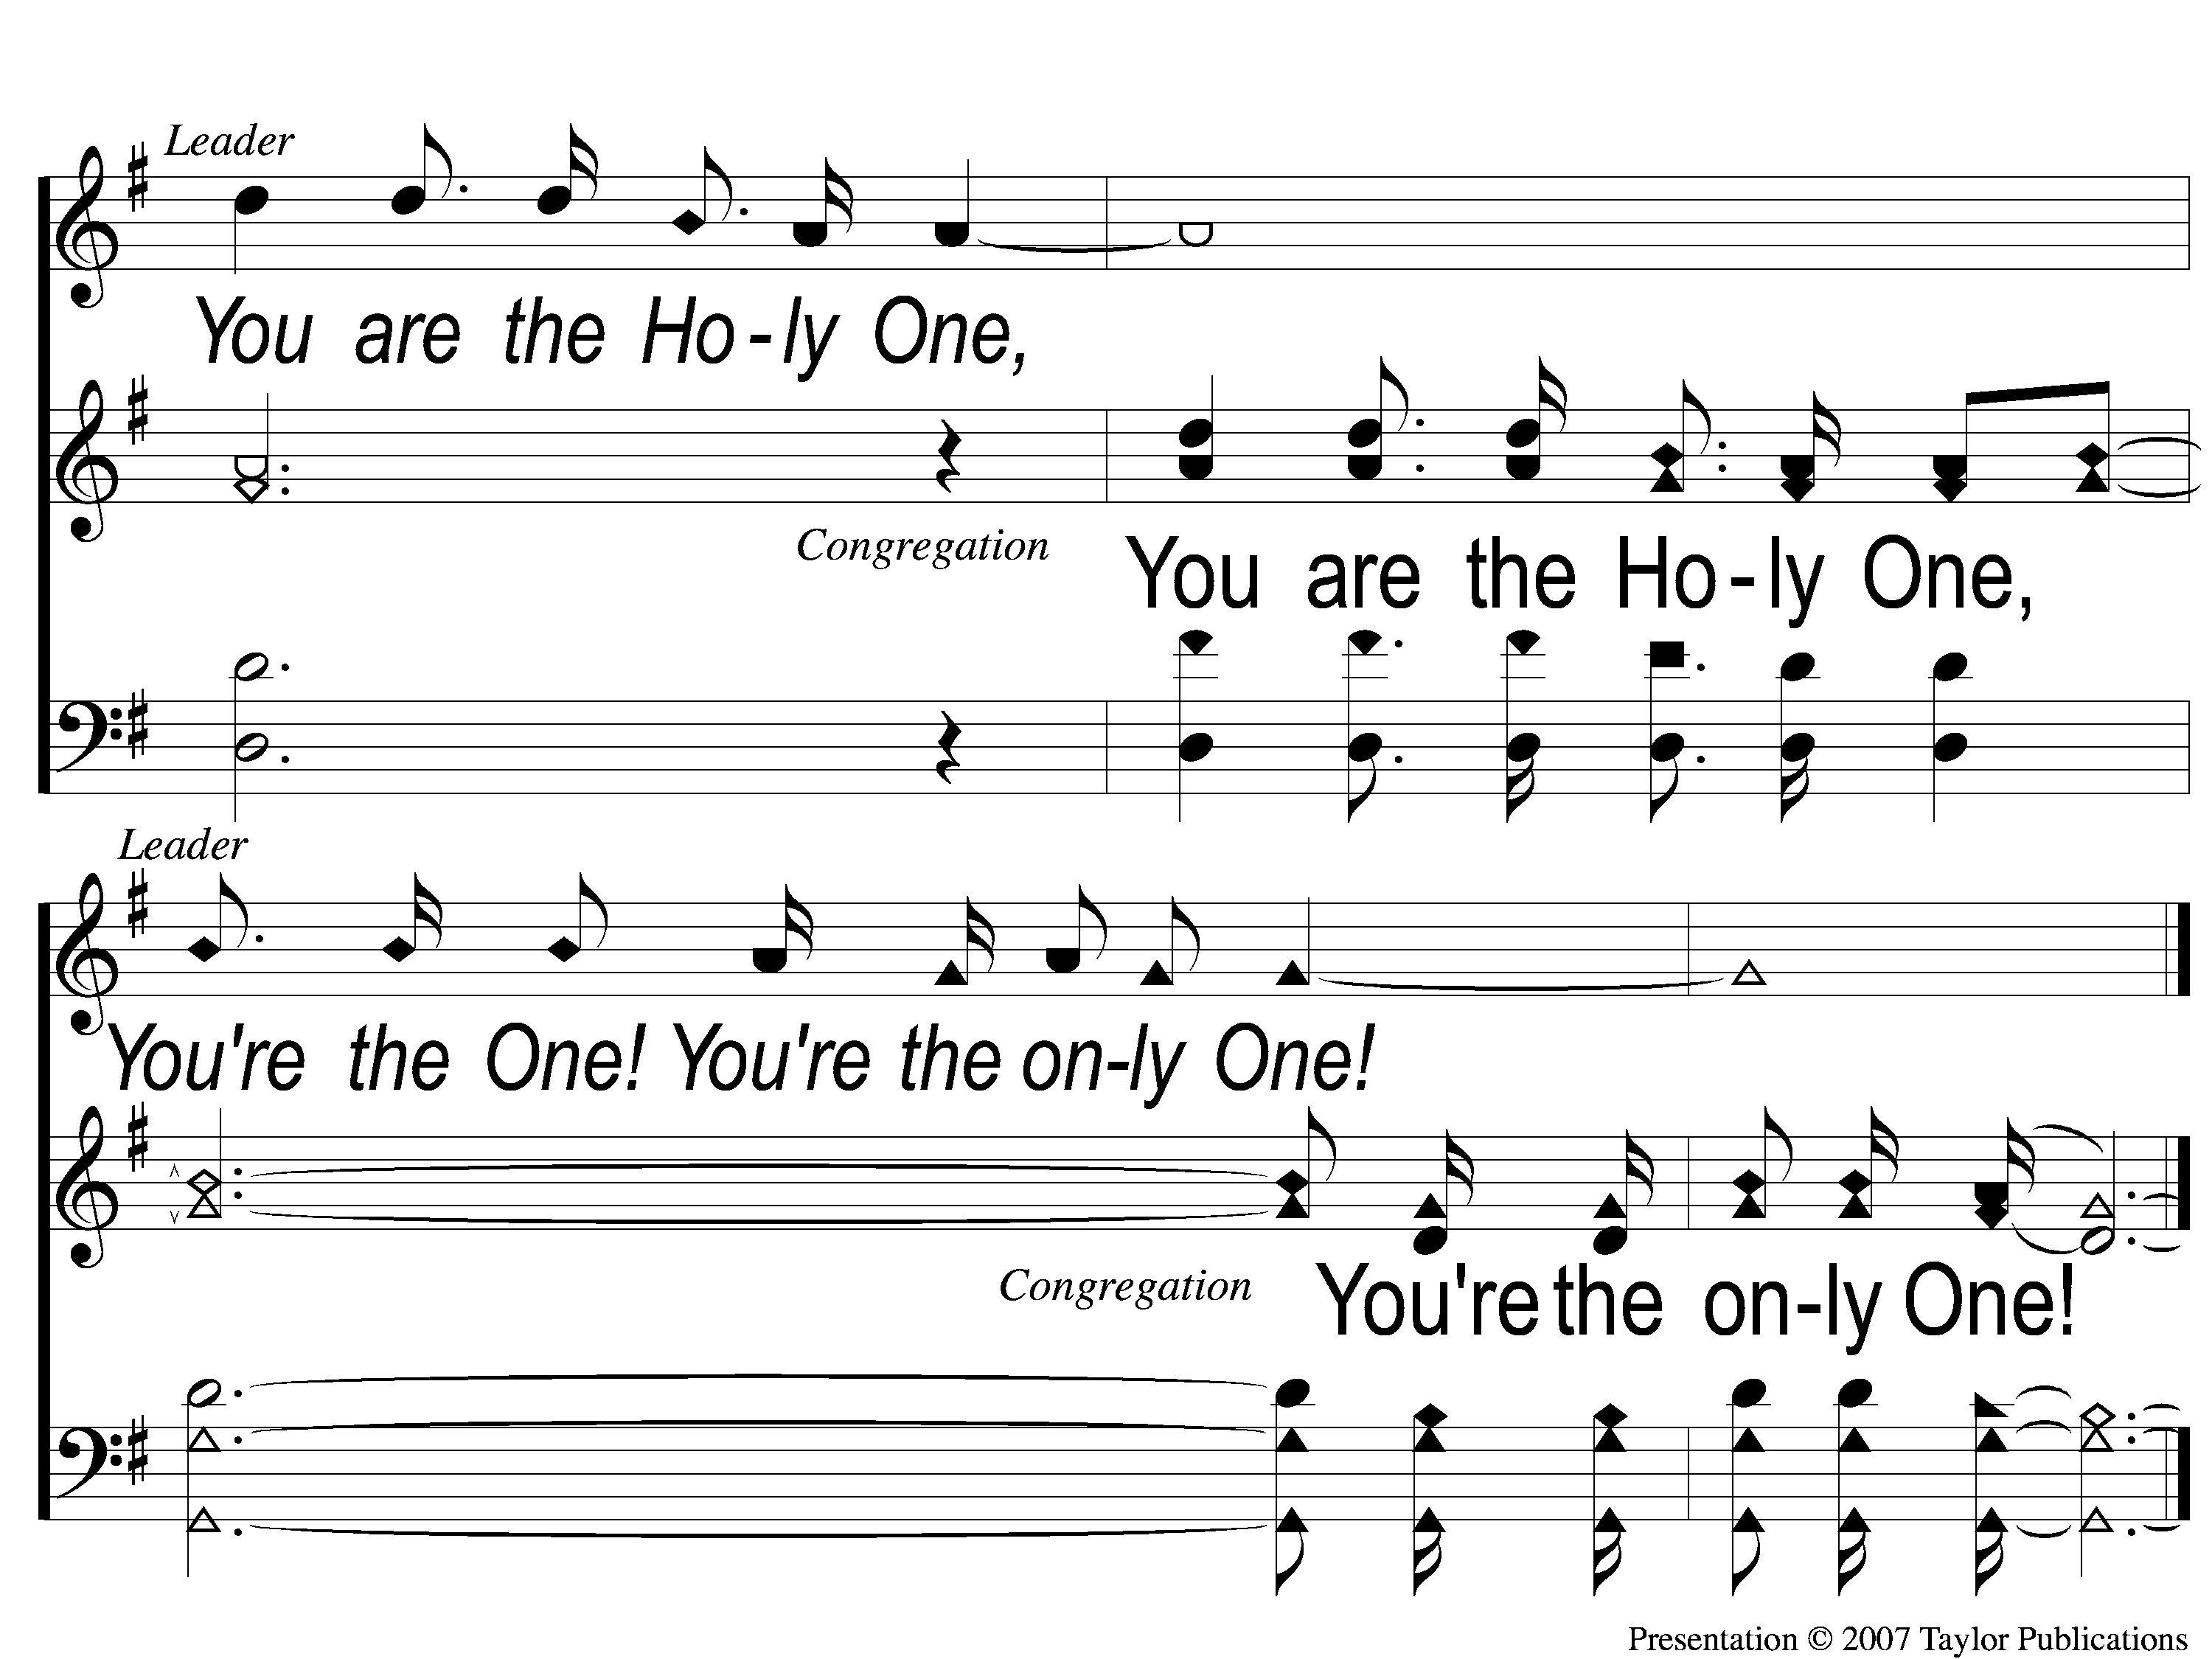
5-4 You’re the One
You’re the One
294

Slide 54
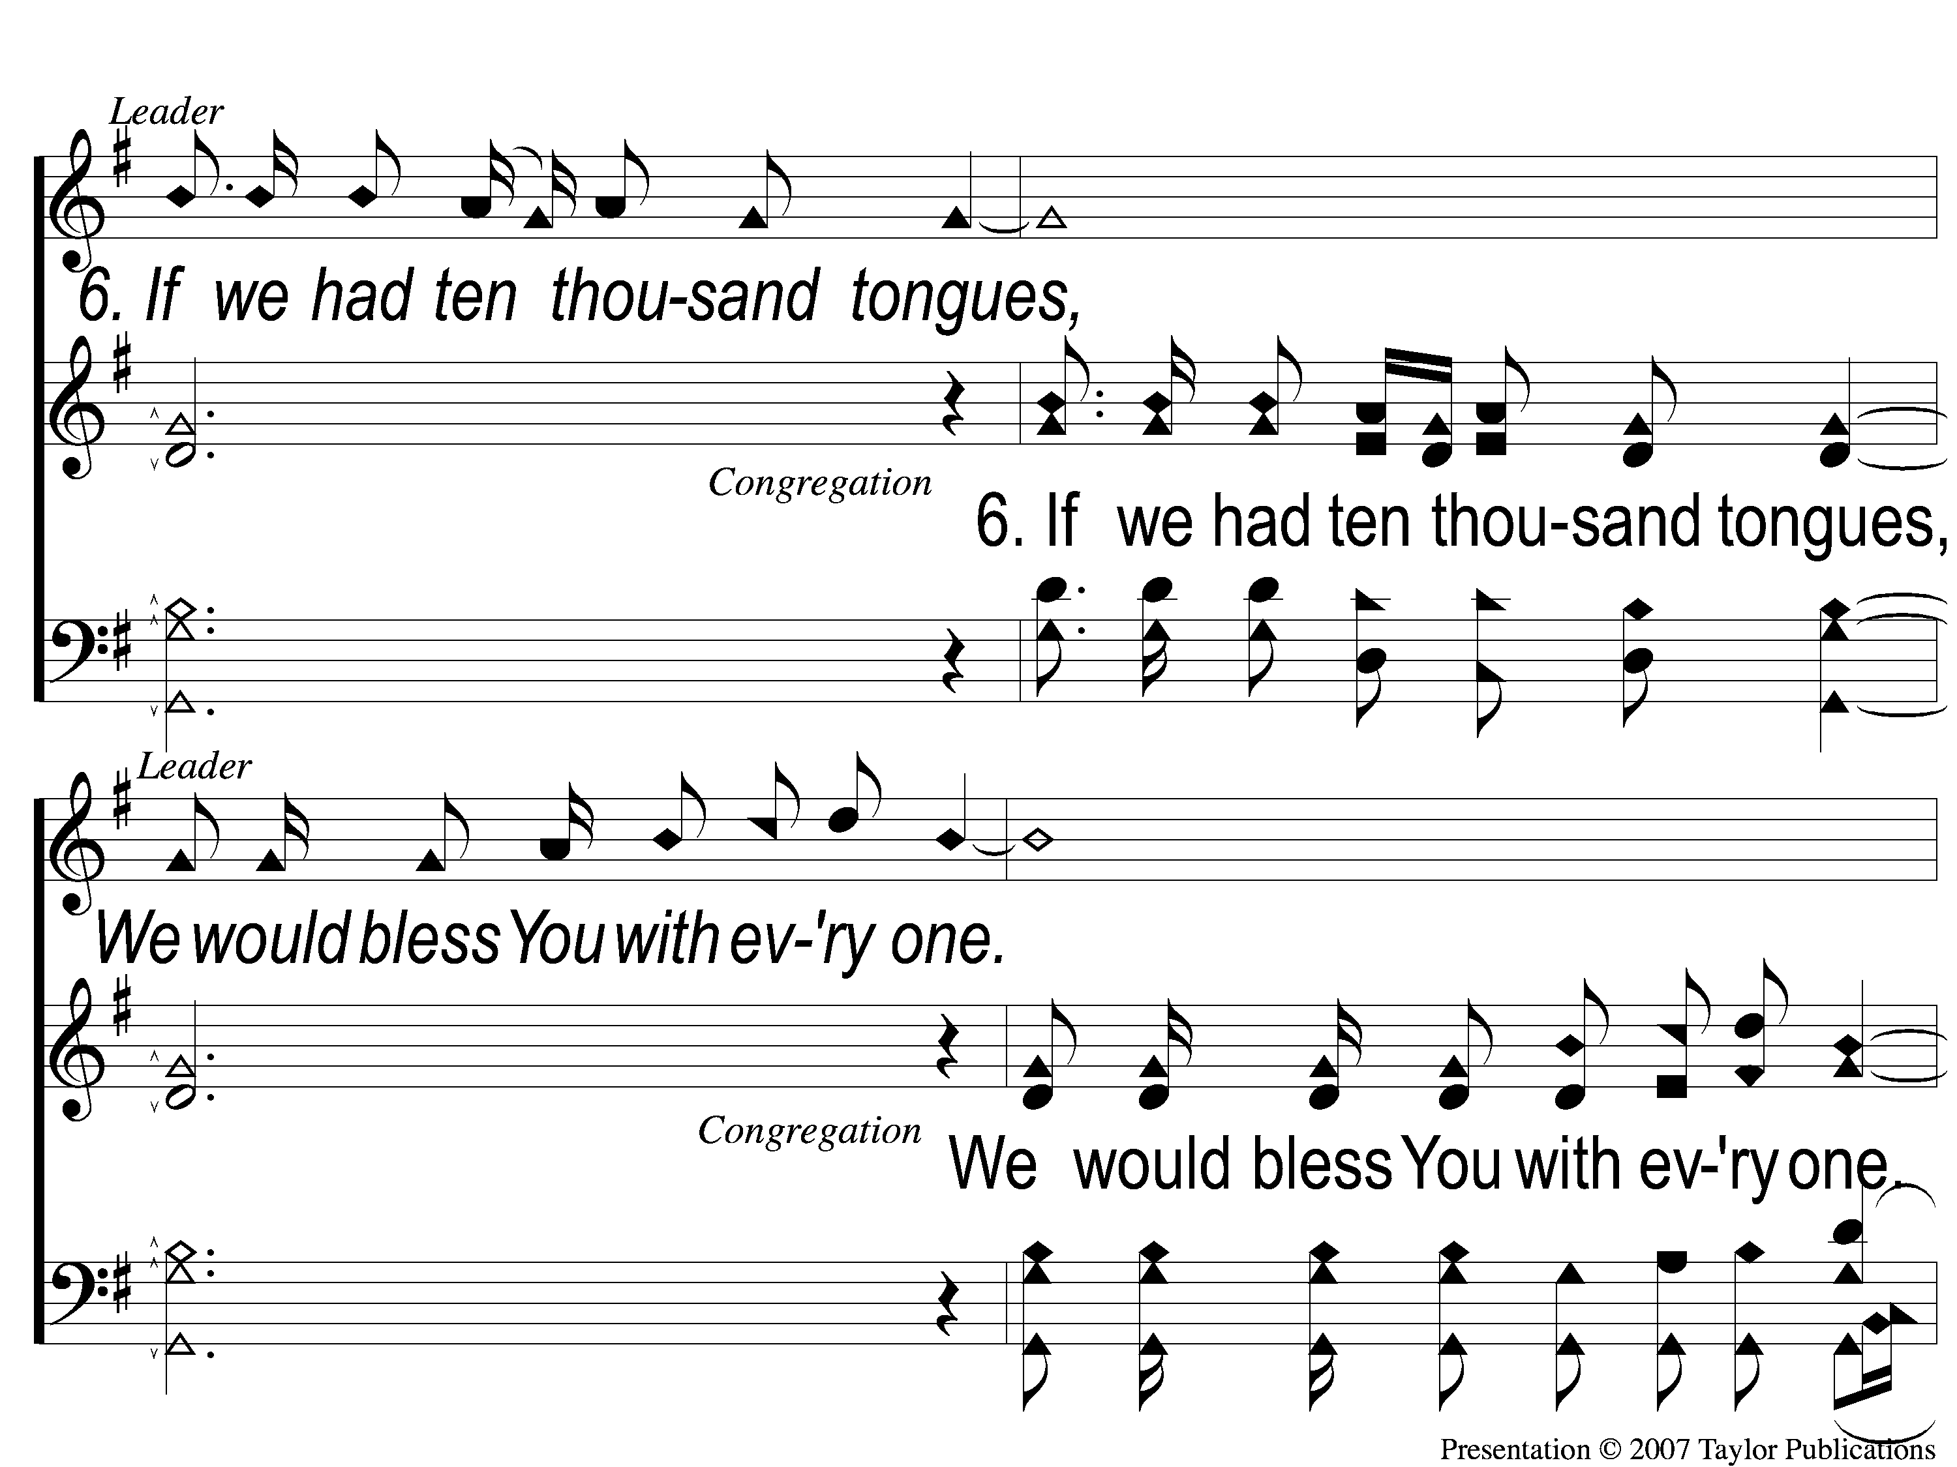
6-1 You’re the One
You’re the One
294

Slide 55
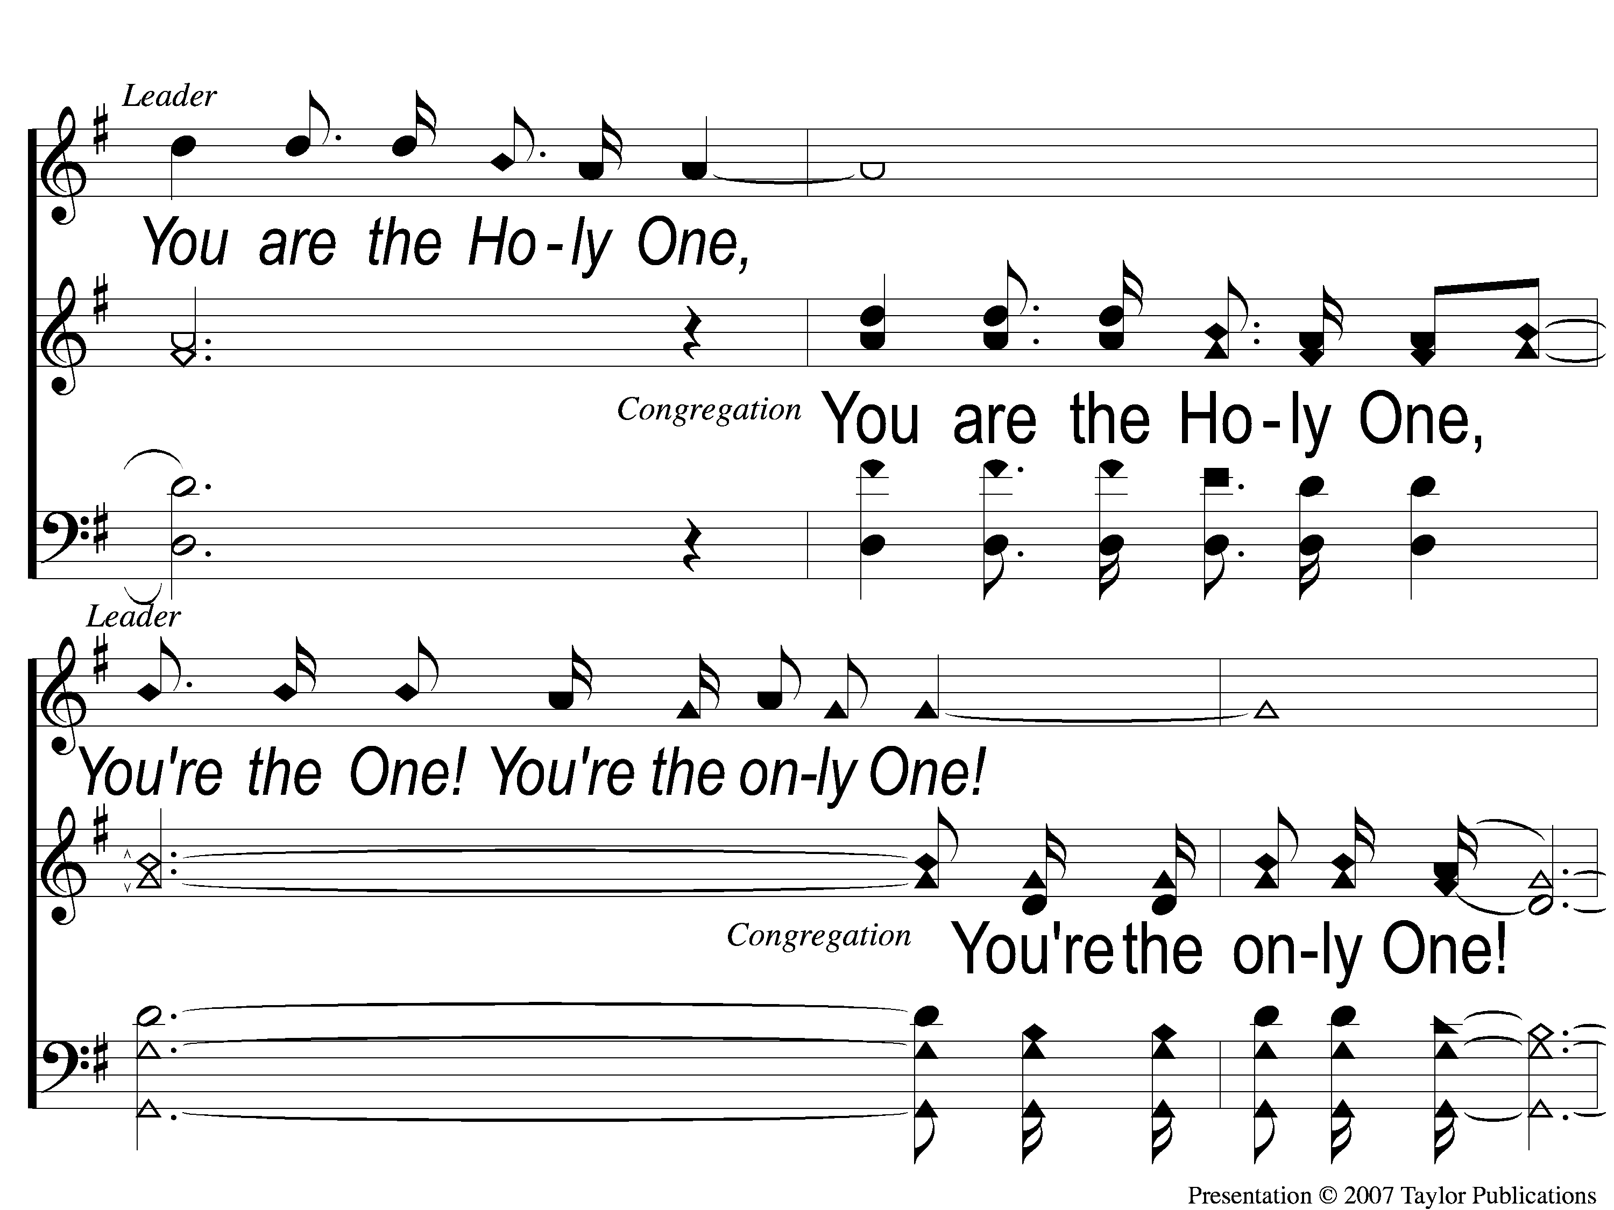
6-2 You’re the One
You’re the One
294

Slide 56
6-3 You’re the One
You’re the One
294

Slide 57
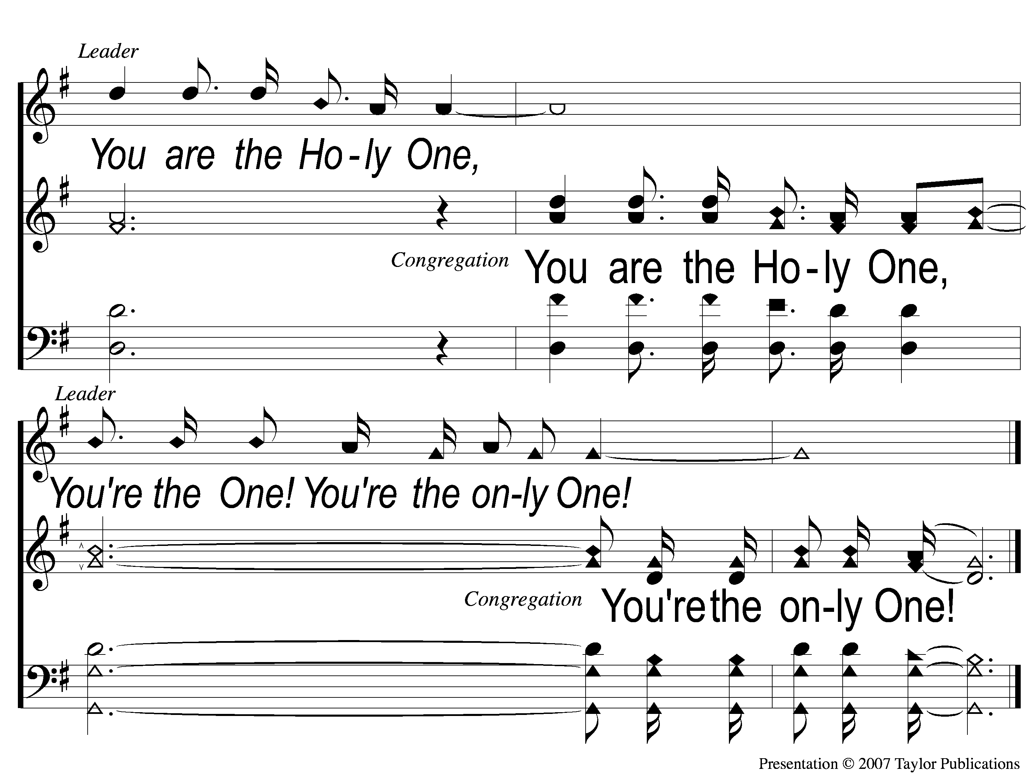
6-4 You’re the One
You’re the One
294

Slide 58
Song:
Highest Place
#155

Slide 59
1 Highest Place
Highest Place
155

Slide 60
2 Highest Place
Highest Place
155

Slide 61
3 Highest Place
Highest Place
155

Slide 62
4 Highest Place
Highest Place
155

Slide 63
5 Highest Place
Highest Place
155

Slide 64
Tag Highest Place
Highest Place
155

Slide 65
Scripture Reading:
Genesis 44:1-10

Slide 66
RESTORE
OUR
FOUNDATIONS
JANUARY - APRIL

Slide 67
Tonight:
The Providence of God
Saving Israel Through Joseph

Slide 68
Propitiation
Redemption
Expiation
Intercession

Slide 69
A of
Intercession
Shadow
Genesis Ch. 44

Slide 70
What Does It Mean?
1 Timothy 2:1 – “Therefore I exhort first of all that supplications, prayers, intercessions, and giving of thanks be made for all men,”

Slide 71
What Does It Mean?
1 Timothy 2:1 – “Therefore I exhort first of all that supplications, prayers, intercessions, and giving of thanks be made for all men,”

Slide 72
What Does It Mean?
Supplications = urgent request or plea
Prayers = general speaking to God
Giving of Thanks = Expressing gratitude

Slide 73
What Does It Mean?
Intercessions (ἐντεύξεις)
= to speak to someone on behalf of someone else

Slide 74
What Does It Mean?
1. Humanity
Abraham – Gen. 18:22-26

Slide 75
Who Makes Intercession?
1. Humanity
Abraham – Gen. 18:22-26

Slide 76
Who Makes Intercession?
1. Humanity
Abraham – Gen. 18:22-26
Moses – Num. 14:13, 17-19

Slide 77
Who Makes Intercession?
2. The Holy Spirit
Rom. 8:26-27

Slide 78
Who Makes Intercession?
3. Jesus Christ
Rom. 8:34
Heb. 7:25

Slide 79
What Is The Difference?

Slide 80
What Is The Difference?
Mediator vs. Intercessor

Slide 81
What Is The Difference?
Mediator vs. Intercessor
Mediator → Only 1 between God & Man = Jesus Christ
Intercessor → Can be more than 1

Slide 82
Examples Of Intercession

Slide 83
Examples Of Intercession
Reuben
Gen. 37:21-22, 42:37

Slide 84
Examples Of Intercession
Judah
Gen. 43:8-9, 44:18, 32-33

Slide 85
The Results Of Intercession
Gen. 45:1-5

Slide 86
The Results Of Intercession
Gen. 45:1-5
Reconciliation
Forgiveness
Joy
Love
Mercy

Slide 87
Do You Want
With God
Reconciliation
?

Slide 88
Invitation
Song:
Amazing Grace
– My Chains Are Gone

Slide 89
1-1 Amazing Grace-My Chains
Amazing Grace -My Chains Are Gone

Slide 90
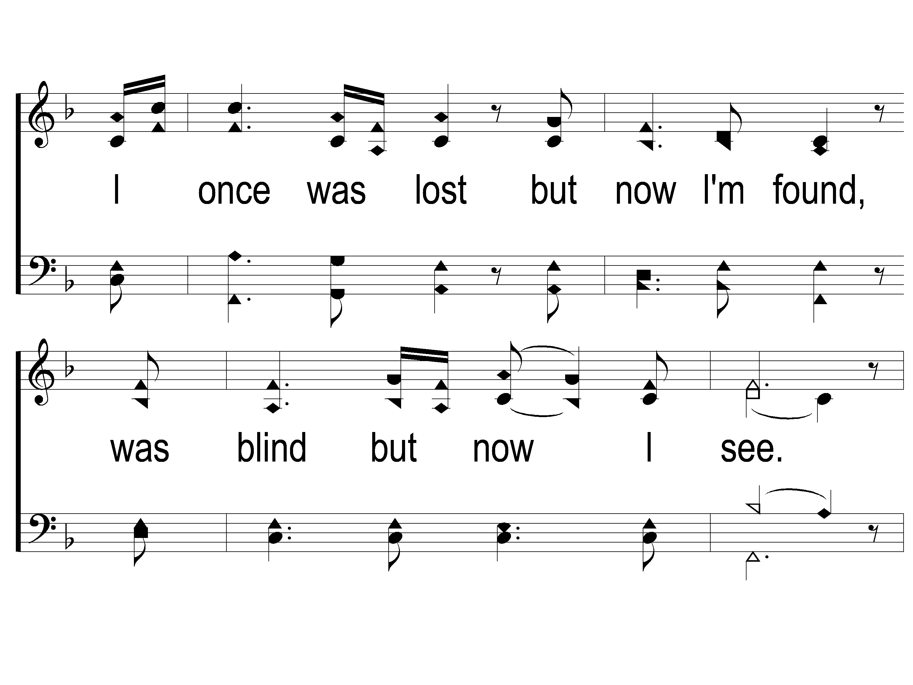
1-2 Amazing Grace-My Chains
Amazing Grace -My Chains Are Gone

Slide 91
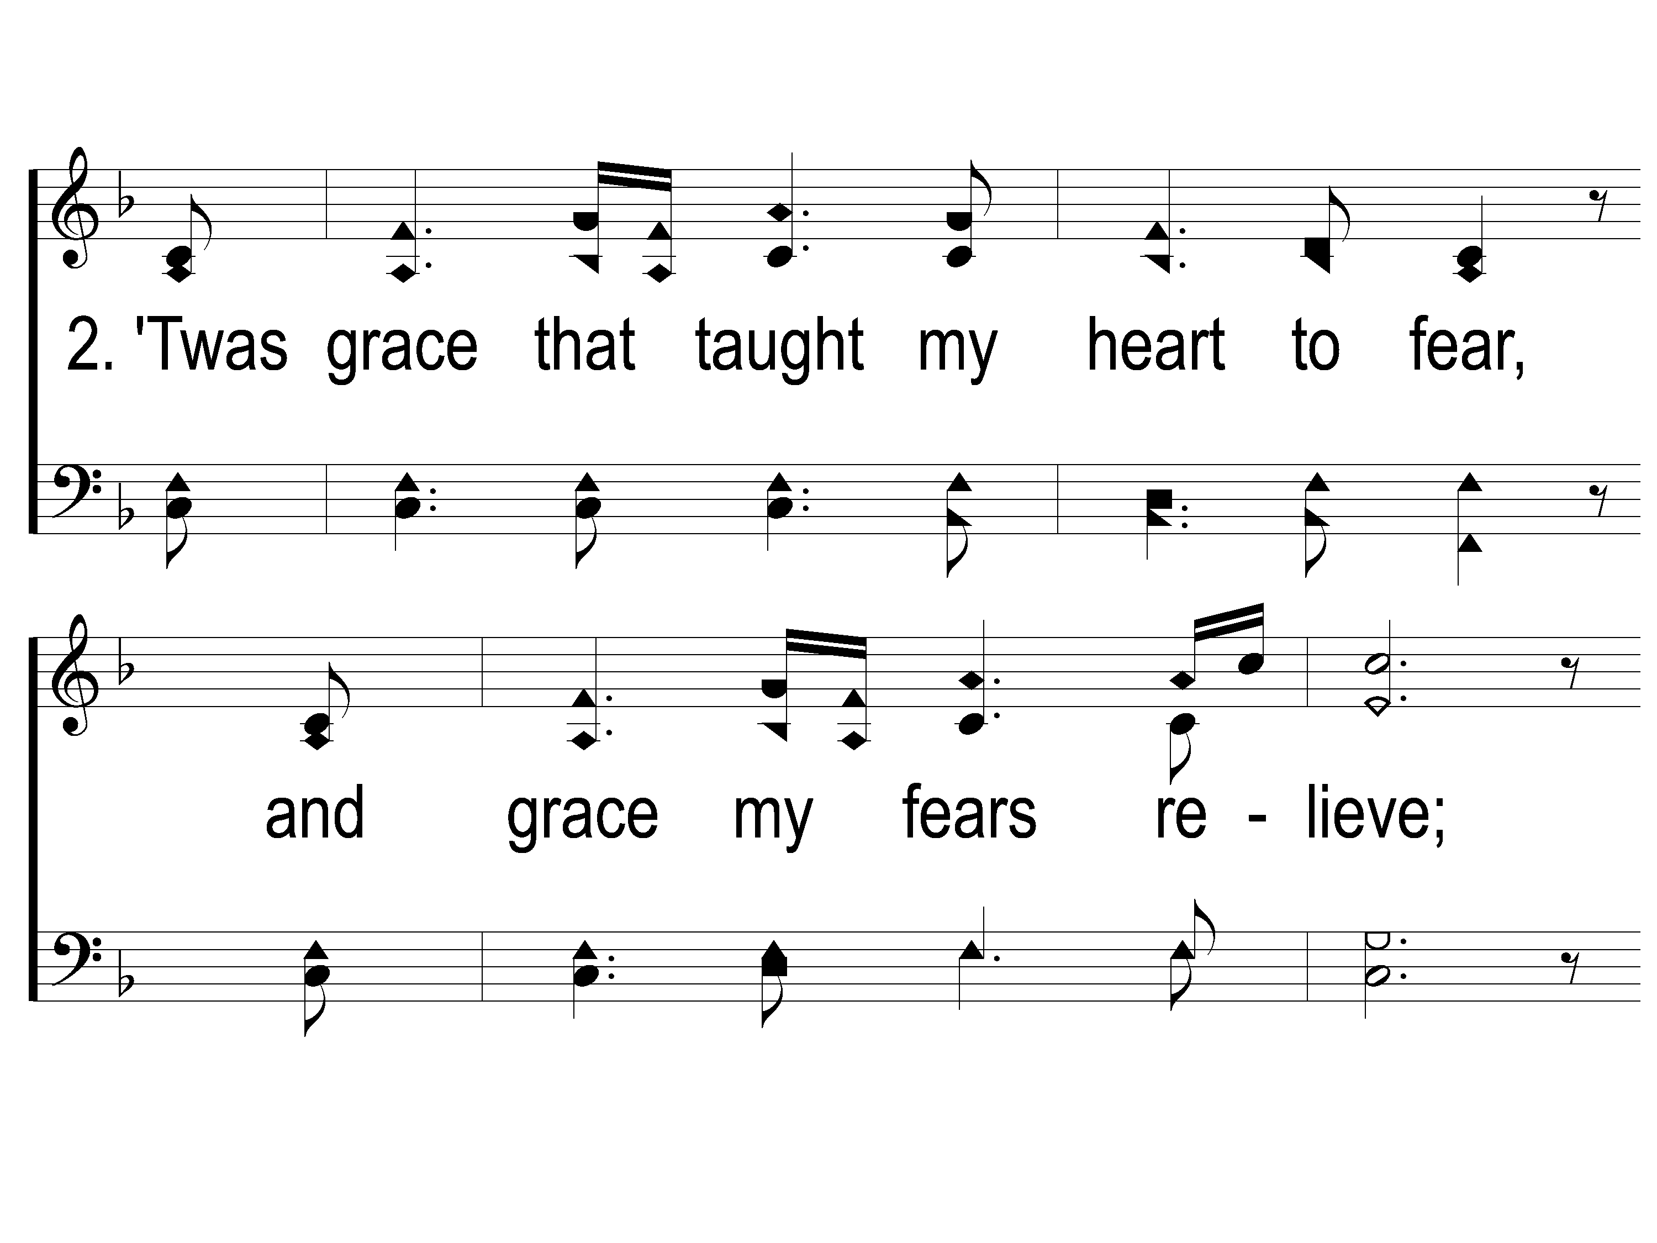
2-1 Amazing Grace-My Chains
Amazing Grace -My Chains Are Gone

Slide 92
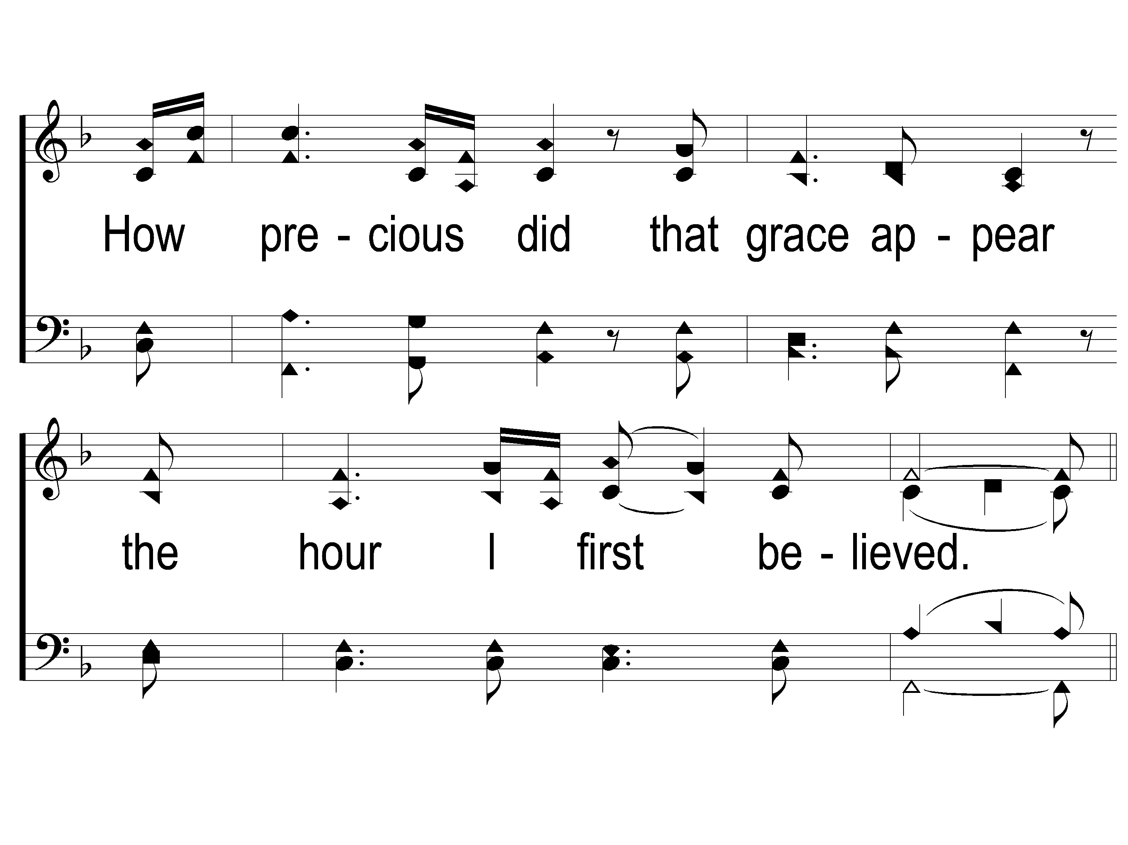
2-2 Amazing Grace-My Chains
Amazing Grace -My Chains Are Gone

Slide 93
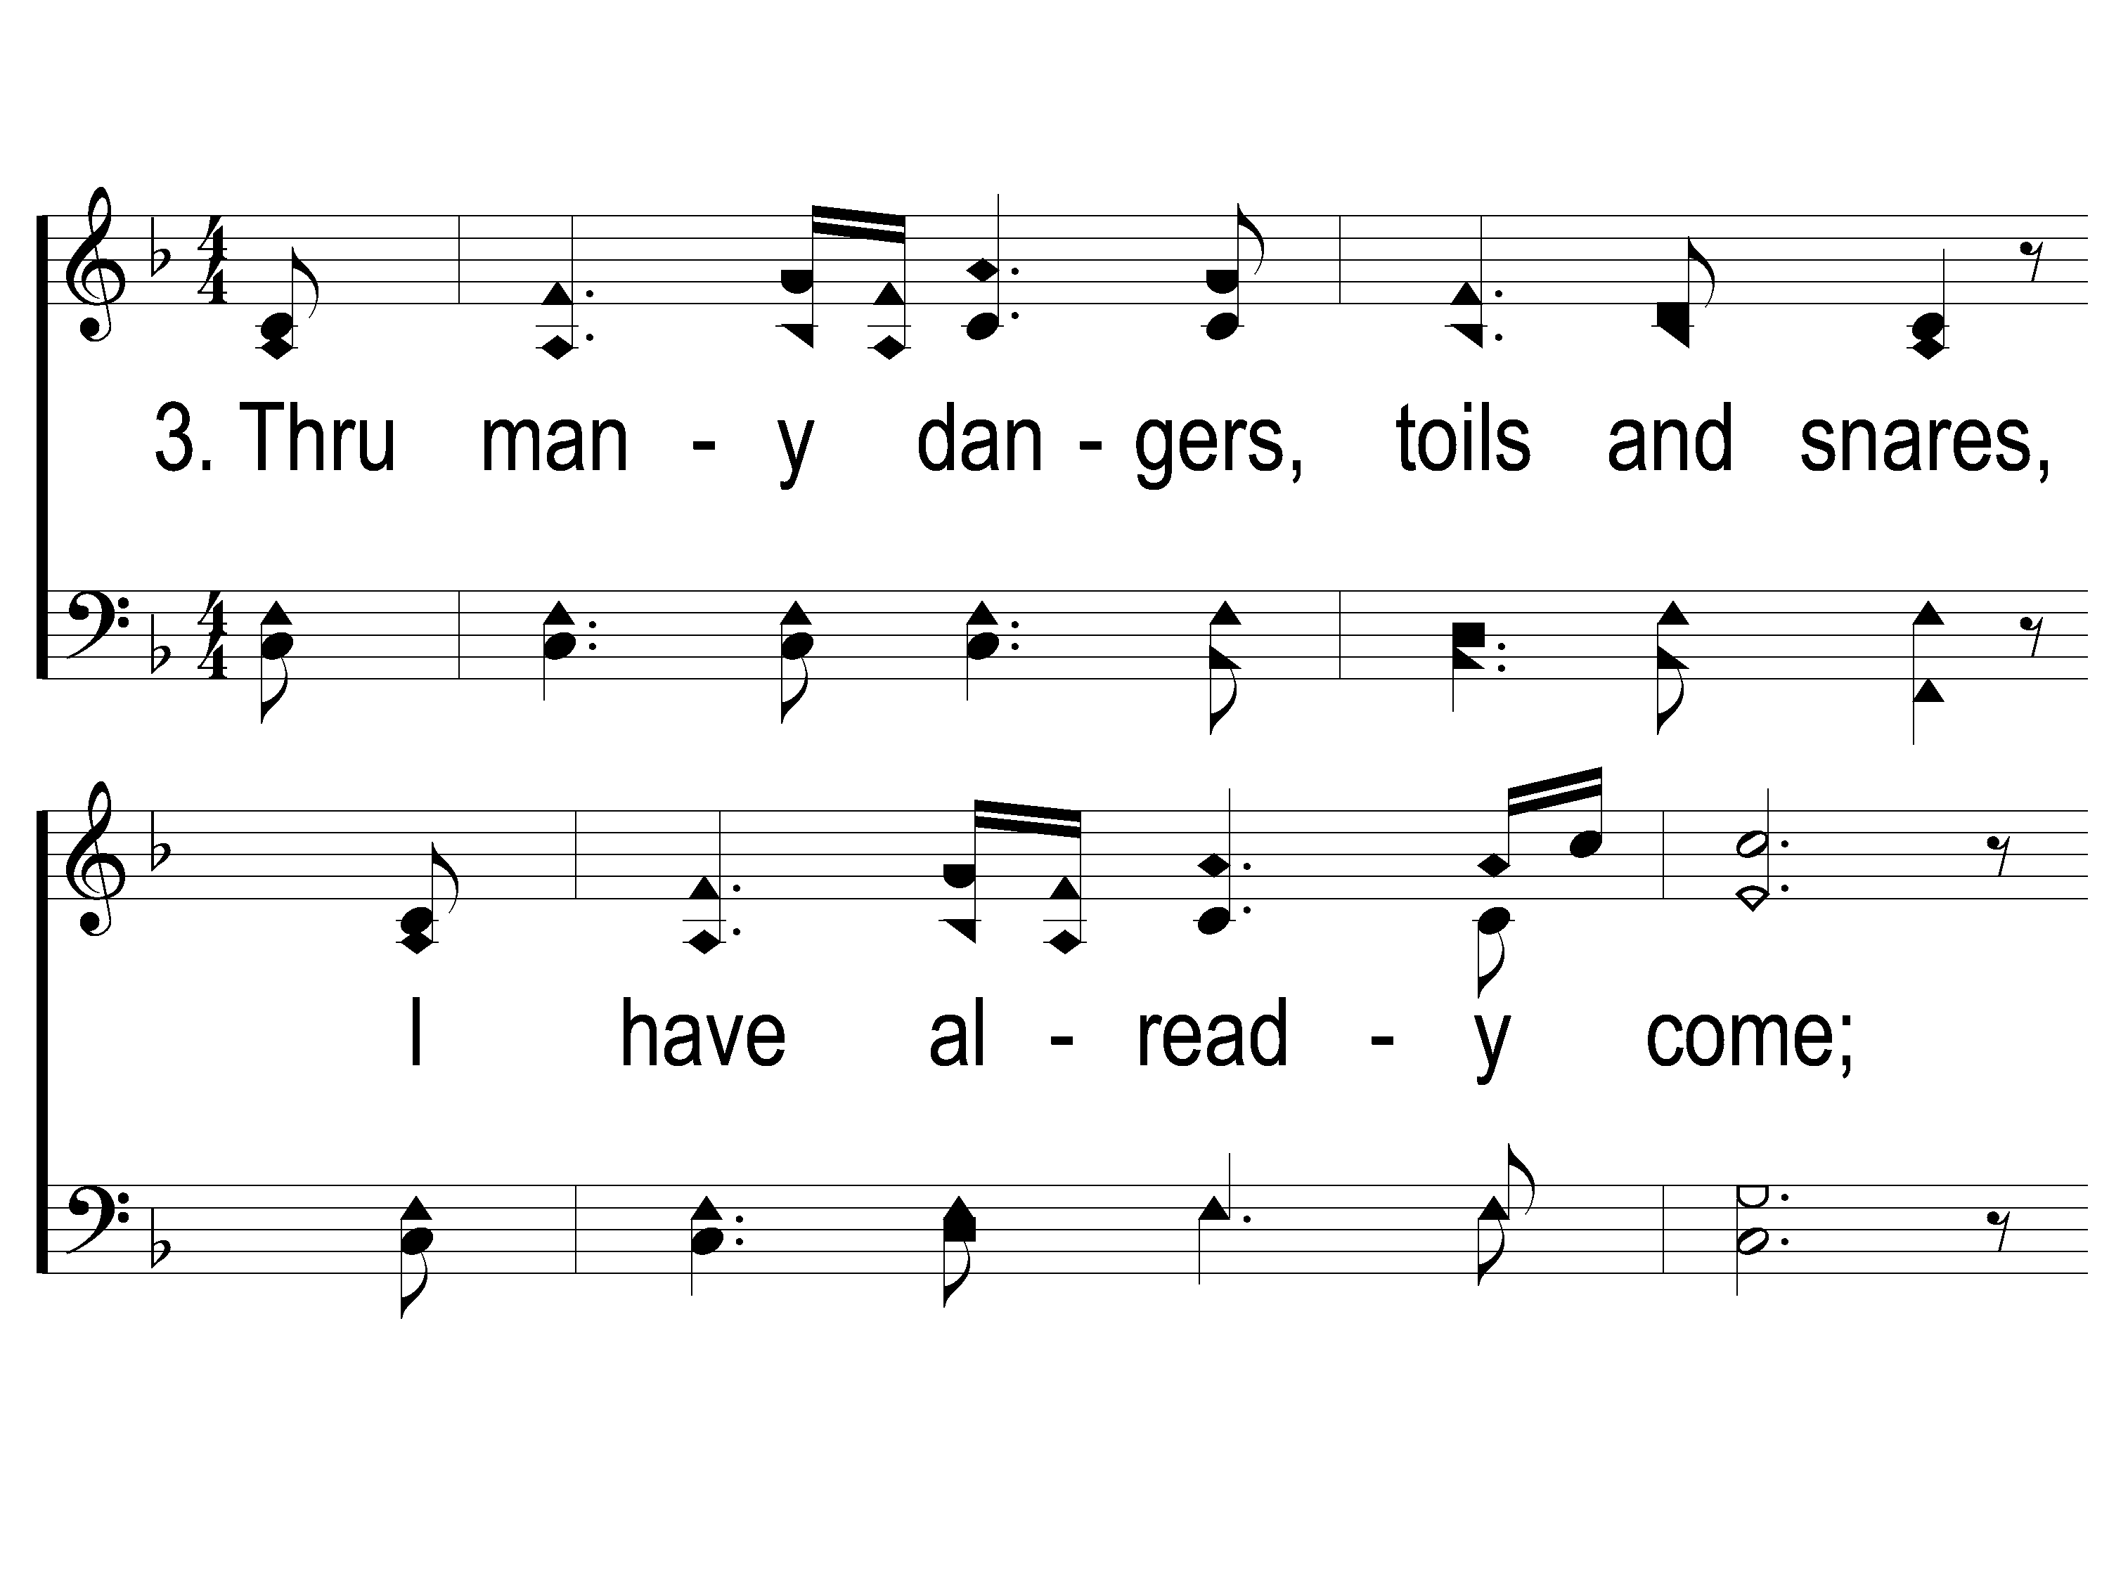
3-1 Amazing Grace-My Chains
Amazing Grace -My Chains Are Gone

Slide 94
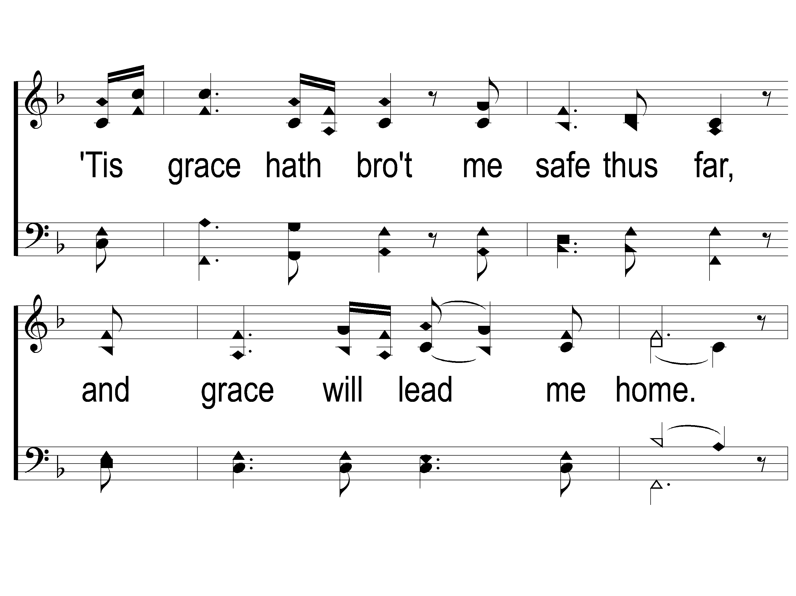
3-2 Amazing Grace-My Chains
Amazing Grace -My Chains Are Gone

Slide 95
4-1 Amazing Grace-My Chains
Amazing Grace -My Chains Are Gone

Slide 96
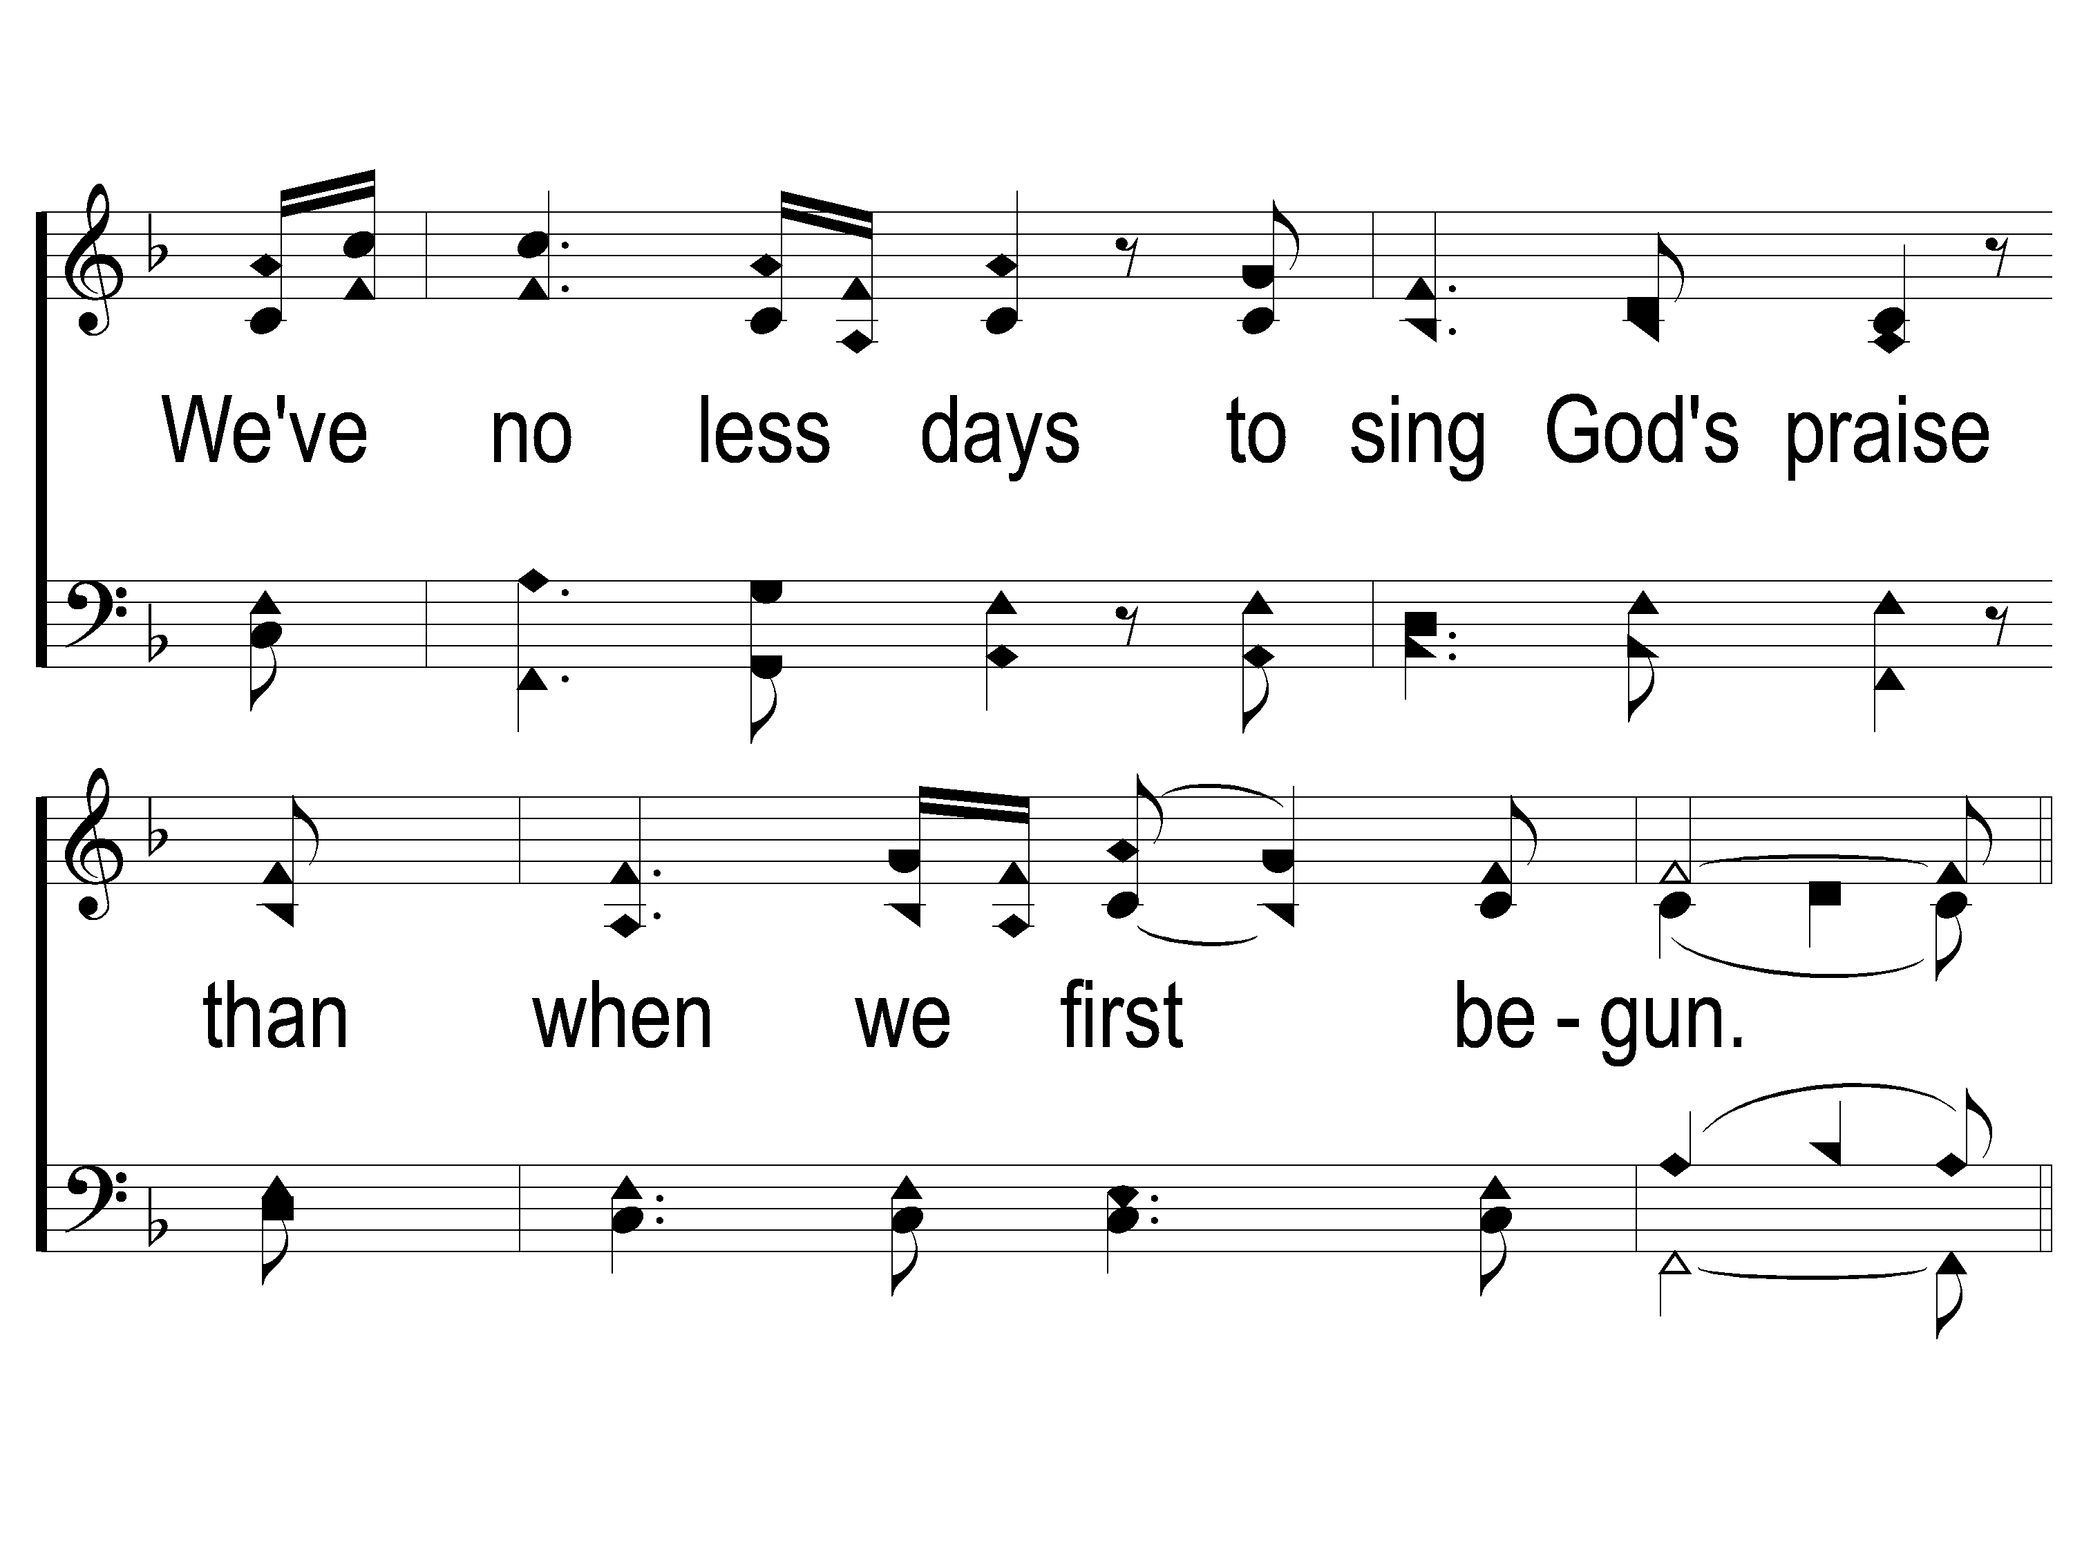
4-2 Amazing Grace-My Chains
Amazing Grace -My Chains Are Gone

Slide 97
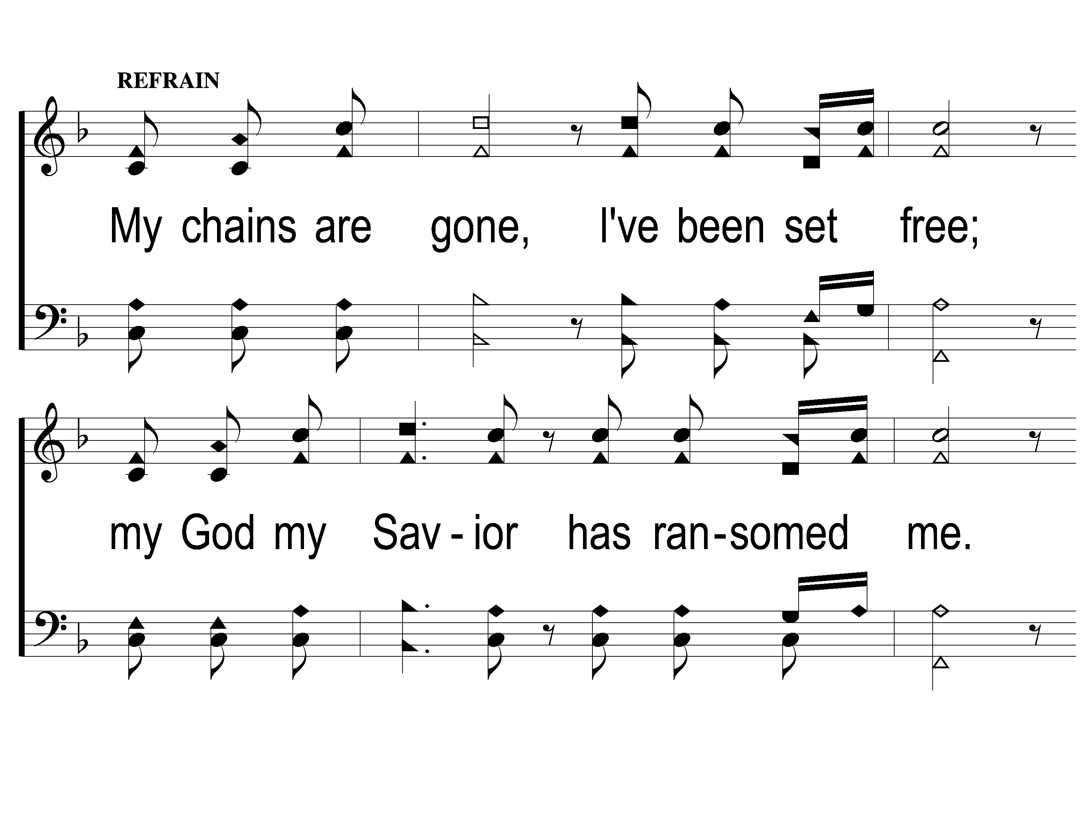
C-1 Amazing Grace-My Chains
Amazing Grace -My Chains Are Gone

Slide 98
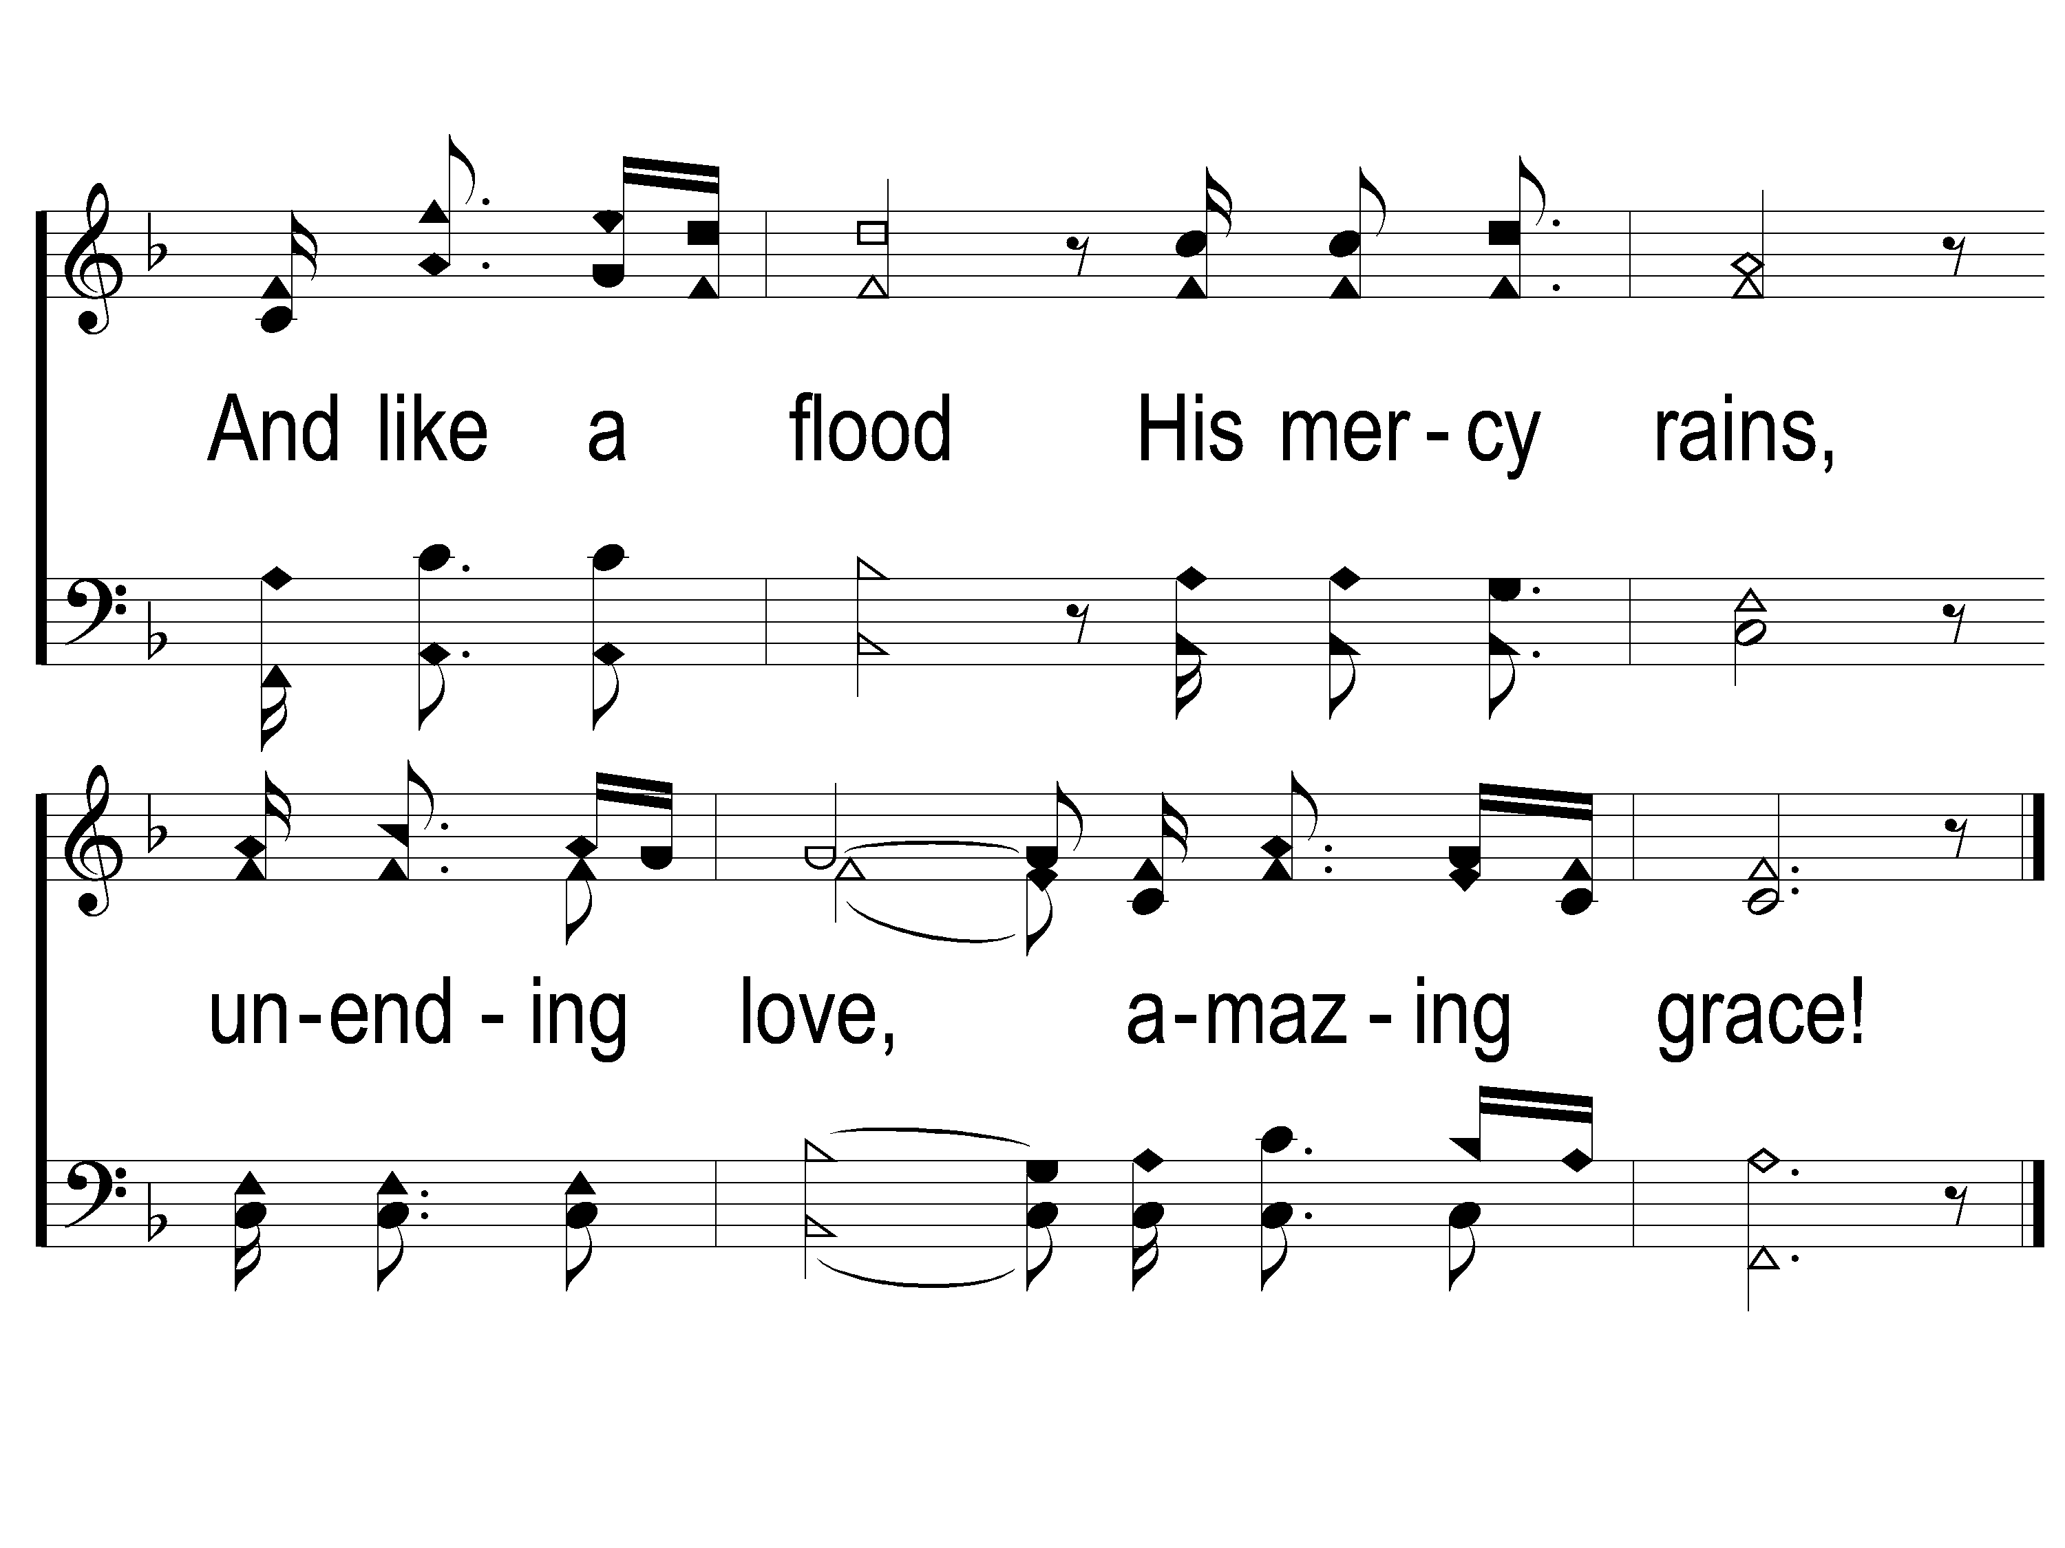
C-2 Amazing Grace-My Chains
Amazing Grace -My Chains Are Gone

Slide 99
DS-1 Amazing Grace-My Chains
Amazing Grace -My Chains Are Gone

Slide 100
The Contribution:
Luke 12:15
“And He said to them, ‘Take heed and beware of covetousness, for one’s life does not consist in the abundance of the things he possesses.’ ”

Slide 101
Song:
Why Did My Savior
Come To Earth?
#382

Slide 102
1-1 Why Did My Savior Come to Earth?
Why Did My Savior Come to Earth?
382

Slide 103
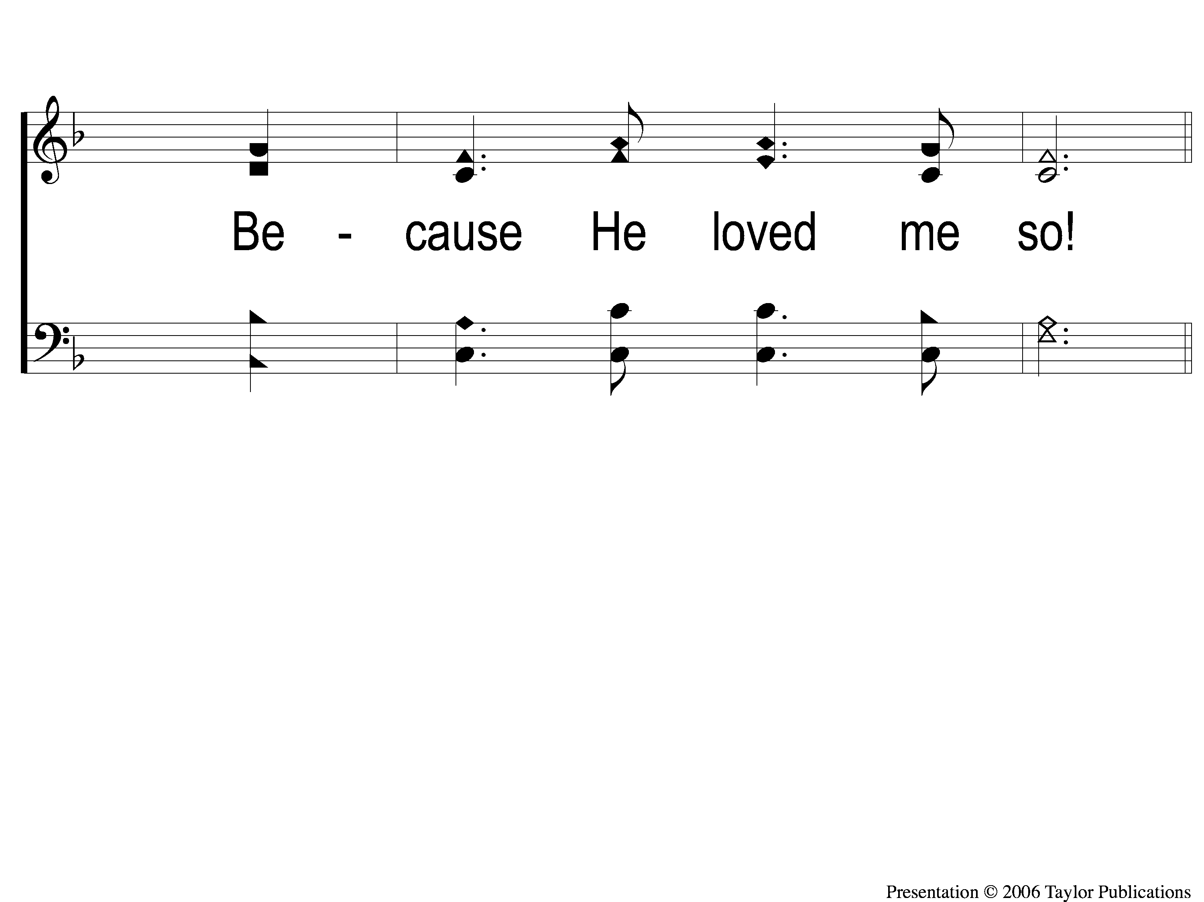
1-2 Why Did My Savior Come to Earth?
Why Did My Savior Come to Earth?
382

Slide 104
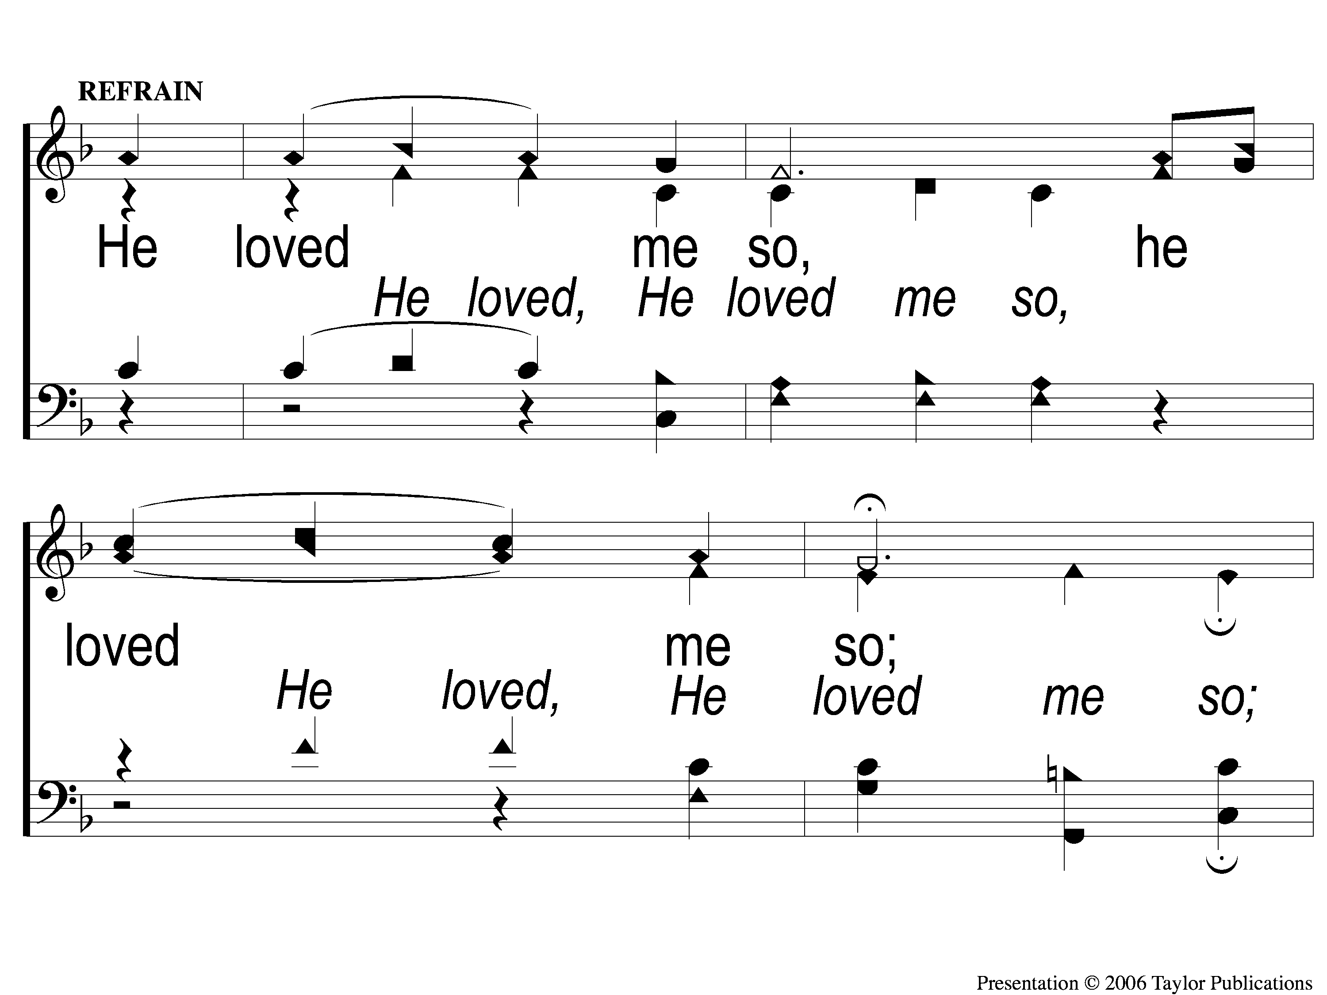
C-1 Why Did My Savior Come to Earth?
Why Did My Savior Come to Earth?
382

Slide 105
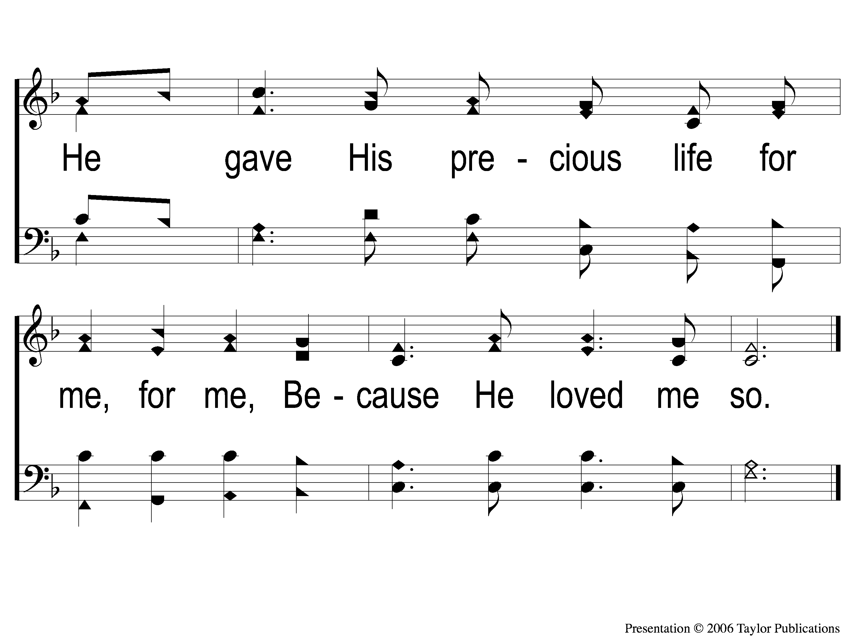
C-2 Why Did My Savior Come to Earth?
Why Did My Savior Come to Earth?
382

Slide 106
2-1 Why Did My Savior Come to Earth?
Why Did My Savior Come to Earth?
382

Slide 107
2-2 Why Did My Savior Come to Earth?
Why Did My Savior Come to Earth?
382

Slide 108
C-1 Why Did My Savior Come to Earth?
Why Did My Savior Come to Earth?
382

Slide 109
C-2 Why Did My Savior Come to Earth?
Why Did My Savior Come to Earth?
382

Slide 110
3-1 Why Did My Savior Come to Earth?
Why Did My Savior Come to Earth?
382

Slide 111
3-2 Why Did My Savior Come to Earth?
Why Did My Savior Come to Earth?
382

Slide 112
C-1 Why Did My Savior Come to Earth?
Why Did My Savior Come to Earth?
382

Slide 113
C-2 Why Did My Savior Come to Earth?
Why Did My Savior Come to Earth?
382

Slide 114
The Unleavened Bread
Luke 9:23-24
“Then He said to them all, “If anyone desires to come after Me, let him deny himself, and take up his cross daily, and follow Me. For whoever desires to save his life will lose it, but whoever loses his life for My sake will save it.”

Slide 115
The Fruit
of the Vine
Luke 9:25-26
“For what profit is it to a man if he gains the whole world, and is himself destroyed or lost? For whoever is ashamed of Me and My words, of him the Son of Man will be ashamed when He comes in His own glory, and in His Father’s, and of the holy angels.”

Slide 116
Closing Prayer

Slide 117
Song:
Victory In Jesus
#470

Slide 118
1-1 Victory in Jesus
Victory in Jesus
470

Slide 119
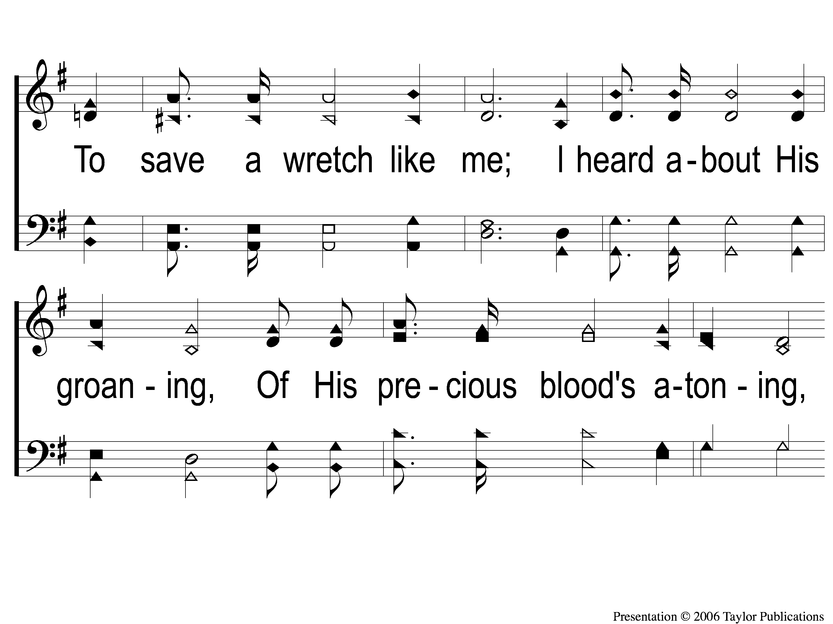
1-2 Victory in Jesus
Victory in Jesus
470

Slide 120
1-3 Victory in Jesus
Victory in Jesus
470

Slide 121
C-1 Victory in Jesus
Victory in Jesus
470

Slide 122
C-2 Victory in Jesus
Victory in Jesus
470

Slide 123
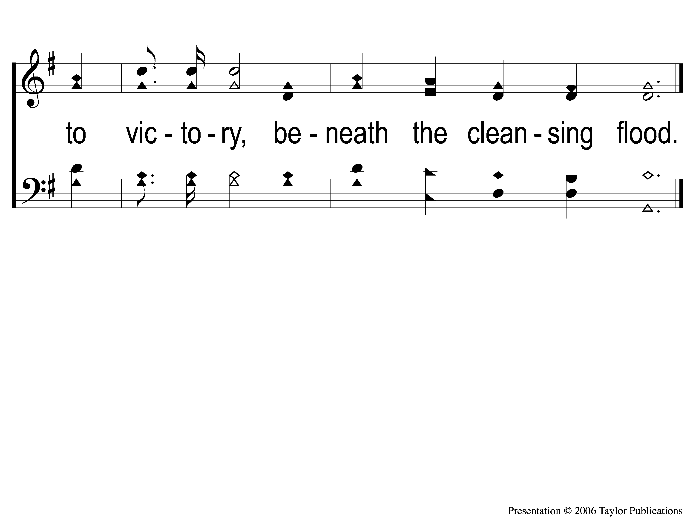
C-3 Victory in Jesus
Victory in Jesus
470

Slide 124
3-1 Victory in Jesus
Victory in Jesus
470

Slide 125
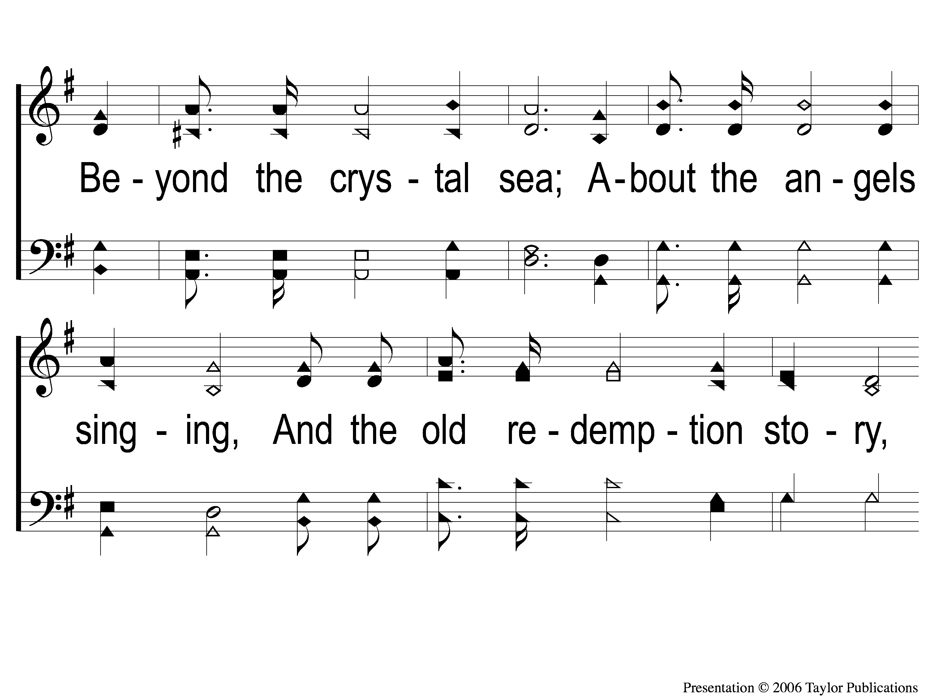
3-2 Victory in Jesus
Victory in Jesus
470

Slide 126
3-3 Victory in Jesus
Victory in Jesus
470

Slide 127
C-1 Victory in Jesus
Victory in Jesus
470

Slide 128
C-2 Victory in Jesus
Victory in Jesus
470

Slide 129
C-3 Victory in Jesus
Victory in Jesus
470

Slide 130
After Worship
Fellowship Meal @ 12:00 PM
Devo @ 1:00 PM
Camp Registration @ 2:00 PM
Wednesday
Worship/Classes @ 6:30 pm
RESTORE REBUILD RENEW
IN 2022
WHEELER
CHURCH
OF
CHRIST

Slide 131
Tonight
Worship @ 6:00 PM
Wednesday
Worship/Classes @ 6:30 pm
RESTORE REBUILD RENEW
IN 2022
WHEELER
CHURCH
OF
CHRIST

