Slide 1
RESTORE REBUILD RENEW
welcome
we are glad to
Have you with us
IN 2022
WHEELER
CHURCH
OF
CHRIST

Slide 2
Songs of Praise To God

Slide 3
Opening Prayer

Slide 4
Songs of Praise To God

Slide 5
RESTORE
OUR
FOUNDATIONS
JANUARY - APRIL

Slide 6
The Providence of God
Saving Israel Through Joseph

Slide 7
The Providence Of God
Extra-Biblical → Carthage’s Defeat

Slide 8
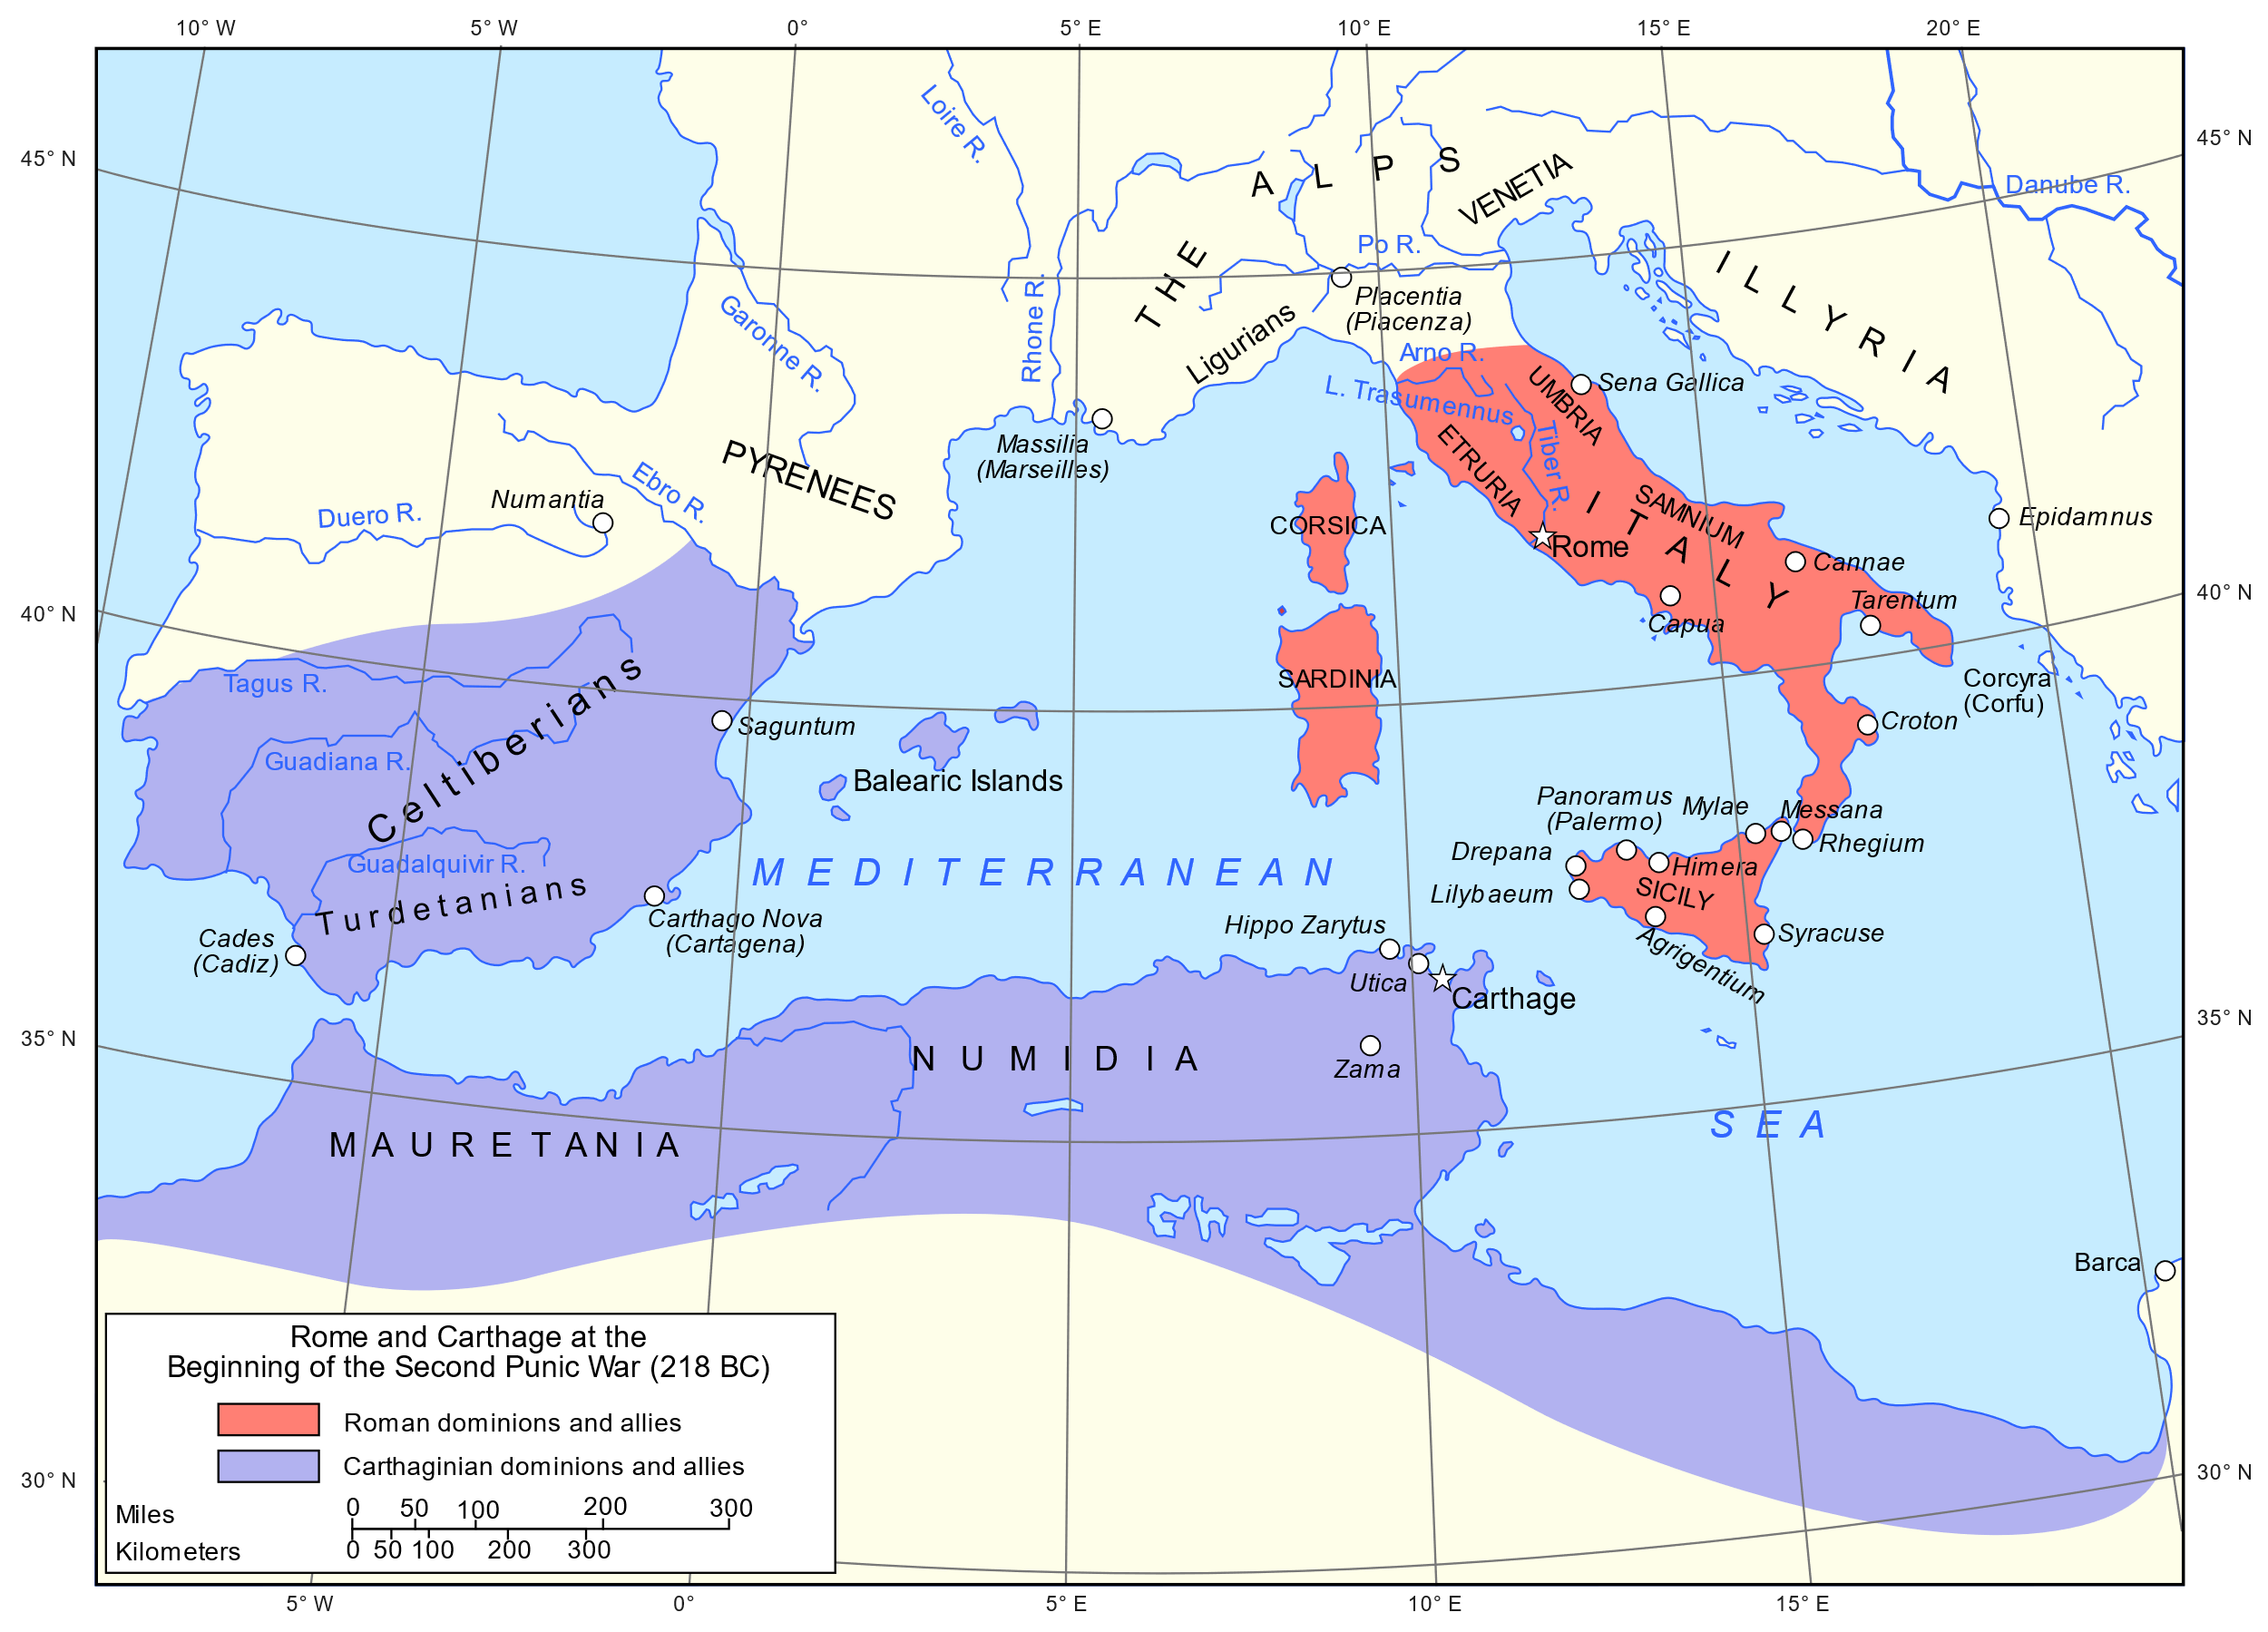

Slide 9
The Providence Of God
Extra-Biblical → Carthage’s Defeat
Biblical → Queen Esther

Slide 10
What Is Providence?
Providence
“the hand of God in the glove of history”

Slide 11
What Is Providence?
Providence =/= Miracle
Different in Purpose
1 Cor. 13:8-10

Slide 12
What Is Providence?
Providence
“a provable, nonprovable proposition”
– Wayne Jackson

Slide 13
How Is Providence Provable?

Slide 14
How Is Providence Provable?
God desires for us to pray (1 Tim. 2:1)
God says prayer is powerful (Jms. 5:16)

Slide 15
How Is Providence Provable?
New Testament Writers Say Prayer Works
Phili. 1:19-20
Col. 4:3
Jms. 4:2-3
2 Thess. 3:1
3 Jn. 2

Slide 16
How Is Providence Nonprovable?
The Life of Esther
Esther 4:14
Gal. 4:4

Slide 17
How Is Providence Nonprovable?
The Life of Joseph
Gen. 37:5, 9, 23-24, 45:5-8, 50:15-20

Slide 18
Songs of Praise To God

Slide 19
The Lord’s Supper
Acts 20:7

Slide 20
Closing Prayer

Slide 21
Songs of Praise To God

Slide 22
RESTORE REBUILD RENEW
Wednesday
Worship/Classes @ 6:30 pm
IN 2022
WHEELER
CHURCH
OF
CHRIST

