Slide 1
PLEASE STANDBY
OUR LIVESTREAM
WILL BEGIN SOON

Slide 2
WELCOME
THANKS FOR JOINING US!

Slide 3
#458
SONG:
Redeemed

Slide 4
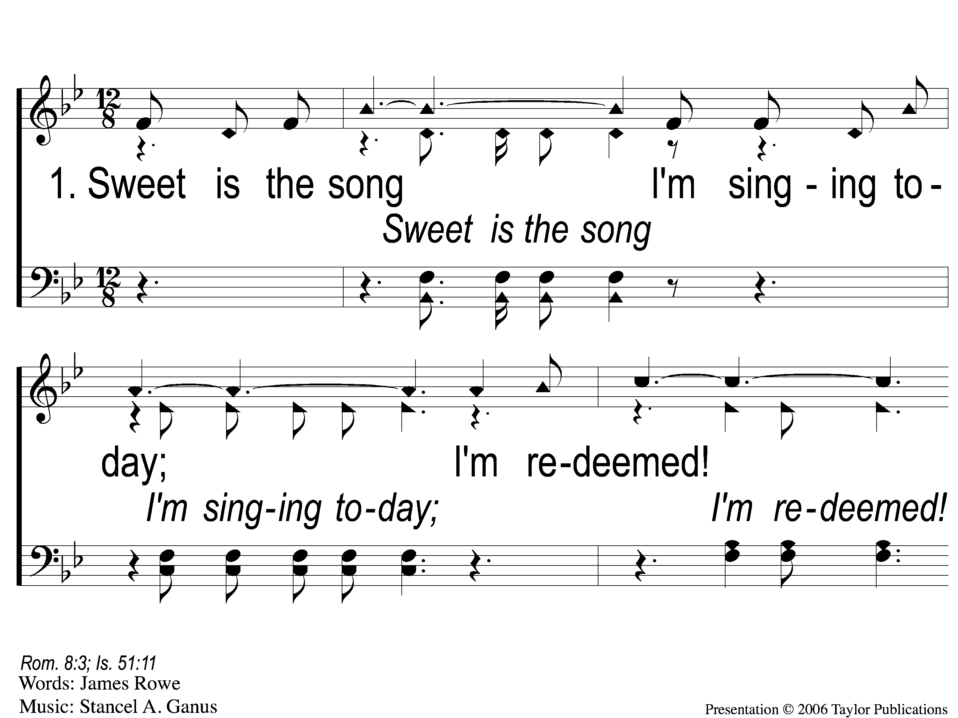
1-1 Redeemed - Sweet is the Song
Redeemed
458

Slide 5
1-2 Redeemed - Sweet is the Song
Redeemed
458

Slide 6
1-3 Redeemed - Sweet is the Song
Redeemed
458

Slide 7
C-1 Redeemed - Sweet is the Song
Redeemed
458

Slide 8
C-2 Redeemed - Sweet is the Song
Redeemed
458

Slide 9
3-1 Redeemed - Sweet is the Song
Redeemed
458

Slide 10
3-2 Redeemed - Sweet is the Song
Redeemed
458

Slide 11
3-3 Redeemed - Sweet is the Song
Redeemed
458

Slide 12
C-1 Redeemed - Sweet is the Song
Redeemed
458

Slide 13
C-2 Redeemed - Sweet is the Song
Redeemed
458

Slide 14
1-1 Redeemed
Redeemed
514

Slide 15
1-2 Redeemed
Redeemed
514

Slide 16
C-1 Redeemed
Redeemed
514

Slide 17
C-2 Redeemed
Redeemed
514

Slide 18
3-1 Redeemed
Redeemed
514

Slide 19
3-2 Redeemed
Redeemed
514

Slide 20
C-1 Redeemed
Redeemed
514

Slide 21
C-2 Redeemed
Redeemed
514

Slide 22
1-1 I Know That My Redeemer Lives
I Know That My Redeemer Lives
528

Slide 23
1-2 I Know That My Redeemer Lives
I Know That My Redeemer Lives
528

Slide 24
C-1 I Know That My Redeemer Lives
I Know That My Redeemer Lives
528

Slide 25
C-2 I Know That My Redeemer Lives
I Know That My Redeemer Lives
528

Slide 26
4-1 I Know That My Redeemer Lives
I Know That My Redeemer Lives
528

Slide 27
4-2 I Know That My Redeemer Lives
I Know That My Redeemer Lives
528

Slide 28
C-1 I Know That My Redeemer Lives
I Know That My Redeemer Lives
528

Slide 29
C-2 I Know That My Redeemer Lives
I Know That My Redeemer Lives
528

Slide 30
#810
SONG:
Listen To Our Hearts

Slide 31
1-1 Listen to our Hearts
Listen To Our Hearts
810

Slide 32
1-2 Listen to our Hearts
Listen To Our Hearts
810

Slide 33
1-3 Listen to our Hearts
Listen To Our Hearts
810

Slide 34
C-1 Listen to our Hearts
Listen To Our Hearts
810

Slide 35
C-2 Listen to our Hearts
Listen To Our Hearts
810

Slide 36
C-3 Listen to our Hearts
Listen To Our Hearts
810

Slide 37
C-4 Listen to our Hearts
Listen To Our Hearts
810

Slide 38
2-1 Listen to our Hearts
Listen To Our Hearts
810

Slide 39
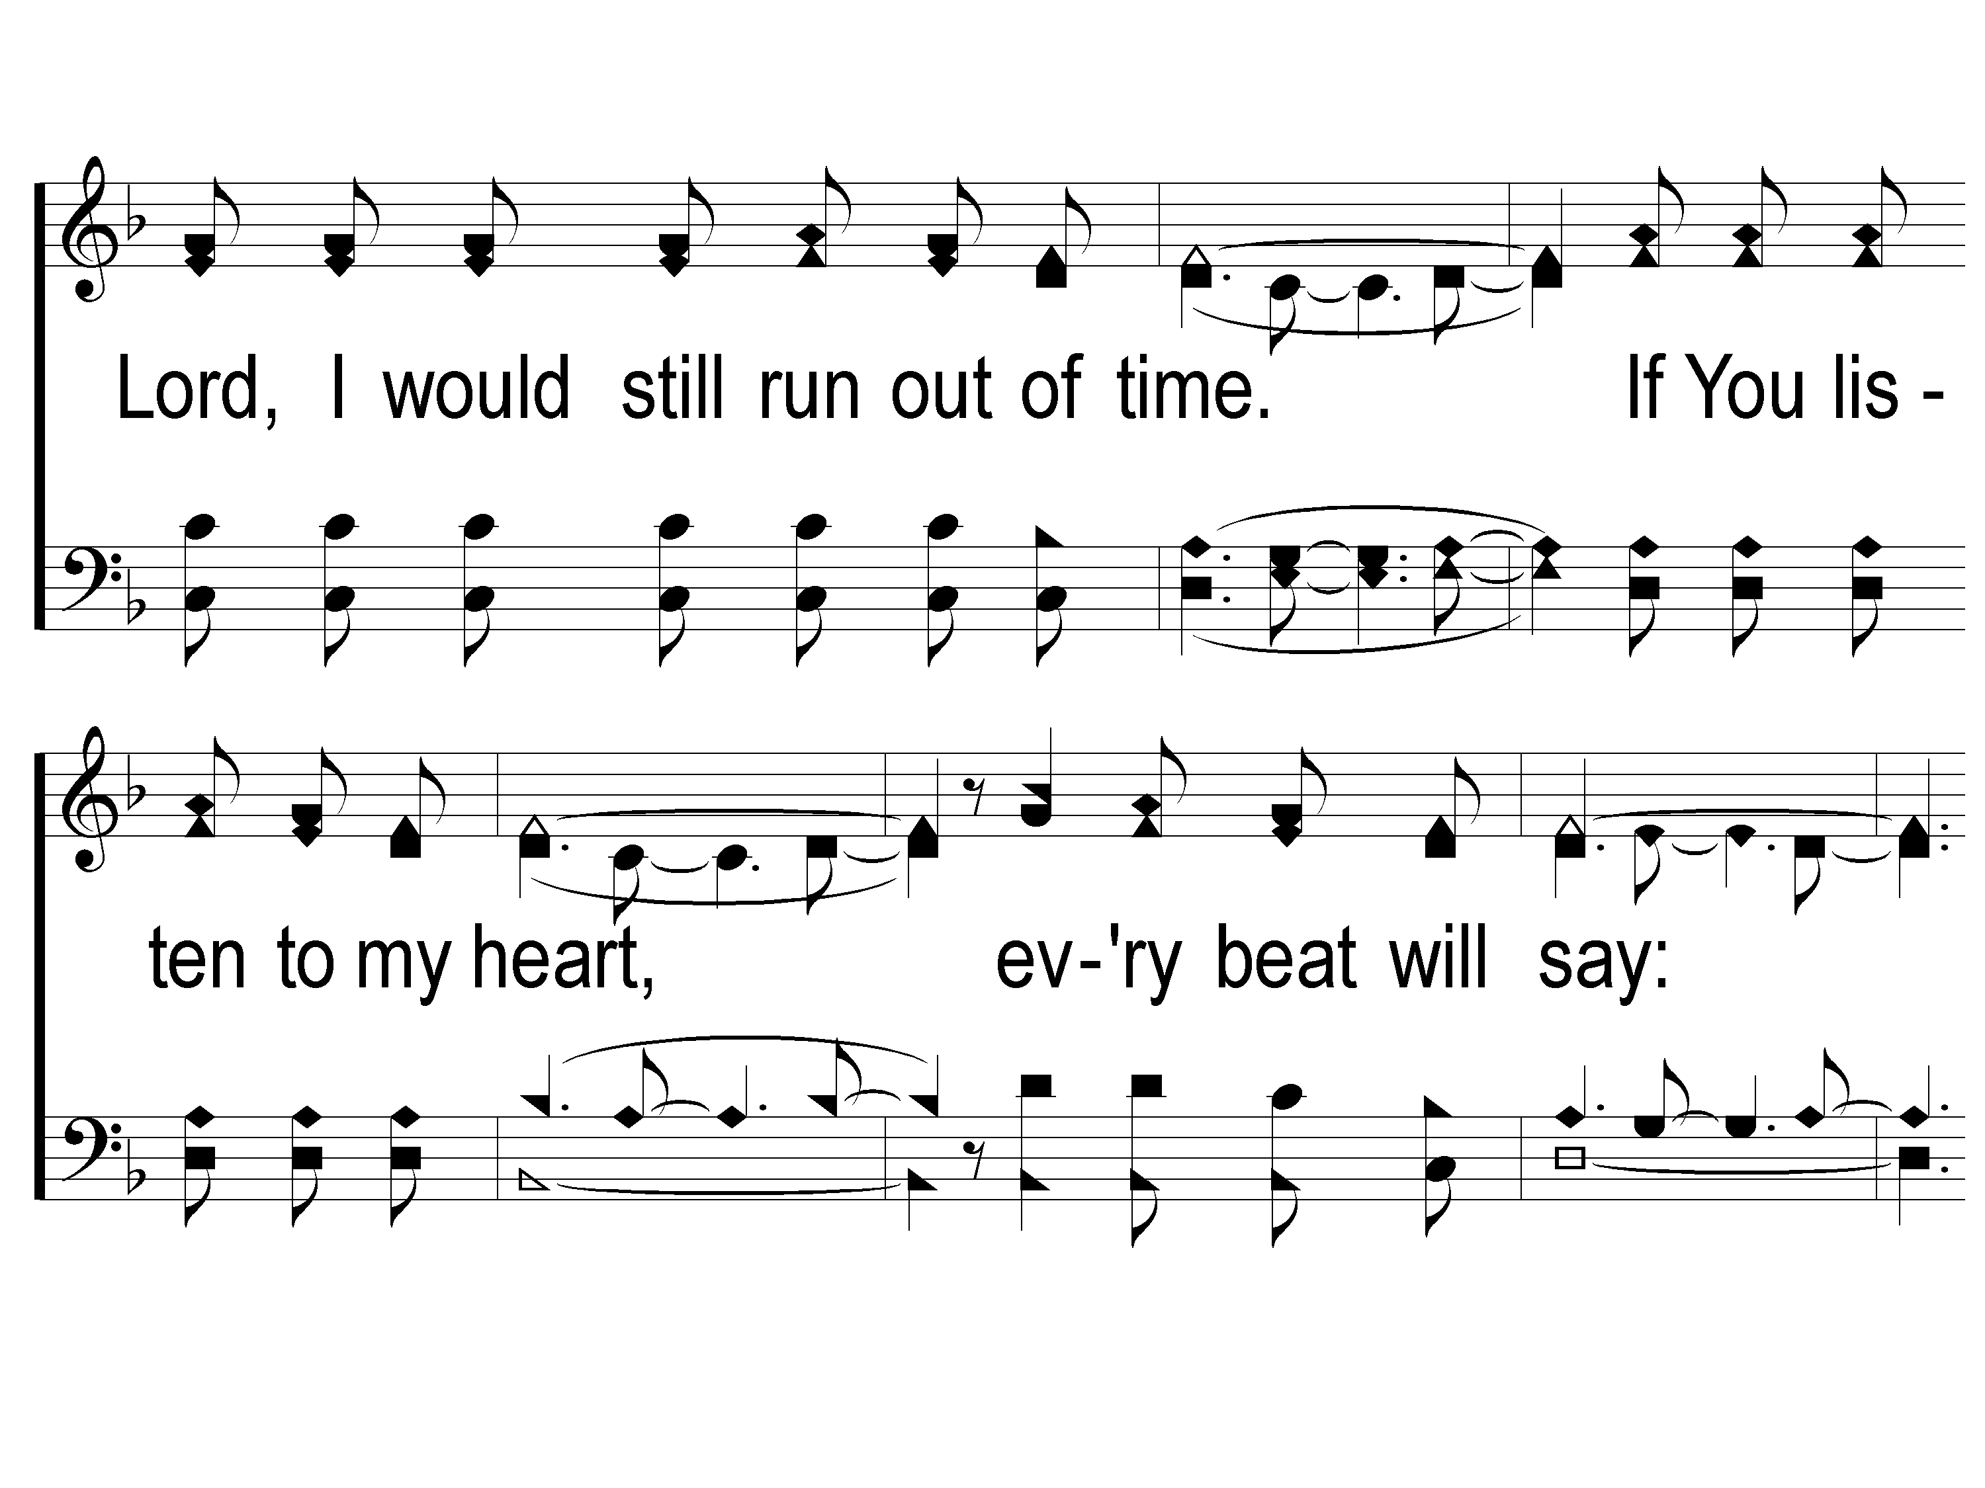
2-2 Listen to our Hearts
Listen To Our Hearts
810

Slide 40
2-3 Listen to our Hearts
Listen To Our Hearts
810

Slide 41
C-1 Listen to our Hearts
Listen To Our Hearts
810

Slide 42
C-2 Listen to our Hearts
Listen To Our Hearts
810

Slide 43
C-3 Listen to our Hearts
Listen To Our Hearts
810

Slide 44
C-4 Listen to our Hearts
Listen To Our Hearts
810

Slide 45
Opening PRAYER

Slide 46
SONG:
Firm Foundation

Slide 47
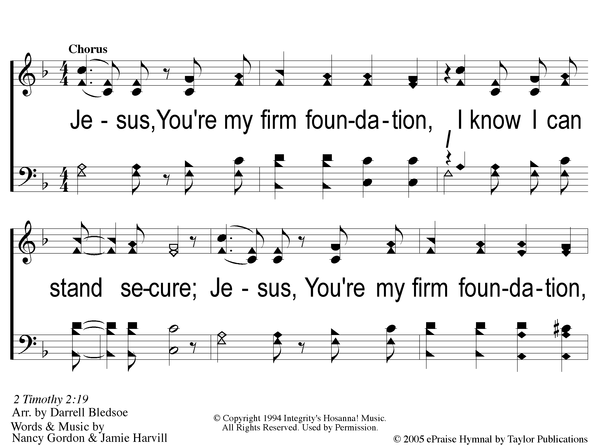
C-1 Firm Foundation
Firm Foundation

Slide 48
C-2 Firm Foundation
Firm Foundation

Slide 49
C-1 Firm Foundation
Firm Foundation

Slide 50
C-2 Firm Foundation
Firm Foundation

Slide 51
1-1 Firm Foundation
Firm Foundation

Slide 52
1-2 Firm Foundation
Firm Foundation

Slide 53
C-1 Firm Foundation
Firm Foundation

Slide 54
C-2 Firm Foundation
Firm Foundation

Slide 55
2-1 Firm Foundation
Firm Foundation

Slide 56
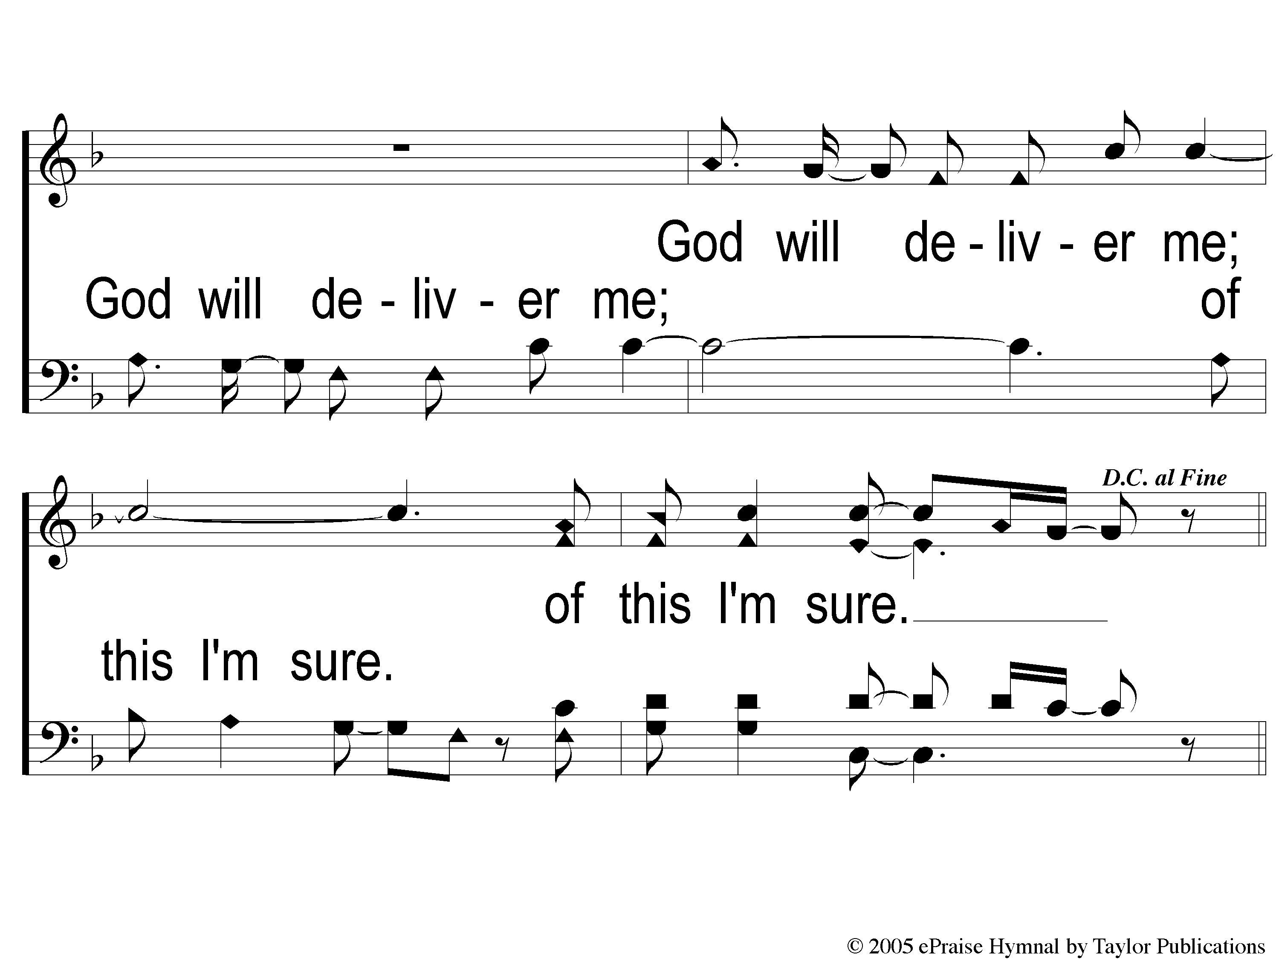
2-2 Firm Foundation
Firm Foundation

Slide 57
C-1 Firm Foundation
Firm Foundation

Slide 58
C-2 Firm Foundation
Firm Foundation

Slide 59
Ds-1 Firm Foundation
Firm Foundation

Slide 60
Ds-2 Firm Foundation
Firm Foundation

Slide 61
#155
SONG:
Highest Place

Slide 62
1 Highest Place
Highest Place
155

Slide 63
2 Highest Place
Highest Place
155

Slide 64
3 Highest Place
Highest Place
155

Slide 65
4 Highest Place
Highest Place
155

Slide 66
5 Highest Place
Highest Place
155

Slide 67
Tag Highest Place
Highest Place
155

Slide 68
SCRIPTURE:
Revelation 20:1-3

Slide 69
THE REVELATION OF JESUS CHRIST
“WHO IS ABLE TO STAND?”
REVELATION 6:17 (NKJV)

Slide 70
THE REVELATION OF JESUS CHRIST
“AND REIGNED WITH CHRIST FOR 1000 YEARS”
REVELATION 20:4 (NKJV)

Slide 71
THE REVELATION OF JESUS CHRIST
“THE HOLY CITY, THE NEW JERUSALEM”
REVELATION 21:2 (NKJV)

Slide 72
Two Challenges:
Read through all of the book
Write a one-sentence summary of the book

Slide 73
REVIEW
Ch. 1-3 – Jesus is among His Church
Ch. 4-7 – God is on His Throne
Ch. 8-11 – God’s People are being Persecuted
Ch. 12-14 – Rome is influenced by Satan
Ch. 15-19 – Rome will Fall

Slide 74
Chapter 20
The Binding of Satan (v. 1-3)
The Reigning of Christians (v. 4-6)
The End of Satan (v. 7-10)
The End of those who oppose God (v. 11-15)

Slide 75
The Binding of Satan (v. 1-3)
An angel with a key and a chain (v. 1)
Binds the dragon for 1000 years (v. 2)

Slide 76
The Binding of Satan (v. 1-3)
“Bound” = restricted, limited (Mt. 12:29)
How?
No longer able to “deceive the nations” (v. 3)
Decreased persecution?

Slide 77
The Binding of Satan (v. 1-3)
“Released” = unrestricted
“for a little while”
Rev. 6:10-11, 3:10

Slide 78
The Reigning of Christians (v. 4-6)
“I saw thrones” (v. 4a)
Judging the World – 1 Cor. 6:2
Reigning as Kings – Rev. 1:6

Slide 79
The Reigning of Christians (v. 4-6)
“I saw…souls” (v. 4b)
Beheaded for the cause of Christ
Did not worship the Beast
Did not have the mark of the Beast

Slide 80
The Reigning of Christians (v. 4-6)
“the first resurrection” (v. 5-6)
Included: Faithful of God’s people
Not Included:
Not Beheaded for the cause of Christ
Worshipped the Beast
Had the mark of the Beast

Slide 81
The End of Satan (v. 7-10)
“The Devil” (v. 9-10)
Cast into the Lake of Fire and Brimstone
Tormented forever

Slide 82
The End of Satan (v. 7-10)
Parallels with Ezekiel:
Resurrection of God’s People (Ch. 37)
Rise of an opposing army (38:9-12, 15-17)
Defeat of that army (38:18-23, 39:4-7)

Slide 83
The End of Those Who Oppose God (v. 11-15)
Recapitulation of:
19:11-21 – End of the Beast(s)
20:1-10 – End of Satan / Dragon

Slide 84
The End of Those Who Oppose God (v. 11-15)
“The Sea” (v. 13)
Those who follow the beasts and the Dragon
Dead because of God’s wrath on Rome (Ch. 16)

Slide 85
The End of Those Who Oppose God (v. 11-15)
“Anyone not found written in the Book of Life” (v. 15)
Vision of Complete defeat of those who oppose God & His cause

Slide 86
The Application
1. All is Past
The “1000-year” binding of Satan
The “1000-year” reign of Christ/Christians
Satan Released to Deceive Nations

Slide 87
The Application
Satan Has Been Defeated
When Jesus overcame Death
Any attempt to overthrow God is useless

Slide 88
The Application
Victory belongs to the Christian
Because Jesus overcame Death
We can have assurance when it all seems unsure

Slide 89
Have I Gained The Victory?

Slide 90
#909
SONG:
There’s A Fountain Free

Slide 91
1-1 There’s A Fountain free
There’s A Fountain Free
909

Slide 92
1-2 There’s A Fountain free
There’s A Fountain Free
909

Slide 93
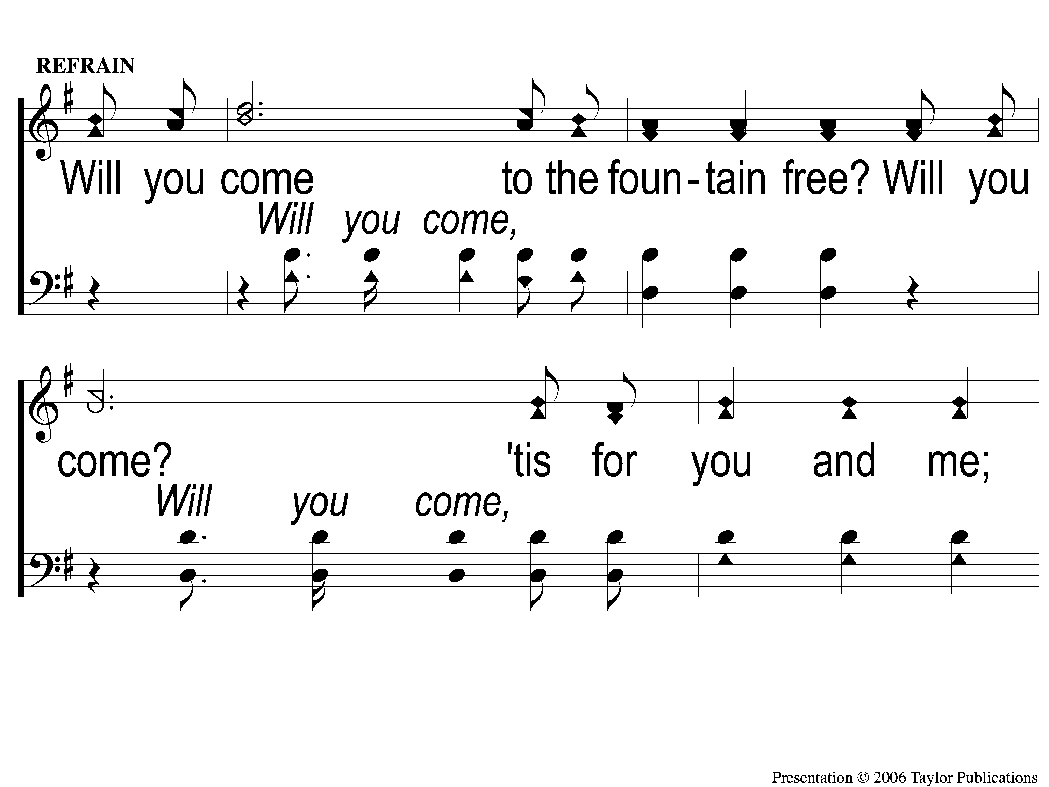
C-1 There’s A Fountain free
There’s A Fountain Free
909

Slide 94
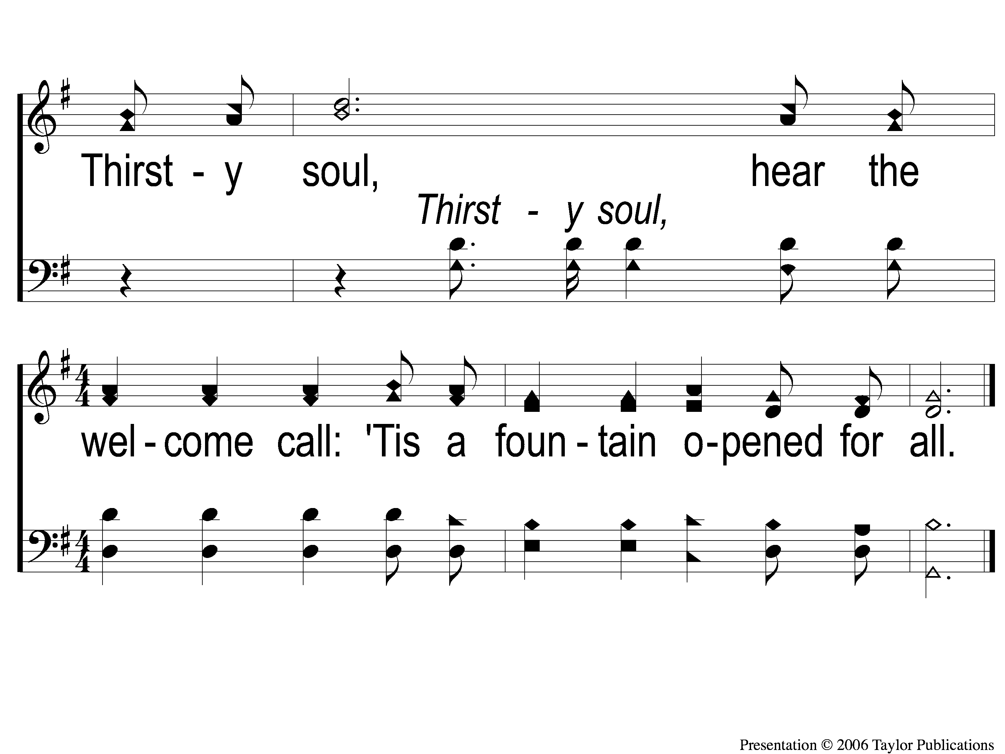
C-2 There’s A Fountain free
There’s A Fountain Free
909

Slide 95
3-1 There’s A Fountain free
There’s A Fountain Free
909

Slide 96
3-2 There’s A Fountain free
There’s A Fountain Free
909

Slide 97
C-1 There’s A Fountain free
There’s A Fountain Free
909

Slide 98
C-2 There’s A Fountain free
There’s A Fountain Free
909

Slide 99
#792
SONG:
My Eyes Are Dry

Slide 100
1 My Eyes are Dry
My Eyes Are Dry
792

Slide 101
2 My Eyes are Dry
My Eyes Are Dry
792

Slide 102
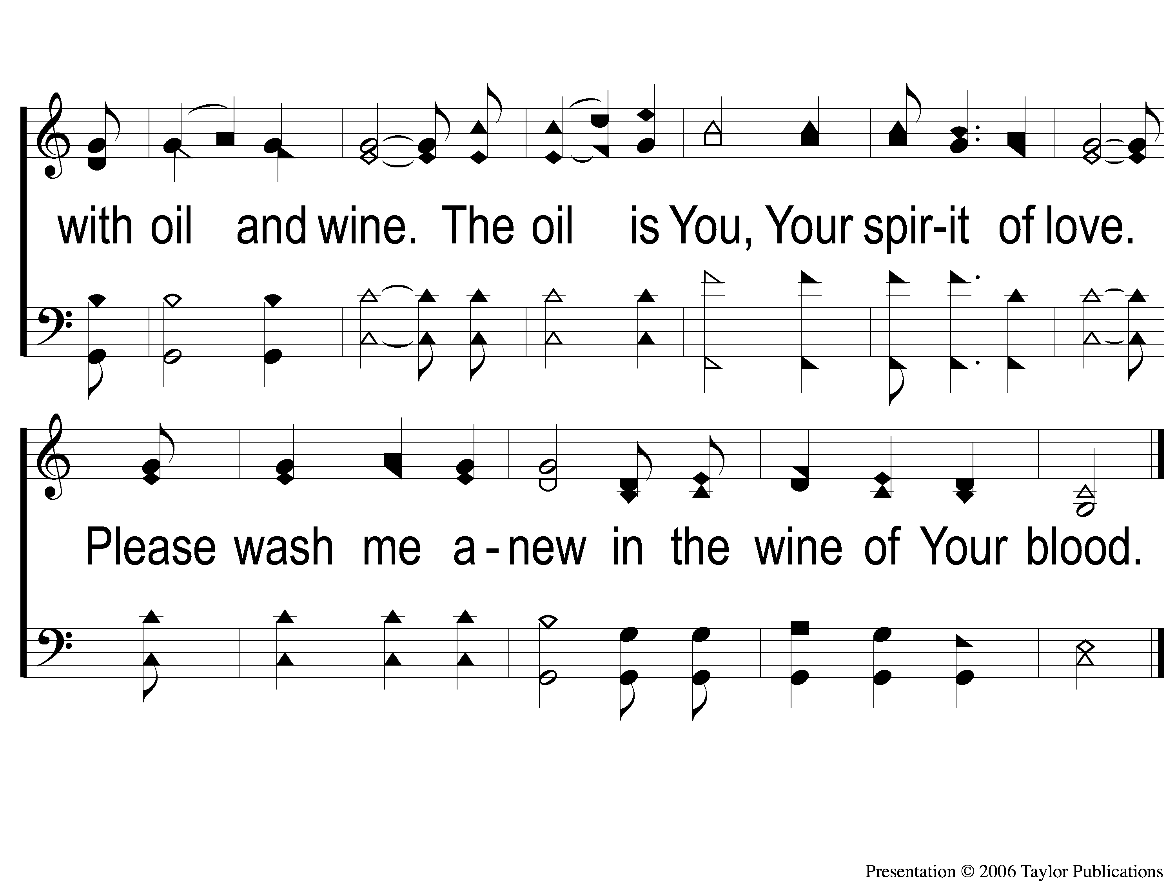
3 My Eyes are Dry
My Eyes Are Dry
792

Slide 103
LORD’S SUPPER
The
1 Cor. 11:23-26

Slide 104
Unleavened Bread
LORD’S SUPPER
There is therefore now no condemnation to those who are in Christ Jesus, who do not walk according to the flesh, but according to the Spirit. ² For the law of the Spirit of life in Christ Jesus has made me free from the law of sin and death.
.
Romans 8:1-2

Slide 105
Fruit of the Vine
LORD’S SUPPER
³¹ What then shall we say to these things? If God is for us, who can be against us? ³² He who did not spare His own Son, but delivered Him up for us all, how shall He not with Him also freely give us all things?
Romans 8:31-32

Slide 106
Acts 20:35
OFFERING
³⁵ I have shown you in every way, ^{r}by laboring like this, that you must support the weak. And remember the words of the Lord Jesus, that He said, ‘It is more blessed to give than to receive.’ ”

Slide 107
Closing PRAYER

Slide 108
867
SONG:
To Canaan’s Land
I’m On My Way

Slide 109
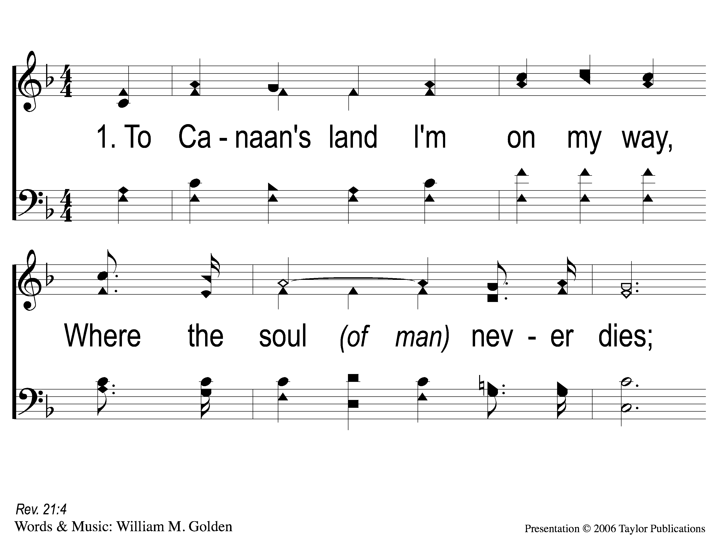
1-1 To Canaan’s Land
To Canaan’s Land I’m On My Way
867

Slide 110
1-2 To Canaan’s Land
To Canaan’s Land I’m On My Way
867

Slide 111
C-1 To Canaan’s Land
To Canaan’s Land I’m On My Way
867

Slide 112
C-2 To Canaan’s Land
To Canaan’s Land I’m On My Way
867

Slide 113
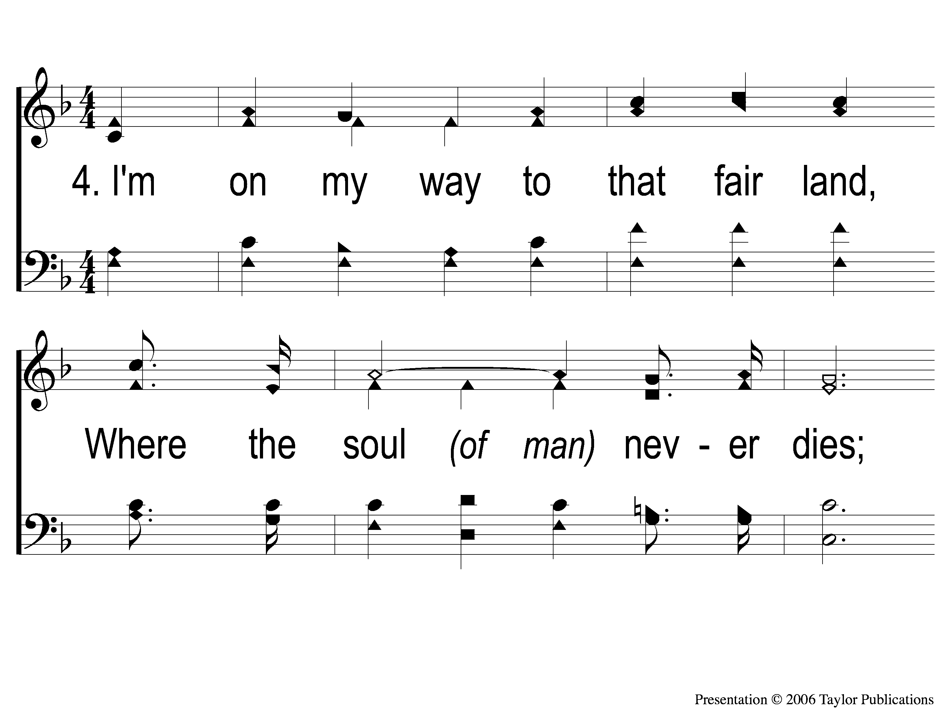
4-1 To Canaan’s Land
To Canaan’s Land I’m On My Way
867

Slide 114
4-2 To Canaan’s Land
To Canaan’s Land I’m On My Way
867

Slide 115
C-1 To Canaan’s Land
To Canaan’s Land I’m On My Way
867

Slide 116
C-2 To Canaan’s Land
To Canaan’s Land I’m On My Way
867

Slide 117
TONIGHT @ 6:00 pm
EVENING WORSHIP
HOPE TO SEE YOU THERE!

