Slide 1
PLEASE STANDBY
OUR LIVESTREAM
WILL BEGIN SOON

Slide 2
WELCOME
THANKS FOR JOINING US!

Slide 3
#290
SONG:
Shine, Jesus, Shine

Slide 4
1-1 Shine Jesus Shine
Shine, Jesus, Shine
290

Slide 5
1-2 Shine Jesus Shine
Shine, Jesus, Shine
290

Slide 6
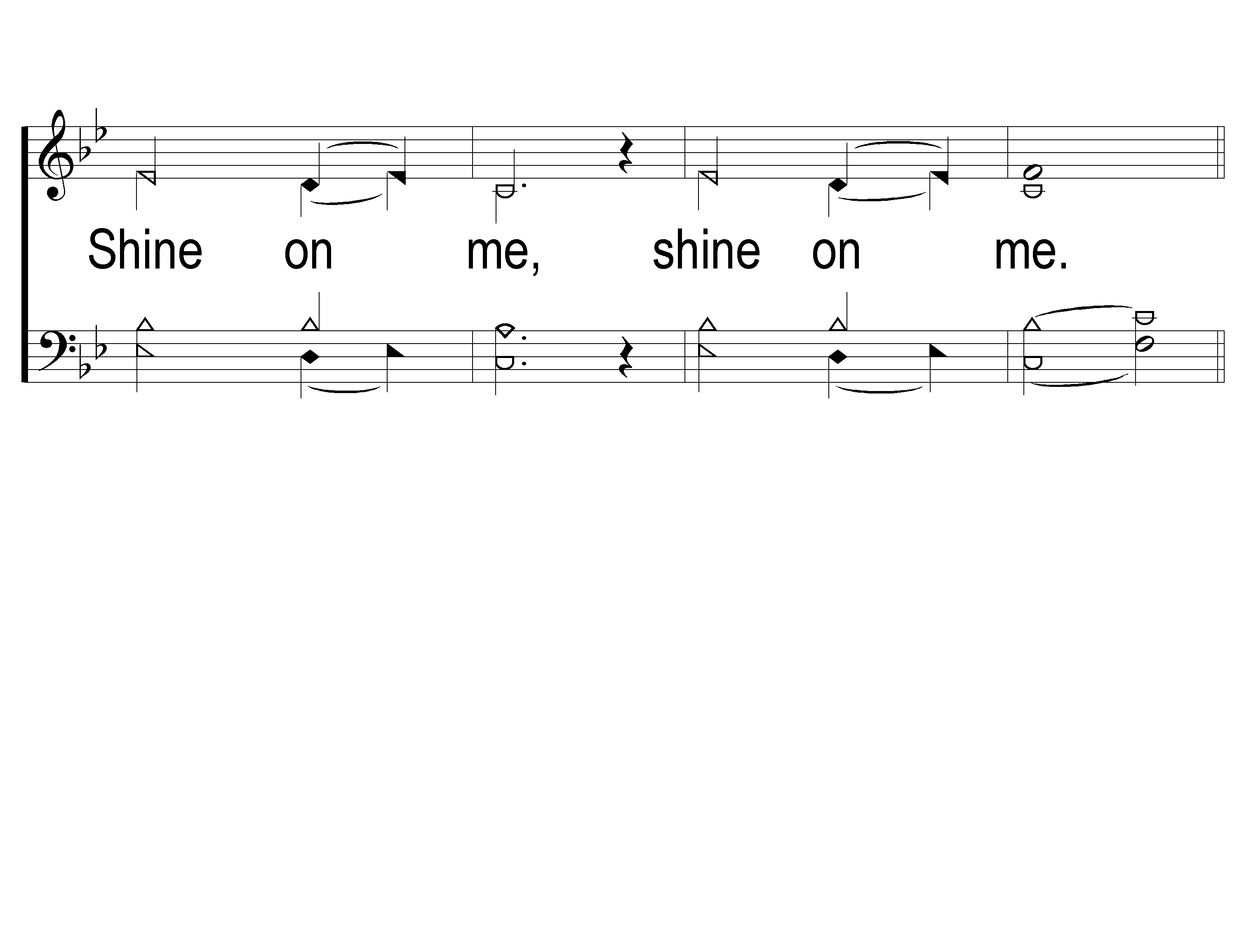
1-3 Shine Jesus Shine
Shine, Jesus, Shine
290

Slide 7
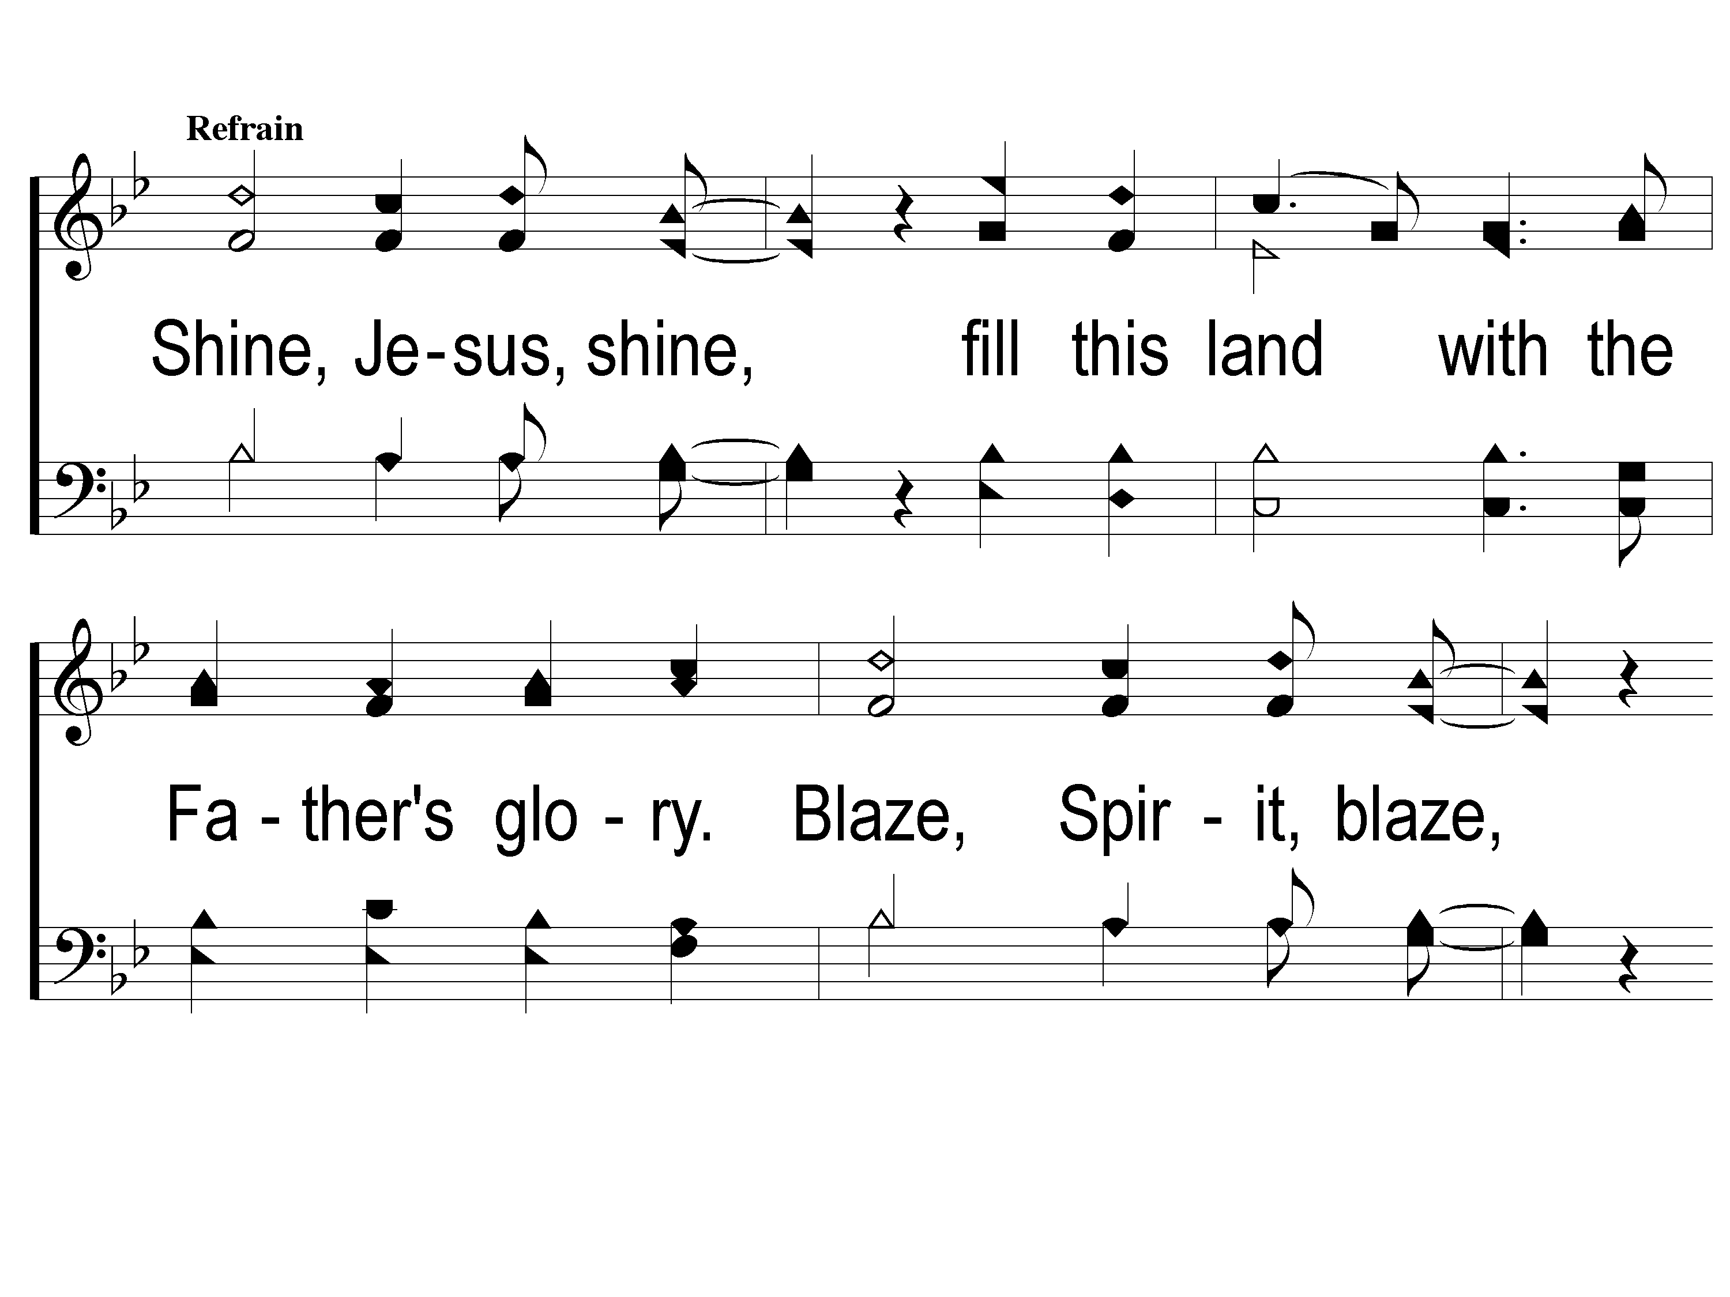
C-1 Shine Jesus Shine
Shine, Jesus, Shine
290

Slide 8
C-2 Shine Jesus Shine
Shine, Jesus, Shine
290

Slide 9
C-3 Shine Jesus Shine
Shine, Jesus, Shine
290

Slide 10
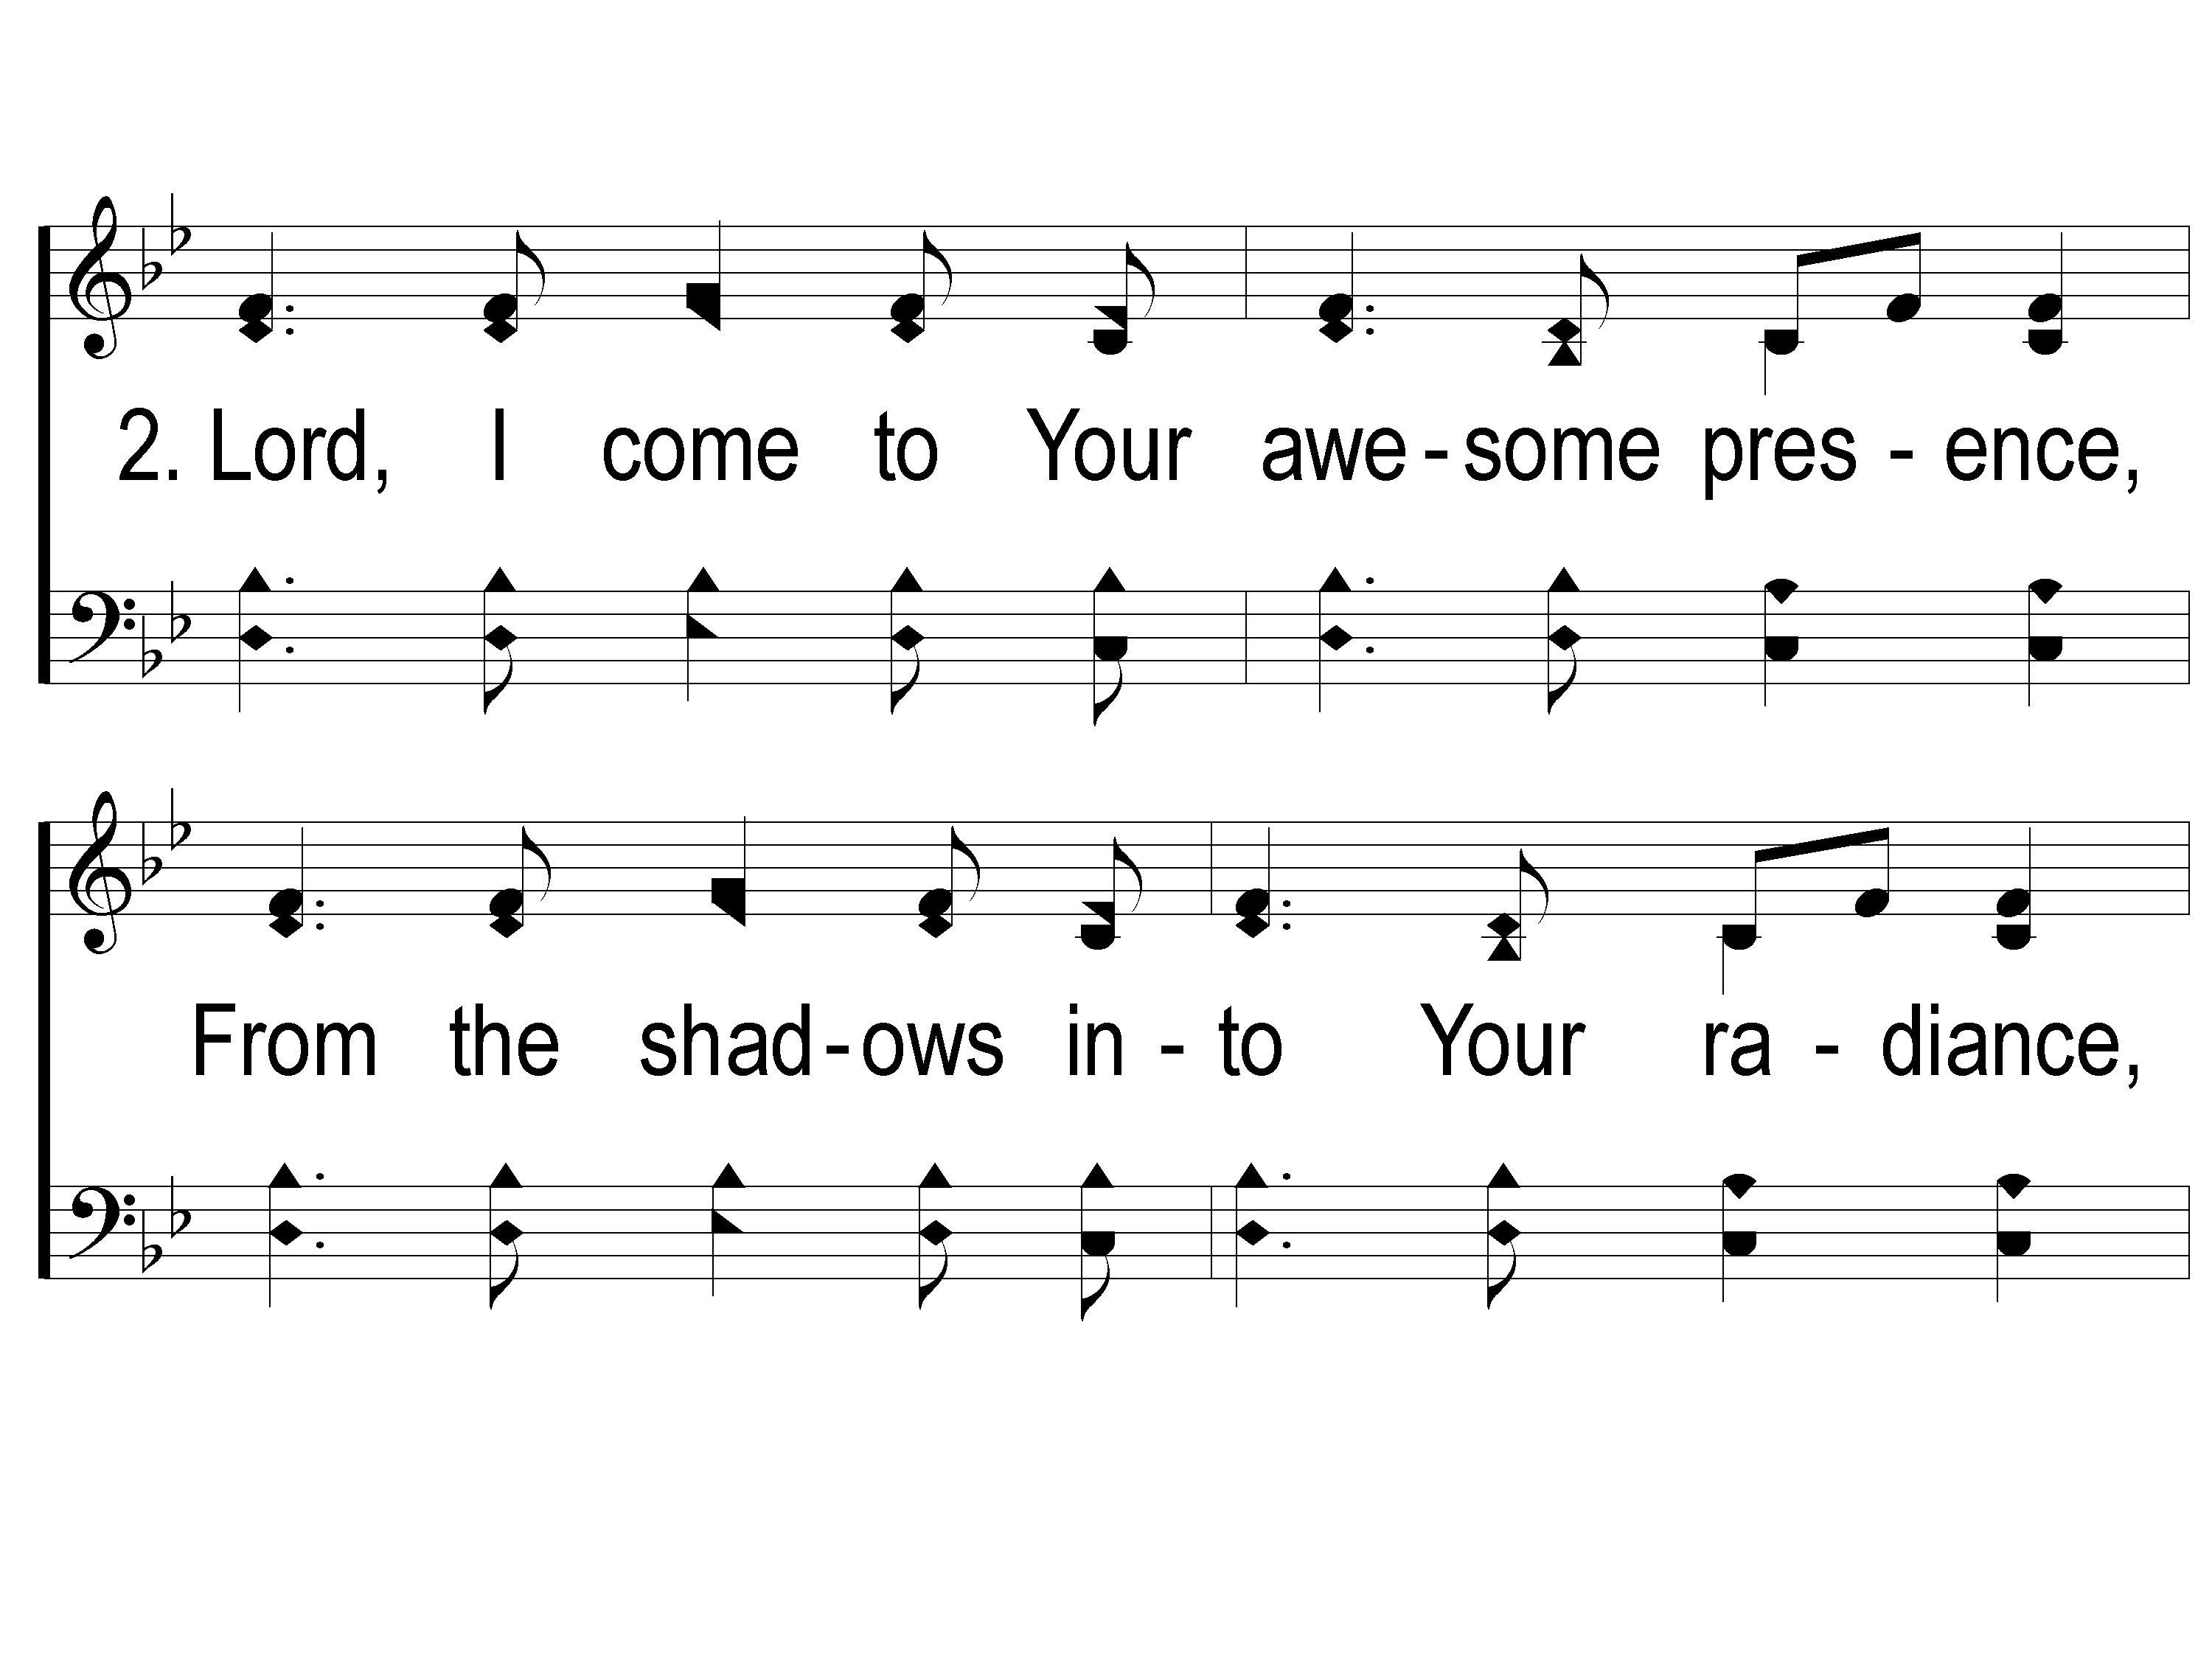
2-1 Shine Jesus Shine
Shine, Jesus, Shine
290

Slide 11
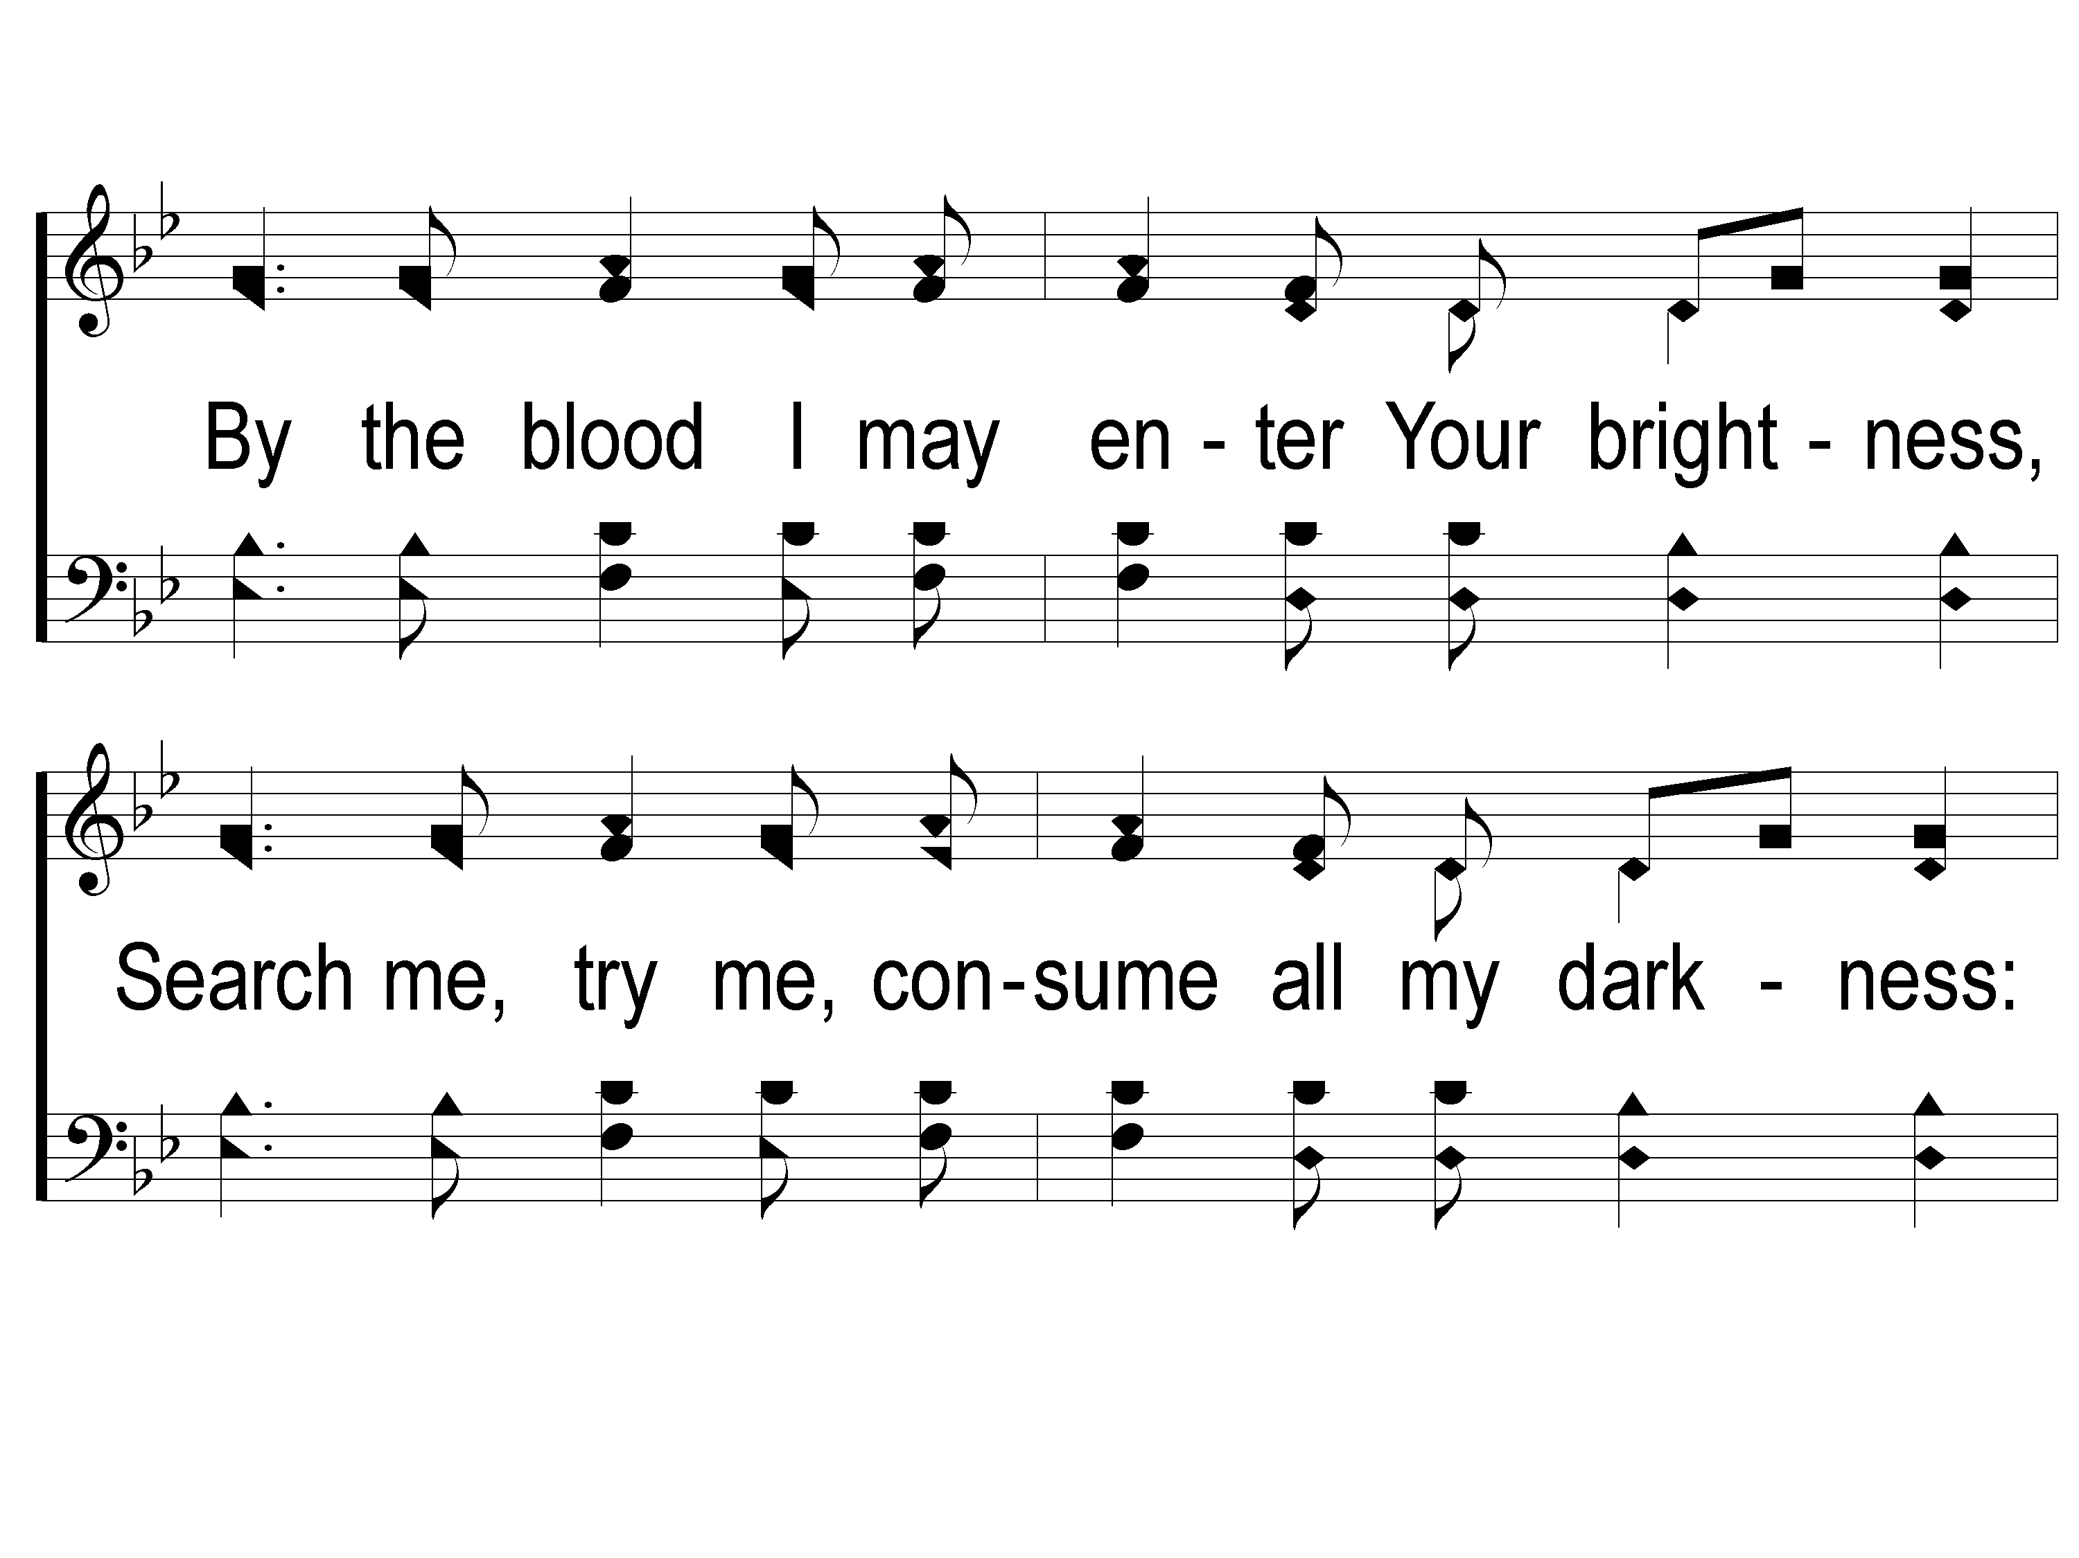
2-2 Shine Jesus Shine
Shine, Jesus, Shine
290

Slide 12
2-3 Shine Jesus Shine
Shine, Jesus, Shine
290

Slide 13
C-1 Shine Jesus Shine
Shine, Jesus, Shine
290

Slide 14
C-2 Shine Jesus Shine
Shine, Jesus, Shine
290

Slide 15
C-3 Shine Jesus Shine
Shine, Jesus, Shine
290

Slide 16
#959
SONG:
Just A Little
Talk With Jesus

Slide 17
1-1 Just A Little Talk With Jesus
Just A Little Talk With Jesus
959

Slide 18
1-2 Just A Little Talk With Jesus
Just A Little Talk With Jesus
959

Slide 19
C-1 Just A Little Talk With Jesus
Just A Little Talk With Jesus
959

Slide 20
C-2 Just A Little Talk With Jesus
Just A Little Talk With Jesus
959

Slide 21
C-3 Just A Little Talk With Jesus
Just A Little Talk With Jesus
959

Slide 22
2-1 Just A Little Talk With Jesus
Just A Little Talk With Jesus
959

Slide 23
2-2 Just A Little Talk With Jesus
Just A Little Talk With Jesus
959

Slide 24
C-1 Just A Little Talk With Jesus
Just A Little Talk With Jesus
959

Slide 25
C-2 Just A Little Talk With Jesus
Just A Little Talk With Jesus
959

Slide 26
C-3 Just A Little Talk With Jesus
Just A Little Talk With Jesus
959

Slide 27
3-1 Just A Little Talk With Jesus
Just A Little Talk With Jesus
959

Slide 28
3-2 Just A Little Talk With Jesus
Just A Little Talk With Jesus
959

Slide 29
C-1 Just A Little Talk With Jesus
Just A Little Talk With Jesus
959

Slide 30
C-2 Just A Little Talk With Jesus
Just A Little Talk With Jesus
959

Slide 31
C-3 Just A Little Talk With Jesus
Just A Little Talk With Jesus
959

Slide 32
Opening PRAYER

Slide 33
#535
SONG:
The Gloryland Way

Slide 34
1-1 The Glory Land Way
The Glory Land Way
535

Slide 35
1-2 The Glory Land Way
The Glory Land Way
535

Slide 36
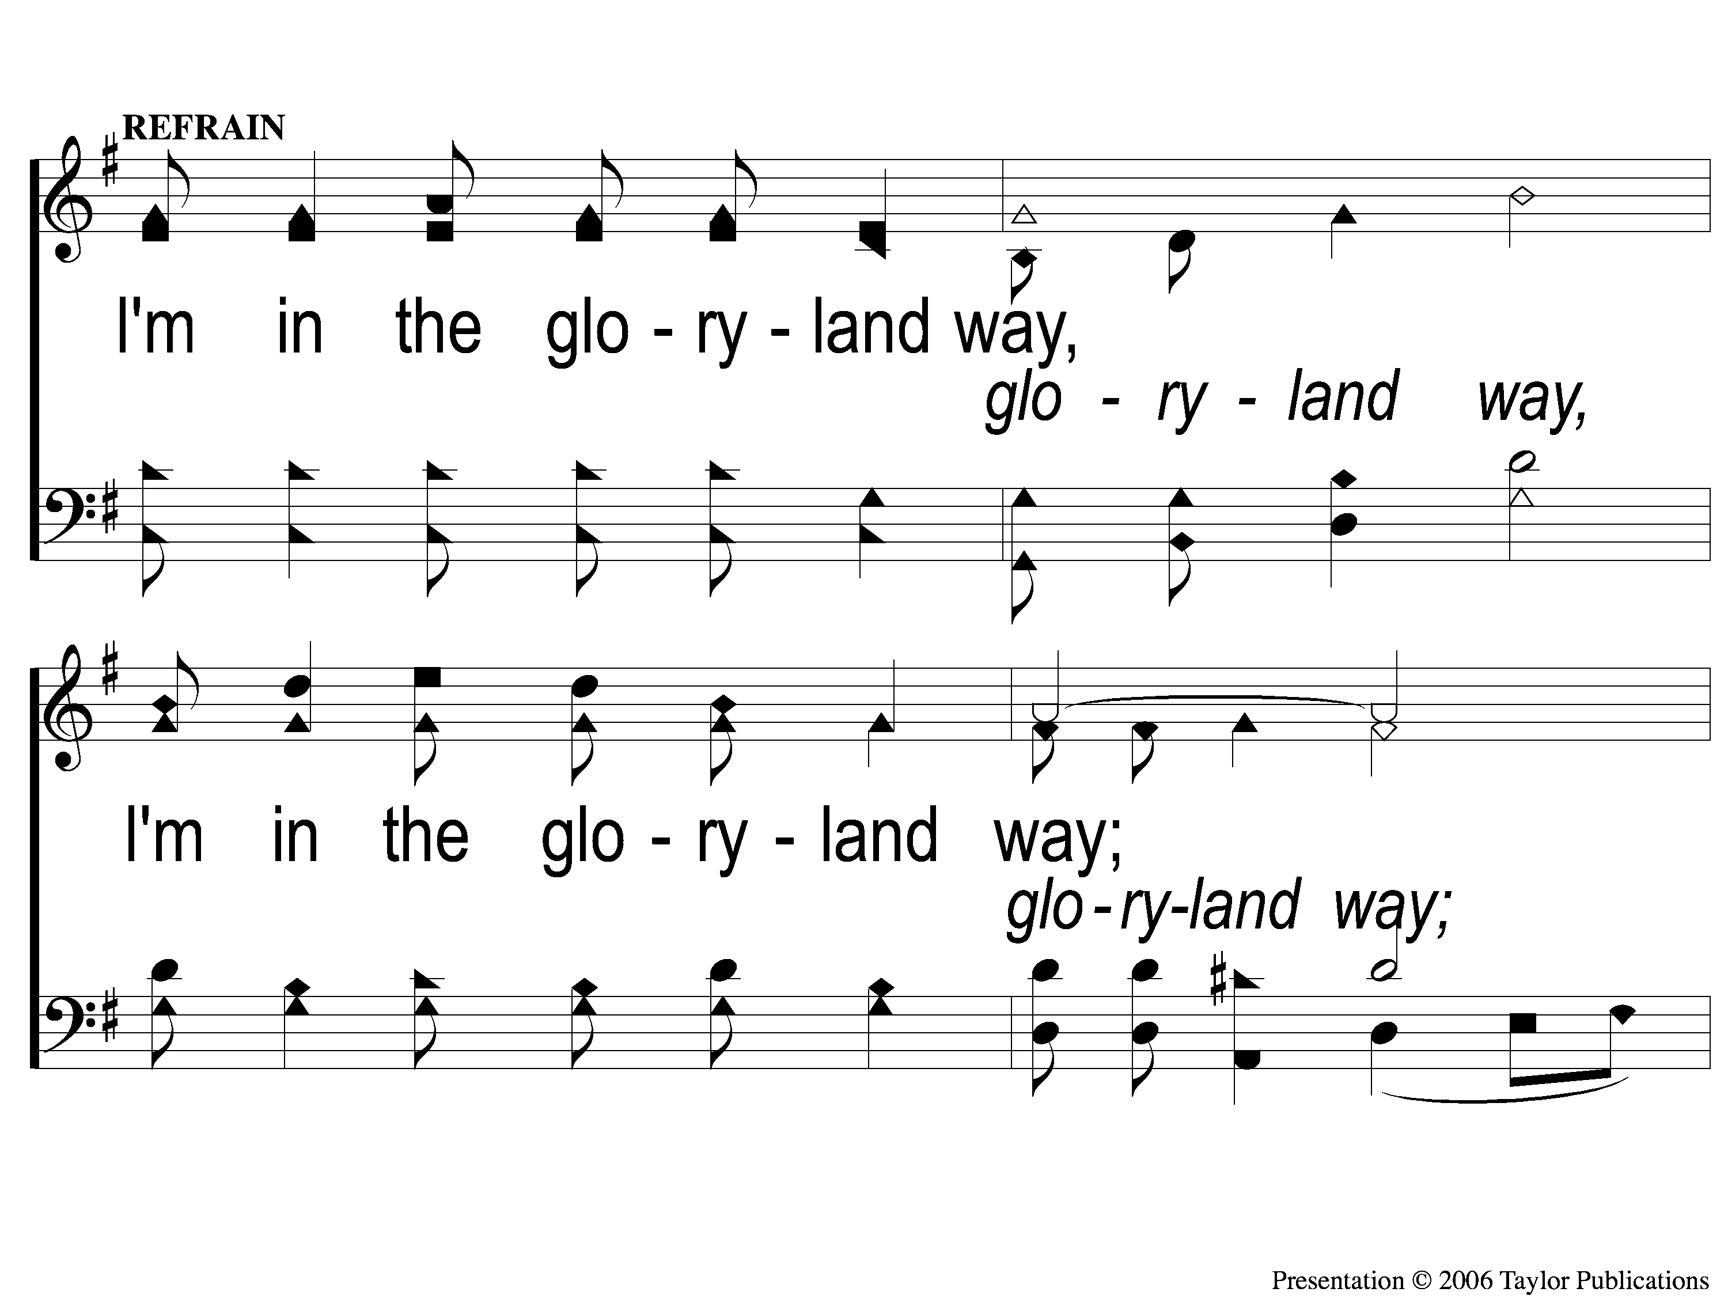
C-1 The Glory Land Way
The Glory Land Way
535

Slide 37
C-2 The Glory Land Way
The Glory Land Way
535

Slide 38
2-1 The Glory Land Way
The Glory Land Way
535

Slide 39
2-2 The Glory Land Way
The Glory Land Way
535

Slide 40
C-1 The Glory Land Way
The Glory Land Way
535

Slide 41
C-2 The Glory Land Way
The Glory Land Way
535

Slide 42
3-1 The Glory Land Way
The Glory Land Way
535

Slide 43
3-2 The Glory Land Way
The Glory Land Way
535

Slide 44
C-1 The Glory Land Way
The Glory Land Way
535

Slide 45
C-2 The Glory Land Way
The Glory Land Way
535

Slide 46
#538
SONG:
My Hope Is Built

Slide 47
1-1 My Hope is Built
My Hope Is Built
538

Slide 48
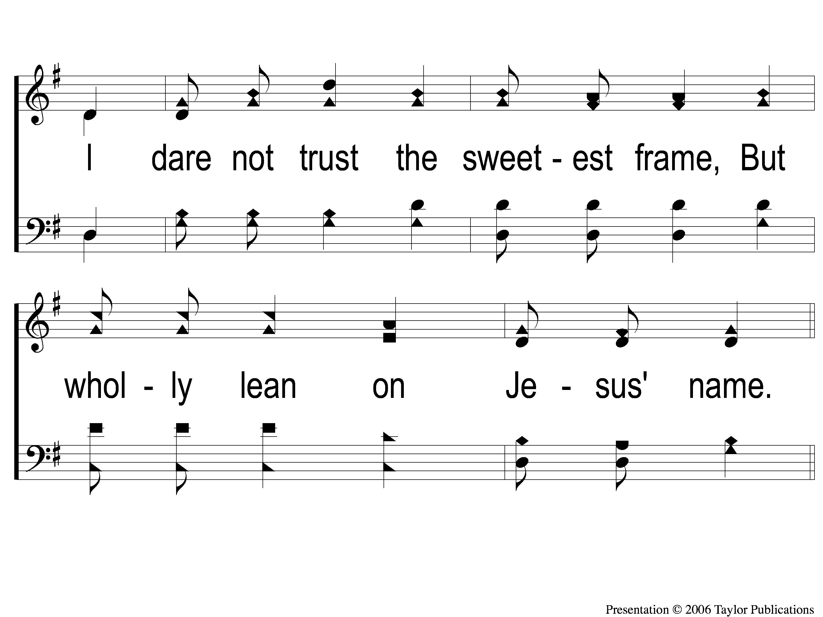
1-2 My Hope is Built
My Hope Is Built
538

Slide 49
c My Hope is Built
My Hope Is Built
538

Slide 50
2-1 My Hope is Built
My Hope Is Built
538

Slide 51
2-2 My Hope is Built
My Hope Is Built
538

Slide 52
c My Hope is Built
My Hope Is Built
538

Slide 53
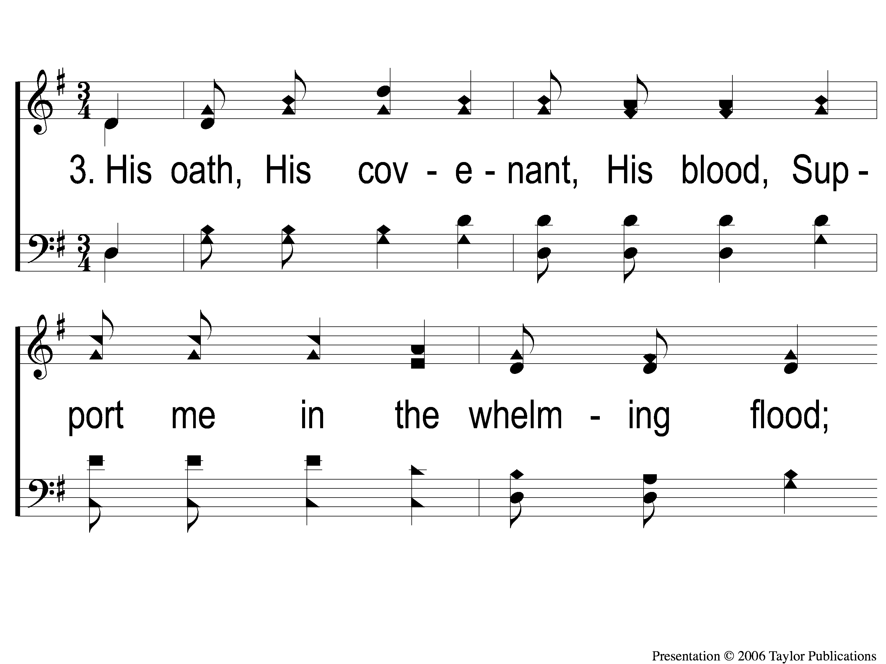
3-1 My Hope is Built
My Hope Is Built
538

Slide 54
3-2 My Hope is Built
My Hope Is Built
538

Slide 55
c My Hope is Built
My Hope Is Built
538

Slide 56
4-1 My Hope is Built
My Hope Is Built
538

Slide 57
4-2 My Hope is Built
My Hope Is Built
538

Slide 58
c My Hope is Built
My Hope Is Built
538

Slide 59
SCRIPTURE:
Matthew 5:13-16

Slide 60
B E T R A Y E D
John 18:1-11

Slide 61
Standing with Jesus
In The Garden

Slide 62
Standing

Slide 63
“Put on the full armor of God so that you will be able to stand firm against the schemes of the devil” – Eph. 6:11, 13-14

Slide 64
Stand out!

Slide 65
CONTAGIOUS CHRISTIANs

Slide 66
ThE NEED TO BE CONTAGIOUS
Called by God
Matt. 5:13-16
Phili. 2:15
1 Pet. 2:12

Slide 67
ThE NEED TO BE CONTAGIOUS
Many Lost Souls
Lk. 10:2
Jn. 4:35

Slide 68
HOW TO BE CONTAGIOUS
A Heart for Evangelism
Lk. 19:10
Matt. 28:18-20
Acts 5:42, 8:4

Slide 69
HOW TO BE CONTAGIOUS
A Joyous Tongue
Psa. 122:1
Jms. 3:5-6
Col. 4:6

Slide 70
HOW TO BE CONTAGIOUS
A Positive Spirit
Psa. 118:24
Phili. 4:8

Slide 71
HOW TO BE CONTAGIOUS
A Life of Prayer
Acts 20:36
Lk. 21:37, 22:39

Slide 72
HOW TO BE CONTAGIOUS
A Love for God’s People
Jn. 13:35
1 Jn. 4:7
Eph. 1:10, 2:5-6, 21-22, 4:16

Slide 73
THE BENEFITS
1. Saved Souls
1 Tim. 2:4
Titus 2:11
2 Pet. 3:15

Slide 74
THE BENEFITS
2. Larger Family
Gal. 6:1
1 Tim. 5:1-2

Slide 75
AM I
CONTAGIOUS?

Slide 76
#916
SONG:
What A Day
That Will Be

Slide 77
1-1 What a Day That Will Be
What a Day That Will Be
916

Slide 78
1-2 What a Day That Will Be
What a Day That Will Be
916

Slide 79
1-3 What a Day That Will Be
What a Day That Will Be
916

Slide 80
C-1 What a Day That Will Be
What a Day That Will Be
916

Slide 81
C-2 What a Day That Will Be
What a Day That Will Be
916

Slide 82
C-3 What a Day That Will Be
What a Day That Will Be
916

Slide 83
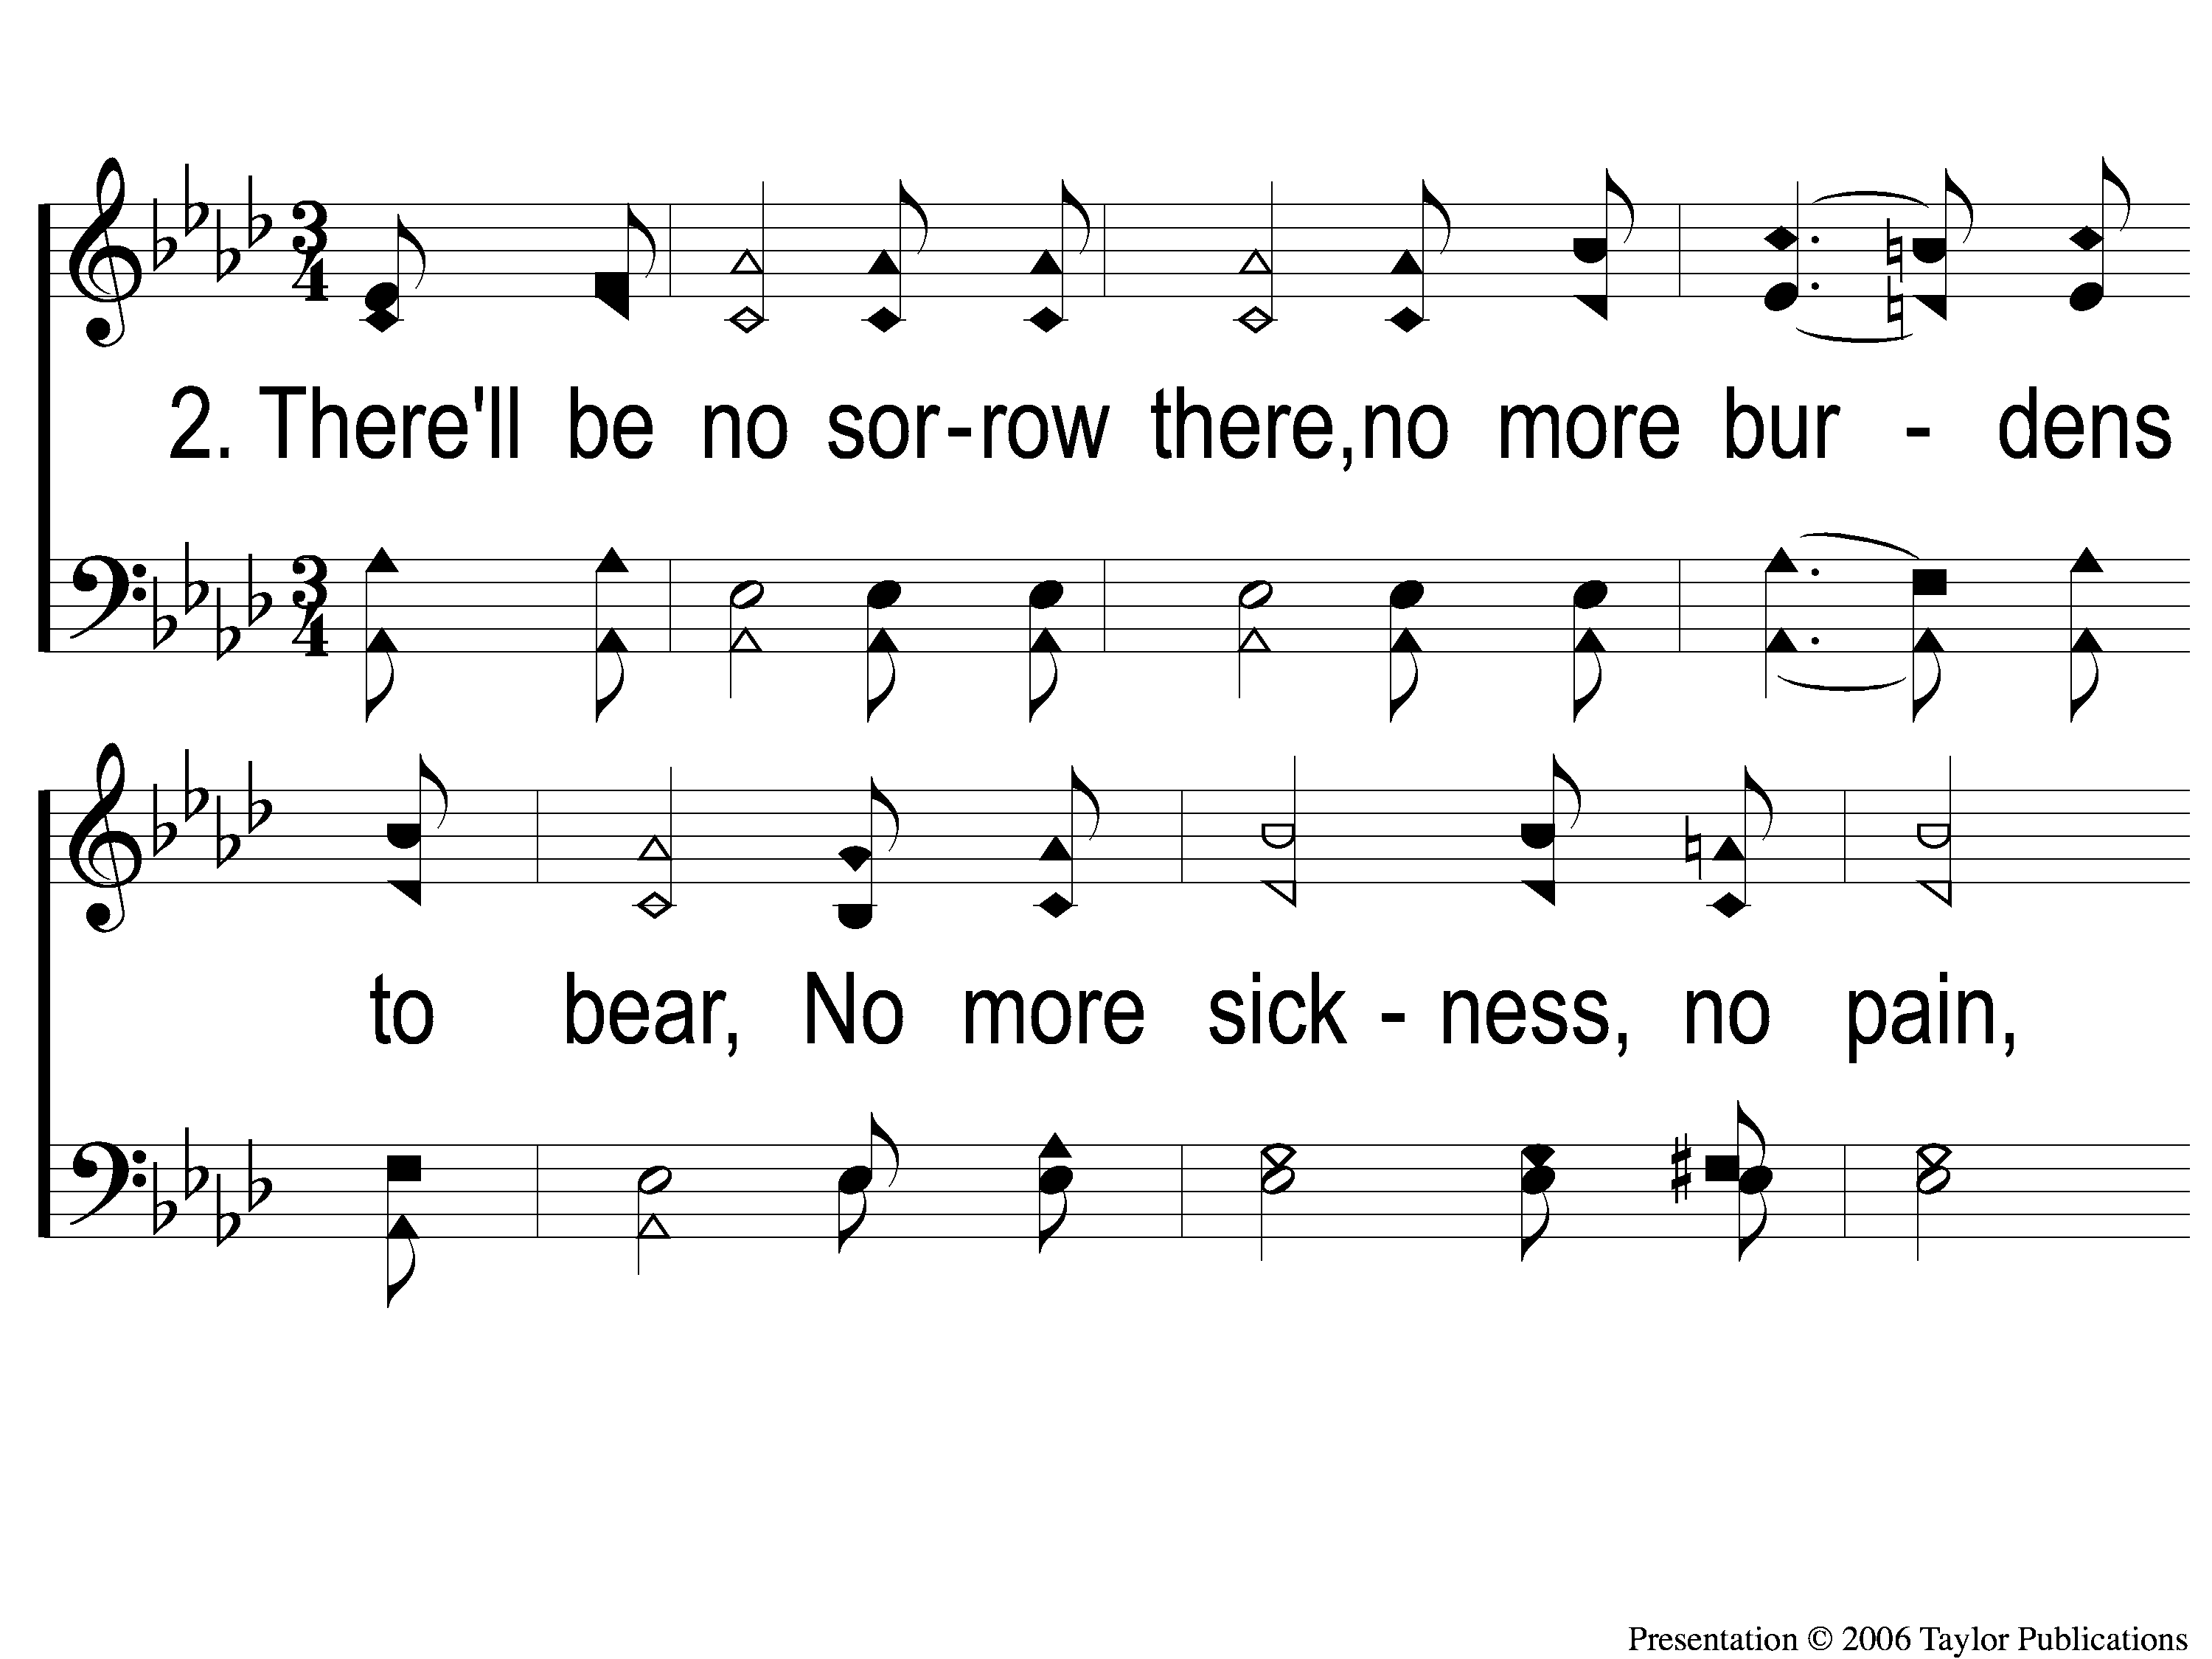
2-1 What a Day That Will Be
What a Day That Will Be
916

Slide 84
2-2 What a Day That Will Be
What a Day That Will Be
916

Slide 85
2-3 What a Day That Will Be
What a Day That Will Be
916

Slide 86
C-1 What a Day That Will Be
What a Day That Will Be
916

Slide 87
C-2 What a Day That Will Be
What a Day That Will Be
916

Slide 88
C-3 What a Day That Will Be
What a Day That Will Be
916

Slide 89
#176
SONG:
Lamb of God

Slide 90
1-1 Lamb of God
Lamb of God
176

Slide 91
1-2 Lamb of God
Lamb of God
176

Slide 92
1-3 Lamb of God
Lamb of God
176

Slide 93
1-4 Lamb of God
Lamb of God
176

Slide 94
C-1 Lamb of God
Lamb of God
176

Slide 95
C-2 Lamb of God
Lamb of God
176

Slide 96
2-1 Lamb of God
Lamb of God
176

Slide 97
2-2 Lamb of God
Lamb of God
176

Slide 98
C-1 Lamb of God
Lamb of God
176

Slide 99
C-2 Lamb of God
Lamb of God
176

Slide 100
LORD’S SUPPER
The
1 Cor. 11:23-26

Slide 101
Unleavened Bread
LORD’S SUPPER
Inasmuch then as the children have partaken of flesh and blood, He Himself likewise shared in the same, that through death He might destroy him who had the power of death, that is, the devil, ¹⁵ and release those who through fear of death were all their lifetime subject to bondage.
.
Hebrews 2:14-15

Slide 102
Fruit of the Vine
LORD’S SUPPER
Therefore we also, since we are surrounded by so great a cloud of witnesses, let us lay aside every weight, and the sin which so easily ensnares us, and let us run with endurance the race that is set before us, 2 looking unto Jesus, the author and finisher of our faith, who for the joy that was set before Him endured the cross, despising the shame, and has sat down at the right hand of the throne of God.
Hebrews 12:1-2

Slide 103
Luke 6:38
OFFERING
“Give, and it will be given to you: good measure, pressed down, shaken together, and running over will be put into your bosom. For with the same measure that you use, it will be measured back to you.”

Slide 104
Closing PRAYER

Slide 105
SONG:
Lord, Reign In Me

Slide 106
1-1 Lord Reign in Me
Lord, Reign In Me

Slide 107
1-2 Lord Reign in Me
Lord, Reign In Me

Slide 108
C-1 Lord Reign in Me
Lord, Reign In Me

Slide 109
C-2 Lord Reign in Me
Lord, Reign In Me

Slide 110
2-1 Lord Reign in Me
Lord, Reign In Me

Slide 111
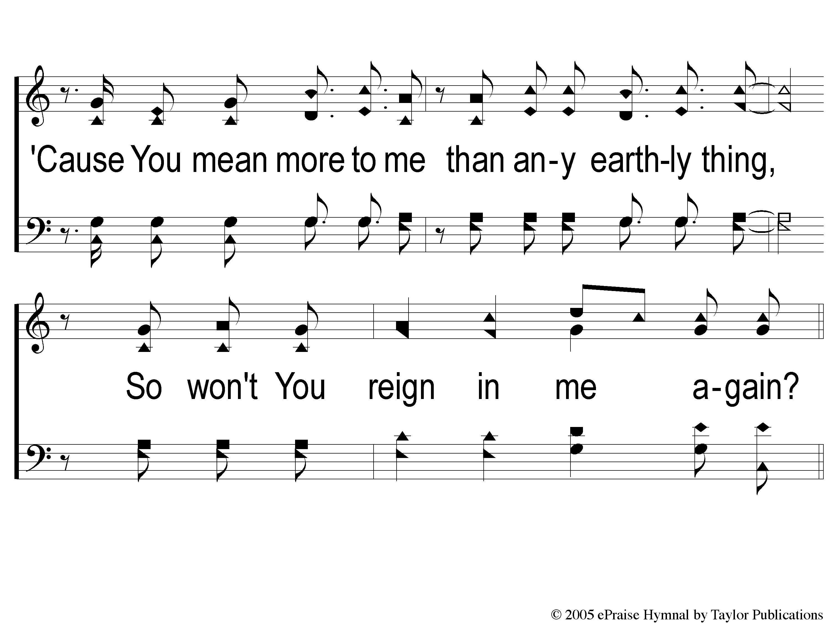
2-2 Lord Reign in Me
Lord, Reign In Me

Slide 112
2C-1 Lord Reign in Me
Lord, Reign In Me

Slide 113
2C-2 Lord Reign in Me
Lord, Reign In Me

Slide 114
Ds-1 Lord Reign in Me
Lord, Reign In Me

Slide 115
Ds-2 Lord Reign in Me
Lord, Reign In Me

Slide 116
Coda Lord Reign in Me
Lord, Reign In Me

Slide 117
TONIGHT @ 6:00 pm
EVENING WORSHIP
HOPE TO SEE YOU THERE!

