Slide 1
PLEASE STANDBY
OUR LIVESTREAM
WILL BEGIN SOON

Slide 2
1-1 On Bended Knee
On Bended Knee
791

Slide 3
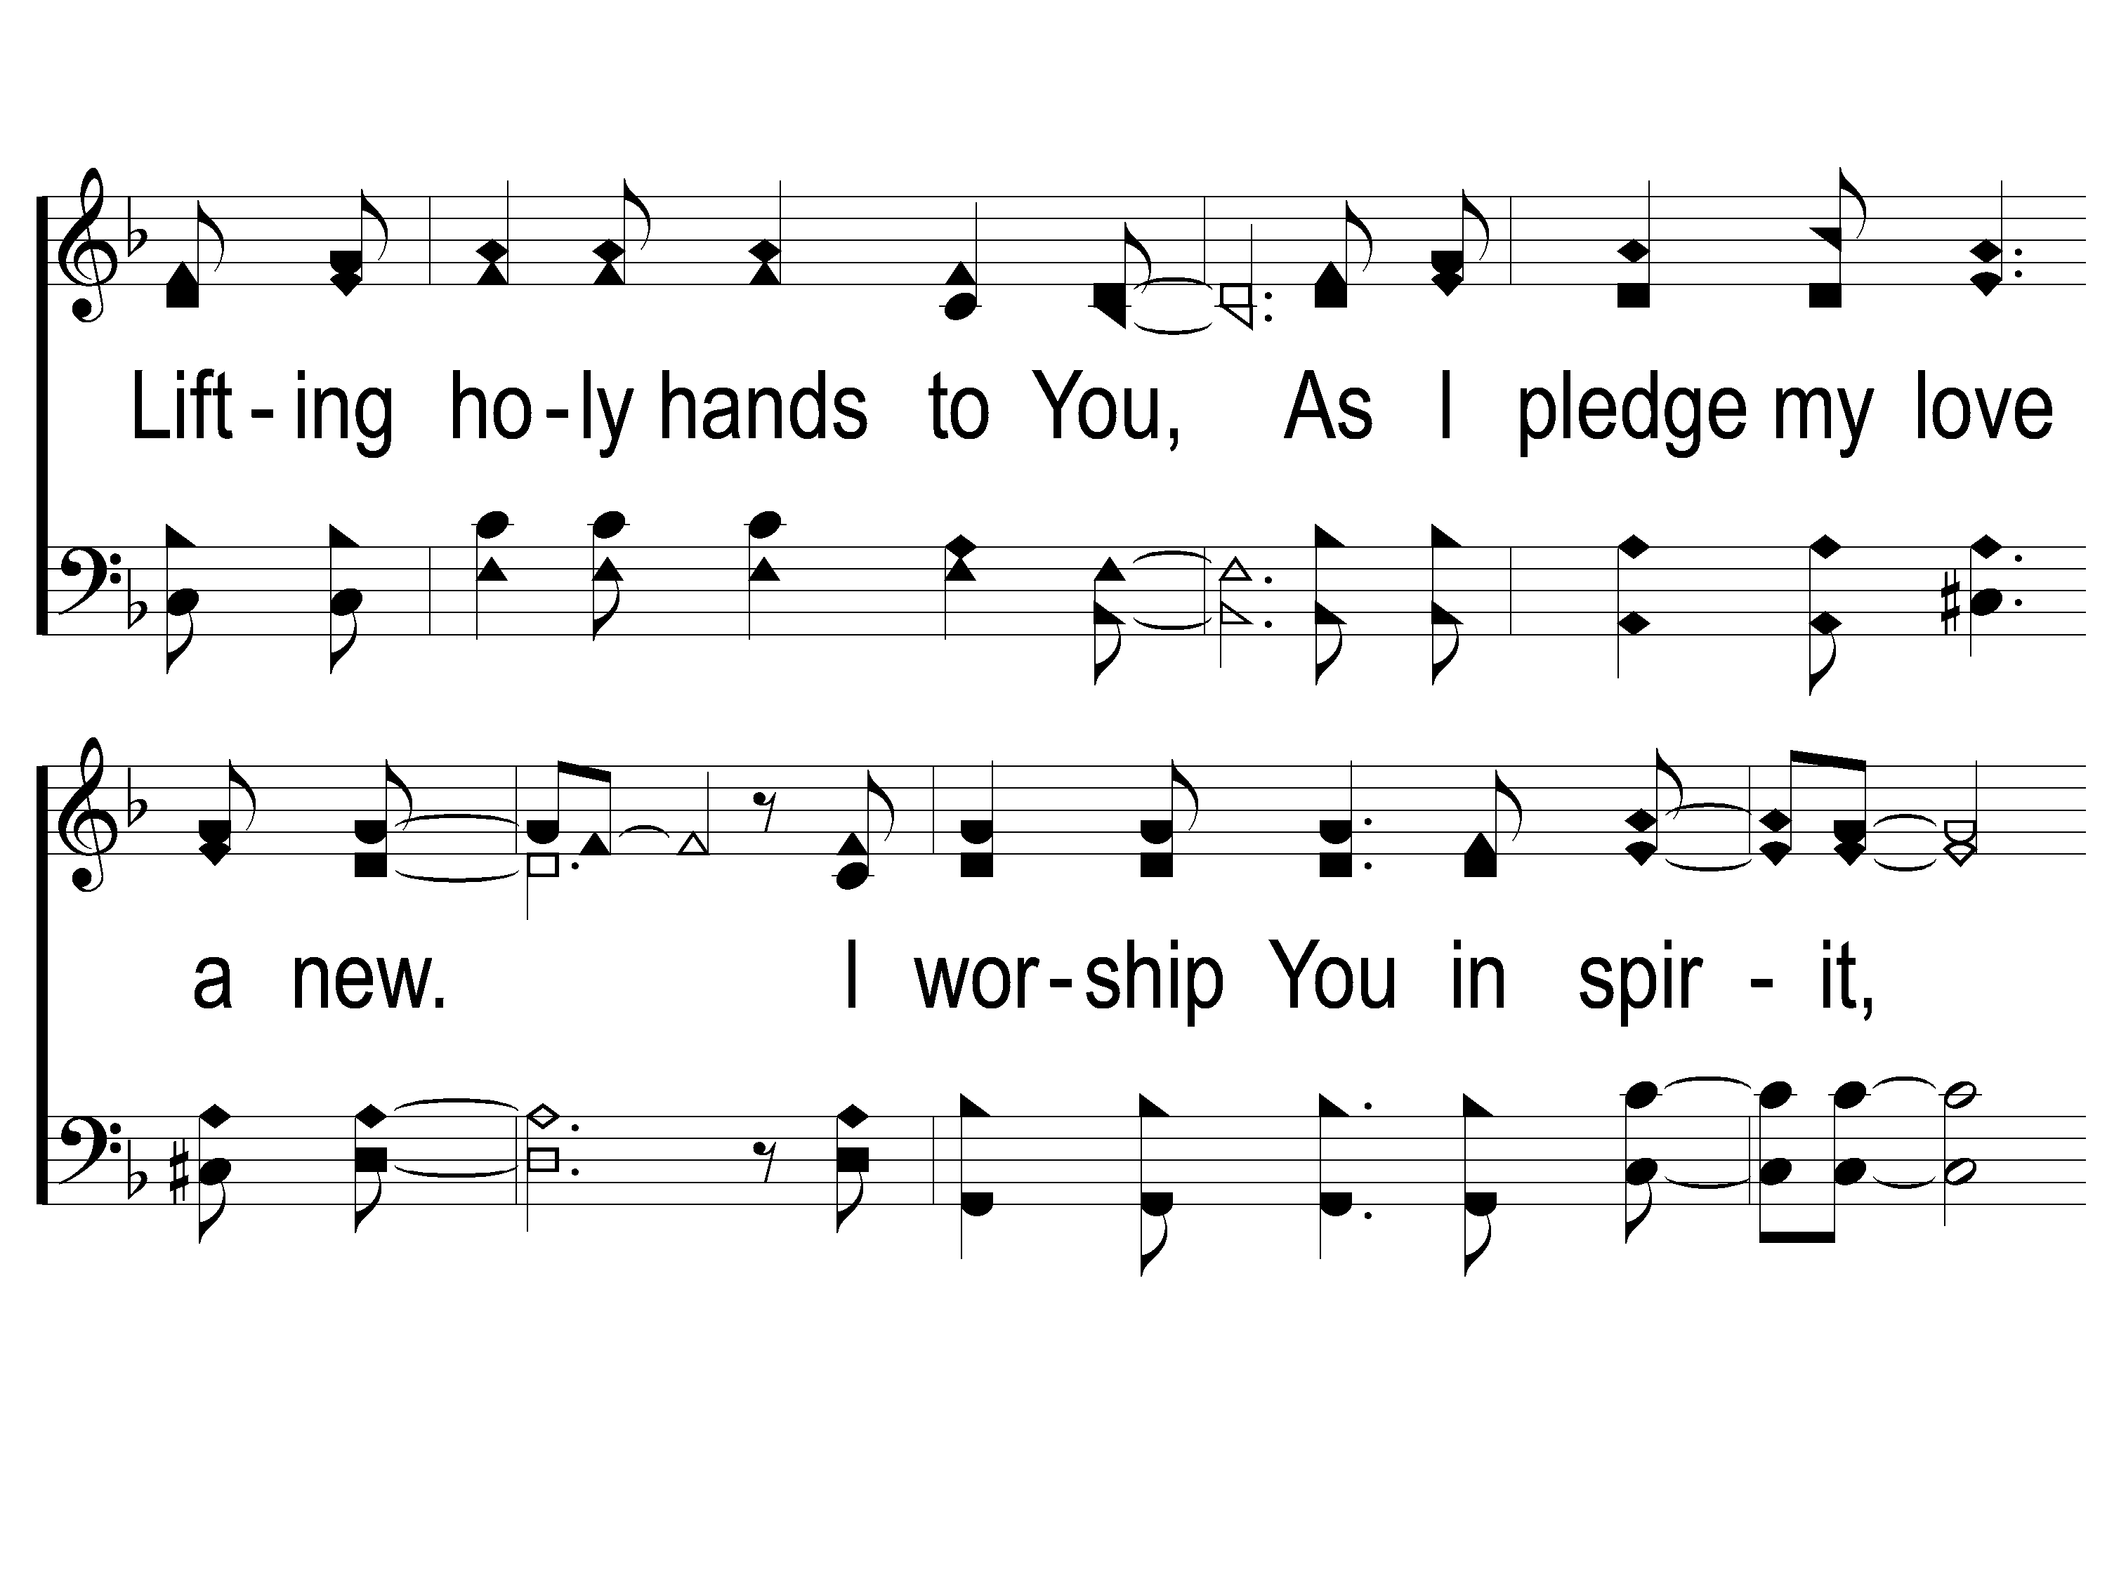
1-2 On Bended Knee
On Bended Knee
791

Slide 4
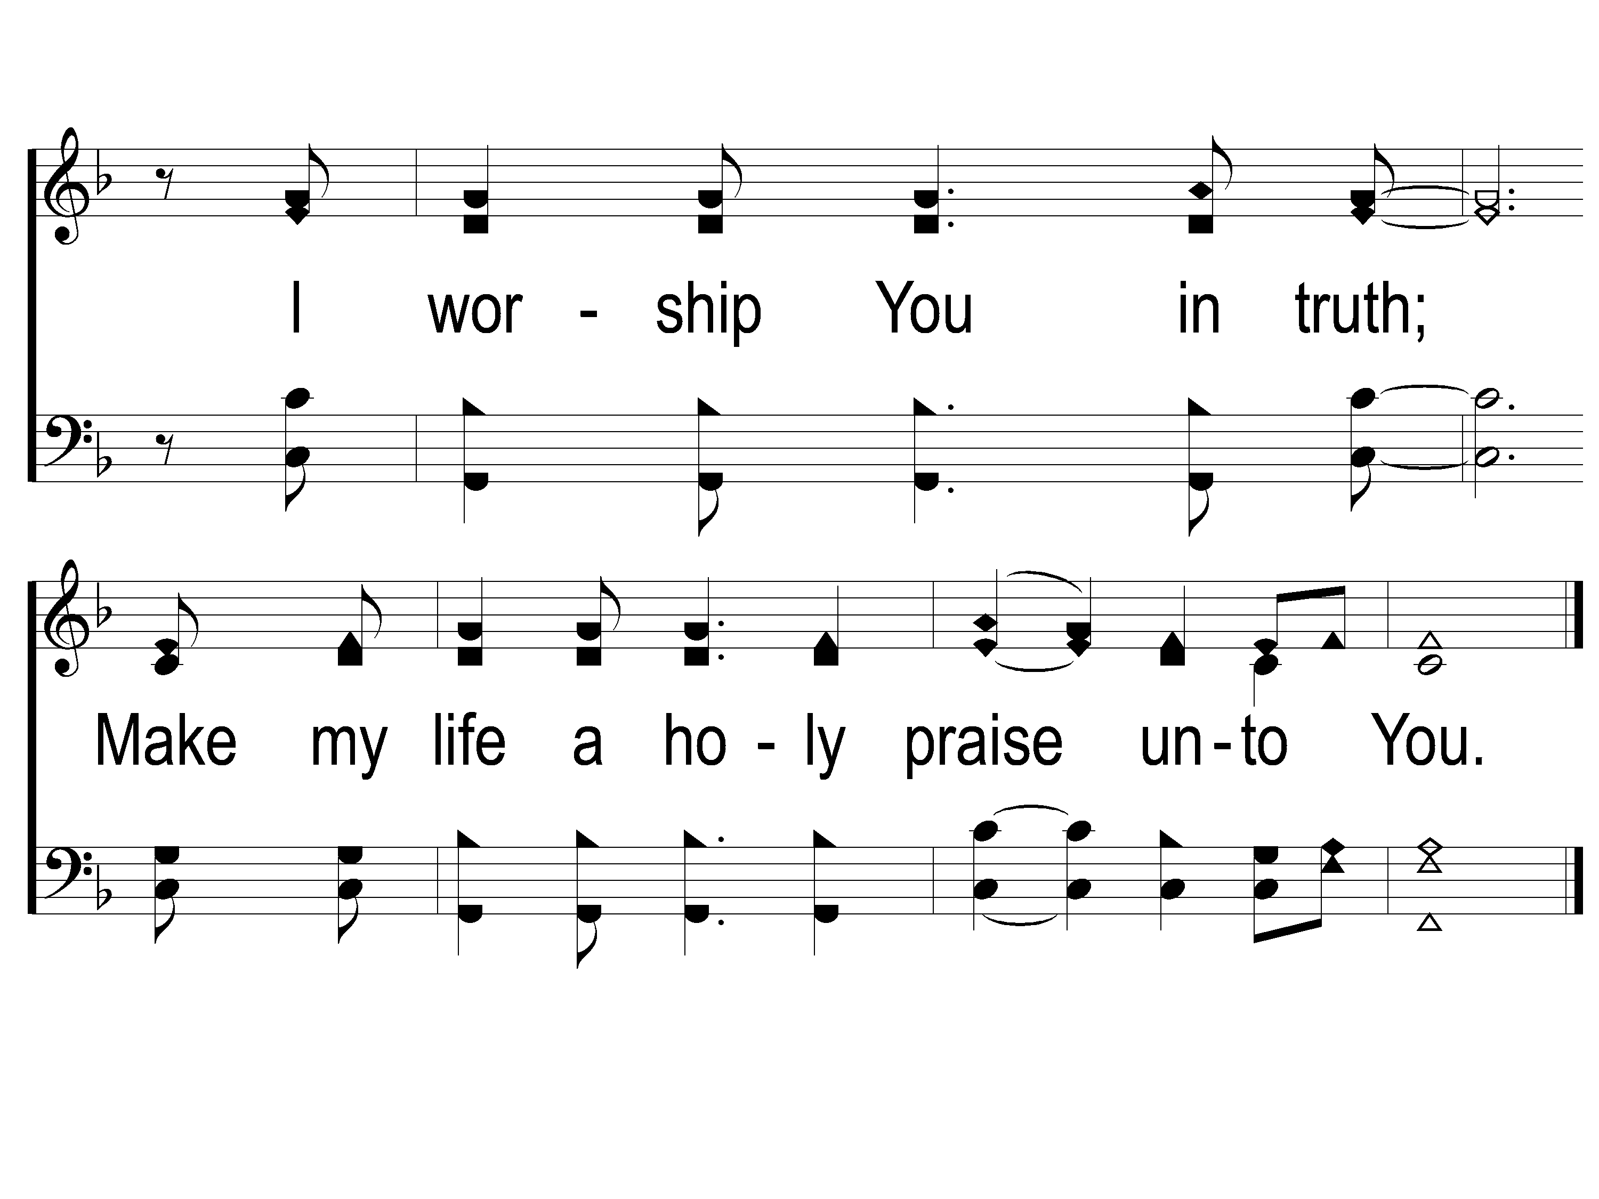
1-3 On Bended Knee
On Bended Knee
791

Slide 5
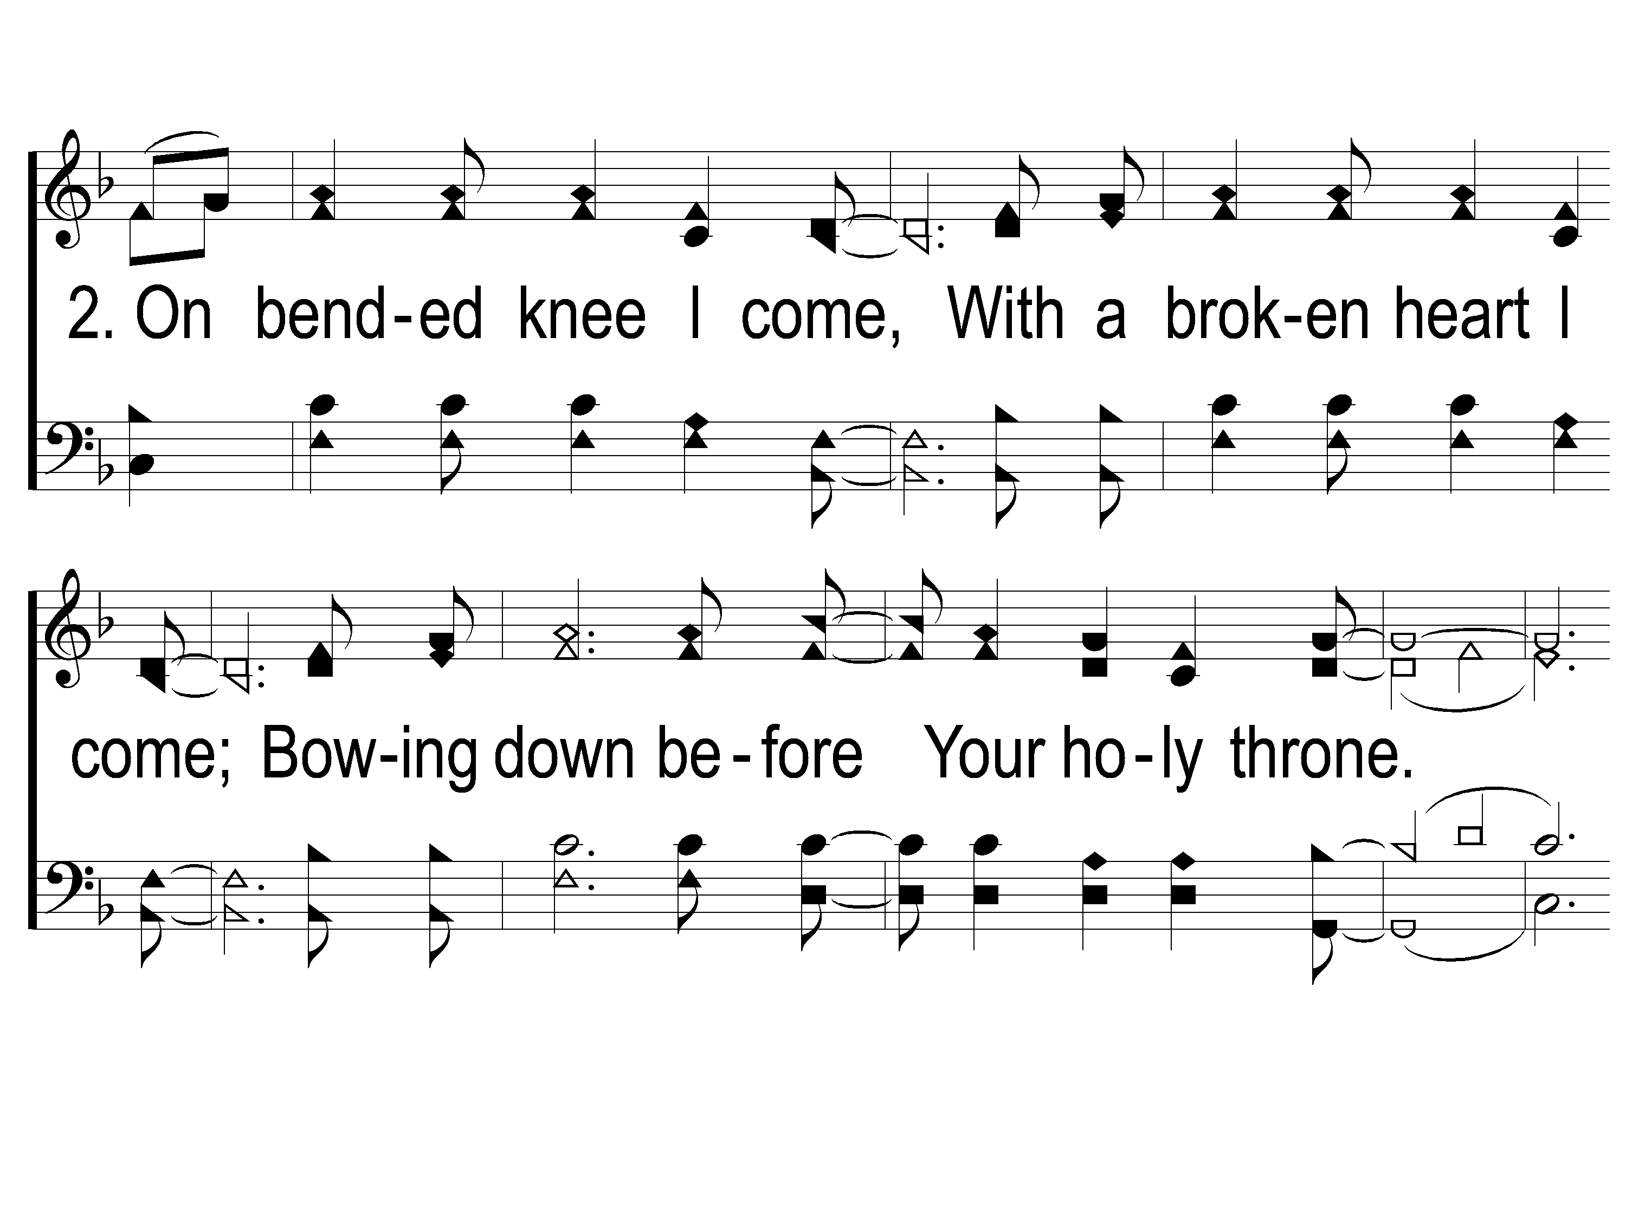
2-1 On Bended Knee
On Bended Knee
791

Slide 6
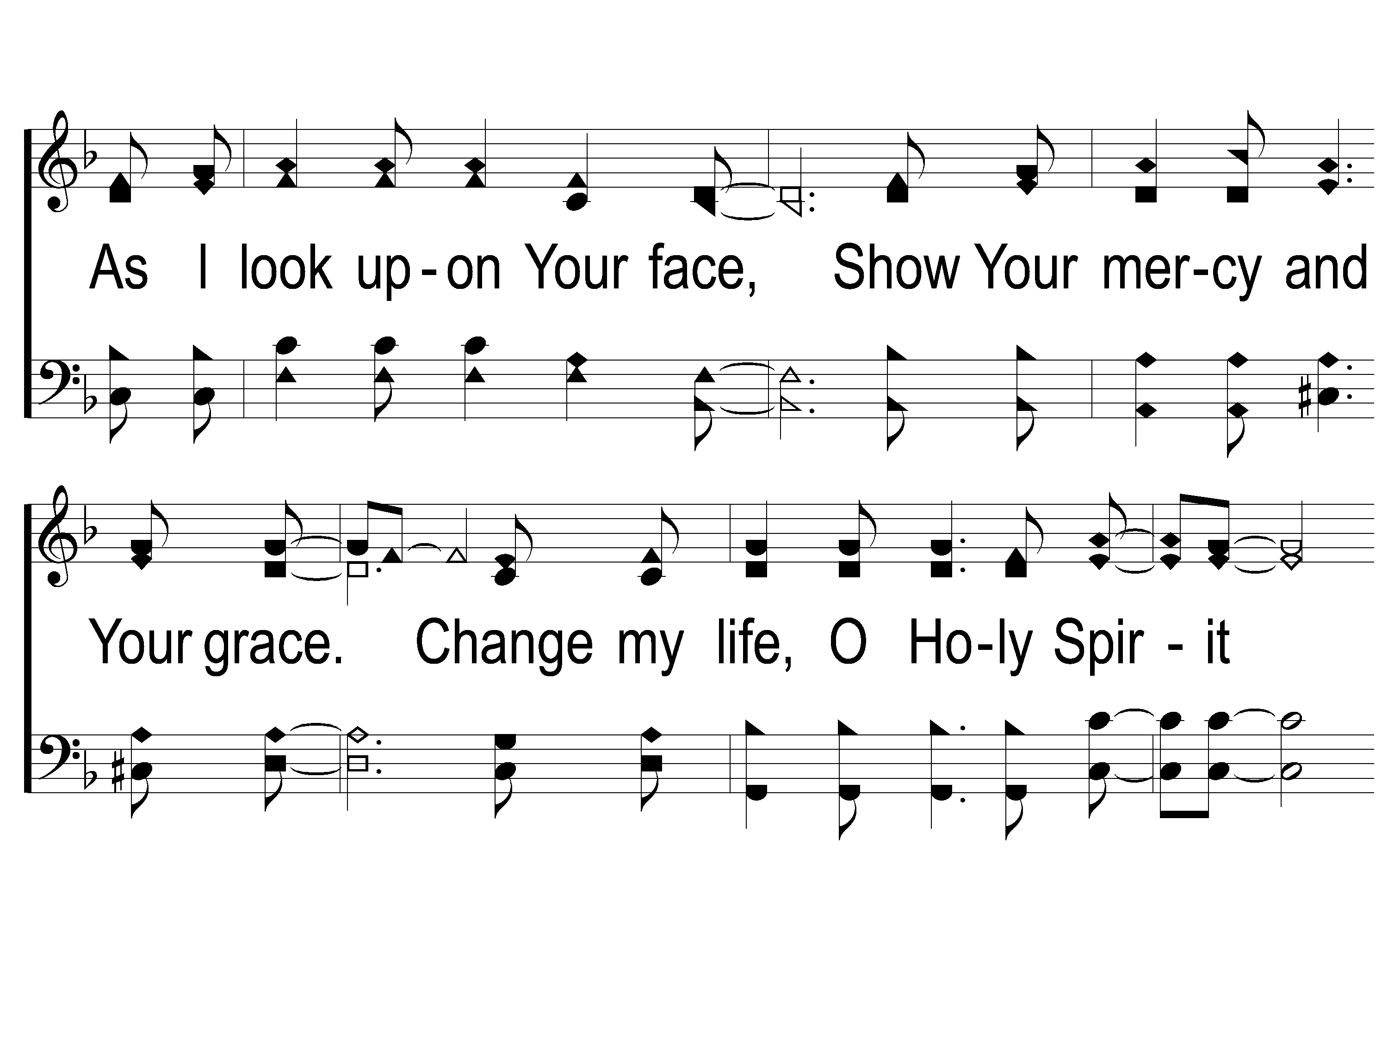
2-2 On Bended Knee
On Bended Knee
791

Slide 7
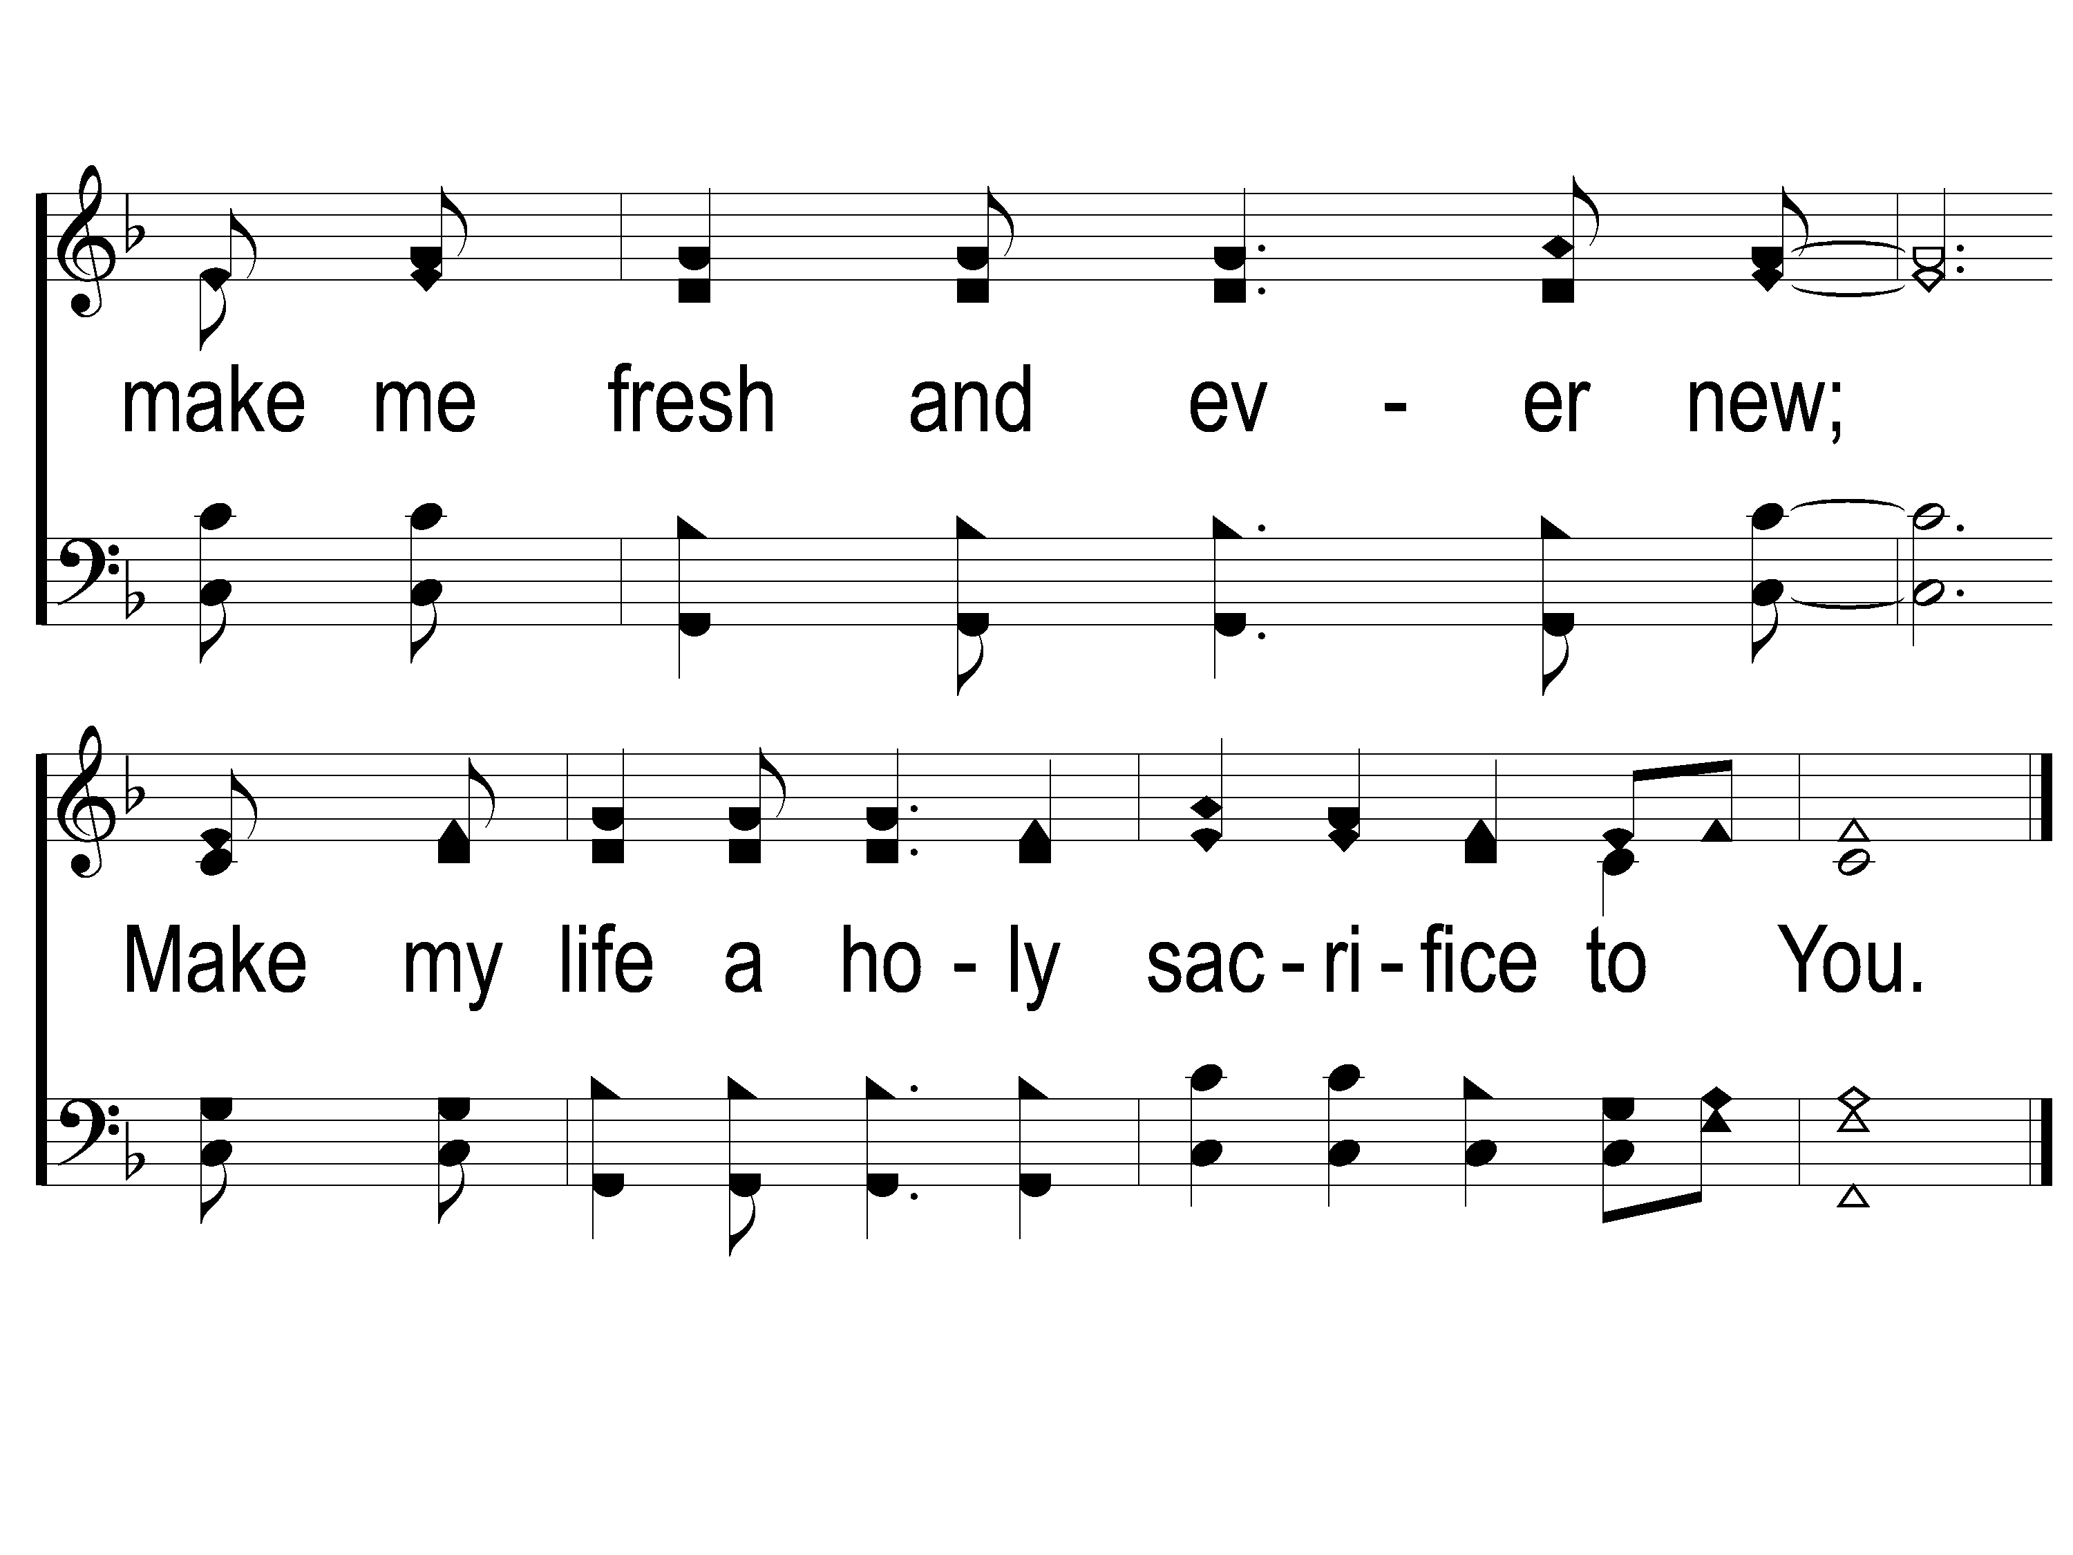
2-3 On Bended Knee
On Bended Knee
791

Slide 8
WELCOME
THANKS FOR JOINING US!

Slide 9
#550
SONG:
I Walk With The King

Slide 10
1-1 I Walk With the King
I Walk With The King
550

Slide 11
1-2 I Walk With the King
I Walk With The King
550

Slide 12
1-3 I Walk With the King
I Walk With The King
550

Slide 13
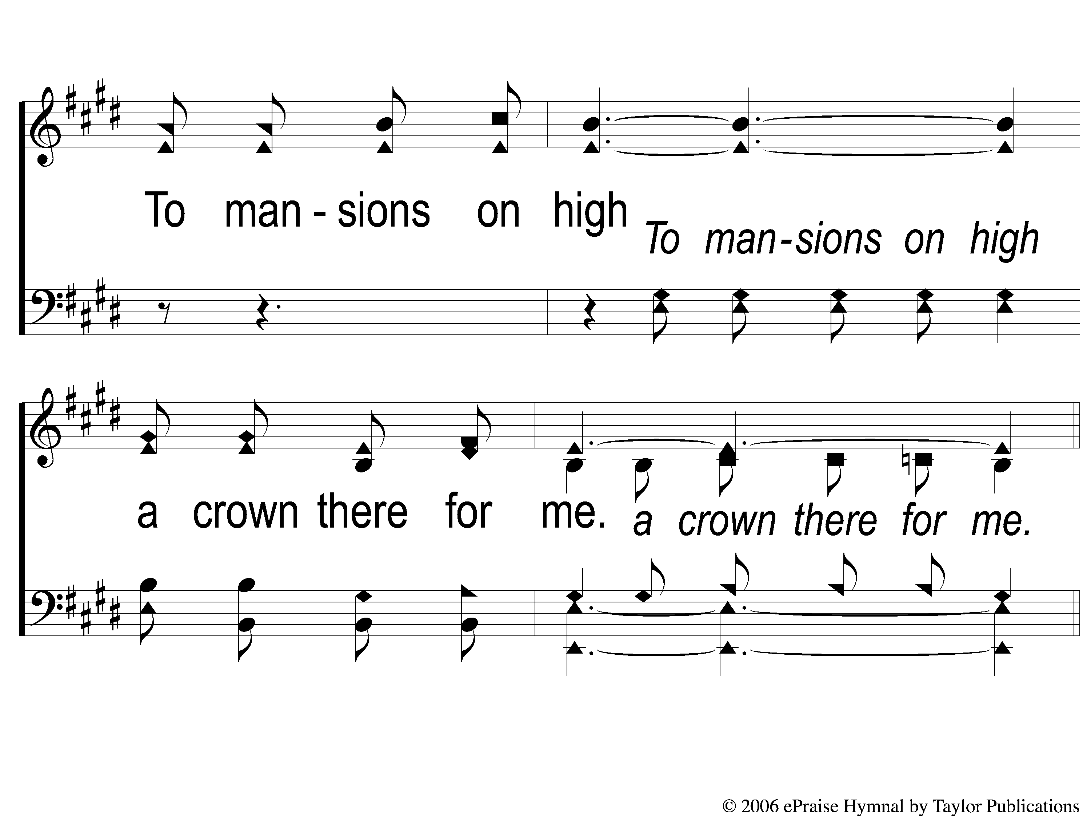
1-4 I Walk With the King
I Walk With The King
550

Slide 14
C-1 I Walk With the King
I Walk With The King
550

Slide 15
C-2 I Walk With the King
I Walk With The King
550

Slide 16
C-3 I Walk With the King
I Walk With The King
550

Slide 17
C-4 I Walk With the King
I Walk With The King
550

Slide 18
3-1 I Walk With the King
I Walk With The King
550

Slide 19
3-2 I Walk With the King
I Walk With The King
550

Slide 20
3-3 I Walk With the King
I Walk With The King
550

Slide 21
3-4 I Walk With the King
I Walk With The King
550

Slide 22
C-1 I Walk With the King
I Walk With The King
550

Slide 23
C-2 I Walk With the King
I Walk With The King
550

Slide 24
C-3 I Walk With the King
I Walk With The King
550

Slide 25
C-4 I Walk With the King
I Walk With The King
550

Slide 26
1-1 He’s My King
He’s My King
166

Slide 27
1-2 He’s My King
He’s My King
166

Slide 28
C-1 He’s My King
He’s My King
166

Slide 29
C-2 He’s My King
He’s My King
166

Slide 30
3-1 He’s My King
He’s My King
166

Slide 31
3-2 He’s My King
He’s My King
166

Slide 32
C-1 He’s My King
He’s My King
166

Slide 33
C-2 He’s My King
He’s My King
166

Slide 34
#786
SONG:
Take My Hand
Precious Lord

Slide 35
1-1 Take My Hand Precious Lord
Take My Hand Precious Lord
786

Slide 36
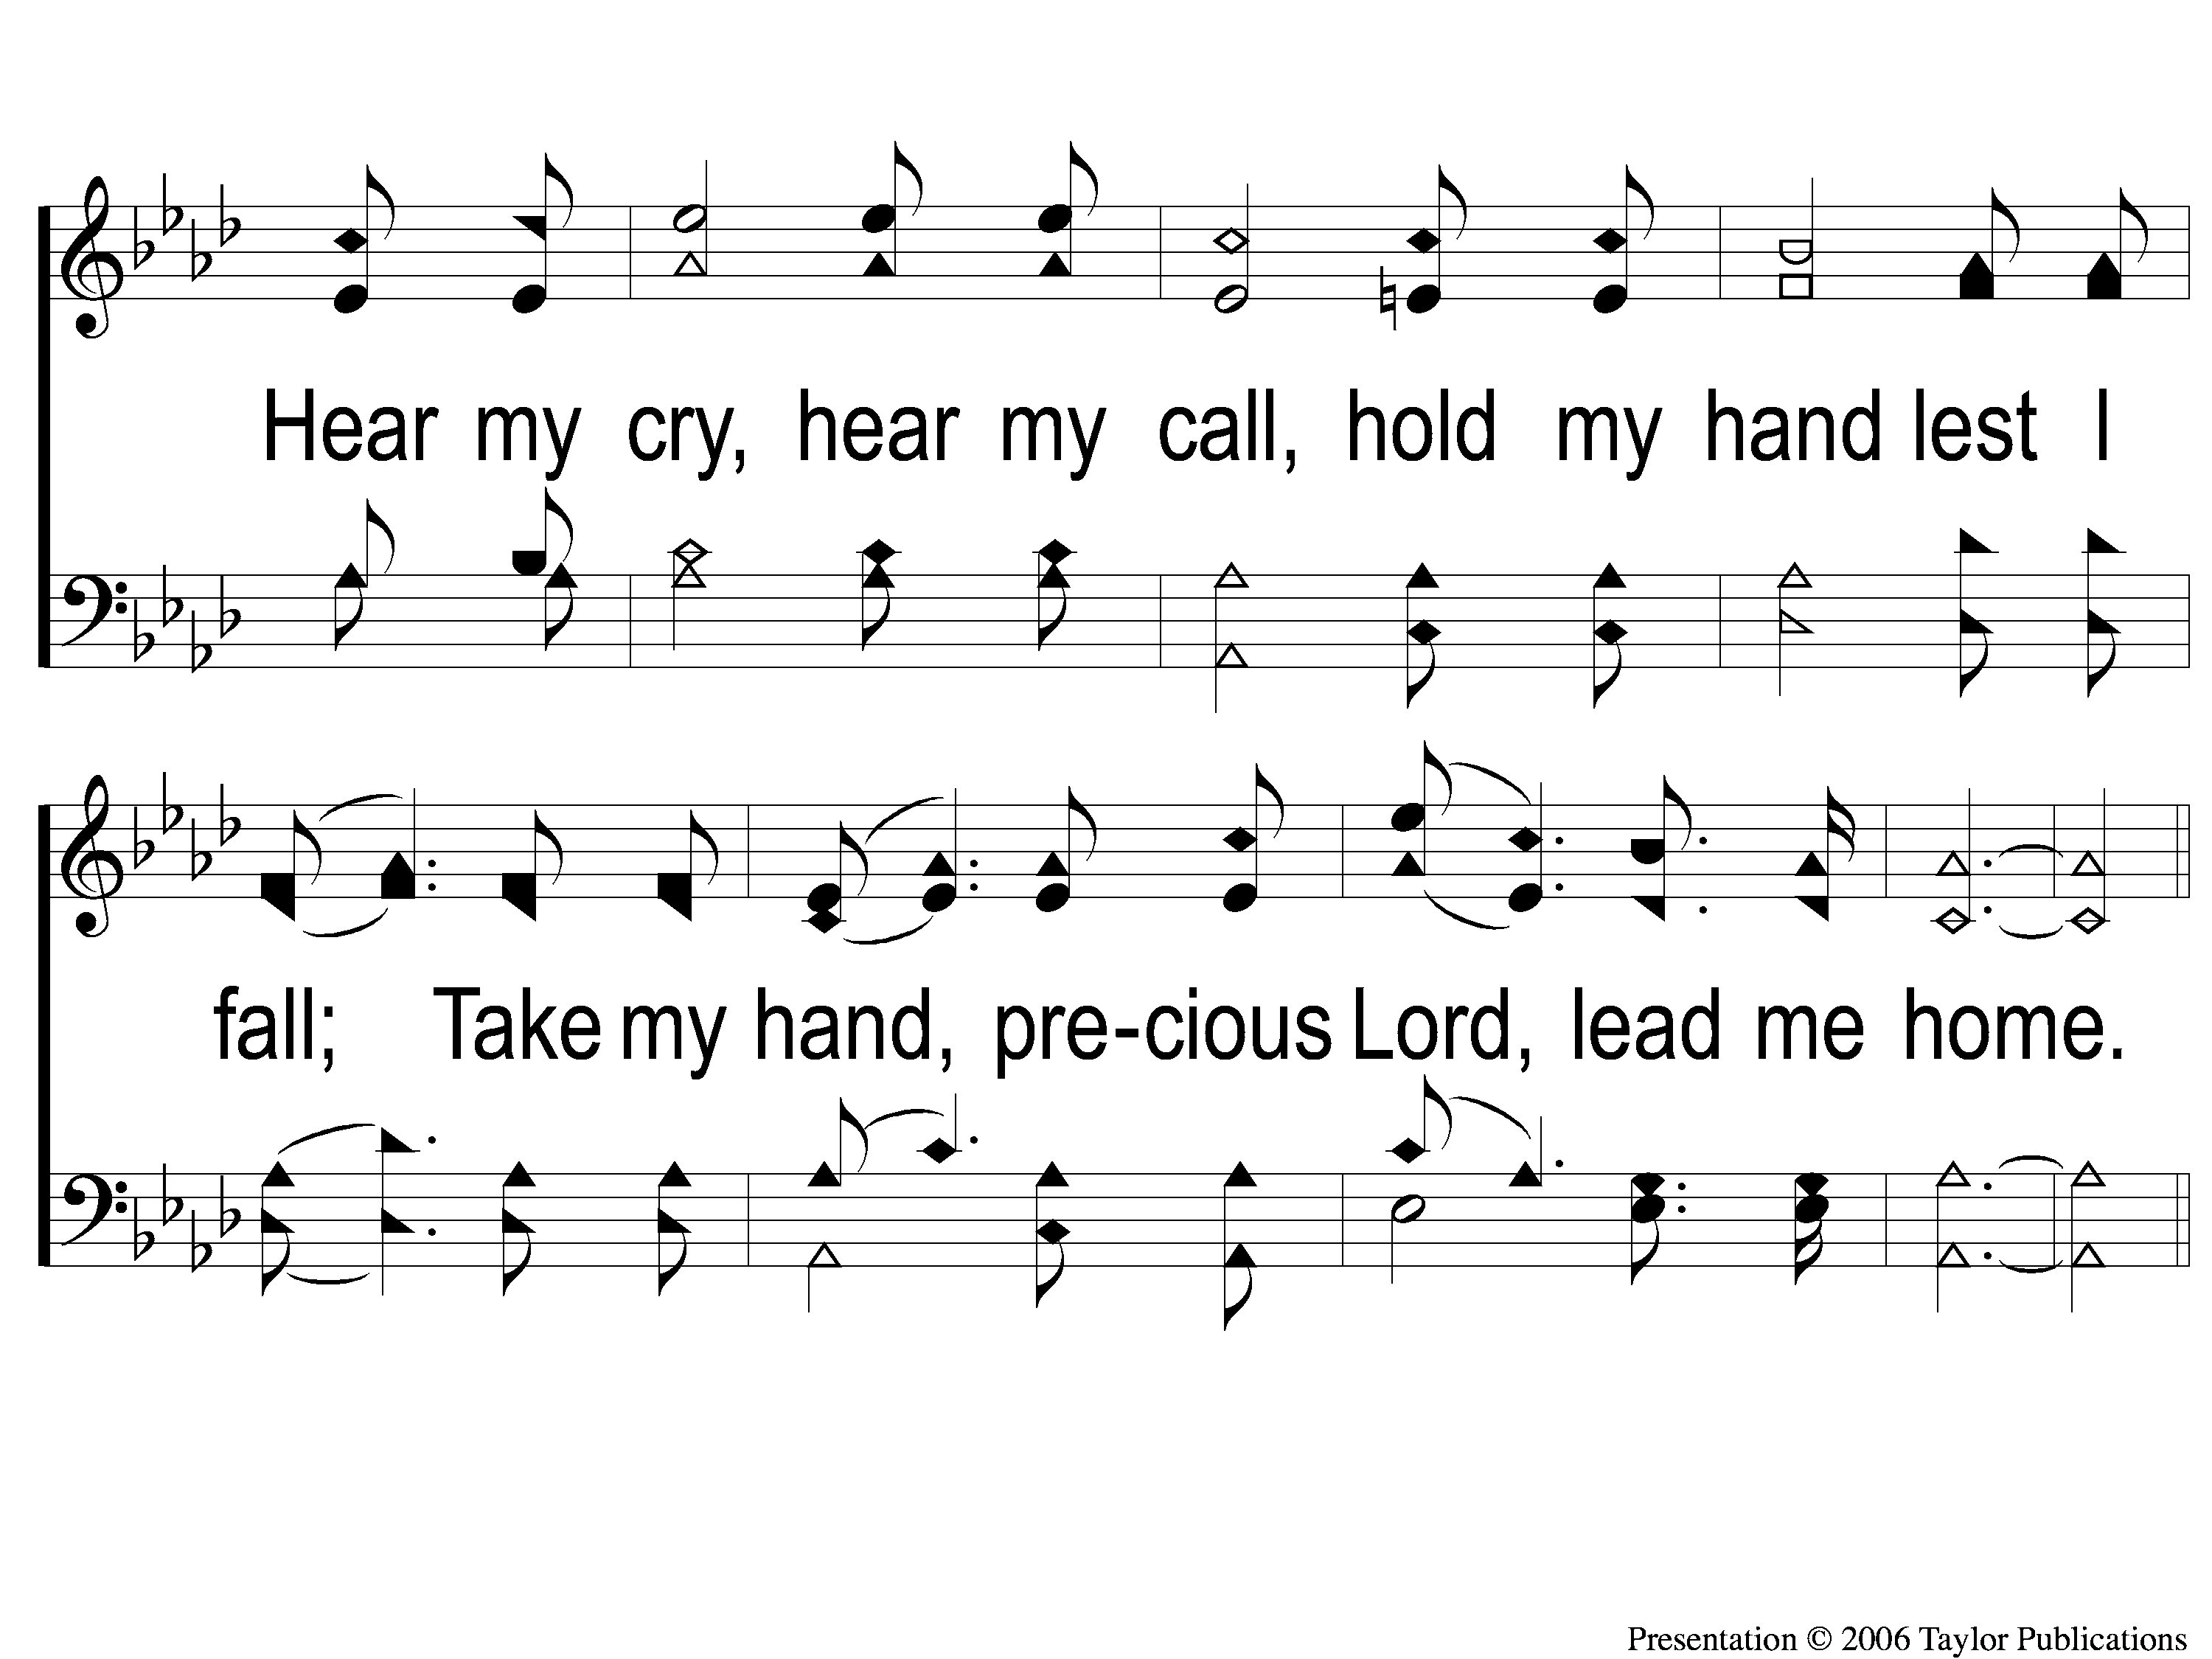
1-2 Take My Hand Precious Lord
Take My Hand Precious Lord
786

Slide 37
2-1 Take My Hand Precious Lord
Take My Hand Precious Lord
786

Slide 38
2-2 Take My Hand Precious Lord
Take My Hand Precious Lord
786

Slide 39
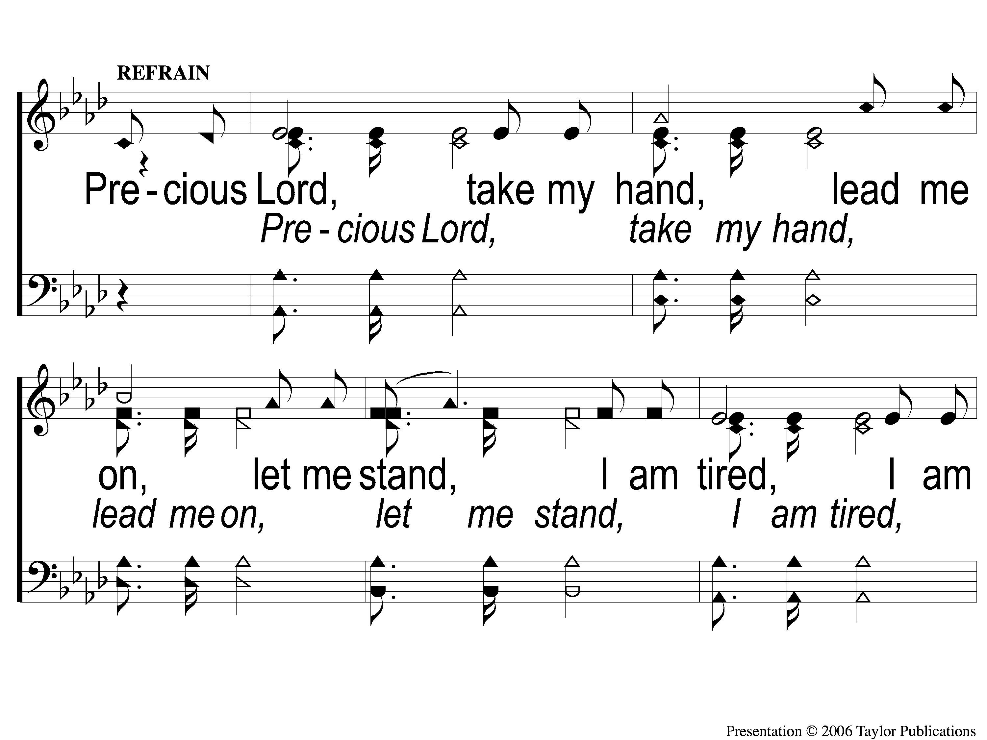
C-1 Take My Hand Precious Lord
Take My Hand Precious Lord
786

Slide 40
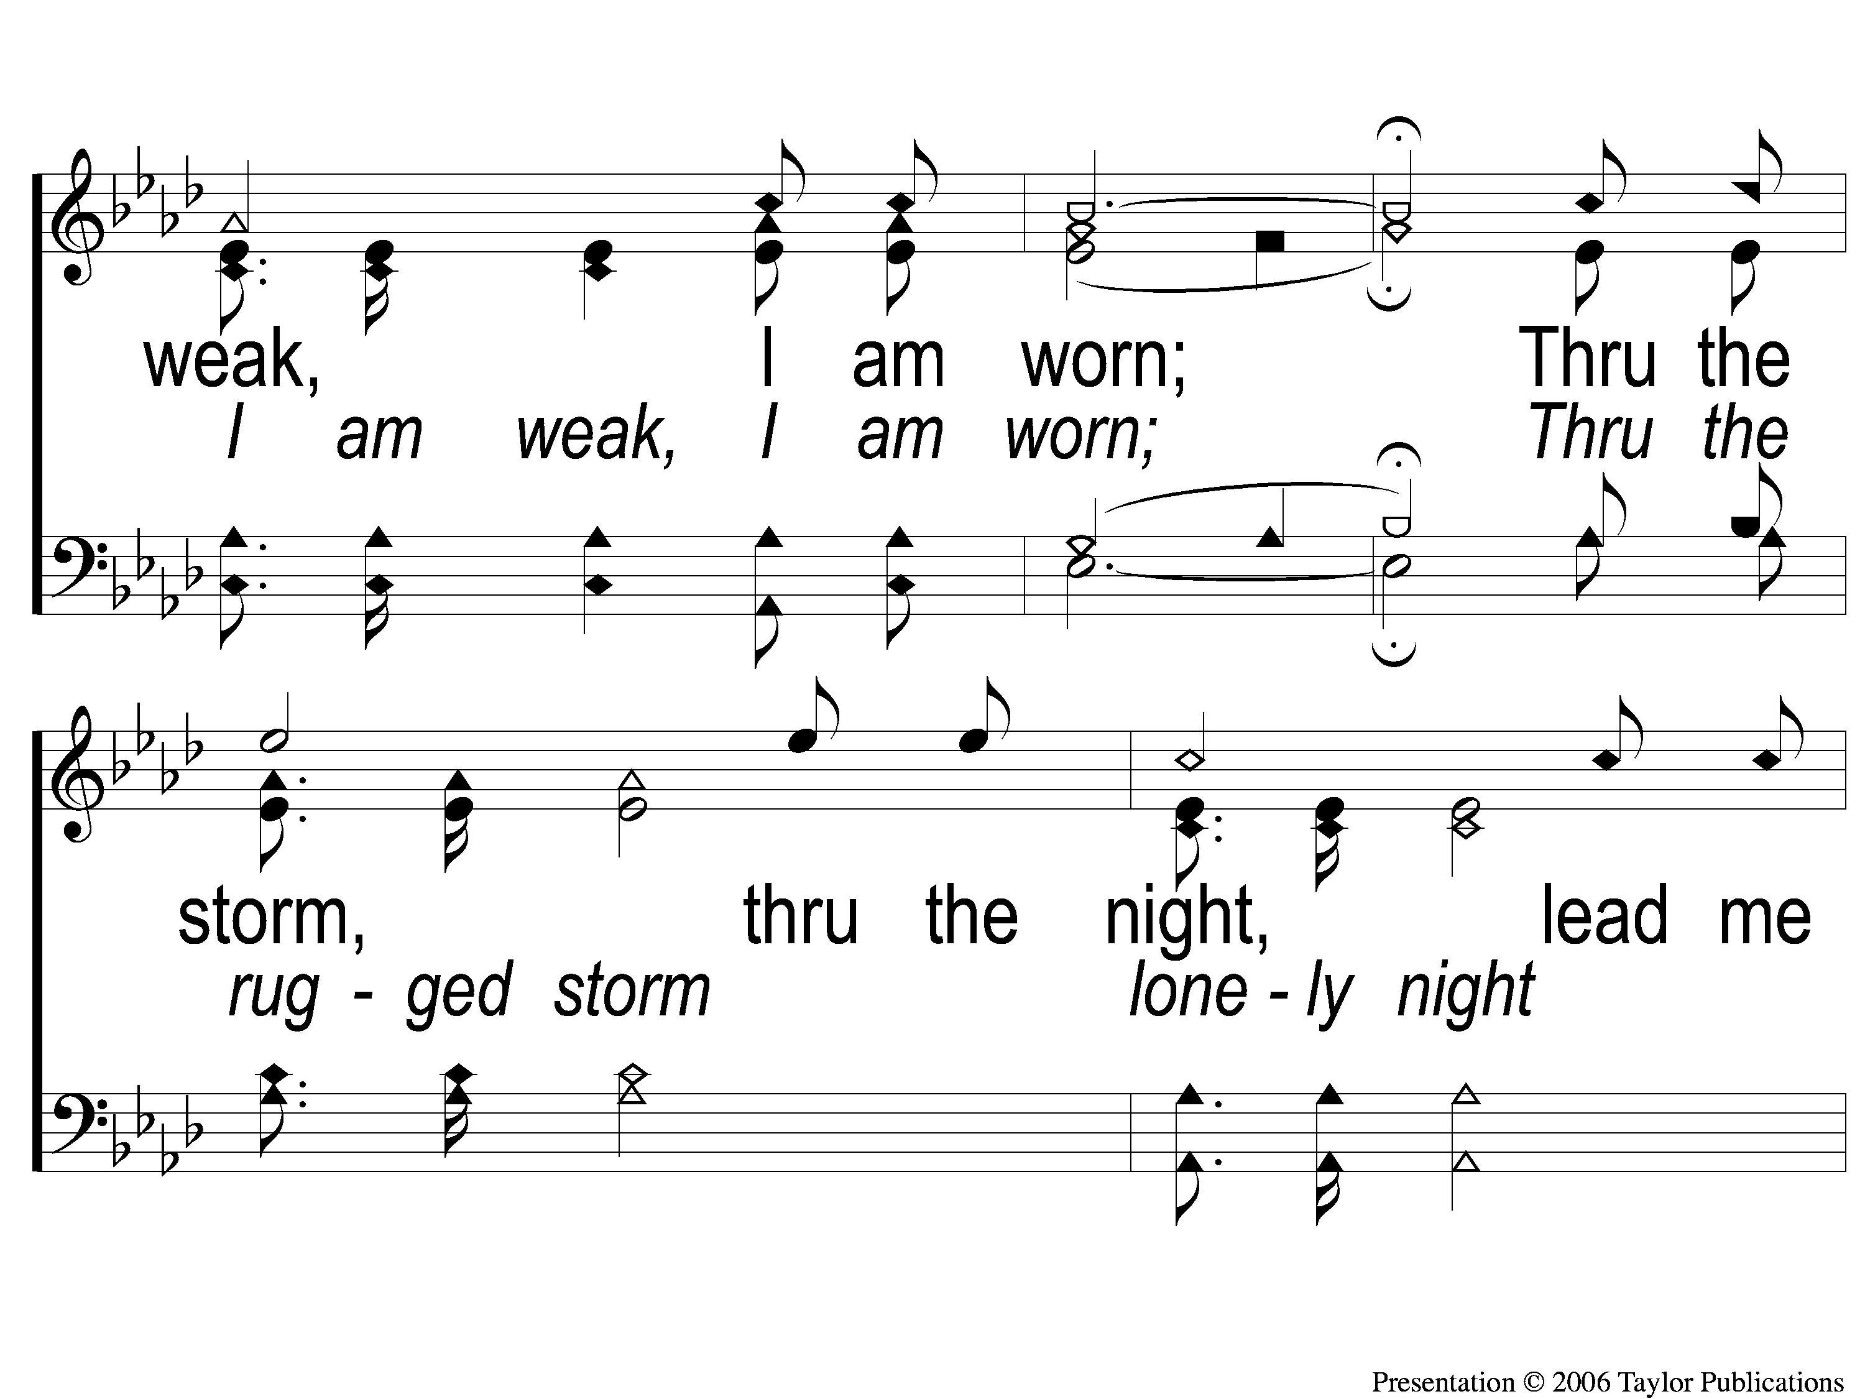
C-2 Take My Hand Precious Lord
Take My Hand Precious Lord
786

Slide 41
C-3 Take My Hand Precious Lord
Take My Hand Precious Lord
786

Slide 42
Opening PRAYER

Slide 43
#539
SONG:
Higher Ground

Slide 44
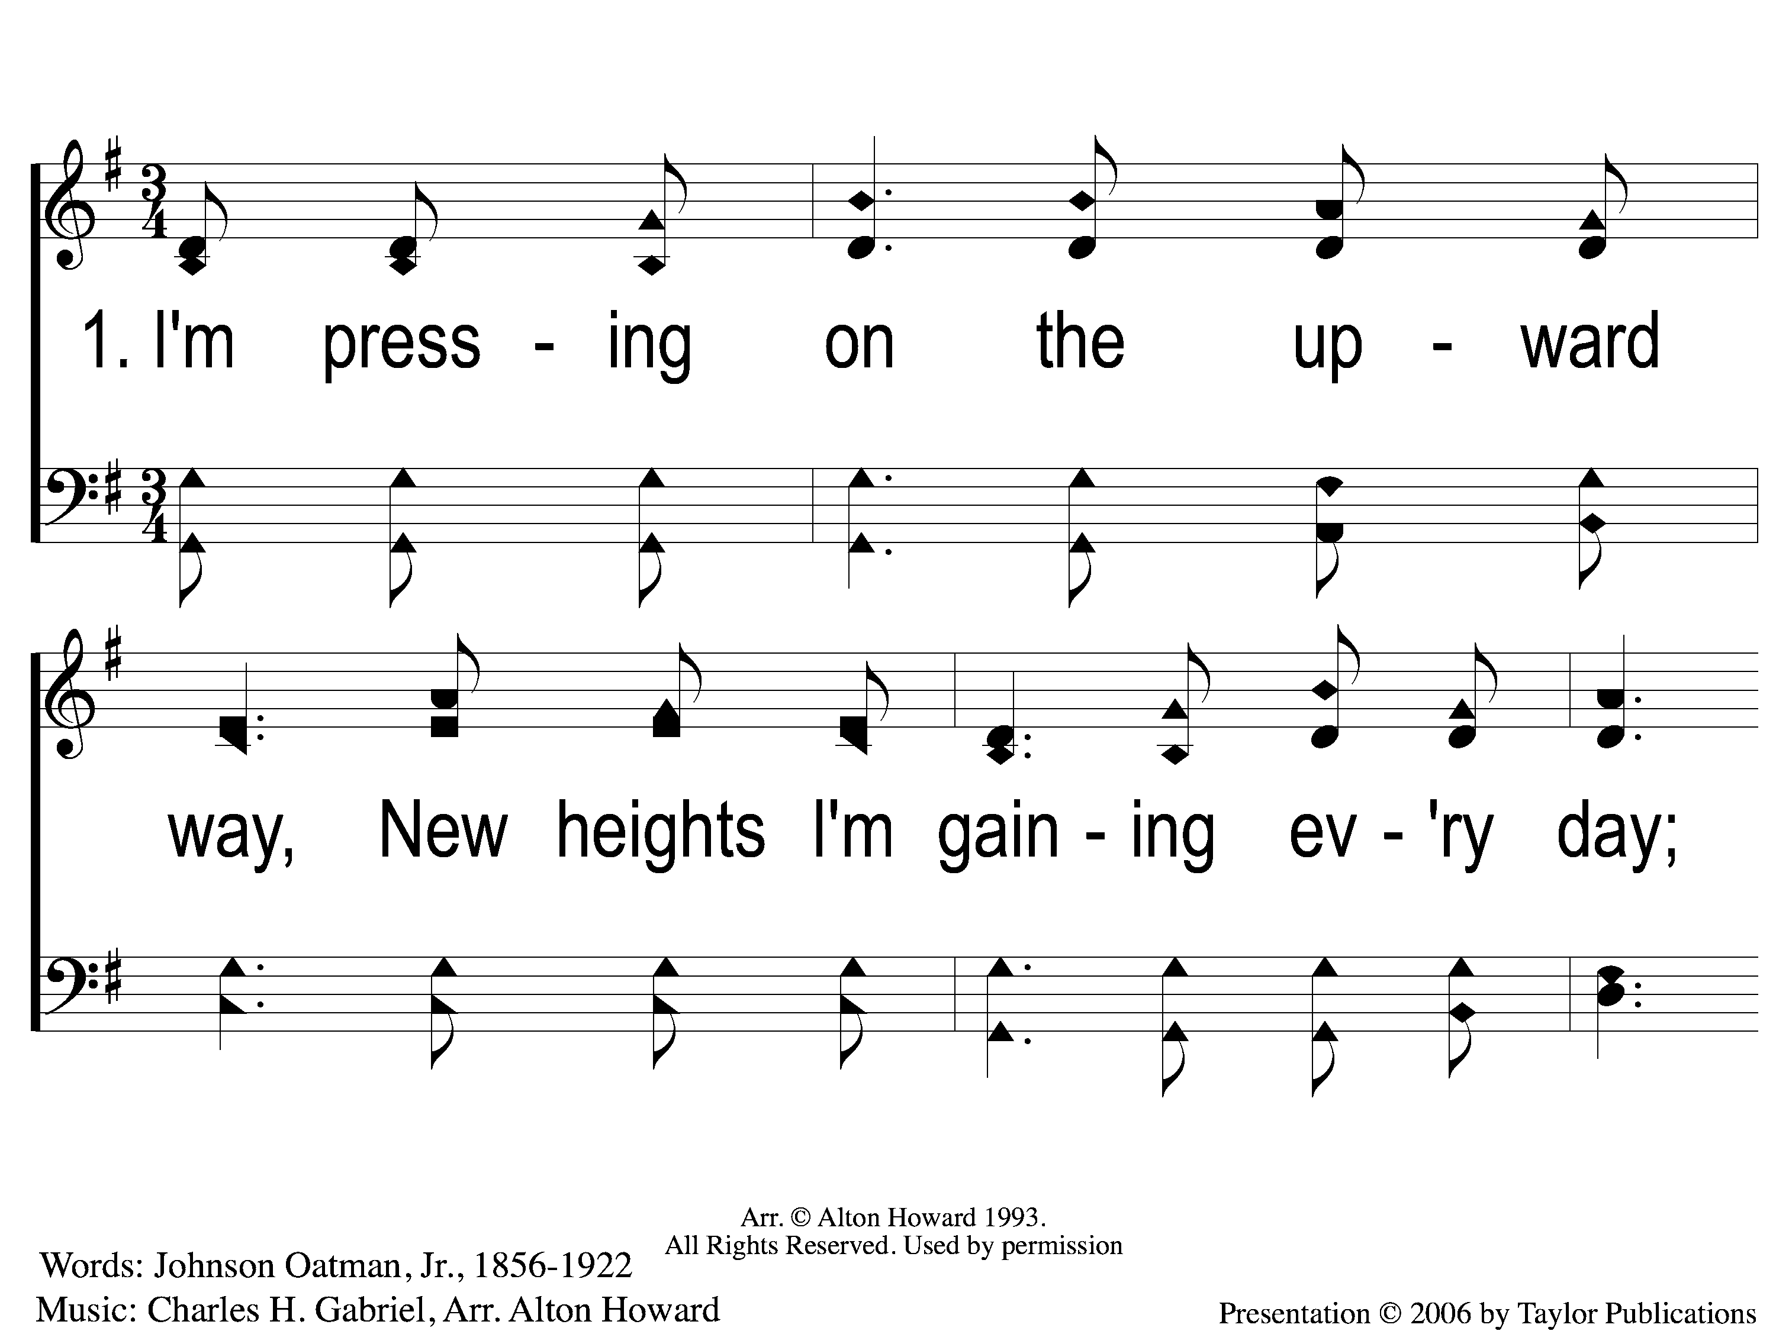
1-1 Higher Ground
Higher Ground
539

Slide 45
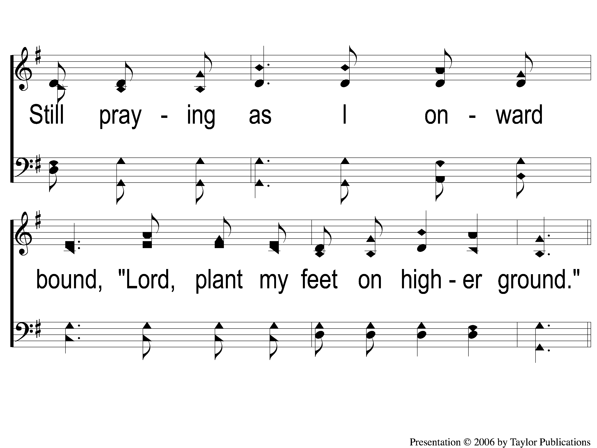
1-2 Higher Ground
Higher Ground
539

Slide 46
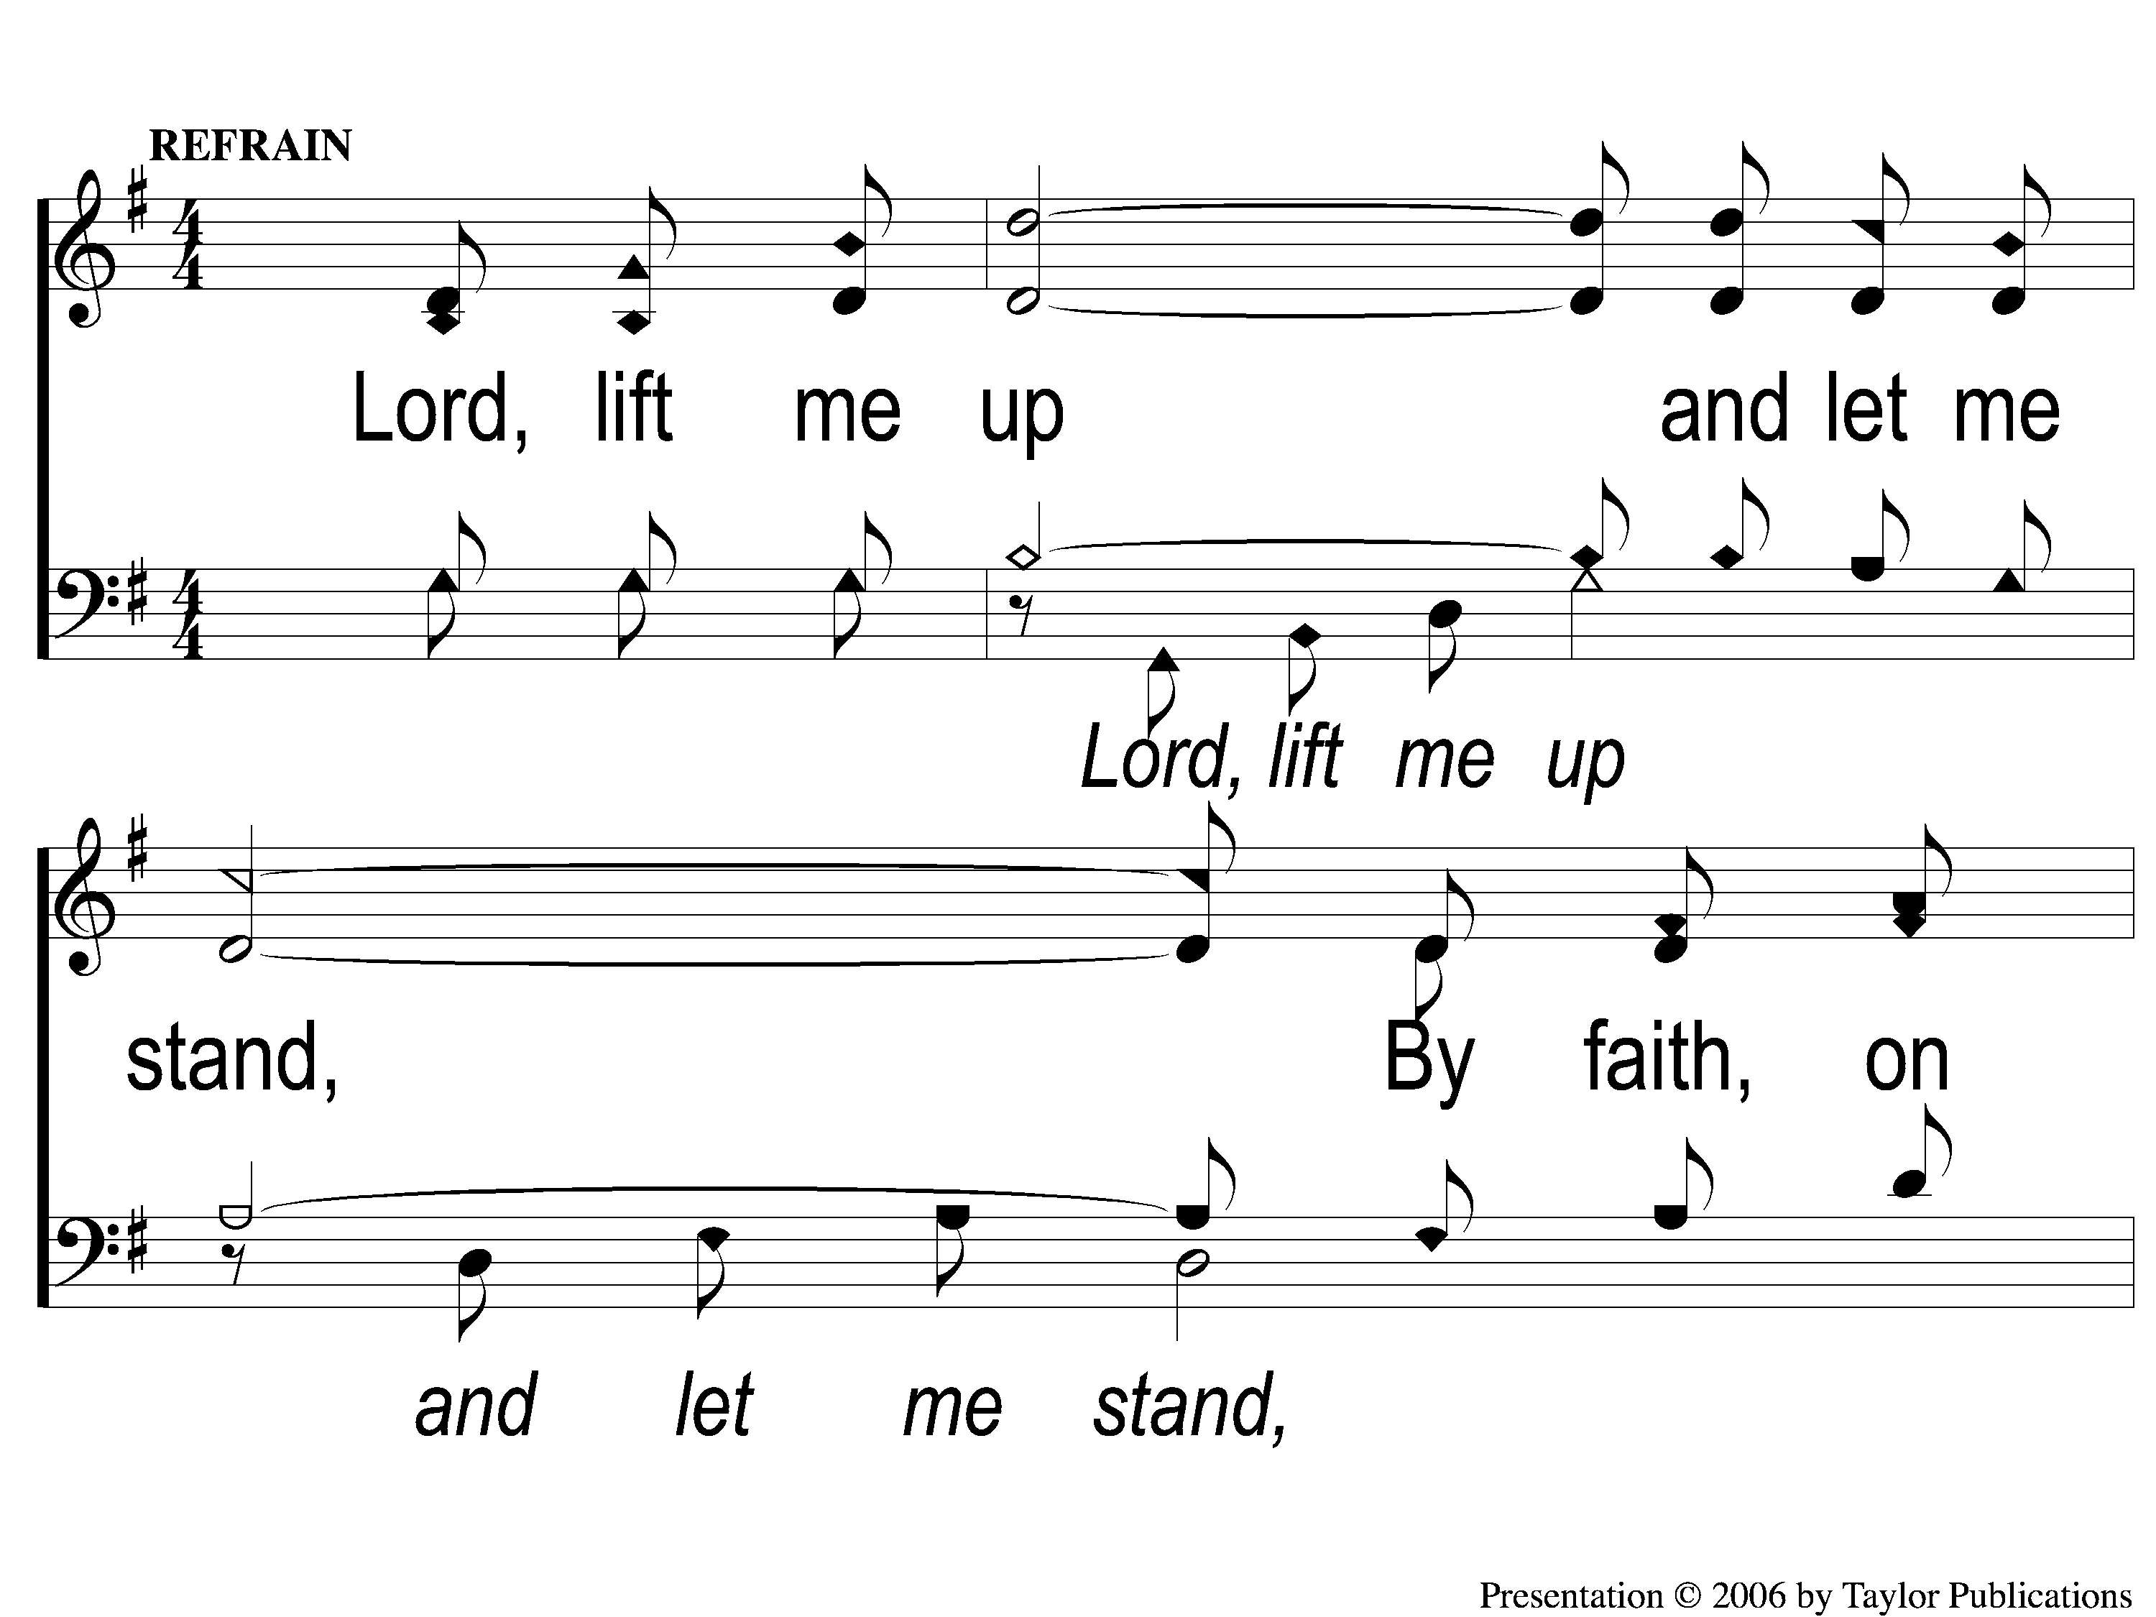
C-1 Higher Ground
Higher Ground
539

Slide 47
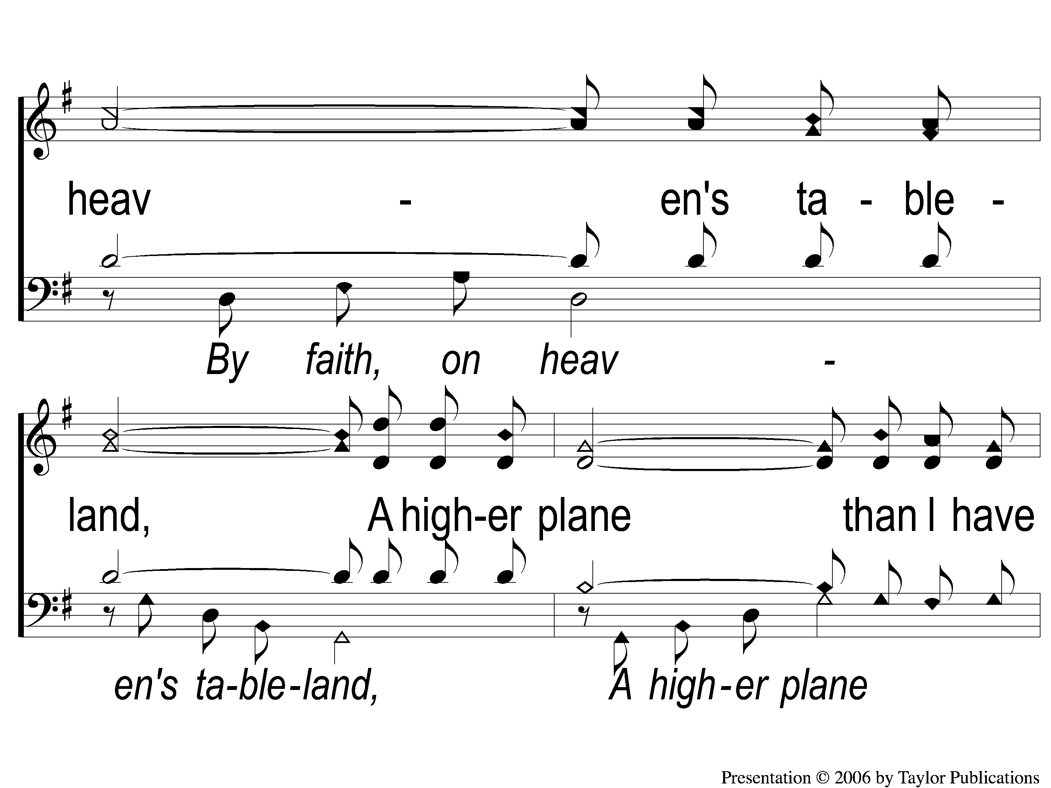
C-2 Higher Ground
Higher Ground
539

Slide 48
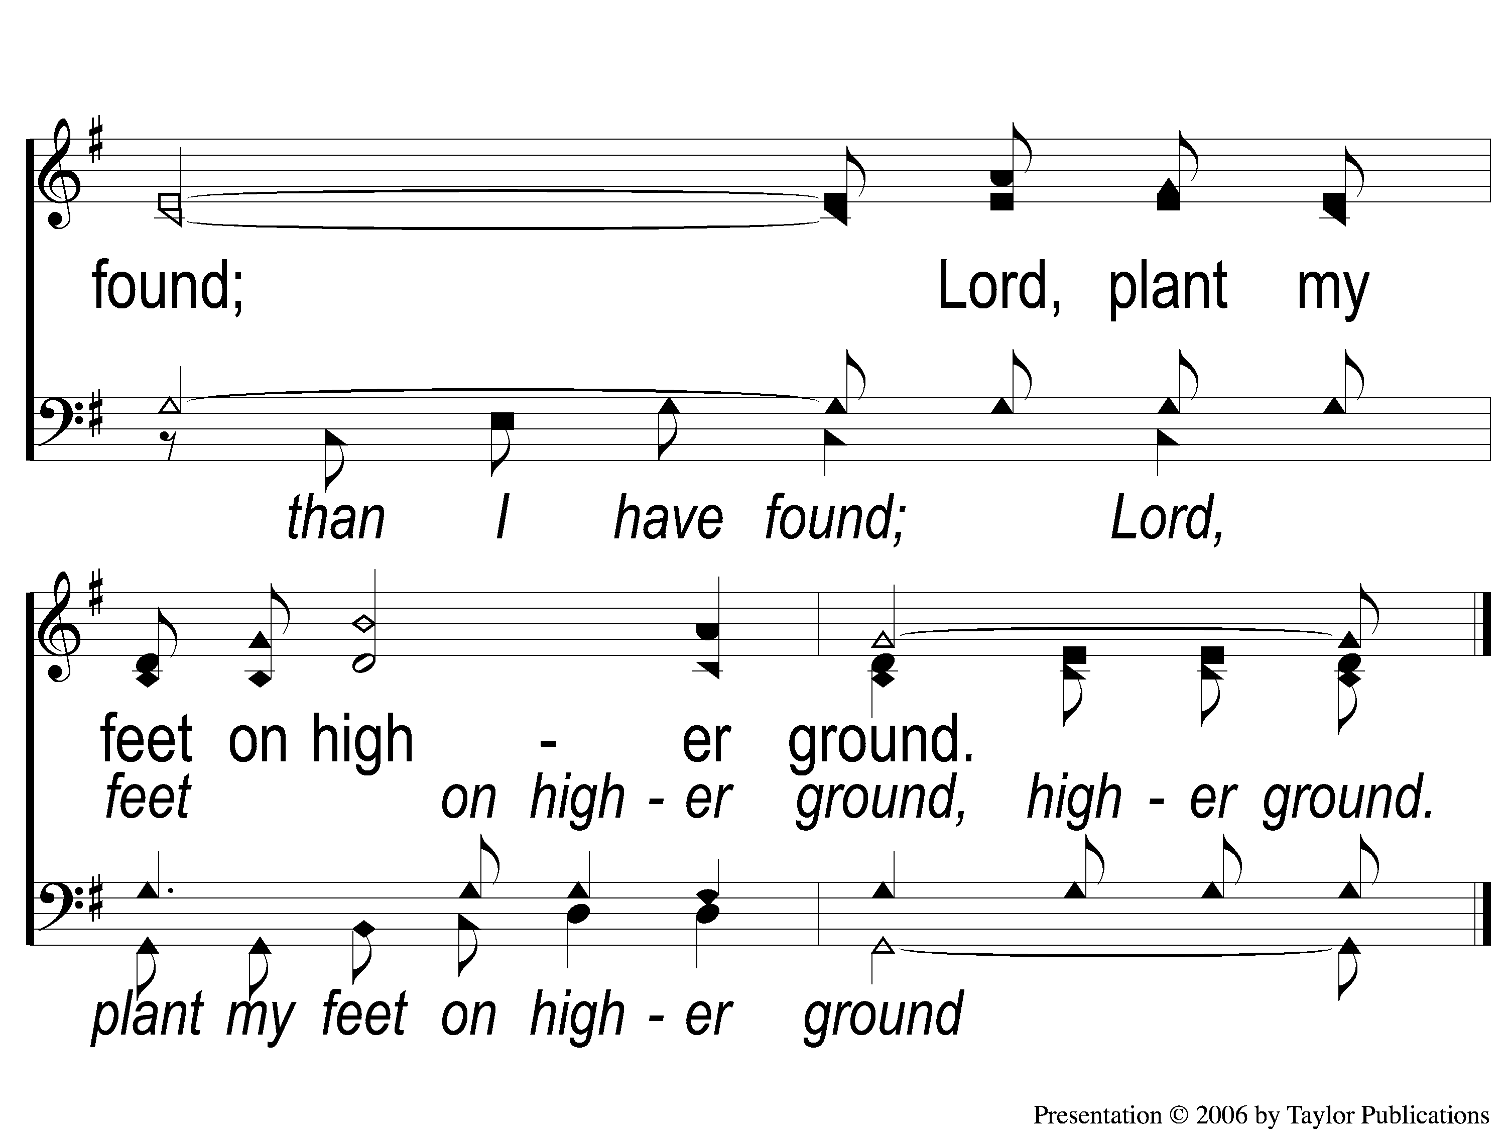
C-3 Higher Ground
Higher Ground
539

Slide 49
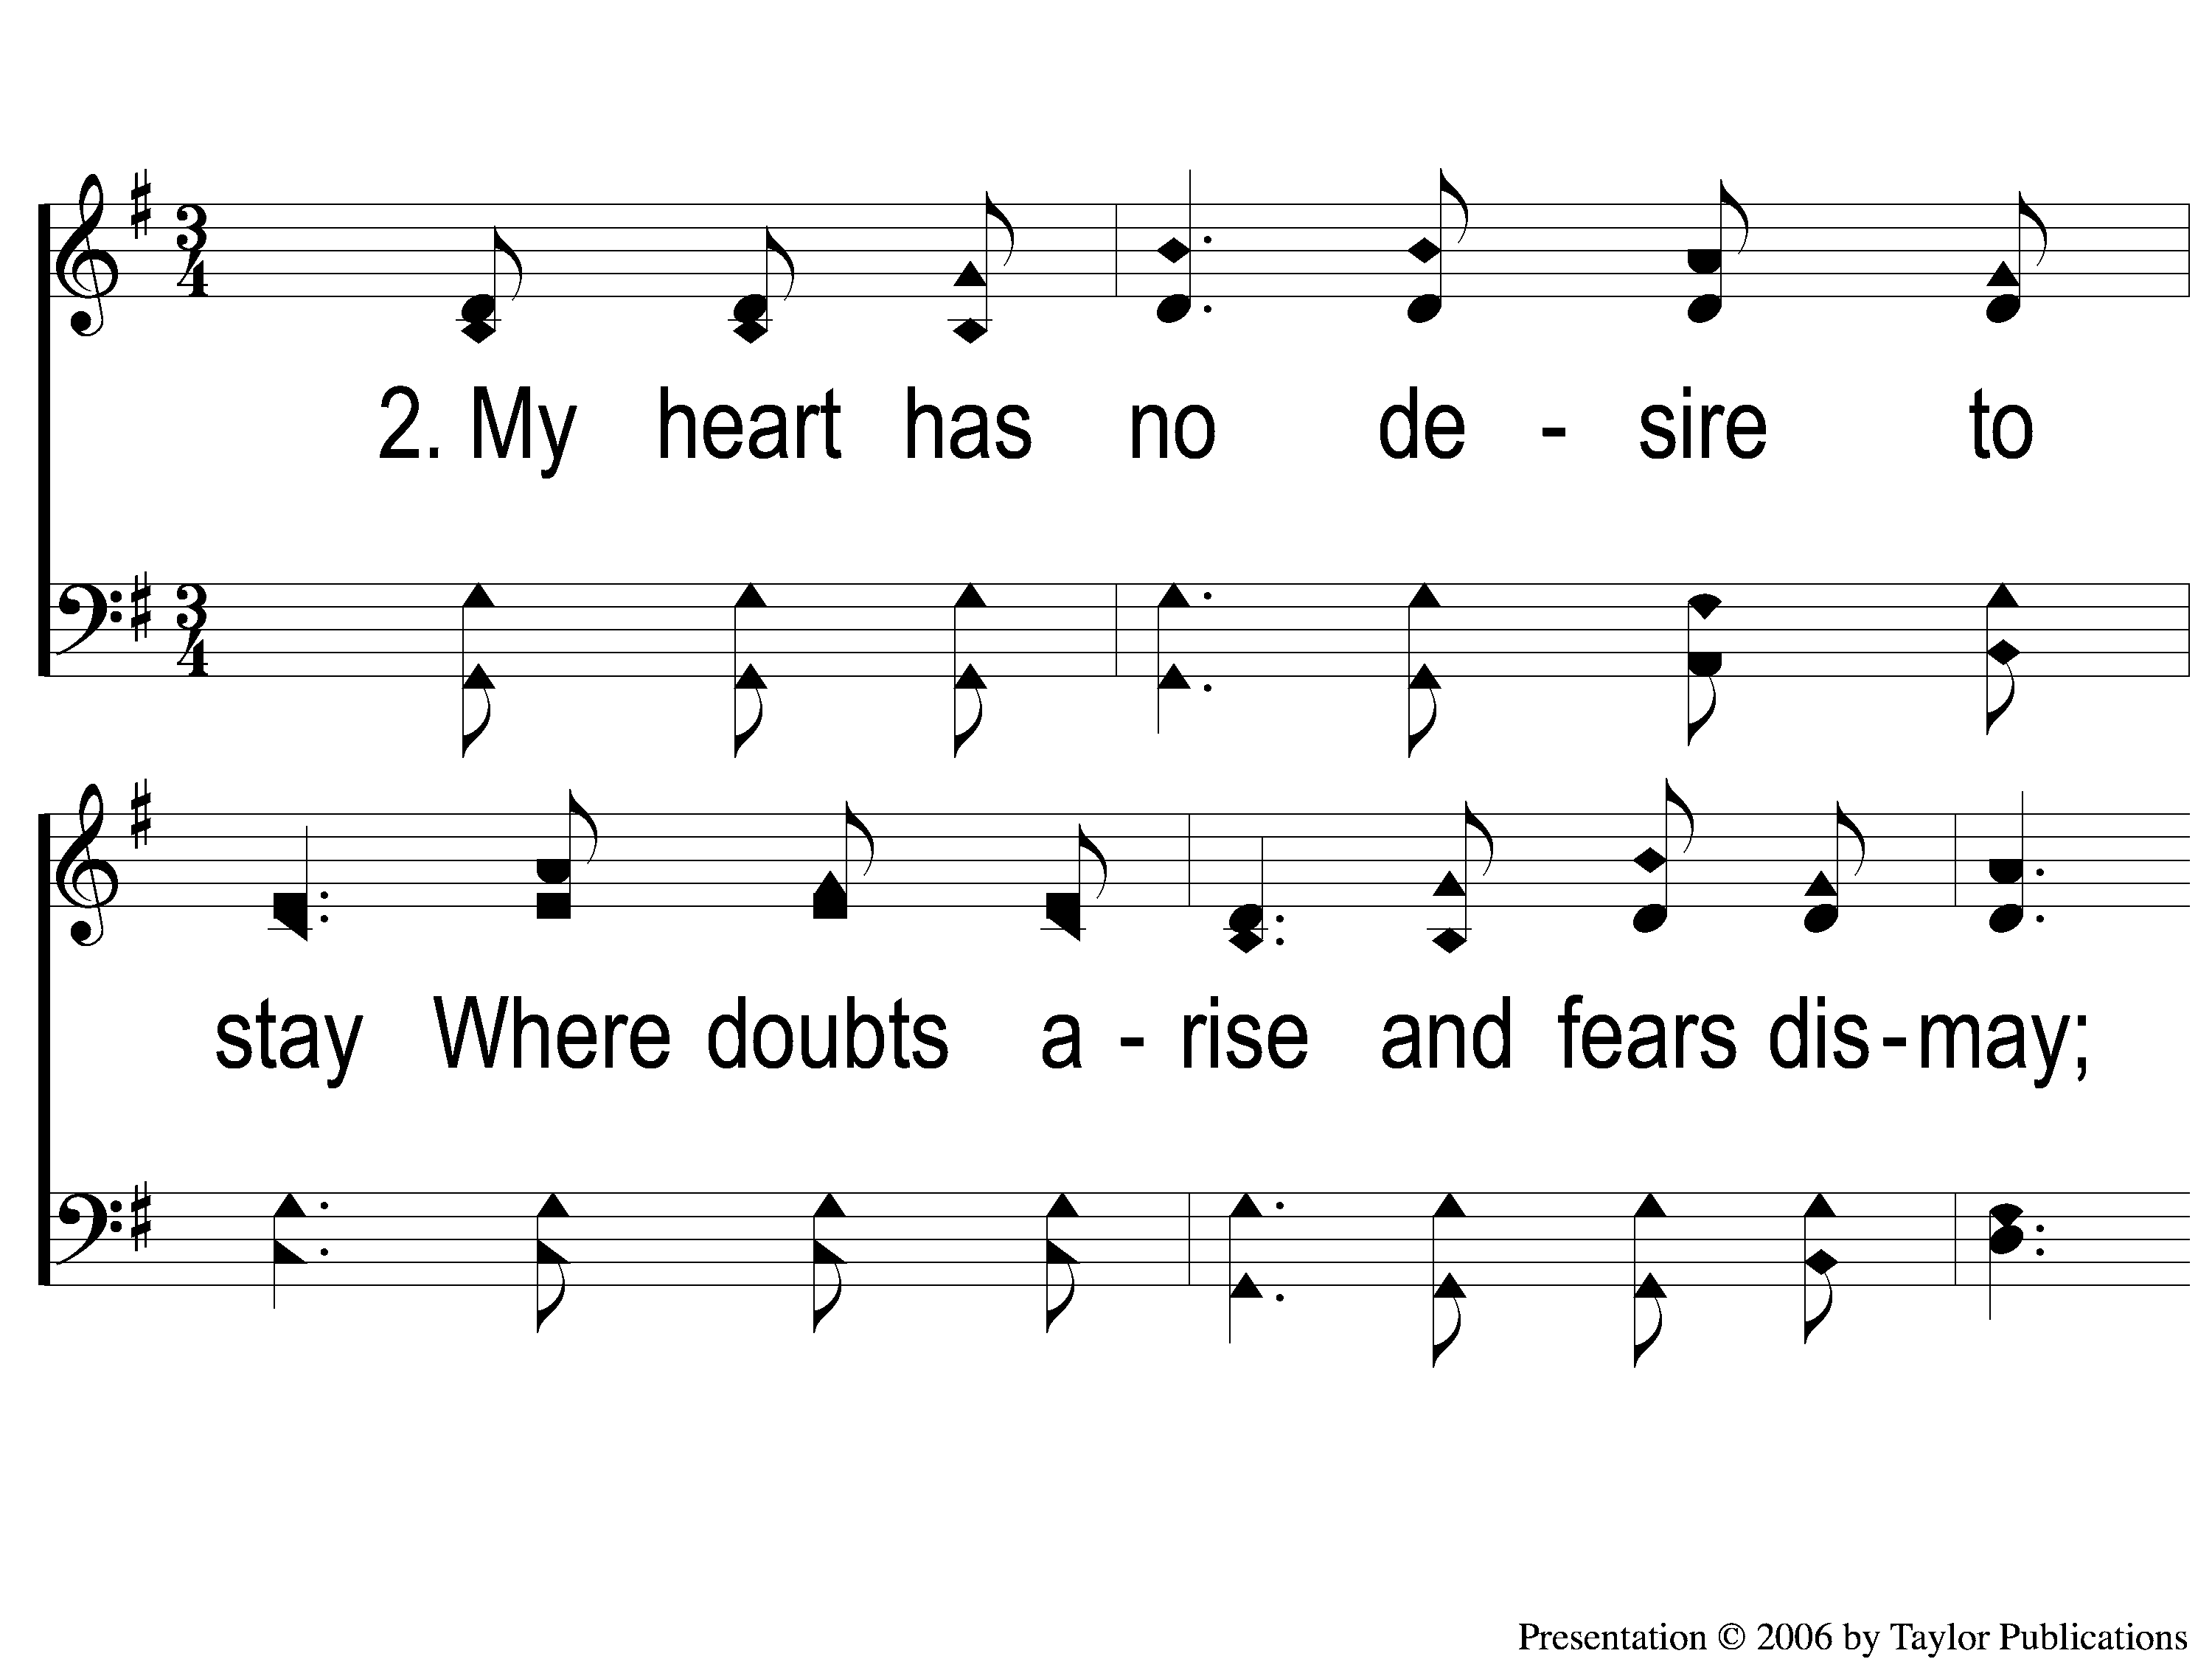
2-1 Higher Ground
Higher Ground
539

Slide 50
2-2 Higher Ground
Higher Ground
539

Slide 51
C-1 Higher Ground
Higher Ground
539

Slide 52
C-2 Higher Ground
Higher Ground
539

Slide 53
C-3 Higher Ground
Higher Ground
539

Slide 54
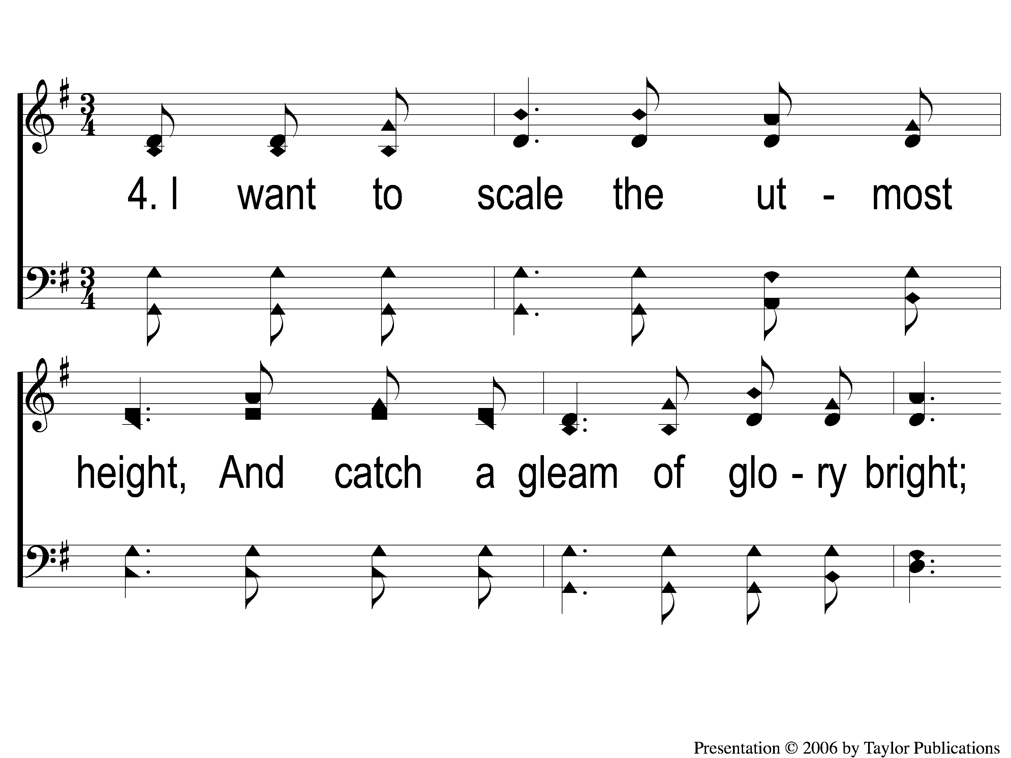
4-1 Higher Ground
Higher Ground
539

Slide 55
4-2 Higher Ground
Higher Ground
539

Slide 56
C-1 Higher Ground
Higher Ground
539

Slide 57
C-2 Higher Ground
Higher Ground
539

Slide 58
C-3 Higher Ground
Higher Ground
539

Slide 59
#535
SONG:
The Glory Land Way

Slide 60
1-1 The Glory Land Way
The Glory Land Way
535

Slide 61
1-2 The Glory Land Way
The Glory Land Way
535

Slide 62
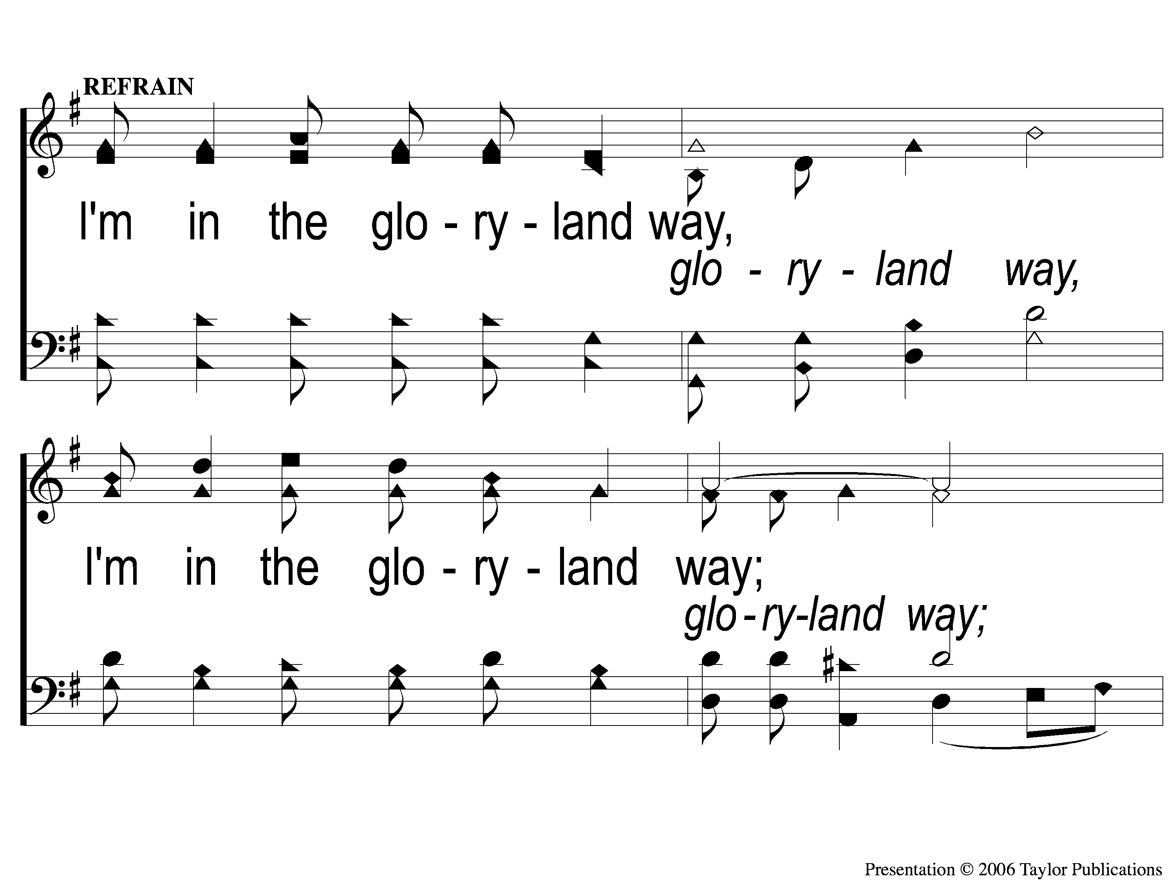
C-1 The Glory Land Way
The Glory Land Way
535

Slide 63
C-2 The Glory Land Way
The Glory Land Way
535

Slide 64
2-1 The Glory Land Way
The Glory Land Way
535

Slide 65
2-2 The Glory Land Way
The Glory Land Way
535

Slide 66
C-1 The Glory Land Way
The Glory Land Way
535

Slide 67
C-2 The Glory Land Way
The Glory Land Way
535

Slide 68
3-1 The Glory Land Way
The Glory Land Way
535

Slide 69
3-2 The Glory Land Way
The Glory Land Way
535

Slide 70
C-1 The Glory Land Way
The Glory Land Way
535

Slide 71
C-2 The Glory Land Way
The Glory Land Way
535

Slide 72
SCRIPTURE:
Luke 19:1-5

Slide 73
Stand out!

Slide 74
CONTAGIOUS CHRISTIANs

Slide 75
Case Study: zacchaeus
Luke 19:1-10

Slide 76
THE SETTING
City of Jericho (v. 1)
Mark 10:1, 46

Slide 77
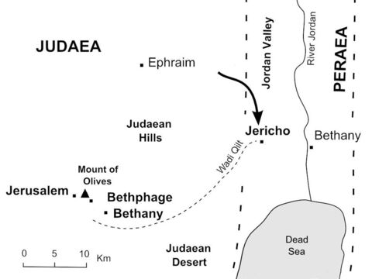

Slide 78
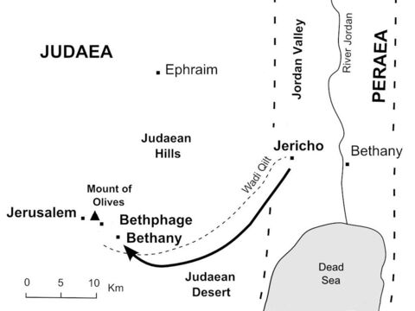

Slide 79
THE SETTING
City of Jericho (v. 1)

Slide 80
THE SETTING
City of Jericho (v. 1)
Rahab saved; Israel’s victory
Healed Bartimaeus

Slide 81
Zacchaeus stood out…
In His Reservation (v. 2)

Slide 82
In his reservation
“A Chief Tax Collector”
Jewish View:
v. 7 – “…who is a sinner.”
Lk. 5:30, Mt. 5:46-47

Slide 83
In his reservation
“A Chief Tax Collector”
Jesus’ View:
5:27 – “…Follow Me.”
7:34, 15:1, Mt. 21:32

Slide 84
In his reservation
“He Was Rich”
Physically Wealthy
Lk. 18 – Similar to the Ruler

Slide 85
In his reservation
“He Was Rich”
Physically Wealthy
Lk. 18 – Similar to the Ruler
“Poor in Spirit” – Matt. 5:3

Slide 86
Zacchaeus stood out…
In His Reservation (v. 2)
In His Action (v. 3-5a)

Slide 87
In his ACTION
“He sought to see…Jesus”
Wanted to see for himself

Slide 88
In his ACTION
“He sought to see…Jesus”
Wanted to see for himself
Not to see the crowd
Not to hear from the crowd

Slide 89
In his ACTION
Could Not See Jesus
Problems:
Short stature
Large Crowd

Slide 90
In his ACTION
Could Not See Jesus
Solutions:
“ran ahead”

Slide 91
In his ACTION
Could Not See Jesus
Solutions:
“ran ahead”
“climbed…a sycamore tree”
Amos 7:14, 1 Chr. 27:28

Slide 92
In his ACTION
Luke 19:5a

Slide 93
In his ACTION
Luke 19:5a
Jesus:
Saw Zacchaeus!
Spoke to Zacchaeus

Slide 94
Zacchaeus stood out…
In His Reservation (v. 2)
In His Action (v. 3-5a)
In His Transformation (v. 5b-10)

Slide 95
In his transformation
Luke 19:5b-6

Slide 96
In his transformation
Luke 19:5b-6
Listened to Jesus
Obeyed Jesus

Slide 97
In his transformation
“Made Haste & Came Down”
Opposite of Jesus on the Cross
Told to come down → Save Himself

Slide 98
In his transformation
“Received Him Joyfully”
Unlike the Rich, Young Ruler
Lk. 18:23 – “became very sorrowful, for he was very rich.”

Slide 99
In his transformation
Making Restitution (v. 8)

Slide 100
In his transformation
Making Restitution (v. 8)
Give to the Poor
Restoring 4-fold
Beyond what was required!

Slide 101
In his transformation
Receiving Salvation (v. 9)

Slide 102
In his transformation
Receiving Salvation (v. 9)
“to this house”
“son of Abraham”
Gal. 3:16, 29

Slide 103
In his transformation
Receiving Salvation (v. 10)

Slide 104
In his transformation
Receiving Salvation (v. 10)
Zacchaeus = righteous
Luke 5:32

Slide 105
Zacchaeus had an outstanding
Down-to-earth Attitude
Desire to Seek Jesus
Determination to be Righteous

Slide 106
Are you standing out?

Slide 107
#916
SONG:
What A Day
That Will Be

Slide 108
1-1 Jesus Paid It All
Jesus Paid It All
922

Slide 109
1-2 Jesus Paid It All
Jesus Paid It All
922

Slide 110
C Jesus Paid It All
Jesus Paid It All
922

Slide 111
2-1 Jesus Paid It All
Jesus Paid It All
922

Slide 112
2-2 Jesus Paid It All
Jesus Paid It All
922

Slide 113
C Jesus Paid It All
Jesus Paid It All
922

Slide 114
3-1 Jesus Paid It All
Jesus Paid It All
922

Slide 115
3-2 Jesus Paid It All
Jesus Paid It All
922

Slide 116
C Jesus Paid It All
Jesus Paid It All
922

Slide 117
SONG:
Create In Me

Slide 118
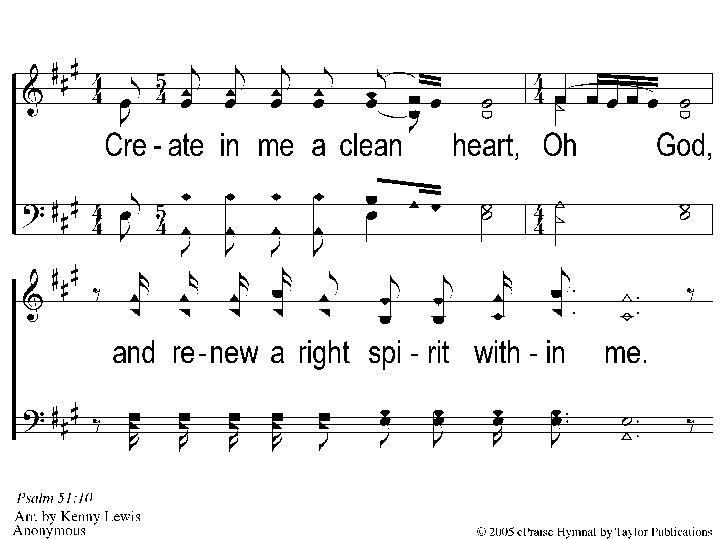
1 Create in Me
Create In Me A Clean Heart

Slide 119
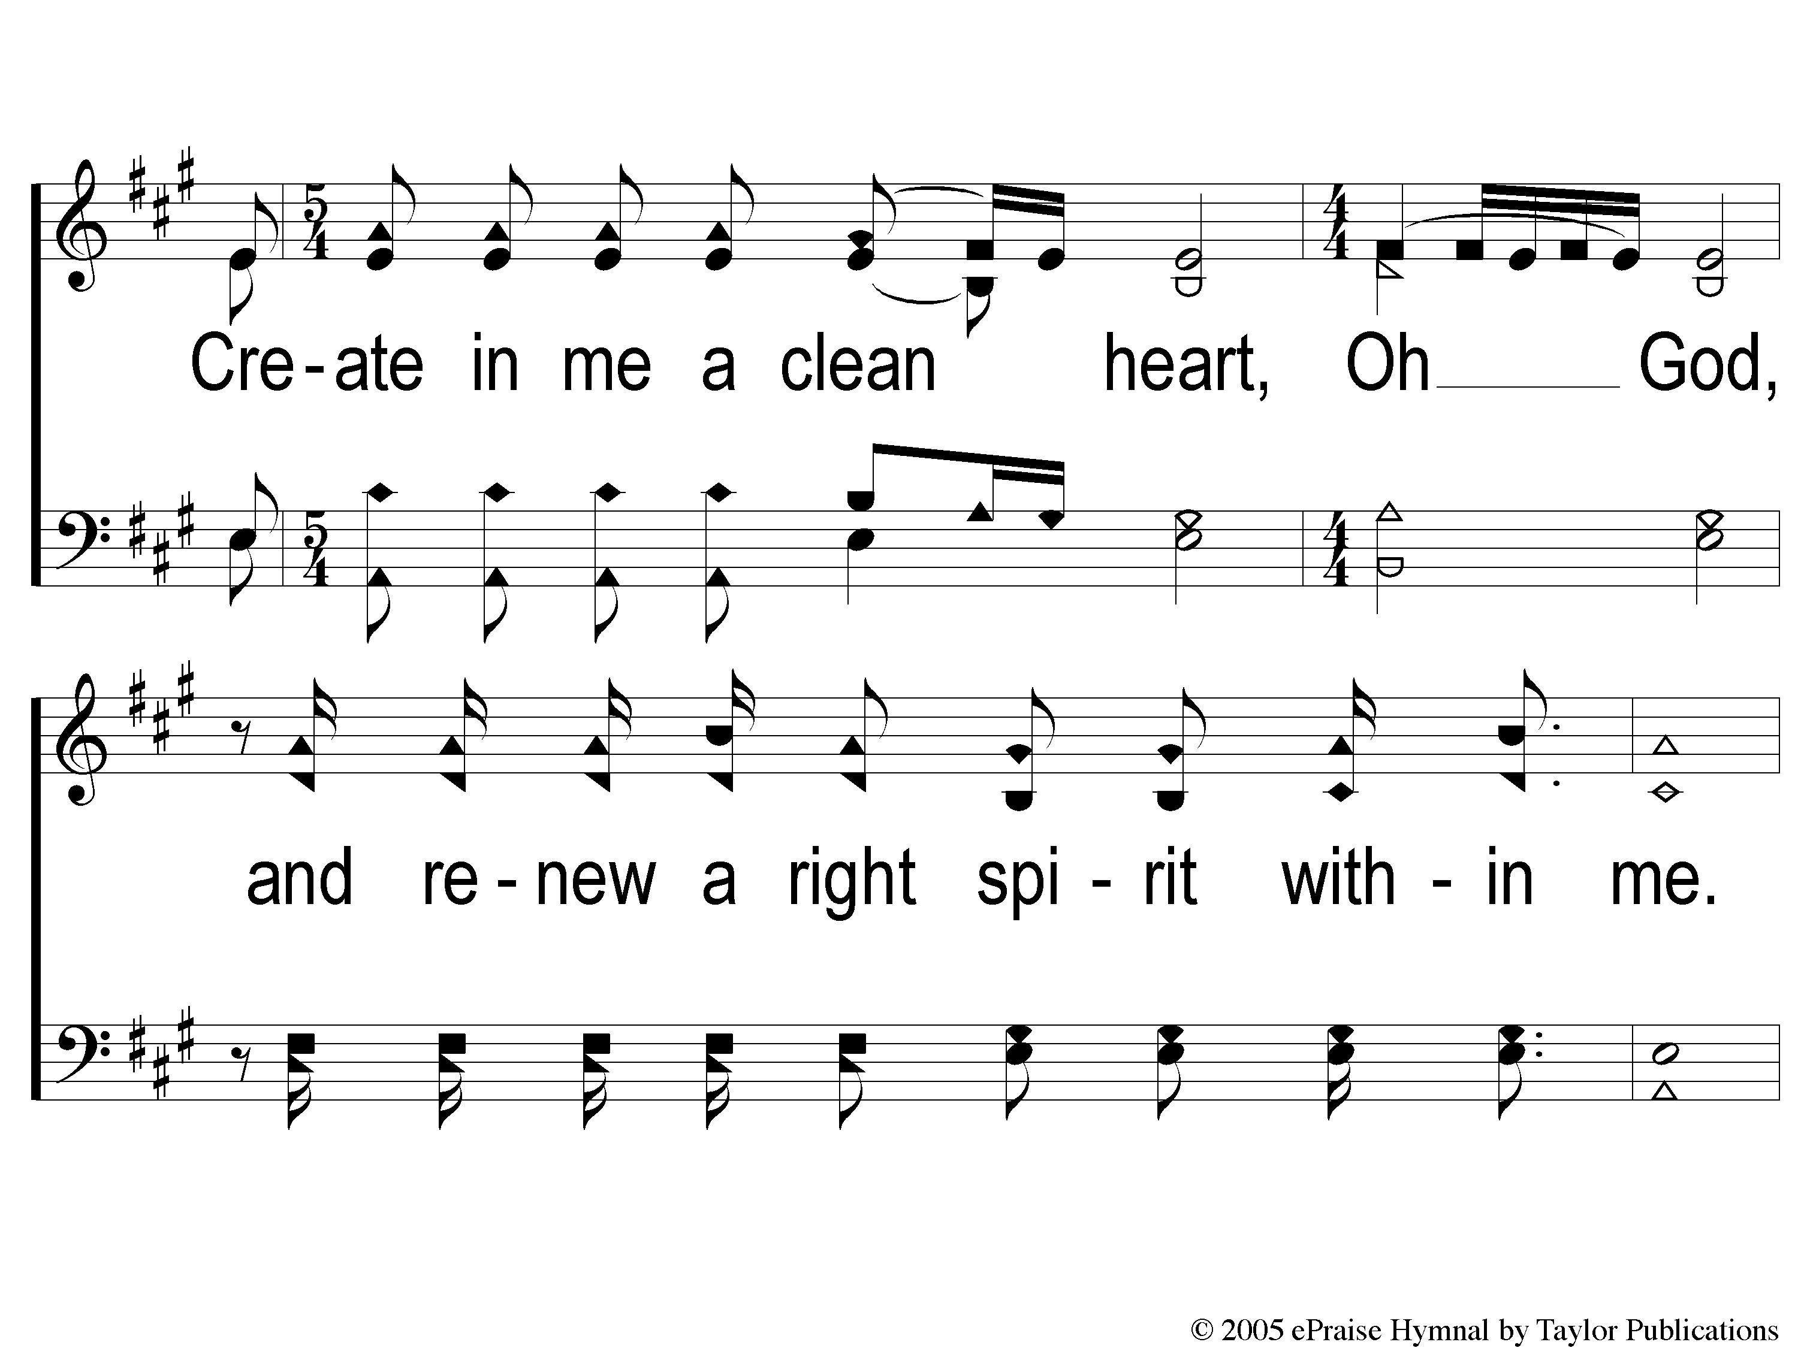
2 Create in Me
Create In Me A Clean Heart

Slide 120
3 Create in Me
Create In Me A Clean Heart

Slide 121
4 Create in Me
Create In Me A Clean Heart

Slide 122
1 Create in Me
Create In Me A Clean Heart

Slide 123
2 Create in Me
Create In Me A Clean Heart

Slide 124
3 Create in Me
Create In Me A Clean Heart

Slide 125
4 Create in Me
Create In Me A Clean Heart

Slide 126
LORD’S SUPPER
The
1 Cor. 11:23-26

Slide 127
Closing PRAYER

Slide 128
#886
SONG:
On Jordan’s
Stormy Banks

Slide 129
1-1 On Jordan’s Stormy Banks
On Jordan’s Stormy Banks
886

Slide 130
1-2 On Jordan’s Stormy Banks
On Jordan’s Stormy Banks
886

Slide 131
C-1 On Jordan’s Stormy Banks
On Jordan’s Stormy Banks
886

Slide 132
C-2 On Jordan’s Stormy Banks
On Jordan’s Stormy Banks
886

Slide 133
4-1 On Jordan’s Stormy Banks
On Jordan’s Stormy Banks
886

Slide 134
4-2 On Jordan’s Stormy Banks
On Jordan’s Stormy Banks
886

Slide 135
C-1 On Jordan’s Stormy Banks
On Jordan’s Stormy Banks
886

Slide 136
C-2 On Jordan’s Stormy Banks
On Jordan’s Stormy Banks
886

Slide 137
TONIGHT @ 6:00 pm
EVENING WORSHIP
HOPE TO SEE YOU THERE!

