Slide 1
1-1 As the Deer
As The Deer
71

Slide 2
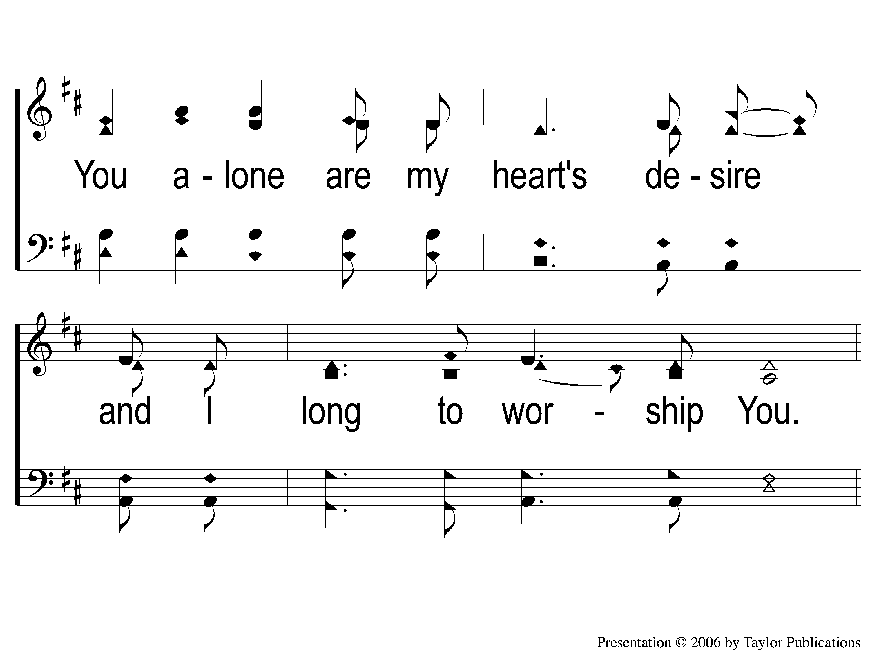
1-2 As the Deer
As The Deer
71

Slide 3
C-1 As the Deer
As The Deer
71

Slide 4
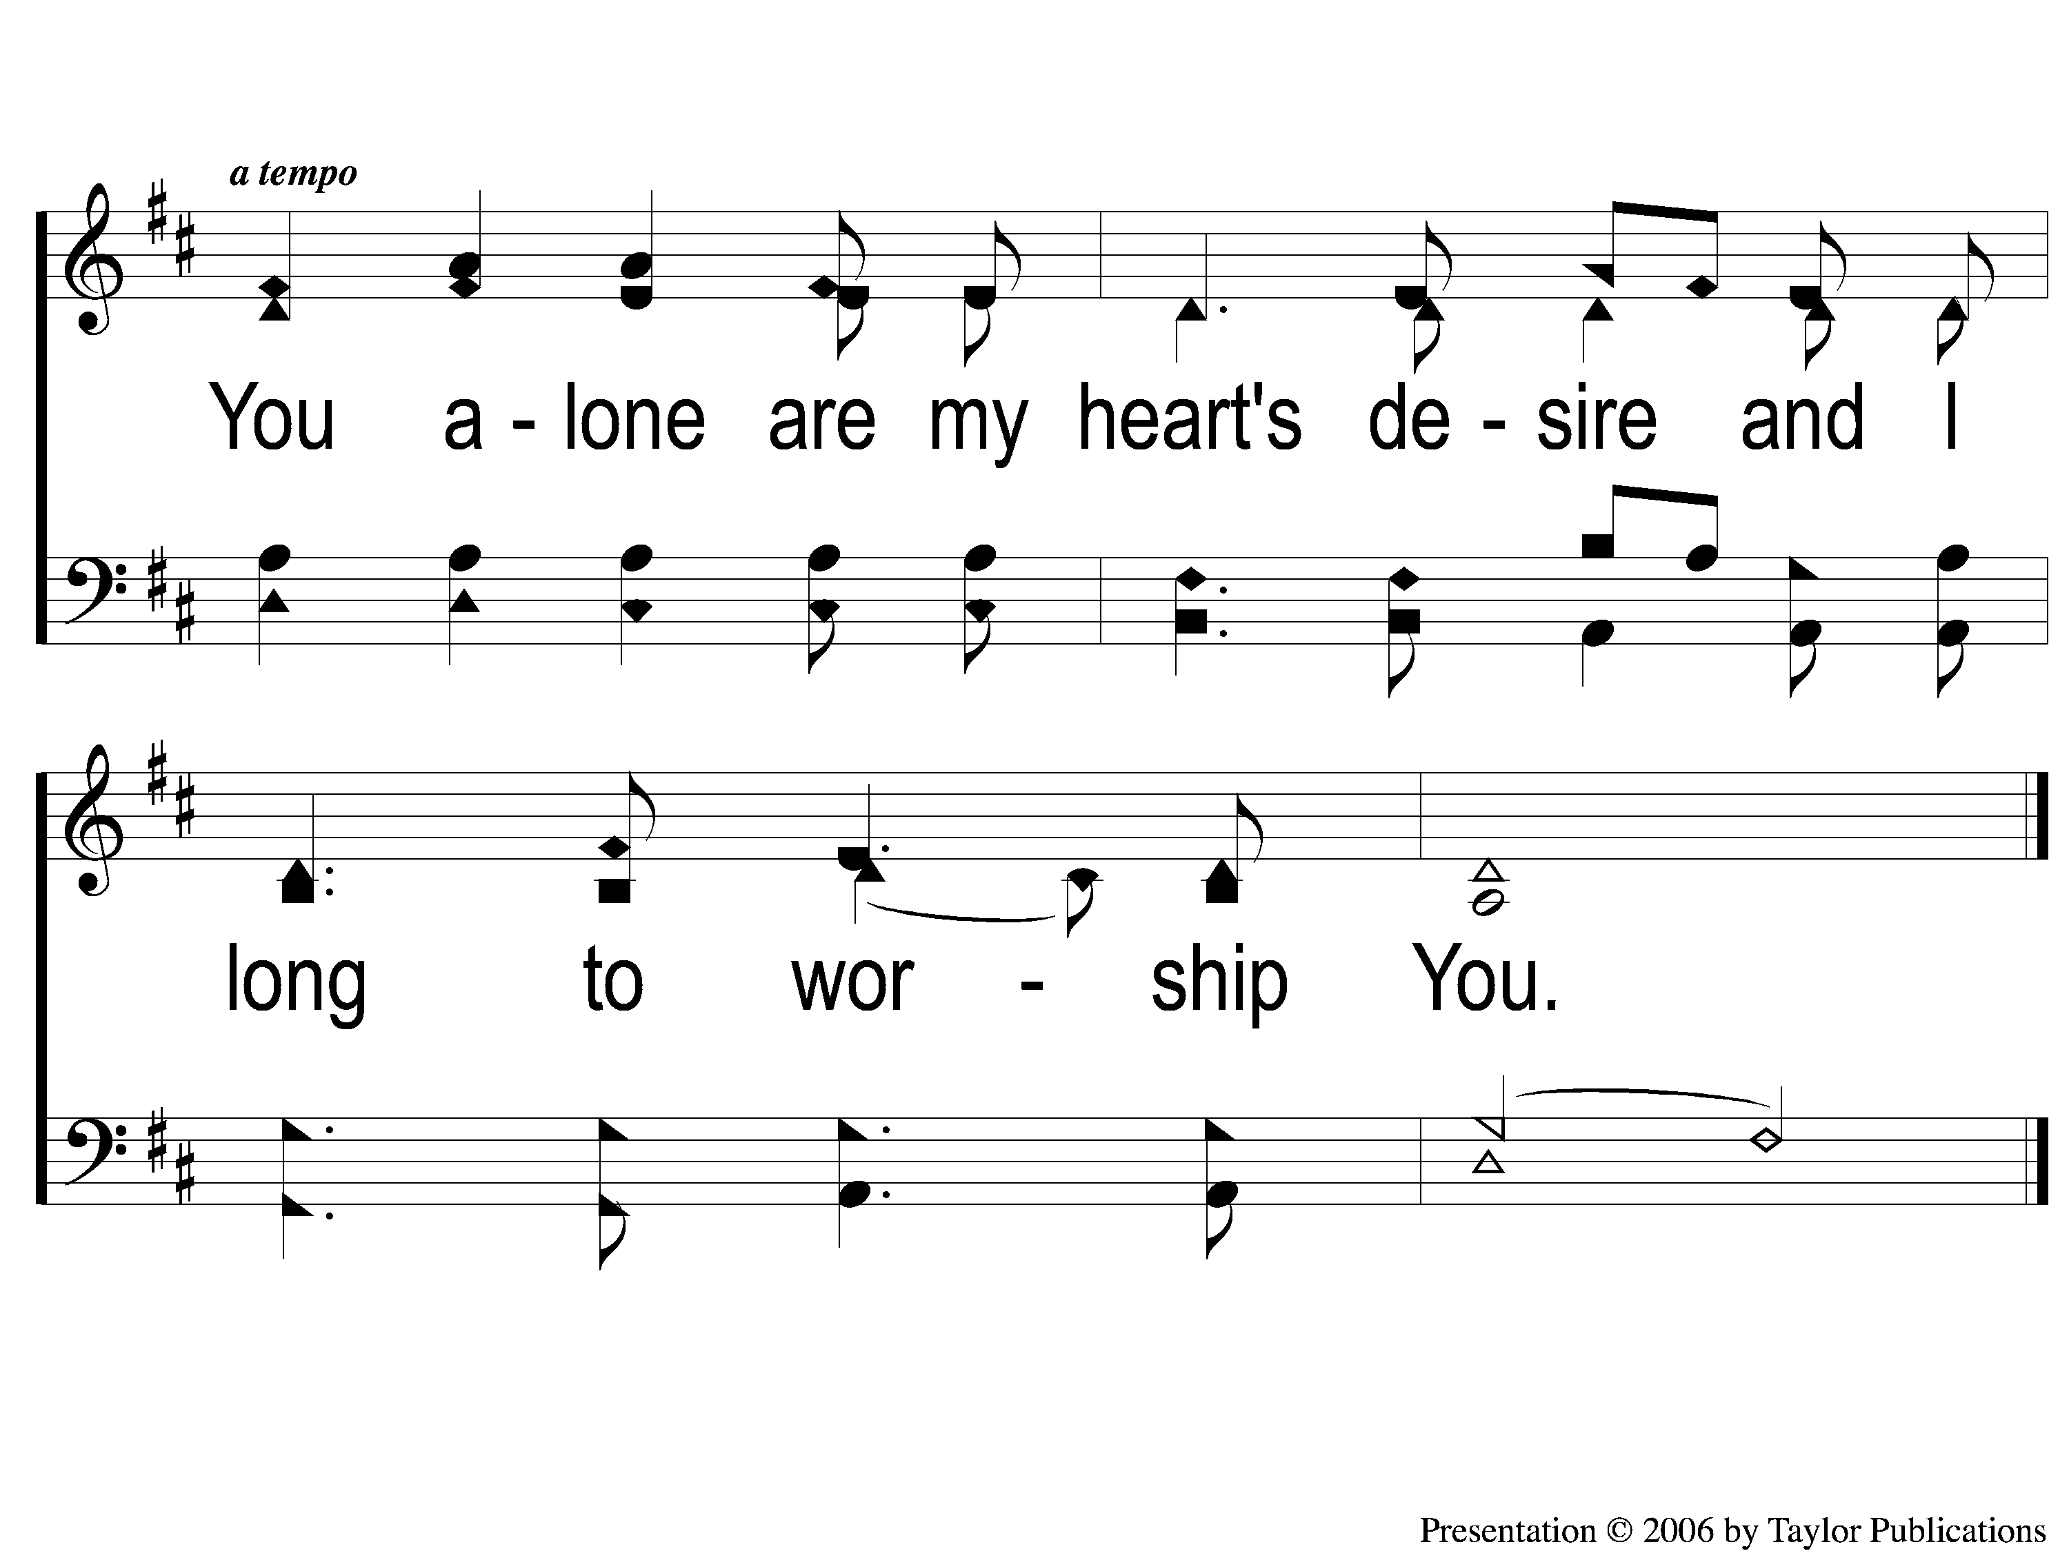
C-2 As the Deer
As The Deer
71

Slide 5
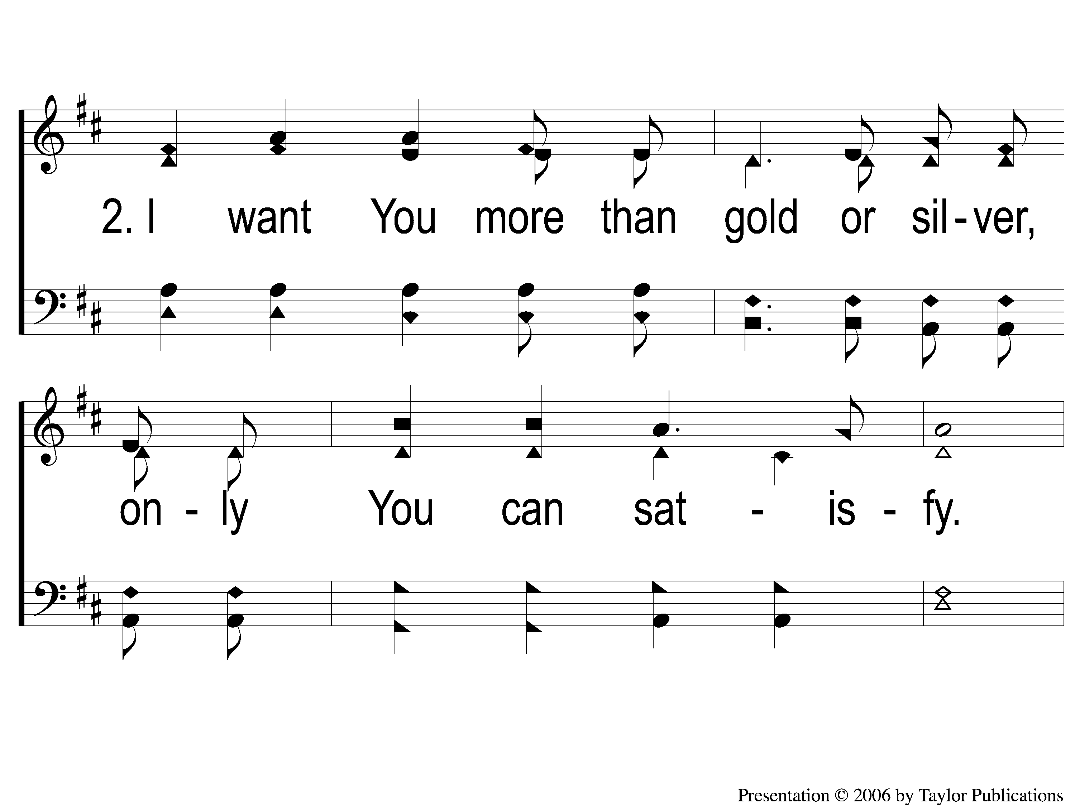
2-1 As the Deer
As The Deer
71

Slide 6
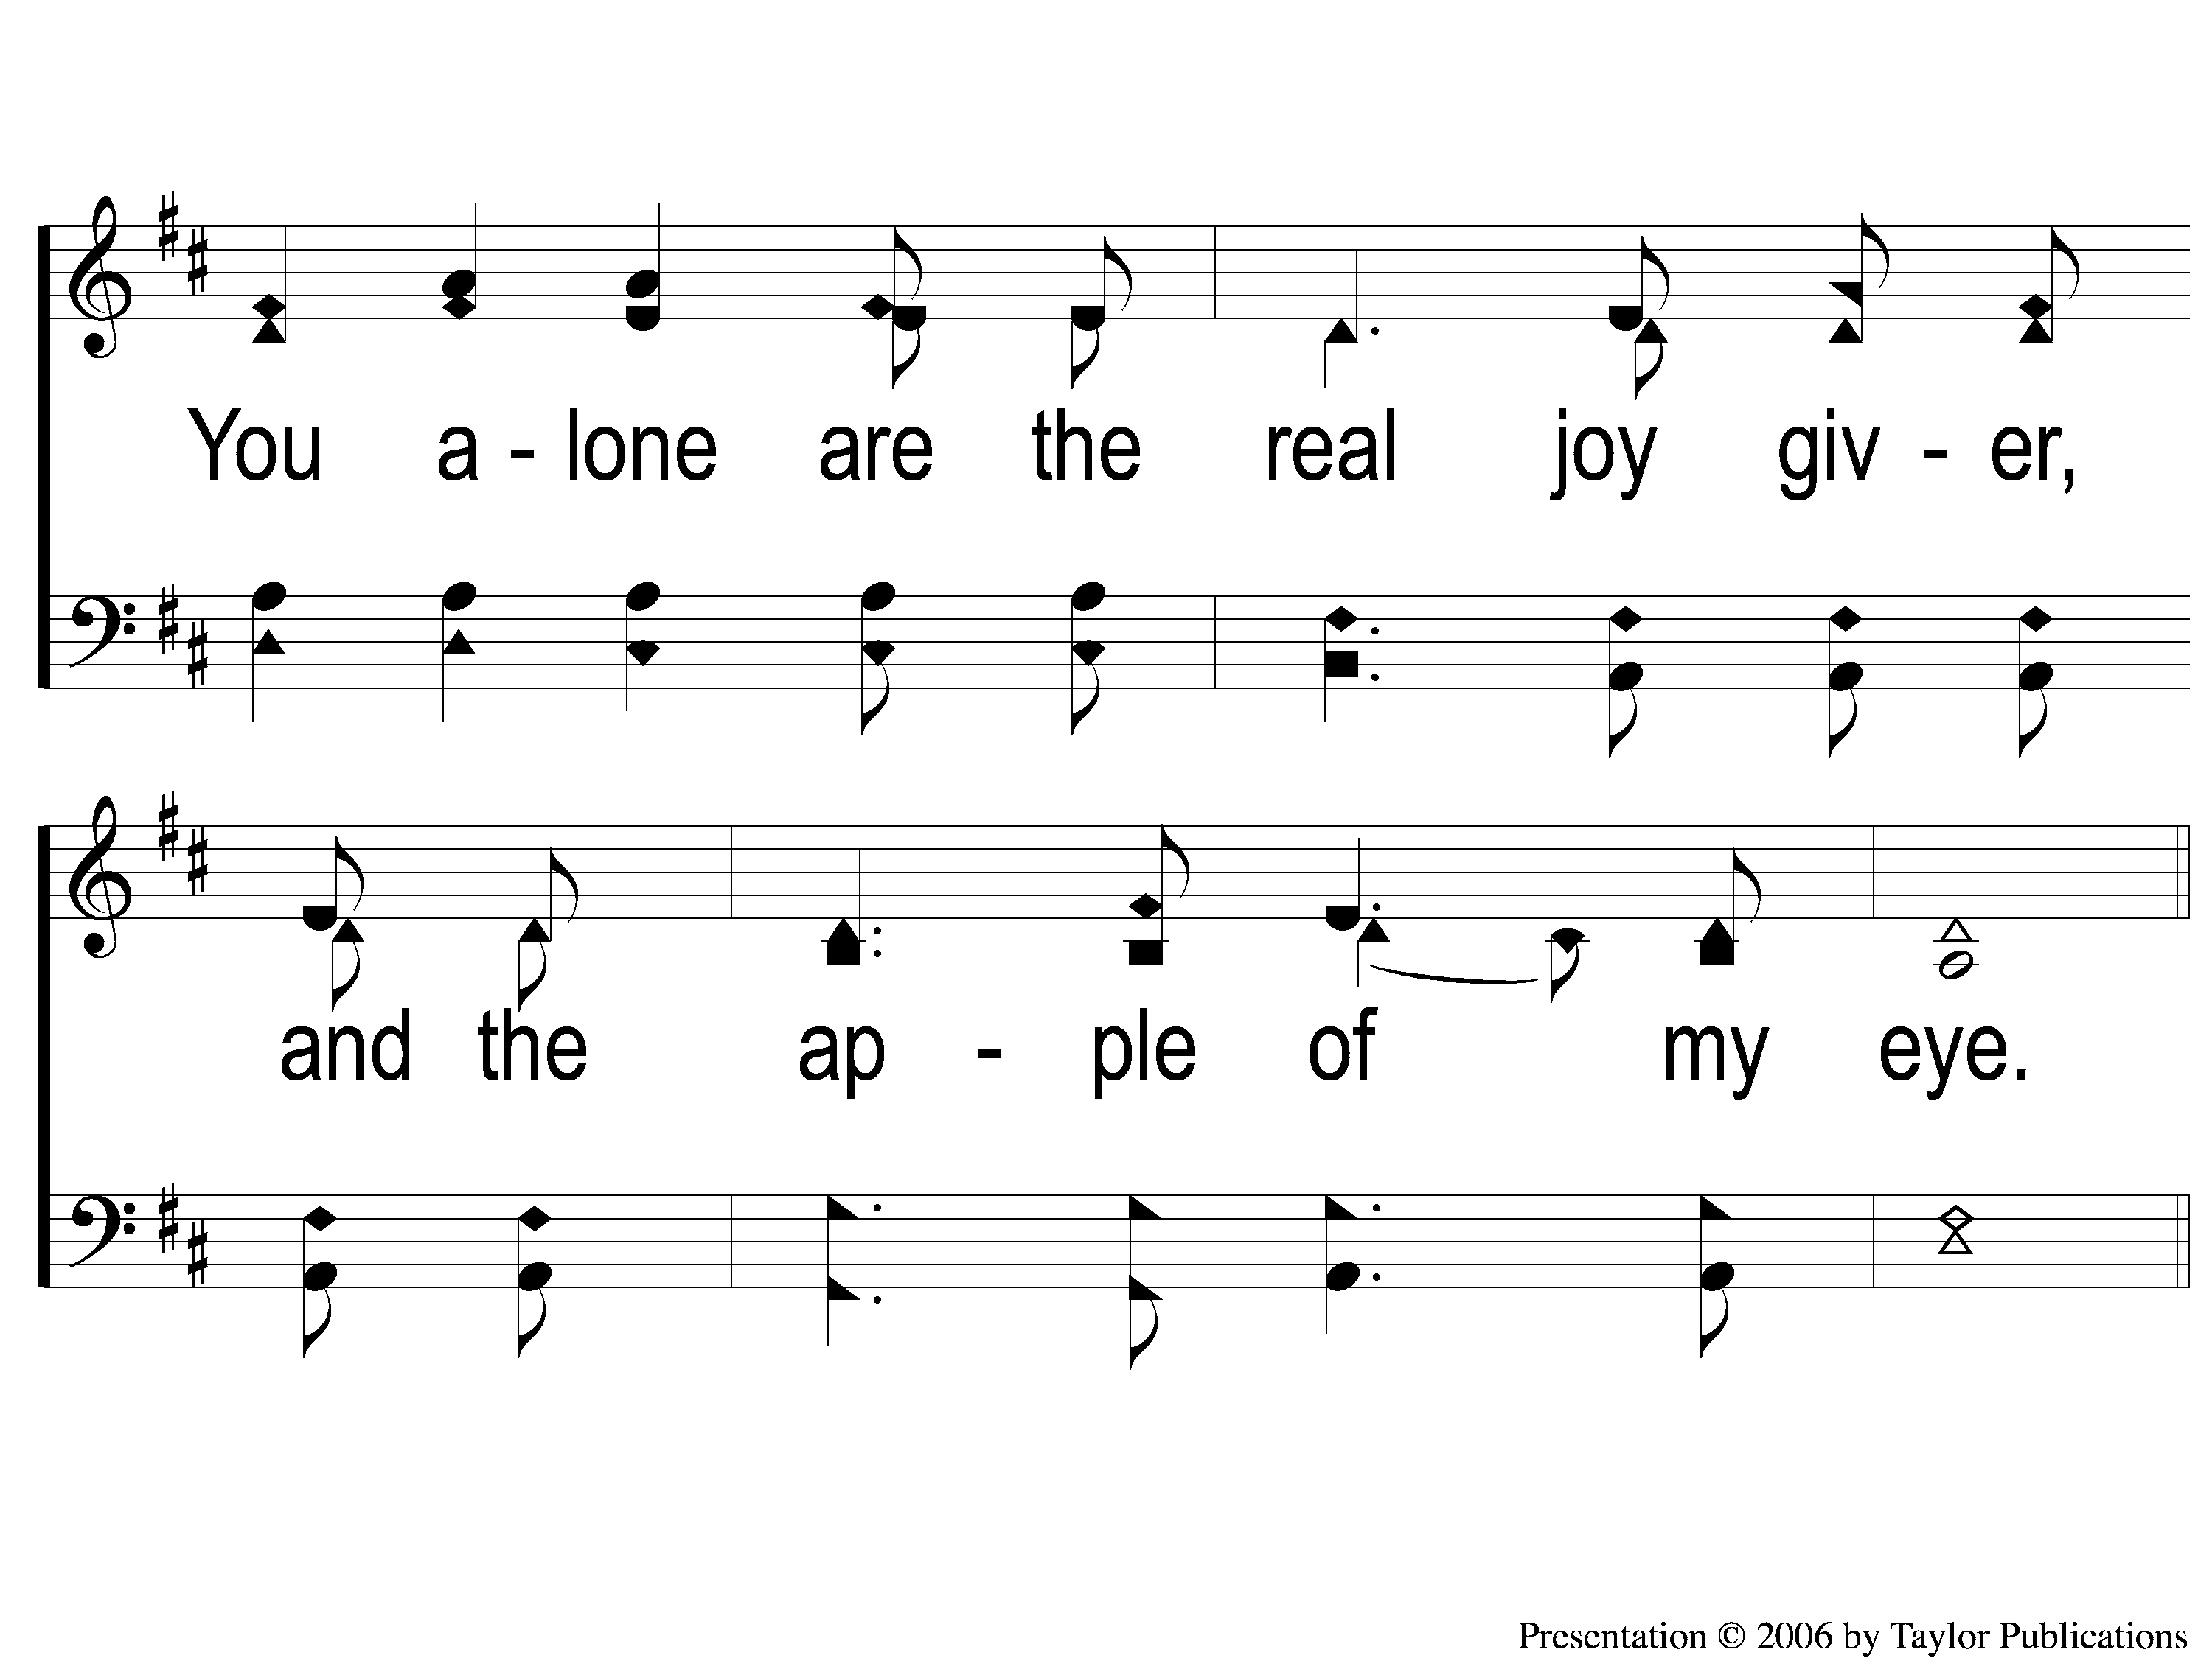
2-2 As the Deer
As The Deer
71

Slide 7
C-1 As the Deer
As The Deer
71

Slide 8
C-2 As the Deer
As The Deer
71

Slide 9
RESTORE REBUILD RENEW
welcome
we are glad to
Have you with us
IN 2022
WHEELER
CHURCH
OF
CHRIST

Slide 10
Song:
Unto Thee, O Lord
#794

Slide 11
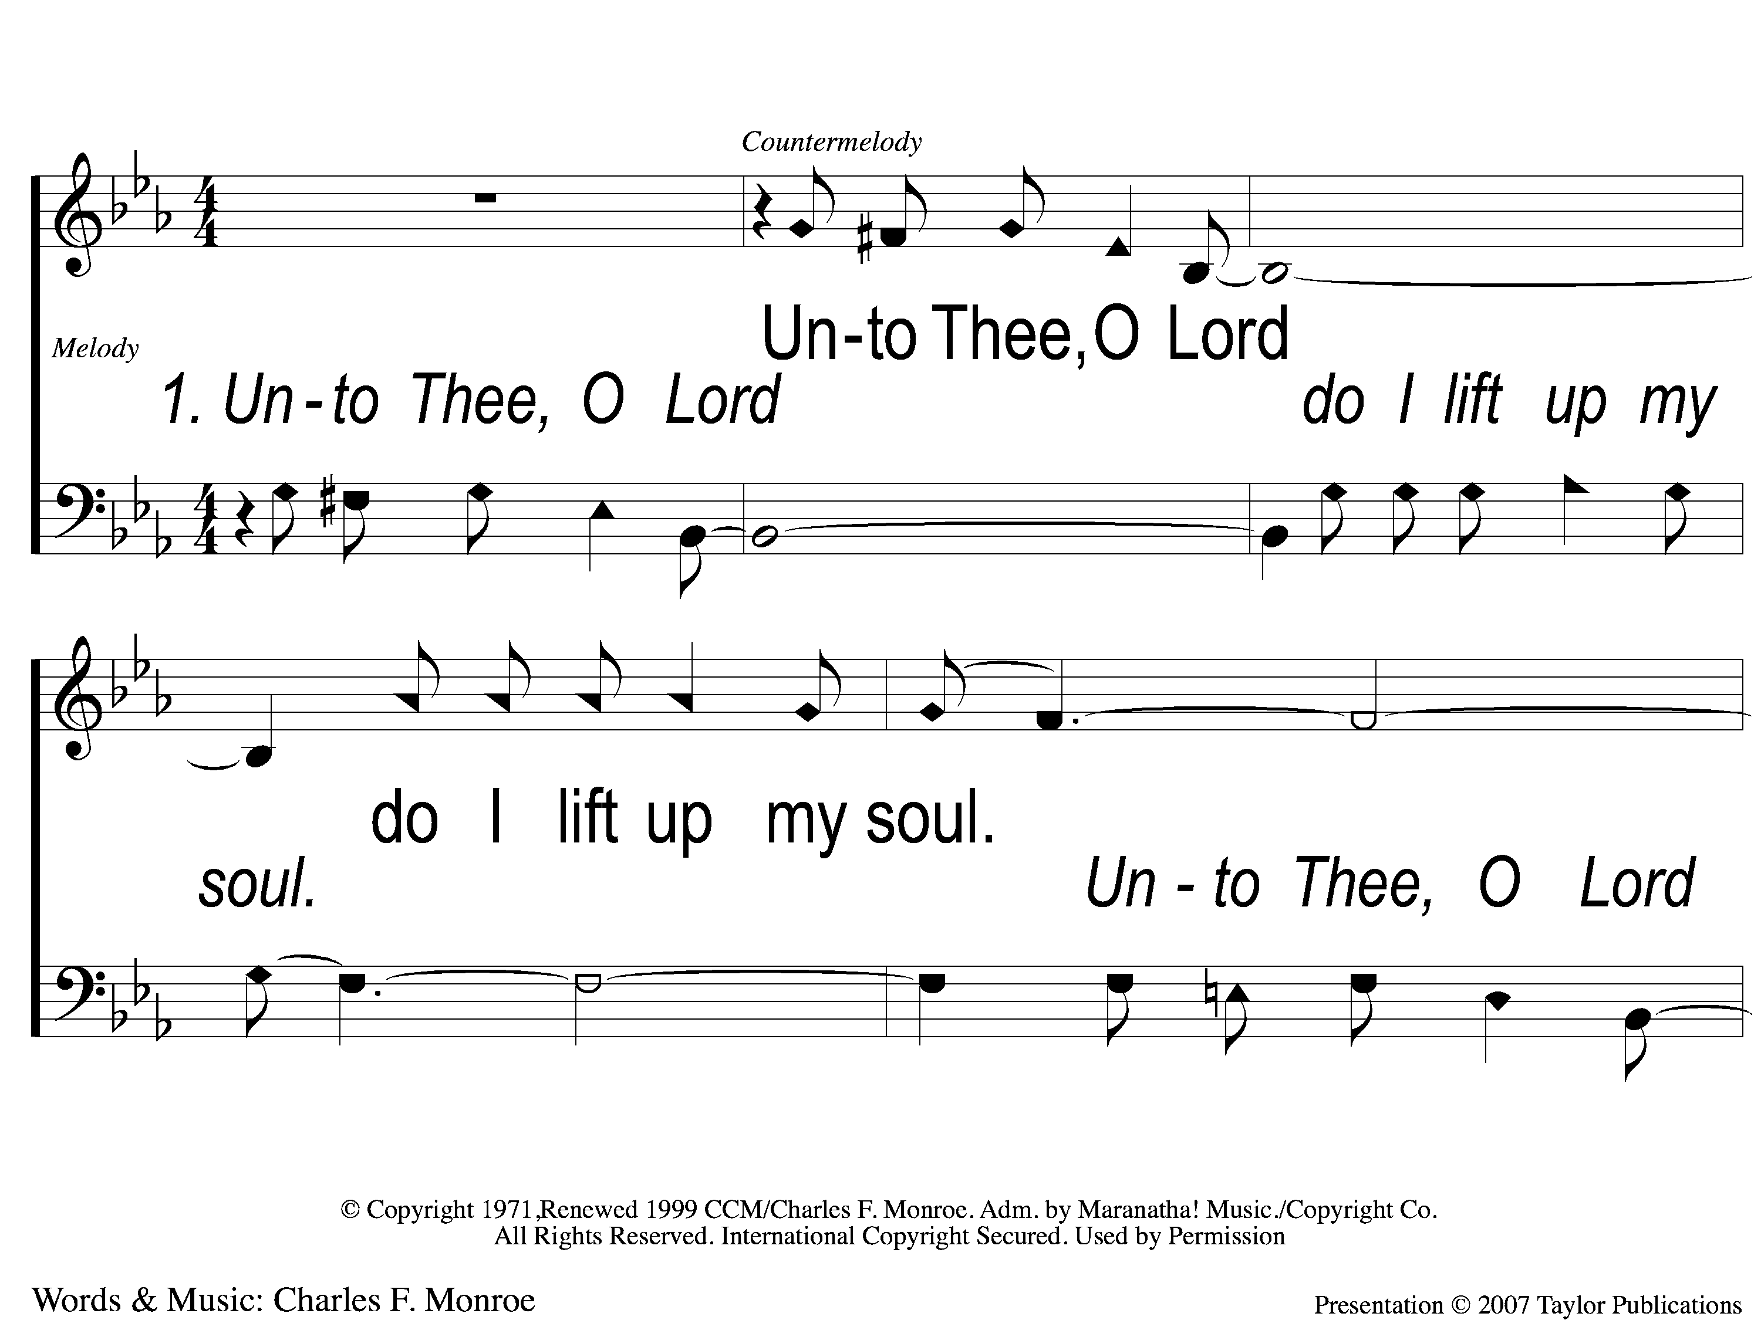
1-1 Unto Thee O Lord
Unto to Thee O Lord
794

Slide 12
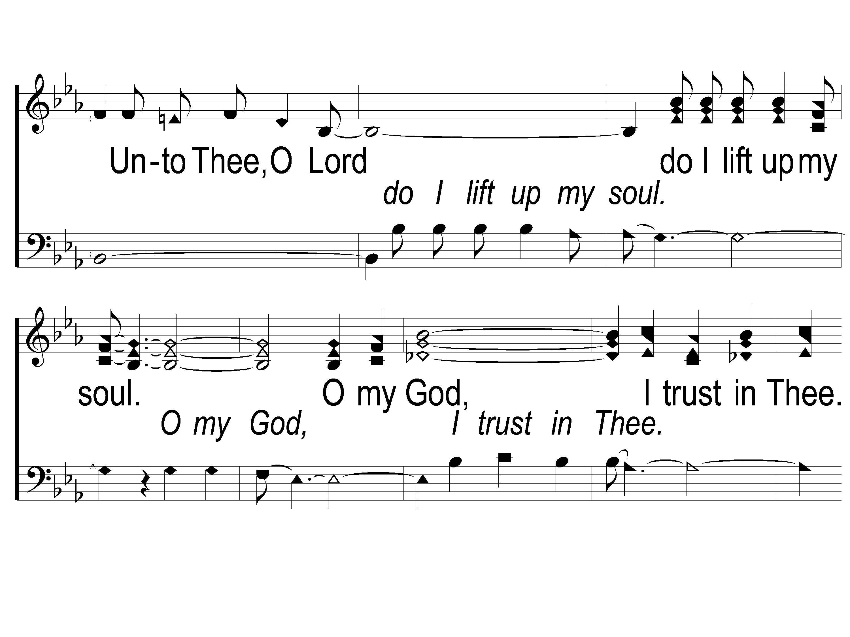
1-2 Unto Thee O Lord
Unto to Thee O Lord
794

Slide 13
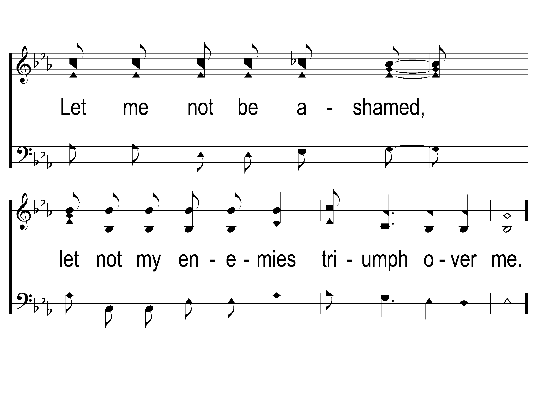
1-3 Unto Thee O Lord
Unto to Thee O Lord
794

Slide 14
2-1 Unto Thee O Lord
Unto to Thee O Lord
794

Slide 15
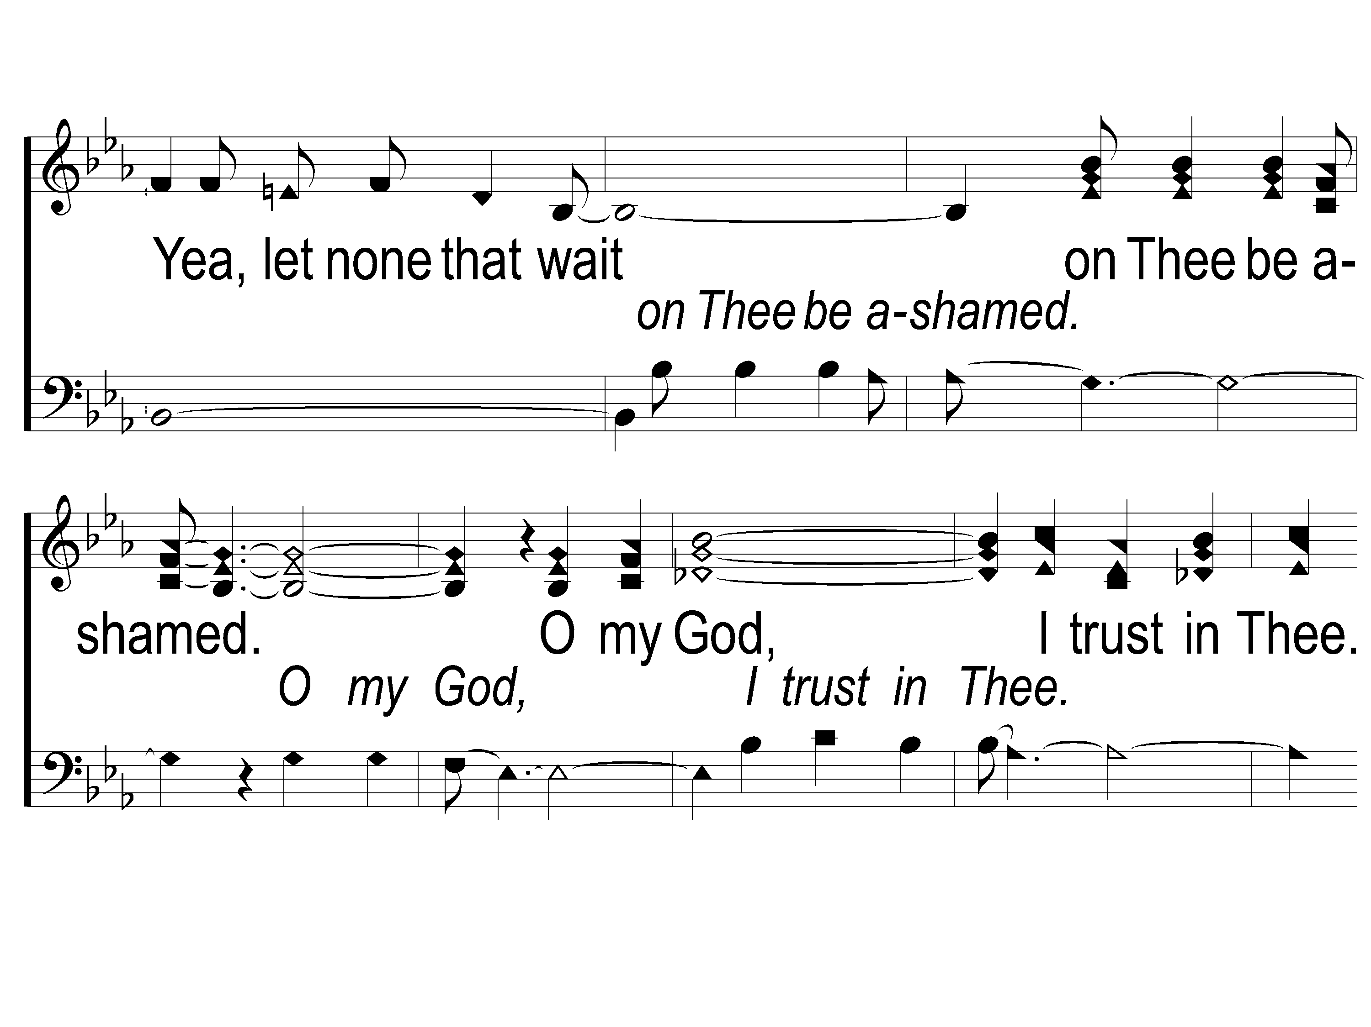
2-2 Unto Thee O Lord
Unto to Thee O Lord
794

Slide 16
2-3 Unto Thee O Lord
Unto to Thee O Lord
794

Slide 17
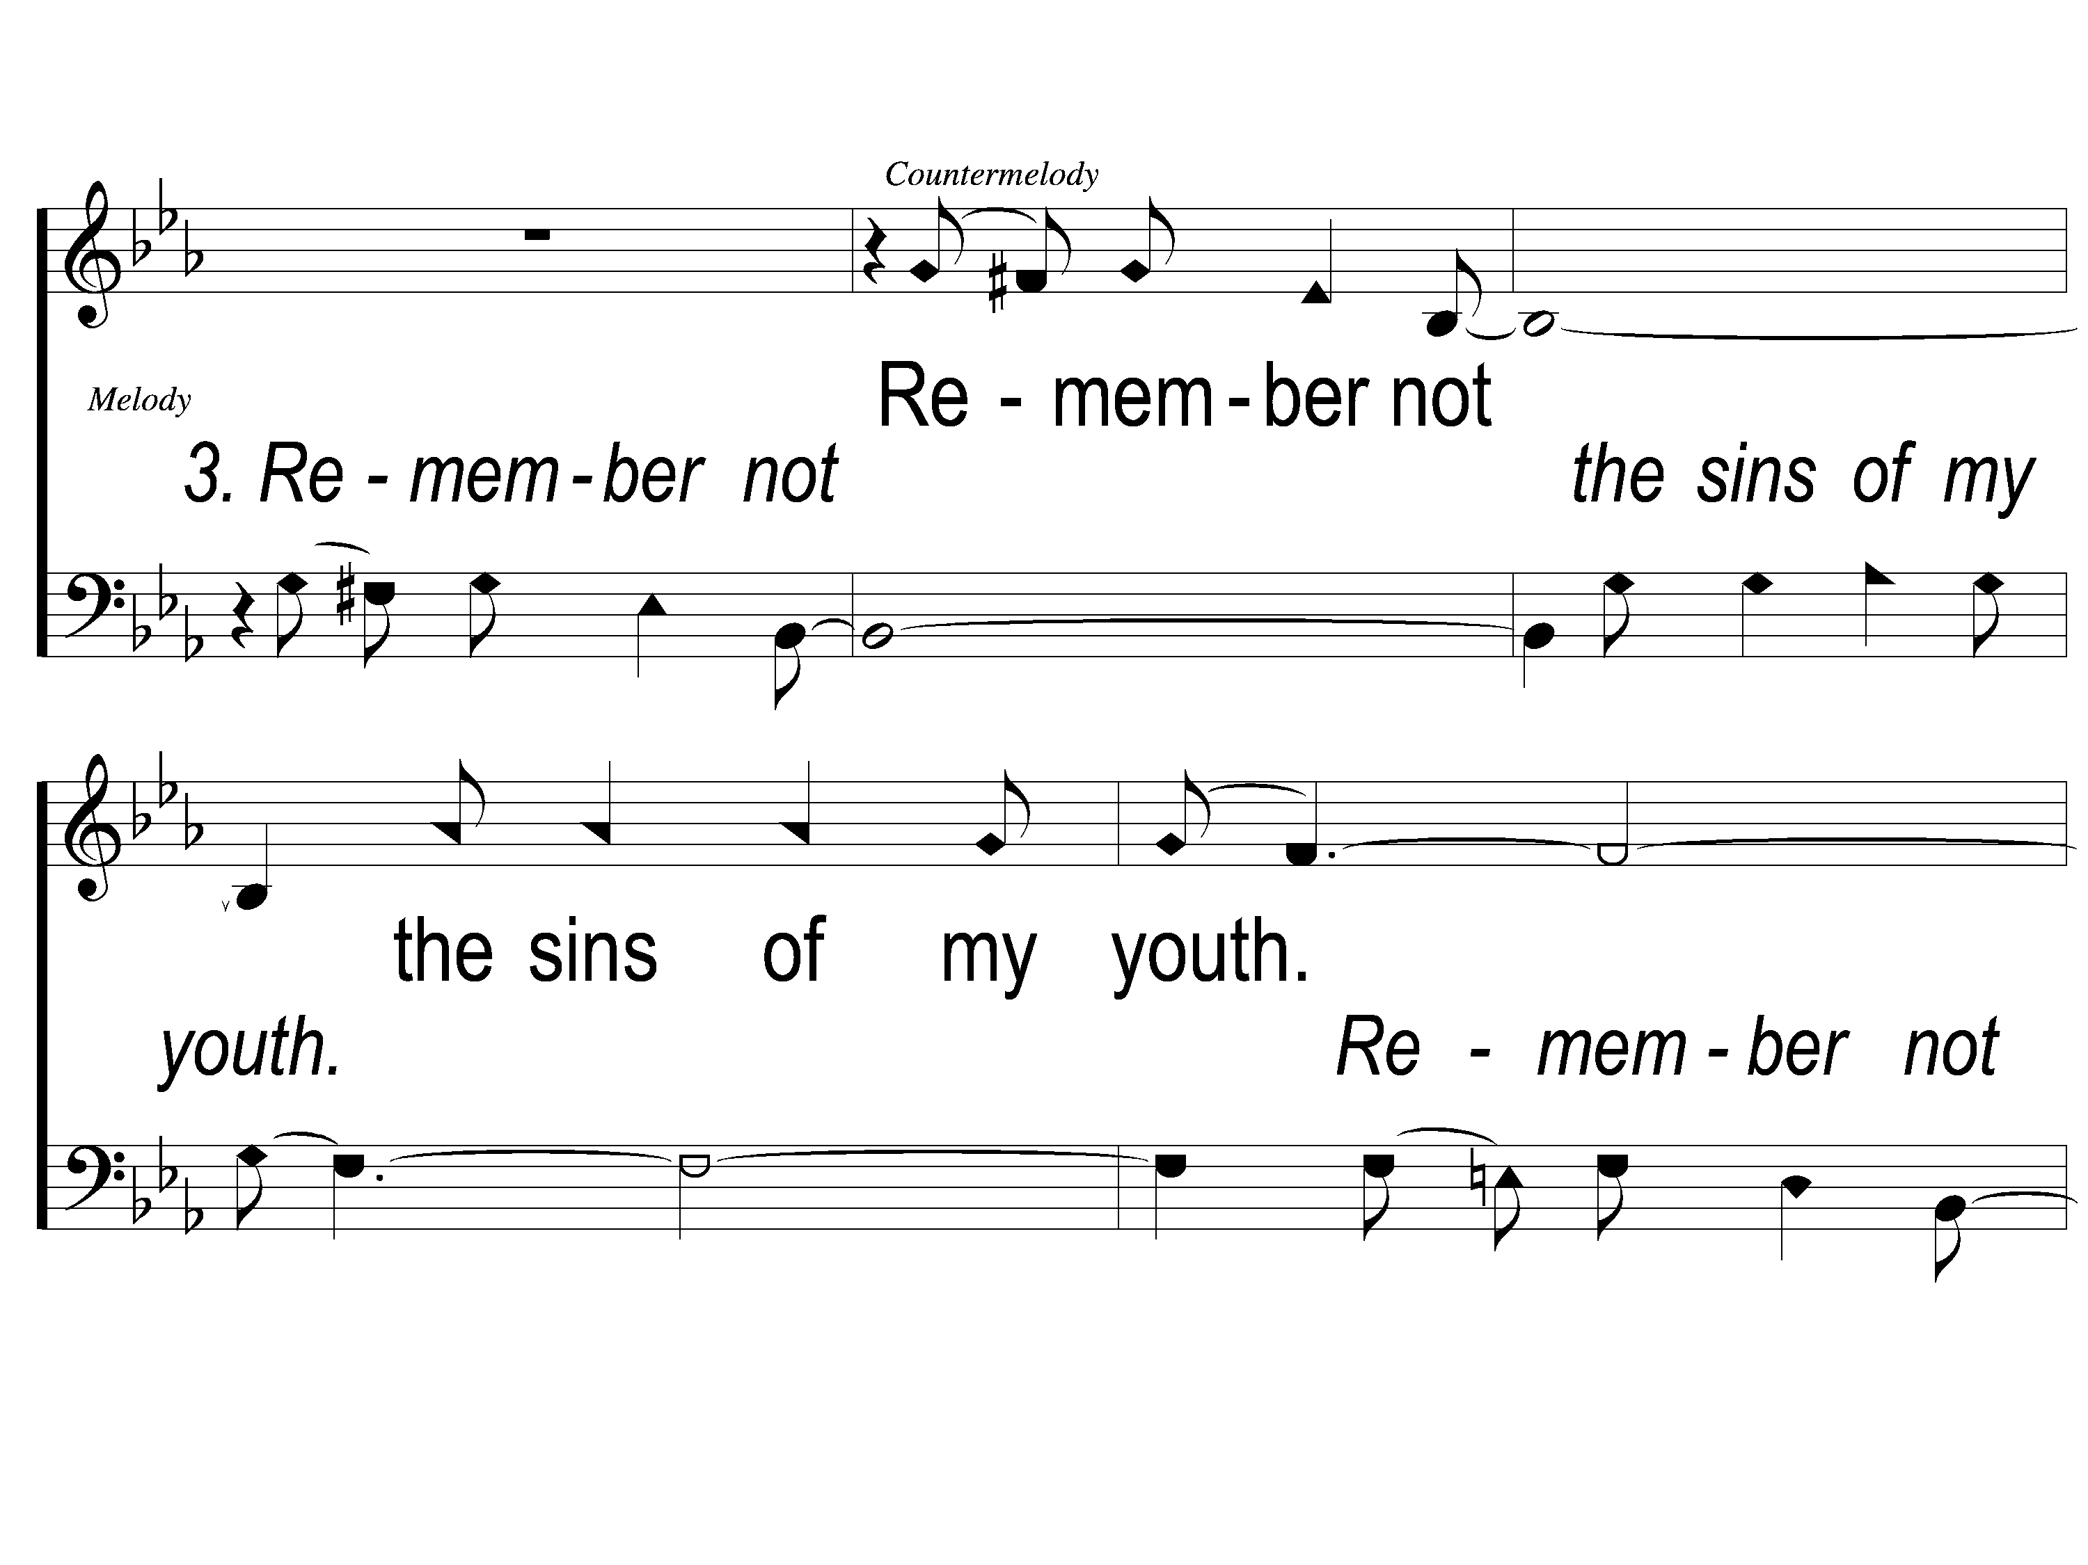
3-1 Unto Thee O Lord
Unto to Thee O Lord
794

Slide 18
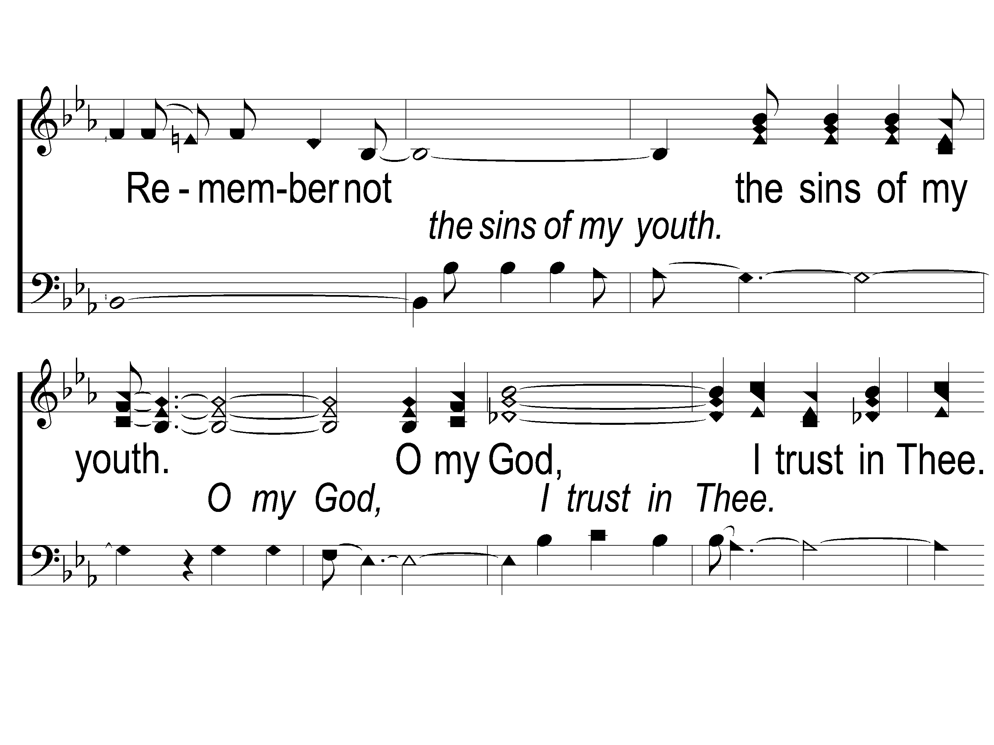
3-2 Unto Thee O Lord
Unto to Thee O Lord
794

Slide 19
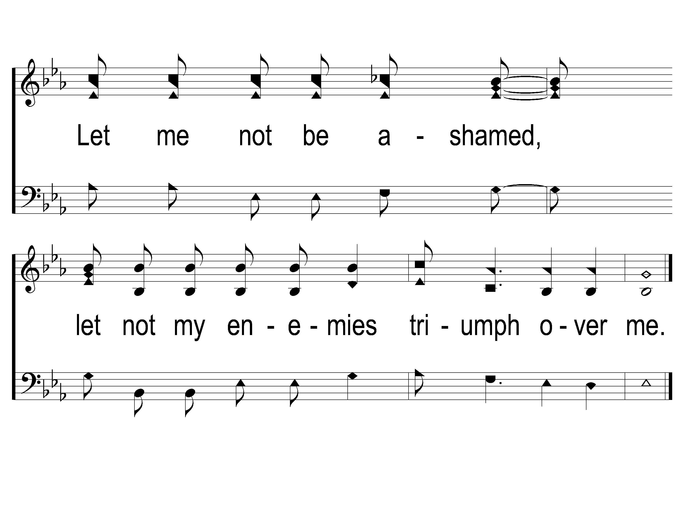
3-3 Unto Thee O Lord
Unto to Thee O Lord
794

Slide 20
Song:
Just A Little Talk With Jesus
#959

Slide 21
1-1 Just A Little Talk With Jesus
Just A Little Talk With Jesus
959

Slide 22
1-2 Just A Little Talk With Jesus
Just A Little Talk With Jesus
959

Slide 23
C-1 Just A Little Talk With Jesus
Just A Little Talk With Jesus
959

Slide 24
C-2 Just A Little Talk With Jesus
Just A Little Talk With Jesus
959

Slide 25
C-3 Just A Little Talk With Jesus
Just A Little Talk With Jesus
959

Slide 26
2-1 Just A Little Talk With Jesus
Just A Little Talk With Jesus
959

Slide 27
2-2 Just A Little Talk With Jesus
Just A Little Talk With Jesus
959

Slide 28
C-1 Just A Little Talk With Jesus
Just A Little Talk With Jesus
959

Slide 29
C-2 Just A Little Talk With Jesus
Just A Little Talk With Jesus
959

Slide 30
C-3 Just A Little Talk With Jesus
Just A Little Talk With Jesus
959

Slide 31
3-1 Just A Little Talk With Jesus
Just A Little Talk With Jesus
959

Slide 32
3-2 Just A Little Talk With Jesus
Just A Little Talk With Jesus
959

Slide 33
C-1 Just A Little Talk With Jesus
Just A Little Talk With Jesus
959

Slide 34
C-2 Just A Little Talk With Jesus
Just A Little Talk With Jesus
959

Slide 35
C-3 Just A Little Talk With Jesus
Just A Little Talk With Jesus
959

Slide 36
Opening Prayer

Slide 37
Song:
My Hope Is Built
#538

Slide 38
1-1 My Hope is Built
My Hope Is Built
538

Slide 39
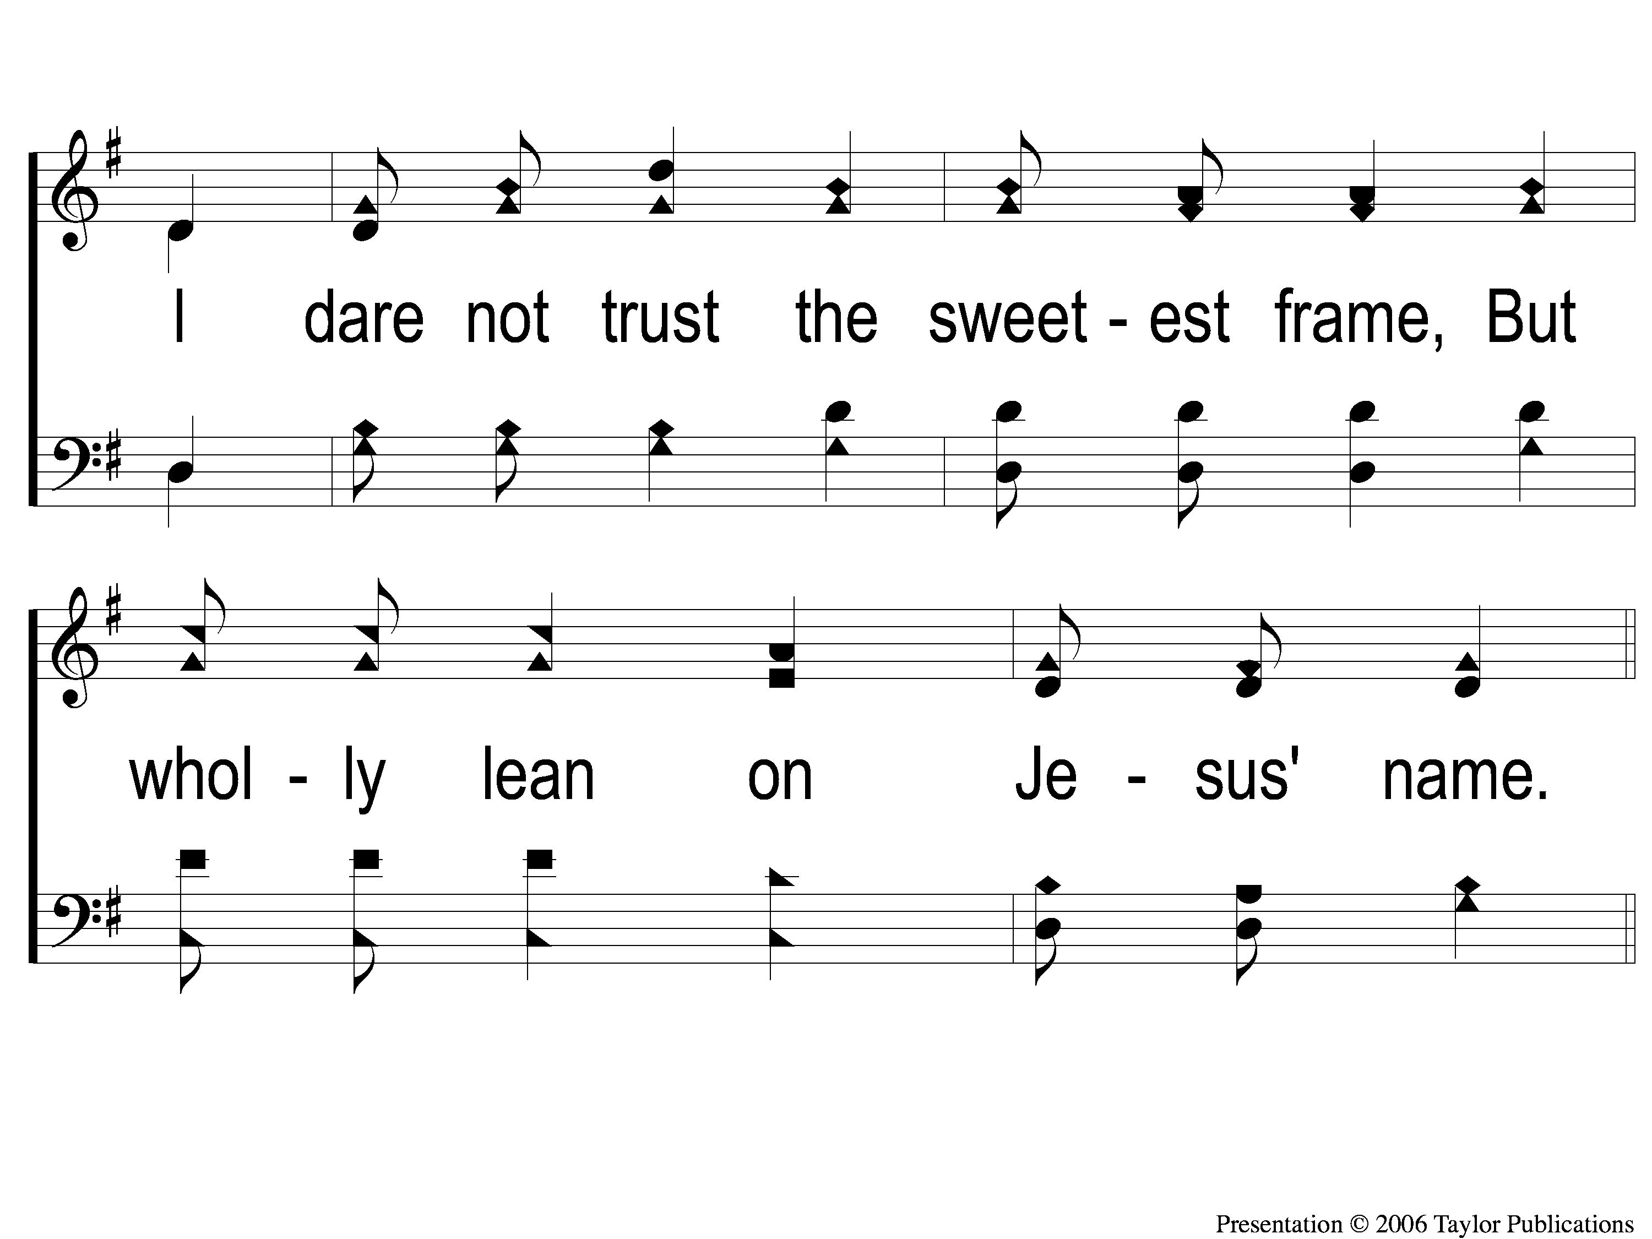
1-2 My Hope is Built
My Hope Is Built
538

Slide 40
c My Hope is Built
My Hope Is Built
538

Slide 41
2-1 My Hope is Built
My Hope Is Built
538

Slide 42
2-2 My Hope is Built
My Hope Is Built
538

Slide 43
c My Hope is Built
My Hope Is Built
538

Slide 44
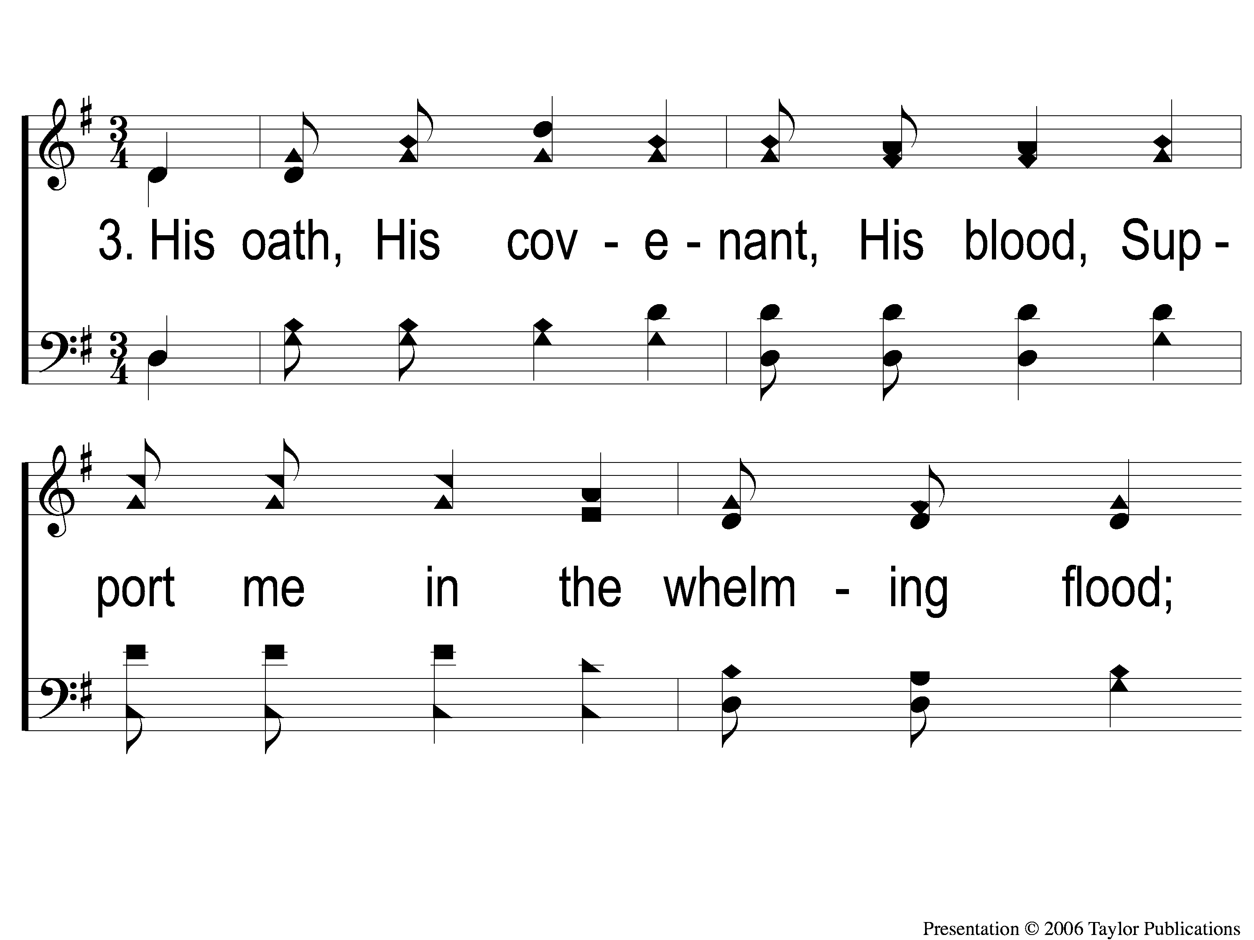
3-1 My Hope is Built
My Hope Is Built
538

Slide 45
3-2 My Hope is Built
My Hope Is Built
538

Slide 46
c My Hope is Built
My Hope Is Built
538

Slide 47
4-1 My Hope is Built
My Hope Is Built
538

Slide 48
4-2 My Hope is Built
My Hope Is Built
538

Slide 49
c My Hope is Built
My Hope Is Built
538

Slide 50
Song:
Sing & Be Happy
#716

Slide 51
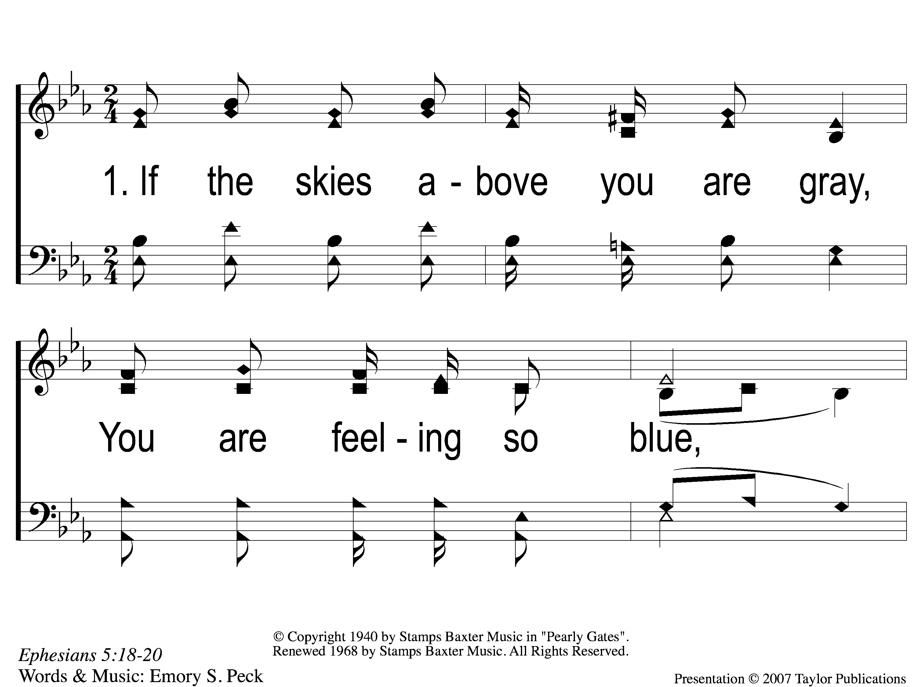
1-1 Sing and Be Happy
Sing and Be Happy
587

Slide 52
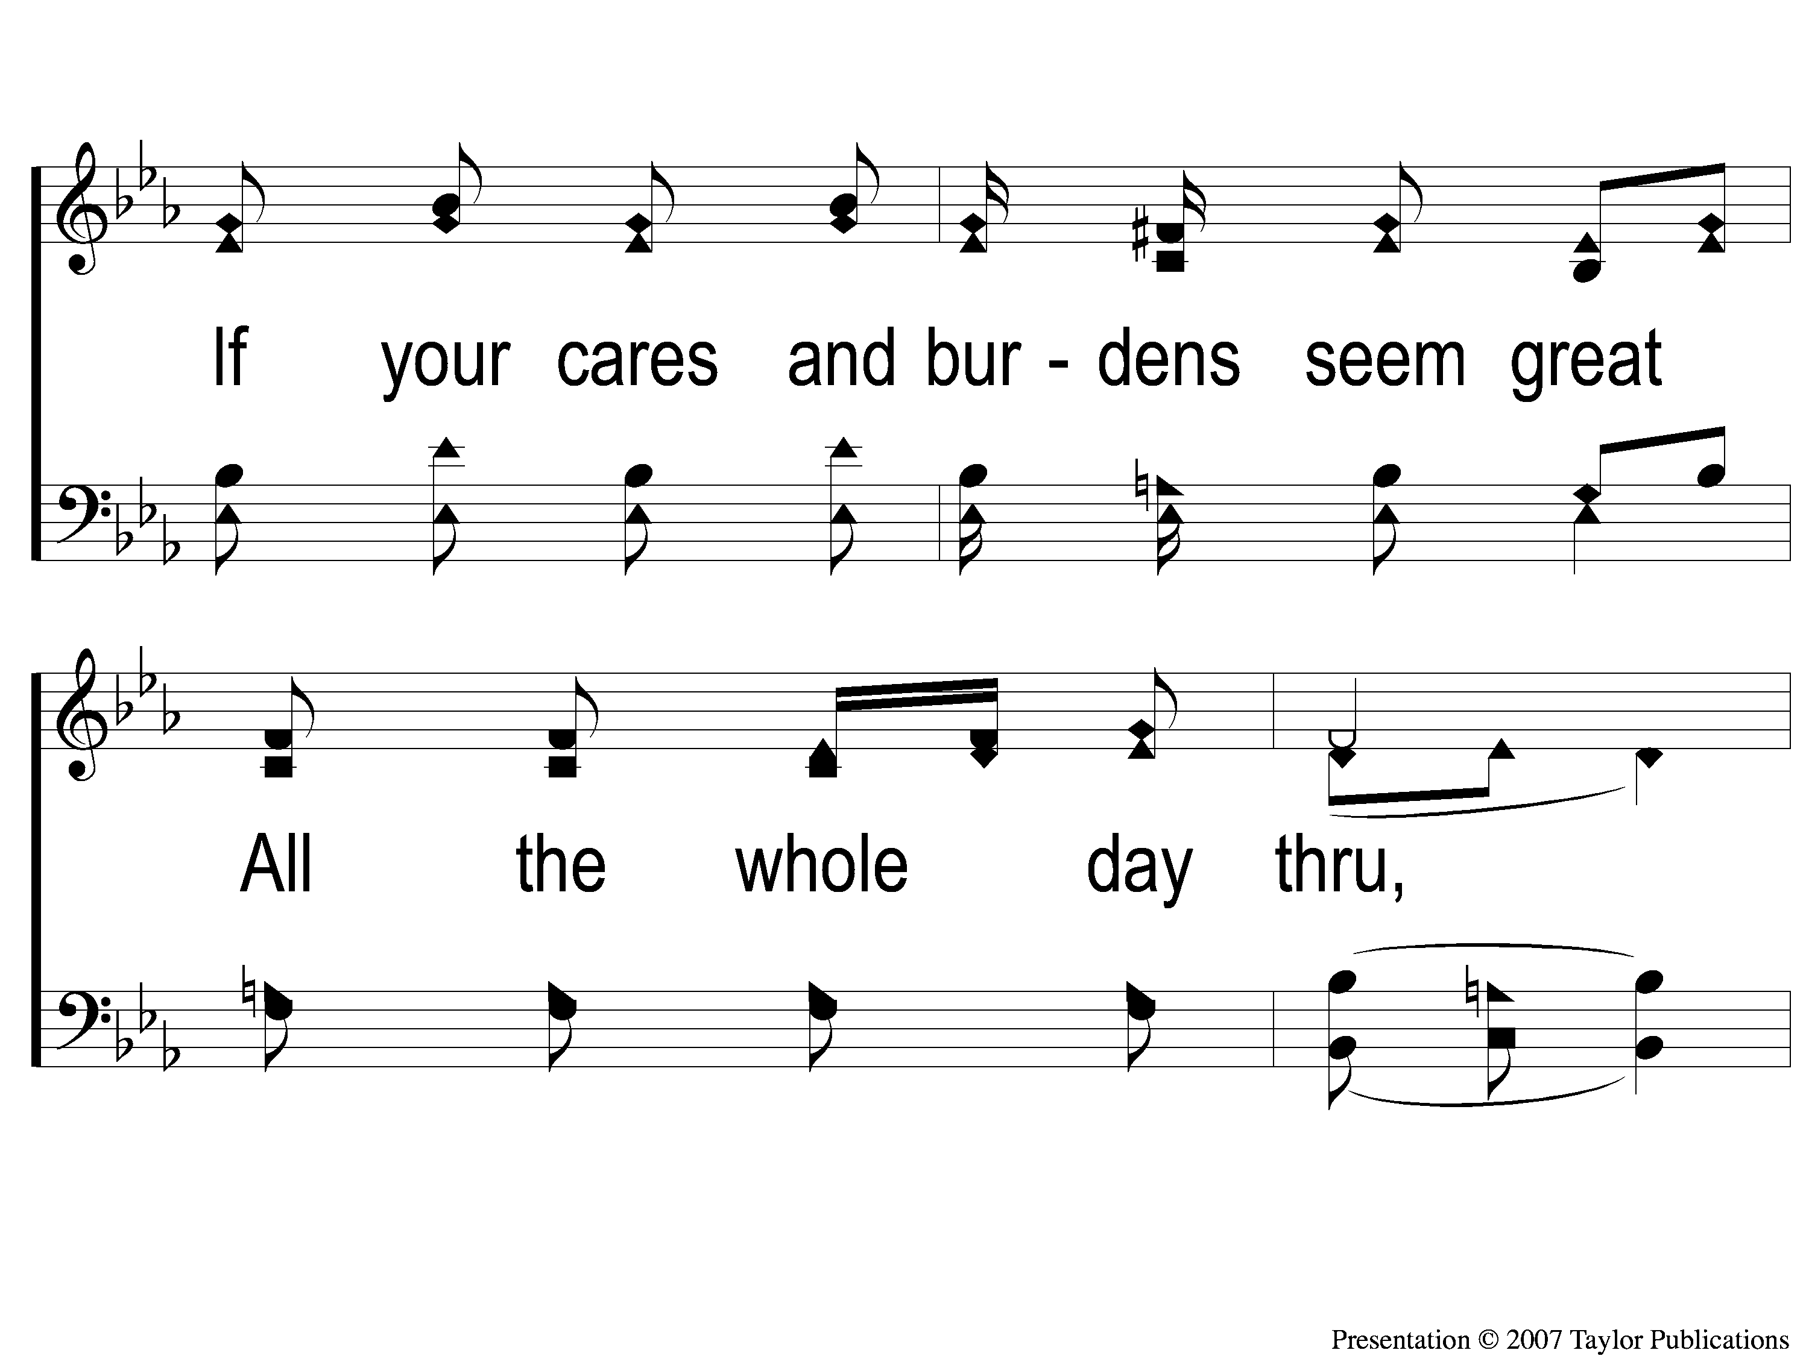
1-2 Sing and Be Happy
Sing and Be Happy
587

Slide 53
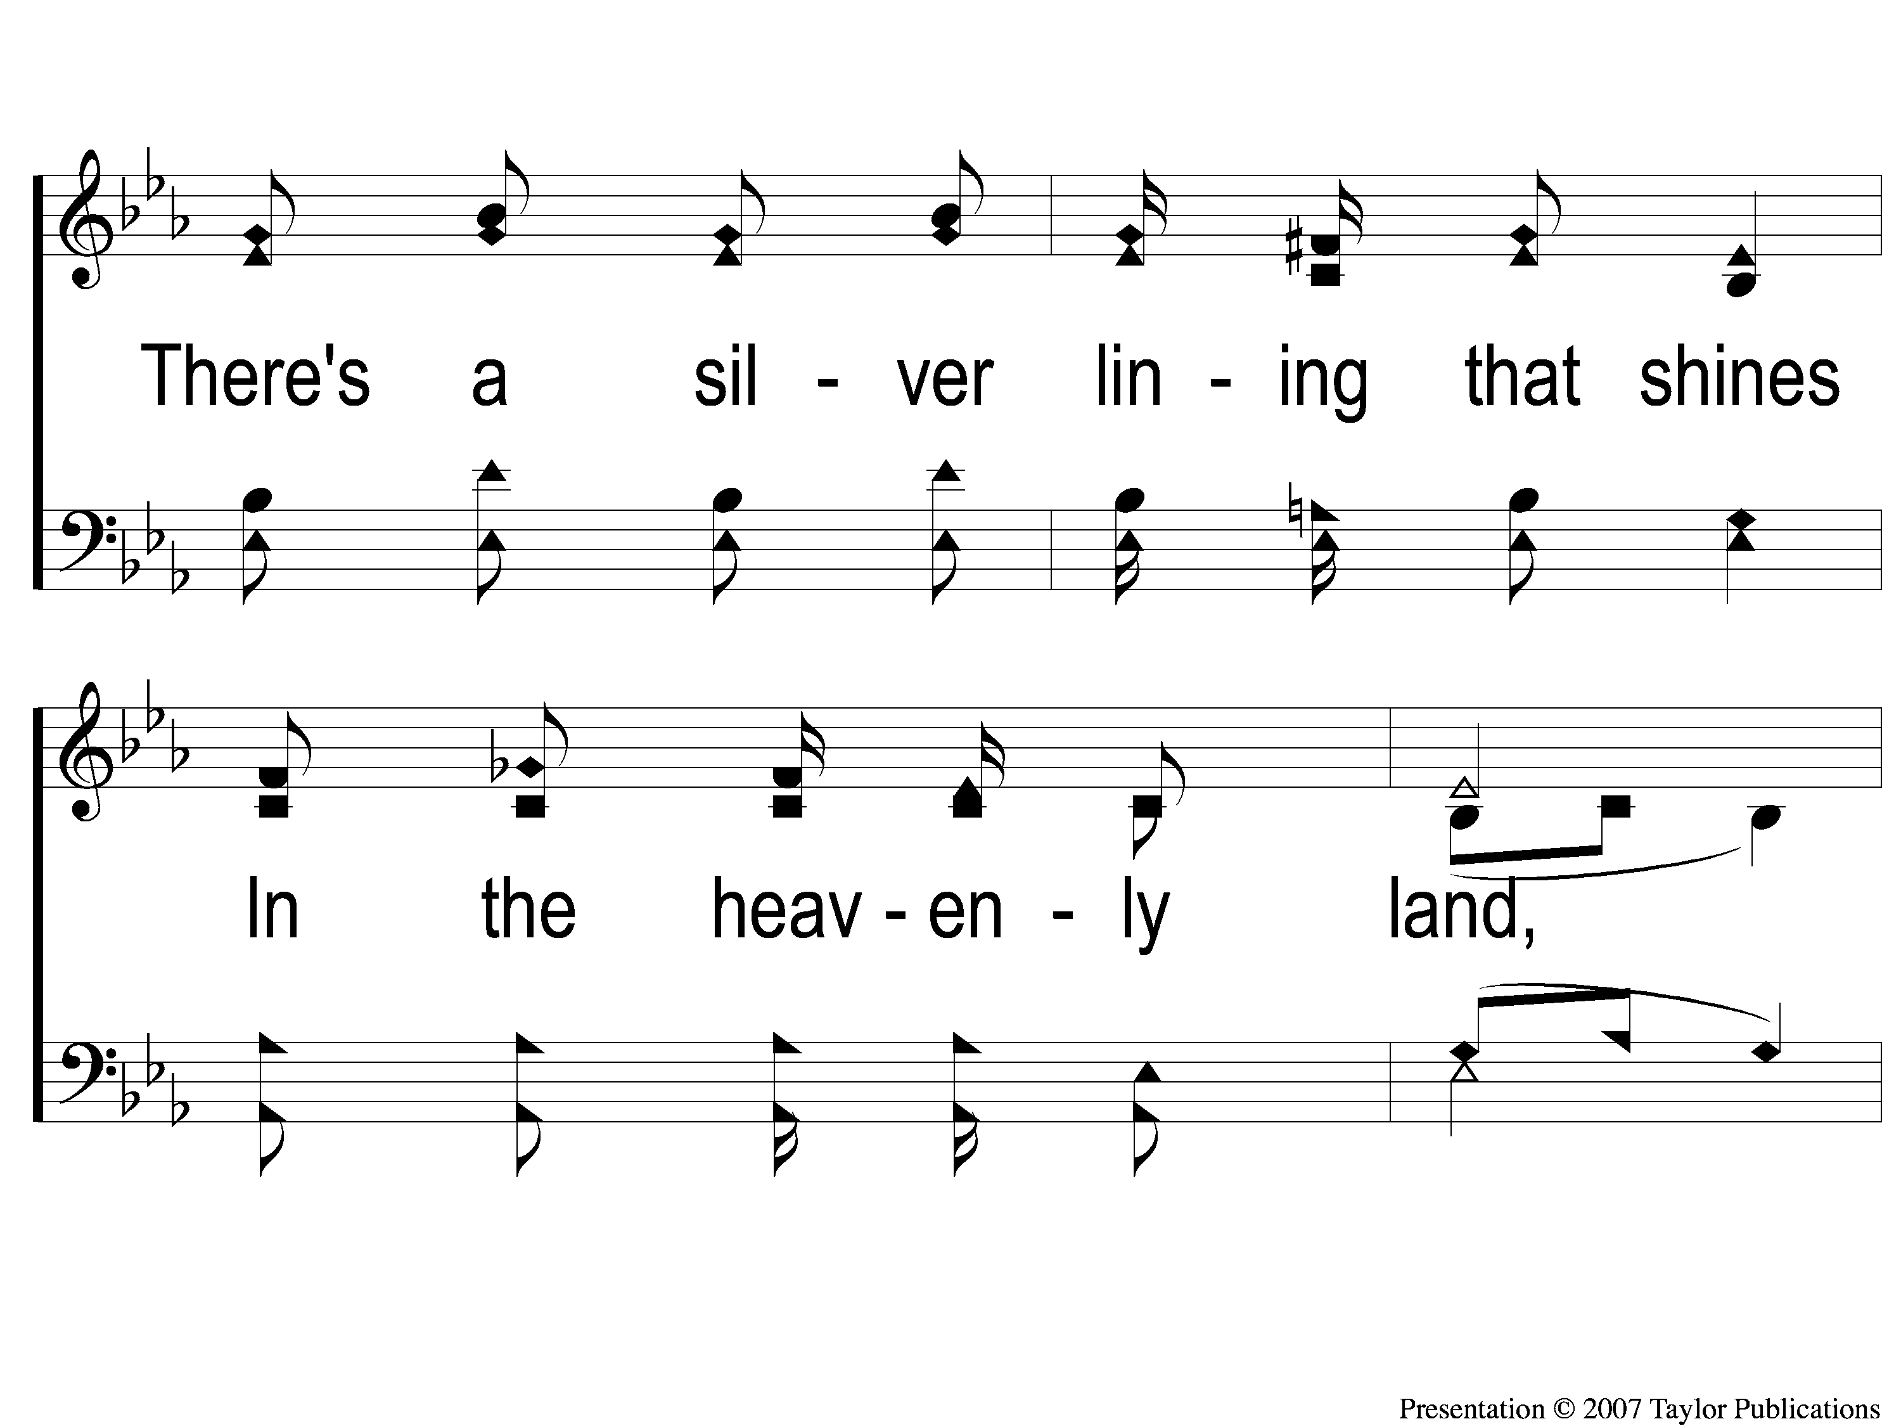
1-3 Sing and Be Happy
Sing and Be Happy
587

Slide 54
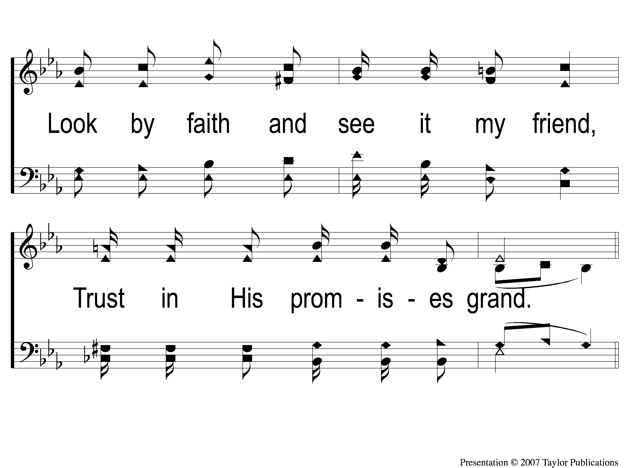
1-4 Sing and Be Happy
Sing and Be Happy
587

Slide 55
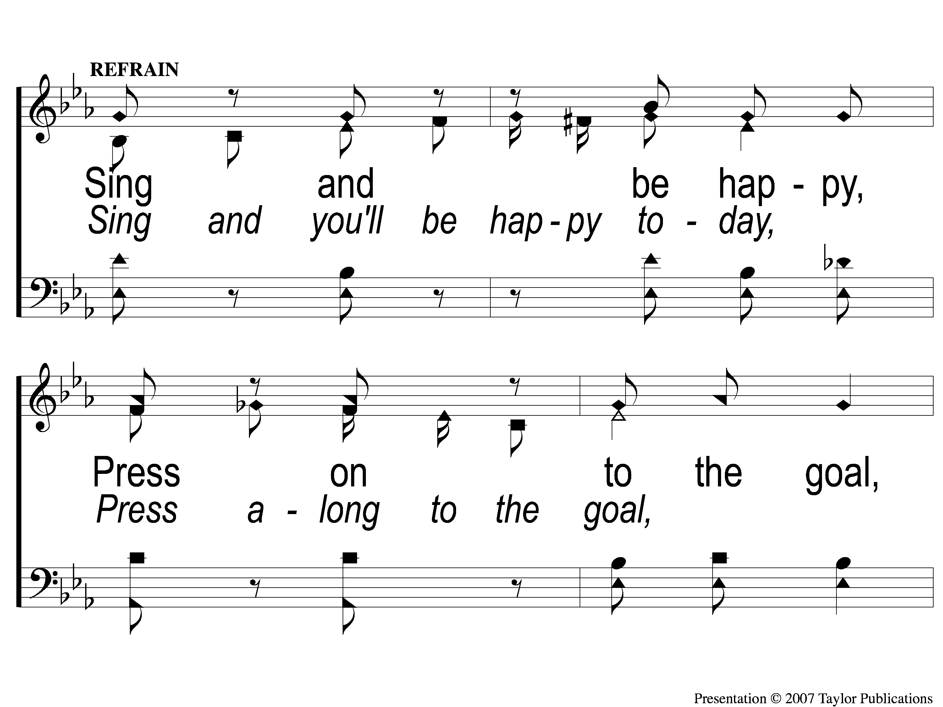
C-1 Sing and Be Happy
Sing and Be Happy
587

Slide 56
C-2 Sing and Be Happy
Sing and Be Happy
587

Slide 57
C-3 Sing and Be Happy
Sing and Be Happy
587

Slide 58
C-4 Sing and Be Happy
Sing and Be Happy
587

Slide 59
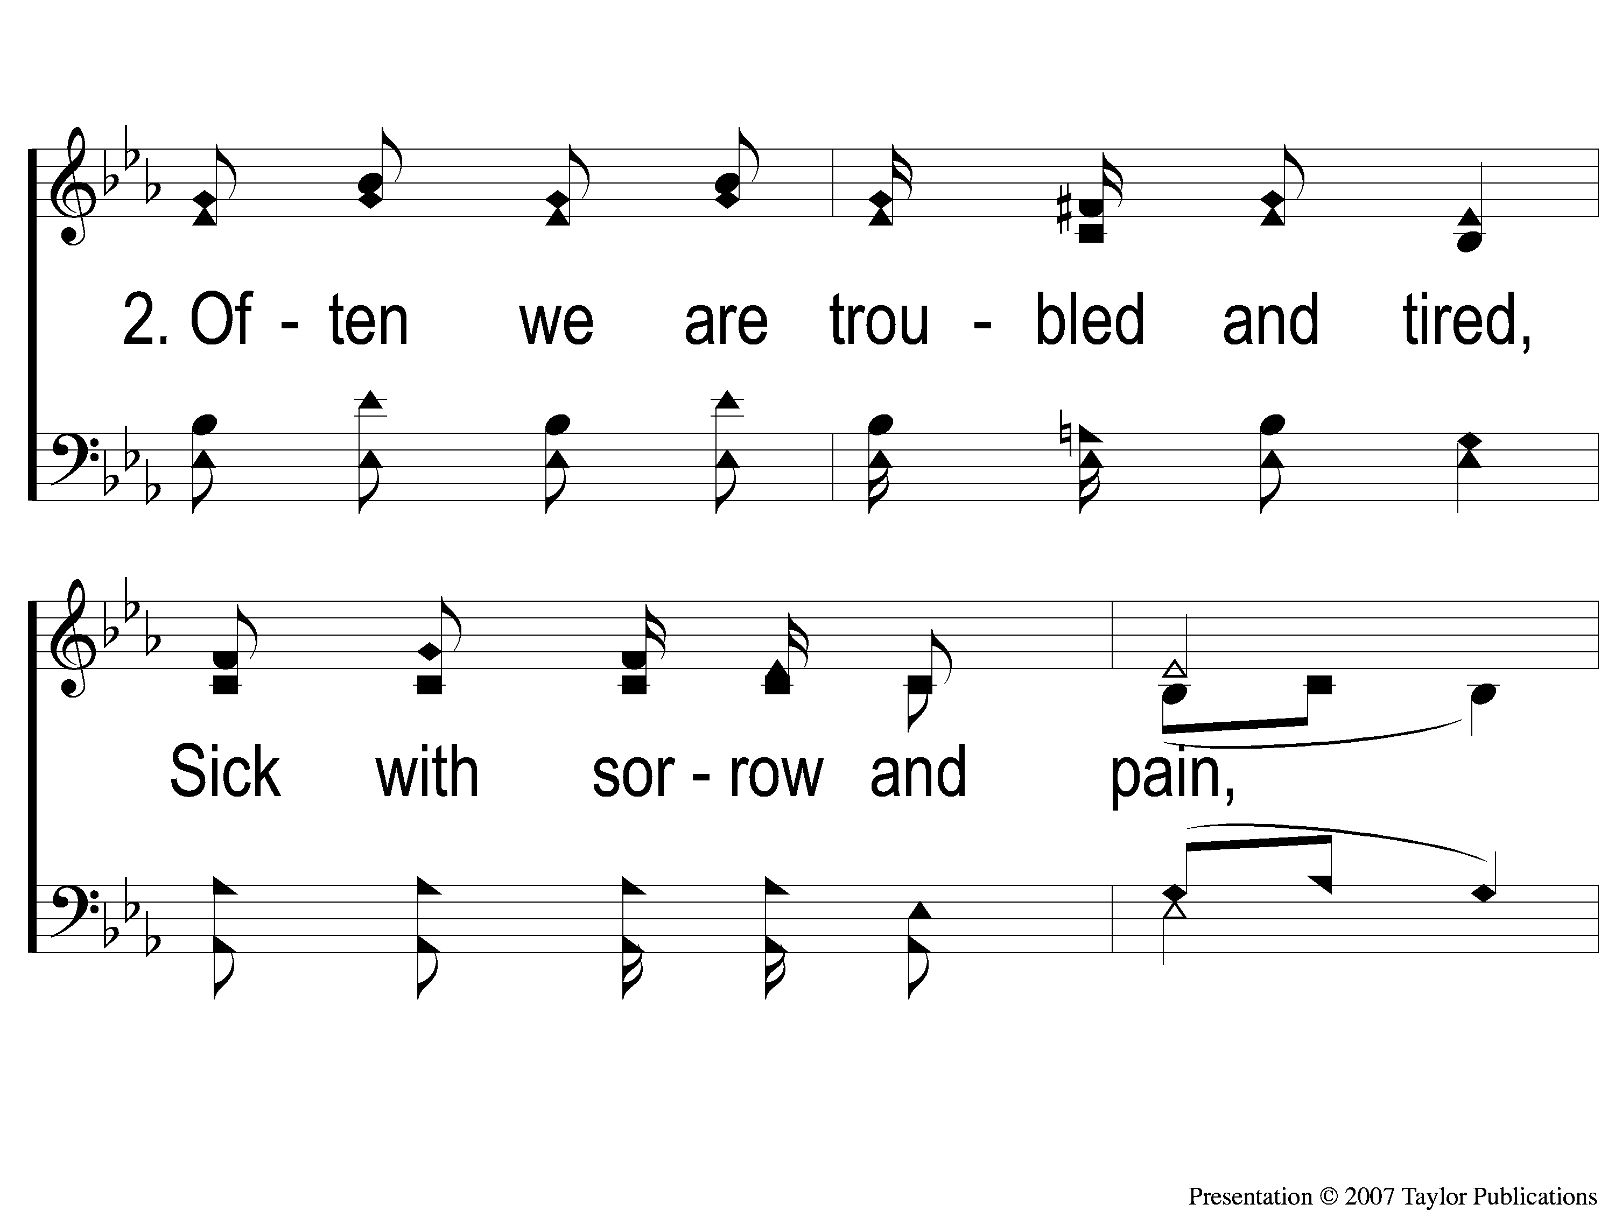
2-1 Sing and Be Happy
Sing and Be Happy
587

Slide 60
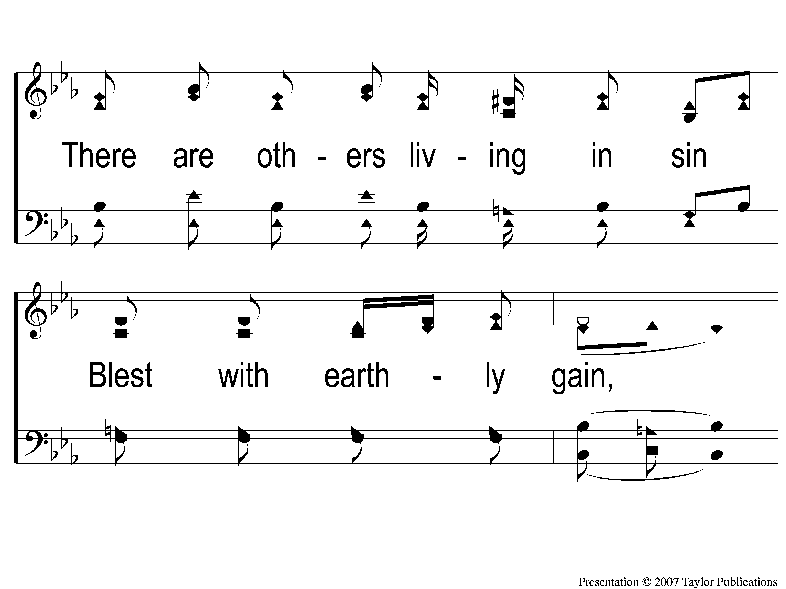
2-2 Sing and Be Happy
Sing and Be Happy
587

Slide 61
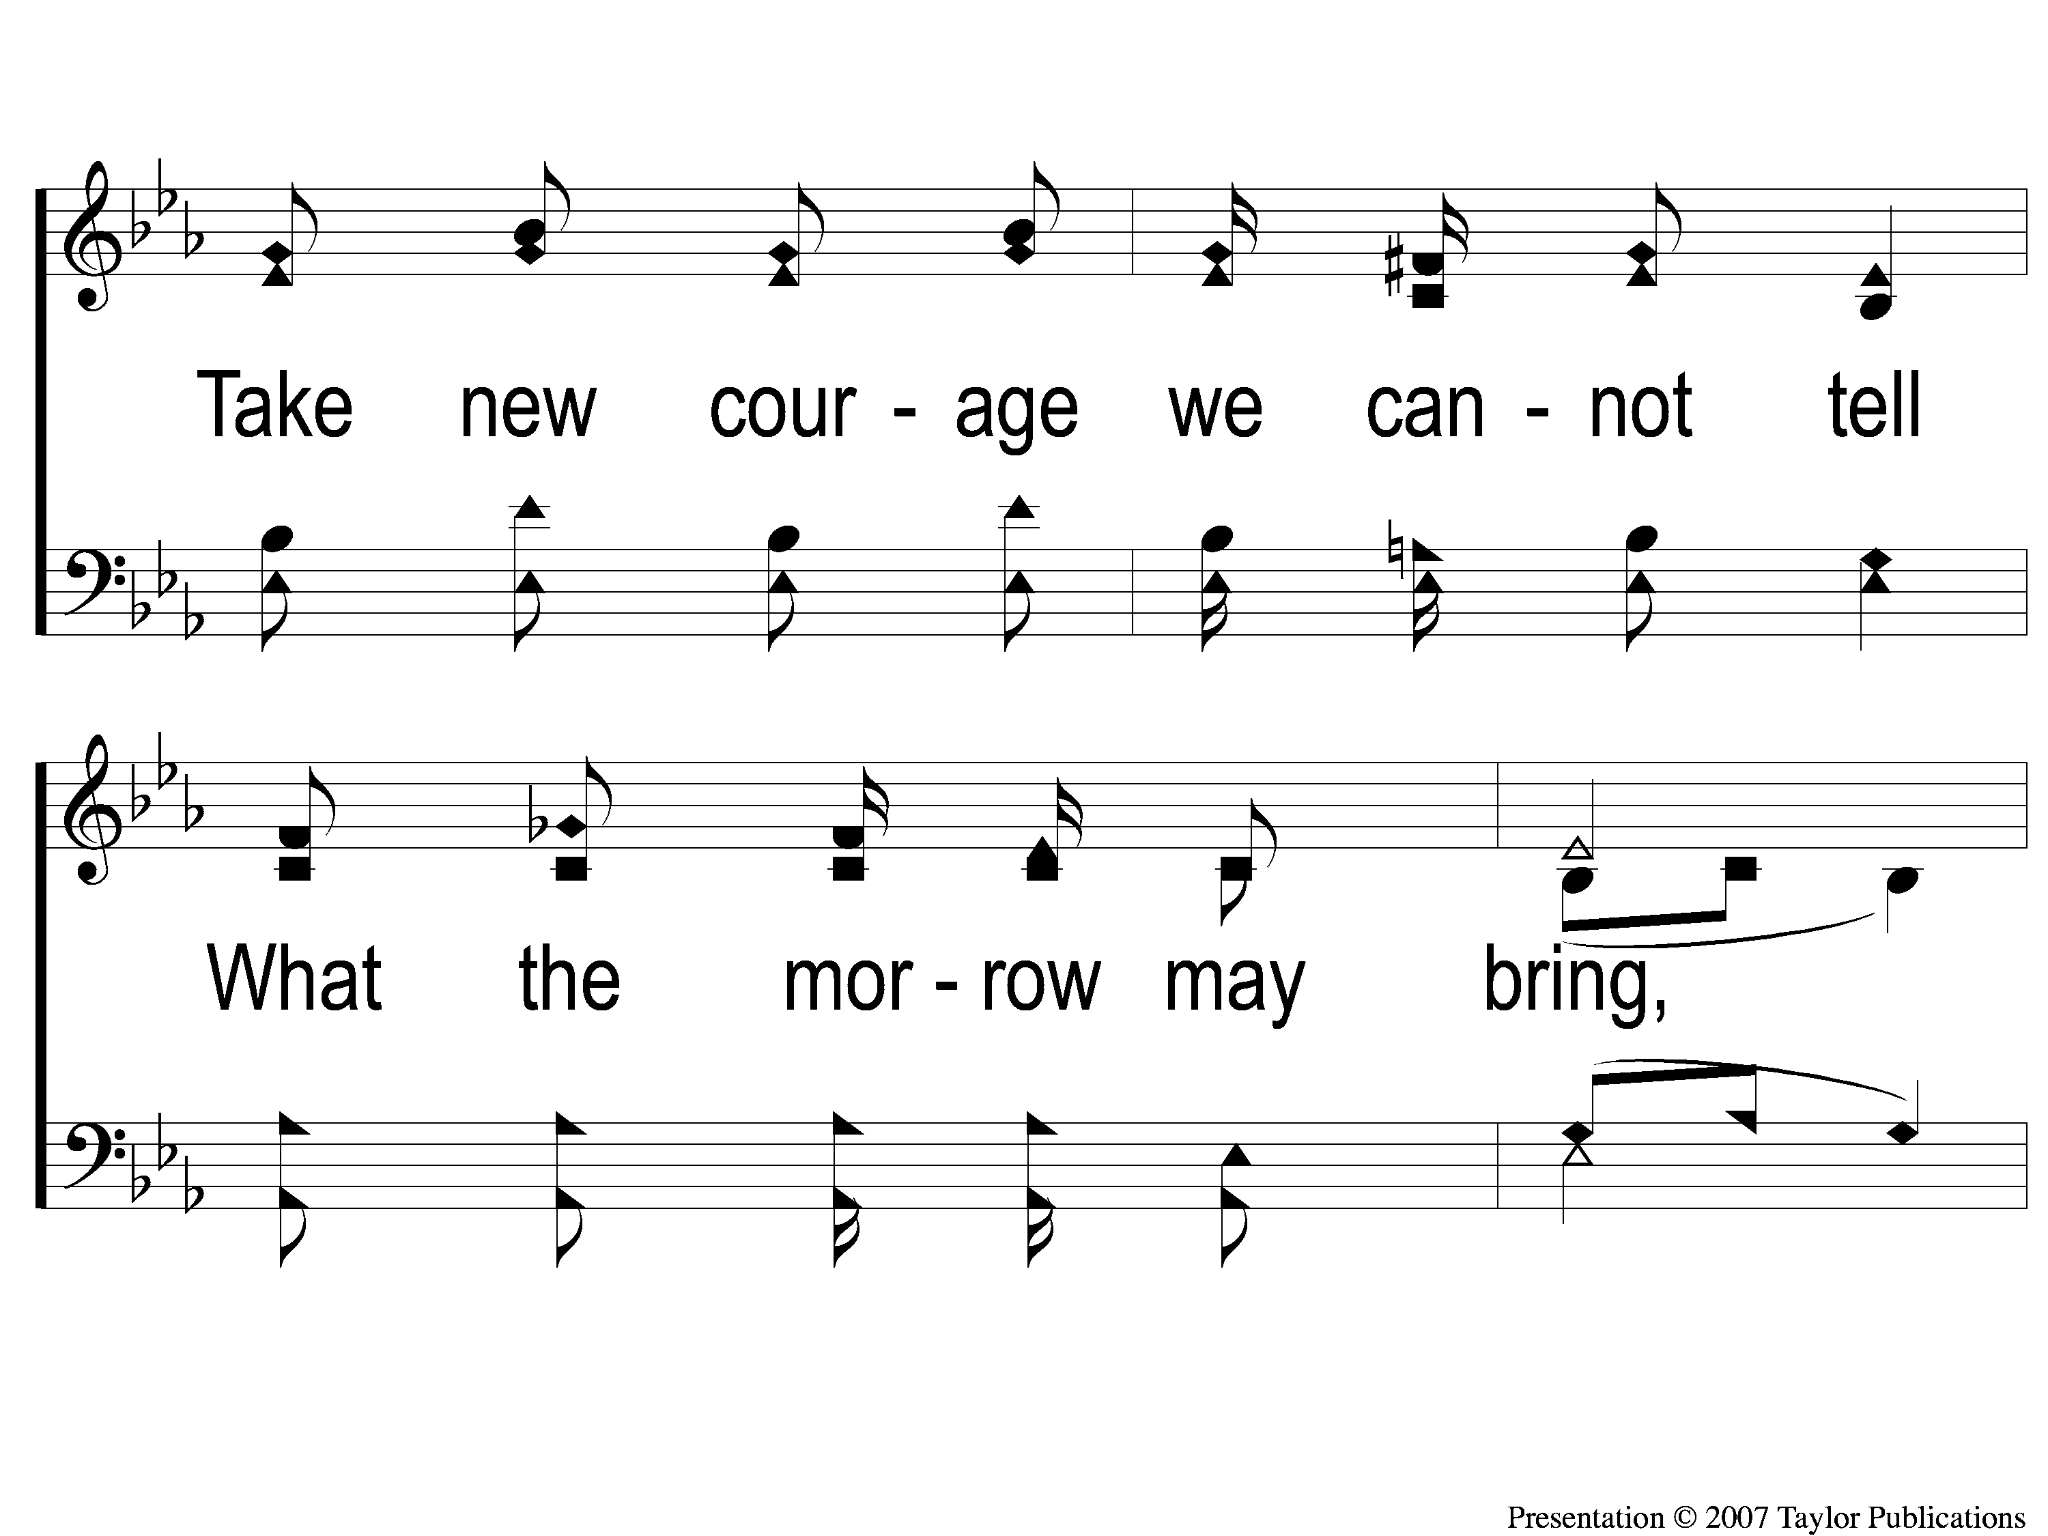
2-3 Sing and Be Happy
Sing and Be Happy
587

Slide 62
2-4 Sing and Be Happy
Sing and Be Happy
587

Slide 63
C-1 Sing and Be Happy
Sing and Be Happy
587

Slide 64
C-2 Sing and Be Happy
Sing and Be Happy
587

Slide 65
C-3 Sing and Be Happy
Sing and Be Happy
587

Slide 66
C-4 Sing and Be Happy
Sing and Be Happy
587

Slide 67
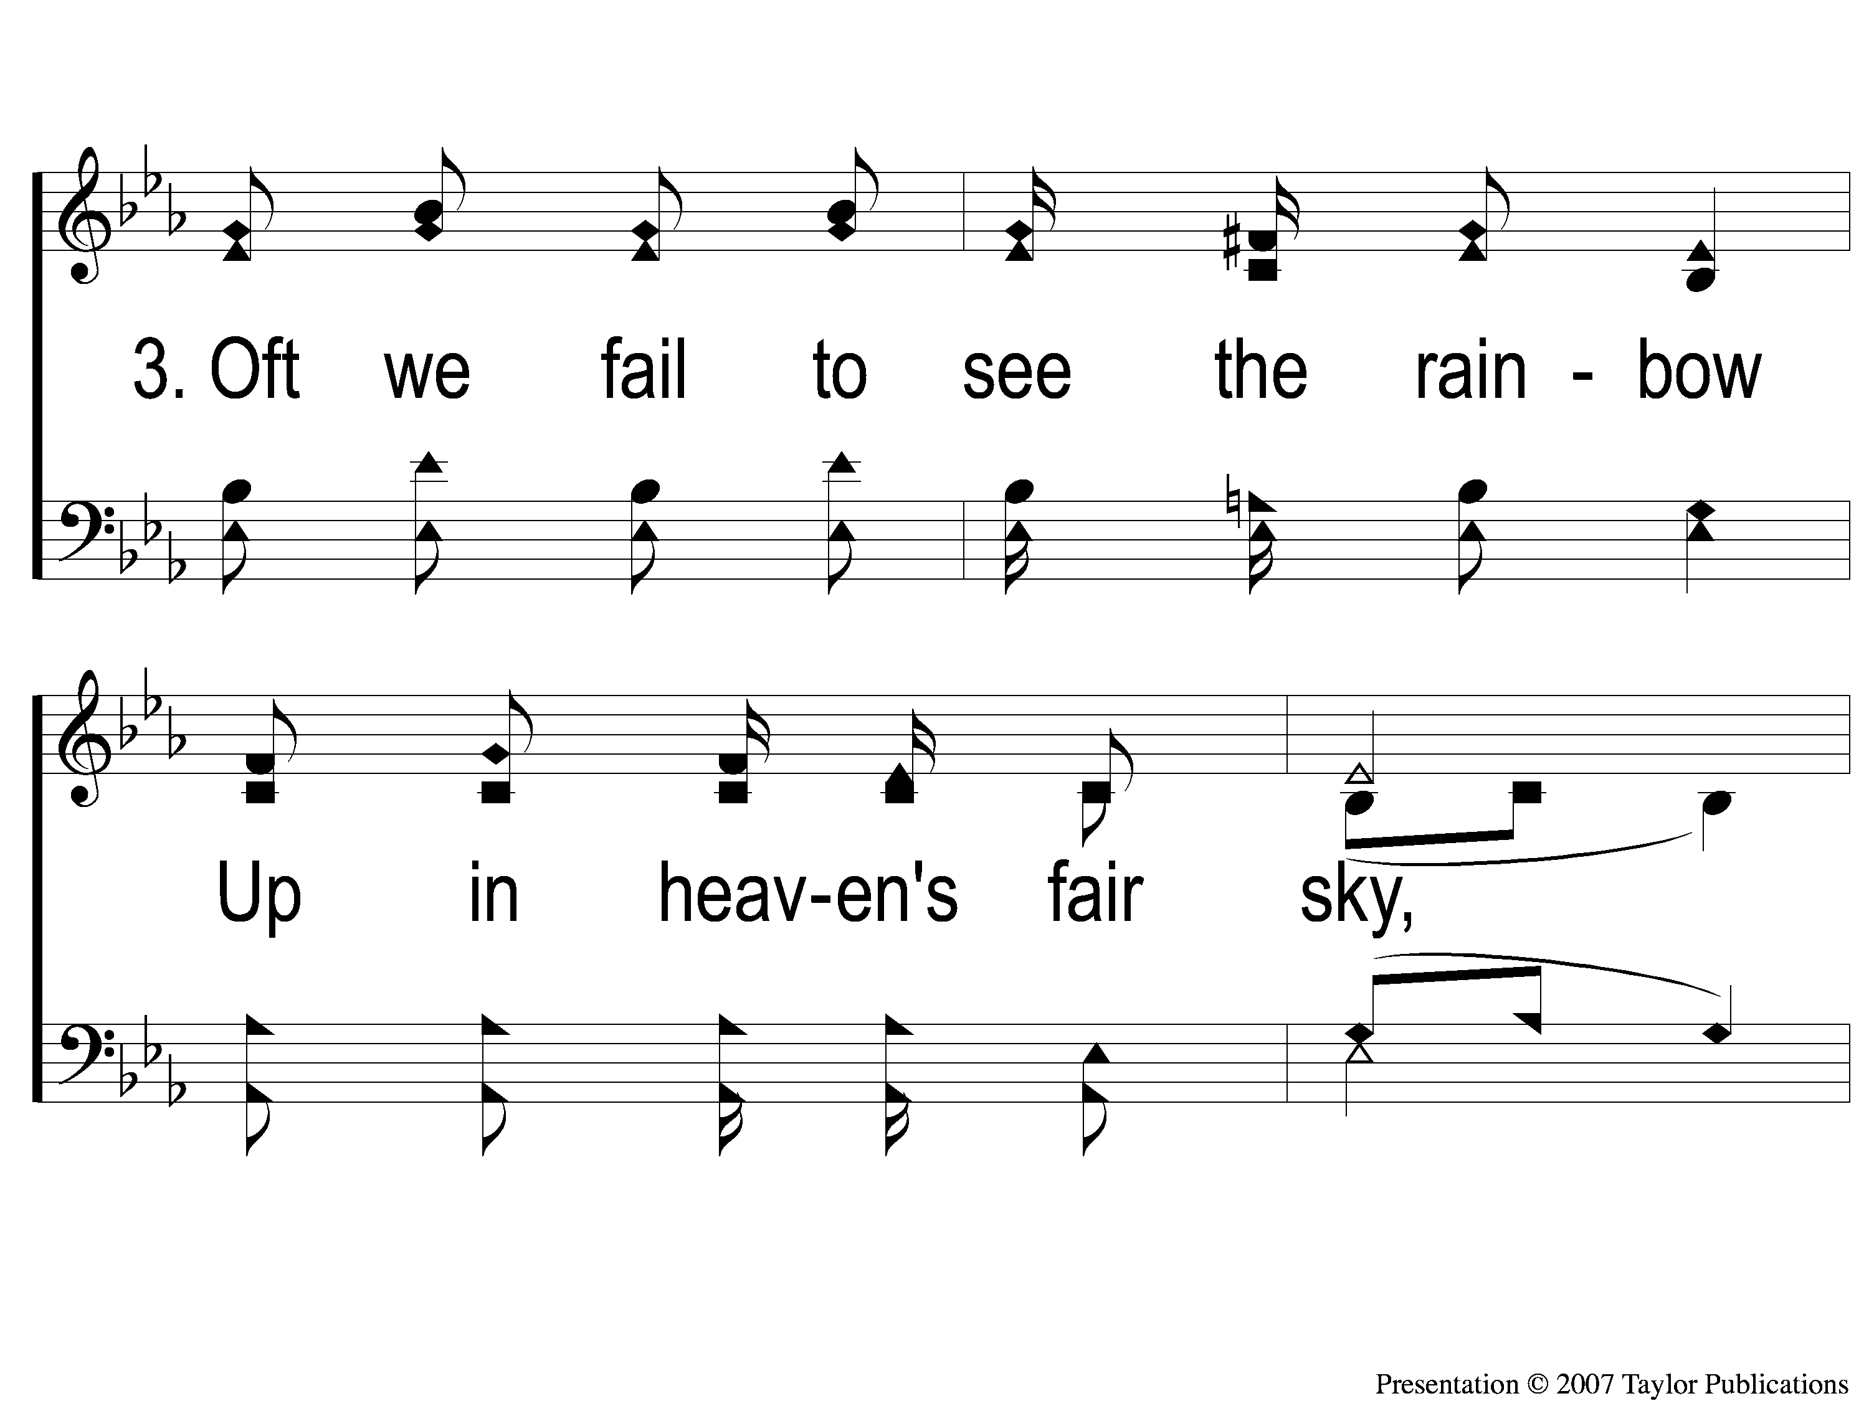
3-1 Sing and Be Happy
Sing and Be Happy
587

Slide 68
3-2 Sing and Be Happy
Sing and Be Happy
587

Slide 69
3-3 Sing and Be Happy
Sing and Be Happy
587

Slide 70
3-4 Sing and Be Happy
Sing and Be Happy
587

Slide 71
C-1 Sing and Be Happy
Sing and Be Happy
587

Slide 72
C-2 Sing and Be Happy
Sing and Be Happy
587

Slide 73
C-3 Sing and Be Happy
Sing and Be Happy
587

Slide 74
C-4 Sing and Be Happy
Sing and Be Happy
587

Slide 75
Scripture Reading:
Genesis 37:1-11

Slide 76
RESTORE
OUR
FOUNDATIONS
JANUARY - APRIL

Slide 77
Envy
The Emptiness Of
Genesis Ch. 37

Slide 78
“7 Deadly Sins”
Pride
Greed
Lust
Envy
Gluttony
Wrath
Sloth

Slide 79
What Is Envy?
Envy= “to experience a feeling of ill will due to real or presumed advantage experienced by someone else”

Slide 80
What Is Envy?
Envy, Jealousy, & Covetousness
What are the differences?

Slide 81
Where Does Envy Come From?
A Focus On What Others Have
Psa. 73:3, Eccl. 4:4
Gen. 37:11

Slide 82
What Does Envy Promise?

Slide 83
What Does Envy Promise?
Satisfaction & Success
Gen. 37:20
Matt. 27:18, Mk. 15:10

Slide 84
What Does Envy Promise?
Discontentment & Failure
Gen. 37:20
Matt. 27:18, Mk. 15:10

Slide 85
What Are The Results Of Envy?

Slide 86
What Are The Results Of Envy?
On The Envious One:

Slide 87
What Are The Results Of Envy?
On The Envious One:
Discontentment, Depression, & Devaluation
Prov. 14:30, Job 5:2, Gen. 42:21-22
Gal. 5:19-21

Slide 88
What Are The Results Of Envy?
“…envy has detrimental ramifications that go beyond the individual and extend to interpersonal relationships…Envy would result in greater motive to harm as well as greater likelihood of engaging in harmful behavior”

Slide 89
What Are The Results Of Envy?
On Others:
Death, Depression, & Defeat
Gen. 37:31-35
Jms. 3:16

Slide 90
What Are The Results Of Envy?
On Others:
Division, Disputes, & Defamation
1 Cor. 1:11-12, 3:3
1 Tim. 6:4

Slide 91
What Is The Cure For Envy?

Slide 92
What Is The Cure For Envy?
Gratitude / Contentment
Heb. 13:5
1 Tim. 6:6-8
Phili. 4:11

Slide 93
Is There
In Your Heart
Envy & Self-Seeking
?

Slide 94
Invitation
Song:
When The Roll Is
Called Up Yonder
#852

Slide 95
1-1 When The Roll Is Called Up Yonder
When The Roll Is Called Up Yonder
852

Slide 96
1-2 When The Roll Is Called Up Yonder
When The Roll Is Called Up Yonder
852

Slide 97
1-3 When The Roll Is Called Up Yonder
When The Roll Is Called Up Yonder
852

Slide 98
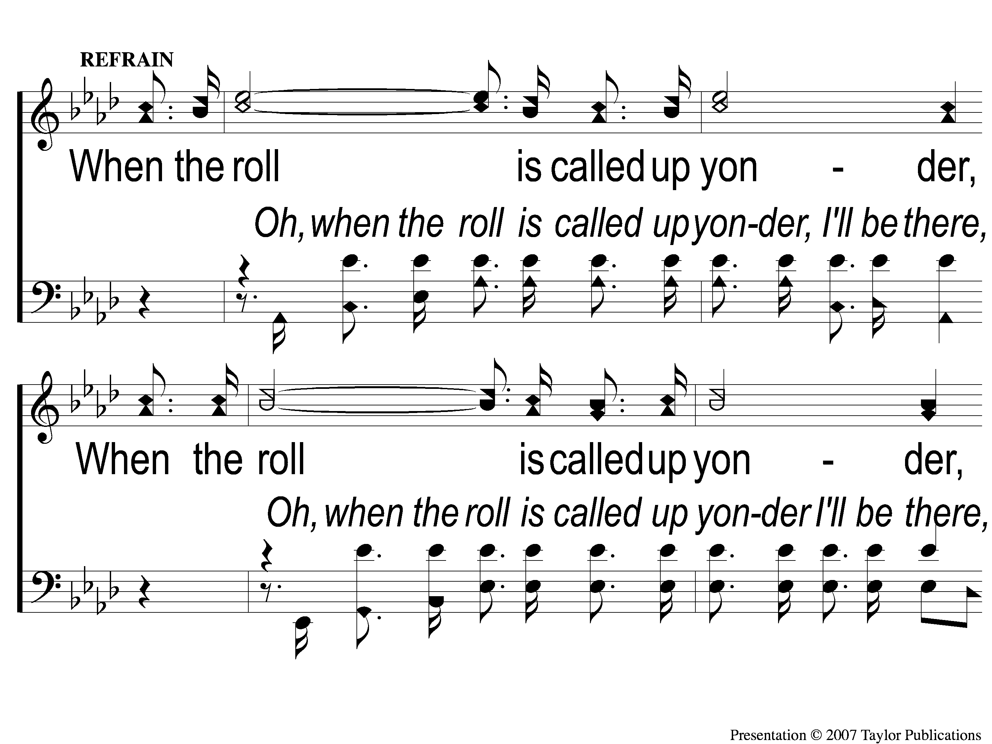
C-1 When The Roll Is Called Up Yonder
When The Roll Is Called Up Yonder
852

Slide 99
C-2 When The Roll Is Called Up Yonder
When The Roll Is Called Up Yonder
852

Slide 100
2-1 When The Roll Is Called Up Yonder
When The Roll Is Called Up Yonder
852

Slide 101
2-2 When The Roll Is Called Up Yonder
When The Roll Is Called Up Yonder
852

Slide 102
2-3 When The Roll Is Called Up Yonder
When The Roll Is Called Up Yonder
852

Slide 103
C-1 When The Roll Is Called Up Yonder
When The Roll Is Called Up Yonder
852

Slide 104
C-2 When The Roll Is Called Up Yonder
When The Roll Is Called Up Yonder
852

Slide 105
3-1 When The Roll Is Called Up Yonder
When The Roll Is Called Up Yonder
852

Slide 106
3-2 When The Roll Is Called Up Yonder
When The Roll Is Called Up Yonder
852

Slide 107
3-3 When The Roll Is Called Up Yonder
When The Roll Is Called Up Yonder
852

Slide 108
C-1 When The Roll Is Called Up Yonder
When The Roll Is Called Up Yonder
852

Slide 109
C-2 When The Roll Is Called Up Yonder
When The Roll Is Called Up Yonder
852

Slide 110
The Contribution:
Luke 6:38
“Give, and it will be given to you: good measure, pressed down, shaken together, and running over will be put into your bosom. For with the same measure that you use, it will be measured back to you.”

Slide 111
Song:
Come, Share The Lord
#364

Slide 112
1-1 Come Share the Lord
Come, Share The Lord
364

Slide 113
1-2 Come Share the Lord
Come, Share The Lord
364

Slide 114
C-1 Come Share the Lord
Come, Share The Lord
364

Slide 115
2-1 Come Share the Lord
Come, Share The Lord
364

Slide 116
2-2 Come Share the Lord
Come, Share The Lord
364

Slide 117
C-2 Come Share the Lord
Come, Share The Lord
364

Slide 118
3-1 Come Share the Lord
Come, Share The Lord
364

Slide 119
3-2 Come Share the Lord
Come, Share The Lord
364

Slide 120
The Unleavened Bread
Hebrews 2:14-15
“Inasmuch then as the children have partaken of flesh and blood, He Himself likewise shared in the same, that through death He might destroy him who had the power of death, that is, the devil, and release those who through fear of death were all their lifetime subject to bondage.”

Slide 121
The Fruit
of the Vine
Hebrews 12:1-2
“Therefore we also, since we are surrounded by so great a cloud of witnesses, let us lay aside every weight, and the sin which so easily ensnares us, and let us run with endurance the race that is set before us, looking unto Jesus, the author and finisher of our faith, who for the joy that was set before Him endured the cross, despising the shame, and has sat down at the right hand of the throne of God.”

Slide 122
Closing Prayer

Slide 123
Song:
Shine, Jesus, Shine
#290

Slide 124
1-1 Shine Jesus Shine
Shine, Jesus, Shine
290

Slide 125
1-2 Shine Jesus Shine
Shine, Jesus, Shine
290

Slide 126
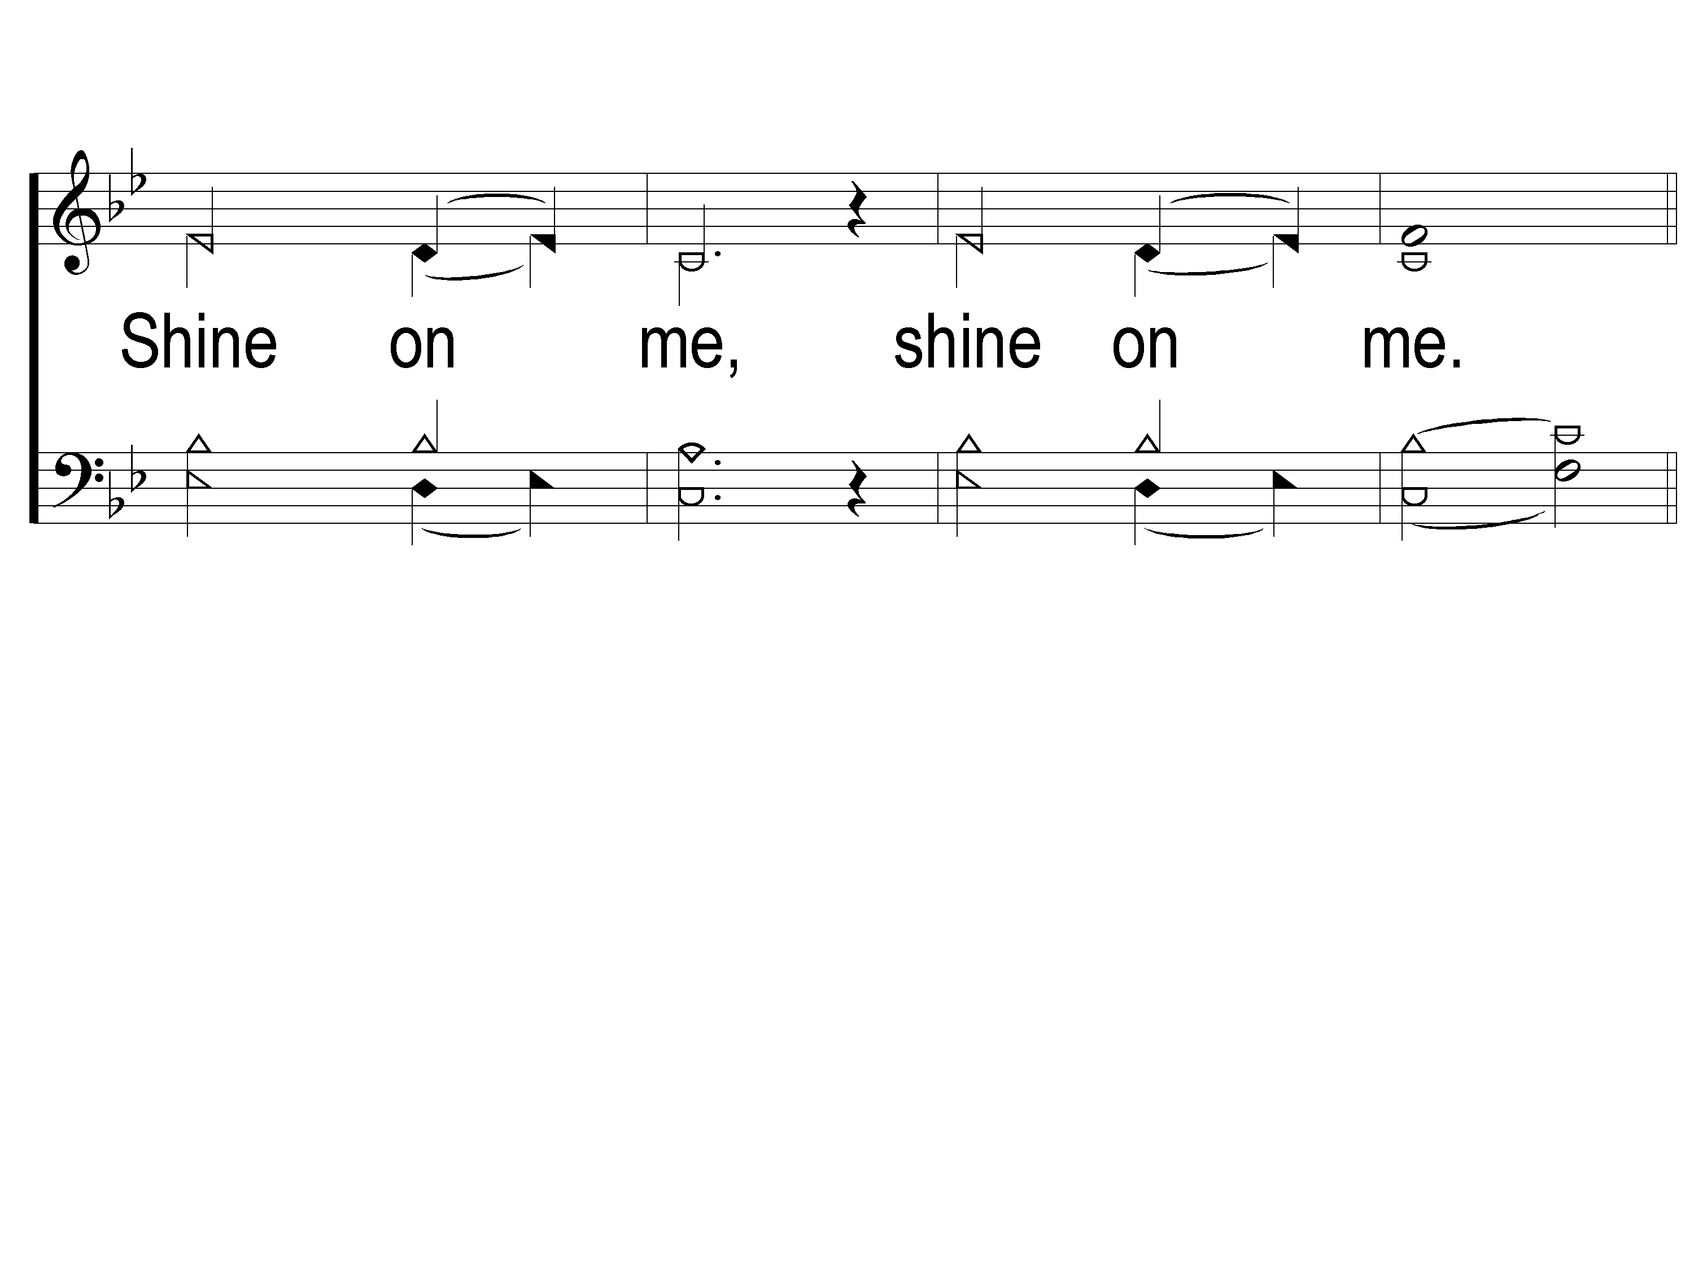
1-3 Shine Jesus Shine
Shine, Jesus, Shine
290

Slide 127
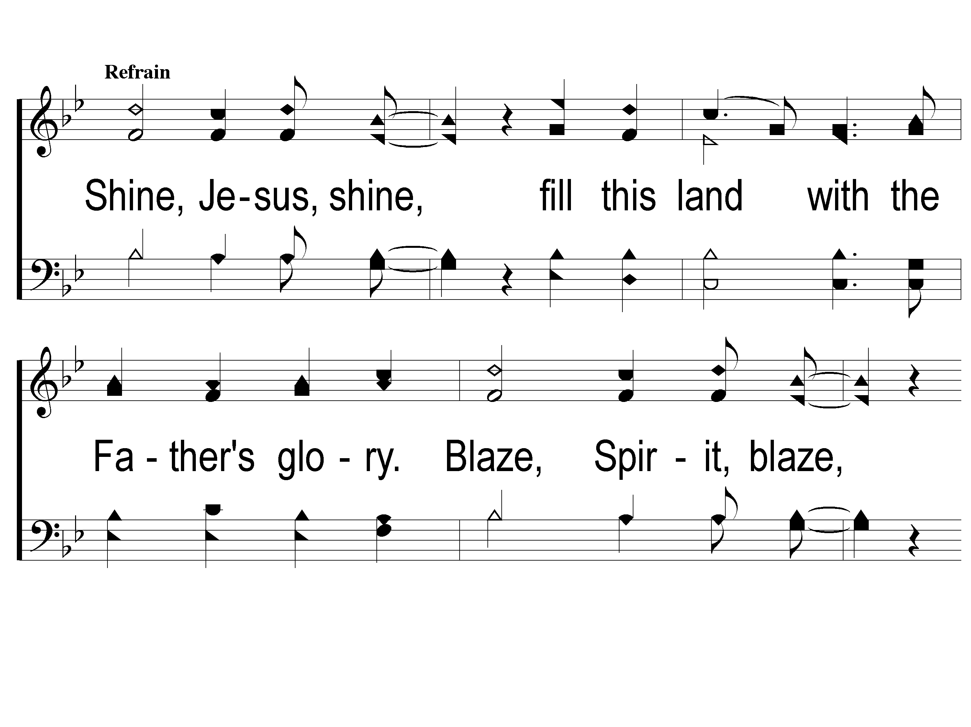
C-1 Shine Jesus Shine
Shine, Jesus, Shine
290

Slide 128
C-2 Shine Jesus Shine
Shine, Jesus, Shine
290

Slide 129
C-3 Shine Jesus Shine
Shine, Jesus, Shine
290

Slide 130
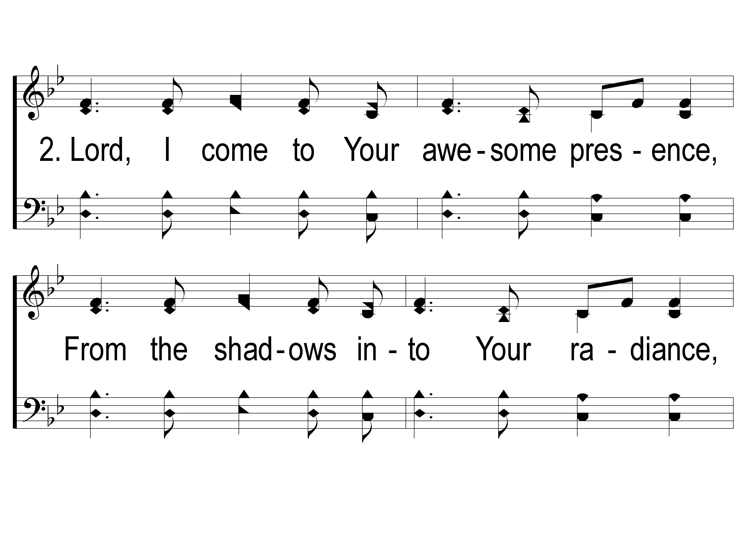
2-1 Shine Jesus Shine
Shine, Jesus, Shine
290

Slide 131
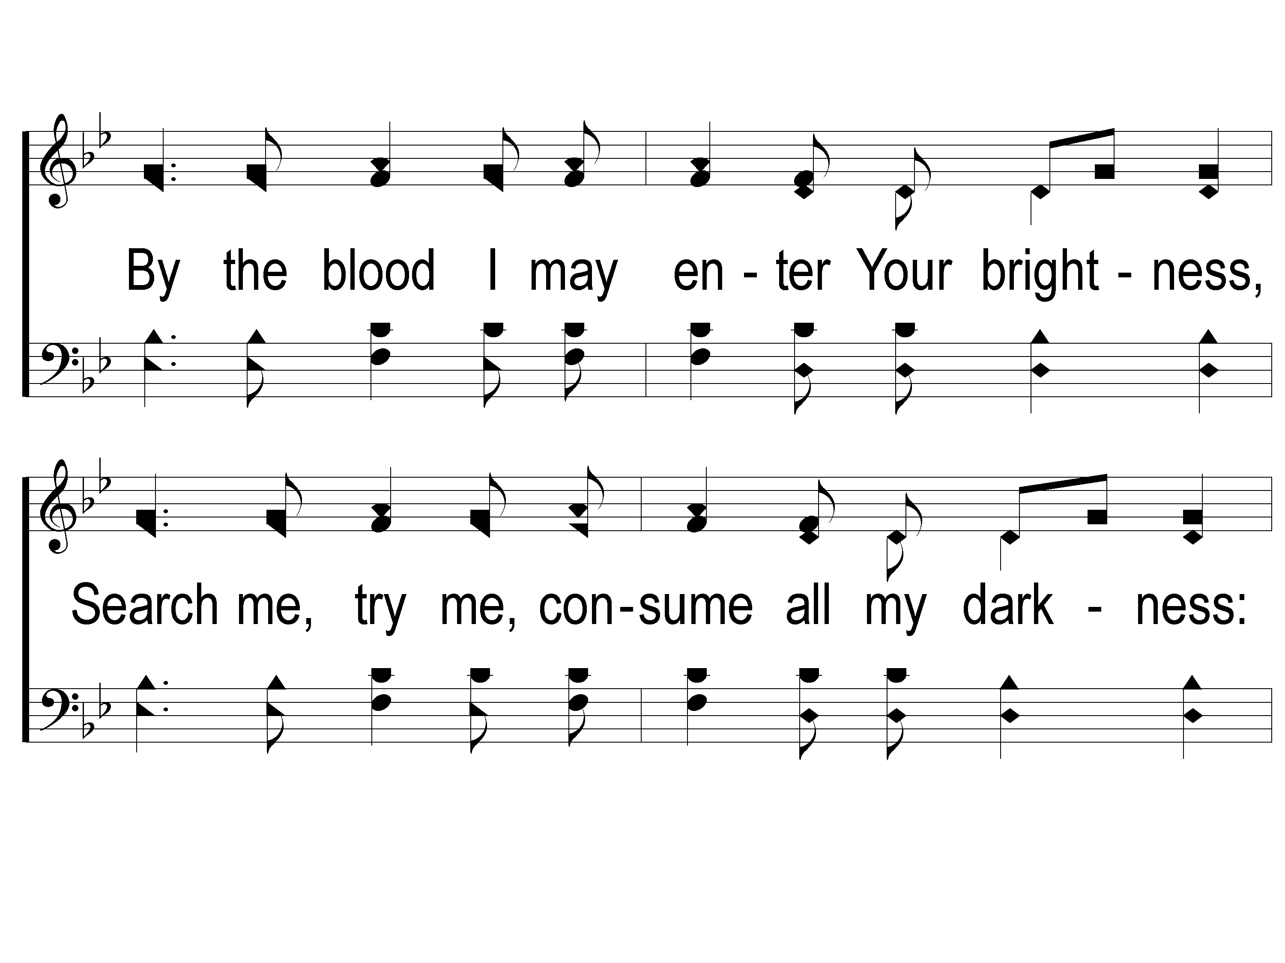
2-2 Shine Jesus Shine
Shine, Jesus, Shine
290

Slide 132
2-3 Shine Jesus Shine
Shine, Jesus, Shine
290

Slide 133
C-1 Shine Jesus Shine
Shine, Jesus, Shine
290

Slide 134
C-2 Shine Jesus Shine
Shine, Jesus, Shine
290

Slide 135
C-3 Shine Jesus Shine
Shine, Jesus, Shine
290

Slide 136
After Worship
Fellowship Meal @ 12:00 PM
Devo @ 1:00 PM
Camp Registration @ 2:00 PM
Wednesday
Worship/Classes @ 6:30 pm
RESTORE REBUILD RENEW
IN 2022
WHEELER
CHURCH
OF
CHRIST

