Slide 1
PLEASE STANDBY
OUR LIVESTREAM
WILL BEGIN SOON

Slide 2
1-1 Lamb of God
Lamb of God
176

Slide 3
1-2 Lamb of God
Lamb of God
176

Slide 4
1-3 Lamb of God
Lamb of God
176

Slide 5
1-4 Lamb of God
Lamb of God
176

Slide 6
C-1 Lamb of God
Lamb of God
176

Slide 7
C-2 Lamb of God
Lamb of God
176

Slide 8
2-1 Lamb of God
Lamb of God
176

Slide 9
2-2 Lamb of God
Lamb of God
176

Slide 10
C-1 Lamb of God
Lamb of God
176

Slide 11
C-2 Lamb of God
Lamb of God
176

Slide 12
WELCOME
THANKS FOR JOINING US!

Slide 13
#63
SONG:
I Will Call
Upon The Lord

Slide 14
1 I Will Call Upon the Lord
I Will Call Upon the Lord
63

Slide 15
2 I Will Call Upon the Lord
I Will Call Upon the Lord
63

Slide 16
3 I Will Call Upon the Lord
I Will Call Upon the Lord
63

Slide 17
4 I Will Call Upon the Lord
I Will Call Upon the Lord
63

Slide 18
DC1 I Will Call Upon the Lord
I Will Call Upon the Lord
63

Slide 19
DC2 I Will Call Upon the Lord
I Will Call Upon the Lord
63

Slide 20
DC3 I Will Call Upon the Lord
I Will Call Upon the Lord
63

Slide 21
DC4 I Will Call Upon the Lord
I Will Call Upon the Lord
63

Slide 22
tag I Will Call Upon the Lord
I Will Call Upon the Lord
63

Slide 23
#103
SONG:
He Has Made Me Glad

Slide 24
1 He has made me Glad
He Has Made Me Glad
103

Slide 25
2 He has made me Glad
He Has Made Me Glad
103

Slide 26
3 He has made me Glad
He Has Made Me Glad
103

Slide 27
4 He has made me Glad
He Has Made Me Glad
103

Slide 28
First PRAYER

Slide 29
#538
SONG:
My Hope Is Built

Slide 30
1-1 My Hope is Built
My Hope Is Built
538

Slide 31
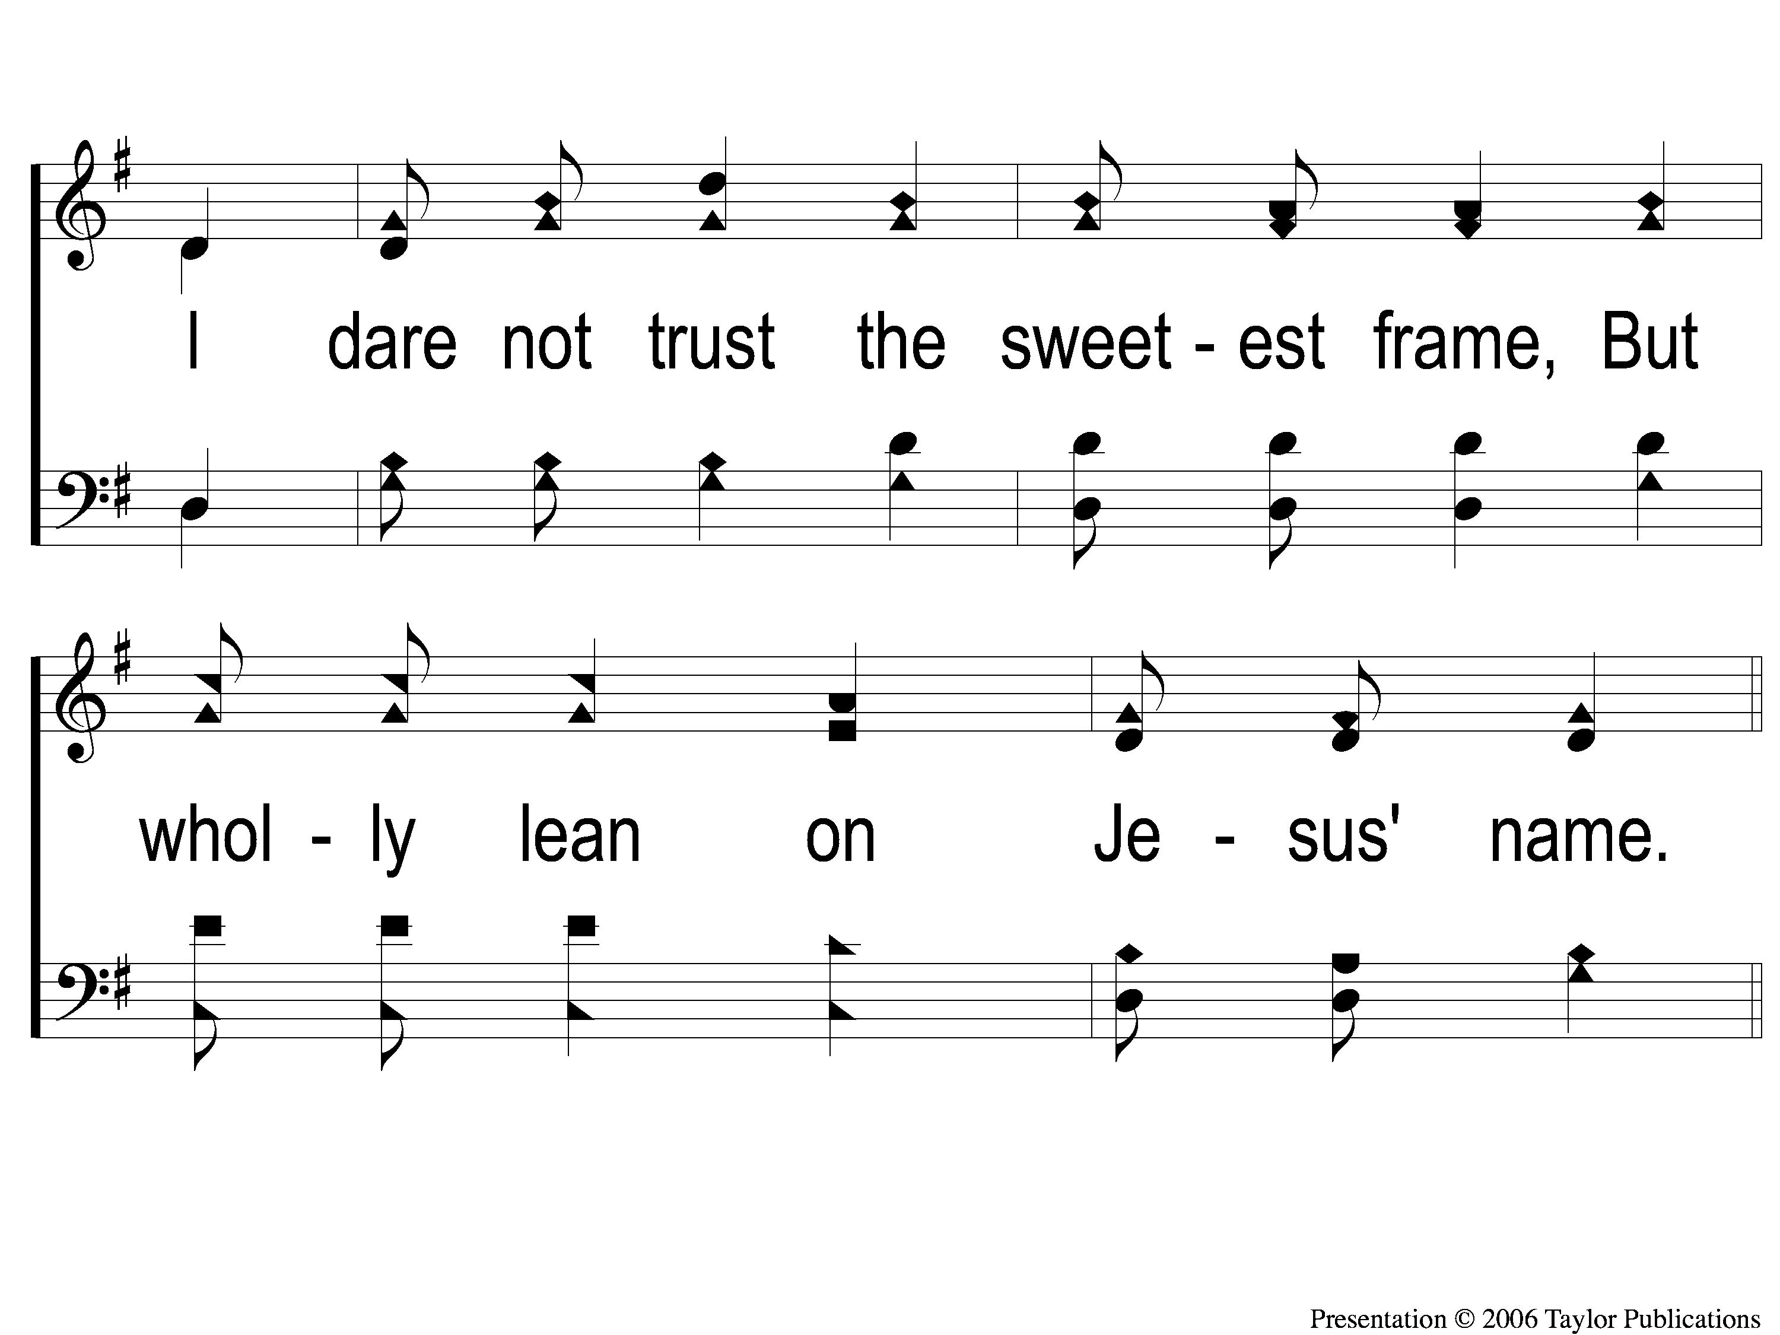
1-2 My Hope is Built
My Hope Is Built
538

Slide 32
c My Hope is Built
My Hope Is Built
538

Slide 33
2-1 My Hope is Built
My Hope Is Built
538

Slide 34
2-2 My Hope is Built
My Hope Is Built
538

Slide 35
c My Hope is Built
My Hope Is Built
538

Slide 36
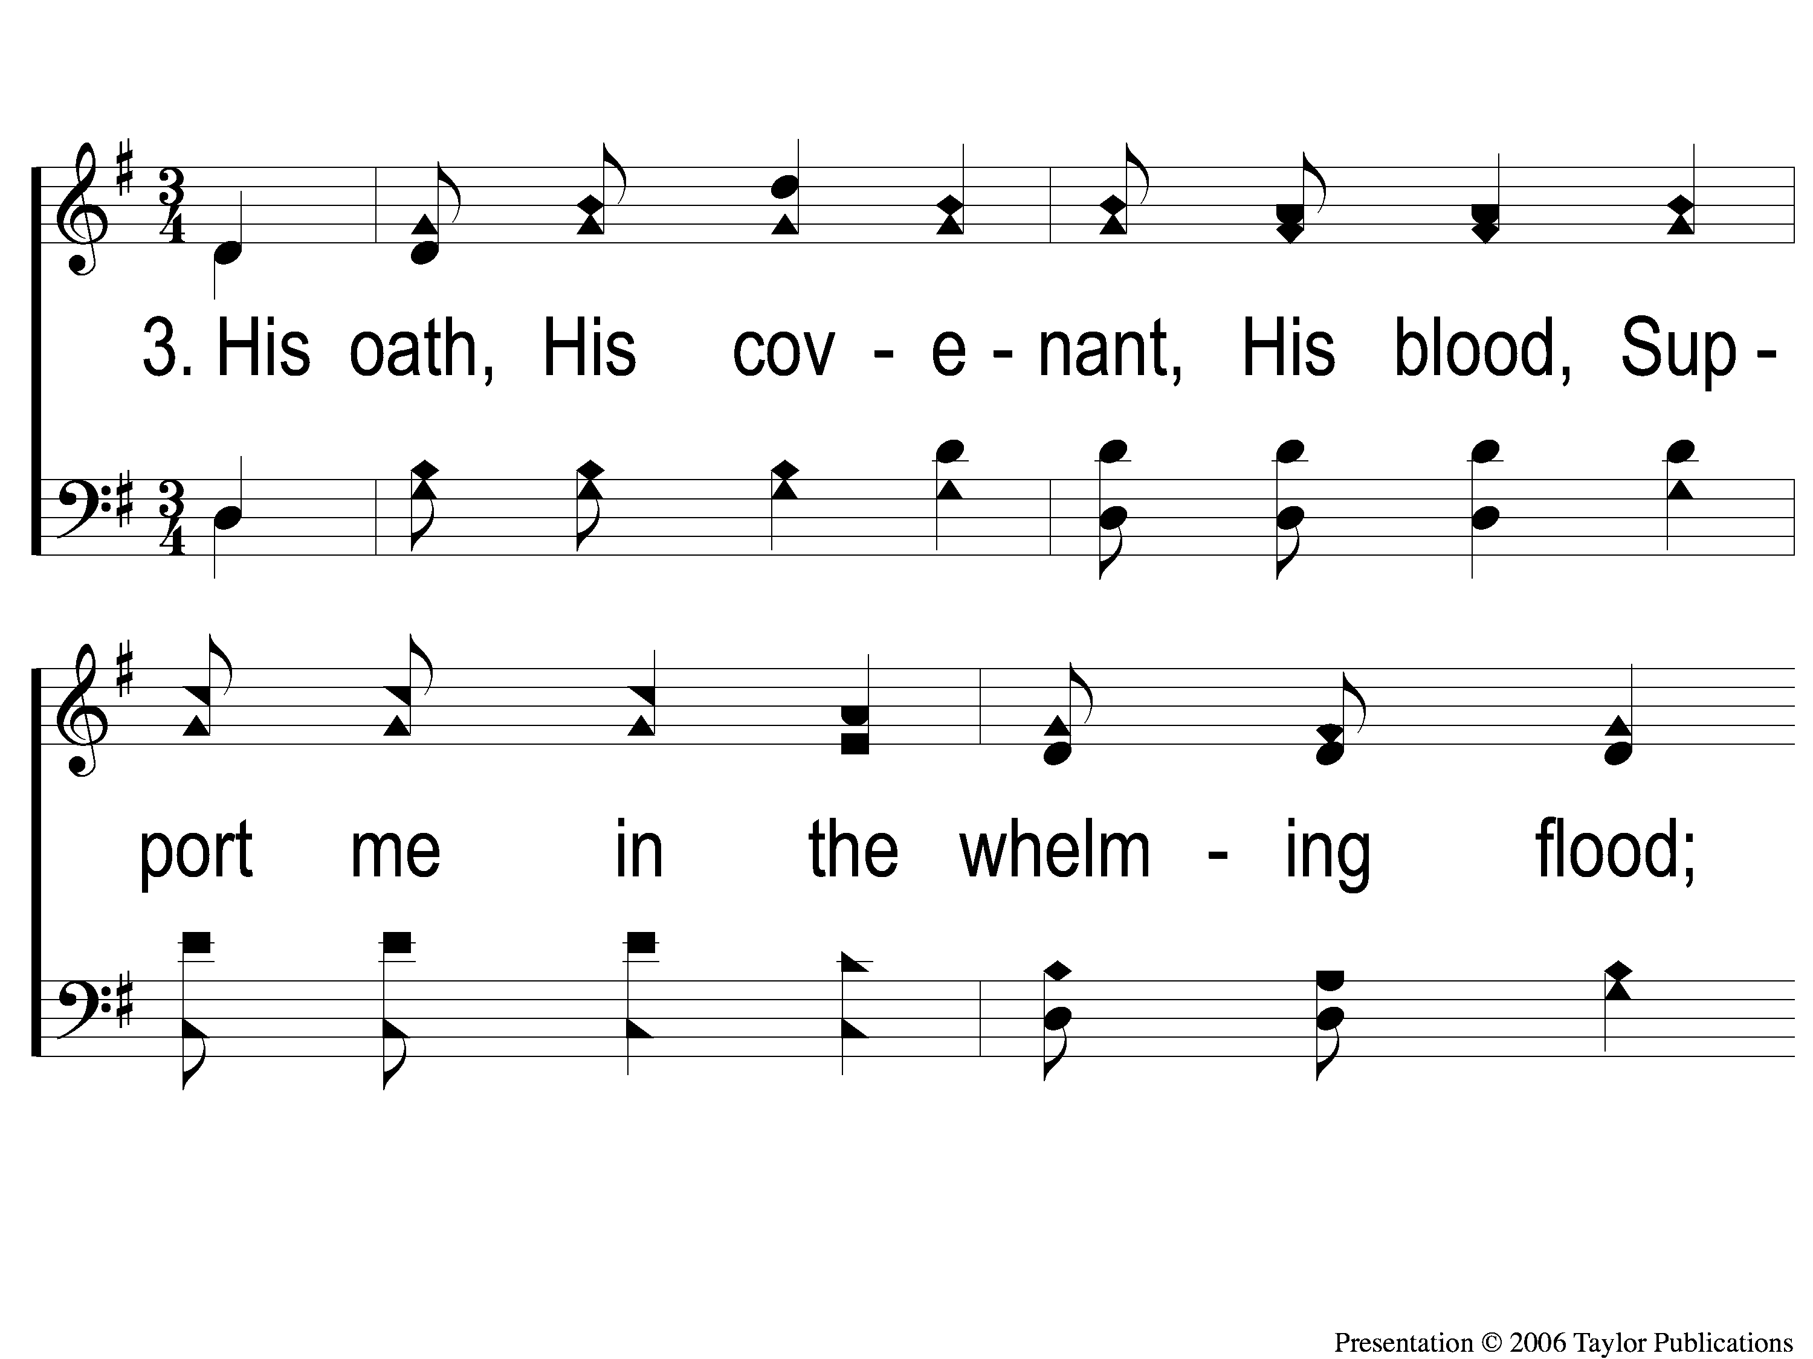
3-1 My Hope is Built
My Hope Is Built
538

Slide 37
3-2 My Hope is Built
My Hope Is Built
538

Slide 38
c My Hope is Built
My Hope Is Built
538

Slide 39
4-1 My Hope is Built
My Hope Is Built
538

Slide 40
4-2 My Hope is Built
My Hope Is Built
538

Slide 41
c My Hope is Built
My Hope Is Built
538

Slide 42
#853
SONG:
When We All
Get To Heaven

Slide 43
1-1 When We All Get To Heaven
When We All Get To Heaven
853

Slide 44
1-2 When We All Get To Heaven
When We All Get To Heaven
853

Slide 45
C-1 When We All Get To Heaven
When We All Get To Heaven
853

Slide 46
C-2 When We All Get To Heaven
When We All Get To Heaven
853

Slide 47
2-1 When We All Get To Heaven
When We All Get To Heaven
853

Slide 48
2-2 When We All Get To Heaven
When We All Get To Heaven
853

Slide 49
C-1 When We All Get To Heaven
When We All Get To Heaven
853

Slide 50
C-2 When We All Get To Heaven
When We All Get To Heaven
853

Slide 51
3-1 When We All Get To Heaven
When We All Get To Heaven
853

Slide 52
3-2 When We All Get To Heaven
When We All Get To Heaven
853

Slide 53
C-1 When We All Get To Heaven
When We All Get To Heaven
853

Slide 54
C-2 When We All Get To Heaven
When We All Get To Heaven
853

Slide 55
SCRIPTURE:
Daniel 1:1-7

Slide 56
Stand out!

Slide 57
Case Study: zacchaeus
Luke 19:1-10

Slide 58
Case Study:
a demon-possessed man
Mark 5:1-20

Slide 59
Case Study:
FOUR WOMEN with Jesus
John 19:25-20:18

Slide 60
Case Study:
Hananiah, Mishael,
& Azariah
Daniel 3:1-30

Slide 61
The three Men
Daniel 1:6-7
Hananiah
Mishael
Azariah

Slide 62
The three Men
Daniel 1:6-7
Hananiah → Shadrach
“Yahweh is Gracious” → “Aku’s command”

Slide 63
The three Men
Daniel 1:6-7
Mishael → Meshach
“Who is like God?” → “Who is like Aku?”

Slide 64
The three Men
Daniel 1:6-7
Azariah → Abed-nego
“Yahweh has Helped” → “Servant of Nego”

Slide 65
Daniel chapter 3

Slide 66
Daniel chapter 3
They Stood Out…
…in Conviction

Slide 67
Their Conviction
They Chose to Obey God
Daniel 3:16-18
Acts 5:29

Slide 68
Daniel chapter 3
They Stood Out…
…in Conviction
…in Consistency

Slide 69
Their consistency
In Jerusalem

Slide 70
Their consistency
In Jerusalem
In Babylon
Dan. 1:8, 11-14, 3:21-23

Slide 71
Daniel chapter 3
They Stood Out…
…in Conviction
…in Consistency
…in Compensation

Slide 72
Their compensation
Rewarded by God
Physically – Dan. 1:17, 19-20

Slide 73
Their compensation
Rewarded by God
Physically – Dan. 1:17, 19-20
Spiritually – Heb. 11:16, 39-40

Slide 74
Do you
stand out?

Slide 75
#916
SONG:
What A Day
That Will Be

Slide 76
1-1 What a Day That Will Be
What a Day That Will Be
916

Slide 77
1-2 What a Day That Will Be
What a Day That Will Be
916

Slide 78
1-3 What a Day That Will Be
What a Day That Will Be
916

Slide 79
C-1 What a Day That Will Be
What a Day That Will Be
916

Slide 80
C-2 What a Day That Will Be
What a Day That Will Be
916

Slide 81
C-3 What a Day That Will Be
What a Day That Will Be
916

Slide 82
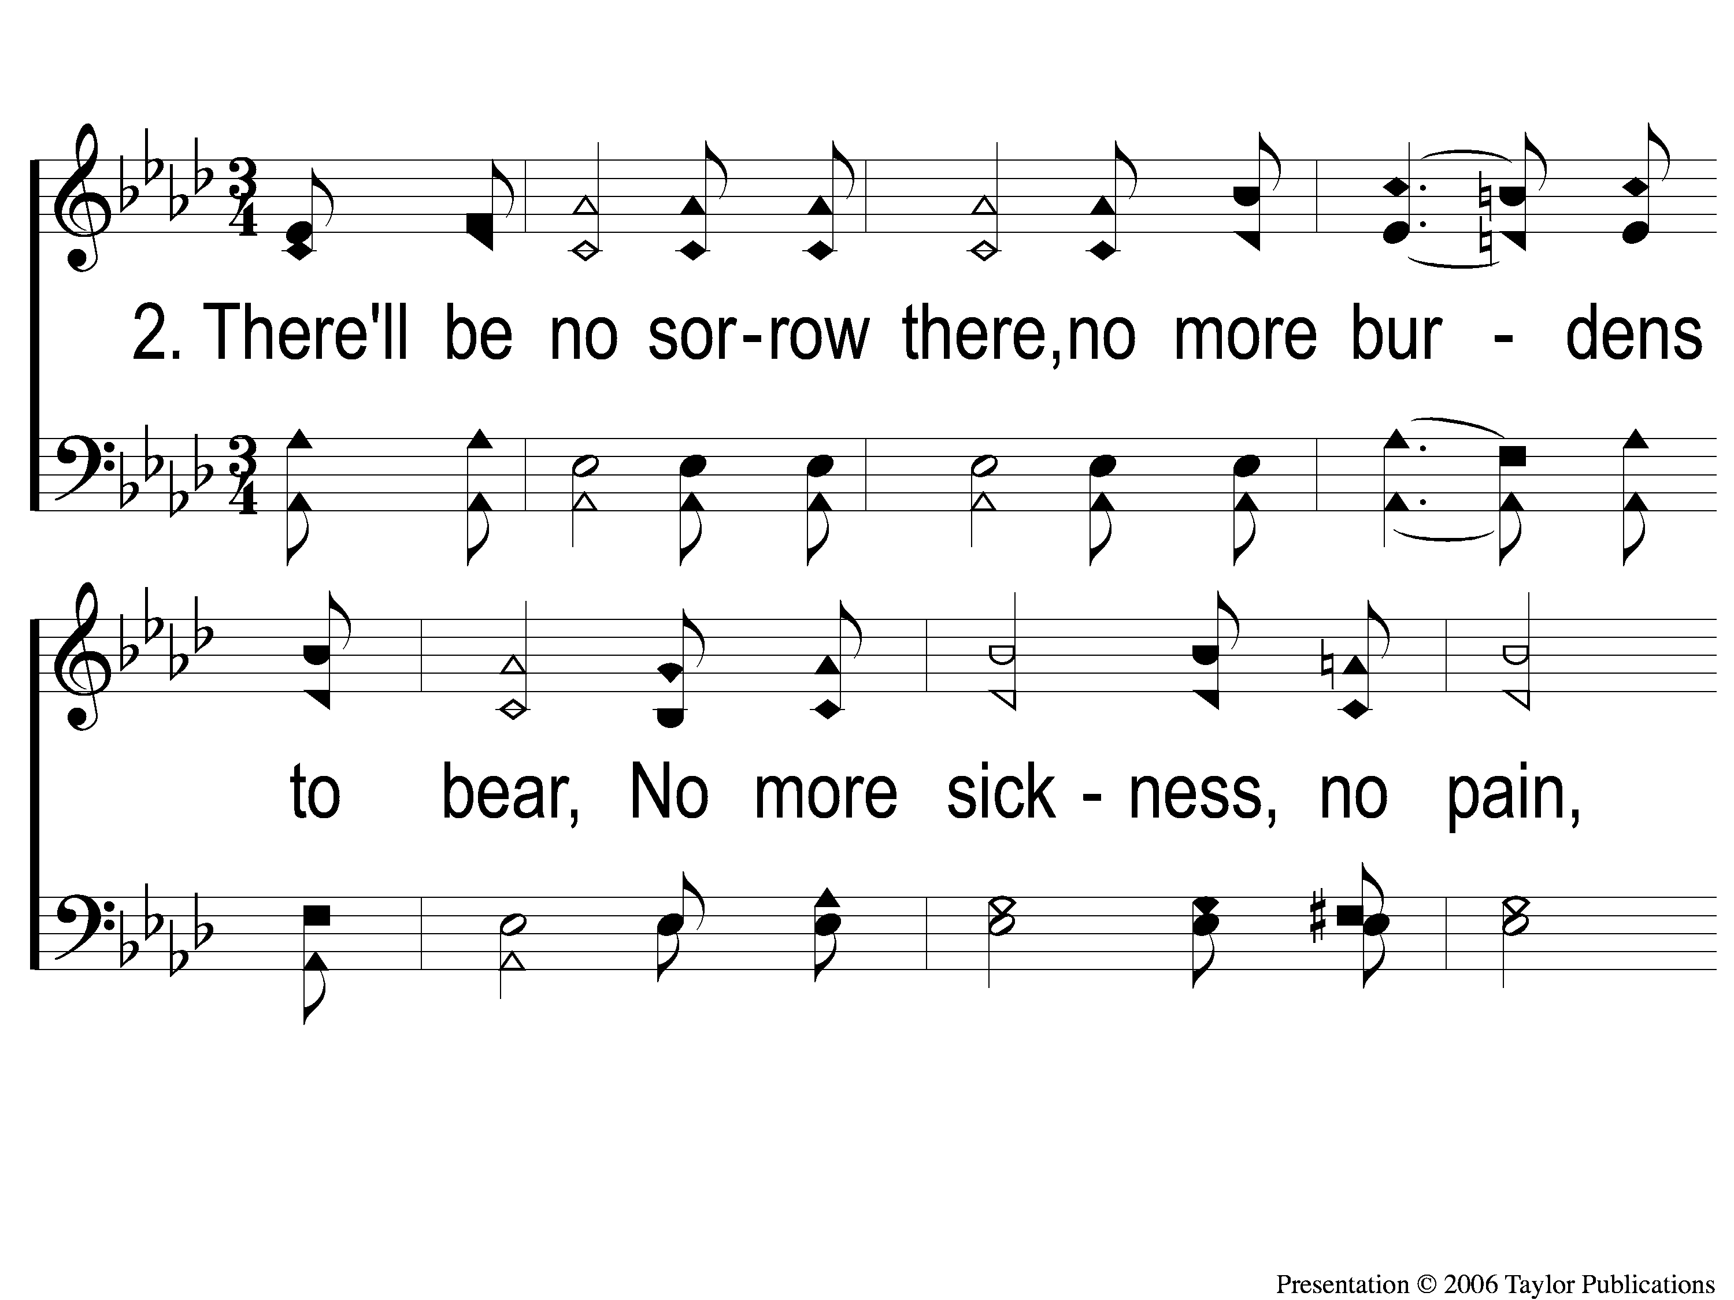
2-1 What a Day That Will Be
What a Day That Will Be
916

Slide 83
2-2 What a Day That Will Be
What a Day That Will Be
916

Slide 84
2-3 What a Day That Will Be
What a Day That Will Be
916

Slide 85
C-1 What a Day That Will Be
What a Day That Will Be
916

Slide 86
C-2 What a Day That Will Be
What a Day That Will Be
916

Slide 87
C-3 What a Day That Will Be
What a Day That Will Be
916

Slide 88
#470
SONG:
Victory In Jesus

Slide 89
1-1 Victory in Jesus
Victory in Jesus
470

Slide 90
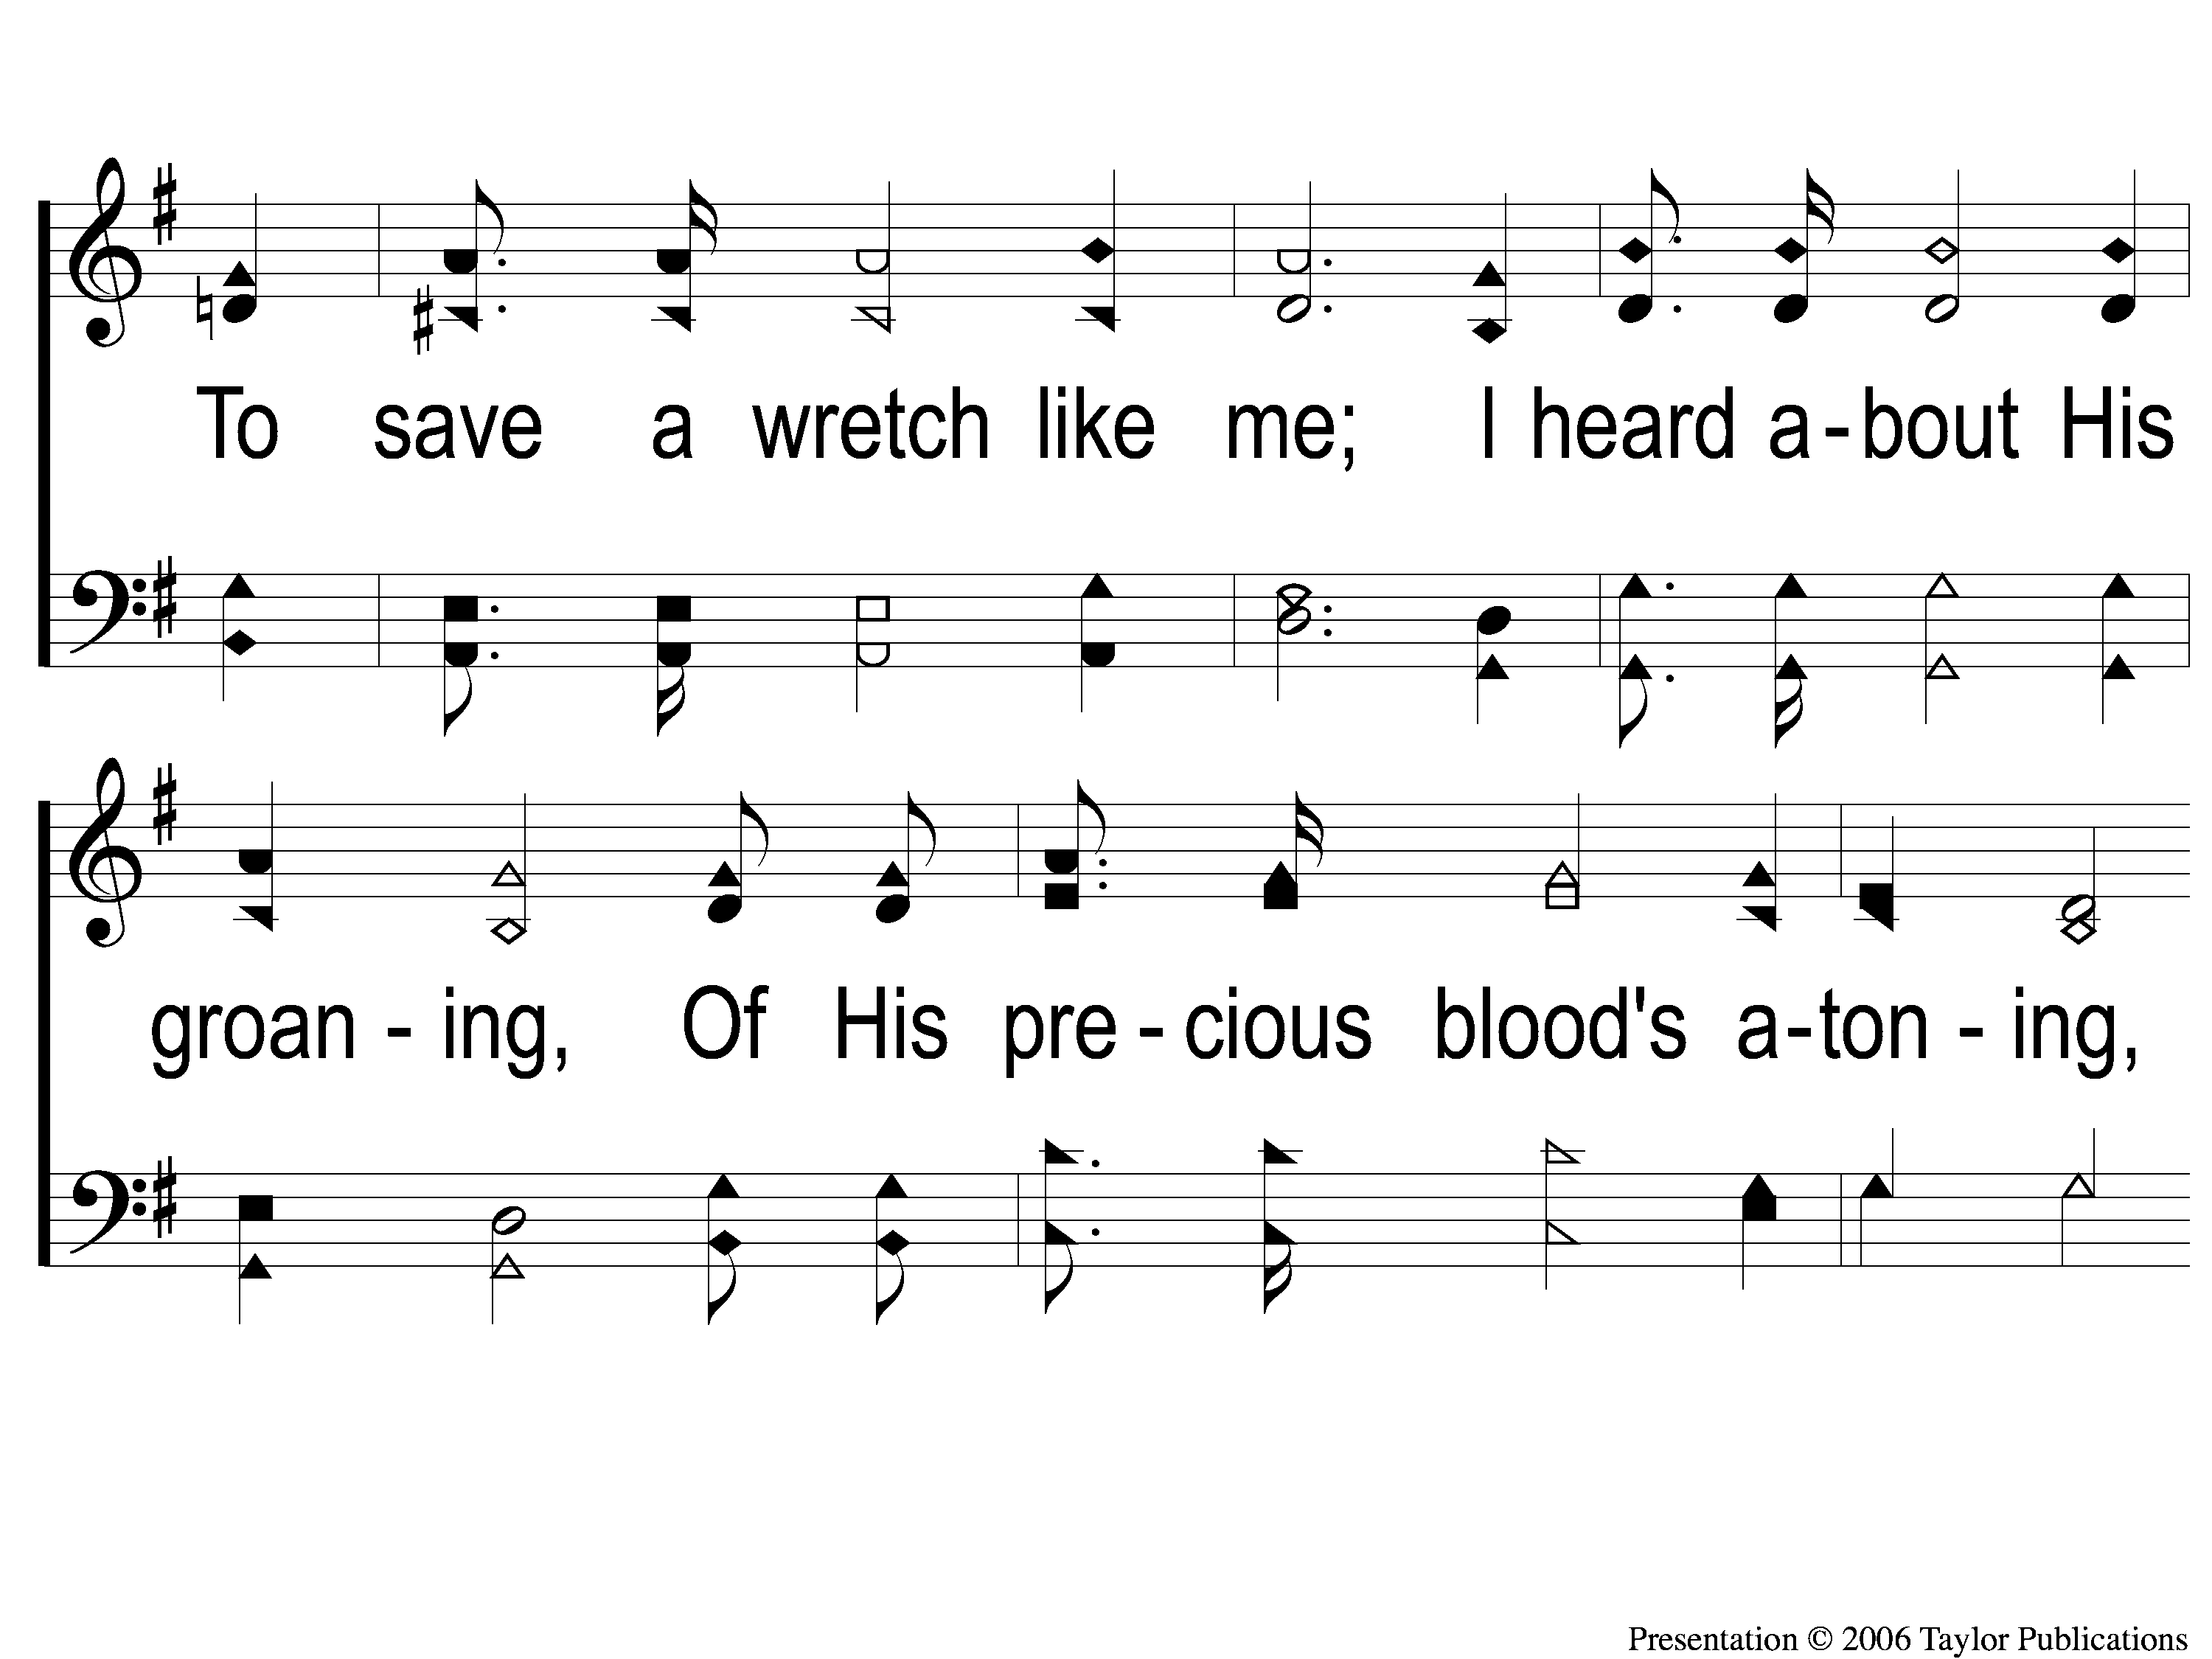
1-2 Victory in Jesus
Victory in Jesus
470

Slide 91
1-3 Victory in Jesus
Victory in Jesus
470

Slide 92
C-1 Victory in Jesus
Victory in Jesus
470

Slide 93
C-2 Victory in Jesus
Victory in Jesus
470

Slide 94
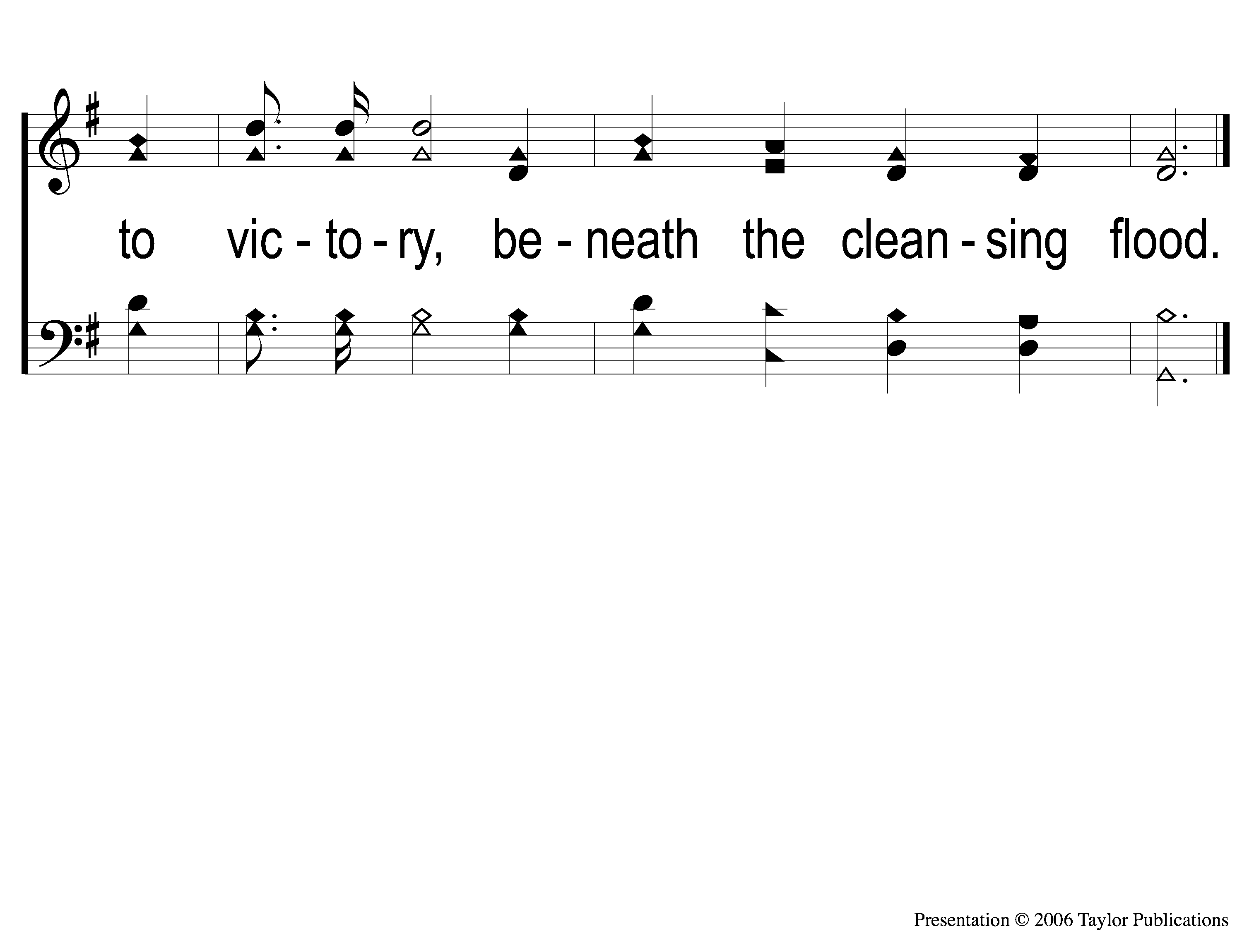
C-3 Victory in Jesus
Victory in Jesus
470

Slide 95
2-1 Victory in Jesus
Victory in Jesus
470

Slide 96
2-2 Victory in Jesus
Victory in Jesus
470

Slide 97
2-3 Victory in Jesus
Victory in Jesus
470

Slide 98
C-1 Victory in Jesus
Victory in Jesus
470

Slide 99
C-2 Victory in Jesus
Victory in Jesus
470

Slide 100
C-3 Victory in Jesus
Victory in Jesus
470

Slide 101
3-1 Victory in Jesus
Victory in Jesus
470

Slide 102
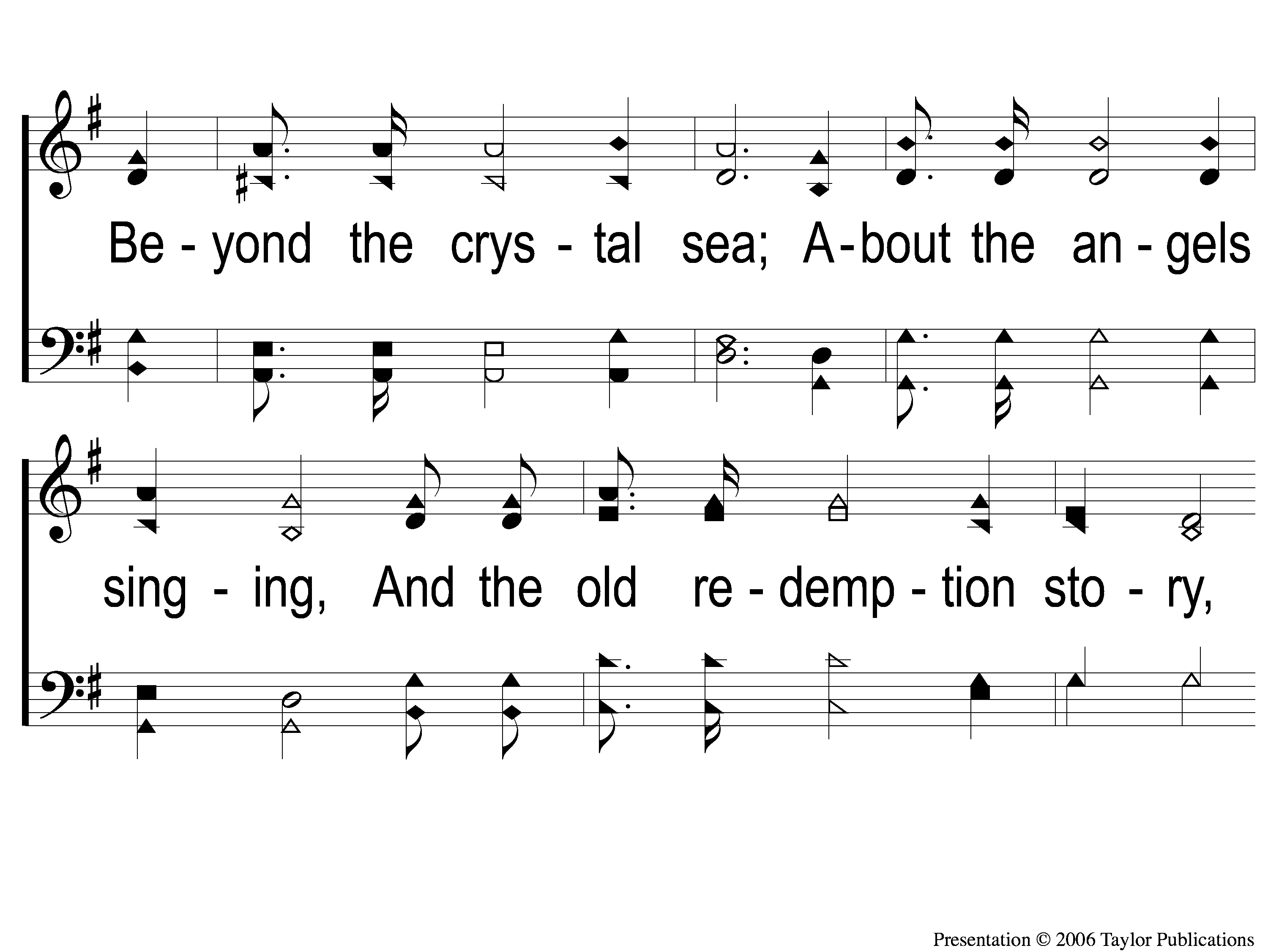
3-2 Victory in Jesus
Victory in Jesus
470

Slide 103
3-3 Victory in Jesus
Victory in Jesus
470

Slide 104
C-1 Victory in Jesus
Victory in Jesus
470

Slide 105
C-2 Victory in Jesus
Victory in Jesus
470

Slide 106
C-3 Victory in Jesus
Victory in Jesus
470

Slide 107
LORD’S SUPPER
The
Acts 20:7

Slide 108
Unleavened Bread
LORD’S SUPPER
18 Therefore, as through one man’s offense judgment came to all men, resulting in condemnation, even so through one Man’s righteous act the free gift came to all men, resulting in justification of life. 19 For as by one man’s disobedience many were made sinners, so also by one Man’s obedience many will be made righteous.
Rom. 5:18-19

Slide 109
Fruit of the Vine
LORD’S SUPPER
9 Since, therefore, we have now been justified by his blood, much more shall we be saved by him from the wrath of God. 10 For if while we were enemies we were reconciled to God by the death of his Son, much more, now that we are reconciled, shall we be saved by his life. 11 More than that, we also rejoice in God through our Lord Jesus Christ, through whom we have now received reconciliation.
Rom. 5:9-11

Slide 110
Rom. 9:6-8
OFFERING
6The point is this: whoever sows sparingly will also reap sparingly, and whoever sows bountifully will also reap bountifully. 7 Each one must give as he has decided in his heart, not reluctantly or under compulsion, for God loves a cheerful giver. 8 And God is able to make all grace abound to you, so that having all sufficiency in all things at all times, you may abound in every good work.

Slide 111
Closing PRAYER

Slide 112
#587
SONG:
Sing & Be Happy

Slide 113
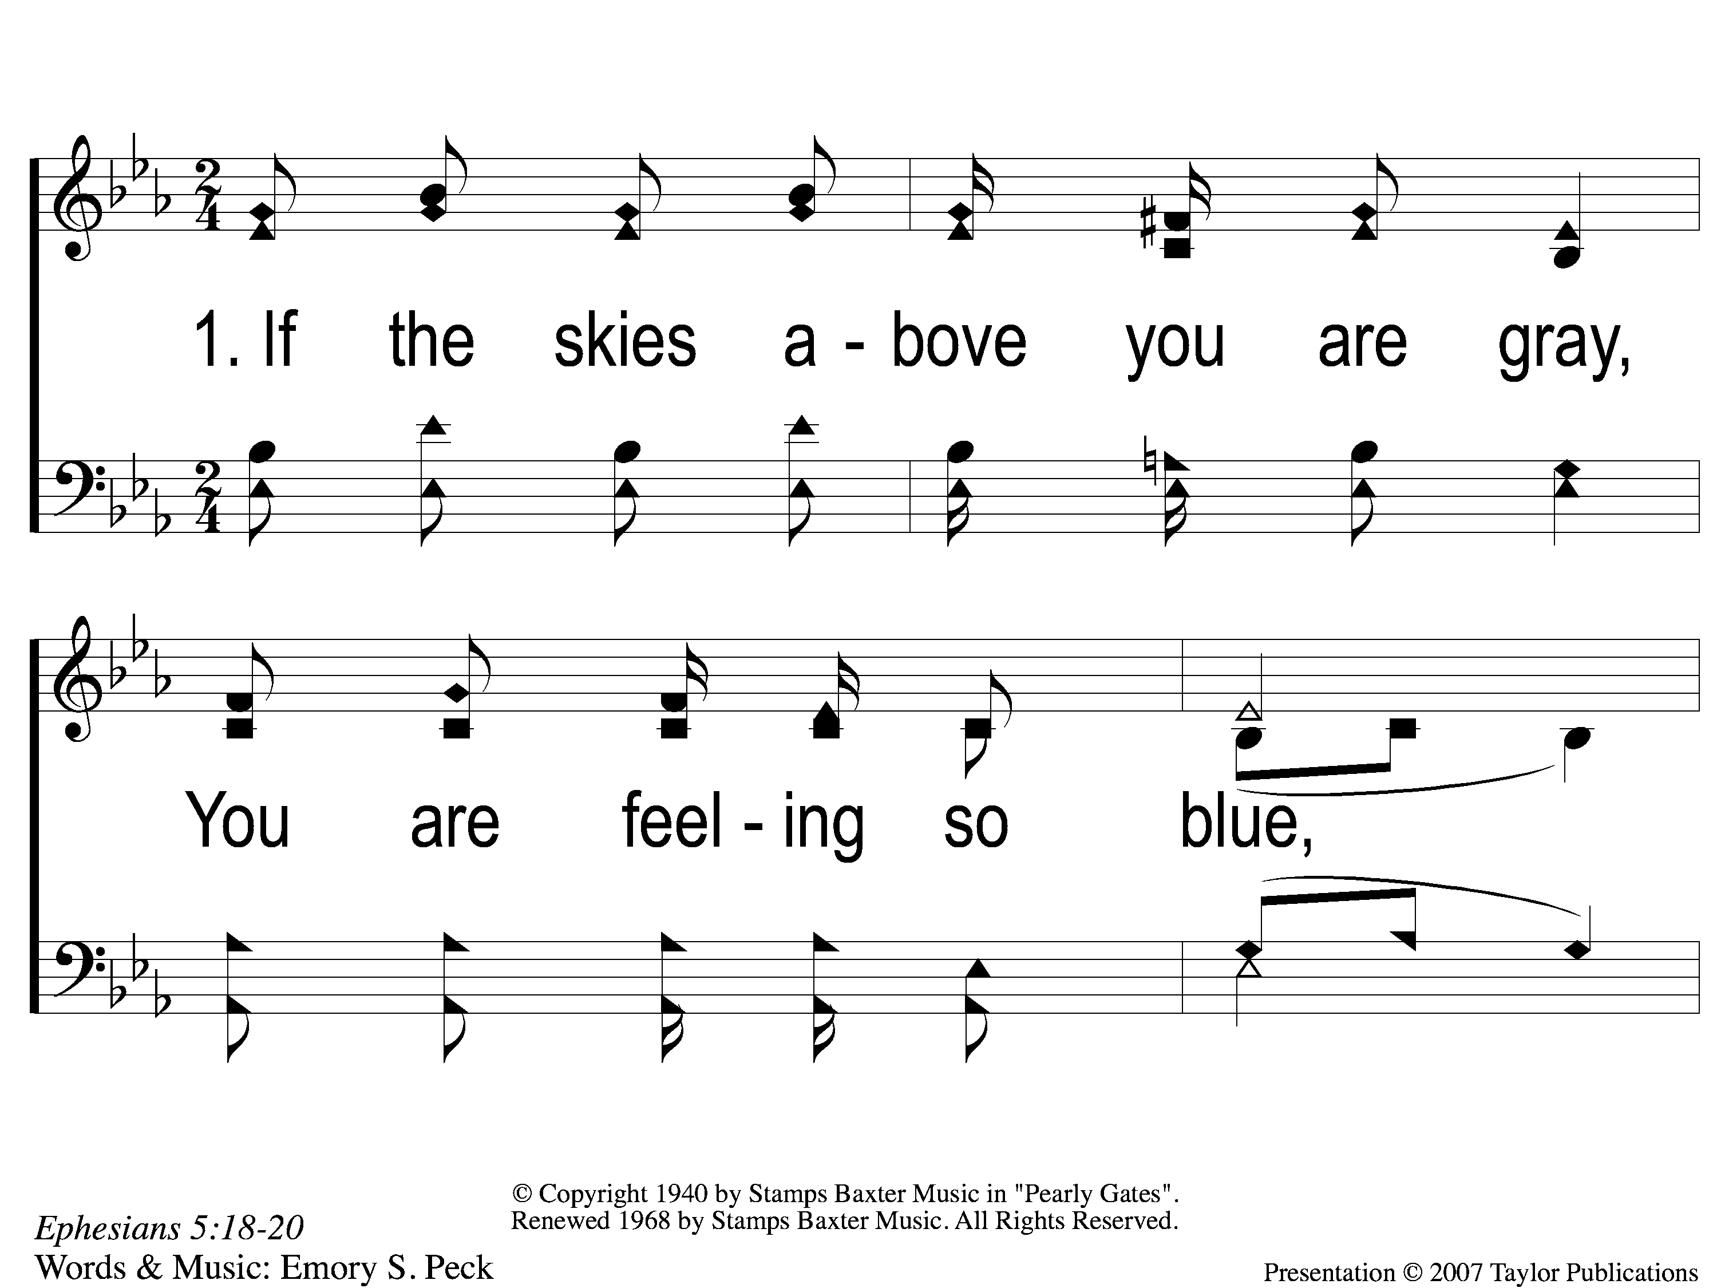
1-1 Sing and Be Happy
Sing and Be Happy
587

Slide 114
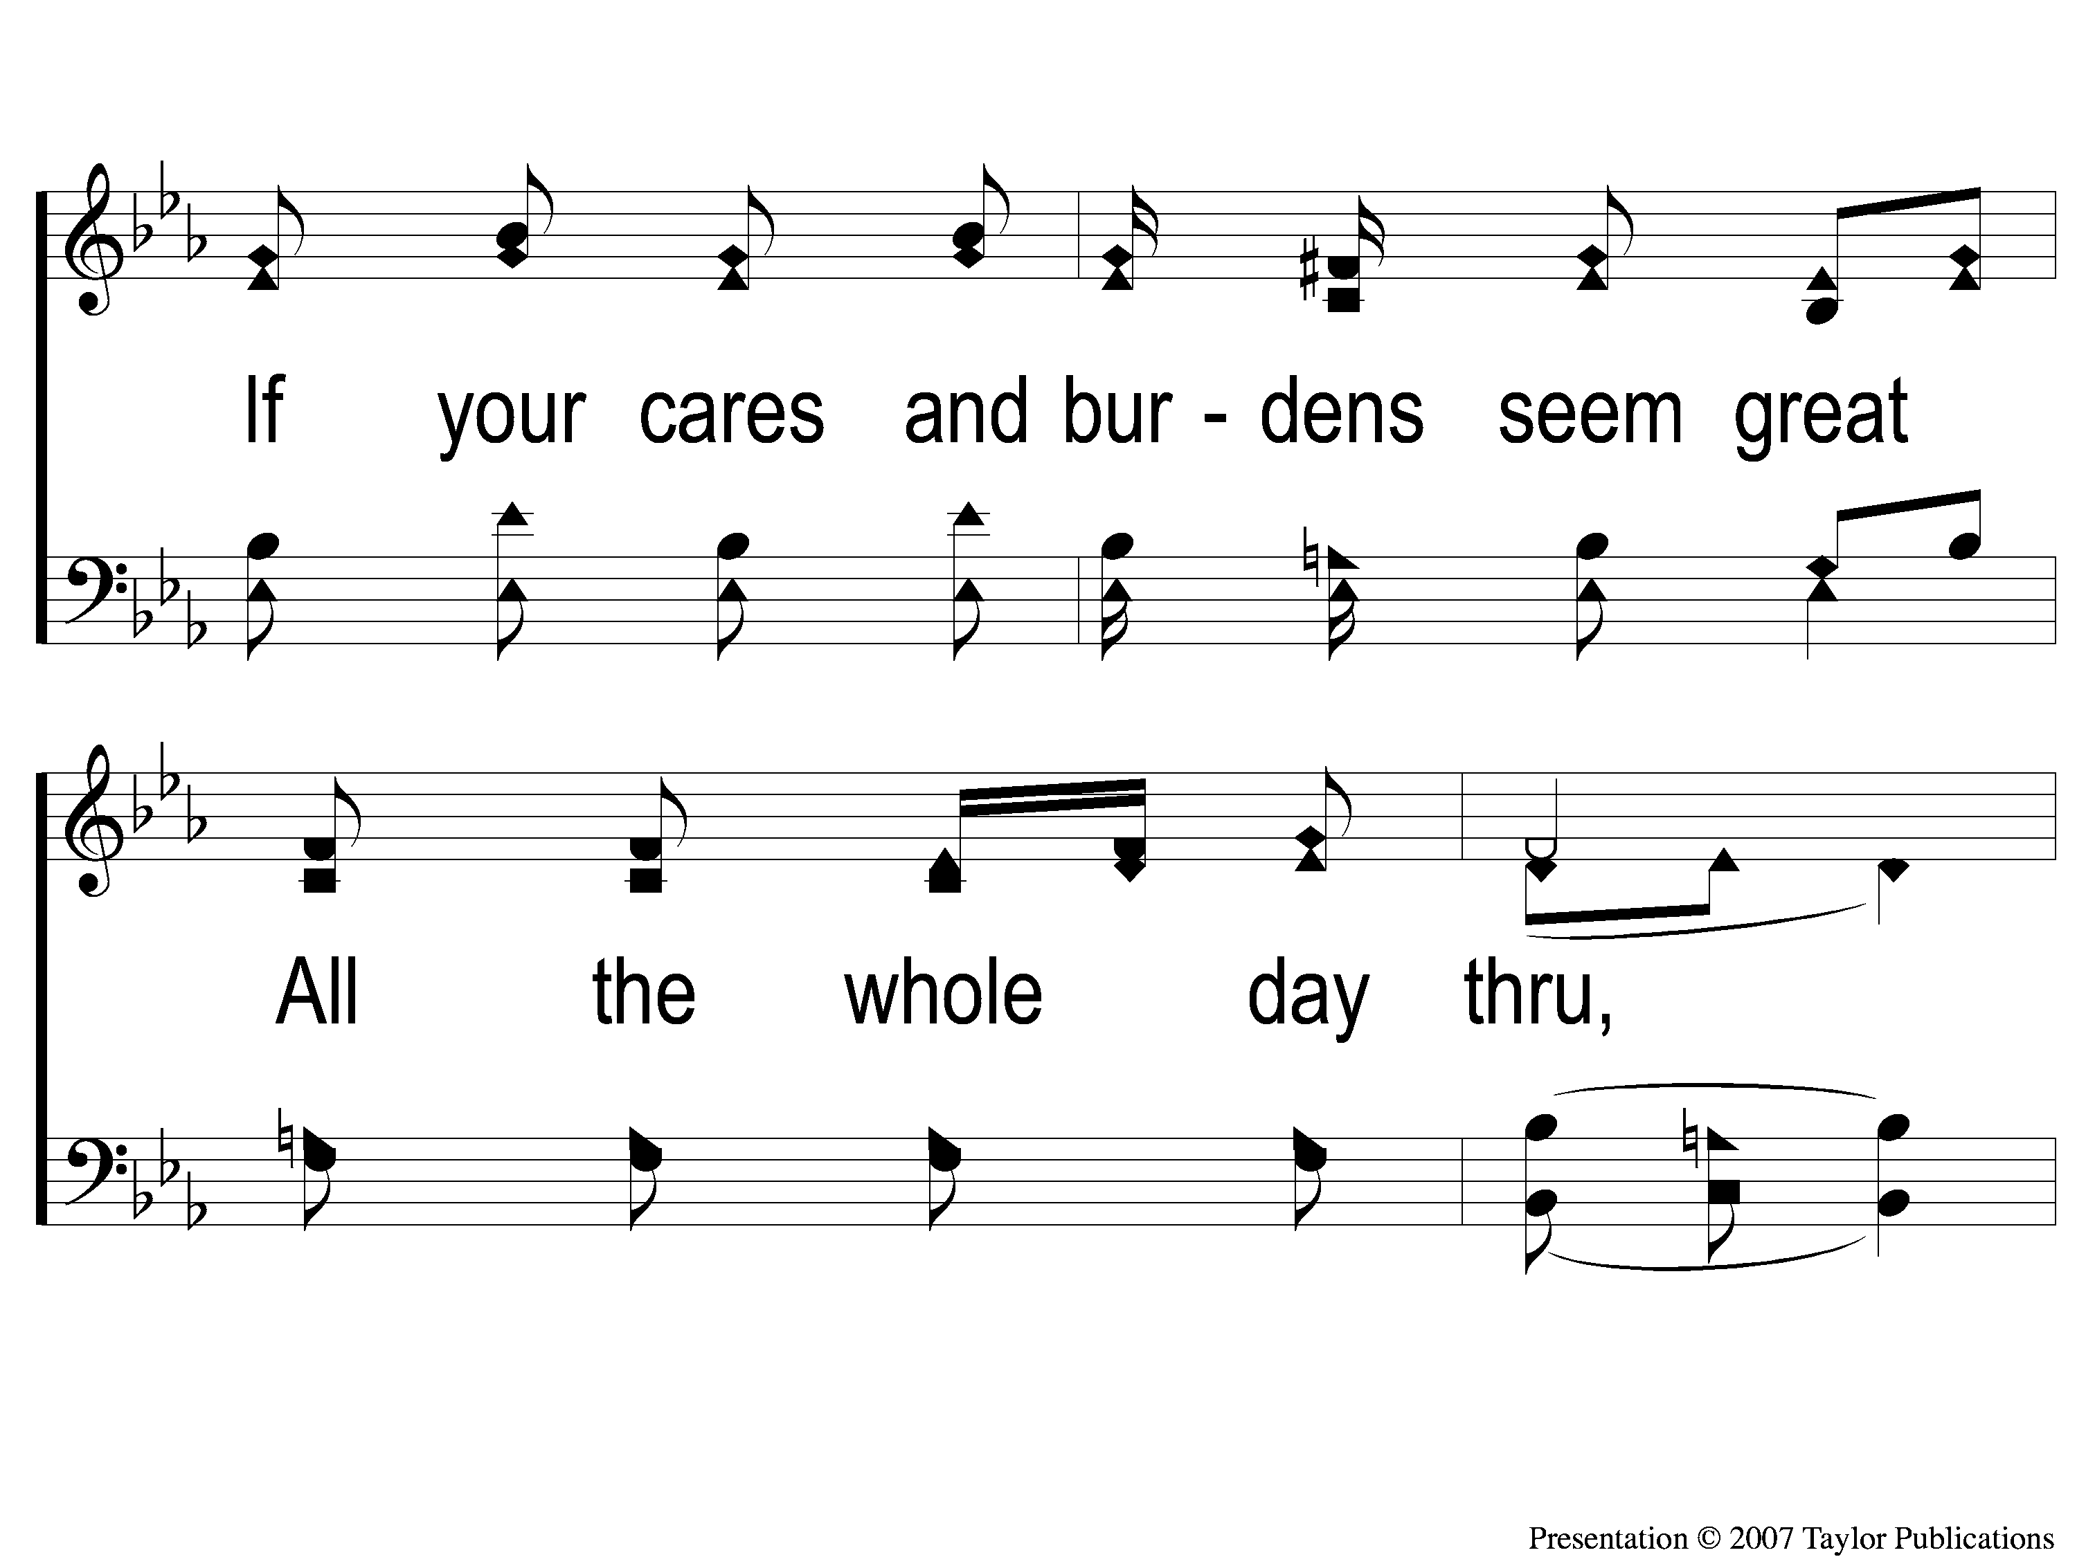
1-2 Sing and Be Happy
Sing and Be Happy
587

Slide 115
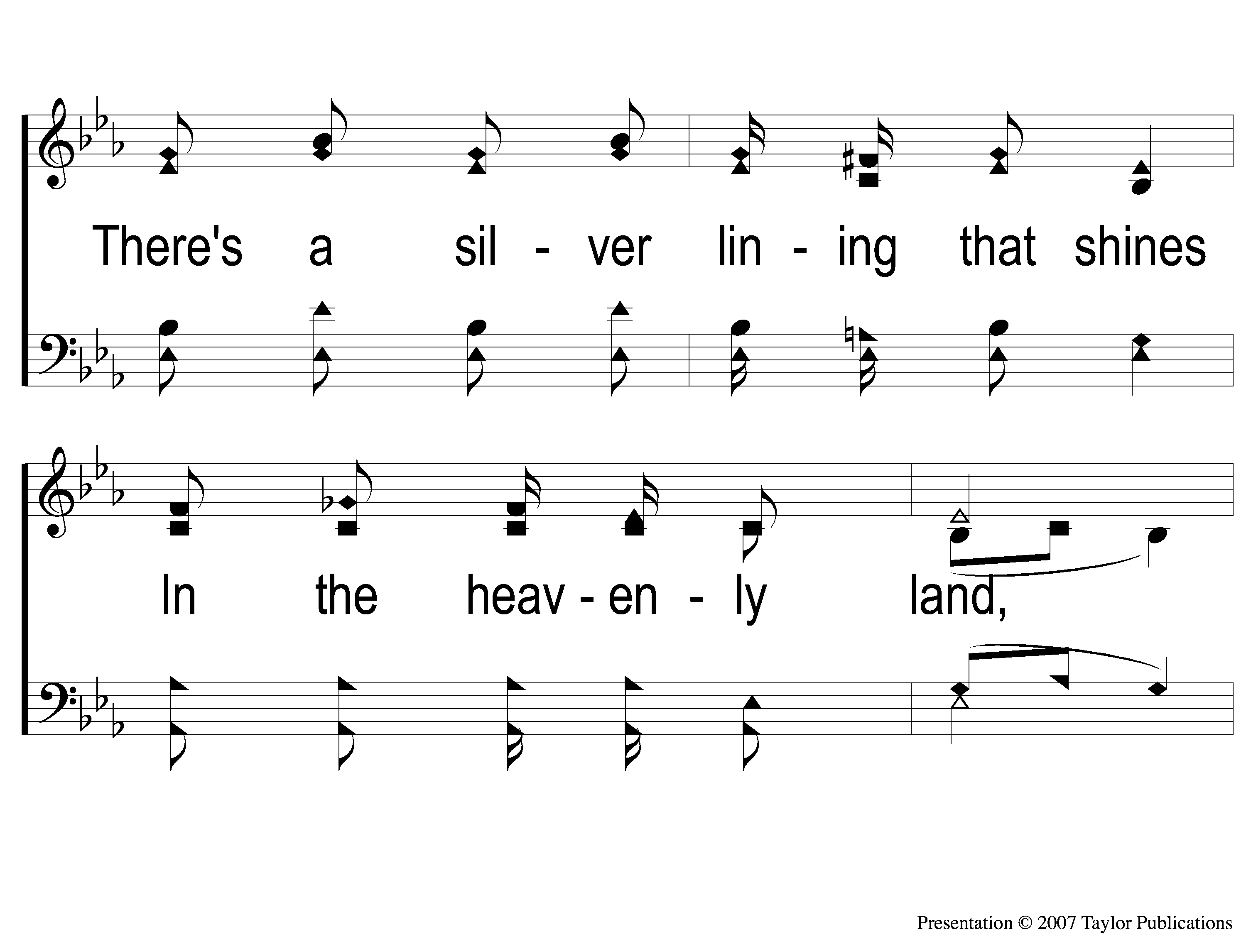
1-3 Sing and Be Happy
Sing and Be Happy
587

Slide 116
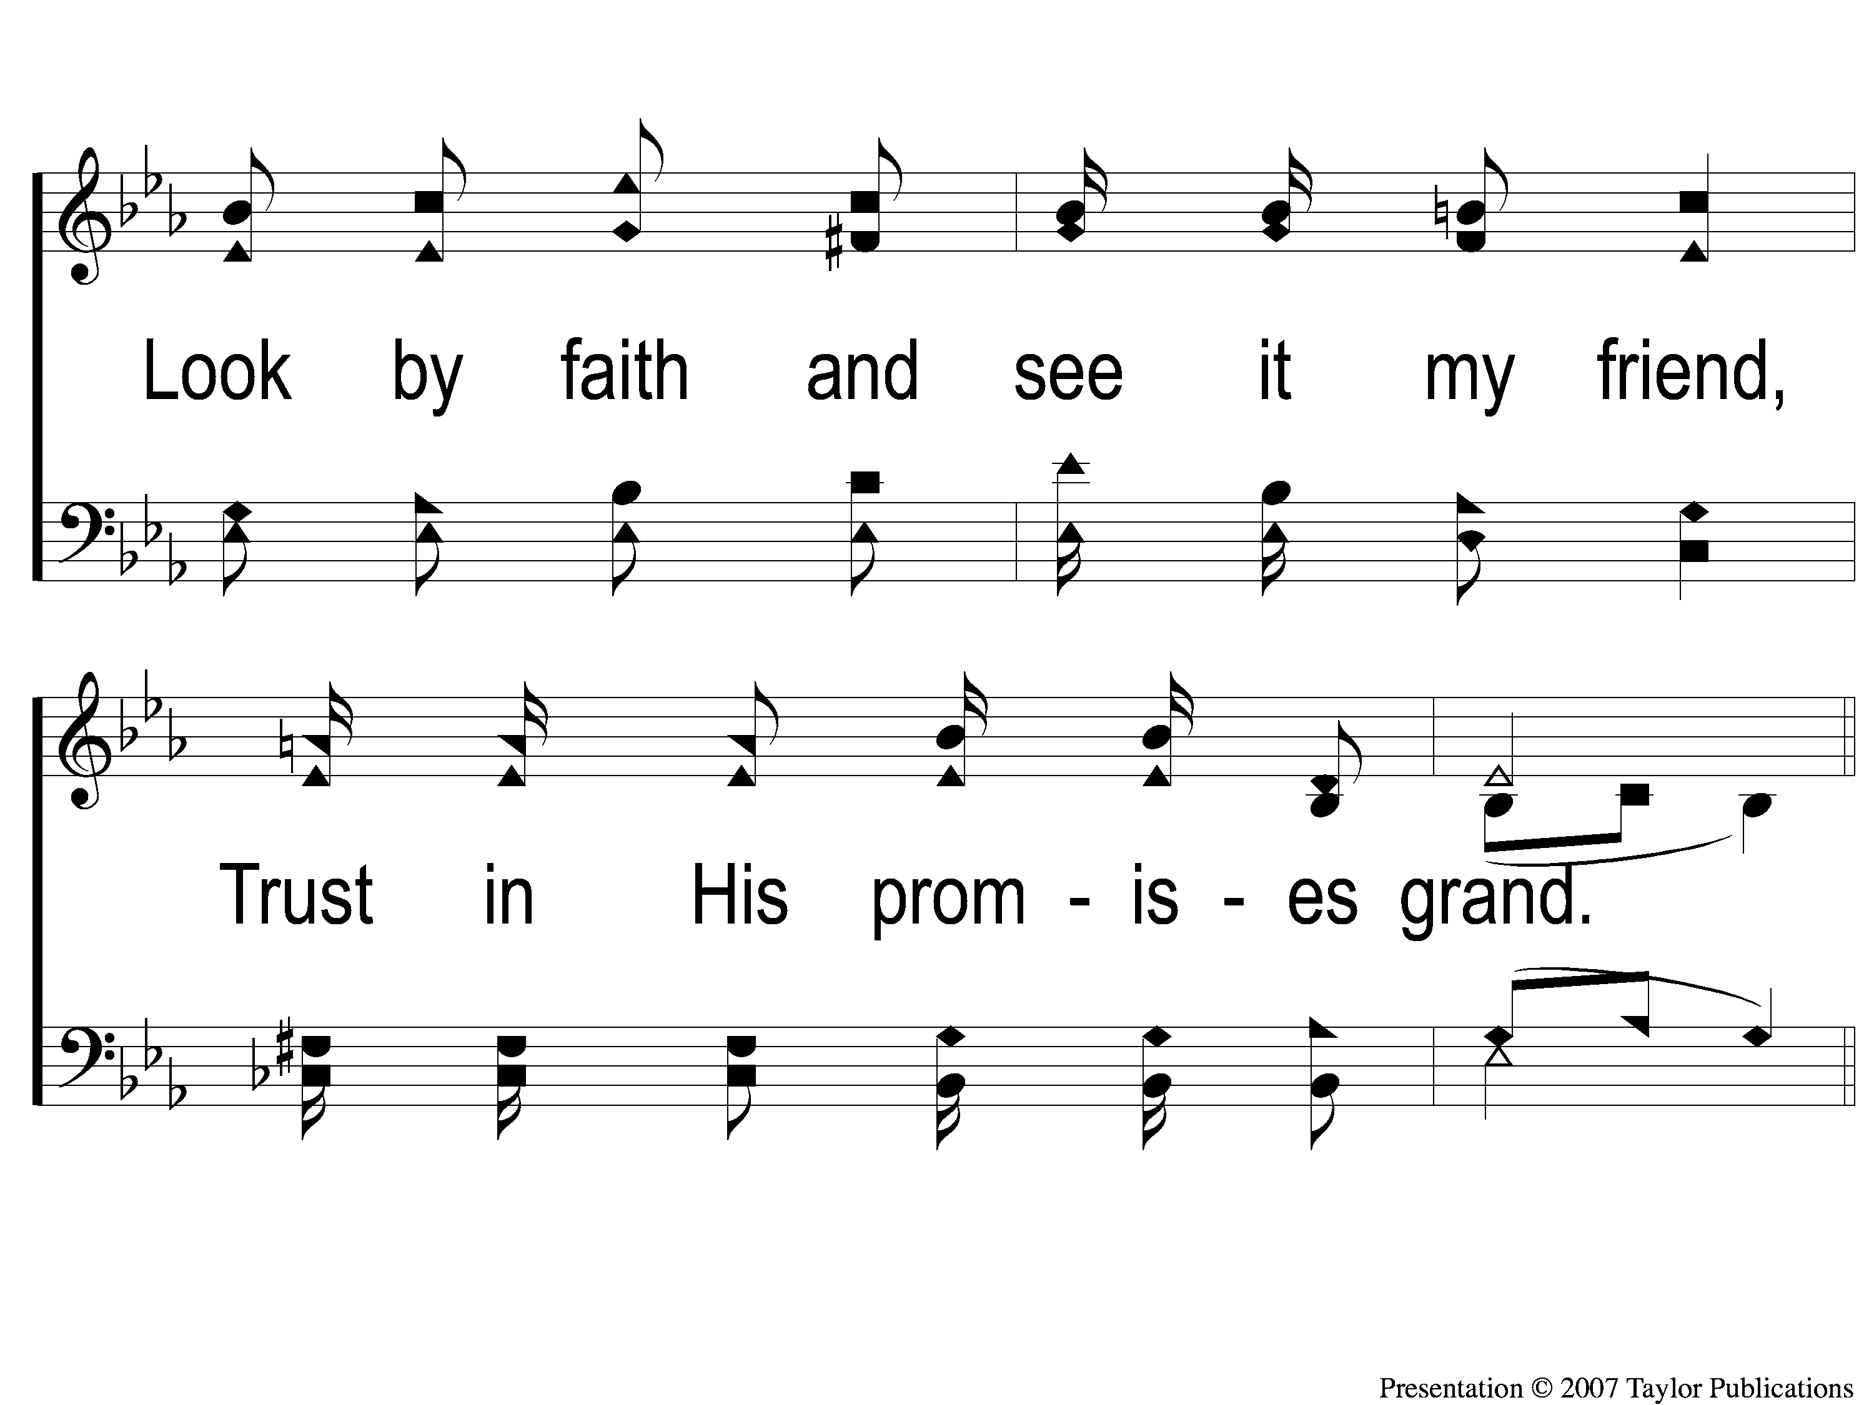
1-4 Sing and Be Happy
Sing and Be Happy
587

Slide 117
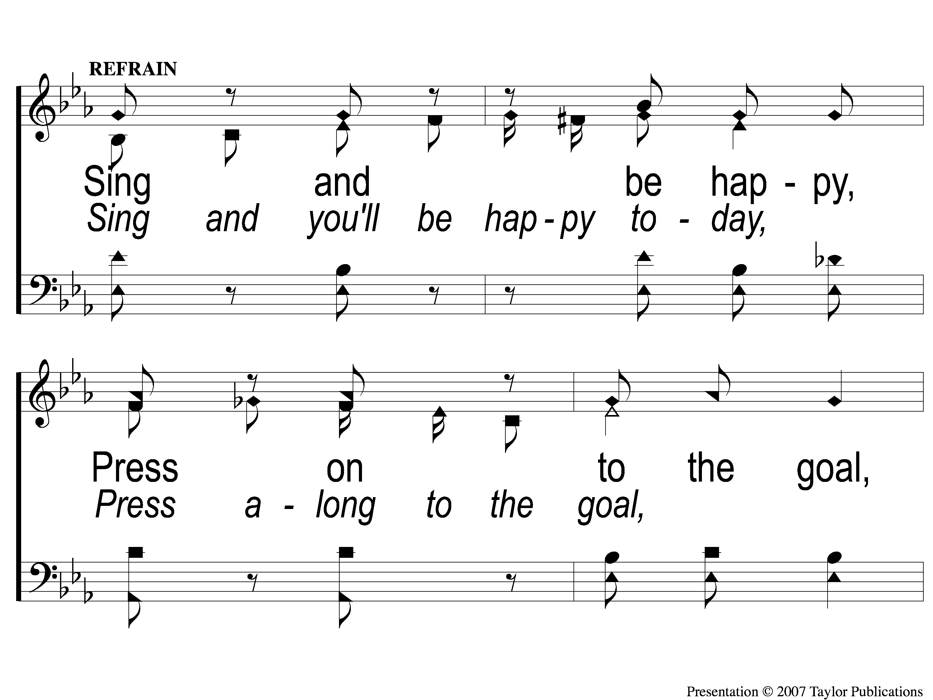
C-1 Sing and Be Happy
Sing and Be Happy
587

Slide 118
C-2 Sing and Be Happy
Sing and Be Happy
587

Slide 119
C-3 Sing and Be Happy
Sing and Be Happy
587

Slide 120
C-4 Sing and Be Happy
Sing and Be Happy
587

Slide 121
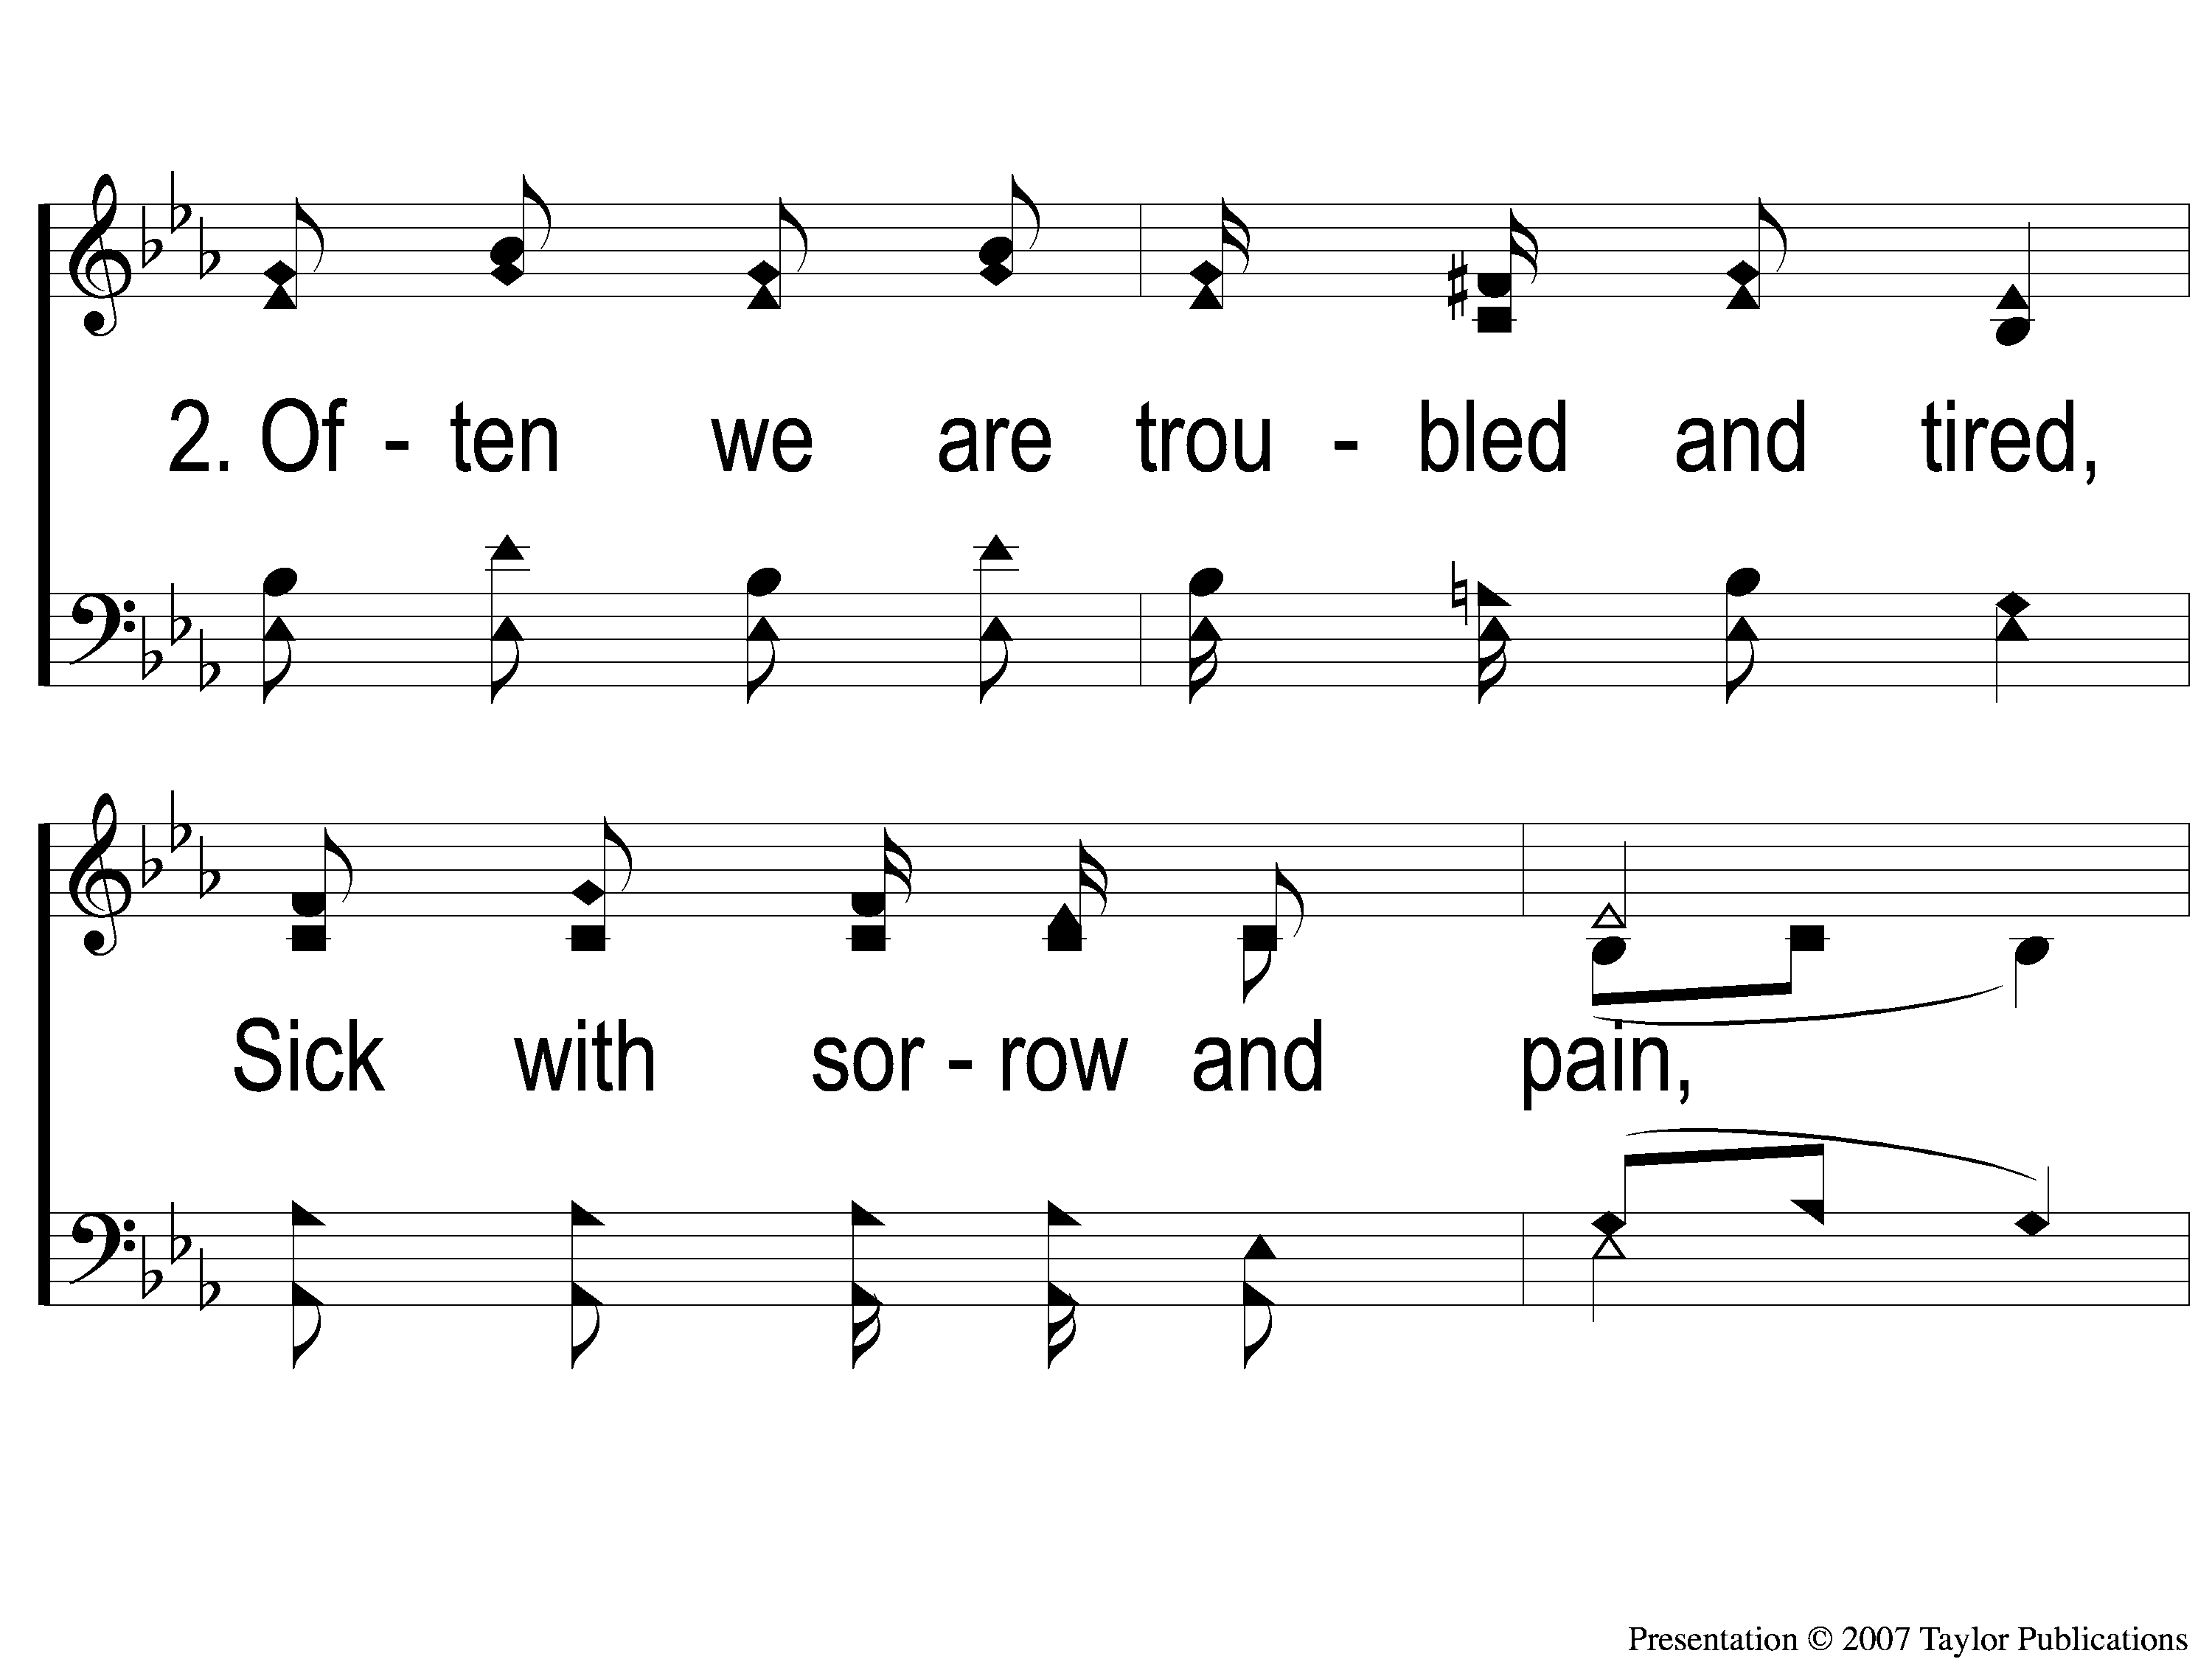
2-1 Sing and Be Happy
Sing and Be Happy
587

Slide 122
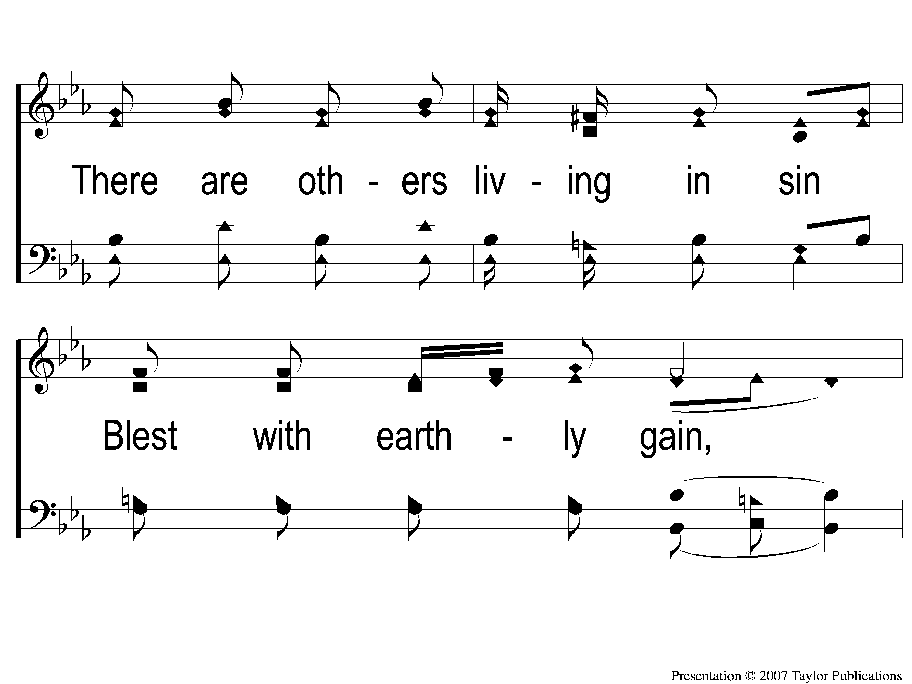
2-2 Sing and Be Happy
Sing and Be Happy
587

Slide 123
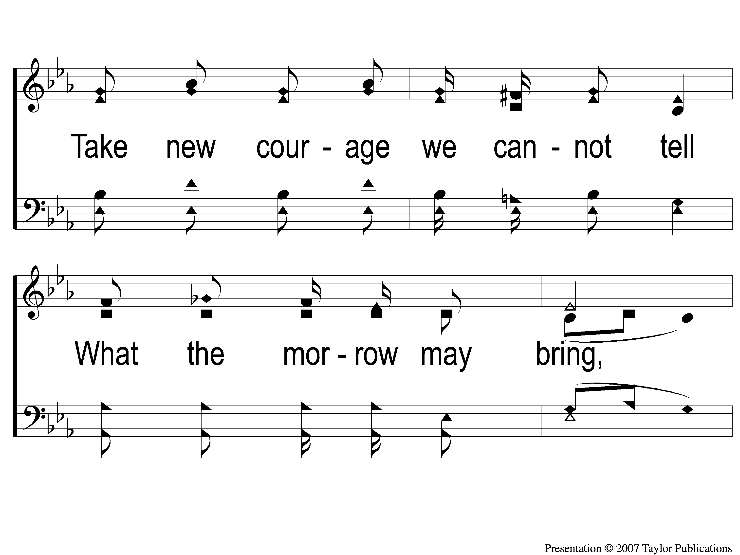
2-3 Sing and Be Happy
Sing and Be Happy
587

Slide 124
2-4 Sing and Be Happy
Sing and Be Happy
587

Slide 125
C-1 Sing and Be Happy
Sing and Be Happy
587

Slide 126
C-2 Sing and Be Happy
Sing and Be Happy
587

Slide 127
C-3 Sing and Be Happy
Sing and Be Happy
587

Slide 128
C-4 Sing and Be Happy
Sing and Be Happy
587

Slide 129
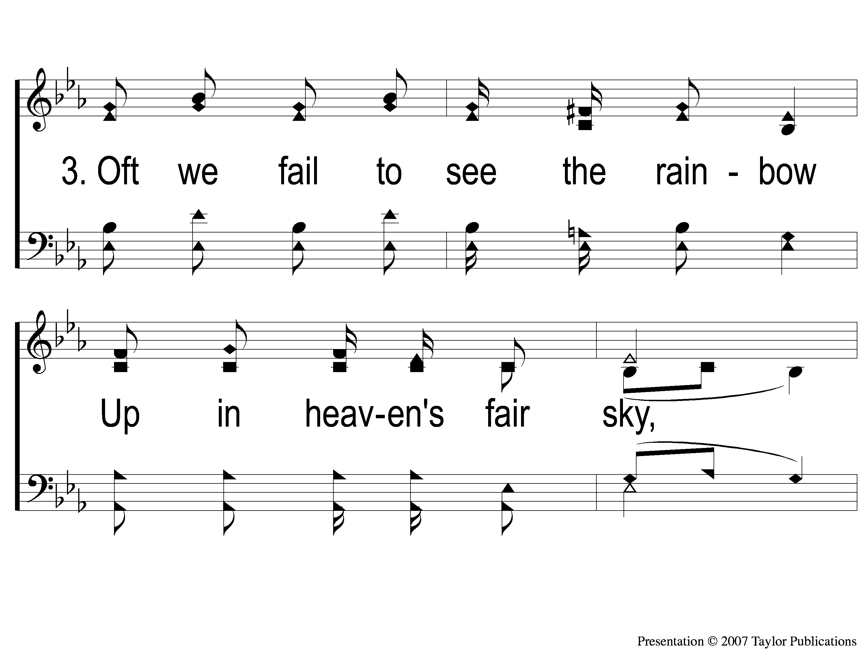
3-1 Sing and Be Happy
Sing and Be Happy
587

Slide 130
3-2 Sing and Be Happy
Sing and Be Happy
587

Slide 131
3-3 Sing and Be Happy
Sing and Be Happy
587

Slide 132
3-4 Sing and Be Happy
Sing and Be Happy
587

Slide 133
C-1 Sing and Be Happy
Sing and Be Happy
587

Slide 134
C-2 Sing and Be Happy
Sing and Be Happy
587

Slide 135
C-3 Sing and Be Happy
Sing and Be Happy
587

Slide 136
C-4 Sing and Be Happy
Sing and Be Happy
587

Slide 137
TONIGHT @ 6:00 pm
EVENING WORSHIP
HOPE TO SEE YOU THERE!

