Slide 1
RESTORE REBUILD RENEW
welcome
we are glad to
Have you with us
IN 2022
WHEELER
CHURCH
OF
CHRIST

Slide 2
Songs of Praise To God

Slide 3
Opening Prayer

Slide 4
Songs of Praise To God

Slide 5
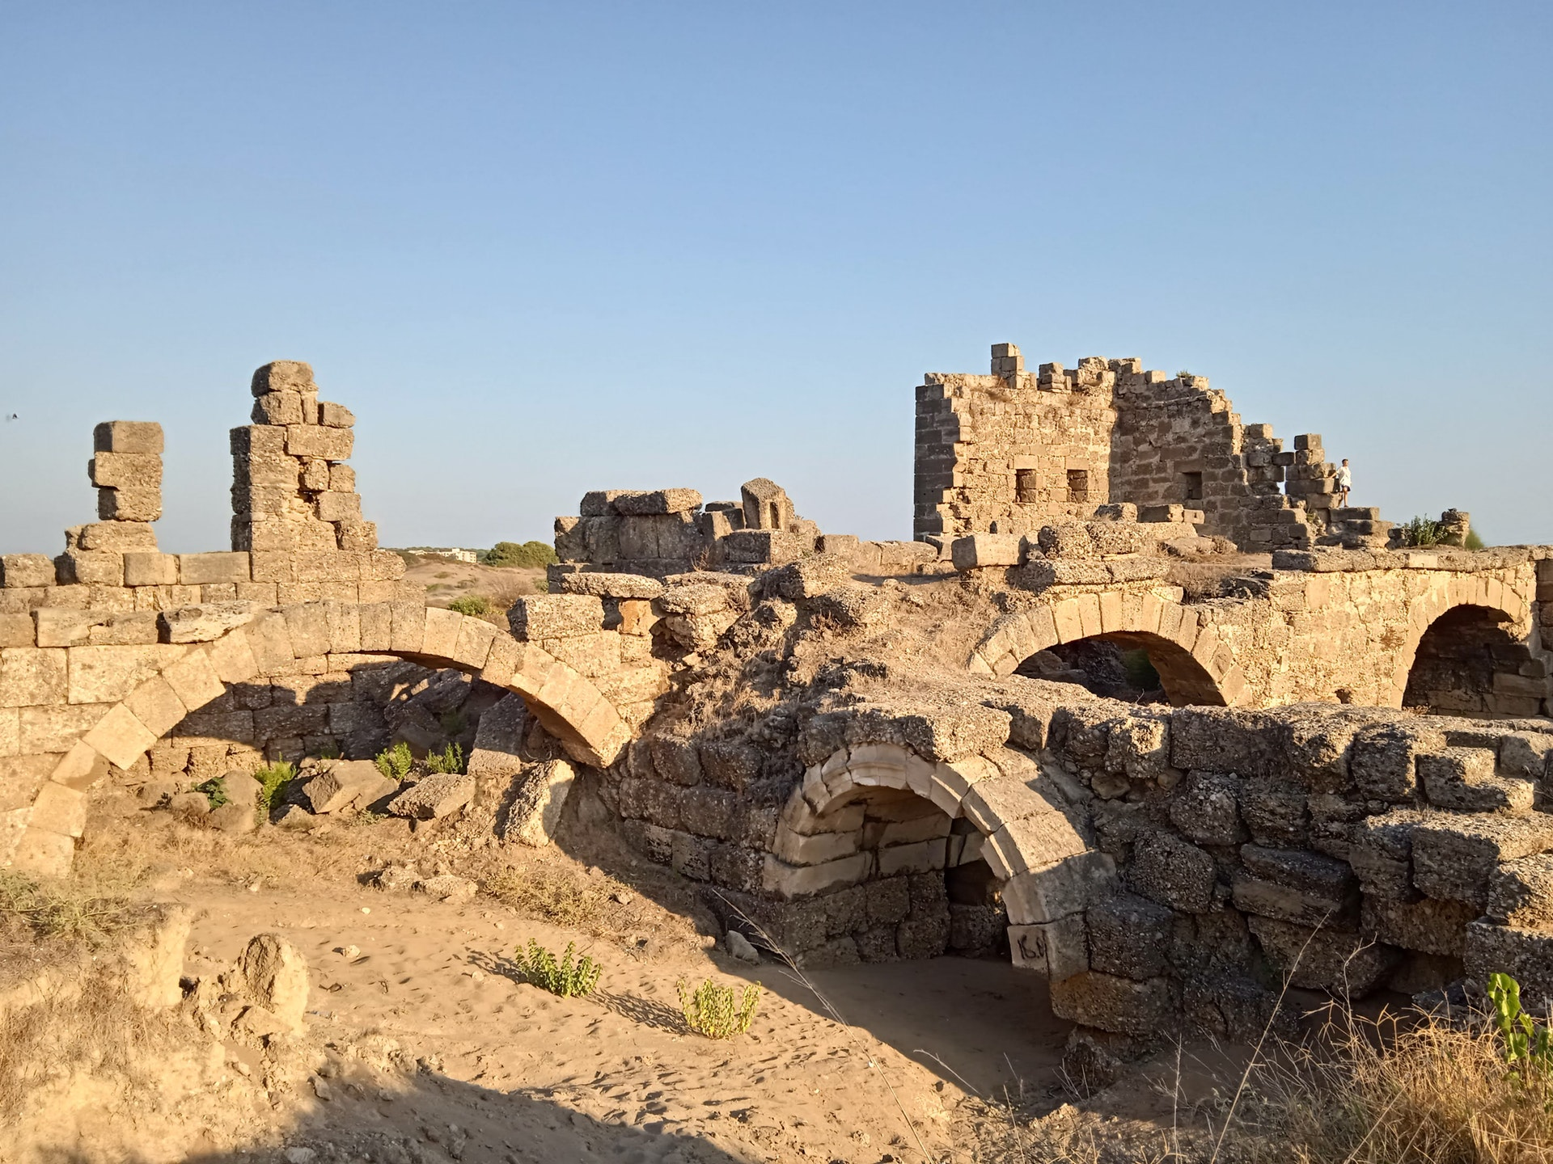
Rebuilding Jerusalem

Slide 6
The Book of Nehemiah
Ch. 2 – The Work Begins

Slide 7
The Book of Nehemiah
Ch. 2 – The Work Begins

Slide 8
The Book of Nehemiah
Ch. 2 – The Work Begins
Ch. 3 – The Work Organized

Slide 9
The Book of Nehemiah
Ch. 2 – The Work Begins
Ch. 3 – The Work Organized
Ch. 4 – The Work Opposed

Slide 10
Rebuilding Needs Active Leaders

Slide 11
Rebuilding Needs Active Leaders
4:1-3 - The Work Opposed
Condescending Words
Mocking Words

Slide 12
▪“Sticks and stones may break my bones, but words can also hurt me.
Stones and sticks break only skin, while words are ghosts that haunt me.
Slant and curved the word-swords fall, it pierces and sticks inside me.
Bats and bricks may ache through bones, but words can mortify me.
Pain from words has left its’ scar, on mind and hear that’s tender.
Cuts and bruises have not healed, it’s words that I remember.”

Slide 13
Nehemiah
Prayed

Slide 14
Nehemiah Prayed
Neh. 4:4-5
Influenced others to Pray (4:9)
2 Thess. 1:11

Slide 15
Nehemiah
Prayed
Worked

Slide 16
Nehemiah Worked
Neh. 4:6 – “WE”

Slide 17
Nehemiah Worked
Neh. 4:6 – “WE”
“fellow worker (s)”
Rom. 16:3, 9, 21, 2 Cor. 8:23, Phili. 2:25, 4:3
1 Cor. 3:9, 15:58 – 3 Jn. 8

Slide 18
Nehemiah
Prayed
Worked
Kept Watch

Slide 19
Nehemiah Kept Watch
Neh. 4:7-9 – “we set a watch”
Mk. 13:9
Heb. 13:17

Slide 20
Nehemiah
Prayed
Worked
Kept Watch
Listened

Slide 21
Nehemiah Listened
Neh. 4:10-12

Slide 22
Nehemiah Listened
Neh. 4:10-12
They Lost their…
Vision (v. 10)
Strength (v. 10)
Confidence (v. 10)
Security (v. 11-12)

Slide 23
Nehemiah
Prayed
Worked
Kept Watch
Listened
Provided Solutions

Slide 24
Nehemiah Provided Solutions
Neh. 4:13
“I” = Nehemiah himself
“positioned” and “set”
“with their swords, their spears,
and their bows.”

Slide 25
Nehemiah Provided Solutions
Neh. 4:13
Nehemiah Gave Each Family…
A Place To Defend
Weapons To Defend
Neh. 4:21

Slide 26
Nehemiah
Prayed
Worked
Kept Watch
Listened
Provided Solutions
Encouraged

Slide 27
Nehemiah Encouraged
Neh. 4:14

Slide 28
Nehemiah Encouraged
Neh. 4:14
Nehemiah Spoke To:
The Nobles
The Other Leaders
The Rest of the People

Slide 29
Nehemiah Encouraged
Neh. 4:14
Nehemiah Recalled To Their Minds:
The Lord
The People of God
Their Families
Their Houses
Acts 4:36, 11:23

Slide 30
Songs of Praise To God

Slide 31
The Lord’s Supper
Acts 20:7

Slide 32
Closing Prayer

Slide 33
Songs of Praise To God

Slide 34
RESTORE REBUILD RENEW
Wednesday
Worship/Classes @ 6:30 pm
IN 2022
WHEELER
CHURCH
OF
CHRIST

