Slide 1
PLEASE STANDBY
OUR LIVESTREAM
WILL BEGIN SOON

Slide 2
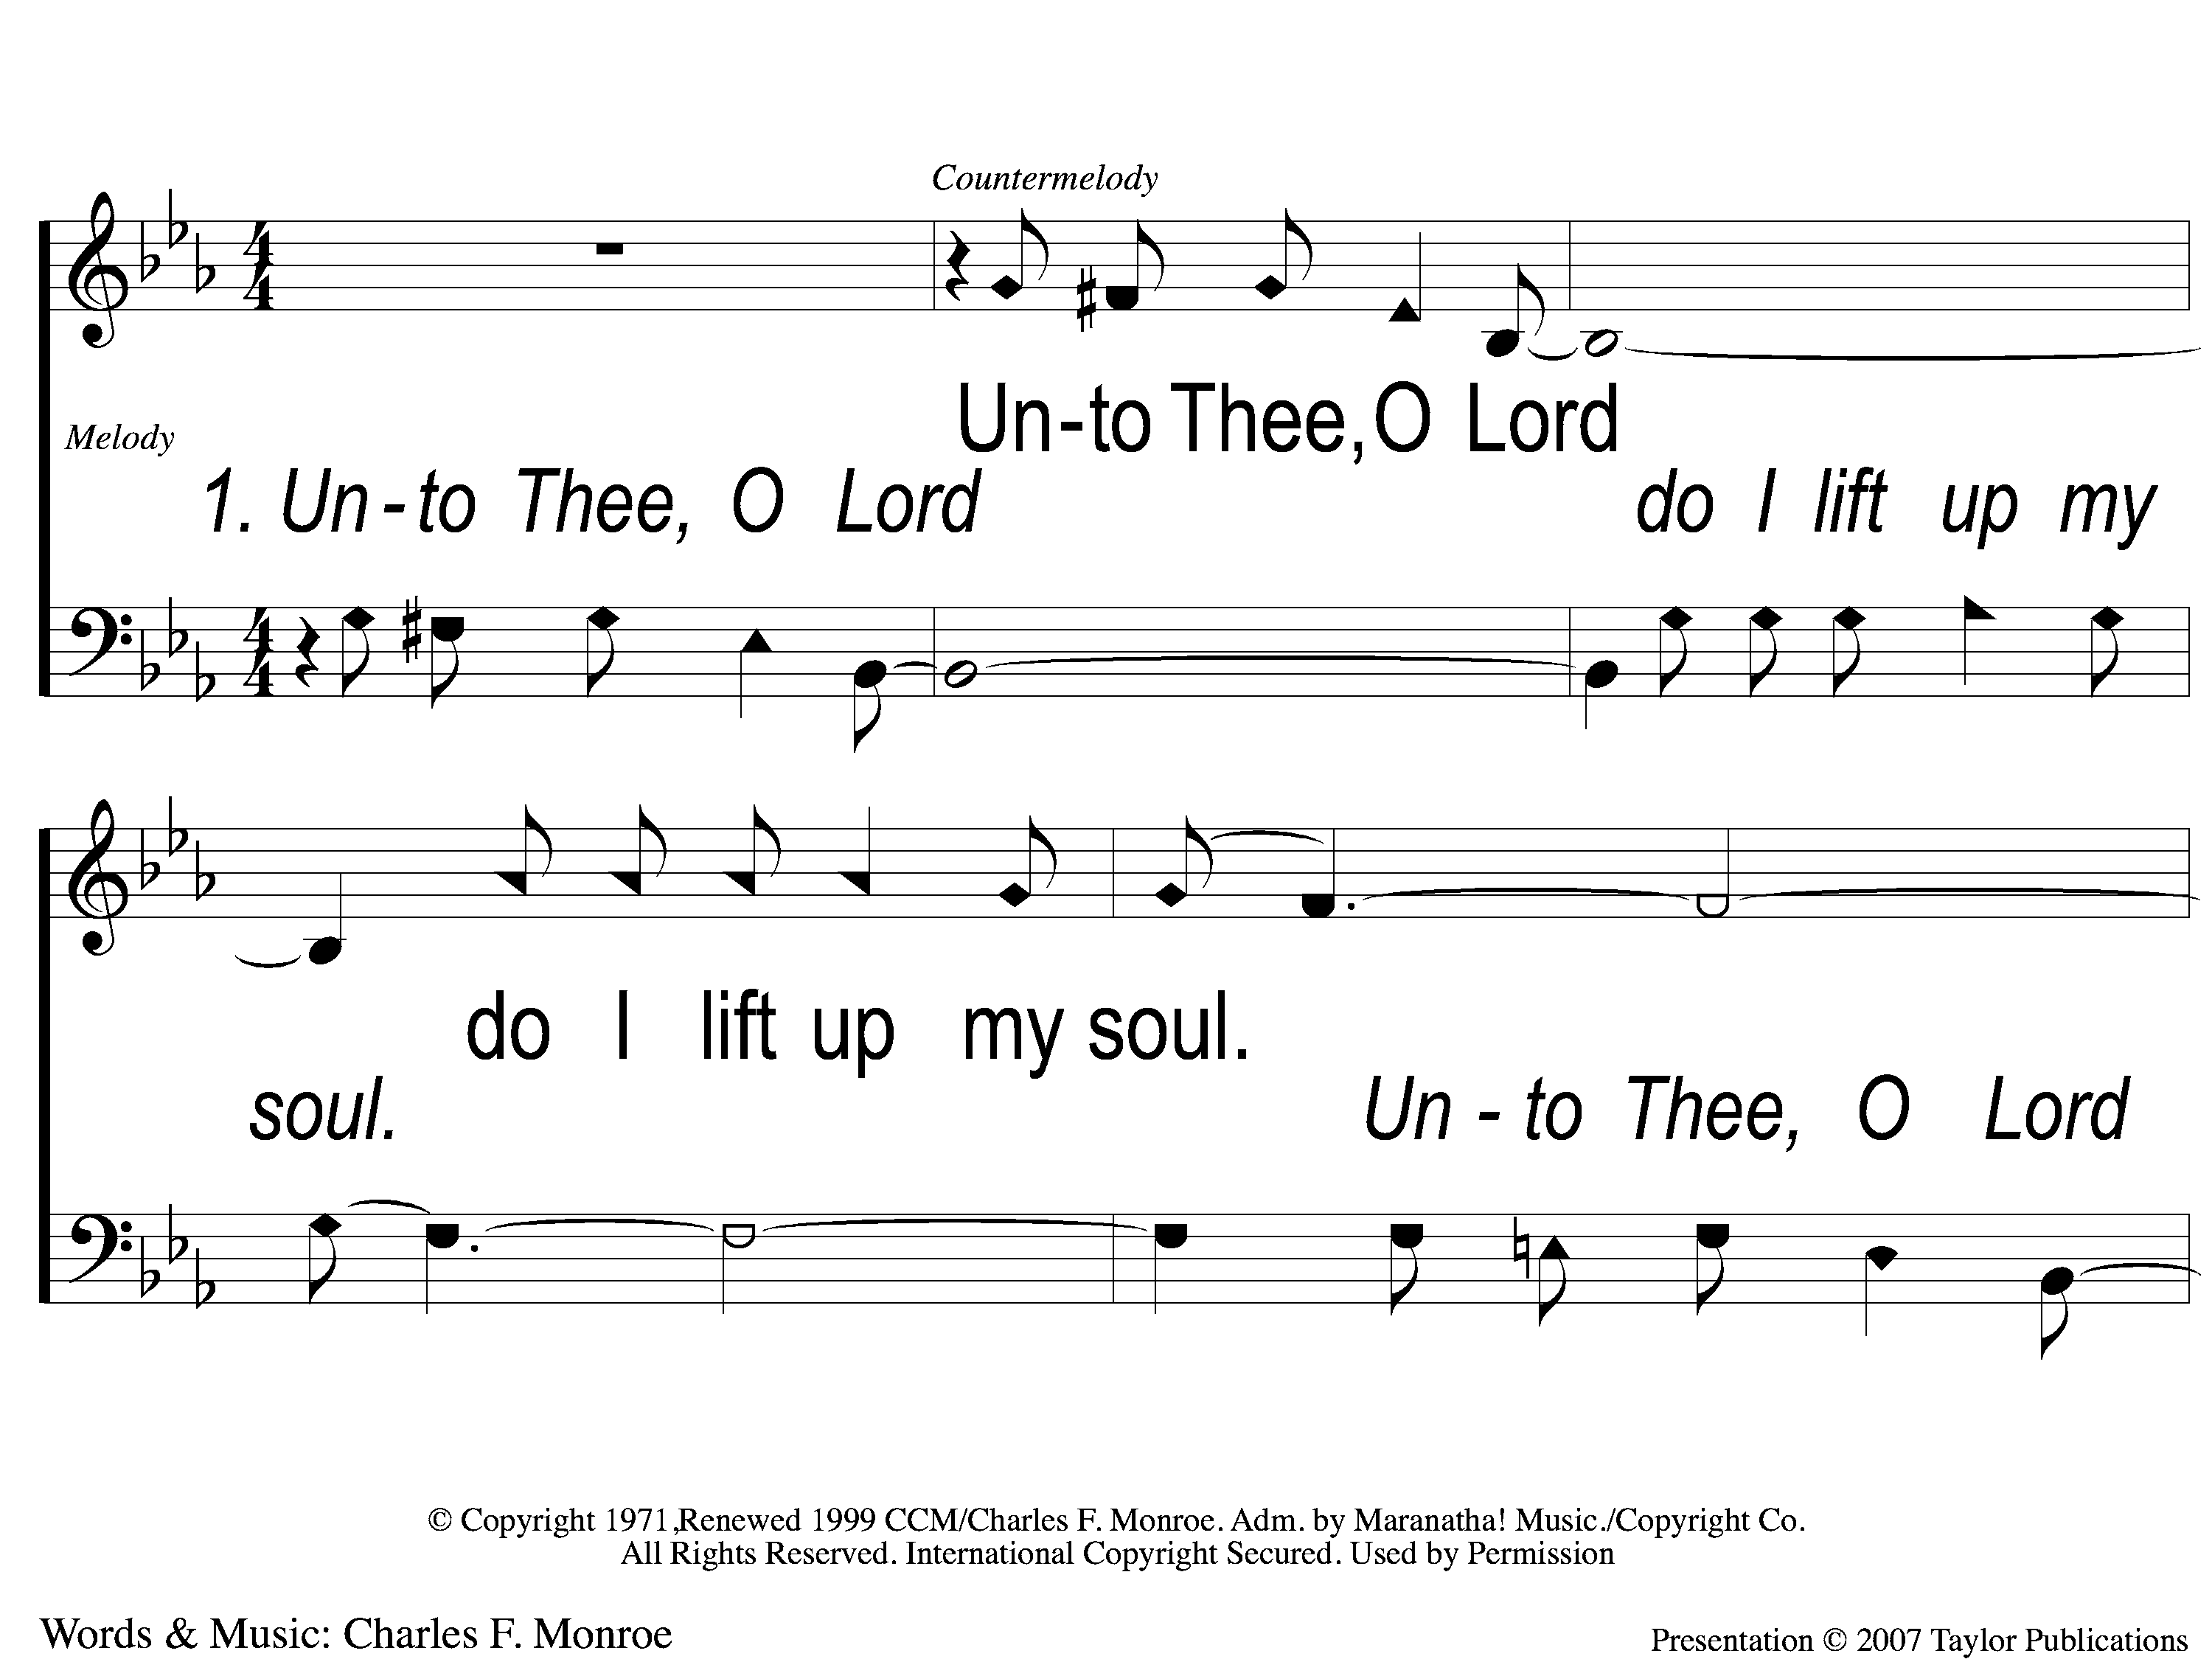
1-1 Unto Thee O Lord
Unto to Thee O Lord
794

Slide 3
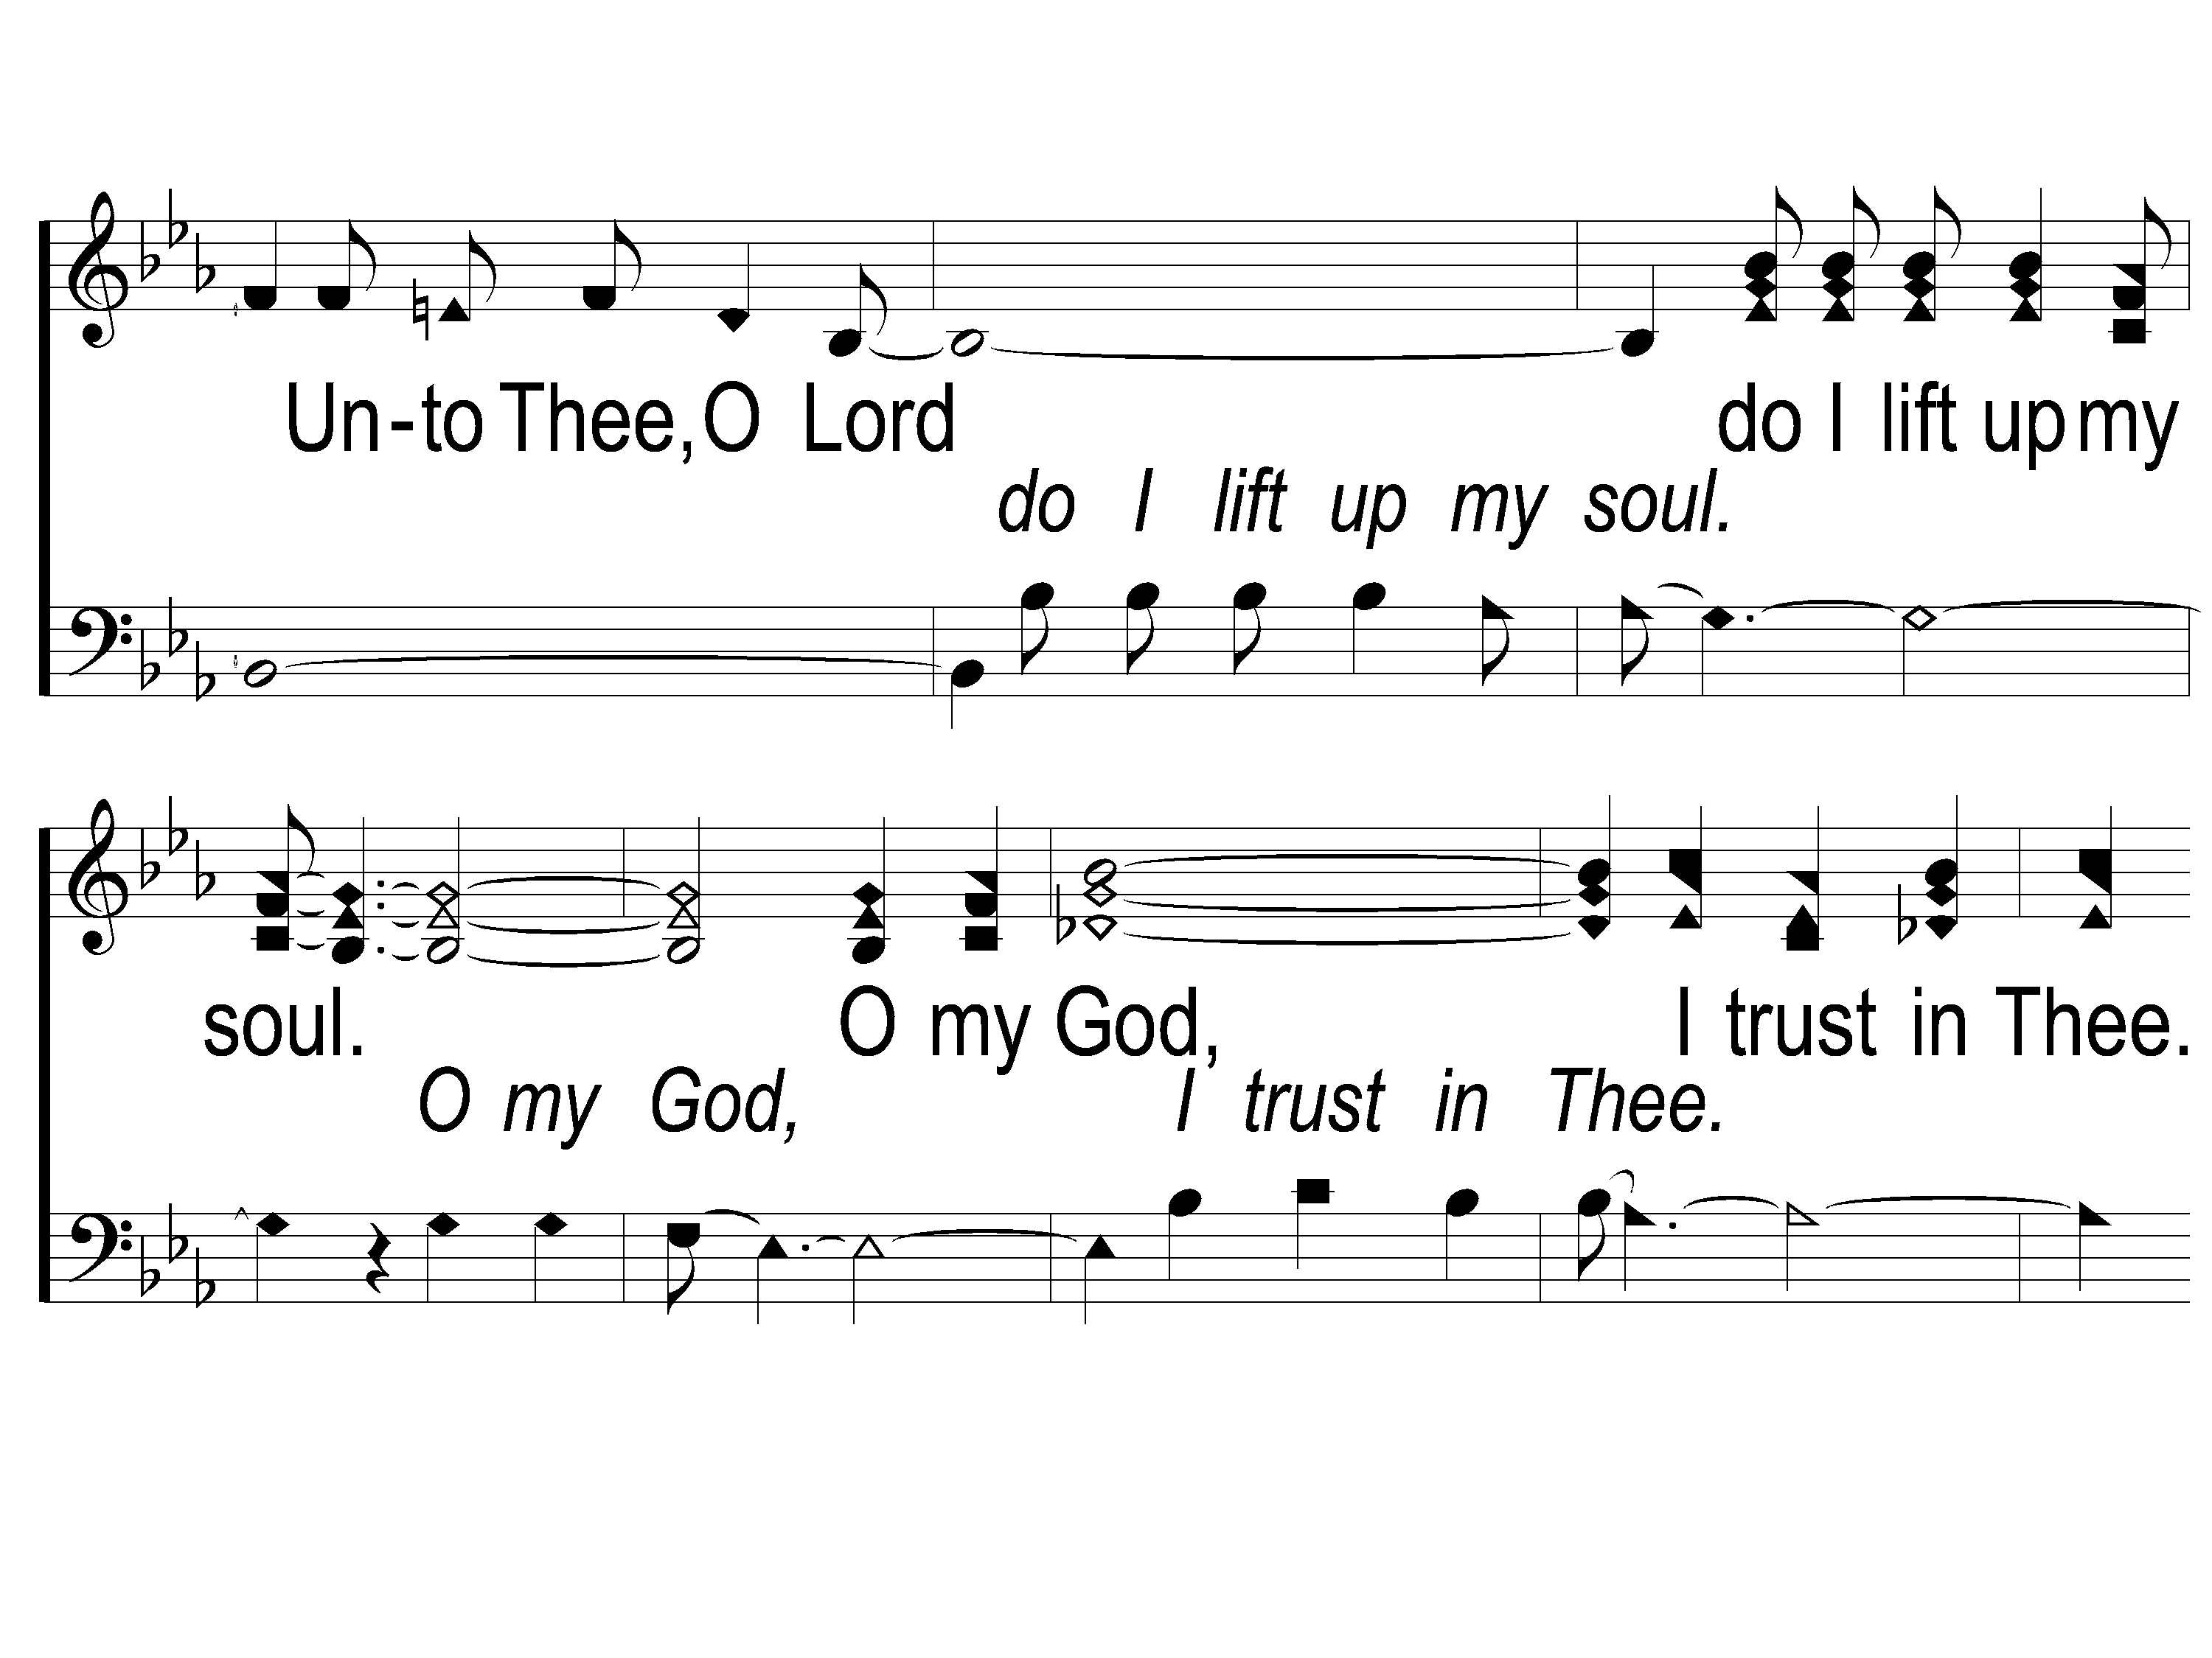
1-2 Unto Thee O Lord
Unto to Thee O Lord
794

Slide 4
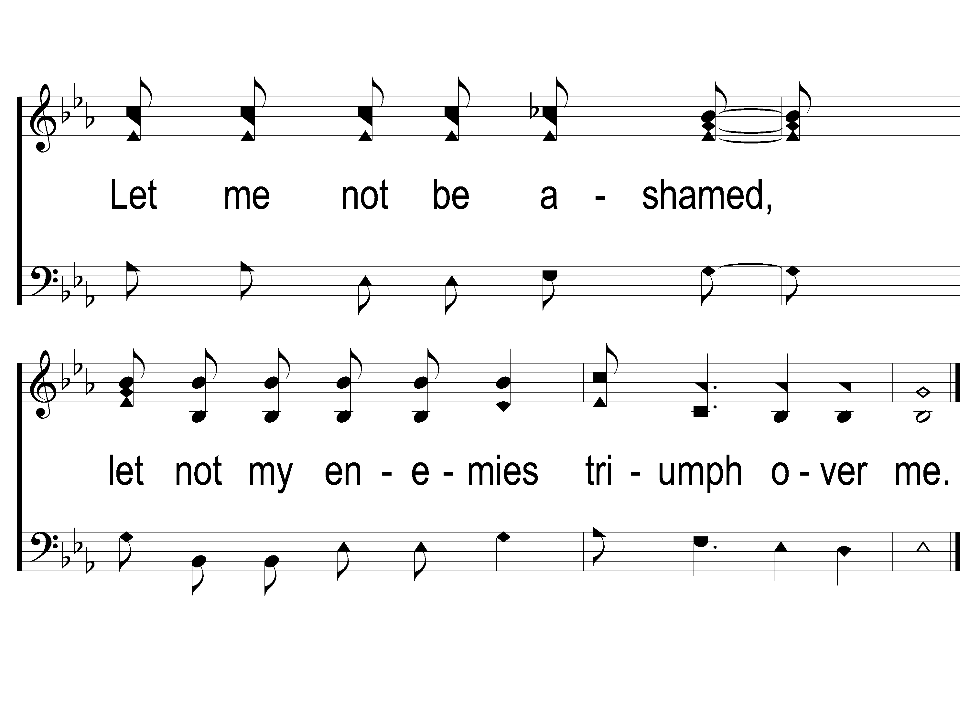
1-3 Unto Thee O Lord
Unto to Thee O Lord
794

Slide 5
2-1 Unto Thee O Lord
Unto to Thee O Lord
794

Slide 6
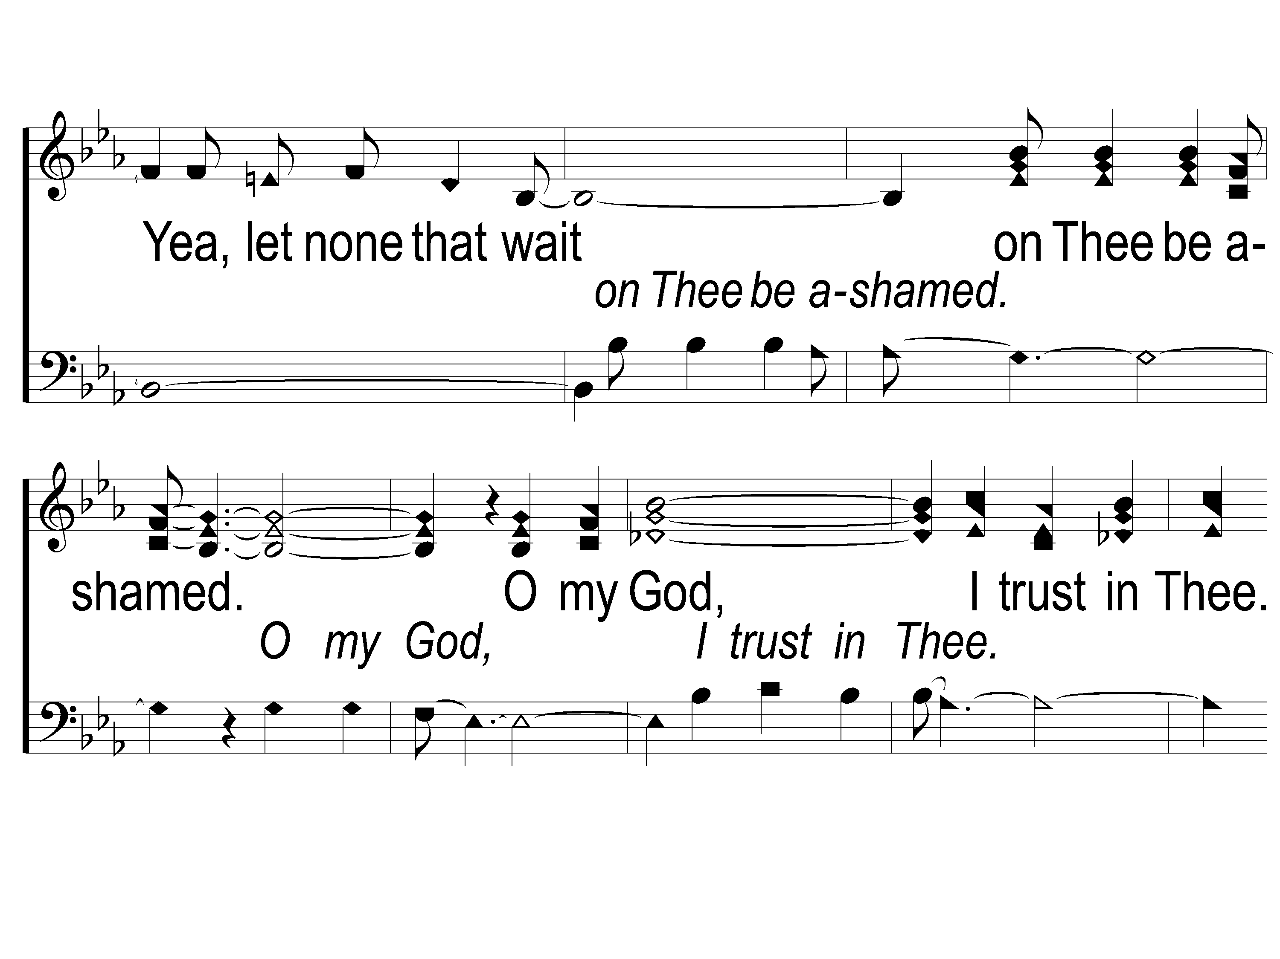
2-2 Unto Thee O Lord
Unto to Thee O Lord
794

Slide 7
2-3 Unto Thee O Lord
Unto to Thee O Lord
794

Slide 8
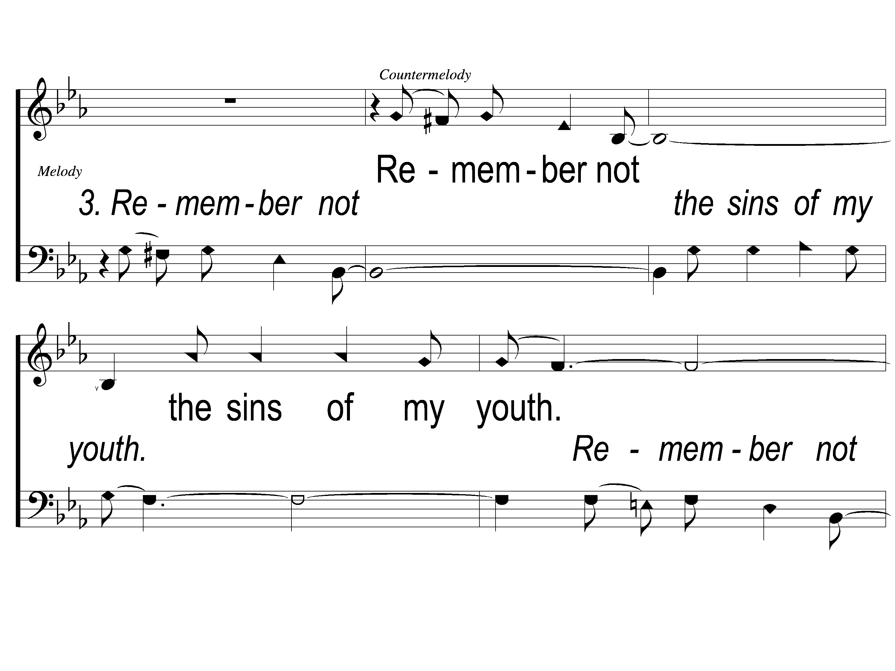
3-1 Unto Thee O Lord
Unto to Thee O Lord
794

Slide 9
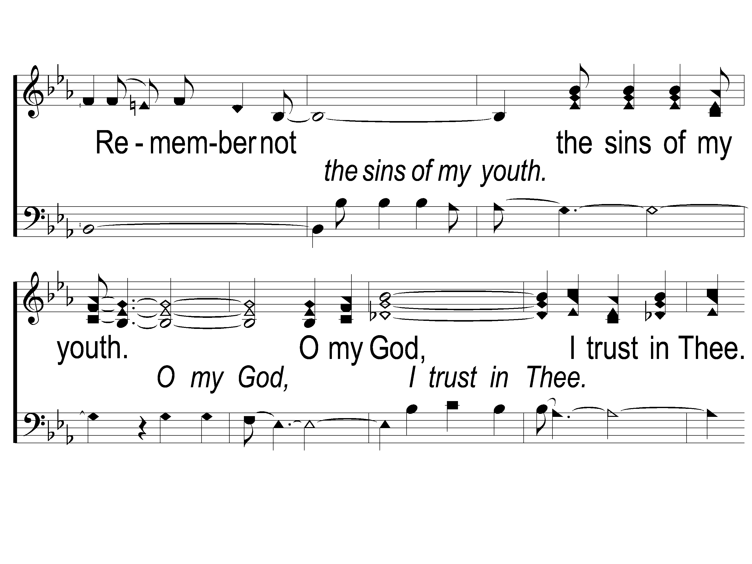
3-2 Unto Thee O Lord
Unto to Thee O Lord
794

Slide 10
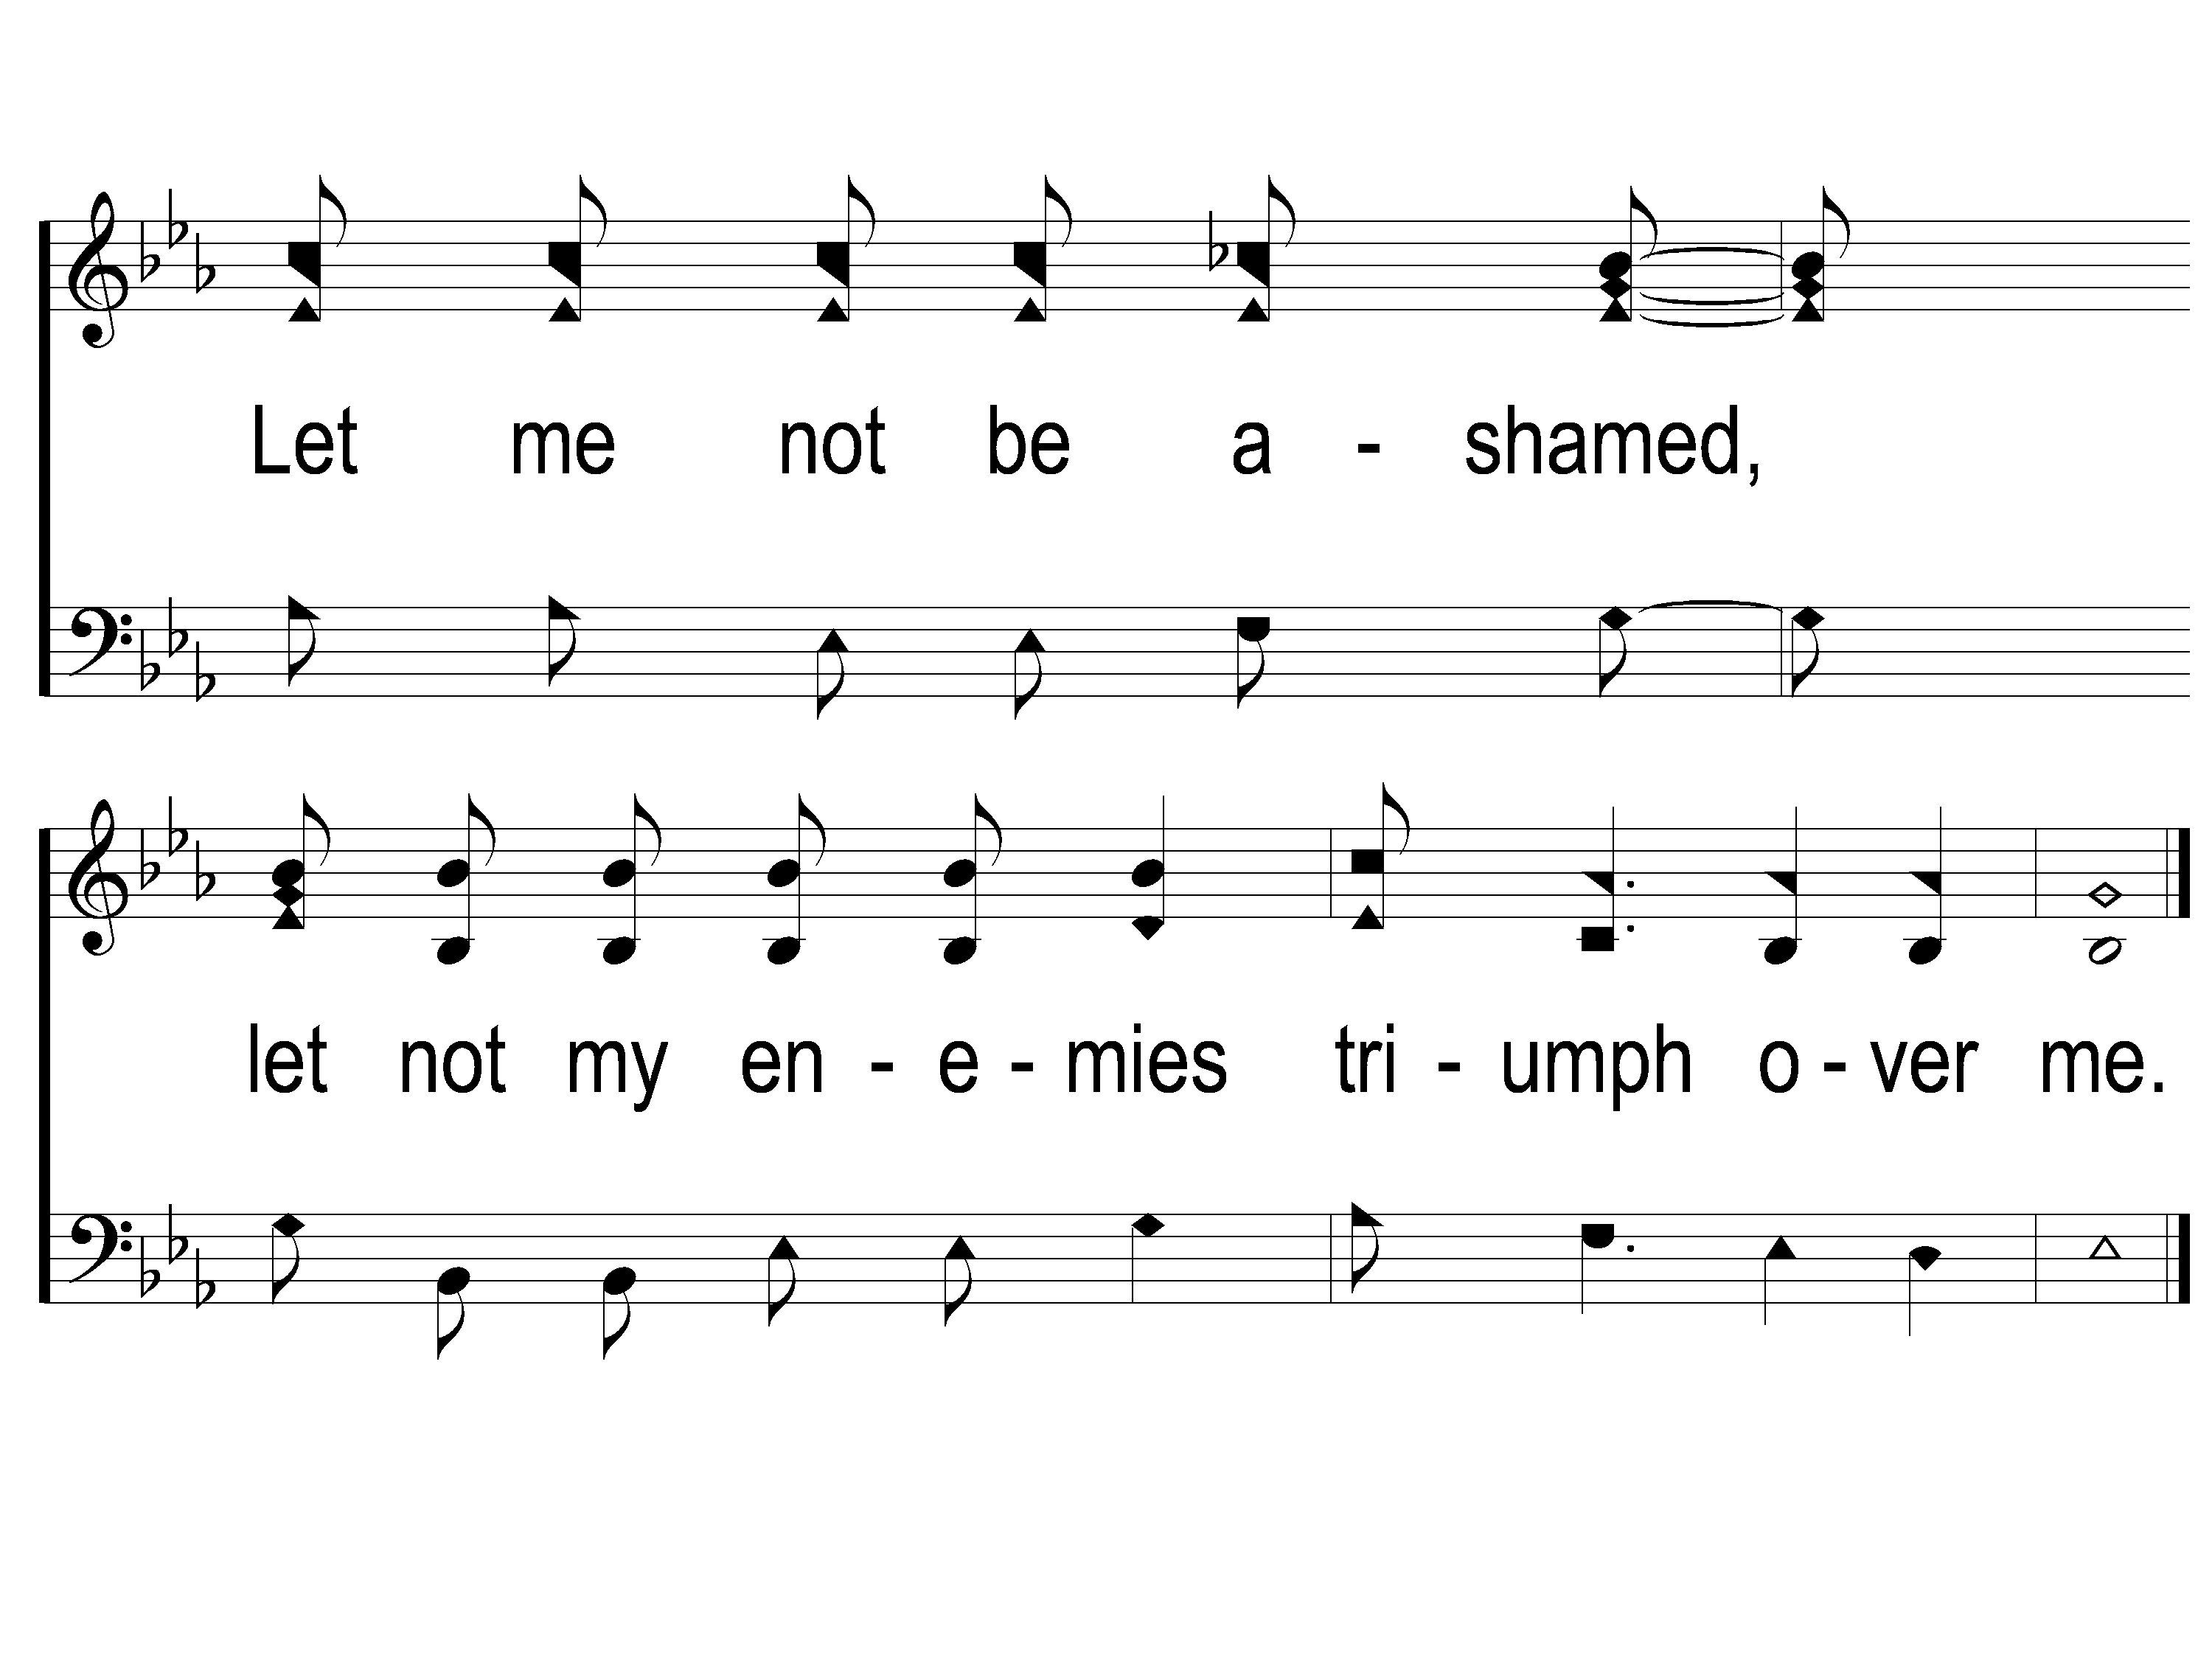
3-3 Unto Thee O Lord
Unto to Thee O Lord
794

Slide 11
WELCOME
THANKS FOR JOINING US!

Slide 12
#712
SONG:
Jesus Is Coming Soon

Slide 13
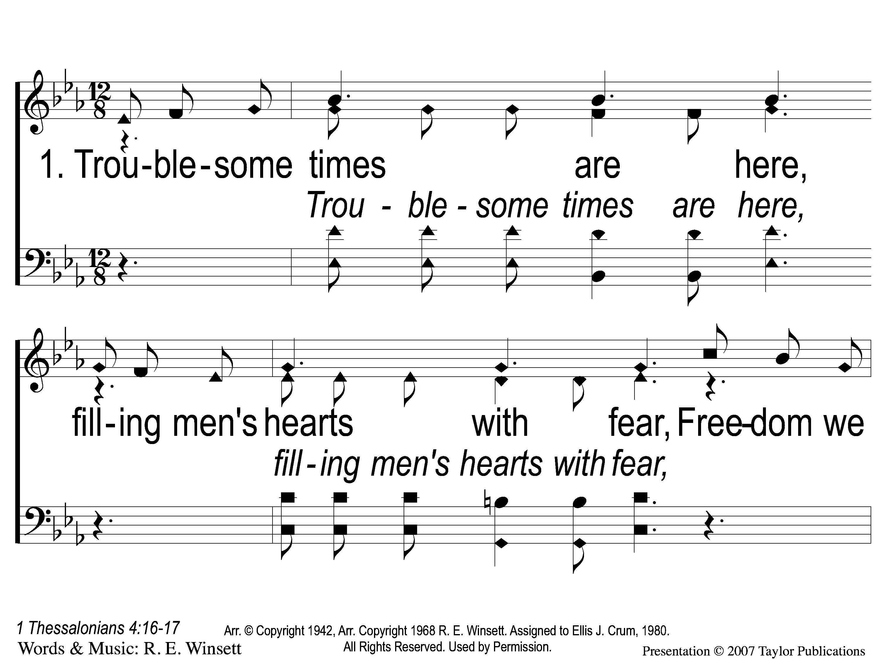
1-1 Jesus is Coming Soon
Jesus is Coming Soon
712

Slide 14
1-2 Jesus is Coming Soon
Jesus is Coming Soon
712

Slide 15
1-3 Jesus is Coming Soon
Jesus is Coming Soon
712

Slide 16
C-1 Jesus is Coming Soon
Jesus is Coming Soon
712

Slide 17
C-2 Jesus is Coming Soon
Jesus is Coming Soon
712

Slide 18
C-3 Jesus is Coming Soon
Jesus is Coming Soon
712

Slide 19
C-4 Jesus is Coming Soon
Jesus is Coming Soon
712

Slide 20
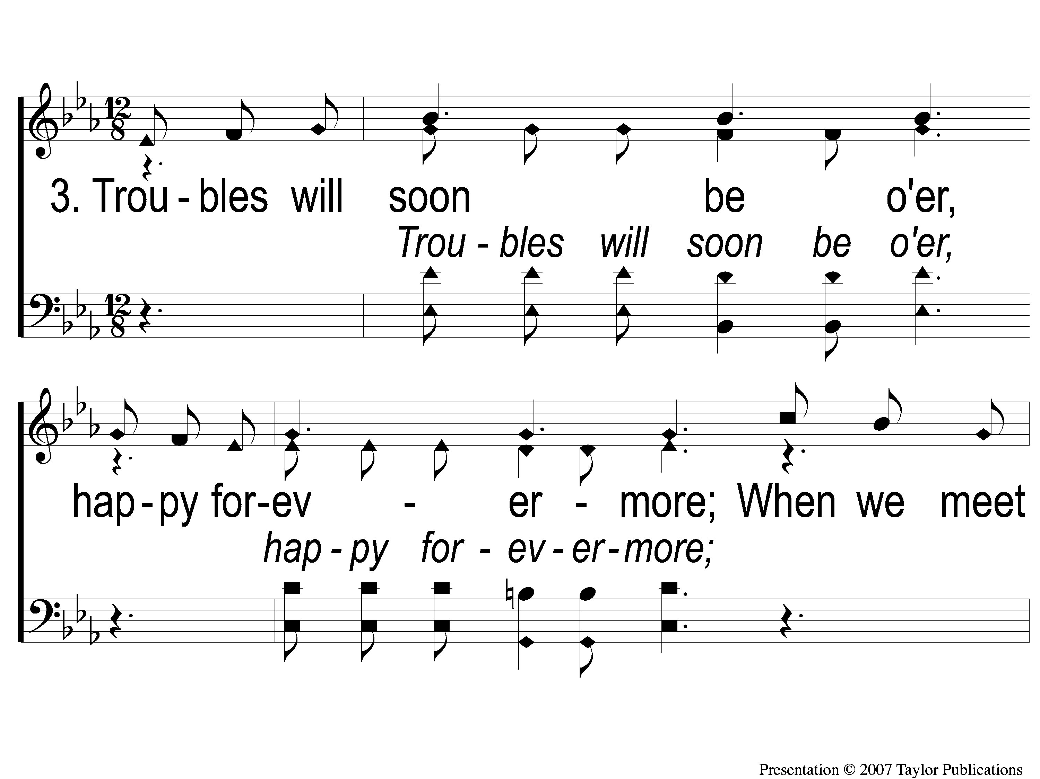
3-1 Jesus is Coming Soon
Jesus is Coming Soon
712

Slide 21
3-2 Jesus is Coming Soon
Jesus is Coming Soon
712

Slide 22
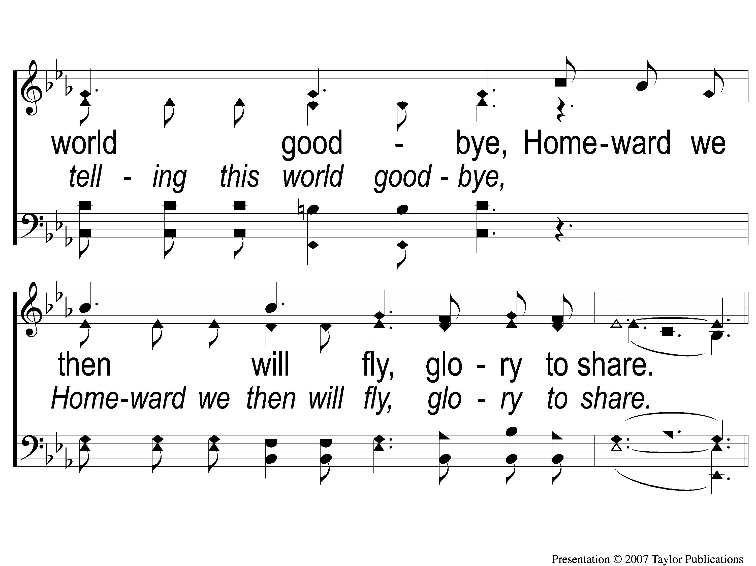
3-3 Jesus is Coming Soon
Jesus is Coming Soon
712

Slide 23
C-1 Jesus is Coming Soon
Jesus is Coming Soon
712

Slide 24
C-2 Jesus is Coming Soon
Jesus is Coming Soon
712

Slide 25
C-3 Jesus is Coming Soon
Jesus is Coming Soon
712

Slide 26
C-4 Jesus is Coming Soon
Jesus is Coming Soon
712

Slide 27
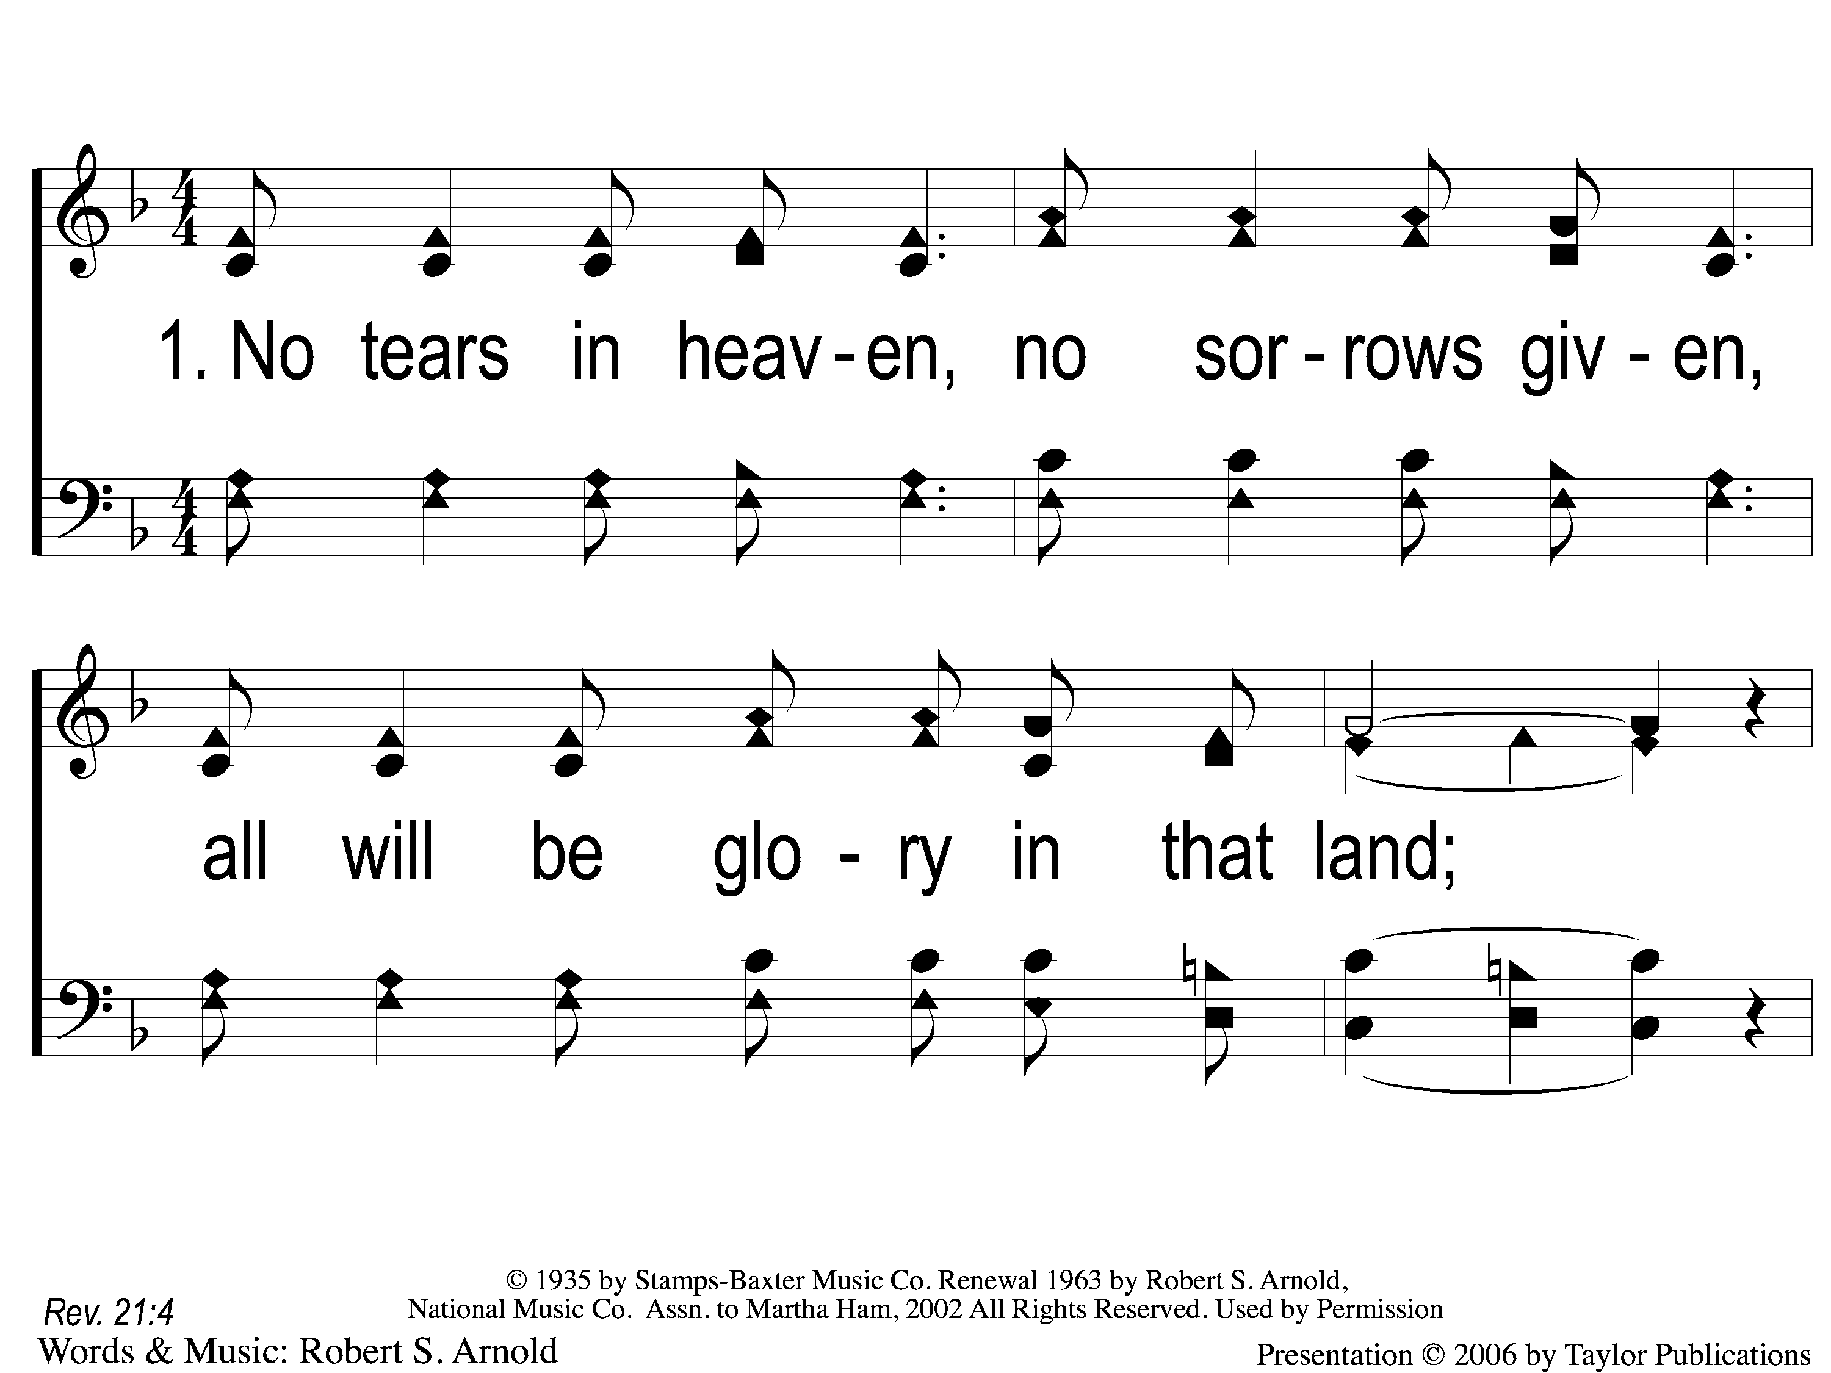
1-1 No Tears in Heaven
No Tears In Heaven
882

Slide 28
1-2 No Tears in Heaven
No Tears In Heaven
882

Slide 29
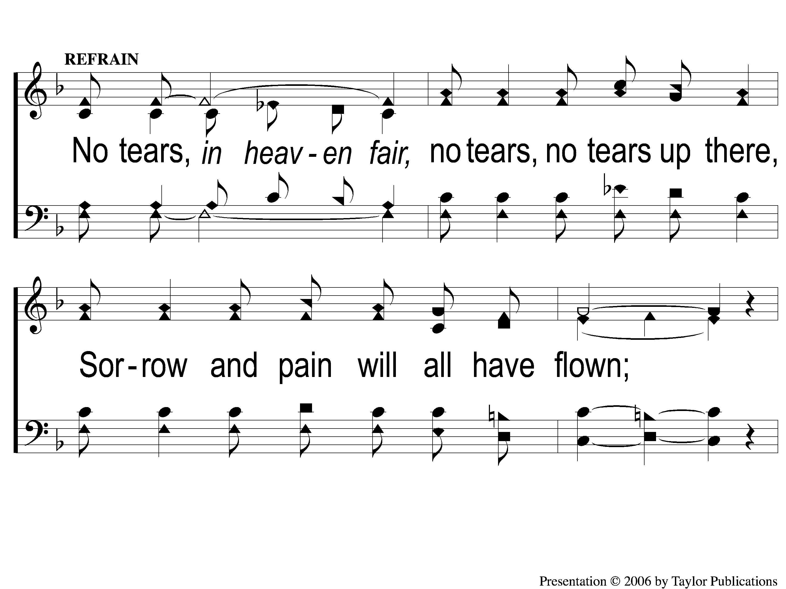
C-1 No Tears in Heaven
No Tears In Heaven
882

Slide 30
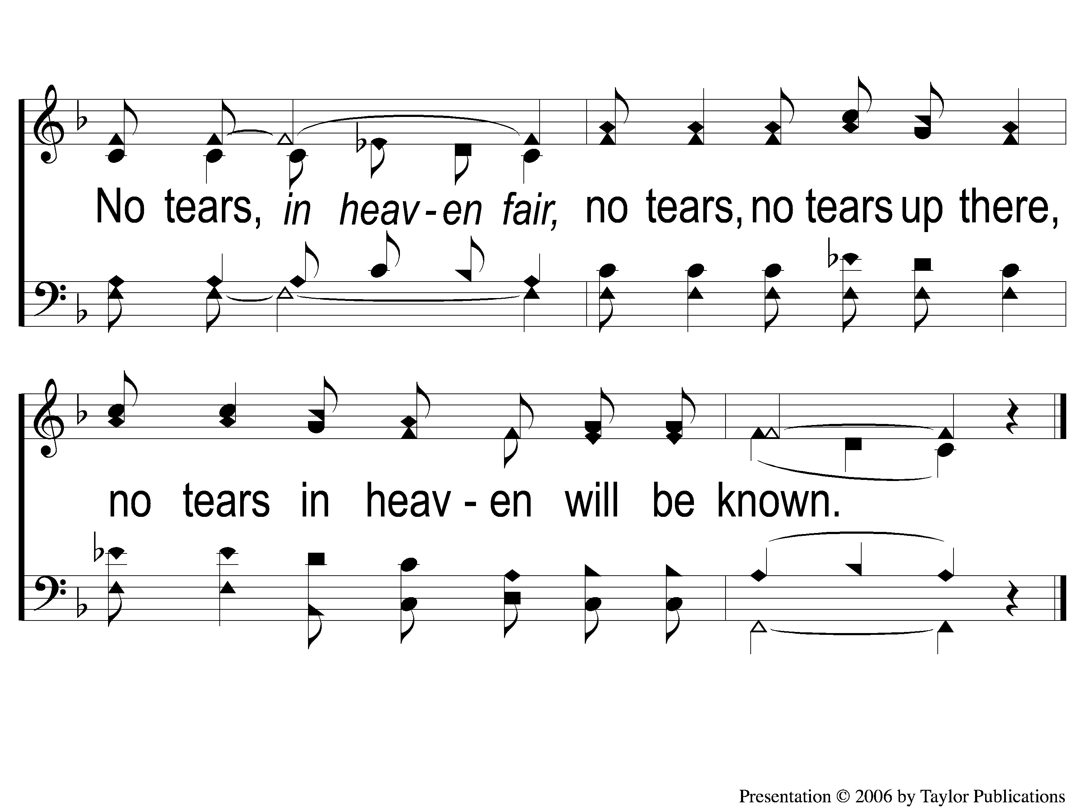
C-2 No Tears in Heaven
No Tears In Heaven
882

Slide 31
3-1 No Tears in Heaven
No Tears In Heaven
882

Slide 32
3-2 No Tears in Heaven
No Tears In Heaven
882

Slide 33
C-1 No Tears in Heaven
No Tears In Heaven
882

Slide 34
C-2 No Tears in Heaven
No Tears In Heaven
882

Slide 35
#764
SONG:
Teach Me Lord, To Wait

Slide 36
1-1 Teach Me Lord to Wait
Teach Me Lord, To Wait
764

Slide 37
1-2 Teach Me Lord to Wait
Teach Me Lord, To Wait
764

Slide 38
C-1 Teach Me Lord to Wait
Teach Me Lord, To Wait
764

Slide 39
C-2 Teach Me Lord to Wait
Teach Me Lord, To Wait
764

Slide 40
2-1 Teach Me Lord to Wait
Teach Me Lord, To Wait
764

Slide 41
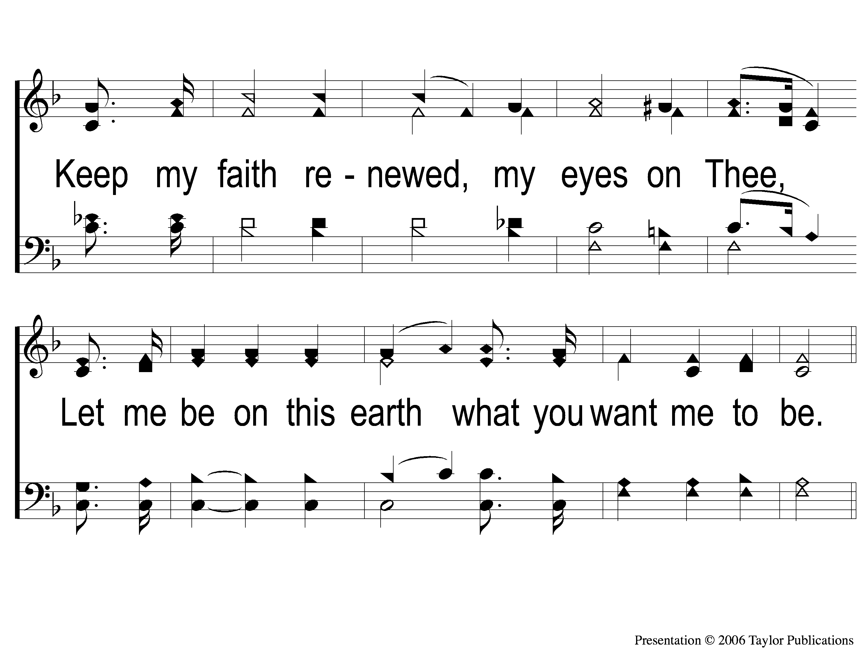
2-2 Teach Me Lord to Wait
Teach Me Lord, To Wait
764

Slide 42
C-1 Teach Me Lord to Wait
Teach Me Lord, To Wait
764

Slide 43
C-2 Teach Me Lord to Wait
Teach Me Lord, To Wait
764

Slide 44
First PRAYER

Slide 45
#610
SONG:
I Love My Savior, Too

Slide 46
1-1 I Love My Savior
I Love My Savior, Too
610

Slide 47
1-2 I Love My Savior
I Love My Savior, Too
610

Slide 48
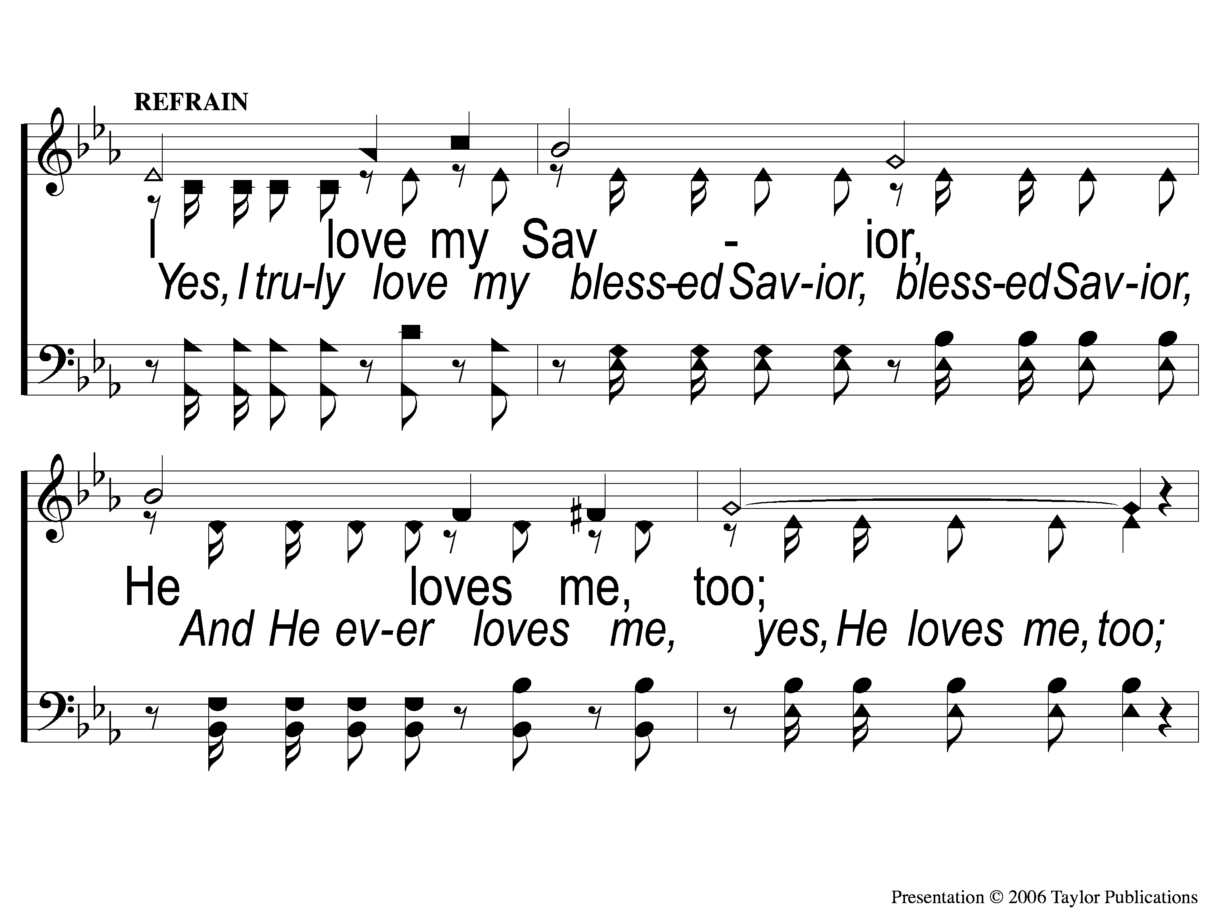
C-1 I Love My Savior
I Love My Savior, Too
610

Slide 49
C-2 I Love My Savior
I Love My Savior, Too
610

Slide 50
3-1 I Love My Savior
I Love My Savior, Too
610

Slide 51
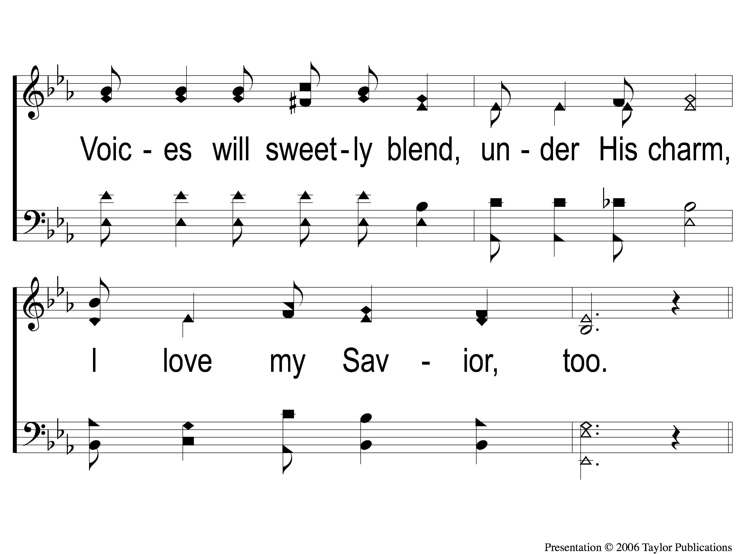
3-2 I Love My Savior
I Love My Savior, Too
610

Slide 52
C-1 I Love My Savior
I Love My Savior, Too
610

Slide 53
C-2 I Love My Savior
I Love My Savior, Too
610

Slide 54
#631
SONG:
Lift Him Up

Slide 55
1-1 Lift Him Up
Lift Him Up
724
631

Slide 56
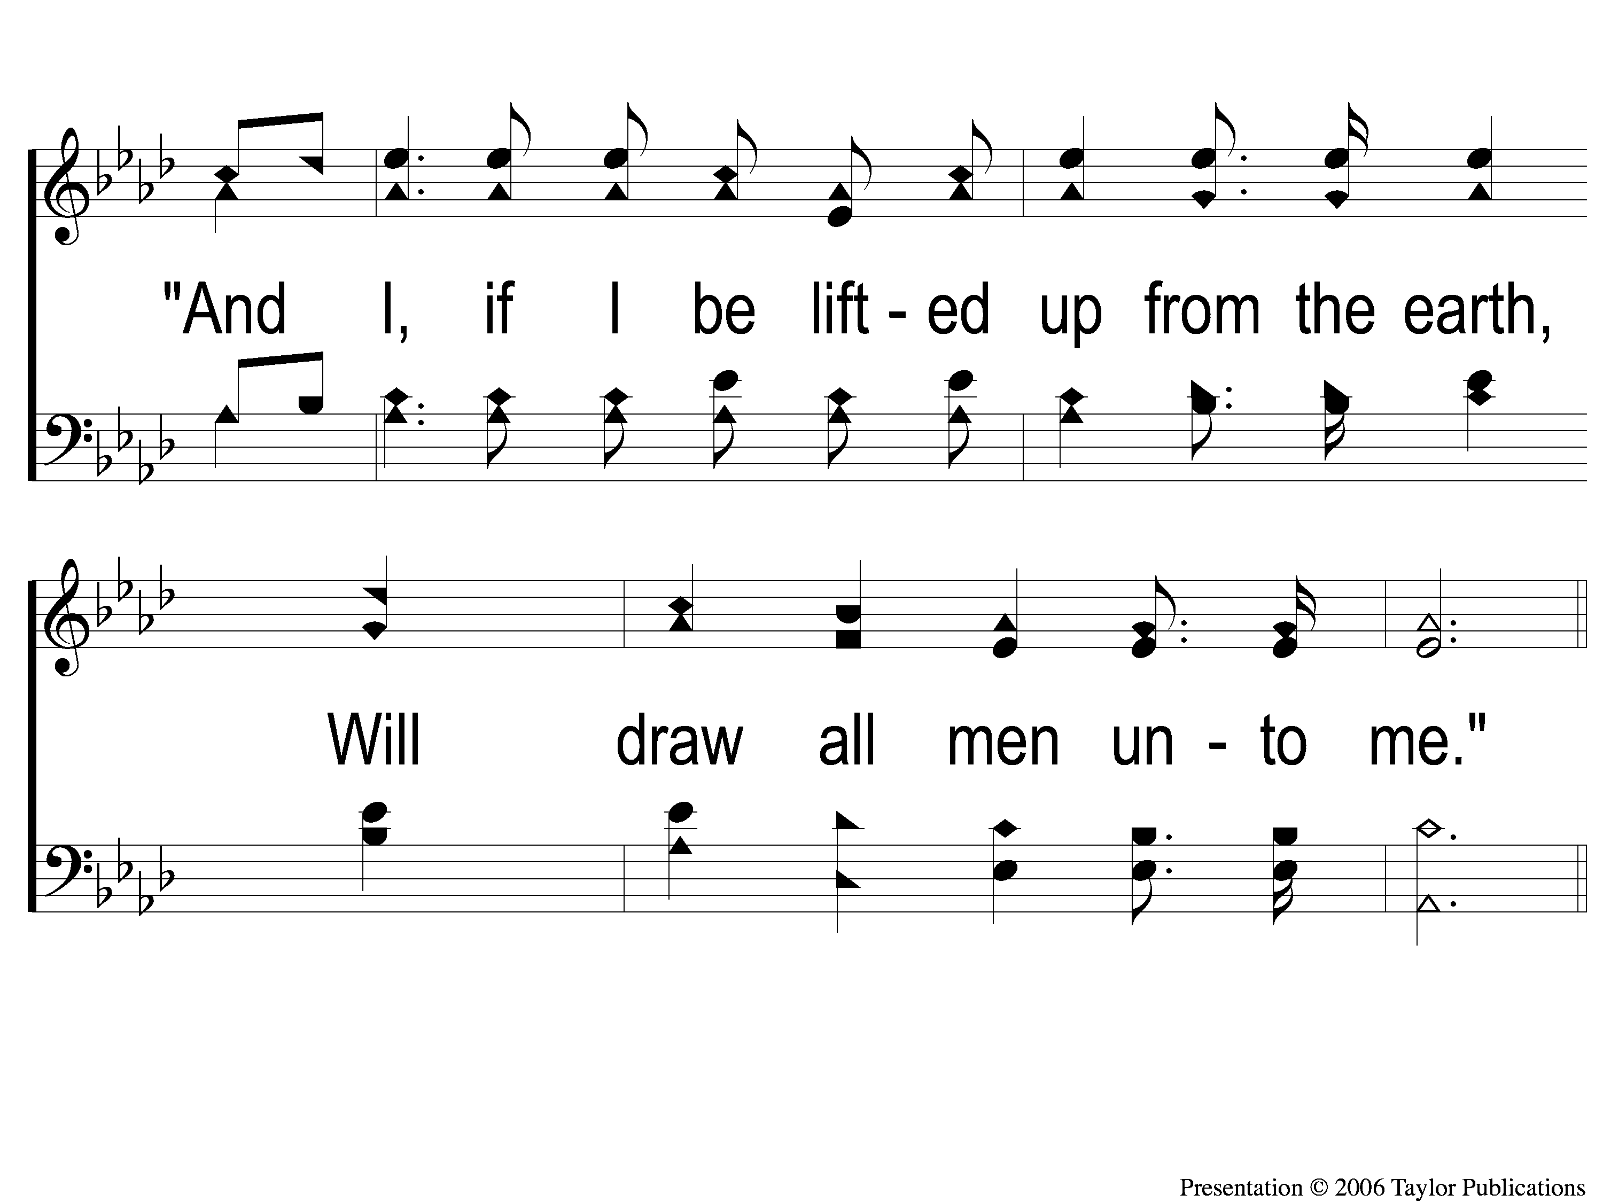
1-2 Lift Him Up
Lift Him Up
724
631

Slide 57
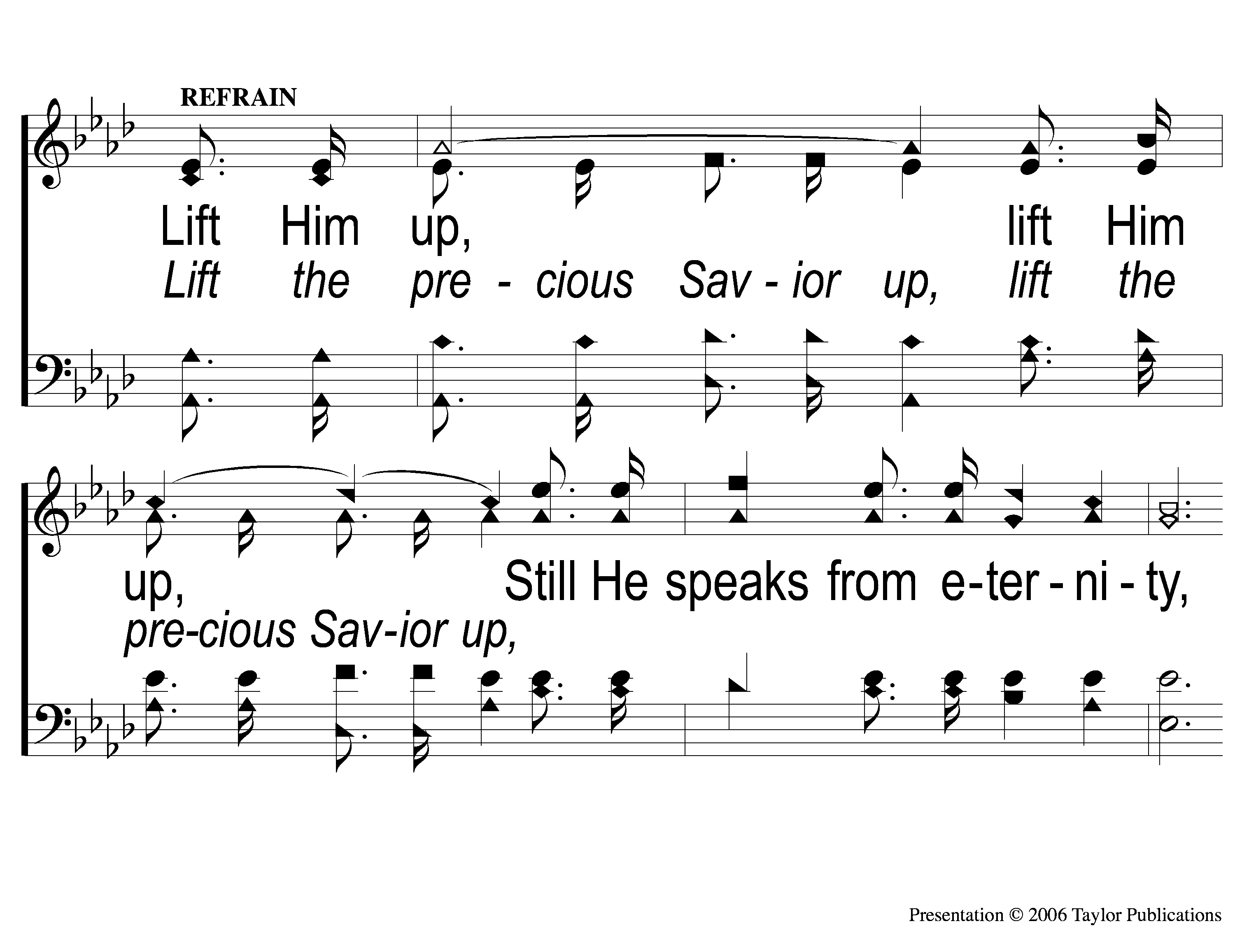
C-1 Lift Him Up
Lift Him Up
724
631

Slide 58
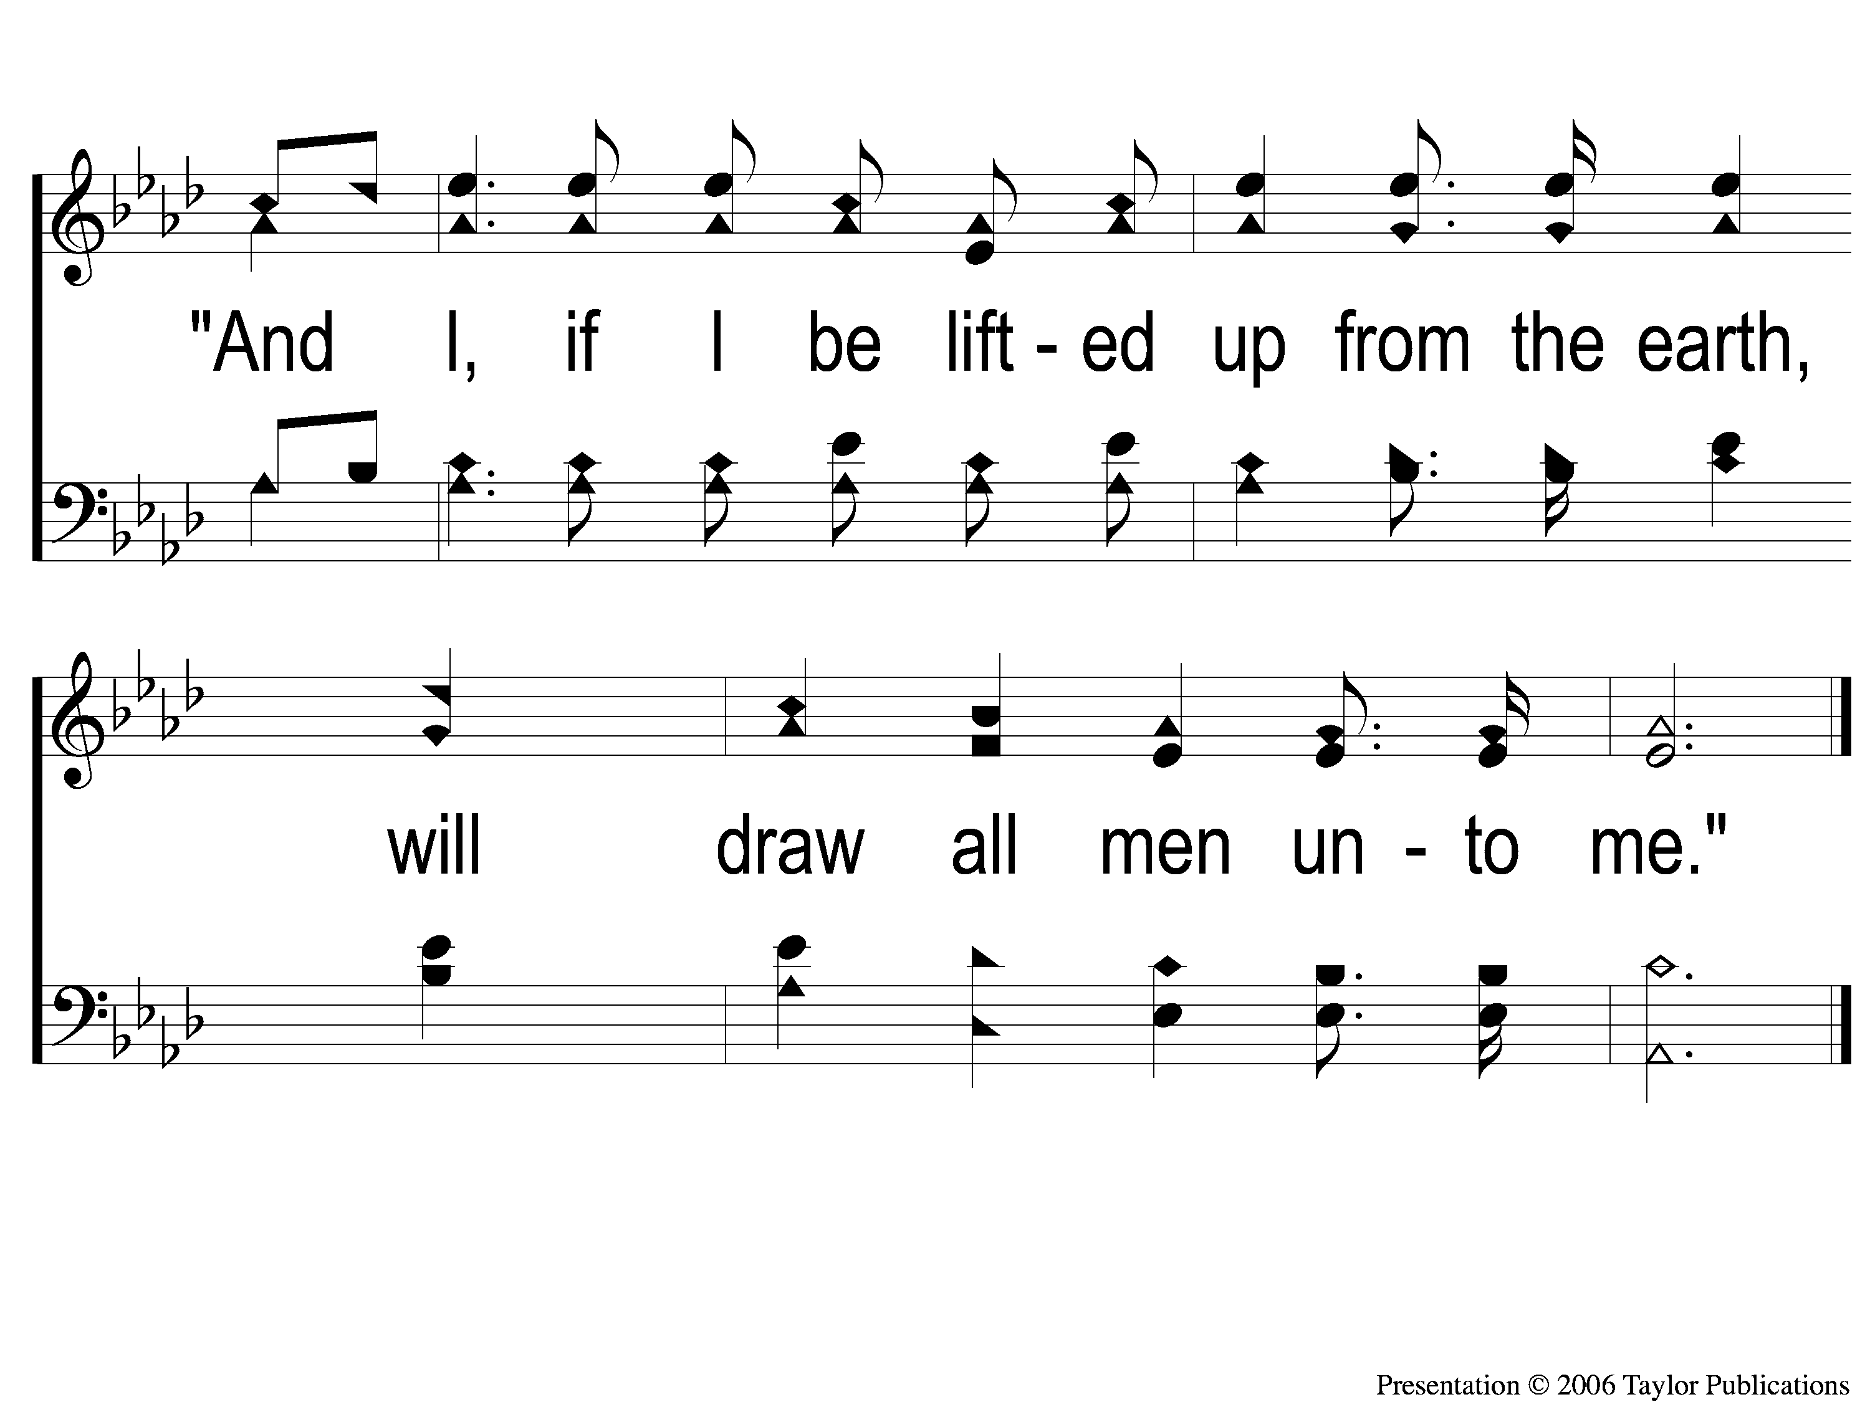
C-2 Lift Him Up
Lift Him Up
724
631

Slide 59
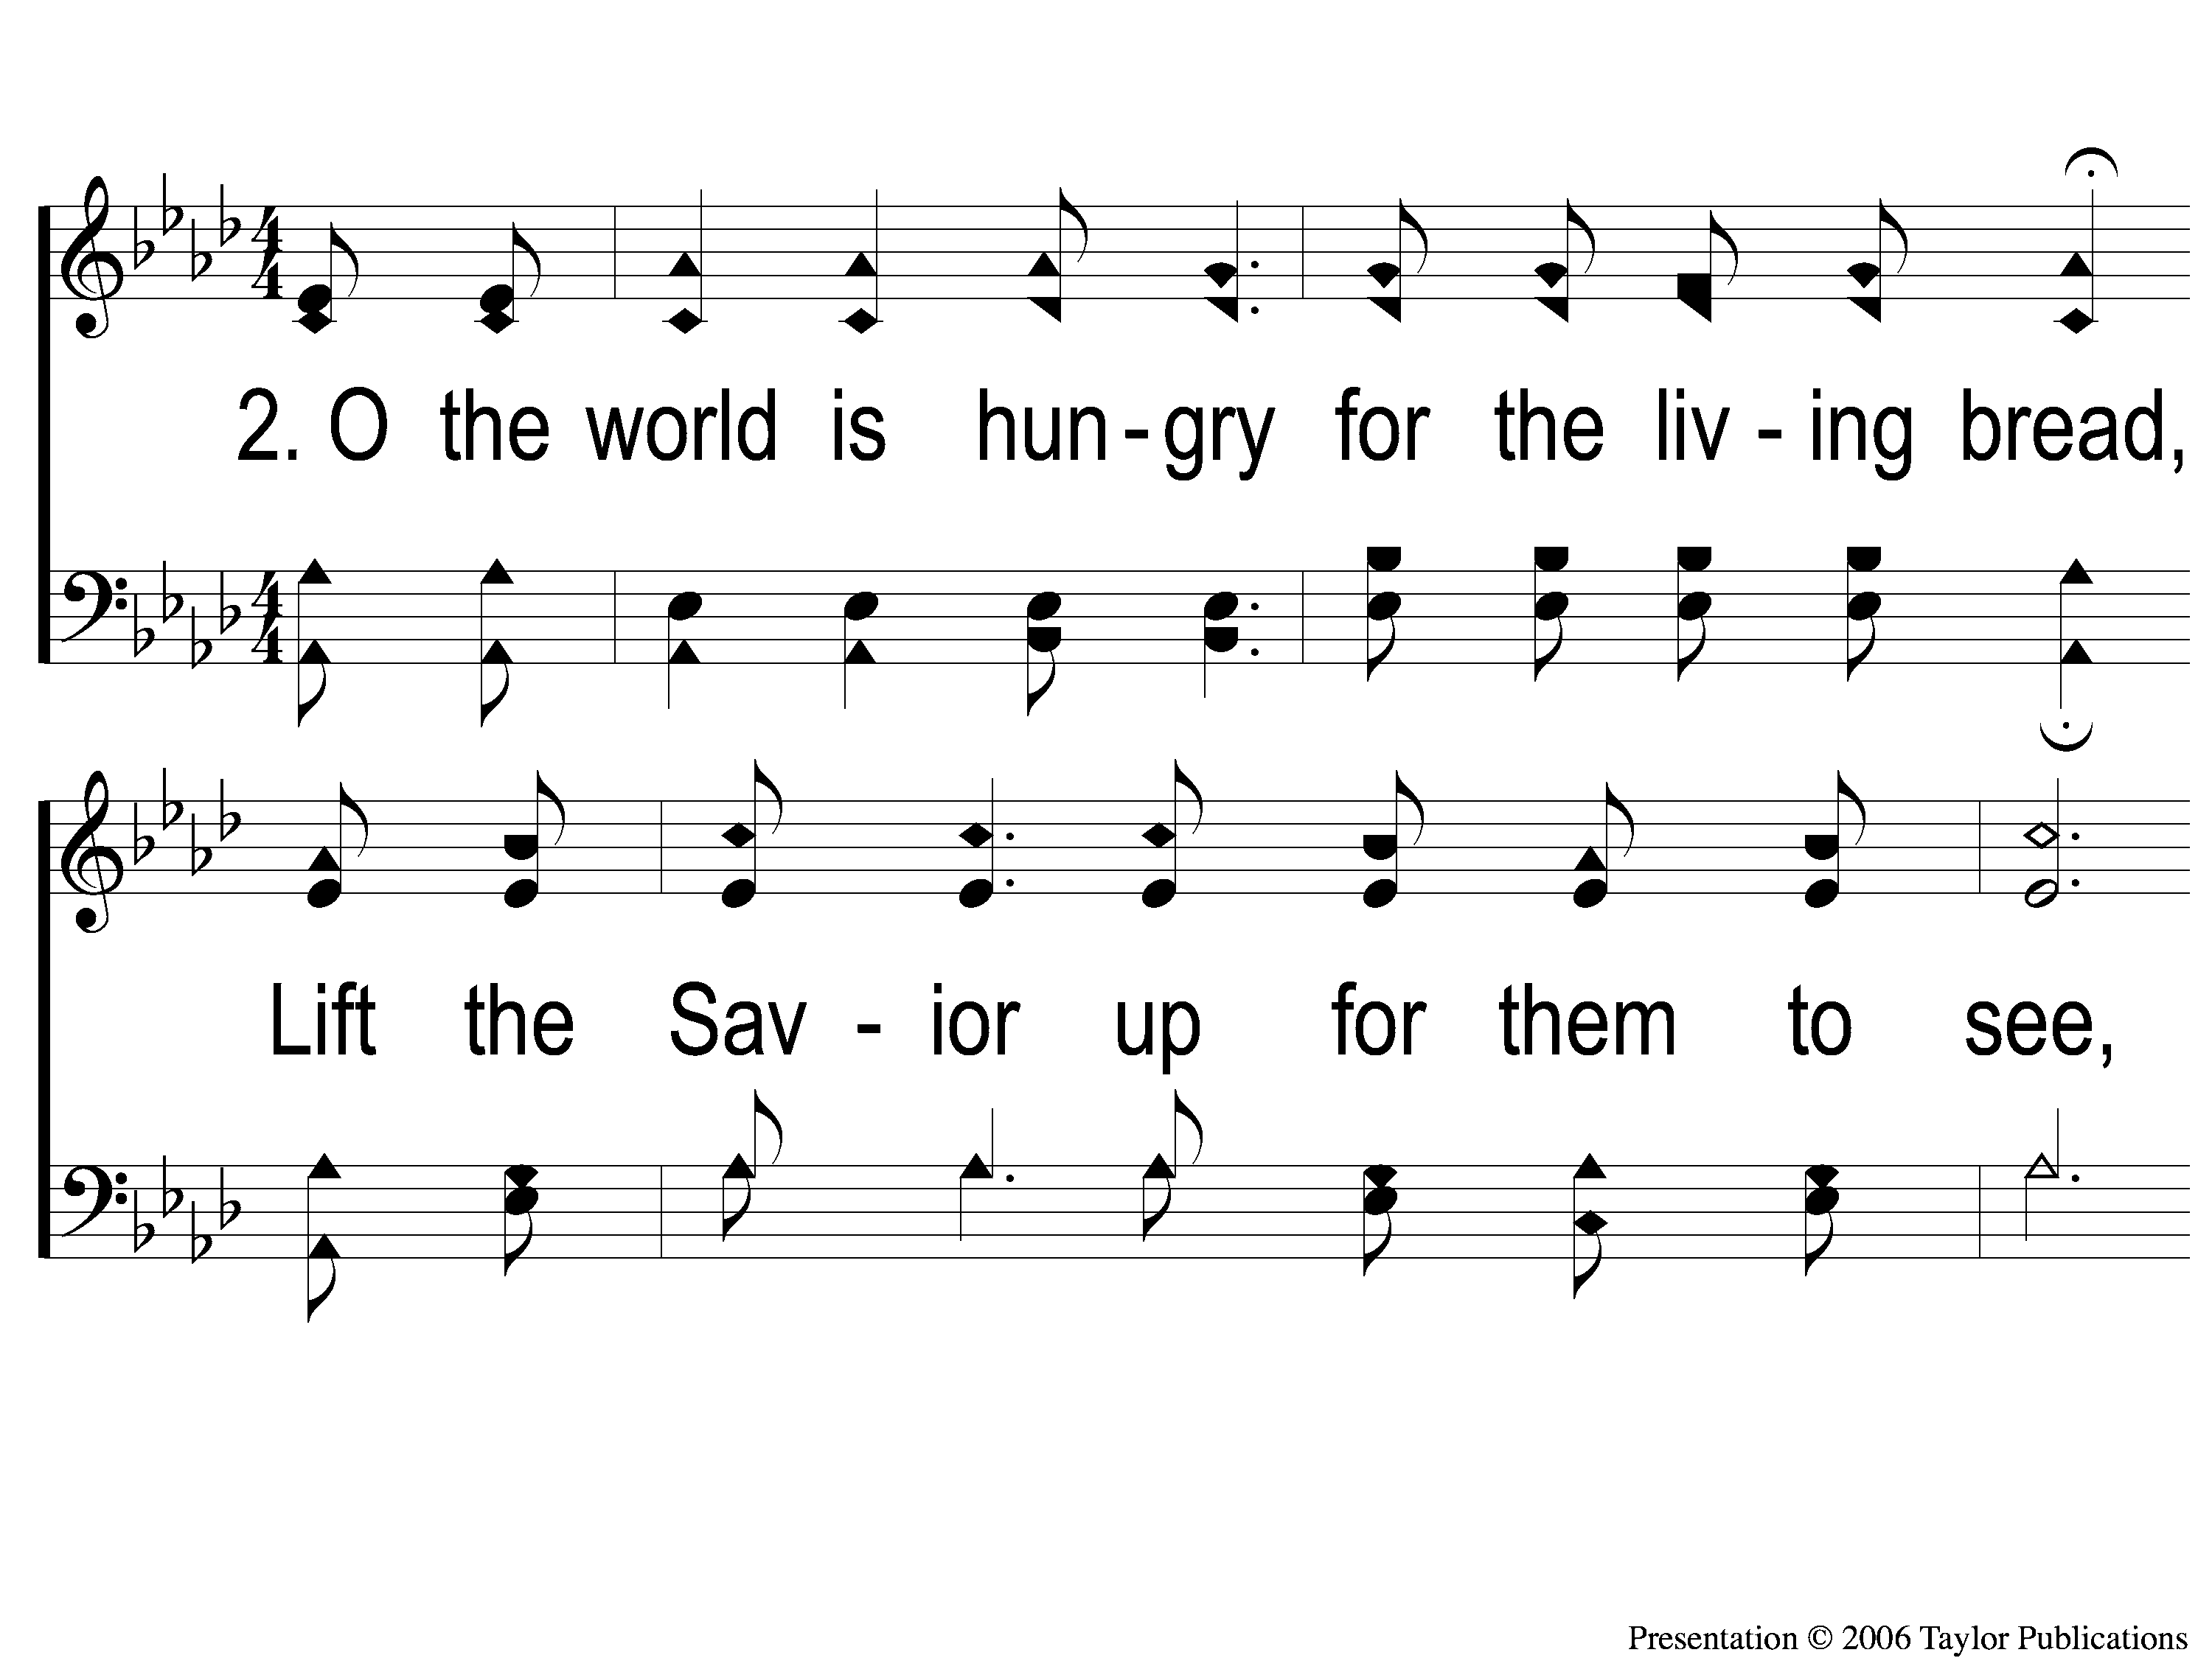
2-1 Lift Him Up
Lift Him Up
724
631

Slide 60
2-2 Lift Him Up
Lift Him Up
724
631

Slide 61
C-1 Lift Him Up
Lift Him Up
724
631

Slide 62
C-2 Lift Him Up
Lift Him Up
724
631

Slide 63
3-1 Lift Him Up
Lift Him Up
724
631

Slide 64
3-2 Lift Him Up
Lift Him Up
724
631

Slide 65
C-1 Lift Him Up
Lift Him Up
724
631

Slide 66
C-2 Lift Him Up
Lift Him Up
724
631

Slide 67
SCRIPTURE:
1 Chronicles 4:9-10

Slide 68
Stand out!

Slide 69
Case Study: jabez
1 Chron. 4:9-10

Slide 70
jabez
1 Chron. 4:9
“more honorable” – Why?

Slide 71
Jabez stood out…
…by Acknowledging God
…by Asking God
…being Accepted by God

Slide 72
Acknowledging God
1 Chron. 4:10a

Slide 73
Acknowledging God
1 Chron. 4:10a
Realized his Current Condition

Slide 74
Acknowledging God
1 Chron. 4:10a
Realized his Current Condition
Recognized God’s Power

Slide 75
Jabez stood out…
…by Acknowledging God
…by Asking God

Slide 76
asking God
1 Chron. 4:10b

Slide 77
asking God
1 Chron. 4:10b
3 Categories of Requests:

Slide 78
asking God
1 Chron. 4:10b
3 Categories of Requests:
Physical Blessings

Slide 79
asking God
1 Chron. 4:10b
3 Categories of Requests:
Physical Blessings
Spiritual Guidance

Slide 80
asking God
1 Chron. 4:10b
3 Categories of Requests:
Physical Blessings
Spiritual Guidance
Spiritual Protection

Slide 81
Jabez stood out…
…by Acknowledging God
…by Asking God
…being Accepted by God

Slide 82
accepted by God
1 Chron. 4:10c

Slide 83
accepted by God
1 Chron. 4:10c
God is Faithful!
Jms. 5:16b-18

Slide 84
Jabez stood out…
…by Acknowledging God
…by Asking God
…being Accepted by God

Slide 85
ARE YOU STANDING OUT?

Slide 86
SONG:
Just As I Am –
I Come Broken

Slide 87
1-1 Just as I am-I come broken
Just As I Am-I Come Broken

Slide 88
1-2 Just as I am-I come broken
Just As I Am-I Come Broken

Slide 89
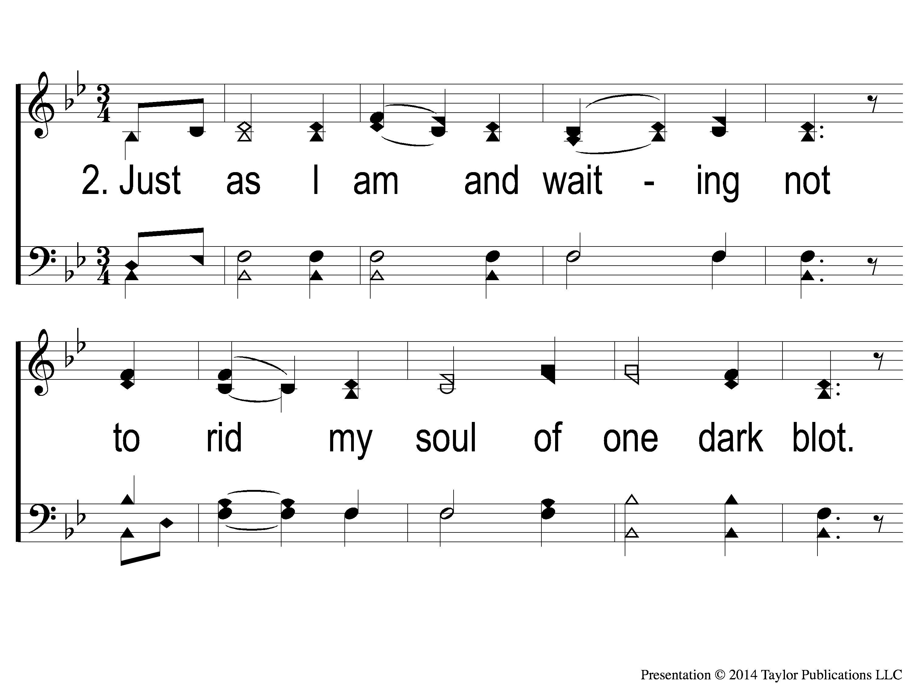
2-1 Just as I am-I come broken
Just As I Am-I Come Broken

Slide 90
2-2 Just as I am-I come broken
Just As I Am-I Come Broken

Slide 91
1c-1 Just as I am-I come broken
Just As I Am-I Come Broken

Slide 92
1c-2 Just as I am-I come broken
Just As I Am-I Come Broken

Slide 93
1c-3 Just as I am-I come broken
Just As I Am-I Come Broken

Slide 94
3-1 Just as I am-I come broken
Just As I Am-I Come Broken

Slide 95
3-2 Just as I am-I come broken
Just As I Am-I Come Broken

Slide 96
2c-1 Just as I am-I come broken
Just As I Am-I Come Broken

Slide 97
2c-2 Just as I am-I come broken
Just As I Am-I Come Broken

Slide 98
2c-3 Just as I am-I come broken
Just As I Am-I Come Broken

Slide 99
Ds-1 Just as I am-I come broken
Just As I Am-I Come Broken

Slide 100
Ds-2 Just as I am-I come broken
Just As I Am-I Come Broken

Slide 101
Ds-3 Just as I am-I come broken
Just As I Am-I Come Broken

Slide 102
SONG:
In Need

Slide 103
1 In Need
342
In Need
CCLI#645323

Slide 104
2 In Need
342
In Need

Slide 105
3 In Need
342
In Need

Slide 106
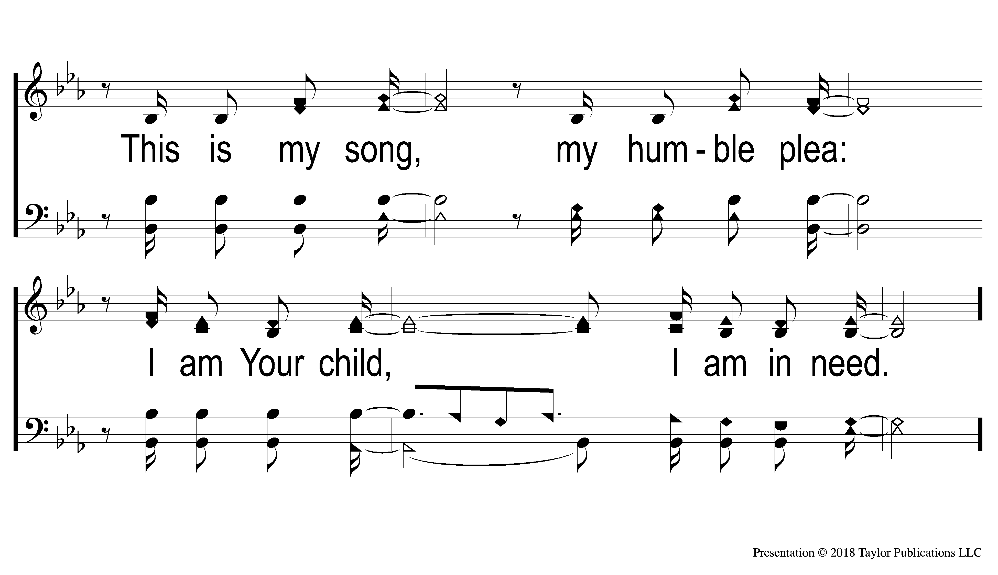
4 In Need
342
In Need

Slide 107
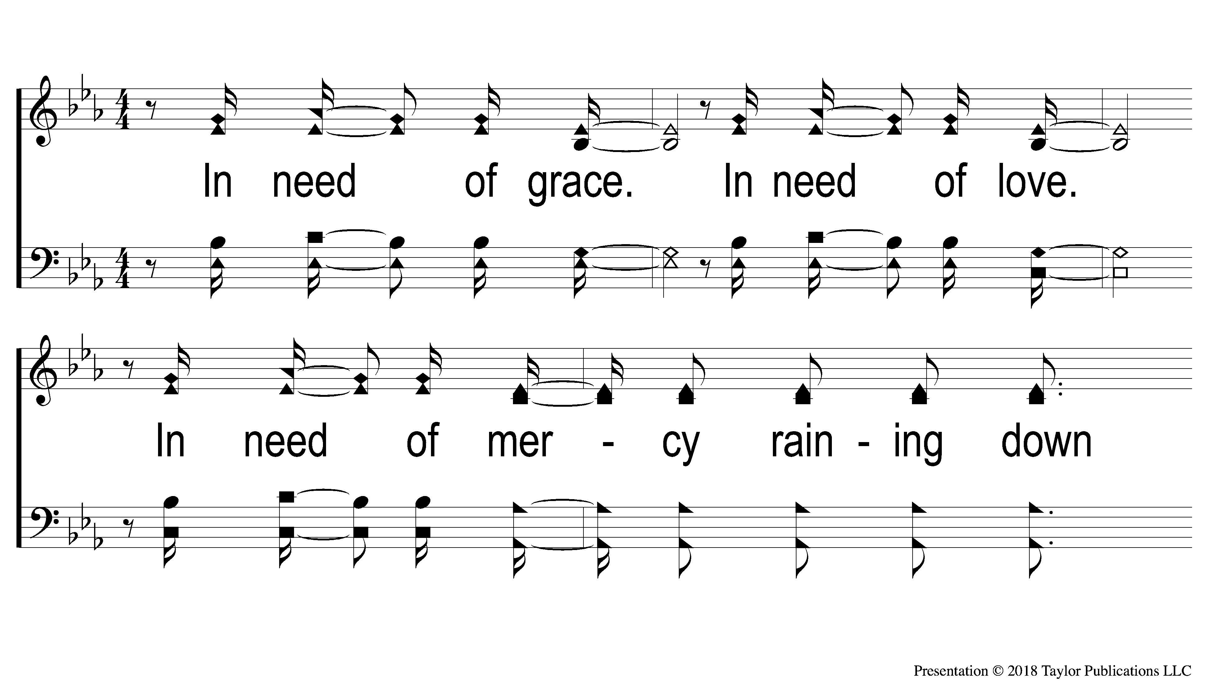
5 In Need
342
In Need

Slide 108
6 In Need
342
In Need

Slide 109
7 In Need
342
In Need

Slide 110
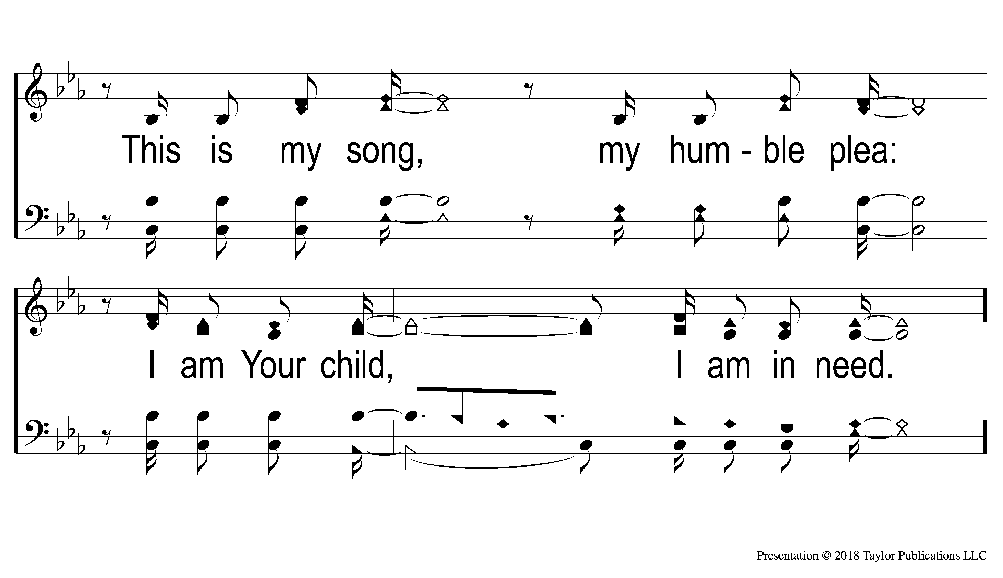
8 In Need
342
In Need

Slide 111
DS1 In Need
342
In Need

Slide 112
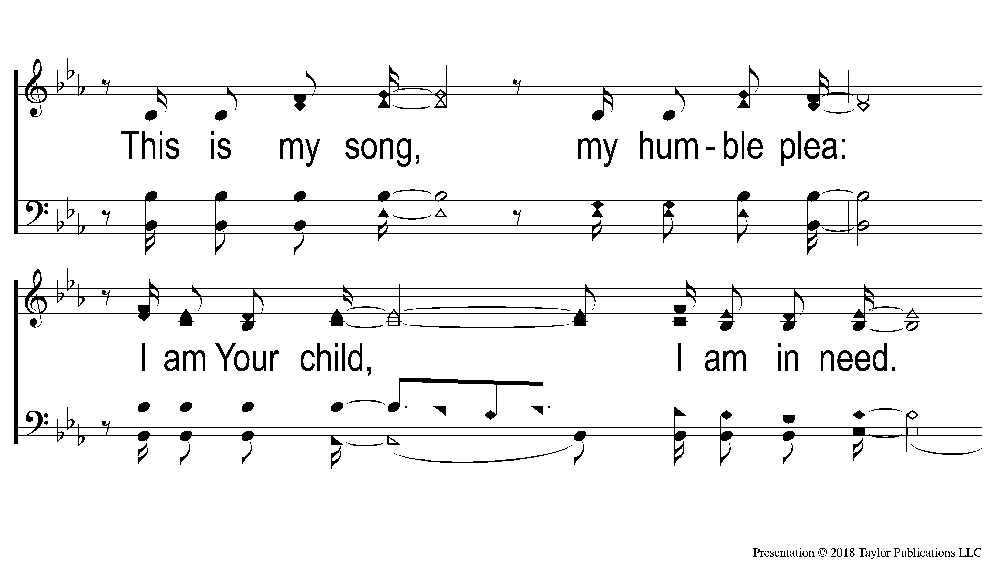
DS2 In Need
342
In Need

Slide 113
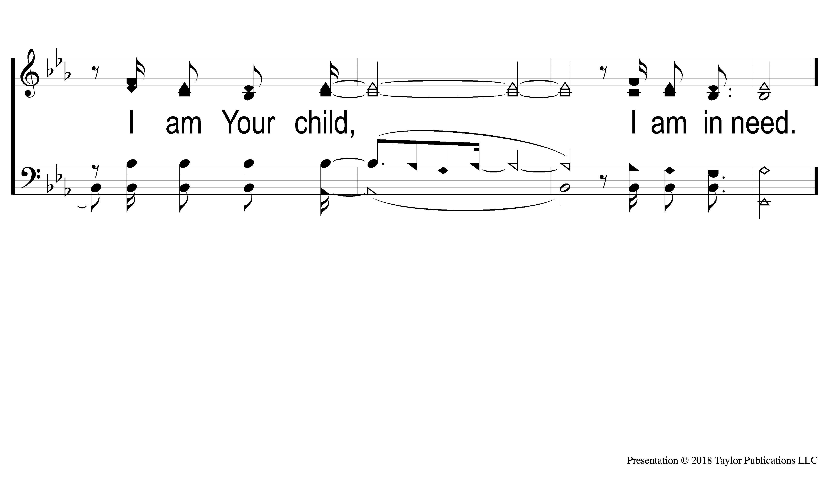
DS3 In Need
342
In Need

Slide 114
LORD’S SUPPER
The
Acts 20:7

Slide 115
Unleavened Bread
LORD’S SUPPER
11 Therefore remember that you, once Gentiles in the flesh—who are called Uncircumcision by what is called the Circumcision made in the flesh by hands—12 that at that time you were without Christ, being aliens from the commonwealth of Israel and strangers from the covenants of promise, having no hope and without God in the world. 13 But now in Christ Jesus you who once were far off have been brought near by the blood of Christ.
Eph. 5:11-13

Slide 116
Fruit of the Vine
LORD’S SUPPER
7 In Him we have redemption through His blood, the forgiveness of sins, according to the riches of His grace 8 which He made to abound toward us in all wisdom and prudence, 9 having made known to us the mystery of His will, according to His good pleasure which He purposed in Himself, 10 that in the dispensation of the fullness of the times He might gather together in one ^{p}all things in Christ, ³both which are in heaven and which are on earth—in Him.
Eph. 1:7-10

Slide 117
1 Peter 4:10
OFFERING
10 As each one has received a gift, minister it to one another, as good stewards of the manifold grace of God.

Slide 118
Closing PRAYER

Slide 119
#801
SONG:
Where No One
Stands Alone

Slide 120
1-1 Where No One Stands Alone
Where No One Stands Alone
801

Slide 121
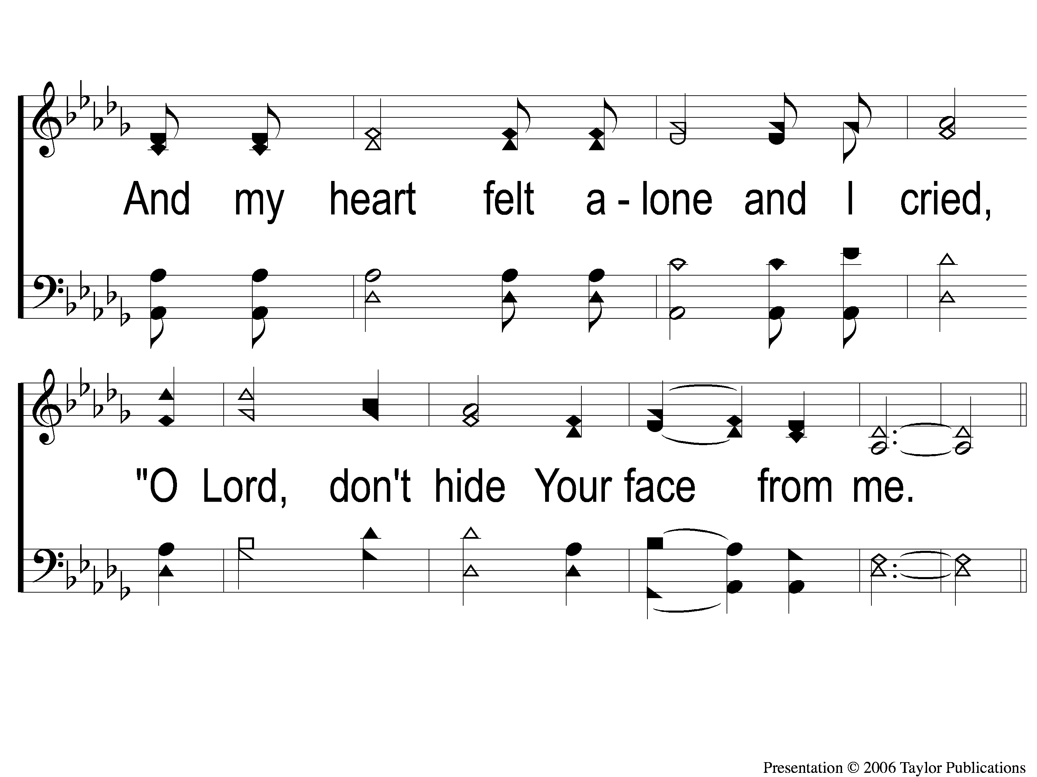
1-2 Where No One Stands Alone
Where No One Stands Alone
801

Slide 122
C-1 Where No One Stands Alone
Where No One Stands Alone
801

Slide 123
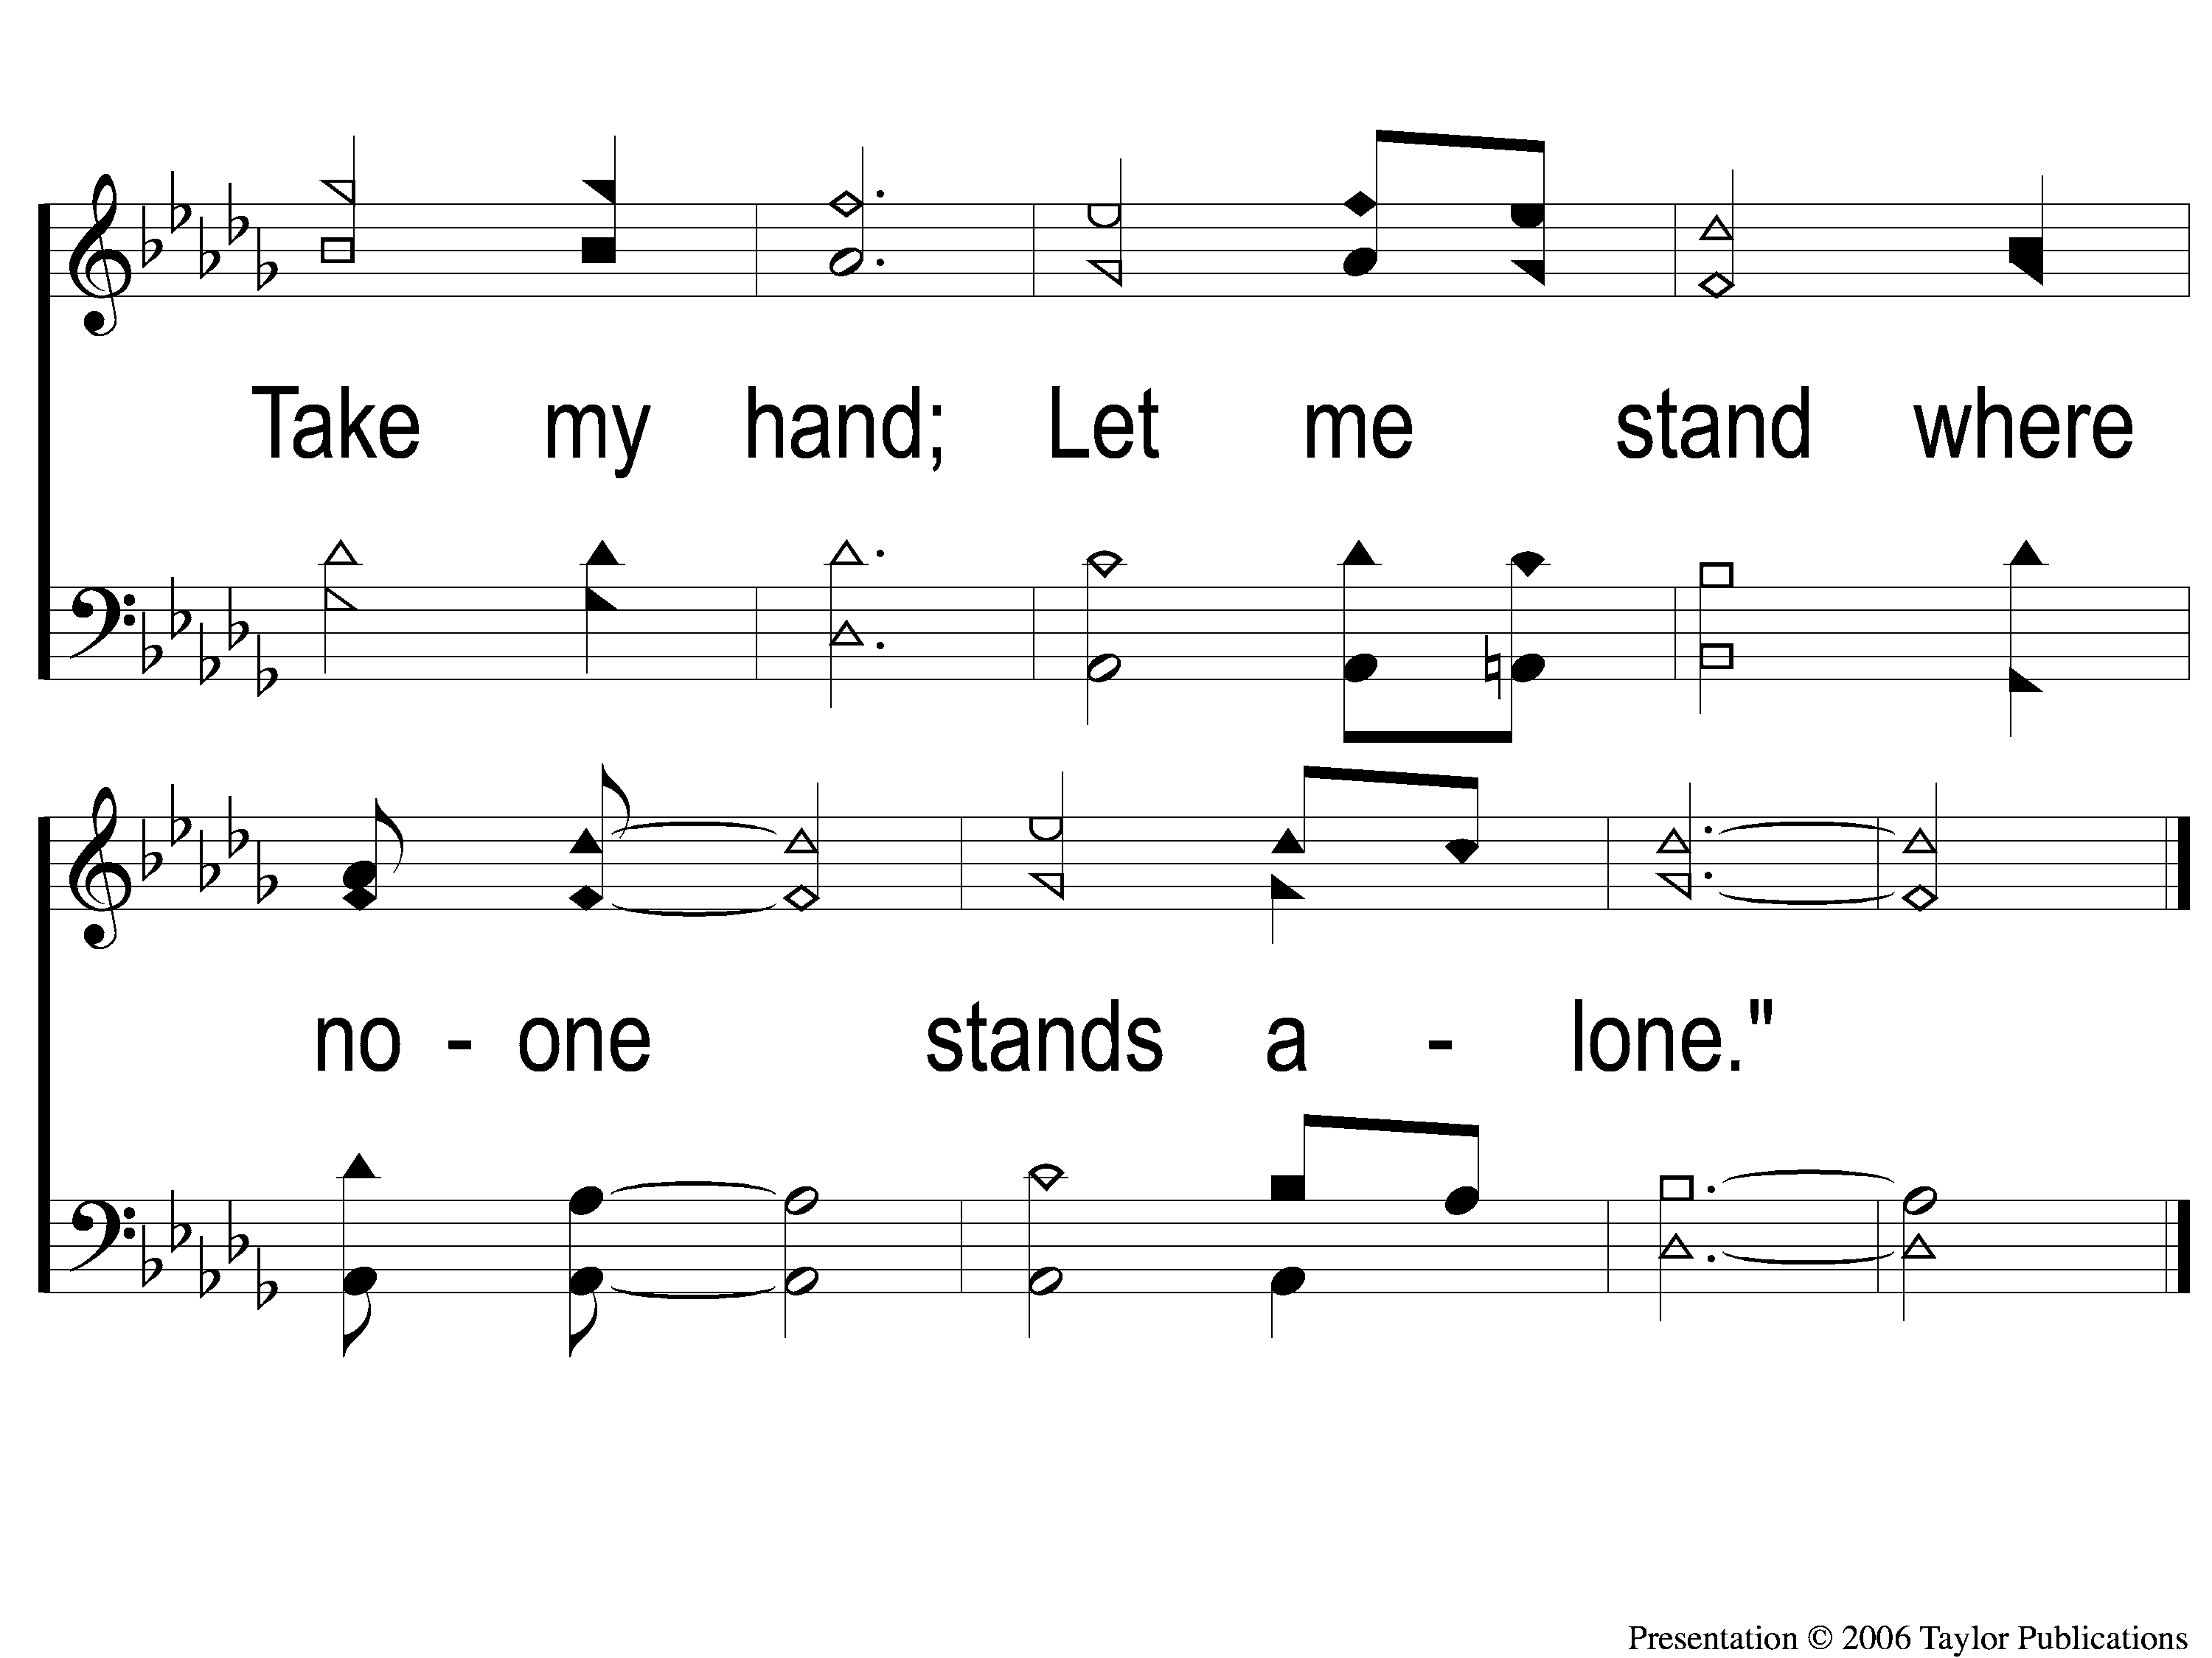
C-2 Where No One Stands Alone
Where No One Stands Alone
801

Slide 124
2-1 Where No One Stands Alone
Where No One Stands Alone
801

Slide 125
2-2 Where No One Stands Alone
Where No One Stands Alone
801

Slide 126
C-1 Where No One Stands Alone
Where No One Stands Alone
801

Slide 127
C-2 Where No One Stands Alone
Where No One Stands Alone
801

Slide 128
Opt tag Where No One Stands Alone
Where No One Stands Alone
801
Tag

Slide 129
TONIGHT @ 6:00 pm
EVENING WORSHIP
HOPE TO SEE YOU THERE!

