Slide 1
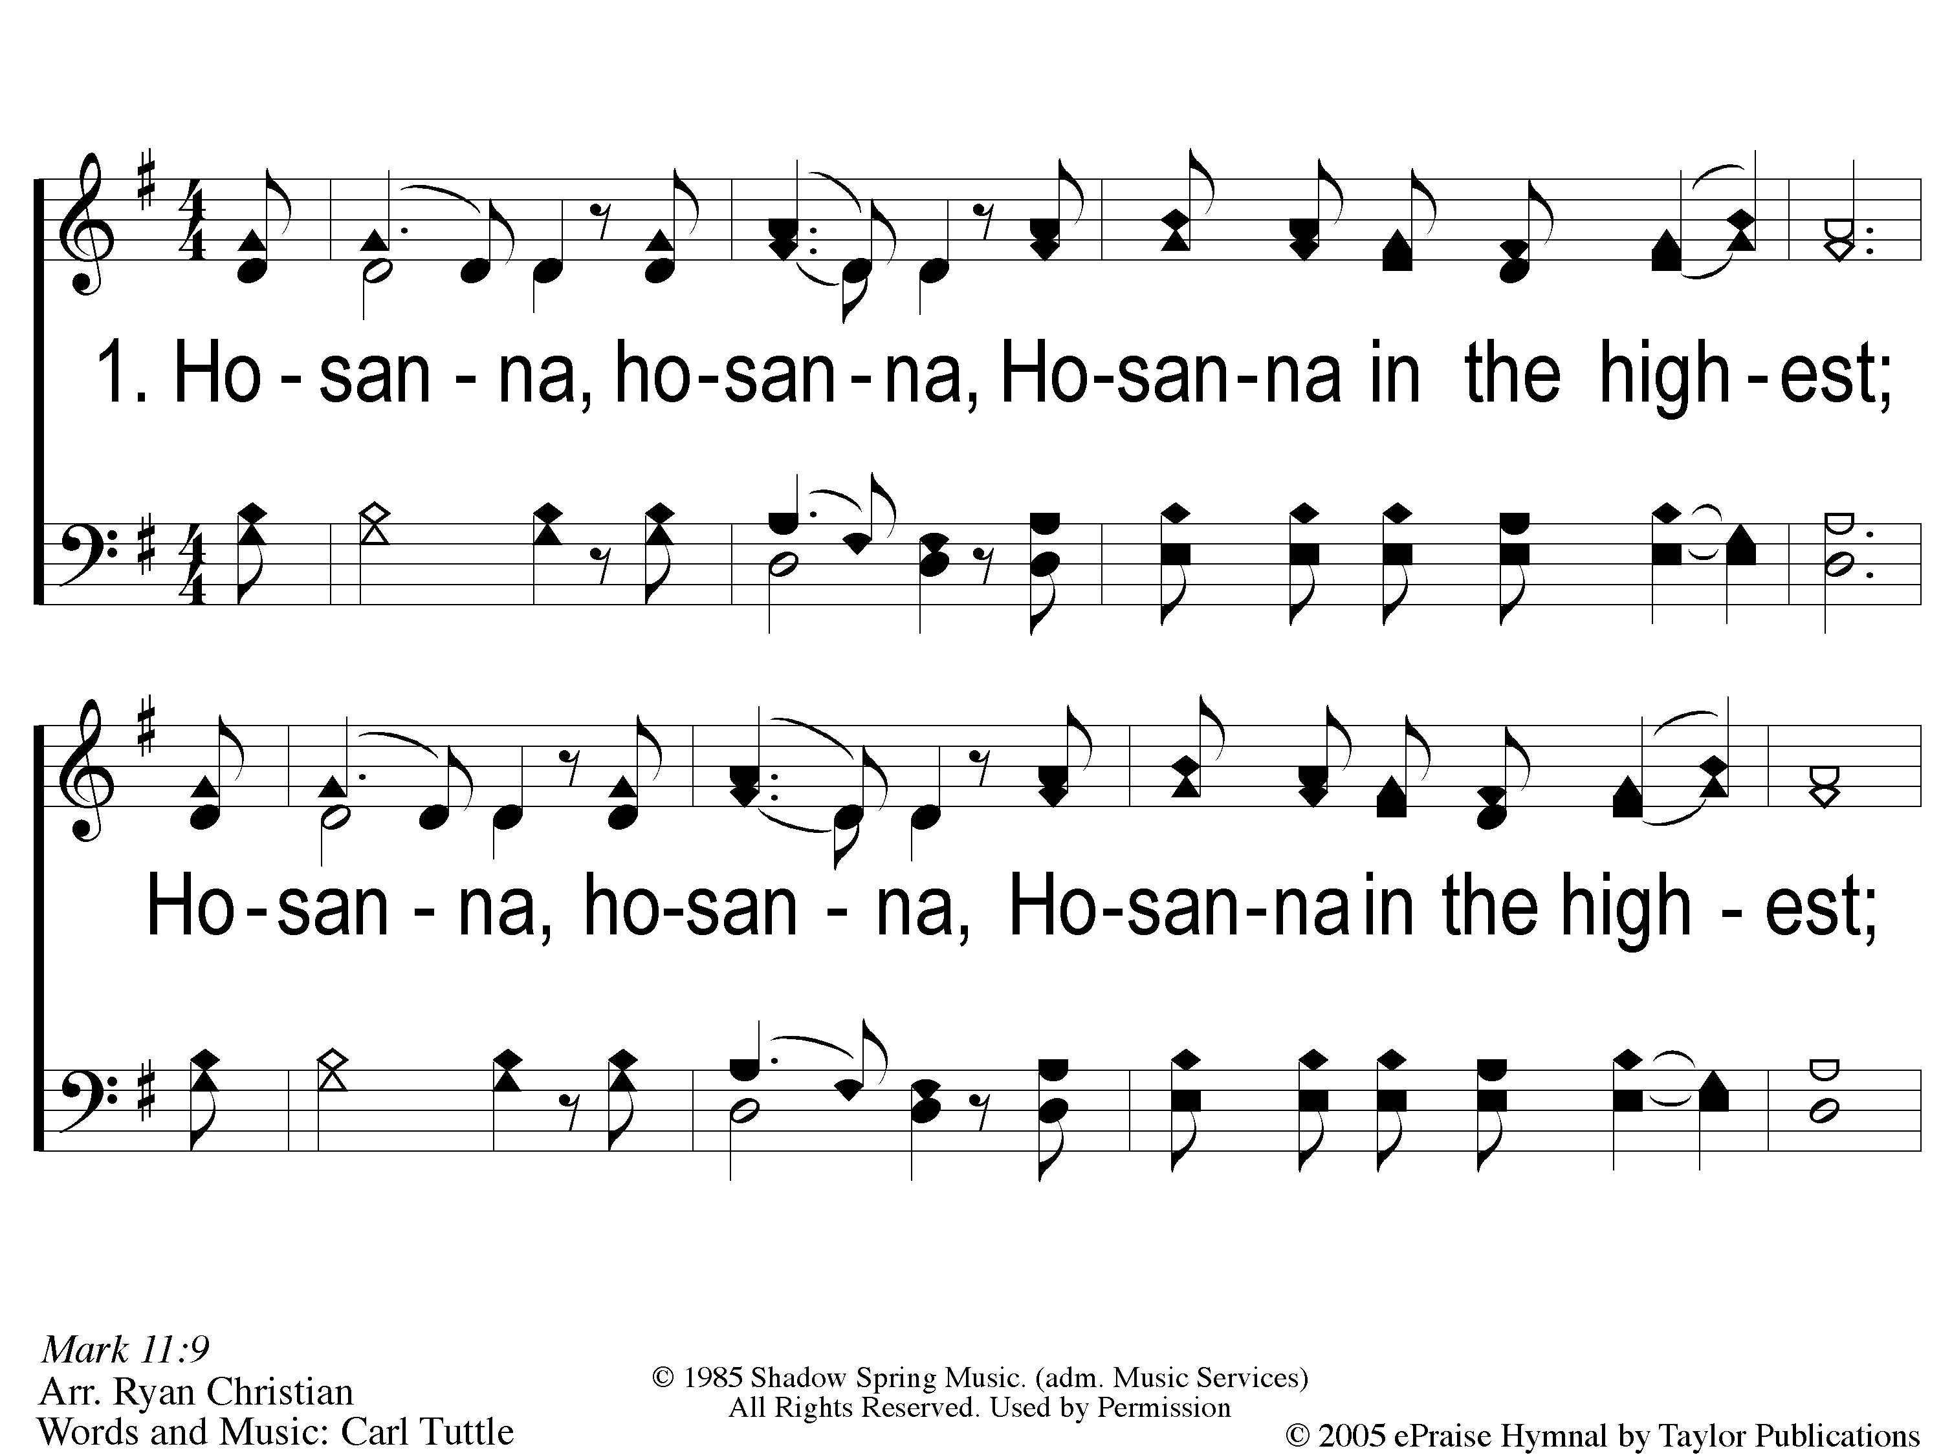
1 Hosanna
Hosanna
167

Slide 2
C-1 Hosanna
Hosanna
167

Slide 3
C-2 Hosanna
Hosanna
167

Slide 4
2 Hosanna
Hosanna
167

Slide 5
C-1 Hosanna
Hosanna
167

Slide 6
C-2 Hosanna
Hosanna
167

Slide 7
RESTORE REBUILD RENEW
welcome
we are glad to
Have you with us
IN 2022
WHEELER
CHURCH
OF
CHRIST

Slide 8
Song:
Here I Am To Worship

Slide 9
1-1 Here I Am To Worship
Here I Am To Worship

Slide 10
1-2 Here I Am To Worship
Here I Am To Worship

Slide 11
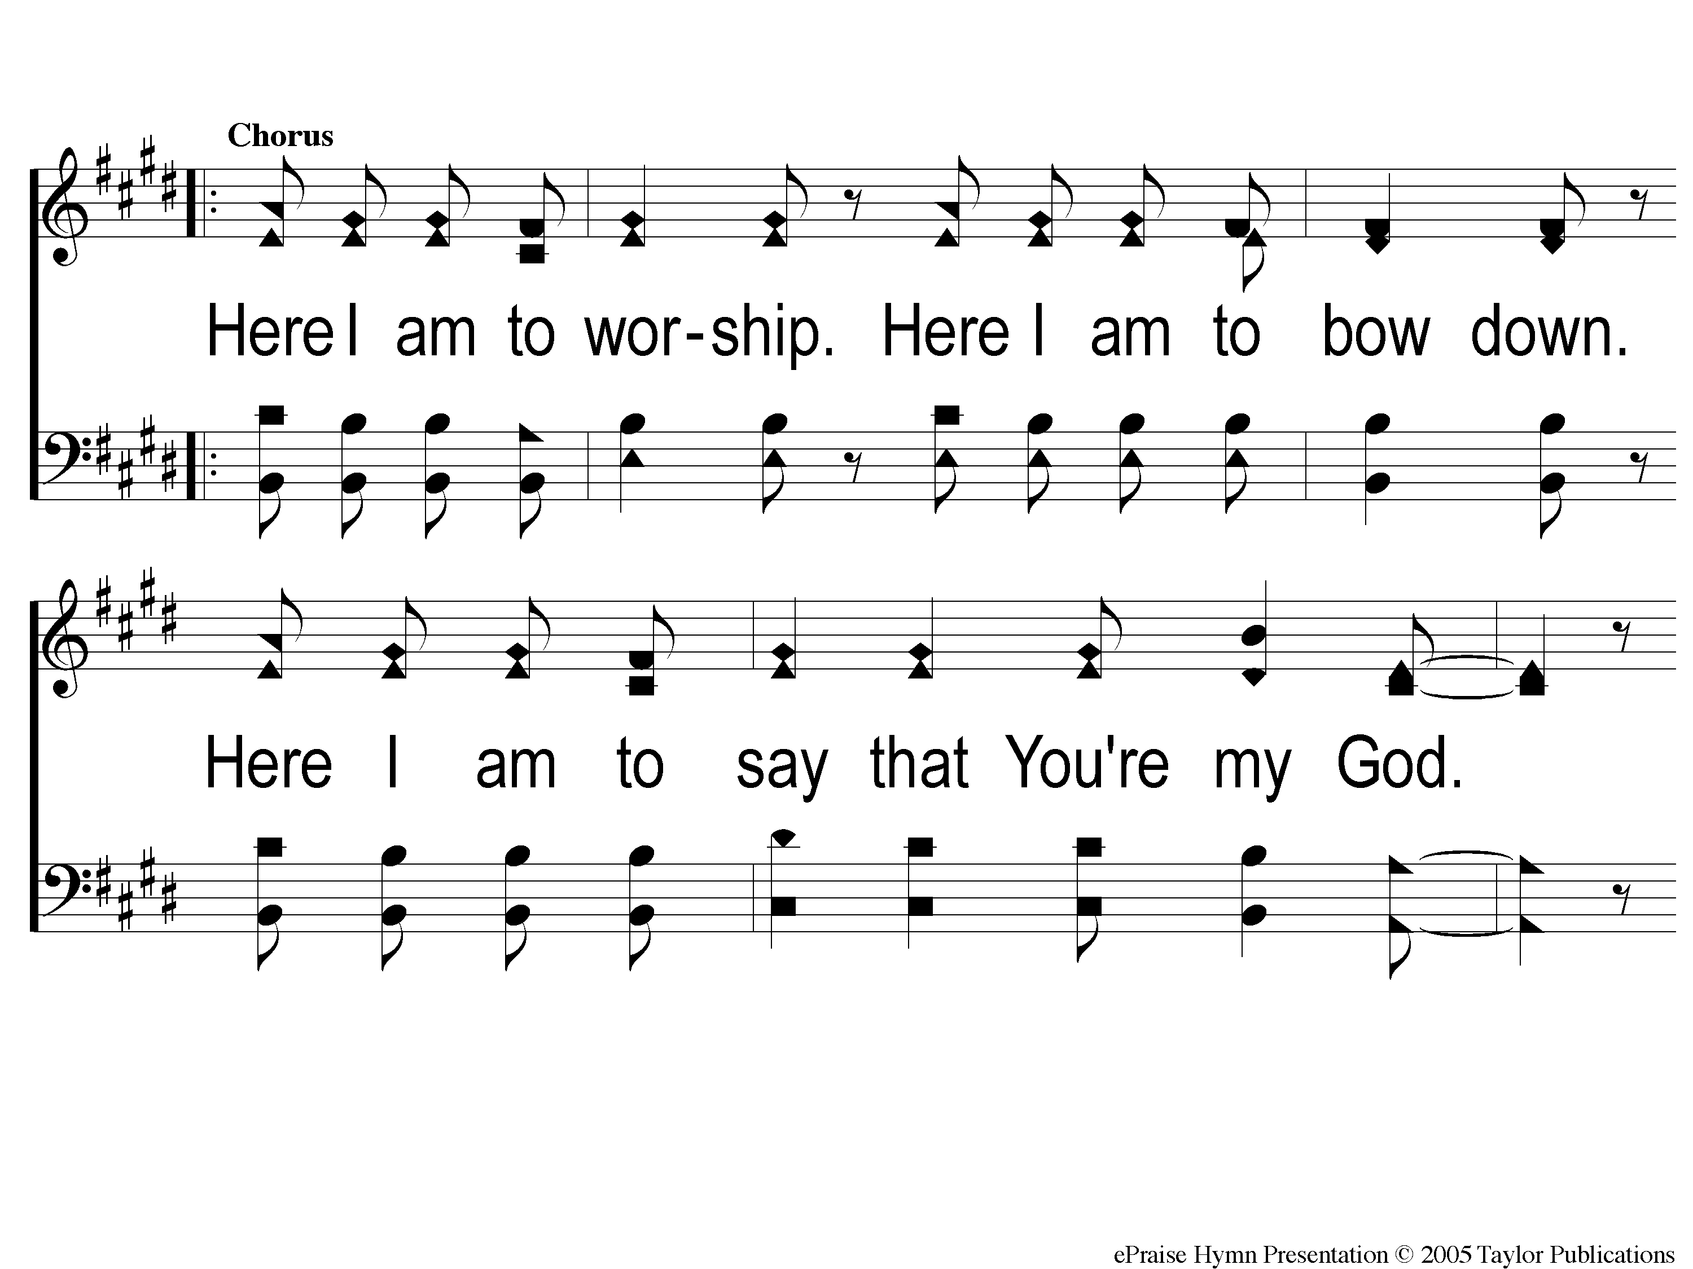
C-1 Here I Am To Worship
Here I Am To Worship

Slide 12
C-2 Here I Am To Worship
Here I Am To Worship

Slide 13
2-1 Here I Am To Worship
Here I Am To Worship

Slide 14
2-2 Here I Am To Worship
Here I Am To Worship

Slide 15
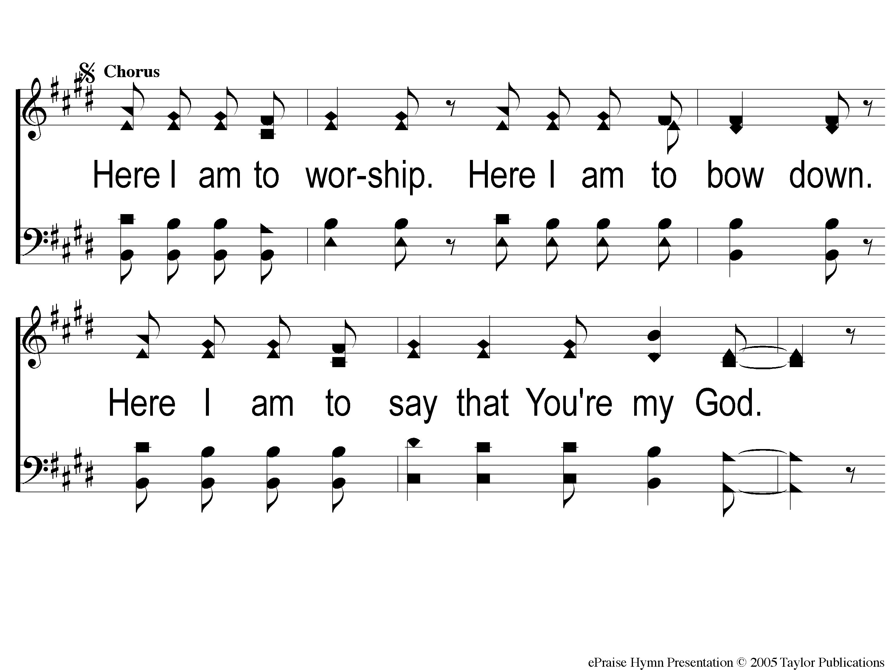
C2-1 Here I Am To Worship
Here I Am To Worship

Slide 16
C2-2 Here I Am To Worship
Here I Am To Worship

Slide 17
Bridge1 Here I Am To Worship
Here I Am To Worship

Slide 18
Bridge2 Here I Am To Worship
Here I Am To Worship

Slide 19
C2-1 Here I Am To Worship
Here I Am To Worship

Slide 20
C2-2 Here I Am To Worship
Here I Am To Worship

Slide 21
tag Here I Am To Worship
Here I Am To Worship

Slide 22
Song:
Just A Little Talk With Jesus
#959

Slide 23
1-1 Just A Little Talk With Jesus
Just A Little Talk With Jesus
959

Slide 24
1-2 Just A Little Talk With Jesus
Just A Little Talk With Jesus
959

Slide 25
C-1 Just A Little Talk With Jesus
Just A Little Talk With Jesus
959

Slide 26
C-2 Just A Little Talk With Jesus
Just A Little Talk With Jesus
959

Slide 27
C-3 Just A Little Talk With Jesus
Just A Little Talk With Jesus
959

Slide 28
2-1 Just A Little Talk With Jesus
Just A Little Talk With Jesus
959

Slide 29
2-2 Just A Little Talk With Jesus
Just A Little Talk With Jesus
959

Slide 30
C-1 Just A Little Talk With Jesus
Just A Little Talk With Jesus
959

Slide 31
C-2 Just A Little Talk With Jesus
Just A Little Talk With Jesus
959

Slide 32
C-3 Just A Little Talk With Jesus
Just A Little Talk With Jesus
959

Slide 33
3-1 Just A Little Talk With Jesus
Just A Little Talk With Jesus
959

Slide 34
3-2 Just A Little Talk With Jesus
Just A Little Talk With Jesus
959

Slide 35
C-1 Just A Little Talk With Jesus
Just A Little Talk With Jesus
959

Slide 36
C-2 Just A Little Talk With Jesus
Just A Little Talk With Jesus
959

Slide 37
C-3 Just A Little Talk With Jesus
Just A Little Talk With Jesus
959

Slide 38
Opening Prayer

Slide 39
Song:
The Lily Of The Valley
#548

Slide 40
1-1 The Lily of the Valley
The Lily of the Valley
548

Slide 41
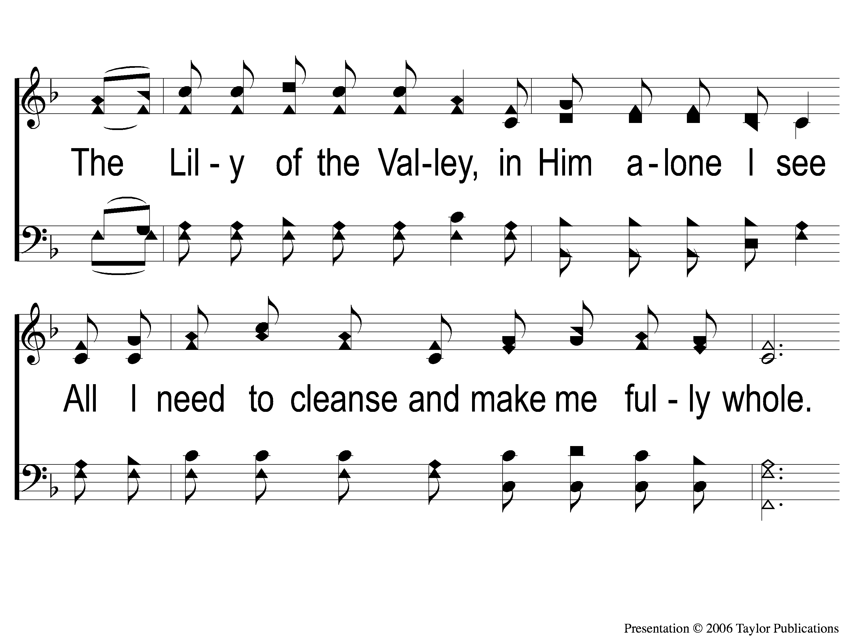
1-2 The Lily of the Valley
The Lily of the Valley
548

Slide 42
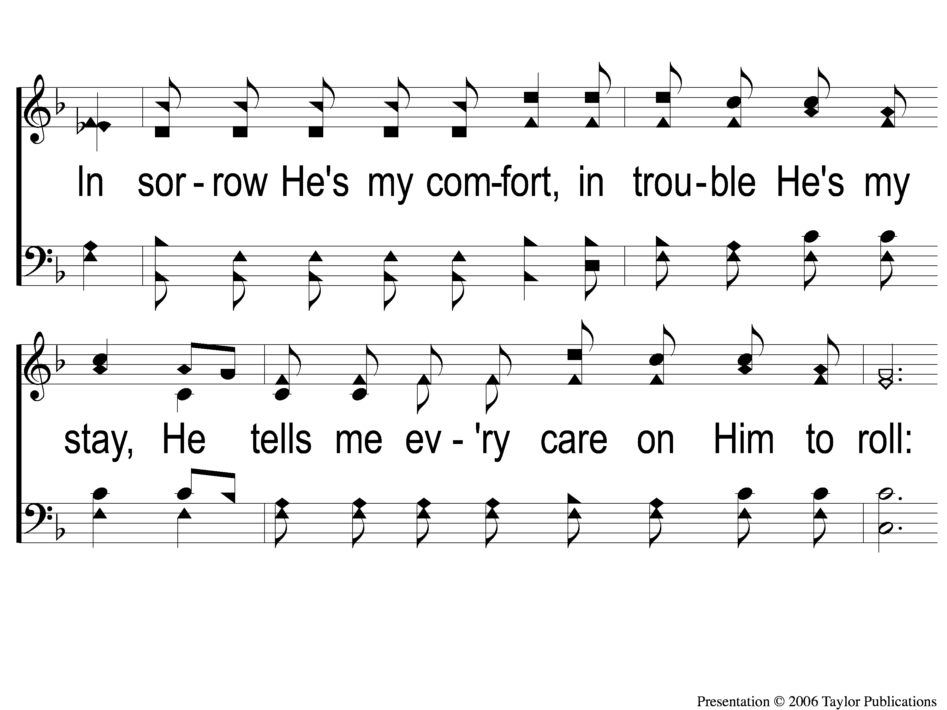
1-3 The Lily of the Valley
The Lily of the Valley
548

Slide 43
C The Lily of the Valley
The Lily of the Valley
548

Slide 44
2-1 The Lily of the Valley
The Lily of the Valley
548

Slide 45
2-2 The Lily of the Valley
The Lily of the Valley
548

Slide 46
2-3 The Lily of the Valley
The Lily of the Valley
548

Slide 47
C The Lily of the Valley
The Lily of the Valley
548

Slide 48
3-1 The Lily of the Valley
The Lily of the Valley
548

Slide 49
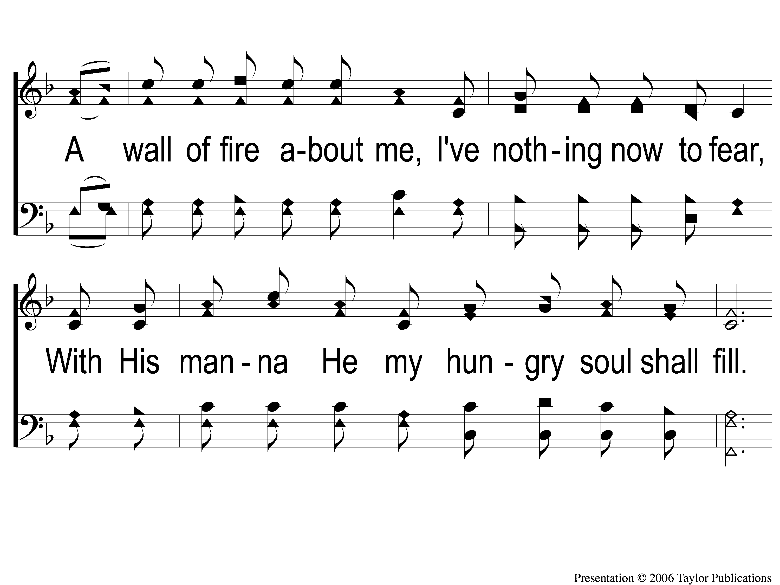
3-2 The Lily of the Valley
The Lily of the Valley
548

Slide 50
3-3 The Lily of the Valley
The Lily of the Valley
548

Slide 51
C The Lily of the Valley
The Lily of the Valley
548

Slide 52
Song:
Give Me The Bible
#450

Slide 53
1-1 Give Me the Bible
Give Me The Bible
450

Slide 54
1-2 Give Me the Bible
Give Me The Bible
450

Slide 55
C-1 Give Me the Bible
Give Me The Bible
450

Slide 56
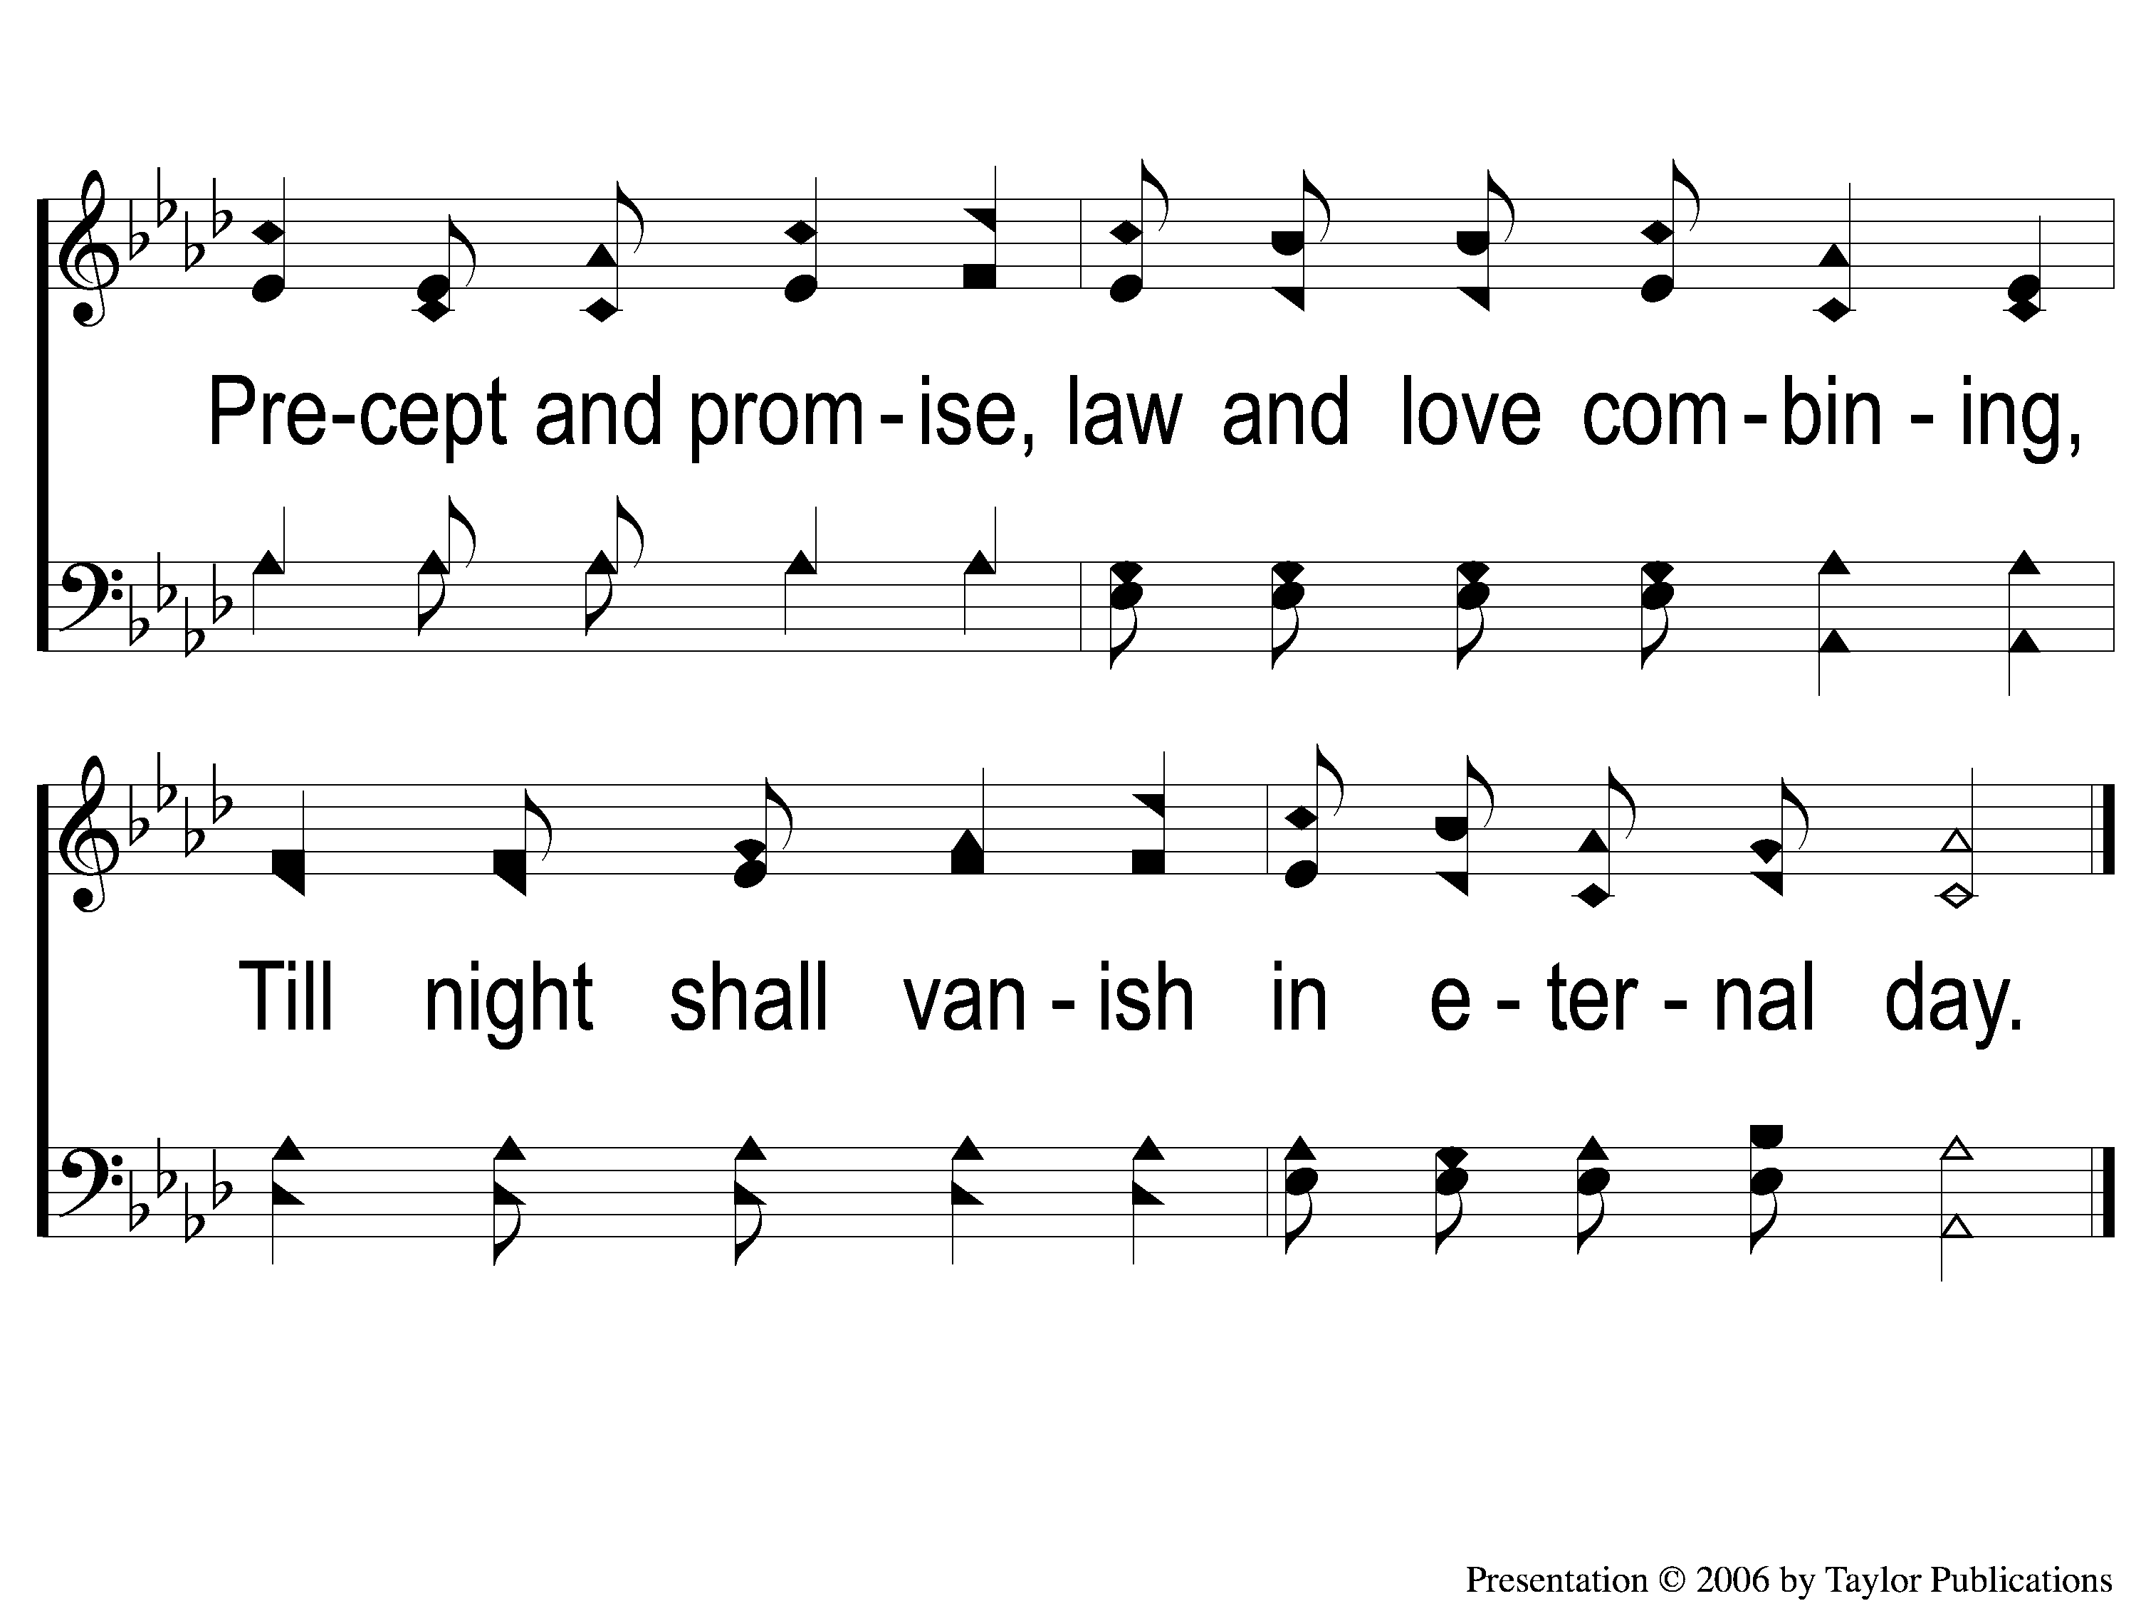
C-2 Give Me the Bible
Give Me The Bible
450

Slide 57
2-1 Give Me the Bible
Give Me The Bible
450

Slide 58
2-2 Give Me the Bible
Give Me The Bible
450

Slide 59
C-1 Give Me the Bible
Give Me The Bible
450

Slide 60
C-2 Give Me the Bible
Give Me The Bible
450

Slide 61
3-1 Give Me the Bible
Give Me The Bible
450

Slide 62
3-2 Give Me the Bible
Give Me The Bible
450

Slide 63
C-1 Give Me the Bible
Give Me The Bible
450

Slide 64
C-2 Give Me the Bible
Give Me The Bible
450

Slide 65
Scripture Reading:
Acts 17:1-4

Slide 66
RESTORE REBUILD RENEW
IN 2022

Slide 67
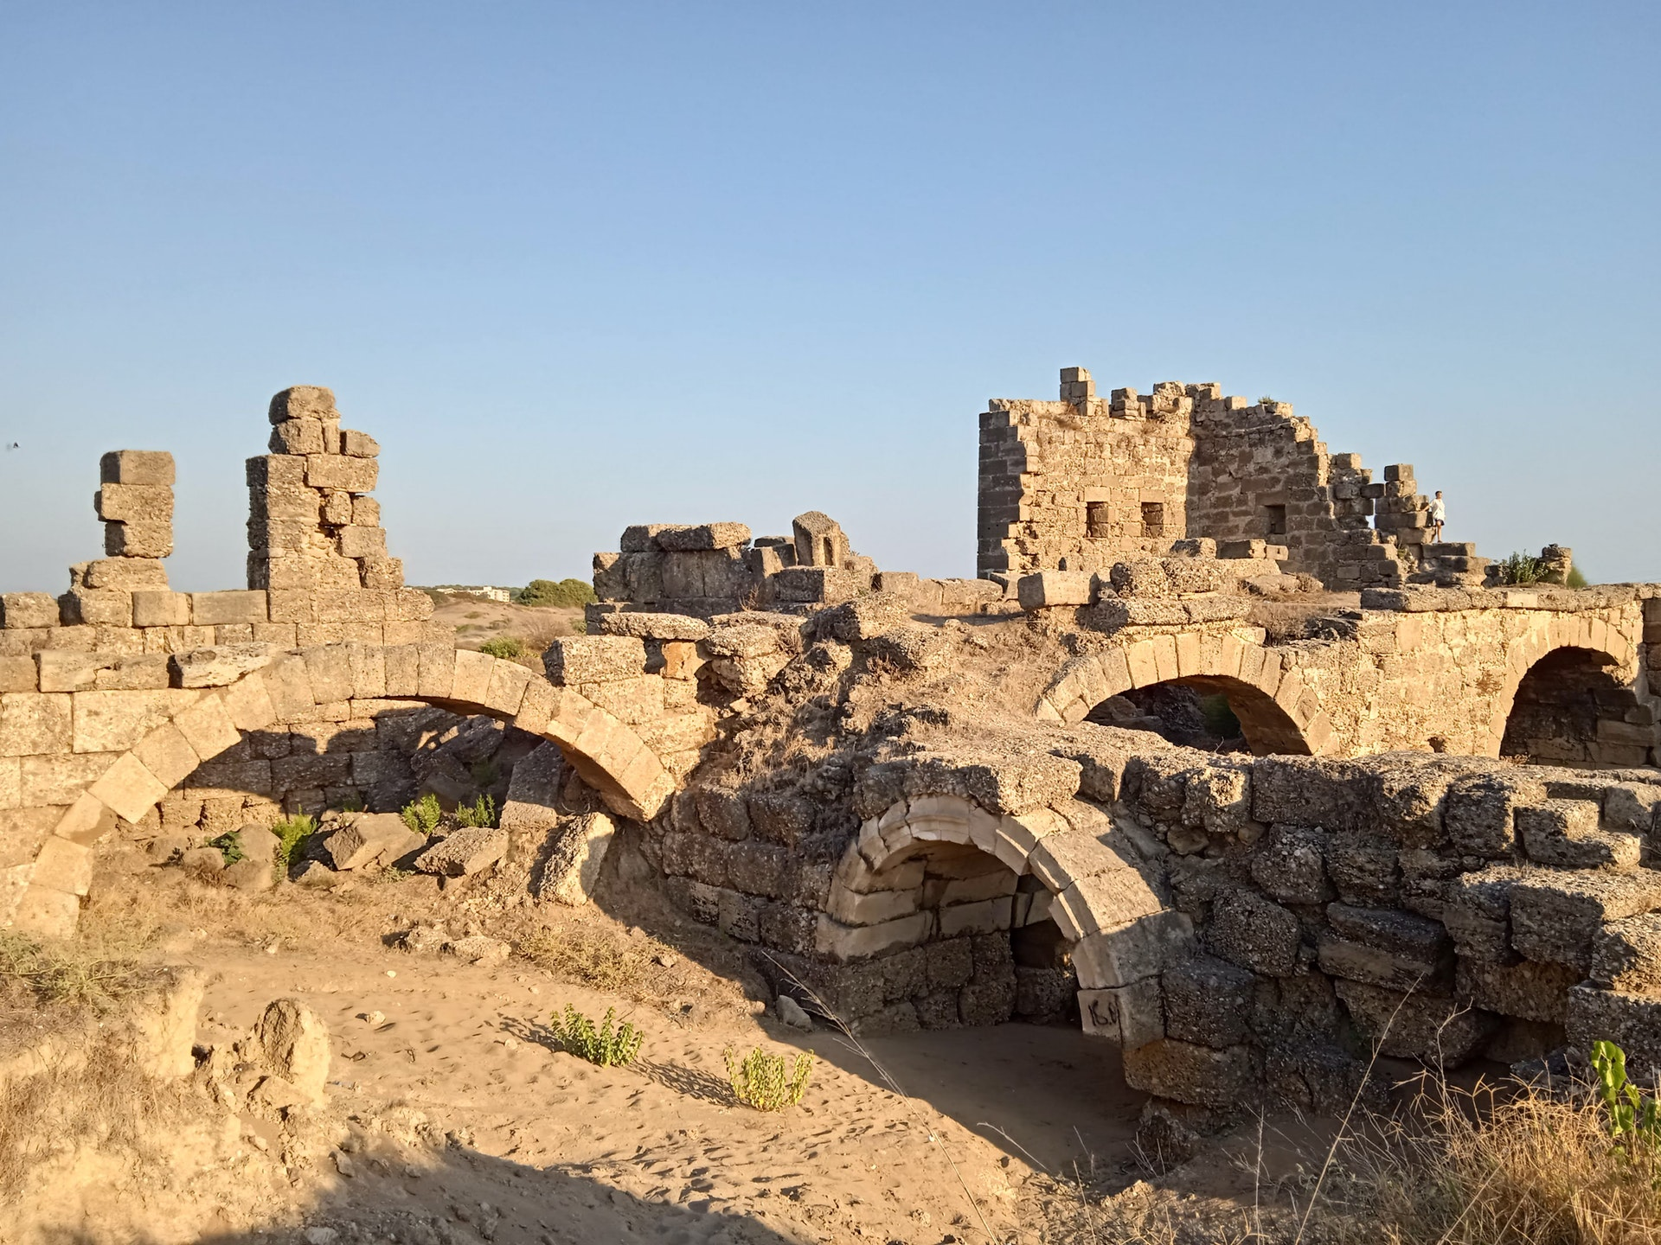
Rebuilding Jerusalem

Slide 68
REBUILDING NEEDS:
GODLY MOTHERS & FATHERS

Slide 69
REBUILDING NEEDS:
GODLY MOTHERS & FATHERS
UNITY

Slide 70
REBUILDING NEEDS:
GODLY MOTHERS & FATHERS
UNITY
ACTIVE LEADERS

Slide 71
Logic
REASON

Slide 72
A FACT ABOUT FEELINGS:
FEELINGS DO NOT CHANGE FACTS
Logic
&
REASON

Slide 73
JESUS USED LOGIC & REASON
Matt. 5:13
6:5, 16
7:13-14
26:51, 75

Slide 74
PAUL USED LOGIC & REASON
Acts 9:3-6, 20
13:14, 44
15:1
26:19
Phili. 1:21-24

Slide 75
LOGIC & REASON…
…Provided Protection

Slide 76
…PROVIDED PROTECTION
Physical Protection
Neh. 4:9, 13-14, 16-18; 7:3

Slide 77
…PROVIDED PROTECTION
Spiritual Protection
Neh. 6:10-13

Slide 78
…PROVIDED PROTECTION
Physical Protection
1 Cor. 6:18 – 2 Tim. 2:22
1 Prov. 23:29-30 – Titus 6:18
1 Pet. 2:13

Slide 79
…PROVIDED PROTECTION
Spiritual Protection
Matt. 25:46
Titus 3:7
1 Jn. 3:15

Slide 80
LOGIC & REASON…
…Provided Protection
…Pacified Confrontation

Slide 81
…PACIFIED CONFRONTATION
Internal Oppression
Neh. 5:7-11

Slide 82
…PACIFIED CONFRONTATION
Internal Oppression
Neh. 5:7-11
1 Cor. 6:1-5
Gal. 5:15
Eph. 5:21

Slide 83
…PACIFIED CONFRONTATION
External Opposition
Neh. 6:1-7

Slide 84
LOGIC & REASON…
…Provided Protection
…Pacified Confrontation
…Permitted Sanctification

Slide 85
…PERMITTED SANCTIFICATION
Their Worship
Neh. 12:44-47

Slide 86
…PERMITTED SANCTIFICATION
Their Worship
Neh. 12:44-47
Lev. 10:1-2
1 Cor. 14:26-33

Slide 87
…PERMITTED SANCTIFICATION
Their Ways
Neh. 13:1-3, 23-31

Slide 88
…PERMITTED SANCTIFICATION
Their Ways
Neh. 13:1-3, 23-31
1 Pet. 1:15-16
1 Cor. 5:9 – 2 Thess. 3:6
Matt. 18:15-17, 19:17

Slide 89
LOGIC & SALVATION
Hear His Word – Rom. 10:17
Believe in His Son – Jn. 20:30-31
Repent of Your Sins – Acts 17:30
Confess Jesus Christ – Rom. 10:10
Be Baptized In Water – Mark 16:16
Remain Faithful to God – Rev. 2:10

Slide 90
Invitation
Song:
When We All Get To Heaven
#853

Slide 91
1-1 When We All Get To Heaven
When We All Get To Heaven
853

Slide 92
1-2 When We All Get To Heaven
When We All Get To Heaven
853

Slide 93
C-1 When We All Get To Heaven
When We All Get To Heaven
853

Slide 94
C-2 When We All Get To Heaven
When We All Get To Heaven
853

Slide 95
2-1 When We All Get To Heaven
When We All Get To Heaven
853

Slide 96
2-2 When We All Get To Heaven
When We All Get To Heaven
853

Slide 97
C-1 When We All Get To Heaven
When We All Get To Heaven
853

Slide 98
C-2 When We All Get To Heaven
When We All Get To Heaven
853

Slide 99
3-1 When We All Get To Heaven
When We All Get To Heaven
853

Slide 100
3-2 When We All Get To Heaven
When We All Get To Heaven
853

Slide 101
C-1 When We All Get To Heaven
When We All Get To Heaven
853

Slide 102
C-2 When We All Get To Heaven
When We All Get To Heaven
853

Slide 103
The Contribution:
Hebrews 13:15-16
“Therefore by Him let us continually offer the sacrifice of praise to God, that is, the fruit of our lips, giving thanks to His name. But do not forget to do good and to share, for with such sacrifices God is well pleased.”

Slide 104
Song:
Worthy Is The Lamb
#234

Slide 105
1-1 Worthy is the Lamb
Worthy Is the Lamb
234

Slide 106
1-2 Worthy is the Lamb
Worthy Is the Lamb
234

Slide 107
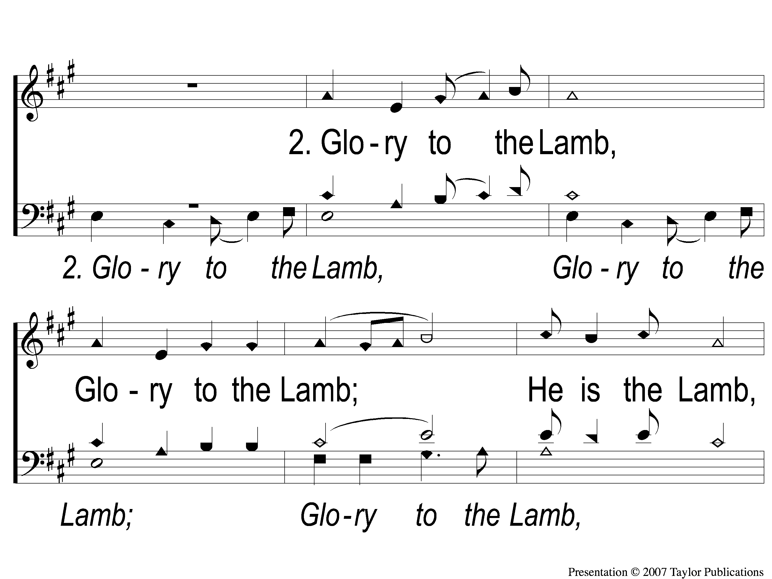
2-1 Worthy is the Lamb
Worthy Is the Lamb
234

Slide 108
2-2 Worthy is the Lamb
Worthy Is the Lamb
234

Slide 109
3-1 Worthy is the Lamb
Worthy Is the Lamb
234

Slide 110
3-2 Worthy is the Lamb
Worthy Is the Lamb
234

Slide 111
The Unleavened Bread
Hebrews 4:14-16
“Seeing then that we have a great High Priest who has passed through the heavens, Jesus the Son of God, olet us hold fast our confession. For we do not have a High Priest who cannot sympathize with our weaknesses, but was in all points tempted as we are, yet without sin. Let us therefore come boldly to the throne of grace, that we may obtain mercy and find grace to help in time of need.”

Slide 112
The Fruit
of the Vine
Hebrews 9:11-14
“But Christ came as High Priest of the good things to come, with the greater and more perfect tabernacle not made with hands, that is, not of this creation. Not with the blood of goats and calves, but with His own blood…For if the blood of bulls and goats and the ashes of a heifer, sprinkling the unclean, sanctifies for the purifying of the flesh, how much more shall the blood of Christ, who through the eternal Spirit offered Himself without spot to God, cleanse your conscience from dead works to serve the living God?”

Slide 113
Closing Prayer

Slide 114
Song:
Victory In Jesus
#470

Slide 115
1-1 Victory in Jesus
Victory in Jesus
470

Slide 116
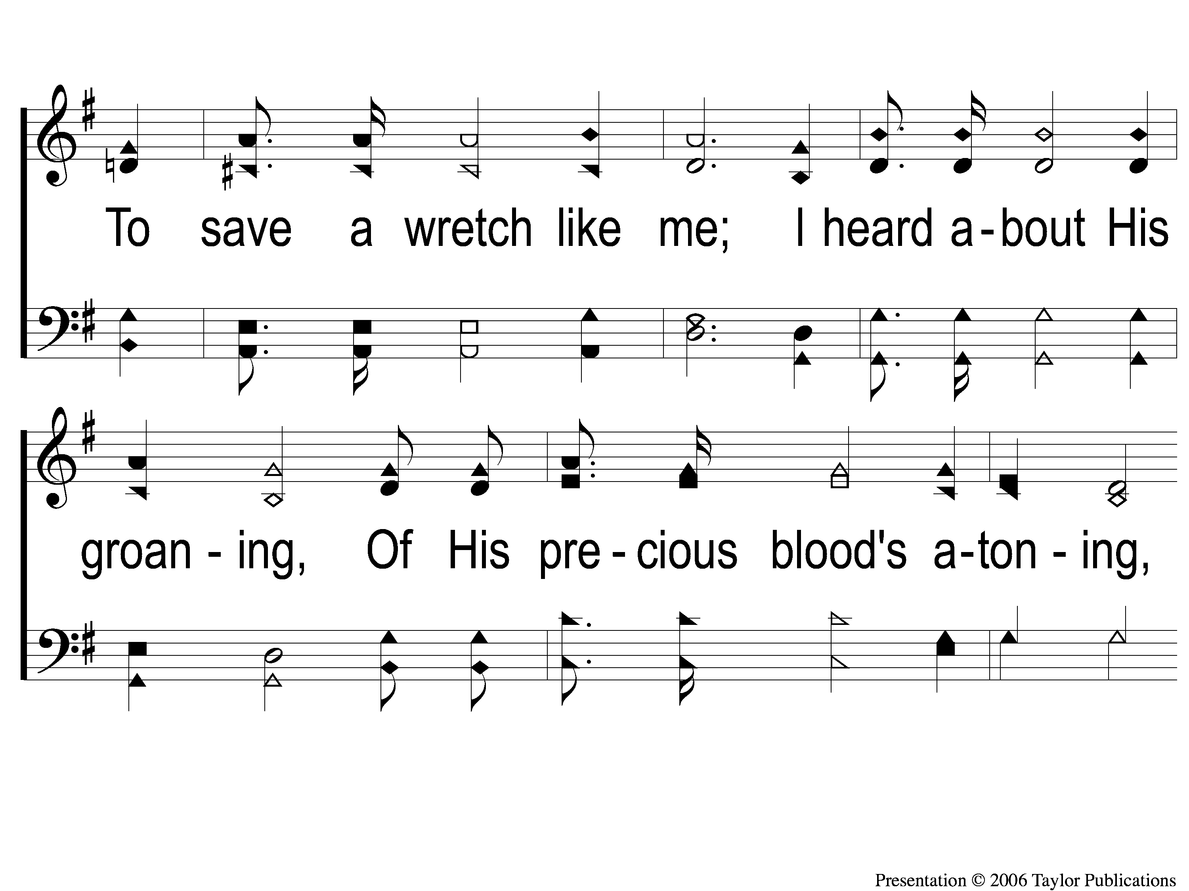
1-2 Victory in Jesus
Victory in Jesus
470

Slide 117
1-3 Victory in Jesus
Victory in Jesus
470

Slide 118
C-1 Victory in Jesus
Victory in Jesus
470

Slide 119
C-2 Victory in Jesus
Victory in Jesus
470

Slide 120
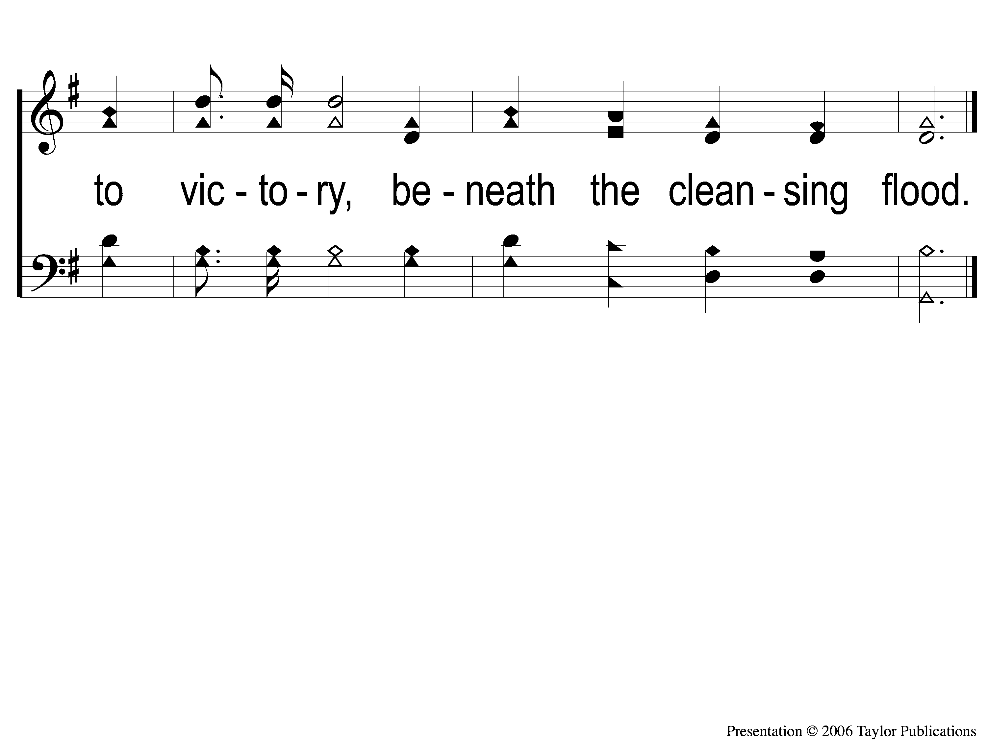
C-3 Victory in Jesus
Victory in Jesus
470

Slide 121
2-1 Victory in Jesus
Victory in Jesus
470

Slide 122
2-2 Victory in Jesus
Victory in Jesus
470

Slide 123
2-3 Victory in Jesus
Victory in Jesus
470

Slide 124
C-1 Victory in Jesus
Victory in Jesus
470

Slide 125
C-2 Victory in Jesus
Victory in Jesus
470

Slide 126
C-3 Victory in Jesus
Victory in Jesus
470

Slide 127
3-1 Victory in Jesus
Victory in Jesus
470

Slide 128
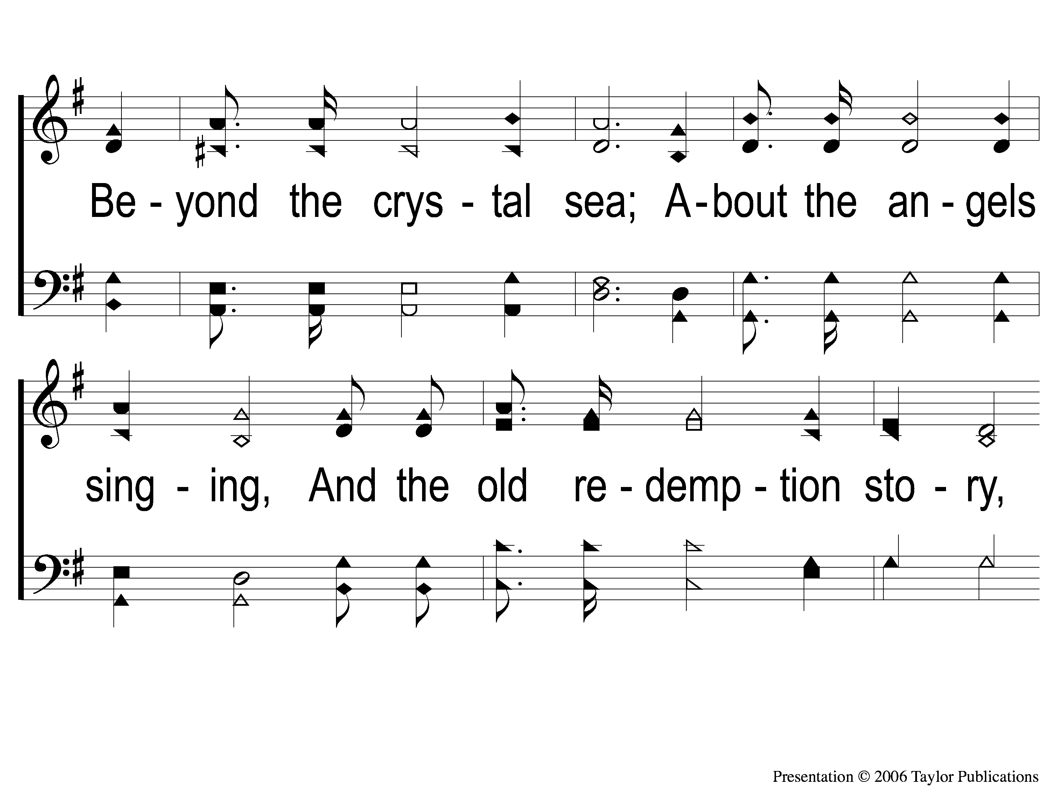
3-2 Victory in Jesus
Victory in Jesus
470

Slide 129
3-3 Victory in Jesus
Victory in Jesus
470

Slide 130
C-1 Victory in Jesus
Victory in Jesus
470

Slide 131
C-2 Victory in Jesus
Victory in Jesus
470

Slide 132
C-3 Victory in Jesus
Victory in Jesus
470

Slide 133
Tonight
Worship @ 6:00 PM
Wednesday
Worship & Classes @ 6:30 pm
RESTORE REBUILD RENEW
IN 2022
WHEELER
CHURCH
OF
CHRIST

Slide 134
Today
Fellowship Meal @ Noon
Devo & Singing @ 1:00 PM
Wednesday
Worship & Classes @ 6:30 pm
RESTORE REBUILD RENEW
IN 2022
WHEELER
CHURCH
OF
CHRIST

