Slide 1
PLEASE STANDBY
OUR LIVESTREAM
WILL BEGIN SOON

Slide 2
1 I Will Call Upon the Lord
I Will Call Upon the Lord
63

Slide 3
2 I Will Call Upon the Lord
I Will Call Upon the Lord
63

Slide 4
3 I Will Call Upon the Lord
I Will Call Upon the Lord
63

Slide 5
4 I Will Call Upon the Lord
I Will Call Upon the Lord
63

Slide 6
DC1 I Will Call Upon the Lord
I Will Call Upon the Lord
63

Slide 7
DC2 I Will Call Upon the Lord
I Will Call Upon the Lord
63

Slide 8
DC3 I Will Call Upon the Lord
I Will Call Upon the Lord
63

Slide 9
DC4 I Will Call Upon the Lord
I Will Call Upon the Lord
63

Slide 10
tag I Will Call Upon the Lord
I Will Call Upon the Lord
63

Slide 11
WELCOME
THANKS FOR JOINING US!

Slide 12
#452
SONG:
Standing On
The Promises

Slide 13
1-1 Standing on the Promises
Standing On the Promises
452

Slide 14
1-2 Standing on the Promises
Standing On the Promises
452

Slide 15
C-1 Standing on the Promises
Standing On the Promises
452

Slide 16
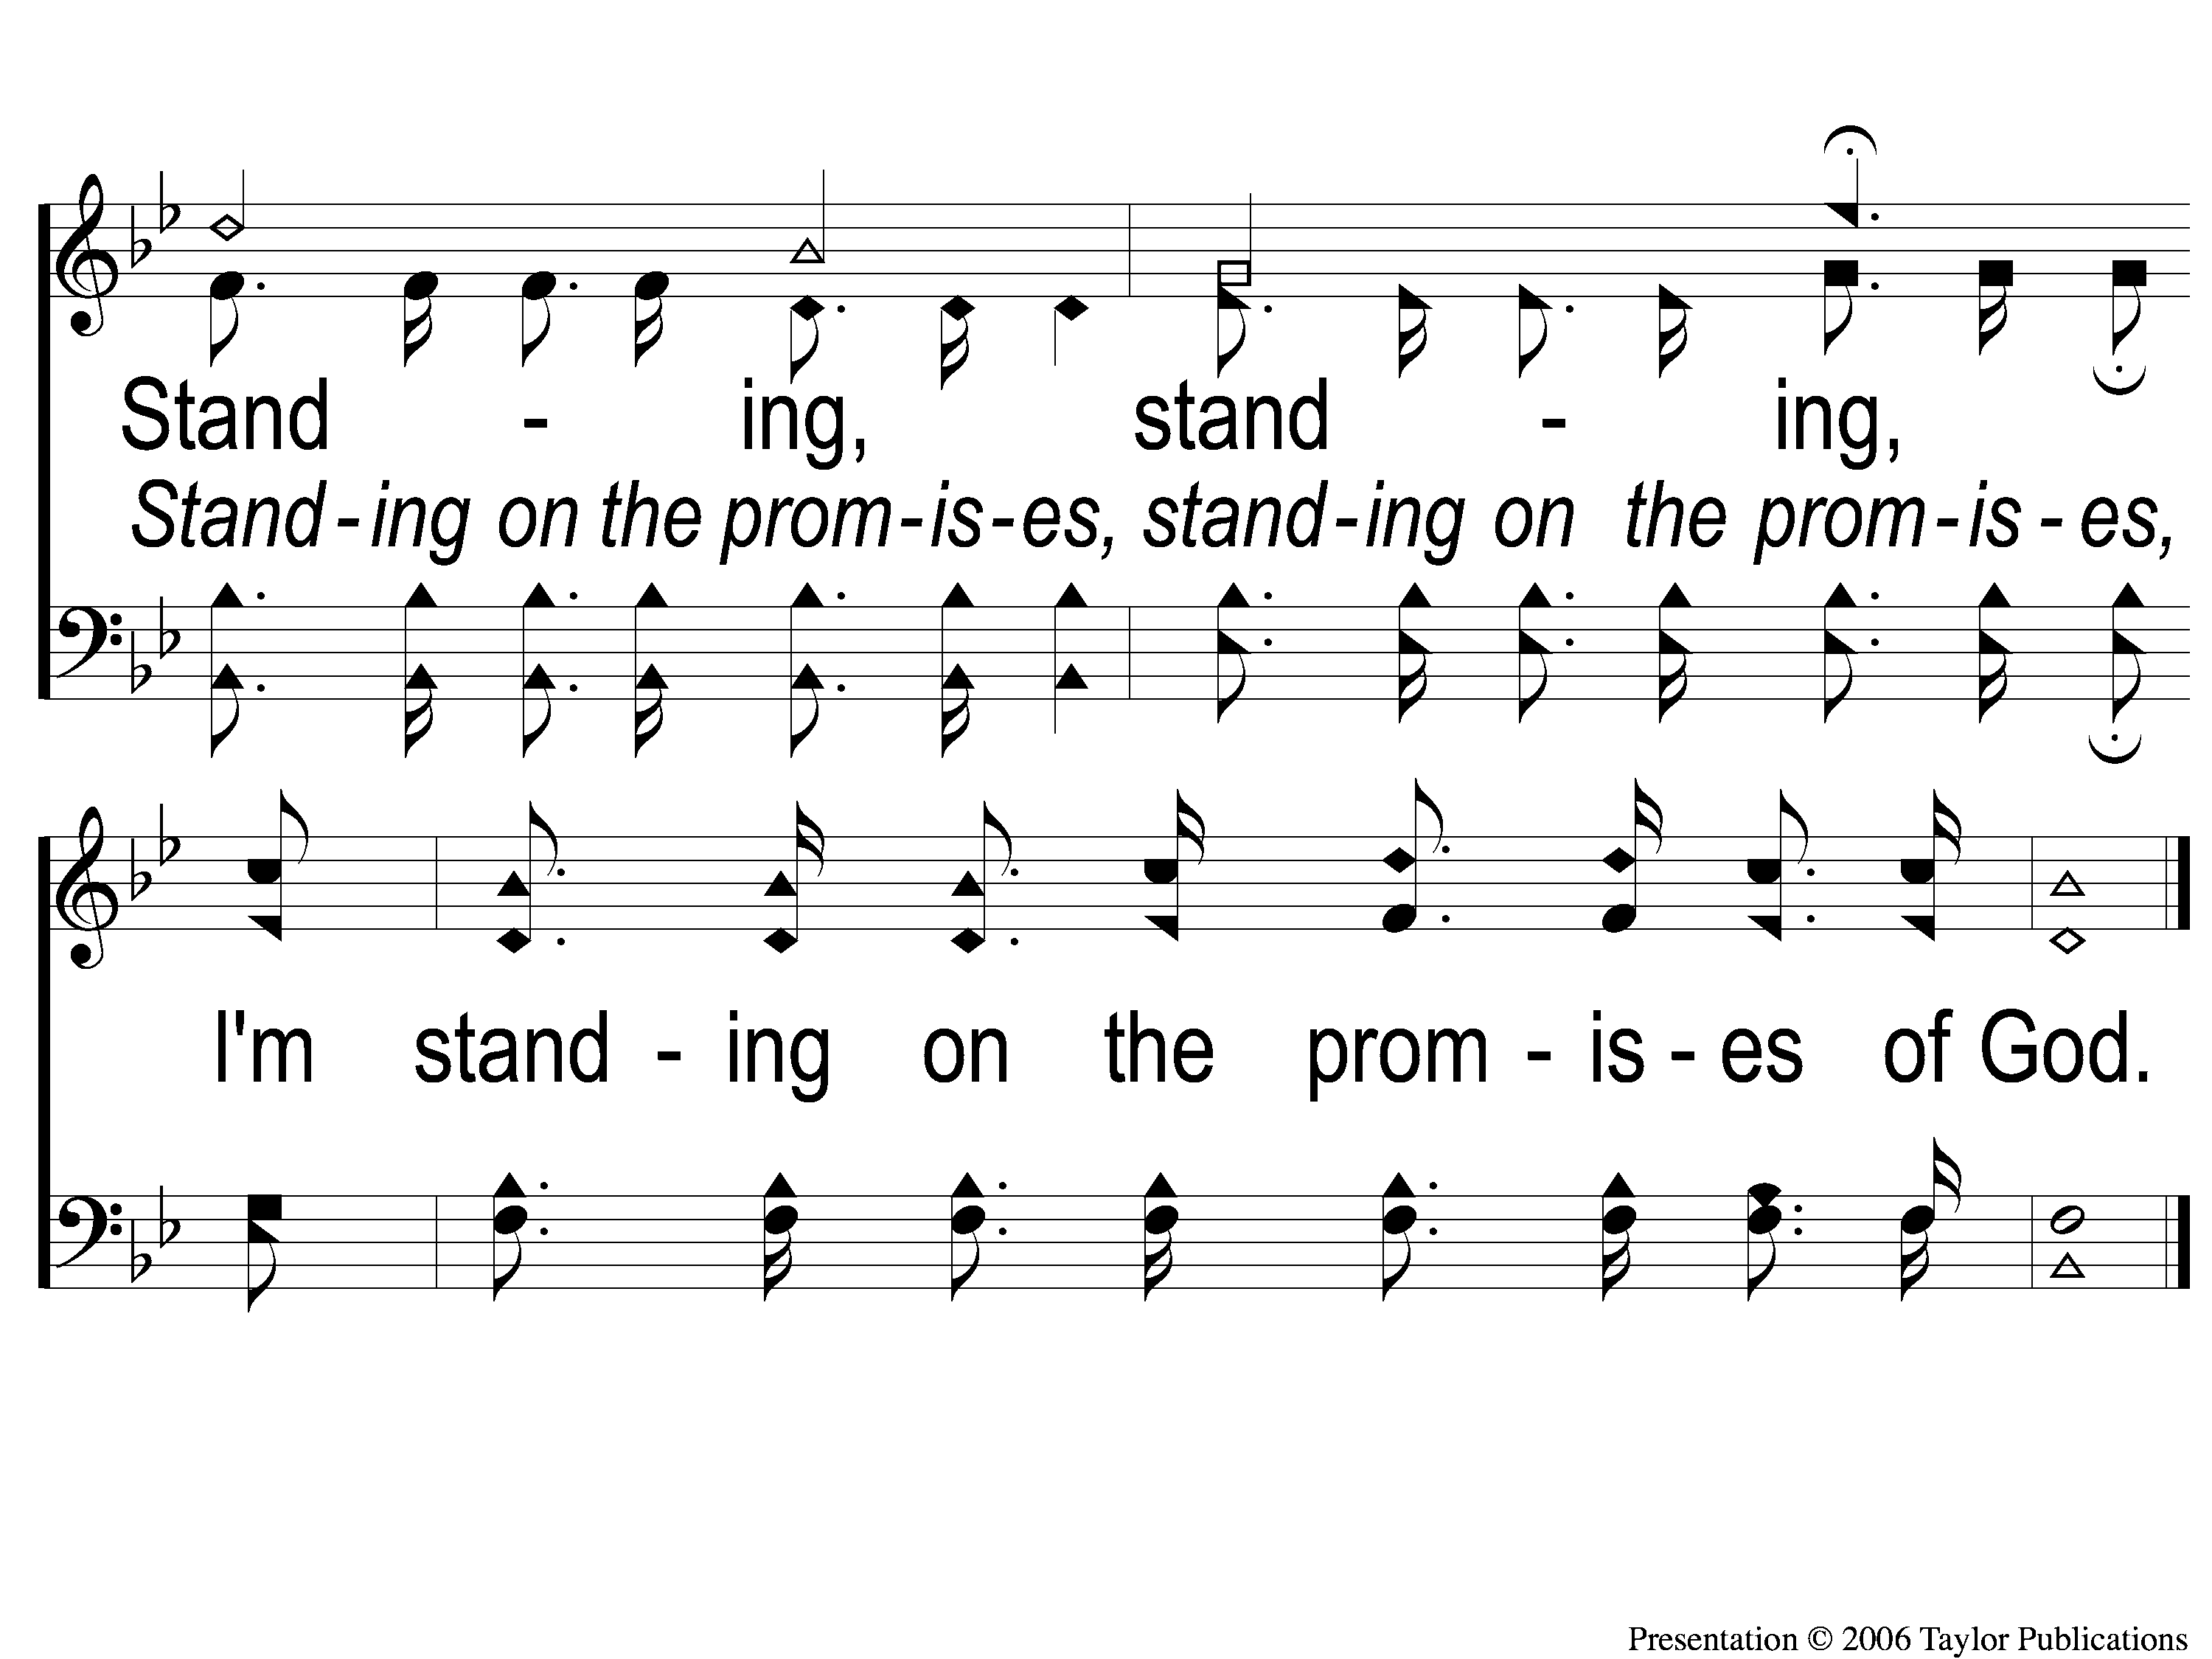
C-2 Standing on the Promises
Standing On the Promises
452

Slide 17
2-1 Standing on the Promises
Standing On the Promises
452

Slide 18
2-2 Standing on the Promises
Standing On the Promises
452

Slide 19
C-1 Standing on the Promises
Standing On the Promises
452

Slide 20
C-2 Standing on the Promises
Standing On the Promises
452

Slide 21
4-1 Standing on the Promises
Standing On the Promises
452

Slide 22
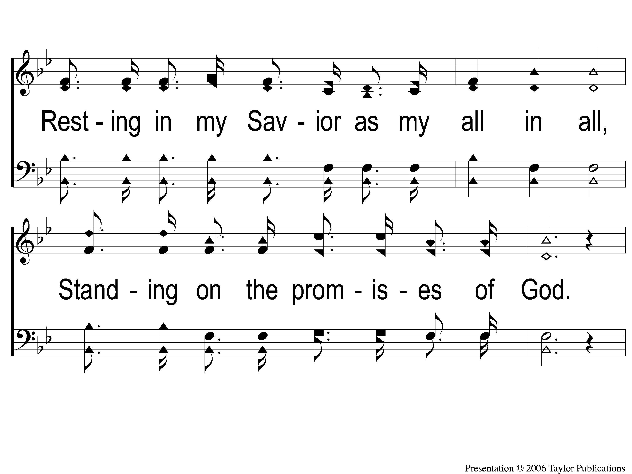
4-2 Standing on the Promises
Standing On the Promises
452

Slide 23
C-1 Standing on the Promises
Standing On the Promises
452

Slide 24
C-2 Standing on the Promises
Standing On the Promises
452

Slide 25
#564
SONG:
I Must Tell Jesus

Slide 26
1-1 I Must Tell Jesus
I Must Tell Jesus
564

Slide 27
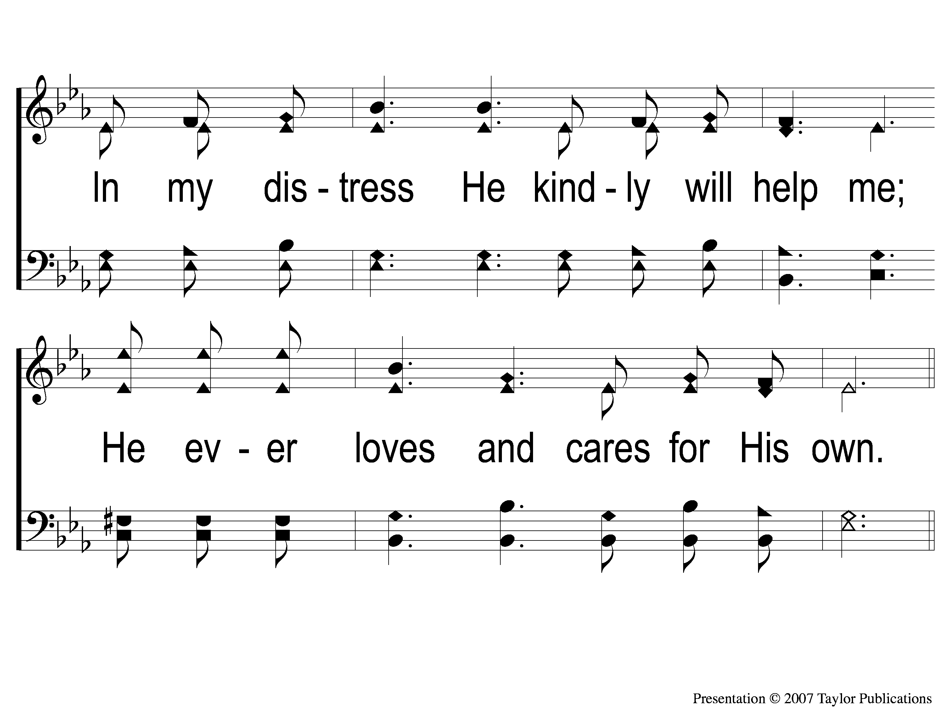
1-2 I Must Tell Jesus
I Must Tell Jesus
564

Slide 28
C-1 I Must Tell Jesus
I Must Tell Jesus
564

Slide 29
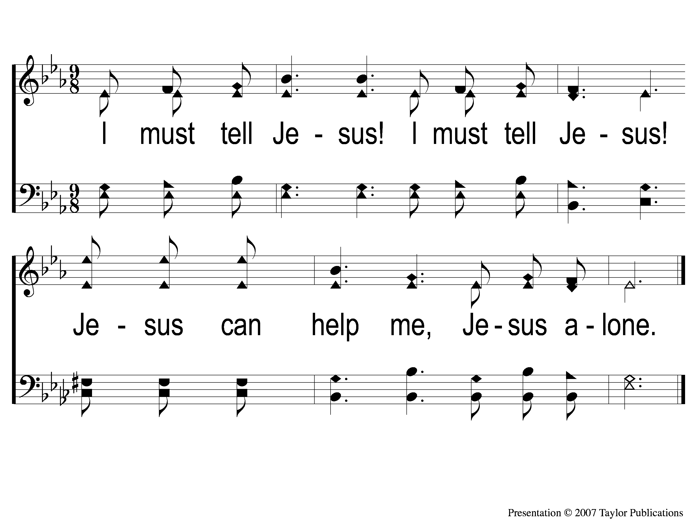
C-2 I Must Tell Jesus
I Must Tell Jesus
564

Slide 30
2-1 I Must Tell Jesus
I Must Tell Jesus
564

Slide 31
2-2 I Must Tell Jesus
I Must Tell Jesus
564

Slide 32
C-1 I Must Tell Jesus
I Must Tell Jesus
564

Slide 33
C-2 I Must Tell Jesus
I Must Tell Jesus
564

Slide 34
3-1 I Must Tell Jesus
I Must Tell Jesus
564

Slide 35
3-2 I Must Tell Jesus
I Must Tell Jesus
564

Slide 36
C-1 I Must Tell Jesus
I Must Tell Jesus
564

Slide 37
C-2 I Must Tell Jesus
I Must Tell Jesus
564

Slide 38
First PRAYER

Slide 39
#469
SONG:
Faith Is The Victory

Slide 40
1-1 Faith is the Victory
Faith Is The Victory
469

Slide 41
1-2 Faith is the Victory
Faith Is The Victory
469

Slide 42
1-3 Faith is the Victory
Faith Is The Victory
469

Slide 43
C-1 Faith is the Victory
Faith Is The Victory
469

Slide 44
3-1 Faith is the Victory
Faith Is The Victory
469

Slide 45
3-2 Faith is the Victory
Faith Is The Victory
469

Slide 46
3-3 Faith is the Victory
Faith Is The Victory
469

Slide 47
C-1 Faith is the Victory
Faith Is The Victory
469

Slide 48
#450
SONG:
Give Me The Bible

Slide 49
1-1 Give Me the Bible
Give Me The Bible
450

Slide 50
1-2 Give Me the Bible
Give Me The Bible
450

Slide 51
C-1 Give Me the Bible
Give Me The Bible
450

Slide 52
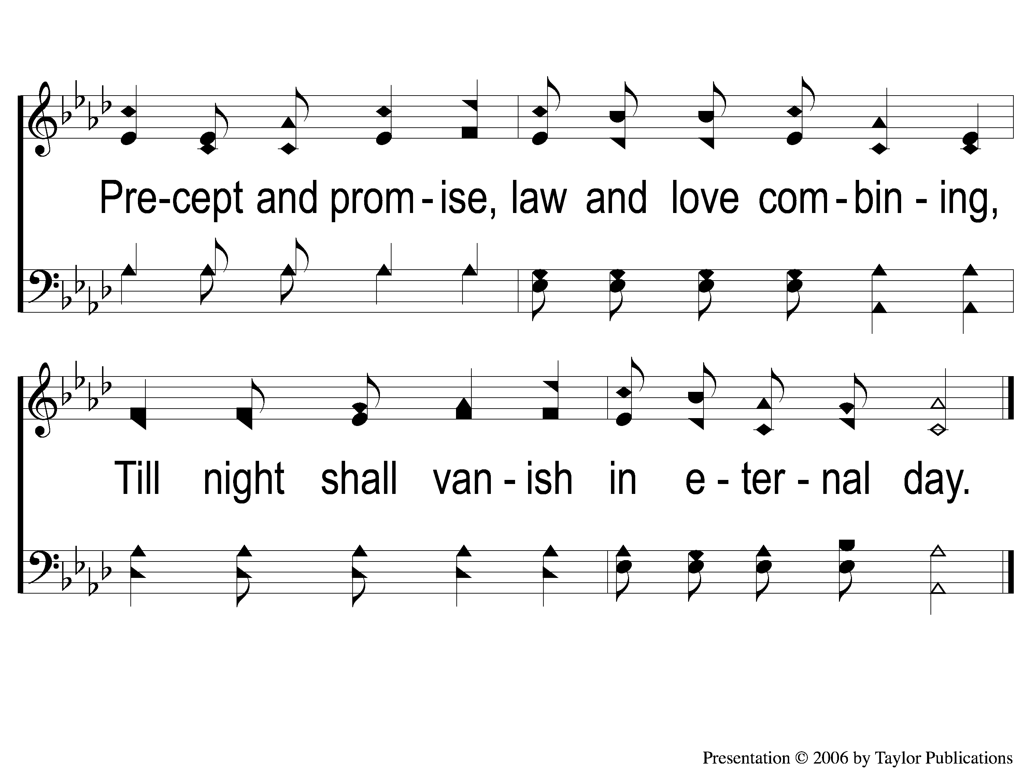
C-2 Give Me the Bible
Give Me The Bible
450

Slide 53
2-1 Give Me the Bible
Give Me The Bible
450

Slide 54
2-2 Give Me the Bible
Give Me The Bible
450

Slide 55
C-1 Give Me the Bible
Give Me The Bible
450

Slide 56
C-2 Give Me the Bible
Give Me The Bible
450

Slide 57
3-1 Give Me the Bible
Give Me The Bible
450

Slide 58
3-2 Give Me the Bible
Give Me The Bible
450

Slide 59
C-1 Give Me the Bible
Give Me The Bible
450

Slide 60
C-2 Give Me the Bible
Give Me The Bible
450

Slide 61
SCRIPTURE:
2 Kings 21:1-9

Slide 63
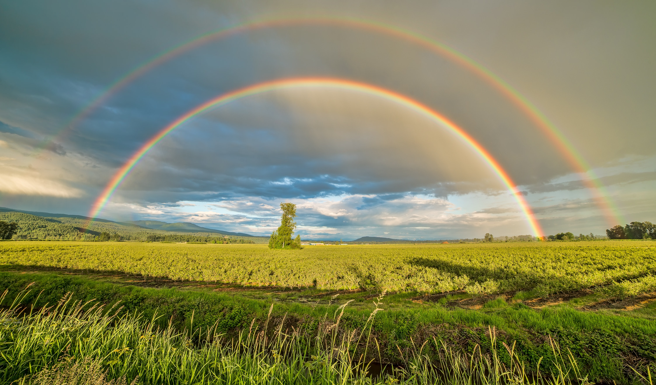
STANDING ON THE PROMISES

Slide 64
Stand out!

Slide 65
Case Study: jabez
1 Chron. 4:9-10

Slide 66
Case Study:
KING MANASSEH
2 Chron. 33:1-20

Slide 67
KING MANASSEH
His Family
Son of Hezekiah
Grandfather of Josiah

Slide 68
KING MANASSEH
His Reign
55 Years
King of Judah (S. Kingdom)

Slide 69
MANASSEH stood out…
…in His Sinfulness

Slide 70
HIS SINS
Rebuilt the high places (v. 3)

Slide 71
HIS SINS
Rebuilt the high places (v. 3)
Raised up altars for Baals (v. 3)

Slide 72
HIS SINS
Rebuilt the high places (v. 3)
Raised up altars for Baals (v. 3)
Made wooden idols (v. 3)

Slide 73
HIS SINS
Rebuilt the high places (v. 3)
Raised up altars for Baals (v. 3)
Made wooden idols (v. 3)
Worshiped all the host of heaven (v. 3)

Slide 74
HIS SINS
Rebuilt the high places (v. 3)
Raised up altars for Baals (v. 3)
Made wooden idols (v. 3)
Worshiped all the host of heaven (v. 3)
Built altars in the Temple (v. 4)
In each of the 2 courts (v. 5)

Slide 75
HIS SINS
Sacrificed his sons to false gods (v. 6)

Slide 76
HIS SINS
Sacrificed his sons to false gods (v. 6)
Practiced soothsaying (v. 6)

Slide 77
HIS SINS
Sacrificed his sons to false gods (v. 6)
Practiced soothsaying (v. 6)
Used witchcraft / sorcery (v. 6)

Slide 78
HIS SINS
Sacrificed his sons to false gods (v. 6)
Practiced soothsaying (v. 6)
Used witchcraft / sorcery (v. 6)
Consulted mediums and spiritists (v. 6)

Slide 79
HIS SINS
Sacrificed his sons to false gods (v. 6)
Practiced soothsaying (v. 6)
Used witchcraft / sorcery (v. 6)
Consulted mediums and spiritists (v. 6)
Made an idol to Asherah in the Temple (v. 7)

Slide 80
HIS SINS
Sacrificed his sons to false gods (v. 6)
Practiced soothsaying (v. 6)
Used witchcraft / sorcery (v. 6)
Consulted mediums and spiritists (v. 6)
Made an idol to Asherah in the Temple (v. 7)
Influenced an entire nation to do evil (v. 9)

Slide 81
MANASSEH stood out…
…in His Sinfulness
…in His Seeking of God

Slide 82
HIS SEEKING OF GOD
2 Chron. 33:10-13

Slide 83
HIS SEEKING OF GOD
2 Chron. 33:10-13
Taken Captive by Assyrian king
Psa. 34:18, 51:17

Slide 84
HIS SEEKING OF GOD
Salvation Requires Humility
Mic. 6:8
Jms. 4:6, 10
1 Pet. 5:6

Slide 85
MANASSEH stood out…
…in His Sinfulness
…in His Seeking of God
…in His Setting Things Right

Slide 86
HIS SETTING THINGS RIGHT
2 Chron. 33:14-17

Slide 87
HIS SETTING THINGS RIGHT
2 Chron. 33:14-17
True Repentance
Acts 26:19-20
Matt. 3:8

Slide 88
HIS SETTING THINGS RIGHT
What did Manasseh do?

Slide 89
HIS SETTING THINGS RIGHT
What did Manasseh do?
Fortified Jerusalem and other cities in Judah with walls and military captains (v. 14)

Slide 90
HIS SETTING THINGS RIGHT
What did Manasseh do?
Fortified Jerusalem and other cities in Judah with walls and military captains (v. 14)
Took away foreign gods and idol of Asherah in the Temple (v. 15)

Slide 91
HIS SETTING THINGS RIGHT
What did Manasseh do?
Fortified Jerusalem and other cities in Judah with walls and military captains (v. 14)
Took away foreign gods and idol of Asherah in the Temple (v. 15)
Repaired the altar in the Temple (v. 16)

Slide 92
HIS SETTING THINGS RIGHT
What did Manasseh do?
Fortified Jerusalem and other cities in Judah with walls and military captains (v. 14)
Took away foreign gods and idol of Asherah in the Temple (v. 15)
Repaired the altar in the Temple (v. 16)
Offered peace and thank offerings on it (v. 16)

Slide 93
HIS SETTING THINGS RIGHT
What did Manasseh do?
Fortified Jerusalem and other cities in Judah with walls and military captains (v. 14)
Took away foreign gods and idol of Asherah in the Temple (v. 15)
Repaired the altar in the Temple (v. 16)
Offered peace and thank offerings on it (v. 16)
Commanded Judah to serve God alone! (v. 16)

Slide 94
Lessons:

Slide 95
Lessons:
True Repentance Stands Out!
1 Pet. 4:1-4

Slide 96
Lessons:
True Repentance Stands Out!
1 Pet. 4:1-4
True Success is Finishing Well
Psa. 86:13, 2 Tim. 4:7

Slide 97
Have you
truly repented?

Slide 98
#948
SONG:
I Am Resolved

Slide 99
1-1 I Am Resolved
I Am Resolved
948

Slide 100
1-2 I Am Resolved
I Am Resolved
948

Slide 101
C-1 I Am Resolved
I Am Resolved
948

Slide 102
C-2 I Am Resolved
I Am Resolved
948

Slide 103
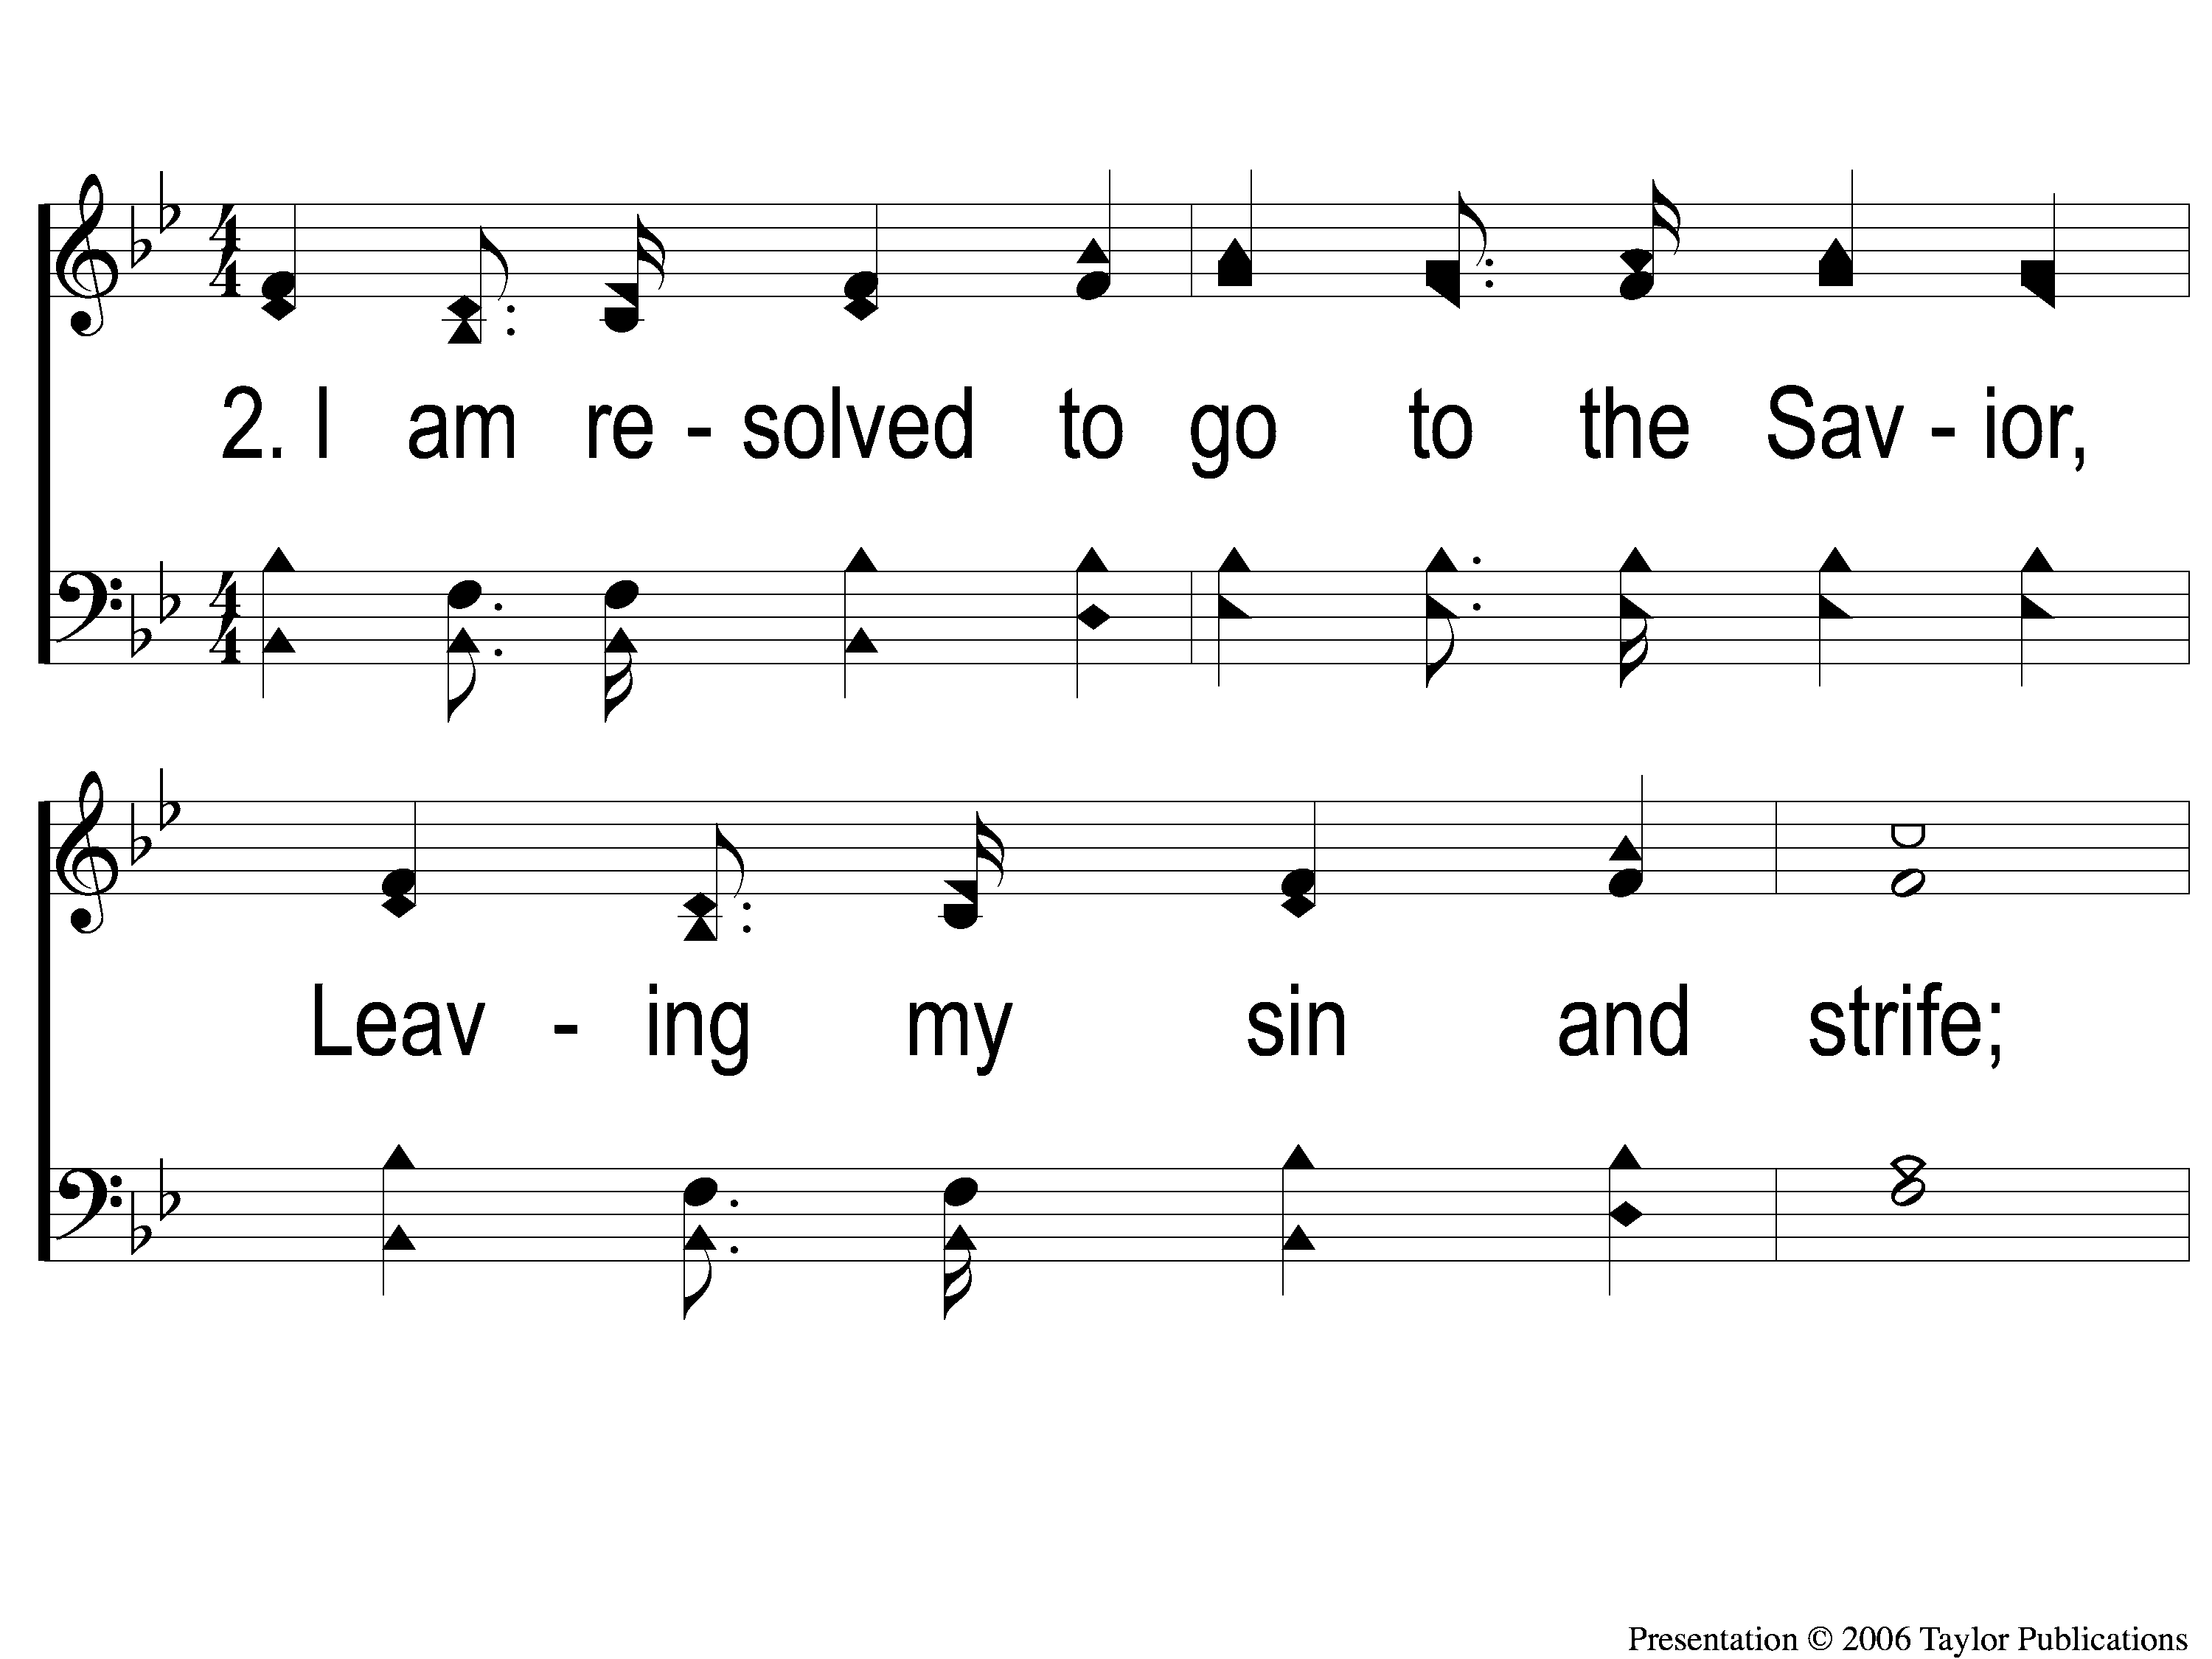
2-1 I Am Resolved
I Am Resolved
948

Slide 104
2-2 I Am Resolved
I Am Resolved
948

Slide 105
C-1 I Am Resolved
I Am Resolved
948

Slide 106
C-2 I Am Resolved
I Am Resolved
948

Slide 107
4-1 I Am Resolved
I Am Resolved
948

Slide 108
4-2 I Am Resolved
I Am Resolved
948

Slide 109
C-1 I Am Resolved
I Am Resolved
948

Slide 110
C-2 I Am Resolved
I Am Resolved
948

Slide 111
#922
SONG:
Jesus Paid It All

Slide 112
1-1 Jesus Paid It All
Jesus Paid It All
922

Slide 113
1-2 Jesus Paid It All
Jesus Paid It All
922

Slide 114
C Jesus Paid It All
Jesus Paid It All
922

Slide 115
2-1 Jesus Paid It All
Jesus Paid It All
922

Slide 116
2-2 Jesus Paid It All
Jesus Paid It All
922

Slide 117
C Jesus Paid It All
Jesus Paid It All
922

Slide 118
3-1 Jesus Paid It All
Jesus Paid It All
922

Slide 119
3-2 Jesus Paid It All
Jesus Paid It All
922

Slide 120
C Jesus Paid It All
Jesus Paid It All
922

Slide 121
LORD’S SUPPER
The
Acts 20:7

Slide 122
Unleavened Bread
LORD’S SUPPER
⁵ For there is one God and one Mediator between God and men, the Man Christ Jesus, ⁶ who gave Himself a ransom for all, to be testified in due time, ⁷ for which I was appointed a preacher and an apostle—I am speaking the truth ⁴in Christ and not lying—a teacher of the Gentiles in faith and truth.
1 Tim. 2:5-7

Slide 123
Fruit of the Vine
LORD’S SUPPER
9 For God did not appoint us to wrath, but to obtain salvation through our Lord Jesus Christ, 10 who died for us, that whether we wake or sleep, we should live together with Him.11 Therefore comfort each other and edify one another, just as you also are doing.
1 Thes. 5:9-11

Slide 124
2 Corinthians 8:12
OFFERING
¹² For if there is first a willing mind, it is accepted according to what one has, and not according to what he does not have.

Slide 125
Closing PRAYER

Slide 126
#859
SONG:
When All Of God’s Singers Get Home

Slide 127
1-1 When all of God’s Singers get Home
When All Of God’s Singers Get Home
859

Slide 128
1-2 When all of God’s Singers get Home
When All Of God’s Singers Get Home
859

Slide 129
C-1 When all of God’s Singers get Home
When All Of God’s Singers Get Home
859

Slide 130
C-2 When all of God’s Singers get Home
When All Of God’s Singers Get Home
859

Slide 131
TONIGHT @ 6:00 pm
EVENING WORSHIP
HOPE TO SEE YOU THERE!

