Slide 1
PLEASE STANDBY
OUR LIVESTREAM
WILL BEGIN SOON

Slide 2
1-1 On Bended Knee
On Bended Knee
791

Slide 3
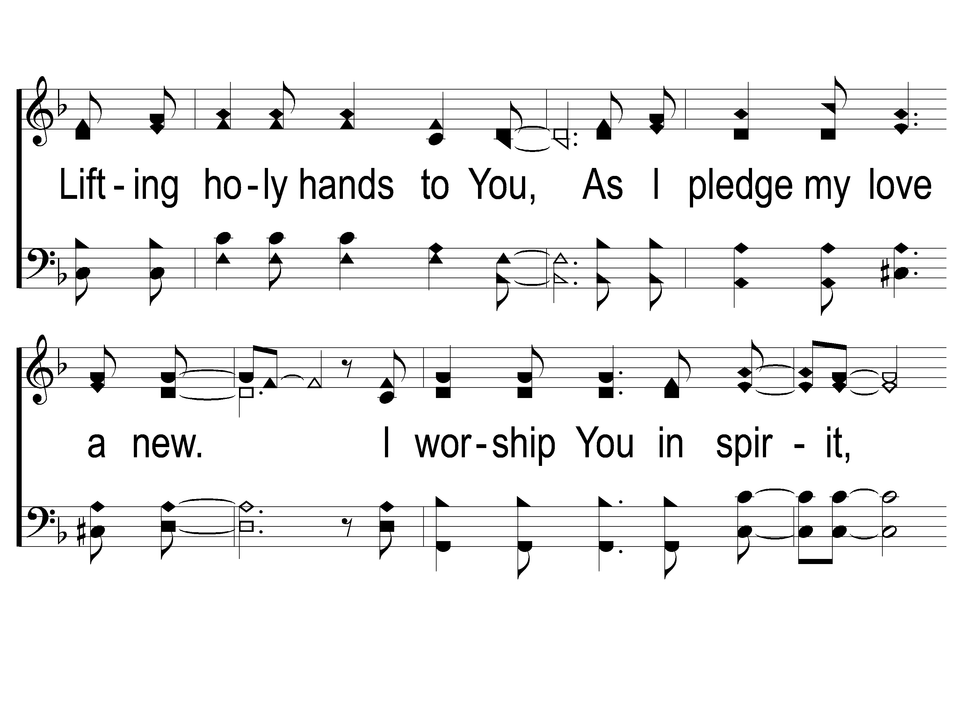
1-2 On Bended Knee
On Bended Knee
791

Slide 4
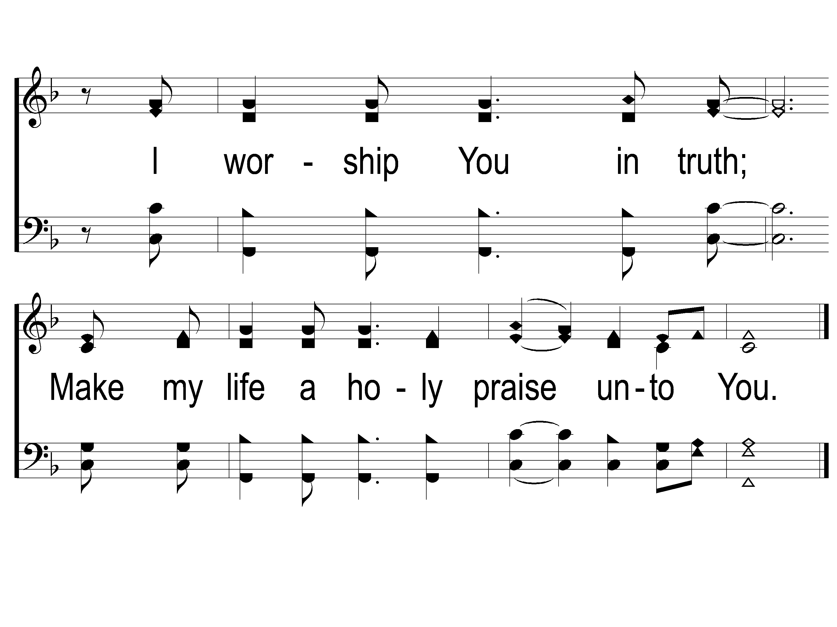
1-3 On Bended Knee
On Bended Knee
791

Slide 5
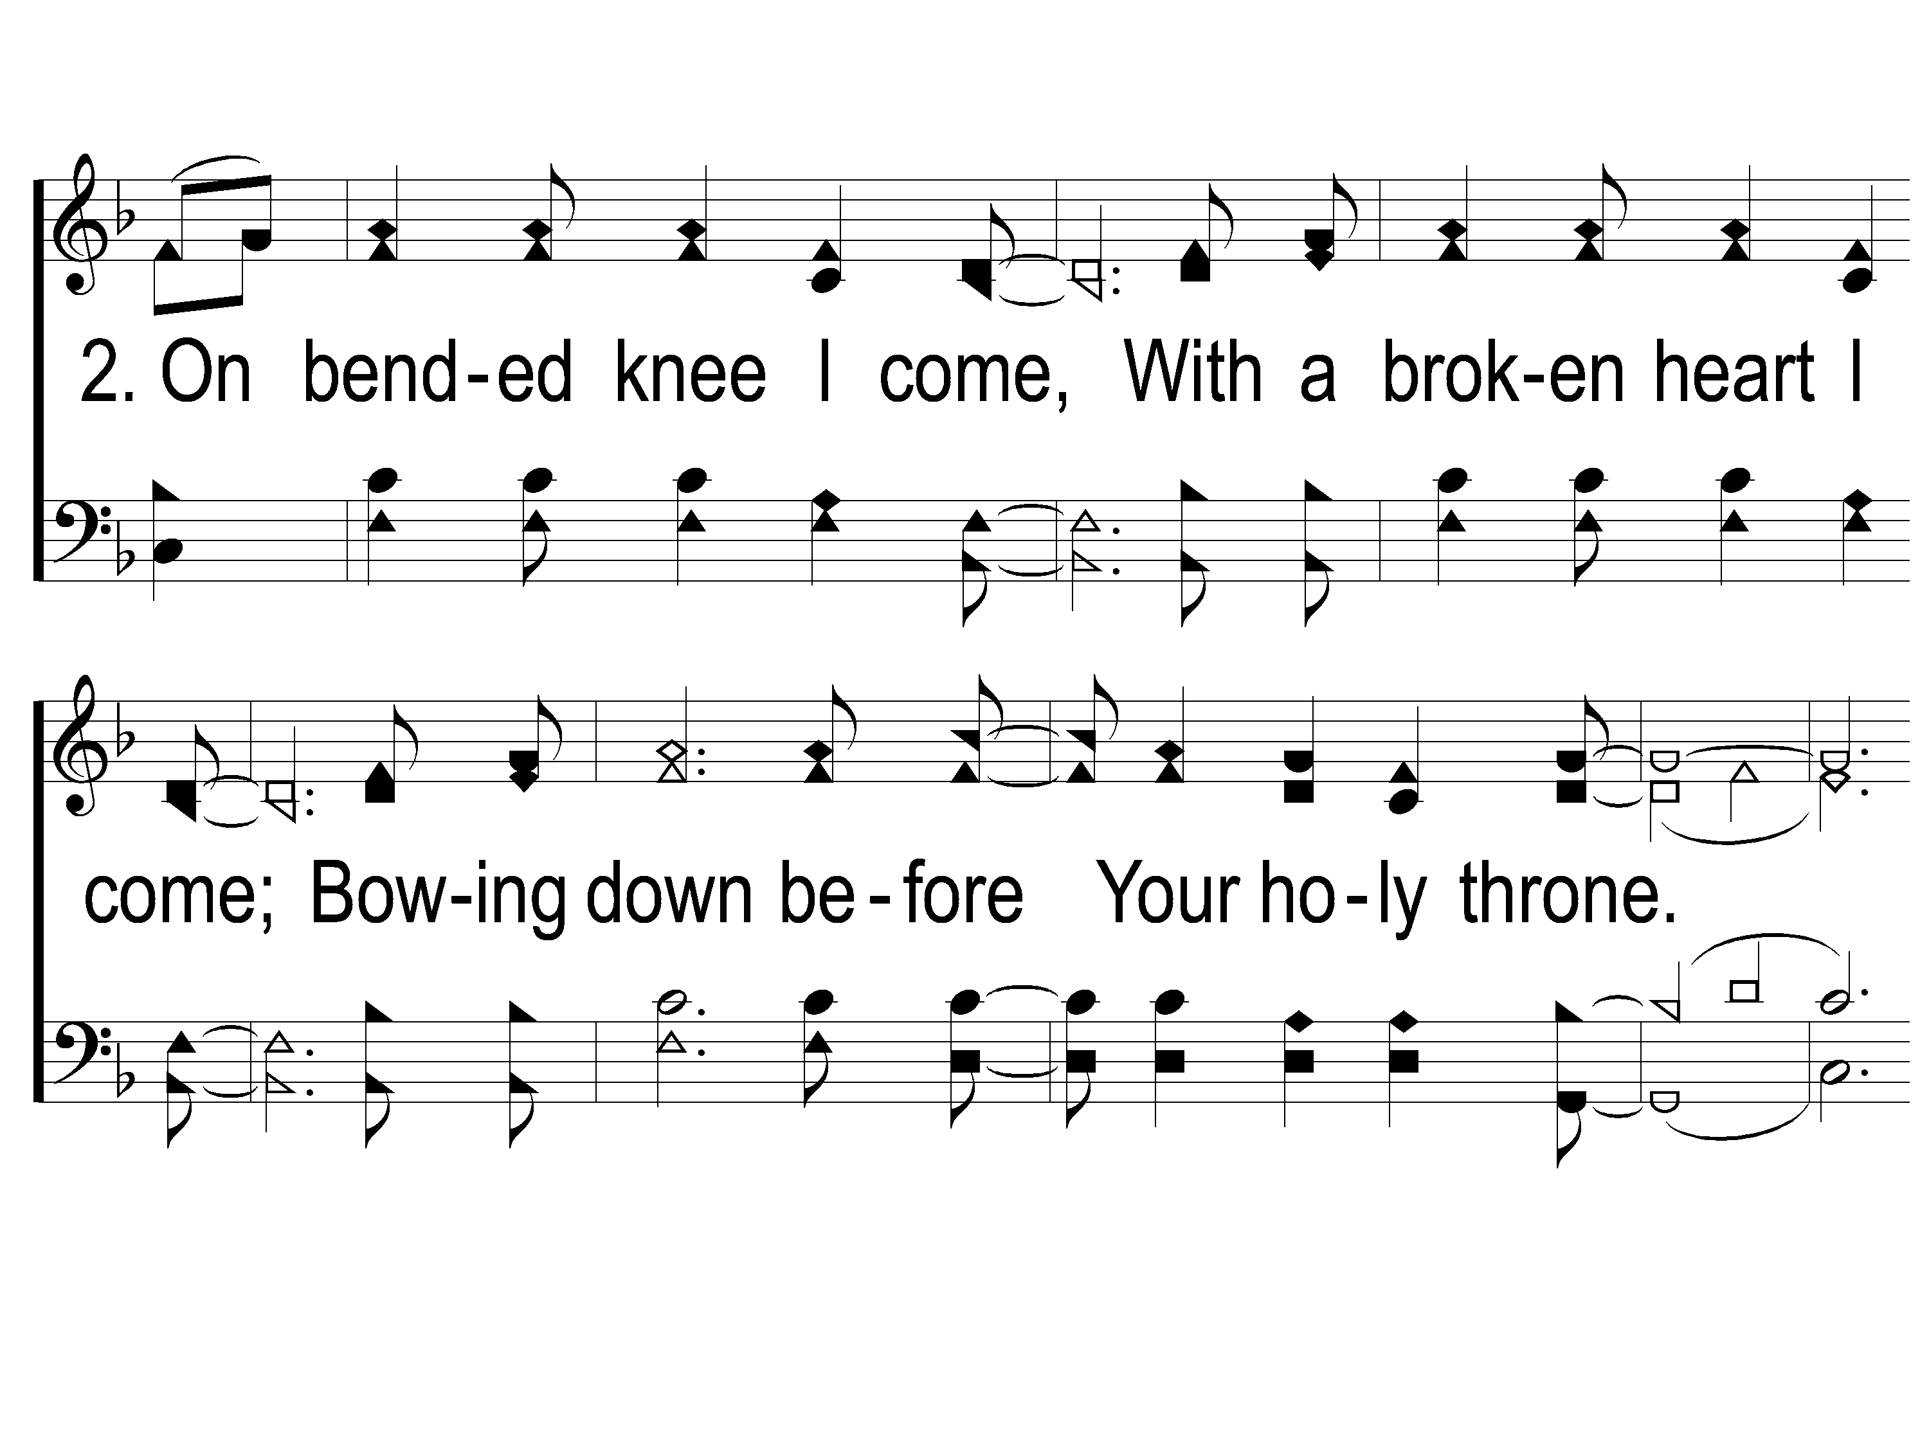
2-1 On Bended Knee
On Bended Knee
791

Slide 6
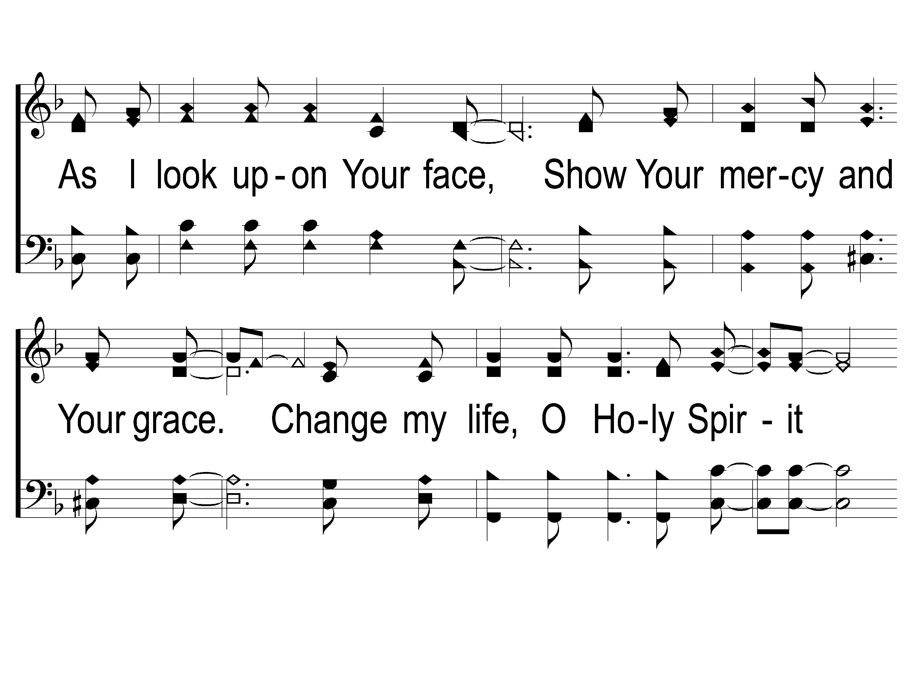
2-2 On Bended Knee
On Bended Knee
791

Slide 7
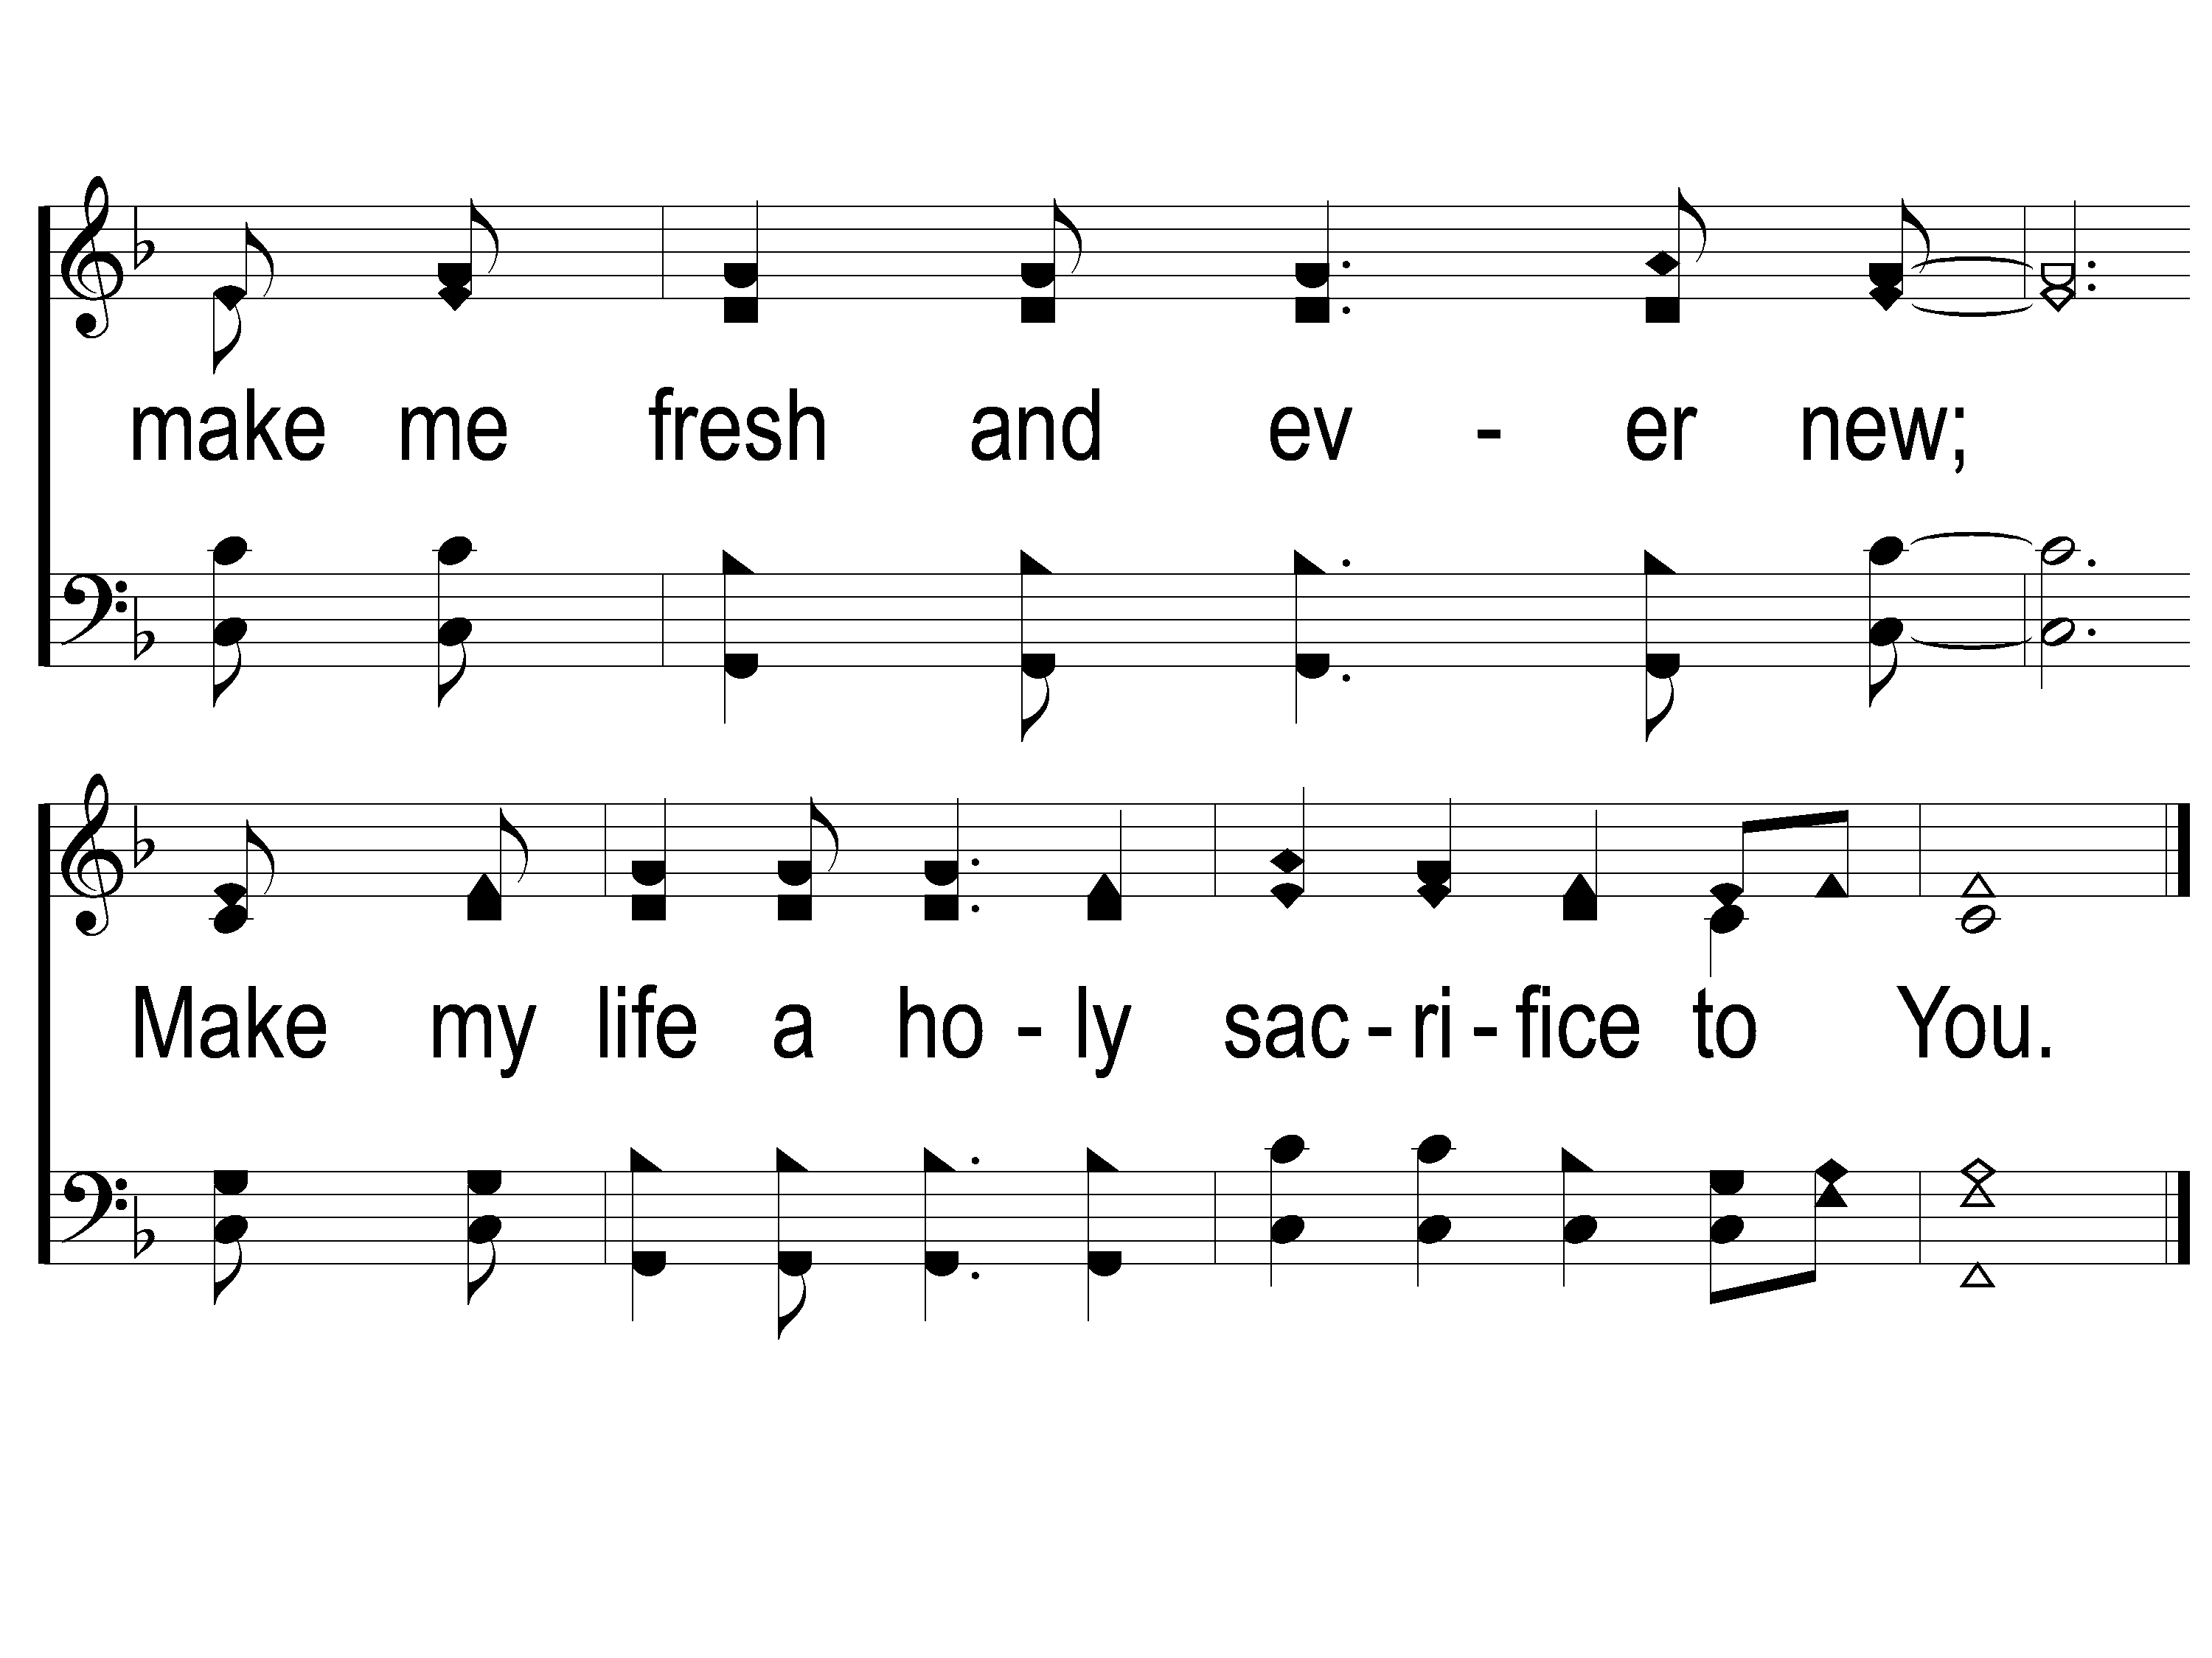
2-3 On Bended Knee
On Bended Knee
791

Slide 8
WELCOME
THANKS FOR JOINING US!

Slide 9
#76
SONG:
How Great Thou Art

Slide 10
1-1 How Great Thou Art
How Great Thou Art
76

Slide 11
1-2 How Great Thou Art
How Great Thou Art
76

Slide 12
C-1 How Great Thou Art
How Great Thou Art
76

Slide 13
C-2 How Great Thou Art
How Great Thou Art
76

Slide 14
2-1 How Great Thou Art
How Great Thou Art
76

Slide 15
2-2 How Great Thou Art
How Great Thou Art
76

Slide 16
C-1 How Great Thou Art
How Great Thou Art
76

Slide 17
C-2 How Great Thou Art
How Great Thou Art
76

Slide 18
4-1 How Great Thou Art
How Great Thou Art
76

Slide 19
4-2 How Great Thou Art
How Great Thou Art
76

Slide 20
C-1 How Great Thou Art
How Great Thou Art
76

Slide 21
C-2 How Great Thou Art
How Great Thou Art
76

Slide 22
SONG:
Surround Us, O Lord

Slide 23
1-1 Surround Us O Lord
Surround Us, O Lord

Slide 24
1-2 Surround Us O Lord
Surround Us, O Lord

Slide 25
1-3 Surround Us O Lord
Surround Us, O Lord

Slide 26
DS1 Surround Us O Lord
Surround Us, O Lord

Slide 27
DS2 Surround Us O Lord
Surround Us, O Lord

Slide 28
DS3 Surround Us O Lord
Surround Us, O Lord

Slide 29
DS4 Surround Us O Lord
Surround Us, O Lord

Slide 30
DS5 Surround Us O Lord
Surround Us, O Lord

Slide 31
First PRAYER

Slide 32
#218
SONG:
Blessed Jesus

Slide 33
1 Blessed Jesus
Blessed Jesus
218

Slide 34
2 Blessed Jesus
Blessed Jesus
218

Slide 35
c Blessed Jesus
Blessed Jesus
218

Slide 36
3 Blessed Jesus
Blessed Jesus
218

Slide 37
c Blessed Jesus
Blessed Jesus
218

Slide 38
Opt tag Blessed Jesus
Blessed Jesus
218

Slide 39
#452
SONG:
Father God

Slide 40
1-1 Father God
Father God, Just For Today

Slide 41
1-2 Father God
Father God, Just For Today

Slide 42
1C-1 Father God
Father God, Just For Today

Slide 43
1C-2 Father God
Father God, Just For Today

Slide 44
1C-1 Father God
Father God, Just For Today

Slide 45
1C-2 Father God
Father God, Just For Today

Slide 46
SCRIPTURE:
Psalm 10:14-18

Slide 47
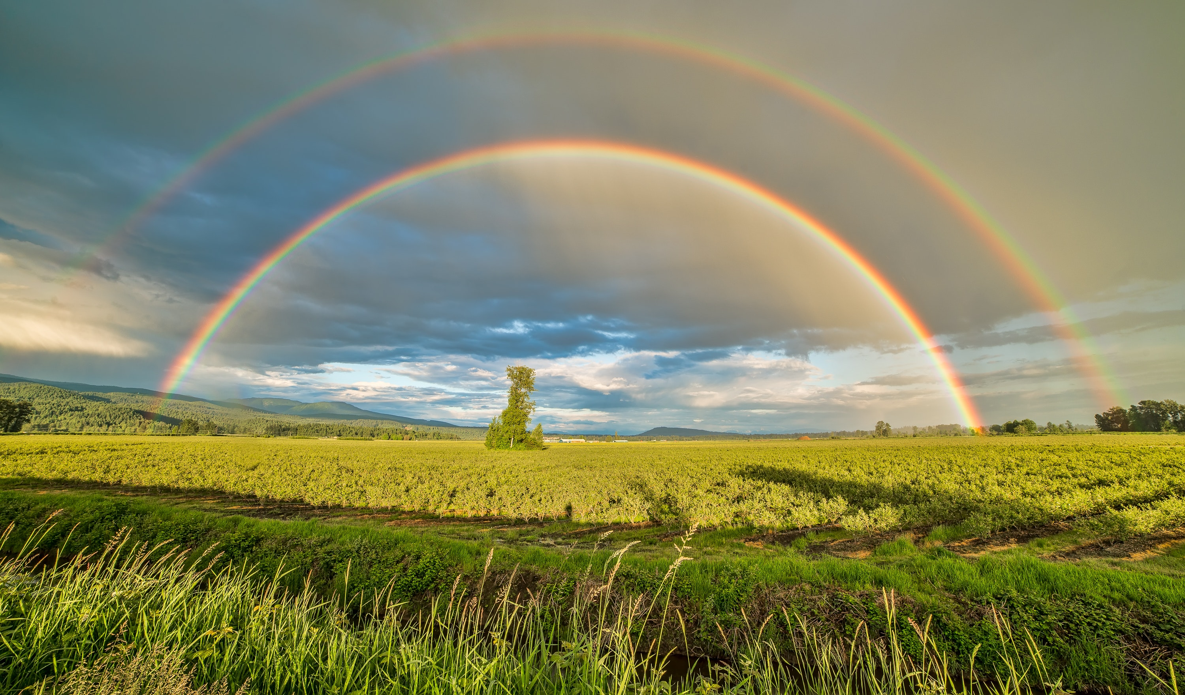
STANDING ON THE PROMISES

Slide 48
Tonight!
THE 1ST COMMAND WITH PROMISE

Slide 49
THE PROMISE OF ADOPTION

Slide 50
A Judge of Character

Slide 51
A Judge of Character
Job 29:12, 31:21

Slide 52
A Judge of Character
Job 29:12, 31:21
Ezek. 22:7

Slide 53
HE PROTECTS & PROVIDES
Deut. 24:20-21

Slide 54
HE PROTECTS & PROVIDES
Deut. 24:20-21
Psalm 10:14-18, 68:5, 146:9

Slide 55
HE PROTECTS & PROVIDES
Deut. 24:20-21
Psalm 10:14-18, 68:5, 146:9
Eph. 5:1

Slide 56
HE PROMISES

Slide 57
HE PROMISES
Adoption
Rom. 9:26 Gal. 4:4-8
Eph. 1:4-6 1 Jn. 3:1

Slide 58
FAMOUS ORPHANS

Slide 59
FAMOUS ORPHANS
Alexander Hamilton
Andrew Jackson
Herbert Hoover

Slide 60
FAMOUS ORPHANS
Alexander Hamilton
Andrew Jackson
Herbert Hoover
Babe Ruth

Slide 61
FAMOUS ORPHANS
Alexander Hamilton
Andrew Jackson
Herbert Hoover
Babe Ruth
Steve Jobs

Slide 62
WHEN IN GOD’S FAMILY…

Slide 63
WHEN IN GOD’S FAMILY…
A Loving Father

Slide 64
WHEN IN GOD’S FAMILY…
A Loving Father
An Older Brother (Jesus)

Slide 65
WHEN IN GOD’S FAMILY…
A Loving Father
An Older Brother (Jesus)
Countless Caring Siblings

Slide 66
WHEN IN GOD’S FAMILY…
A Loving Father
An Older Brother (Jesus)
Countless Caring Siblings
A Home Prepared

Slide 67
ARE YOU A CHILD OF THE HEAVENLY FATHER?

Slide 68
SONG:
In Need

Slide 69
1 In Need
342
In Need
CCLI#645323

Slide 70
2 In Need
342
In Need

Slide 71
3 In Need
342
In Need

Slide 72
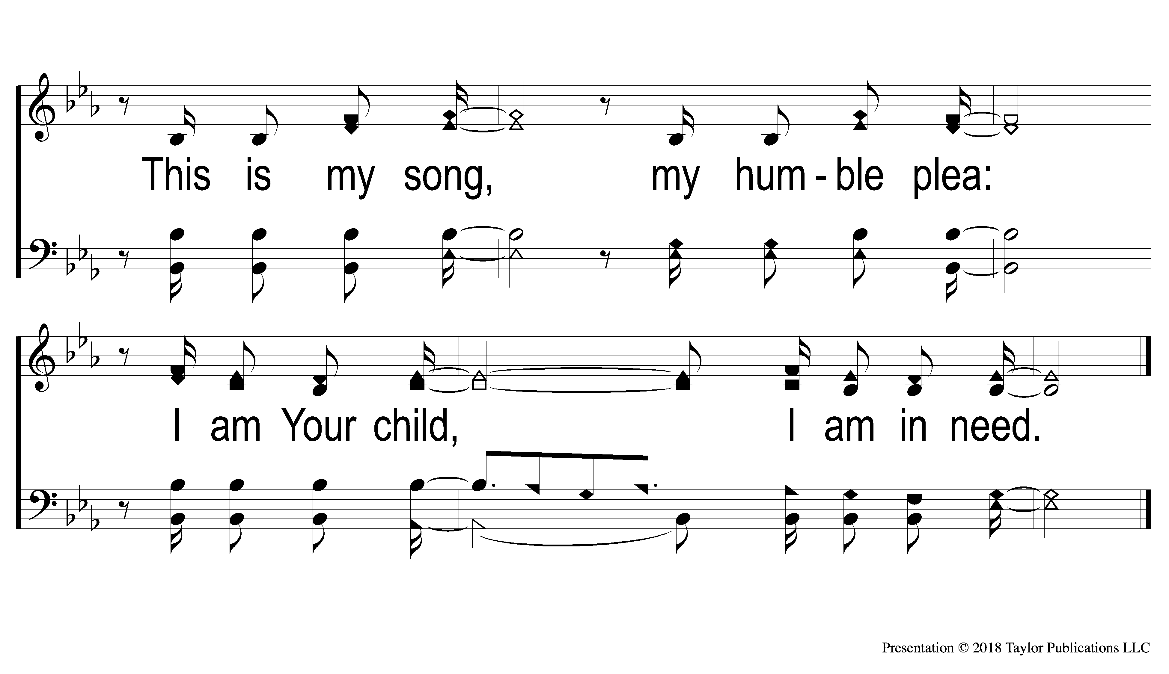
4 In Need
342
In Need

Slide 73
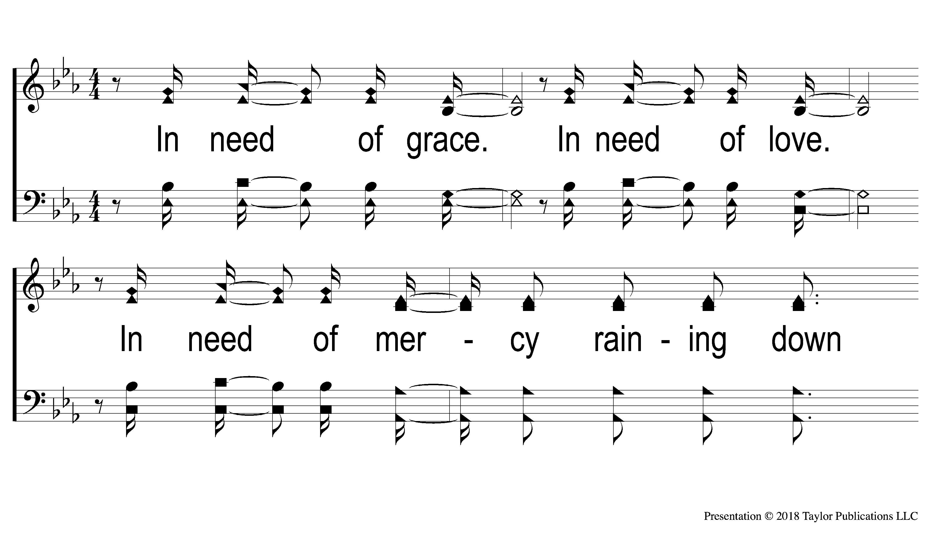
5 In Need
342
In Need

Slide 74
6 In Need
342
In Need

Slide 75
7 In Need
342
In Need

Slide 76
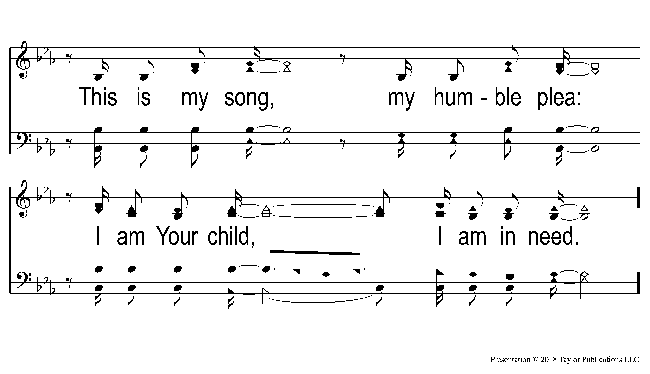
8 In Need
342
In Need

Slide 77
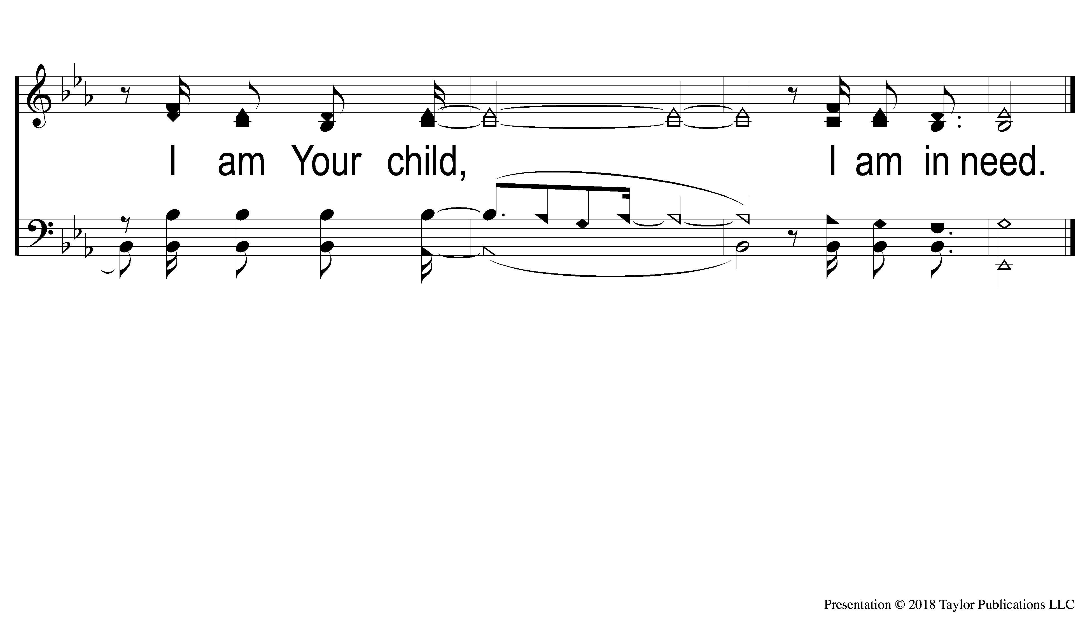
DS3 In Need
342
In Need

Slide 78
SONG:
How Deep
The Father’s Love

Slide 79
1-1 How Deep the Father’s Love
How Deep The Father’s Love

Slide 80
1-2 How Deep the Father’s Love
How Deep The Father’s Love

Slide 81
1-3 How Deep the Father’s Love
How Deep The Father’s Love

Slide 82
1-4 How Deep the Father’s Love
How Deep The Father’s Love

Slide 83
2-1 How Deep the Father’s Love
How Deep The Father’s Love

Slide 84
2-2 How Deep the Father’s Love
How Deep The Father’s Love

Slide 85
2-3 How Deep the Father’s Love
How Deep The Father’s Love

Slide 86
2-4 How Deep the Father’s Love
How Deep The Father’s Love

Slide 87
3-1 How Deep the Father’s Love
How Deep The Father’s Love

Slide 88
3-2 How Deep the Father’s Love
How Deep The Father’s Love

Slide 89
3-3 How Deep the Father’s Love
How Deep The Father’s Love

Slide 90
3-4 How Deep the Father’s Love
How Deep The Father’s Love

Slide 91
LORD’S SUPPER
The
Acts 20:7

Slide 92
Unleavened Bread
LORD’S SUPPER
²³ For I received from the Lord that which I also delivered to you: that the Lord Jesus on the same night in which He was betrayed took bread; ²⁴ and when He had given thanks, He broke it and said, “Take, eat; this is My body which is broken for you; do this in remembrance of Me.”
1 Corinthians 11:23-24

Slide 93
Fruit of the Vine
LORD’S SUPPER
²⁵ In the same manner He also took the cup after supper, saying, “This cup is the new covenant in My blood. This do, as often as you drink it, in remembrance of Me.”²⁶ For as often as you eat this bread and drink this cup, you proclaim the Lord’s death till He comes.
1Corinthians 11:25-26

Slide 94
Proverbs 22:9
OFFERING
⁹ He who has a generous eye will be blessed,
For he gives of his bread to the poor.

Slide 95
Closing PRAYER

Slide 96
SONG:
The Greatest Commands

Slide 97
1-1 How Beautiful Heaven Must Be
How Beautiful Heaven Must Be
885

Slide 98
1-2 How Beautiful Heaven Must Be
How Beautiful Heaven Must Be
885

Slide 99
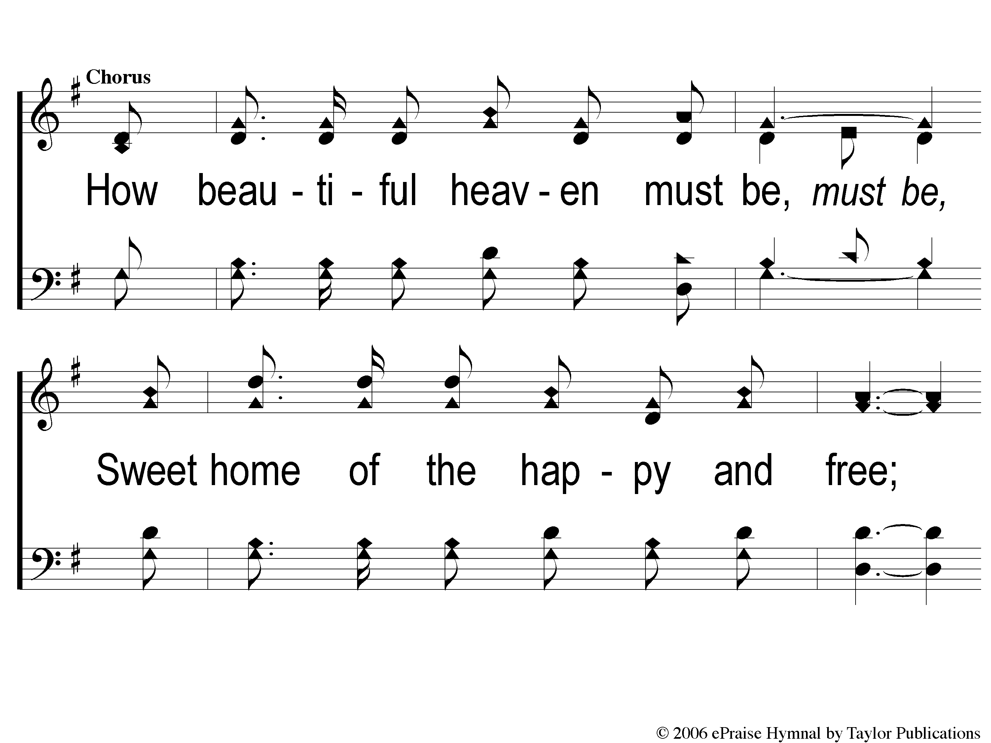
C-1 How Beautiful Heaven Must Be
How Beautiful Heaven Must Be
885

Slide 100
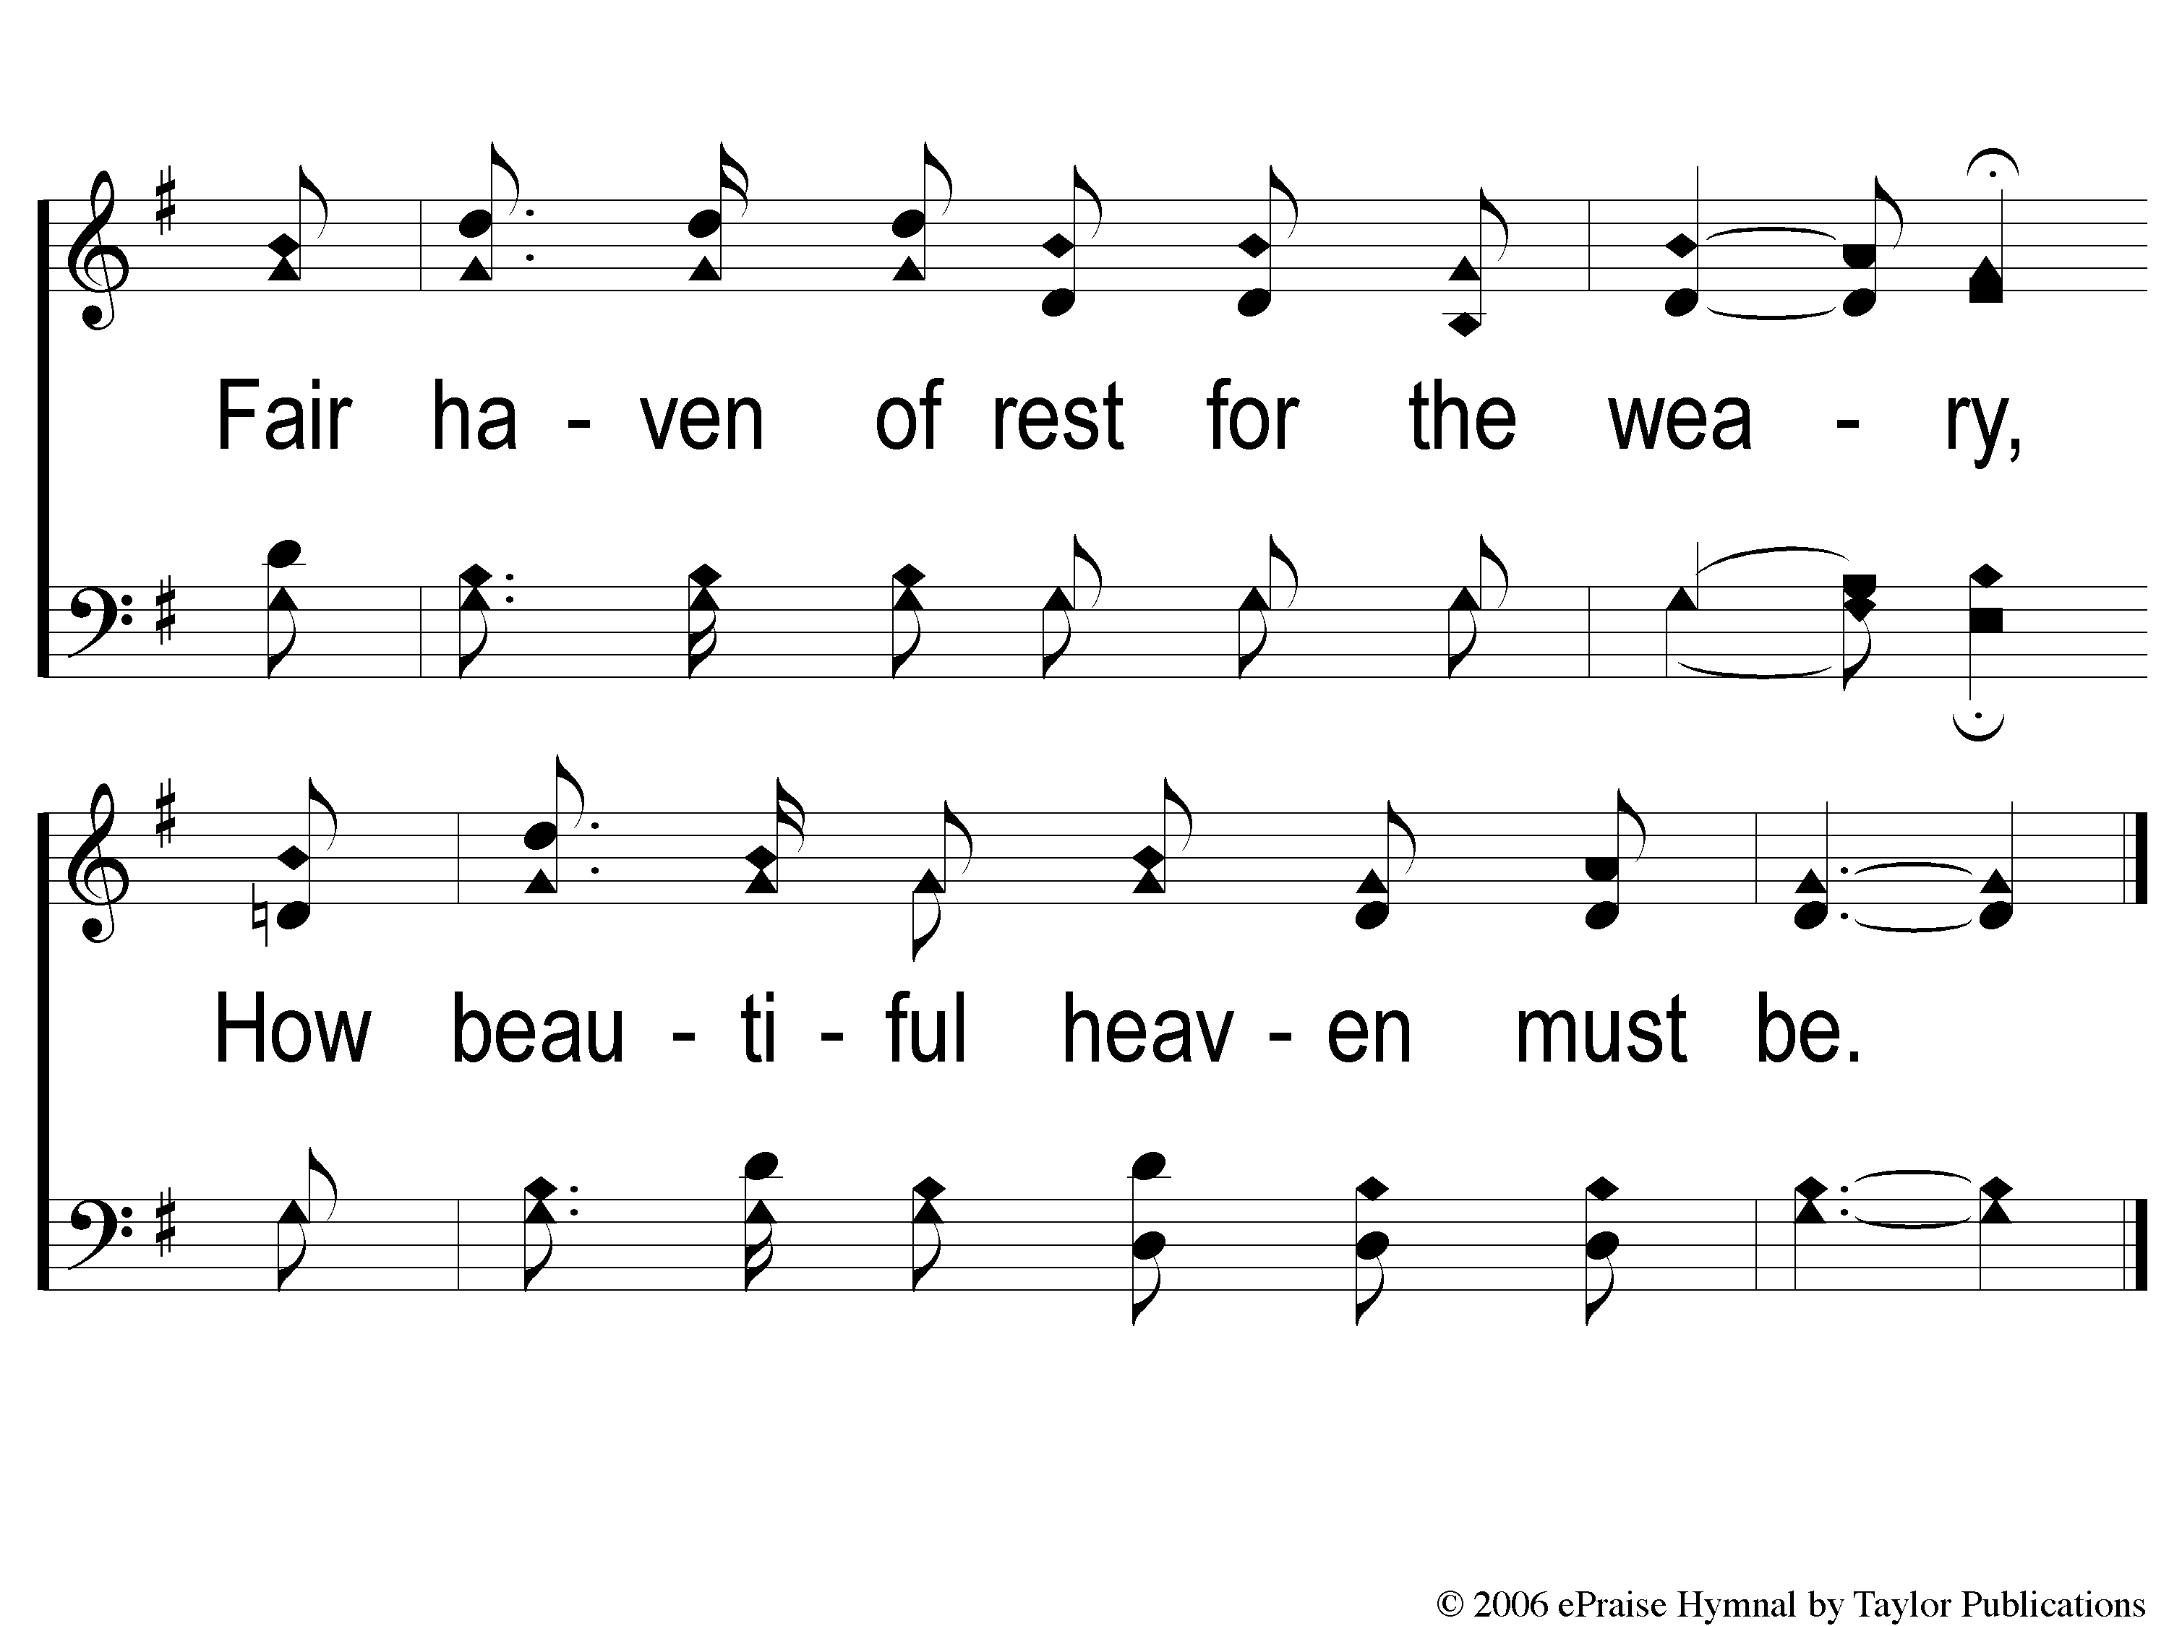
C-2 How Beautiful Heaven Must Be
How Beautiful Heaven Must Be
885

Slide 101
3-1 How Beautiful Heaven Must Be
How Beautiful Heaven Must Be
885

Slide 102
3-2 How Beautiful Heaven Must Be
How Beautiful Heaven Must Be
885

Slide 103
C-1 How Beautiful Heaven Must Be
How Beautiful Heaven Must Be
885

Slide 104
C-2 How Beautiful Heaven Must Be
How Beautiful Heaven Must Be
885

Slide 105
TONIGHT @ 6:00 pm
EVENING WORSHIP
HOPE TO SEE YOU THERE!

