Slide 1
PLEASE STANDBY
OUR LIVESTREAM
WILL BEGIN SOON

Slide 2
WELCOME
THANKS FOR JOINING US!

Slide 3
Songs of
Praise to God

Slide 4
First PRAYER

Slide 5
Songs of
Praise to God

Slide 6
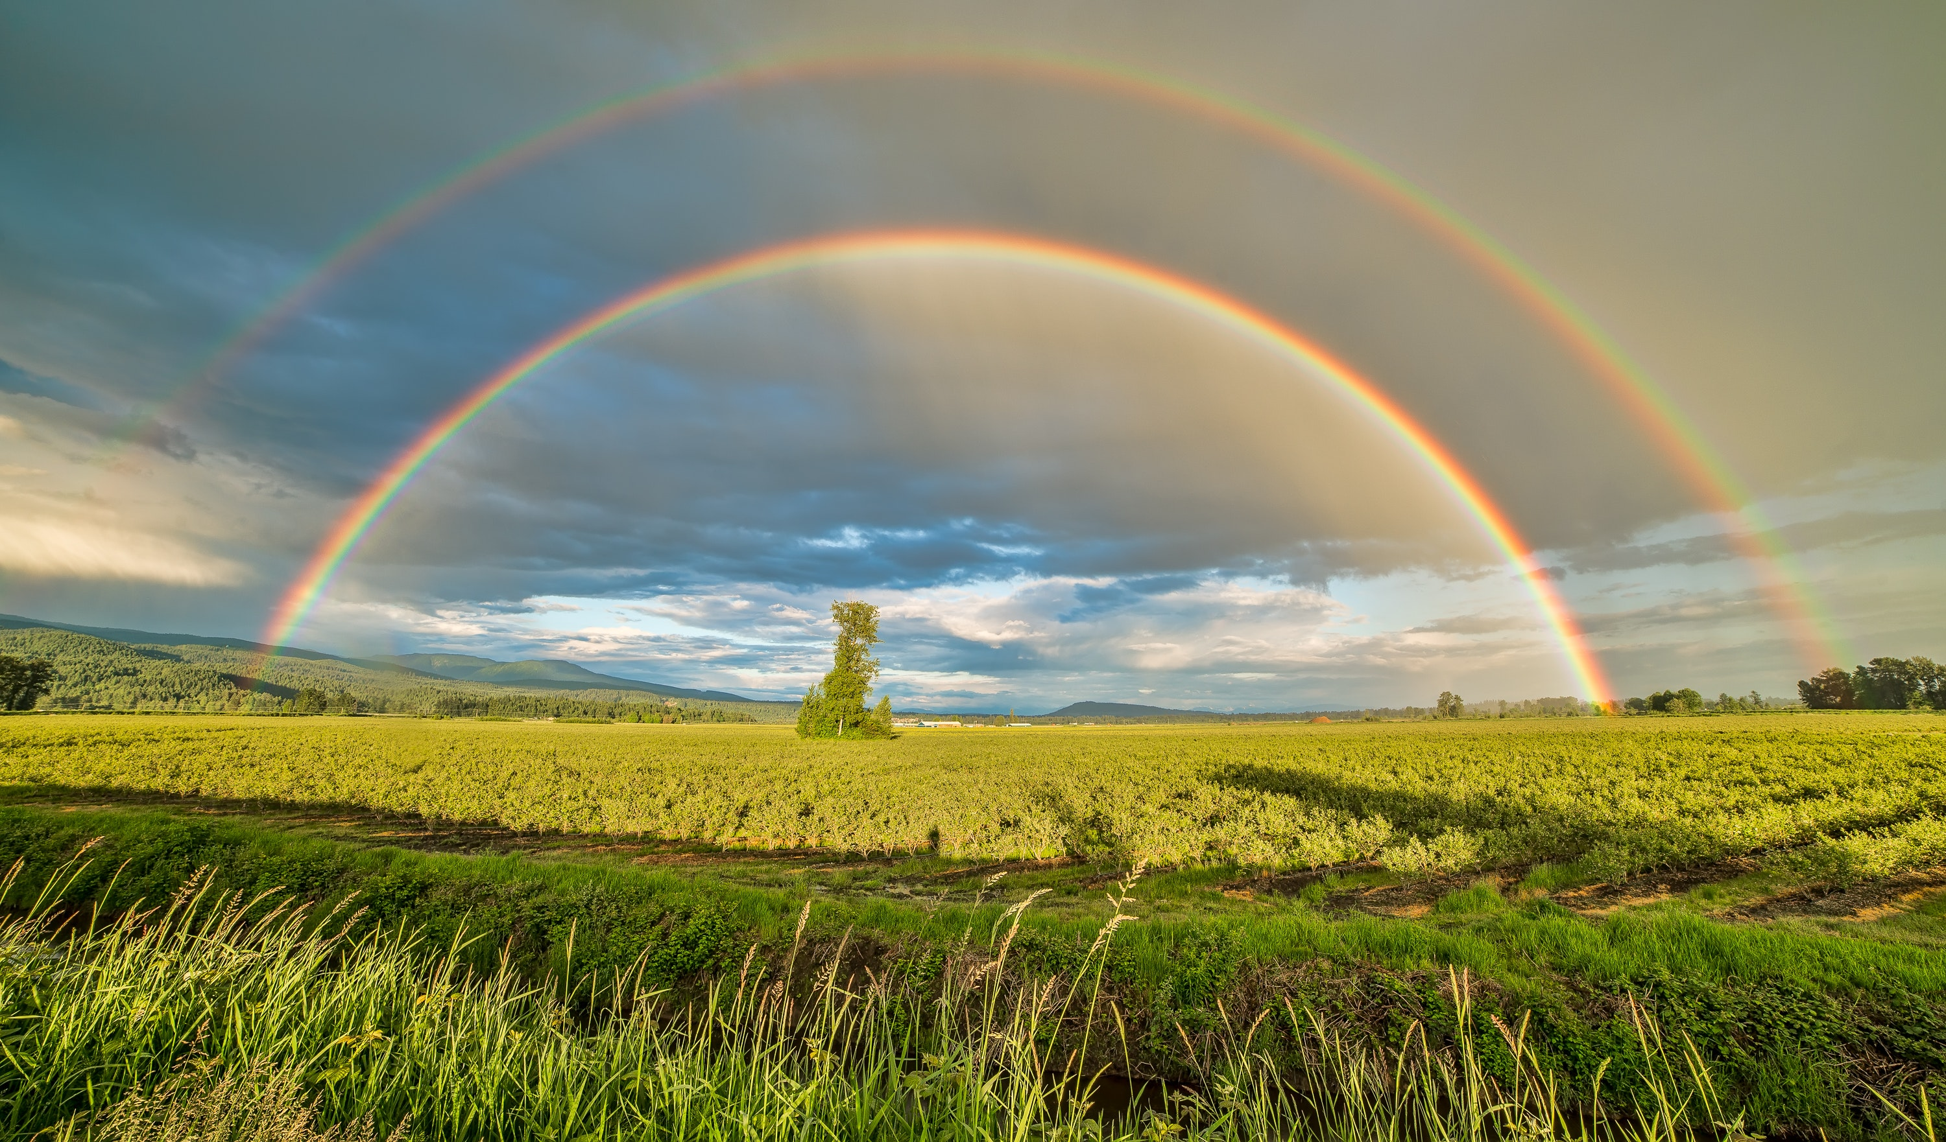
STANDING ON THE PROMISES

Slide 7
THE 1ST COMMAND WITH PROMISE

Slide 8
1ST COMMAND WITH PROMISE
Eph. 6:1-2
Col. 3:20

Slide 9
FOUR COMMANDS
Two For Children:
Obey Your Parents/Guardians
Honor Your Parents/Guardians

Slide 10
A CHANGE OF STATUS
Roman View of Children:

Slide 11
A CHANGE OF STATUS
Roman View of Children:
Patria Potestas

Slide 12
A CHANGE OF STATUS
Roman View of Children:
Patria Potestas
Child Abandonment
Child Mistreatment

Slide 13
OBEY?
Greek: ὑπακούω (Hupakouo)
Hupo → under
Akouw → to hear
= Listen with intent to do

Slide 14
OBEY WHOM & HOW?
Whom? Obey Both Parents

Slide 15
OBEY WHOM & HOW?
Whom? Obey Both Parents
How? “in the Lord”
Acts 5:20, Eph. 5:22, Col. 3:20

Slide 16
FOUR COMMANDS
Two For Children:
Obey Your Parents/Guardians
Honor Your Parents/Guardians

Slide 17
HONOR?
Greek: Τίμαω (Timao)
= attribute high status, show respect to
1 Tim. 5:3, Matt. 15:3-6, Ezek. 22:7

Slide 18
1ST WITH PROMISE?
Eph. 6:3

Slide 19
1ST WITH PROMISE?
Eph. 6:3
“that it may be well with you and you may live long on the earth”
Ex. 20:12, Deut. 5:16

Slide 20
FOUR COMMANDS
Two For Parents:
Provoke Not Your Children
Bring Up Your Children

Slide 21
DO YOU HONOR
YOUR HEAVENLY FATHER?

Slide 22
Songs of
Praise to God

Slide 23
Closing PRAYER

Slide 24
Songs of
Praise to God

Slide 25
WEDNESDAY @ 6:30 pm
JOIN US
HOPE TO SEE YOU THERE!

