Slide 1
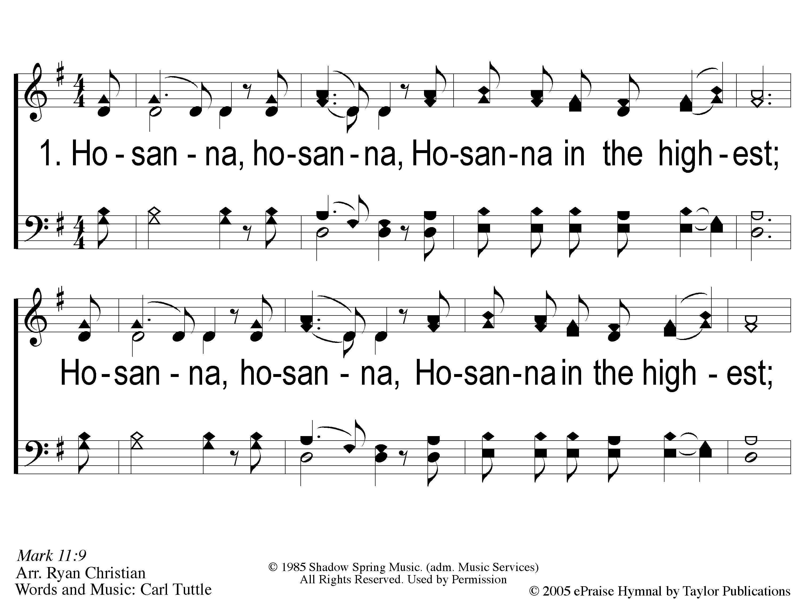
1 Hosanna
Hosanna
167

Slide 2
C-1 Hosanna
Hosanna
167

Slide 3
C-2 Hosanna
Hosanna
167

Slide 4
2 Hosanna
Hosanna
167

Slide 5
C-1 Hosanna
Hosanna
167

Slide 6
C-2 Hosanna
Hosanna
167

Slide 7
RESTORE REBUILD RENEW
welcome
we are glad to
Have you with us
IN 2022
WHEELER
CHURCH
OF
CHRIST

Slide 8
Song:
Unto Thee, O Lord
#794

Slide 9
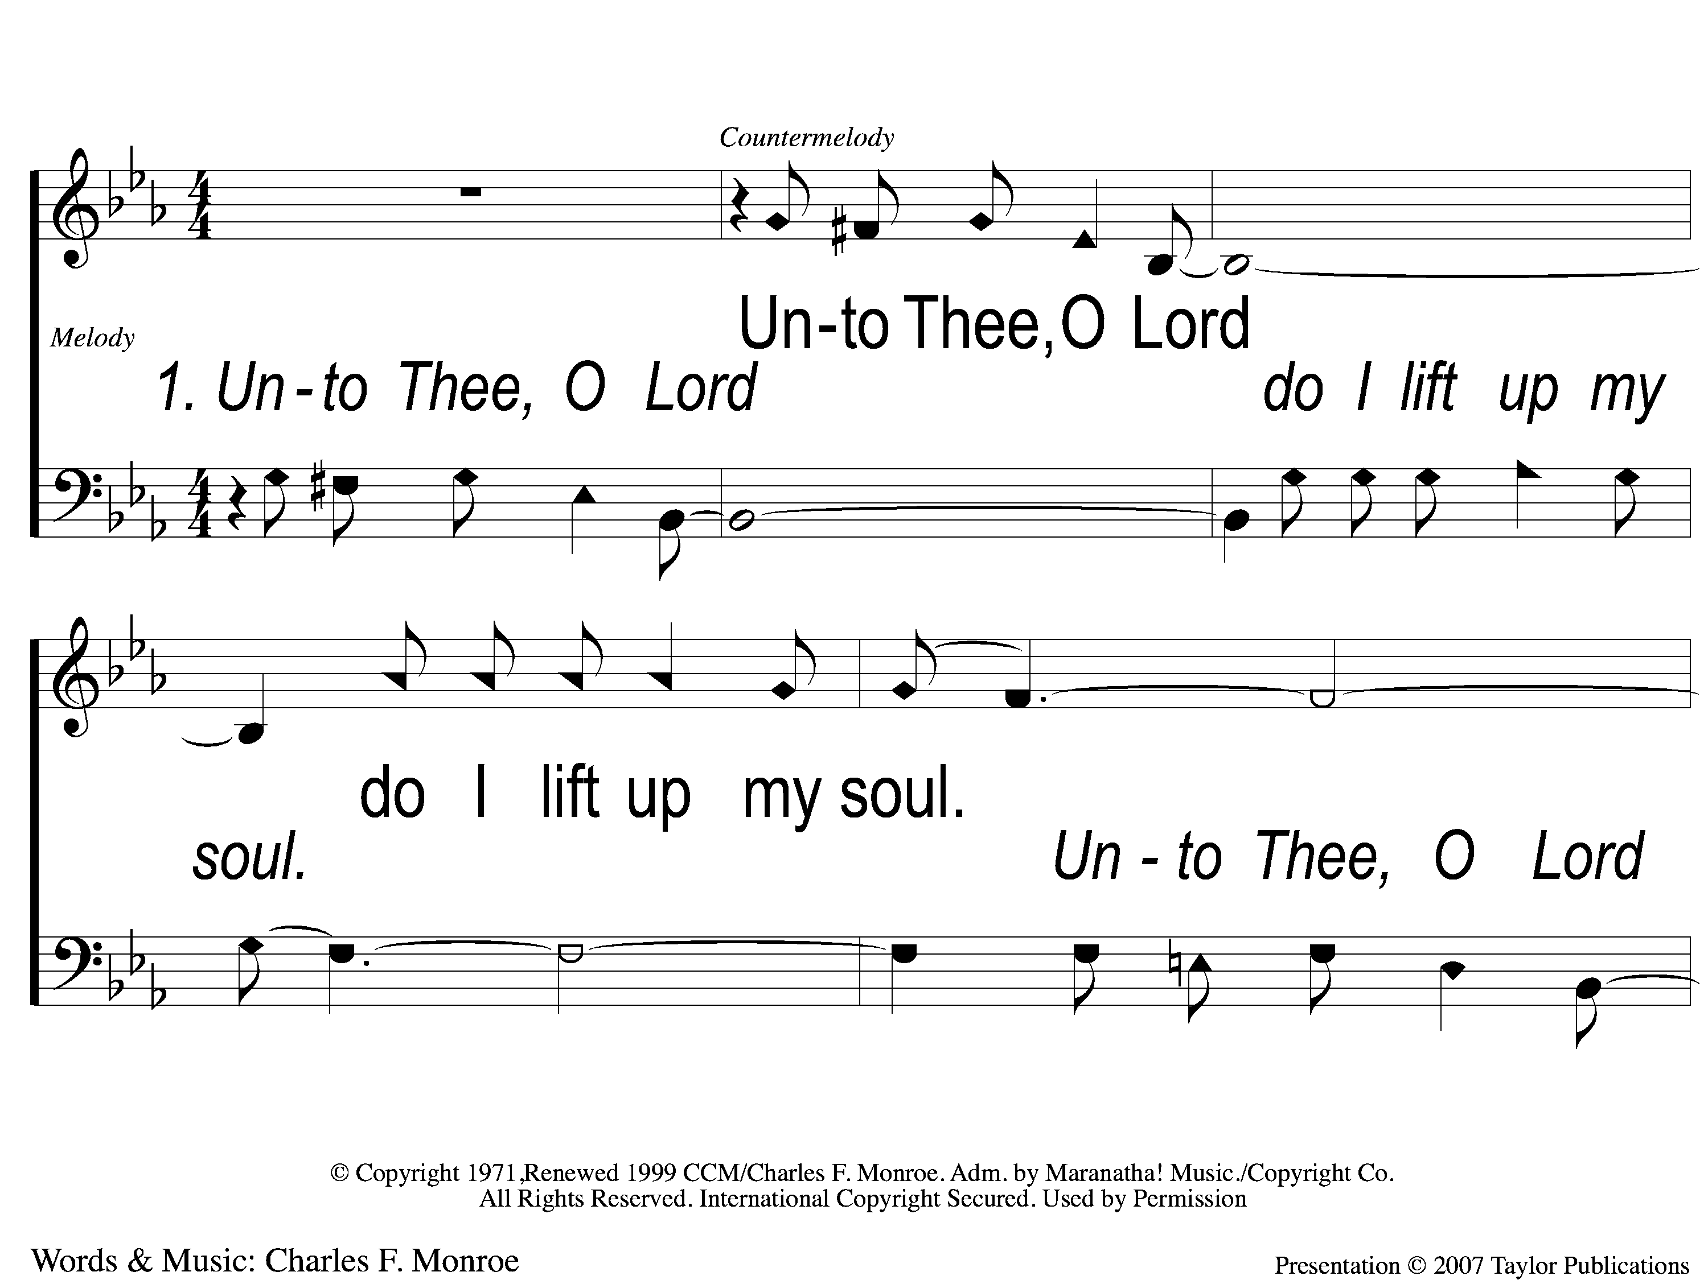
1-1 Unto Thee O Lord
Unto to Thee O Lord
794

Slide 10
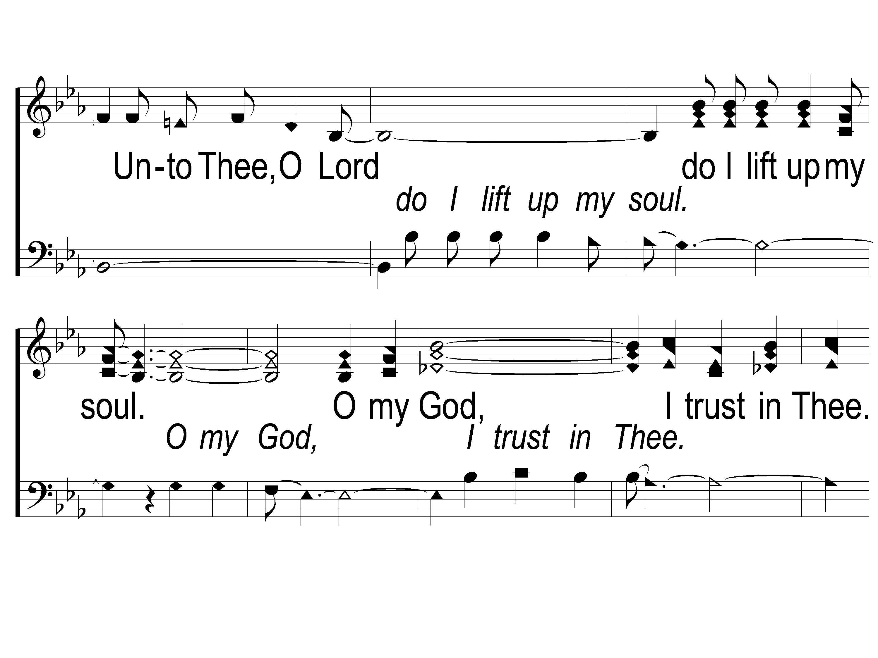
1-2 Unto Thee O Lord
Unto to Thee O Lord
794

Slide 11
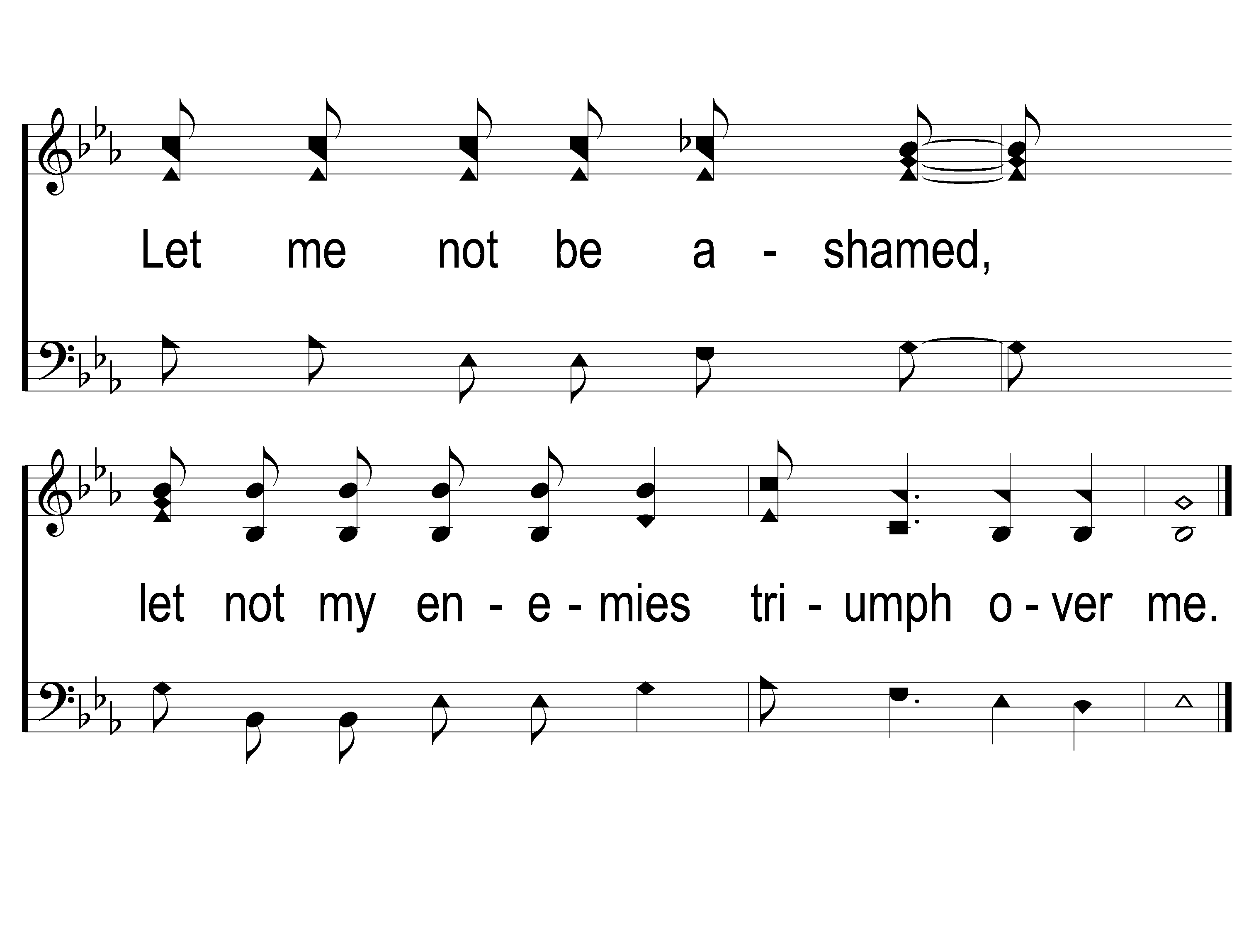
1-3 Unto Thee O Lord
Unto to Thee O Lord
794

Slide 12
2-1 Unto Thee O Lord
Unto to Thee O Lord
794

Slide 13
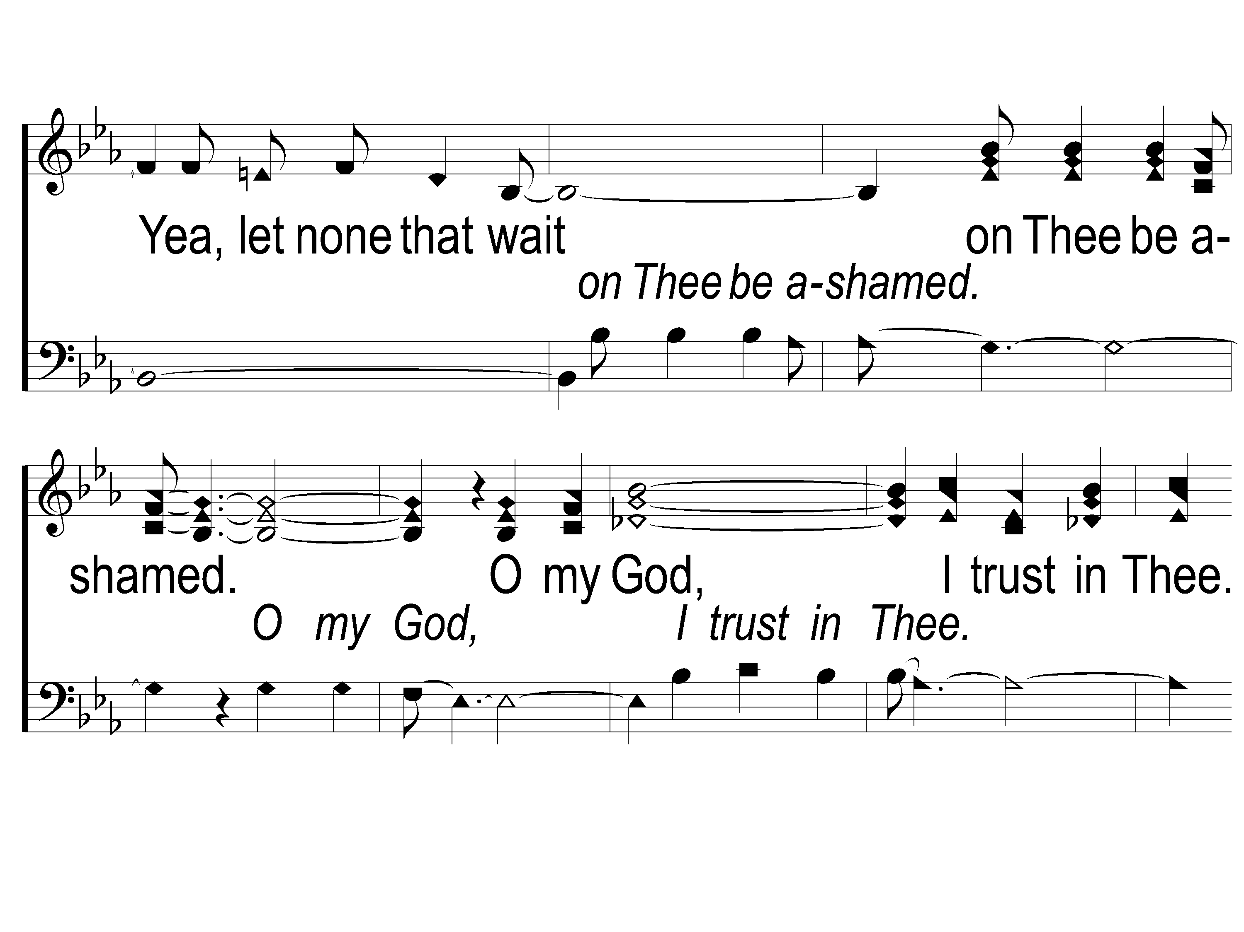
2-2 Unto Thee O Lord
Unto to Thee O Lord
794

Slide 14
2-3 Unto Thee O Lord
Unto to Thee O Lord
794

Slide 15
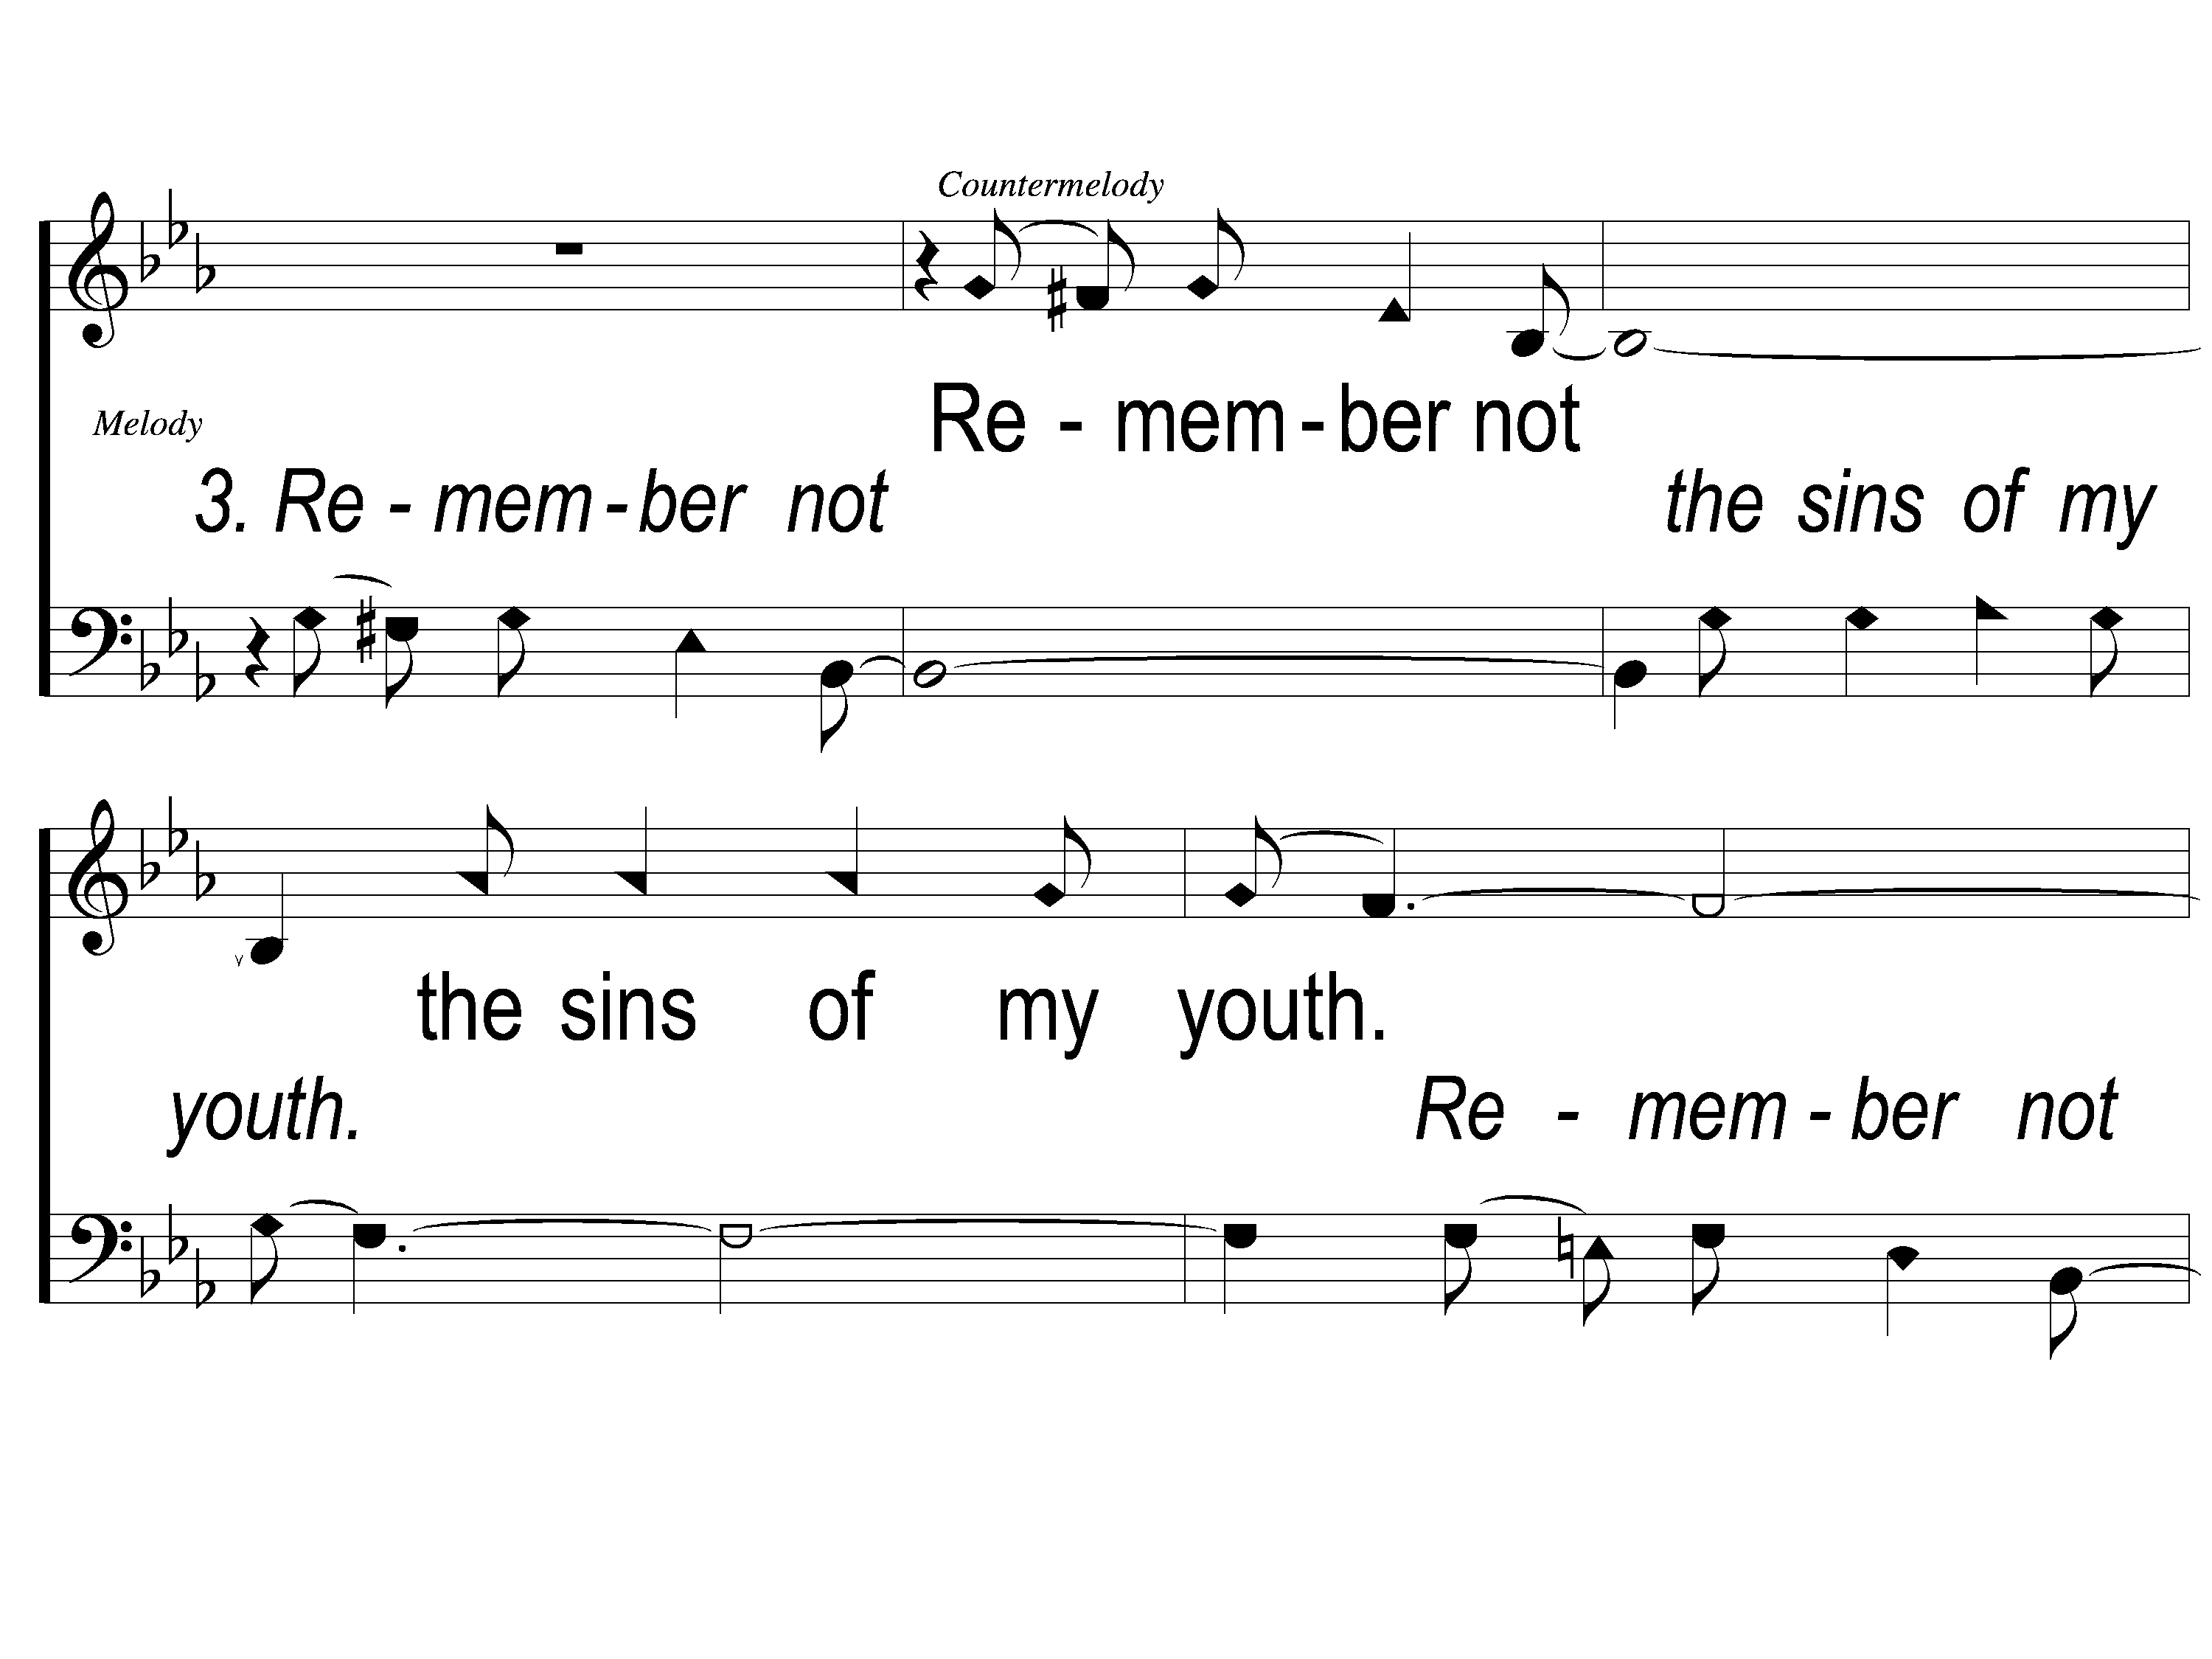
3-1 Unto Thee O Lord
Unto to Thee O Lord
794

Slide 16
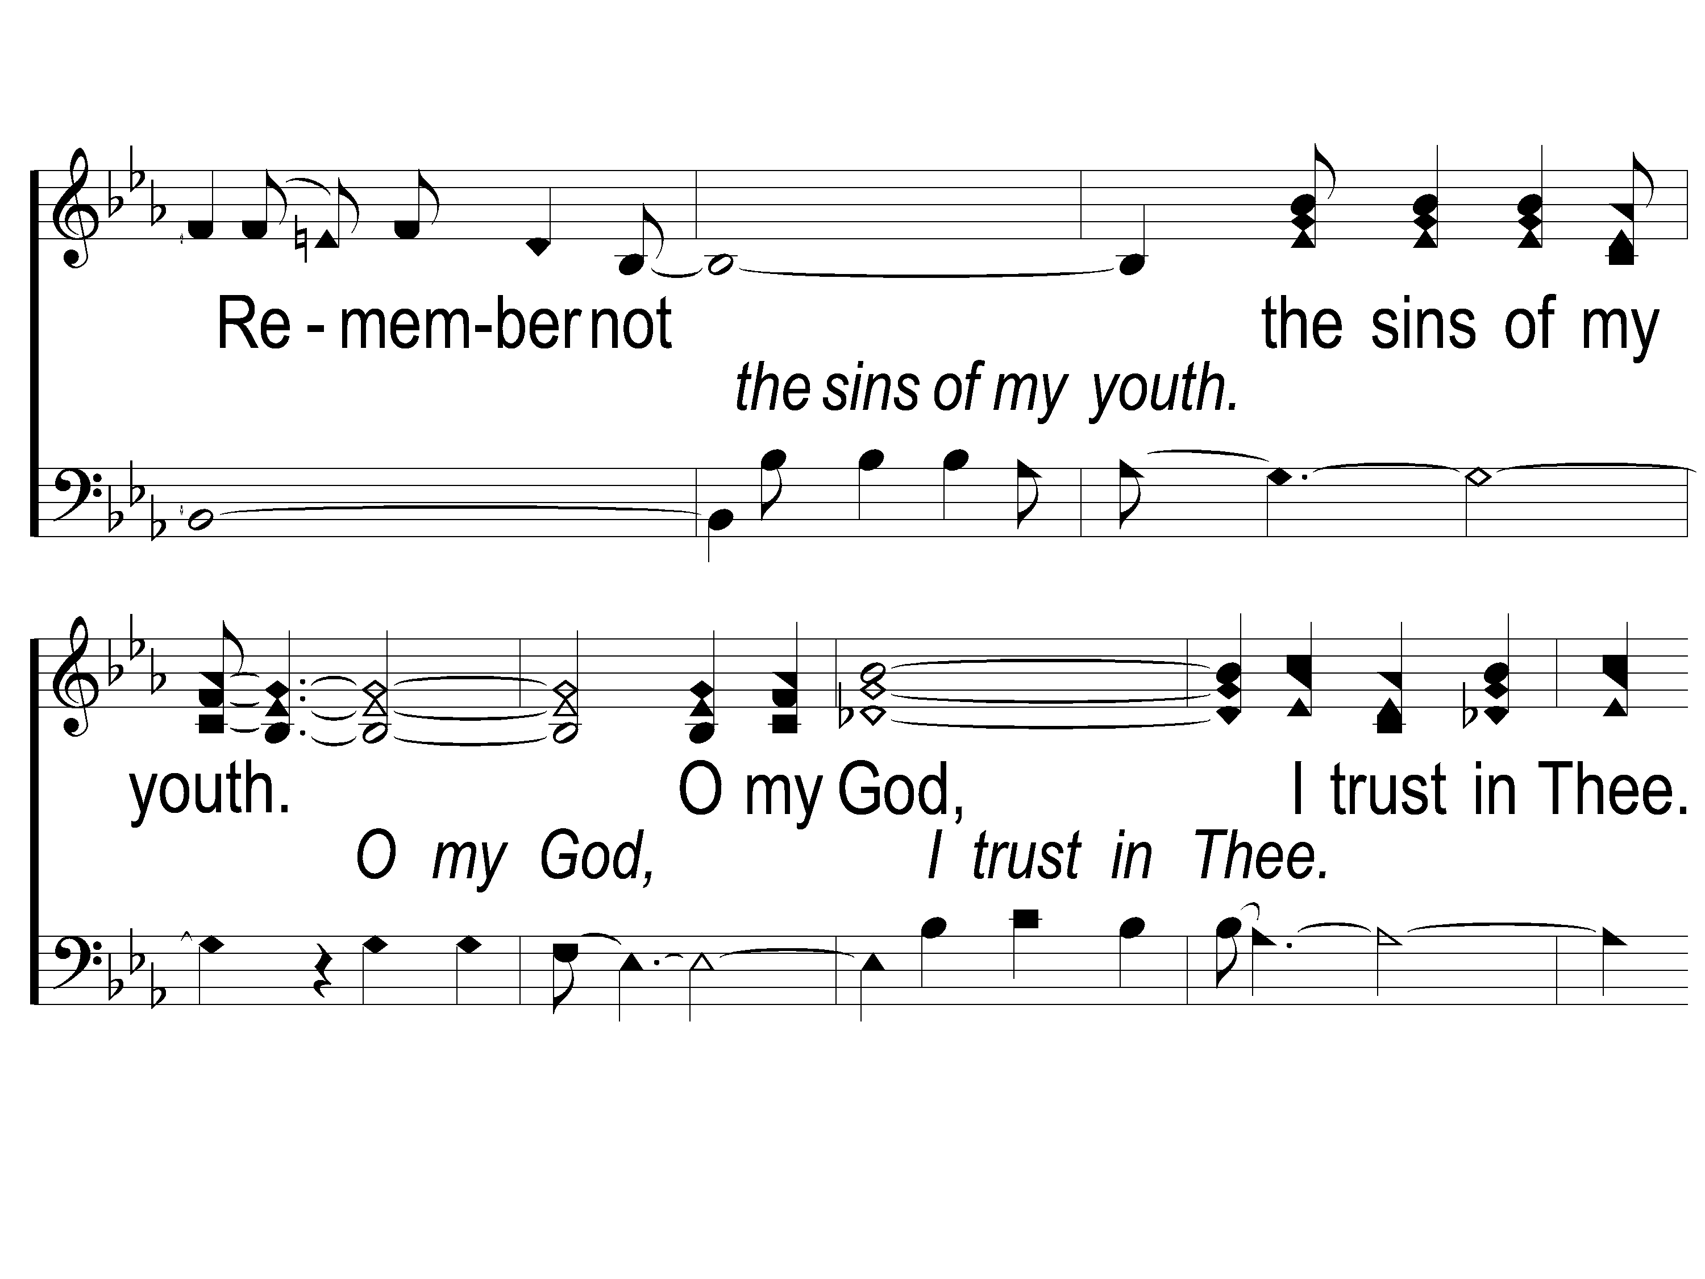
3-2 Unto Thee O Lord
Unto to Thee O Lord
794

Slide 17
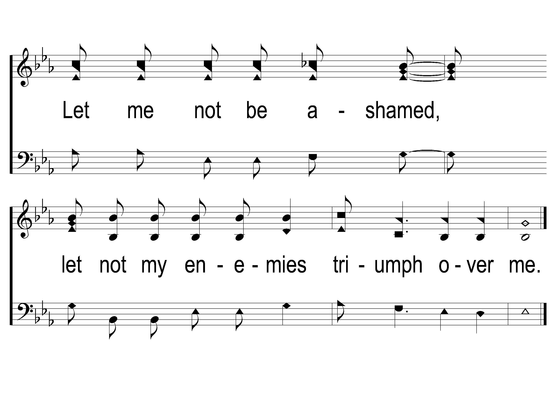
3-3 Unto Thee O Lord
Unto to Thee O Lord
794

Slide 18
Song:
Just A Little Talk With Jesus
#959

Slide 19
1-1 Just A Little Talk With Jesus
Just A Little Talk With Jesus
959

Slide 20
1-2 Just A Little Talk With Jesus
Just A Little Talk With Jesus
959

Slide 21
C-1 Just A Little Talk With Jesus
Just A Little Talk With Jesus
959

Slide 22
C-2 Just A Little Talk With Jesus
Just A Little Talk With Jesus
959

Slide 23
C-3 Just A Little Talk With Jesus
Just A Little Talk With Jesus
959

Slide 24
2-1 Just A Little Talk With Jesus
Just A Little Talk With Jesus
959

Slide 25
2-2 Just A Little Talk With Jesus
Just A Little Talk With Jesus
959

Slide 26
C-1 Just A Little Talk With Jesus
Just A Little Talk With Jesus
959

Slide 27
C-2 Just A Little Talk With Jesus
Just A Little Talk With Jesus
959

Slide 28
C-3 Just A Little Talk With Jesus
Just A Little Talk With Jesus
959

Slide 29
3-1 Just A Little Talk With Jesus
Just A Little Talk With Jesus
959

Slide 30
3-2 Just A Little Talk With Jesus
Just A Little Talk With Jesus
959

Slide 31
C-1 Just A Little Talk With Jesus
Just A Little Talk With Jesus
959

Slide 32
C-2 Just A Little Talk With Jesus
Just A Little Talk With Jesus
959

Slide 33
C-3 Just A Little Talk With Jesus
Just A Little Talk With Jesus
959

Slide 34
Opening Prayer

Slide 35
Song:
Shine, Jesus, Shine
#290

Slide 36
1-1 Shine Jesus Shine
Shine, Jesus, Shine
290

Slide 37
1-2 Shine Jesus Shine
Shine, Jesus, Shine
290

Slide 38
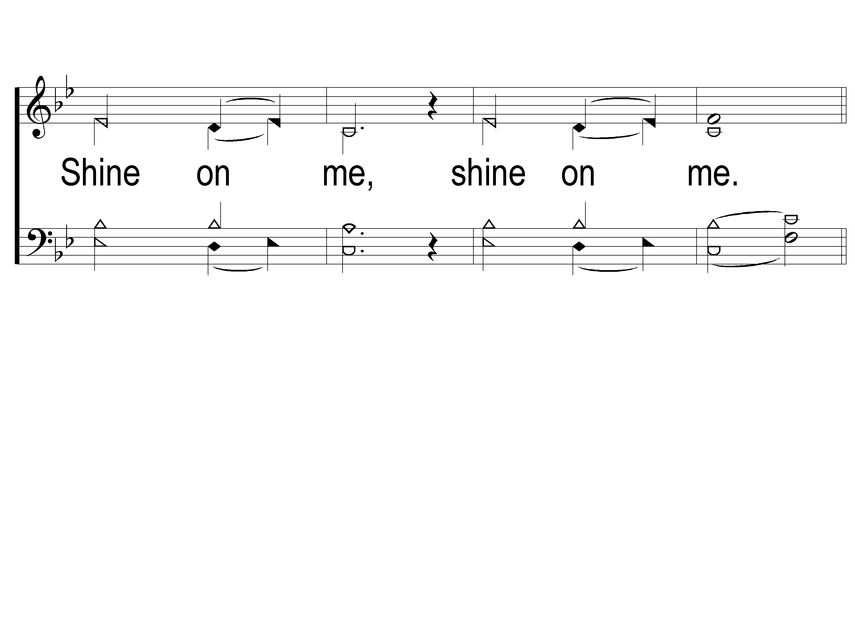
1-3 Shine Jesus Shine
Shine, Jesus, Shine
290

Slide 39
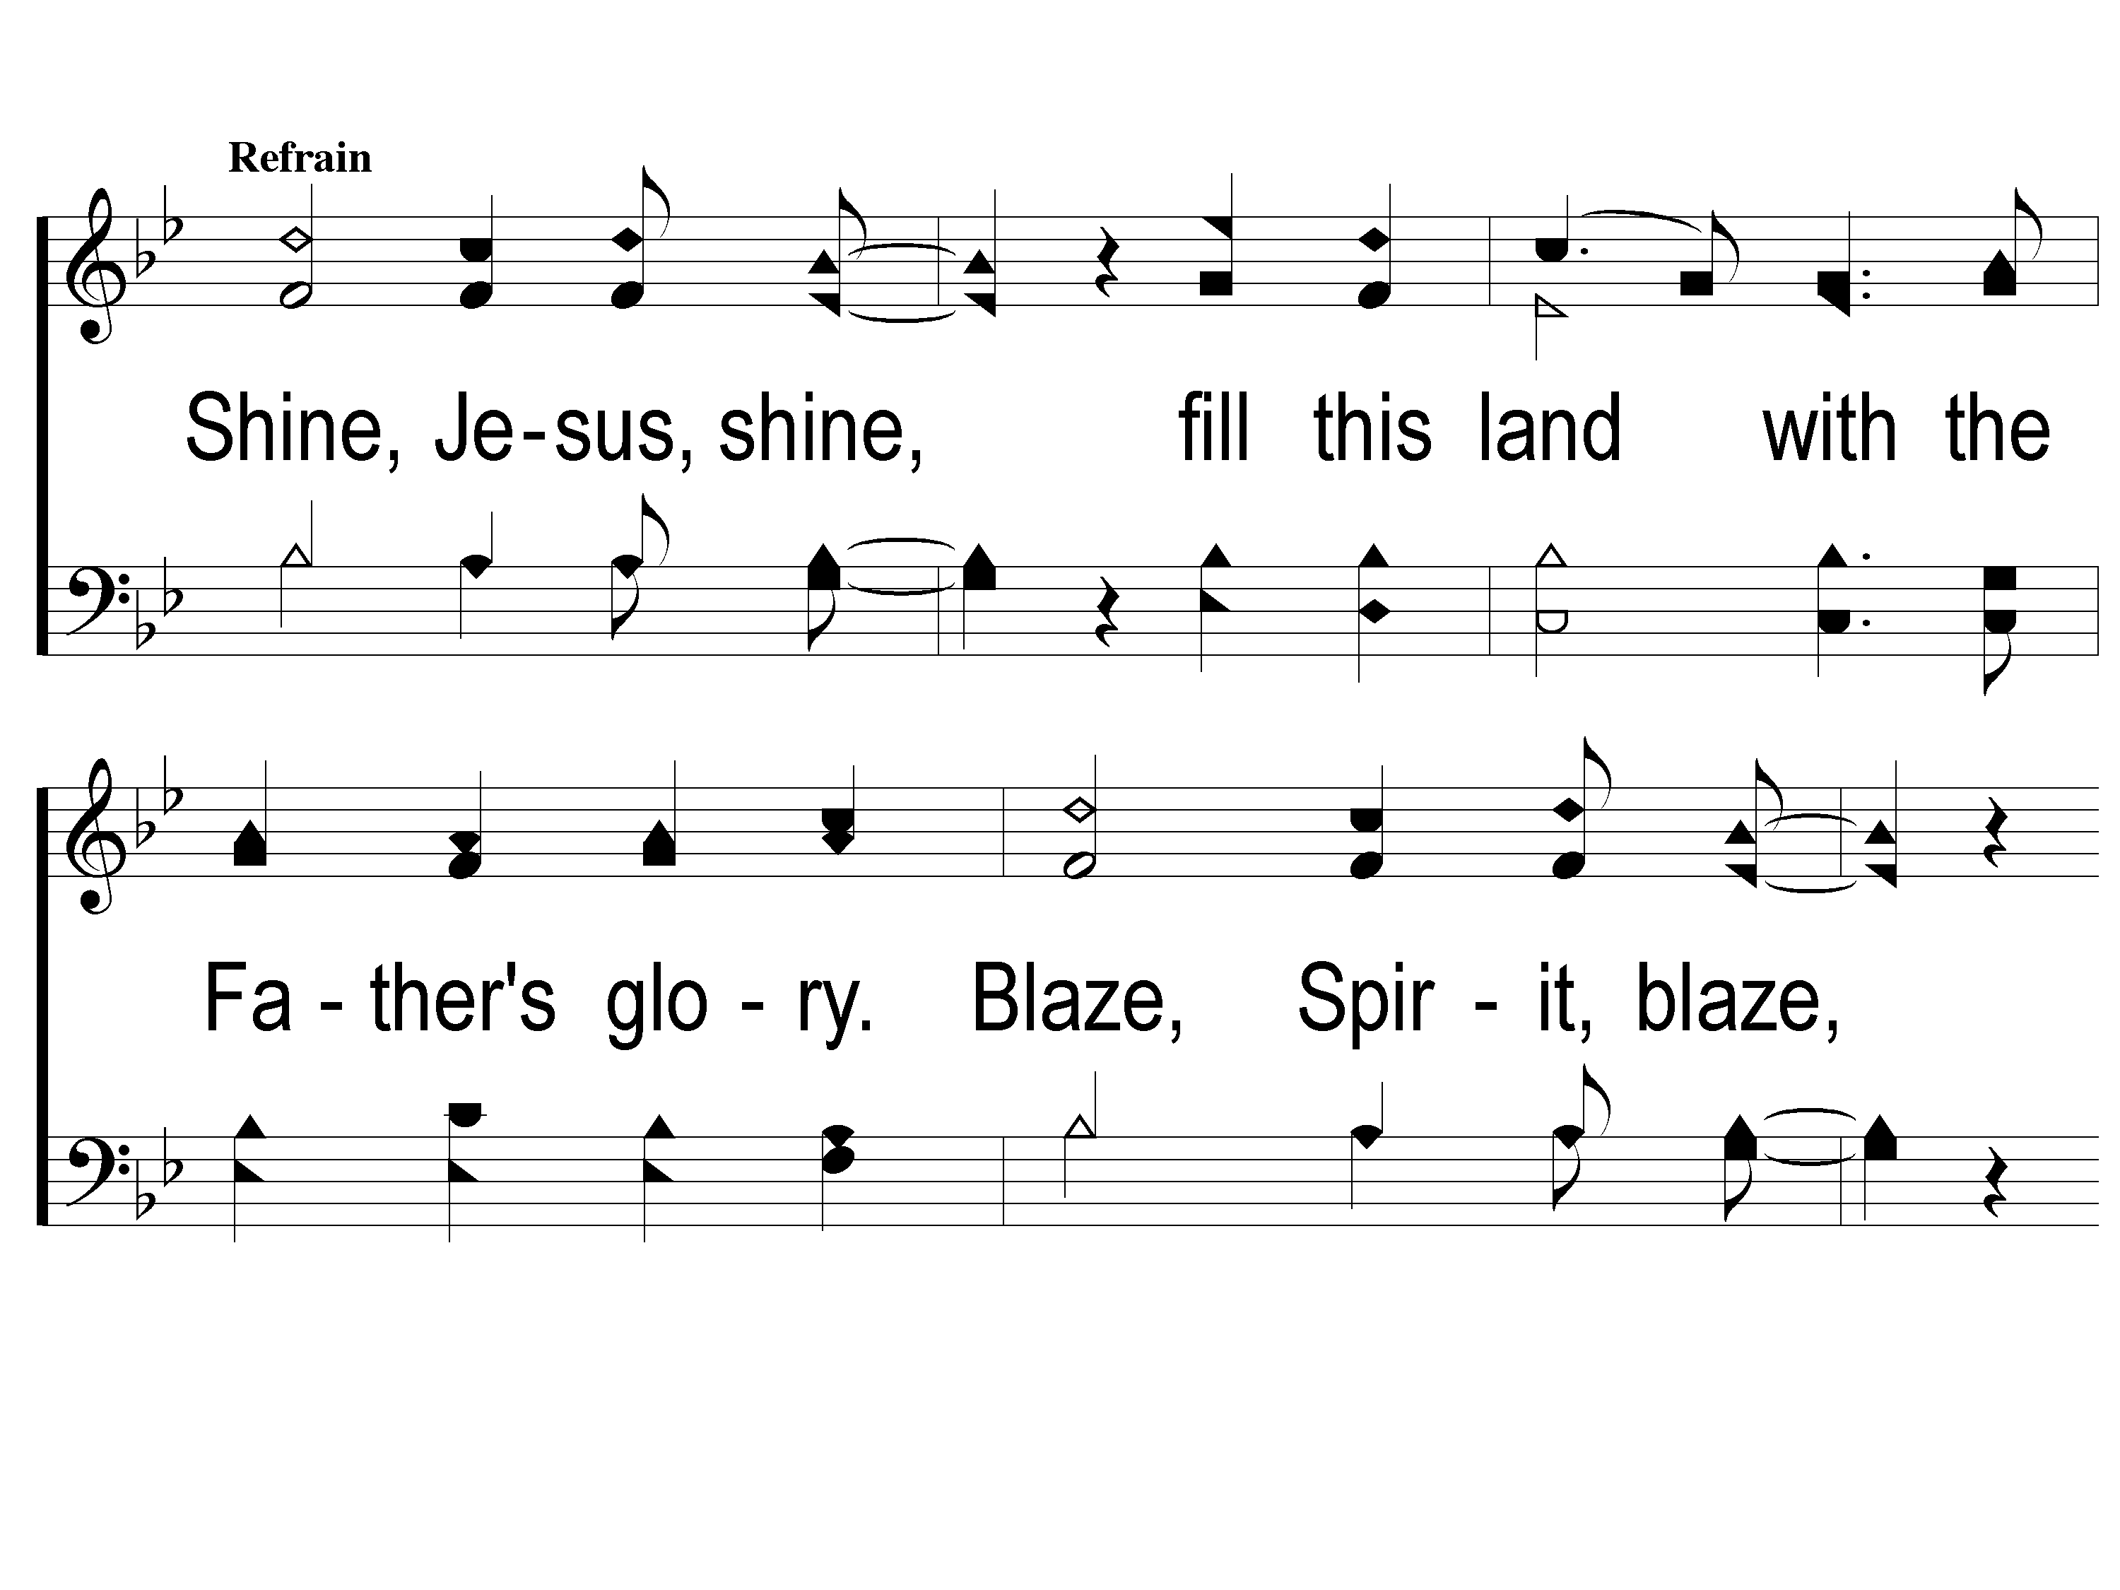
C-1 Shine Jesus Shine
Shine, Jesus, Shine
290

Slide 40
C-2 Shine Jesus Shine
Shine, Jesus, Shine
290

Slide 41
C-3 Shine Jesus Shine
Shine, Jesus, Shine
290

Slide 42
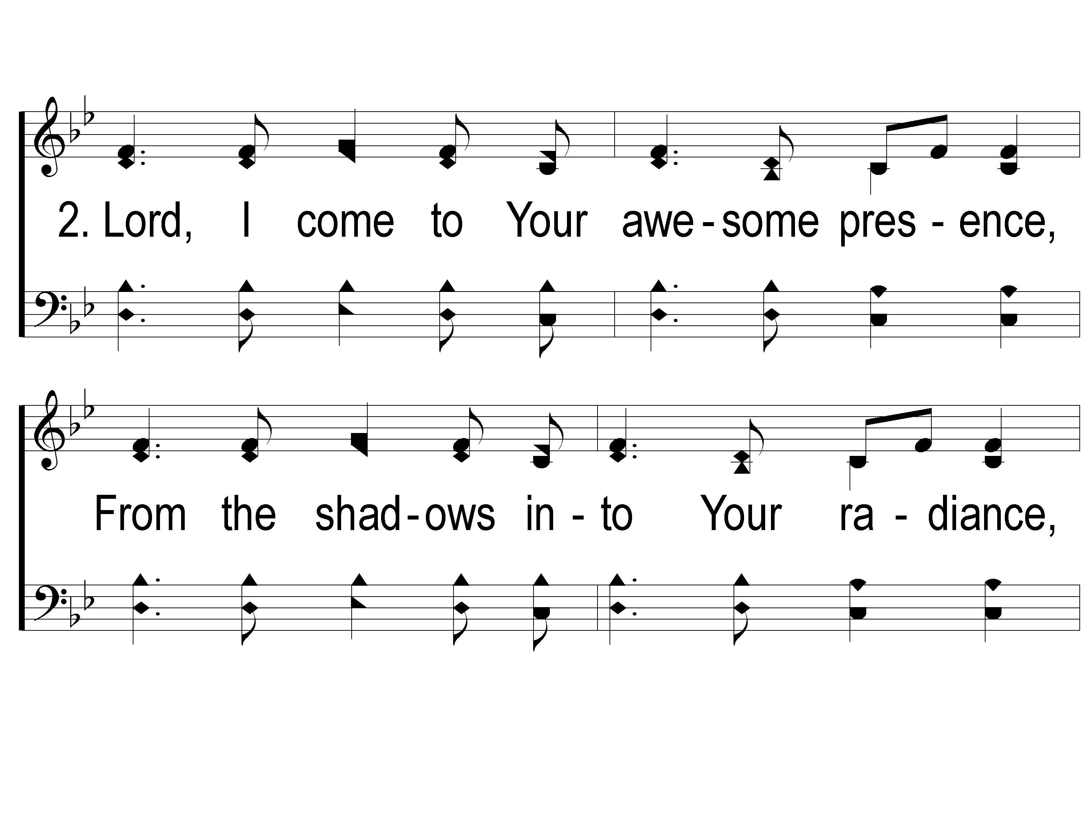
2-1 Shine Jesus Shine
Shine, Jesus, Shine
290

Slide 43
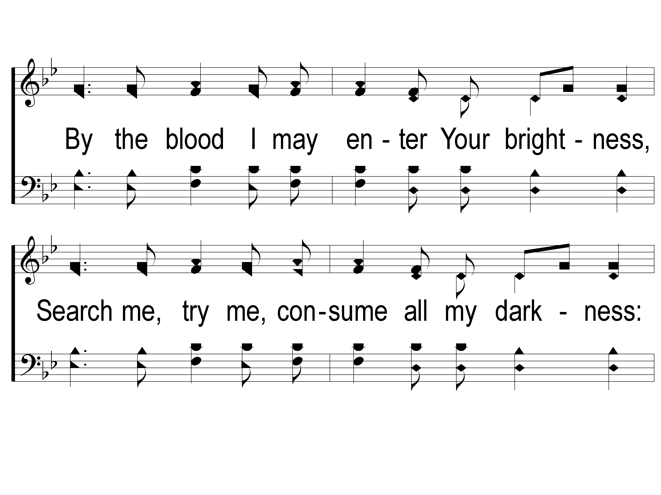
2-2 Shine Jesus Shine
Shine, Jesus, Shine
290

Slide 44
2-3 Shine Jesus Shine
Shine, Jesus, Shine
290

Slide 45
C-1 Shine Jesus Shine
Shine, Jesus, Shine
290

Slide 46
C-2 Shine Jesus Shine
Shine, Jesus, Shine
290

Slide 47
C-3 Shine Jesus Shine
Shine, Jesus, Shine
290

Slide 48
Song:
Seek Ye First
#555

Slide 49
1-1 Seek Ye First
Seek Ye First
555

Slide 50
1-2 Seek Ye First
Seek Ye First
555

Slide 51
2-1 Seek Ye First
Seek Ye First
555

Slide 52
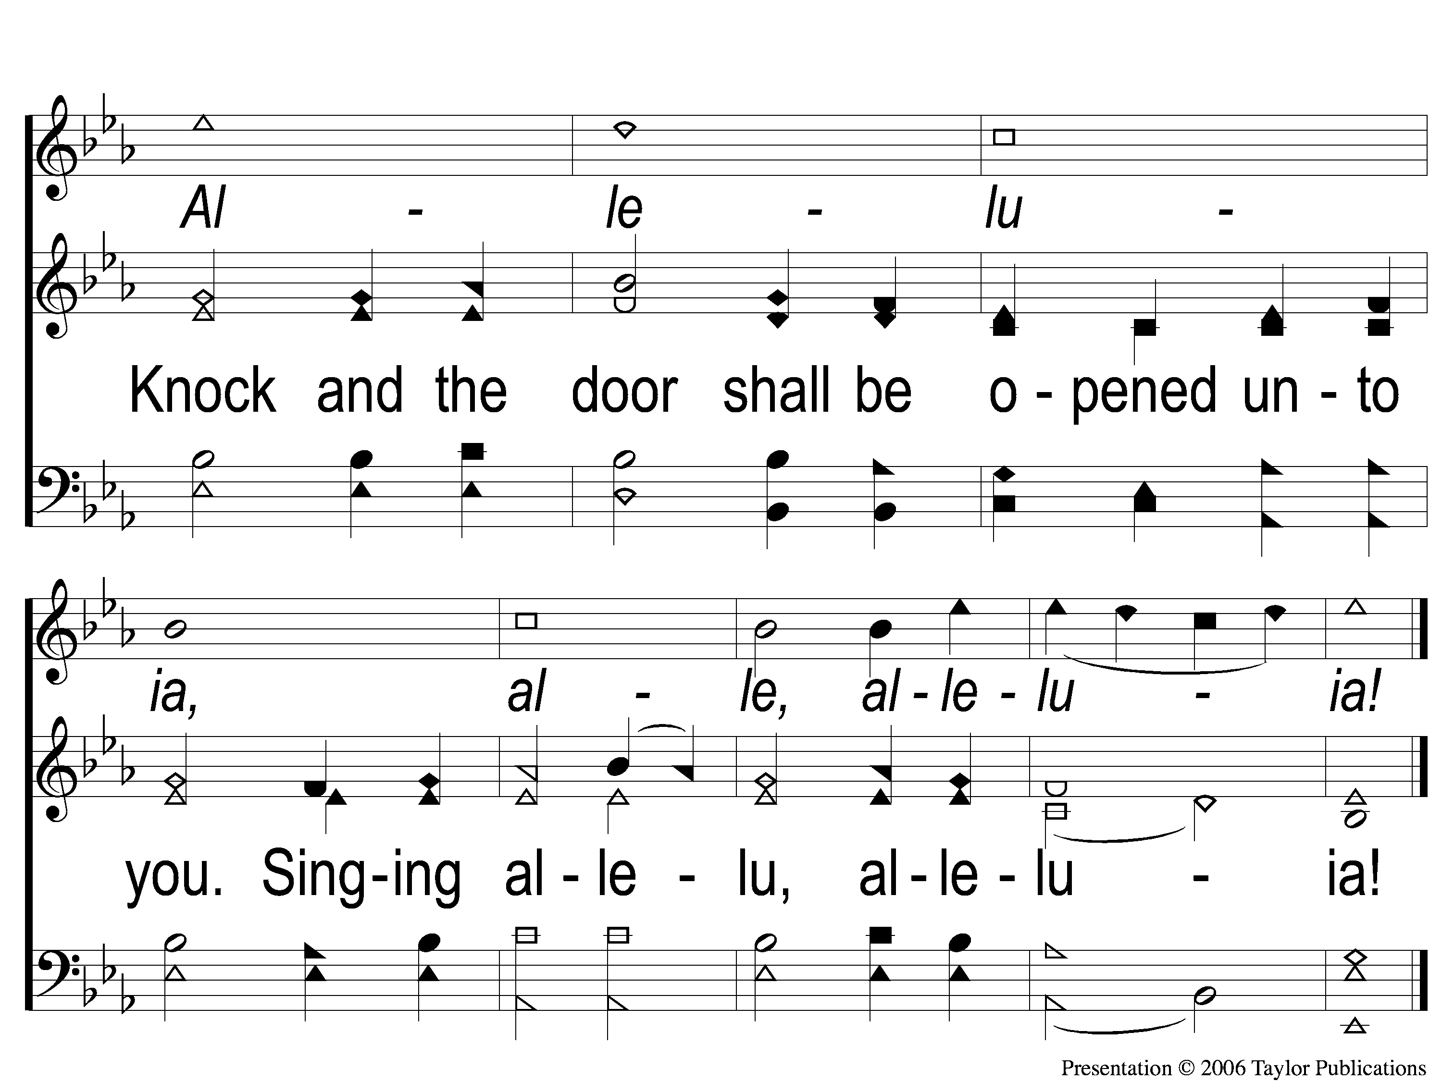
2-2 Seek Ye First
Seek Ye First
555

Slide 53
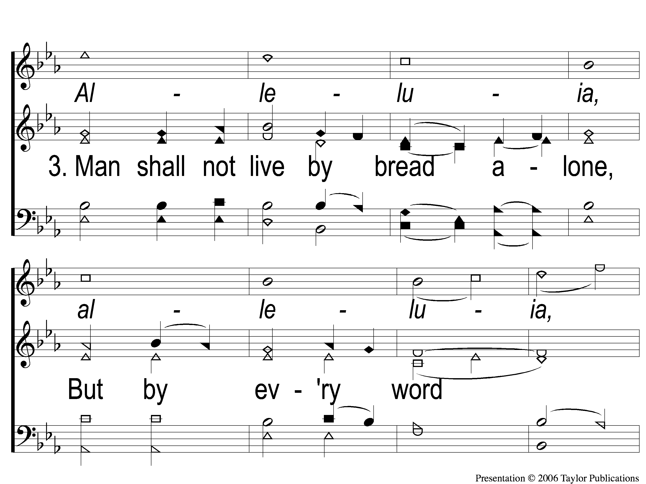
3-1 Seek Ye First
Seek Ye First
555

Slide 54
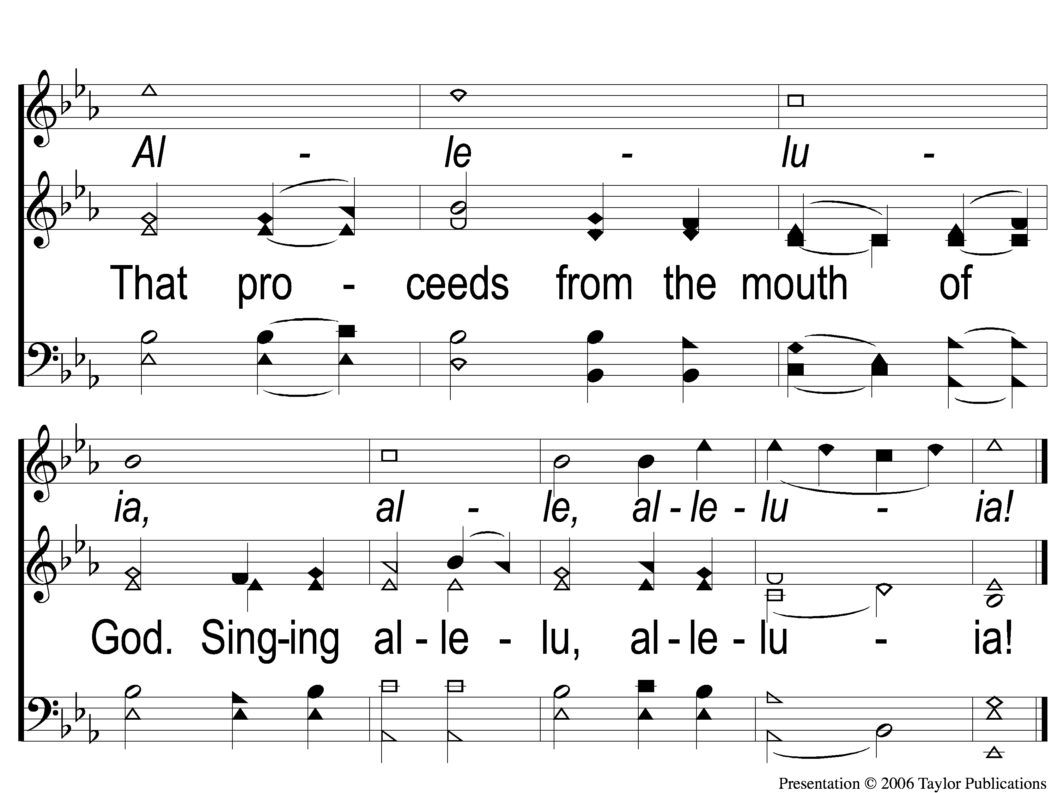
3-2 Seek Ye First
Seek Ye First
555

Slide 55
Scripture Reading:
1 Corinthians 12:15-22

Slide 56
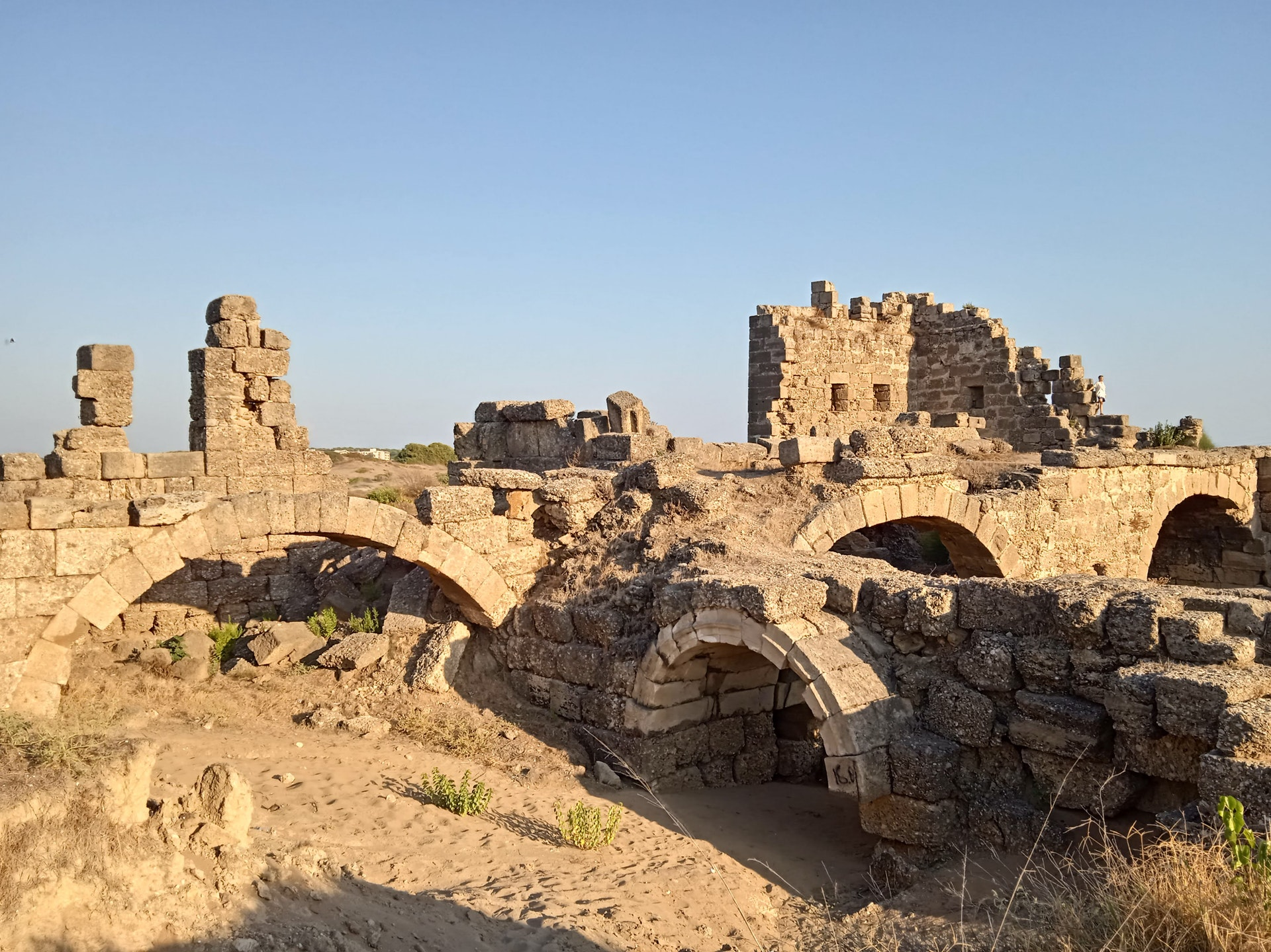
Rebuilding Jerusalem

Slide 57
Every Part
of
the Body of Christ
is
Necessary
1 Corinthians 12

Slide 58
1. Admonish Their Sins (Ch. 1-6) 2. Answer Their Questions (Ch. 7-15)
Purposes of Paul’s First Letter To The Corinthians:

Slide 59
1. The People of God = The Body of Christ 2. There Must Be No Divisions (1:10)
Reminders In Paul’s First Letter To The Corinthians:
Rom. 12:4-5 – Eph. 4:4

Slide 60
1. Occupations – Neh. 3, Lk. 6:15ff
In the Body of Christ, there are Differences in:

Slide 61
1. Occupations 2. Situations – 1 Cor. 1:22, 24, 12:13, Acts 16:1, 3
In the Body of Christ, there are Differences in:
Col. 3:11

Slide 62
1. Occupations 2. Situations 3. Generations – 1 Tim. 5:1-2, Titus 2:2-3
In the Body of Christ, there are Differences in:

Slide 63
In the Body of Christ, there are Similarities in:
Passion – 2 Cor. 7:11

Slide 64
In the Body of Christ, there are Similarities in:
Passion
Patience – 1 Cor. 13:4

Slide 65
In the Body of Christ, there are Similarities in:
Passion
Patience
Purpose – Rom. 8:28, Phili. 2:5

Slide 66
The Church Needs EVERYONE

Slide 67
The Church Needs EVERYONE
Problem in Rebuilding: Not Everyone Is Willing
Neh. 3:5 – The Tekoite Nobles
1 Cor. 12:15-22

Slide 68
The Church Needs EVERYONE
How Does The Church Grow?
Eph. 4:14-16

Slide 69
The Church Needs The Elderly

Slide 70
The Church Needs The Elderly
Because They Have Wisdom Through Experience
Prov. 22:15
Job 12:12

Slide 71
The Church Needs The Elderly
Because They Have Wisdom Through Experience
Wisdom = Knowledge + Perspective + Experience

Slide 72
The Church Needs The Elderly
Because They Have Wisdom Through Experience
True Wisdom = Obeying God (Prov. 9:10, 16:31)

Slide 73
The Church Needs The Elderly
They Have Experience In…
Defeating Temptations & False Teachers
Caleb’s Example (Josh. 14:12)
NT Examples (Titus 1:9-14)

Slide 74
The Church Needs The Elderly
They Have Experience In…
Defeating Temptations & False Teachers
Praying to God
Worshiping God

Slide 75
The Church Needs The Elderly
We Need You…
…To Do What You Are Able – Mk. 14:8

Slide 76
The Church Needs The Elderly
We Need You…
…To Do What You Are Able – Mk. 14:8
…To Be Visible – Matt. 5:16, 1 Pet. 2:12
Psa. 92:14-15

Slide 77
The Church Needs The Youth
Because They Bring Energy

Slide 78
The Church Needs The Youth
Because They Bring Energy
Timothy & Titus
Went with Paul – Acts 20:4, Gal. 2:1

Slide 79
The Church Needs The Youth
Because They Bring Energy
Timothy & Titus
Went with Paul – Acts 20:4, Gal. 2:1
Sent by Paul - Acts 19:22, 1 Cor. 4:17, 2 Cor. 7:6, 12:18

Slide 80
The Church Needs The Youth
Because They Bring Energy
Timothy & Titus
Went with Paul – Acts 20:4, Gal. 2:1
Sent by Paul - Acts 19:22, 1 Cor. 4:17, 2 Cor. 7:6, 12:18
1 Tim. 4:12, 5:1-2 – Titus 2:2-3

Slide 81
The Church Needs Everyone
Imagine what we could do when we combine the wisdom of the older generations with the energy of the younger generations!

Slide 82
The Church Needs YOU

Slide 83
Invitation
Song:
What A Day That Will Be
#916

Slide 84
1-1 What a Day That Will Be
What a Day That Will Be
916

Slide 85
1-2 What a Day That Will Be
What a Day That Will Be
916

Slide 86
1-3 What a Day That Will Be
What a Day That Will Be
916

Slide 87
C-1 What a Day That Will Be
What a Day That Will Be
916

Slide 88
C-2 What a Day That Will Be
What a Day That Will Be
916

Slide 89
C-3 What a Day That Will Be
What a Day That Will Be
916

Slide 90
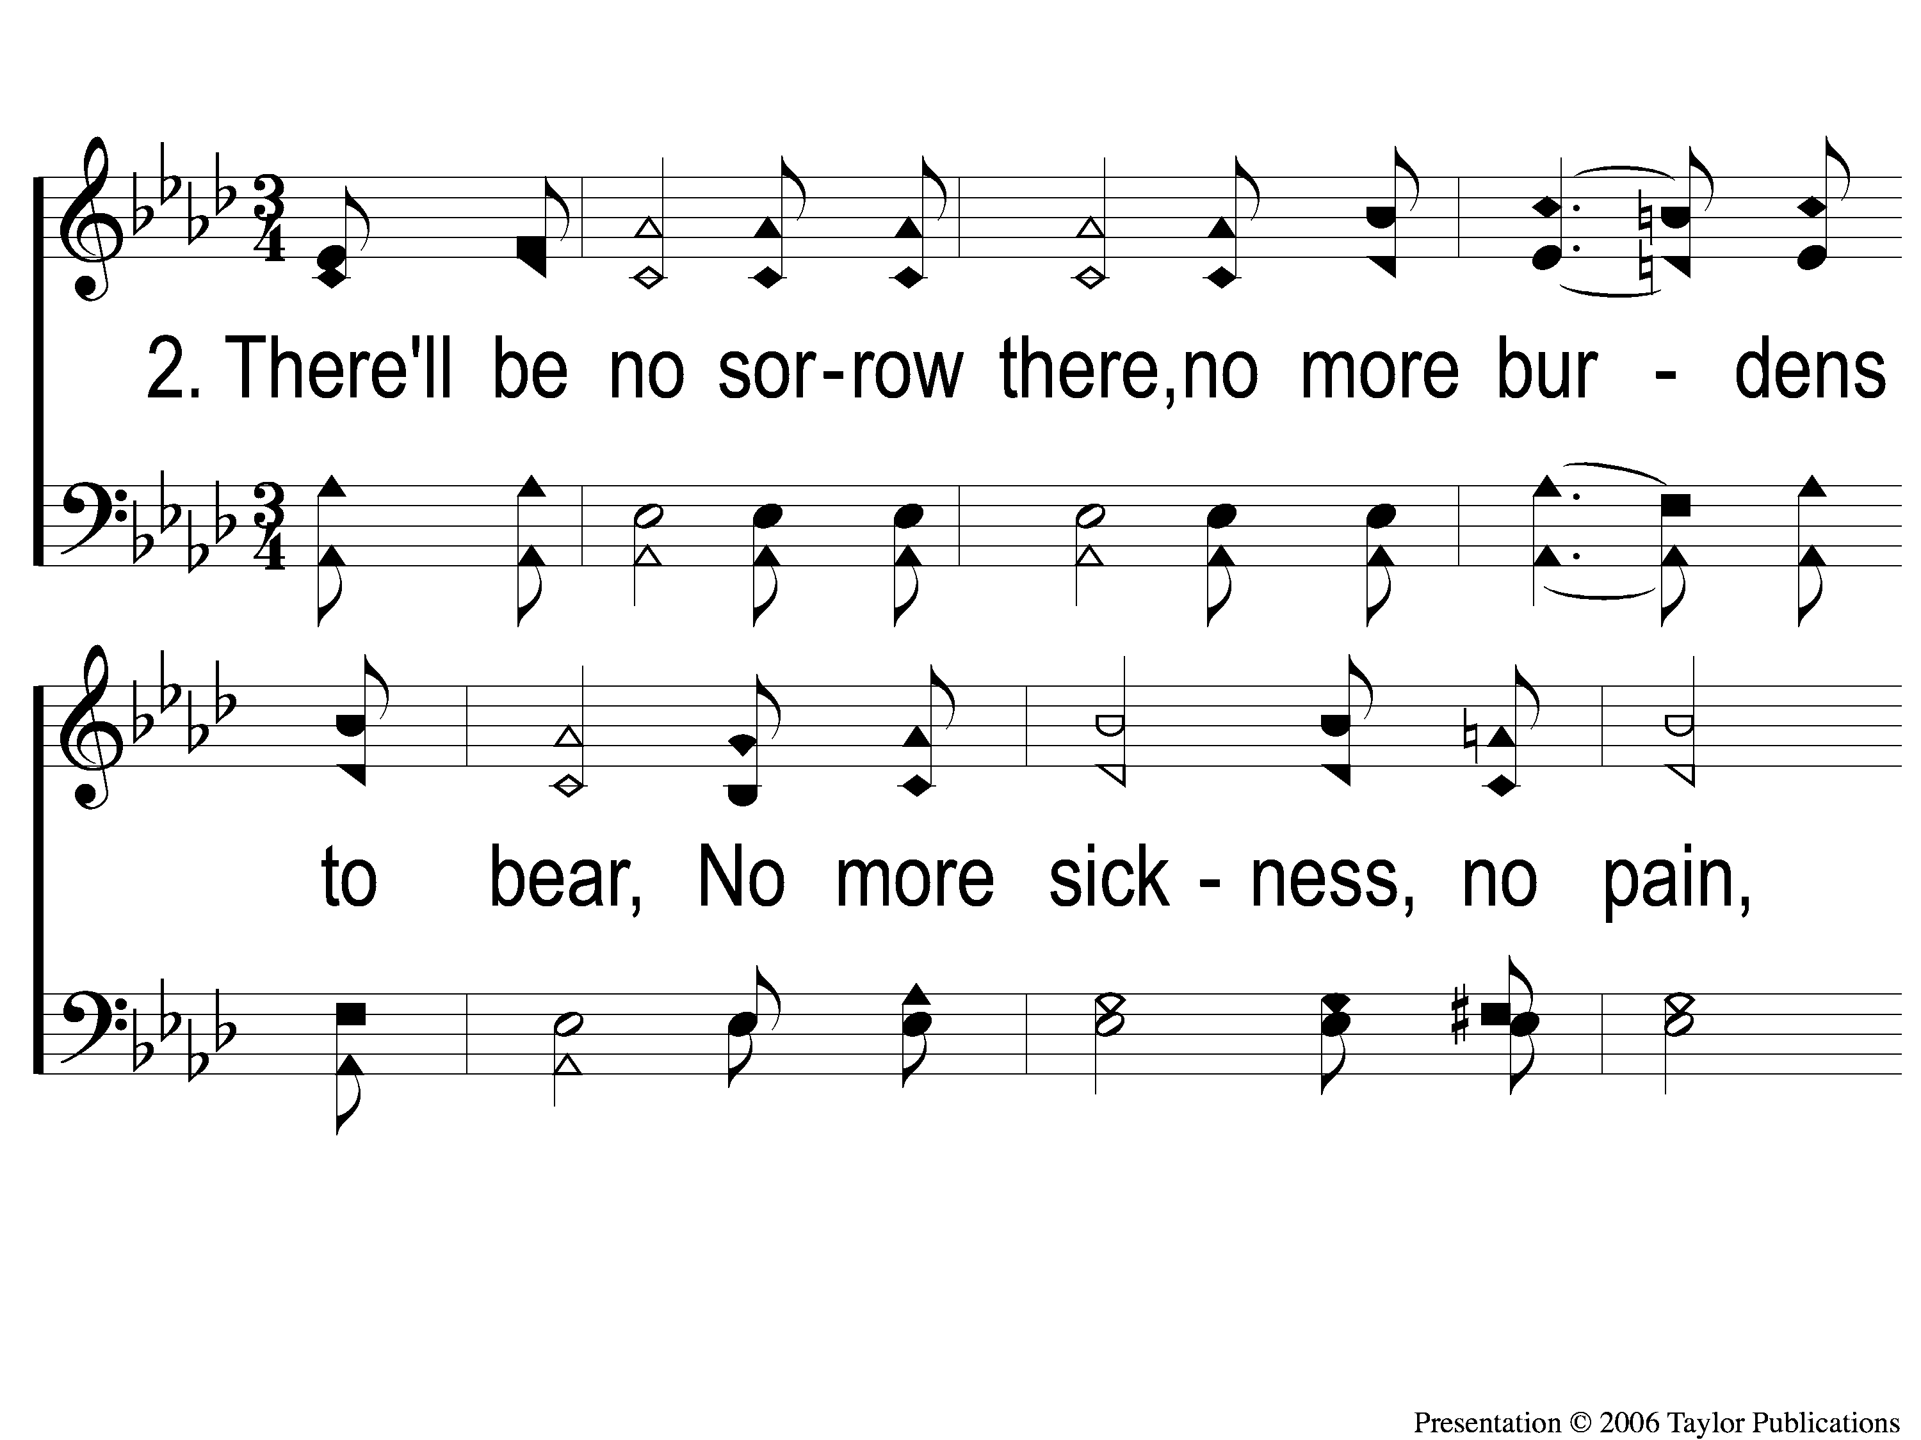
2-1 What a Day That Will Be
What a Day That Will Be
916

Slide 91
2-2 What a Day That Will Be
What a Day That Will Be
916

Slide 92
2-3 What a Day That Will Be
What a Day That Will Be
916

Slide 93
C-1 What a Day That Will Be
What a Day That Will Be
916

Slide 94
C-2 What a Day That Will Be
What a Day That Will Be
916

Slide 95
C-3 What a Day That Will Be
What a Day That Will Be
916

Slide 96
The Contribution:
Luke 6:38
“Give, and it will be given to you: good measure, pressed down, shaken together, and running over will be put into your bosom. For with the same measure that you use, it will be measured back to you.”

Slide 97
Song:
Lamb Of God
#176

Slide 98
1-1 Lamb of God
Lamb of God
176

Slide 99
1-2 Lamb of God
Lamb of God
176

Slide 100
1-3 Lamb of God
Lamb of God
176

Slide 101
1-4 Lamb of God
Lamb of God
176

Slide 102
C-1 Lamb of God
Lamb of God
176

Slide 103
C-2 Lamb of God
Lamb of God
176

Slide 104
2-1 Lamb of God
Lamb of God
176

Slide 105
2-2 Lamb of God
Lamb of God
176

Slide 106
C-1 Lamb of God
Lamb of God
176

Slide 107
C-2 Lamb of God
Lamb of God
176

Slide 108
The Unleavened Bread
Luke 22:19
And He took bread, gave thanks and broke it, and gave it to them, saying, “This is My body which is given for you; do this in remembrance of Me.”

Slide 109
The Fruit
of the Vine
Luke 22:20
“Likewise He also took the cup after supper, saying, ‘This cup is the new covenant in My blood, which is shed for you.’ ”

Slide 110
Closing Prayer

Slide 111
Song:
I’ll Fly Away
#851

Slide 112
1-1 I’ll Fly Away
I’ll Fly Away
851

Slide 113
1-2 I’ll Fly Away
I’ll Fly Away
851

Slide 114
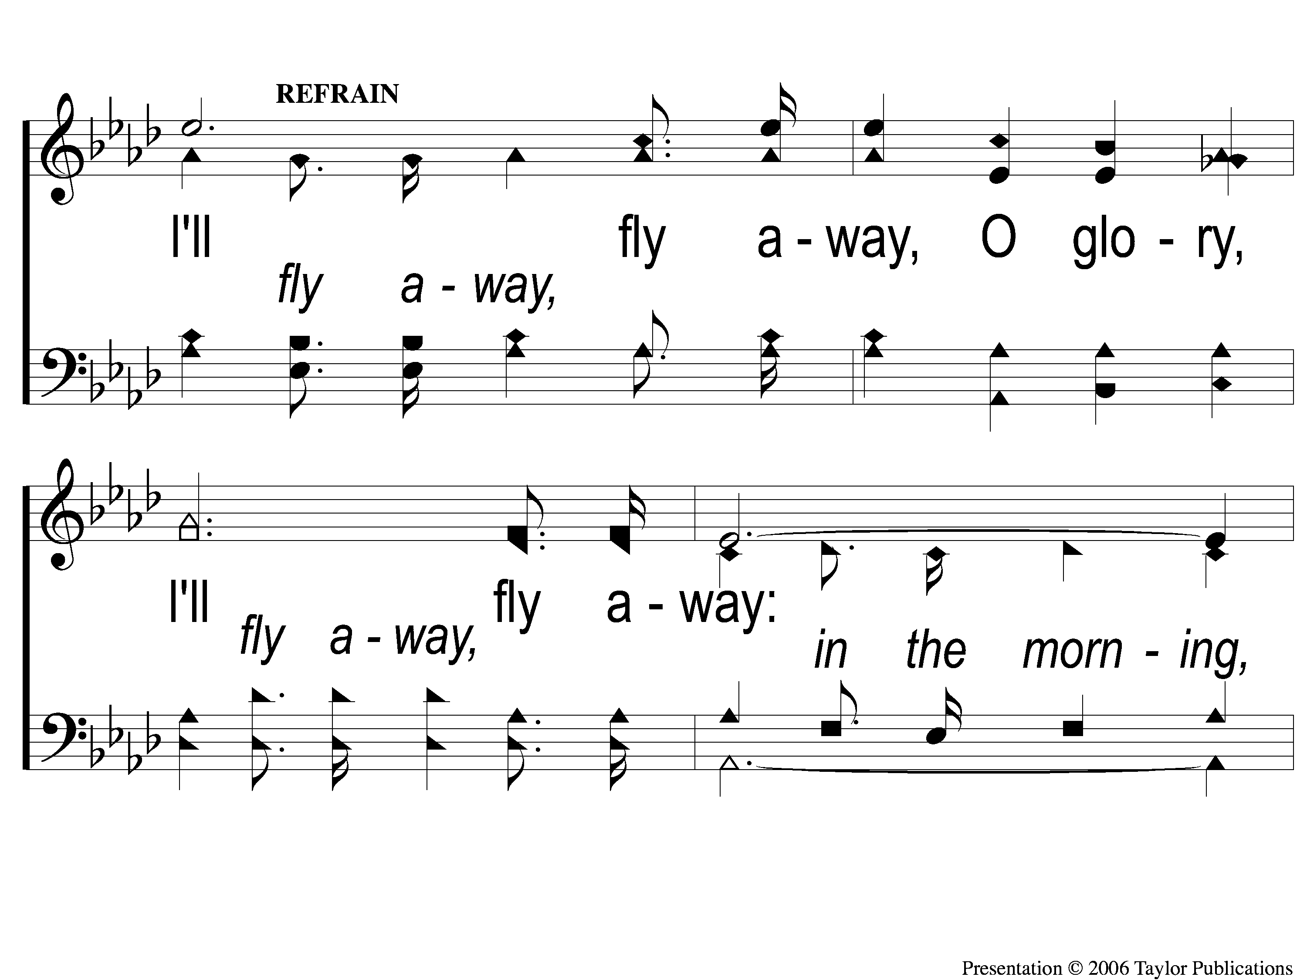
C-1 I’ll Fly Away
I’ll Fly Away
851

Slide 115
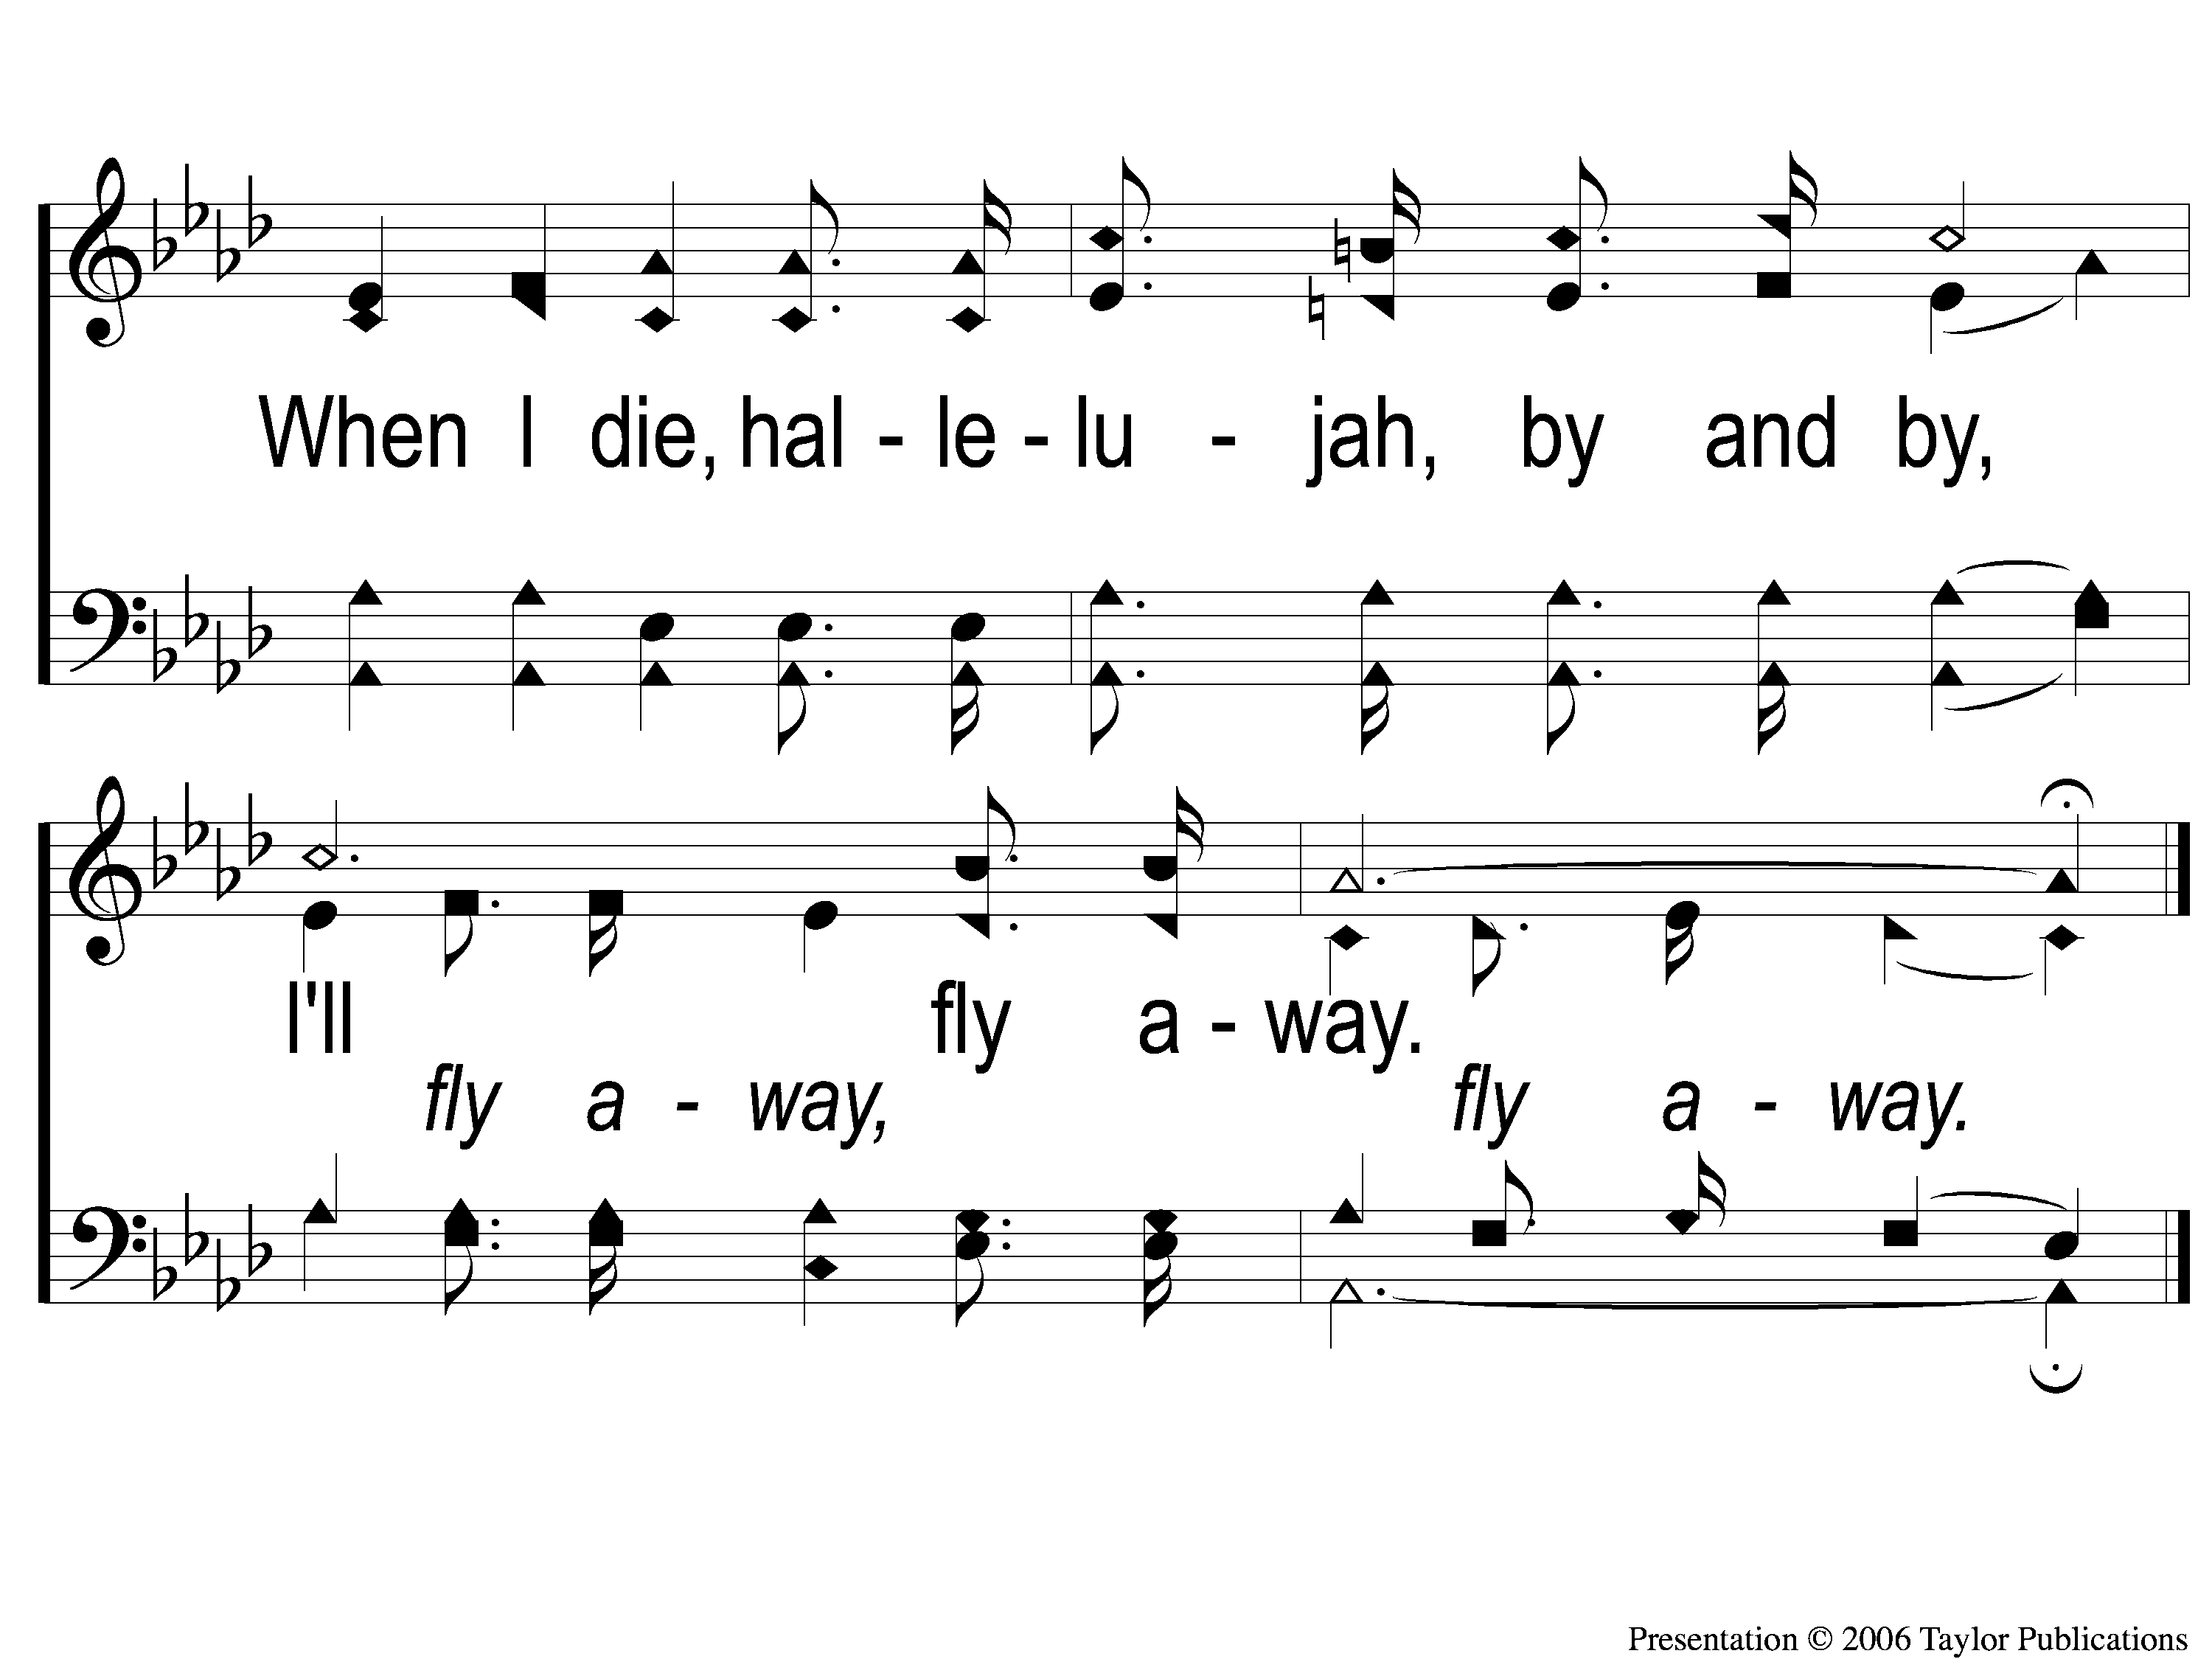
C-2 I’ll Fly Away
I’ll Fly Away
851

Slide 116
2-1 I’ll Fly Away
I’ll Fly Away
851

Slide 117
2-2 I’ll Fly Away
I’ll Fly Away
851

Slide 118
C-1 I’ll Fly Away
I’ll Fly Away
851

Slide 119
C-2 I’ll Fly Away
I’ll Fly Away
851

Slide 120
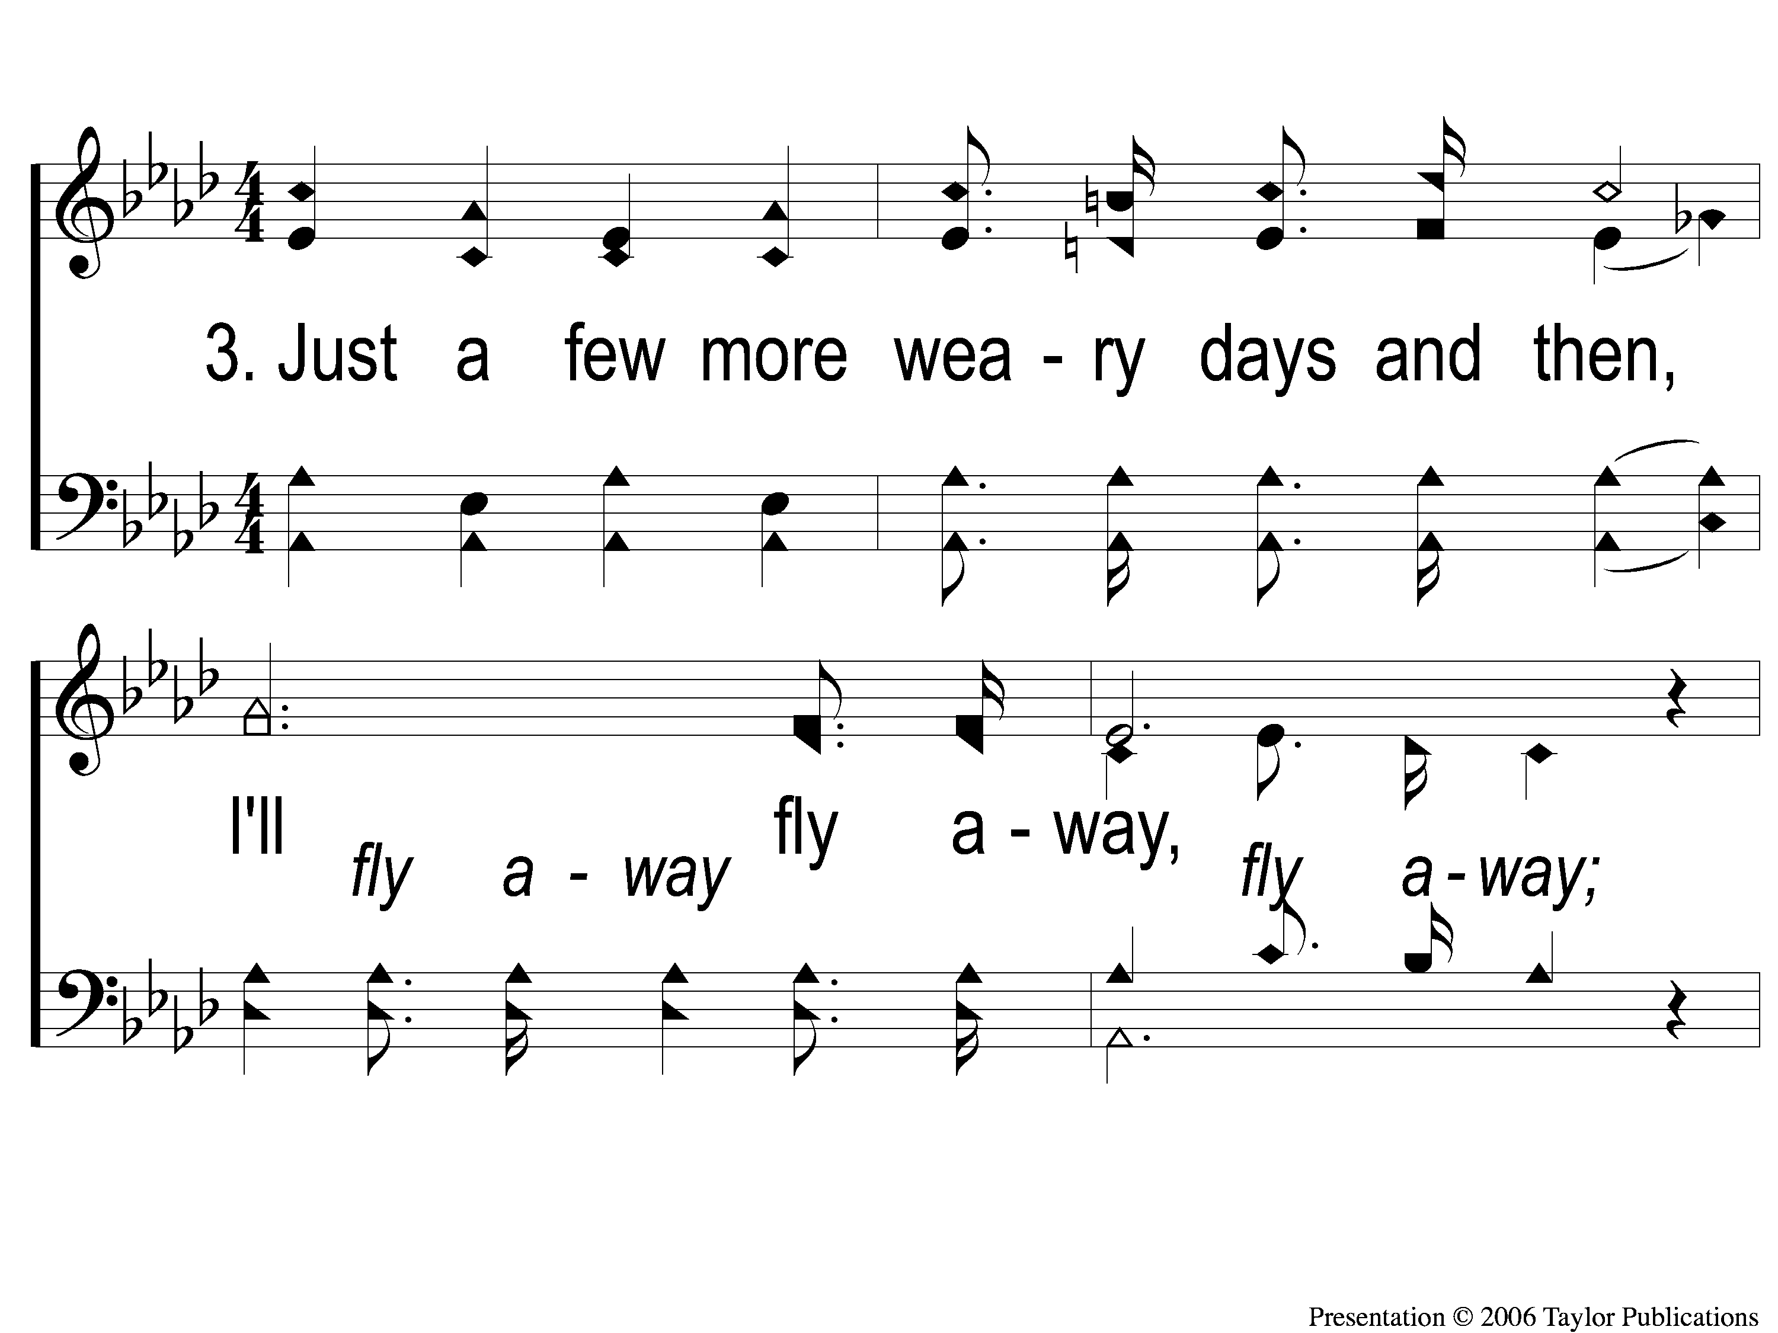
3-1 I’ll Fly Away
I’ll Fly Away
851

Slide 121
3-2 I’ll Fly Away
I’ll Fly Away
851

Slide 122
C-1 I’ll Fly Away
I’ll Fly Away
851

Slide 123
C-2 I’ll Fly Away
I’ll Fly Away
851

Slide 124
Today
VBS Meeting @ 4:30 PM
Elders Meeting @ 5:00 PM
Evening Worship @ 6:00 PM
Men’s Meeting After Worship
Tuesday
VBS Workshop @ 6:30 PM
RESTORE REBUILD RENEW
IN 2022
WHEELER
CHURCH
OF
CHRIST

