Slide 1
PLEASE STANDBY
OUR LIVESTREAM
WILL BEGIN SOON

Slide 2
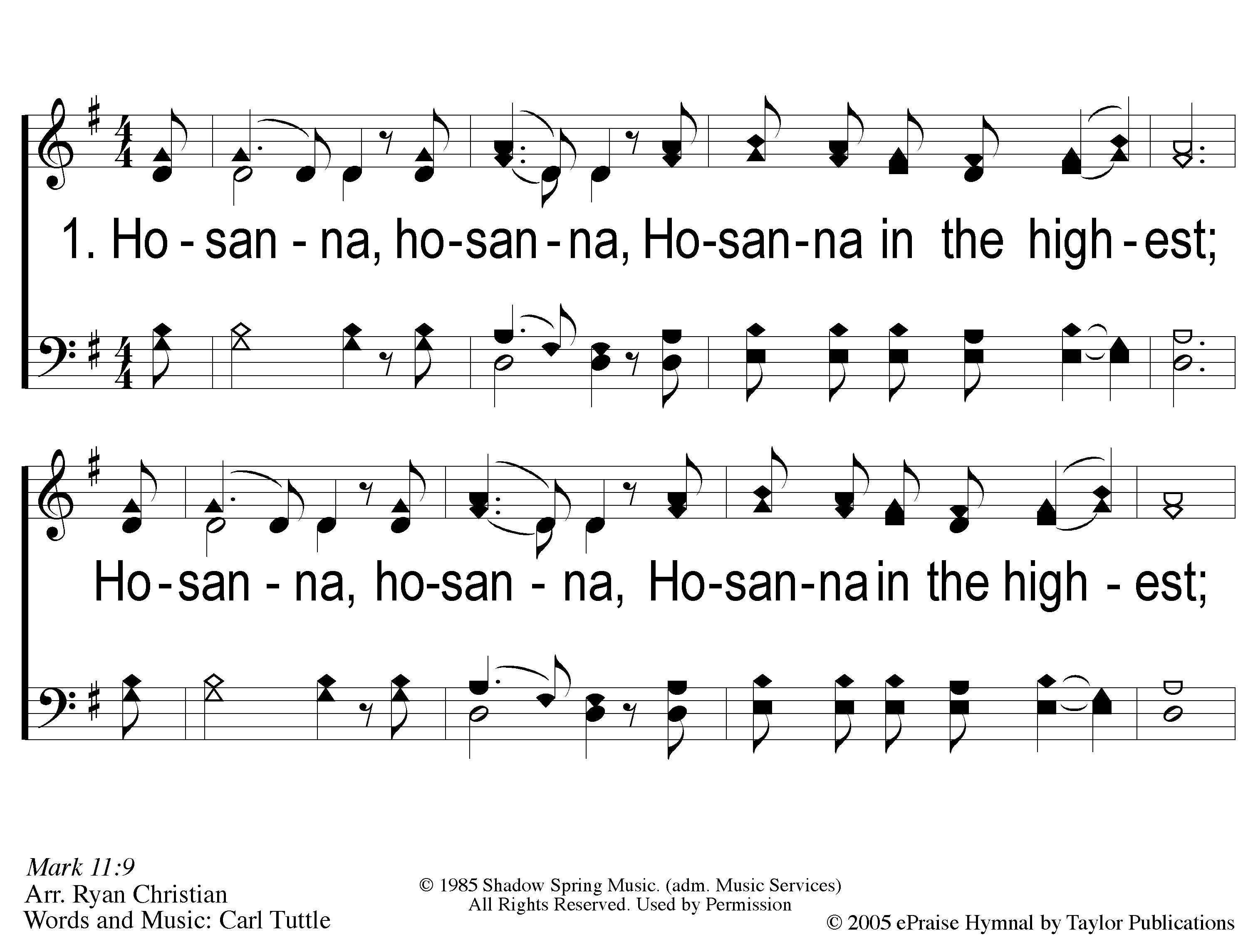
1 Hosanna
Hosanna

Slide 3
C-1 Hosanna
Hosanna

Slide 4
C-2 Hosanna
Hosanna

Slide 5
2 Hosanna
Hosanna

Slide 6
C-1 Hosanna
Hosanna

Slide 7
C-2 Hosanna
Hosanna

Slide 8
3 Hosanna
Hosanna

Slide 9
C-1 Hosanna
Hosanna

Slide 10
C-2 Hosanna
Hosanna

Slide 11
WELCOME
THANKS FOR JOINING US!

Slide 12
#608
SONG:
He Gave Me A Song

Slide 13
1-1 He Gave Me A Song
He Gave Me A Song
608

Slide 14
1-2 He Gave Me A Song
He Gave Me A Song
608

Slide 15
1-3 He Gave Me A Song
He Gave Me A Song
608

Slide 16
C-1 He Gave Me A Song
He Gave Me A Song
608

Slide 17
C-2 He Gave Me A Song
He Gave Me A Song
608

Slide 18
C-3 He Gave Me A Song
He Gave Me A Song
608

Slide 19
2-1 He Gave Me A Song
He Gave Me A Song
608

Slide 20
2-2 He Gave Me A Song
He Gave Me A Song
608

Slide 21
2-3 He Gave Me A Song
He Gave Me A Song
608

Slide 22
C-1 He Gave Me A Song
He Gave Me A Song
608

Slide 23
C-2 He Gave Me A Song
He Gave Me A Song
608

Slide 24
C-3 He Gave Me A Song
He Gave Me A Song
608

Slide 25
3-1 He Gave Me A Song
He Gave Me A Song
608

Slide 26
3-2 He Gave Me A Song
He Gave Me A Song
608

Slide 27
3-3 He Gave Me A Song
He Gave Me A Song
608

Slide 28
C-1 He Gave Me A Song
He Gave Me A Song
608

Slide 29
C-2 He Gave Me A Song
He Gave Me A Song
608

Slide 30
C-3 He Gave Me A Song
He Gave Me A Song
608

Slide 31
#749
SONG:
The Battle Belongs
To The Lord

Slide 32
1-1 The Battle Belongs to the Lord
The Battle Belongs to the Lord
749

Slide 33
1-2 The Battle Belongs to the Lord
The Battle Belongs to the Lord
749

Slide 34
C-1 The Battle Belongs to the Lord
The Battle Belongs to the Lord
749

Slide 35
C-2 The Battle Belongs to the Lord
The Battle Belongs to the Lord
749

Slide 36
2-1 The Battle Belongs to the Lord
The Battle Belongs to the Lord
749

Slide 37
2-2 The Battle Belongs to the Lord
The Battle Belongs to the Lord
749

Slide 38
C-1 The Battle Belongs to the Lord
The Battle Belongs to the Lord
749

Slide 39
C-2 The Battle Belongs to the Lord
The Battle Belongs to the Lord
749

Slide 40
3-1 The Battle Belongs to the Lord
The Battle Belongs to the Lord
749

Slide 41
3-2 The Battle Belongs to the Lord
The Battle Belongs to the Lord
749

Slide 42
C-1 The Battle Belongs to the Lord
The Battle Belongs to the Lord
749

Slide 43
C-2 The Battle Belongs to the Lord
The Battle Belongs to the Lord
749

Slide 44
First PRAYER

Slide 45
#916
SONG:
What A Day
That Will Be

Slide 46
1-1 What a Day That Will Be
What a Day That Will Be
916

Slide 47
1-2 What a Day That Will Be
What a Day That Will Be
916

Slide 48
1-3 What a Day That Will Be
What a Day That Will Be
916

Slide 49
C-1 What a Day That Will Be
What a Day That Will Be
916

Slide 50
C-2 What a Day That Will Be
What a Day That Will Be
916

Slide 51
C-3 What a Day That Will Be
What a Day That Will Be
916

Slide 52
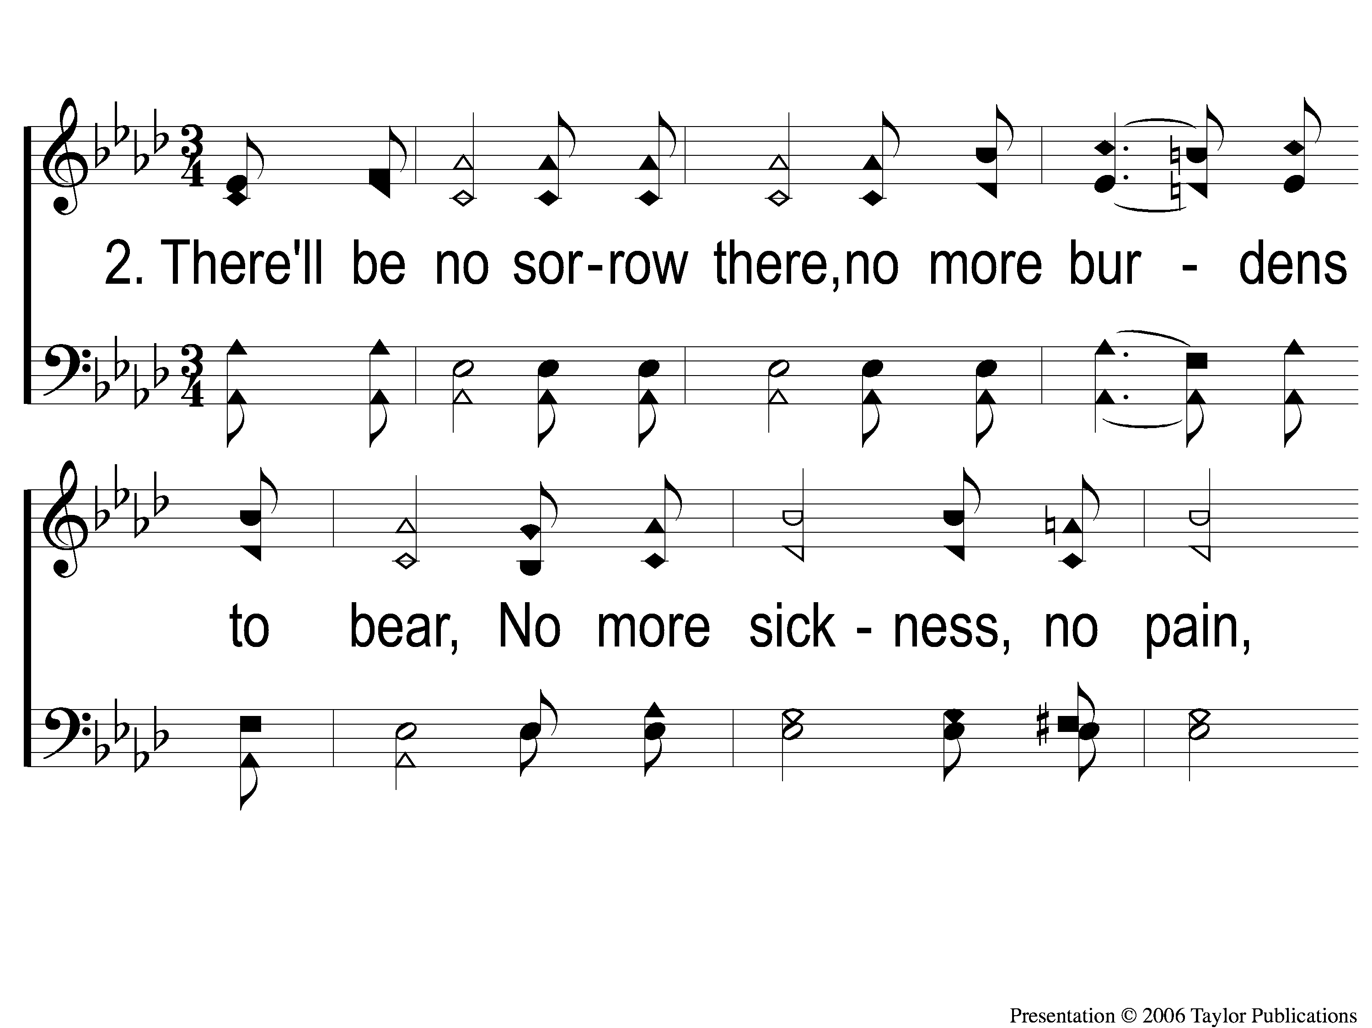
2-1 What a Day That Will Be
What a Day That Will Be
916

Slide 53
2-2 What a Day That Will Be
What a Day That Will Be
916

Slide 54
2-3 What a Day That Will Be
What a Day That Will Be
916

Slide 55
C-1 What a Day That Will Be
What a Day That Will Be
916

Slide 56
C-2 What a Day That Will Be
What a Day That Will Be
916

Slide 57
C-3 What a Day That Will Be
What a Day That Will Be
916

Slide 58
#535
SONG:
The Glory Land Way

Slide 59
1-1 The Glory Land Way
The Glory Land Way
535

Slide 60
1-2 The Glory Land Way
The Glory Land Way
535

Slide 61
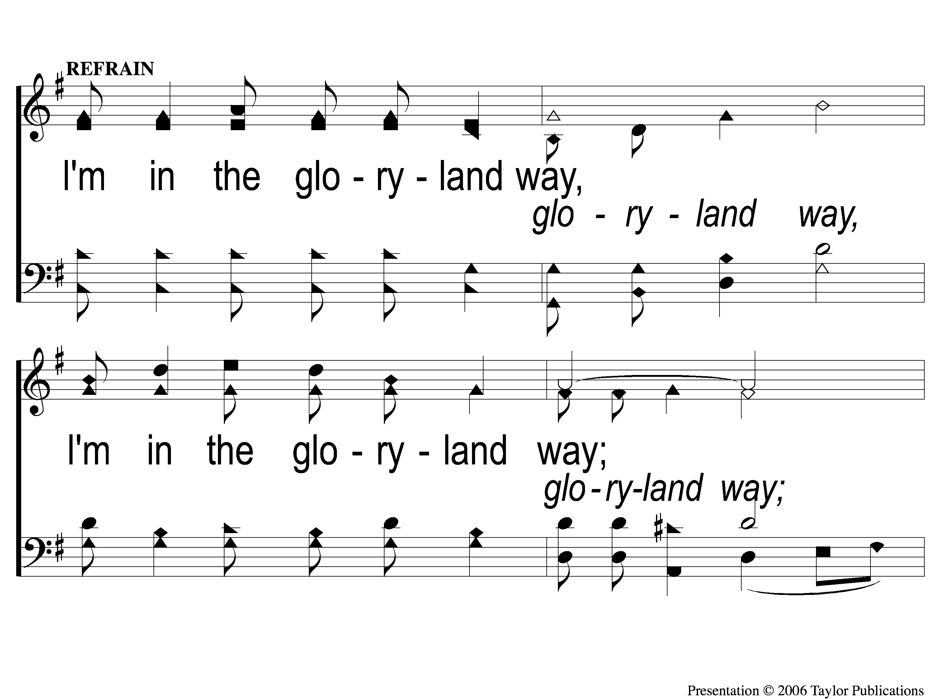
C-1 The Glory Land Way
The Glory Land Way
535

Slide 62
C-2 The Glory Land Way
The Glory Land Way
535

Slide 63
2-1 The Glory Land Way
The Glory Land Way
535

Slide 64
2-2 The Glory Land Way
The Glory Land Way
535

Slide 65
C-1 The Glory Land Way
The Glory Land Way
535

Slide 66
C-2 The Glory Land Way
The Glory Land Way
535

Slide 67
3-1 The Glory Land Way
The Glory Land Way
535

Slide 68
3-2 The Glory Land Way
The Glory Land Way
535

Slide 69
C-1 The Glory Land Way
The Glory Land Way
535

Slide 70
C-2 The Glory Land Way
The Glory Land Way
535

Slide 71
SCRIPTURE:
Psalm 10:14-18

Slide 72
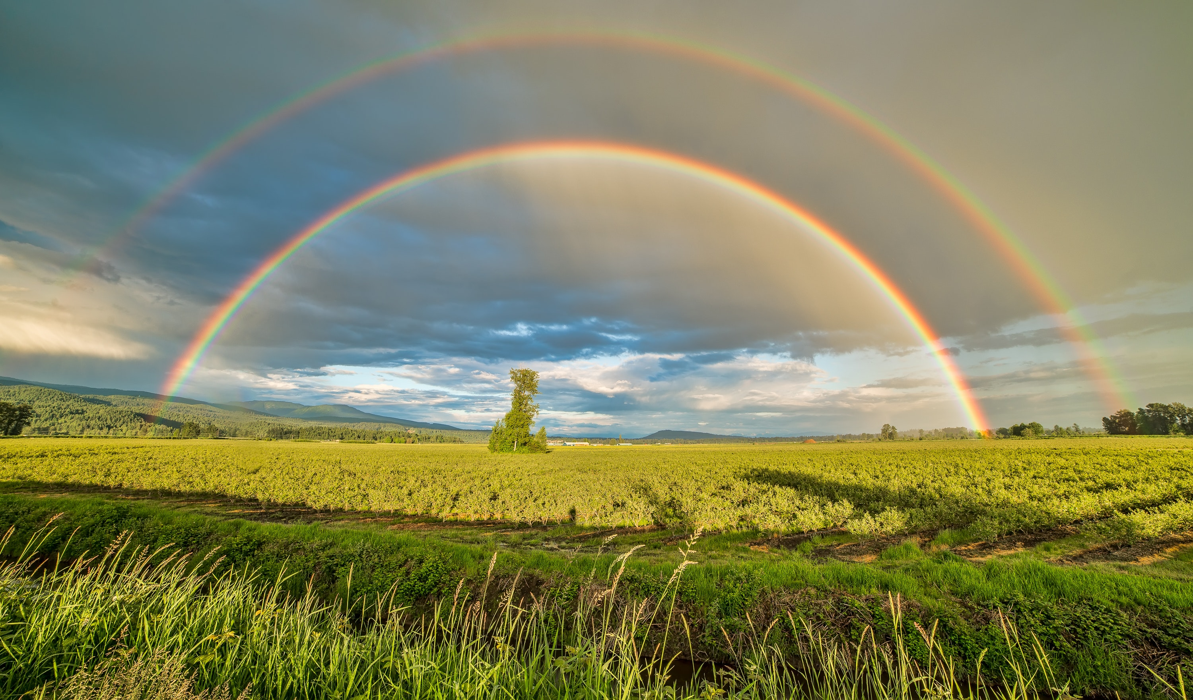
STANDING ON THE PROMISES

Slide 73
Tonight!
THE PROMISE OF PROXIMITY

Slide 74
THE PROMISE OF BLESSINGS

Slide 75
THE PROMISE
“This one will be blessed
in what he does” – Jms. 1:25

Slide 76
THE PROMISE
“This one will be blessed
in what he does” – Jms. 1:25
Matt. 5:3-11

Slide 77
THE CONDITION
“But he who looks…and continues in it, and is not a forgetful hearer but a doer of the work” – Jms. 1:25

Slide 78
THE CONDITION
“But he who looks…and continues in it, and is not a forgetful hearer but a doer of the work” – Jms. 1:25

Slide 79
THE RELIABILITY
Promised Before the Law of Moses
Promised in the Law of Moses
Promised in the Law of Christ

Slide 80
THE RELIABILITY
Promised Before the Law of Moses
Gen. 2:15-17 – Adam
Gen. 22:18 – Abraham
Gen. 26:5 – Isaac
Ex. 15:26 – Israelites

Slide 81
THE RELIABILITY
Promised in the Law of Moses
Deut. 28:1-2

Slide 82
THE RELIABILITY
Promised in the Law of Christ
Matt. 5:3-5
Jn. 13:17
Rom. 2:13
Jms. 1:21-25

Slide 83
THE PROMISE OF BLESSINGS

Slide 84
THE PROMISE OF BLESSINGS
God Does NOT Change
Mal. 3:6, Heb. 13:8

Slide 85
THE PROMISE OF BLESSINGS
God Does NOT Change
Mal. 3:6, Heb. 13:8
We Must be Active Doers of God’s Word
Lk. 6:46-49, Deut. 28:15, Gen. 2:17

Slide 86
AM I A HEARER AND
A DOER OF GOD’S WORD?

Slide 87
SONG:
Light The Fire

Slide 88
1 Light The Fire
Light The Fire

Slide 89
C-1 Light The Fire
Light The Fire

Slide 90
C-2 Light The Fire
Light The Fire

Slide 91
2-1 Light The Fire
Light The Fire

Slide 92
2-2 Light The Fire
Light The Fire

Slide 93
C-1 Light The Fire
Light The Fire

Slide 94
C-2 Light The Fire
Light The Fire

Slide 95
#129
SONG:
Amazing Grace

Slide 96
1-1 Amazing Grace
Amazing Grace
129

Slide 97
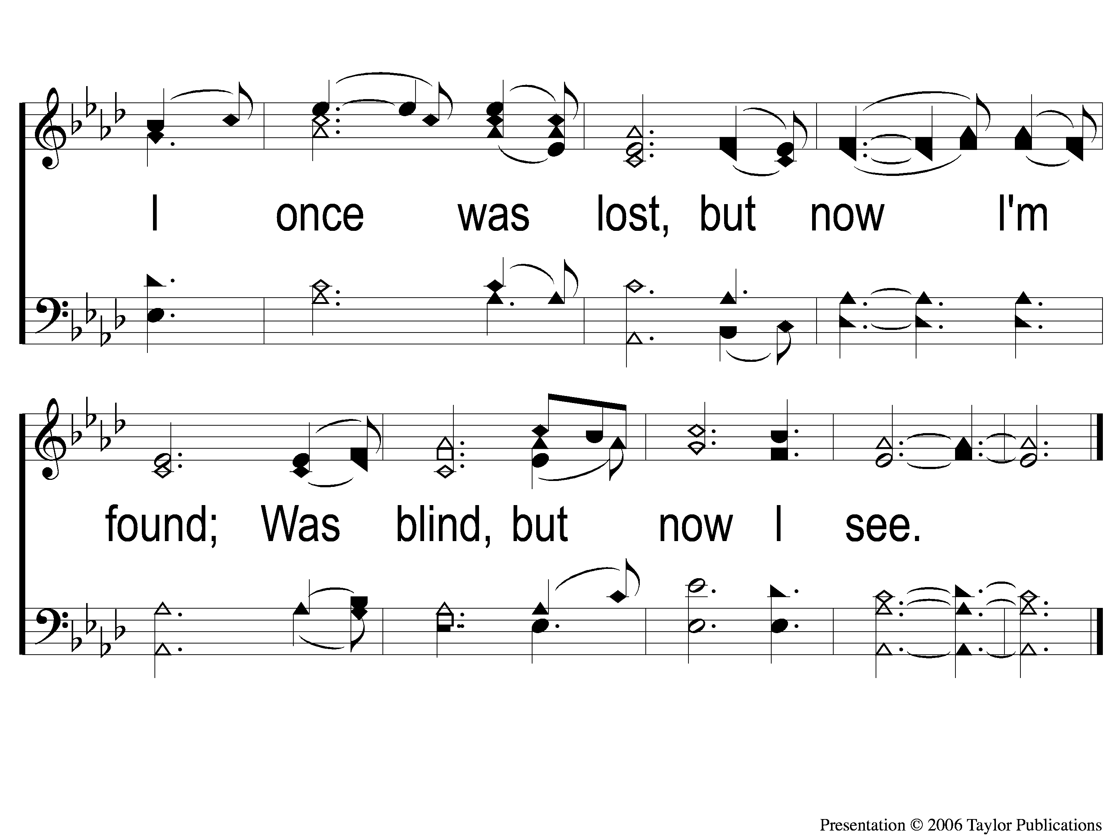
1-2 Amazing Grace
Amazing Grace
129

Slide 98
2-1 Amazing Grace
Amazing Grace
129

Slide 99
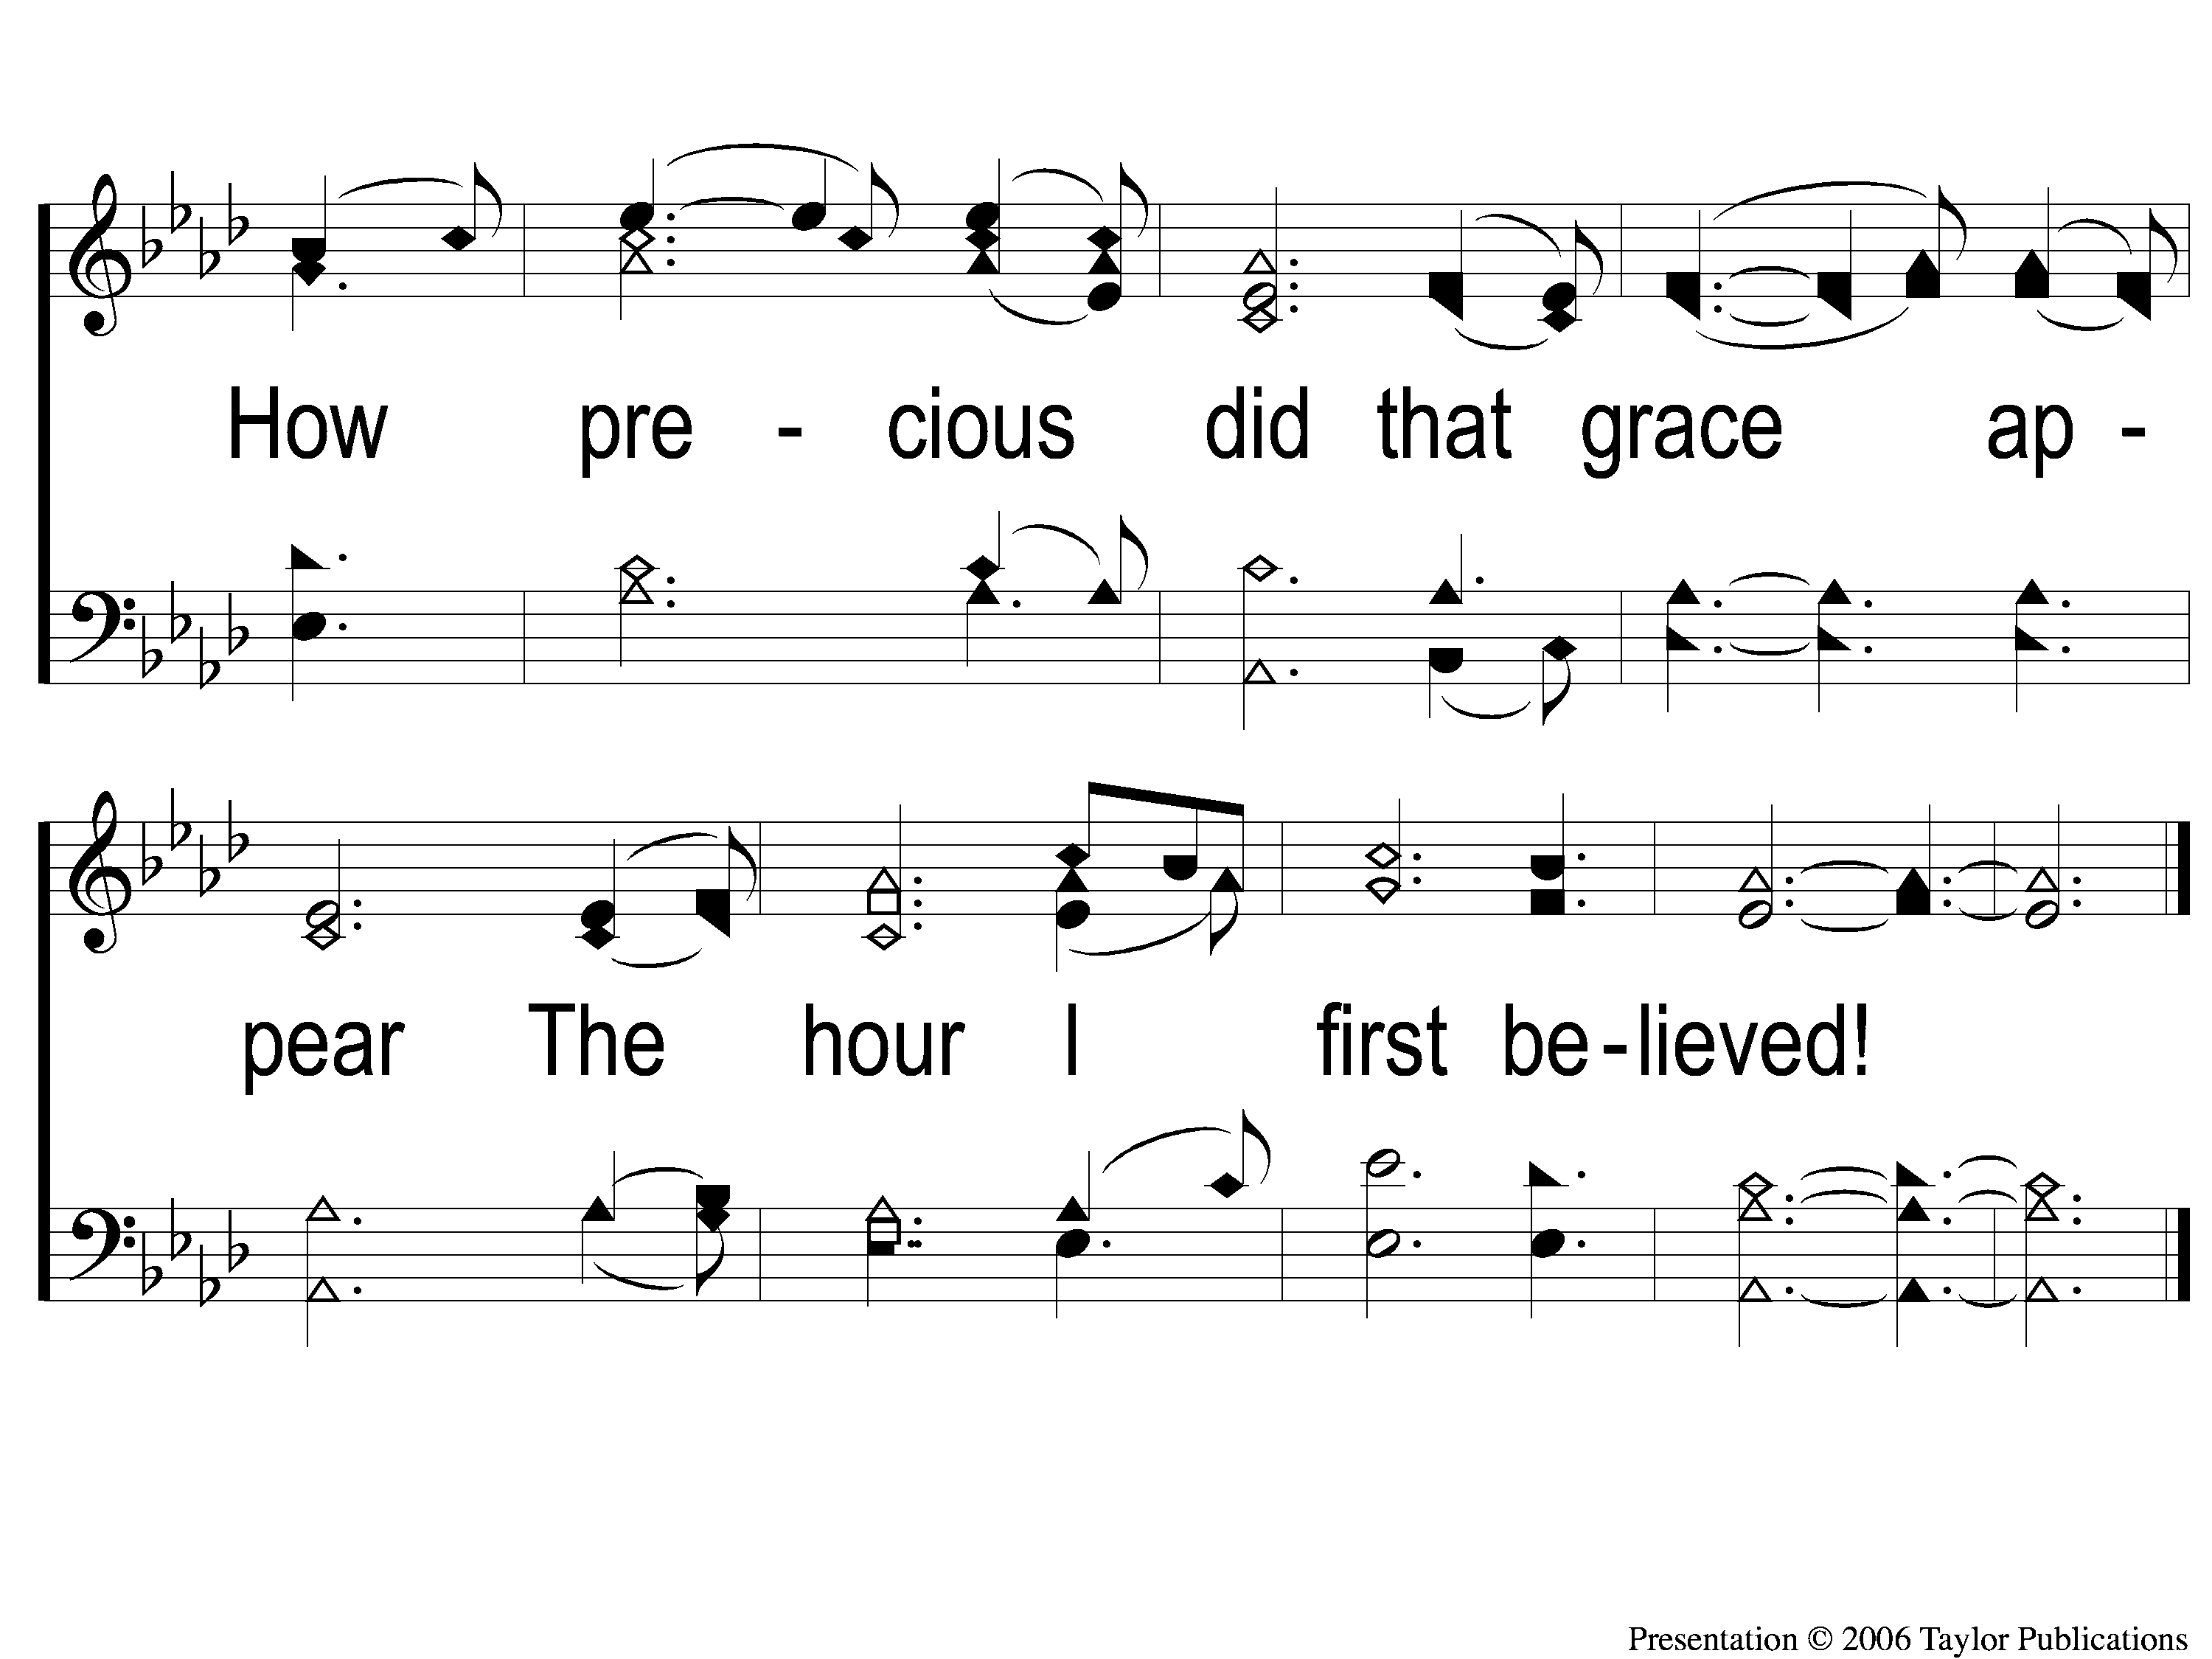
2-2 Amazing Grace
Amazing Grace
129

Slide 100
3-1 Amazing Grace
Amazing Grace
129

Slide 101
3-2 Amazing Grace
Amazing Grace
129

Slide 102
4-1 Amazing Grace
Amazing Grace
129

Slide 103
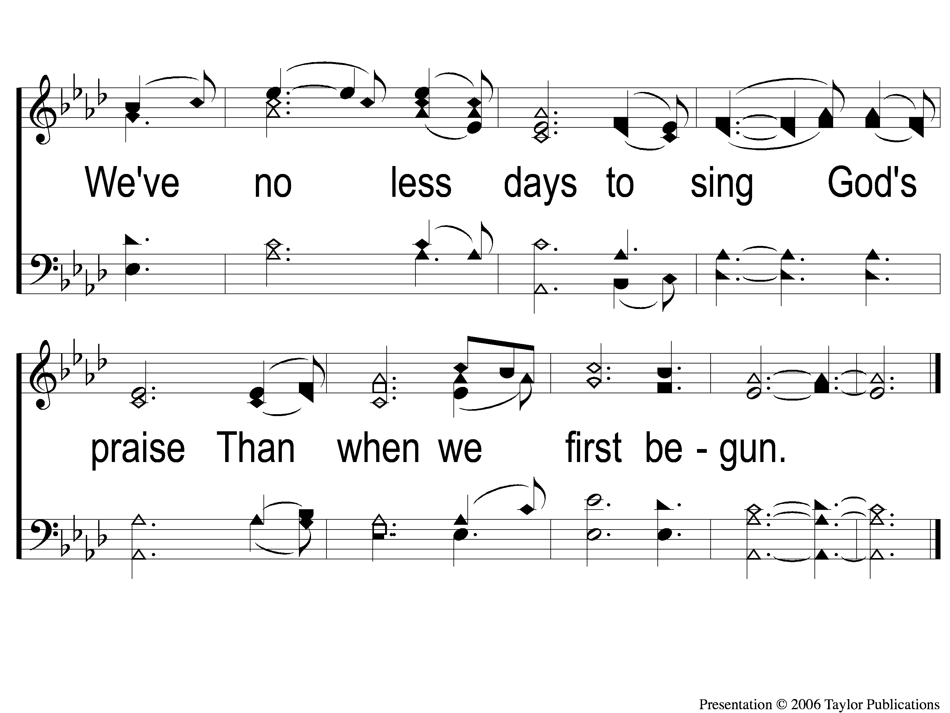
4-2 Amazing Grace
Amazing Grace
129

Slide 104
LORD’S SUPPER
The
Acts 20:7

Slide 105
Unleavened Bread
LORD’S SUPPER
Who has believed our report?
And to whom has the arm of the Lord been revealed?
² For He shall grow up before Him as a tender plant,
And as a root out of dry ground.
He has no form or comeliness;
And when we see Him,
There is no beauty that we should desire Him.
³ He is despised and rejected by men,
A Man of sorrows and acquainted with grief.
And we hid, as it were, our faces from Him;
He was despised, and we did not esteem Him.
.
Isaiah 53:1-3

Slide 106
Fruit of the Vine
LORD’S SUPPER
Surely He has borne our griefs
And carried our sorrows;
Yet we esteemed Him stricken,
Smitten by God, and afflicted.
⁵ But He was wounded for our transgressions,
He was bruised for our iniquities;
The chastisement for our peace was upon Him,
And by His stripes we are healed.
Isaiah 53:4-5

Slide 107
2 Corinthians 8:12
OFFERING
¹² For if there is first a willing mind, it is accepted according to what one has, and not according to what he does not have.

Slide 108
Closing PRAYER

Slide 109
SONG:
The Greatest Commands

Slide 110
1-1 The Greatest Commands
The Greatest Commands

Slide 111
1-2 The Greatest Commands
The Greatest Commands

Slide 112
1-3 The Greatest Commands
The Greatest Commands

Slide 113
1-4 The Greatest Commands
The Greatest Commands

Slide 114
2-1 The Greatest Commands
The Greatest Commands

Slide 115
2-2 The Greatest Commands
The Greatest Commands

Slide 116
2-3 The Greatest Commands
The Greatest Commands

Slide 117
2-4 The Greatest Commands
The Greatest Commands

Slide 118
3-1 The Greatest Commands
The Greatest Commands

Slide 119
3-2 The Greatest Commands
The Greatest Commands

Slide 120
3-3 The Greatest Commands
The Greatest Commands

Slide 121
3-4 The Greatest Commands
The Greatest Commands

Slide 122
4-1 The Greatest Commands
The Greatest Commands

Slide 123
4-2 The Greatest Commands
The Greatest Commands

Slide 124
4-3 The Greatest Commands
The Greatest Commands

Slide 125
4-4 The Greatest Commands
The Greatest Commands

Slide 126
TONIGHT @ 6:00 pm
EVENING WORSHIP
HOPE TO SEE YOU THERE!

