Slide 1
PLEASE STANDBY
OUR LIVESTREAM
WILL BEGIN SOON

Slide 2
WELCOME
THANKS FOR JOINING US!

Slide 3
Opening Song

Slide 4
First PRAYER

Slide 5
Songs of
Praise to God

Slide 6
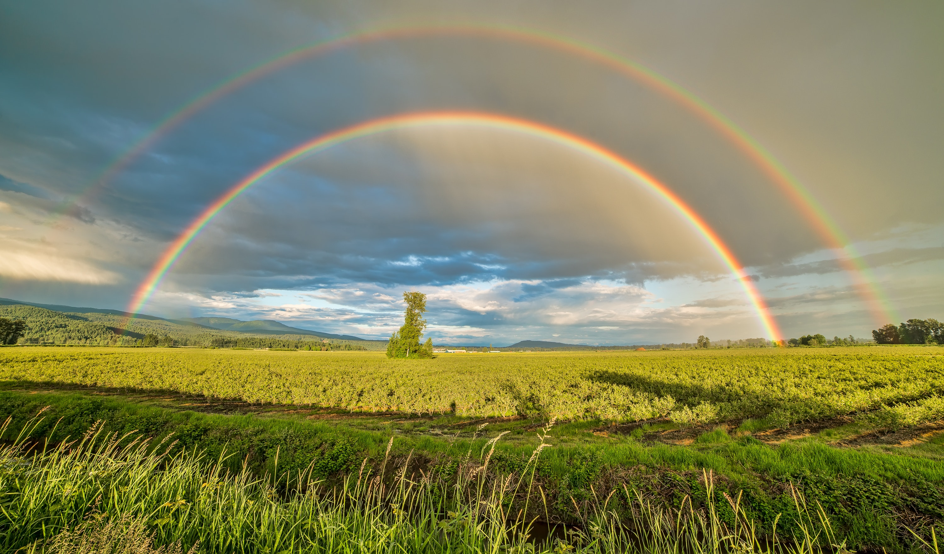
STANDING ON THE PROMISES

Slide 7
THE PROMISE OF PROXIMITY

Slide 8
PROXIMITY
= Nearness in Space, Time, or Relationship

Slide 9
THE BOOK OF JAMES

Slide 10
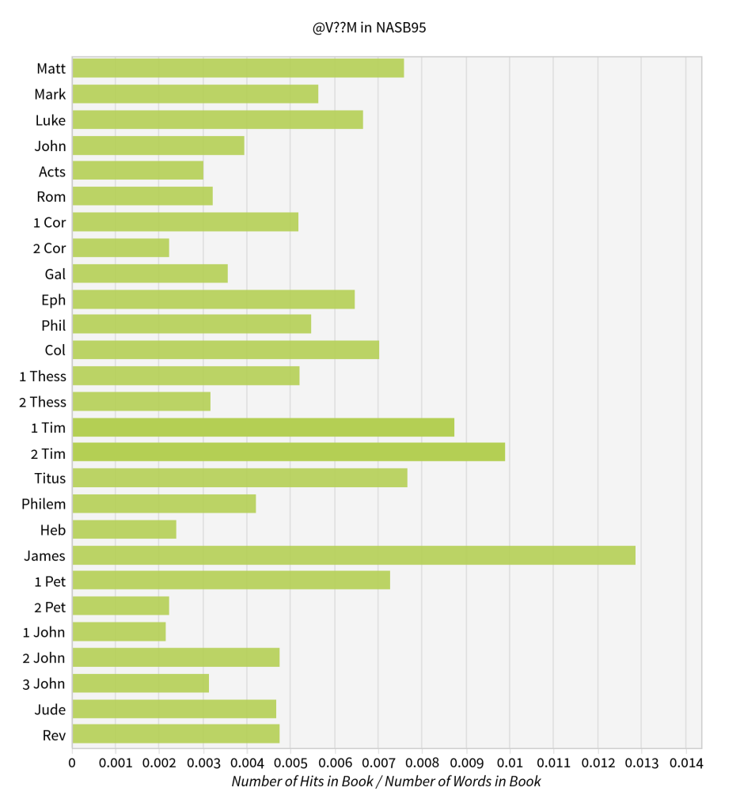

Slide 12
THE BOOK OF JAMES
The Most Commands!

Slide 13
THE BOOK OF JAMES
The Most Commands!
54 Commands in 108 Verses

Slide 14
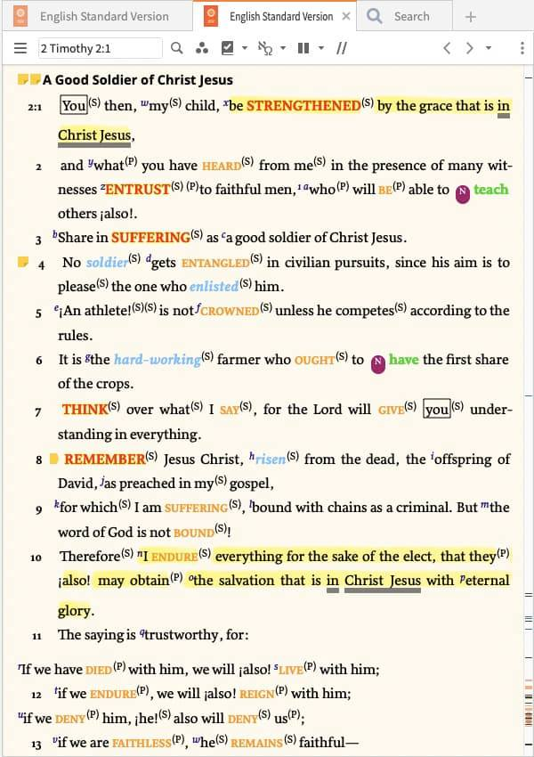

Slide 15
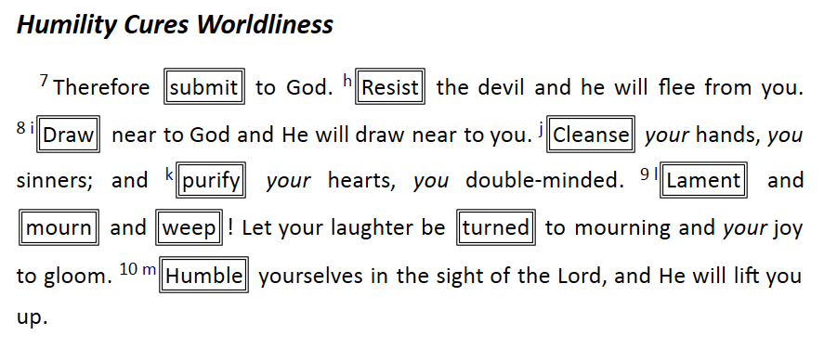

Slide 16
THE BOOK OF JAMES
Ch. 3:13-17 – Wisdom: God vs. World

Slide 17
THE BOOK OF JAMES
Ch. 3:13-17 – Wisdom: God vs. World
Ch. 4:1-6 – Wordly Wisdom → Division

Slide 18
THE BOOK OF JAMES
Ch. 3:13-17 – Wisdom: God vs. World
Ch. 4:1-6 – Wordly Wisdom → Division
Ch. 4:7-17 – Godly Wisdom → Unity

Slide 19
THE PROMISE
Greek: ἐγγίζω (Engizo)
= approach, move closer to

Slide 20
THE PROMISE
Greek: ἐγγίζω (Engizo)
= approach, move closer to
In what way?
Not spatially or in time (Lk. 18:40)

Slide 21
THE PROMISE
Greek: ἐγγίζω (Engizo)
= approach, move closer to
In what way?
Relationally / Spiritually

Slide 22
THE CONDITION
“Draw near to God”

Slide 23
THE CONDITION
“Draw near to God”
Same condition in the OT
2 Chron. 15:2
Zech. 1:3

Slide 24
THE CONDITION
How do we draw near to God?

Slide 25
THE CONDITION
How do we draw near to God?
“Cleanse your hands”

Slide 26
THE CONDITION
How do we draw near to God?
“Cleanse your hands”
“Purify your hearts” – Psa. 24:3-4

Slide 27
THE CONDITION
How do we draw near to God?
“Cleanse your hands”
“Purify your hearts” – Psa. 24:3-4
“Lament…weep” – 2 Cor. 7:10

Slide 28
THE CONDITION
How do we draw near to God?
“Cleanse your hands”
“Purify your hearts” – Psa. 24:3-4
“Lament…weep” – 2 Cor. 7:10
“Humble yourselves”

Slide 29
THE CONDITION
How do we draw near to God?
“Cleanse your hands”
“Purify your hearts” – Psa. 24:3-4
“Lament…weep” – 2 Cor. 7:10
“Humble yourselves”
“Do not speak evil…”

Slide 30
ARE YOU DRAWING
NEAR TO GOD?

Slide 31
Song of Invitation

Slide 32
LORD’S SUPPER
The
Acts 20:7

Slide 33
Closing PRAYER

Slide 34
Closing Song

Slide 35
WEDNESDAY @ 6:30 pm
JOIN US
HOPE TO SEE YOU THERE!

