Slide 1
1-1 Listen to our Hearts
Listen To Our Hearts
810

Slide 2
1-2 Listen to our Hearts
Listen To Our Hearts
810

Slide 3
1-3 Listen to our Hearts
Listen To Our Hearts
810

Slide 4
C-1 Listen to our Hearts
Listen To Our Hearts
810

Slide 5
C-2 Listen to our Hearts
Listen To Our Hearts
810

Slide 6
C-3 Listen to our Hearts
Listen To Our Hearts
810

Slide 7
C-4 Listen to our Hearts
Listen To Our Hearts
810

Slide 8
2-1 Listen to our Hearts
Listen To Our Hearts
810

Slide 9
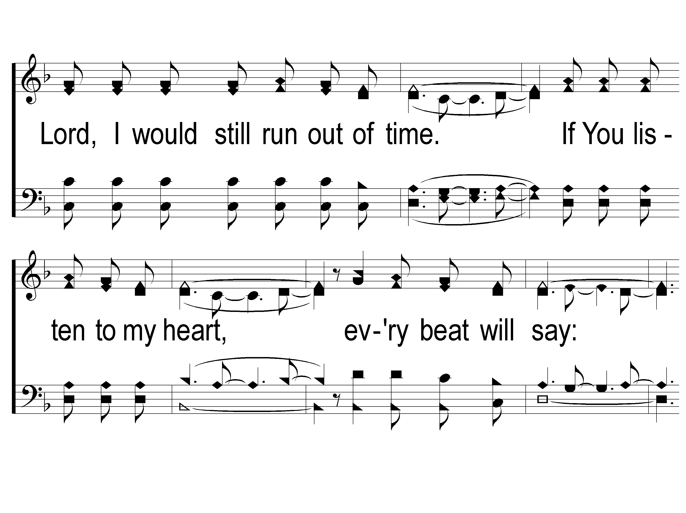
2-2 Listen to our Hearts
Listen To Our Hearts
810

Slide 10
2-3 Listen to our Hearts
Listen To Our Hearts
810

Slide 11
C-1 Listen to our Hearts
Listen To Our Hearts
810

Slide 12
C-2 Listen to our Hearts
Listen To Our Hearts
810

Slide 13
C-3 Listen to our Hearts
Listen To Our Hearts
810

Slide 14
C-4 Listen to our Hearts
Listen To Our Hearts
810

Slide 15
RESTORE REBUILD RENEW
welcome
we are glad to
Have you with us
IN 2022
WHEELER
CHURCH
OF
CHRIST

Slide 16
Song:
Paradise Valley
#898

Slide 17
1-1 Paradise Valley
Paradise Valley
898

Slide 18
1-2 Paradise Valley
Paradise Valley
898

Slide 19
C-1 Paradise Valley
Paradise Valley
898

Slide 20
C-2 Paradise Valley
Paradise Valley
898

Slide 21
C-3 Paradise Valley
Paradise Valley
898

Slide 22
C-4 Paradise Valley
Paradise Valley
898

Slide 23
3-1 Paradise Valley
Paradise Valley
898

Slide 24
3-2 Paradise Valley
Paradise Valley
898

Slide 25
C-1 Paradise Valley
Paradise Valley
898

Slide 26
C-2 Paradise Valley
Paradise Valley
898

Slide 27
C-3 Paradise Valley
Paradise Valley
898

Slide 28
C-4 Paradise Valley
Paradise Valley
898

Slide 29
Song:
We Have An Anchor
#467

Slide 30
1-1 We Have an Anchor
We Have an Anchor
467

Slide 31
1-2 We Have an Anchor
We Have an Anchor
467

Slide 32
C-1 We Have an Anchor
We Have an Anchor
467

Slide 33
C-2 We Have an Anchor
We Have an Anchor
467

Slide 34
2-1 We Have an Anchor
We Have an Anchor
467

Slide 35
2-2 We Have an Anchor
We Have an Anchor
467

Slide 36
C-1 We Have an Anchor
We Have an Anchor
467

Slide 37
C-2 We Have an Anchor
We Have an Anchor
467

Slide 38
3-1 We Have an Anchor
We Have an Anchor
467

Slide 39
3-2 We Have an Anchor
We Have an Anchor
467

Slide 40
C-1 We Have an Anchor
We Have an Anchor
467

Slide 41
C-2 We Have an Anchor
We Have an Anchor
467

Slide 42
Opening Prayer

Slide 43
Song:
There Stands A Rock
#558

Slide 44
1-1 There Stands A Rock
There Stands A Rock
558

Slide 45
1-2 There’s Stands A Rock
There Stands A Rock
558

Slide 46
C-1 There’s Stands A Rock
There Stands A Rock
558

Slide 47
C-2 There’s Stands A Rock
There Stands A Rock
558

Slide 48
2-1 There’s Stands A Rock
There Stands A Rock
558

Slide 49
2-2 There’s Stands A Rock
There Stands A Rock
558

Slide 50
C-1 There’s Stands A Rock
There Stands A Rock
558

Slide 51
C-2 There’s Stands A Rock
There Stands A Rock
558

Slide 52
3-1 There’s Stands A Rock
There Stands A Rock
558

Slide 53
3-2 There’s Stands A Rock
There Stands A Rock
558

Slide 54
C-1 There’s Stands A Rock
There Stands A Rock
558

Slide 55
C-2 There’s Stands A Rock
There Stands A Rock
558

Slide 56
Song:
Remind Me, Dear Lord
#606

Slide 57
1-1 Remind Me Dear Lord
Remind Me Dear Lord
606

Slide 58
1-2 Remind Me Dear Lord
Remind Me Dear Lord
606

Slide 59
C-1 Remind Me Dear Lord
Remind Me Dear Lord
606

Slide 60
C-2 Remind Me Dear Lord
Remind Me Dear Lord
606

Slide 61
2-1 Remind Me Dear Lord
Remind Me Dear Lord
606

Slide 62
2-2 Remind Me Dear Lord
Remind Me Dear Lord
606

Slide 63
C-1 Remind Me Dear Lord
Remind Me Dear Lord
606

Slide 64
C-2 Remind Me Dear Lord
Remind Me Dear Lord
606

Slide 65
Scripture Reading:
Nehemiah 8:1-6

Slide 66
RESTORE REBUILD RENEW
IN 2022

Slide 67
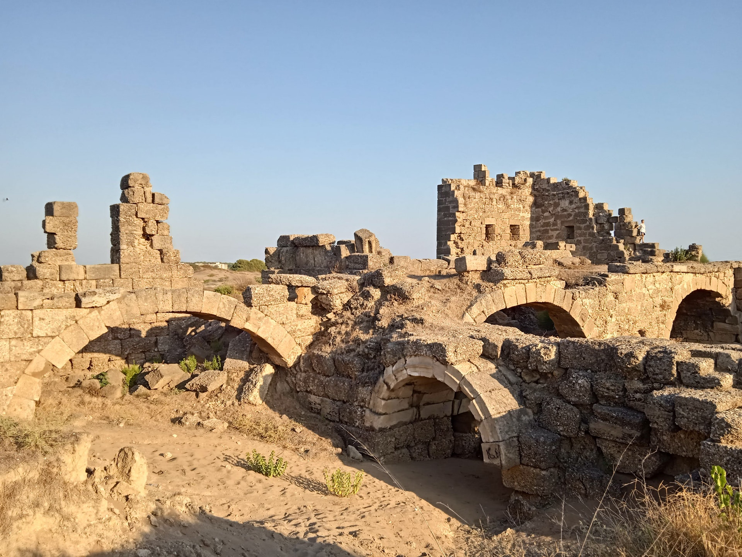
Rebuilding Jerusalem

Slide 68
REBUILDING NEEDS REMINDING

Slide 69
REBUILDING NEEDS REMINDING
Nehemiah 8:1-12

Slide 70
3 MAJOR FEASTS:
Feast of Unleavened Bread
Feast of Booths
Feast of Weeks

Slide 71
SHAVUOT
“FEAST OF WEEKS”
Commemorates the giving of the Law of Moses
Ex. 23:16 – Lev. 23:15-22

Slide 73
EXODUS 20:1-17

Slide 74
EXODUS 20:1-17
Two Sections:
Relationship with God (#1-4)

Slide 75
EXODUS 20:1-17
Two Sections:
Relationship with God (#1-4)
Relationship with Mankind (#5-10)

Slide 76
RELATIONSHIP WITH GOD
No Other “gods”

Slide 77
NO OTHER GODS
EX. 20:3

Slide 78
NO OTHER GODS
EX. 20:3
The Uniqueness of God
YHWH = Self-existing, Eternal One
Isa. 45:22, 46:9
Ex. 34:5-7 – Neh. 9:17

Slide 79
RELATIONSHIP WITH GOD
No Other “gods”
No Idols

Slide 80
NO IDOLS
EX. 20:4-6

Slide 81
NO IDOLS
EX. 20:4-6
No Image Attributed to God
Ex. 32:4

Slide 82
NO IDOLS
EX. 20:4-6
No Image Attributed to God
No Images Attributed to False gods

Slide 83
RELATIONSHIP WITH GOD
No Other “gods”
No Idols
No Profane Use of God’s Name

Slide 84
NO PROFANE USE OF GOD’S NAME
EX. 20:7

Slide 85
NO PROFANE USE OF GOD’S NAME
EX. 20:7
Profane Uses of God’s Name:
Worshiping Him Improperly

Slide 86
NO PROFANE USE OF GOD’S NAME
EX. 20:7
Profane Uses of God’s Name:
Worshiping Him Improperly
Worshiping Other “gods”

Slide 87
NO PROFANE USE OF GOD’S NAME
EX. 20:7
Profane Uses of God’s Name:
Worshiping Him Improperly
Worshiping Other “gods”
Speaking Ill of God

Slide 88
NO PROFANE USE OF GOD’S NAME
EX. 20:7
Profane Uses of God’s Name:
Worshiping Him Improperly
Worshiping Other “gods”
Speaking Ill of God
Using His Name Flippantly / Casually
Lev. 19:12

Slide 89
RELATIONSHIP WITH GOD
No Other “gods”
No Idols
No Profane Use of God’s Name
Observe the Sabbath

Slide 90
OBSERVE THE SABBATH
EX. 20:8-11

Slide 91
OBSERVE THE SABBATH
EX. 20:8-11
Reasons for Observing:
Ex. 20:8-11 → God’s Rest After Creation
Deut. 5:12-15 → God’s Deliverance of Israel from Egypt

Slide 92
OBSERVE THE SABBATH
EX. 20:8-11
NOT Repeated in the New Testament

Slide 93
OBSERVE THE SABBATH
EX. 20:8-11
NOT Repeated in the New Testament
Holy day of the week CHANGED by God
From Last day to the First Day
Matt. 28:1 – Mk. 16:2, 9
Lk. 24:1 – Jn. 20:1, 19

Slide 94
RELATIONSHIP WITH GOD
Summarized in Matt. 22:37:
“You shall love the LORD your God with all your heart, with all your soul, and with all your mind.”

Slide 95
Exodus 19:8
“All that the Lord says we will do.”

Slide 96
Exodus 19:8
“All that the Lord says I will do.”

Slide 97
Invitation
Song:
Just As I Am
#924

Slide 98
1-1 Just As I Am
Just As I Am
924

Slide 99
1-2 Just As I Am
Just As I Am
924

Slide 100
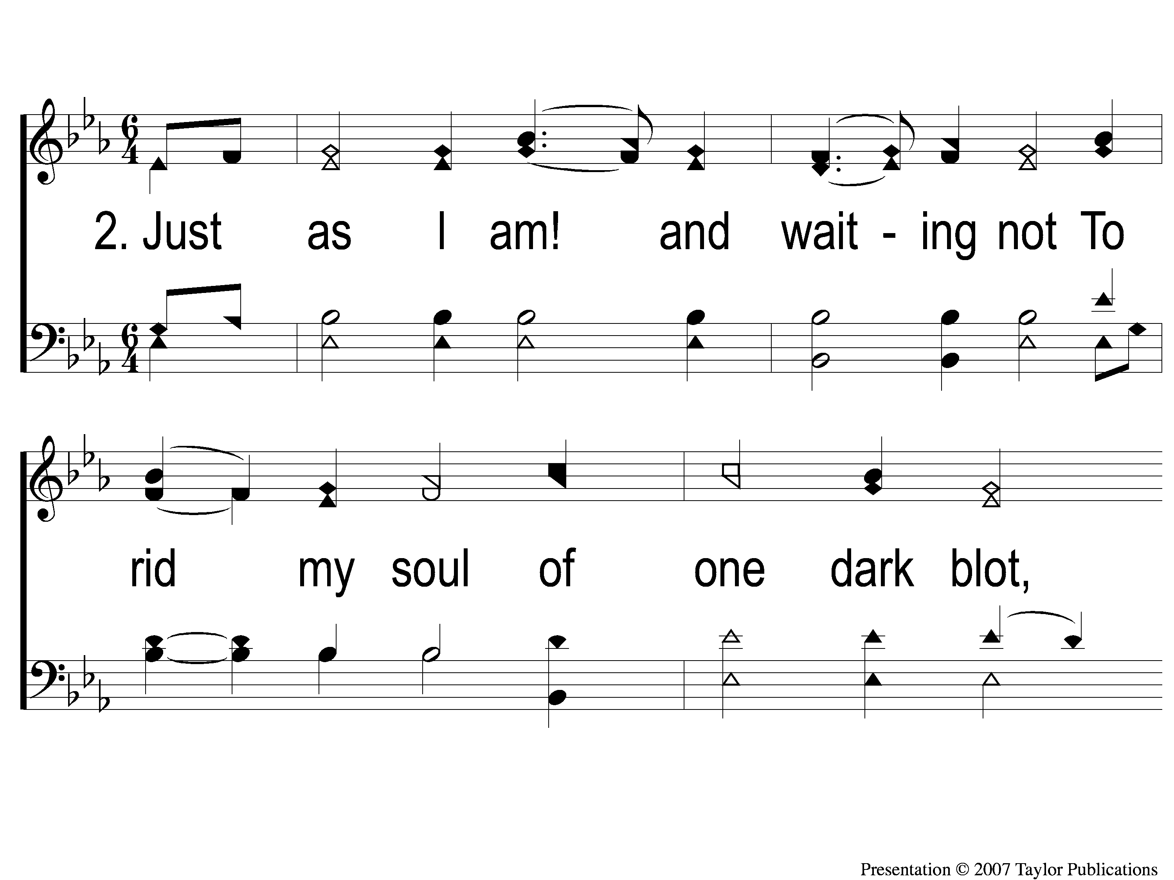
2-1 Just As I Am
Just As I Am
924

Slide 101
2-2 Just As I Am
Just As I Am
924

Slide 102
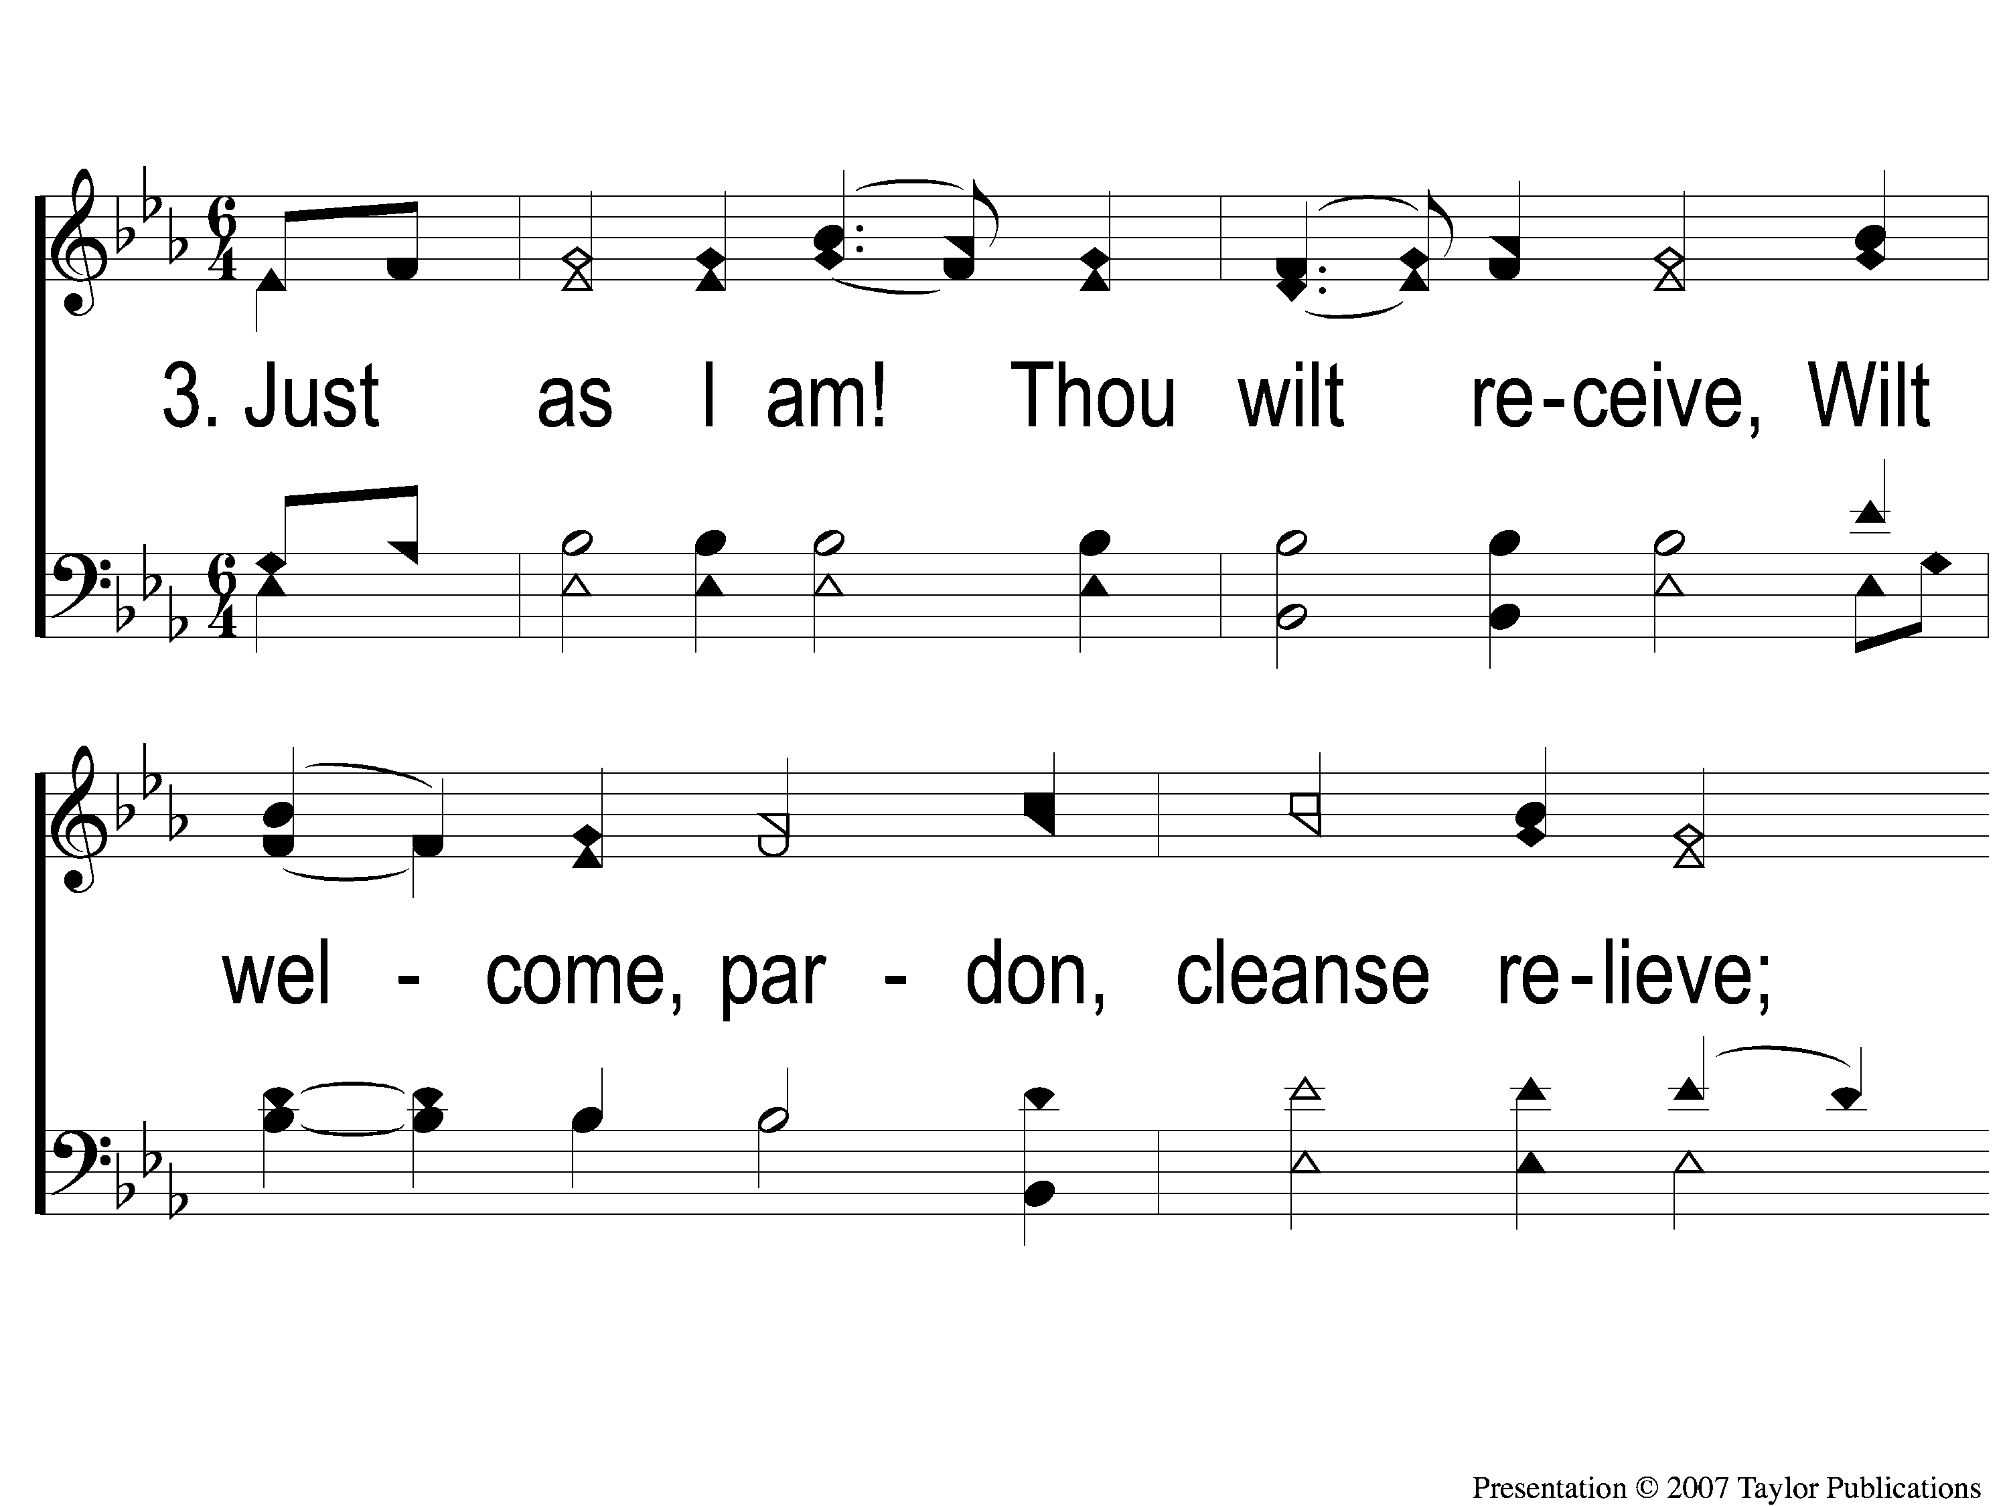
3-1 Just As I Am
Just As I Am
924

Slide 103
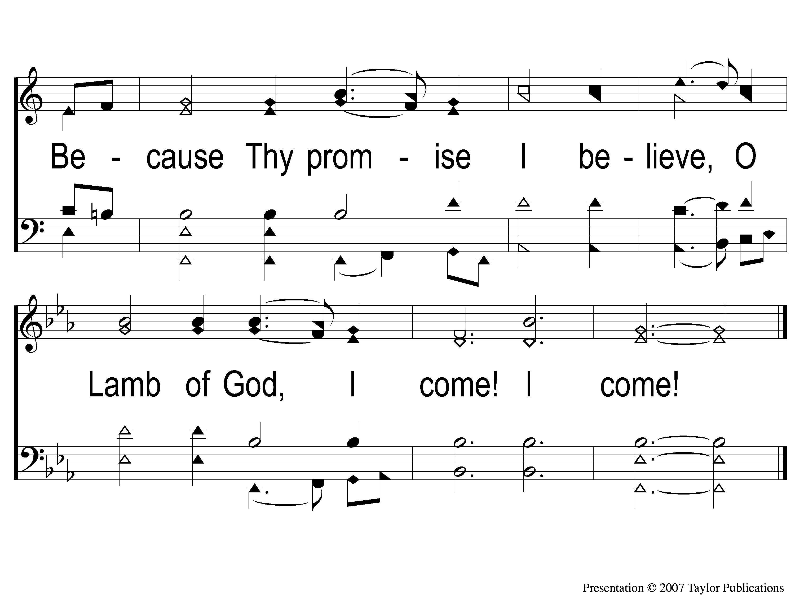
3-2 Just As I Am
Just As I Am
924

Slide 104
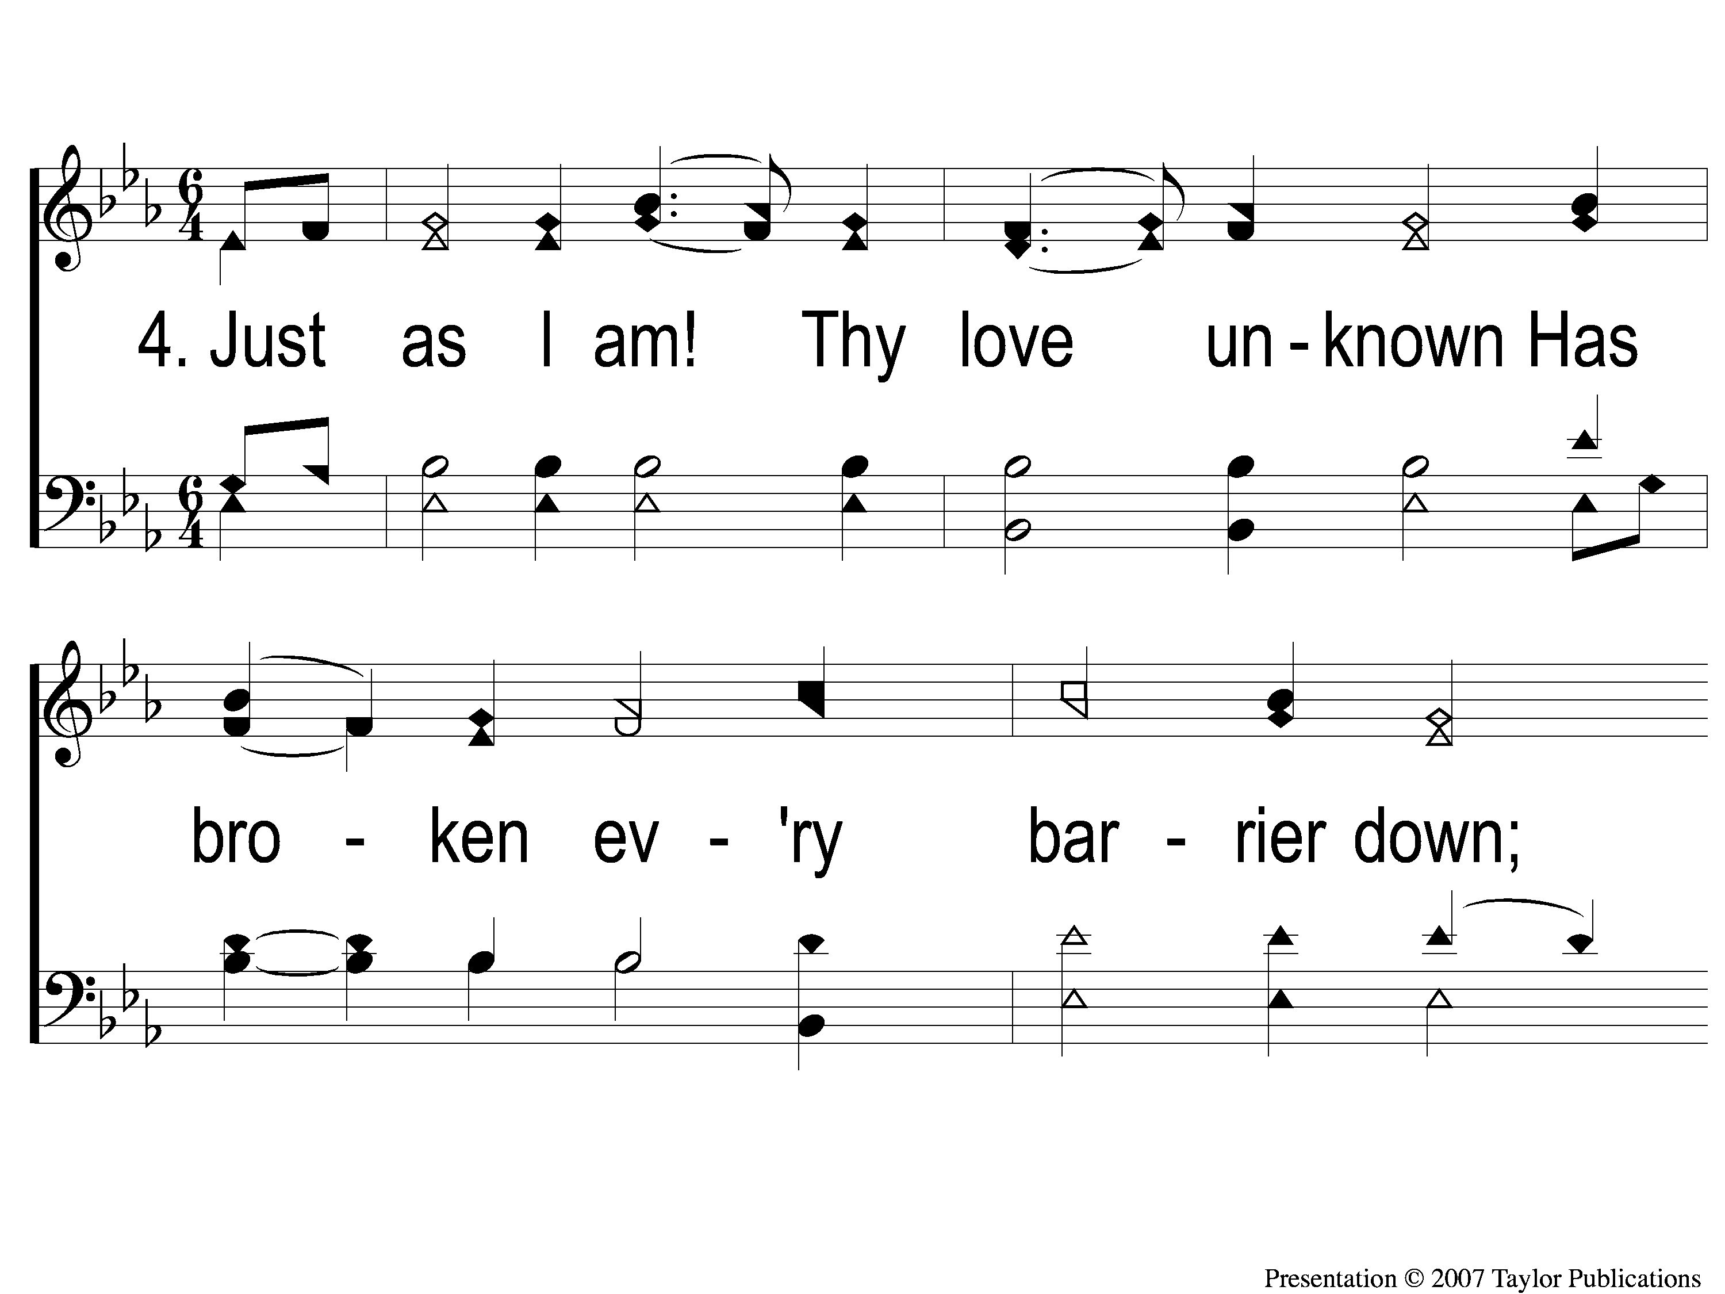
4-1 Just As I Am
Just As I Am
924

Slide 105
4-2 Just As I Am
Just As I Am
924

Slide 106
The Contribution:
2 Corinthians 8:12
“For if there is first a willing mind, it is accepted according to what one has, and not according to what he does not have.”

Slide 107
Song:
Lead Me To Calvary
#332

Slide 108
1-1 Lead Me To Calvary
Lead Me To Calvary
332

Slide 109
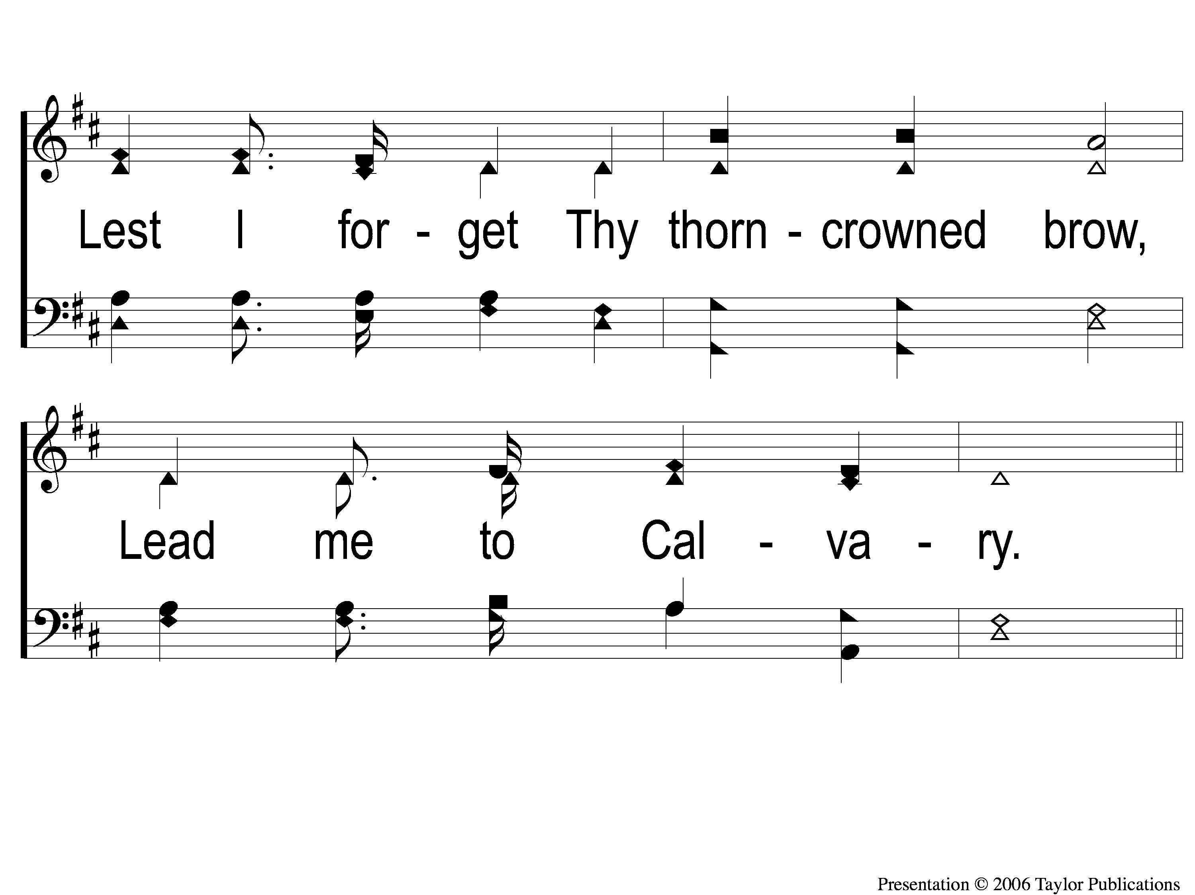
1-2 Lead Me To Calvary
Lead Me To Calvary
332

Slide 110
C-1 Lead Me To Calvary
Lead Me To Calvary
332

Slide 111
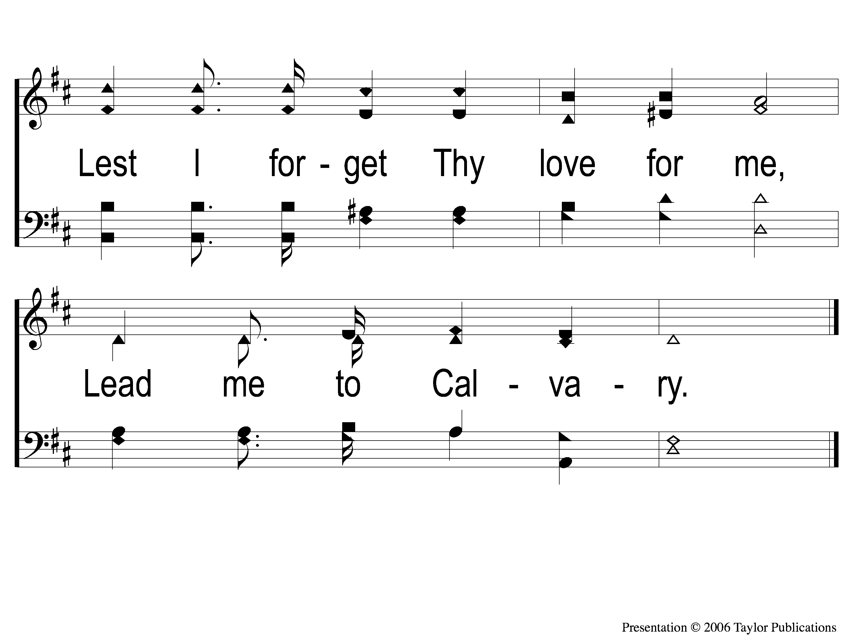
C-2 Lead Me To Calvary
Lead Me To Calvary
332

Slide 112
2-1 Lead Me To Calvary
Lead Me To Calvary
332

Slide 113
2-2 Lead Me To Calvary
Lead Me To Calvary
332

Slide 114
C-1 Lead Me To Calvary
Lead Me To Calvary
332

Slide 115
C-2 Lead Me To Calvary
Lead Me To Calvary
332

Slide 116
3-1 Lead Me To Calvary
Lead Me To Calvary
332

Slide 117
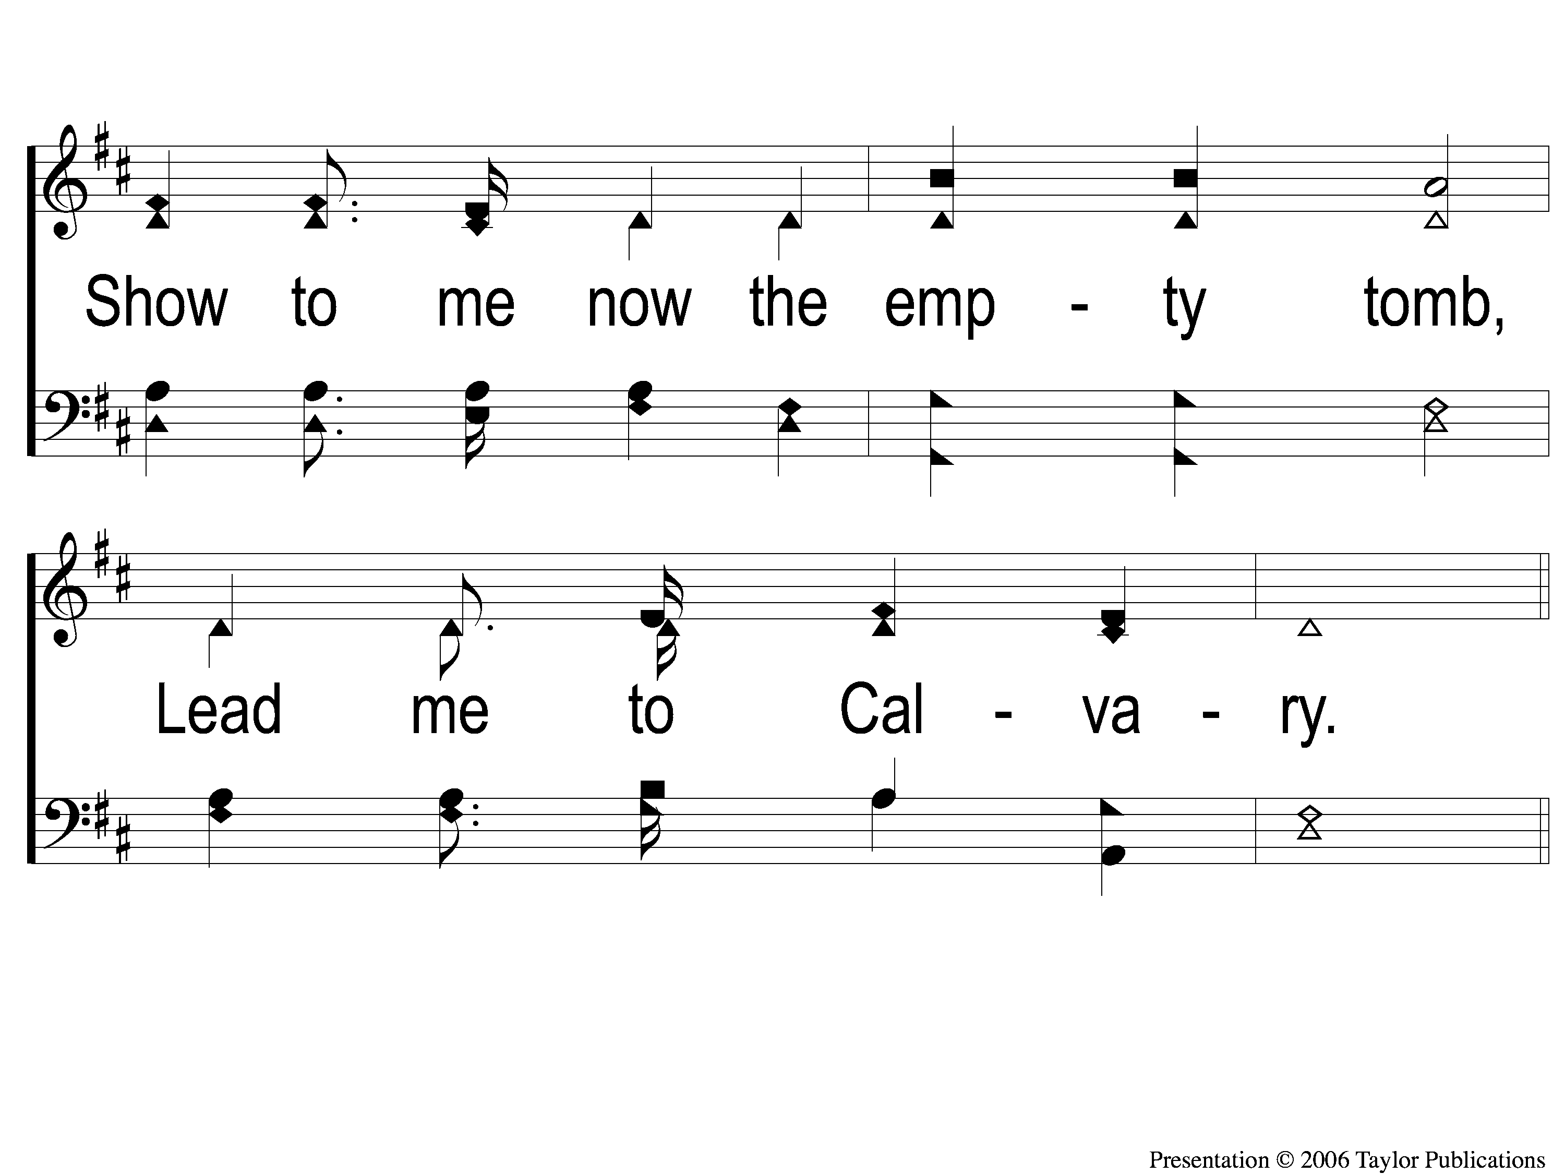
3-2 Lead Me To Calvary
Lead Me To Calvary
332

Slide 118
C-1 Lead Me To Calvary
Lead Me To Calvary
332

Slide 119
C-2 Lead Me To Calvary
Lead Me To Calvary
332

Slide 120
4-1 Lead Me To Calvary
Lead Me To Calvary
332

Slide 121
4-2 Lead Me To Calvary
Lead Me To Calvary
332

Slide 122
C-1 Lead Me To Calvary
Lead Me To Calvary
332

Slide 123
C-2 Lead Me To Calvary
Lead Me To Calvary
332

Slide 124
The Unleavened Bread
Isaiah 53:1-3
“Who has believed our report? And to whom has the arm of the Lord been revealed? For He shall grow up before Him as a tender plant, And as a root out of dry ground. He has no form or comeliness; And when we see Him, There is no beauty that we should desire Him. He is despised and rejected by men, A Man of sorrows and acquainted with grief. And we hid, as it were, our faces from Him; He was despised, and we did not esteem Him.”

Slide 125
The Fruit
of the Vine
Isaiah 53:4-5
“Surely He has borne our griefs And carried our sorrows; Yet we esteemed Him stricken, Smitten by God, and afflicted. But He was wounded for our transgressions, He was bruised for our iniquities; The chastisement for our peace was upon Him, And by His stripes we are healed.”

Slide 126
Closing Prayer

Slide 127
Song:
Take The Name
Of Jesus With You
#738

Slide 128
1-1 Take the Name of Jesus With You
Take the Name of Jesus
738

Slide 129
1-2 Take the Name of Jesus With You
Take the Name of Jesus
738

Slide 130
C-1 Take the Name of Jesus With You
Take the Name of Jesus
738

Slide 131
C-2 Take the Name of Jesus With You
Take the Name of Jesus
738

Slide 132
2-1 Take the Name of Jesus With You
Take the Name of Jesus
738

Slide 133
2-2 Take the Name of Jesus With You
Take the Name of Jesus
738

Slide 134
C-1 Take the Name of Jesus With You
Take the Name of Jesus
738

Slide 135
C-2 Take the Name of Jesus With You
Take the Name of Jesus
738

Slide 136
3-1 Take the Name of Jesus With You
Take the Name of Jesus
738

Slide 137
3-2 Take the Name of Jesus With You
Take the Name of Jesus
738

Slide 138
C-1 Take the Name of Jesus With You
Take the Name of Jesus
738

Slide 139
C-2 Take the Name of Jesus With You
Take the Name of Jesus
738

Slide 140
Tonight
Worship @ 6:00 PM
Wednesday
Worship & Classes @ 6:30 pm
RESTORE REBUILD RENEW
IN 2022
WHEELER
CHURCH
OF
CHRIST

Slide 141
Today
Fellowship Meal @ Noon
Devo & Singing @ 1:00 PM
Wednesday
Worship & Classes @ 6:30 pm
RESTORE REBUILD RENEW
IN 2022
WHEELER
CHURCH
OF
CHRIST

