Slide 1
PLEASE STANDBY
OUR LIVESTREAM
WILL BEGIN SOON

Slide 2
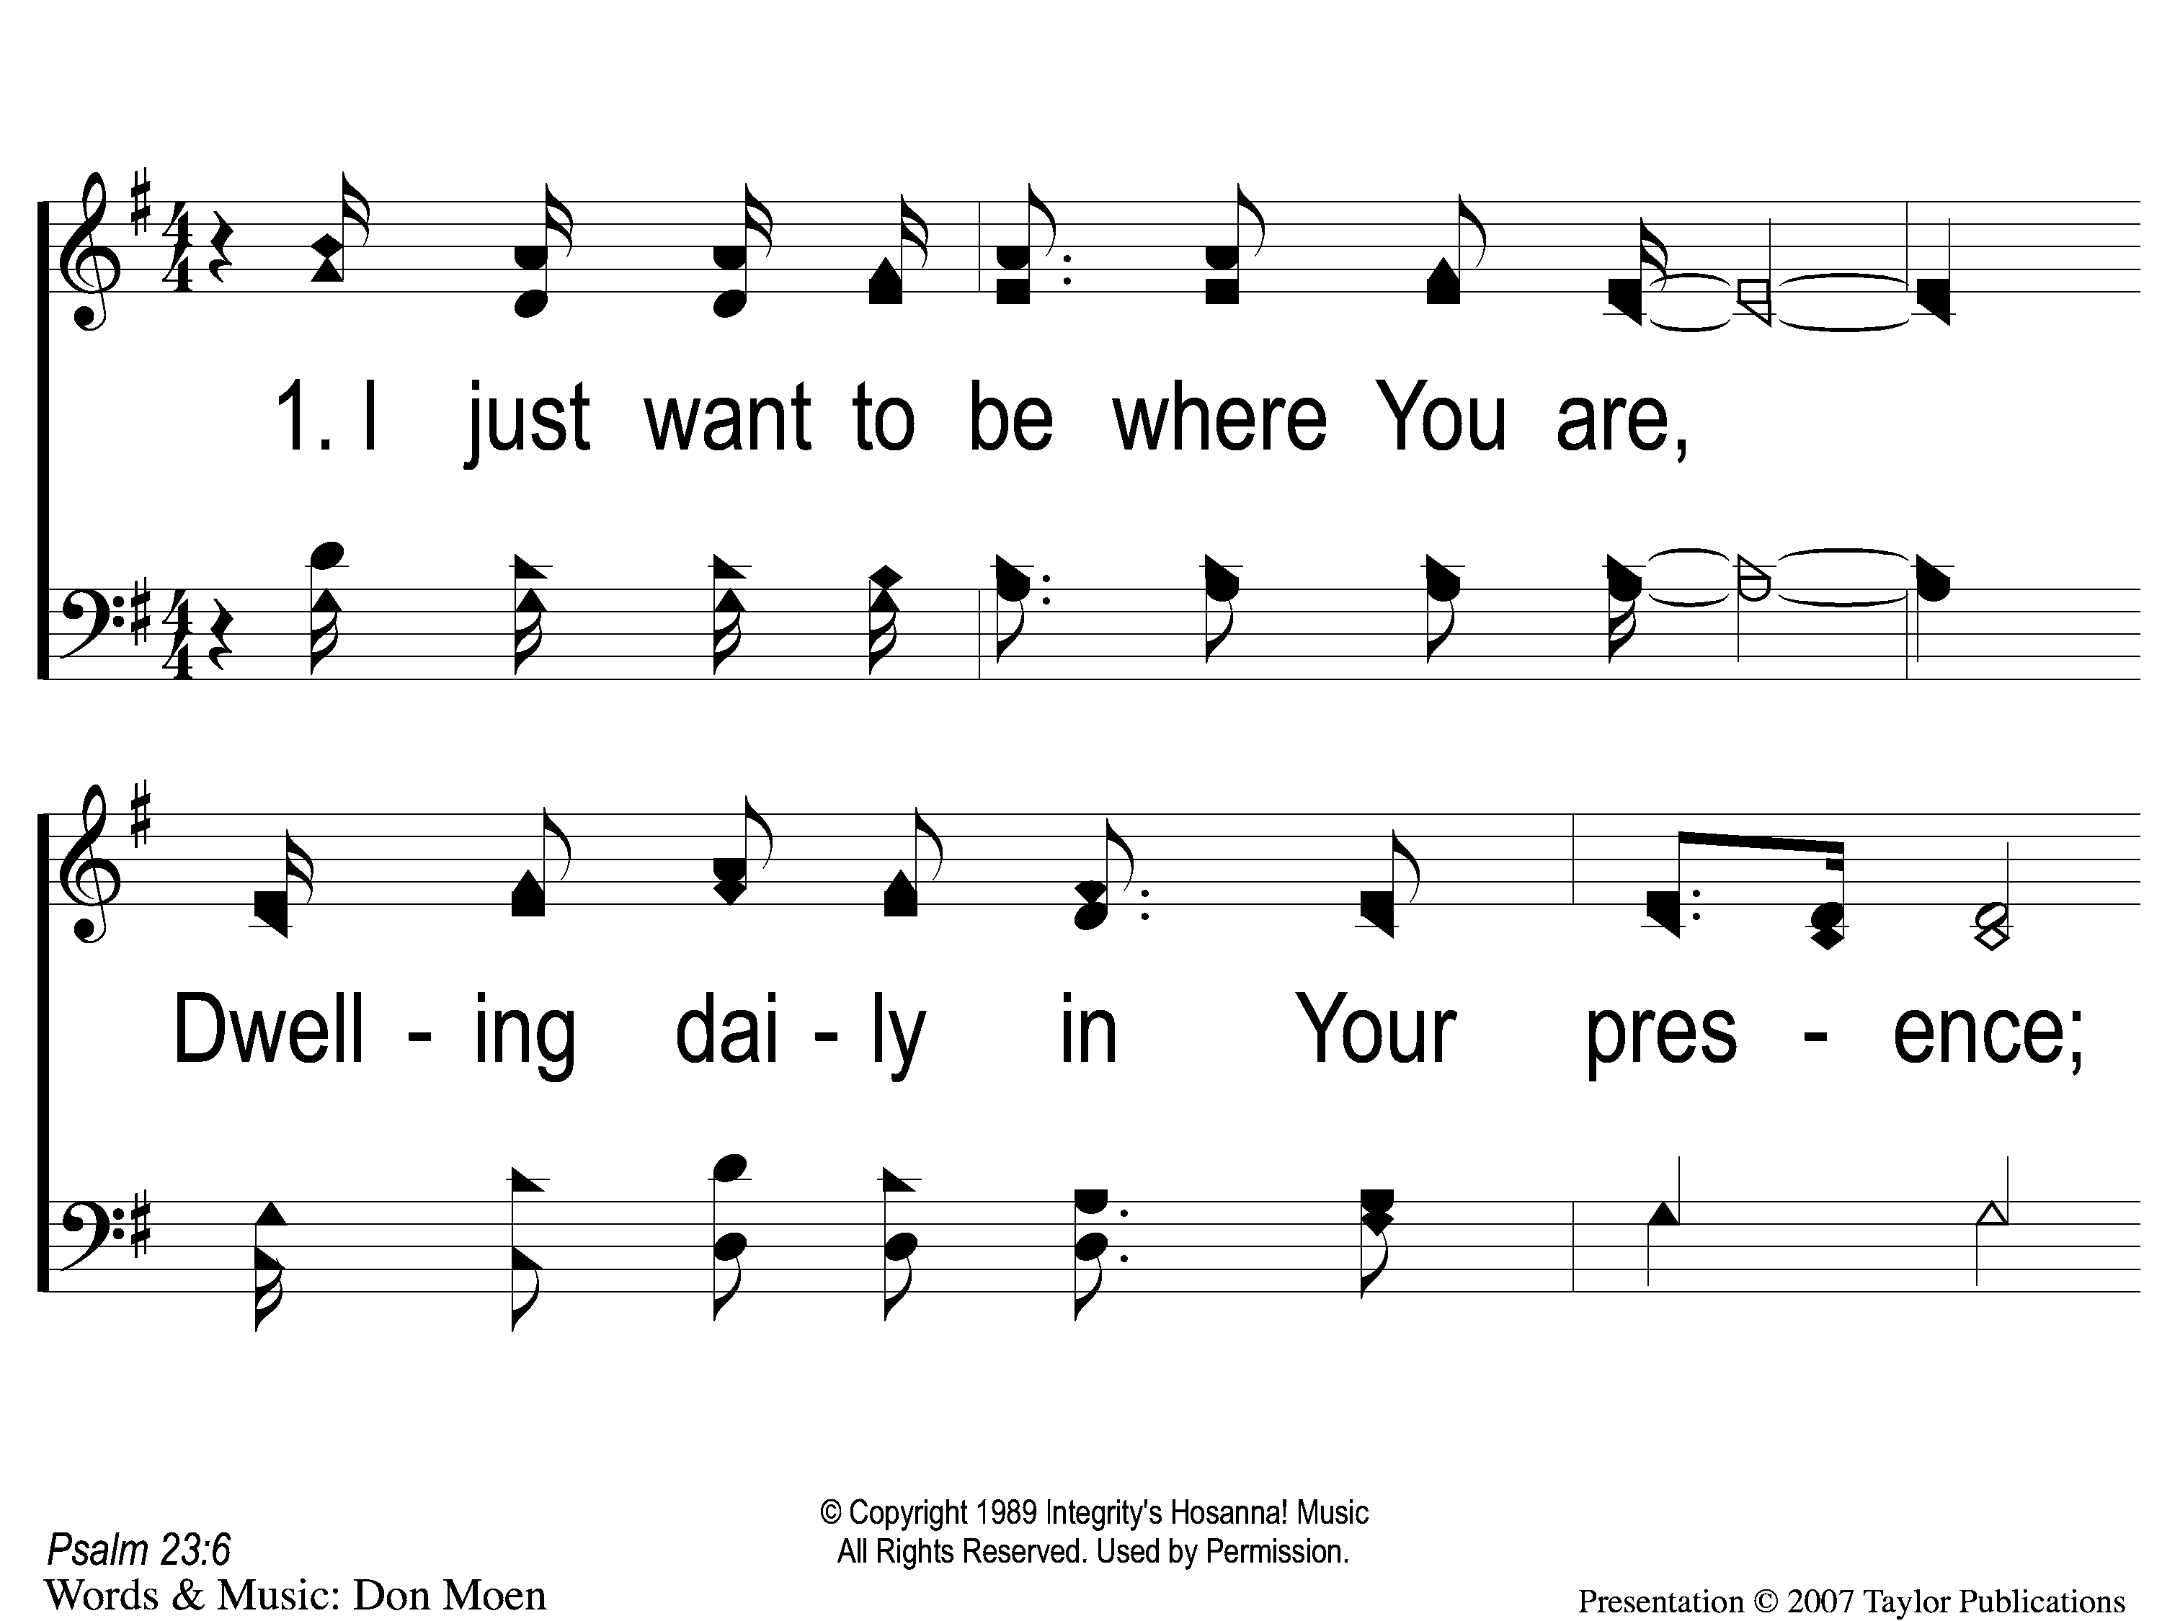
1-1 I Want to Be Where You Are
I Just Want to Be Where You Are
833

Slide 3
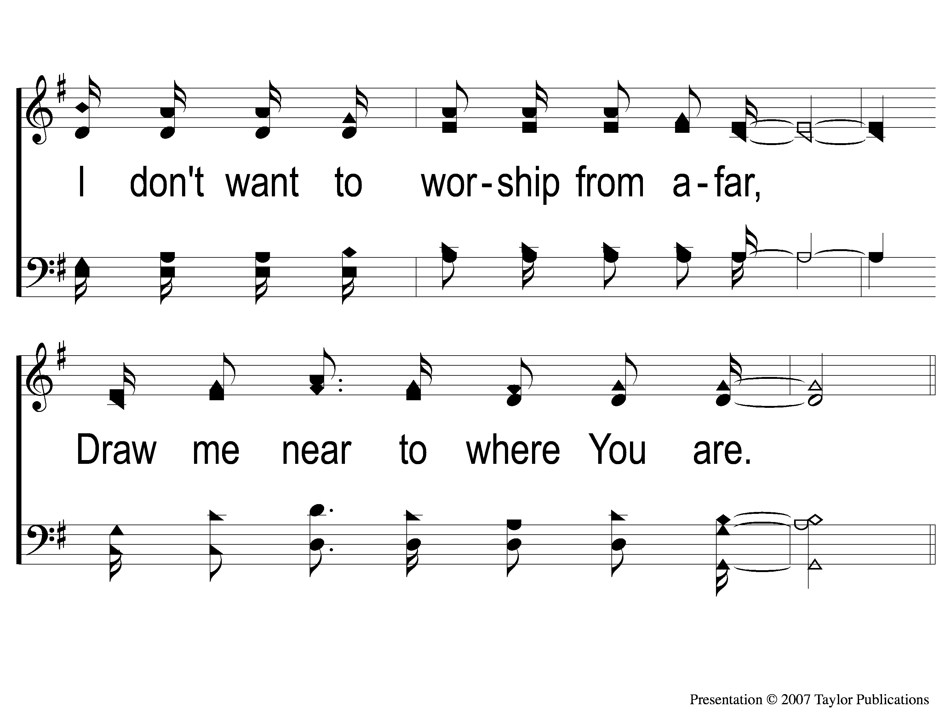
1-2 I Want to Be Where You Are
I Just Want to Be Where You Are
833

Slide 4
C-1 I Want to Be Where You Are
I Just Want to Be Where You Are
833

Slide 5
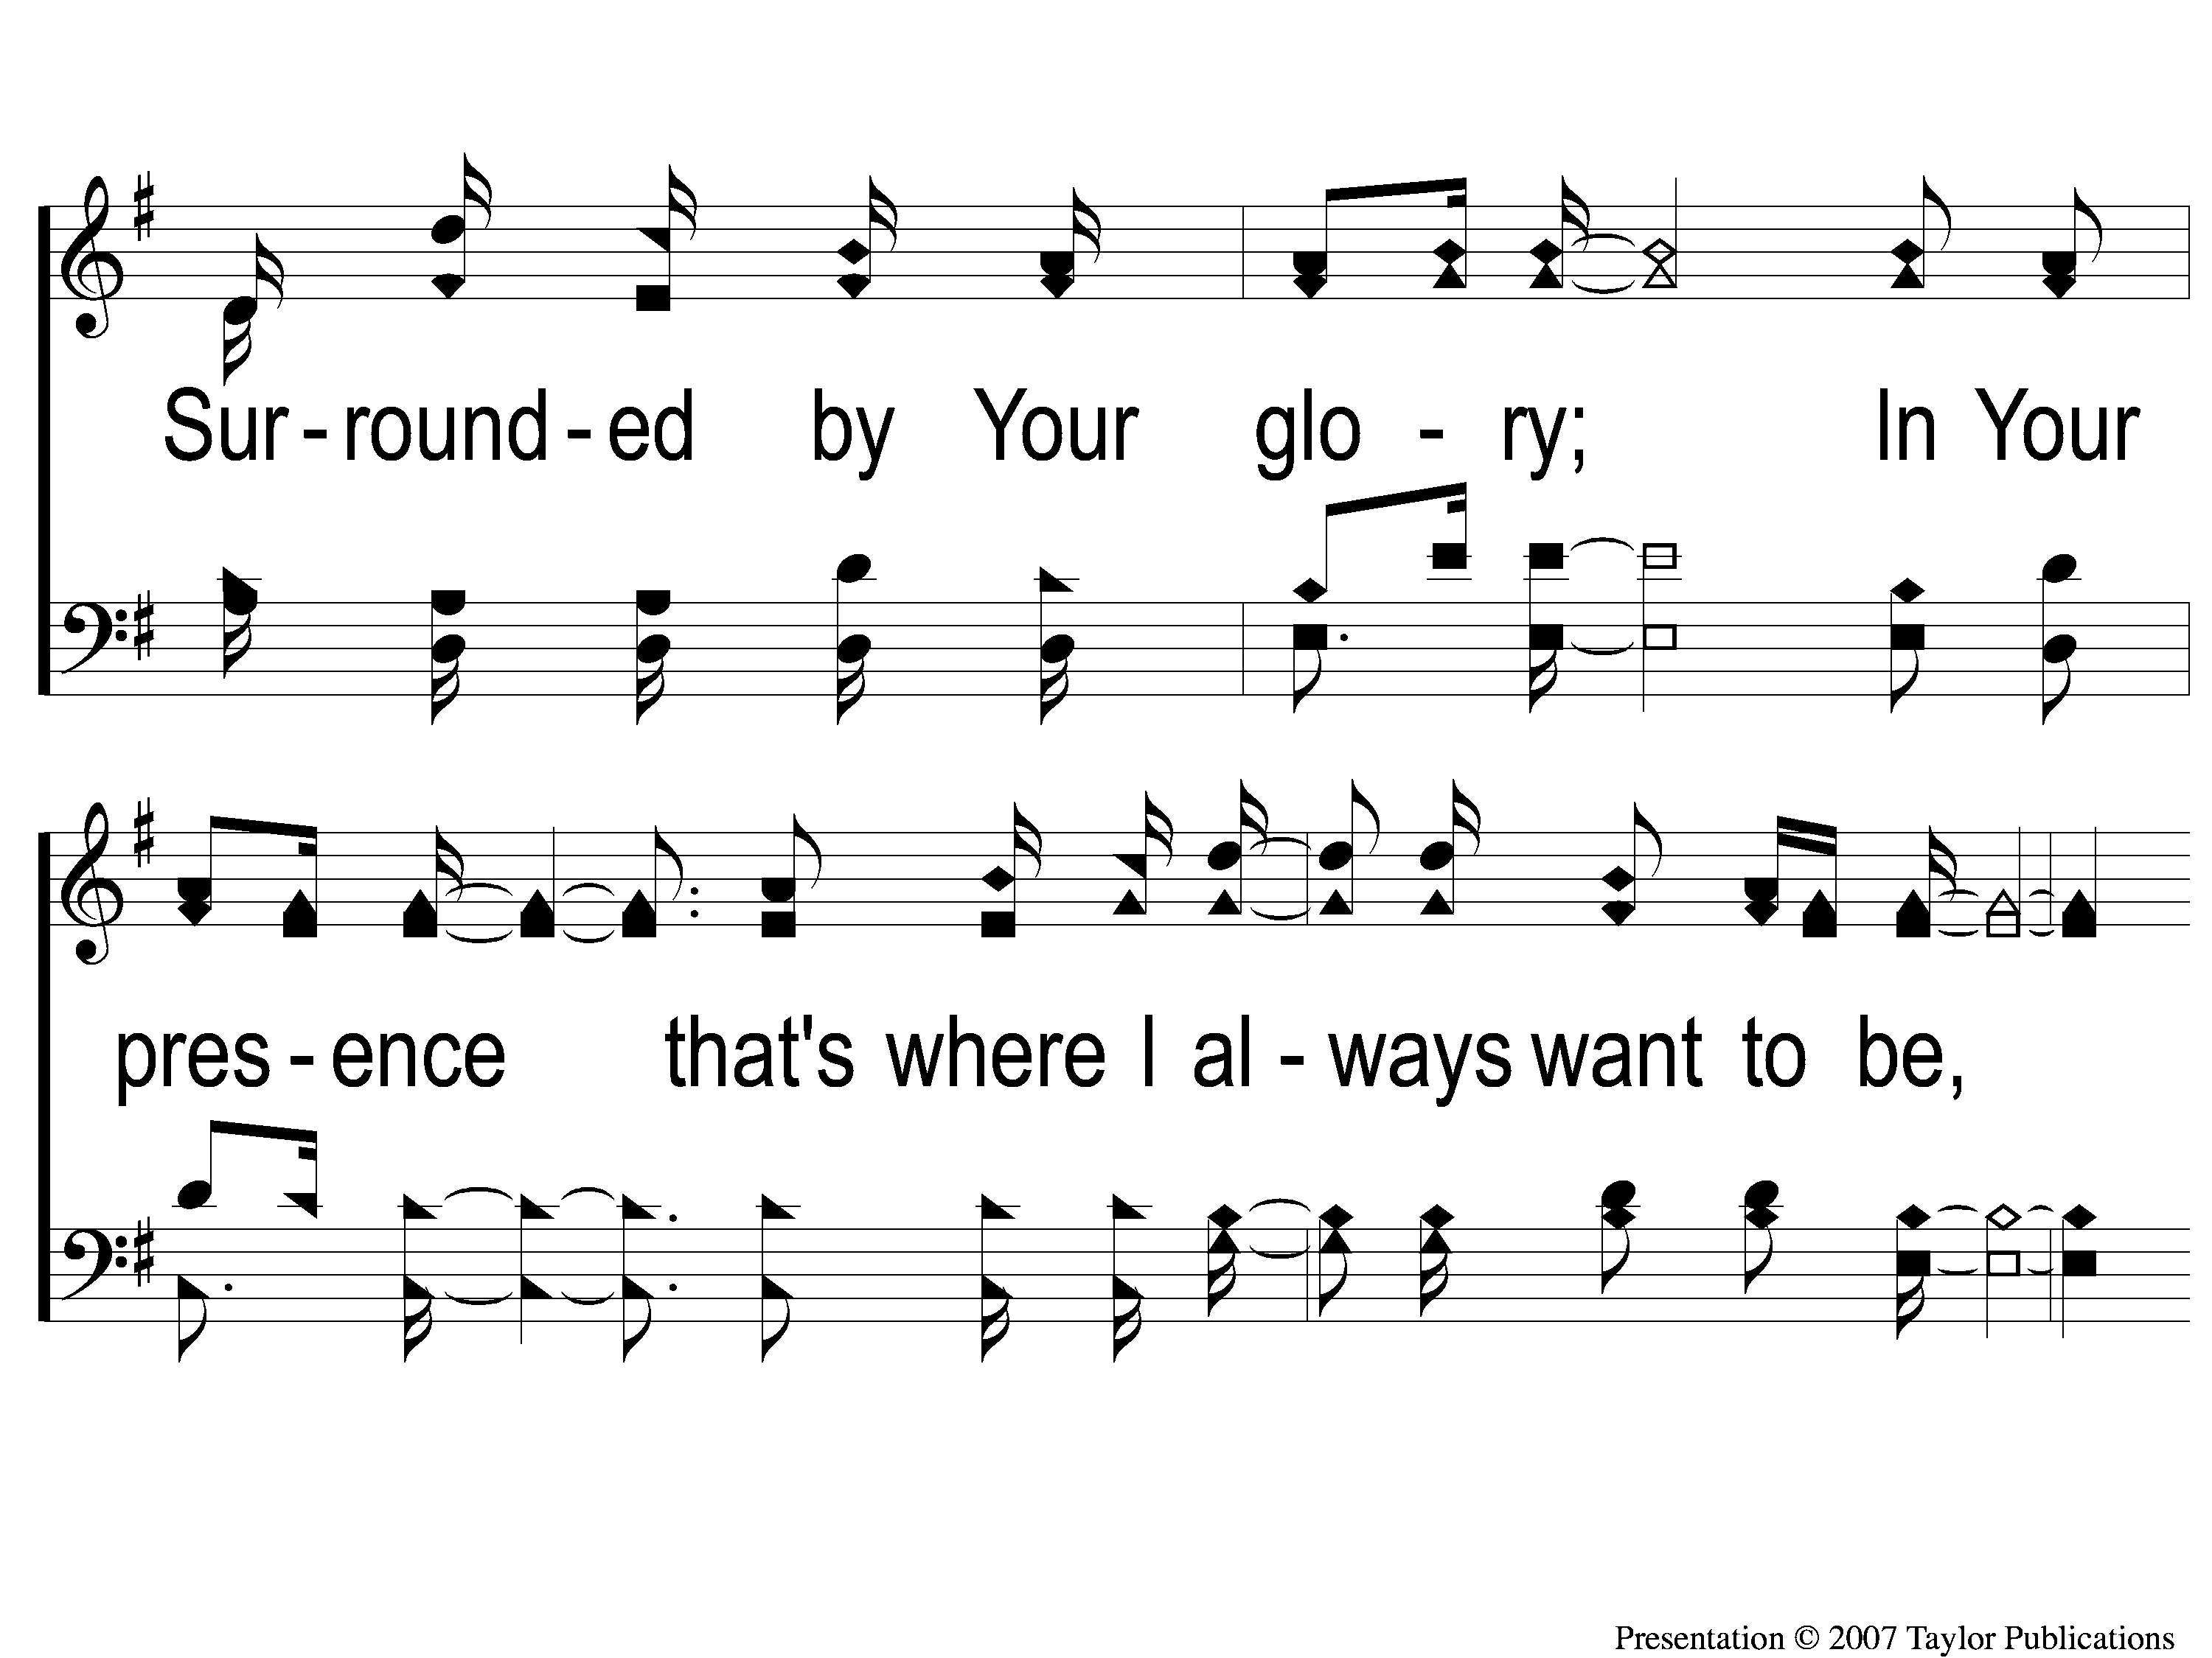
C-2 I Want to Be Where You Are
I Just Want to Be Where You Are
833

Slide 6
C-3 I Want to Be Where You Are
I Just Want to Be Where You Are
833

Slide 7
2-1 I Want to Be Where You Are
I Just Want to Be Where You Are
833

Slide 8
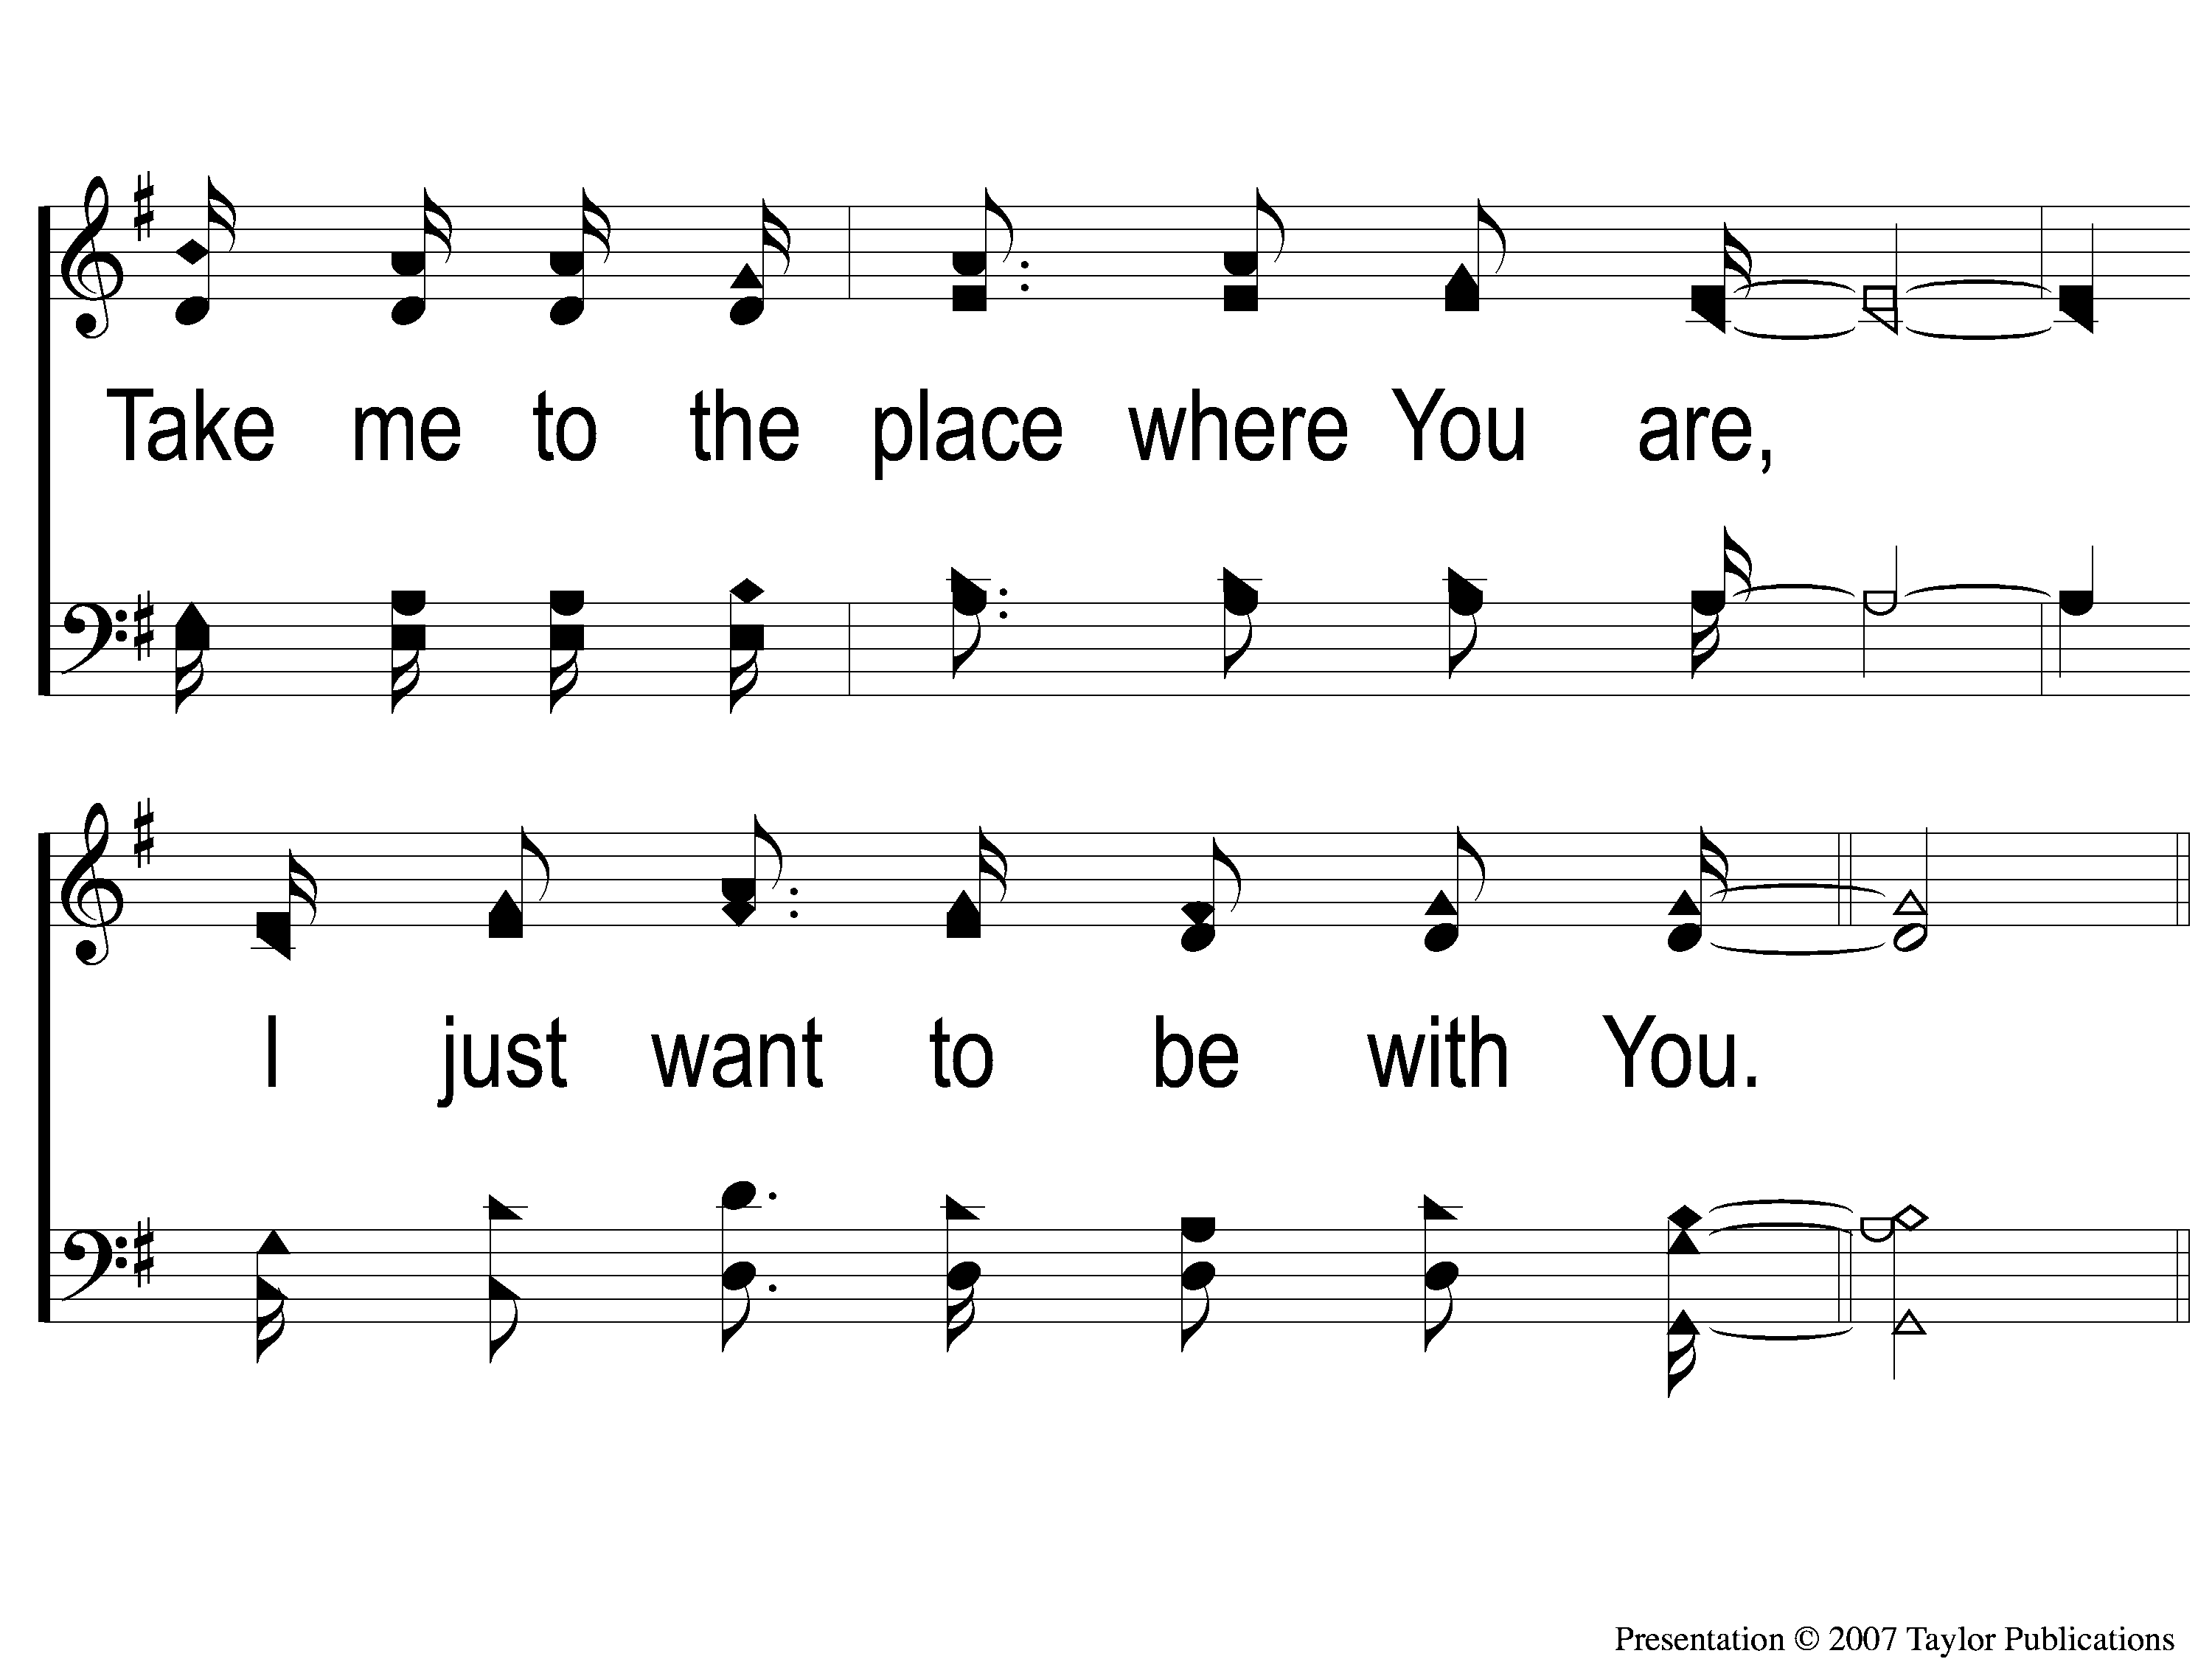
2-2 I Want to Be Where You Are
I Just Want to Be Where You Are
833

Slide 9
C-1 I Want to Be Where You Are
I Just Want to Be Where You Are
833

Slide 10
C-2 I Want to Be Where You Are
I Just Want to Be Where You Are
833

Slide 11
C-3 I Want to Be Where You Are
I Just Want to Be Where You Are
833

Slide 12
DC-1 I Want to Be Where You Are
I Just Want to Be Where You Are
833

Slide 13
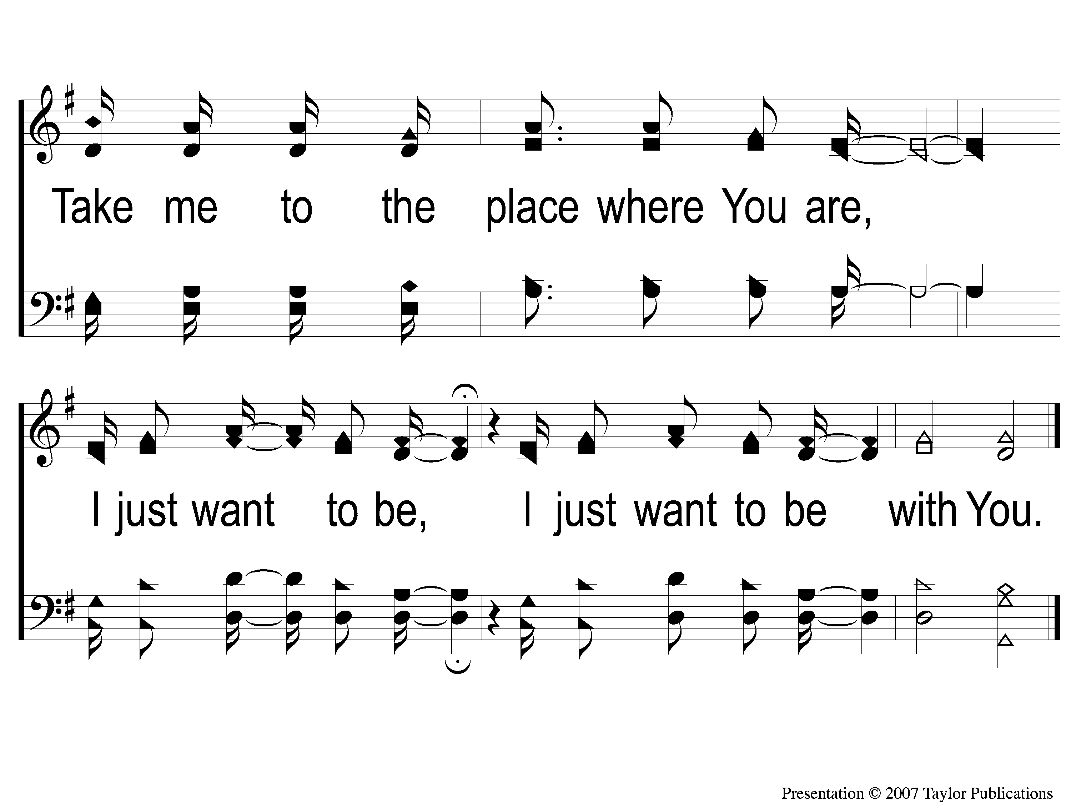
DC-2 I Want to Be Where You Are
I Just Want to Be Where You Are
833

Slide 14
WELCOME
THANKS FOR JOINING US!

Slide 15
SONG:
Firm Foundation

Slide 16
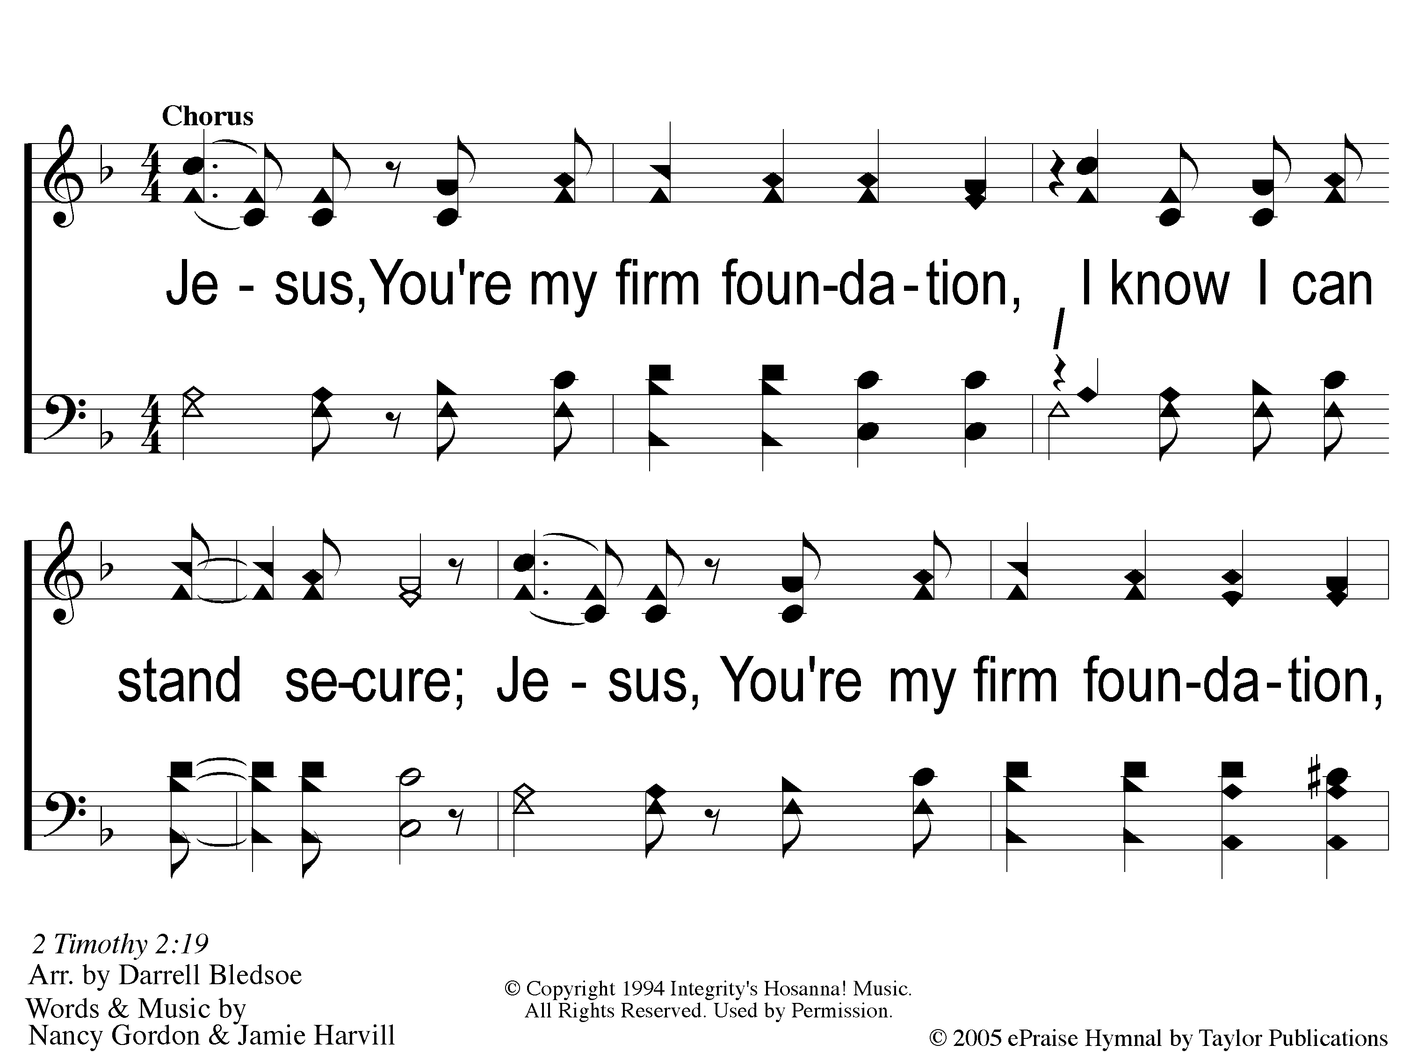
C-1 Firm Foundation
Firm Foundation

Slide 17
C-2 Firm Foundation
Firm Foundation

Slide 18
C-1 Firm Foundation
Firm Foundation

Slide 19
C-2 Firm Foundation
Firm Foundation

Slide 20
1-1 Firm Foundation
Firm Foundation

Slide 21
1-2 Firm Foundation
Firm Foundation

Slide 22
C-1 Firm Foundation
Firm Foundation

Slide 23
C-2 Firm Foundation
Firm Foundation

Slide 24
2-1 Firm Foundation
Firm Foundation

Slide 25
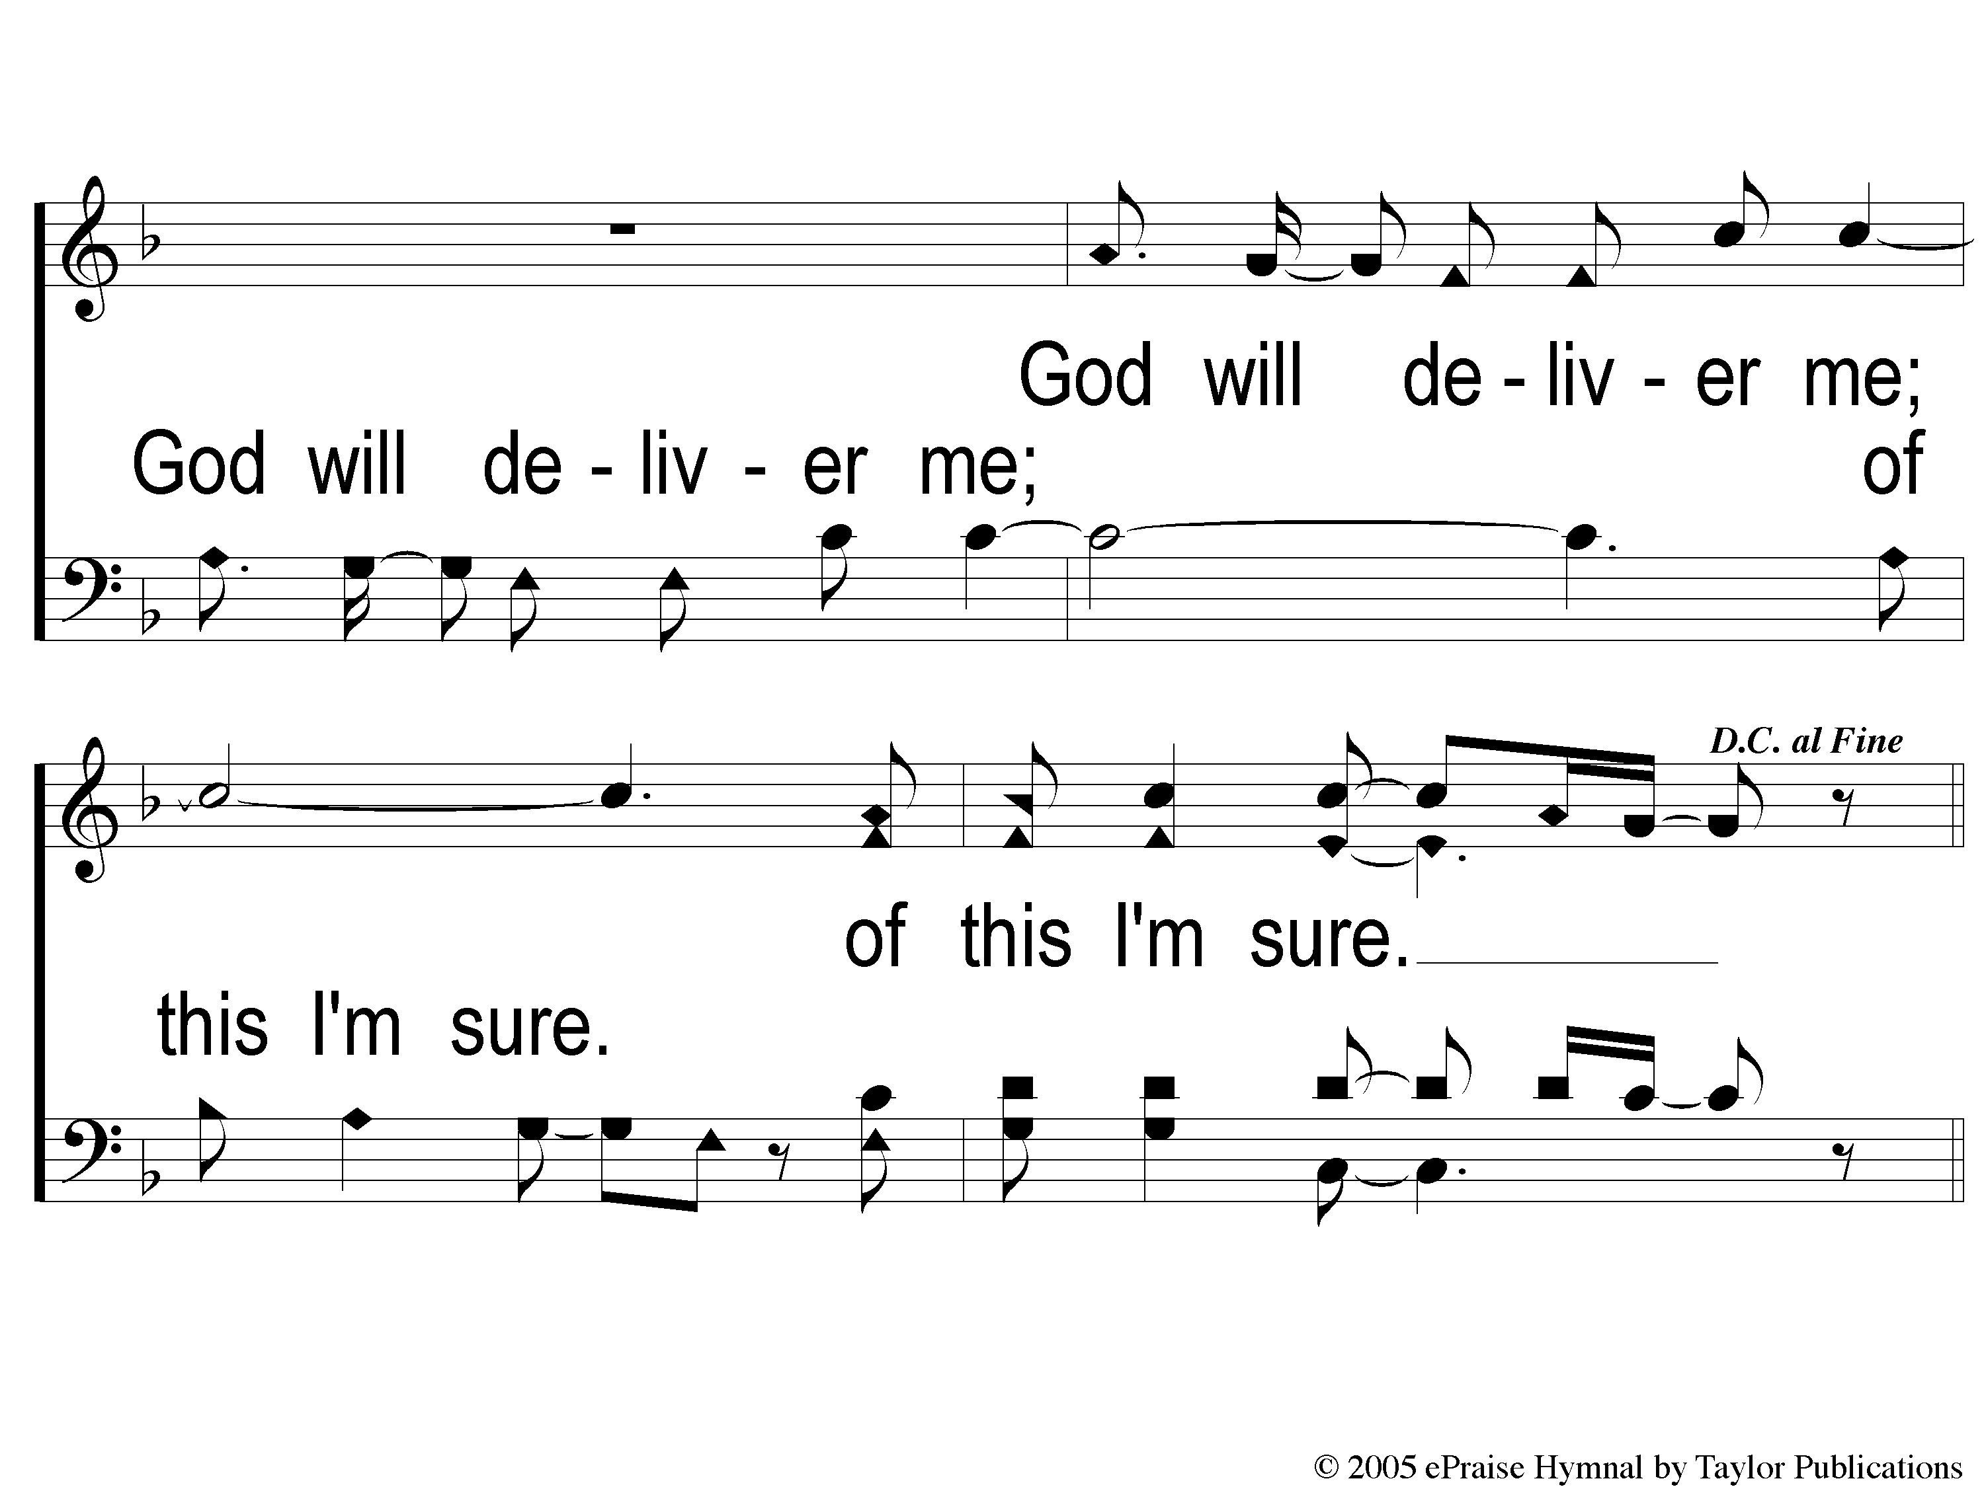
2-2 Firm Foundation
Firm Foundation

Slide 26
C-1 Firm Foundation
Firm Foundation

Slide 27
C-2 Firm Foundation
Firm Foundation

Slide 28
Ds-1 Firm Foundation
Firm Foundation

Slide 29
Ds-2 Firm Foundation
Firm Foundation

Slide 30
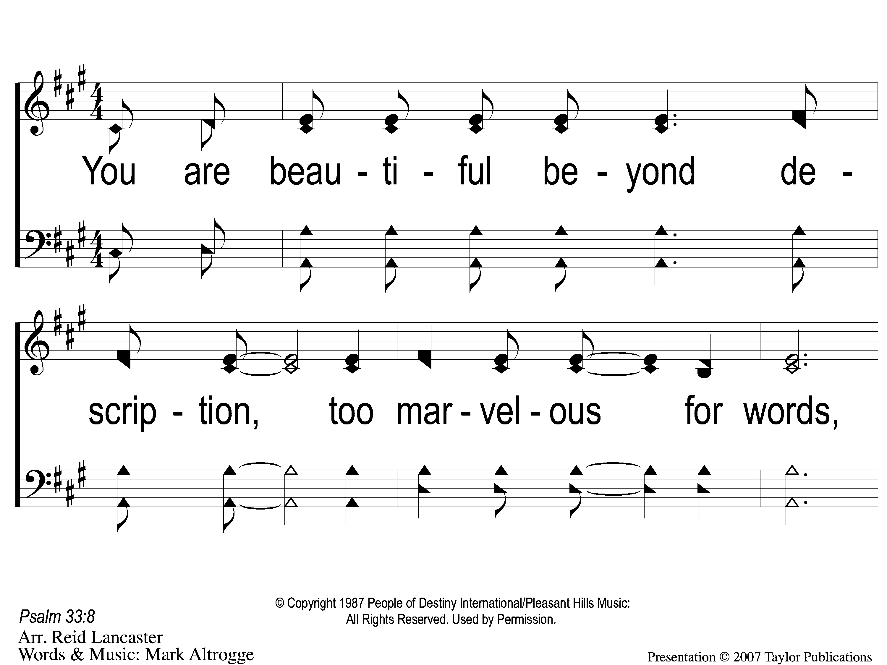
1 I Stand in Awe
I Stand in Awe
96

Slide 31
2 I Stand in Awe
I Stand in Awe
96

Slide 32
3 I Stand in Awe
I Stand in Awe
96

Slide 33
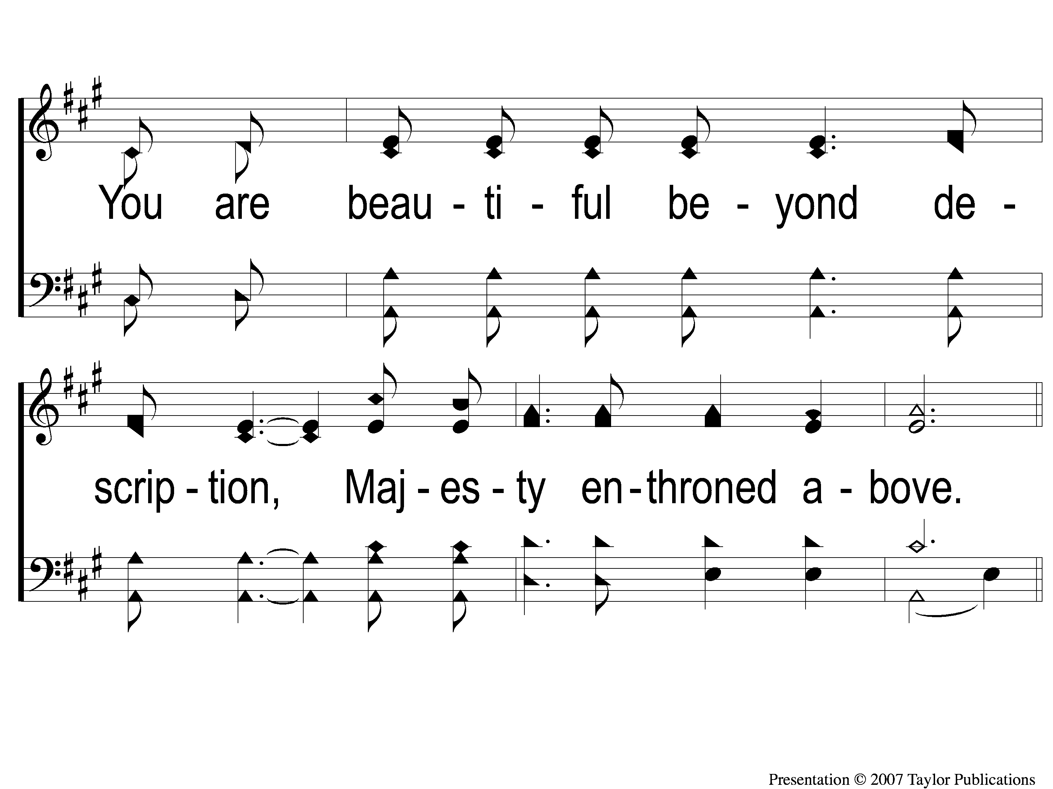
4 I Stand in Awe
I Stand in Awe
96

Slide 34
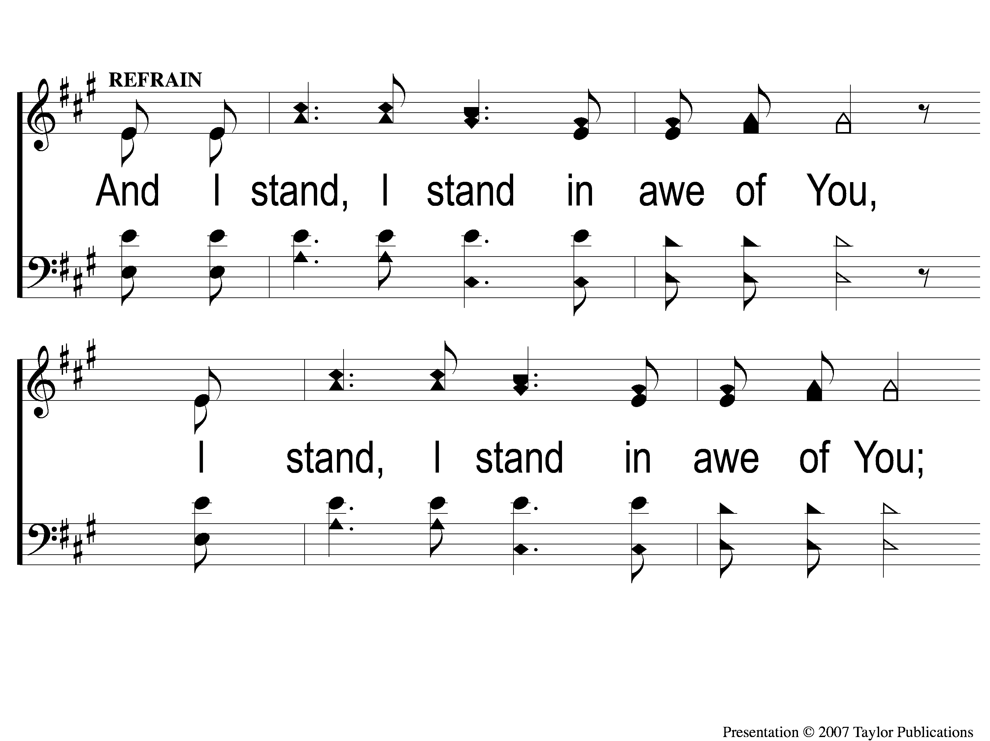
C-1 I Stand in Awe
I Stand in Awe
96

Slide 35
C-2 I Stand in Awe
I Stand in Awe
96

Slide 36
SONG:
Ancient Words

Slide 37
1-1 Ancient Words
Ancient Words

Slide 38
1-2 Ancient Words
Ancient Words

Slide 39
1-3 Ancient Words
Ancient Words

Slide 40
C-1 Ancient Words
Ancient Words

Slide 41
C-2 Ancient Words
Ancient Words

Slide 42
2-1 Ancient Words
Ancient Words

Slide 43
2-2 Ancient Words
Ancient Words

Slide 44
2-3 Ancient Words
Ancient Words

Slide 45
C-1 Ancient Words
Ancient Words

Slide 46
C-2 Ancient Words
Ancient Words

Slide 47
Coda-1 Ancient Words
Ancient Words

Slide 48
Coda-2 Ancient Words
Ancient Words

Slide 49
tag Ancient Words
Ancient Words

Slide 50
First PRAYER

Slide 51
SONG:
Blue Skies & Rainbows

Slide 52
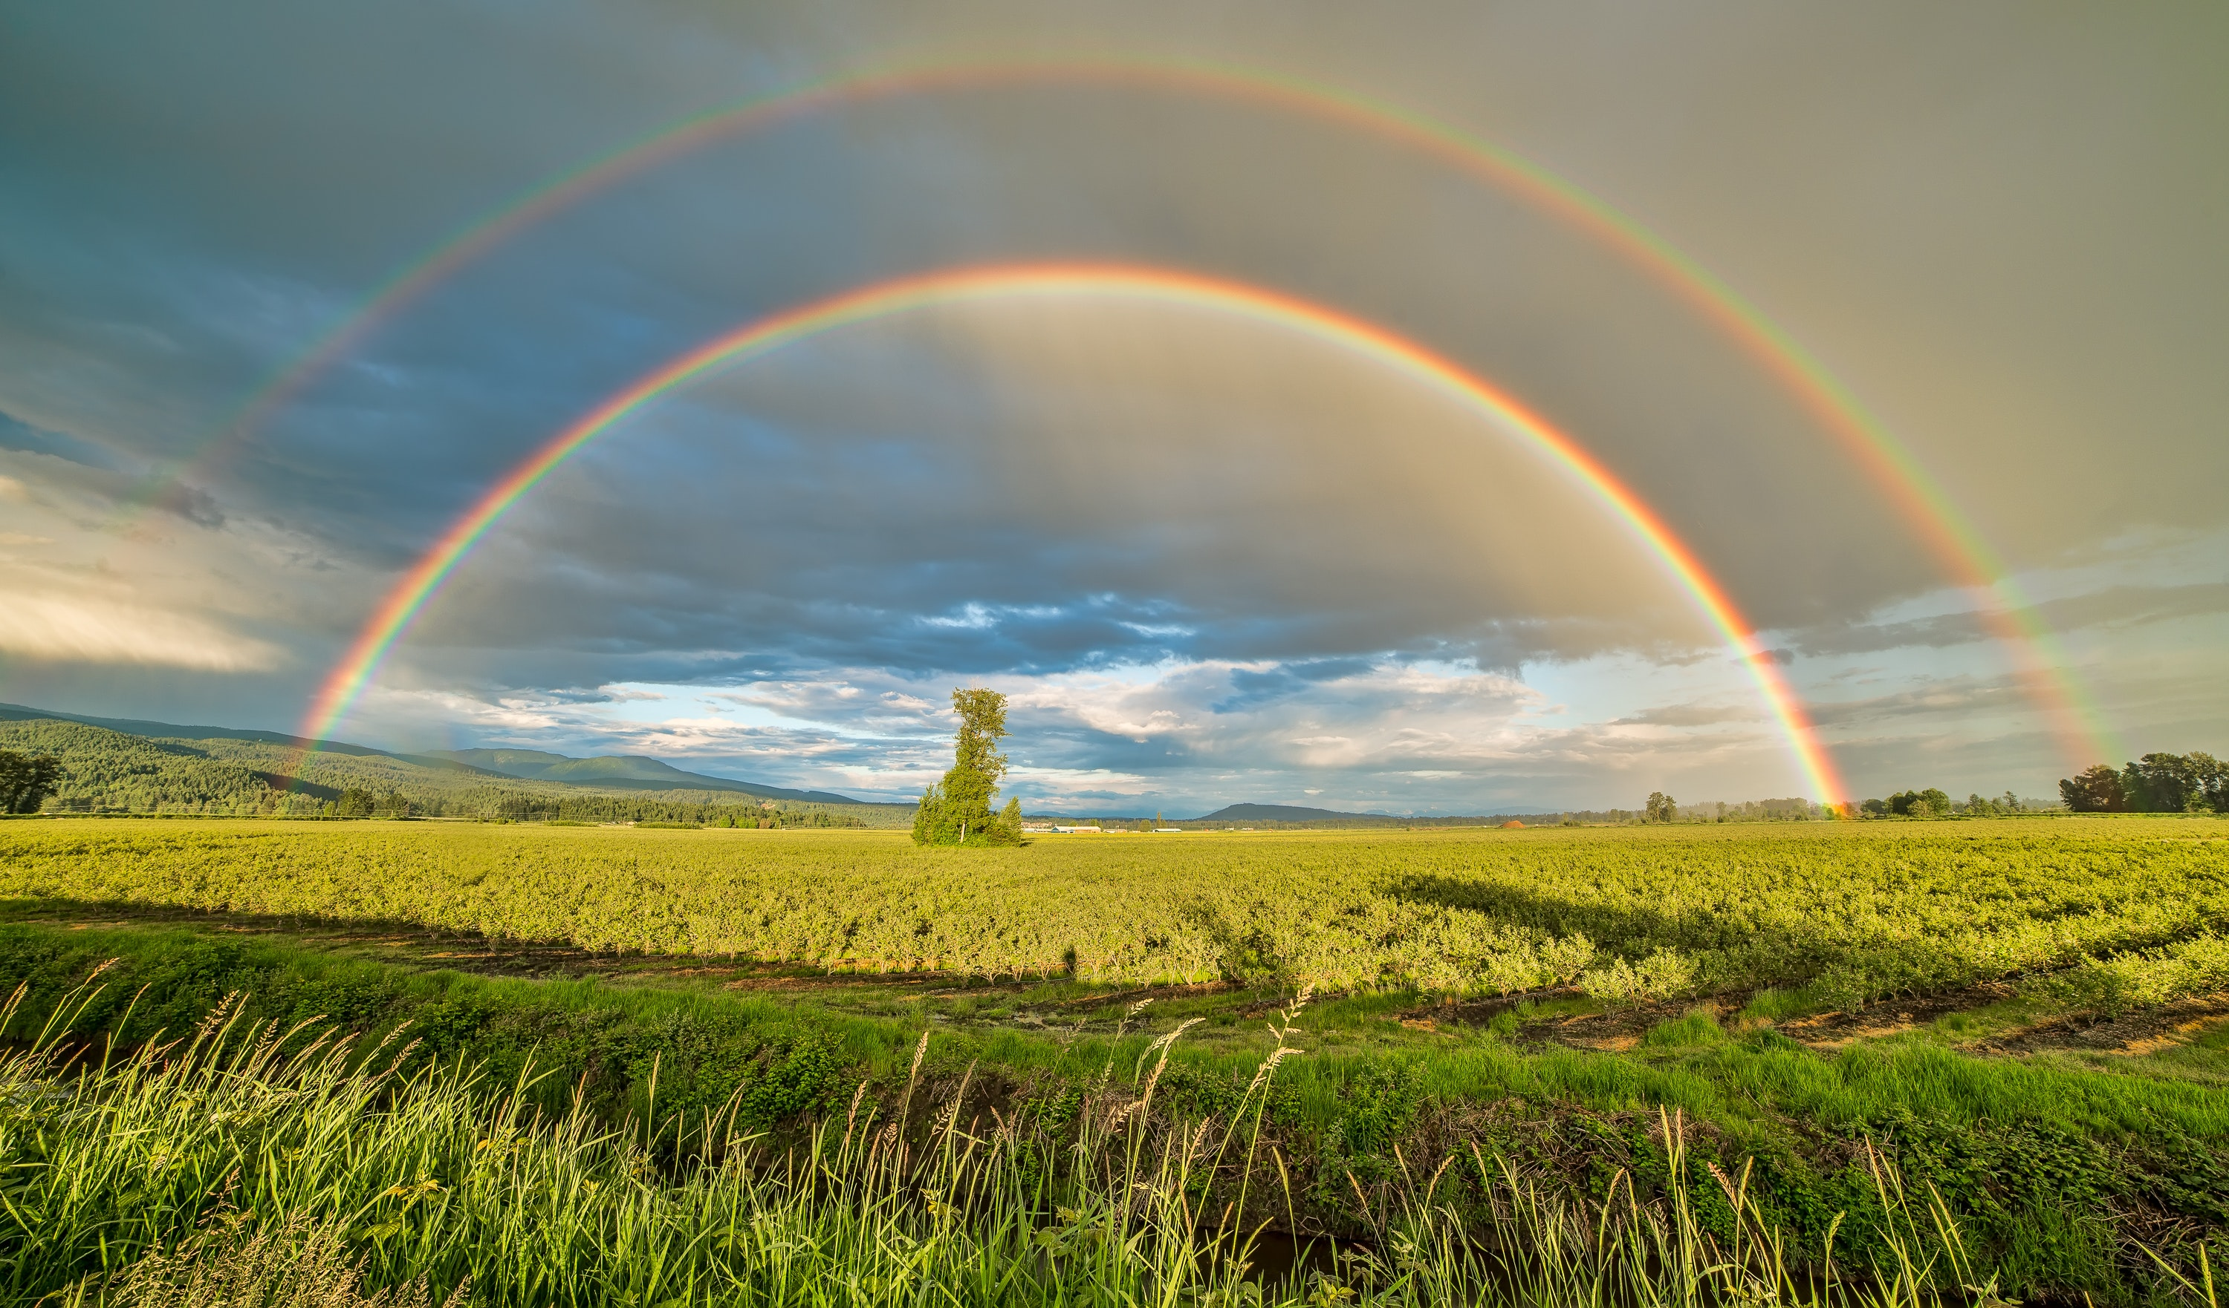
1. Blue skies and rainbows
and sunbeams from Heaven
are what I can see
when my Lord is living in me.

Slide 53
Chorus:
Jesus is well and alive today.
He makes His home in my heart.
Never more will I be all alone since He
promised me that we never would part.

Slide 54
2. Green grass and flowers
all blooming in springtime
are works of the Master
I live for each day.

Slide 55
Chorus:
Jesus is well and alive today.
He makes His home in my heart.
Never more will I be all alone since He
promised me that we never would part.

Slide 56
3. Tall mountains, green valleys,
the beauty that surrounds me
all make me aware
of the One who made it all.

Slide 57
Chorus:
Jesus is well and alive today.
He makes His home in my heart.
Never more will I be all alone since He
promised me that we never would part.

Slide 58
4. I’m not ashamed of
the Gospel of Jesus
for it is the power
that saves us today!

Slide 59
Chorus:
Jesus is well and alive today.
He makes His home in my heart.
Never more will I be all alone since He
promised me that we never would part.

Slide 60
#452
SONG:
Standing On
The Promises

Slide 61
1-1 Standing on the Promises
Standing On the Promises
452

Slide 62
1-2 Standing on the Promises
Standing On the Promises
452

Slide 63
2-1 Standing on the Promises
Standing On the Promises
452

Slide 64
2-2 Standing on the Promises
Standing On the Promises
452

Slide 65
3-1 Standing on the Promises
Standing On the Promises
452

Slide 66
3-2 Standing on the Promises
Standing On the Promises
452

Slide 67
4-1 Standing on the Promises
Standing On the Promises
452

Slide 68
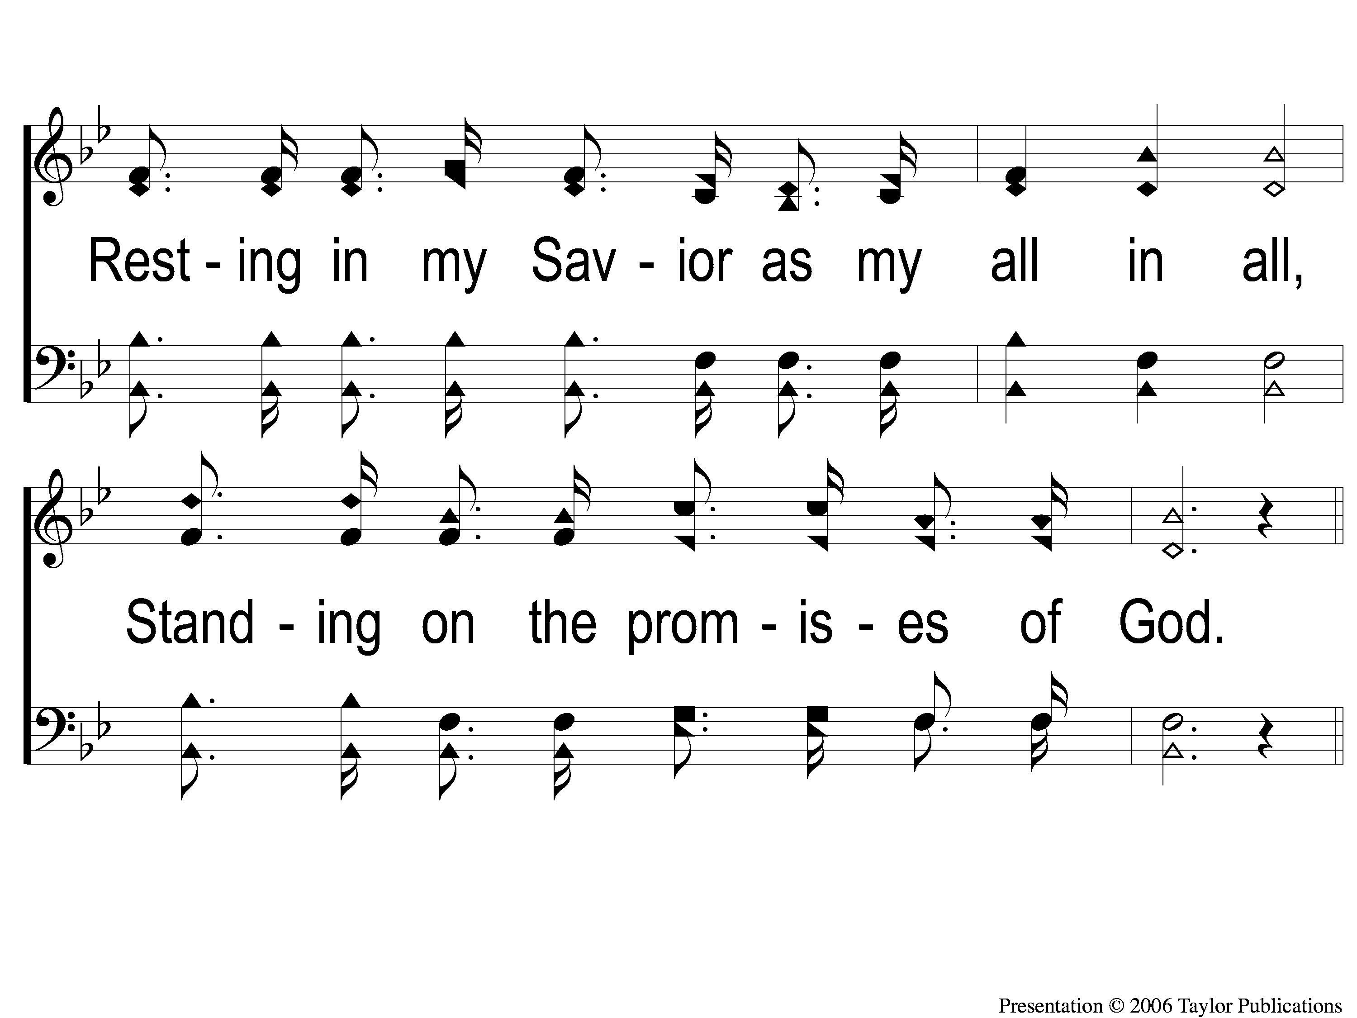
4-2 Standing on the Promises
Standing On the Promises
452

Slide 69
C-1 Standing on the Promises
Standing On the Promises
452

Slide 70
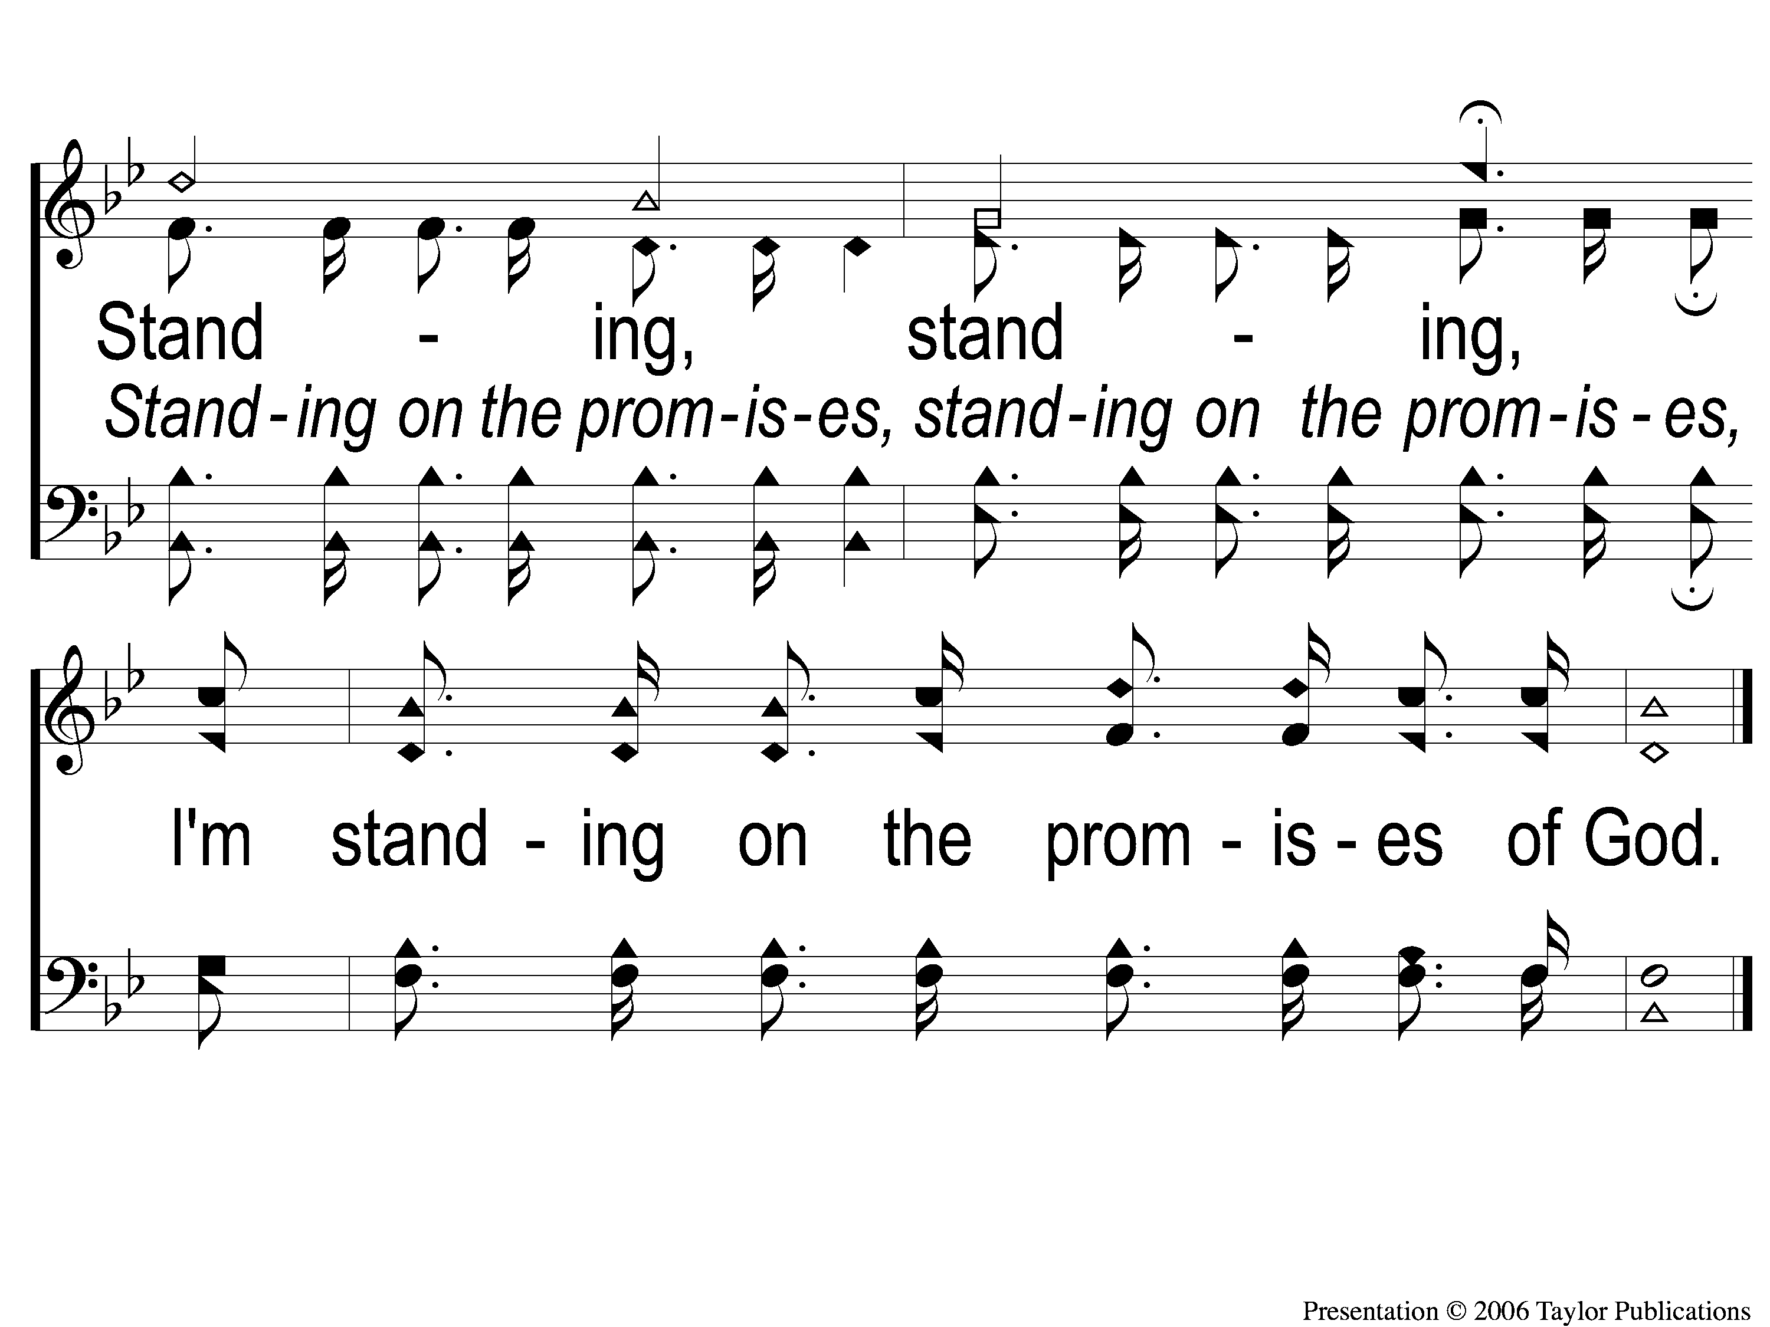
C-2 Standing on the Promises
Standing On the Promises
452

Slide 71
SCRIPTURE:
Hebrews 10:19-23

Slide 74
STANDING ON THE PROMISES

Slide 75
THE PROMISES OF GOD…
…Are Motivated By Love
…Are Communicated By His Word
…Is Trusted By His People
…Must Be Proclaimed By His People

Slide 76
MOTIVATED BY HIS LOVE
GOD IS LOVE
1 Jn. 4:8-9

Slide 77
MOTIVATED BY HIS LOVE
GOD LOVES HIS PEOPLE
Psa. 47:4, 78:68
Deut. 7:7-8, 23:5
2 Chron. 9:8

Slide 78
MOTIVATED BY HIS LOVE
GOD LOVES HIS PEOPLE
Jer. 31:3
Jn. 15:13
Rom. 5:6-8, 8:37
Gal. 2:20

Slide 79
THE PROMISES OF GOD…
…Are Motivated By Love
…Are Communicated By His Word

Slide 80
COMMUNICATED BY HIS WORD
THE WORD OF GOD:
Is Inspired by God
2 Pet. 1:21
Heb. 1:1
2 Tim. 3:16

Slide 81
COMMUNICATED BY HIS WORD
THE WORD OF GOD:
Is Sufficient
2 Tim. 3:16-17
2 Pet. 1:3

Slide 82
THE PROMISES OF GOD…
…Are Motivated By Love
…Are Communicated By His Word
…Is Trusted By His People

Slide 83
TRUSTED BY HIS PEOPLE
God Is Faithful
Deut. 7:9
Heb. 10:23
1 Cor. 1:9

Slide 84
TRUSTED BY HIS PEOPLE
God Is Faithful
Heb. 11:17-19
Josh. 23:43-45

Slide 85
THE PROMISES OF GOD…
…Are Motivated By Love
…Are Communicated By His Word
…Is Trusted By His People
…Must Be Proclaimed By His People

Slide 86
PROCLAIMED BY HIS PEOPLE
PROCLAIMED BY GOD
Deut. 26:18

Slide 87
PROCLAIMED BY HIS PEOPLE
PROCLAIMING HIS PRAISES
Lk. 1:72
1 Pet. 2:9

Slide 88
TWO PROMISES
The Return of Jesus – 2 Pet. 3:9

Slide 89
TWO PROMISES
The Return of Jesus – 2 Pet. 3:9
Eternal Life – 1 Jn. 2:25, Jn. 14:15

Slide 90
ARE YOU WILLING TO RECEIVE
THE PROMISE OF ETERNAL LIFE?

Slide 91
SONG:
Just As I Am –
I Come Broken

Slide 92
1-1 Just as I am-I come broken
Just As I Am-I Come Broken

Slide 93
1-2 Just as I am-I come broken
Just As I Am-I Come Broken

Slide 94
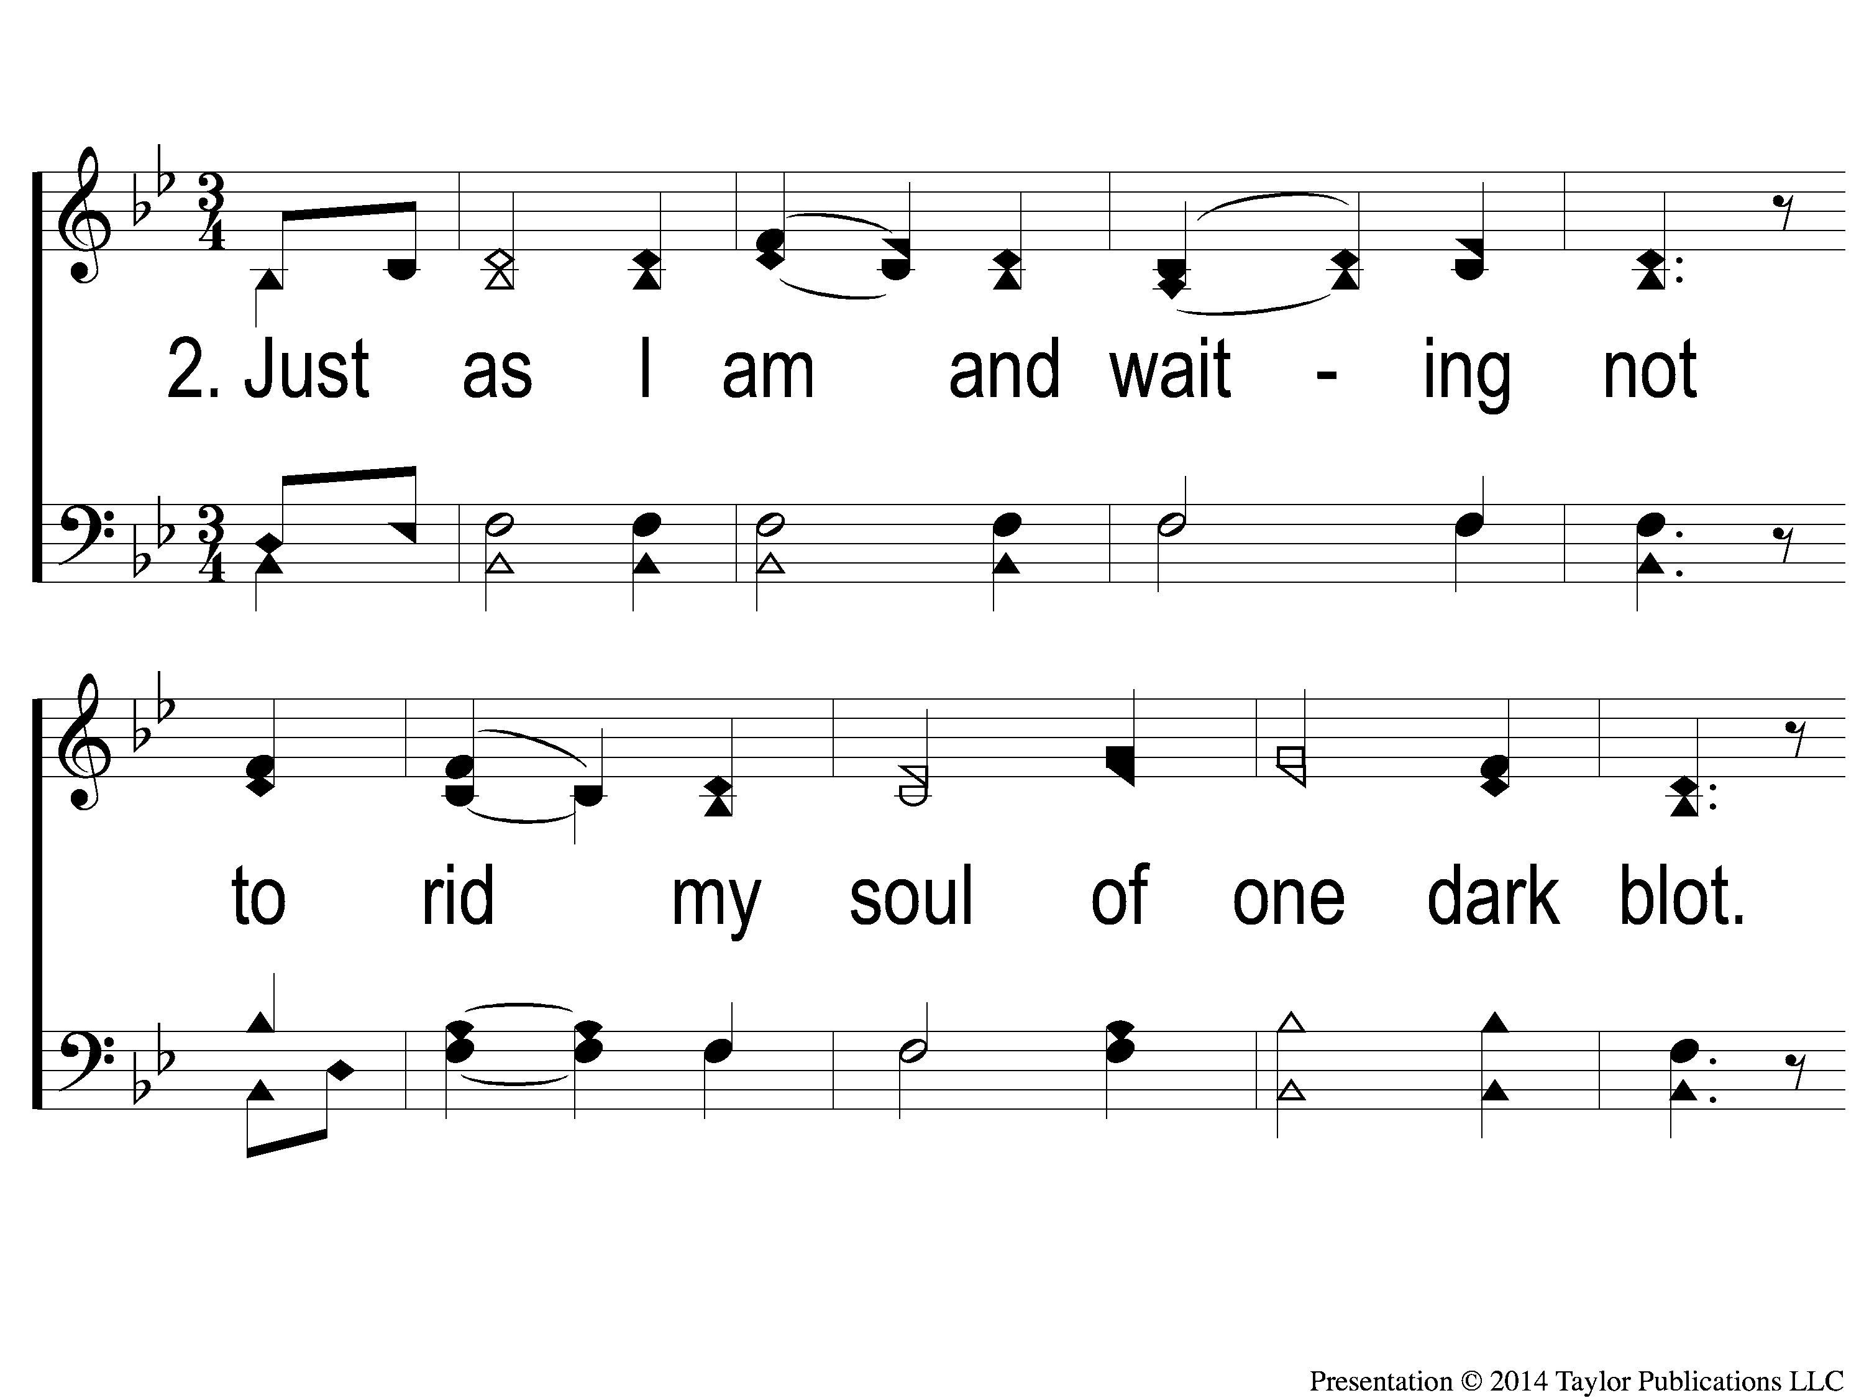
2-1 Just as I am-I come broken
Just As I Am-I Come Broken

Slide 95
2-2 Just as I am-I come broken
Just As I Am-I Come Broken

Slide 96
1c-1 Just as I am-I come broken
Just As I Am-I Come Broken

Slide 97
1c-2 Just as I am-I come broken
Just As I Am-I Come Broken

Slide 98
1c-3 Just as I am-I come broken
Just As I Am-I Come Broken

Slide 99
3-1 Just as I am-I come broken
Just As I Am-I Come Broken

Slide 100
3-2 Just as I am-I come broken
Just As I Am-I Come Broken

Slide 101
2c-1 Just as I am-I come broken
Just As I Am-I Come Broken

Slide 102
2c-2 Just as I am-I come broken
Just As I Am-I Come Broken

Slide 103
2c-3 Just as I am-I come broken
Just As I Am-I Come Broken

Slide 104
Ds-1 Just as I am-I come broken
Just As I Am-I Come Broken

Slide 105
Ds-2 Just as I am-I come broken
Just As I Am-I Come Broken

Slide 106
Ds-3 Just as I am-I come broken
Just As I Am-I Come Broken

Slide 107
SONG:
Above All

Slide 108
1 Above All
Above All

Slide 109
2 Above All
Above All

Slide 110
3 Above All
Above All

Slide 111
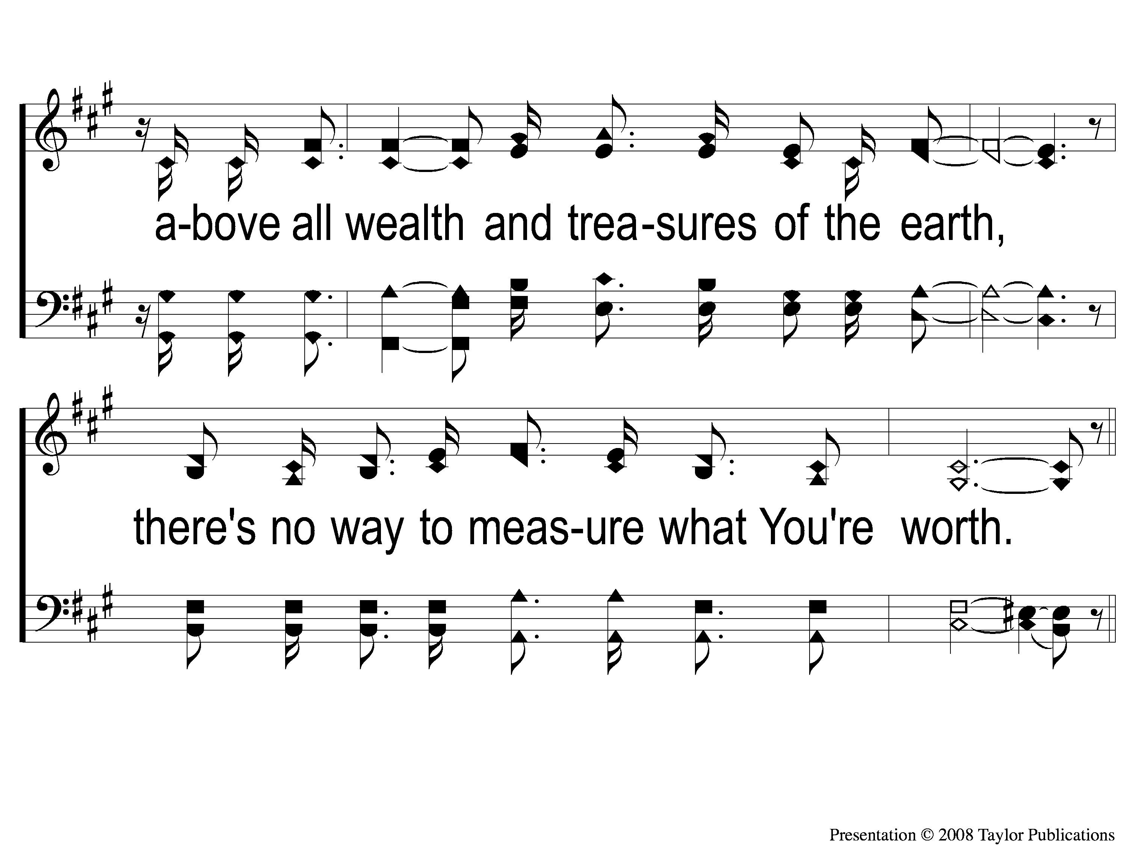
4 Above All
Above All

Slide 112
5 Above All
Above All

Slide 113
6 Above All
Above All

Slide 114
DC1 Above All
Above All

Slide 115
DC2 Above All
Above All

Slide 116
DC3 Above All
Above All

Slide 117
DC4 Above All
Above All

Slide 118
DC5 Above All
Above All

Slide 119
DC6 Above All
Above All

Slide 120
DS1 Above All
Above All

Slide 121
DS2 Above All
Above All

Slide 122
tag Above All
Above All

Slide 123
LORD’S SUPPER
The
Acts 20:7

Slide 124
Unleavened Bread
LORD’S SUPPER
⁴⁸ I am the bread of life. ⁴⁹ Your fathers ate the manna in the wilderness, and are dead. ⁵⁰ This is the bread which comes down from heaven, that one may eat of it and not die. ⁵¹ I am the living bread which came down from heaven. If anyone eats of this bread, he will live forever; and the bread that I shall give is My flesh, which I shall give for the life of the world.
John 6:48-51

Slide 125
Fruit of the Vine
LORD’S SUPPER
⁵³ Then Jesus said to them, “Most assuredly, I say to you, unless you eat the flesh of the Son of Man and drink His blood, you have no life in you. ⁵⁴ Whoever eats My flesh and drinks My blood has eternal life, and I will raise him up at the last day. ⁵⁵ For My flesh is food indeed, and My blood is drink indeed. ⁵⁶ He who eats My flesh and drinks My blood abides in Me, and I in him. ⁵⁷ As the living Father sent Me, and I live because of the Father, so he who feeds on Me will live because of Me.
John 6:53-57

Slide 126
Luke 12:15
OFFERING
And He said to them, “Take heed and beware of covetousness, for one’s life does not consist in the abundance of the things he possesses.”

Slide 127
Closing PRAYER

Slide 128
SONG:
The Greatest Commands

Slide 129
1-1 The Greatest Commands-SFP
The Greatest Commands
448

Slide 130
1-2 The Greatest Commands-SFP
The Greatest Commands
448

Slide 131
1-3 The Greatest Commands-SFP
The Greatest Commands
448

Slide 132
1-4 The Greatest Commands-SFP
The Greatest Commands
448

Slide 133
2-1 The Greatest Commands-SFP
The Greatest Commands
448

Slide 134
2-2 The Greatest Commands-SFP
The Greatest Commands
448

Slide 135
2-3 The Greatest Commands-SFP
The Greatest Commands
448

Slide 136
2-4 The Greatest Commands-SFP
The Greatest Commands
448

Slide 137
3-1 The Greatest Commands-SFP
The Greatest Commands
448

Slide 138
3-2 The Greatest Commands-SFP
The Greatest Commands
448

Slide 139
3-3 The Greatest Commands-SFP
The Greatest Commands
448

Slide 140
3-4 The Greatest Commands-SFP
The Greatest Commands
448

Slide 141
4-1 The Greatest Commands-SFP
The Greatest Commands
448

Slide 142
4-2 The Greatest Commands-SFP
The Greatest Commands
448

Slide 143
4-3 The Greatest Commands-SFP
The Greatest Commands
448

Slide 144
4-4 The Greatest Commands-SFP
The Greatest Commands
448

Slide 145
FELLOWSHIP MEAL
JOIN US FOR OUR
IN THE
MULTIPURPOSE BUILDING

