Slide 1
1-1 Holy, Holy, Holy
Holy, Holy, Holy
47

Slide 2
1-2 Holy, Holy, Holy
Holy, Holy, Holy
47

Slide 3
4-1 Holy, Holy, Holy
Holy, Holy, Holy
47

Slide 4
4-2 Holy, Holy, Holy
Holy, Holy, Holy
47

Slide 5
RESTORE REBUILD RENEW
welcome
we are glad to
Have you with us
IN 2022
WHEELER
CHURCH
OF
CHRIST

Slide 6
Song:
Faithful Love
#18

Slide 7
1-1 Faithful Love
Faithful Love
18

Slide 8
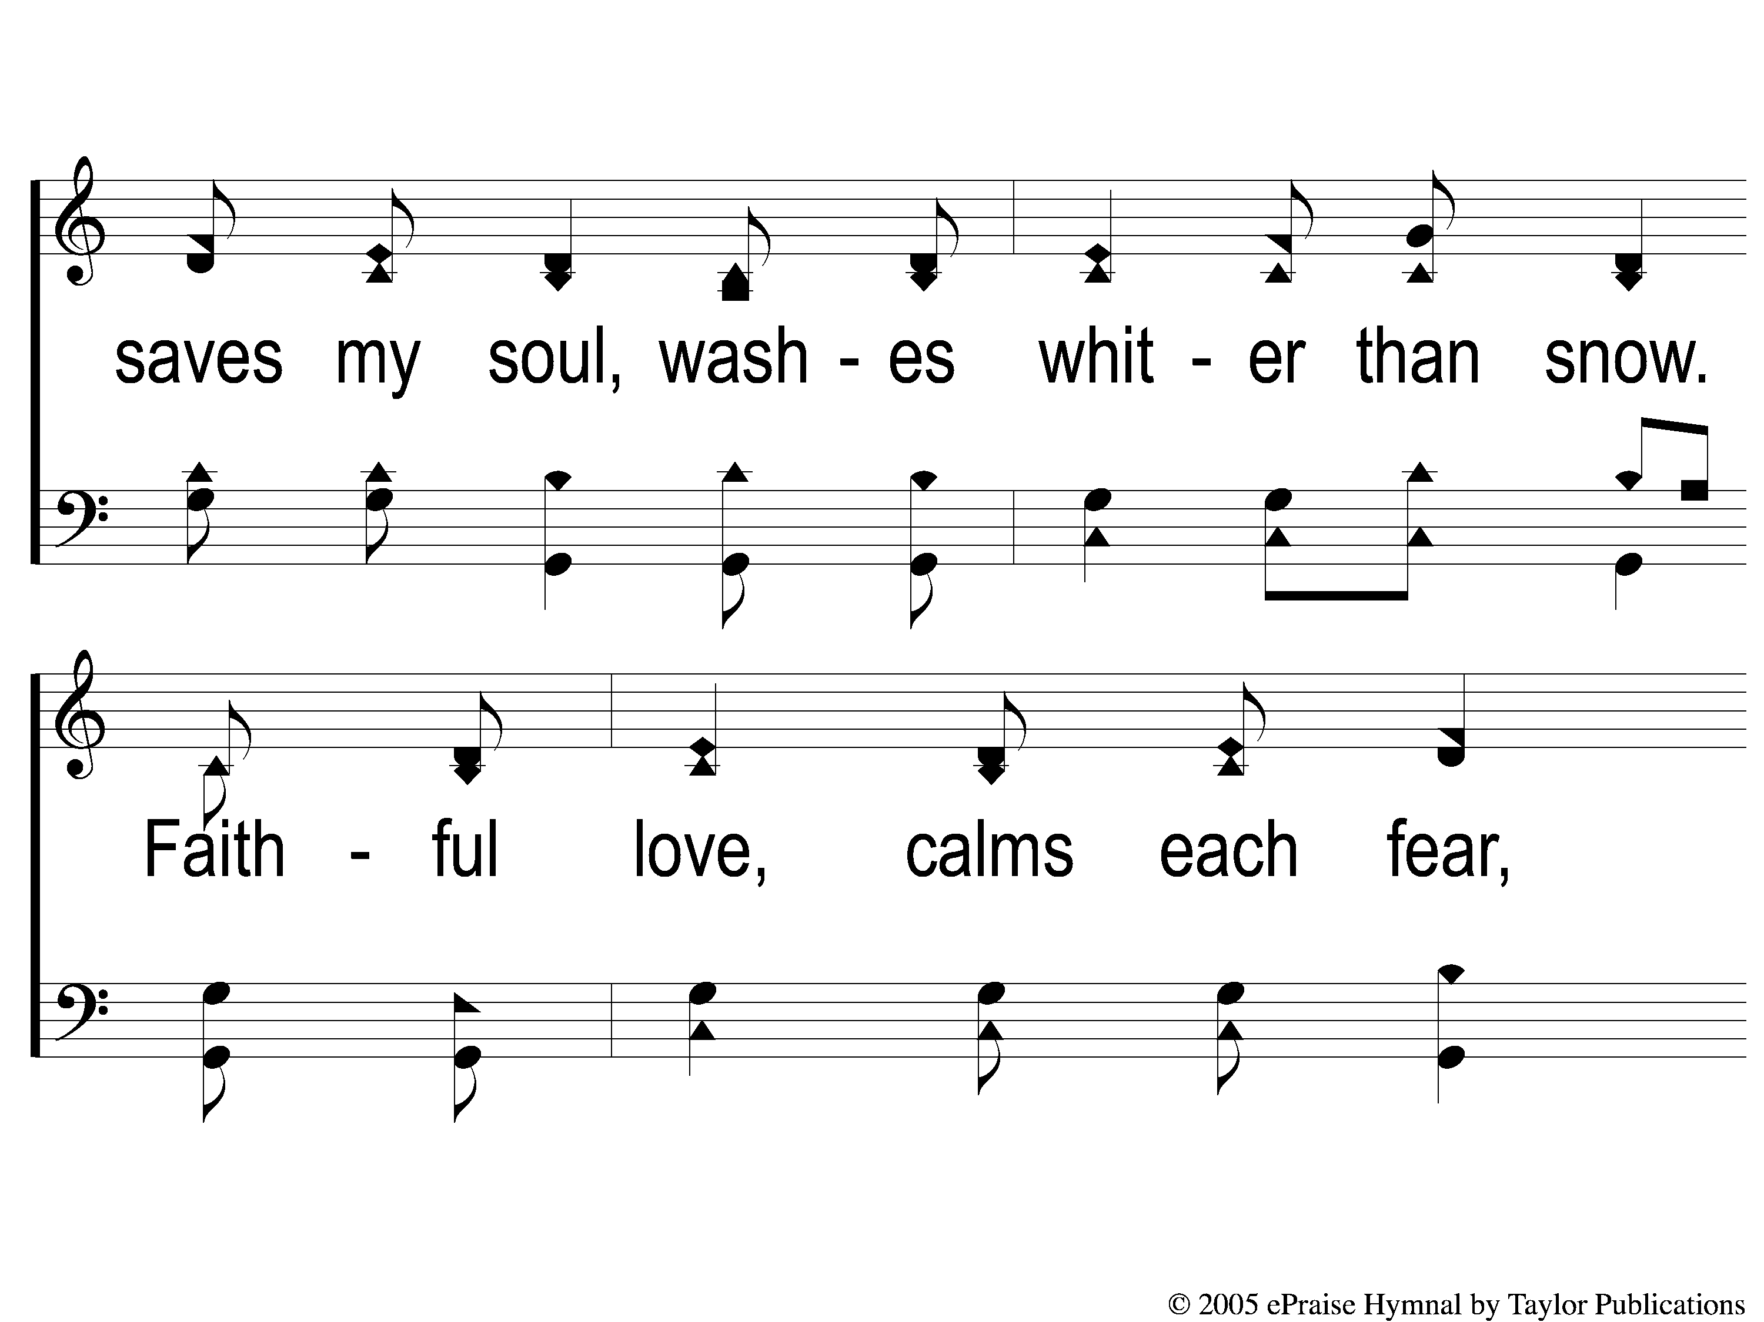
1-2 Faithful Love
Faithful Love
18

Slide 9
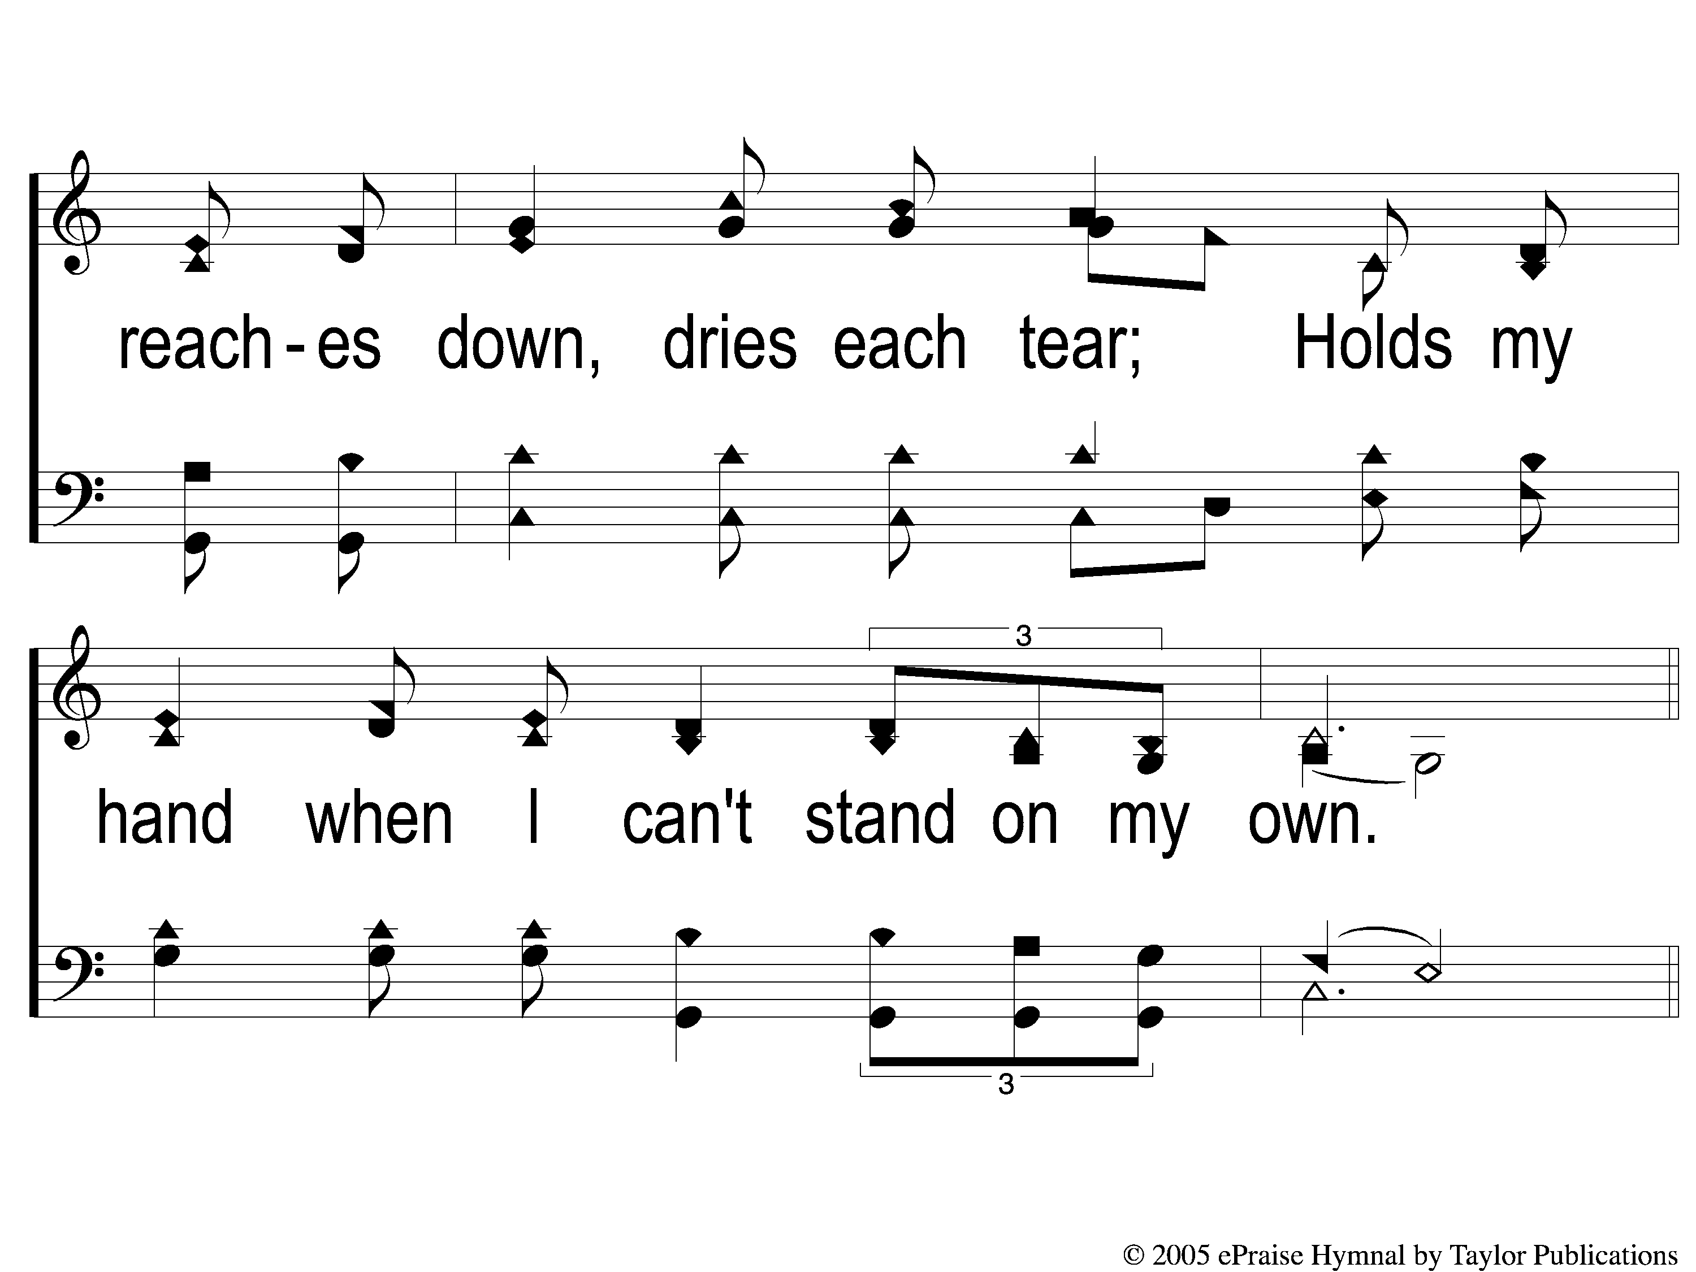
1-3 Faithful Love
Faithful Love
18

Slide 10
C-1 Faithful Love
Faithful Love
18

Slide 11
C-2 Faithful Love
Faithful Love
18

Slide 12
2-1 Faithful Love
Faithful Love
18

Slide 13
2-2 Faithful Love
Faithful Love
18

Slide 14
2-3 Faithful Love
Faithful Love
18

Slide 15
C-1 Faithful Love
Faithful Love
18

Slide 16
C-2 Faithful Love
Faithful Love
18

Slide 17
Song:
Sweet Hour Of Prayer
#827

Slide 18
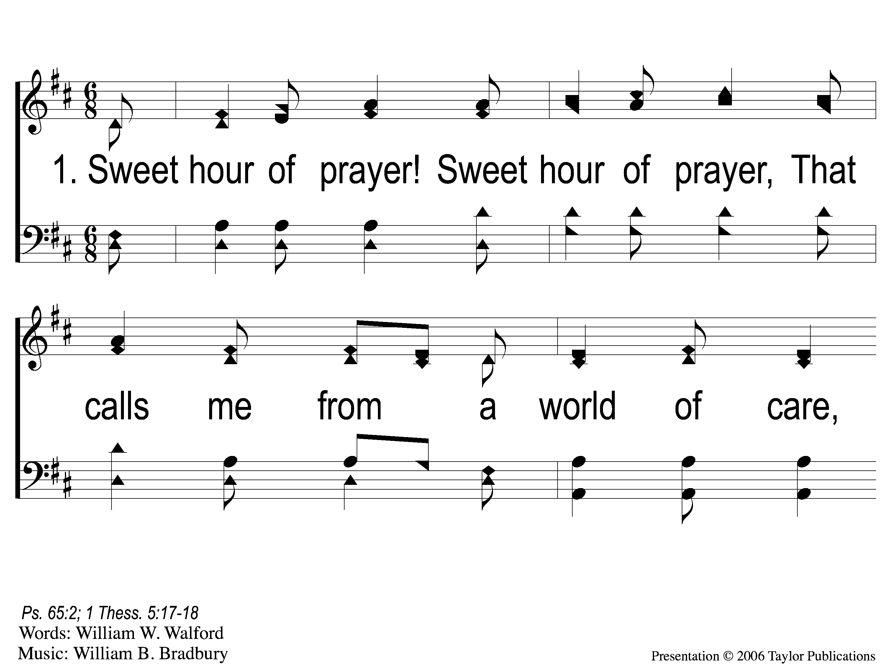
1-1 Sweet Hour of Prayer
Sweet Hour of Prayer
827

Slide 19
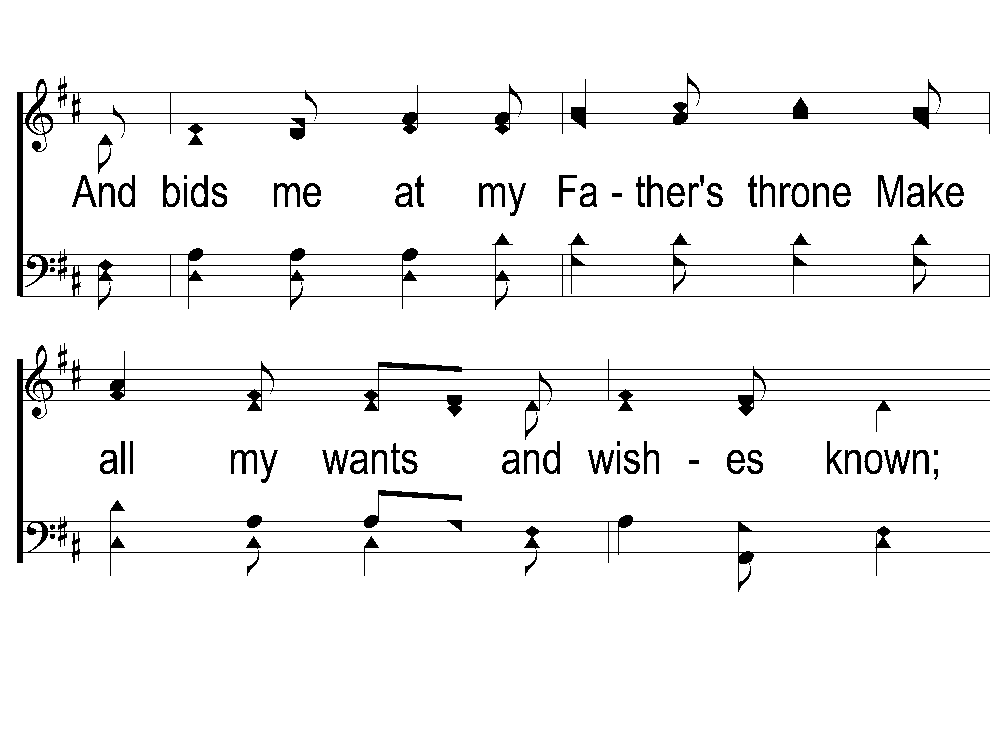
1-2 Sweet Hour of Prayer
Sweet Hour of Prayer
827

Slide 20
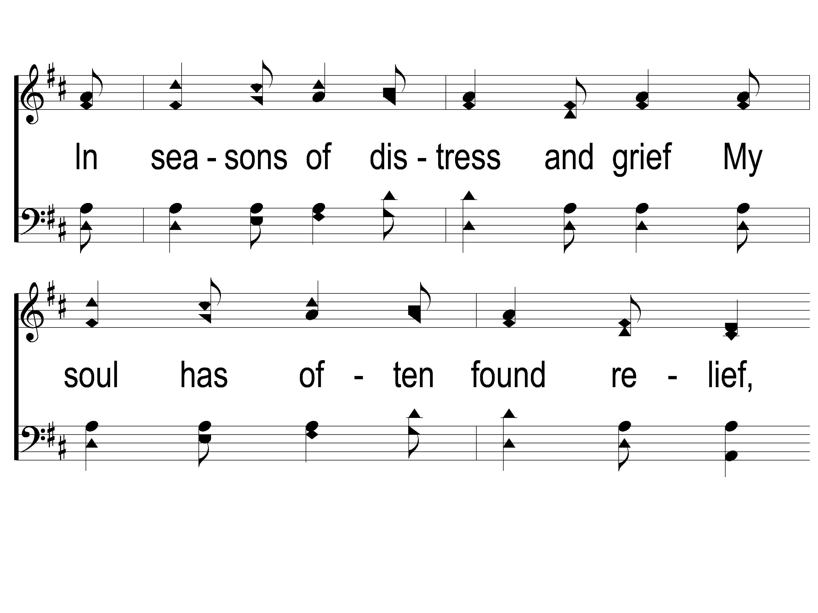
1-3 Sweet Hour of Prayer
Sweet Hour of Prayer
827

Slide 21
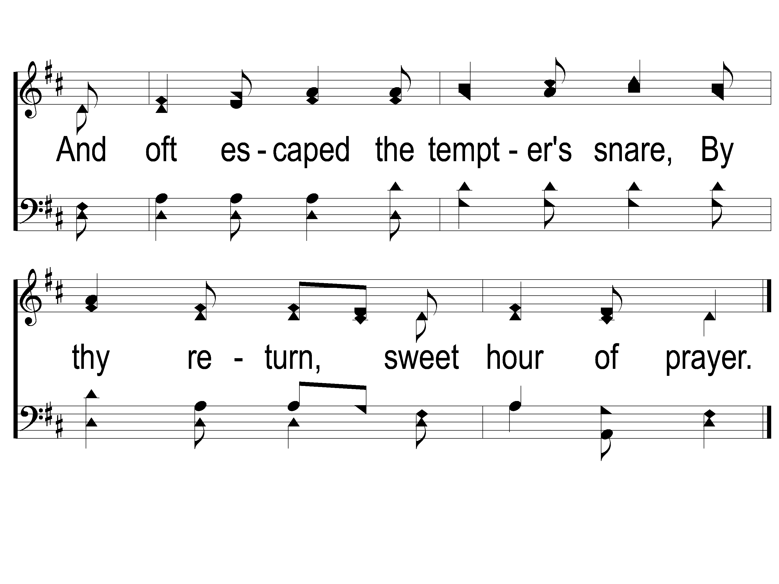
1-4 Sweet Hour of Prayer
Sweet Hour of Prayer
827

Slide 22
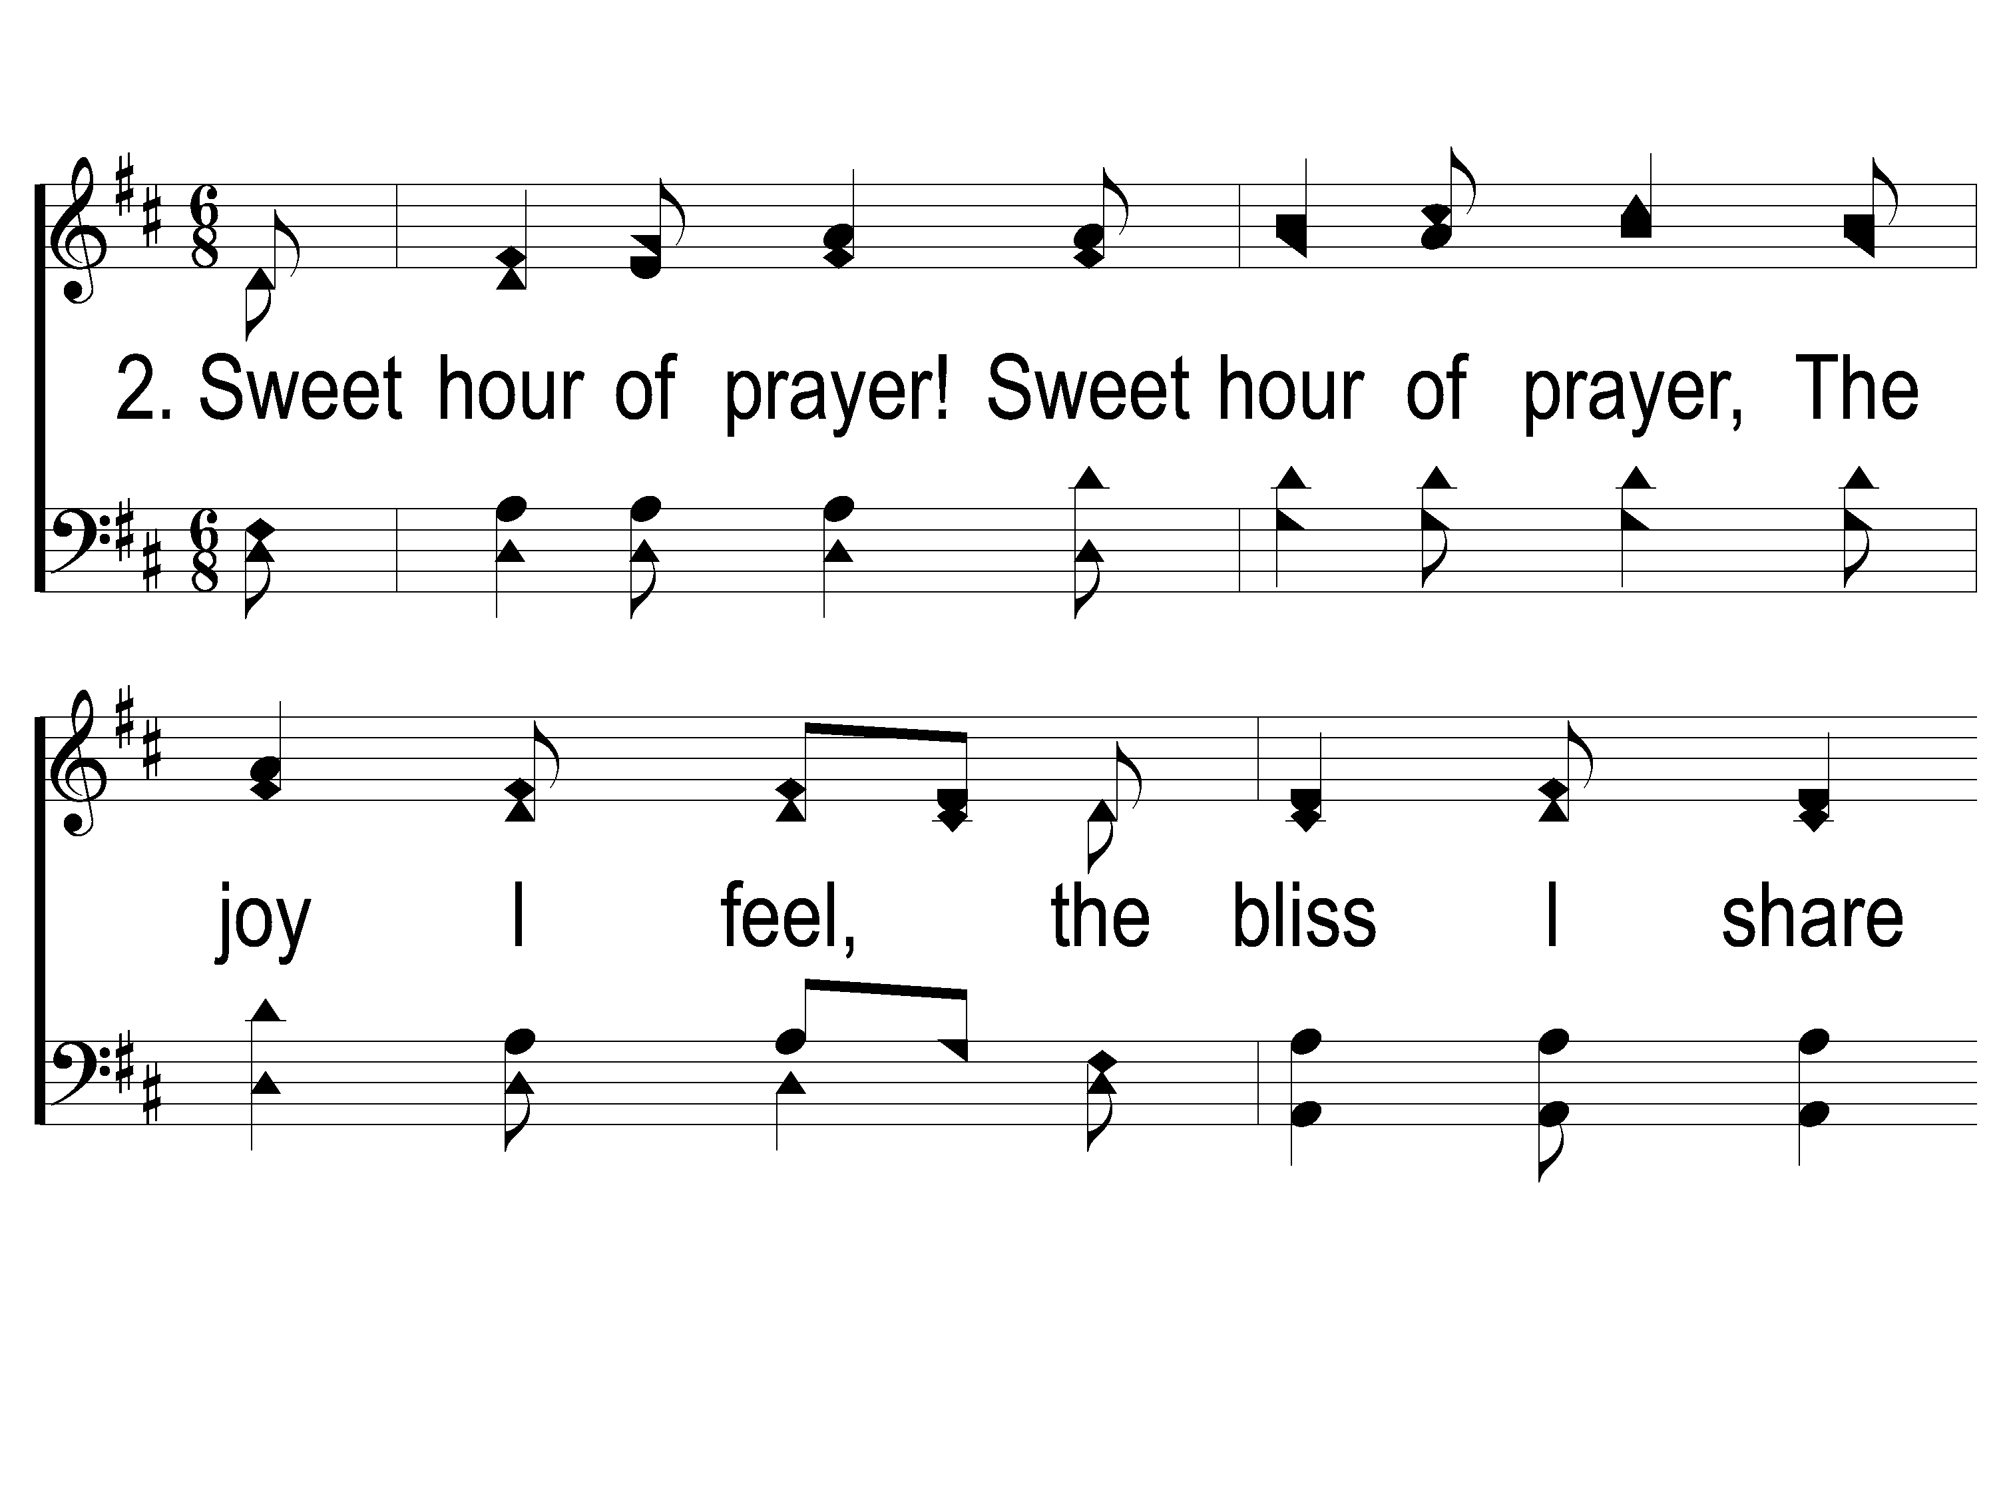
2-1 Sweet Hour of Prayer
Sweet Hour of Prayer
827

Slide 23
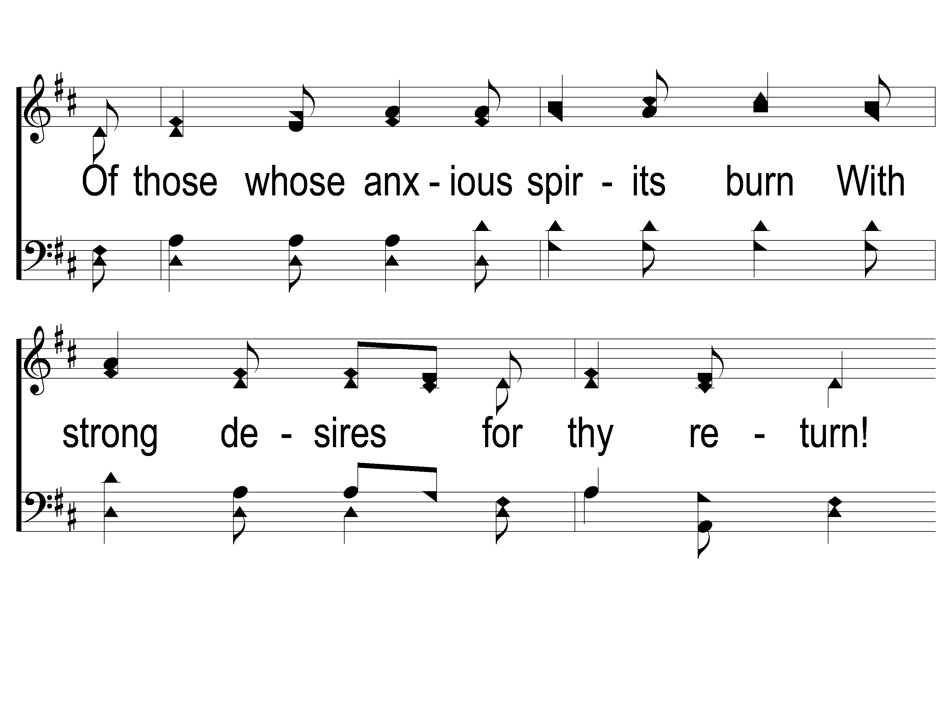
2-2 Sweet Hour of Prayer
Sweet Hour of Prayer
827

Slide 24
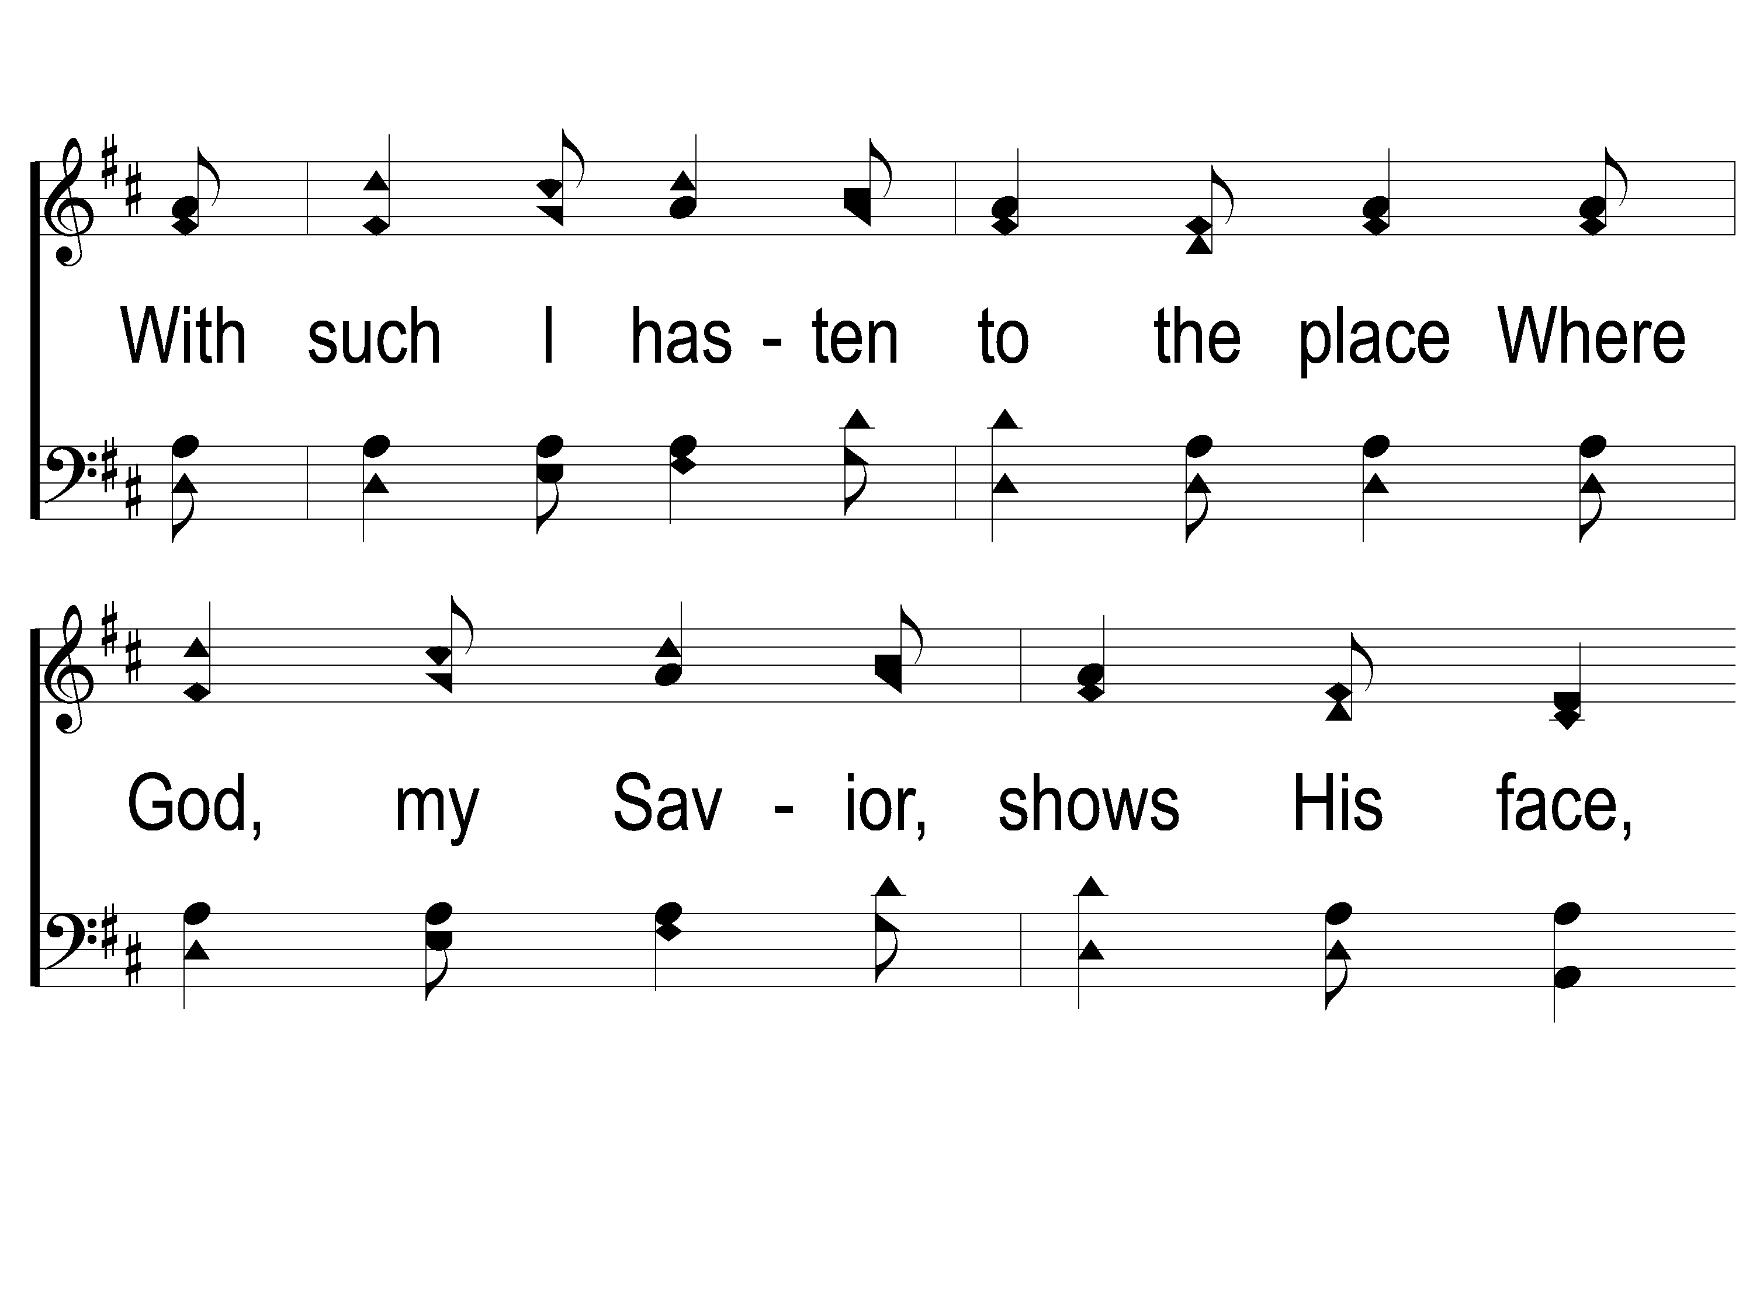
2-3 Sweet Hour of Prayer
Sweet Hour of Prayer
827

Slide 25
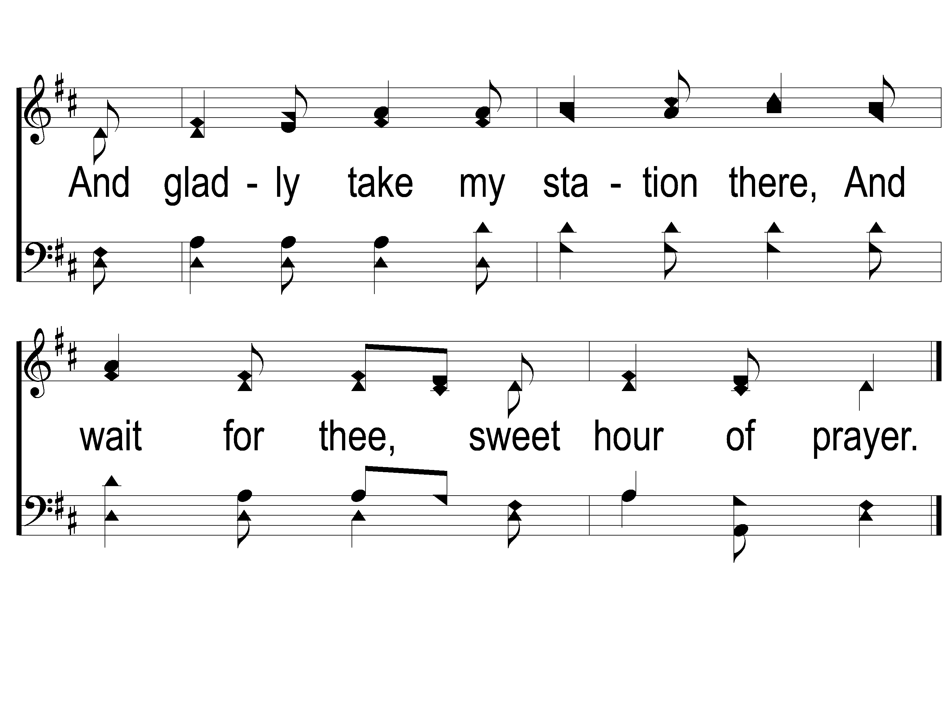
2-4 Sweet Hour of Prayer
Sweet Hour of Prayer
827

Slide 26
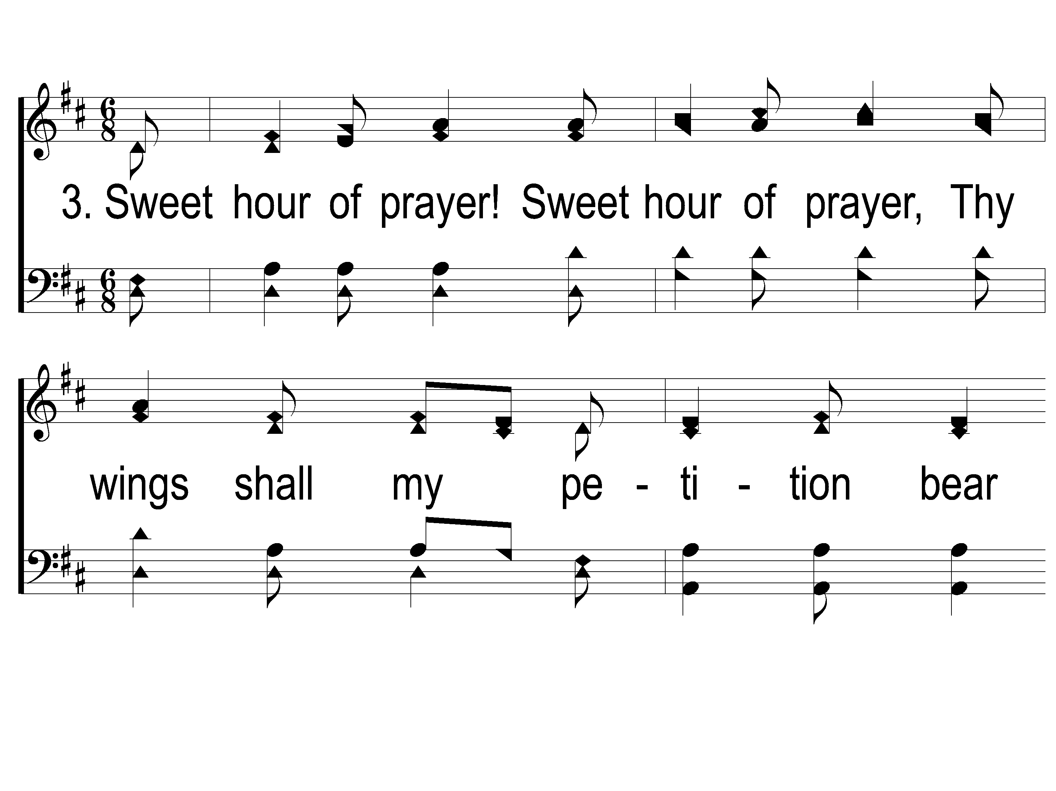
3-1 Sweet Hour of Prayer
Sweet Hour of Prayer
827

Slide 27
3-2 Sweet Hour of Prayer
Sweet Hour of Prayer
827

Slide 28
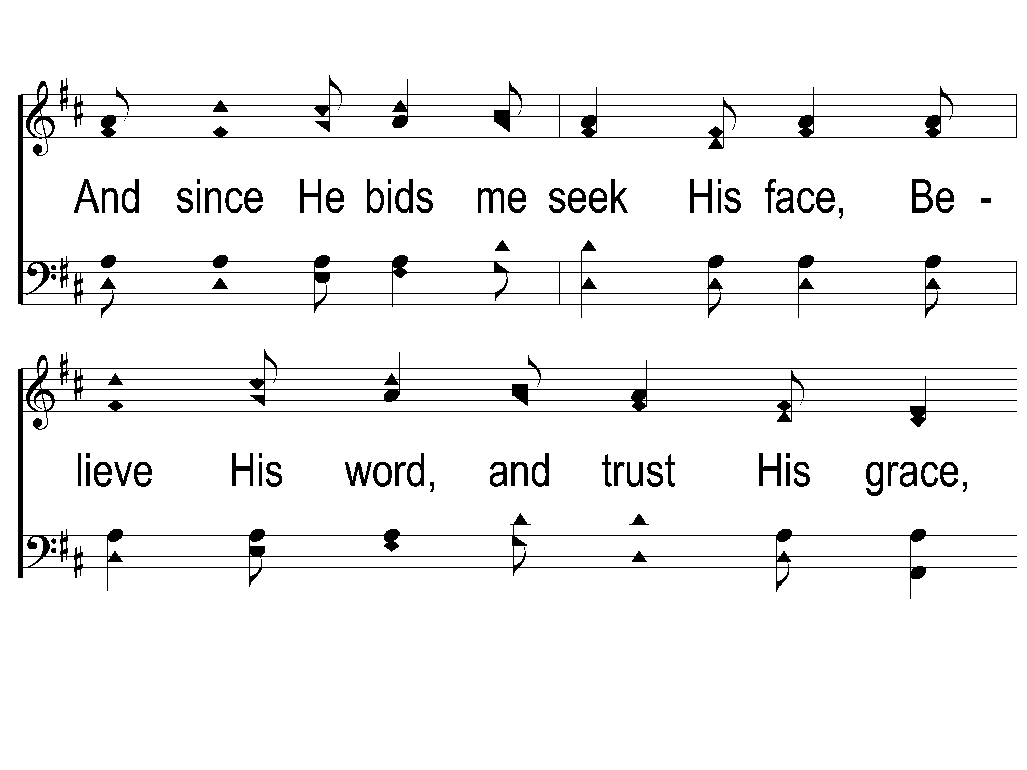
3-3 Sweet Hour of Prayer
Sweet Hour of Prayer
827

Slide 29
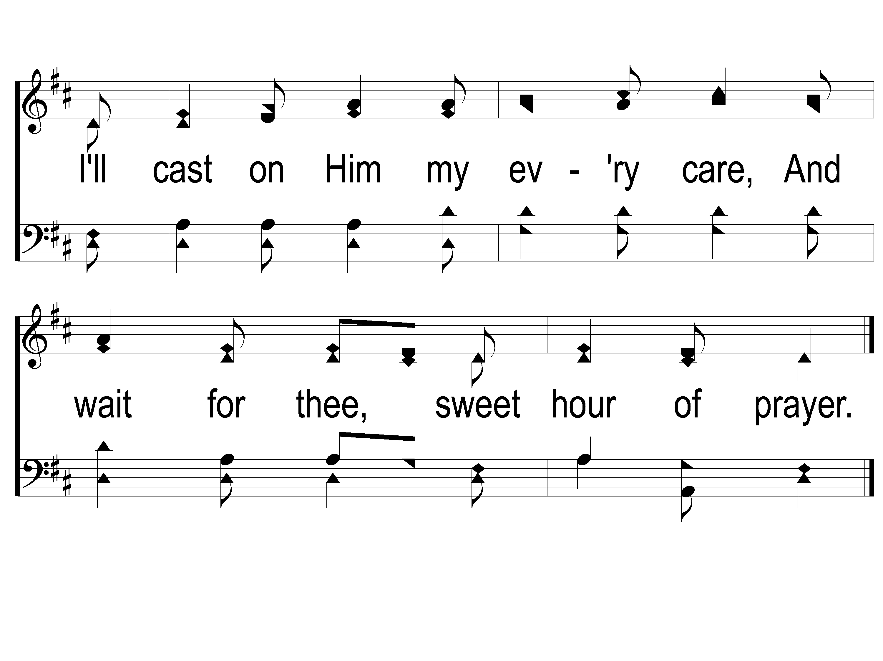
3-4 Sweet Hour of Prayer
Sweet Hour of Prayer
827

Slide 30
Opening Prayer

Slide 31
Song:
Living By Faith
#560

Slide 32
1-1 Living by Faith
Living by Faith
560
© 2005 ePraise Hymn Presentation by Taylor Publications

Slide 33
1-2 Living by Faith
Living by Faith
560
© 2005 ePraise Hymn Presentation by Taylor Publications

Slide 34
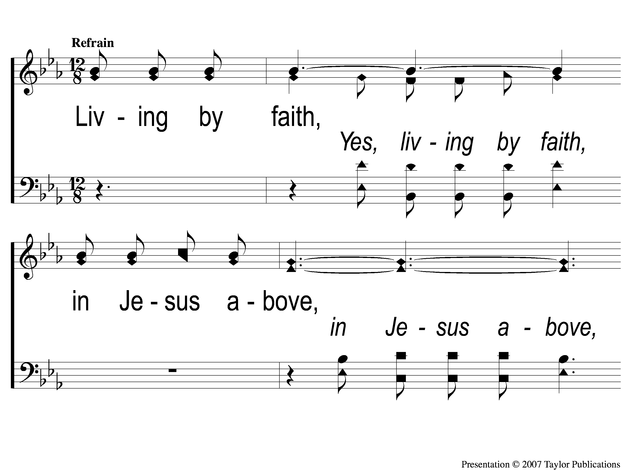
C-1 Living by Faith
Living by Faith
560
© 2005 ePraise Hymn Presentation by Taylor Publications

Slide 35
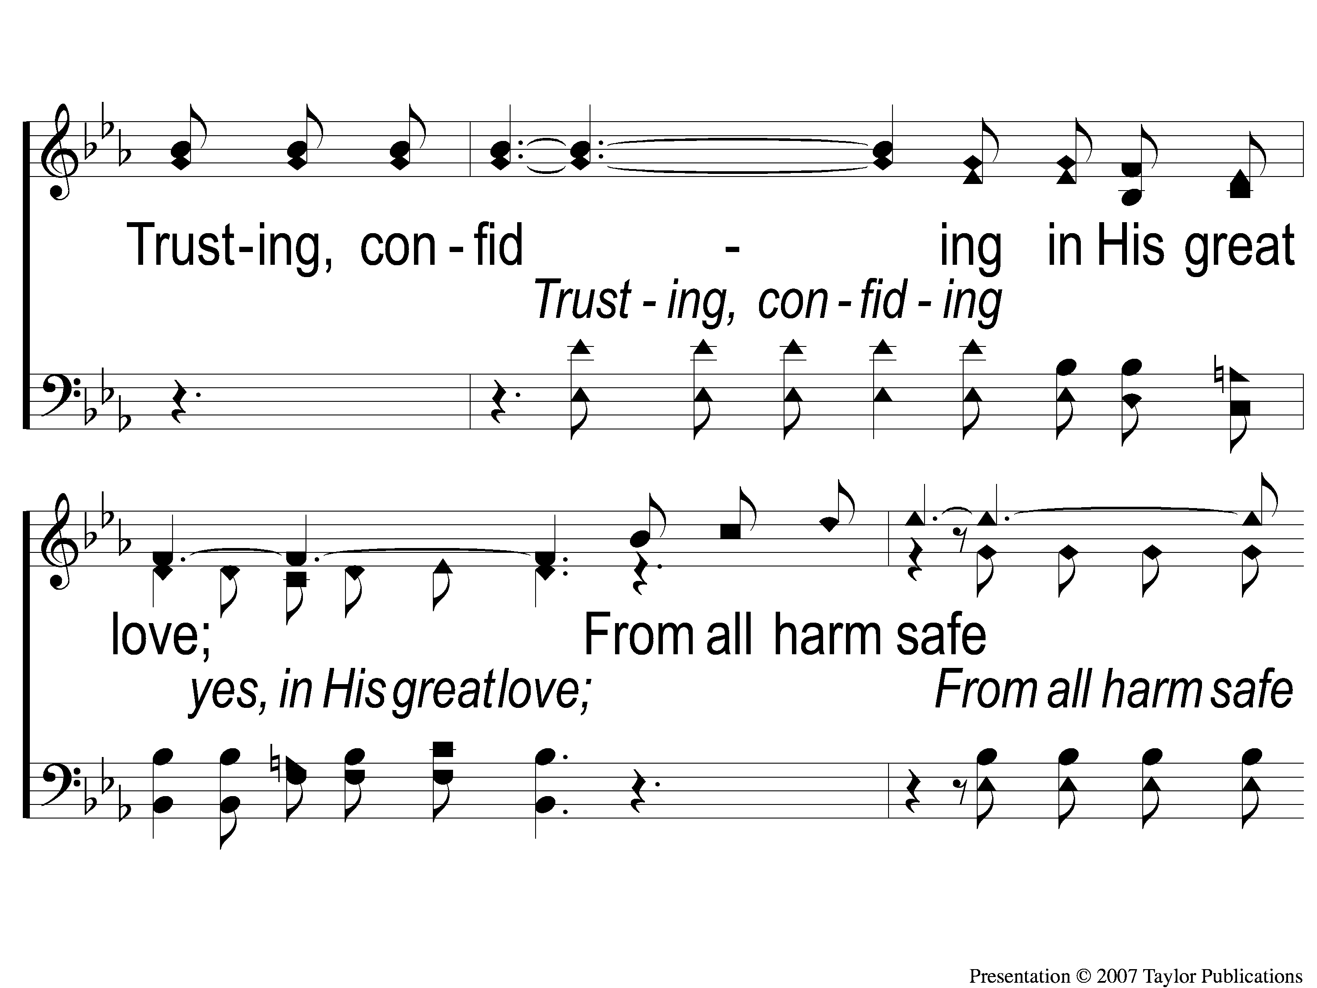
C-2 Living by Faith
Living by Faith
560
© 2005 ePraise Hymn Presentation by Taylor Publications

Slide 36
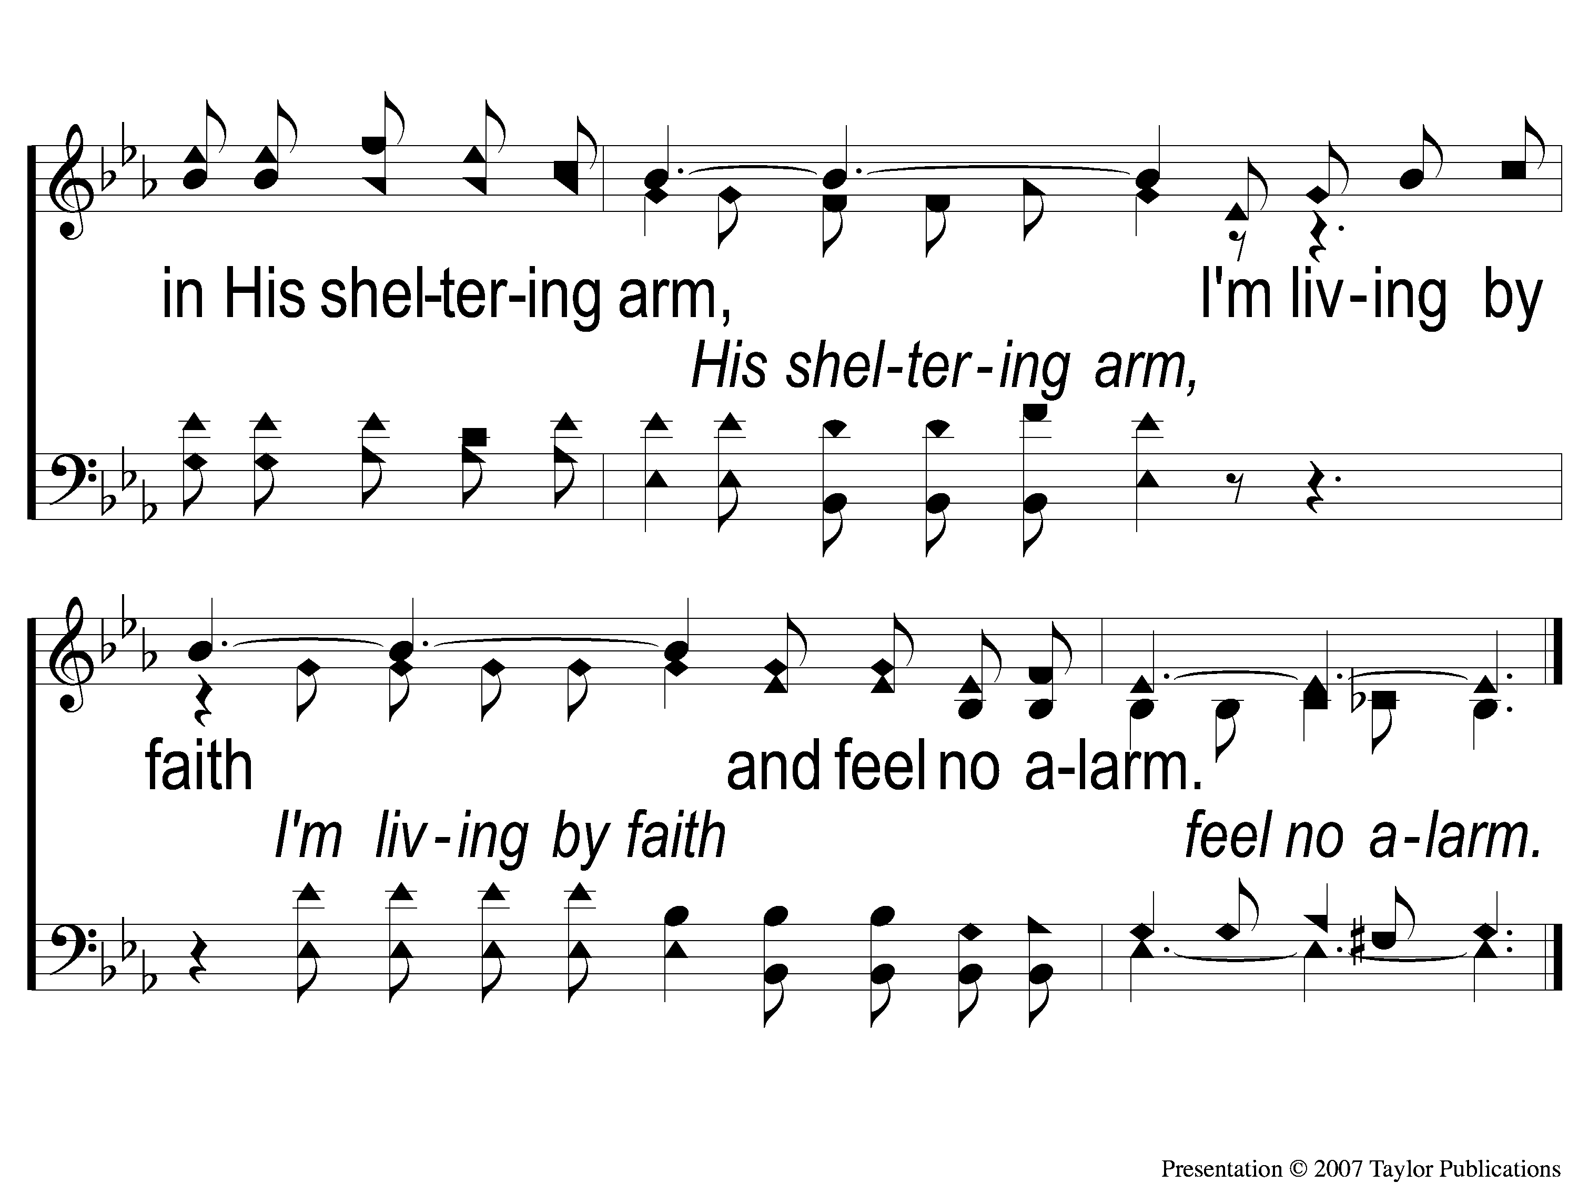
C-3 Living by Faith
Living by Faith
560
© 2005 ePraise Hymn Presentation by Taylor Publications

Slide 37
3-1 Living by Faith
Living by Faith
560
© 2005 ePraise Hymn Presentation by Taylor Publications

Slide 38
3-2 Living by Faith
Living by Faith
560
© 2005 ePraise Hymn Presentation by Taylor Publications

Slide 39
C-1 Living by Faith
Living by Faith
560
© 2005 ePraise Hymn Presentation by Taylor Publications

Slide 40
C-2 Living by Faith
Living by Faith
560
© 2005 ePraise Hymn Presentation by Taylor Publications

Slide 41
C-3 Living by Faith
Living by Faith
560
© 2005 ePraise Hymn Presentation by Taylor Publications

Slide 42
Song:
What A Friend
We Have In Jesus
#912

Slide 43
1-1 What A Friend We Have in Jesus
What a Friend We Have in Jesus
800

Slide 44
1-2 What A Friend We Have in Jesus
What a Friend We Have in Jesus
800

Slide 45
1-3 What A Friend We Have in Jesus
What a Friend We Have in Jesus
800

Slide 46
1-4 What A Friend We Have in Jesus
What a Friend We Have in Jesus
800

Slide 47
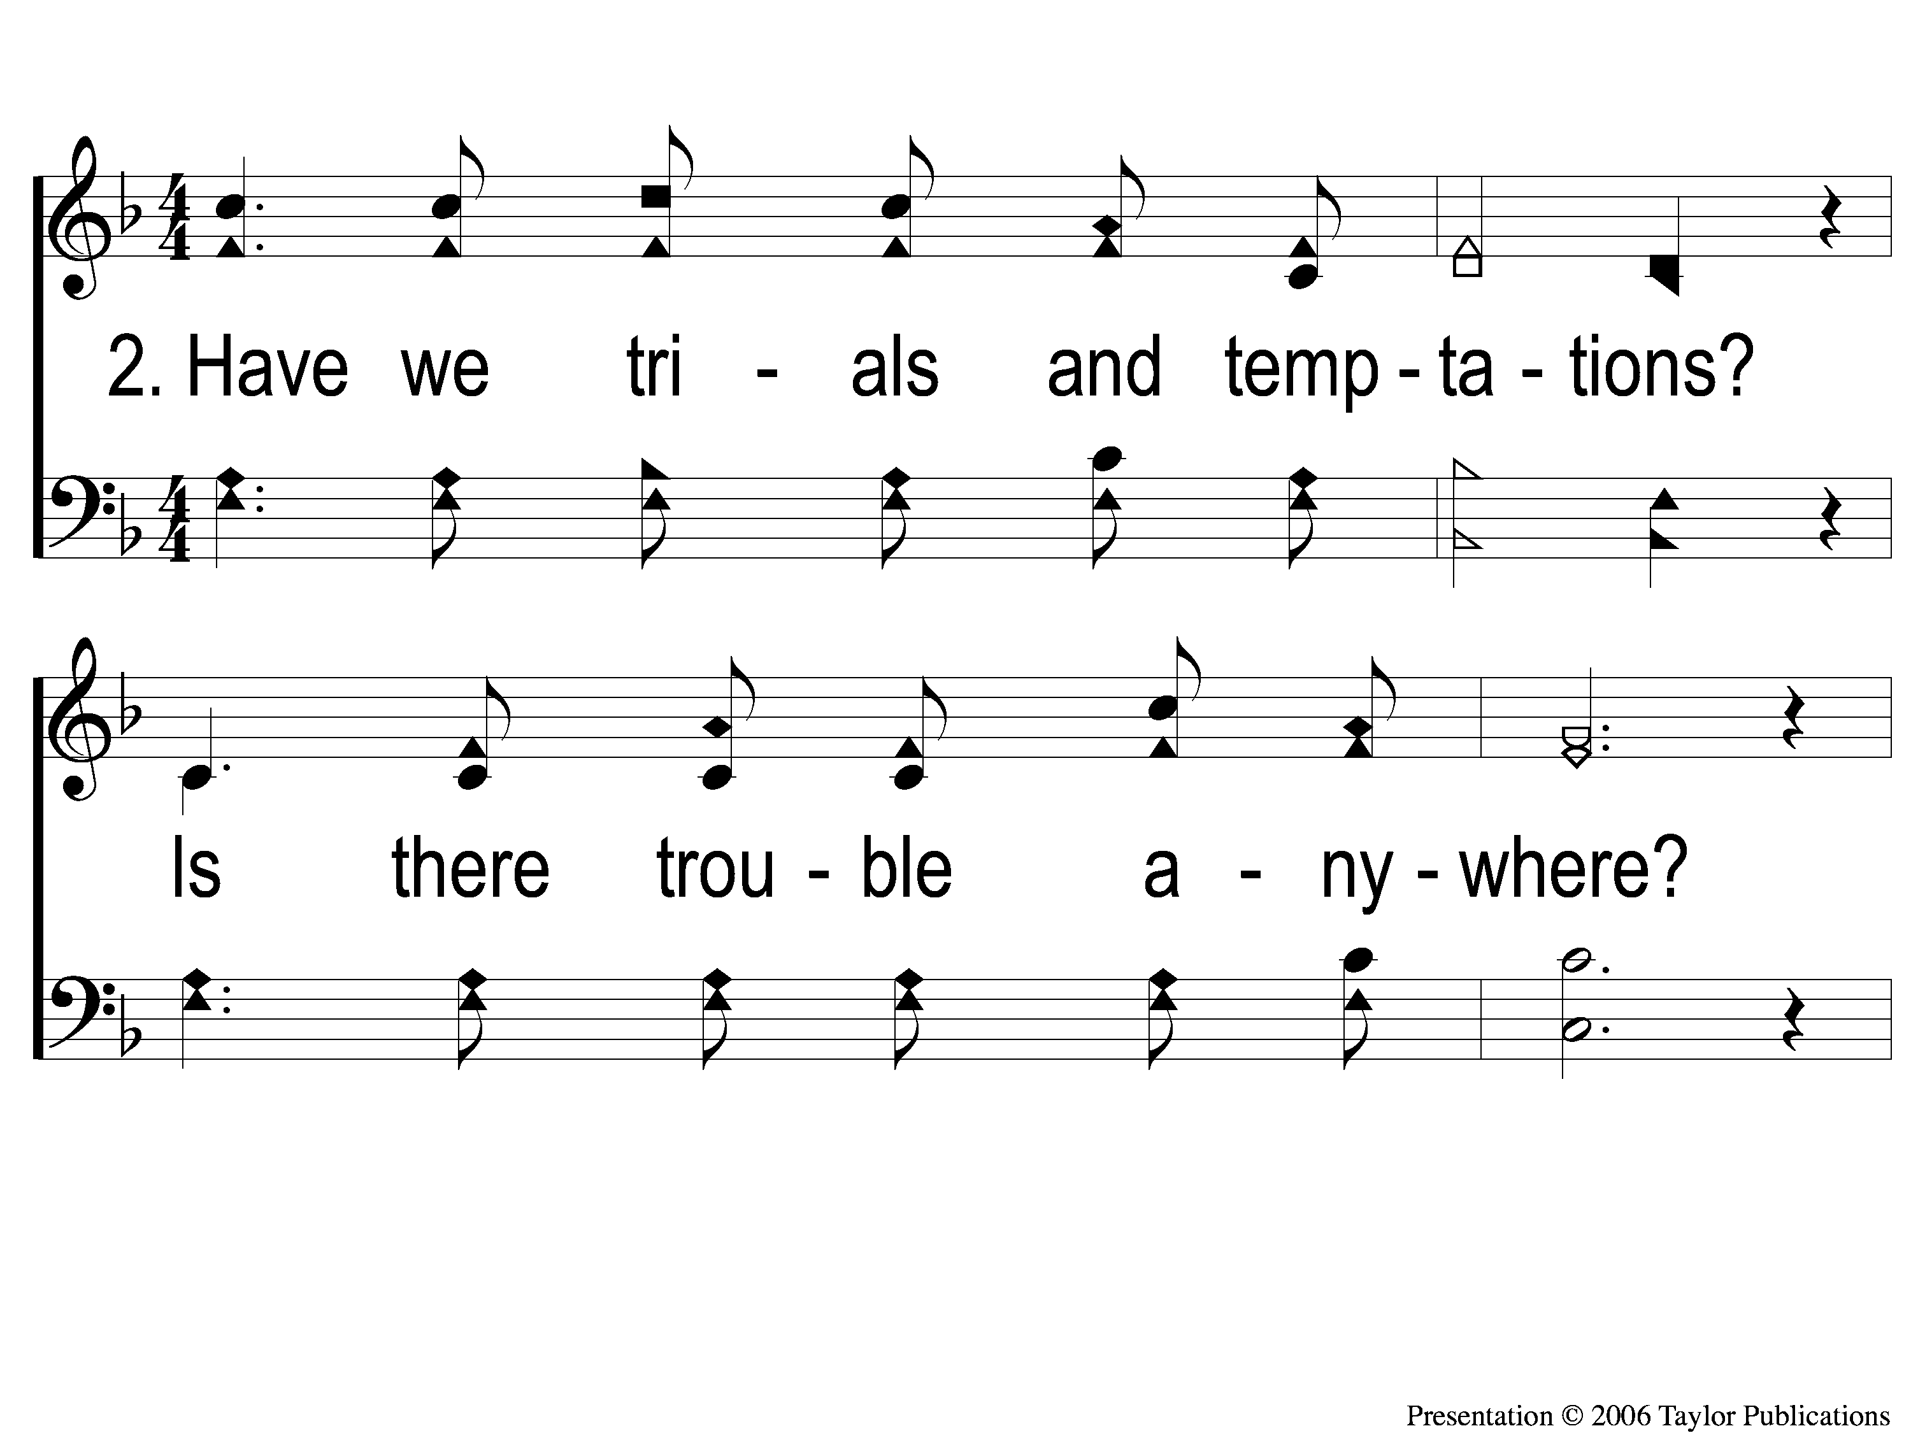
2-1 What A Friend We Have in Jesus
What a Friend We Have in Jesus
800

Slide 48
2-2 What A Friend We Have in Jesus
What a Friend We Have in Jesus
800

Slide 49
2-3 What A Friend We Have in Jesus
What a Friend We Have in Jesus
800

Slide 50
2-4 What A Friend We Have in Jesus
What a Friend We Have in Jesus
800

Slide 51
3-1 What A Friend We Have in Jesus
What a Friend We Have in Jesus
800

Slide 52
3-2 What A Friend We Have in Jesus
What a Friend We Have in Jesus
800

Slide 53
3-3 What A Friend We Have in Jesus
What a Friend We Have in Jesus
800

Slide 54
3-4 What A Friend We Have in Jesus
What a Friend We Have in Jesus
800

Slide 55
Scripture Reading:
Nehemiah 2:16-18

Slide 57
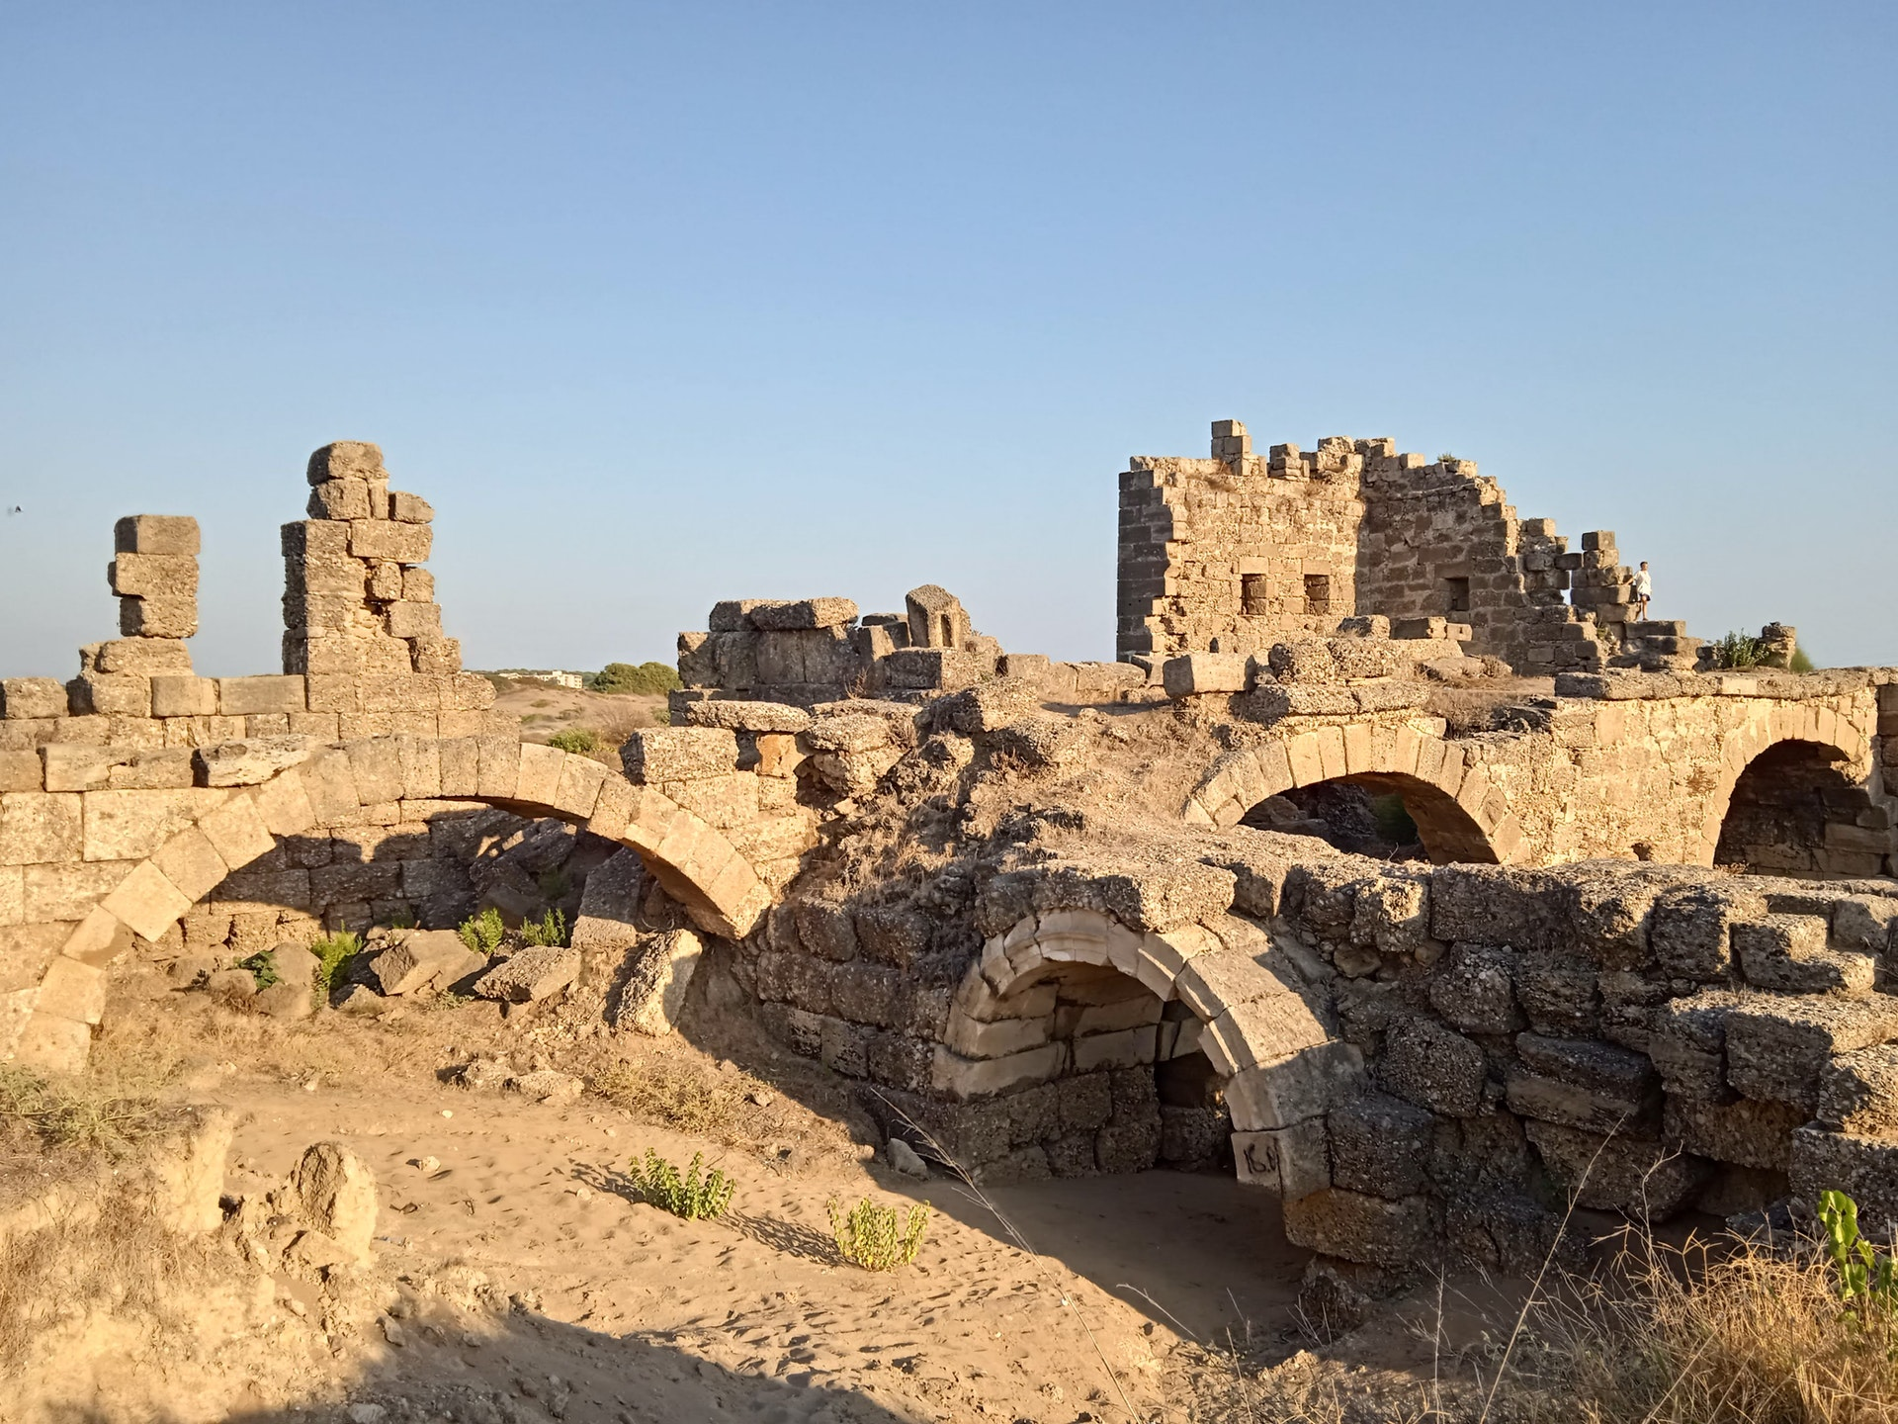
Rebuilding Jerusalem

Slide 58
ENCOURAGEMENT
More

Slide 59
ENCOURAGEMENT
More
Nehemiah: The Encourager

Slide 60
3 Lessons From Nehemiah

Slide 61
3 Lessons From Nehemiah
Leaders Must Be Encouragers
Neh. 2:16-18, 4:14, 19-20, 5:7-11

Slide 62
3 Lessons From Nehemiah
Leaders Must Be Encouragers
Neh. 2:16-18, 4:14, 19-20, 5:7-11
Seeing Potential

Slide 63
3 Lessons From Nehemiah
Leaders Must Be Encouragers
Neh. 2:16-18, 4:14, 19-20, 5:7-11
Seeing Potential
Not Afraid of Rejection

Slide 64
3 Lessons From Nehemiah
Everyone Can Be An Encourager
Neh. Ch. 3 – “next to” → 16 times

Slide 65
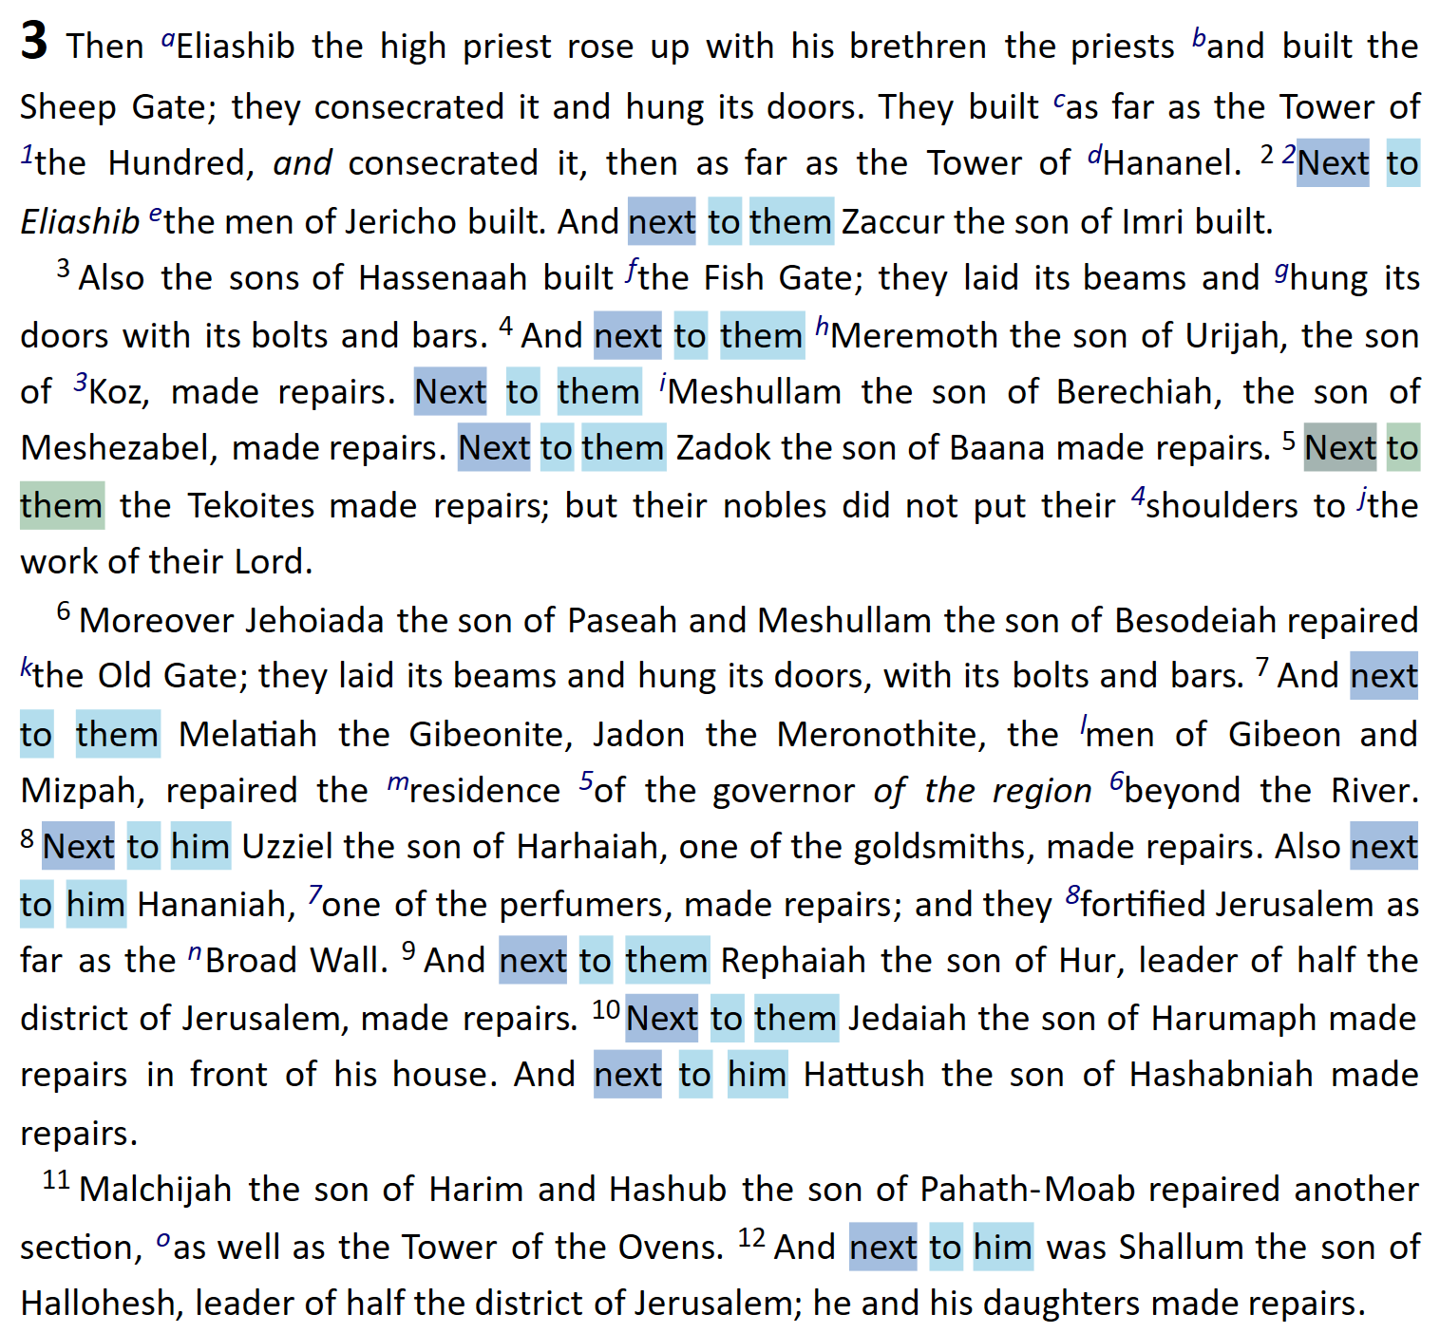

Slide 66
3 Lessons From Nehemiah
Everyone Needs Encouragement
Neh. 4:14, 19-20
“Nobles”
“Leaders”
“The rest of the people”

Slide 67
How To Encourage Others:

Slide 68
How To Encourage Others:
Shift Focus Away From Distractions
Neh. 4:2-3, 14

Slide 69
How To Encourage Others:
Shift Focus To God
Neh. 4:14, 20

Slide 70
How To Encourage Others:
Shift Focus To God
Neh. 4:14, 20
Deut. 31:8; Josh. 1:5, 9, 5:13-15
Matt. 28:20; Heb. 13:5

Slide 71
How To Encourage Others:
Shift Focus To Family
Neh. 4:14

Slide 72
How To Encourage Others:
Shift Focus To Family
Neh. 4:14
2 Sam. 10:12 – Joab
2 Ki. 10:3 – Jehu

Slide 73
WHAT WILL YOU
DO TO BE AN
ENCOURAGER?

Slide 74
Burdens Are Lifted At Calvary
#912
Invitation
Song:

Slide 75
1-1 Burdens Are Lifted At Calvary
Burdens Are Lifted At Calvary
912

Slide 76
1-2 Burdens Are Lifted At Calvary
Burdens Are Lifted At Calvary
912

Slide 77
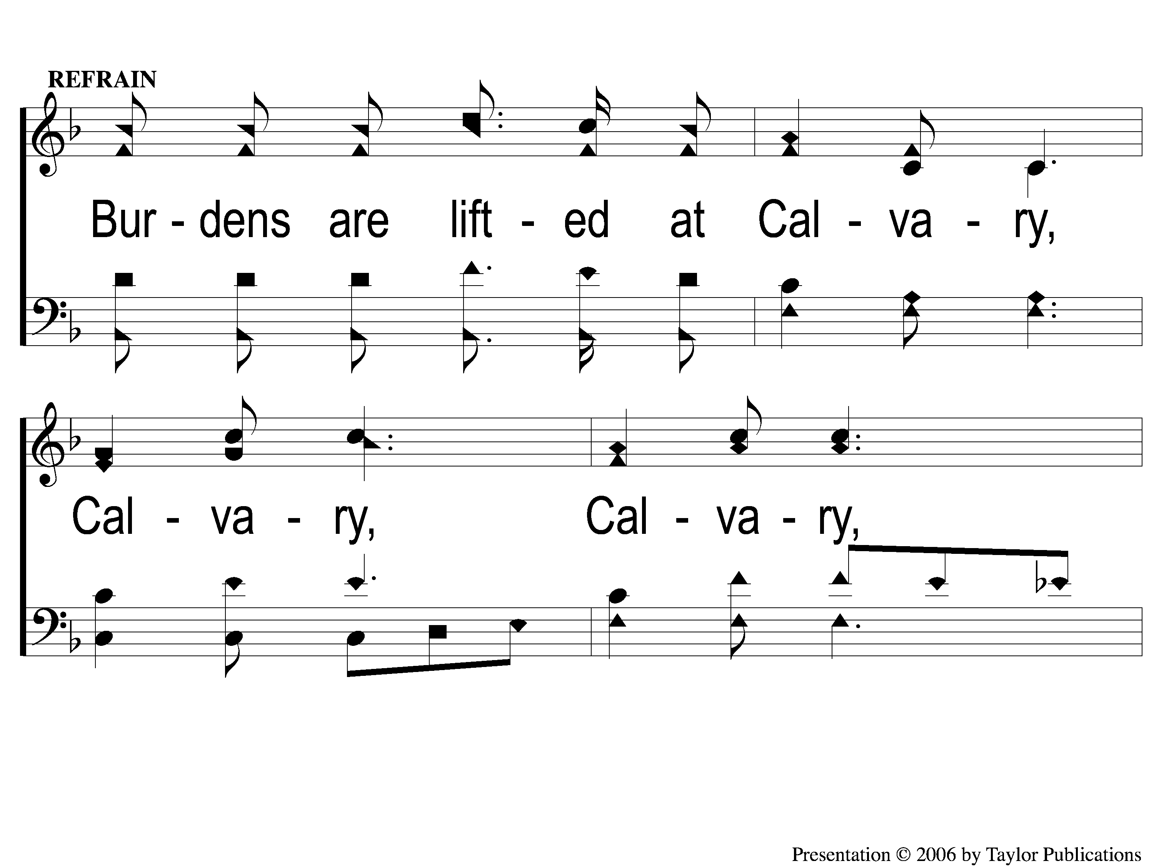
C-1 Burdens Are Lifted At Calvary
Burdens Are Lifted At Calvary
912

Slide 78
C-2 Burdens Are Lifted At Calvary
Burdens Are Lifted At Calvary
912

Slide 79
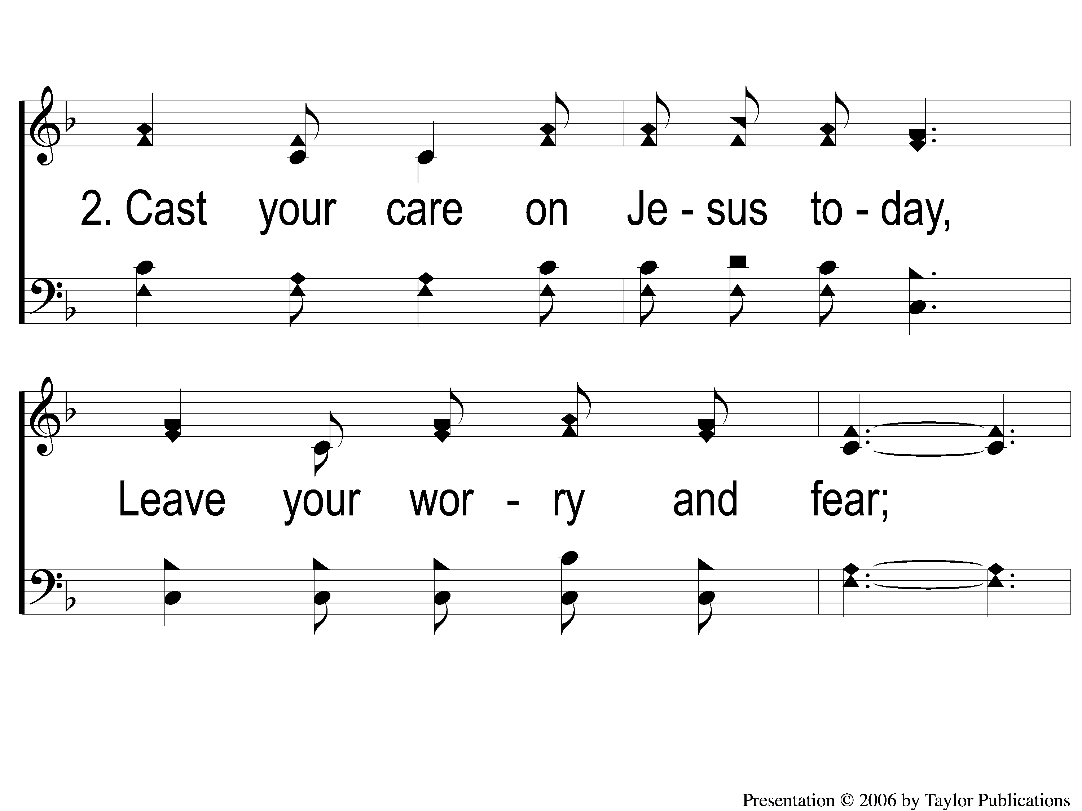
2-1 Burdens Are Lifted At Calvary
Burdens Are Lifted At Calvary
912

Slide 80
2-2 Burdens Are Lifted At Calvary
Burdens Are Lifted At Calvary
912

Slide 81
C-1 Burdens Are Lifted At Calvary
Burdens Are Lifted At Calvary
912

Slide 82
C-2 Burdens Are Lifted At Calvary
Burdens Are Lifted At Calvary
912

Slide 83
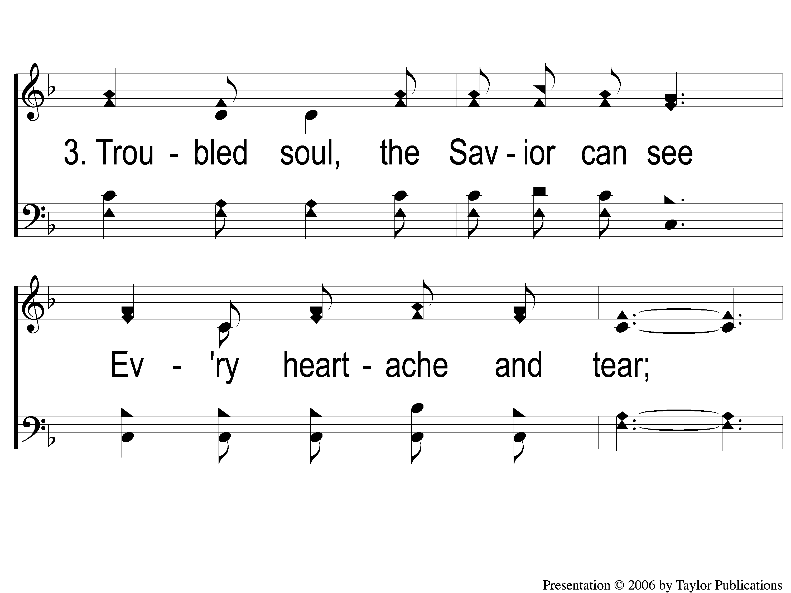
3-1 Burdens Are Lifted At Calvary
Burdens Are Lifted At Calvary
912

Slide 84
3-2 Burdens Are Lifted At Calvary
Burdens Are Lifted At Calvary
912

Slide 85
C-1 Burdens Are Lifted At Calvary
Burdens Are Lifted At Calvary
912

Slide 86
C-2 Burdens Are Lifted At Calvary
Burdens Are Lifted At Calvary
912

Slide 87
The Contribution:
1 John 3:16-17
“By this we know love, because He laid down His life for us. And we also ought to lay down our lives for the brethren. But whoever has this world’s goods, and sees his brother in need, and shuts up his heart from him, how does the love of God abide in him?”

Slide 88
Song:
The Old Rugged Cross
#313

Slide 89
s
The Old Rugged Cross
313

Slide 90
1-2 The Old Rugged Cross
The Old Rugged Cross
313

Slide 91
C-1 The Old Rugged Cross
The Old Rugged Cross
313

Slide 92
C-2 The Old Rugged Cross
The Old Rugged Cross
313

Slide 93
2-1 The Old Rugged Cross
The Old Rugged Cross
313

Slide 94
2-2 The Old Rugged Cross
The Old Rugged Cross
313

Slide 95
C-1 The Old Rugged Cross
The Old Rugged Cross
313

Slide 96
C-2 The Old Rugged Cross
The Old Rugged Cross
313

Slide 97
3-1 The Old Rugged Cross
The Old Rugged Cross
313

Slide 98
3-2 The Old Rugged Cross
The Old Rugged Cross
313

Slide 99
C-1 The Old Rugged Cross
The Old Rugged Cross
313

Slide 100
C-2 The Old Rugged Cross
The Old Rugged Cross
313

Slide 101
4-1 The Old Rugged Cross
The Old Rugged Cross
313

Slide 102
4-2 The Old Rugged Cross
The Old Rugged Cross
313

Slide 103
C-1 The Old Rugged Cross
The Old Rugged Cross
313

Slide 104
C-2 The Old Rugged Cross
The Old Rugged Cross
313

Slide 105
The Unleavened Bread
Isaiah 53:1-3
Who has believed our report? And to whom has the arm of the Lord been revealed? For He shall grow up before Him as a tender plant, And as a root out of dry ground. He has no form or comeliness; And when we see Him, There is no beauty that we should desire Him. He is despised and rejected by men, A Man of sorrows and acquainted with grief. And we hid, as it were, our faces from Him; He was despised, and we did not esteem Him.”

Slide 106
The Fruit
of the Vine
Isaiah 53:4-5
“Surely He has borne our griefs And carried our sorrows; Yet we esteemed Him stricken, Smitten by God, and afflicted. But He was wounded for our transgressions, He was bruised for our iniquities; The chastisement for our peace was upon Him, And by His stripes we are healed.”

Slide 107
Closing Prayer

Slide 108
Song:
The Greatest Commands
#313

Slide 109
1-1 The Greatest Commands-SFP
The Greatest Commands
448

Slide 110
1-2 The Greatest Commands-SFP
The Greatest Commands
448

Slide 111
1-3 The Greatest Commands-SFP
The Greatest Commands
448

Slide 112
1-4 The Greatest Commands-SFP
The Greatest Commands
448

Slide 113
2-1 The Greatest Commands-SFP
The Greatest Commands
448

Slide 114
2-2 The Greatest Commands-SFP
The Greatest Commands
448

Slide 115
2-3 The Greatest Commands-SFP
The Greatest Commands
448

Slide 116
2-4 The Greatest Commands-SFP
The Greatest Commands
448

Slide 117
3-1 The Greatest Commands-SFP
The Greatest Commands
448

Slide 118
3-2 The Greatest Commands-SFP
The Greatest Commands
448

Slide 119
3-3 The Greatest Commands-SFP
The Greatest Commands
448

Slide 120
3-4 The Greatest Commands-SFP
The Greatest Commands
448

Slide 121
4-1 The Greatest Commands-SFP
The Greatest Commands
448

Slide 122
4-2 The Greatest Commands-SFP
The Greatest Commands
448

Slide 123
4-3 The Greatest Commands-SFP
The Greatest Commands
448

Slide 124
4-4 The Greatest Commands-SFP
The Greatest Commands
448

Slide 125
RESTORE REBUILD RENEW
Today
Evening Worship @ 6:00 PM
Wednesday
Worship & Bible Classes @ 6:30 PM
IN 2022
WHEELER
CHURCH
OF
CHRIST

