Slide 1
RESTORE REBUILD RENEW
welcome
we are glad to
Have you with us
IN 2022
WHEELER
CHURCH
OF
CHRIST

Slide 2
Songs of Praise To God

Slide 3
Opening Prayer

Slide 4
Songs of Praise To God

Slide 5
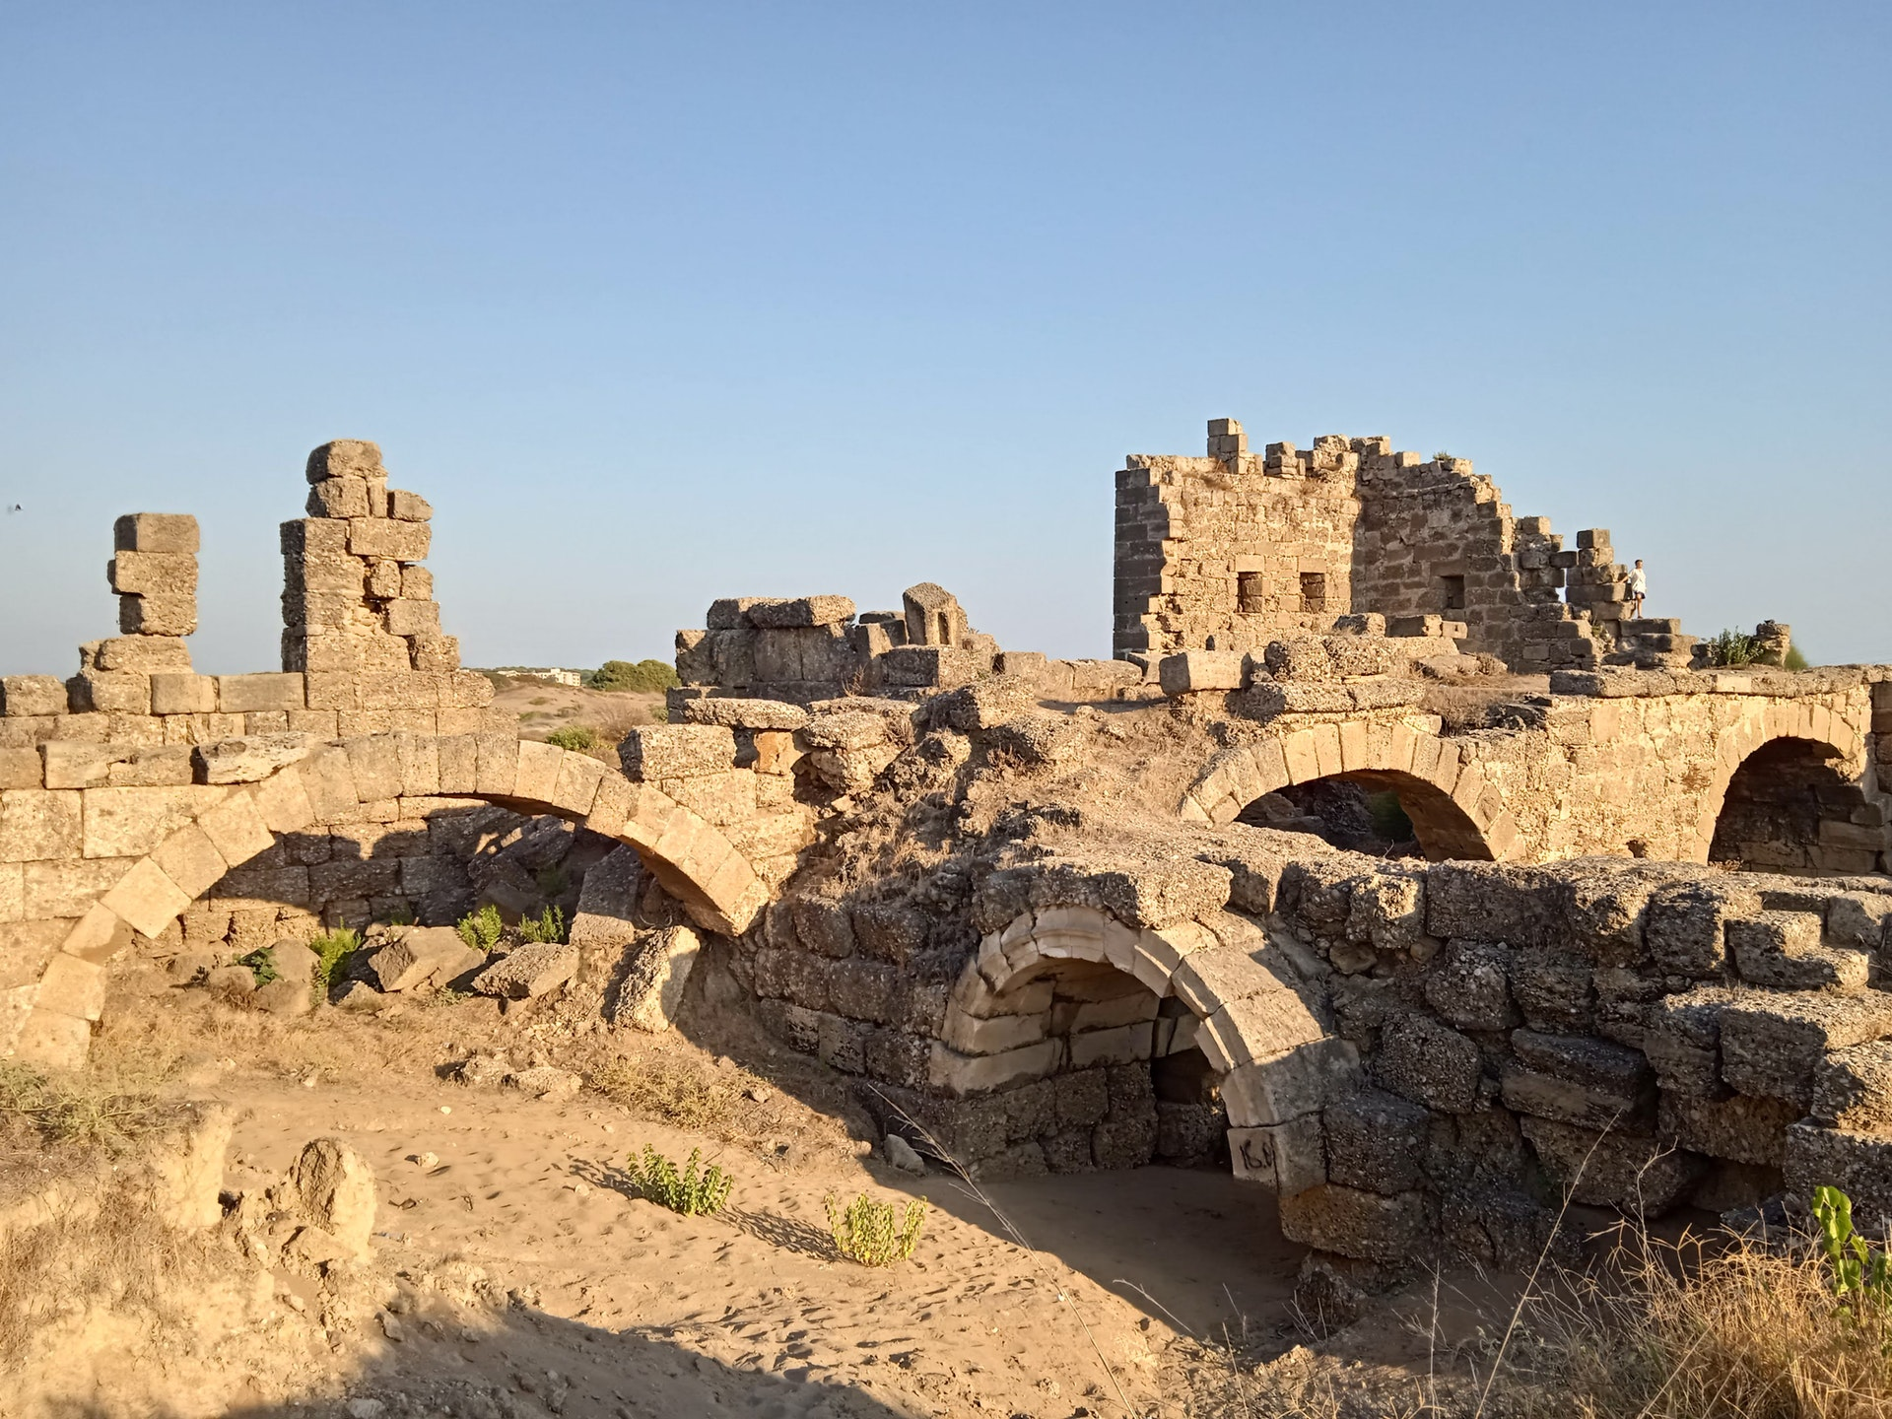
Rebuilding Jerusalem

Slide 6
ENCOURAGEMENT
More

Slide 7
EMOTION
More

Slide 8
EMOTION
More
Like Nehemiah

Slide 9
4 Emotions From Nehemiah

Slide 10
4 Emotions From Nehemiah
Sorrow
Neh. 1:1-4, 6-7
2 Cor. 7:10

Slide 11
4 Emotions From Nehemiah
Compassion
Neh. 1:3-4, 5:14-18
Matt. 9:36, 14:14, 15:32, 20:34

Slide 12
4 Emotions From Nehemiah
Anger
Neh. 5:6-7

Slide 13
4 Emotions From Nehemiah
Anger
Neh. 5:6-7
Anger Over Sin – Psa. 119:53

Slide 14
4 Emotions From Nehemiah
Anger
Neh. 5:6-7
Anger Over Sin – Psa. 119:53
Anger Under Control – Jms. 1:19-20

Slide 15
4 Emotions From Nehemiah
Anger
Neh. 5:6-7
Anger Over Sin – Psa. 119:53
Anger Under Control – Jms. 1:19-20
Anger Channeled Correctly

Slide 16
4 Emotions From Nehemiah
Joy
Neh. 12:27, 43
Jms. 5:13
Psa 66:1, 81:1, 95:2
Lk. 8:13

Slide 17
Songs of Praise To God

Slide 18
The Lord’s Supper
Acts 20:7

Slide 19
Closing Prayer

Slide 20
Songs of Praise To God

Slide 21
RESTORE REBUILD RENEW
Wednesday
Family meal @ 5:30 PM
Worship @ 6:30 PM
IN 2022
WHEELER
CHURCH
OF
CHRIST

