Slide 1
PLEASE
STANDBY
Our Livestream Will Begin Soon

Slide 2
1-1 We Will Glorify
We Will Glorify
578

Slide 3
1-2 We Will Glorify
We Will Glorify
578

Slide 4
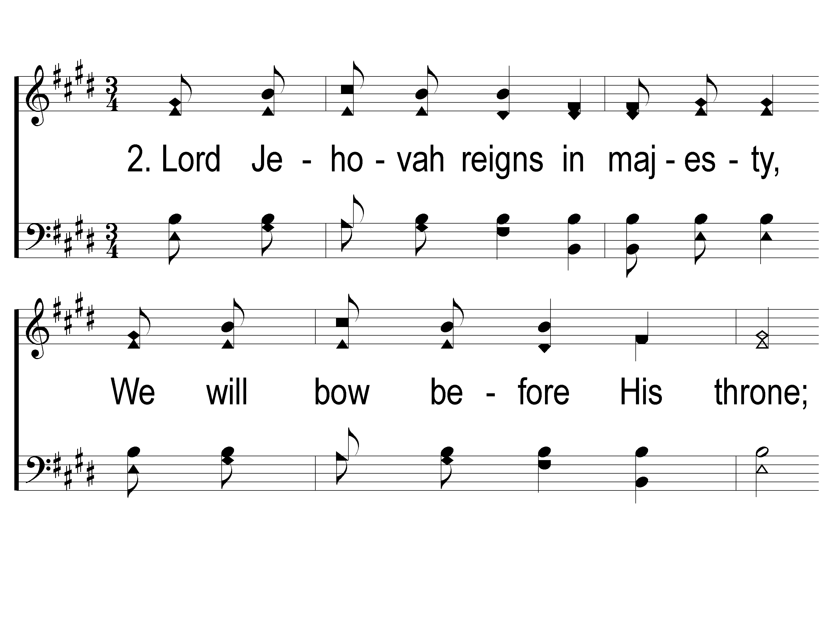
2-1 We Will Glorify
We Will Glorify
578

Slide 5
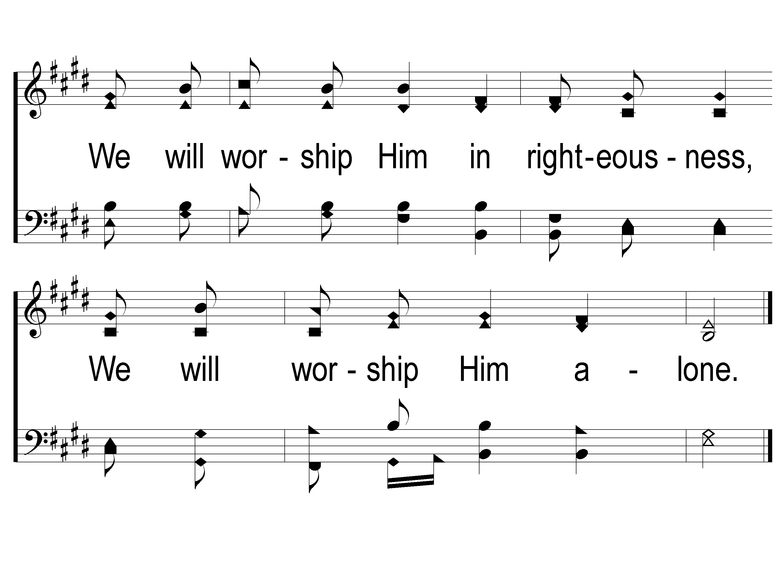
2-2 We Will Glorify
We Will Glorify
578

Slide 6
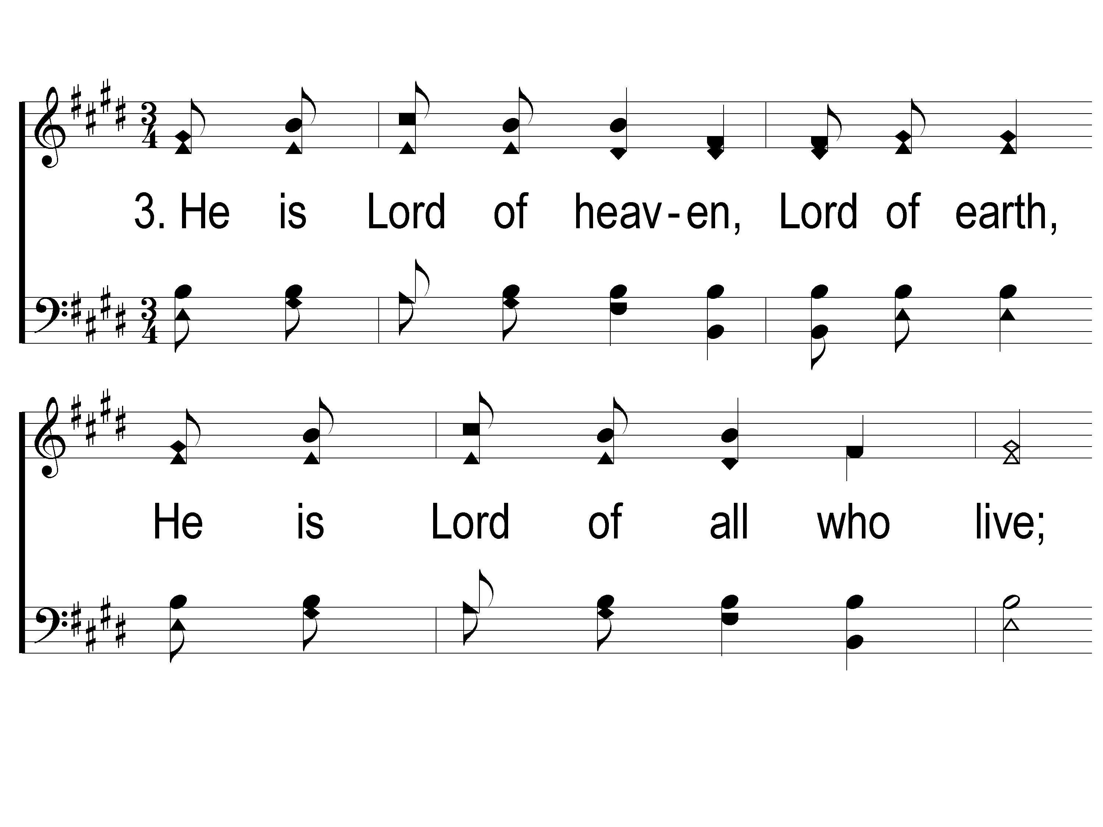
3-1 We Will Glorify
We Will Glorify
578

Slide 7
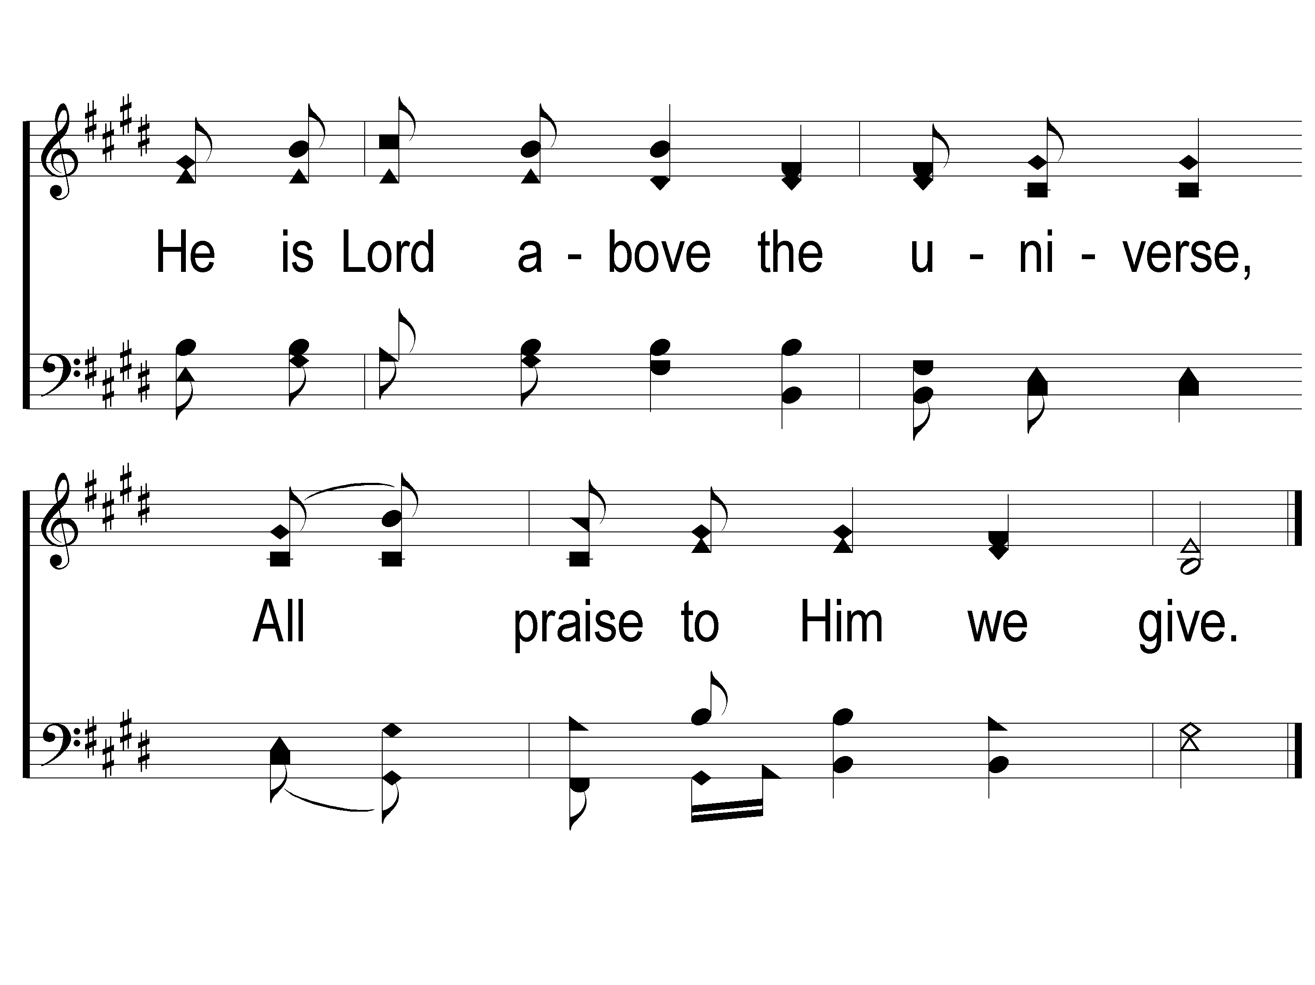
3-2 We Will Glorify
We Will Glorify
578

Slide 8
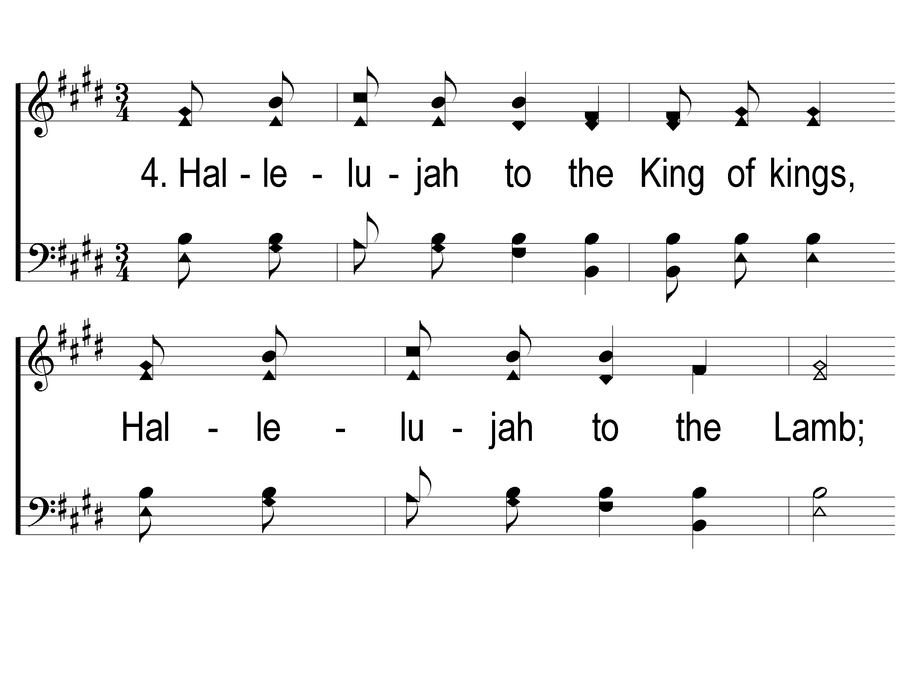
4-1 We Will Glorify
We Will Glorify
578

Slide 9
4-2 We Will Glorify
We Will Glorify
578

Slide 10
WELCOME
THANKS FOR JOINING US!

Slide 11
SONG #458
REDEEMED

Slide 12
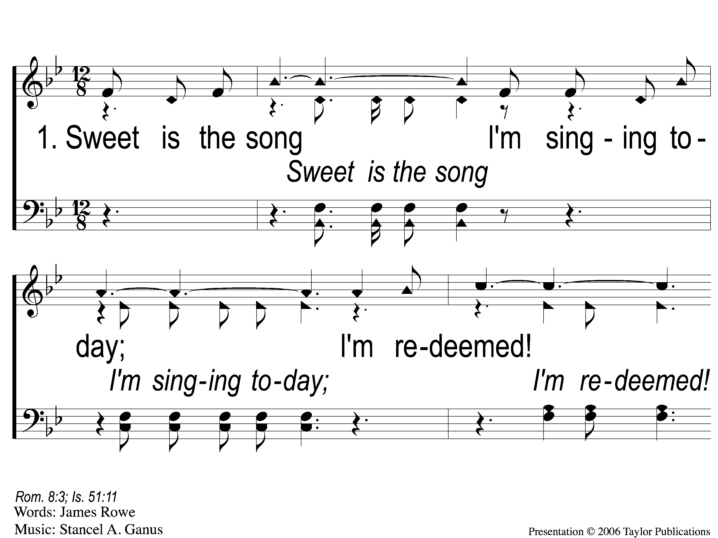
1-1 Redeemed - Sweet is the Song
Redeemed
458

Slide 13
1-2 Redeemed - Sweet is the Song
Redeemed
458

Slide 14
1-3 Redeemed - Sweet is the Song
Redeemed
458

Slide 15
C-1 Redeemed - Sweet is the Song
Redeemed
458

Slide 16
C-2 Redeemed - Sweet is the Song
Redeemed
458

Slide 17
2-1 Redeemed - Sweet is the Song

Slide 18
2-2 Redeemed - Sweet is the Song
Redeemed
458

Slide 19
2-3 Redeemed - Sweet is the Song
Redeemed
458

Slide 20
C-1 Redeemed - Sweet is the Song
Redeemed
458

Slide 21
C-2 Redeemed - Sweet is the Song
Redeemed
458

Slide 22
3-1 Redeemed - Sweet is the Song
Redeemed
458

Slide 23
3-2 Redeemed - Sweet is the Song
Redeemed
458

Slide 24
3-3 Redeemed - Sweet is the Song
Redeemed
458

Slide 25
C-1 Redeemed - Sweet is the Song
Redeemed
458

Slide 26
C-2 Redeemed - Sweet is the Song
Redeemed
458

Slide 27
SONG #308
WONDERFUL LOVE OF JESUS

Slide 28
1-1 Wonderful Love of Jesus
Wonderful Love of Jesus
308

Slide 29
1-2 Wonderful Love of Jesus
Wonderful Love of Jesus
308

Slide 30
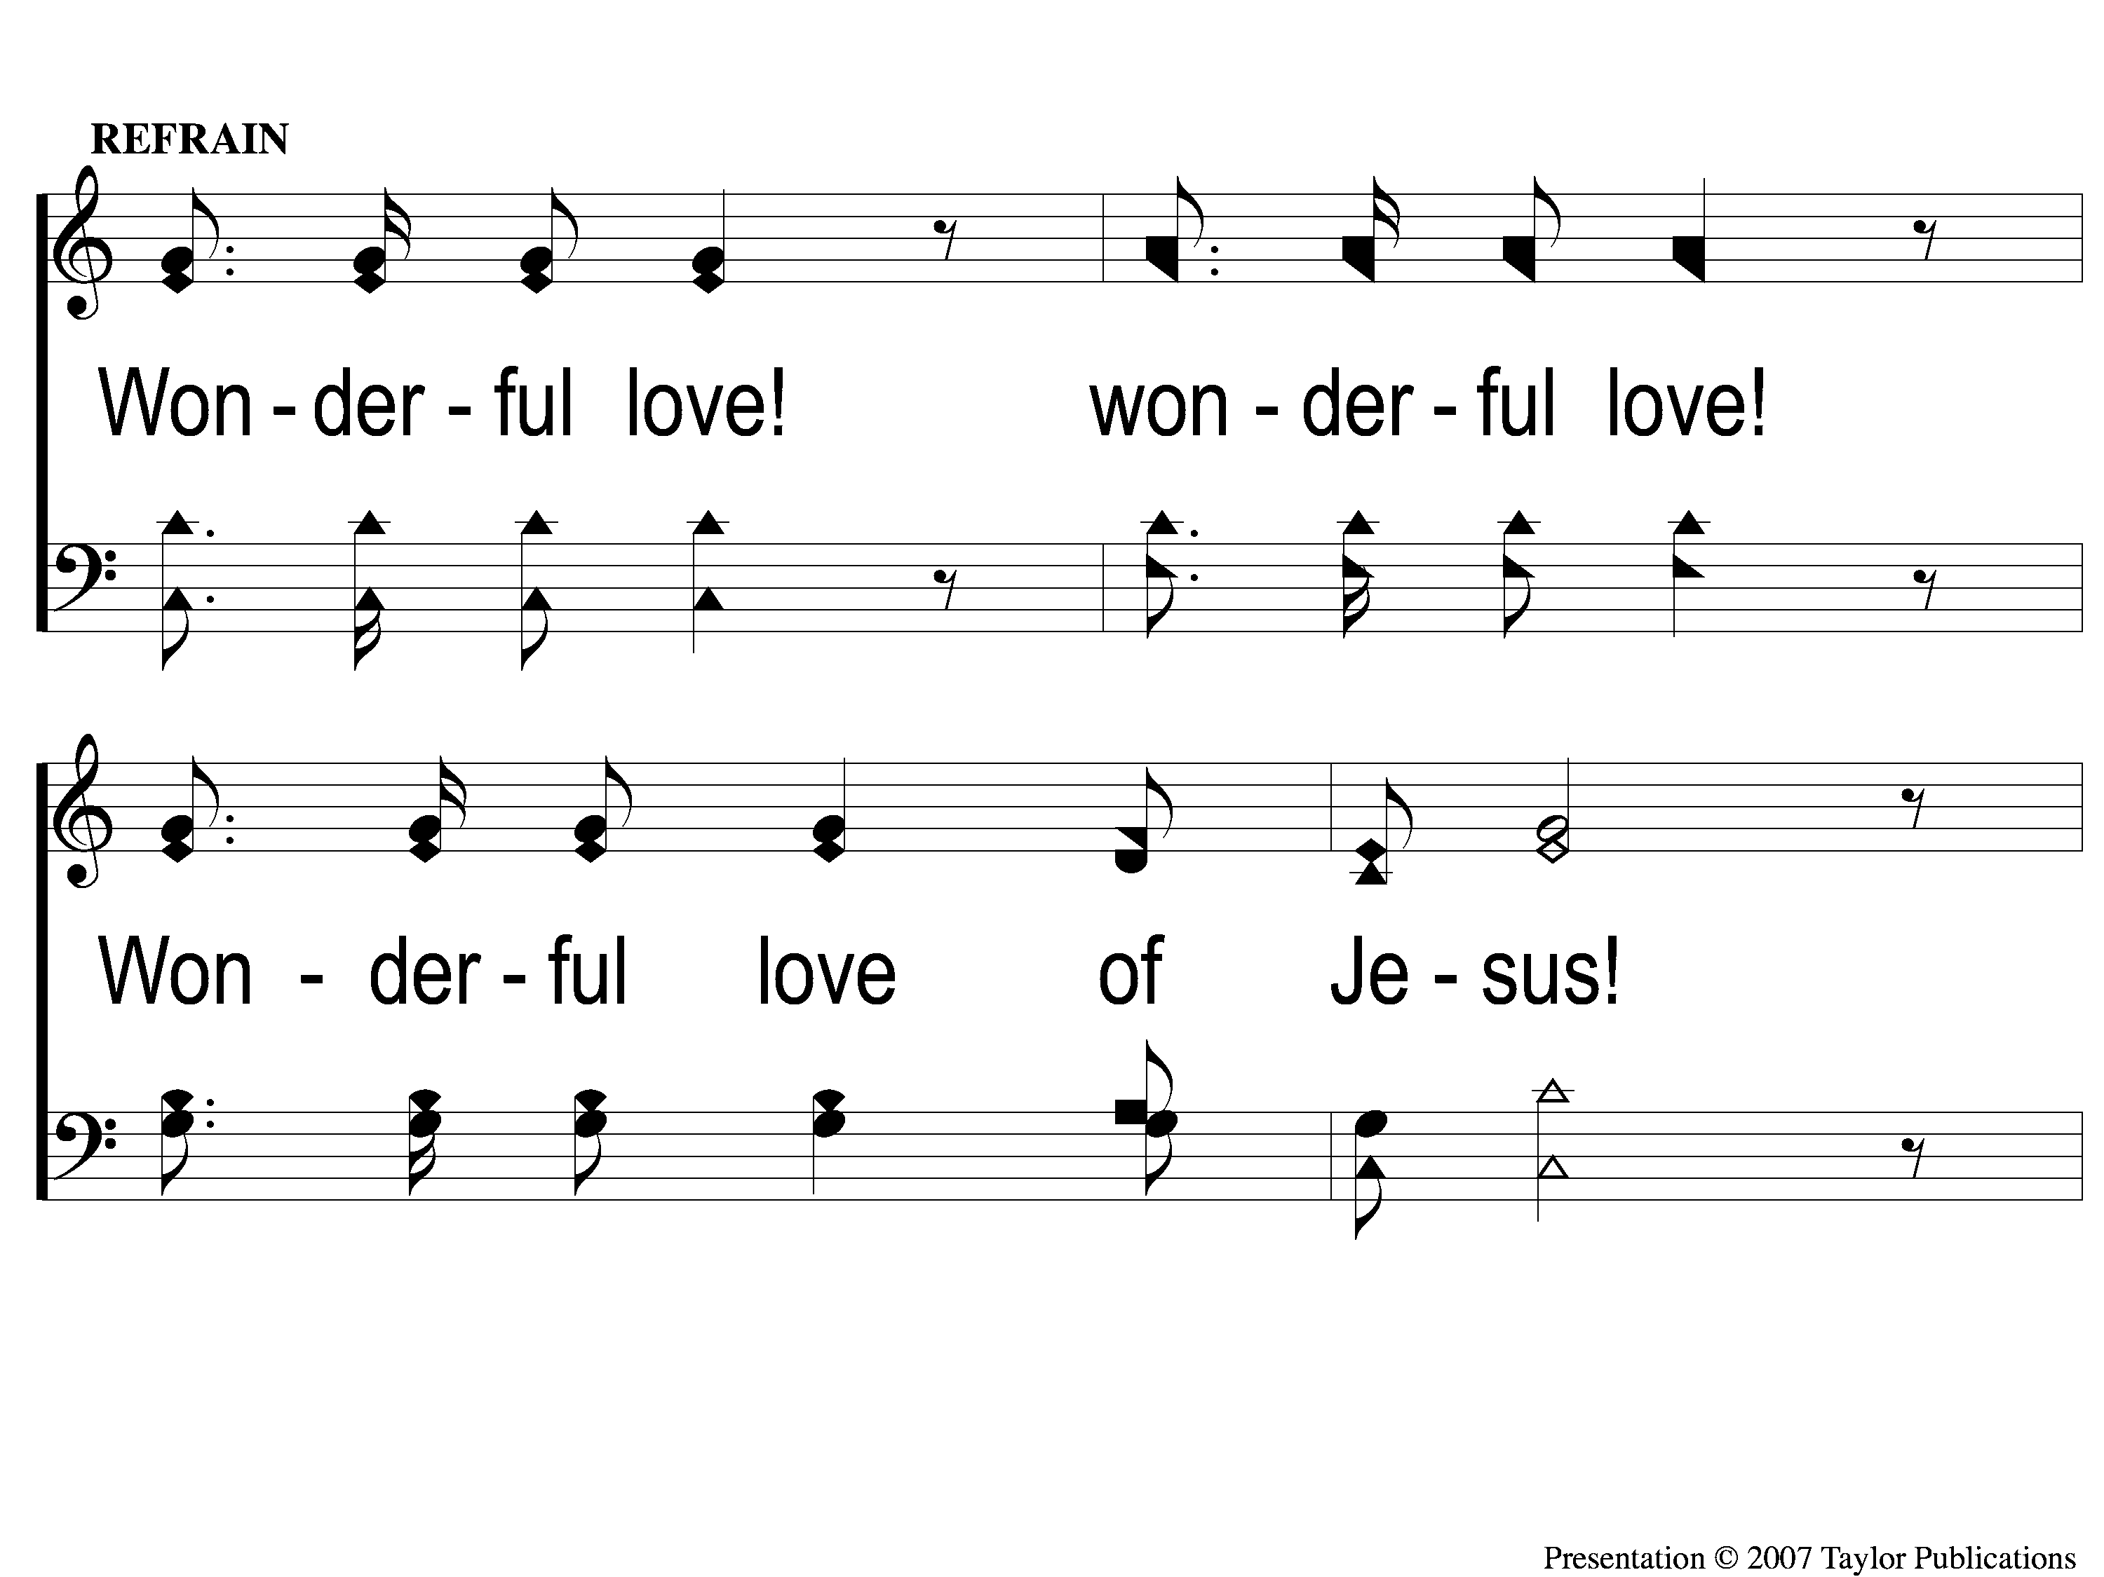
C-1 Wonderful Love of Jesus
Wonderful Love of Jesus
308

Slide 31
C-2 Wonderful Love of Jesus
Wonderful Love of Jesus
308

Slide 32
2-1 Wonderful Love of Jesus
Wonderful Love of Jesus
308

Slide 33
2-2 Wonderful Love of Jesus
Wonderful Love of Jesus
308

Slide 34
C-1 Wonderful Love of Jesus
Wonderful Love of Jesus
308

Slide 35
C-2 Wonderful Love of Jesus
Wonderful Love of Jesus
308

Slide 36
3-1 Wonderful Love of Jesus
Wonderful Love of Jesus
308

Slide 37
3-2 Wonderful Love of Jesus
Wonderful Love of Jesus
308

Slide 38
C-1 Wonderful Love of Jesus
Wonderful Love of Jesus
308

Slide 39
C-2 Wonderful Love of Jesus
Wonderful Love of Jesus
308

Slide 40
OPENING
PRAYER

Slide 41
SONG #679
‘TIS SO SWEET TO
TRUST IN JESUS

Slide 42
1-1 ‘Tis so Sweet To Trust in Jesus
‘Tis So Sweet To Trust In Jesus
679

Slide 43
1-2 ‘Tis so Sweet To Trust in Jesus
‘Tis So Sweet To Trust In Jesus
679

Slide 44
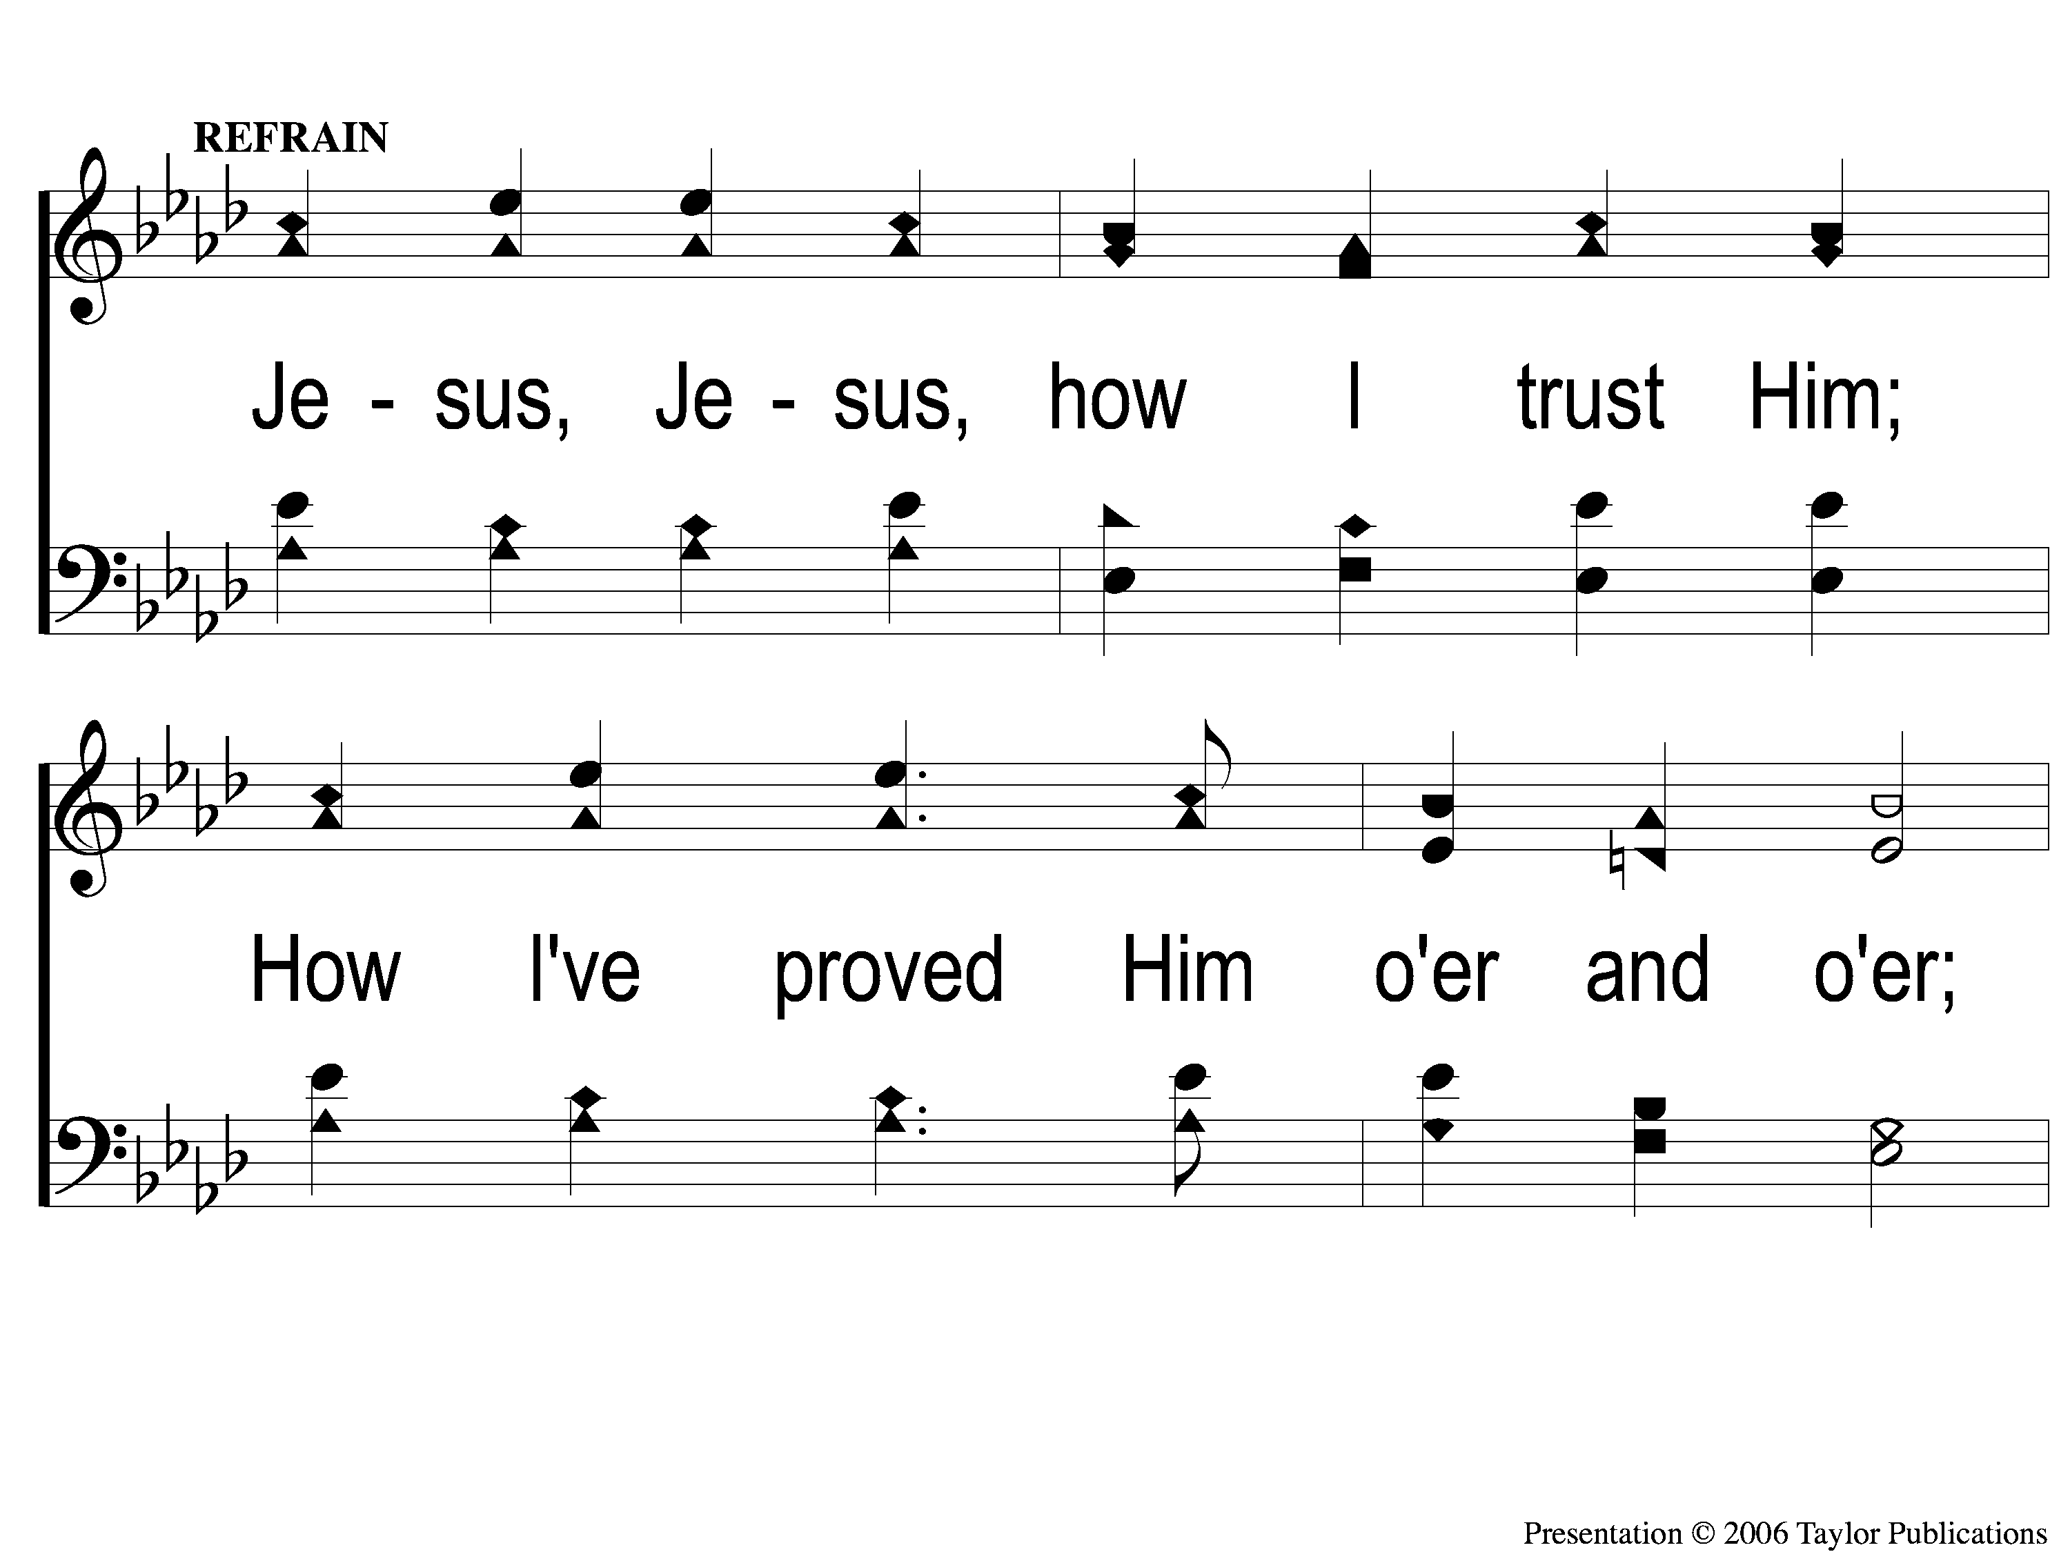
C-1 ‘Tis so Sweet To Trust in Jesus
‘Tis So Sweet To Trust In Jesus
679

Slide 45
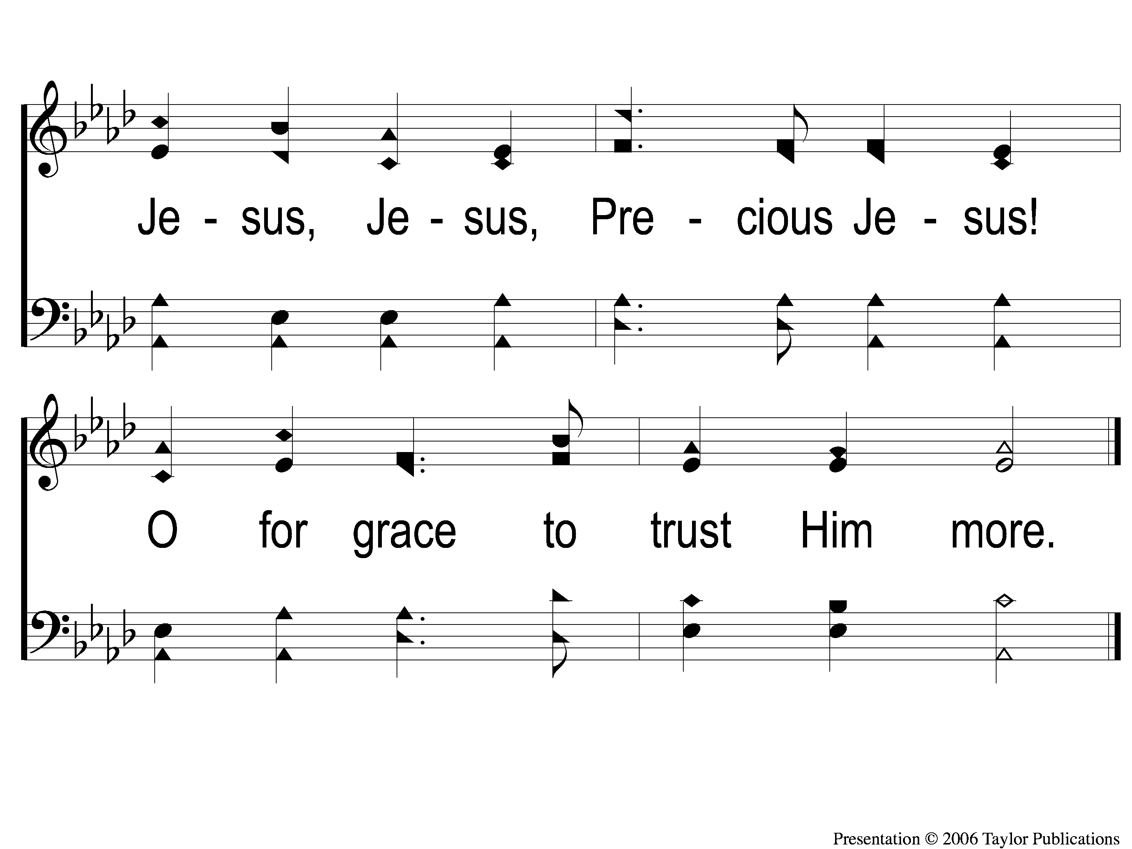
C-2 ‘Tis so Sweet To Trust in Jesus
‘Tis So Sweet To Trust In Jesus
679

Slide 46
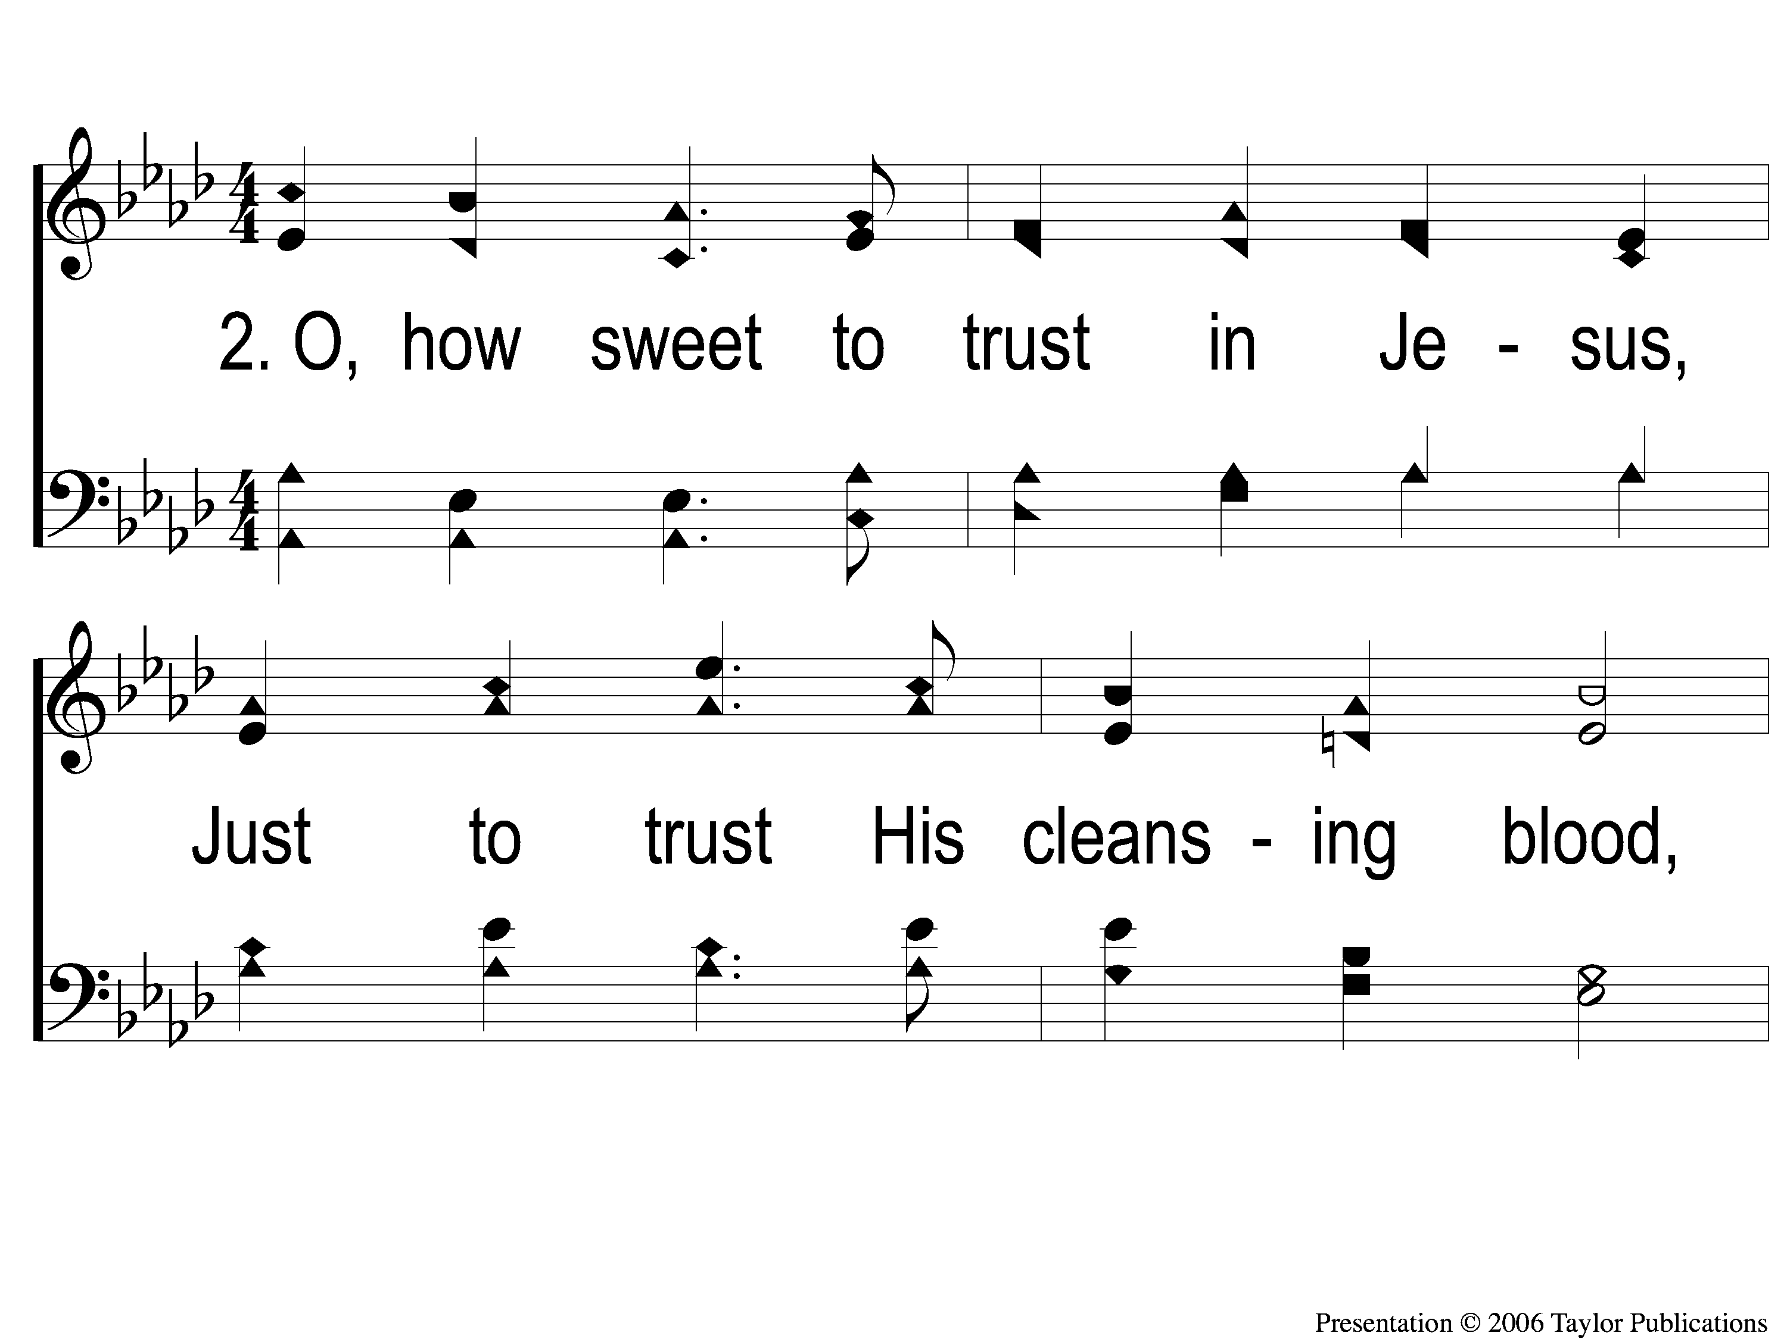
2-1 ‘Tis so Sweet To Trust in Jesus
‘Tis So Sweet To Trust In Jesus
679

Slide 47
2-2 ‘Tis so Sweet To Trust in Jesus
‘Tis So Sweet To Trust In Jesus
679

Slide 48
C-1 ‘Tis so Sweet To Trust in Jesus
‘Tis So Sweet To Trust In Jesus
679

Slide 49
C-2 ‘Tis so Sweet To Trust in Jesus
‘Tis So Sweet To Trust In Jesus
679

Slide 50
4-1 ‘Tis so Sweet To Trust in Jesus
‘Tis So Sweet To Trust In Jesus
679

Slide 51
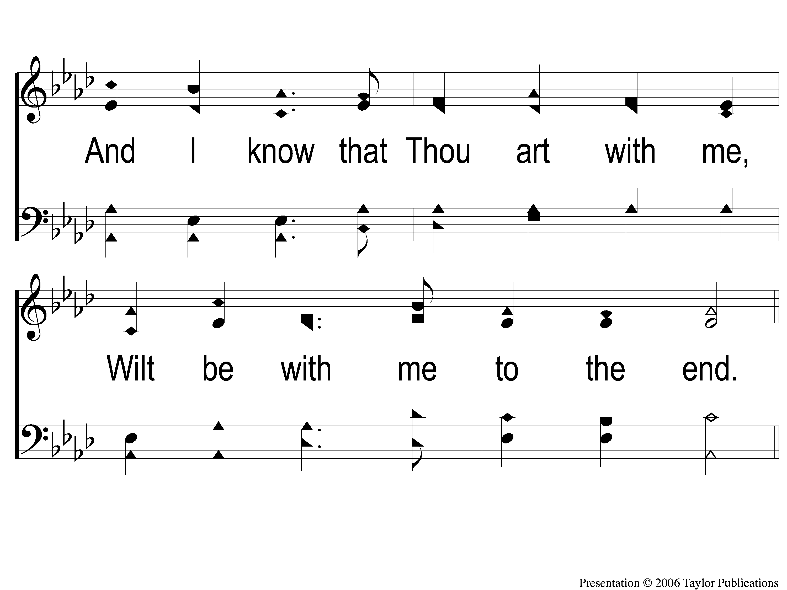
4-2 ‘Tis so Sweet To Trust in Jesus
‘Tis So Sweet To Trust In Jesus
679

Slide 52
C-1 ‘Tis so Sweet To Trust in Jesus
‘Tis So Sweet To Trust In Jesus
679

Slide 53
C-2 ‘Tis so Sweet To Trust in Jesus
‘Tis So Sweet To Trust In Jesus
679

Slide 54
SONG #291
THE GREAT PHYSICIAN

Slide 55
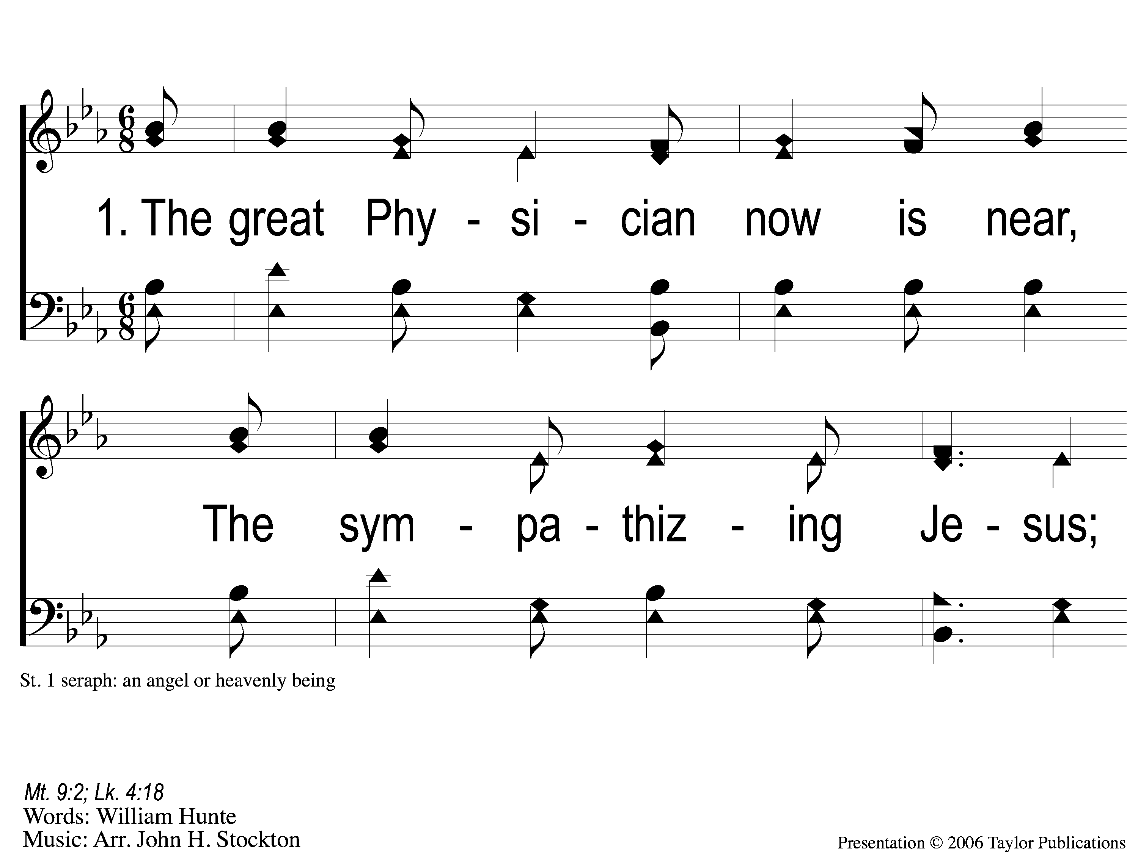
1-1 The Great Physician
The Great Physician
291

Slide 56
1-2 The Great Physician
The Great Physician
291

Slide 57
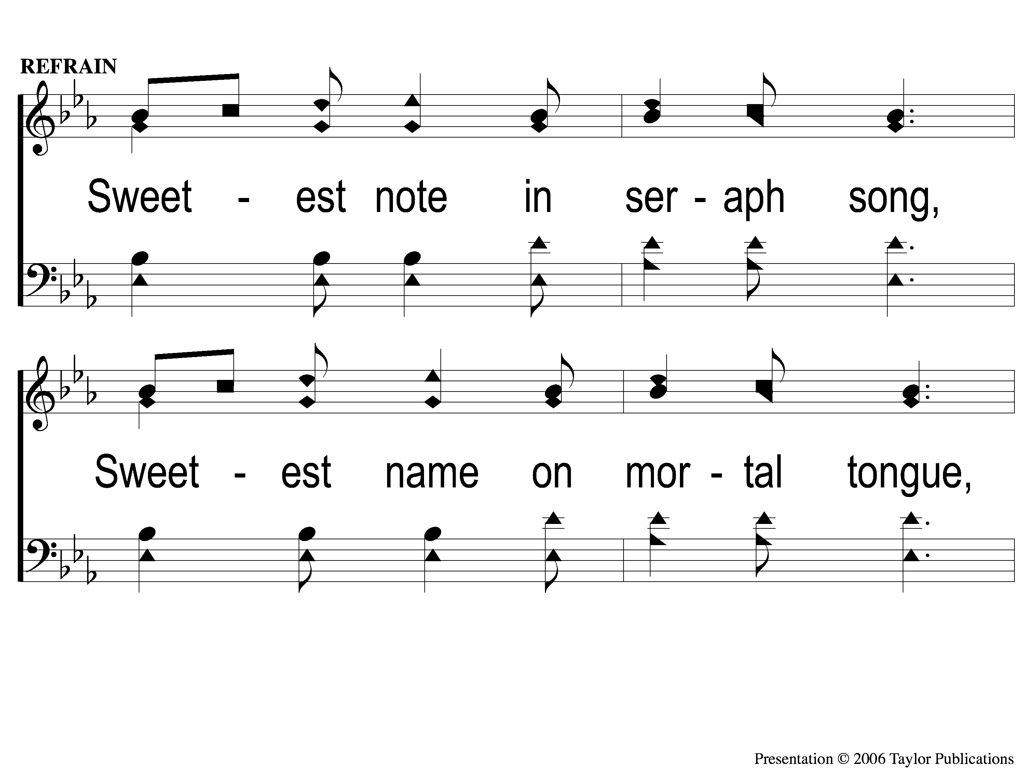
C-1 The Great Physician
The Great Physician
291

Slide 58
C-2 The Great Physician
The Great Physician
291

Slide 59
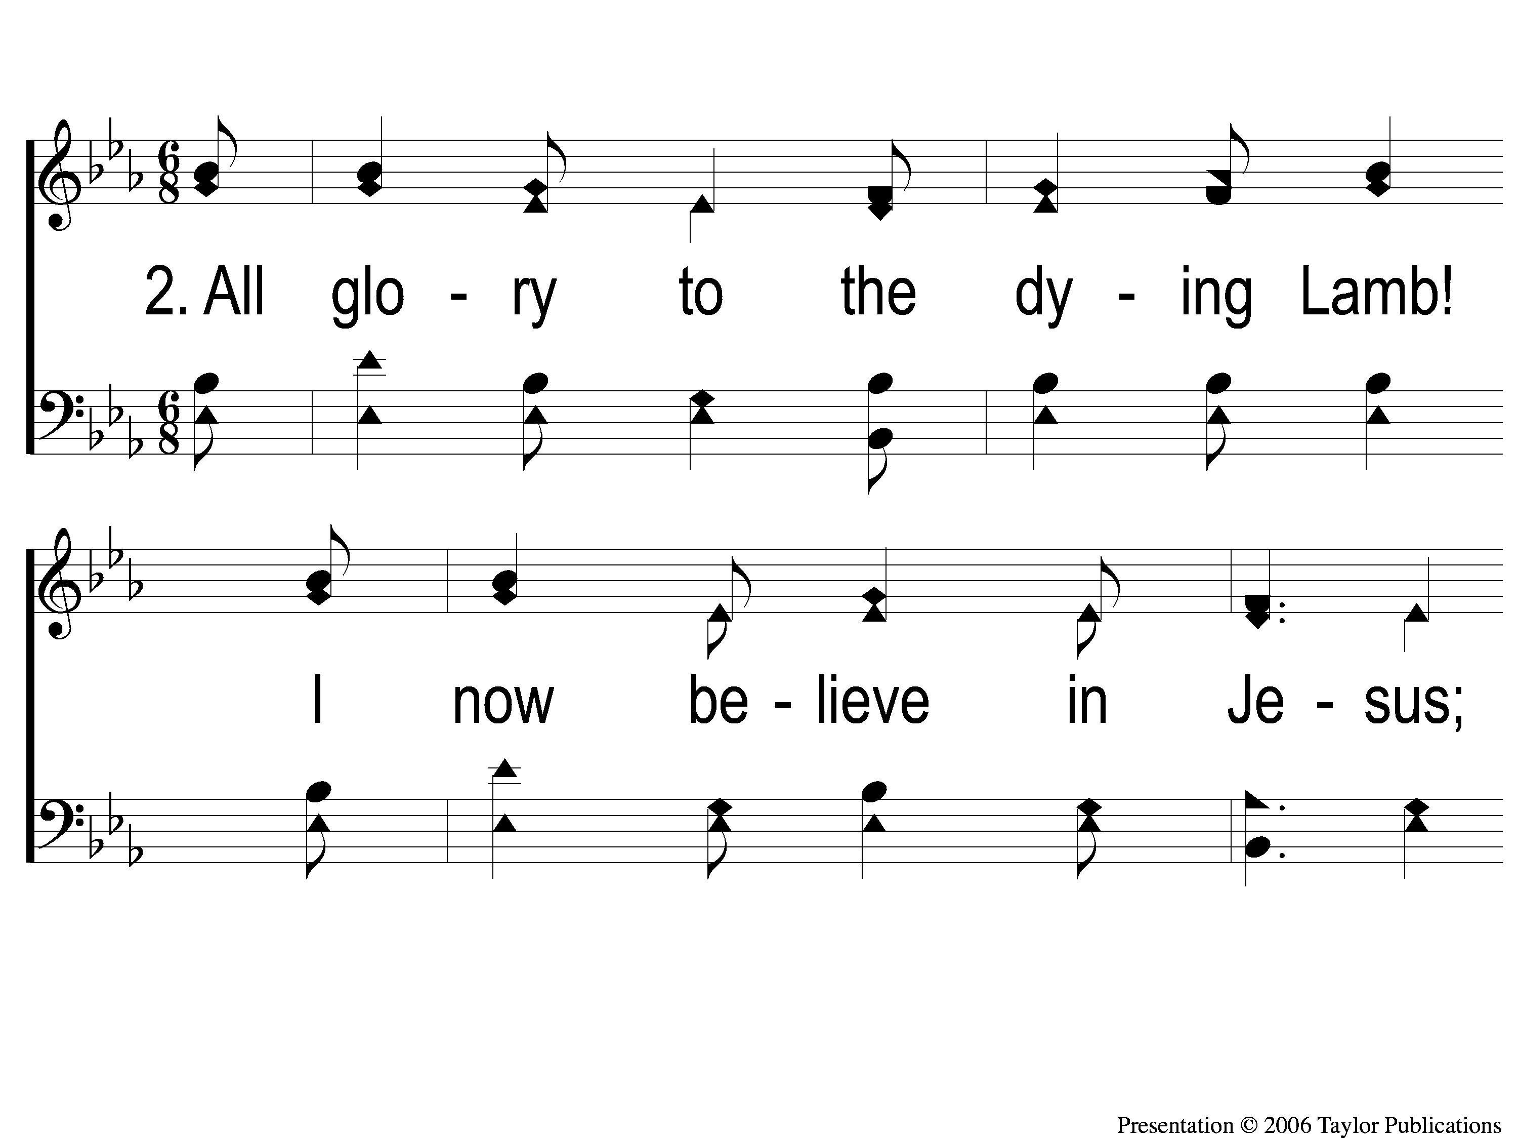
2-1 The Great Physician
The Great Physician
291

Slide 60
2-2 The Great Physician
The Great Physician
291

Slide 61
C-1 The Great Physician
The Great Physician
291

Slide 62
C-2 The Great Physician
The Great Physician
291

Slide 63
4-1 The Great Physician
The Great Physician
291

Slide 64
4-2 The Great Physician
The Great Physician
291

Slide 65
C-1 The Great Physician
The Great Physician
291

Slide 66
C-2 The Great Physician
The Great Physician
291

Slide 67
SCRIPTURE READING:
2 Peter 3:1-7

Slide 68
STANDING ON THE PROMISES

Slide 69
PM Sermon:
THE PROMISE OF GRACE

Slide 70
THE PROMISE OF JESUS’ RETURN

Slide 71
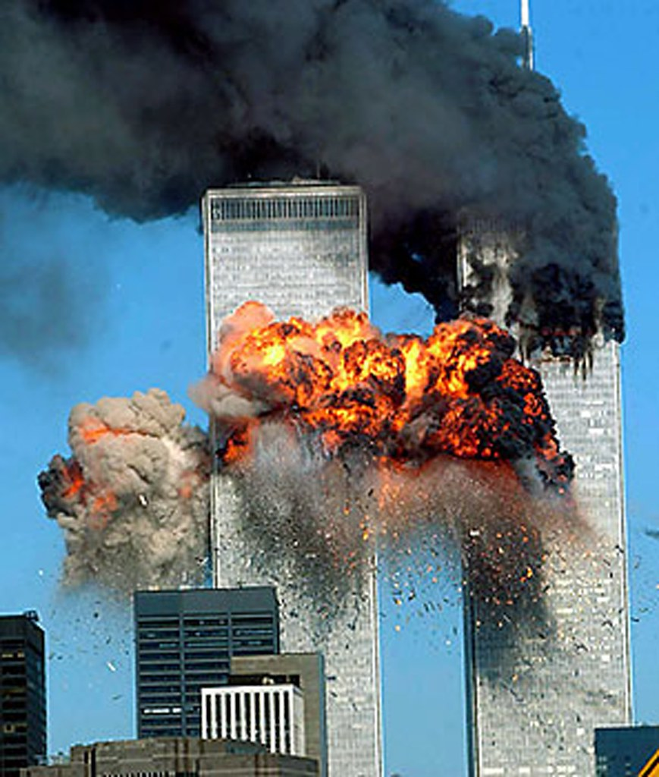

Slide 72
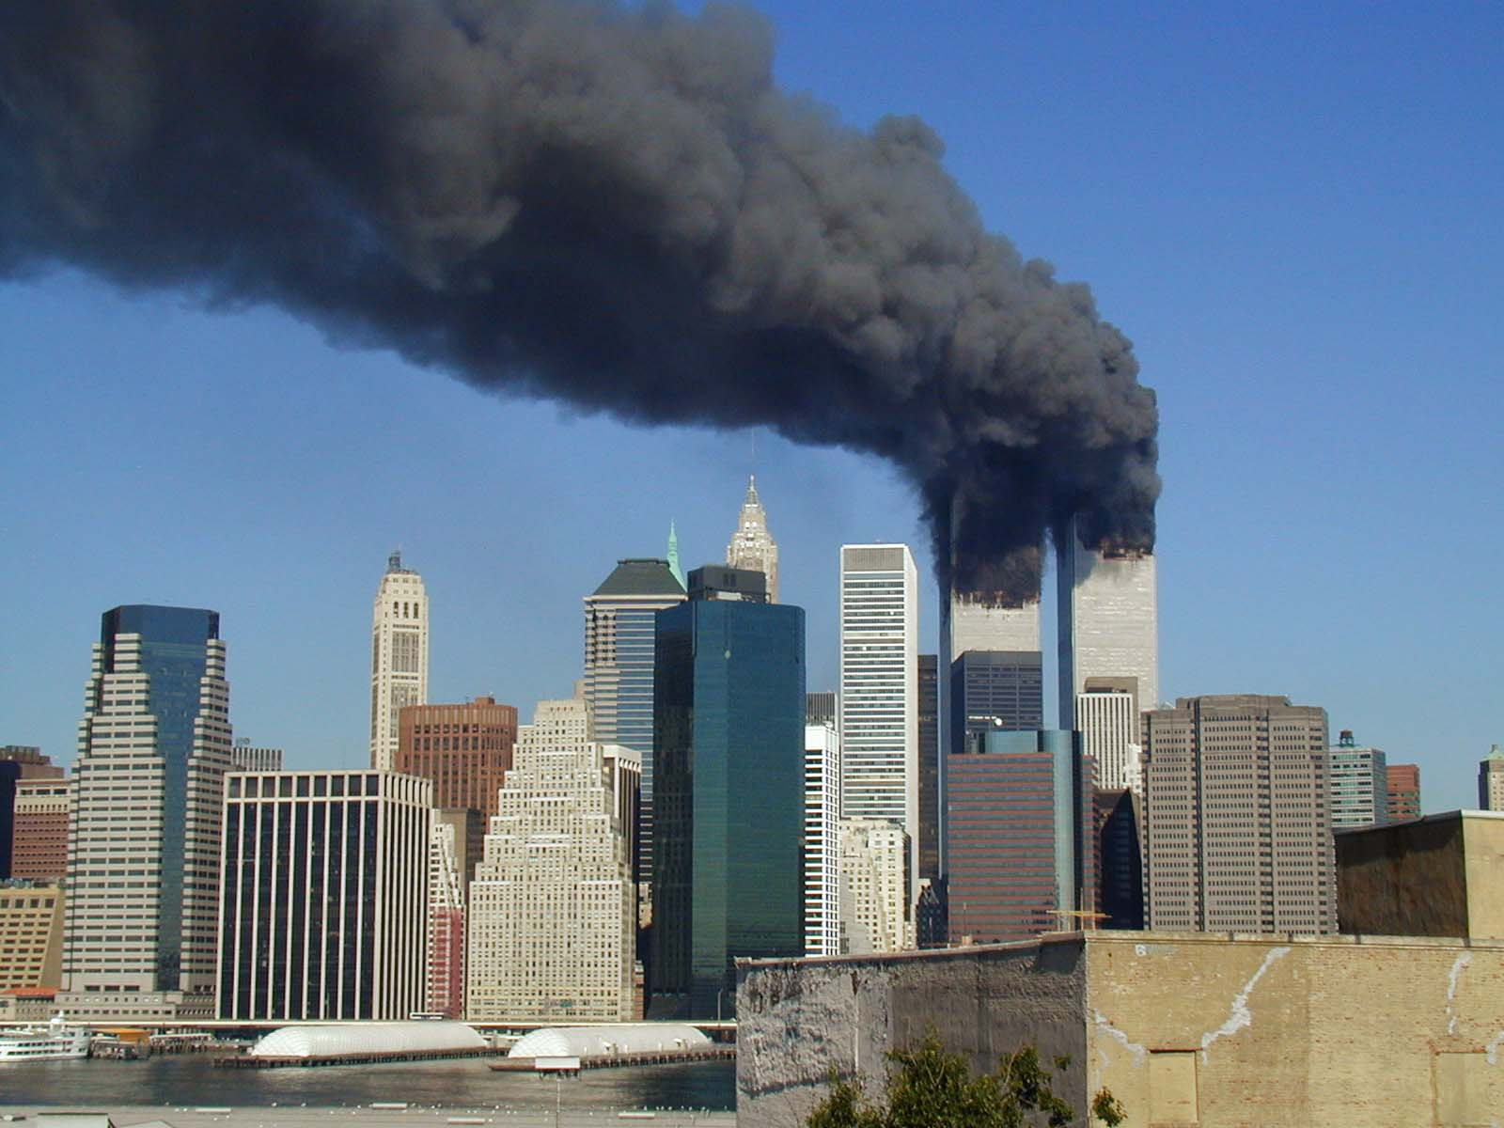

Slide 73
THE PROMISE

Slide 74
THE PROMISE
Given By Jesus:
Matt. 24:36-39, 42-44

Slide 75
THE PROMISE
Given By Jesus:
Matt. 24:36-39, 42-44
25:1-13, 37-46

Slide 76
THE PROMISE
Given By The Apostles:

Slide 77
THE PROMISE
Given By The Apostles:
Acts 24:25
1 Thess. 5:2
Heb. 9:27
2 Pet. 3:1-5

Slide 78
THE CONDITION

Slide 79
THE CONDITION
An Unconditional Promise

Slide 80
THE CONDITION
An Unconditional Promise
“He WILL appear a second time”
Heb. 9:28

Slide 81
ARE YOU READY?

Slide 82
INVITATION SONG:
THERE’S A GREAT DAY COMING

Slide 83
1-1 There’s A Great Day Coming
There’s A Great Day Coming

Slide 84
1-2 There’s A Great Day Coming
There’s A Great Day Coming

Slide 85
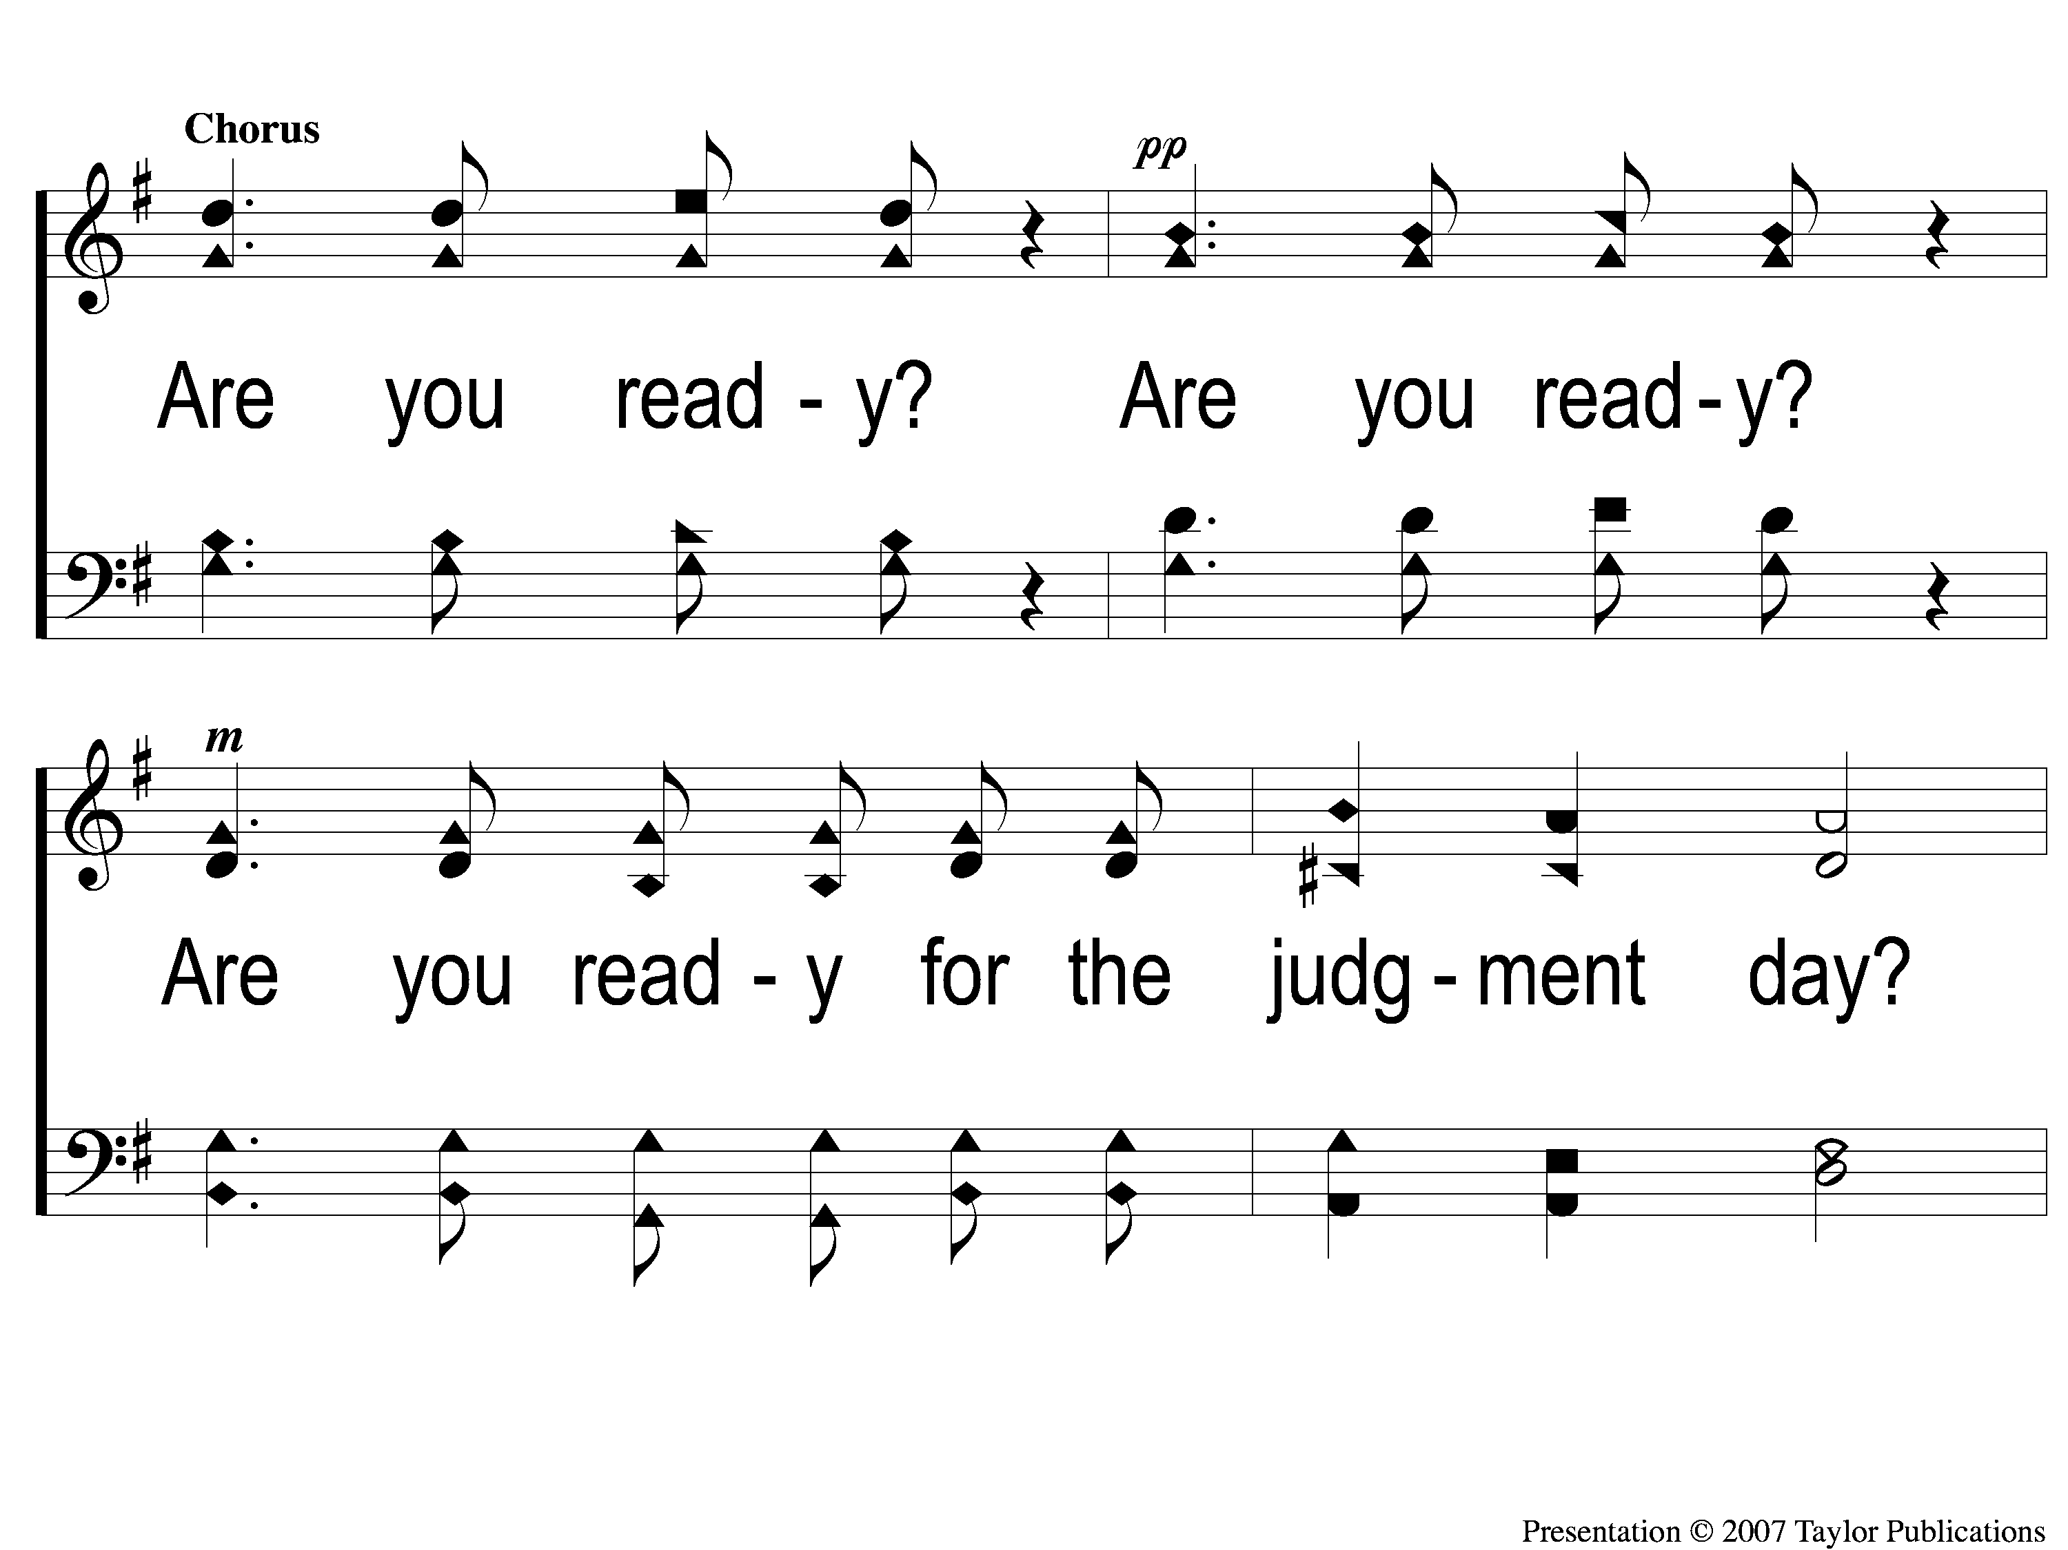
C-1 There’s A Great Day Coming
There’s A Great Day Coming

Slide 86
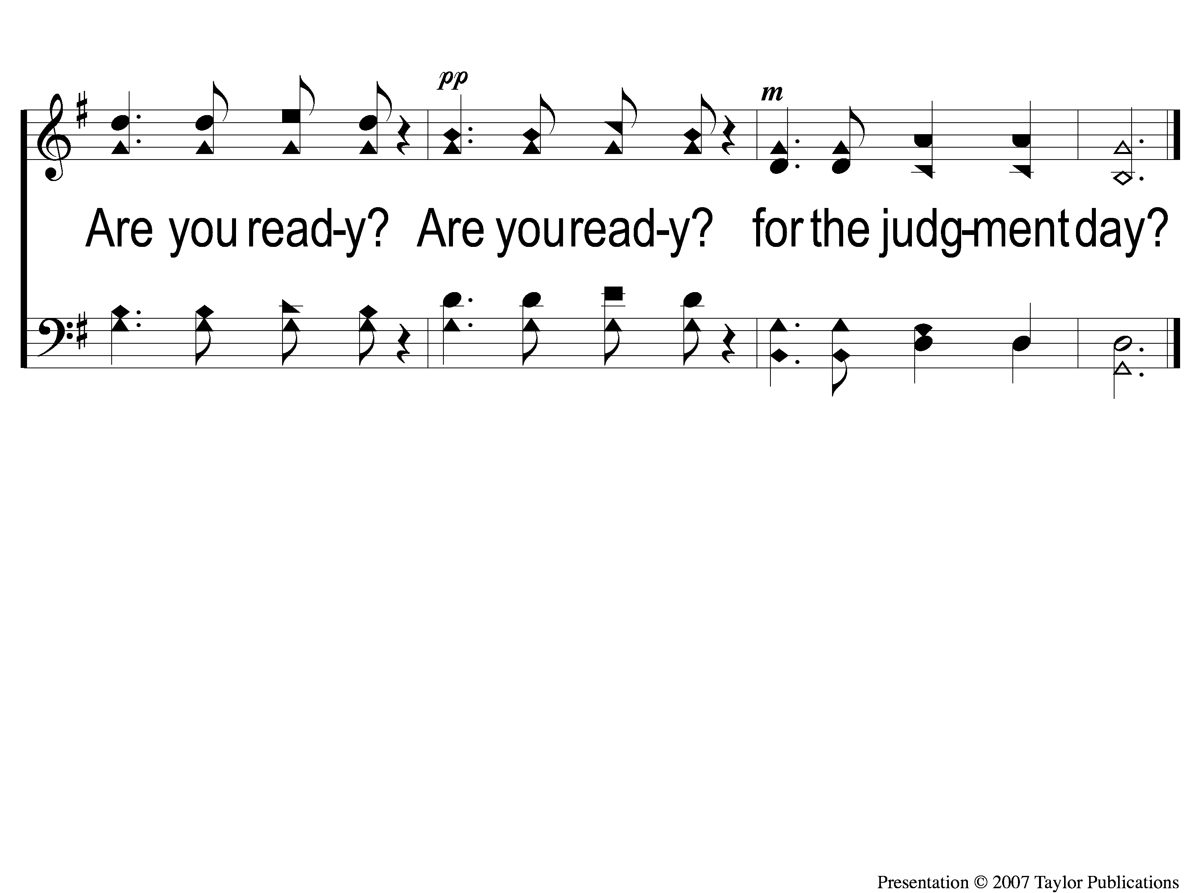
C-2 There’s A Great Day Coming
There’s A Great Day Coming

Slide 87
3-1 There’s A Great Day Coming
There’s A Great Day Coming

Slide 88
3-2 There’s A Great Day Coming
There’s A Great Day Coming

Slide 89
C-1 There’s A Great Day Coming
There’s A Great Day Coming

Slide 90
C-2 There’s A Great Day Coming
There’s A Great Day Coming

Slide 91
SONG #509
I WILL SING
THE WONDROUS STORY

Slide 92
1-1 I Will Sing the Wondrous Story
I Will Sing the Wondrous Story
509

Slide 93
1-2 I Will Sing the Wondrous Story
I Will Sing the Wondrous Story
509

Slide 94
C-1 I Will Sing the Wondrous Story
I Will Sing the Wondrous Story
509

Slide 95
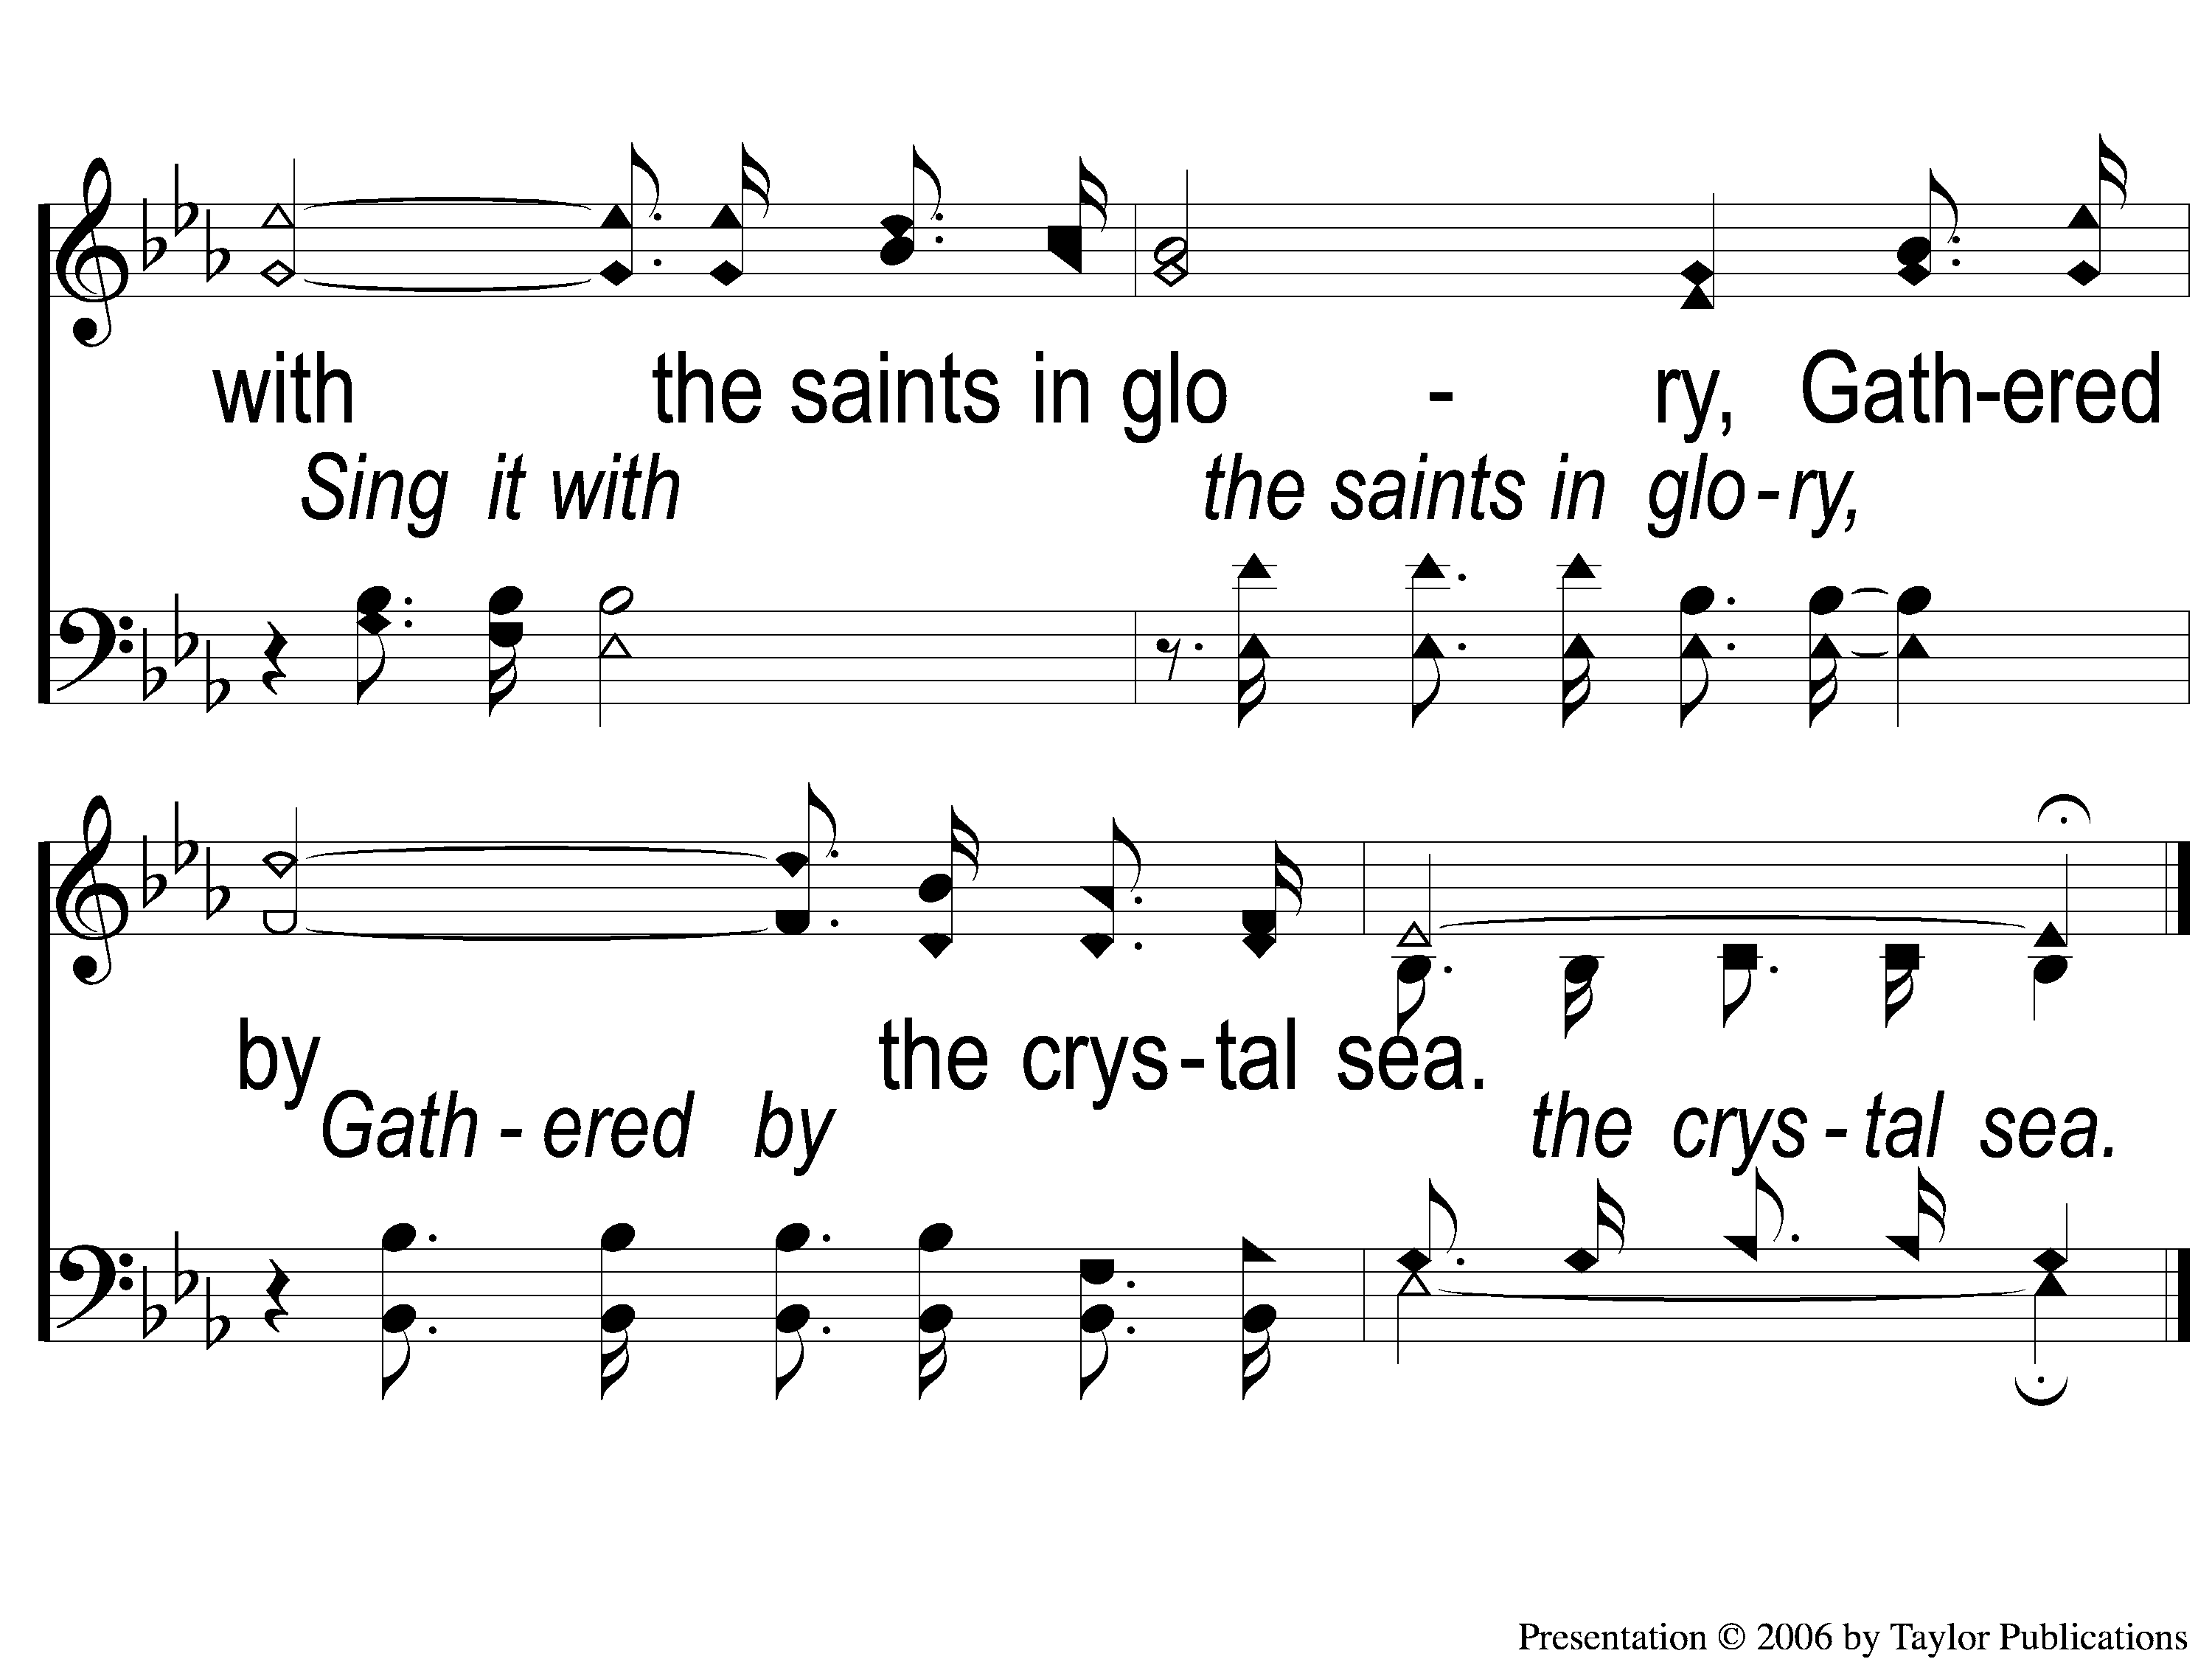
C-2 I Will Sing the Wondrous Story
I Will Sing the Wondrous Story
509

Slide 96
2-1 I Will Sing the Wondrous Story
I Will Sing the Wondrous Story
509

Slide 97
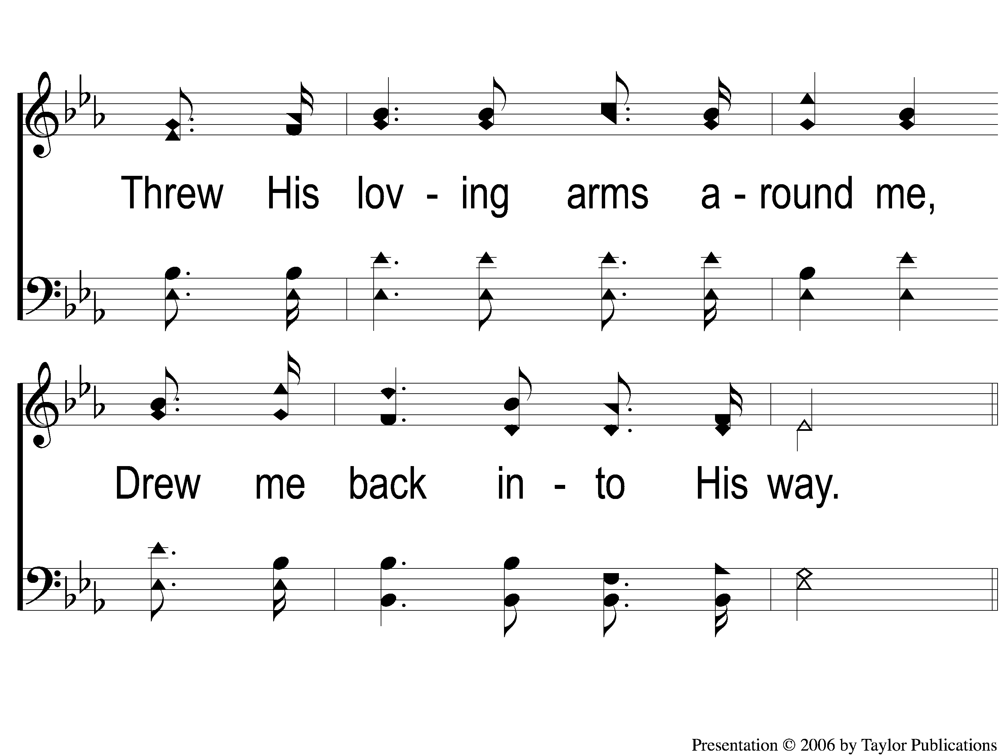
2-2 I Will Sing the Wondrous Story
I Will Sing the Wondrous Story
509

Slide 98
C-1 I Will Sing the Wondrous Story
I Will Sing the Wondrous Story
509

Slide 99
C-2 I Will Sing the Wondrous Story
I Will Sing the Wondrous Story
509

Slide 100
3-1 I Will Sing the Wondrous Story
I Will Sing the Wondrous Story
509

Slide 101
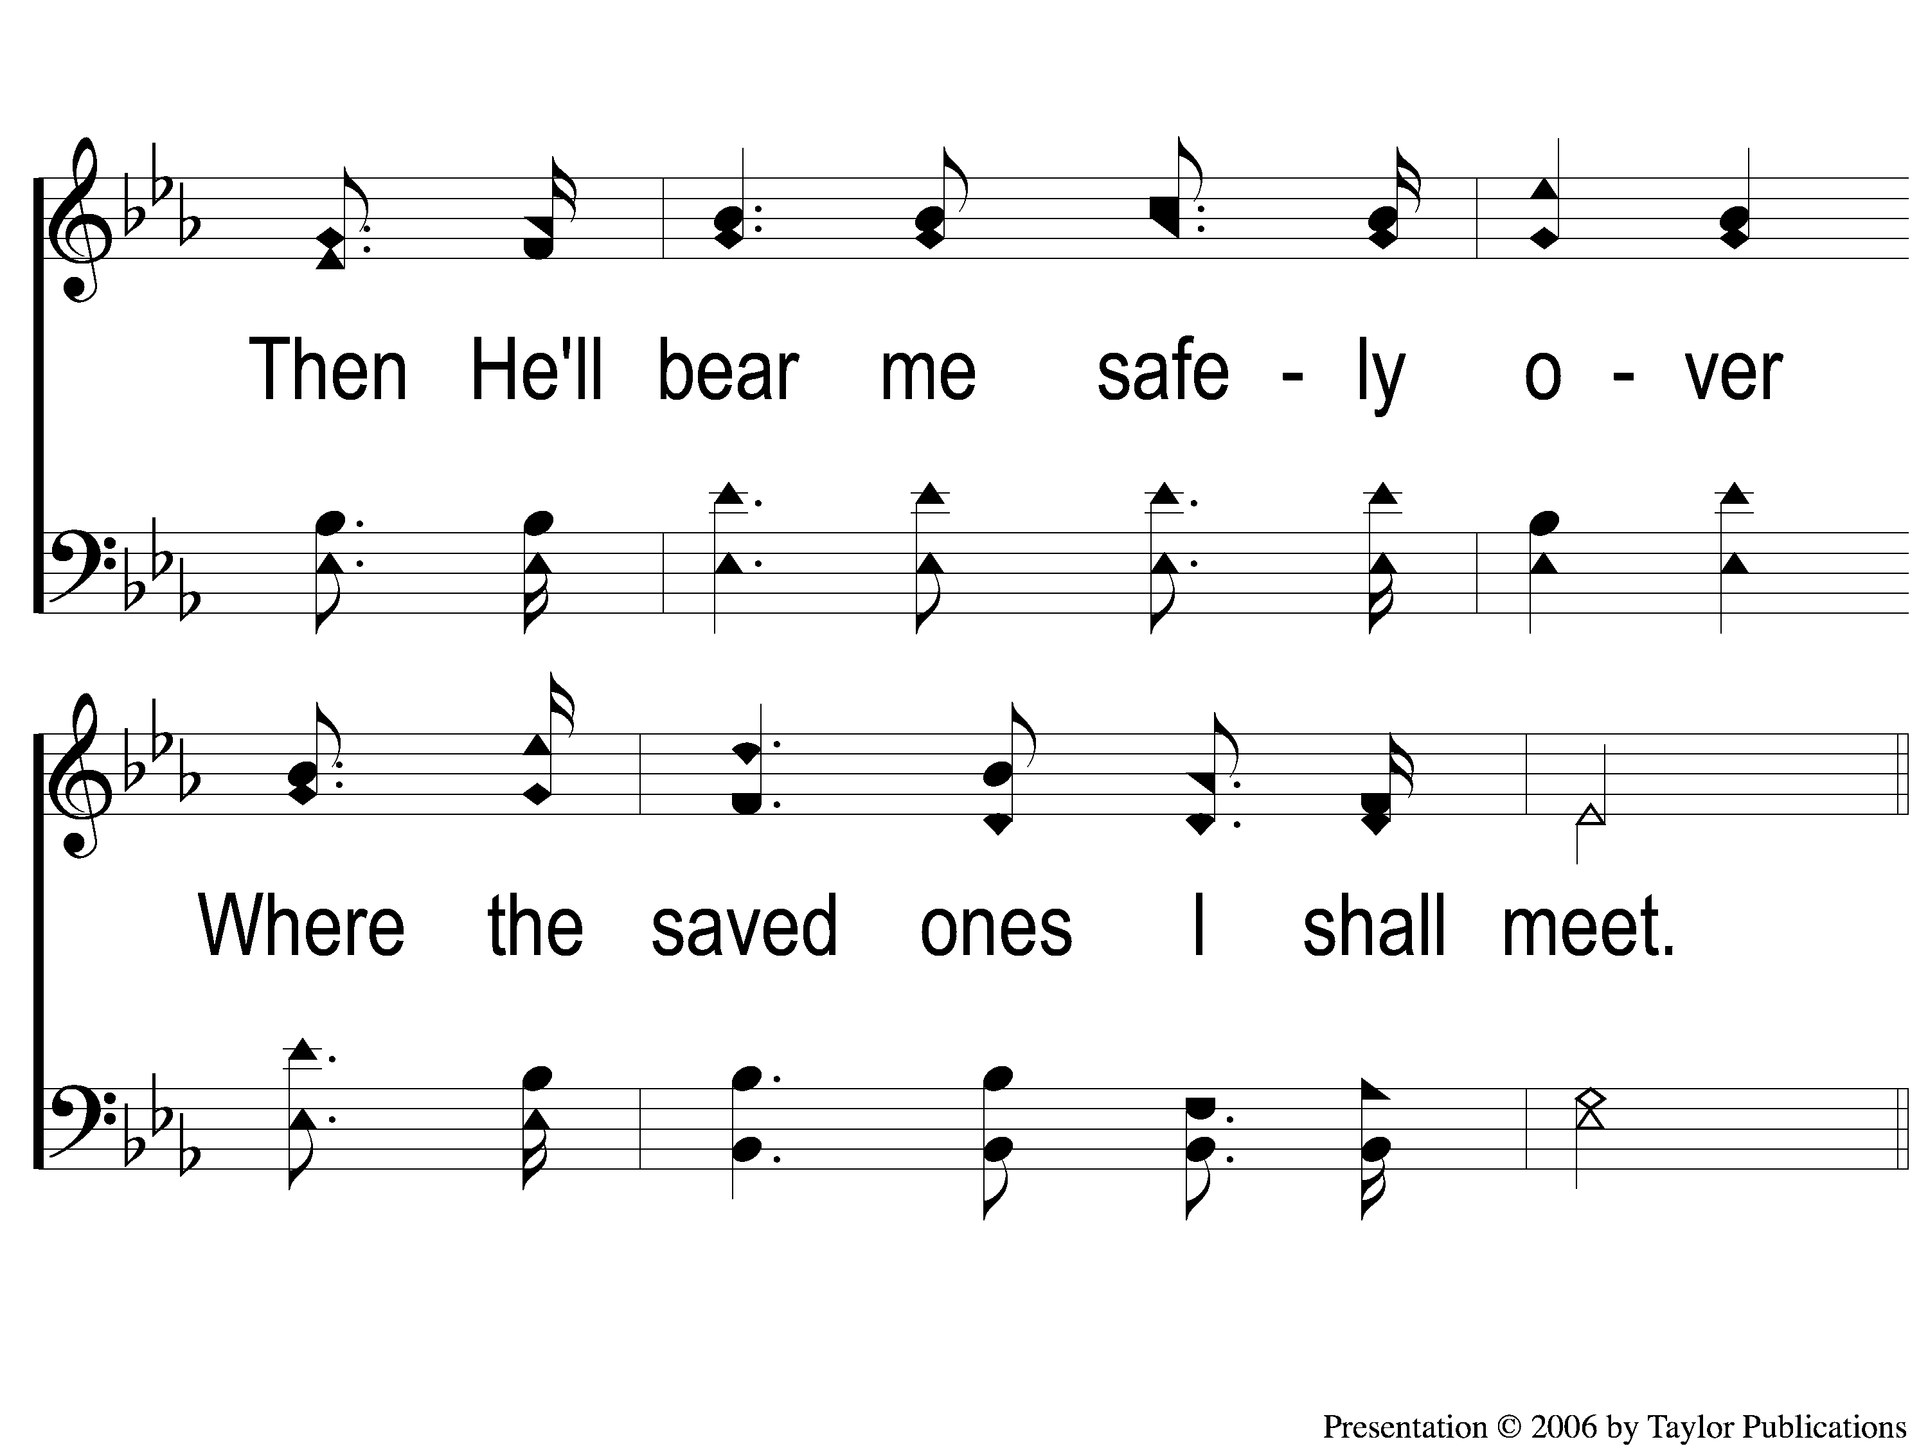
3-2 I Will Sing the Wondrous Story
I Will Sing the Wondrous Story
509

Slide 102
C-1 I Will Sing the Wondrous Story
I Will Sing the Wondrous Story
509

Slide 103
C-2 I Will Sing the Wondrous Story
I Will Sing the Wondrous Story
509

Slide 104
THE LORD’S SUPPER
ACTS 20:7

Slide 105
THE UNLEAVENED BREAD
Hebrews 2:14-15
“Inasmuch then as the children have partaken of flesh and blood, He Himself likewise shared in the same, that through death He might destroy him who had the power of death, that is, the devil, 15 and release those who through fear of death were all their lifetime subject to bondage.”

Slide 106
THE FRUIT OF THE VINE
Hebrews 12:1-2
“Therefore we also, since we are surrounded by so great a cloud of witnesses, let us lay aside every weight, and the sin which so easily ensnares us, and let us run with endurance the race that is set before us, looking unto Jesus, the author and finisher of our faith, who for the joy that was set before Him endured the cross, despising the shame, and has sat down at the right hand of the throne of God.”

Slide 107
THE OFFERING
Luke 6:38
“Give, and it will be given to you: good measure, pressed down, shaken together, and running over will be put into your bosom. For with the same measure that you use, it will be measured back to you.”

Slide 108
CLOSING
PRAYER

Slide 109
SONG #712
JESUS IS COMING SOON

Slide 110
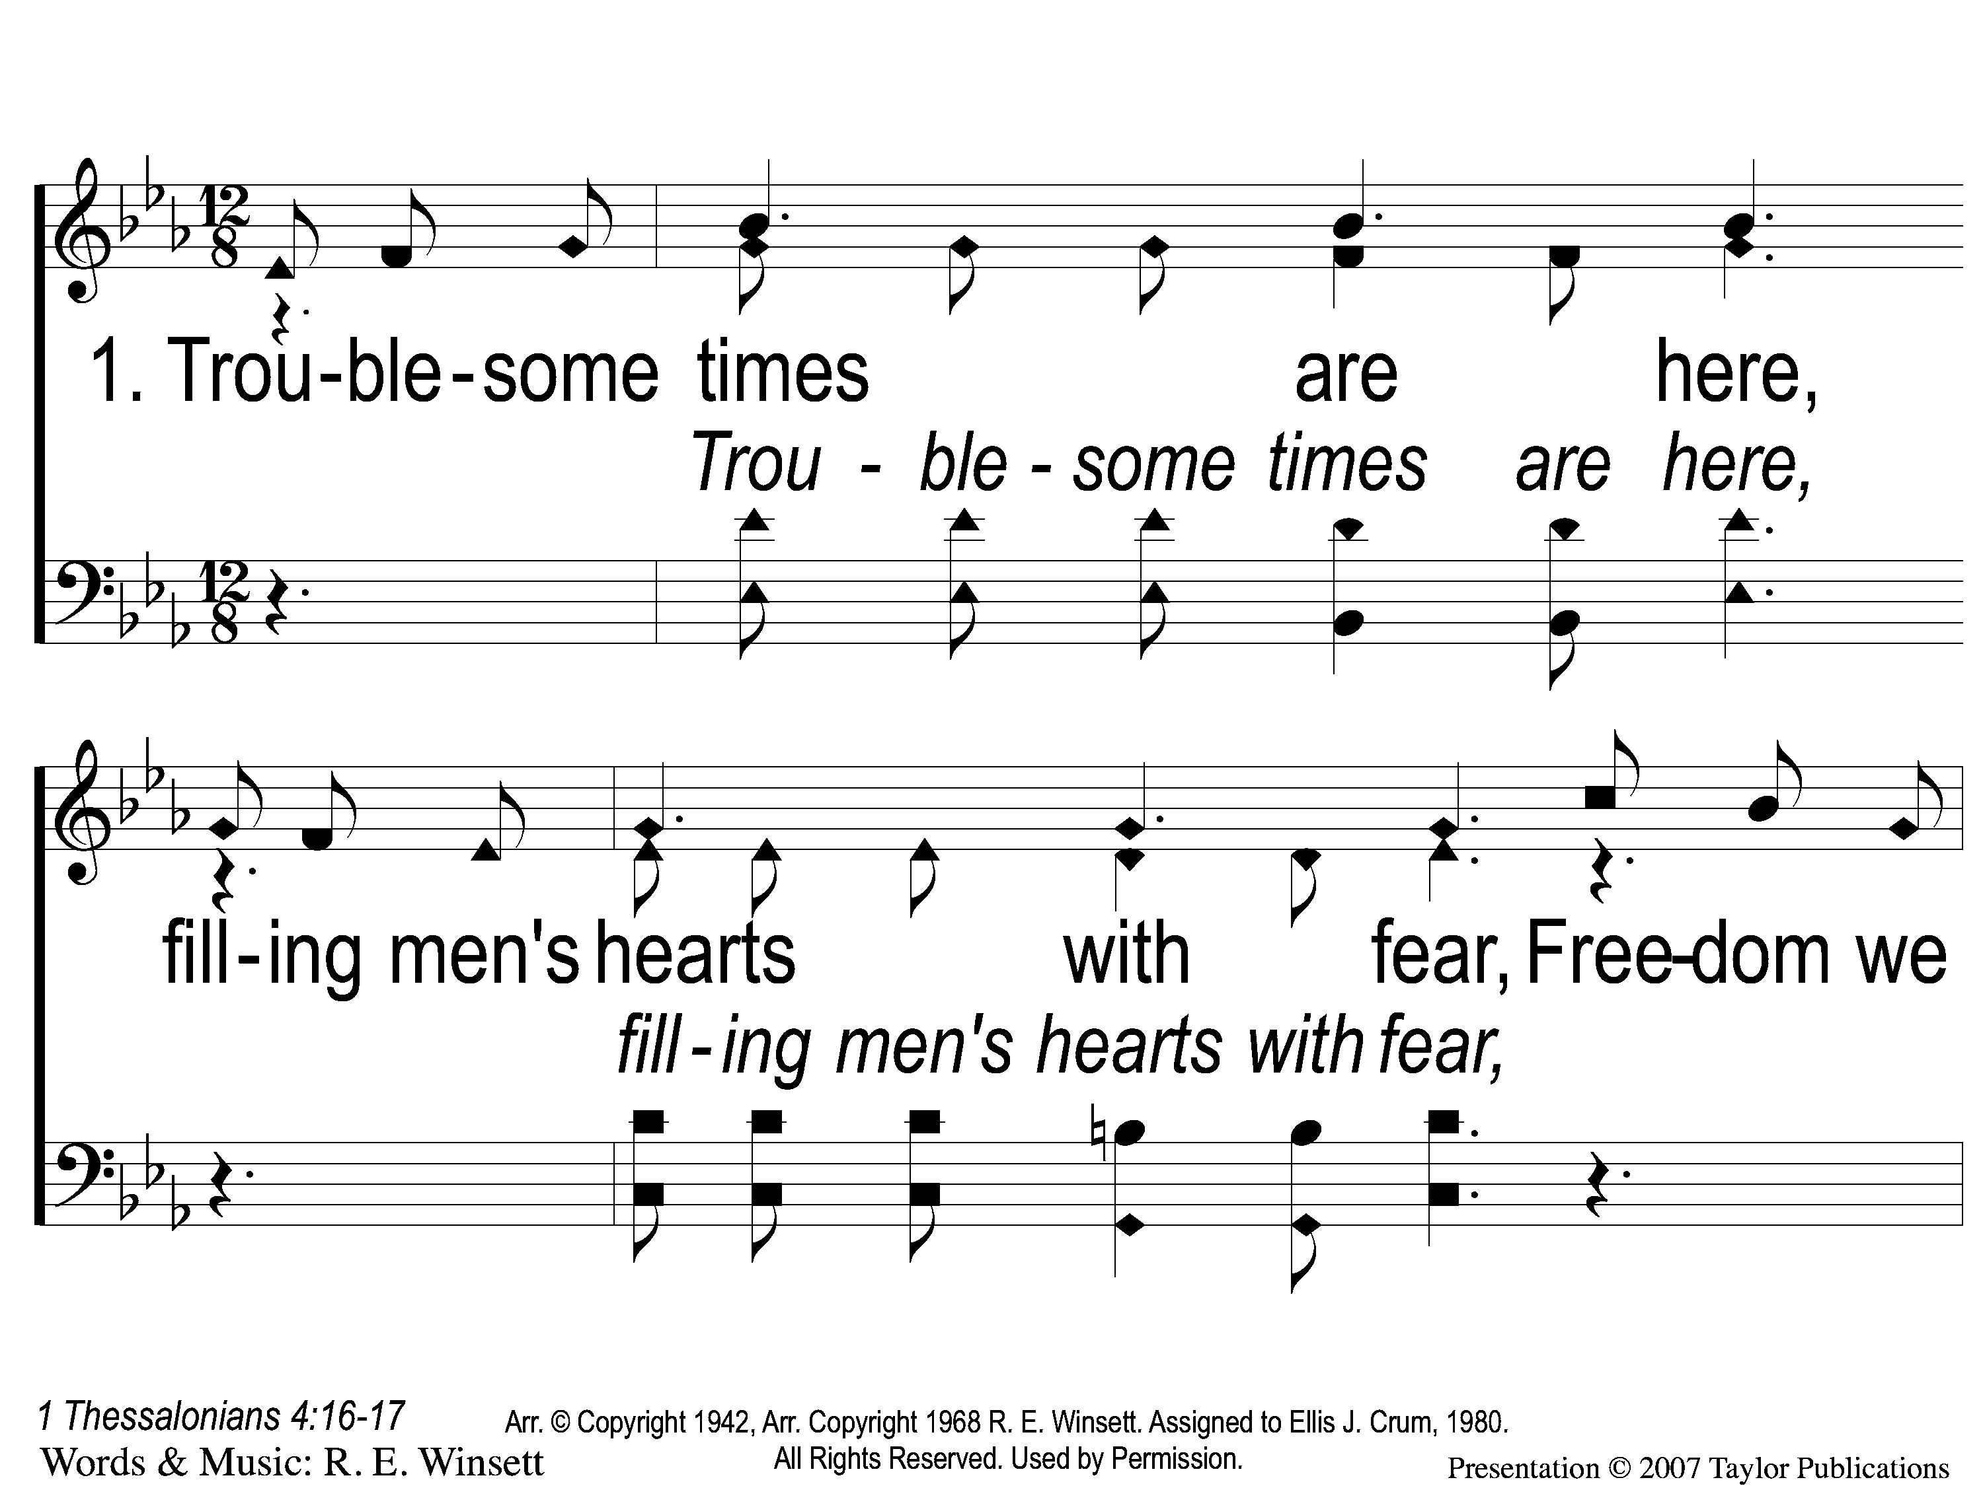
1-1 Jesus is Coming Soon
Jesus is Coming Soon
712

Slide 111
1-2 Jesus is Coming Soon
Jesus is Coming Soon
712

Slide 112
1-3 Jesus is Coming Soon
Jesus is Coming Soon
712

Slide 113
C-1 Jesus is Coming Soon
Jesus is Coming Soon
712

Slide 114
C-2 Jesus is Coming Soon
Jesus is Coming Soon
712

Slide 115
C-3 Jesus is Coming Soon
Jesus is Coming Soon
712

Slide 116
C-4 Jesus is Coming Soon
Jesus is Coming Soon
712

Slide 117
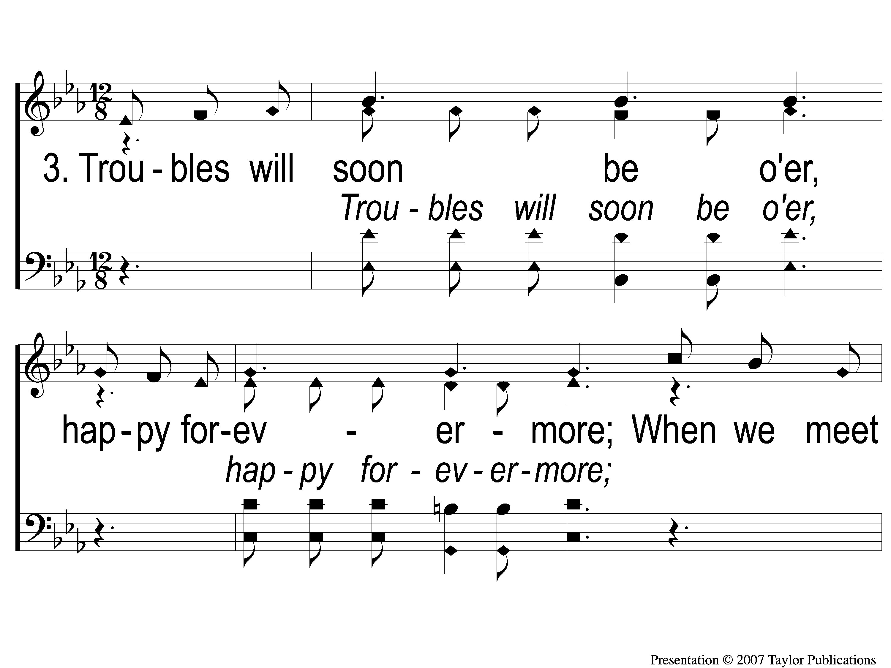
3-1 Jesus is Coming Soon
Jesus is Coming Soon
712

Slide 118
3-2 Jesus is Coming Soon
Jesus is Coming Soon
712

Slide 119
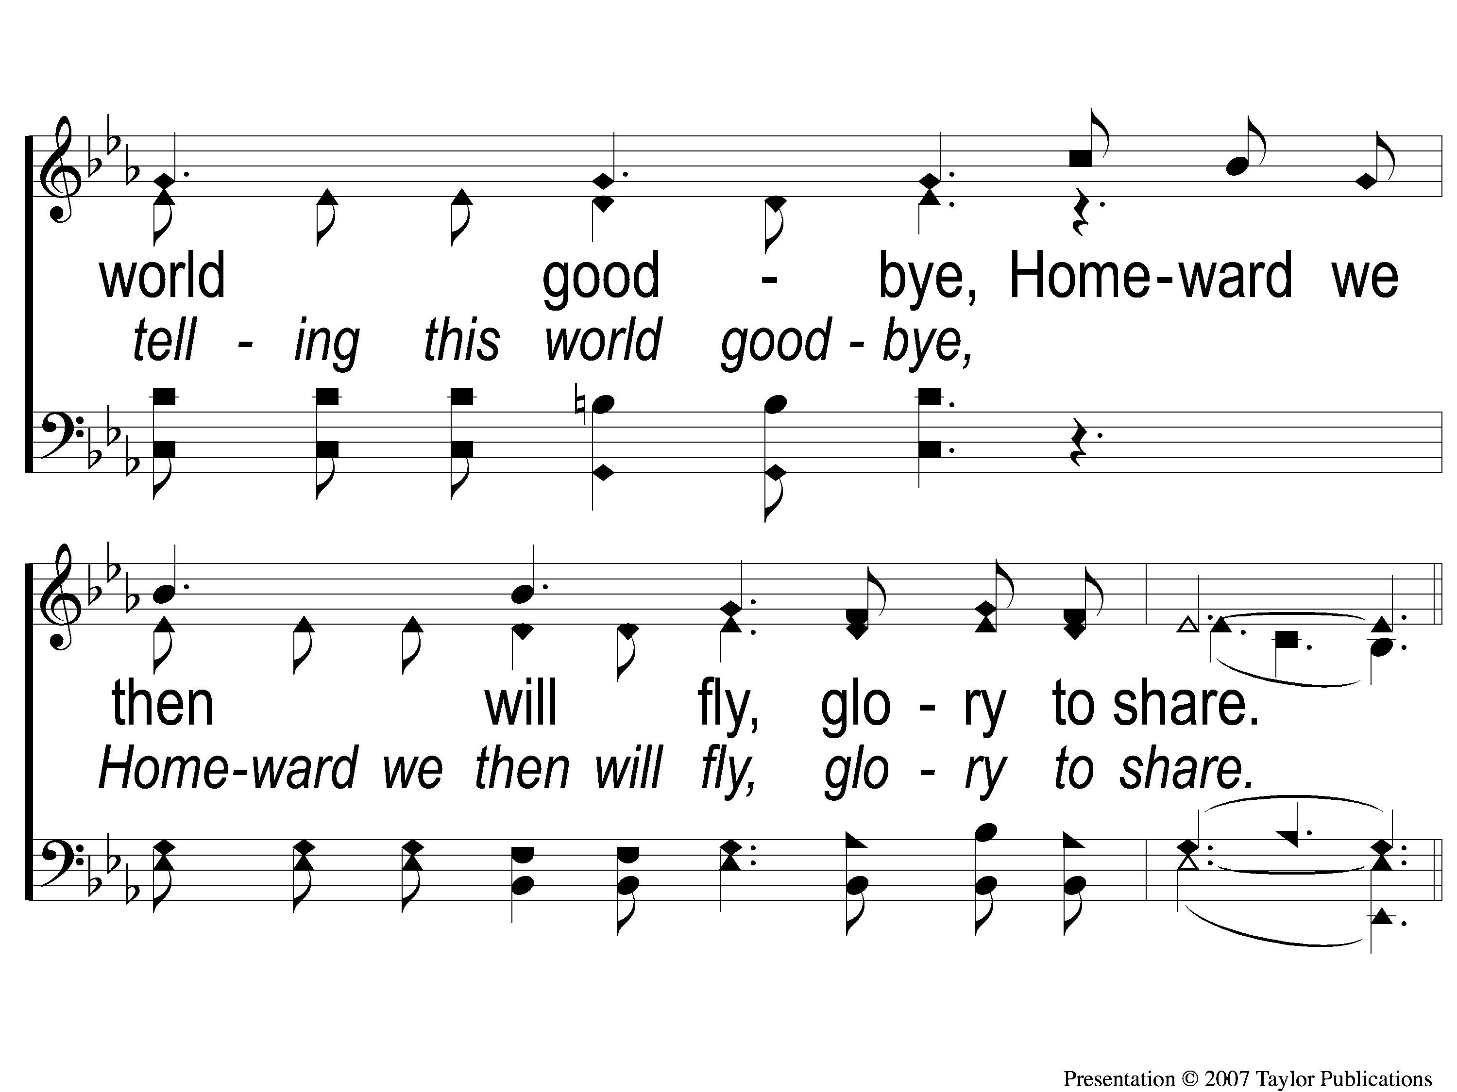
3-3 Jesus is Coming Soon
Jesus is Coming Soon
712

Slide 120
C-1 Jesus is Coming Soon
Jesus is Coming Soon
712

Slide 121
C-2 Jesus is Coming Soon
Jesus is Coming Soon
712

Slide 122
C-3 Jesus is Coming Soon
Jesus is Coming Soon
712

Slide 123
C-4 Jesus is Coming Soon
Jesus is Coming Soon
712

Slide 124
JOIN US
TONIGHT @ 6PM
LESSON: THE PROMISE OF GRACE

