Slide 1
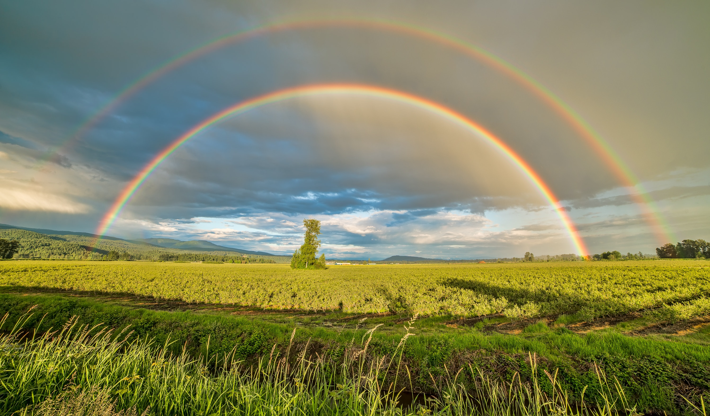
PLEASE
STANDBY
Our Livestream Will Begin Soon

Slide 2
WELCOME
THANKS FOR JOINING US!

Slide 3
SONGS

Slide 4
OPENING
PRAYER

Slide 5
STANDING ON THE PROMISES

Slide 6
SONGS

Slide 7
THE PROMISE OF GRACE

Slide 8
THE PROMISE OF GRACE
2 Peter 1:1-4

Slide 9
THE PROMISE
What Is Grace?

Slide 10
THE PROMISE
What Is Grace?
Gen. 6:8

Slide 11
THE PROMISE
What Is Grace?
Gen. 6:8
= to have favor in
the eyes of someone

Slide 12
THE PROMISE
What Is Grace?
2 Pet. 1:1-4

Slide 13
THE PROMISE
What Is Grace?
2 Pet. 1:1-4
χάρις (Charis) = to have a favorable attitude toward someone

Slide 14
THE PROMISE
Where Does Peter Want For Us?

Slide 15
THE PROMISE
Where Does Peter Want For Us?
Grace To Be Multiplied! (2 Pet. 1:2)
Heb. 6:14 – Acts 9:31

Slide 16
THE CONDITION
How Do I Find God’s Grace?

Slide 17
THE CONDITION
How Do I Find God’s Grace?
Noah – Gen. 6:8-9, 22, 8:9

Slide 18
THE CONDITION
How Do I Find God’s Grace?
Noah – Gen. 6:8-9, 22, 8:9
Moses – Ex. 33:12, Heb. 11:24-27

Slide 19
THE CONDITION
How Do I Find God’s Grace?
Noah – Gen. 6:8-9, 22, 8:9
Moses – Ex. 33:12, Heb. 11:24-27
Mary – Lk. 1:30, Matt. 1:18-19

Slide 20
THE CONDITION
Can I Lose God’s Grace?

Slide 21
THE CONDITION
Can I Lose God’s Grace?
Gal. 5:4
2 Pet. 3:17
Heb. 12:15

Slide 22
HAVE YOU FOUND GRACE
IN THE EYES OF THE LORD?

Slide 23
SONGS

Slide 24
THE LORD’S SUPPER
ACTS 20:7

Slide 25
CLOSING
PRAYER

Slide 26
SONGS

Slide 27
JOIN US
WEDNESDAY
@ 5:30 & 6:30 PM
FAMILY MEAL & WORSHIP

