Slide 1
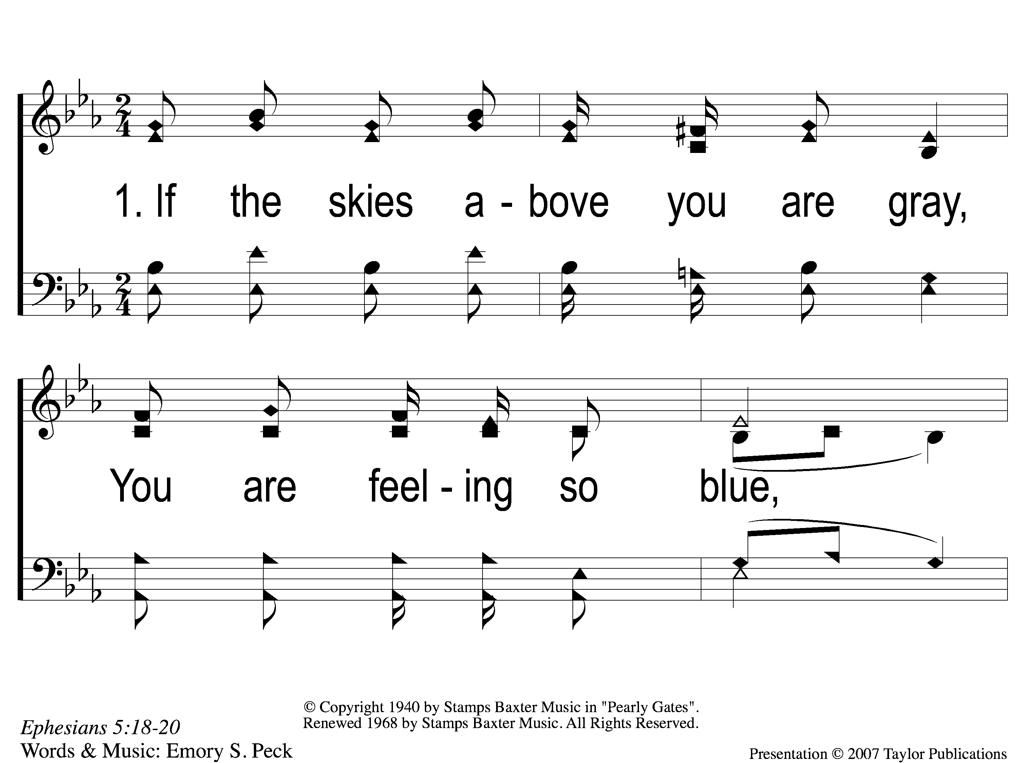
1-1 Sing and Be Happy
Sing and Be Happy
587

Slide 2
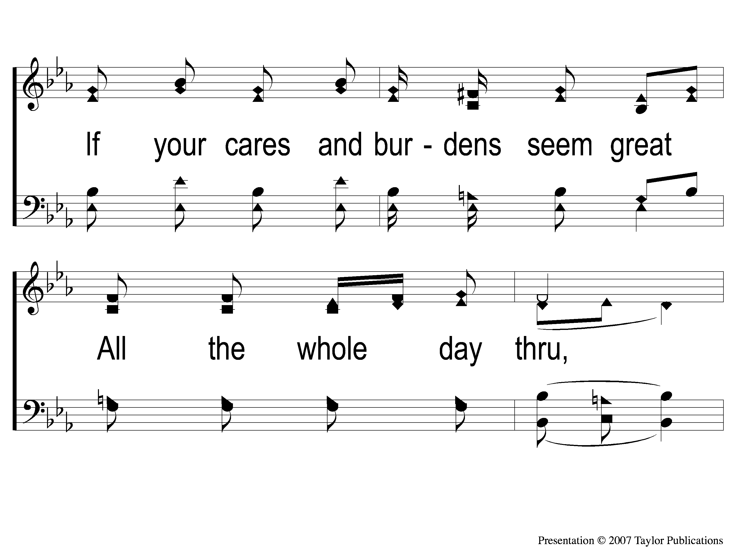
1-2 Sing and Be Happy
Sing and Be Happy
587

Slide 3
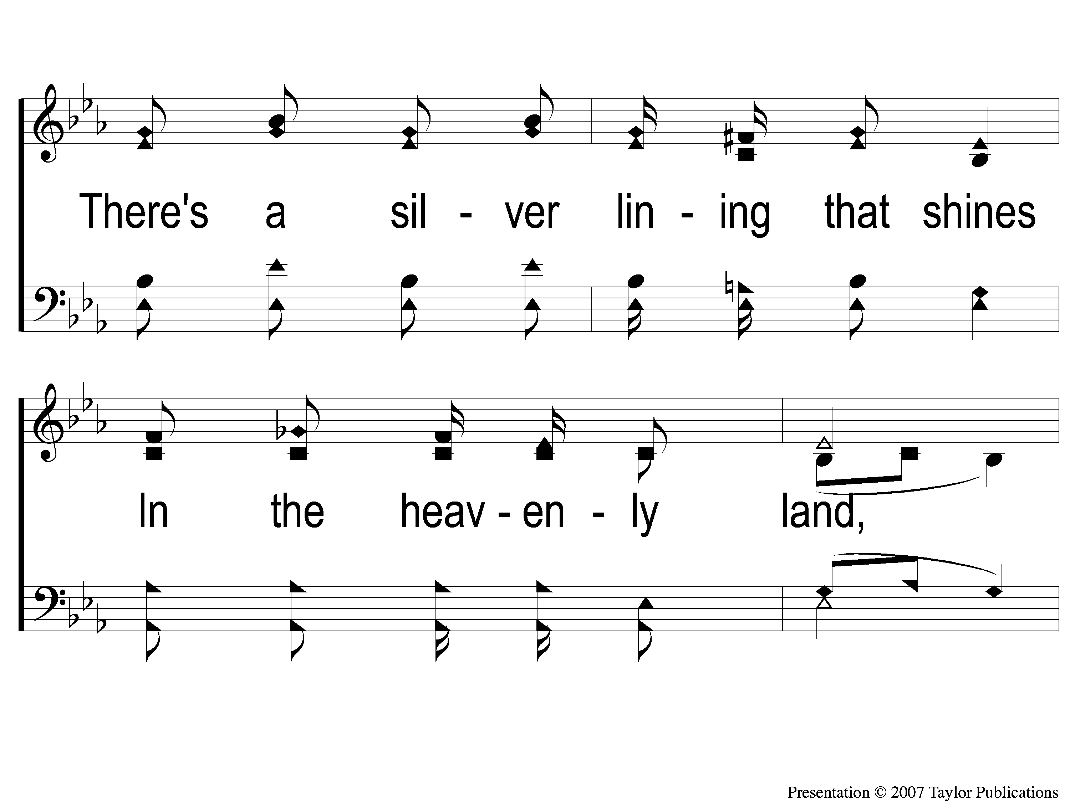
1-3 Sing and Be Happy
Sing and Be Happy
587

Slide 4
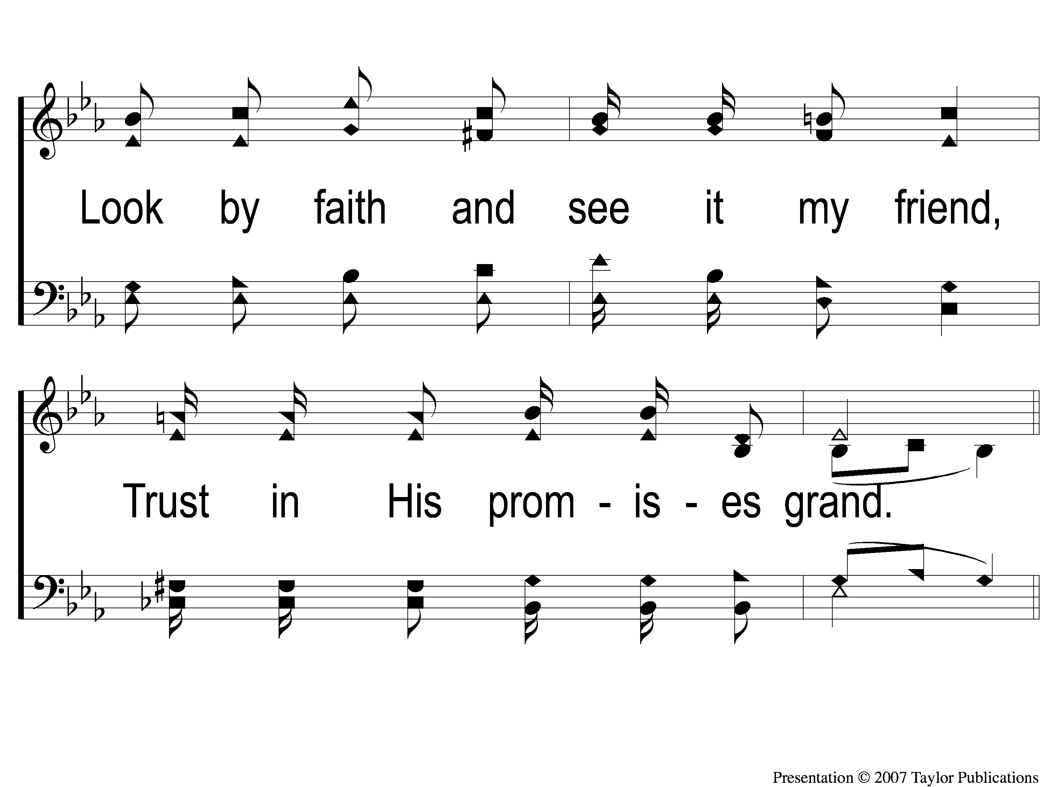
1-4 Sing and Be Happy
Sing and Be Happy
587

Slide 5
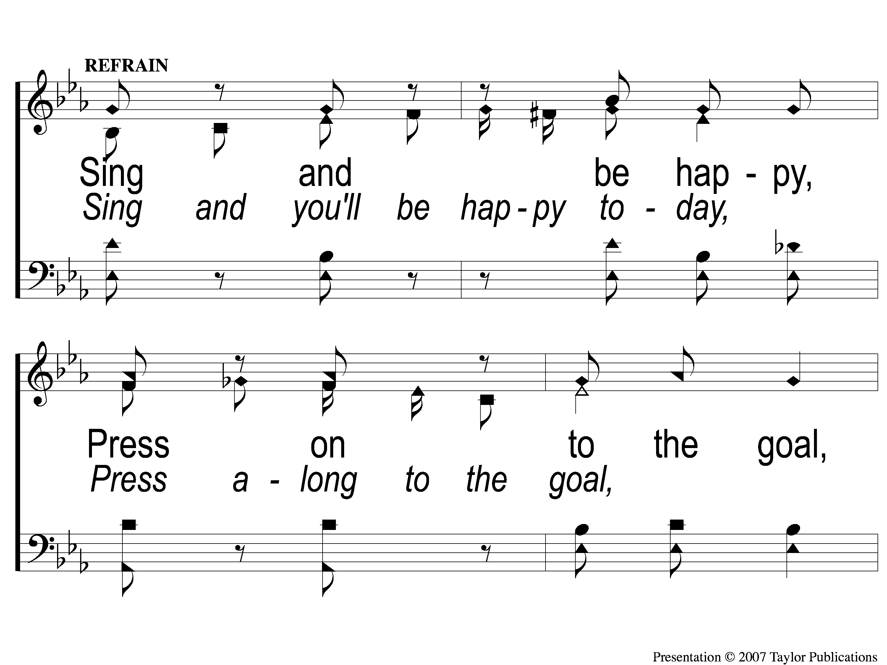
C-1 Sing and Be Happy
Sing and Be Happy
587

Slide 6
C-2 Sing and Be Happy
Sing and Be Happy
587

Slide 7
C-3 Sing and Be Happy
Sing and Be Happy
587

Slide 8
C-4 Sing and Be Happy
Sing and Be Happy
587

Slide 9
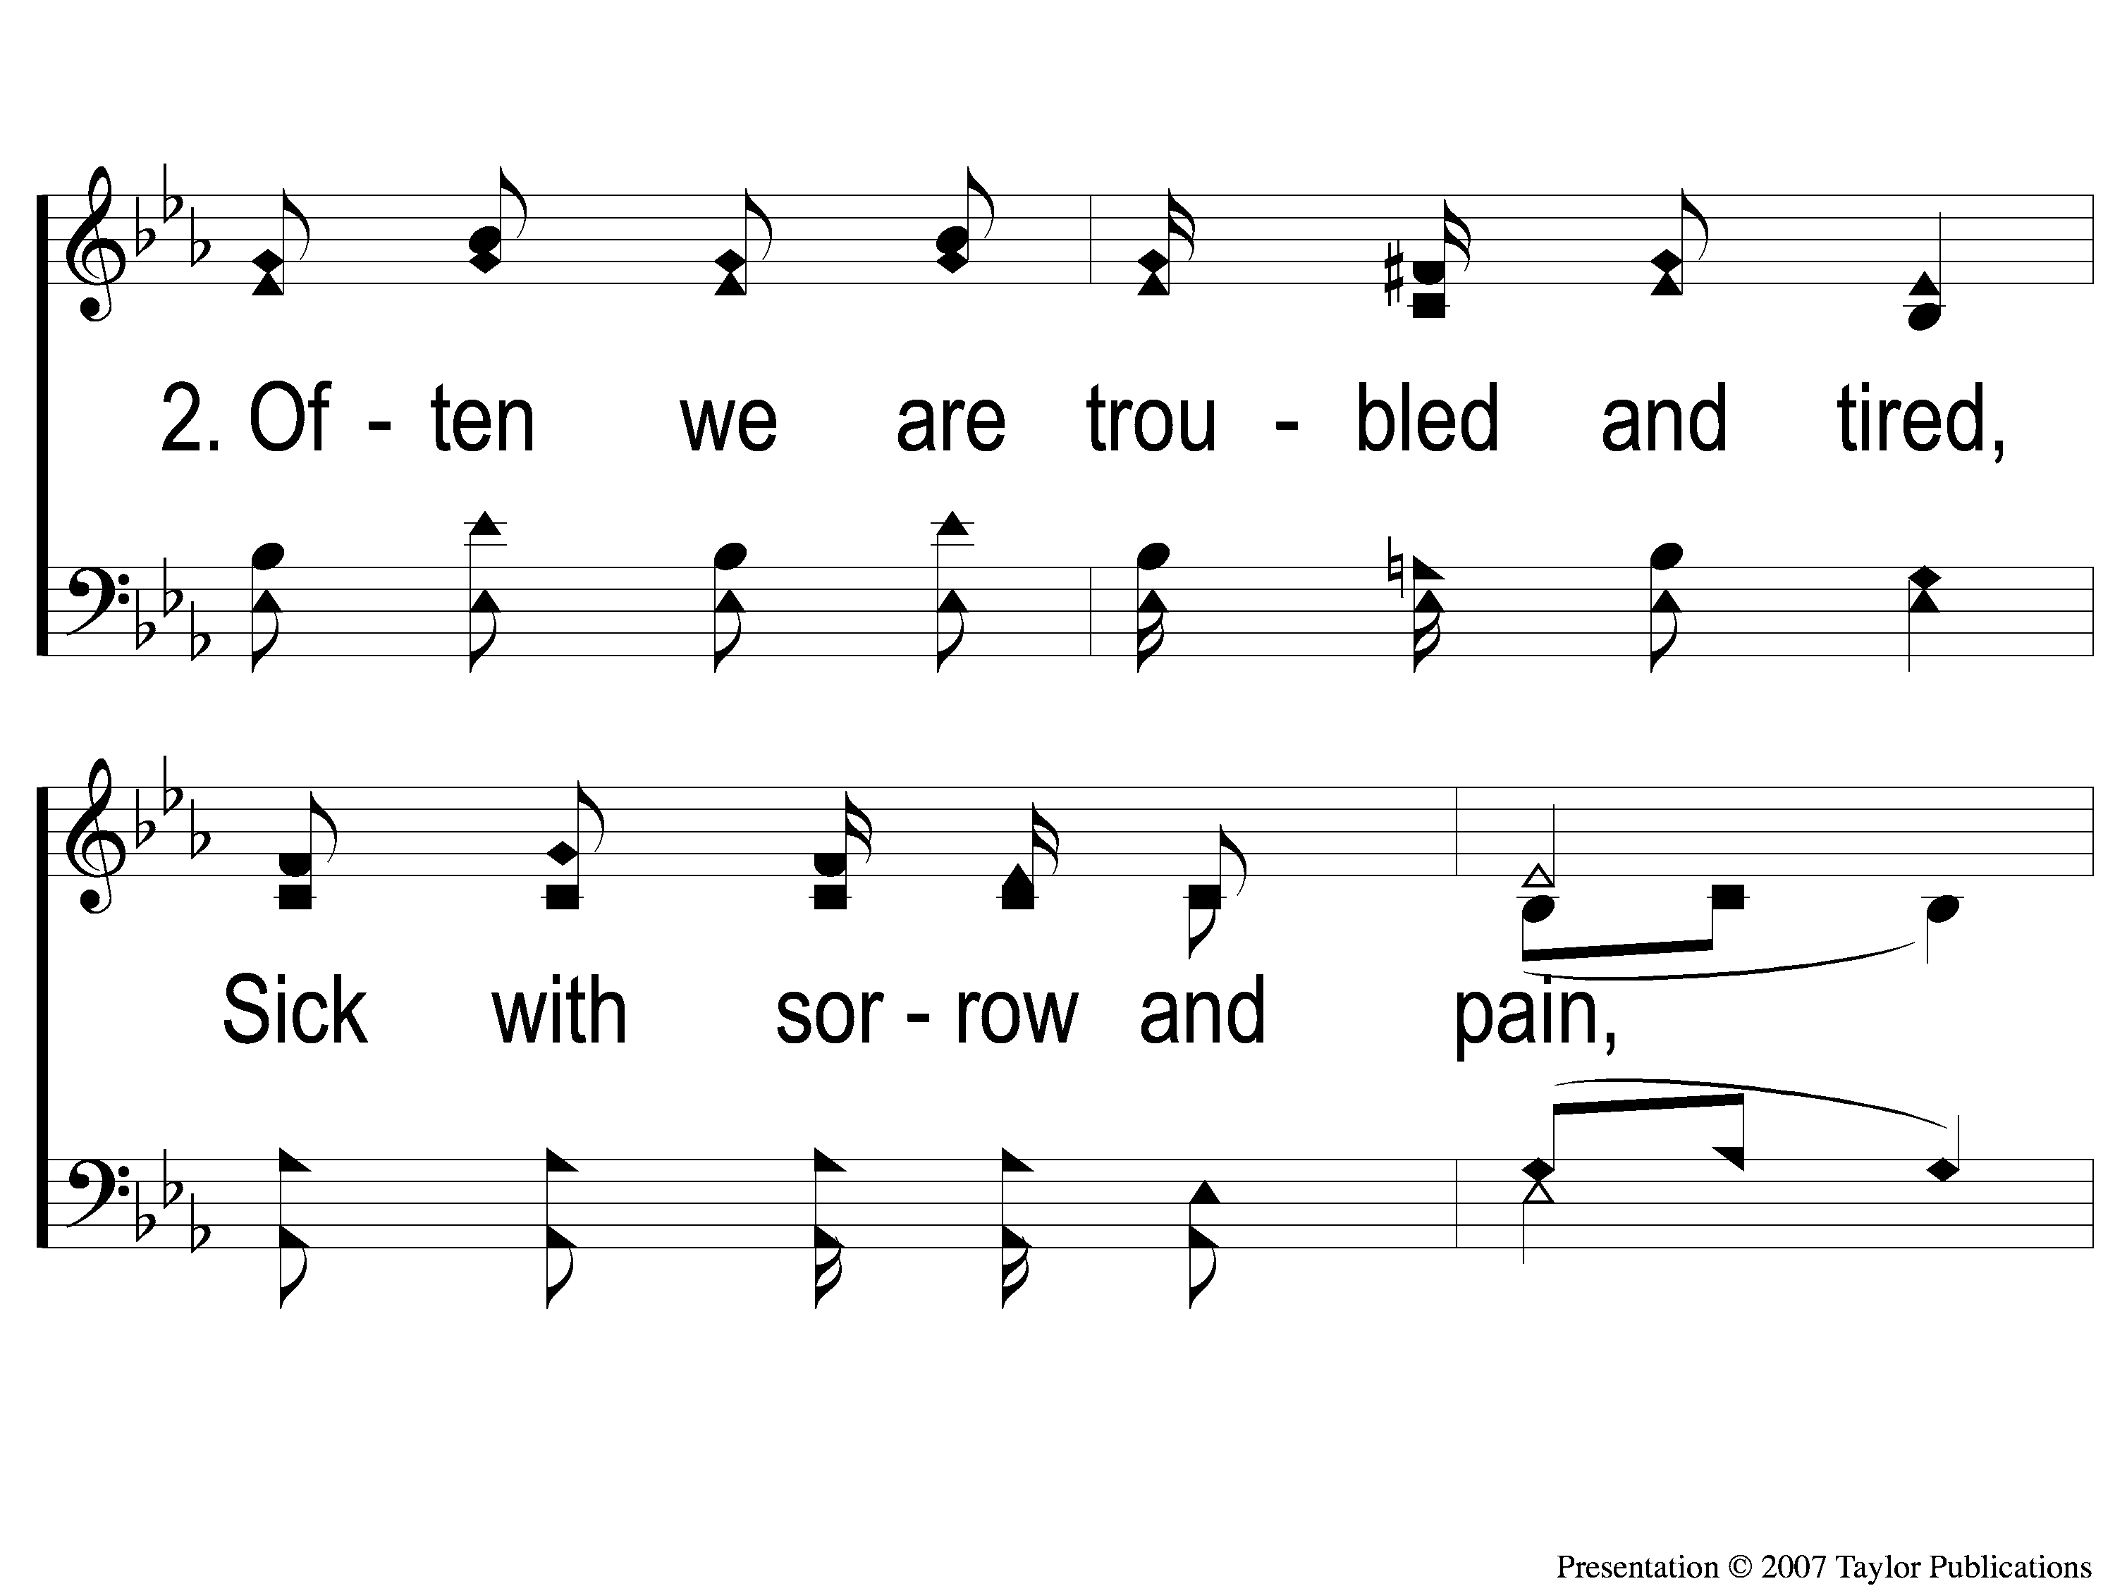
2-1 Sing and Be Happy
Sing and Be Happy
587

Slide 10
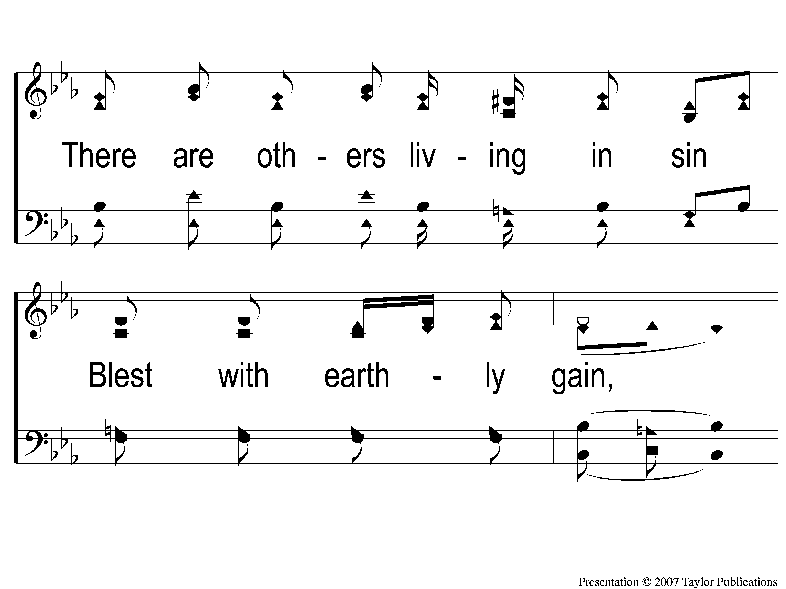
2-2 Sing and Be Happy
Sing and Be Happy
587

Slide 11
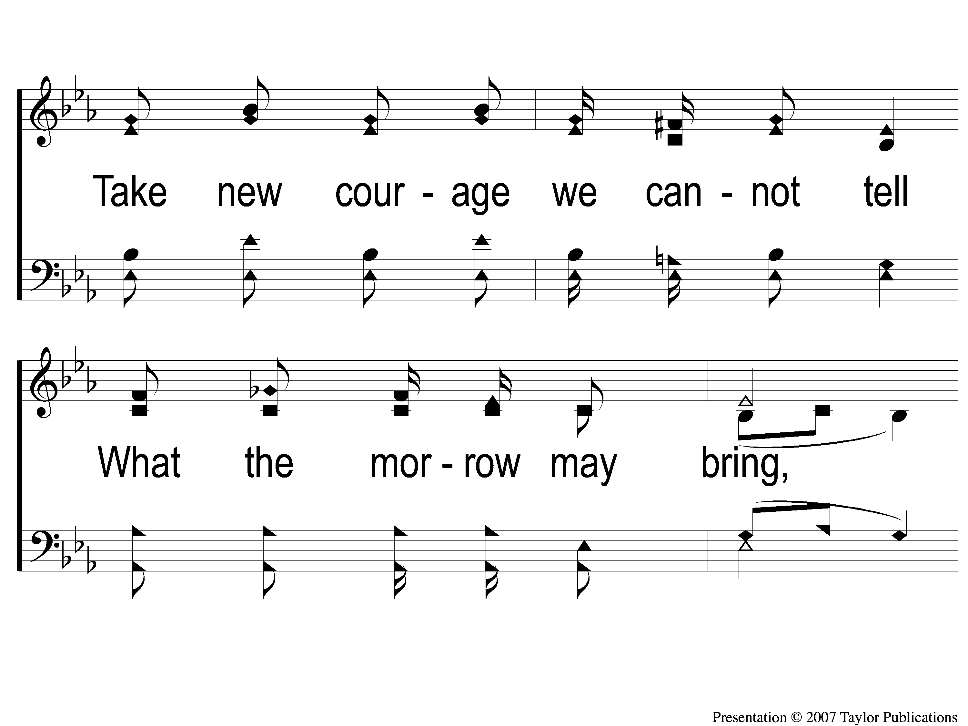
2-3 Sing and Be Happy
Sing and Be Happy
587

Slide 12
2-4 Sing and Be Happy
Sing and Be Happy
587

Slide 13
C-1 Sing and Be Happy
Sing and Be Happy
587

Slide 14
C-2 Sing and Be Happy
Sing and Be Happy
587

Slide 15
C-3 Sing and Be Happy
Sing and Be Happy
587

Slide 16
C-4 Sing and Be Happy
Sing and Be Happy
587

Slide 17
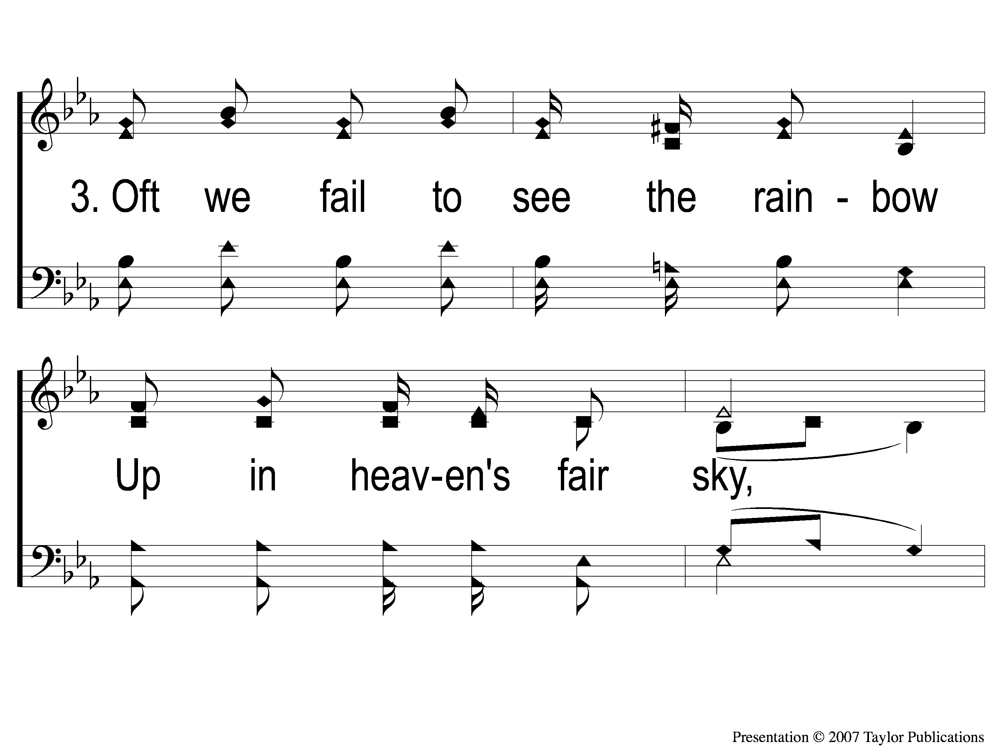
3-1 Sing and Be Happy
Sing and Be Happy
587

Slide 18
3-2 Sing and Be Happy
Sing and Be Happy
587

Slide 19
3-3 Sing and Be Happy
Sing and Be Happy
587

Slide 20
3-4 Sing and Be Happy
Sing and Be Happy
587

Slide 21
C-1 Sing and Be Happy
Sing and Be Happy
587

Slide 22
C-2 Sing and Be Happy
Sing and Be Happy
587

Slide 23
C-3 Sing and Be Happy
Sing and Be Happy
587

Slide 24
C-4 Sing and Be Happy
Sing and Be Happy
587

Slide 25
RESTORE REBUILD RENEW
welcome
we are glad to
Have you with us
IN 2022
WHEELER
CHURCH
OF
CHRIST

Slide 26
Song:
Shine, Jesus, Shine
#290

Slide 27
1-1 Shine Jesus Shine
Shine, Jesus, Shine
290

Slide 28
1-2 Shine Jesus Shine
Shine, Jesus, Shine
290

Slide 29
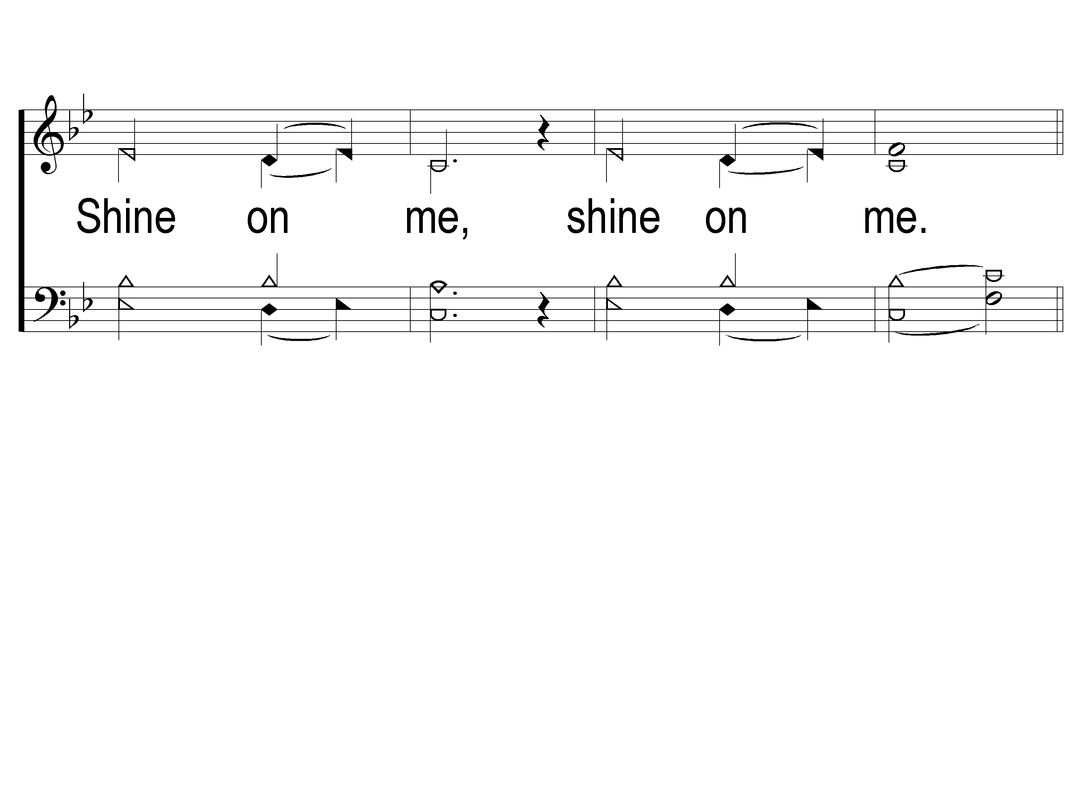
1-3 Shine Jesus Shine
Shine, Jesus, Shine
290

Slide 30
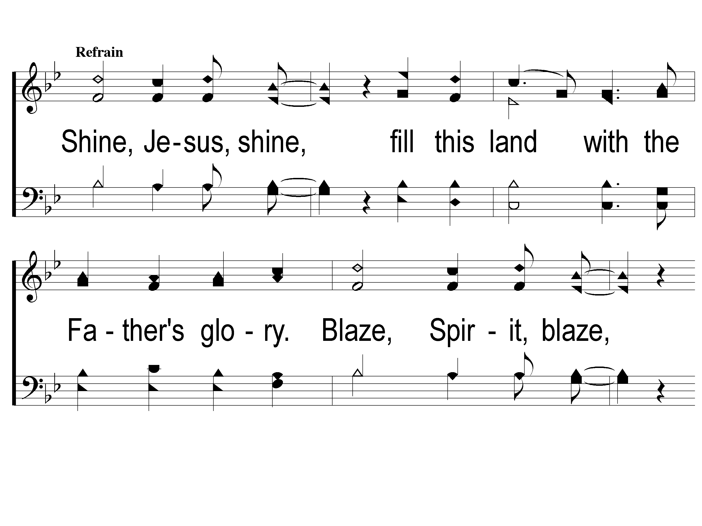
C-1 Shine Jesus Shine
Shine, Jesus, Shine
290

Slide 31
C-2 Shine Jesus Shine
Shine, Jesus, Shine
290

Slide 32
C-3 Shine Jesus Shine
Shine, Jesus, Shine
290

Slide 33
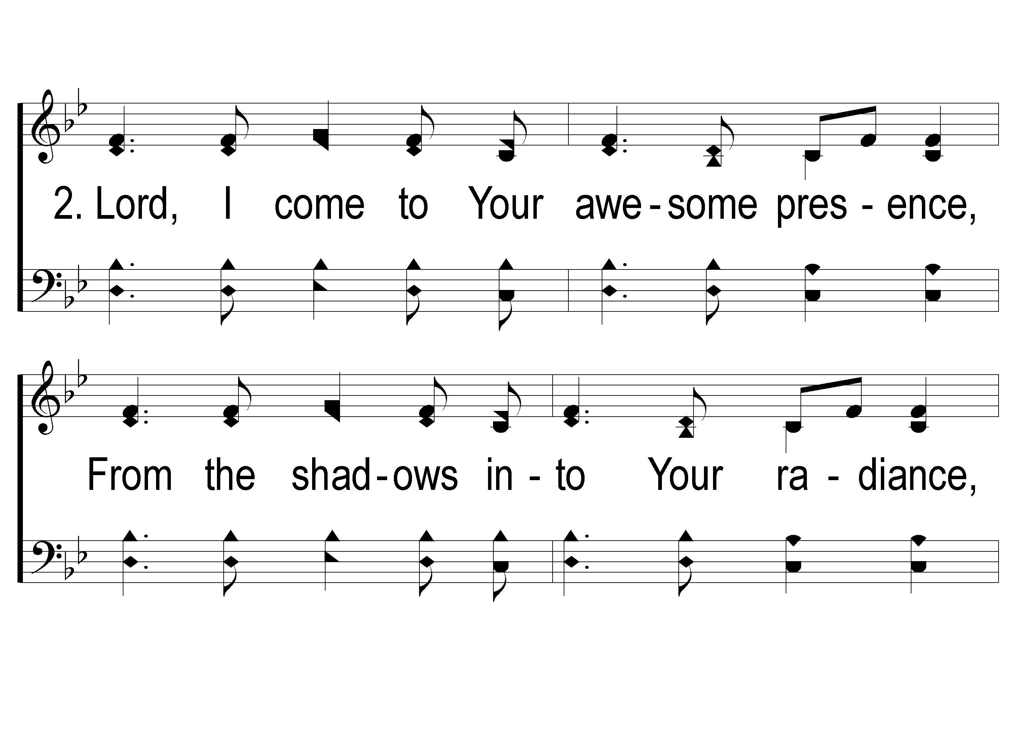
2-1 Shine Jesus Shine
Shine, Jesus, Shine
290

Slide 34
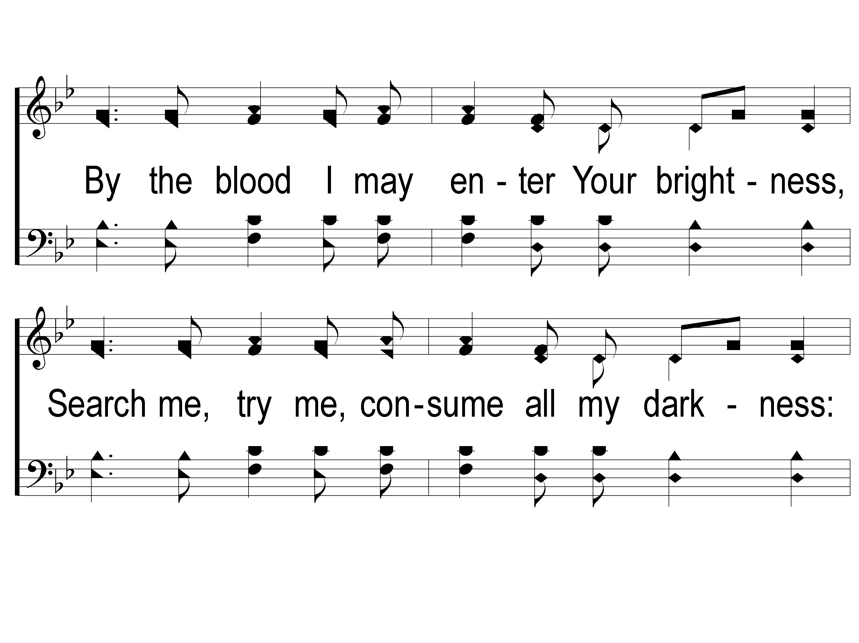
2-2 Shine Jesus Shine
Shine, Jesus, Shine
290

Slide 35
2-3 Shine Jesus Shine
Shine, Jesus, Shine
290

Slide 36
C-1 Shine Jesus Shine
Shine, Jesus, Shine
290

Slide 37
C-2 Shine Jesus Shine
Shine, Jesus, Shine
290

Slide 38
C-3 Shine Jesus Shine
Shine, Jesus, Shine
290

Slide 39
Song:
As The Deer
#71

Slide 40
1-1 As the Deer
As The Deer
71

Slide 41
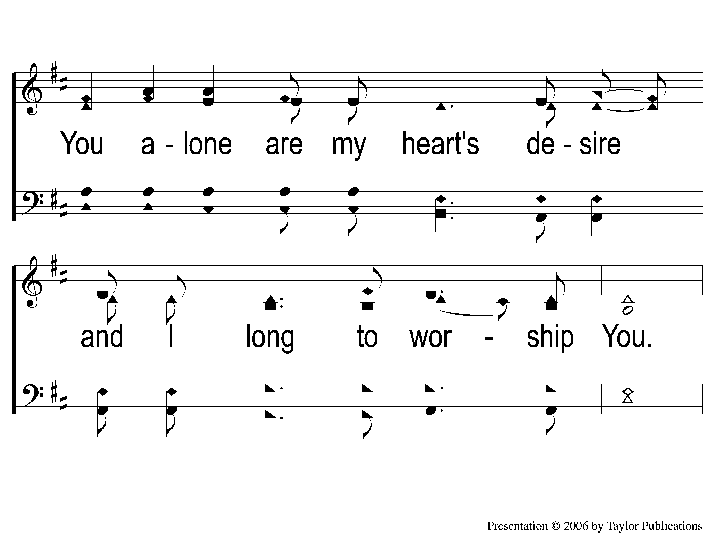
1-2 As the Deer
As The Deer
71

Slide 42
C-1 As the Deer
As The Deer
71

Slide 43
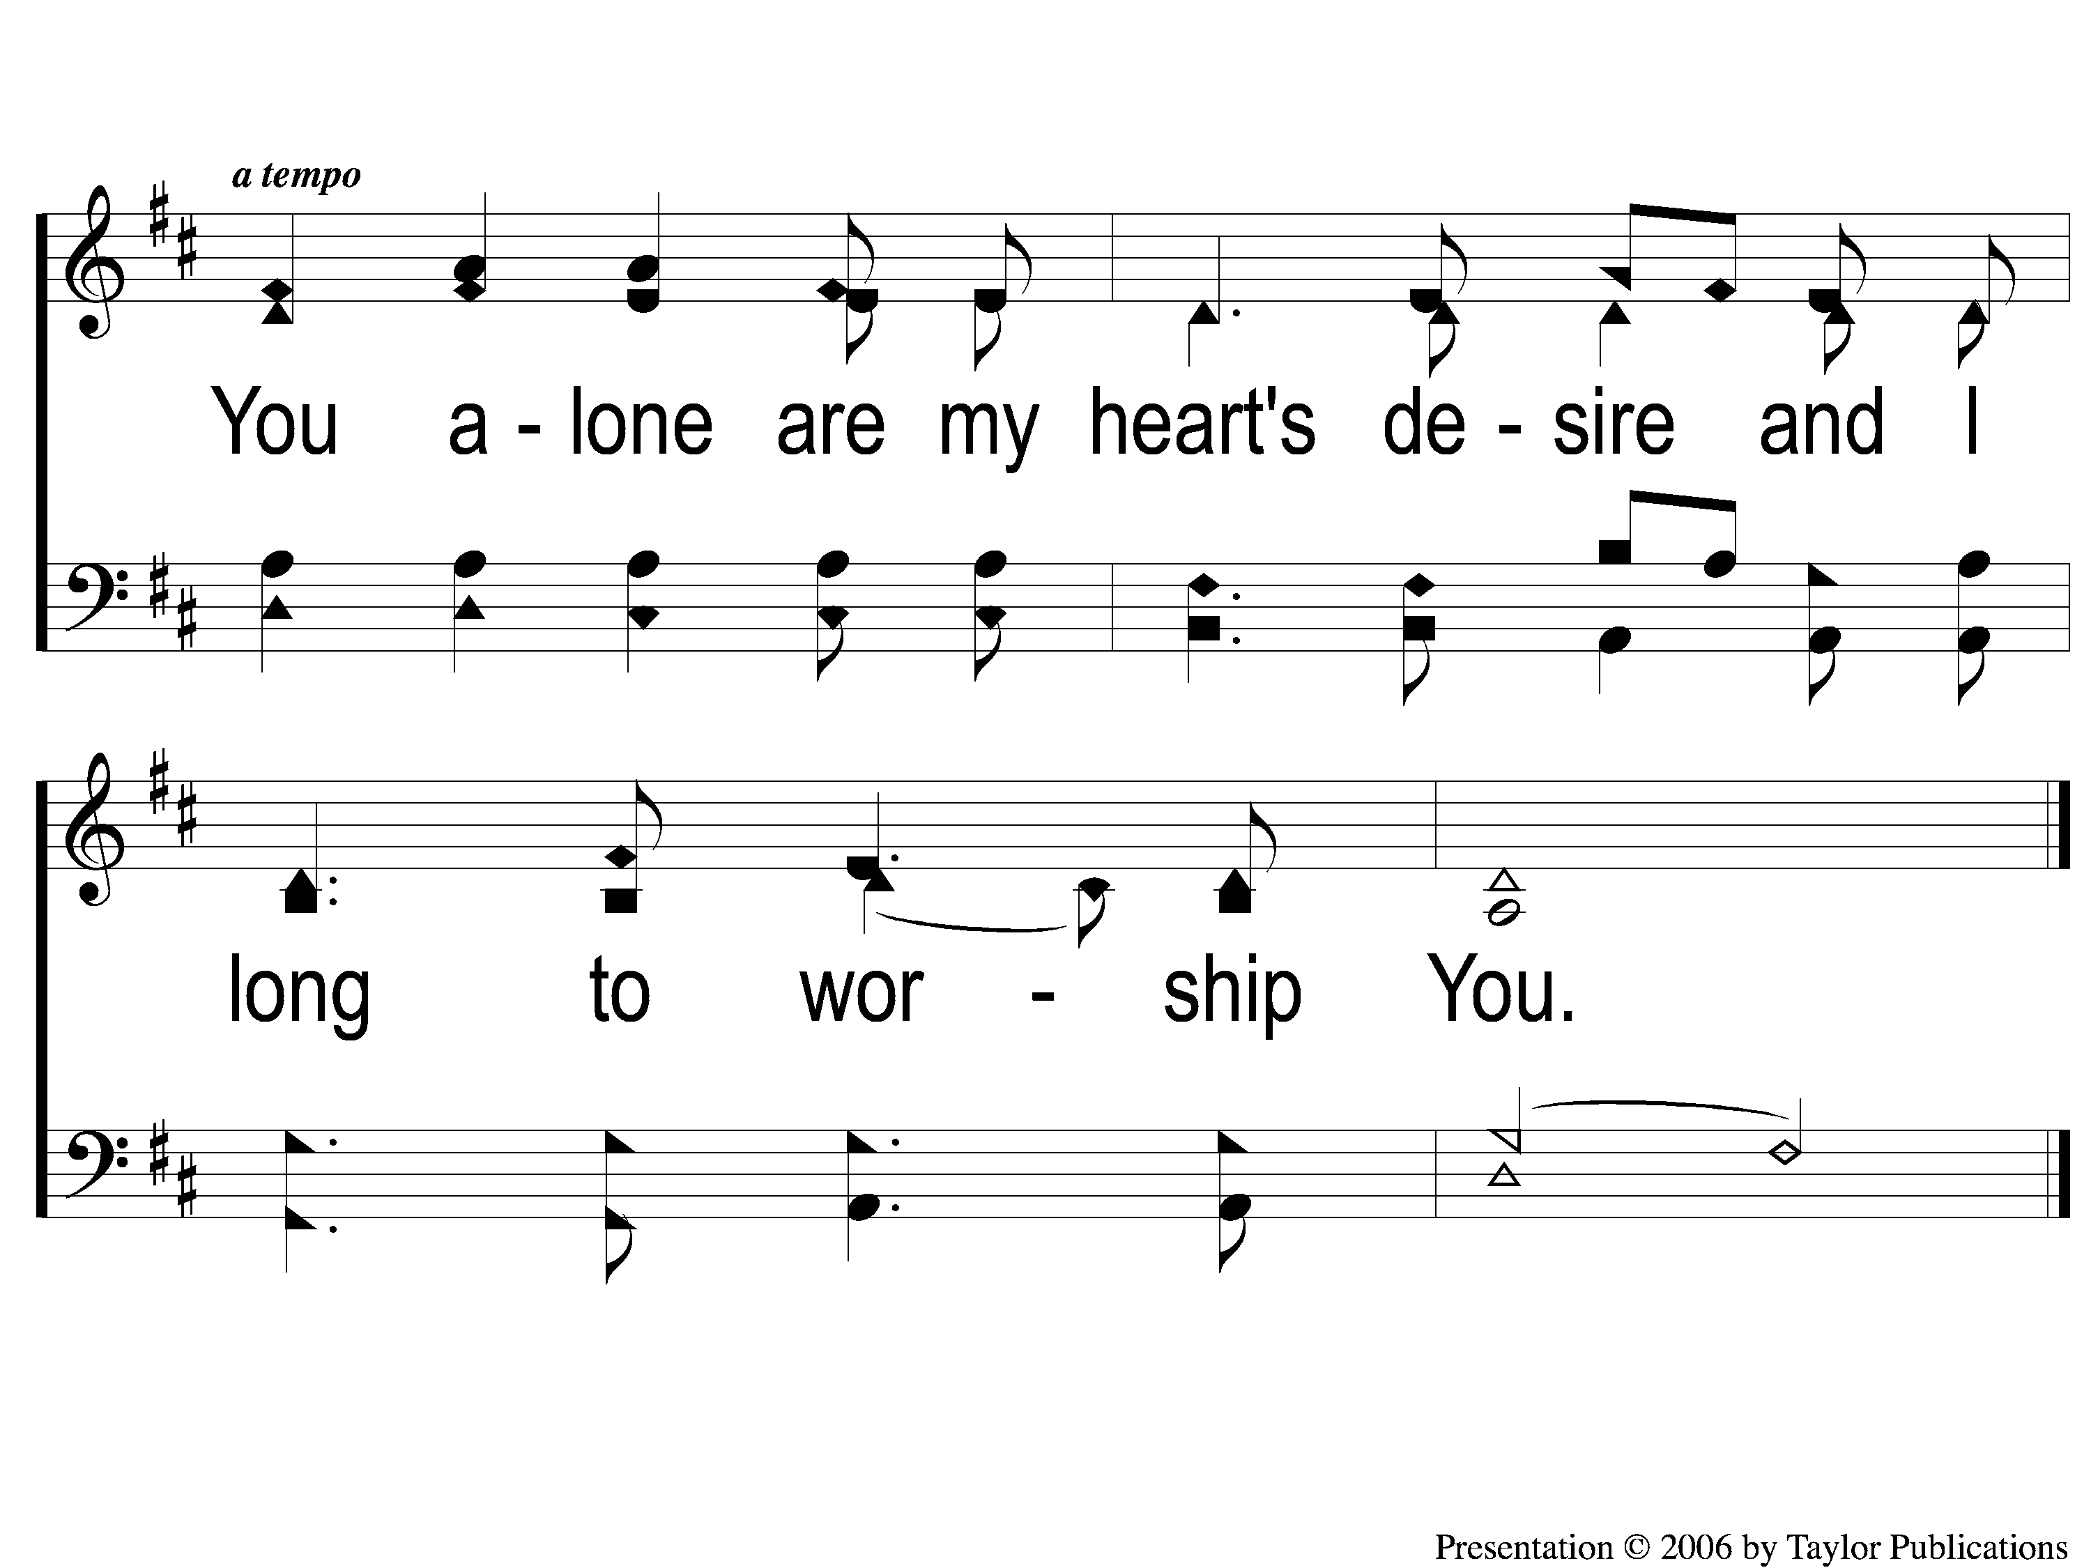
C-2 As the Deer
As The Deer
71

Slide 44
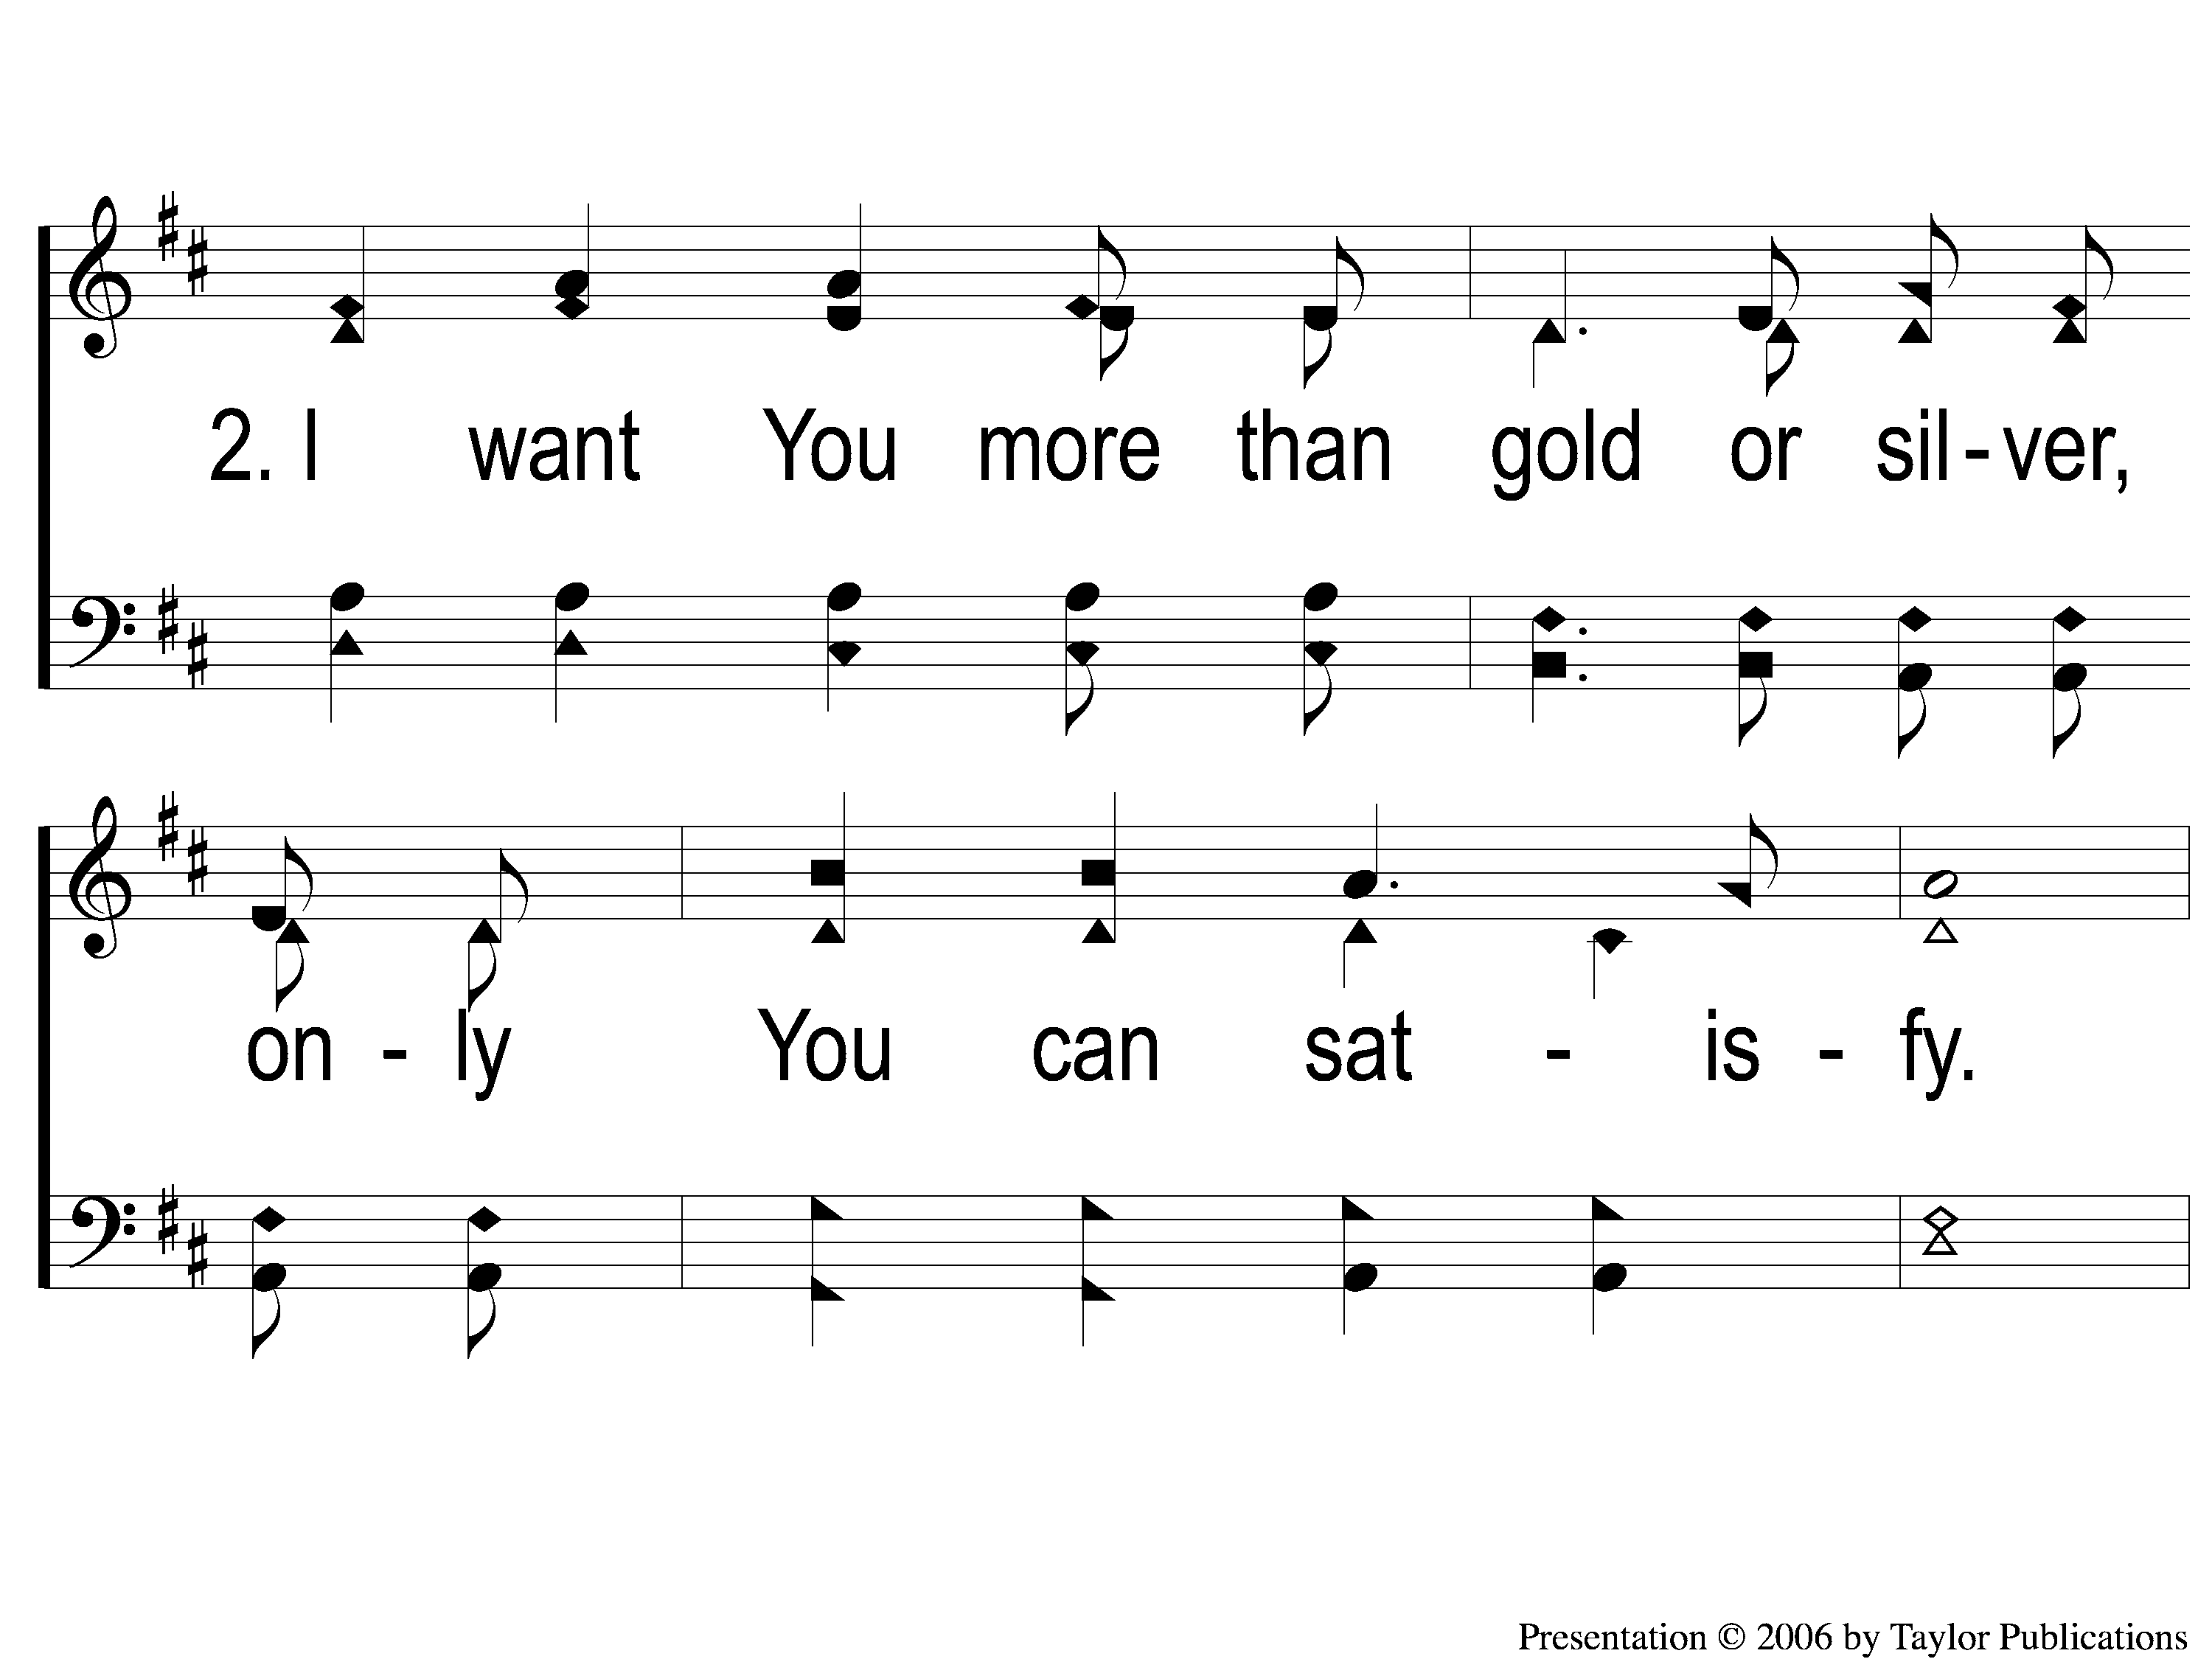
2-1 As the Deer
As The Deer
71

Slide 45
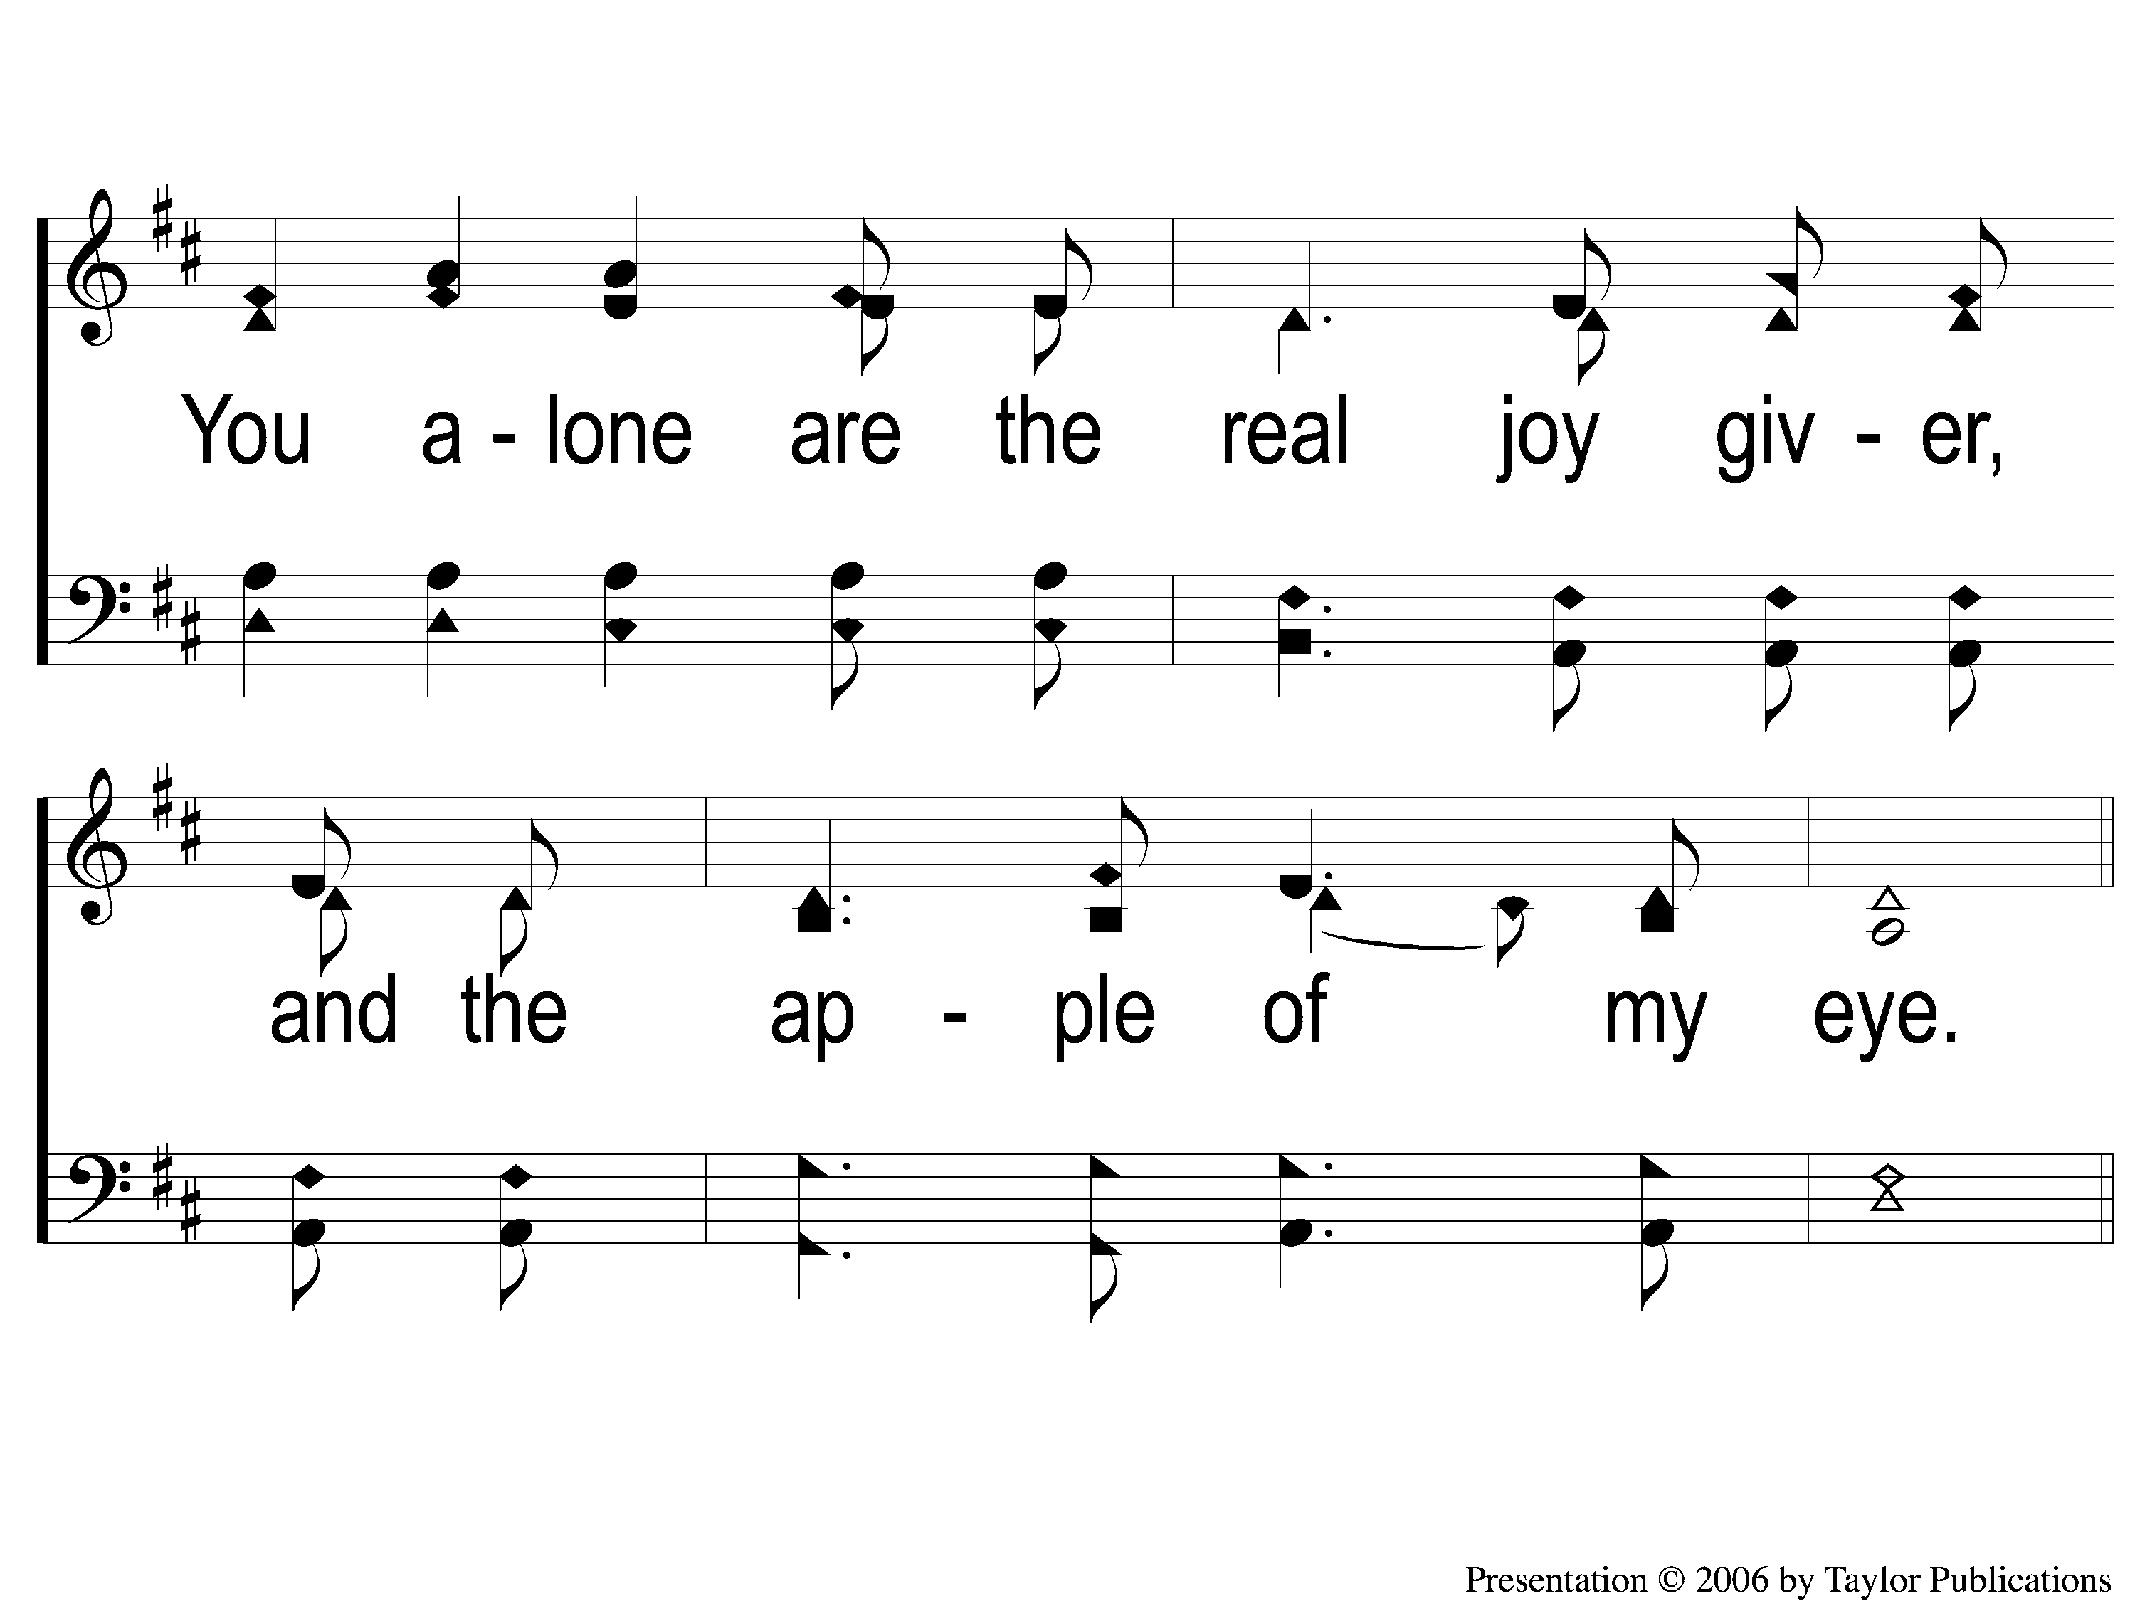
2-2 As the Deer
As The Deer
71

Slide 46
C-1 As the Deer
As The Deer
71

Slide 47
C-2 As the Deer
As The Deer
71

Slide 48
Opening Prayer

Slide 49
Song:
I Am A Poor
Wayfaring Stranger
#979

Slide 50
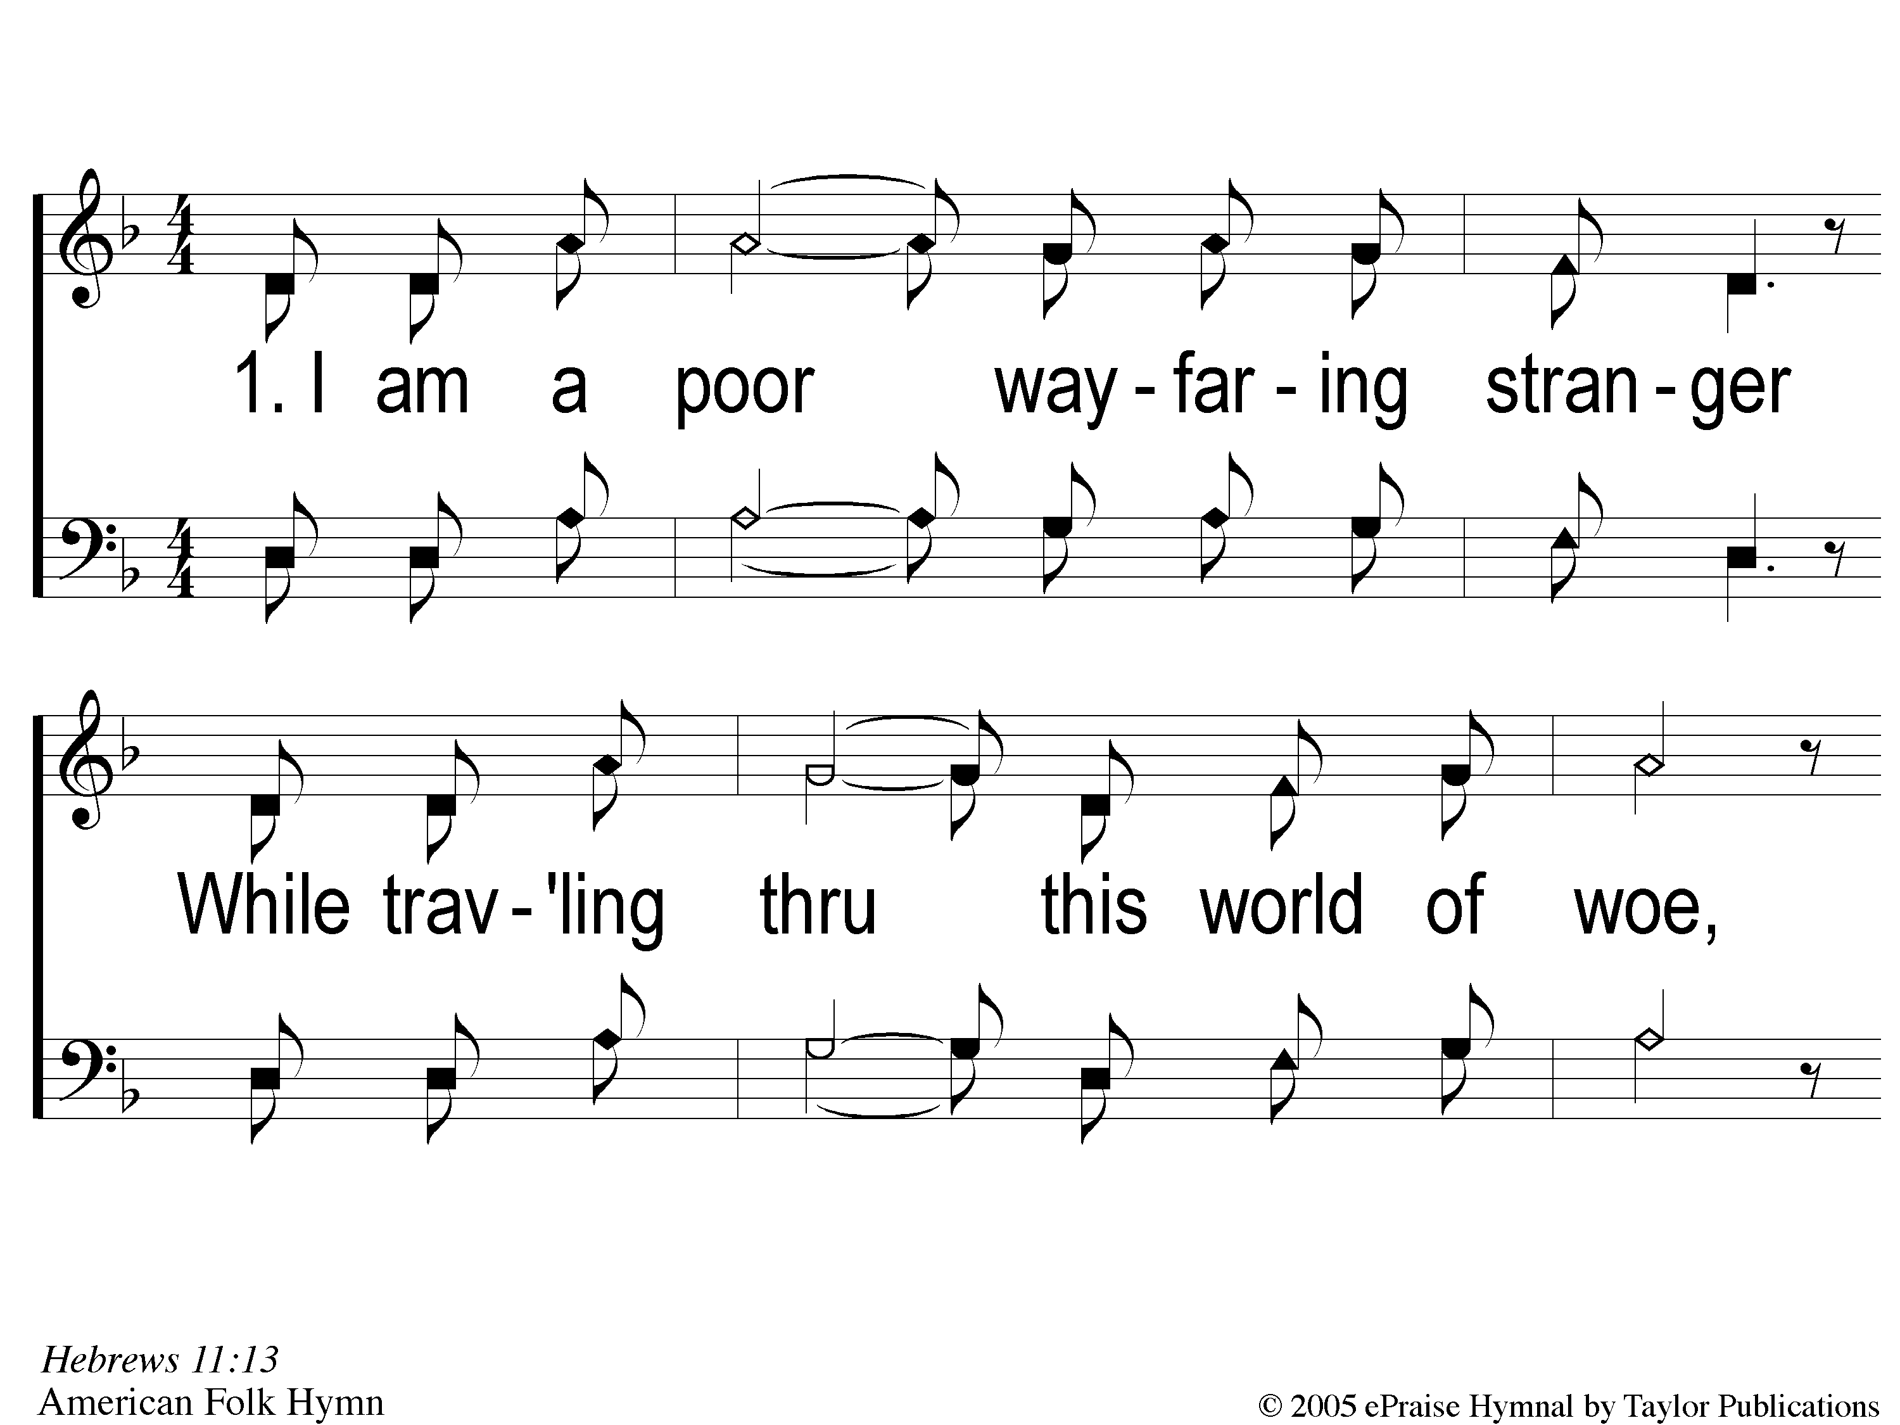
1-1 I Am A Poor Wayfaring Stranger
I Am A Poor Wayfaring Stranger
979

Slide 51
1-2 I Am A Poor Wayfaring Stranger
I Am A Poor Wayfaring Stranger
979

Slide 52
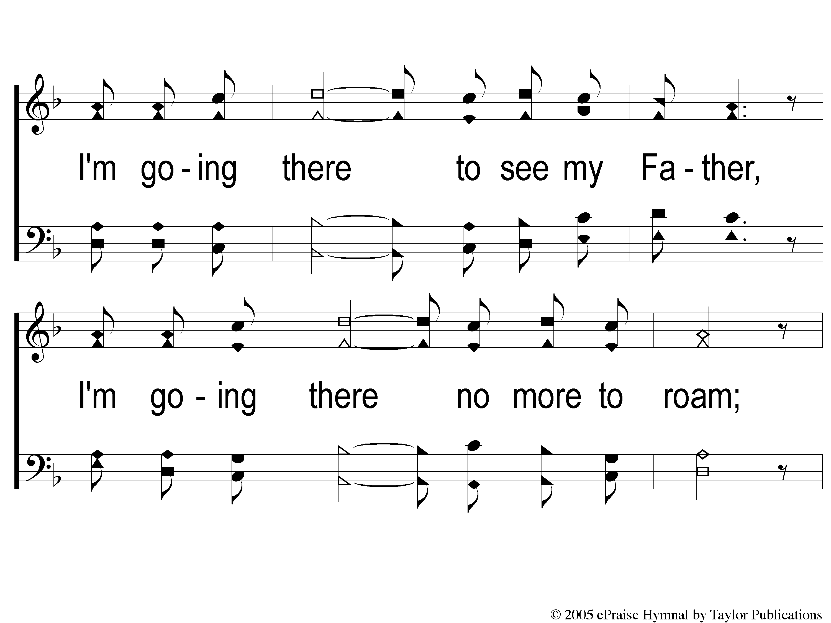
1-3 I Am A Poor Wayfaring Stranger
I Am A Poor Wayfaring Stranger
979

Slide 53
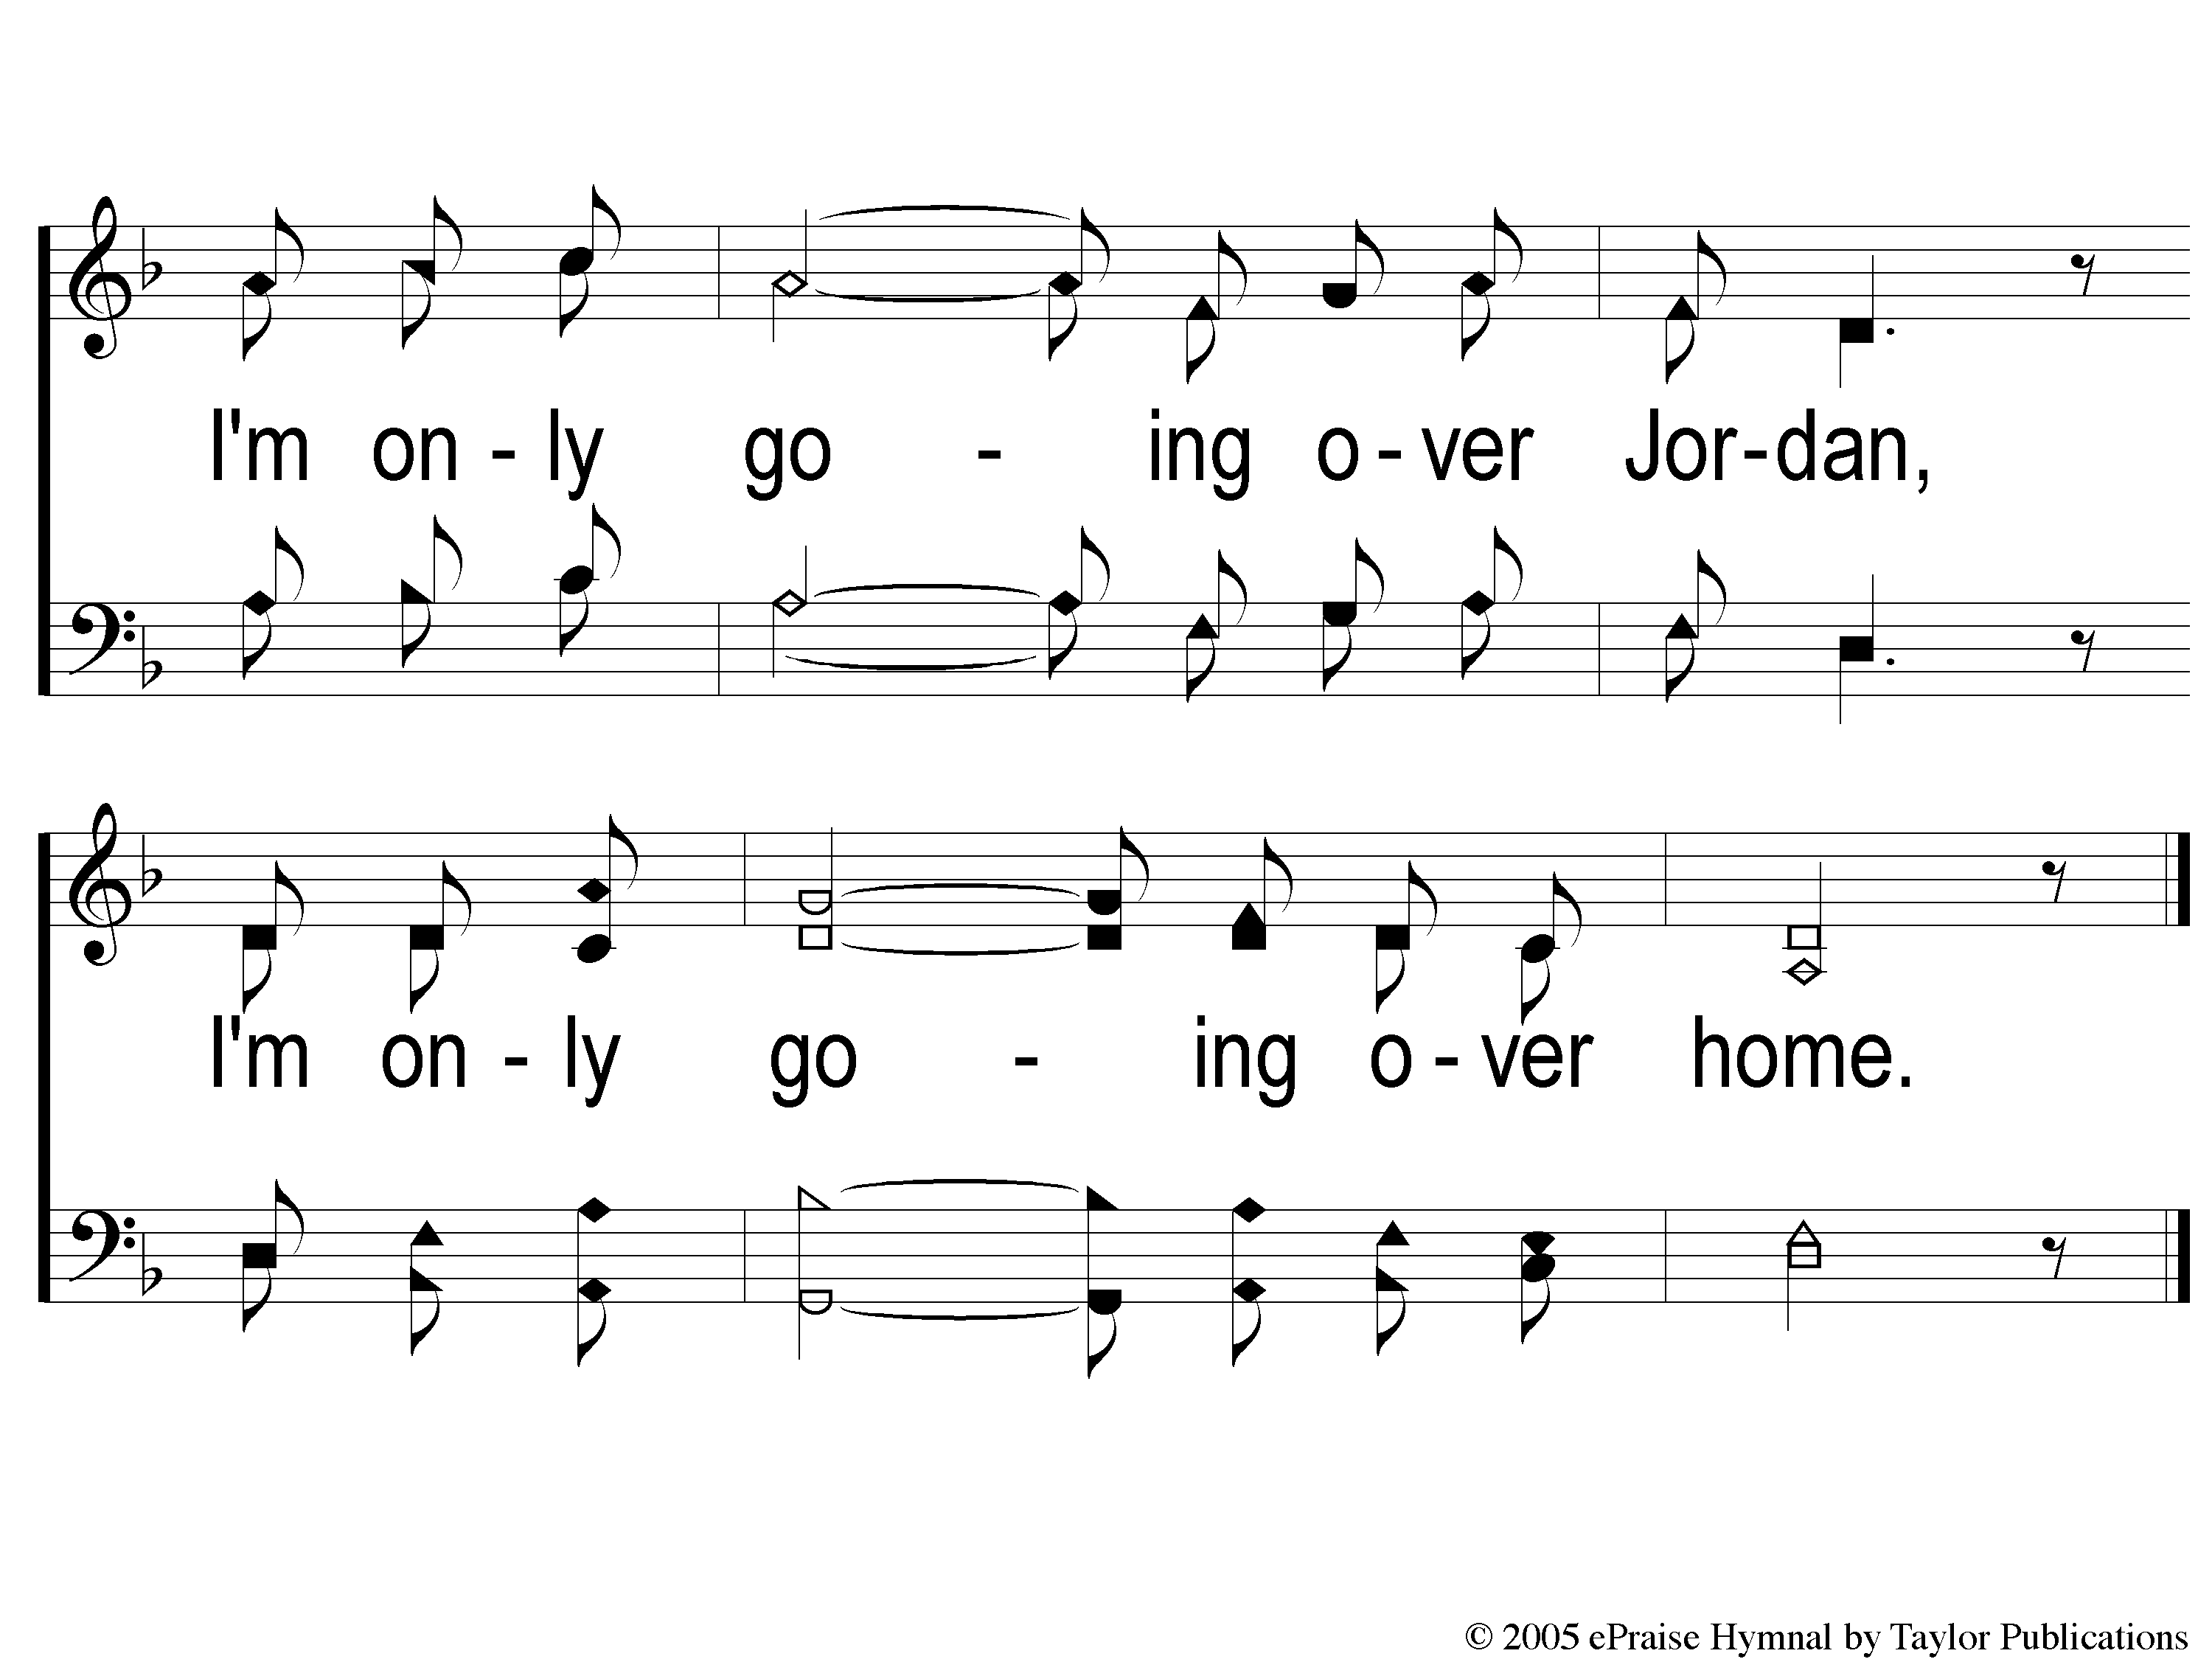
c I Am A Poor Wayfaring Stranger
I Am A Poor Wayfaring Stranger
979

Slide 54
2-1 I Am A Poor Wayfaring Stranger
I Am A Poor Wayfaring Stranger
979

Slide 55
2-2 I Am A Poor Wayfaring Stranger
I Am A Poor Wayfaring Stranger
979

Slide 56
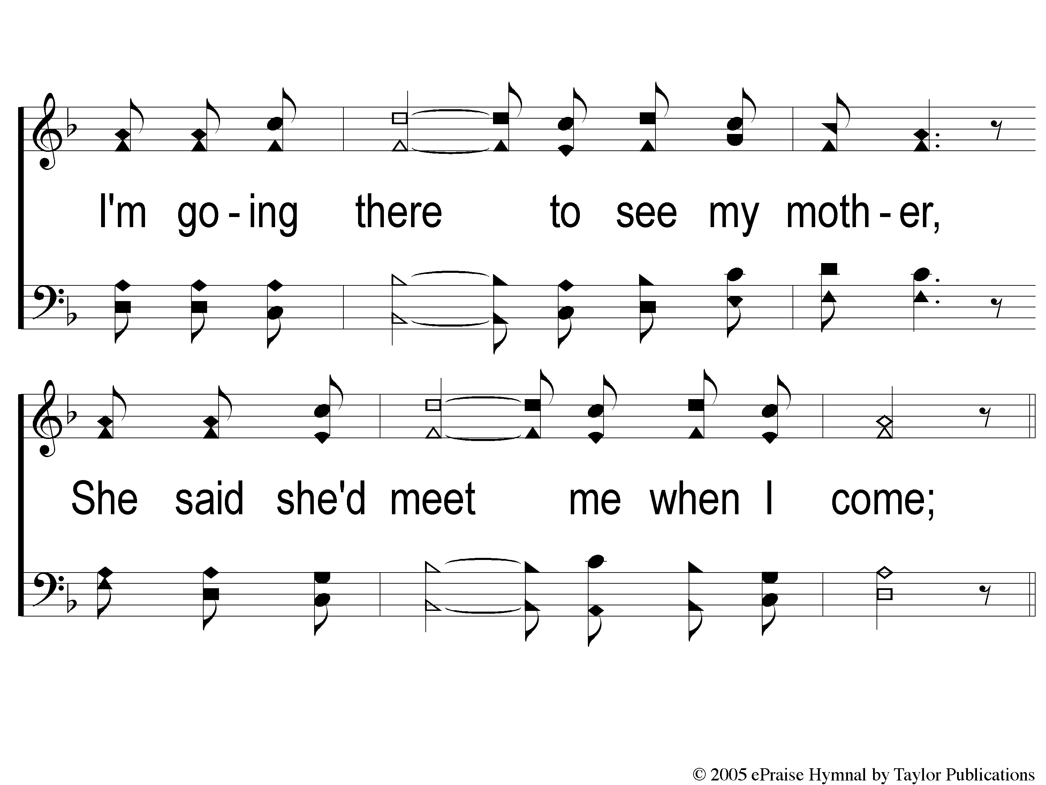
2-3 I Am A Poor Wayfaring Stranger
I Am A Poor Wayfaring Stranger
979

Slide 57
c I Am A Poor Wayfaring Stranger
I Am A Poor Wayfaring Stranger
979

Slide 58
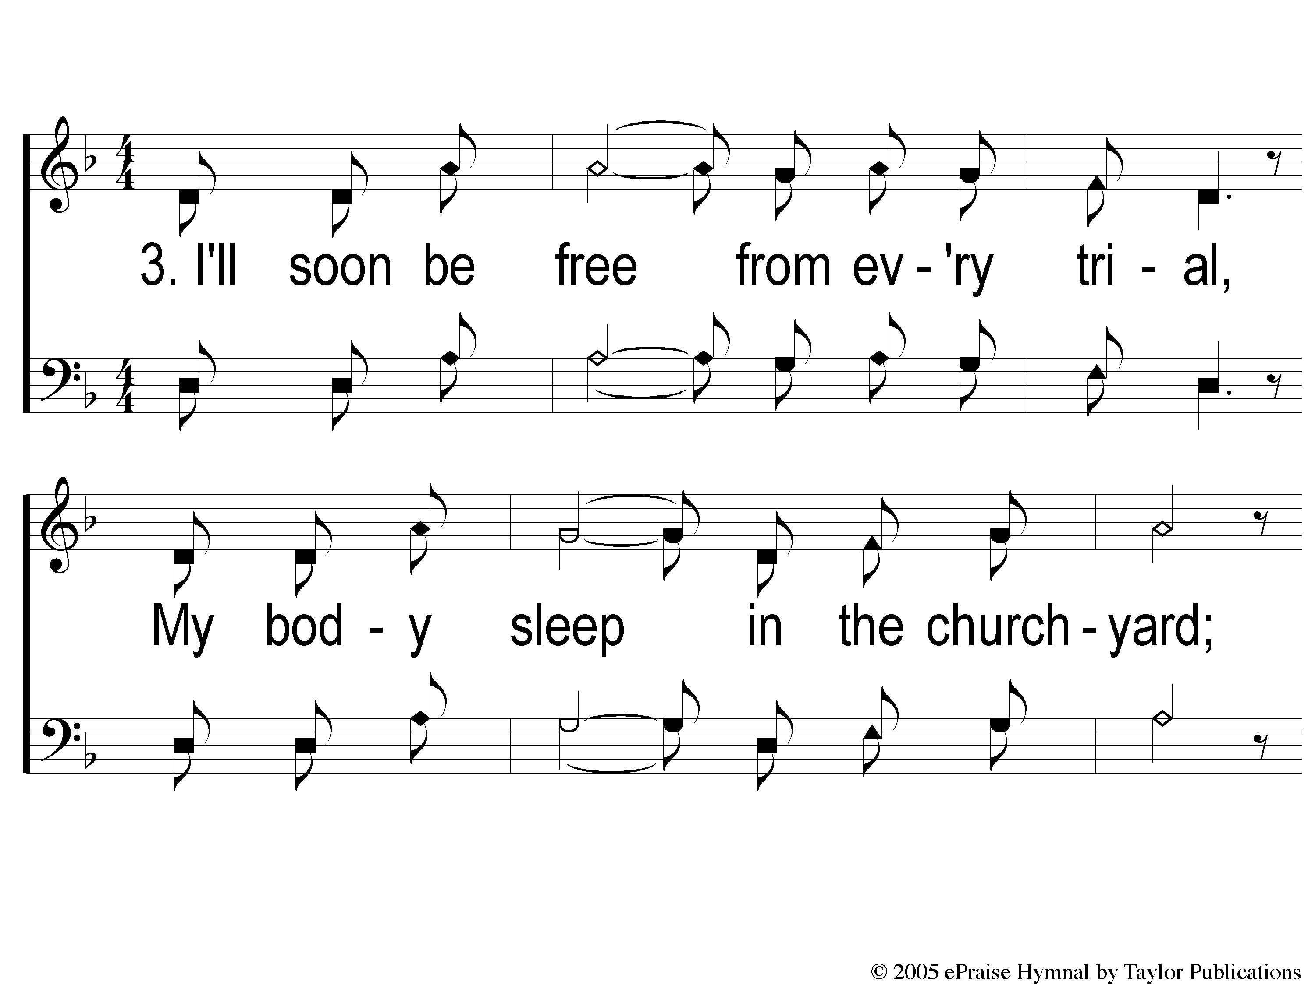
3-1 I Am A Poor Wayfaring Stranger
I Am A Poor Wayfaring Stranger
979

Slide 59
3-2 I Am A Poor Wayfaring Stranger
I Am A Poor Wayfaring Stranger
979

Slide 60
3-3 I Am A Poor Wayfaring Stranger
I Am A Poor Wayfaring Stranger
979

Slide 61
c I Am A Poor Wayfaring Stranger
I Am A Poor Wayfaring Stranger
979

Slide 62
Song:
Jesus Is Coming Soon
#712

Slide 63
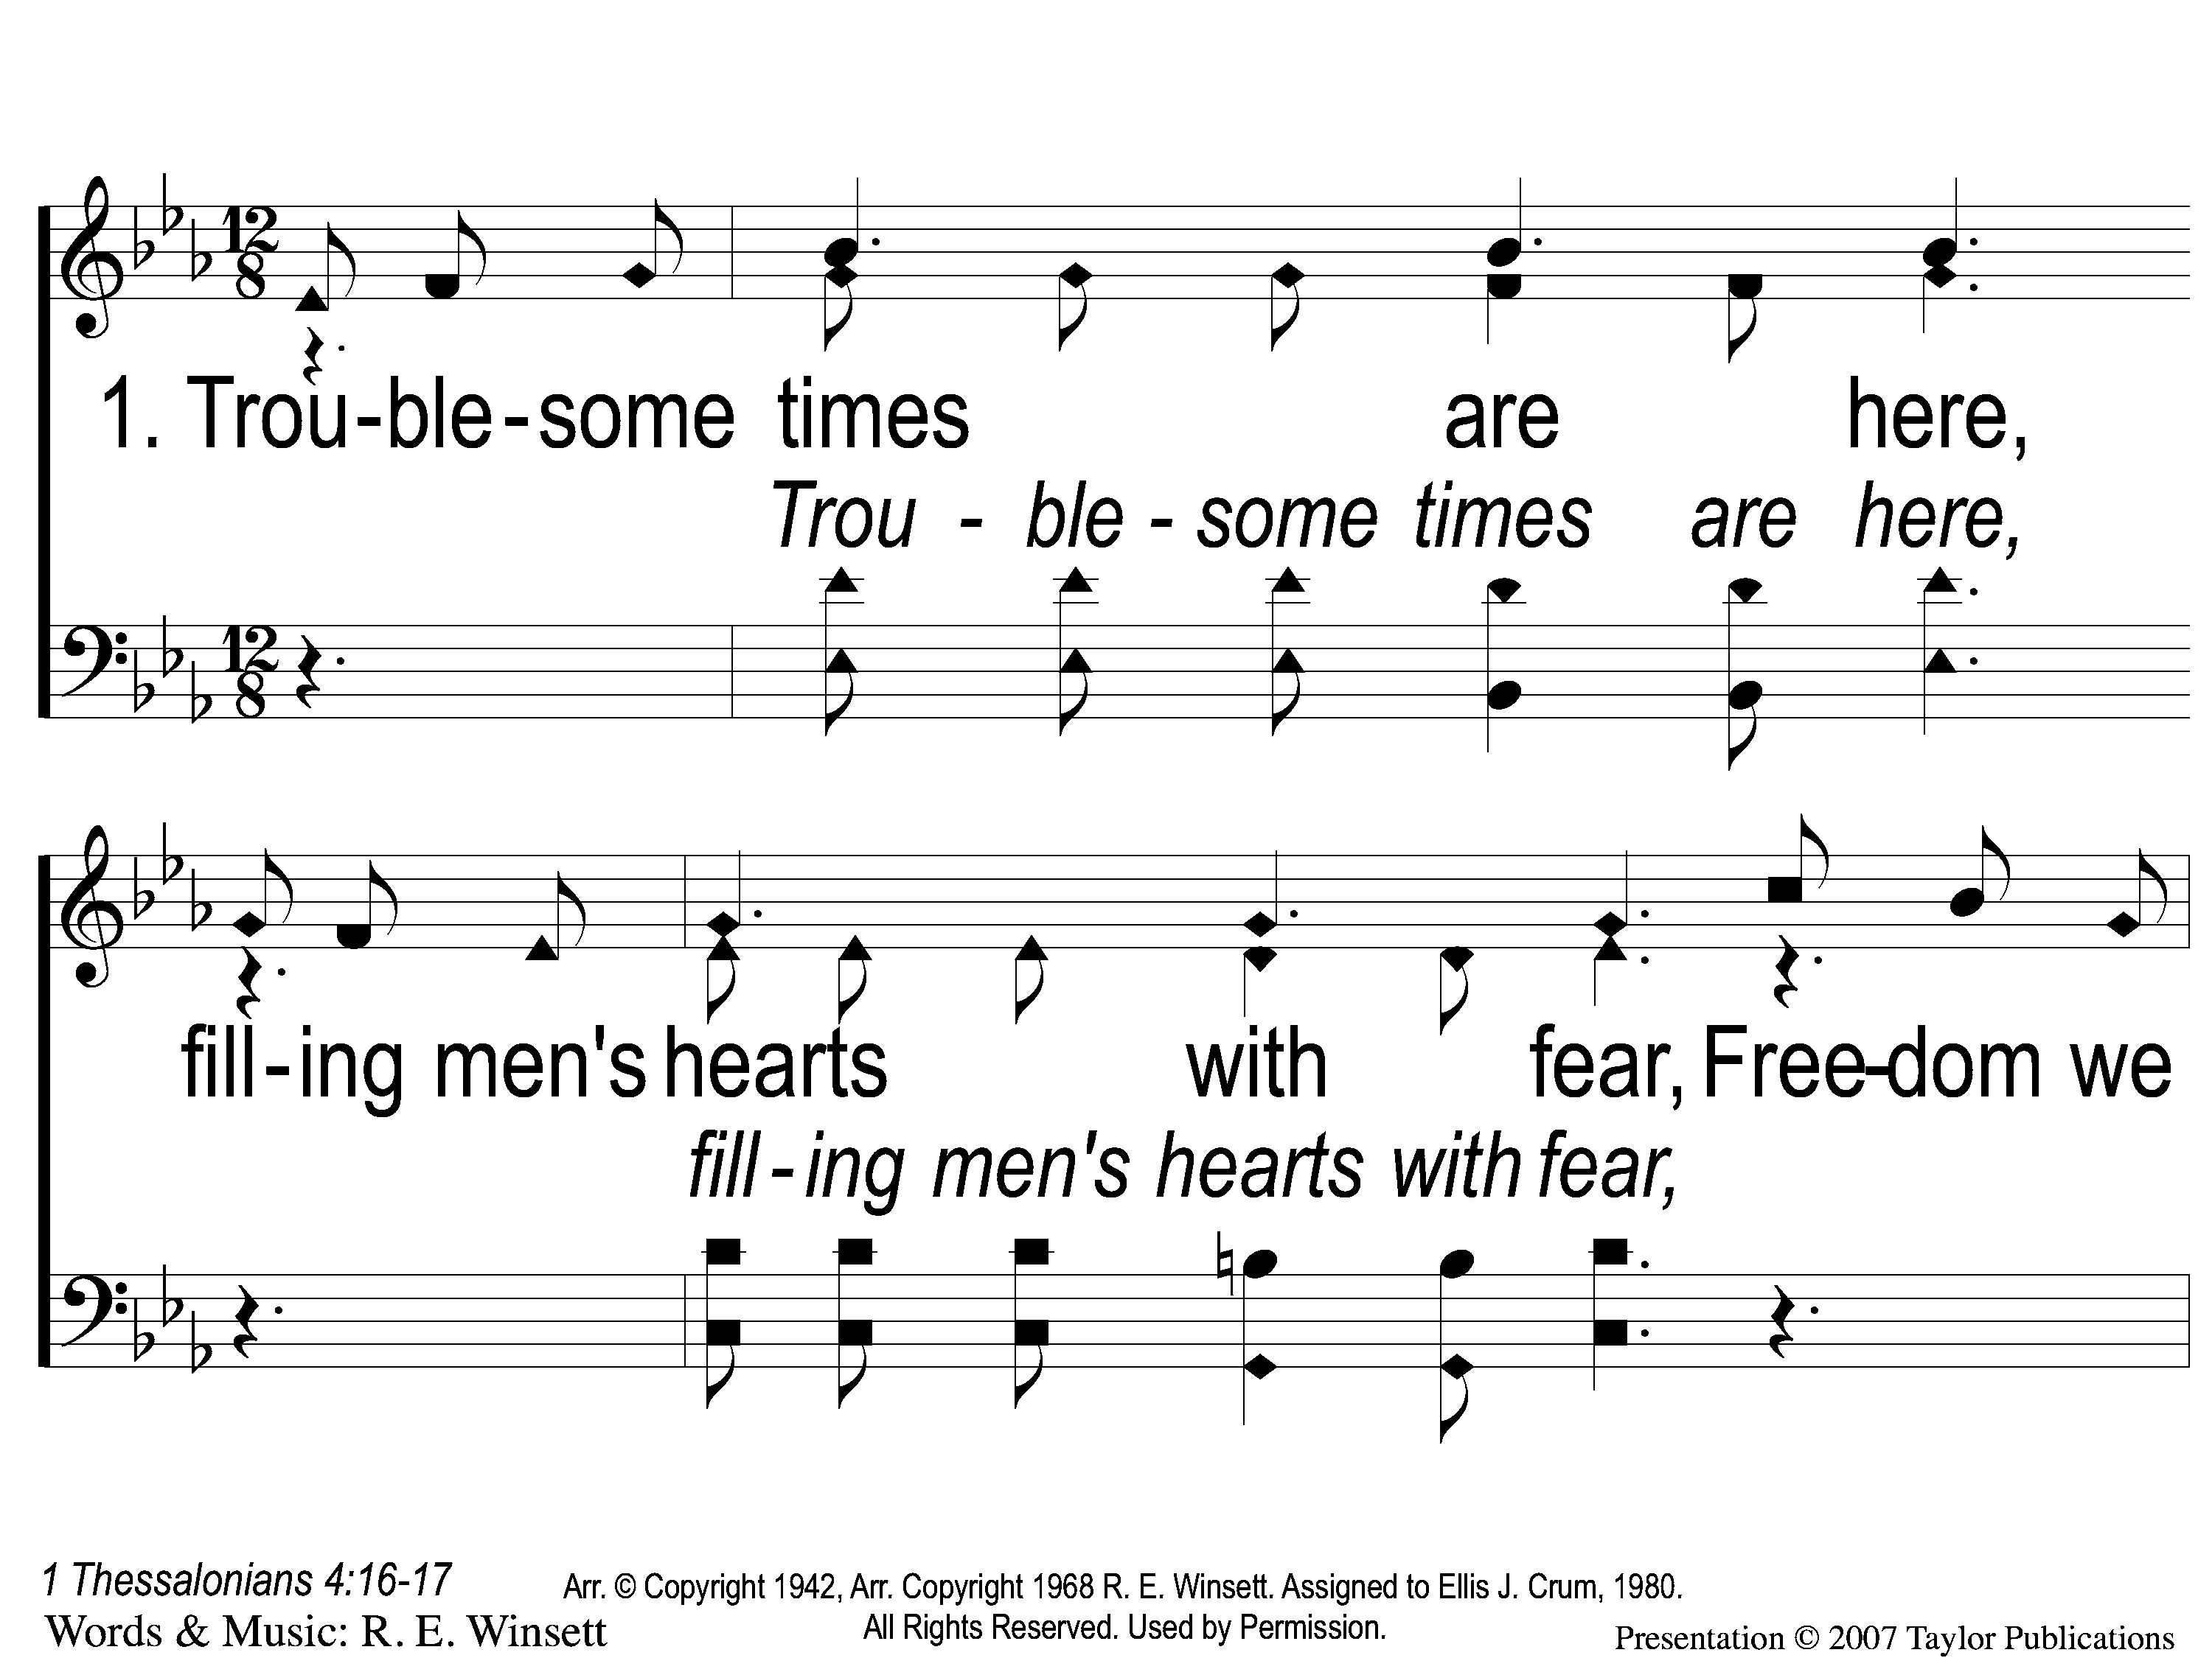
1-1 Jesus is Coming Soon
Jesus is Coming Soon
712

Slide 64
1-2 Jesus is Coming Soon
Jesus is Coming Soon
712

Slide 65
1-3 Jesus is Coming Soon
Jesus is Coming Soon
712

Slide 66
C-1 Jesus is Coming Soon
Jesus is Coming Soon
712

Slide 67
C-2 Jesus is Coming Soon
Jesus is Coming Soon
712

Slide 68
C-3 Jesus is Coming Soon
Jesus is Coming Soon
712

Slide 69
C-4 Jesus is Coming Soon
Jesus is Coming Soon
712

Slide 70
2-1 Jesus is Coming Soon
Jesus is Coming Soon
712

Slide 71
2-2 Jesus is Coming Soon
Jesus is Coming Soon
712

Slide 72
2-3 Jesus is Coming Soon
Jesus is Coming Soon
712

Slide 73
C-1 Jesus is Coming Soon
Jesus is Coming Soon
712

Slide 74
C-2 Jesus is Coming Soon
Jesus is Coming Soon
712

Slide 75
C-3 Jesus is Coming Soon
Jesus is Coming Soon
712

Slide 76
C-4 Jesus is Coming Soon
Jesus is Coming Soon
712

Slide 77
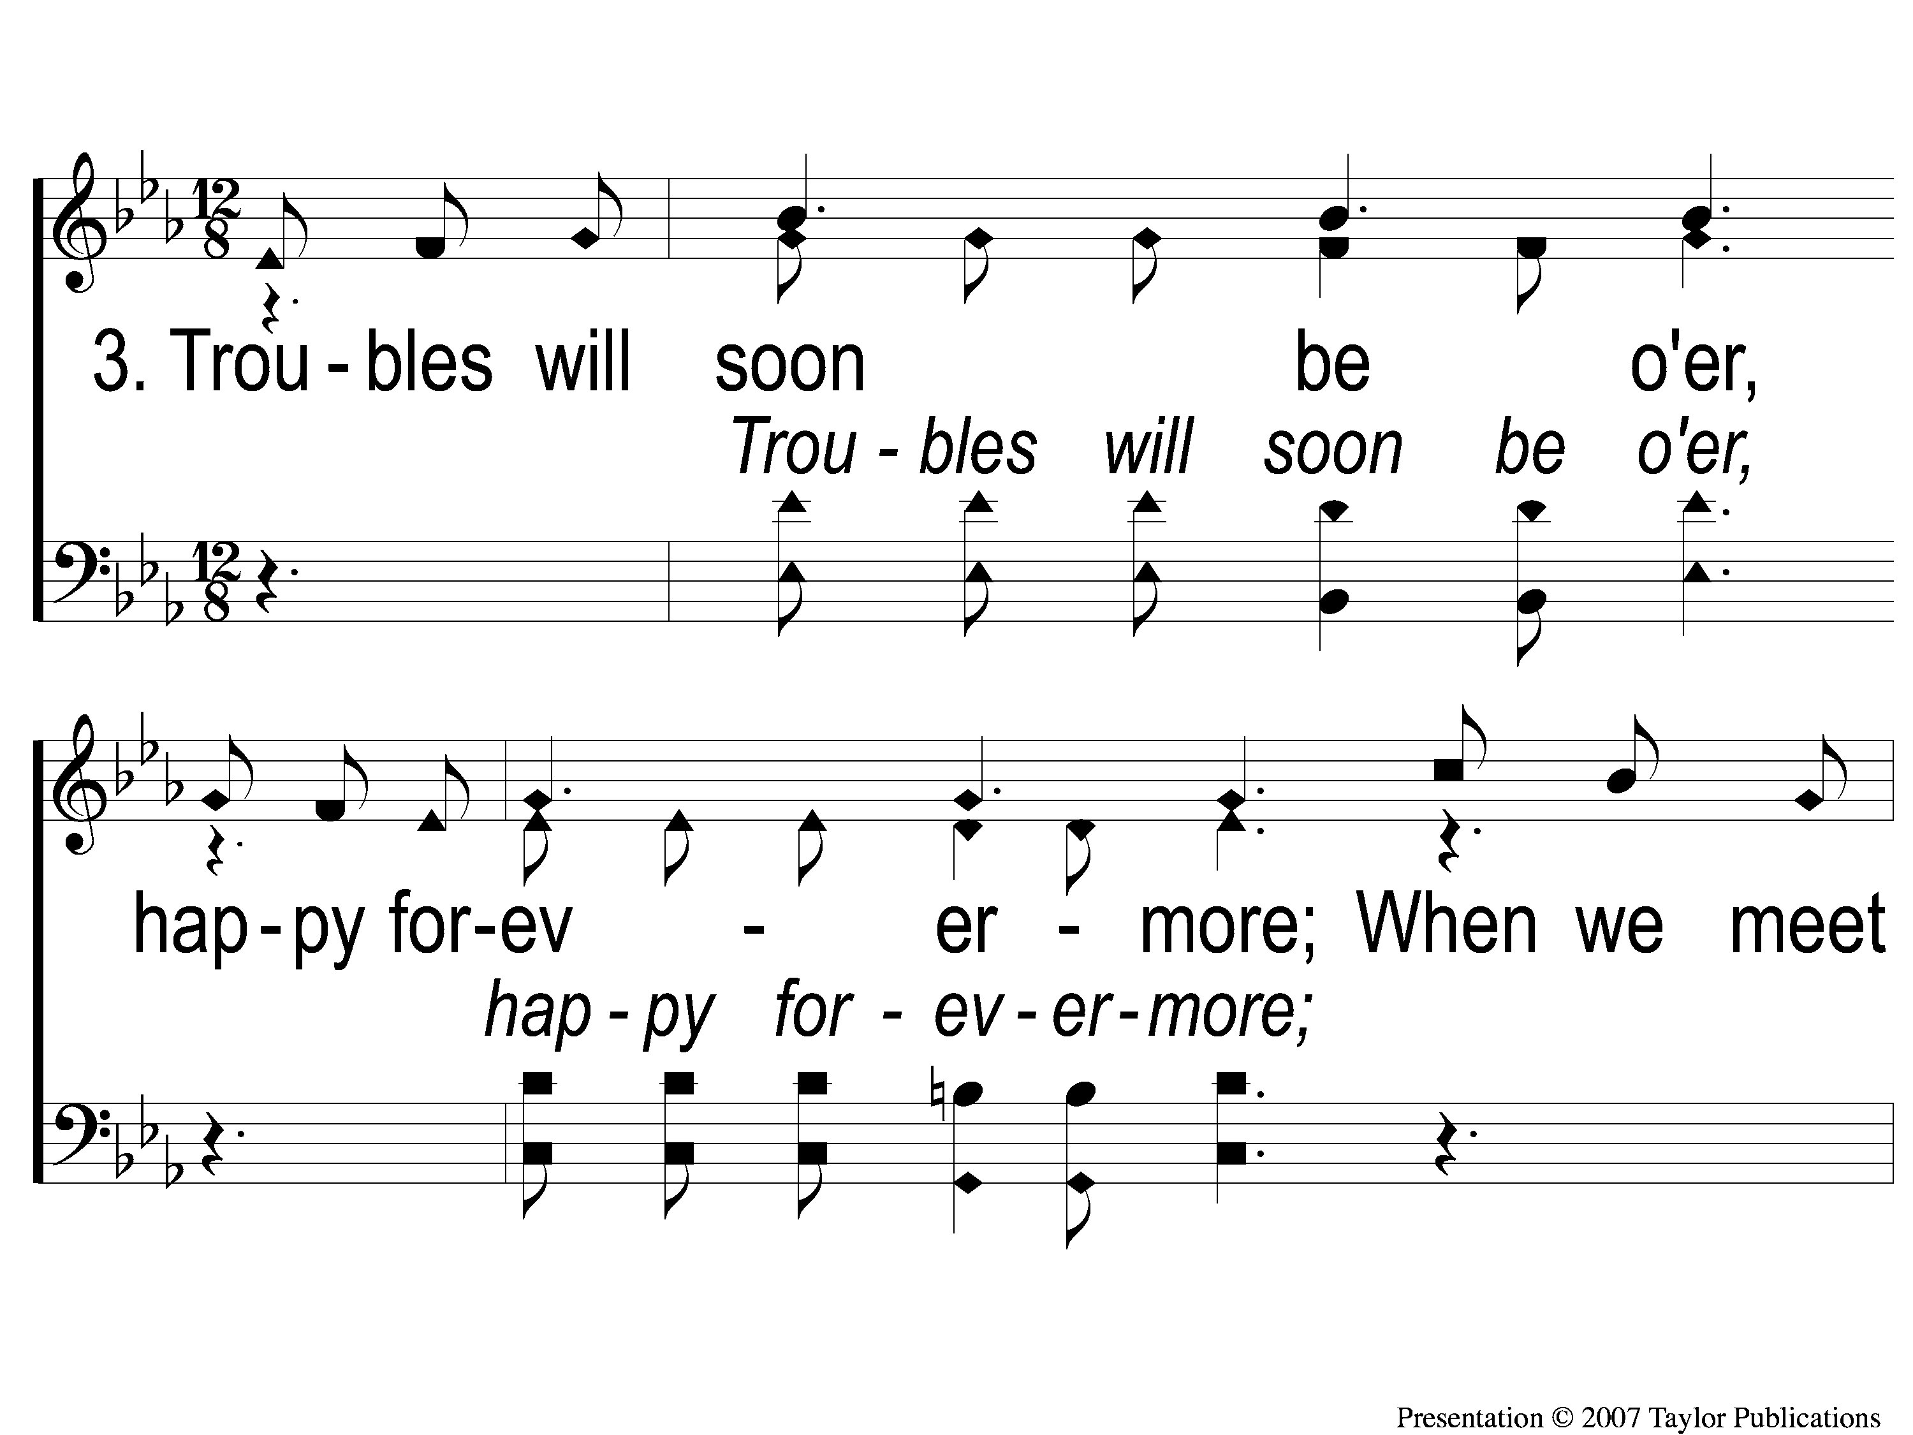
3-1 Jesus is Coming Soon
Jesus is Coming Soon
712

Slide 78
3-2 Jesus is Coming Soon
Jesus is Coming Soon
712

Slide 79
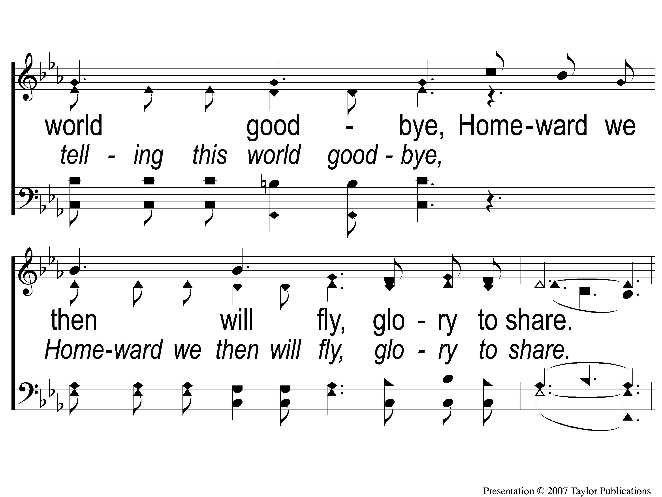
3-3 Jesus is Coming Soon
Jesus is Coming Soon
712

Slide 80
C-1 Jesus is Coming Soon
Jesus is Coming Soon
712

Slide 81
C-2 Jesus is Coming Soon
Jesus is Coming Soon
712

Slide 82
C-3 Jesus is Coming Soon
Jesus is Coming Soon
712

Slide 83
C-4 Jesus is Coming Soon
Jesus is Coming Soon
712

Slide 84
Scripture Reading:
Nehemiah 10:

Slide 85
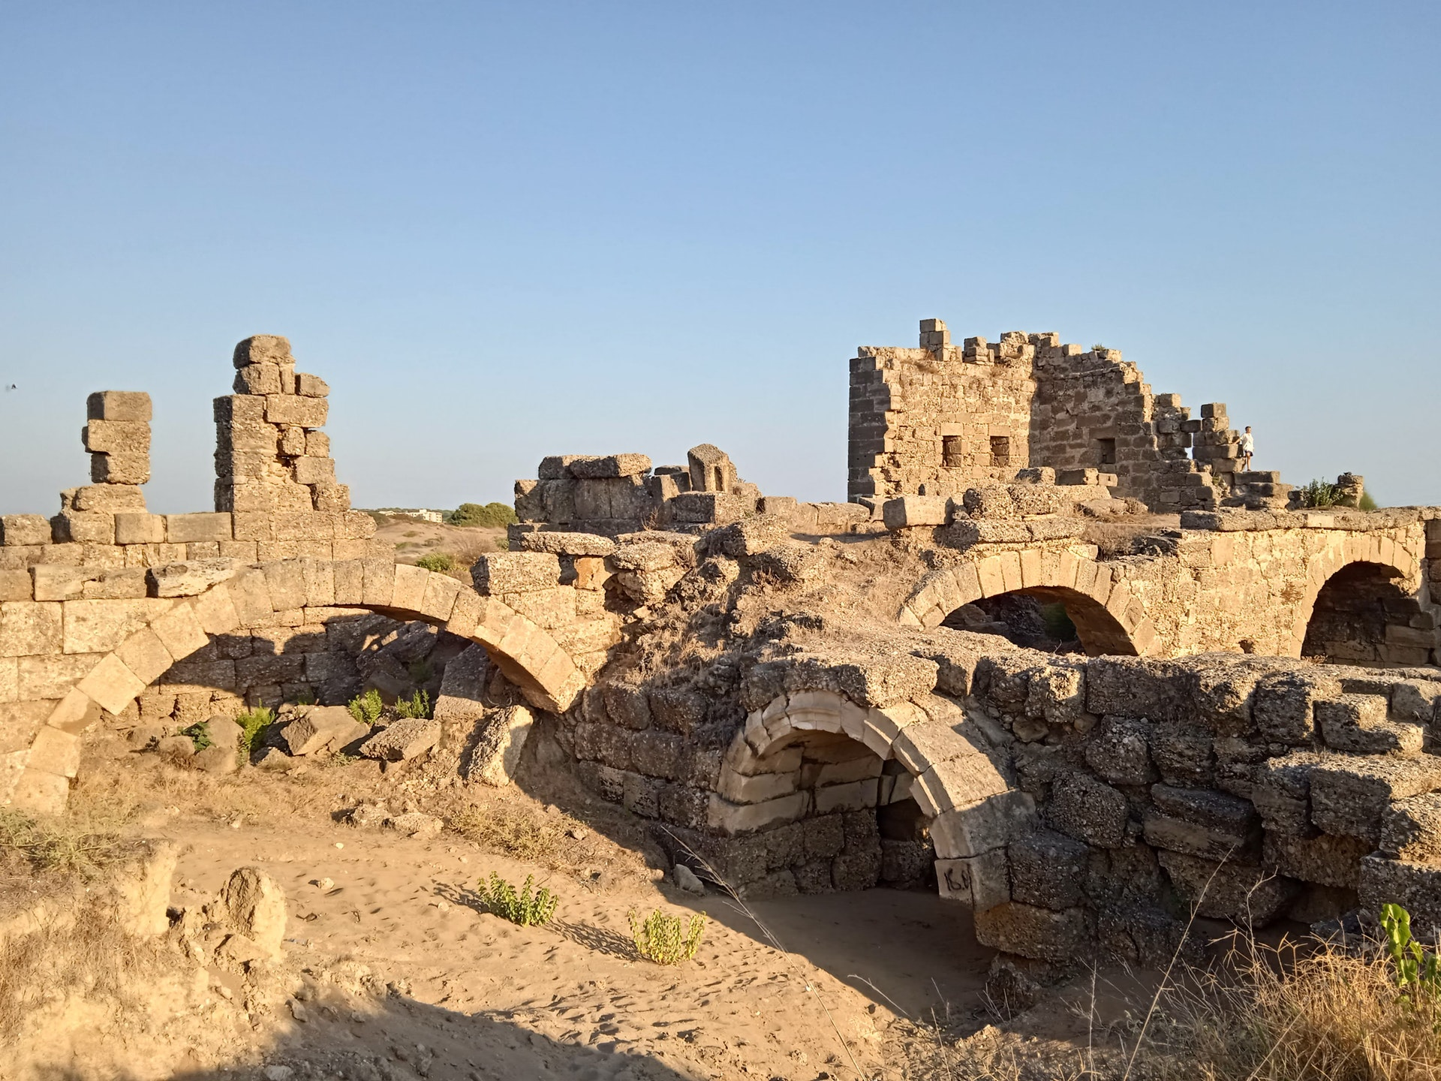
Rebuilding Jerusalem

Slide 87
Preached by JESUS – Matt. 3:2, 4:17

Slide 88
Preached by JESUS – Matt. 3:2, 4:17
Preached by PETER – Acts 2:38, 3:19

Slide 89
Preached by JESUS – Matt. 3:2, 4:17
Preached by PETER – Acts 2:38, 3:19
Preached by PAUL – Acts 17:30, 20:21

Slide 90
What Is Repentance?
OT Words:
נָחַם (nā·ḥǎm) = comforted, grieved, sorry

Slide 91
What Is Repentance?
OT Words:
נָחַם (nā·ḥǎm) = comforted, grieved, sorry
שׁוּב (šûḇ) = return, turn back

Slide 92
What Is Repentance?
OT Words:
נָחַם (nā·ḥǎm) = comforted, grieved, sorry
שׁוּב (šûḇ) = return, turn back
“be in a state of sorrow and regret about a wrong, implying a true understanding about a wrong and desire to change a thought or behavior”

Slide 93
What Is Repentance?
NT Word:
μετανοέω = change of mind

Slide 94
What Is Repentance?
NT Word:
μετανοέω = change of mind
“to change one’s way of life as the result of a complete change of thought and attitude with regard to sin and righteousness”

Slide 95
An Example of Repentance
Nehemiah
Ch. 8 – Great Assembly & Feast of Booths
Ch. 9 – Great Confession & Covenant
Ch. 10 – Great Repentance

Slide 96
An Example of Repentance
Nehemiah
Ch. 8 – Great Assembly & Feast of Booths
Ch. 9 – Great Confession & Covenant
Ch. 10 – Great Repentance
10:28-33

Slide 97
What Does Repentance Produce?
Remorse
Neh. 8:9
2 Sam. 12:13
2 Cor. 7:10
Acts 2:37

Slide 98
What Does Repentance Produce?
Restitution
Lk. 19:8, Ex. 22:1, Lev. 6:5
Ex. 20:13
Eph. 4:28, Neh. 5:10-12
Matt. 19:9, Neh. 13 & Ezra 9
Eph. 4:29

Slide 99
What Does Repentance Produce?
Rejoicing
Neh. 12:43
Lk. 15:7, 10, 22-24

Slide 100
Will You Repent?

Slide 101
When The Roll
Is Called Up Yonder
#852
Invitation
Song:

Slide 102
1-1 When The Roll Is Called Up Yonder
When The Roll Is Called Up Yonder
852

Slide 103
1-2 When The Roll Is Called Up Yonder
When The Roll Is Called Up Yonder
852

Slide 104
1-3 When The Roll Is Called Up Yonder
When The Roll Is Called Up Yonder
852

Slide 105
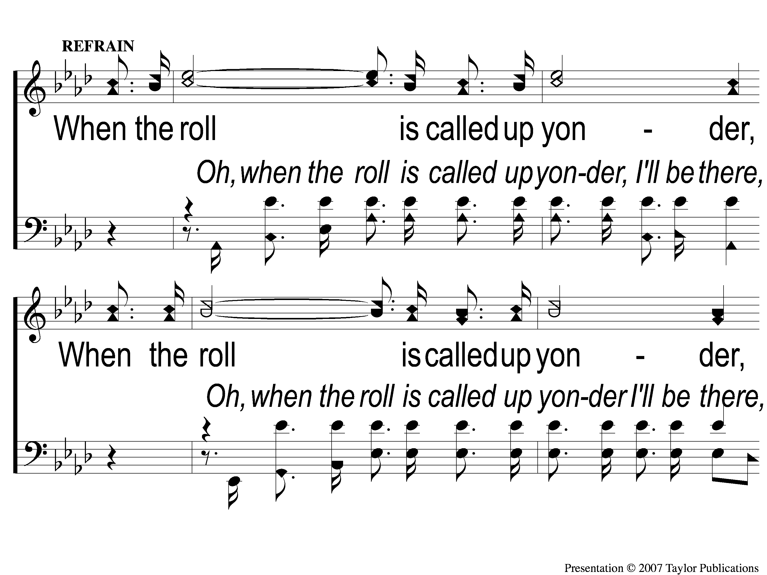
C-1 When The Roll Is Called Up Yonder
When The Roll Is Called Up Yonder
852

Slide 106
C-2 When The Roll Is Called Up Yonder
When The Roll Is Called Up Yonder
852

Slide 107
2-1 When The Roll Is Called Up Yonder
When The Roll Is Called Up Yonder
852

Slide 108
2-2 When The Roll Is Called Up Yonder
When The Roll Is Called Up Yonder
852

Slide 109
2-3 When The Roll Is Called Up Yonder
When The Roll Is Called Up Yonder
852

Slide 110
C-1 When The Roll Is Called Up Yonder
When The Roll Is Called Up Yonder
852

Slide 111
C-2 When The Roll Is Called Up Yonder
When The Roll Is Called Up Yonder
852

Slide 112
3-1 When The Roll Is Called Up Yonder
When The Roll Is Called Up Yonder
852

Slide 113
3-2 When The Roll Is Called Up Yonder
When The Roll Is Called Up Yonder
852

Slide 114
3-3 When The Roll Is Called Up Yonder
When The Roll Is Called Up Yonder
852

Slide 115
C-1 When The Roll Is Called Up Yonder
When The Roll Is Called Up Yonder
852

Slide 116
C-2 When The Roll Is Called Up Yonder
When The Roll Is Called Up Yonder
852

Slide 117
The Contribution:
Matthew 19:21
“Jesus said to him, ‘If you want to be perfect, go, sell what you have and give to the poor, and you will have treasure in heaven; and come, follow Me.’ ”

Slide 118
Song:
Come, Share The Lord
#364

Slide 119
1-1 Come Share the Lord
Come, Share The Lord
364

Slide 120
1-2 Come Share the Lord
Come, Share The Lord
364

Slide 121
C-1 Come Share the Lord
Come, Share The Lord
364

Slide 122
2-1 Come Share the Lord
Come, Share The Lord
364

Slide 123
2-2 Come Share the Lord
Come, Share The Lord
364

Slide 124
C-2 Come Share the Lord
Come, Share The Lord
364

Slide 125
3-1 Come Share the Lord
Come, Share The Lord
364

Slide 126
3-2 Come Share the Lord
Come, Share The Lord
364

Slide 127
The Unleavened Bread
Matthew 26:26
“And as they were eating, Jesus took bread, blessed and broke it, and gave it to the disciples and said, ‘Take, eat; this is My body.’ ”

Slide 128
The Fruit
of the Vine
Matthew 26:27-29
“Then He took the cup, and gave thanks, and gave it to them, saying, ‘Drink from it, all of you. For this is My blood of the new covenant, which is shed for many for the remission of sins. But I say to you, I will not drink of this fruit of the vine from now on until that day when I drink it new with you in My Father’s kingdom.’ ”

Slide 129
Closing Prayer

Slide 130
Song:
The Greatest Commands
#313

Slide 131
1-1 I’ll Fly Away
I’ll Fly Away
851

Slide 132
1-2 I’ll Fly Away
I’ll Fly Away
851

Slide 133
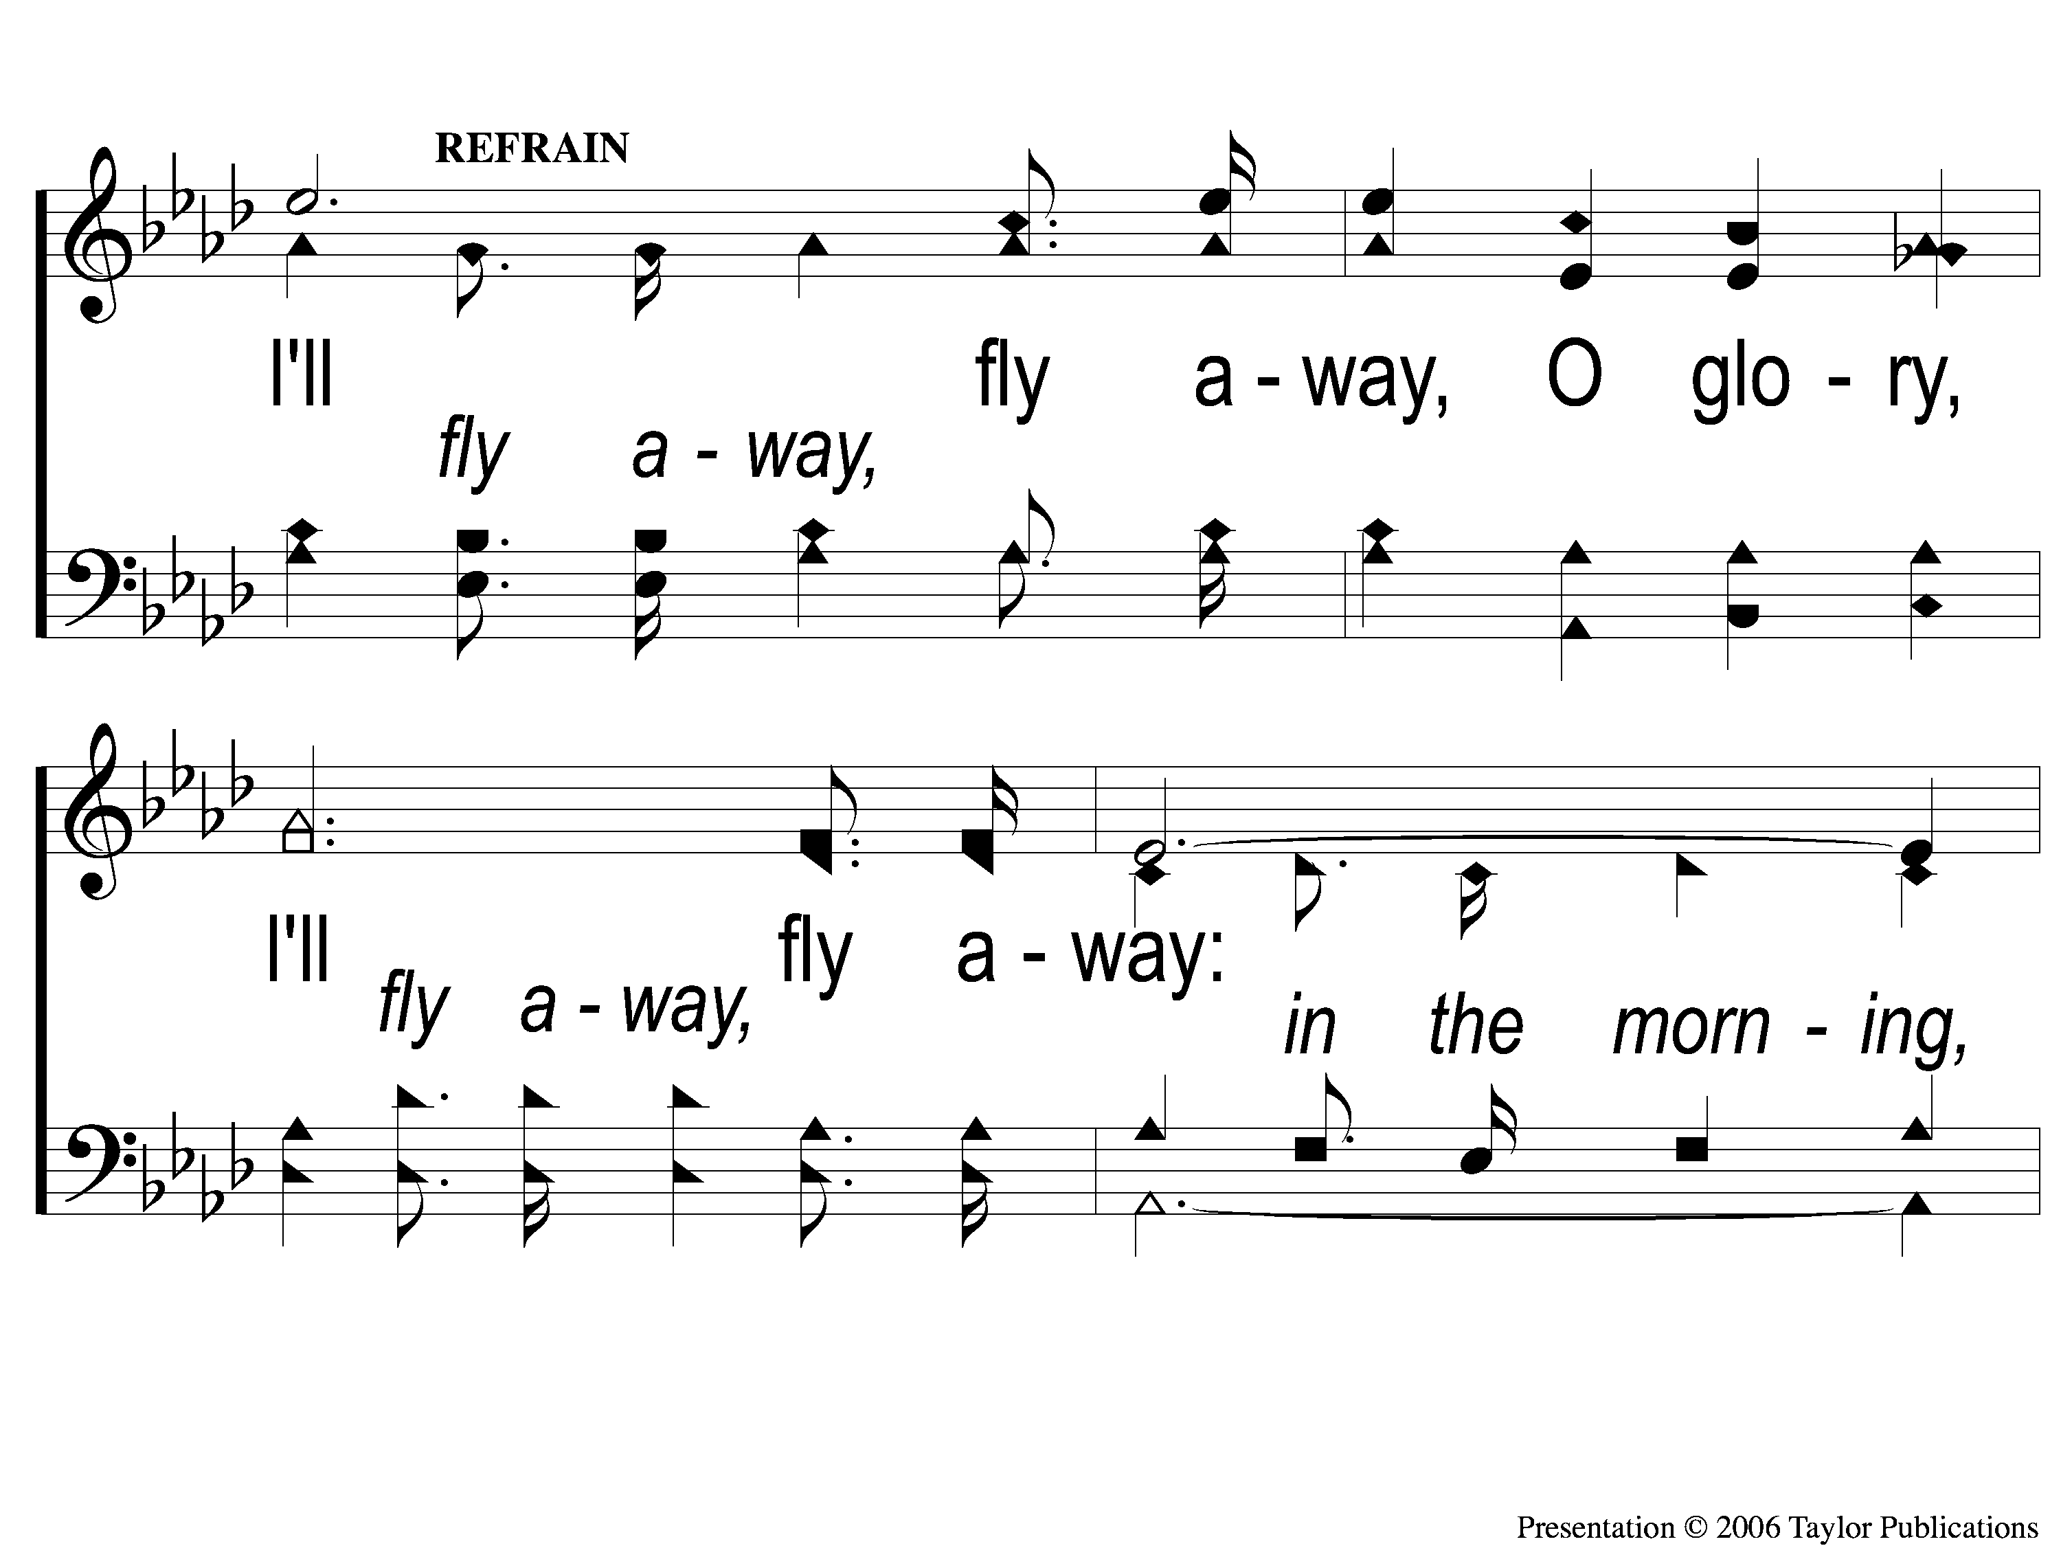
C-1 I’ll Fly Away
I’ll Fly Away
851

Slide 134
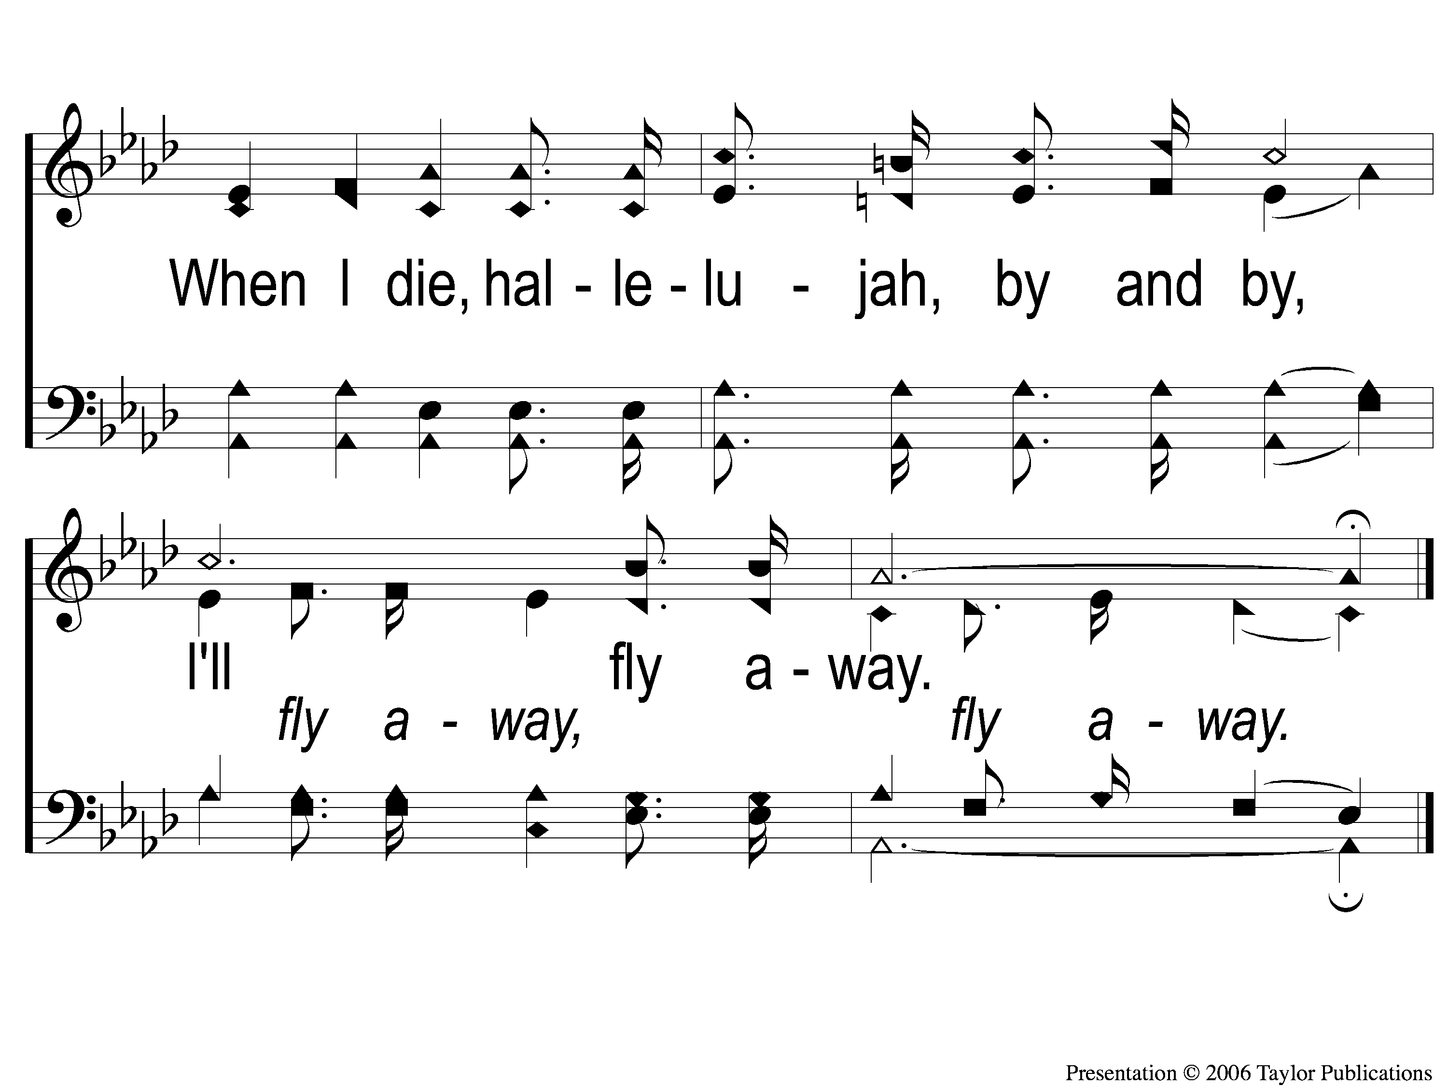
C-2 I’ll Fly Away
I’ll Fly Away
851

Slide 135
2-1 I’ll Fly Away
I’ll Fly Away
851

Slide 136
2-2 I’ll Fly Away
I’ll Fly Away
851

Slide 137
C-1 I’ll Fly Away
I’ll Fly Away
851

Slide 138
C-2 I’ll Fly Away
I’ll Fly Away
851

Slide 139
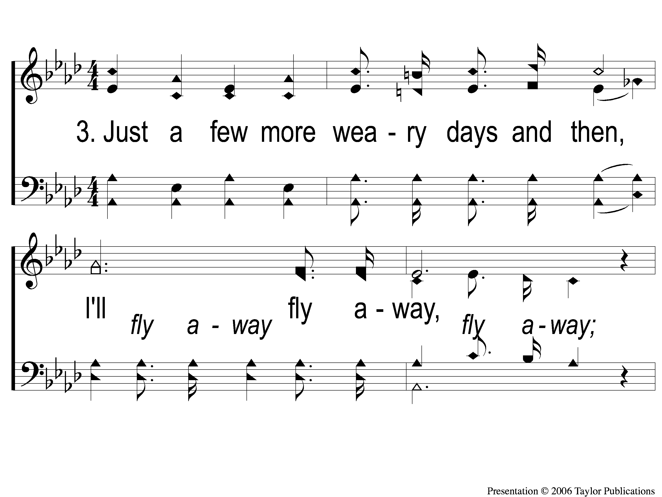
3-1 I’ll Fly Away
I’ll Fly Away
851

Slide 140
3-2 I’ll Fly Away
I’ll Fly Away
851

Slide 141
C-1 I’ll Fly Away
I’ll Fly Away
851

Slide 142
C-2 I’ll Fly Away
I’ll Fly Away
851

Slide 143
RESTORE REBUILD RENEW
Today
Evening Worship @ 6:00 PM
Wednesday
Family night @ The Pages’ Home
IN 2022
WHEELER
CHURCH
OF
CHRIST

