Slide 1
PLEASE
STANDBY
Our Livestream Will Begin Soon

Slide 2
1-1 Listen to our Hearts
Listen To Our Hearts
810

Slide 3
1-2 Listen to our Hearts
Listen To Our Hearts
810

Slide 4
1-3 Listen to our Hearts
Listen To Our Hearts
810

Slide 5
C-1 Listen to our Hearts
Listen To Our Hearts
810

Slide 6
C-2 Listen to our Hearts
Listen To Our Hearts
810

Slide 7
C-3 Listen to our Hearts
Listen To Our Hearts
810

Slide 8
C-4 Listen to our Hearts
Listen To Our Hearts
810

Slide 9
2-1 Listen to our Hearts
Listen To Our Hearts
810

Slide 10
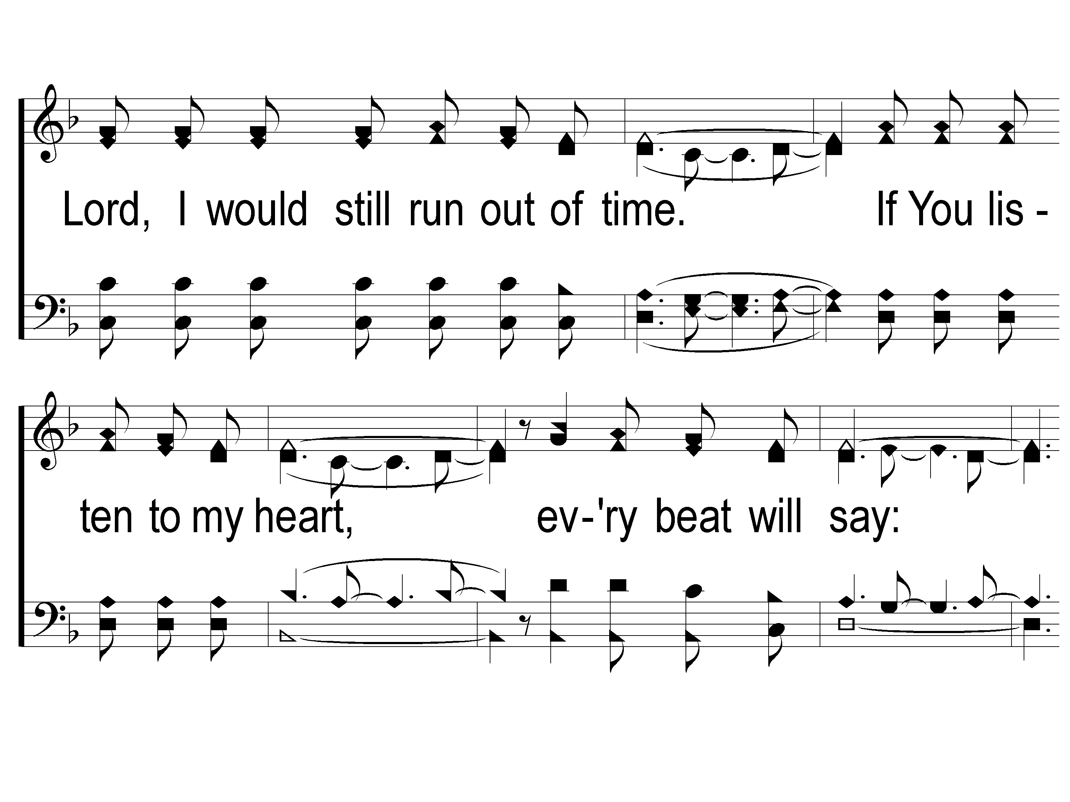
2-2 Listen to our Hearts
Listen To Our Hearts
810

Slide 11
2-3 Listen to our Hearts
Listen To Our Hearts
810

Slide 12
C-1 Listen to our Hearts
Listen To Our Hearts
810

Slide 13
C-2 Listen to our Hearts
Listen To Our Hearts
810

Slide 14
C-3 Listen to our Hearts
Listen To Our Hearts
810

Slide 15
C-4 Listen to our Hearts
Listen To Our Hearts
810

Slide 16
WELCOME
THANKS FOR JOINING US!

Slide 17
SONG #570
A BEAUTIFUL LIFE

Slide 18
1-1 A Beautiful Life
A Beautiful Life
570

Slide 19
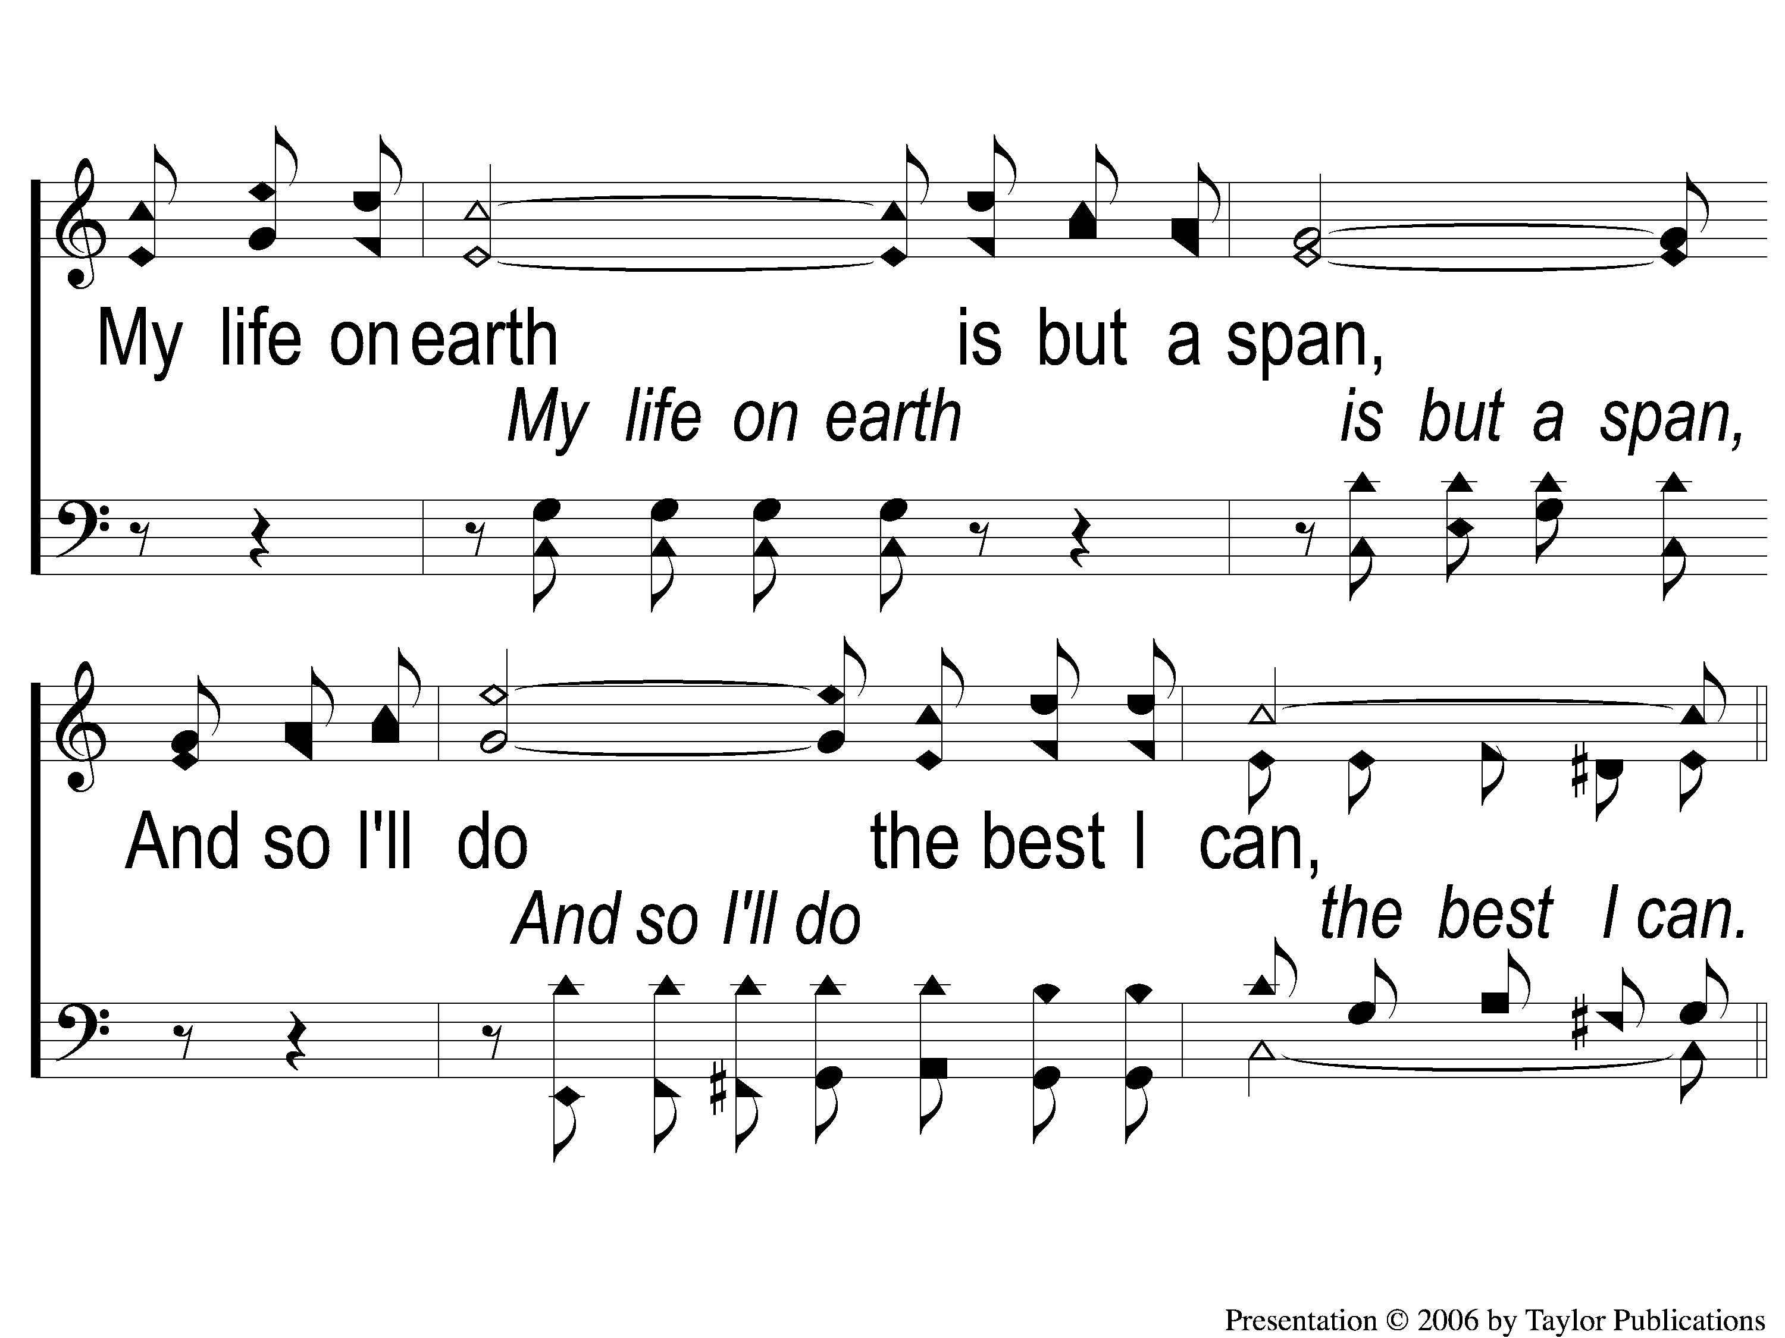
1-2 A Beautiful Life
A Beautiful Life
570

Slide 20
C-1 A Beautiful Life
A Beautiful Life
570

Slide 21
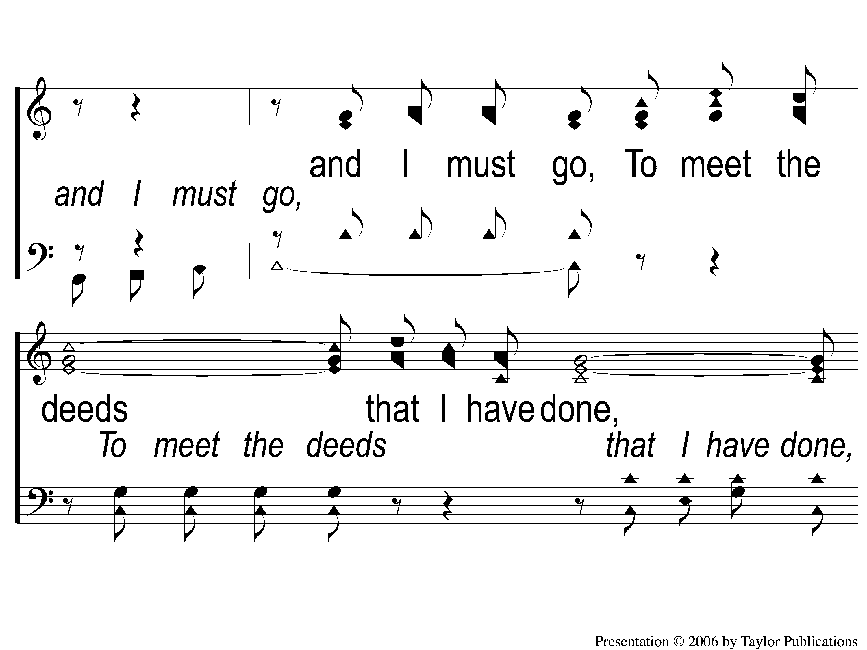
C-2 A Beautiful Life
A Beautiful Life
570

Slide 22
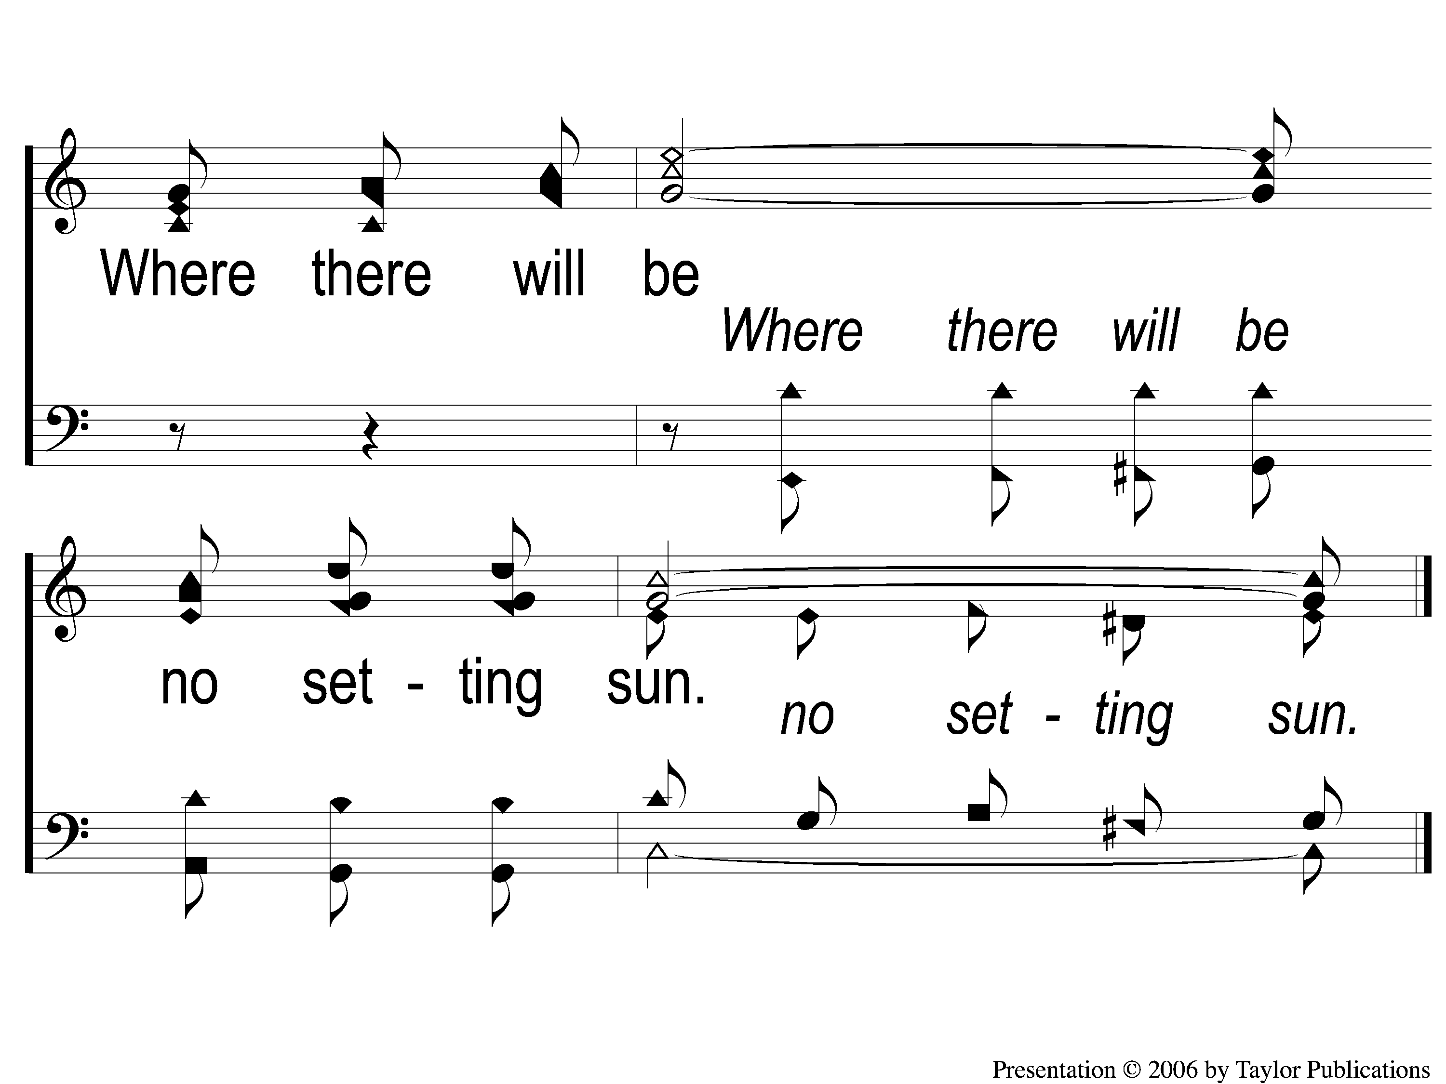
C-3 A Beautiful Life
A Beautiful Life
570

Slide 23
2-1 A Beautiful Life
A Beautiful Life
570

Slide 24
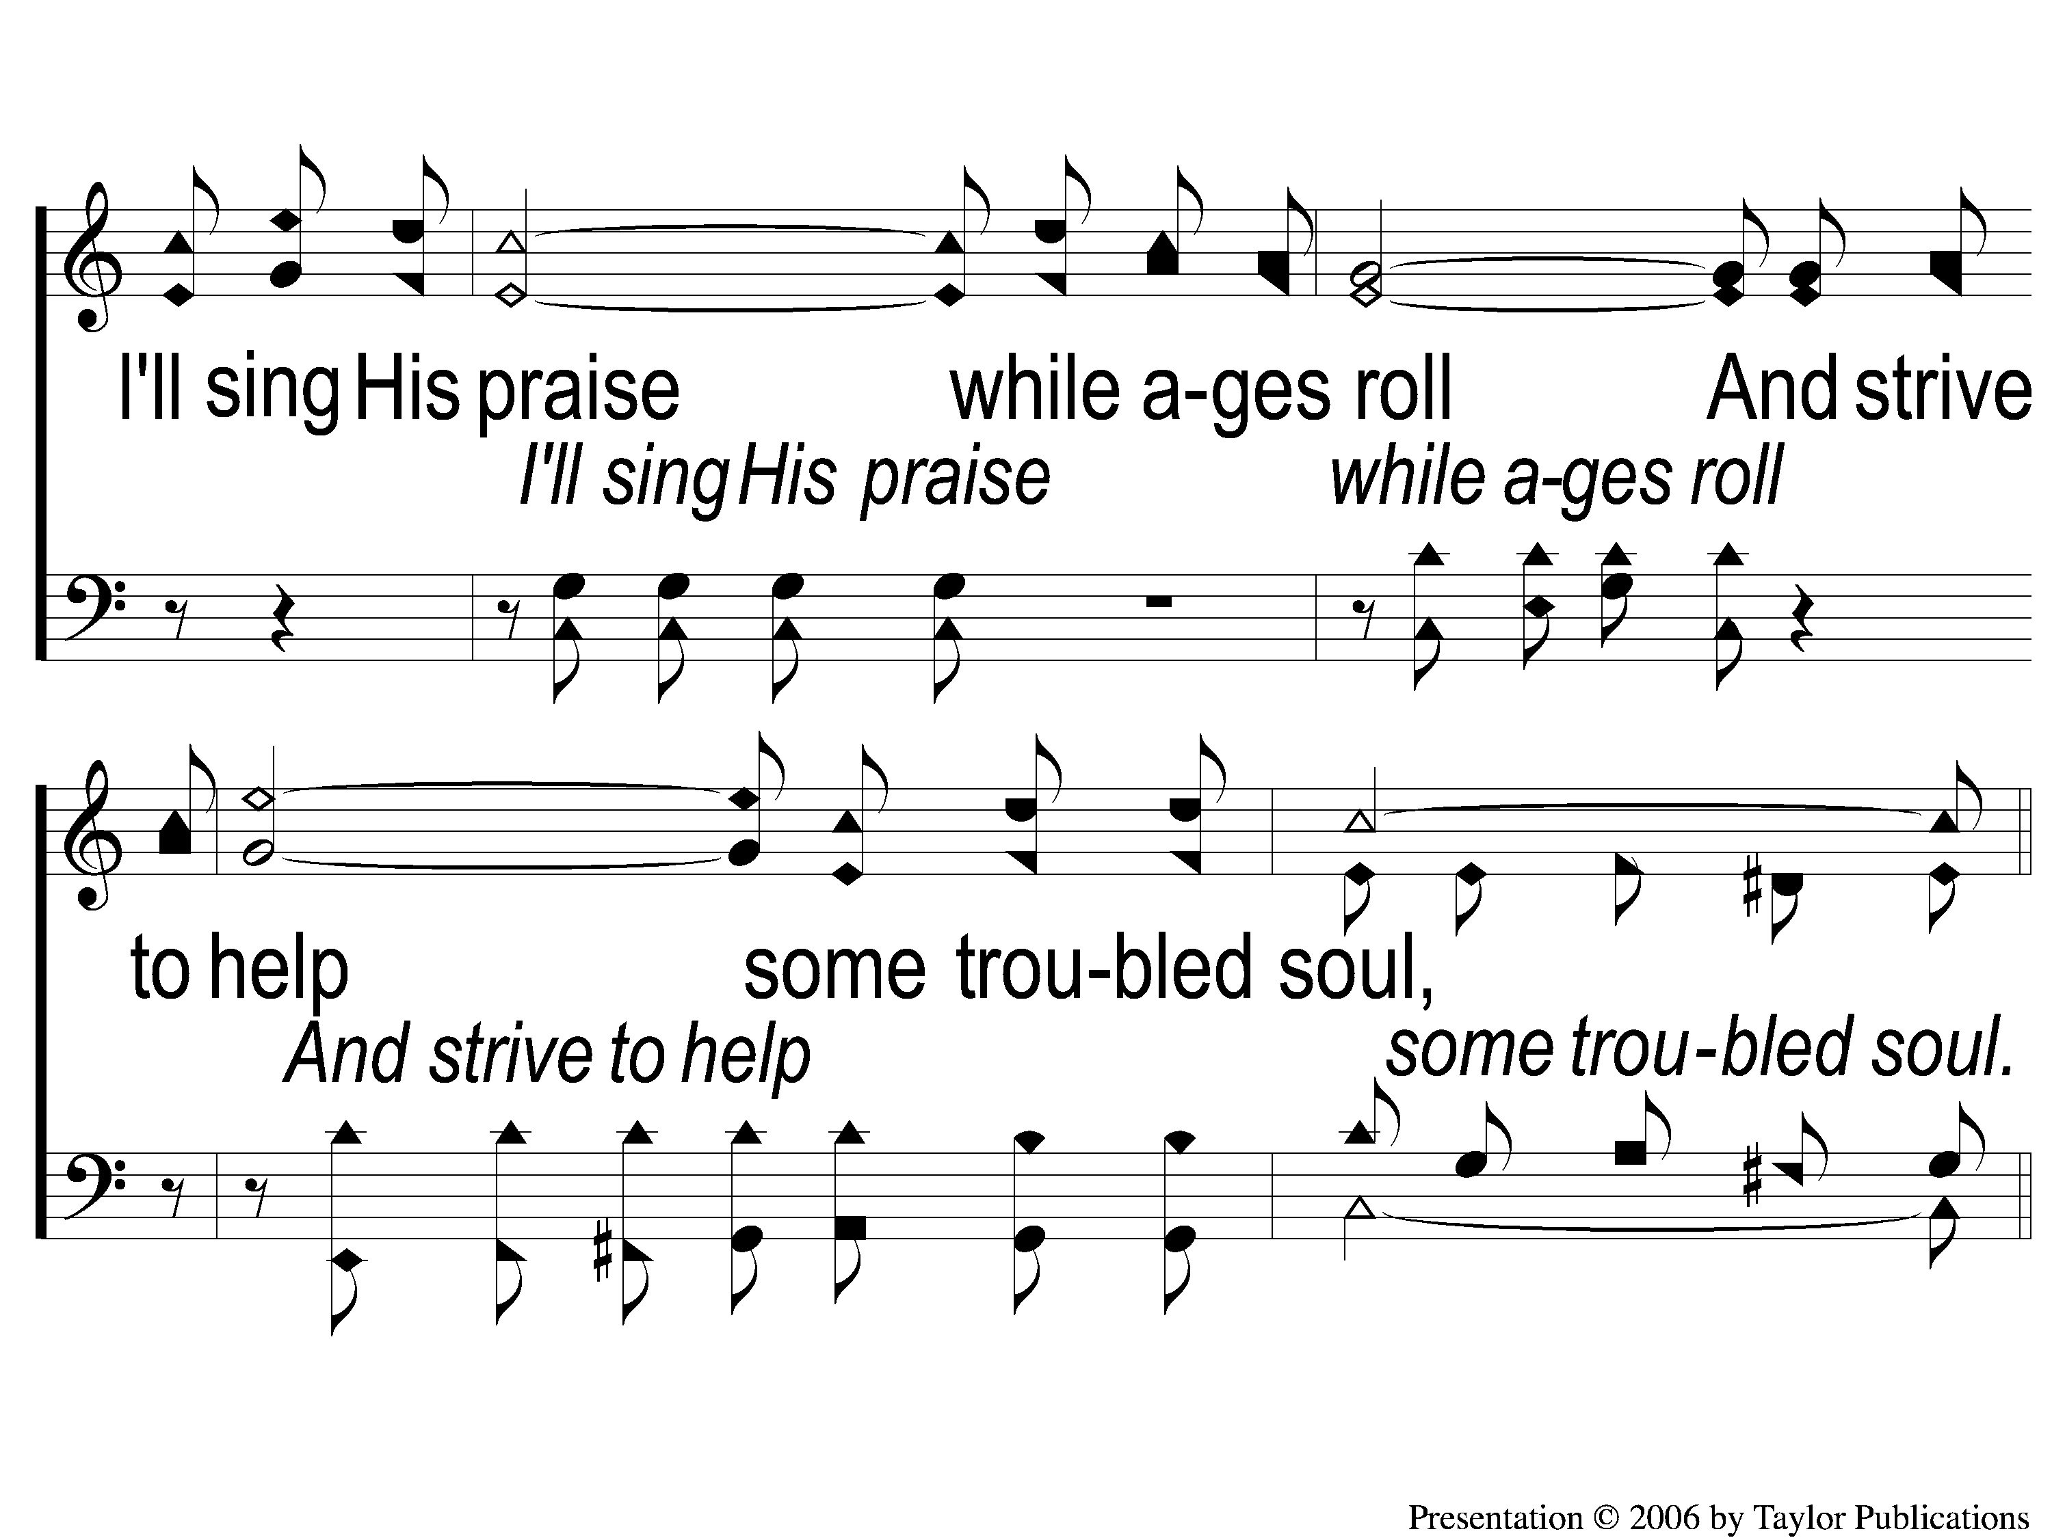
2-2 A Beautiful Life
A Beautiful Life
570

Slide 25
C-1 A Beautiful Life
A Beautiful Life
570

Slide 26
C-2 A Beautiful Life
A Beautiful Life
570

Slide 27
C-3 A Beautiful Life
A Beautiful Life
570

Slide 28
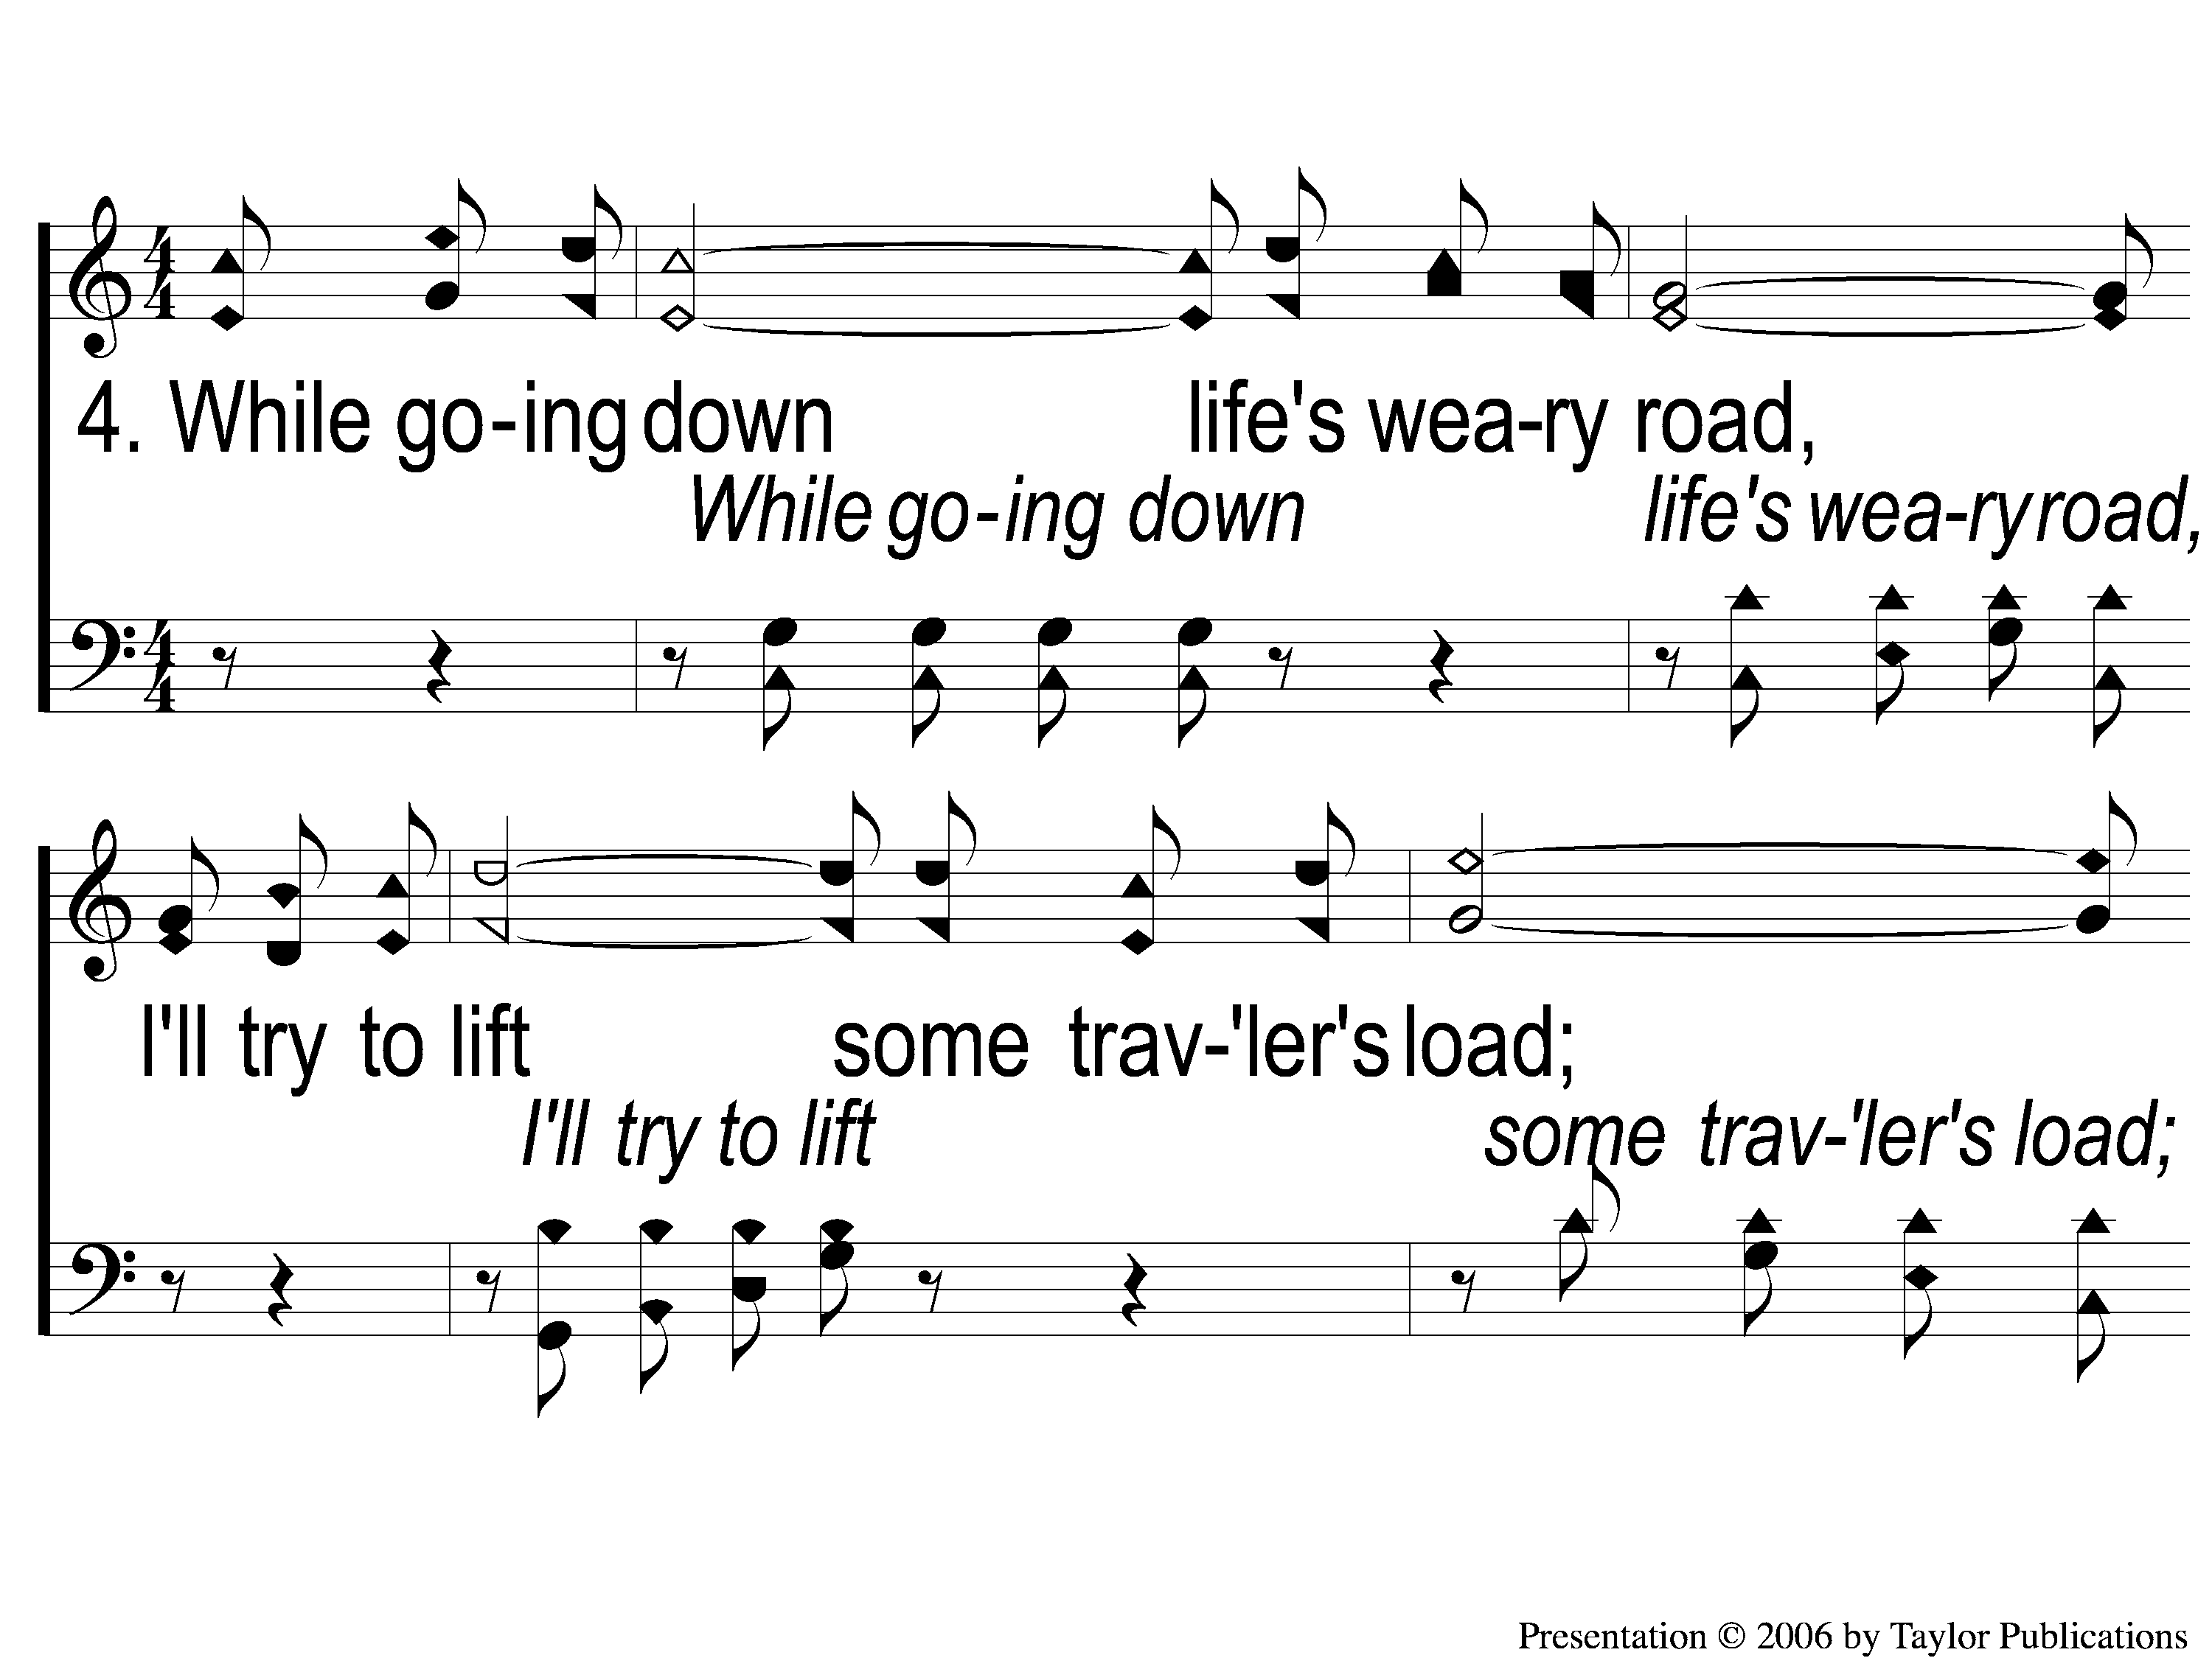
4-1 A Beautiful Life
A Beautiful Life
570

Slide 29
4-2 A Beautiful Life
A Beautiful Life
570

Slide 30
C-1 A Beautiful Life
A Beautiful Life
570

Slide 31
C-2 A Beautiful Life
A Beautiful Life
570

Slide 32
C-3 A Beautiful Life
A Beautiful Life
570

Slide 33
SONG #558
THERE STANDS A ROCK

Slide 34
1-1 There Stands A Rock
There Stands A Rock
558

Slide 35
1-2 There’s Stands A Rock
There Stands A Rock
558

Slide 36
C-1 There’s Stands A Rock
There Stands A Rock
558

Slide 37
C-2 There’s Stands A Rock
There Stands A Rock
558

Slide 38
2-1 There’s Stands A Rock
There Stands A Rock
558

Slide 39
2-2 There’s Stands A Rock
There Stands A Rock
558

Slide 40
C-1 There’s Stands A Rock
There Stands A Rock
558

Slide 41
C-2 There’s Stands A Rock
There Stands A Rock
558

Slide 42
3-1 There’s Stands A Rock
There Stands A Rock
558

Slide 43
3-2 There’s Stands A Rock
There Stands A Rock
558

Slide 44
C-1 There’s Stands A Rock
There Stands A Rock
558

Slide 45
C-2 There’s Stands A Rock
There Stands A Rock
558

Slide 46
OPENING
PRAYER

Slide 47
SONG #452
STANDING ON THE PROMISES

Slide 48
1-1 Standing on the Promises
Standing On the Promises
452

Slide 49
1-2 Standing on the Promises
Standing On the Promises
452

Slide 50
C-1 Standing on the Promises
Standing On the Promises
452

Slide 51
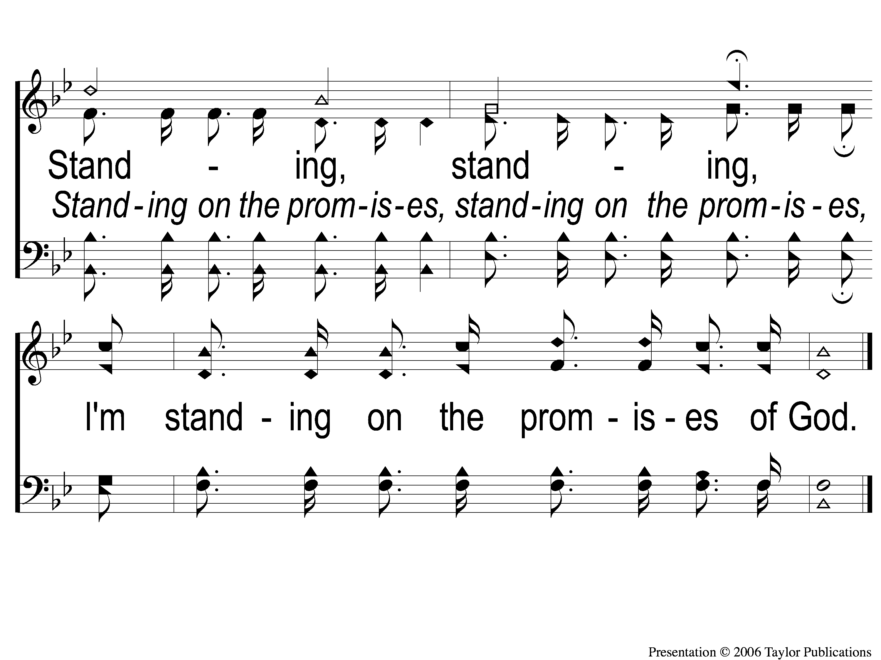
C-2 Standing on the Promises
Standing On the Promises
452

Slide 52
2-1 Standing on the Promises
Standing On the Promises
452

Slide 53
2-2 Standing on the Promises
Standing On the Promises
452

Slide 54
C-1 Standing on the Promises
Standing On the Promises
452

Slide 55
C-2 Standing on the Promises
Standing On the Promises
452

Slide 56
3-1 Standing on the Promises
Standing On the Promises
452

Slide 57
3-2 Standing on the Promises
Standing On the Promises
452

Slide 58
C-1 Standing on the Promises
Standing On the Promises
452

Slide 59
C-2 Standing on the Promises
Standing On the Promises
452

Slide 60
4-1 Standing on the Promises
Standing On the Promises
452

Slide 61
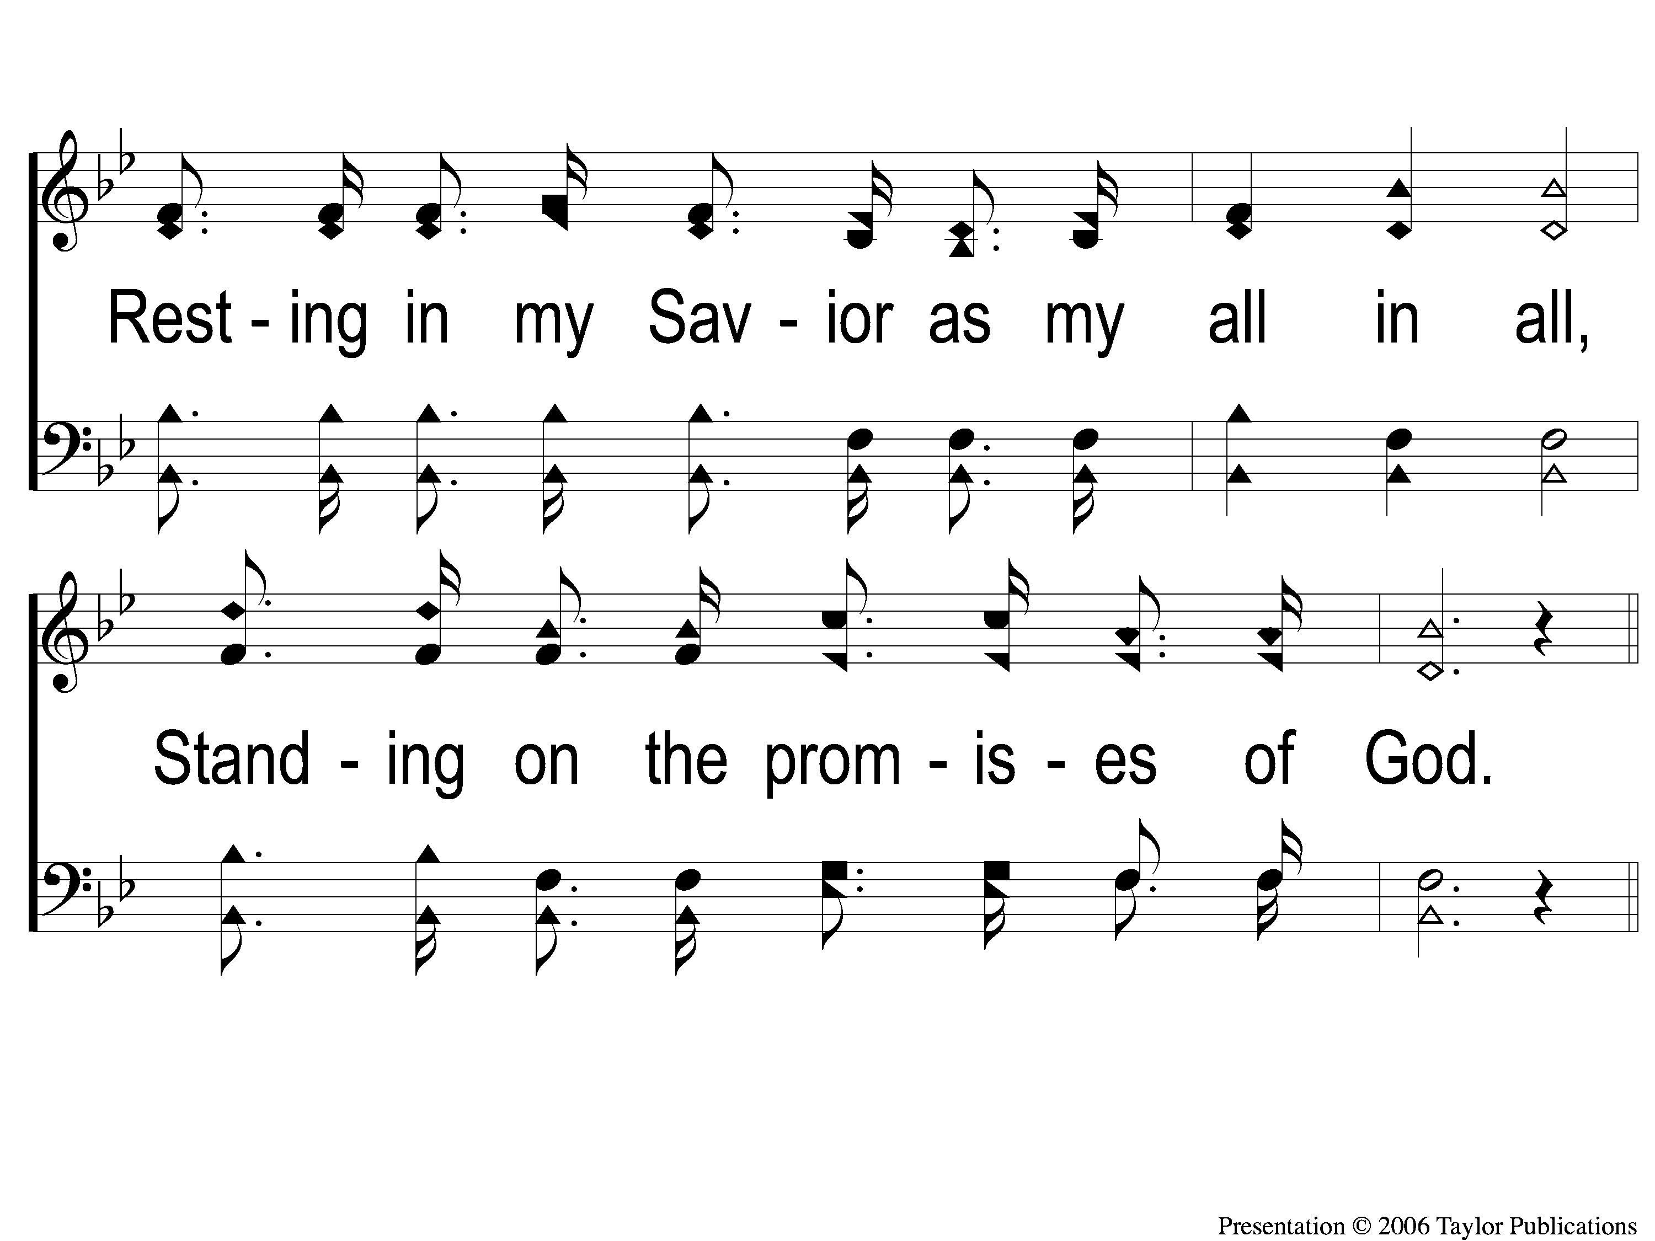
4-2 Standing on the Promises
Standing On the Promises
452

Slide 62
C-1 Standing on the Promises
Standing On the Promises
452

Slide 63
C-2 Standing on the Promises
Standing On the Promises
452

Slide 64
SONG #559
THE JOY OF THE LORD

Slide 65
1-1 The Joy of the Lord
The Joy of the Lord
559

Slide 66
1-2 The Joy of the Lord
The Joy of the Lord
559

Slide 67
C-1 The Joy of the Lord
The Joy of the Lord
559

Slide 68
C-2 The Joy of the Lord
The Joy of the Lord
559

Slide 69
2-1 The Joy of the Lord
The Joy of the Lord
559

Slide 70
2-2 The Joy of the Lord
The Joy of the Lord
559

Slide 71
C-1 The Joy of the Lord
The Joy of the Lord
559

Slide 72
C-2 The Joy of the Lord
The Joy of the Lord
559

Slide 73
3-1 The Joy of the Lord
The Joy of the Lord
559

Slide 74
3-2 The Joy of the Lord
The Joy of the Lord
559

Slide 75
C-1 The Joy of the Lord
The Joy of the Lord
559

Slide 76
C-2 The Joy of the Lord
The Joy of the Lord
559

Slide 77
SCRIPTURE READING:
Galatians 6:7-10

Slide 78
STANDING ON THE PROMISES

Slide 79
THE PROMISES
Adoption – Eph. 1:4-6
Blessings – Jms. 1:25
Proximity – Jms. 4:8
Freedom – Gal. 5:1
Preservation – 1 Pet. 1:25
Peace – Phili. 4:6-7
Jesus’ Return – 2 Pet. 3:9
Grace – 2 Pet. 1:2

Slide 80
PM Sermon:
THE PROMISE OF REST
Hebrews 4:1-11

Slide 81
THE PROMISE OF HARVEST
Galatians 6:7-10

Slide 82
THE PROMISE IN PRINCIPLE

Slide 83
THE PROMISE IN PRINCIPLE
The Law of Sowing & Reaping
Gal. 6:7-8
Gen. 1:11-12

Slide 84
THE PROMISE
REQUIRES CONSIDERATION
Considering Ourselves
Hagg. 1:3-6
2 Tim. 2:7
Rom. 11:22
2 Cor. 13:5

Slide 85
THE PROMISE
REQUIRES CONSIDERATION
Considering Our Children
Prov. 22:6
Eph. 6:4

Slide 86
THE PROMISE
REQUIRES CONSIDERATION
Considering Our Spouse
Eph. 5:22-29

Slide 87
THE PROMISE
REQUIRES CONSIDERATION
Considering Others
Rom. 13:8-14

Slide 88
THE PROMISE NEEDS PATIENCE
p

Slide 89
THE PROMISE NEEDS PATIENCE
p
It Takes Time!
Jms. 5:7
Heb. 6:15

Slide 90
WHAT ARE YOU SOWING?

Slide 91
INVITATION SONG:
WHY KEEP JESUS WAITING?

Slide 92
1-1 Why Keep Jesus Waiting
Why Keep Jesus Waiting?
927

Slide 93
1-2 Why Keep Jesus Waiting
Why Keep Jesus Waiting?
927

Slide 94
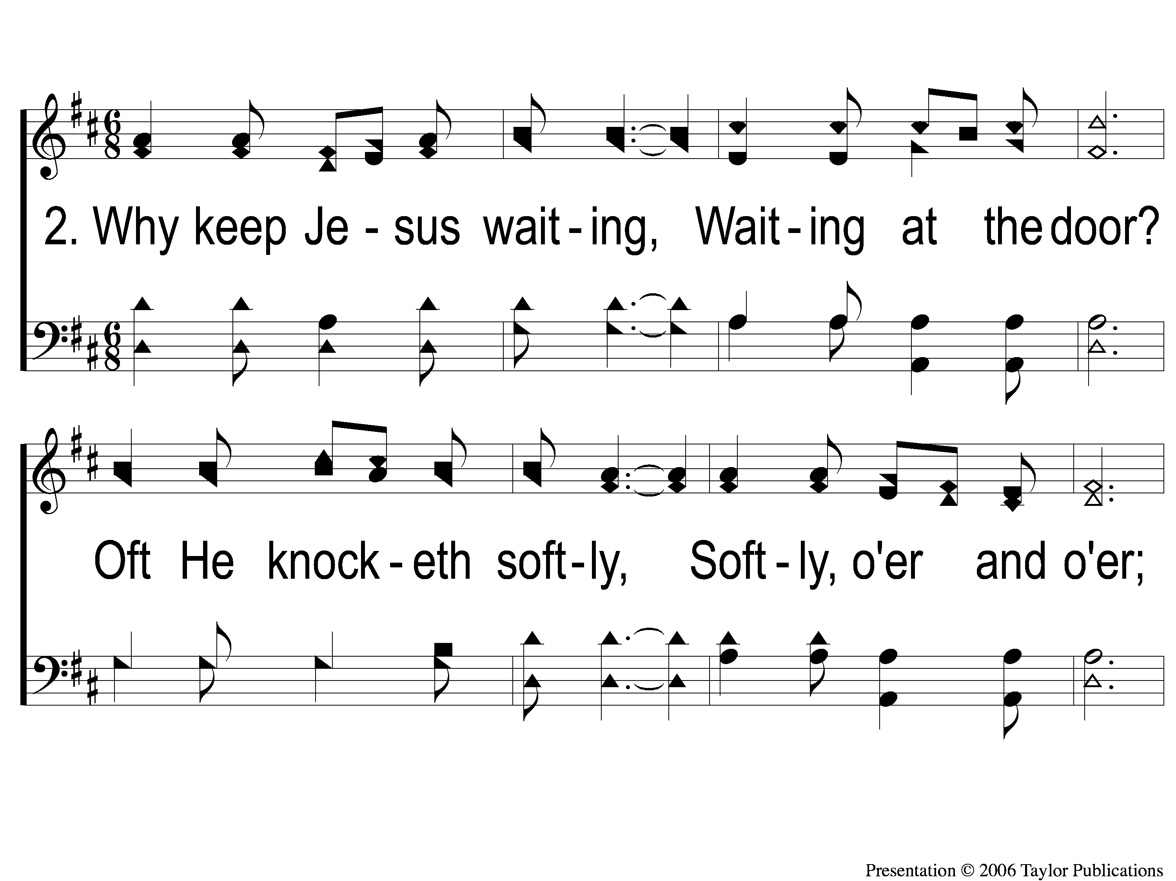
2-1 Why Keep Jesus Waiting
Why Keep Jesus Waiting?
927

Slide 95
2-2 Why Keep Jesus Waiting
Why Keep Jesus Waiting?
927

Slide 96
3-1 Why Keep Jesus Waiting
Why Keep Jesus Waiting?
927

Slide 97
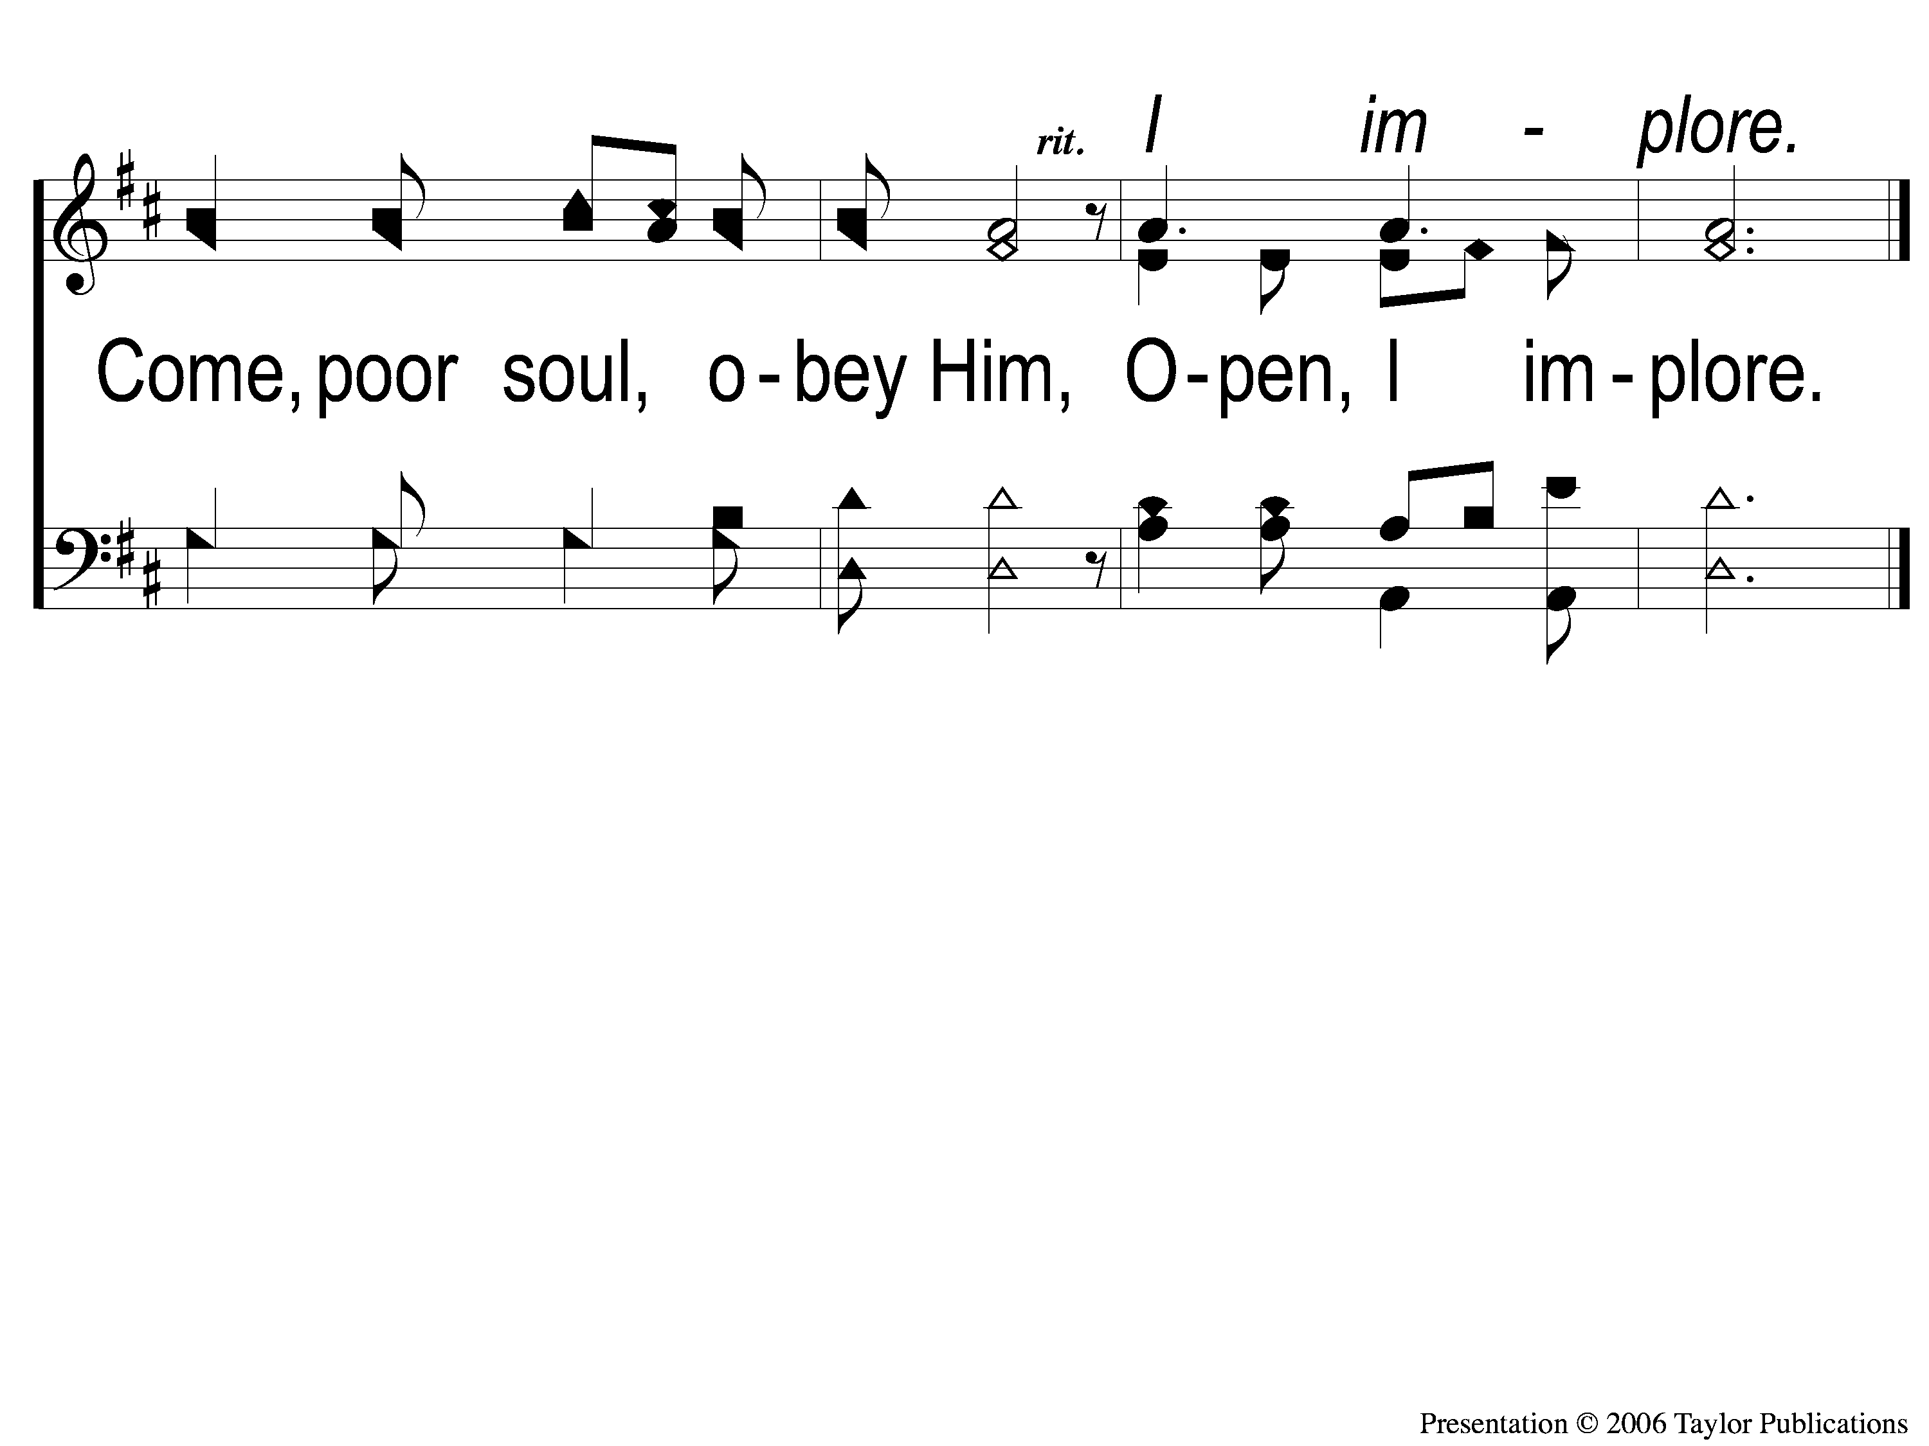
3-2 Why Keep Jesus Waiting
Why Keep Jesus Waiting?
927

Slide 98
SONG #315
WHEN I SURVEY THE WONDROUS CROSS

Slide 99
1-1 When I Survey the Wondrous Cross
When I Survey the Wondrous Cross
315

Slide 100
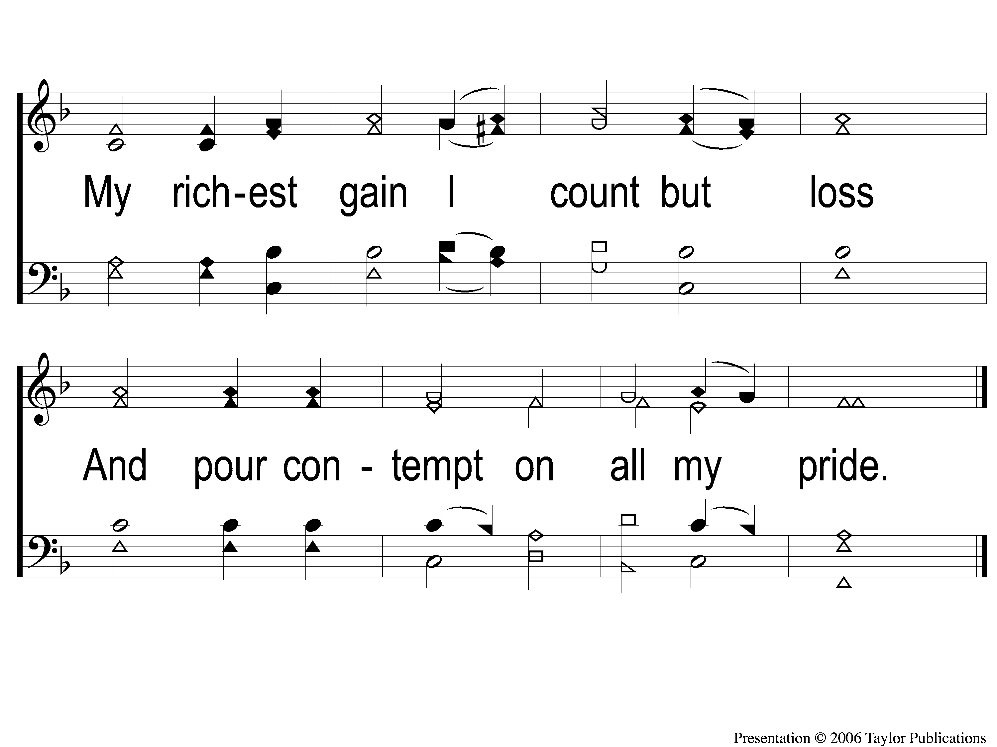
1-2 When I Survey the Wondrous Cross
When I Survey the Wondrous Cross
315

Slide 101
2-1 When I Survey the Wondrous Cross
When I Survey the Wondrous Cross
315

Slide 102
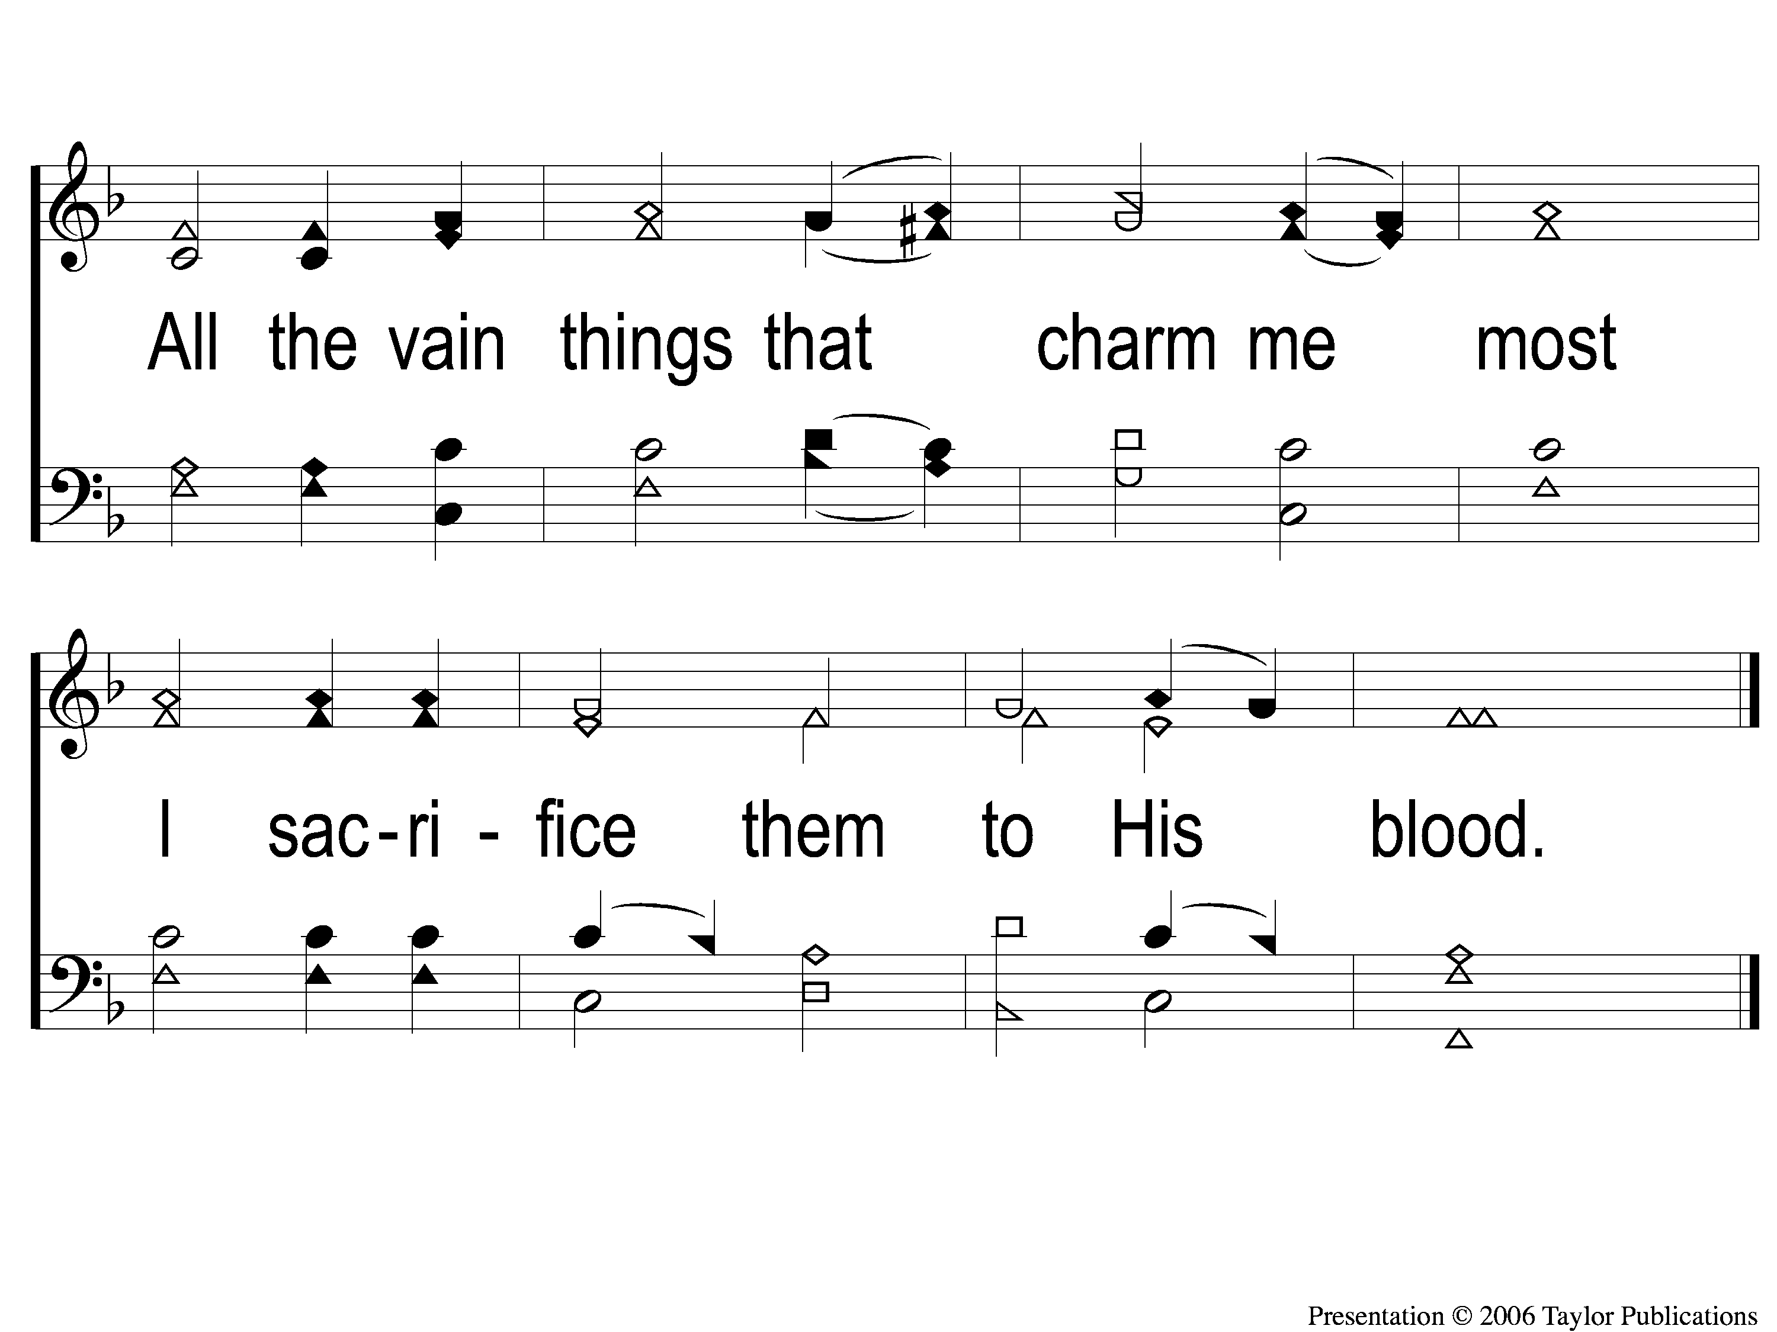
2-2 When I Survey the Wondrous Cross
When I Survey the Wondrous Cross
315

Slide 103
3-1 When I Survey the Wondrous Cross
When I Survey the Wondrous Cross
315

Slide 104
3-2 When I Survey the Wondrous Cross
When I Survey the Wondrous Cross
315

Slide 105
4-1 When I Survey the Wondrous Cross
When I Survey the Wondrous Cross
315

Slide 106
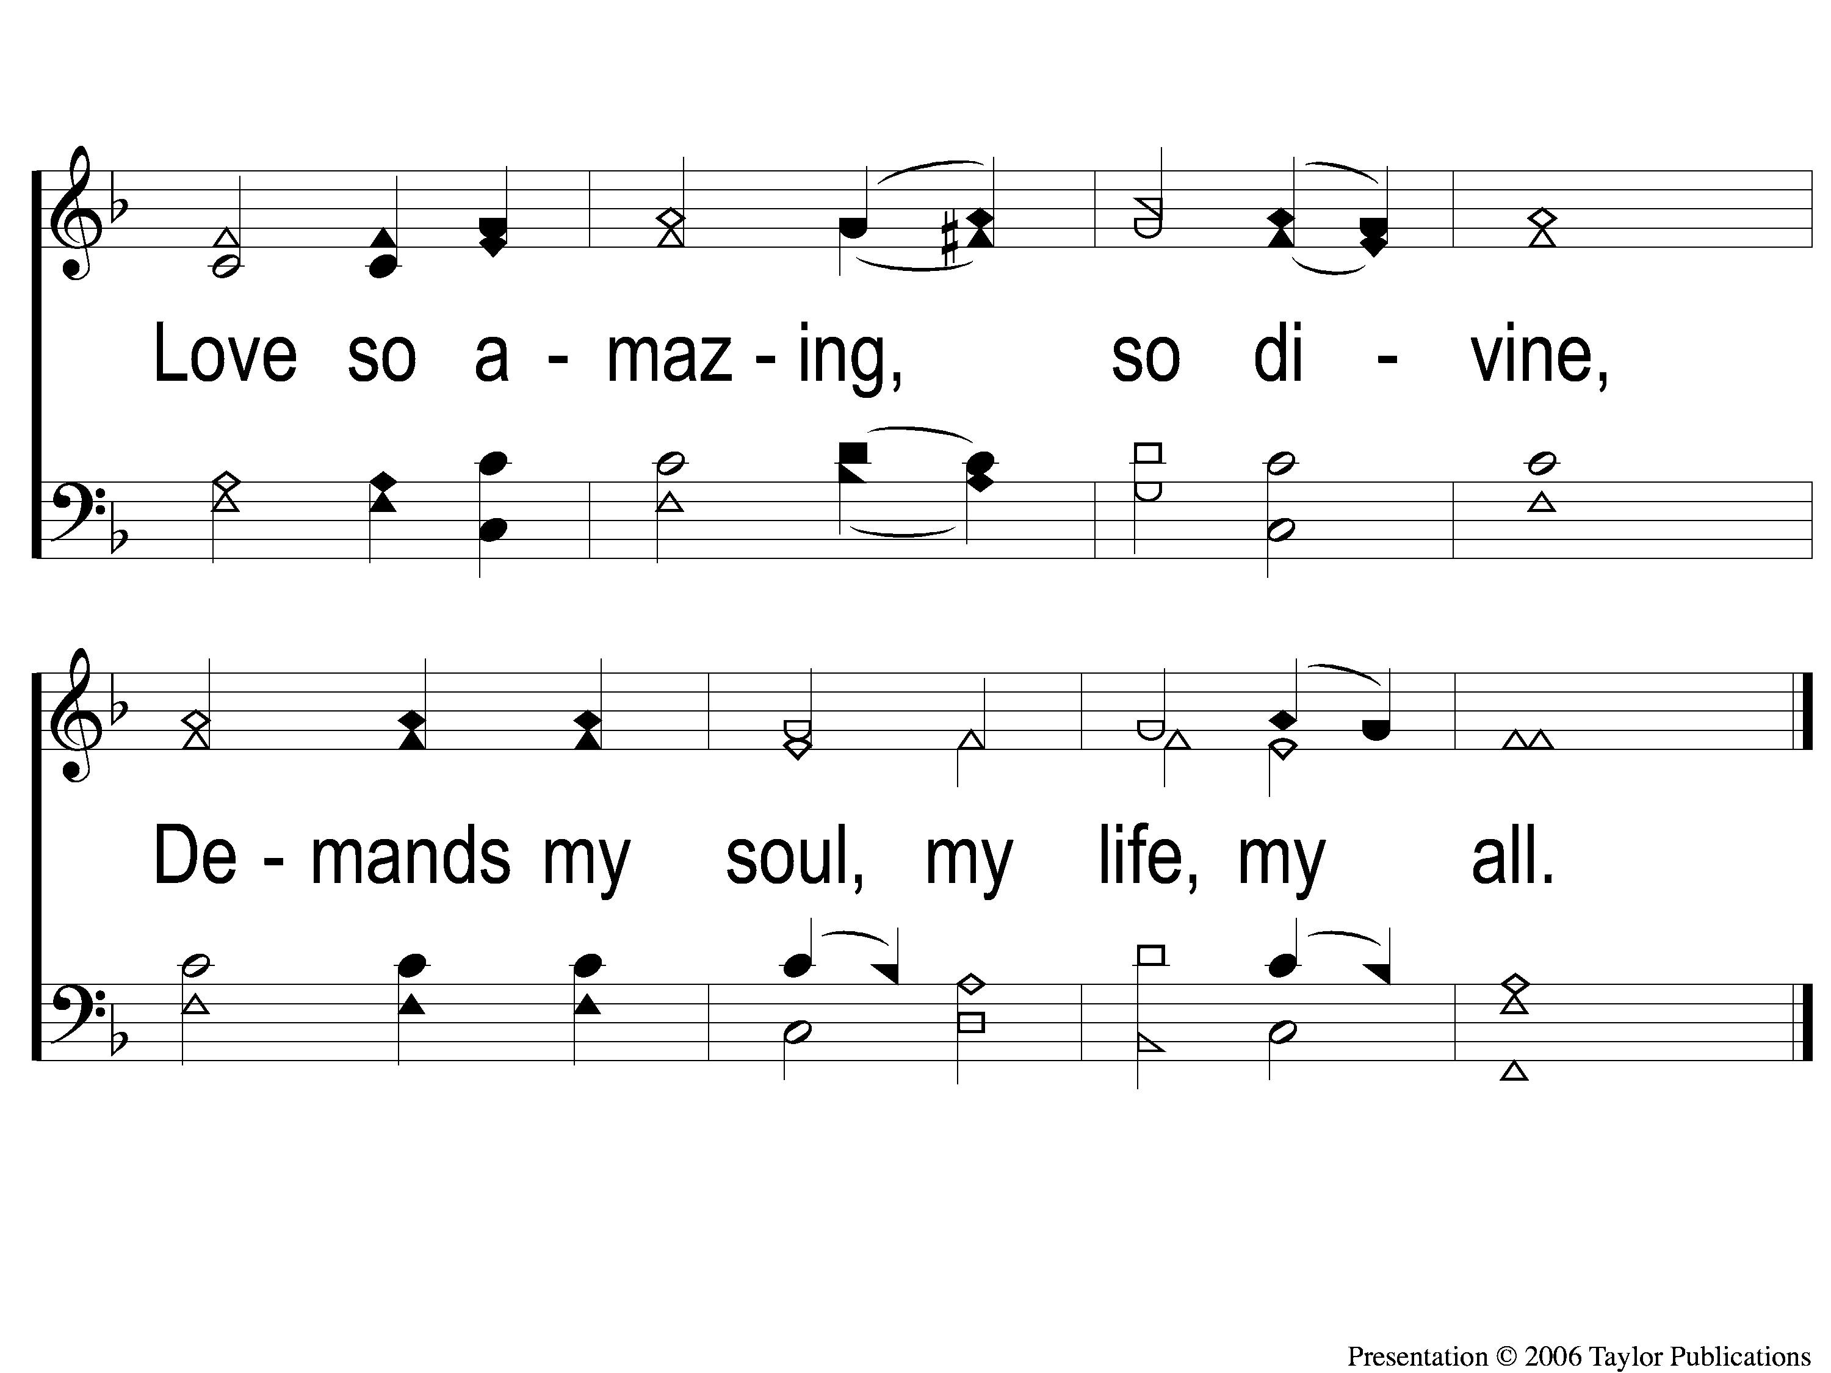
4-2 When I Survey the Wondrous Cross
When I Survey the Wondrous Cross
315

Slide 107
THE LORD’S SUPPER
ACTS 20:7

Slide 108
THE UNLEAVENED BREAD
Luke 9:23-24
”Then He said to them all, “If anyone desires to come after Me, let him deny himself, and take up his cross daily, and follow Me.
For whoever desires to save his life will lose it, but whoever loses his life for My sake will save it.”

Slide 109
THE FRUIT OF THE VINE
Luke 9:25-26
“For what profit is it to a man if he gains the whole world, and is himself destroyed or lost? For whoever is ashamed of Me and My words, of him the Son of Man will be ashamed when He comes in His own glory, and in His Father’s, and of the holy angels.”

Slide 110
THE OFFERING
Luke 12:15
“And He said to them, “Take heed and beware of covetousness, for one’s life does not consist in the abundance of the things he possesses.”

Slide 111
CLOSING
PRAYER

Slide 112
SONG #448
THE GREATEST COMMANDS

Slide 113
1-1 The Greatest Commands-SFP
The Greatest Commands
448

Slide 114
1-2 The Greatest Commands-SFP
The Greatest Commands
448

Slide 115
1-3 The Greatest Commands-SFP
The Greatest Commands
448

Slide 116
1-4 The Greatest Commands-SFP
The Greatest Commands
448

Slide 117
2-1 The Greatest Commands-SFP
The Greatest Commands
448

Slide 118
2-2 The Greatest Commands-SFP
The Greatest Commands
448

Slide 119
2-3 The Greatest Commands-SFP
The Greatest Commands
448

Slide 120
2-4 The Greatest Commands-SFP
The Greatest Commands
448

Slide 121
3-1 The Greatest Commands-SFP
The Greatest Commands
448

Slide 122
3-2 The Greatest Commands-SFP
The Greatest Commands
448

Slide 123
3-3 The Greatest Commands-SFP
The Greatest Commands
448

Slide 124
3-4 The Greatest Commands-SFP
The Greatest Commands
448

Slide 125
4-1 The Greatest Commands-SFP
The Greatest Commands
448

Slide 126
4-2 The Greatest Commands-SFP
The Greatest Commands
448

Slide 127
4-3 The Greatest Commands-SFP
The Greatest Commands
448

Slide 128
4-4 The Greatest Commands-SFP
The Greatest Commands
448

Slide 129
JOIN US
TONIGHT @ 6PM
LESSON: THE PROMISE OF REST

