Slide 1
1-1 Battle Hymn of the Republic
Battle Hymn of the Republic
1009

Slide 2
1-2 Battle Hymn of the Republic
Battle Hymn of the Republic
1009

Slide 3
1-3 Battle Hymn of the Republic
Battle Hymn of the Republic
1009

Slide 4
1-4 Battle Hymn of the Republic
Battle Hymn of the Republic
1009

Slide 5
2-1 Battle Hymn of the Republic
Battle Hymn of the Republic
1009

Slide 6
2-2 Battle Hymn of the Republic
Battle Hymn of the Republic
1009

Slide 7
2-3 Battle Hymn of the Republic
Battle Hymn of the Republic
1009

Slide 8
2-4 Battle Hymn of the Republic
Battle Hymn of the Republic
1009

Slide 9
3-1 Battle Hymn of the Republic
Battle Hymn of the Republic
1009

Slide 10
3-2 Battle Hymn of the Republic
Battle Hymn of the Republic
1009

Slide 11
3-3 Battle Hymn of the Republic
Battle Hymn of the Republic
1009

Slide 12
3-4 Battle Hymn of the Republic
Battle Hymn of the Republic
1009

Slide 13
RESTORE REBUILD RENEW
welcome
we are glad to
Have you with us
IN 2022
WHEELER
CHURCH
OF
CHRIST

Slide 14
Song:
Leaning On The
Everlasting Arms
#589

Slide 15
1-1 What A Fellowship
Leaning on the Everlasting Arms
589

Slide 16
1-2 What A Fellowship
Leaning on the Everlasting Arms
589

Slide 17
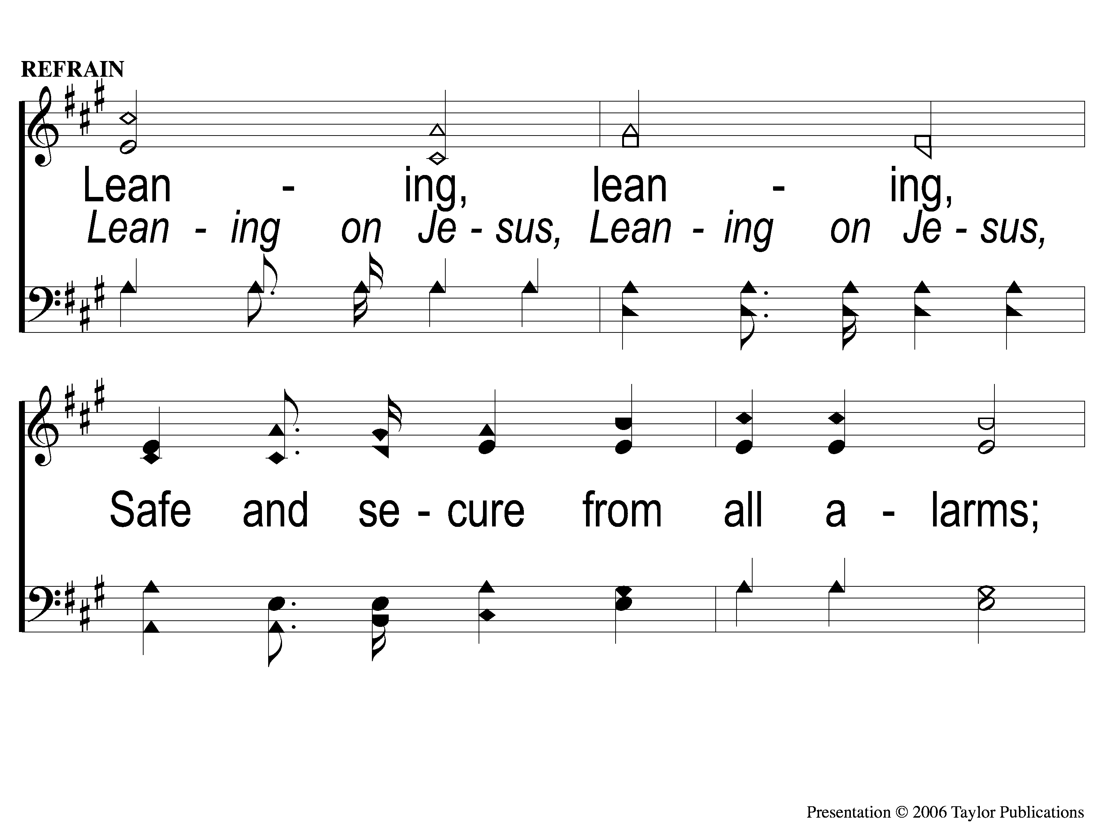
C-1 What A Fellowship
Leaning on the Everlasting Arms
589

Slide 18
C-2 What A Fellowship
Leaning on the Everlasting Arms
589

Slide 19
2-1 What A Fellowship
Leaning on the Everlasting Arms
589

Slide 20
2-2 What A Fellowship
Leaning on the Everlasting Arms
589

Slide 21
C-1 What A Fellowship
Leaning on the Everlasting Arms
589

Slide 22
C-2 What A Fellowship
Leaning on the Everlasting Arms
589

Slide 23
3-1 What A Fellowship
Leaning on the Everlasting Arms
589

Slide 24
3-2 What A Fellowship
Leaning on the Everlasting Arms
589

Slide 25
C-1 What A Fellowship
Leaning on the Everlasting Arms
589

Slide 26
C-2 What A Fellowship
Leaning on the Everlasting Arms
589

Slide 27
Song:
Hark! The Herald Angels Sing
#1001

Slide 28
1-1 Hark the Herald Angels Sing
Hark! The Herald Angels Sing
1001

Slide 29
1-2 Hark the Herald Angels Sing
Hark! The Herald Angels Sing
1001

Slide 30
1-3 Hark the Herald Angels Sing
Hark! The Herald Angels Sing
1001

Slide 31
1-4 Hark the Herald Angels Sing
Hark! The Herald Angels Sing
1001

Slide 32
3-1 Hark the Herald Angels Sing
Hark! The Herald Angels Sing
1001

Slide 33
3-2 Hark the Herald Angels Sing
Hark! The Herald Angels Sing
1001

Slide 34
3-3 Hark the Herald Angels Sing
Hark! The Herald Angels Sing
1001

Slide 35
3-4 Hark the Herald Angels Sing
Hark! The Herald Angels Sing
1001

Slide 36
Opening Prayer

Slide 37
Song:
God Will Take Care Of You
#461

Slide 38
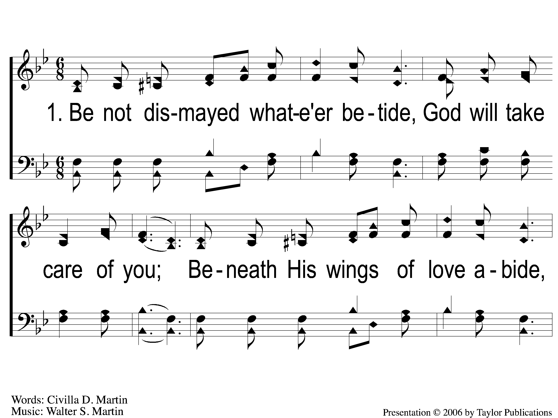
1-1 God Will Take Care Of You
God Will Take Care Of You
461

Slide 39
1-2 God Will Take Care Of You
God Will Take Care Of You
461

Slide 40
C-1 God Will Take Care Of You
God Will Take Care Of You
461

Slide 41
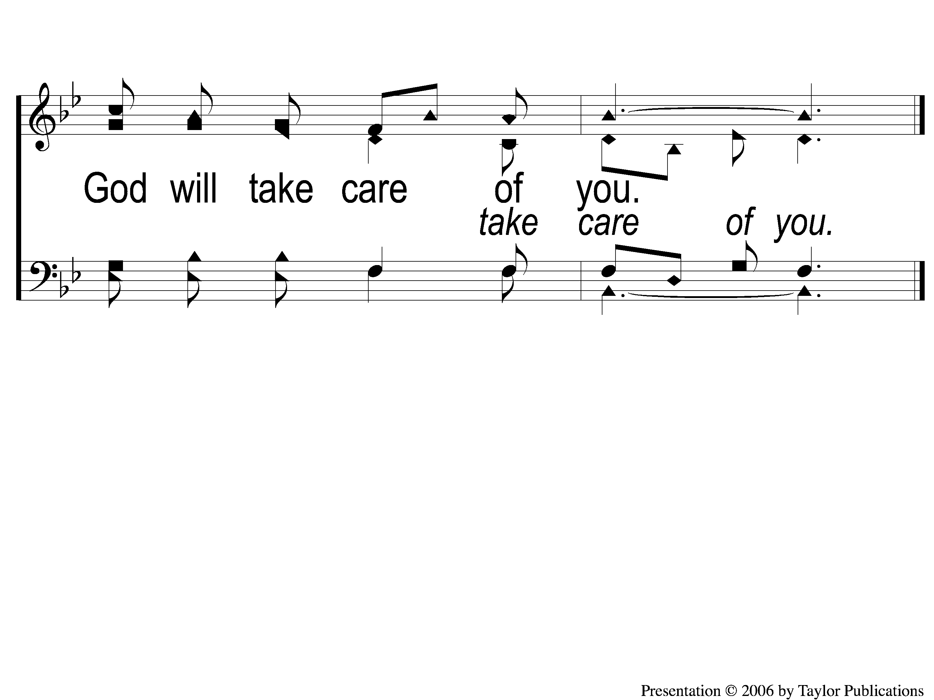
C-2 God Will Take Care Of You
God Will Take Care Of You
461

Slide 42
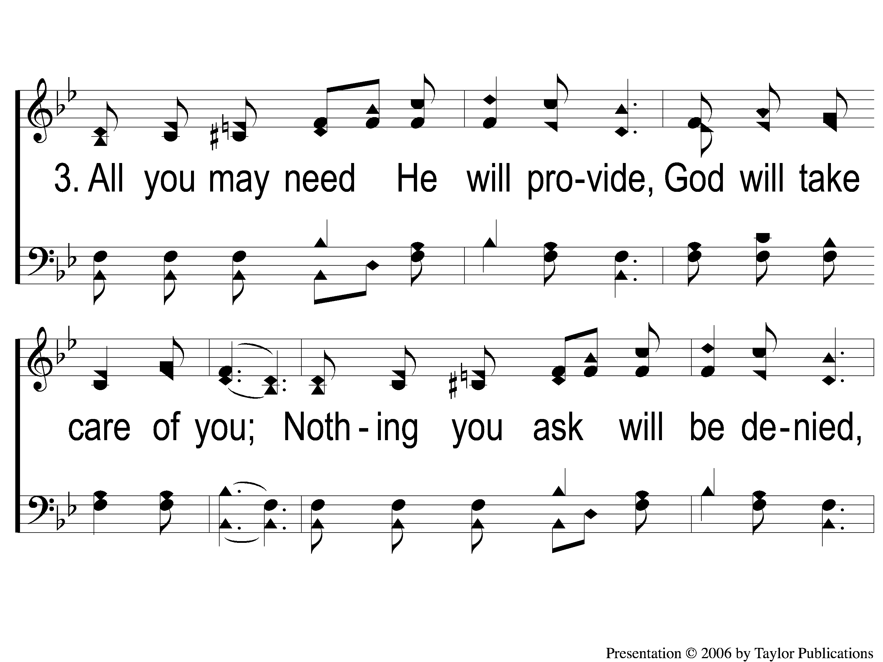
3-1 God Will Take Care Of You
God Will Take Care Of You
461

Slide 43
3-2 God Will Take Care Of You
God Will Take Care Of You
461

Slide 44
C-1 God Will Take Care Of You
God Will Take Care Of You
461

Slide 45
C-2 God Will Take Care Of You
God Will Take Care Of You
461

Slide 46
Song:
I Must Tell Jesus
#564

Slide 47
1-1 I Must Tell Jesus
I Must Tell Jesus
564

Slide 48
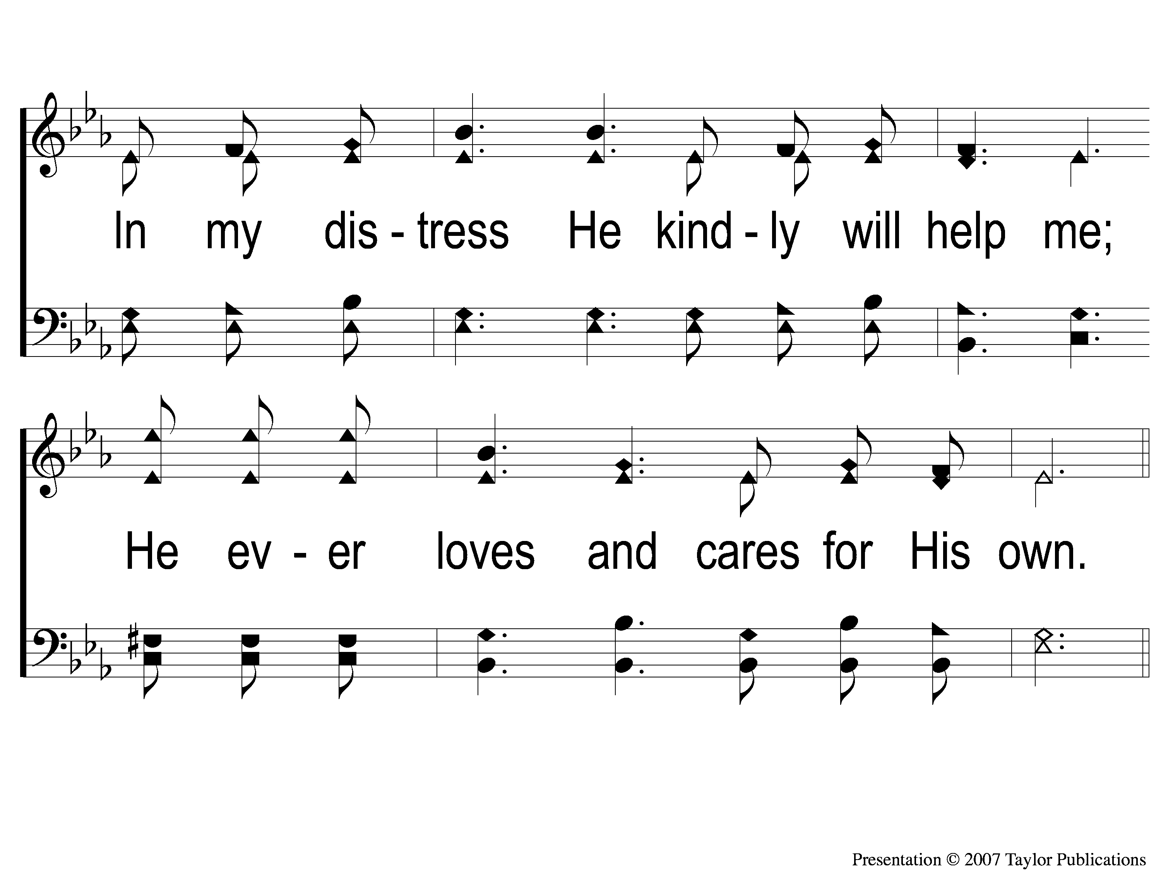
1-2 I Must Tell Jesus
I Must Tell Jesus
564

Slide 49
C-1 I Must Tell Jesus
I Must Tell Jesus
564

Slide 50
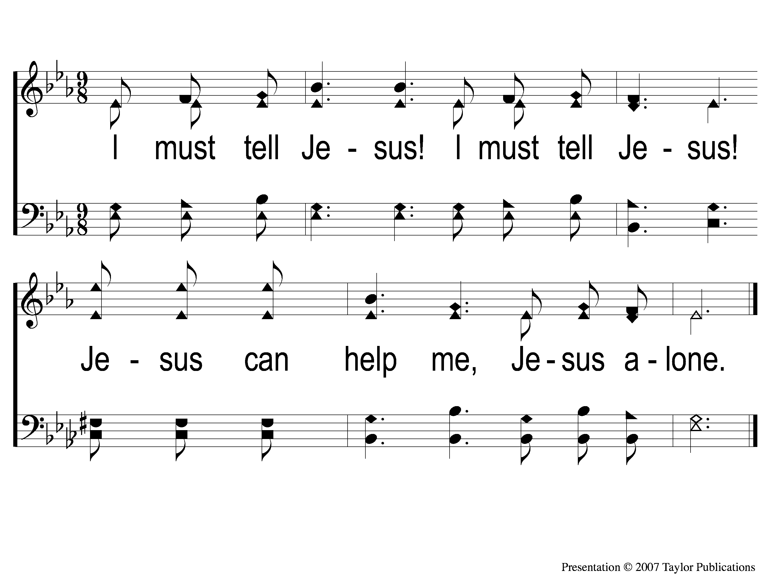
C-2 I Must Tell Jesus
I Must Tell Jesus
564

Slide 51
2-1 I Must Tell Jesus
I Must Tell Jesus
564

Slide 52
2-2 I Must Tell Jesus
I Must Tell Jesus
564

Slide 53
C-1 I Must Tell Jesus
I Must Tell Jesus
564

Slide 54
C-2 I Must Tell Jesus
I Must Tell Jesus
564

Slide 55
3-1 I Must Tell Jesus
I Must Tell Jesus
564

Slide 56
3-2 I Must Tell Jesus
I Must Tell Jesus
564

Slide 57
C-1 I Must Tell Jesus
I Must Tell Jesus
564

Slide 58
C-2 I Must Tell Jesus
I Must Tell Jesus
564

Slide 59
Scripture Reading:
Nehemiah 1:4-7

Slide 60
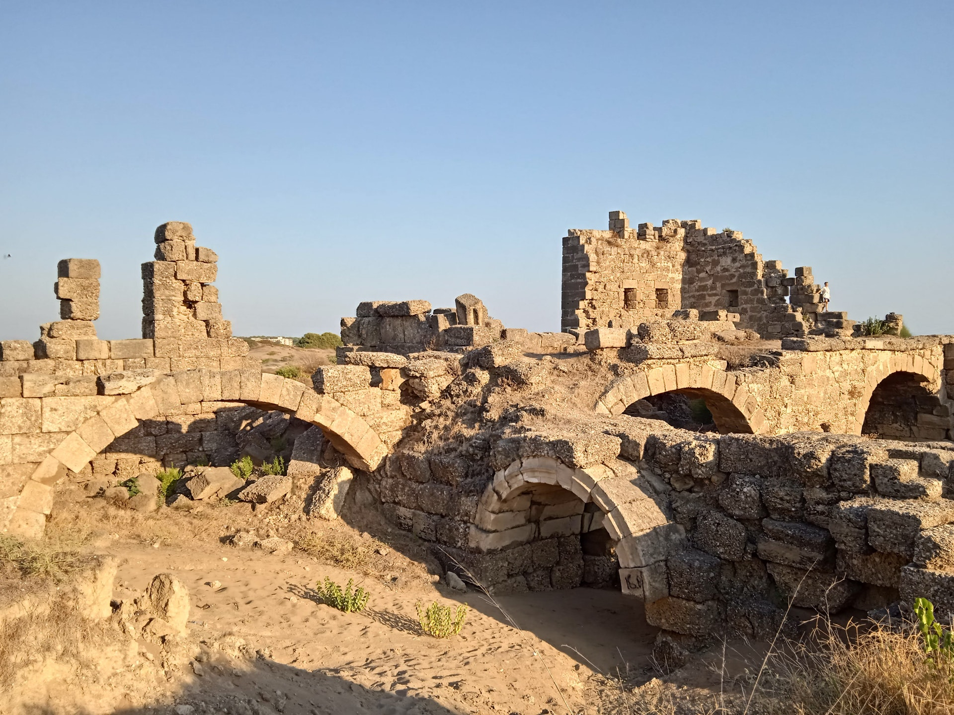
Rebuilding Jerusalem

Slide 61
Rebuilding Needs More

Slide 62
Rebuilding Needs More CONFESSION

Slide 63
What is Confession?
ὁμολογέω

Slide 64
What is Confession?
ὁμολογέω
= to speak the same thing

Slide 65
What is Confession?
ὁμολογέω
= to speak the same thing
1 Pet. 2:5, 9

Slide 66
Which Confession?

Slide 67
Which Confession?
Part of God’s Saving Plan
Hear God’s Word
Believe in His Son
Repent of Your Sins
Confess His Son (Lk. 12:8)
Be Baptized in Water
Live Faithfully until Death

Slide 68
Is Confession Necessary?

Slide 69
Is Confession Necessary?
N. T. Commands:
1 John 1:7-10
Jms. 5:16

Slide 70
What Makes Confession Ineffective?

Slide 71
What Makes Confession Ineffective?
Presumptuousness
Prov. 15:3
Heb. 4:13
Neh. 1:6, 11

Slide 72
What Makes Confession Ineffective?
Presumptuousness
Heartlessness
2 Cor. 7:10
Neh. 1:4
Ezra 10:1

Slide 73
What Makes Confession Ineffective?
Presumptuousness
Heartlessness
Vagueness
Acts 8:22-23
Neh. 1:7

Slide 74
When Confession is Made Correctly…
…It is Honest
Neh. 1:6
Lk. 15:18-19

Slide 75
When Confession is Made Correctly…
…It is Honest
…It Promotes Change
Lk. 18:9-14
Neh. 1:11, 10:28ff

Slide 76
When Confession is Made Correctly…
…It is Honest
…It Promotes Change
…It Results in Forgiveness
Neh. 1:11
1 Jn. 1:9

Slide 77
When is Public Confession Necessary?
When we have Brought Reproach on the Church

Slide 78
When is Public Confession Necessary?
When we have Brought Reproach on the Church
Matt. 5:16

Slide 79
When is Public Confession Necessary?
When we have Brought Reproach on the Church
When we have Created Strife and Division

Slide 80
When is Public Confession Necessary?
When we have Created Strife and Division
1 Cor. 1:10, 17
Jude 19
Eph. 4:17

Slide 81
When is Public Confession Necessary?
When we have Brought Reproach on the Church
When we have Created Strife and Division
When we have Caused Others to Stumble

Slide 82
When is Public Confession Necessary?
When we have Caused Others to Stumble
1 Cor. 5:1-13, 8:9, 13

Slide 83
When is Public Confession Necessary?
When we have Brought Reproach on the Church
When we have Created Strife and Division
When we have Caused Others to Stumble
When we have Forsaken the Assembly

Slide 84
When is Public Confession Necessary?
When we have Forsaken the Assembly
Heb. 3:13, 10:25-26

Slide 85
When is Public Confession Necessary?
When we have Brought Reproach on the Church
When we have Created Strife and Division
When we have Caused Others to Stumble
When we have Forsaken the Assembly
When we have Not Cleared our Conscience

Slide 86
When is Public Confession Necessary?
When we have Not Cleared our Conscience
Rom. 14:22-23

Slide 87
Walking
Light?
Are you
in the

Slide 88
Alas! And Did
My Savior Bleed?
#324
Invitation
Song:

Slide 89
1-1 Alas and Did My Savior Bleed
Alas! And Did My Savior Bleed?
324

Slide 90
1-2 Alas and Did My Savior Bleed
Alas! And Did My Savior Bleed?
324

Slide 91
C-1 Alas and Did My Savior Bleed
Alas! And Did My Savior Bleed?
324

Slide 92
C-2 Alas and Did My Savior Bleed
Alas! And Did My Savior Bleed?
324

Slide 93
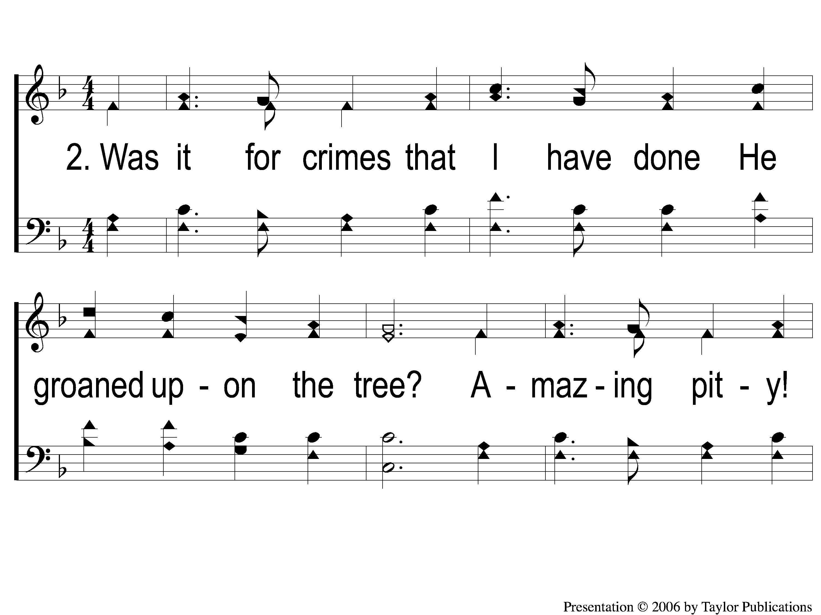
2-1 Alas and Did My Savior Bleed
Alas! And Did My Savior Bleed?
324

Slide 94
2-2 Alas and Did My Savior Bleed
Alas! And Did My Savior Bleed?
324

Slide 95
C-1 Alas and Did My Savior Bleed
Alas! And Did My Savior Bleed?
324

Slide 96
C-2 Alas and Did My Savior Bleed
Alas! And Did My Savior Bleed?
324

Slide 97
4-1 Alas and Did My Savior Bleed
Alas! And Did My Savior Bleed?
324

Slide 98
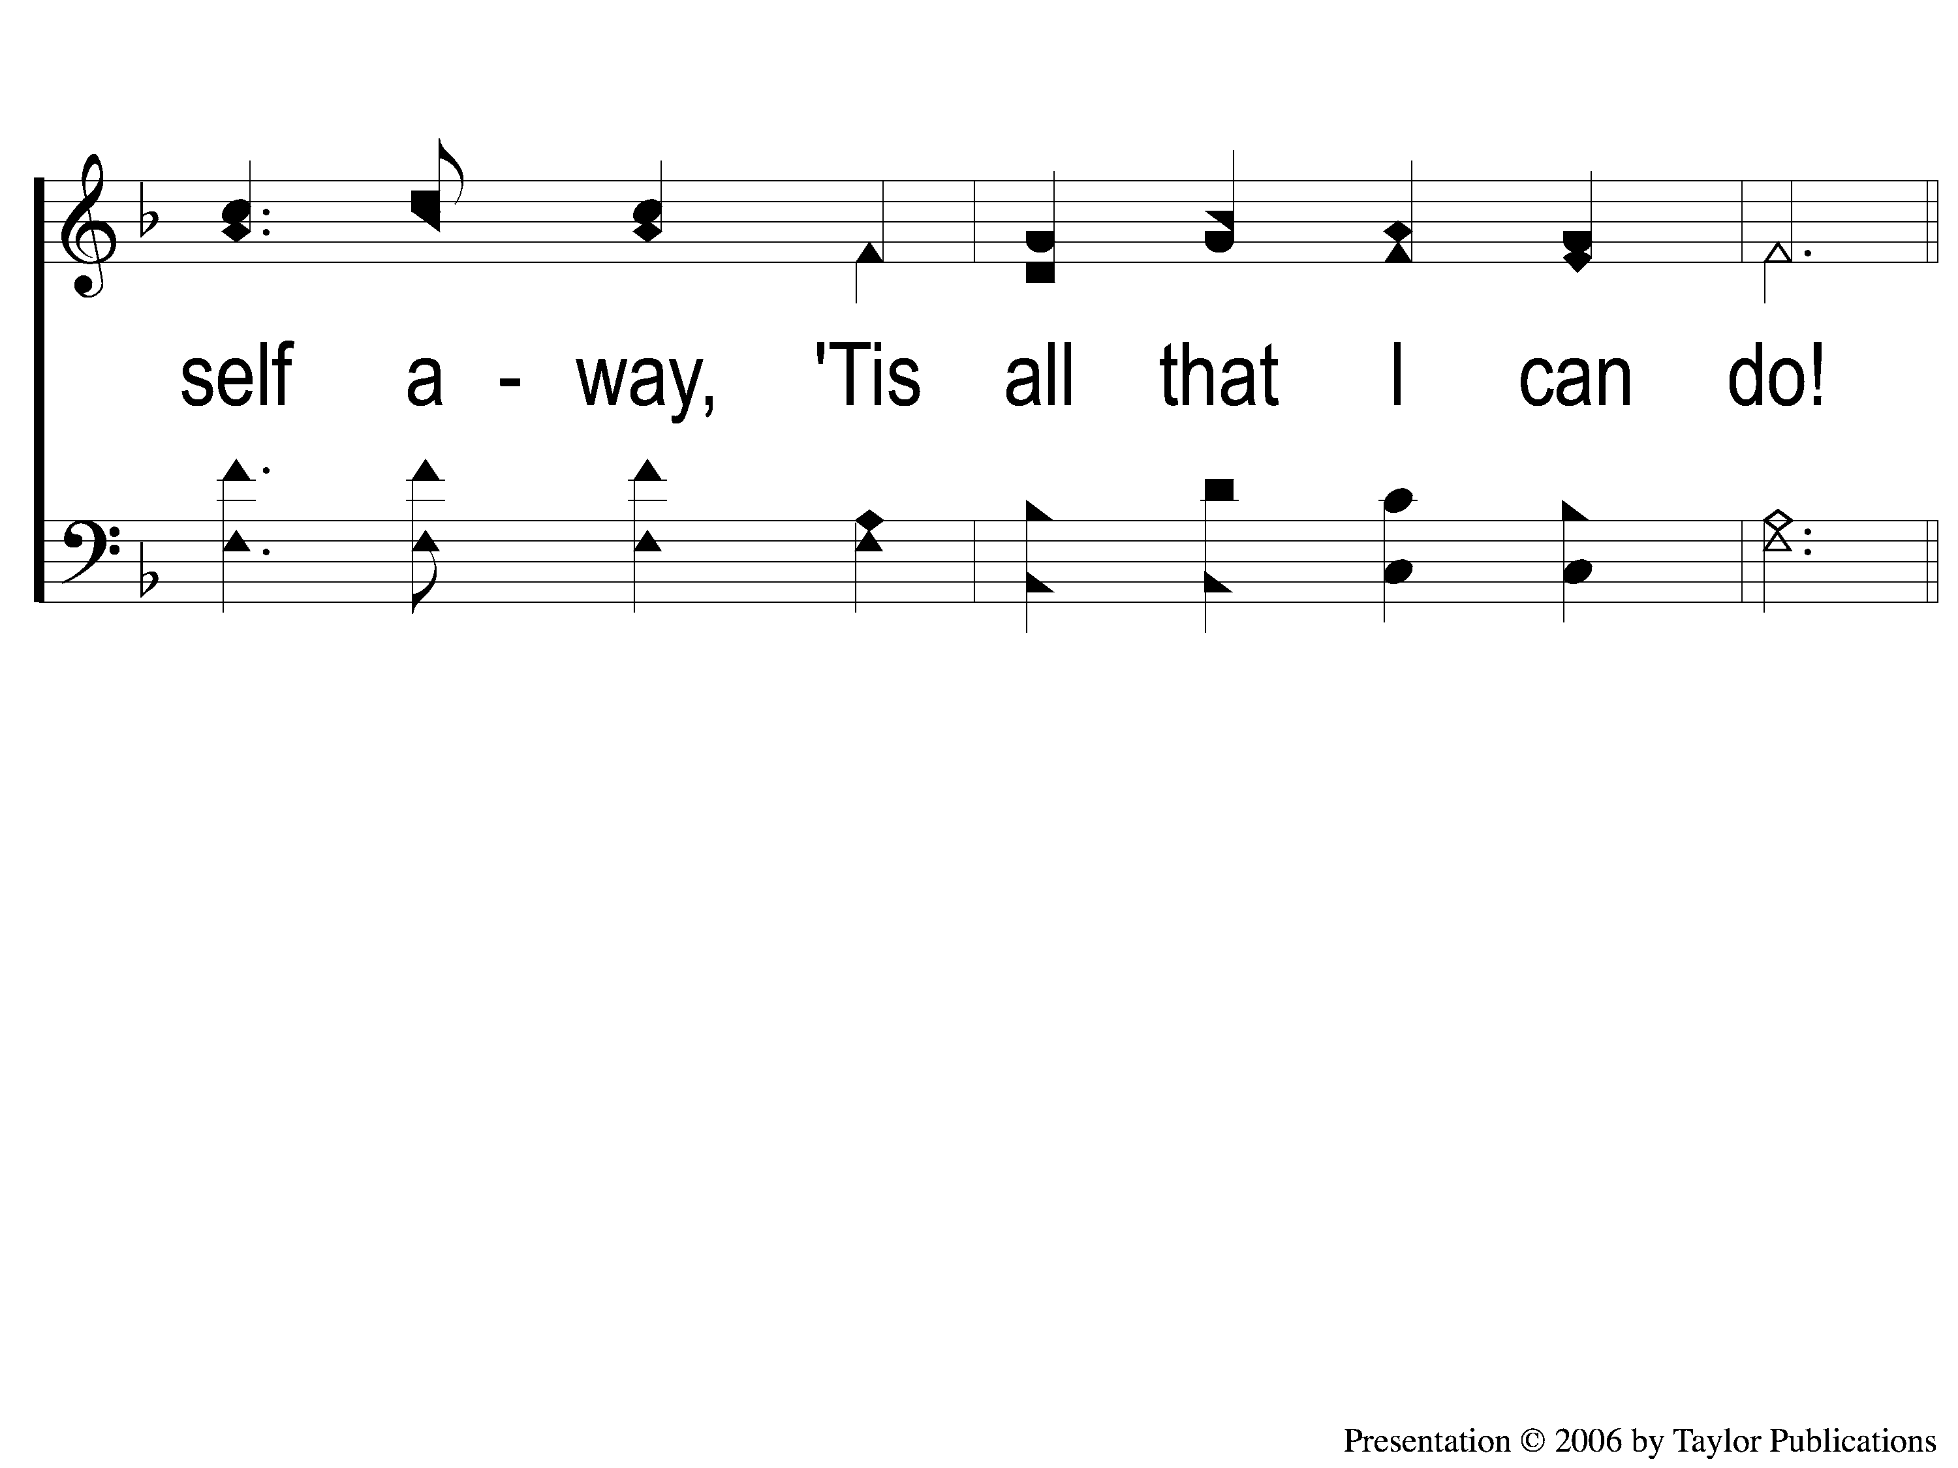
4-2 Alas and Did My Savior Bleed
Alas! And Did My Savior Bleed?
324

Slide 99
C-1 Alas and Did My Savior Bleed
Alas! And Did My Savior Bleed?
324

Slide 100
C-2 Alas and Did My Savior Bleed
Alas! And Did My Savior Bleed?
324

Slide 101
C-1 Alas and Did My Savior Bleed
Alas! And Did My Savior Bleed?
324

Slide 102
C-2 Alas and Did My Savior Bleed
Alas! And Did My Savior Bleed?
324

Slide 103
The Contribution:
Romans 9:6-8
“The point is this: whoever sows sparingly will also reap sparingly, and whoever sows bountifully will also reap bountifully. Each one must give as he has decided in his heart, not reluctantly or under compulsion, for God loves a cheerful giver. And God is able to make all grace abound to you, so that having all sufficiency in all things at all times, you may abound in every good work.”

Slide 104
Song:
In Christ Alone
PH #238

Slide 105
1-1 In Christ Alone
In Christ Alone

Slide 106
1-2 In Christ Alone
In Christ Alone

Slide 107
1-3 In Christ Alone
In Christ Alone

Slide 108
1-4 In Christ Alone
In Christ Alone

Slide 109
2-1 In Christ Alone
In Christ Alone

Slide 110
2-2 In Christ Alone
In Christ Alone

Slide 111
2-3 In Christ Alone
In Christ Alone

Slide 112
2-4 In Christ Alone
In Christ Alone

Slide 113
4-1 In Christ Alone
In Christ Alone

Slide 114
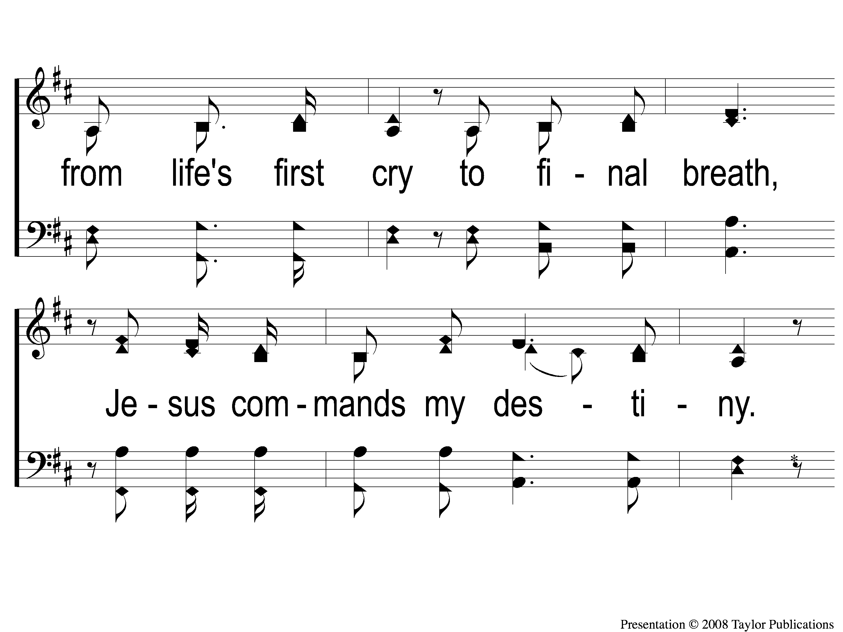
4-2 In Christ Alone
In Christ Alone

Slide 115
4-3 In Christ Alone
In Christ Alone

Slide 116
4-4 In Christ Alone
In Christ Alone

Slide 117
The Unleavened Bread
Romans 5:18-19
“Therefore, as through one man’s offense judgment came to all men, resulting in condemnation, even so through one Man’s righteous act the free gift came to all men, resulting in justification of life. For as by one man’s disobedience many were made sinners, so also by one Man’s obedience many will be made righteous.”

Slide 118
The Fruit
of the Vine
Romans 5:9-11
“Since, therefore, we have now been justified by his blood, much more shall we be saved by him from the wrath of God. For if while we were enemies we were reconciled to God by the death of his Son, much more, now that we are reconciled, shall we be saved by his life. More than that, we also rejoice in God through our Lord Jesus Christ, through whom we have now received reconciliation.”

Slide 119
Closing Prayer

Slide 120
Song:
Just Over In The Glory Land

Slide 121
1-1 Just Over in the Glory Land
Just Over in the Glory Land

Slide 122
1-2 Just Over in the Glory Land
Just Over in the Glory Land

Slide 123
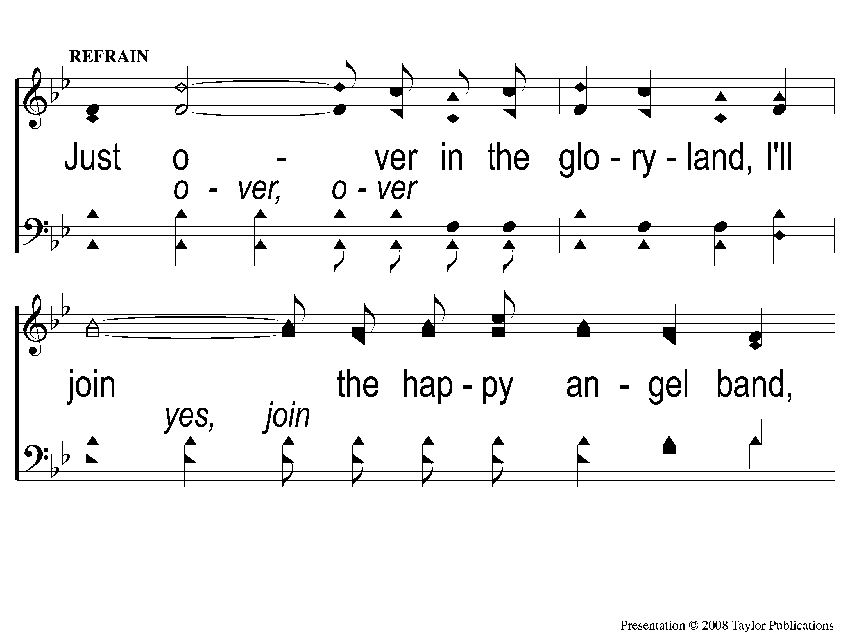
C-1 Just Over in the Glory Land
Just Over in the Glory Land

Slide 124
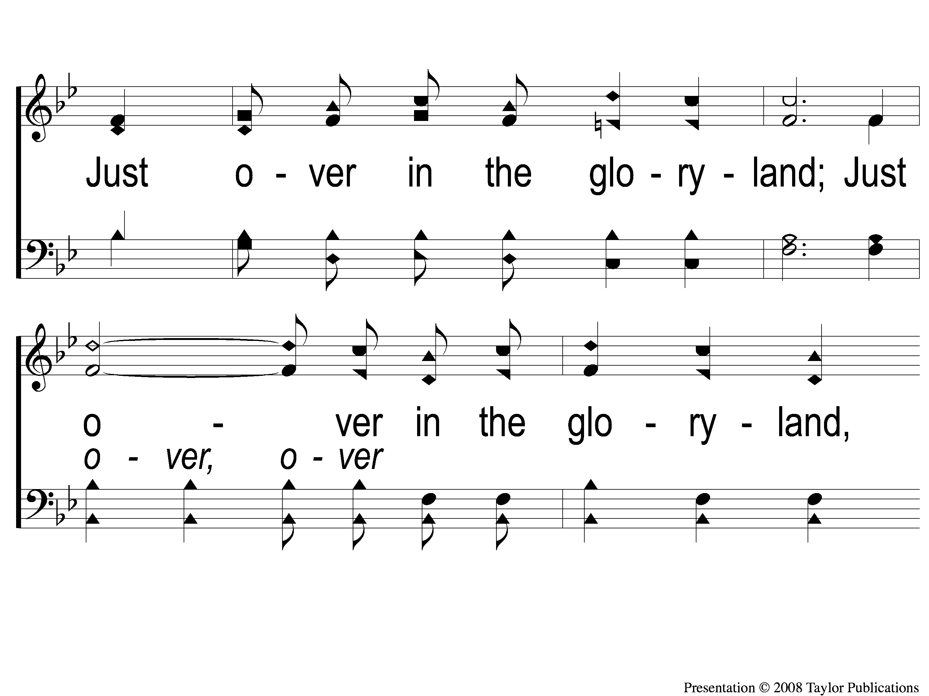
C-2 Just Over in the Glory Land
Just Over in the Glory Land

Slide 125
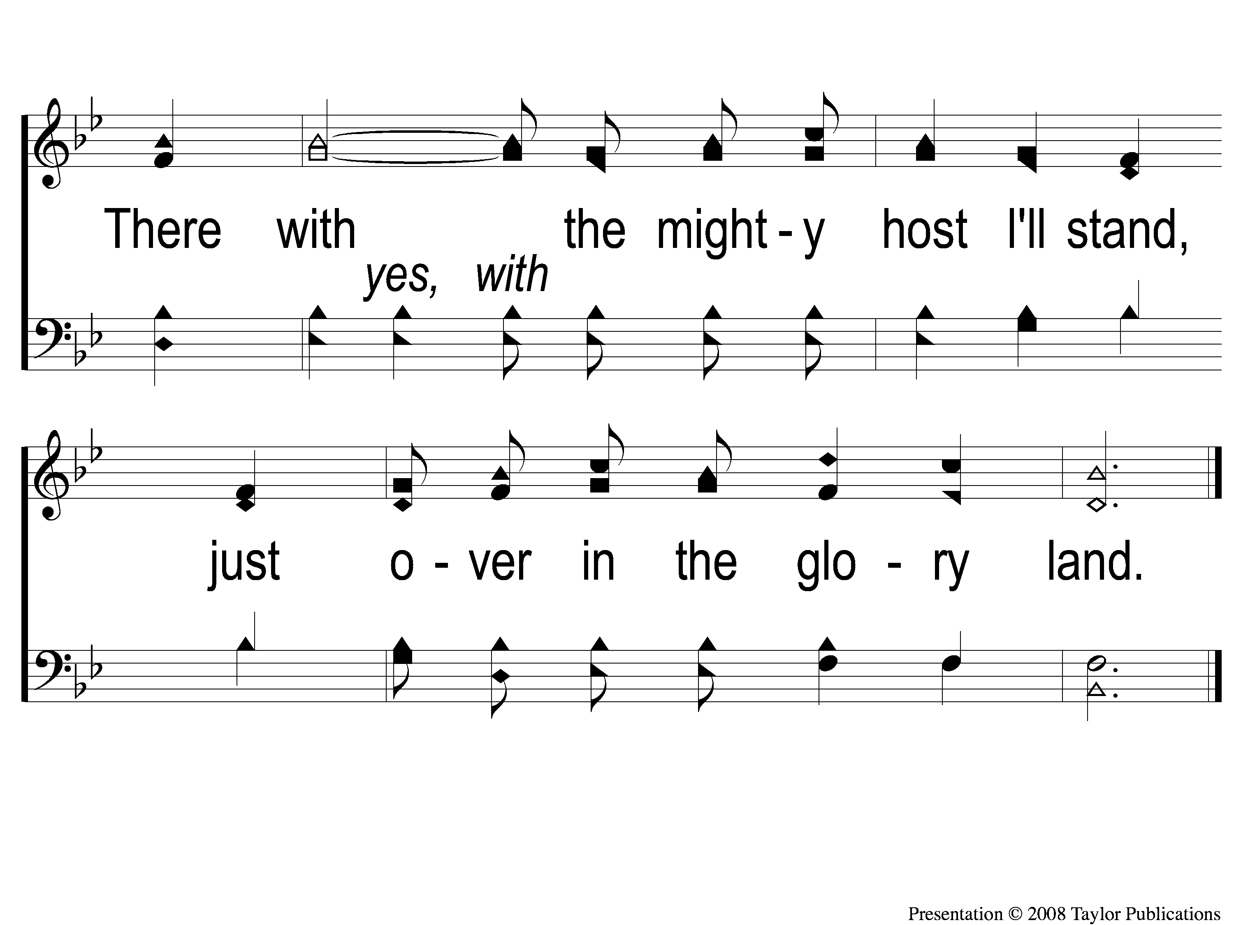
C-3 Just Over in the Glory Land
Just Over in the Glory Land

Slide 126
4-1 Just Over in the Glory Land
Just Over in the Glory Land

Slide 127
4-2 Just Over in the Glory Land
Just Over in the Glory Land

Slide 128
C-1 Just Over in the Glory Land
Just Over in the Glory Land

Slide 129
C-2 Just Over in the Glory Land
Just Over in the Glory Land

Slide 130
C-3 Just Over in the Glory Land
Just Over in the Glory Land

Slide 131
C-1 Just Over in the Glory Land
Just Over in the Glory Land

Slide 132
C-2 Just Over in the Glory Land
Just Over in the Glory Land

Slide 133
C-3 Just Over in the Glory Land
Just Over in the Glory Land

Slide 134
RESTORE REBUILD RENEW
Today
Fellowship Meal & Devo @ Noon
Wednesday
Worship & Bible Classes @ 6:30 PM
IN 2022
WHEELER
CHURCH
OF
CHRIST

