Slide 1
1 I Will Call Upon the Lord
I Will Call Upon the Lord
63

Slide 2
2 I Will Call Upon the Lord
I Will Call Upon the Lord
63

Slide 3
3 I Will Call Upon the Lord
I Will Call Upon the Lord
63

Slide 4
4 I Will Call Upon the Lord
I Will Call Upon the Lord
63

Slide 5
DC1 I Will Call Upon the Lord
I Will Call Upon the Lord
63

Slide 6
DC2 I Will Call Upon the Lord
I Will Call Upon the Lord
63

Slide 7
DC3 I Will Call Upon the Lord
I Will Call Upon the Lord
63

Slide 8
DC4 I Will Call Upon the Lord
I Will Call Upon the Lord
63

Slide 9
tag I Will Call Upon the Lord
I Will Call Upon the Lord
63

Slide 10
RESTORE REBUILD RENEW
welcome
we are glad to
Have you with us
IN 2022
WHEELER
CHURCH
OF
CHRIST

Slide 11
Song:
You Are My All In All
#484

Slide 12
1 All in All
You Are My All in All
484

Slide 13
2 All in All
You Are My All in All
484

Slide 14
3 All in All
You Are My All in All
484

Slide 15
4 All in All
You Are My All in All
484

Slide 16
5 All in All
You Are My All in All
484

Slide 17
6 All in All
You Are My All in All
484

Slide 18
C-1 All in All
You Are My All in All
484

Slide 19
C-2 All in All
You Are My All in All
484

Slide 20
Song:
Just A Little Talk With Jesus
#959

Slide 21
1-1 Just A Little Talk With Jesus
Just A Little Talk With Jesus
959

Slide 22
1-2 Just A Little Talk With Jesus
Just A Little Talk With Jesus
959

Slide 23
C-1 Just A Little Talk With Jesus
Just A Little Talk With Jesus
959

Slide 24
C-2 Just A Little Talk With Jesus
Just A Little Talk With Jesus
959

Slide 25
C-3 Just A Little Talk With Jesus
Just A Little Talk With Jesus
959

Slide 26
2-1 Just A Little Talk With Jesus
Just A Little Talk With Jesus
959

Slide 27
2-2 Just A Little Talk With Jesus
Just A Little Talk With Jesus
959

Slide 28
C-1 Just A Little Talk With Jesus
Just A Little Talk With Jesus
959

Slide 29
C-2 Just A Little Talk With Jesus
Just A Little Talk With Jesus
959

Slide 30
C-3 Just A Little Talk With Jesus
Just A Little Talk With Jesus
959

Slide 31
3-1 Just A Little Talk With Jesus
Just A Little Talk With Jesus
959

Slide 32
3-2 Just A Little Talk With Jesus
Just A Little Talk With Jesus
959

Slide 33
C-1 Just A Little Talk With Jesus
Just A Little Talk With Jesus
959

Slide 34
C-2 Just A Little Talk With Jesus
Just A Little Talk With Jesus
959

Slide 35
C-3 Just A Little Talk With Jesus
Just A Little Talk With Jesus
959

Slide 36
Opening Prayer

Slide 37
Song:
In Christ Alone
PH #

Slide 38
1-1 In Christ Alone
In Christ Alone

Slide 39
1-2 In Christ Alone
In Christ Alone

Slide 40
1-3 In Christ Alone
In Christ Alone

Slide 41
1-4 In Christ Alone
In Christ Alone

Slide 42
2-1 In Christ Alone
In Christ Alone

Slide 43
2-2 In Christ Alone
In Christ Alone

Slide 44
2-3 In Christ Alone
In Christ Alone

Slide 45
2-4 In Christ Alone
In Christ Alone

Slide 46
3-1 In Christ Alone
In Christ Alone

Slide 47
3-2 In Christ Alone
In Christ Alone

Slide 48
3-3 In Christ Alone
In Christ Alone

Slide 49
3-4 In Christ Alone
In Christ Alone

Slide 50
4-1 In Christ Alone
In Christ Alone

Slide 51
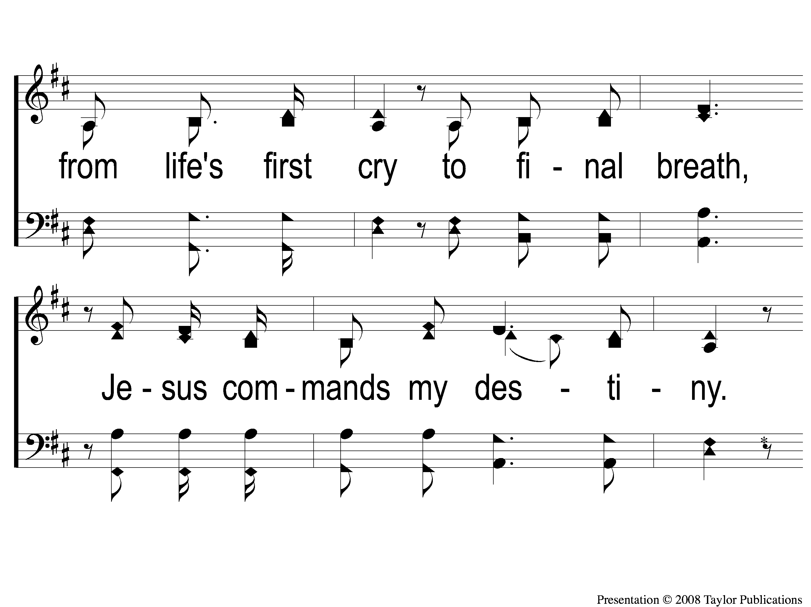
4-2 In Christ Alone
In Christ Alone

Slide 52
4-3 In Christ Alone
In Christ Alone

Slide 53
4-4 In Christ Alone
In Christ Alone

Slide 54
Song:
Here I Am To Worship
PH #

Slide 55
1-1 Here I Am To Worship
Here I Am To Worship

Slide 56
1-2 Here I Am To Worship
Here I Am To Worship

Slide 57
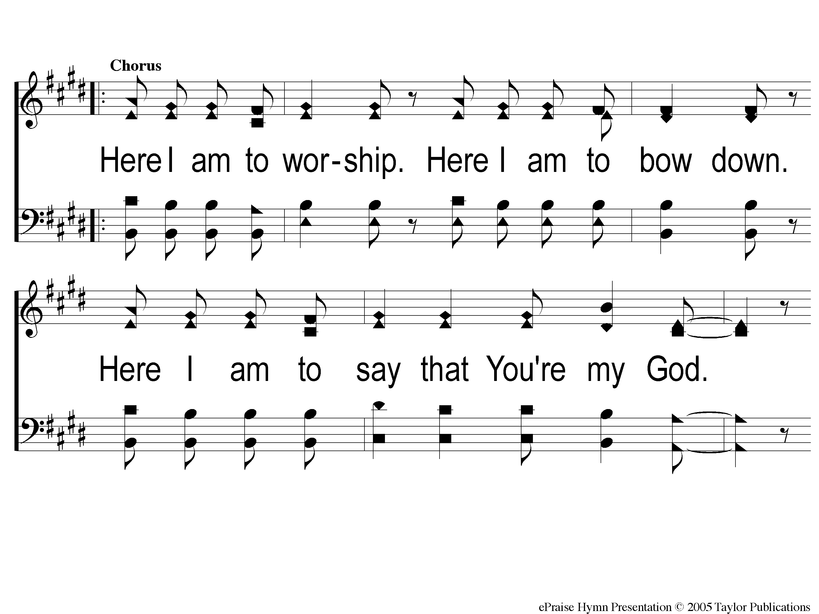
C-1 Here I Am To Worship
Here I Am To Worship

Slide 58
C-2 Here I Am To Worship
Here I Am To Worship

Slide 59
2-1 Here I Am To Worship
Here I Am To Worship

Slide 60
2-2 Here I Am To Worship
Here I Am To Worship

Slide 61
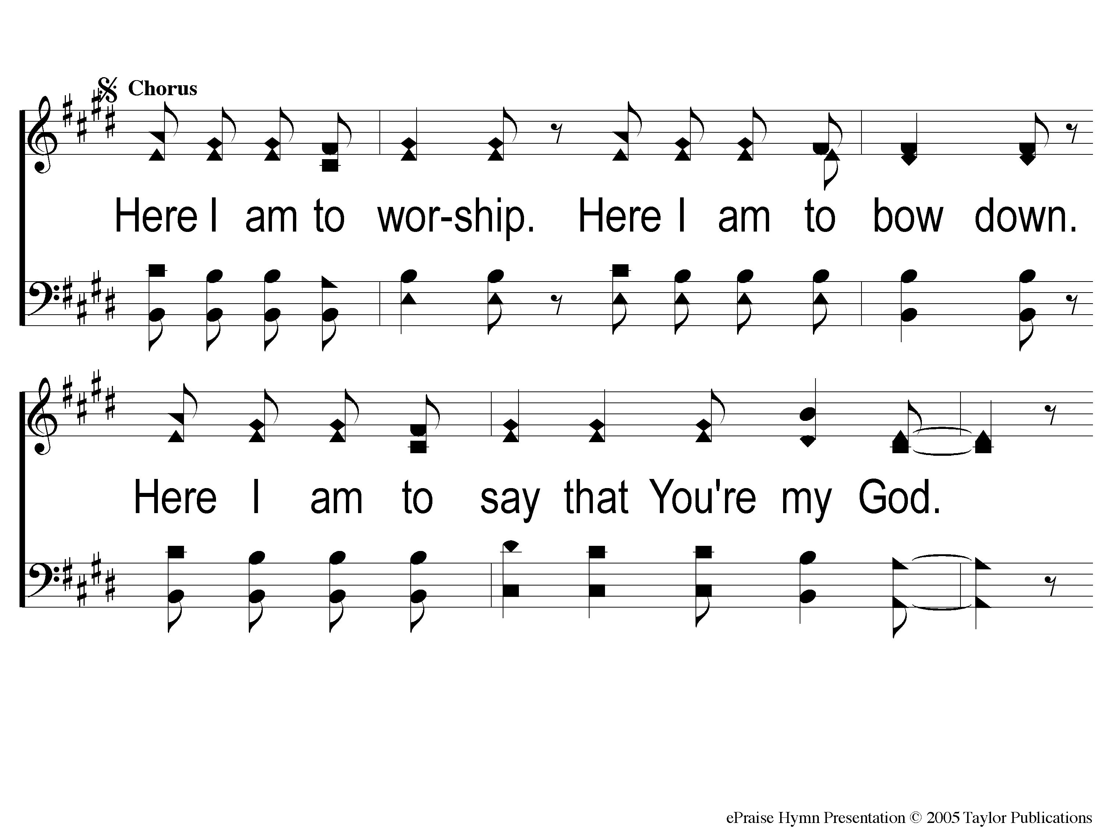
C2-1 Here I Am To Worship
Here I Am To Worship

Slide 62
C2-2 Here I Am To Worship
Here I Am To Worship

Slide 63
Bridge1 Here I Am To Worship
Here I Am To Worship

Slide 64
Bridge2 Here I Am To Worship
Here I Am To Worship

Slide 65
C2-1 Here I Am To Worship
Here I Am To Worship

Slide 66
C2-2 Here I Am To Worship
Here I Am To Worship

Slide 67
tag Here I Am To Worship
Here I Am To Worship

Slide 68
Scripture Reading:
Nehemiah 13:1-3

Slide 69
Tonight @ 6pm

Slide 70
A PEOPLE OF PURITY
God’s People Are Called To Be:
Holy – Lev. 19:22-26, Ezek. 22:26
Pure – Gen. 35:2, Num. 8:21

Slide 71
A PEOPLE OF PURITY
God’s People in Nehemiah 13
Unholy & Impure
Neh. 13:6-7

Slide 72
MORE PURIFICATION
Nehemiah Chapter 13

Slide 73
THE PROCESS OF PURITY
Recognize There Are Problems

Slide 74
RECOGNIZE THERE ARE PROBLEMS
How Do We Do This?

Slide 75
RECOGNIZE THERE ARE PROBLEMS
How Do We Do This?
Hear God’s Word
Neh. 13:1

Slide 76
RECOGNIZE THERE ARE PROBLEMS
Do We Do This?
Jms. 1:21-25

Slide 77
THE PROCESS OF PURITY
Recognize There Are Problems
Isolate The Problems

Slide 78
ISOLATE THE PROBLEMS
How Do We Do This?
Examine Our Lives
2 Cor. 13:5

Slide 79
ISOLATE THE PROBLEMS
What Did They Find?
Impure Worship (v. 1-3)

Slide 80
ISOLATE THE PROBLEMS
What Did They Find?
Impure Worship (v. 1-3)
Impure Friendships (v. 4-9)

Slide 81
ISOLATE THE PROBLEMS
What Did They Find?
Impure Worship (v. 1-3)
Impure Friendships (v. 4-9)
Impure Finances (v. 10-14)

Slide 82
ISOLATE THE PROBLEMS
What Did They Find?
Impure Worship (v. 1-3)
Impure Friendships (v. 4-9)
Impure Finances (v. 10-14)
Impure Use of Time (v. 15-22)

Slide 83
ISOLATE THE PROBLEMS
What Did They Find?
Impure Worship (v. 1-3)
Impure Friendships (v. 4-9)
Impure Finances (v. 10-14)
Impure Use of Time (v. 15-22)
Impure Homes (v. 23-29)

Slide 84
THE PROCESS OF PURITY
Recognize There Are Problems
Isolate The Problems
Address The Problems

Slide 85
ADDRESS THE PROBLEMS
How Do We Do This?
Strongly (v. 25, 28)

Slide 86
ADDRESS THE PROBLEMS
How Do We Do This?
Strongly (v. 25, 28)
Urgently (v. 10-11, 15-17)

Slide 87
ADDRESS THE PROBLEMS
How Do We Do This?
Strongly (v. 25, 28)
Urgently (v. 10-11, 15-17)
Fully

Slide 88
THE PROCESS OF PURITY
Recognize There Are Problems
Isolate The Problems
Address The Problems
Give God Glory!

Slide 89
GIVE GOD GLORY!
For His Mercy (v. 22) – Rom. 15:9

Slide 90
GIVE GOD GLORY!
For His Mercy (v. 22) – Rom. 15:9
For His Goodness (v. 31) – Rom. 11:22

Slide 91
Does God See You As Pure?

Slide 92
Teach Me Lord To Wait
#764
Invitation
Song:

Slide 93
1-1 Teach Me Lord to Wait
Teach Me Lord, To Wait
764

Slide 94
1-2 Teach Me Lord to Wait
Teach Me Lord, To Wait
764

Slide 95
C-1 Teach Me Lord to Wait
Teach Me Lord, To Wait
764

Slide 96
C-2 Teach Me Lord to Wait
Teach Me Lord, To Wait
764

Slide 97
2-1 Teach Me Lord to Wait
Teach Me Lord, To Wait
764

Slide 98
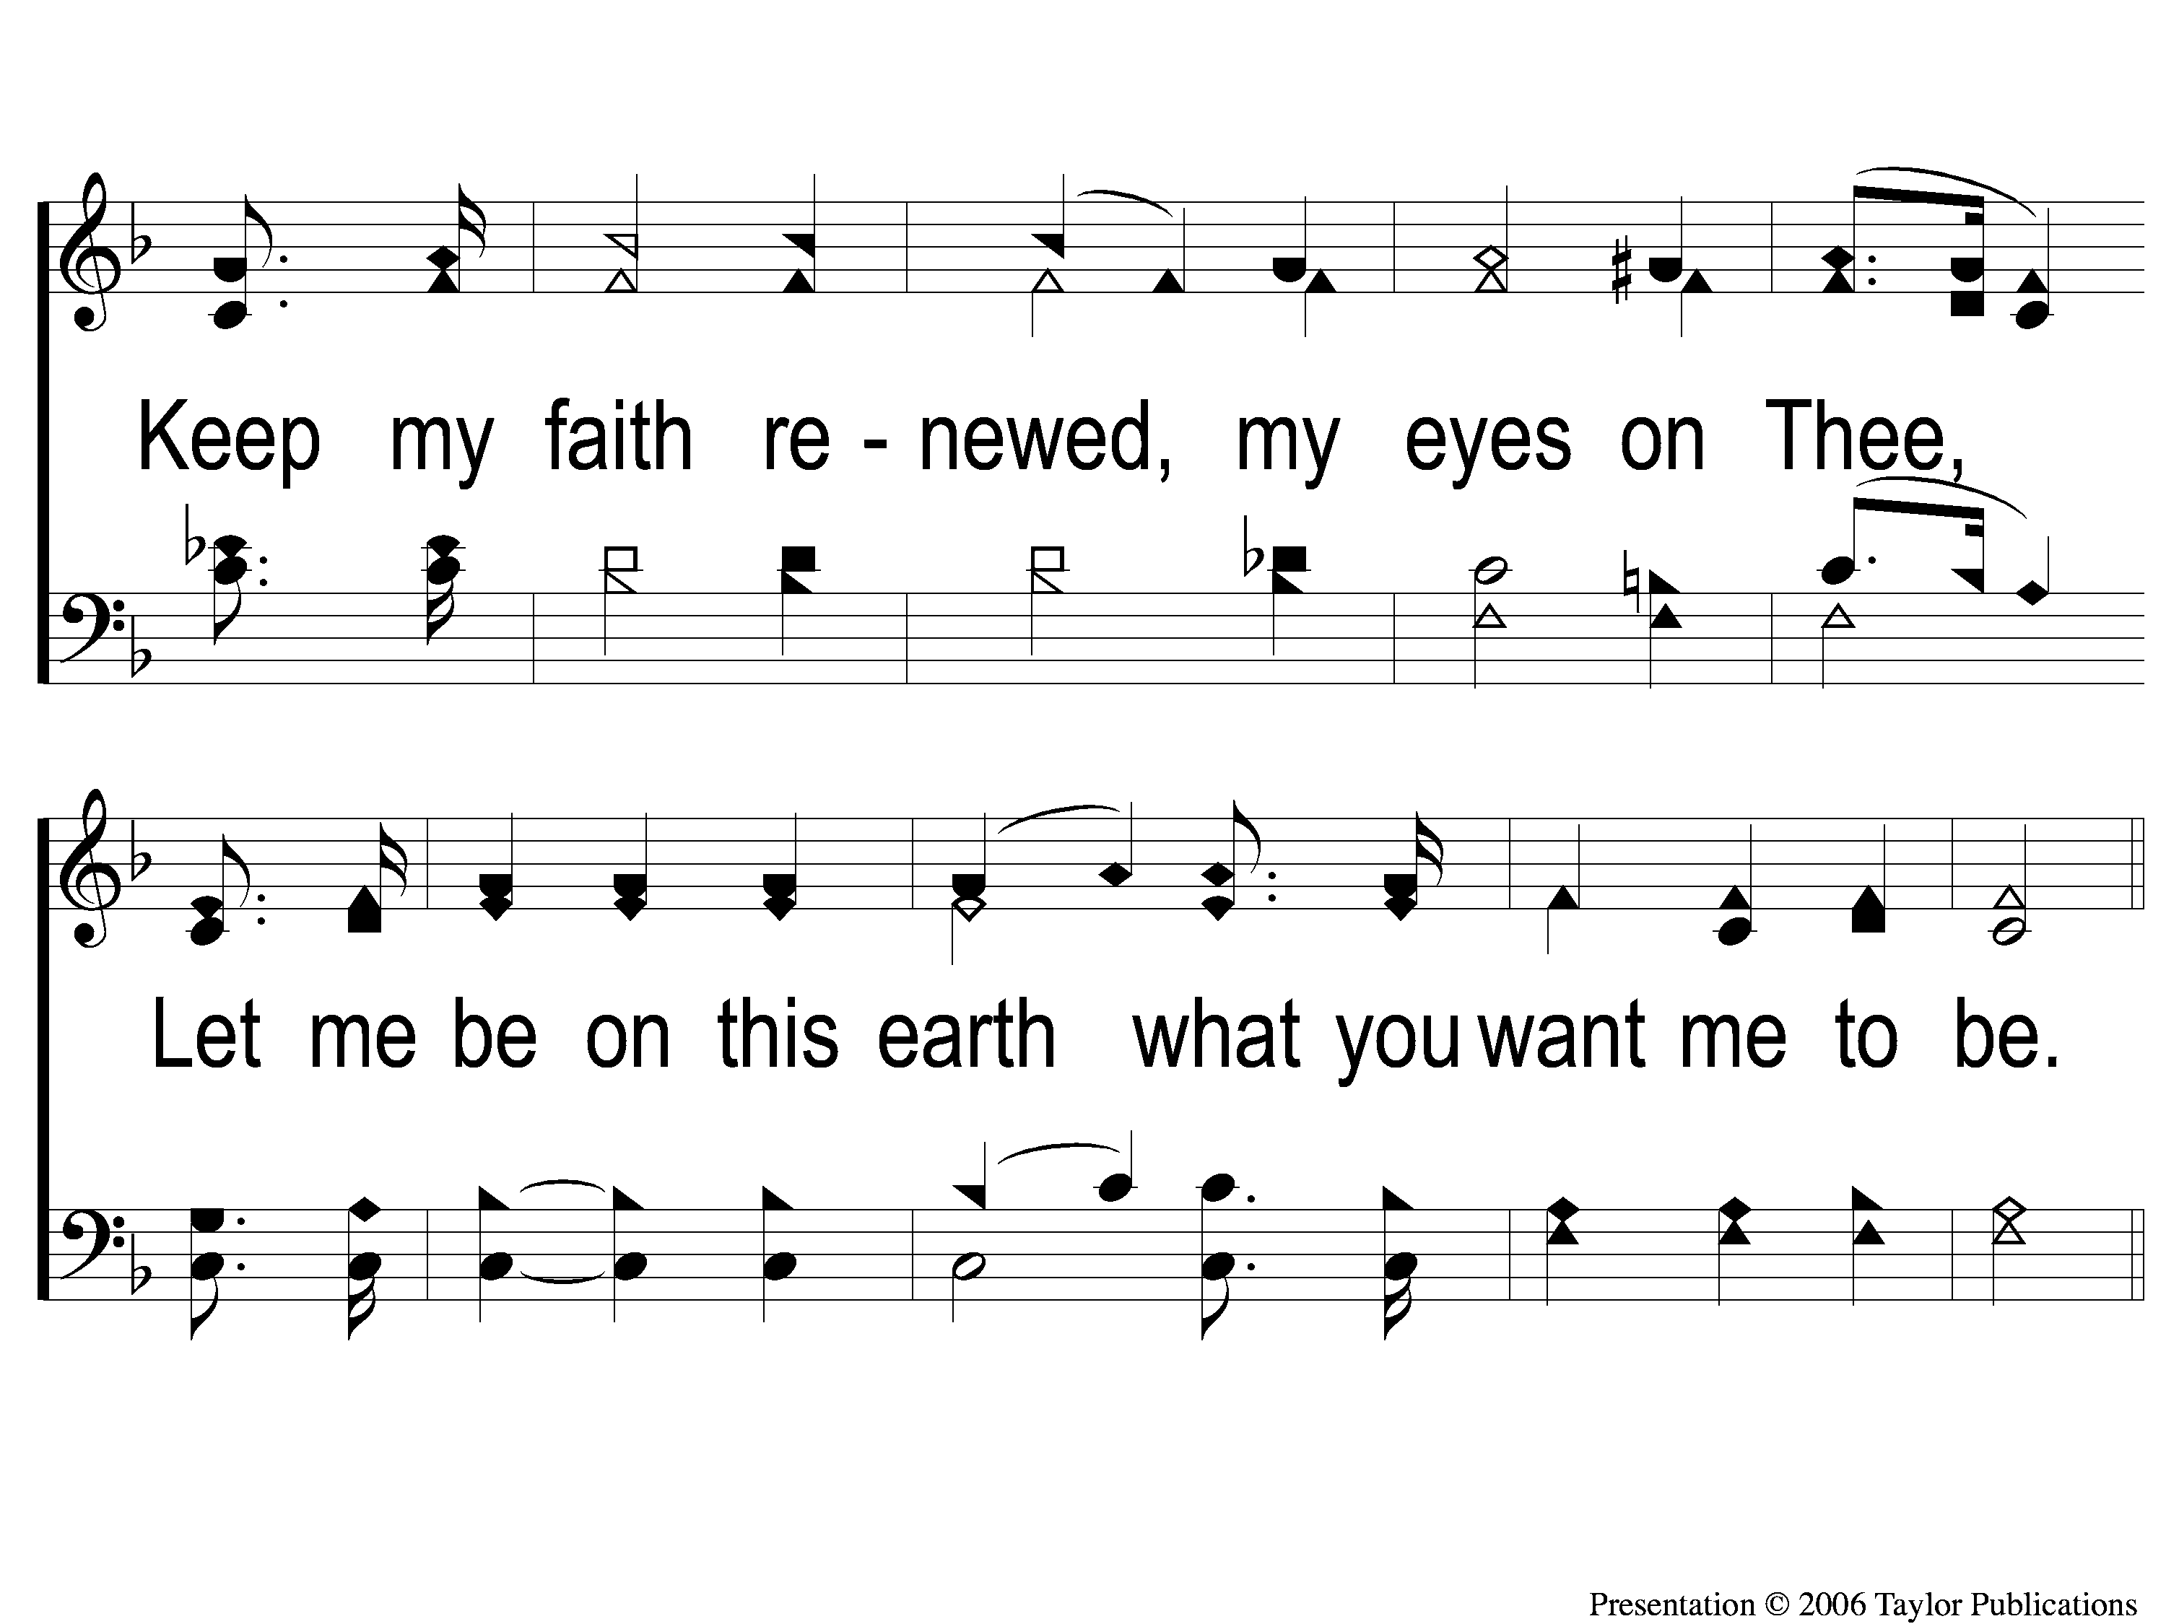
2-2 Teach Me Lord to Wait
Teach Me Lord, To Wait
764

Slide 99
C-1 Teach Me Lord to Wait
Teach Me Lord, To Wait
764

Slide 100
C-2 Teach Me Lord to Wait
Teach Me Lord, To Wait
764

Slide 101
The Contribution:
2 Corinthians 9:7-8
“So let each one give as he purposes in his heart, not grudgingly or of necessity; for God loves a cheerful giver. And God is able to make all grace abound toward you, that you, always having all sufficiency in all things, may have an abundance for every good work.”

Slide 102
Song:
How Deep The Father’s Love
PH #

Slide 103
1-1 How Deep the Father’s Love
How Deep The Father’s Love

Slide 104
1-2 How Deep the Father’s Love
How Deep The Father’s Love

Slide 105
1-3 How Deep the Father’s Love
How Deep The Father’s Love

Slide 106
1-4 How Deep the Father’s Love
How Deep The Father’s Love

Slide 107
2-1 How Deep the Father’s Love
How Deep The Father’s Love

Slide 108
2-2 How Deep the Father’s Love
How Deep The Father’s Love

Slide 109
2-3 How Deep the Father’s Love
How Deep The Father’s Love

Slide 110
2-4 How Deep the Father’s Love
How Deep The Father’s Love

Slide 111
3-1 How Deep the Father’s Love
How Deep The Father’s Love

Slide 112
3-2 How Deep the Father’s Love
How Deep The Father’s Love

Slide 113
3-3 How Deep the Father’s Love
How Deep The Father’s Love

Slide 114
3-4 How Deep the Father’s Love
How Deep The Father’s Love

Slide 115
The Unleavened Bread
1 Peter 4:1-2
“Therefore, since Christ suffered for us in the flesh, arm yourselves also with the same mind, for he who has suffered in the flesh has ceased from sin, that he no longer should live the rest of his time in the flesh for the lusts of men, but for the will of God.”

Slide 116
The Fruit
of the Vine
1 Peter 1:17-19
“And if you call on the Father, who without partiality judges according to each one’s work, conduct yourselves throughout the time of your stay here in fear; knowing that you were not redeemed with corruptible things, like silver or gold, from your aimless conduct received by tradition from your fathers, but with the precious blood of Christ, as of a lamb without blemish and without spot. ”

Slide 117
Closing Prayer

Slide 118
Song:
The Lily Of The Valley
#548

Slide 119
1-1 The Lily of the Valley
The Lily of the Valley
548

Slide 120
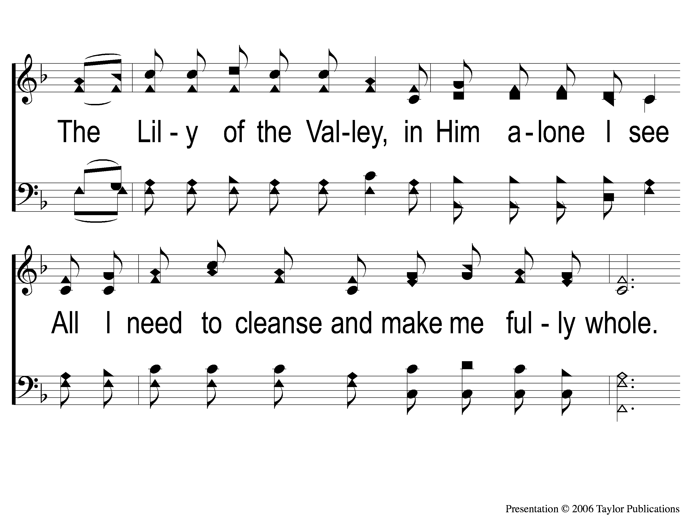
1-2 The Lily of the Valley
The Lily of the Valley
548

Slide 121
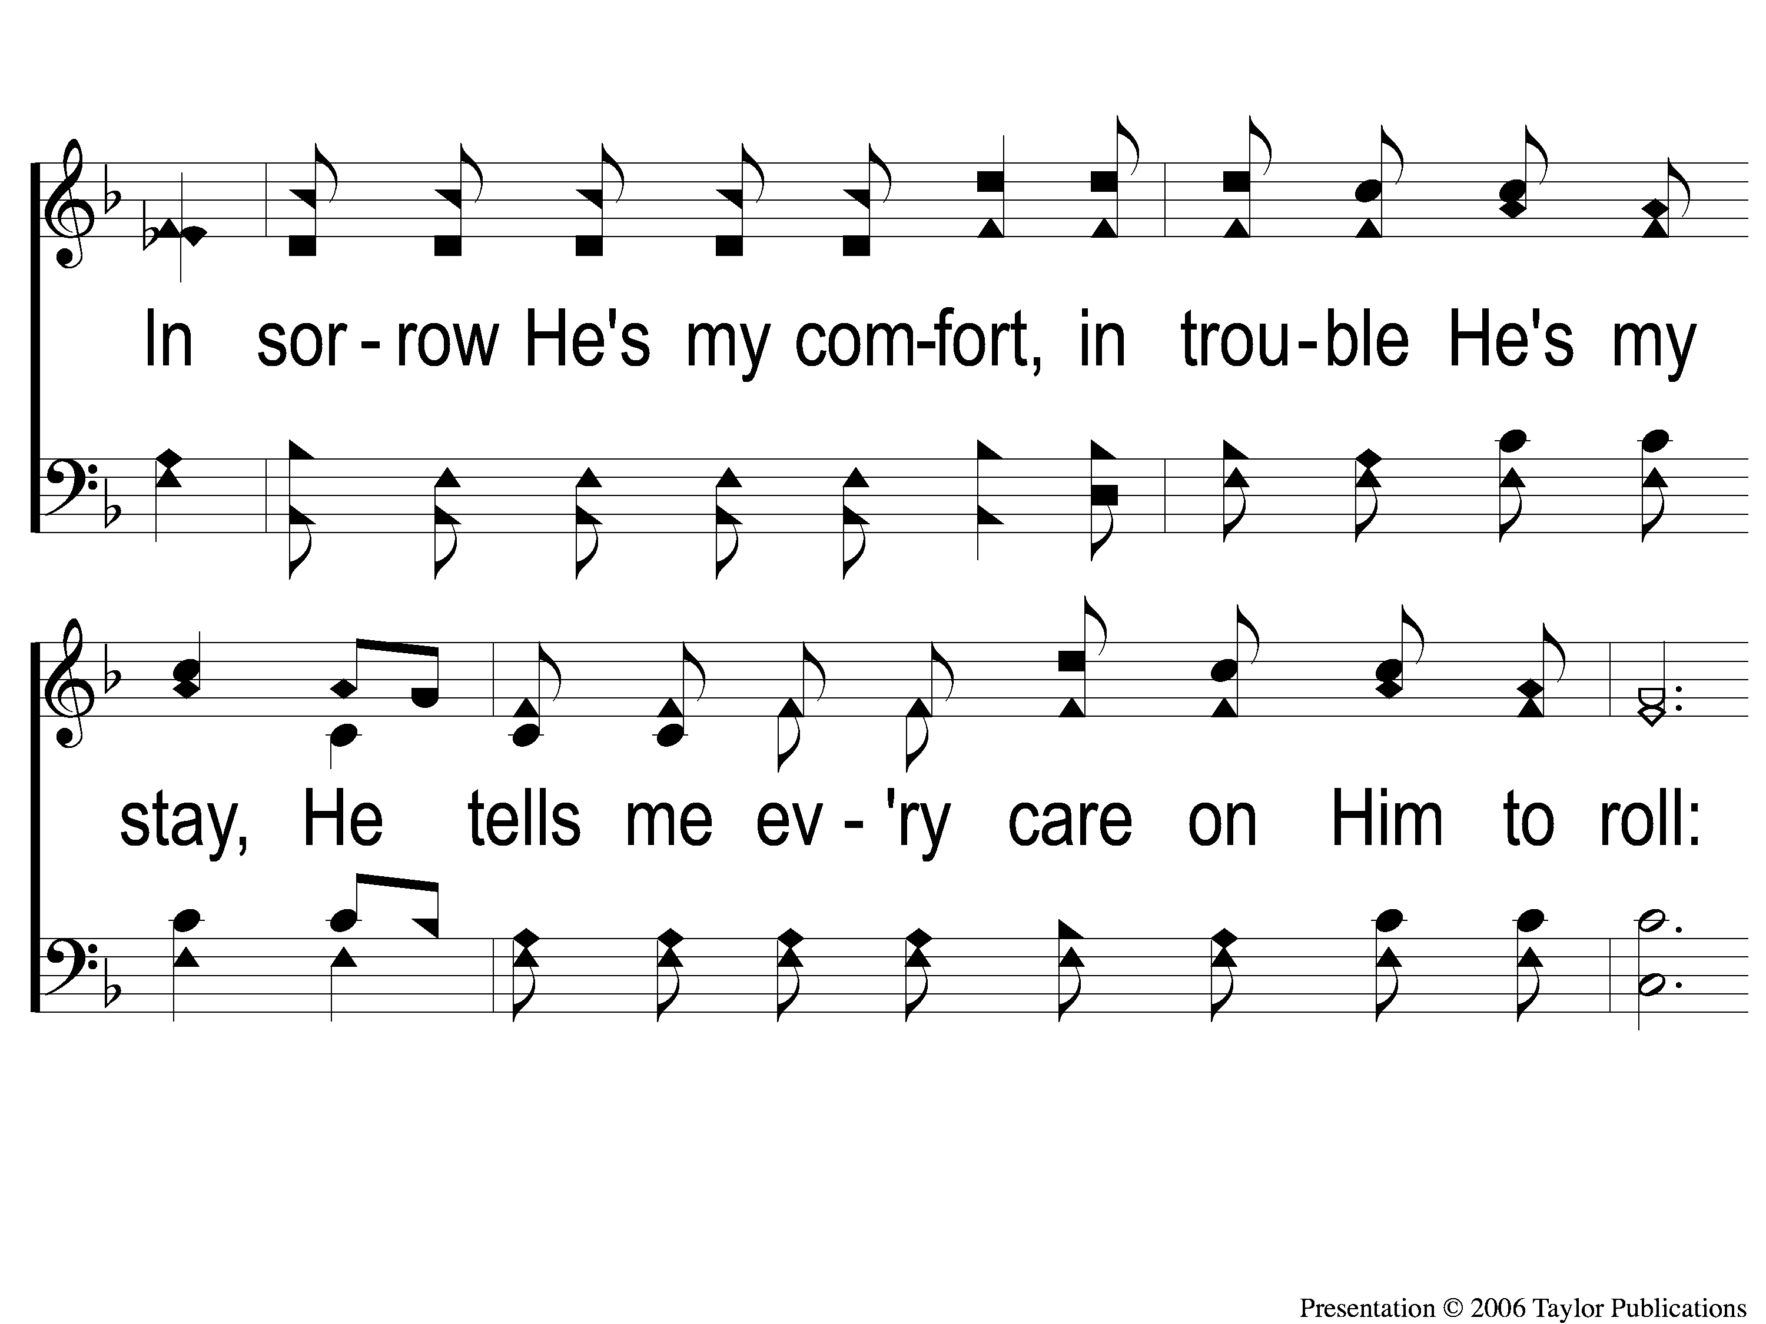
1-3 The Lily of the Valley
The Lily of the Valley
548

Slide 122
C The Lily of the Valley
The Lily of the Valley
548

Slide 123
2-1 The Lily of the Valley
The Lily of the Valley
548

Slide 124
2-2 The Lily of the Valley
The Lily of the Valley
548

Slide 125
2-3 The Lily of the Valley
The Lily of the Valley
548

Slide 126
C The Lily of the Valley
The Lily of the Valley
548

Slide 127
3-1 The Lily of the Valley
The Lily of the Valley
548

Slide 128
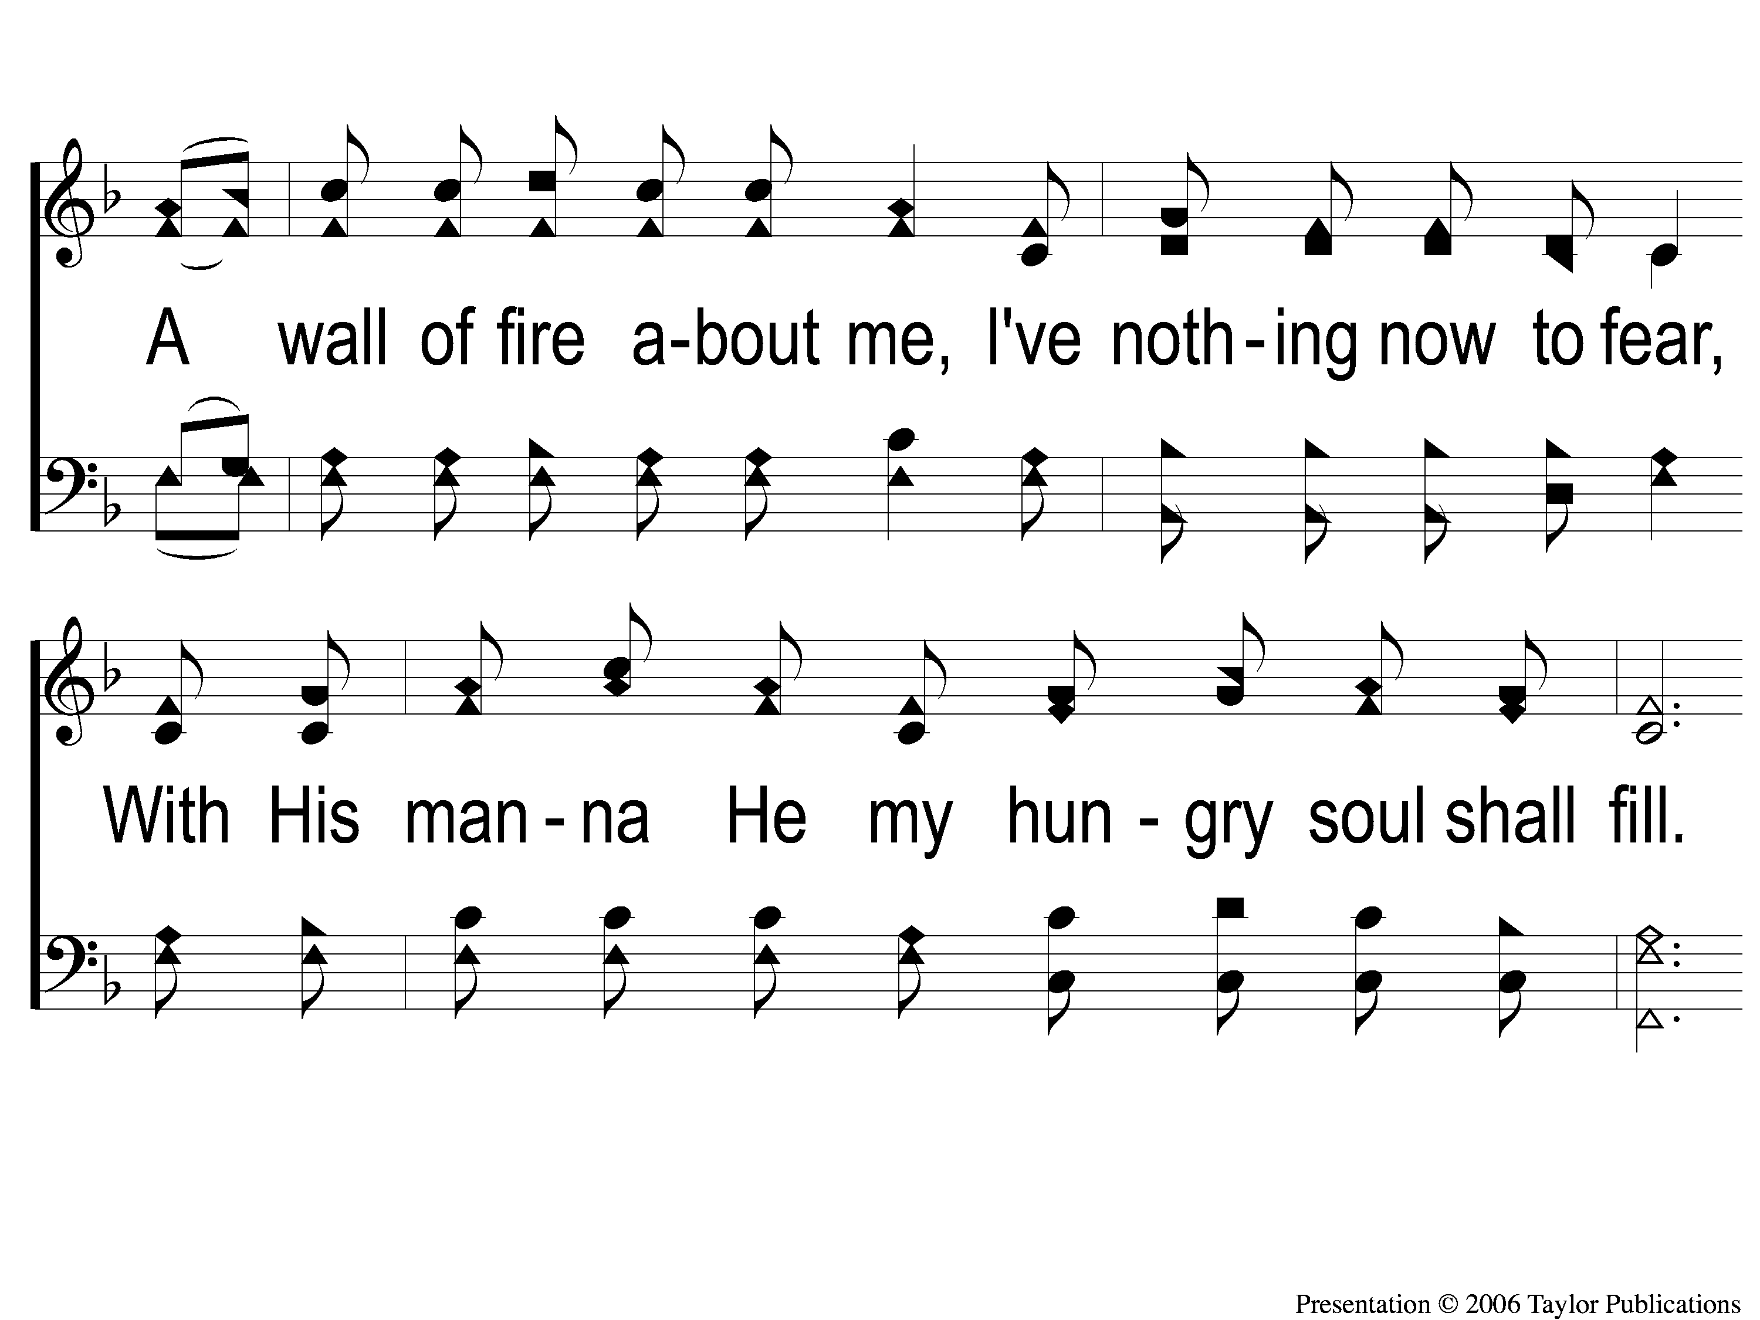
3-2 The Lily of the Valley
The Lily of the Valley
548

Slide 129
3-3 The Lily of the Valley
The Lily of the Valley
548

Slide 130
C The Lily of the Valley
The Lily of the Valley
548

Slide 131
RESTORE REBUILD RENEW
Tonight
Evening Worship @ 6:00 PM
Wednesday
Worship & Classes & 6:30 PM
IN 2022
WHEELER
CHURCH
OF
CHRIST

