Slide 1
PLEASE STANDBY
OUR LIVESTREAM
WILL BEGIN SOON

Slide 2
1-1 Father God
Father God, Just For Today

Slide 3
1-2 Father God
Father God, Just For Today

Slide 4
1C-1 Father God
Father God, Just For Today

Slide 5
1C-2 Father God
Father God, Just For Today

Slide 6
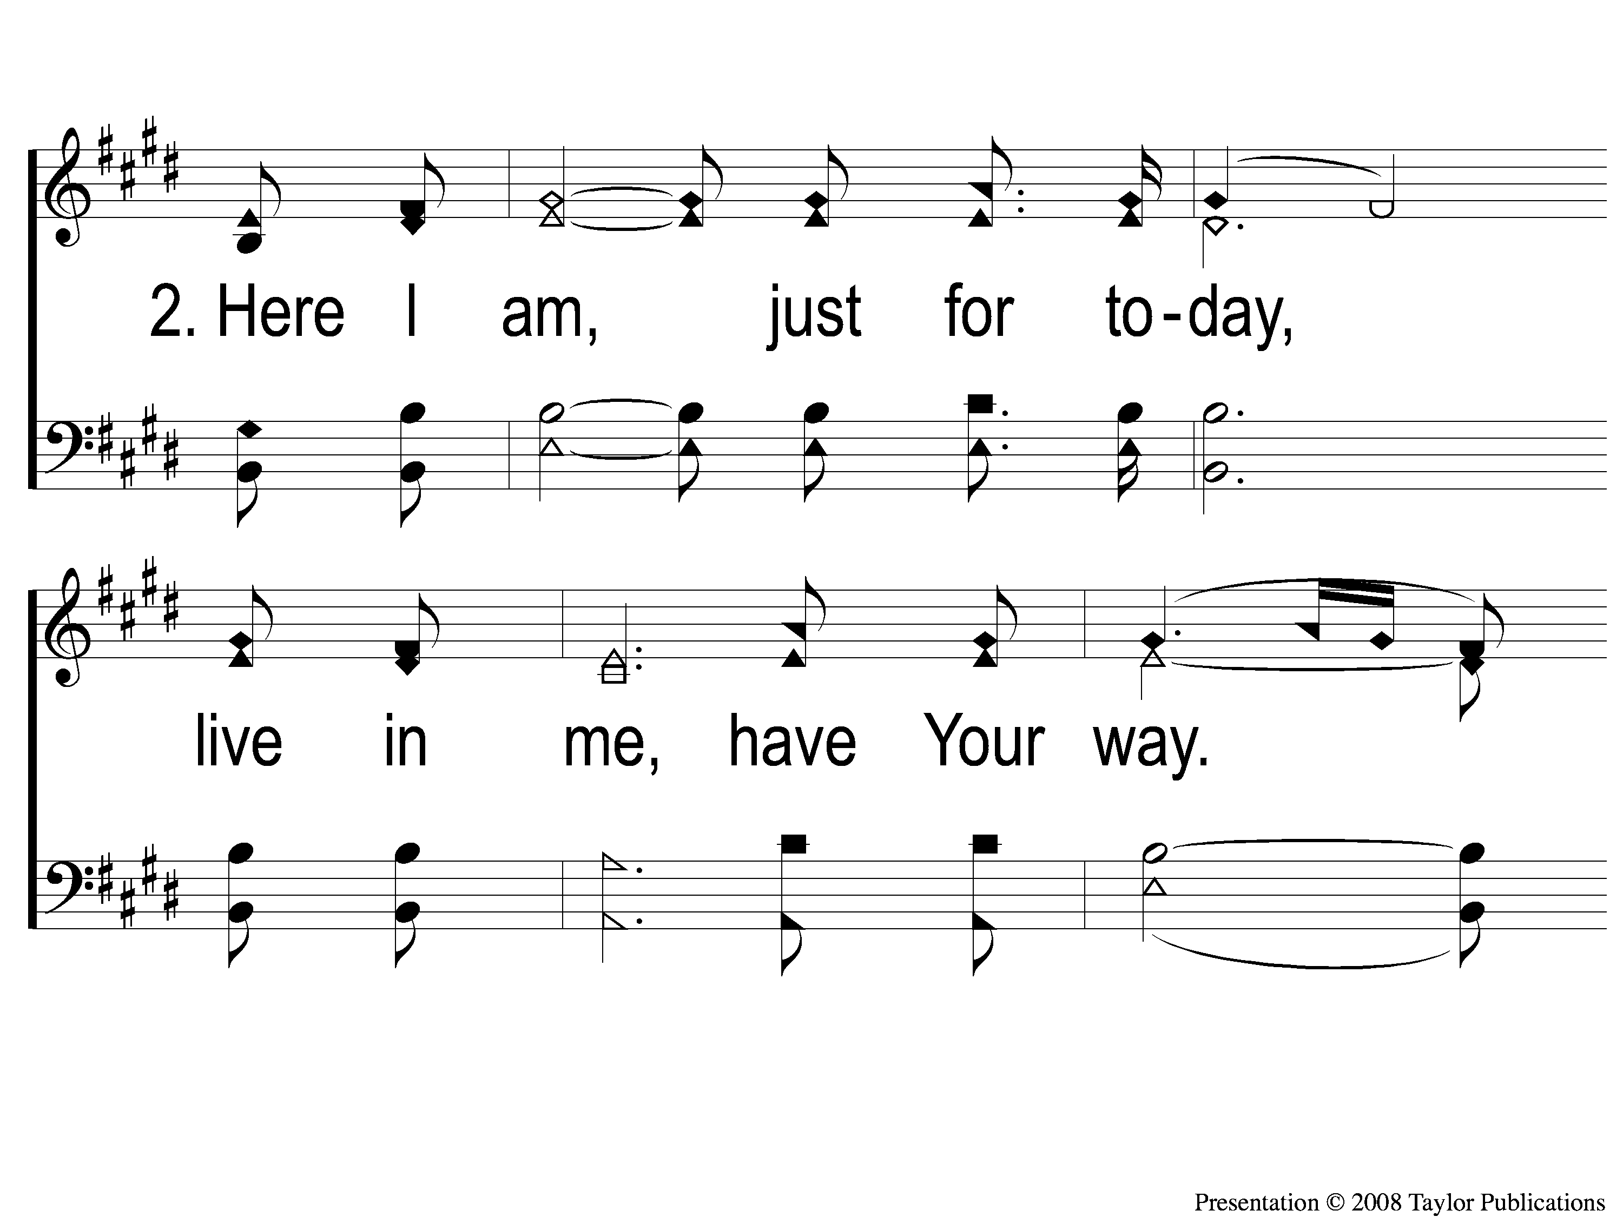
2-1 Father God
Father God, Just For Today

Slide 7
2-2 Father God
Father God, Just For Today

Slide 8
2C-1 Father God
Father God, Just For Today

Slide 9
2C-2 Father God
Father God, Just For Today

Slide 10
WELCOME
THANKS FOR JOINING US!

Slide 11
#452
SONG:
Standing On
The Promises

Slide 12
1-1 Standing on the Promises
Standing On the Promises
452

Slide 13
1-2 Standing on the Promises
Standing On the Promises
452

Slide 14
C-1 Standing on the Promises
Standing On the Promises
452

Slide 15
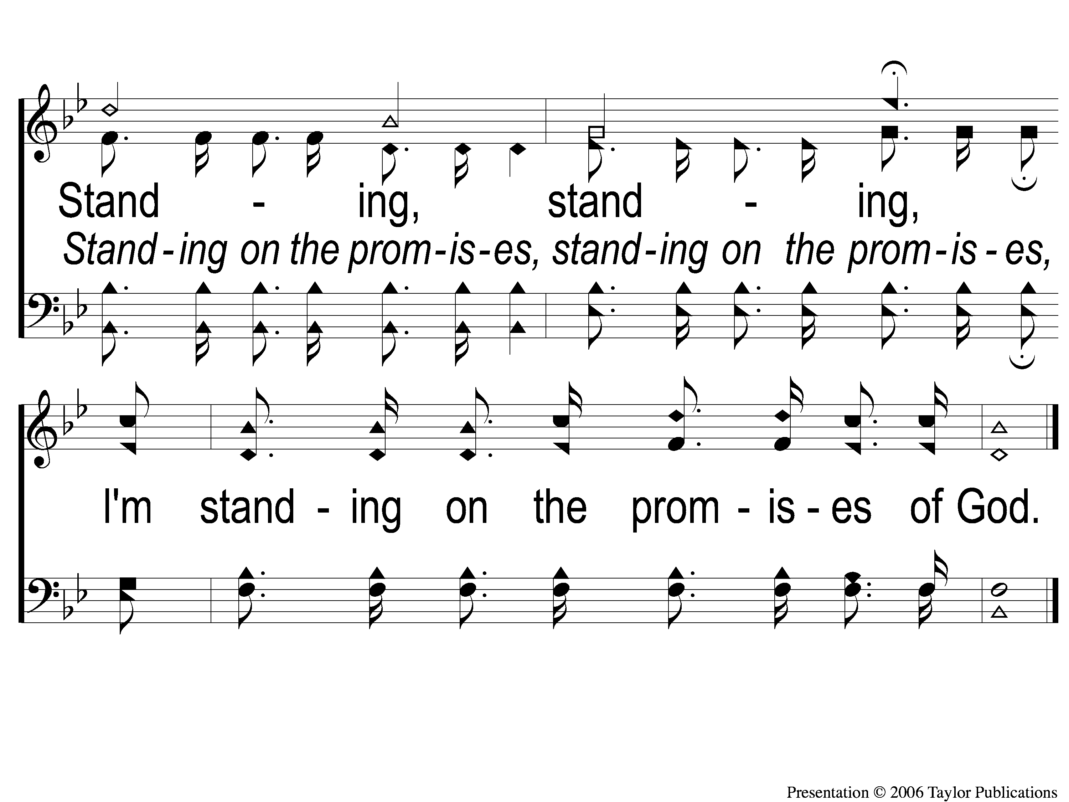
C-2 Standing on the Promises
Standing On the Promises
452

Slide 16
2-1 Standing on the Promises
Standing On the Promises
452

Slide 17
2-2 Standing on the Promises
Standing On the Promises
452

Slide 18
C-1 Standing on the Promises
Standing On the Promises
452

Slide 19
C-2 Standing on the Promises
Standing On the Promises
452

Slide 20
4-1 Standing on the Promises
Standing On the Promises
452

Slide 21
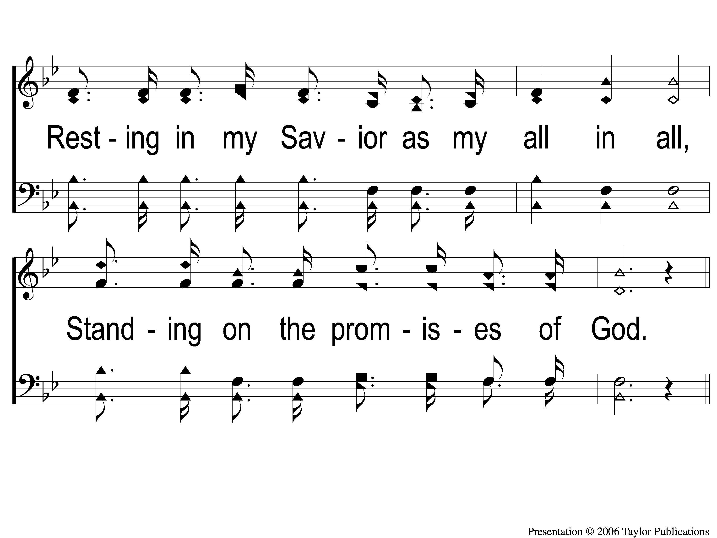
4-2 Standing on the Promises
Standing On the Promises
452

Slide 22
C-1 Standing on the Promises
Standing On the Promises
452

Slide 23
C-2 Standing on the Promises
Standing On the Promises
452

Slide 24
#462
SONG:
I Know Who
Holds Tomorrow

Slide 25
1-1 I Know Who Holds Tomorrow
I Know Who Holds Tomorrow
463

Slide 26
1-2 I Know Who Holds Tomorrow
I Know Who Holds Tomorrow
463

Slide 27
1-3 I Know Who Holds Tomorrow
I Know Who Holds Tomorrow
463

Slide 28
C-1 I Know Who Holds Tomorrow
I Know Who Holds Tomorrow
463

Slide 29
C-2 I Know Who Holds Tomorrow
I Know Who Holds Tomorrow
463

Slide 30
2-1 I Know Who Holds Tomorrow
I Know Who Holds Tomorrow
463

Slide 31
2-2 I Know Who Holds Tomorrow
I Know Who Holds Tomorrow
463

Slide 32
2-3 I Know Who Holds Tomorrow
I Know Who Holds Tomorrow
463

Slide 33
C-1 I Know Who Holds Tomorrow
I Know Who Holds Tomorrow
463

Slide 34
C-2 I Know Who Holds Tomorrow
I Know Who Holds Tomorrow
463

Slide 35
3-1 I Know Who Holds Tomorrow
I Know Who Holds Tomorrow
463

Slide 36
3-2 I Know Who Holds Tomorrow
I Know Who Holds Tomorrow
463

Slide 37
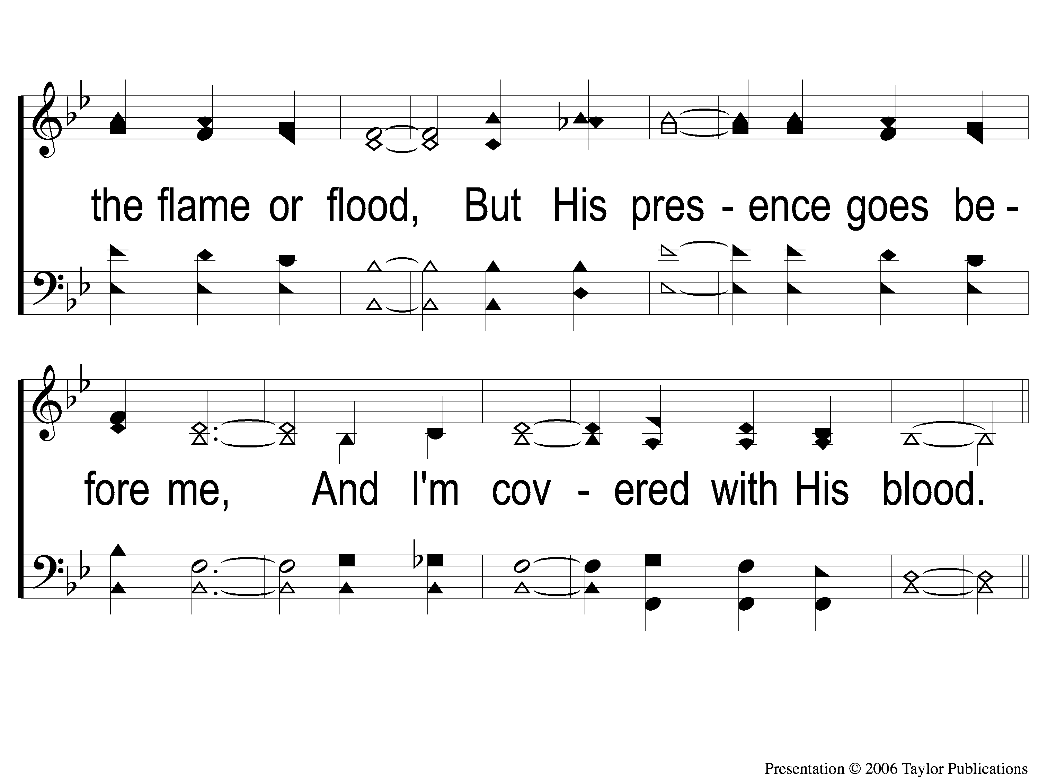
3-3 I Know Who Holds Tomorrow
I Know Who Holds Tomorrow
463

Slide 38
C-1 I Know Who Holds Tomorrow
I Know Who Holds Tomorrow
463

Slide 39
C-2 I Know Who Holds Tomorrow
I Know Who Holds Tomorrow
463

Slide 40
First PRAYER

Slide 41
#414
SONG:
Anywhere With Jesus

Slide 42
1-1 Anywhere with Jesus
Anywhere With Jesus
414

Slide 43
1-2 Anywhere with Jesus
Anywhere With Jesus
414

Slide 44
C-1 Anywhere with Jesus
Anywhere With Jesus
414

Slide 45
2-1 Anywhere with Jesus
Anywhere With Jesus
414

Slide 46
2-2 Anywhere with Jesus
Anywhere With Jesus
414

Slide 47
C-1 Anywhere with Jesus
Anywhere With Jesus
414

Slide 48
4-1 Anywhere with Jesus
Anywhere With Jesus
414

Slide 49
4-2 Anywhere with Jesus
Anywhere With Jesus
414

Slide 50
C-1 Anywhere with Jesus
Anywhere With Jesus
414

Slide 51
#464
SONG:
Because He Lives

Slide 52
1-1 Because He Lives
Because He Lives
464

Slide 53
1-2 Because He Lives
Because He Lives
464

Slide 54
C-1 Because He Lives
Because He Lives
464

Slide 55
C-2 Because He Lives
Because He Lives
464

Slide 56
2-1 Because He Lives
Because He Lives
464

Slide 57
2-2 Because He Lives
Because He Lives
464

Slide 58
C-1 Because He Lives
Because He Lives
464

Slide 59
C-2 Because He Lives
Because He Lives
464

Slide 60
3-1 Because He Lives
Because He Lives
464

Slide 61
3-2 Because He Lives
Because He Lives
464

Slide 62
C-1 Because He Lives
Because He Lives
464

Slide 63
C-2 Because He Lives
Because He Lives
464

Slide 64
SCRIPTURE:
Galatians 4:28-5:1

Slide 65
STANDING ON THE PROMISES

Slide 66
PM Sermon:
THE PROMISE OF PRESERVATION

Slide 67
THE PROMISE OF FREEDOM

Slide 68
THE GOD OF FREEDOM
Jms. 1:25 Psa. 146:7
Isa. 61:1 Jn. 8:32

Slide 69
WHAT IT DOES NOT MEAN:

Slide 70
WHAT IT DOES NOT MEAN:
Free Speech

Slide 71
WHAT IT DOES NOT MEAN:
Free Speech
Col. 4:6
Titus 2:8
Jms. 2:12

Slide 72
WHAT IT DOES NOT MEAN:
Free Speech
Free to Serve Self

Slide 73
WHAT IT DOES NOT MEAN:
Free To Serve Self
Gal. 2:20, 5:13
1 Cor. 8:9, 9:19

Slide 74
WHAT IT DOES NOT MEAN:
Free Speech
Free to Serve Self
Free to Sin

Slide 75
WHAT IT DOES NOT MEAN:
Free To Sin
1 Pet. 2:16
Rom. 6:1-2, 15

Slide 76
WHAT IT MEANS:

Slide 77
WHAT IT MEANS:
Freedom From Sin

Slide 78
WHAT IT MEANS:
Freedom From Sin
Jn. 8:34
Gal. 3:28-29, 4:26, 31, 5:1, 13
Rom. 6:15

Slide 79
WHAT IT MEANS:
Freedom From Sin
Freedom From Shame

Slide 80
WHAT IT MEANS:
Freedom From Shame
1 Cor. 15:34
2 Cor. 4:2

Slide 81
WHAT IT MEANS:
Freedom From Sin
Freedom From Shame
Freedom To Serve God

Slide 82
WHAT IT MEANS:
Freedom To Serve God
Rom. 6:18, 20, 22
Jn. 8:36

Slide 83
HAVE YOU BEEN
MADE FREE?

Slide 84
#924
SONG:
Just As I Am

Slide 85
1-1 Just As I Am
Just As I Am
924

Slide 86
1-2 Just As I Am
Just As I Am
924

Slide 87
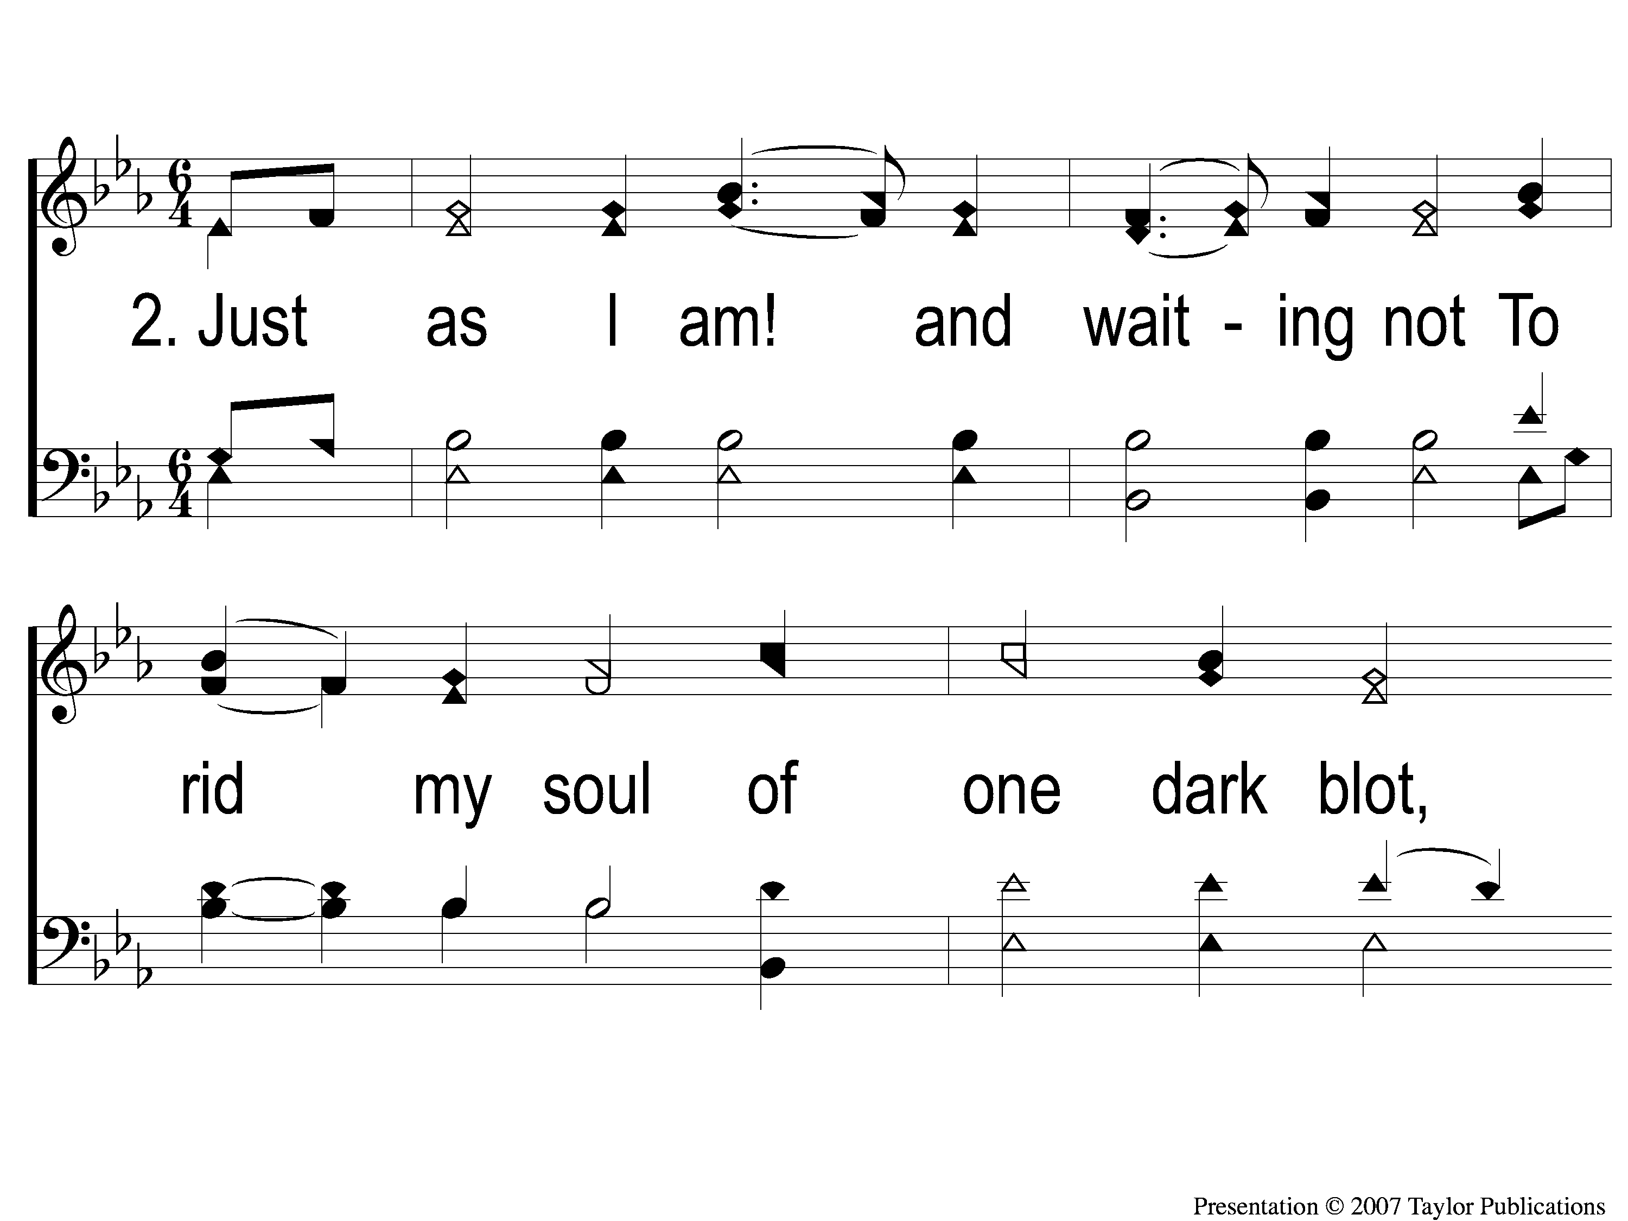
2-1 Just As I Am
Just As I Am
924

Slide 88
2-2 Just As I Am
Just As I Am
924

Slide 89
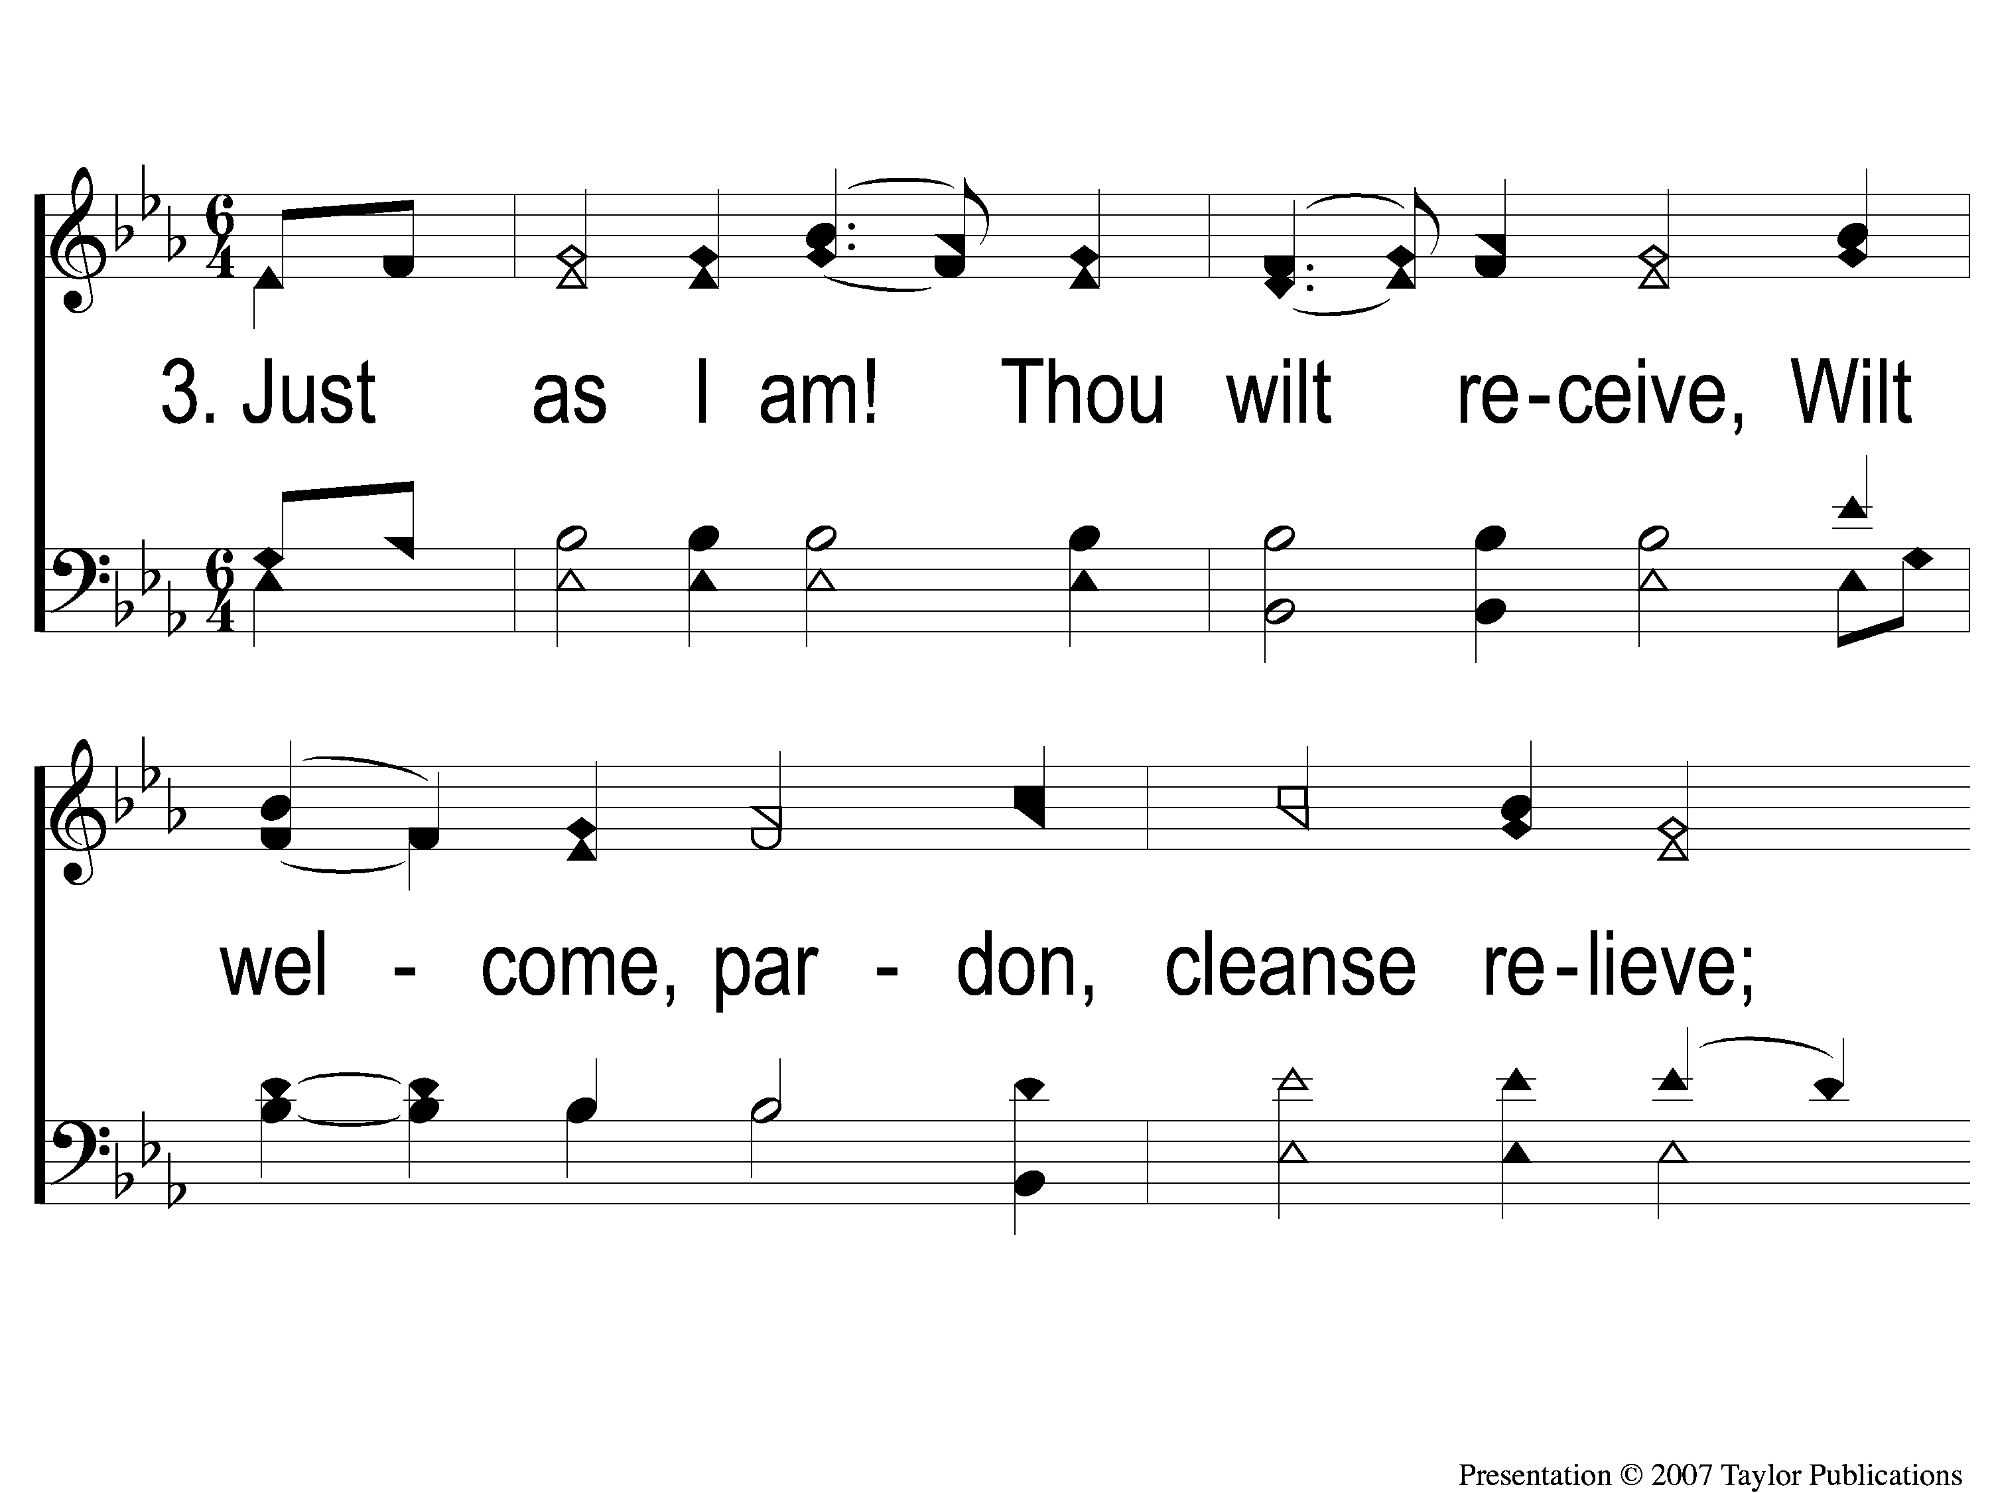
3-1 Just As I Am
Just As I Am
924

Slide 90
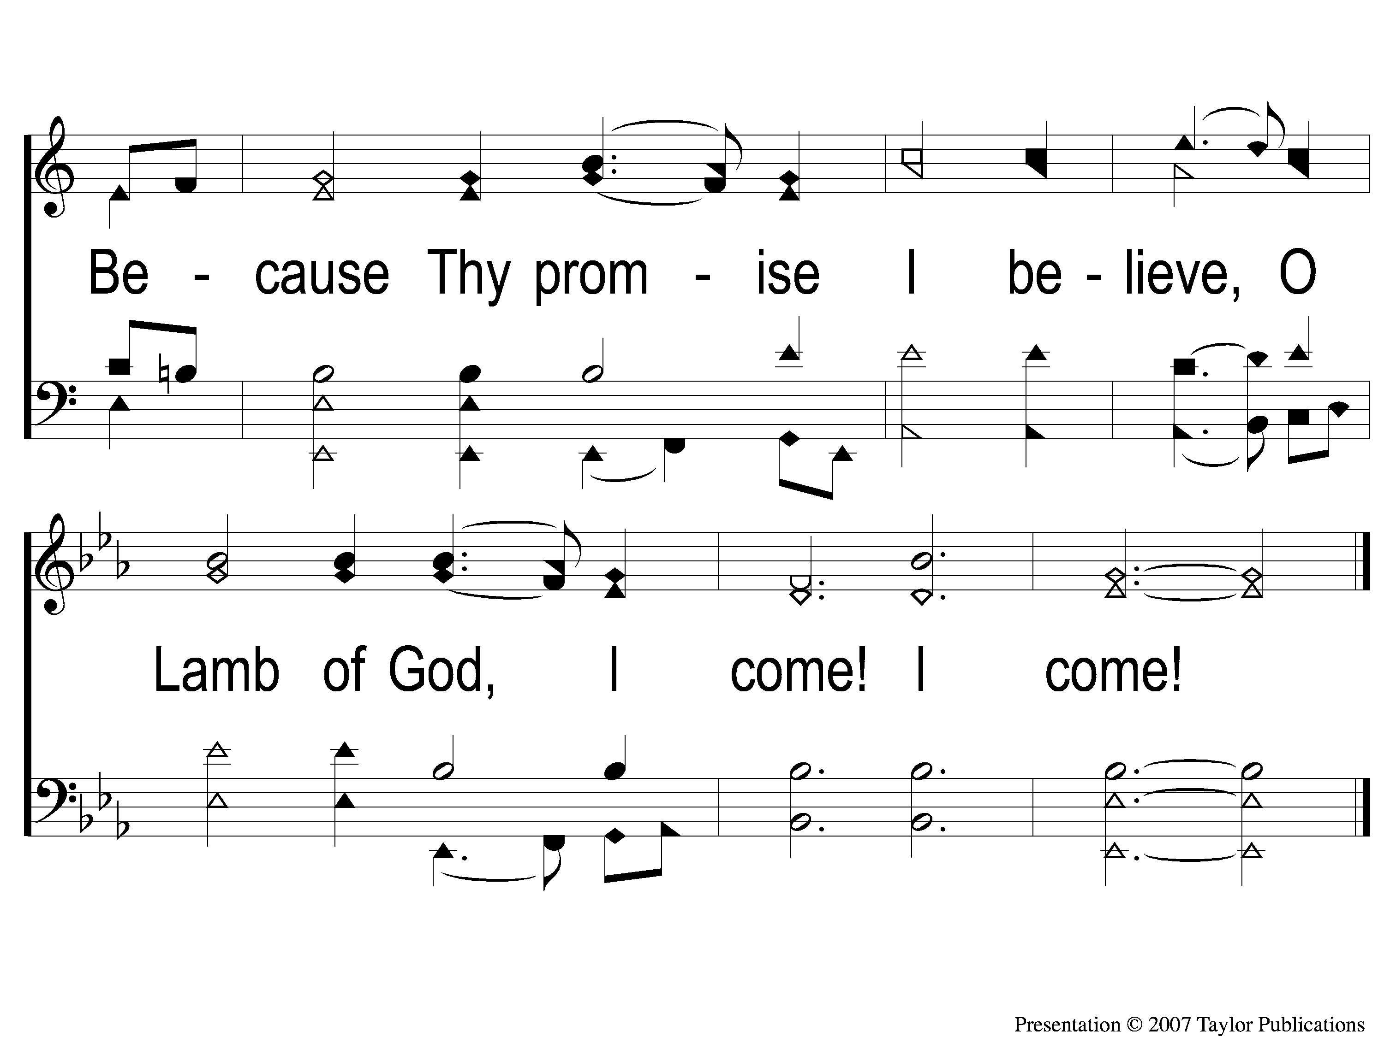
3-2 Just As I Am
Just As I Am
924

Slide 91
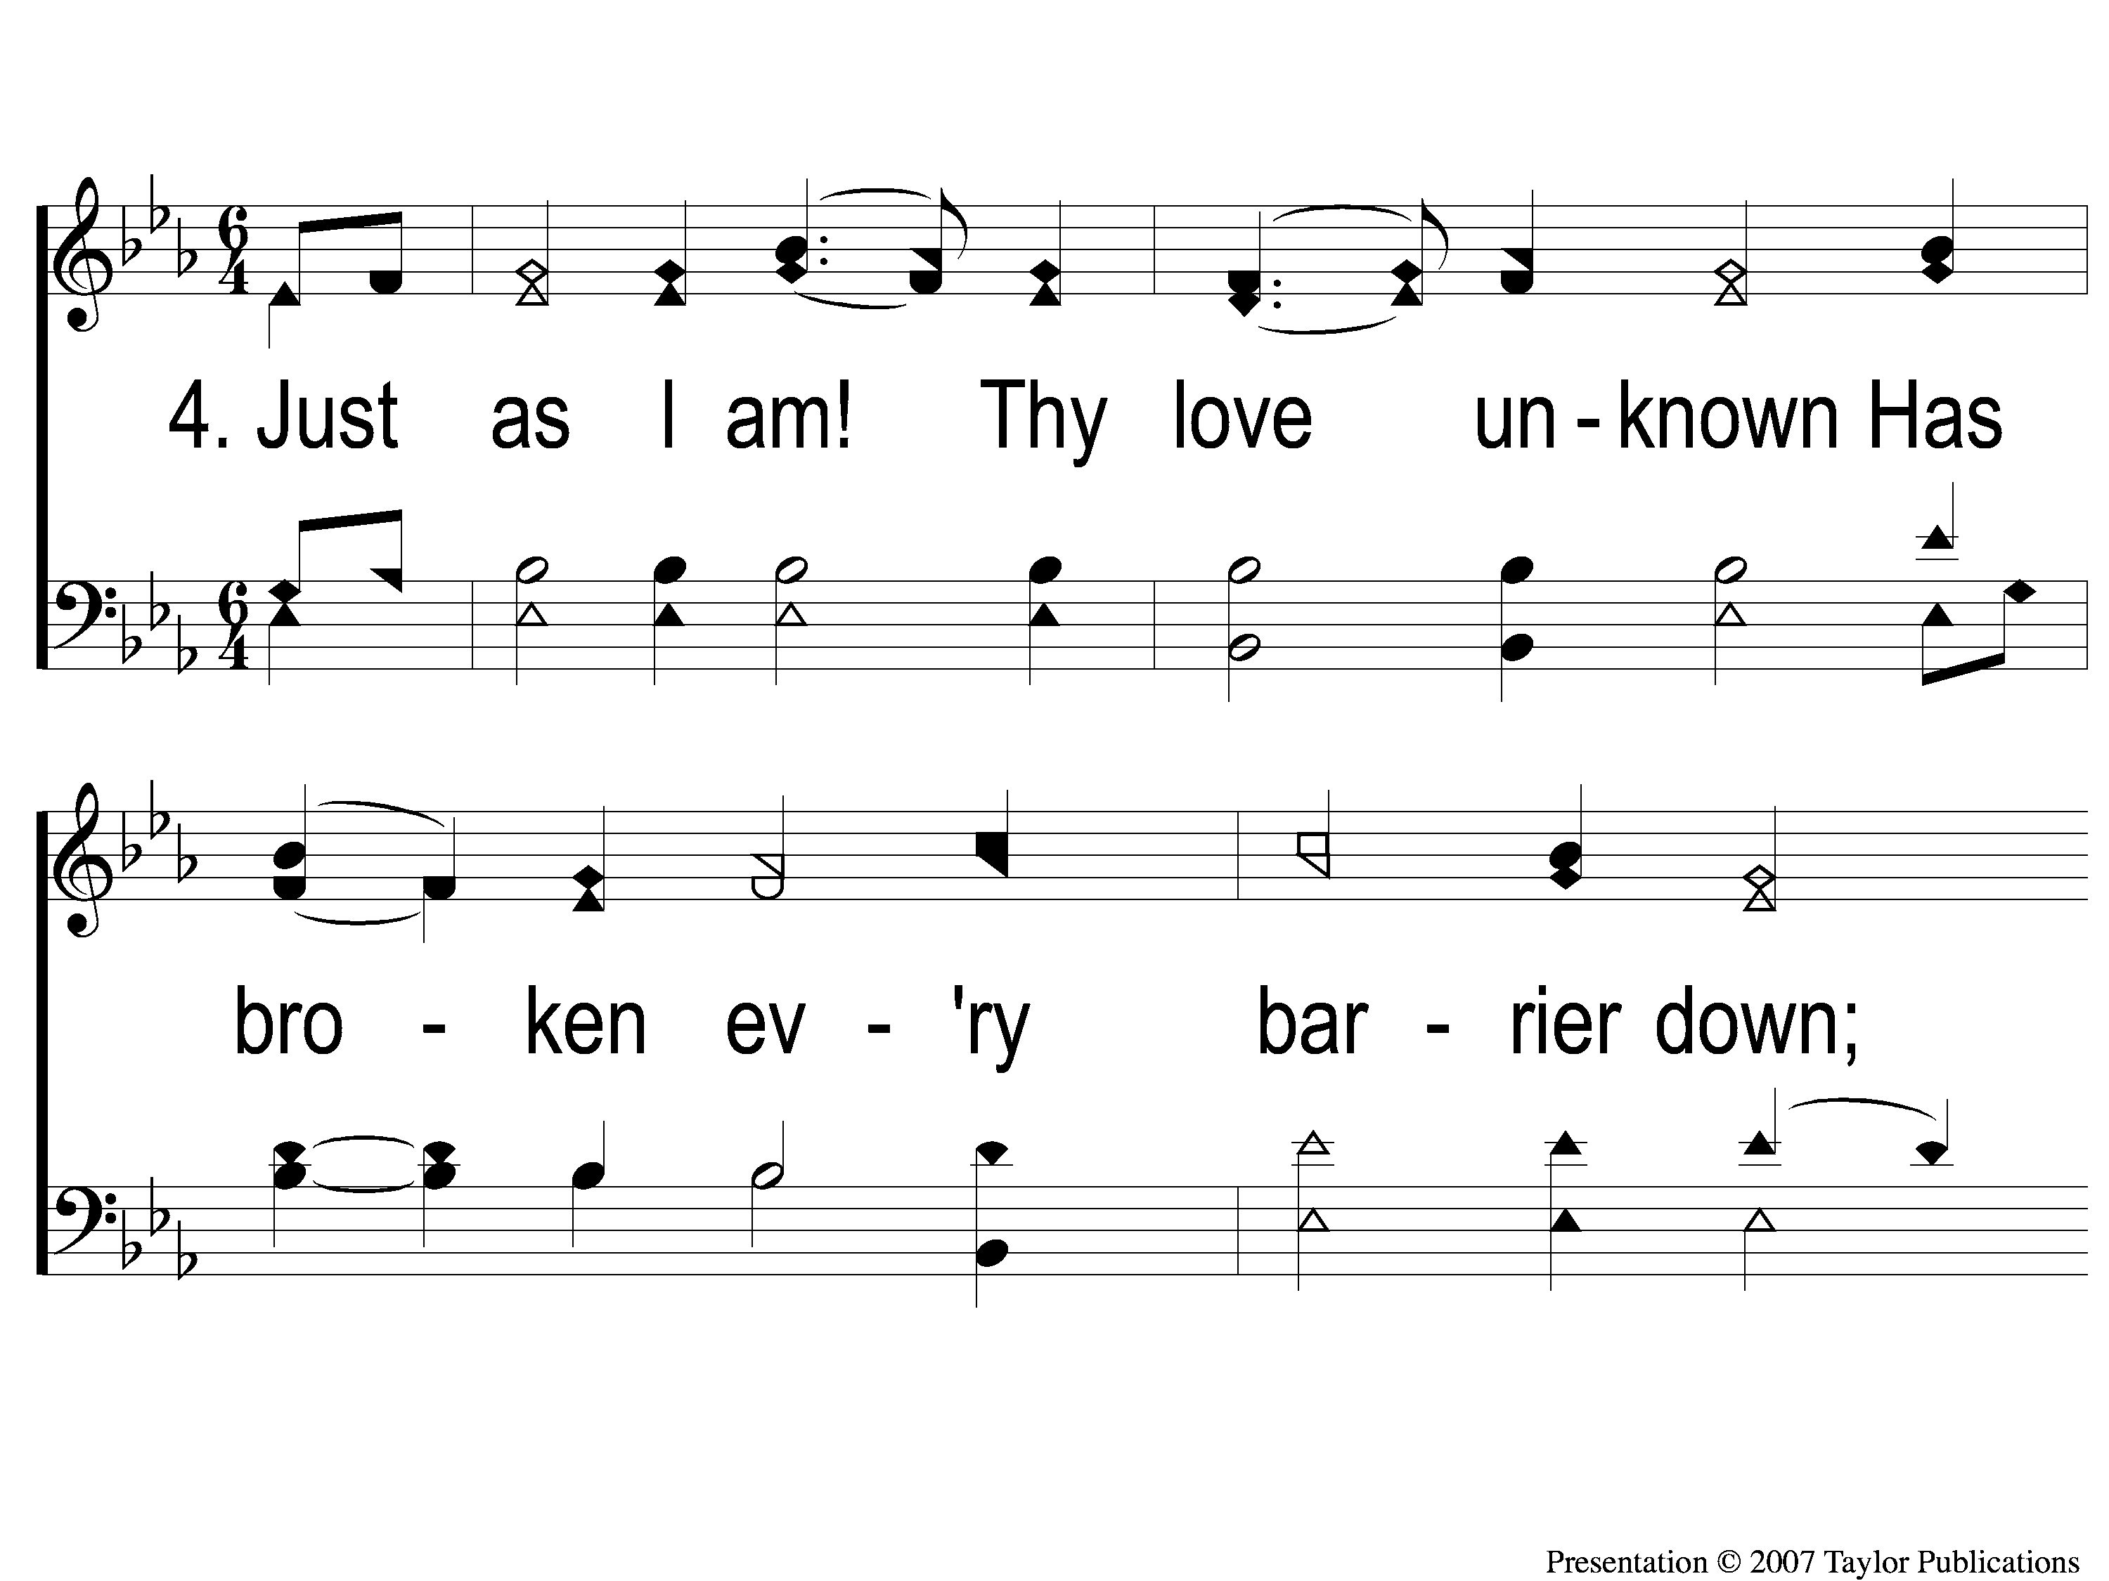
4-1 Just As I Am
Just As I Am
924

Slide 92
4-2 Just As I Am
Just As I Am
924

Slide 93
#332
SONG:
Lead Me To Calvary

Slide 94
1-1 Lead Me To Calvary
Lead Me To Calvary
332

Slide 95
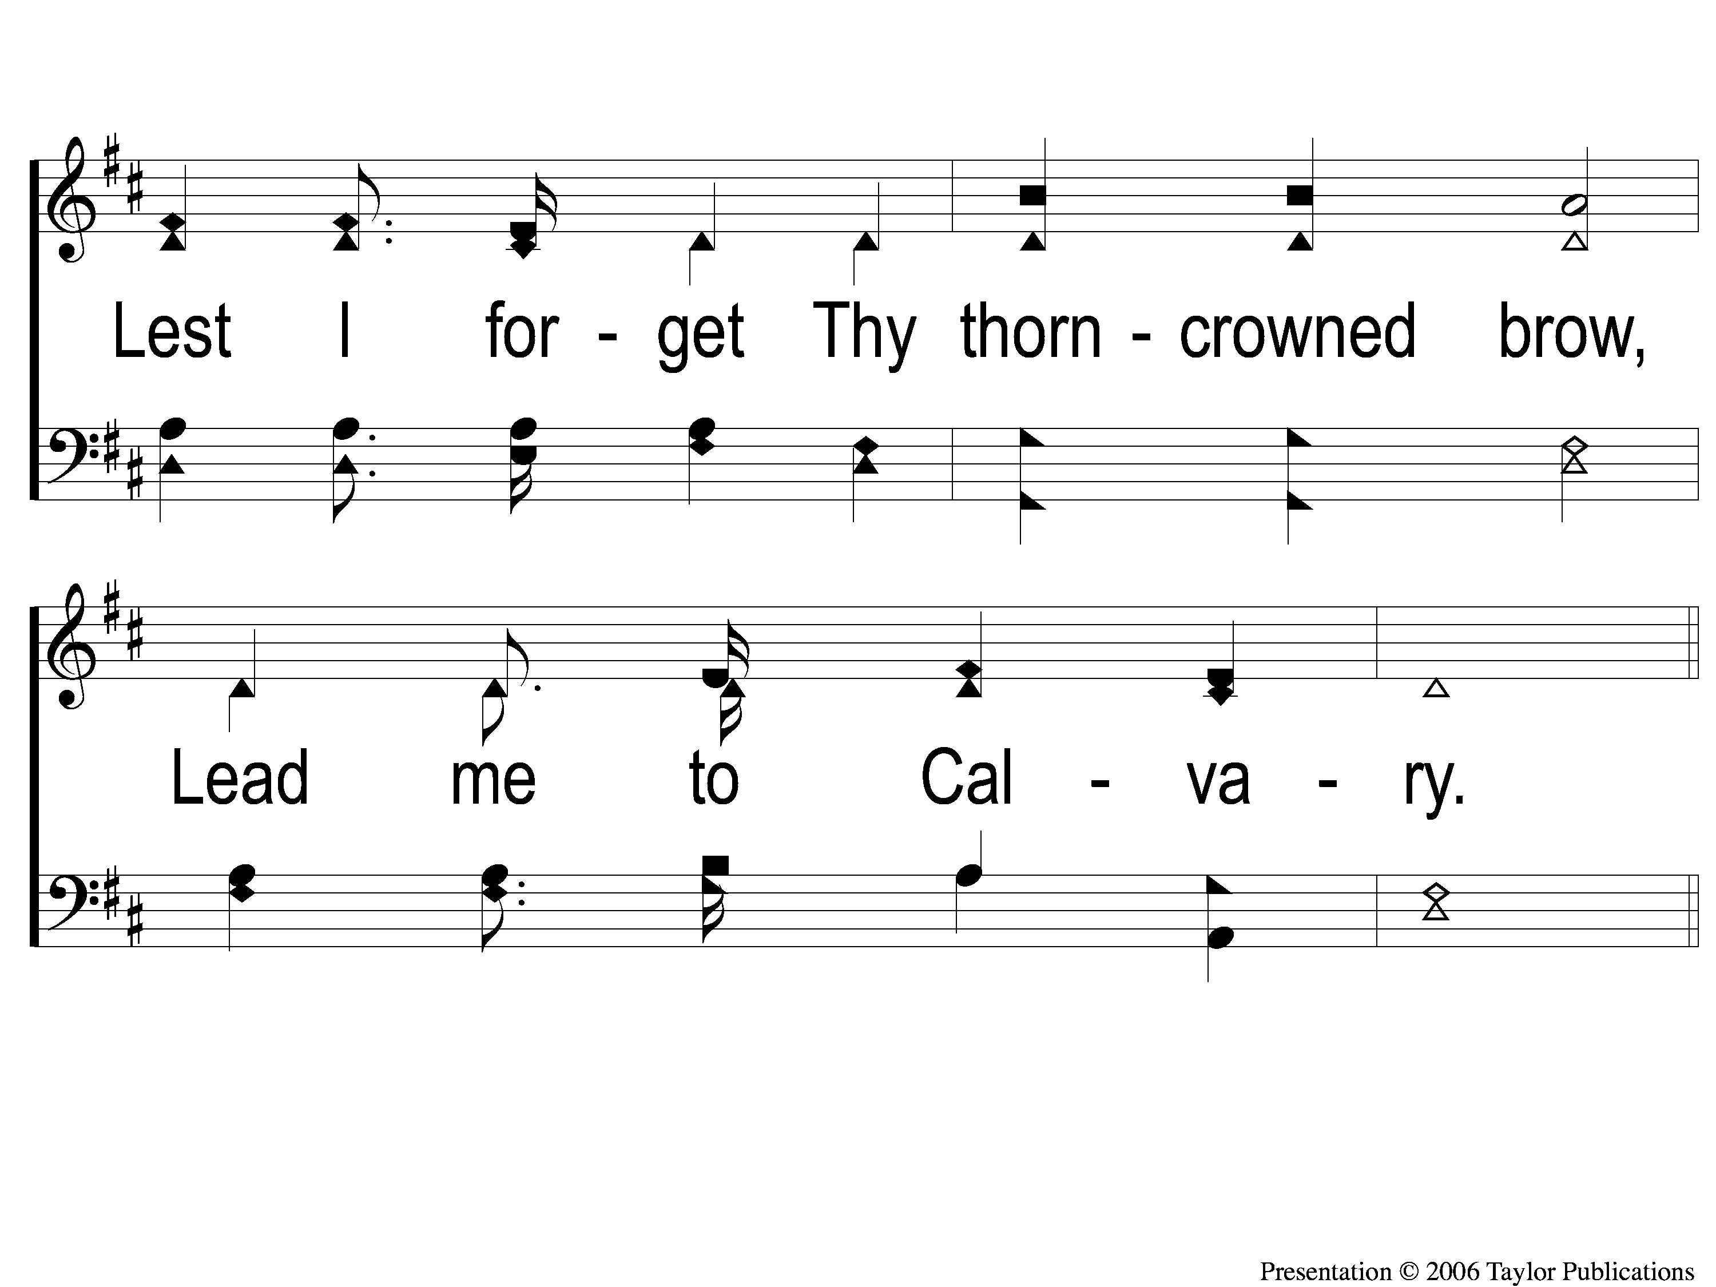
1-2 Lead Me To Calvary
Lead Me To Calvary
332

Slide 96
C-1 Lead Me To Calvary
Lead Me To Calvary
332

Slide 97
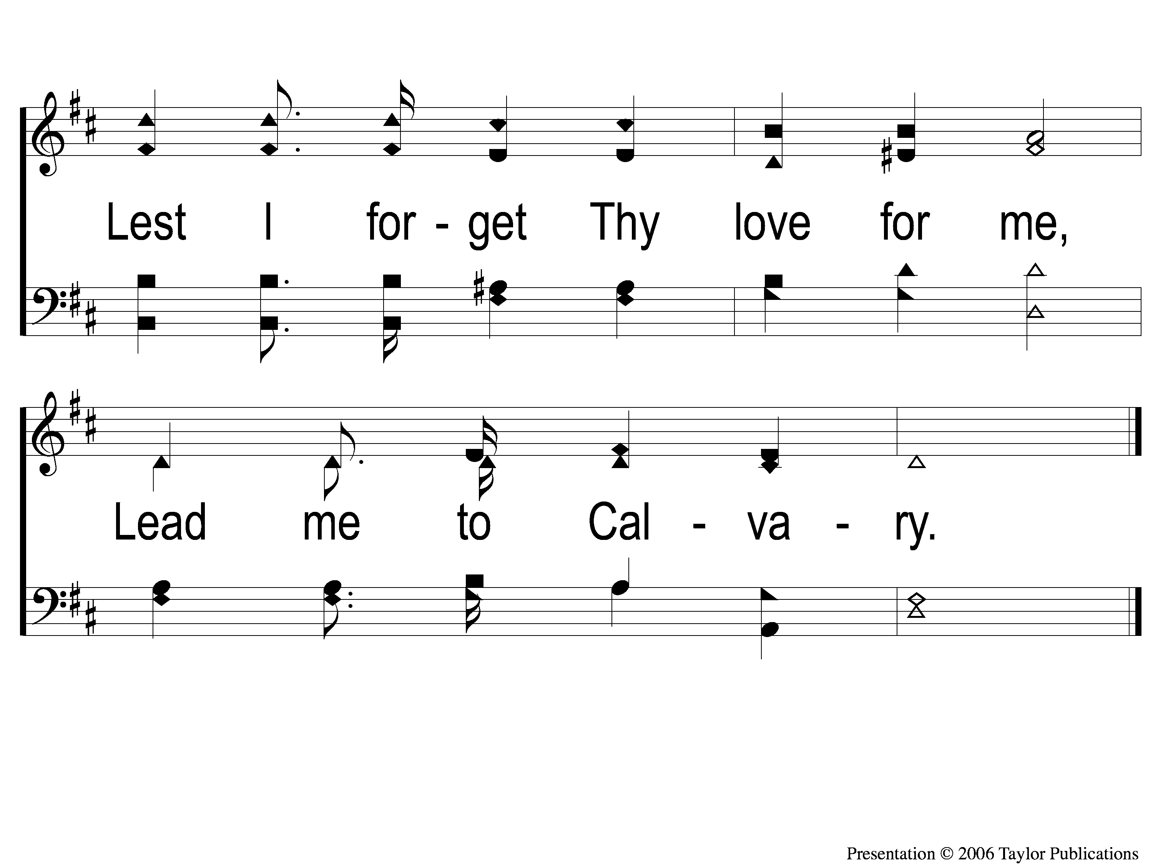
C-2 Lead Me To Calvary
Lead Me To Calvary
332

Slide 98
2-1 Lead Me To Calvary
Lead Me To Calvary
332

Slide 99
2-2 Lead Me To Calvary
Lead Me To Calvary
332

Slide 100
C-1 Lead Me To Calvary
Lead Me To Calvary
332

Slide 101
C-2 Lead Me To Calvary
Lead Me To Calvary
332

Slide 102
3-1 Lead Me To Calvary
Lead Me To Calvary
332

Slide 103
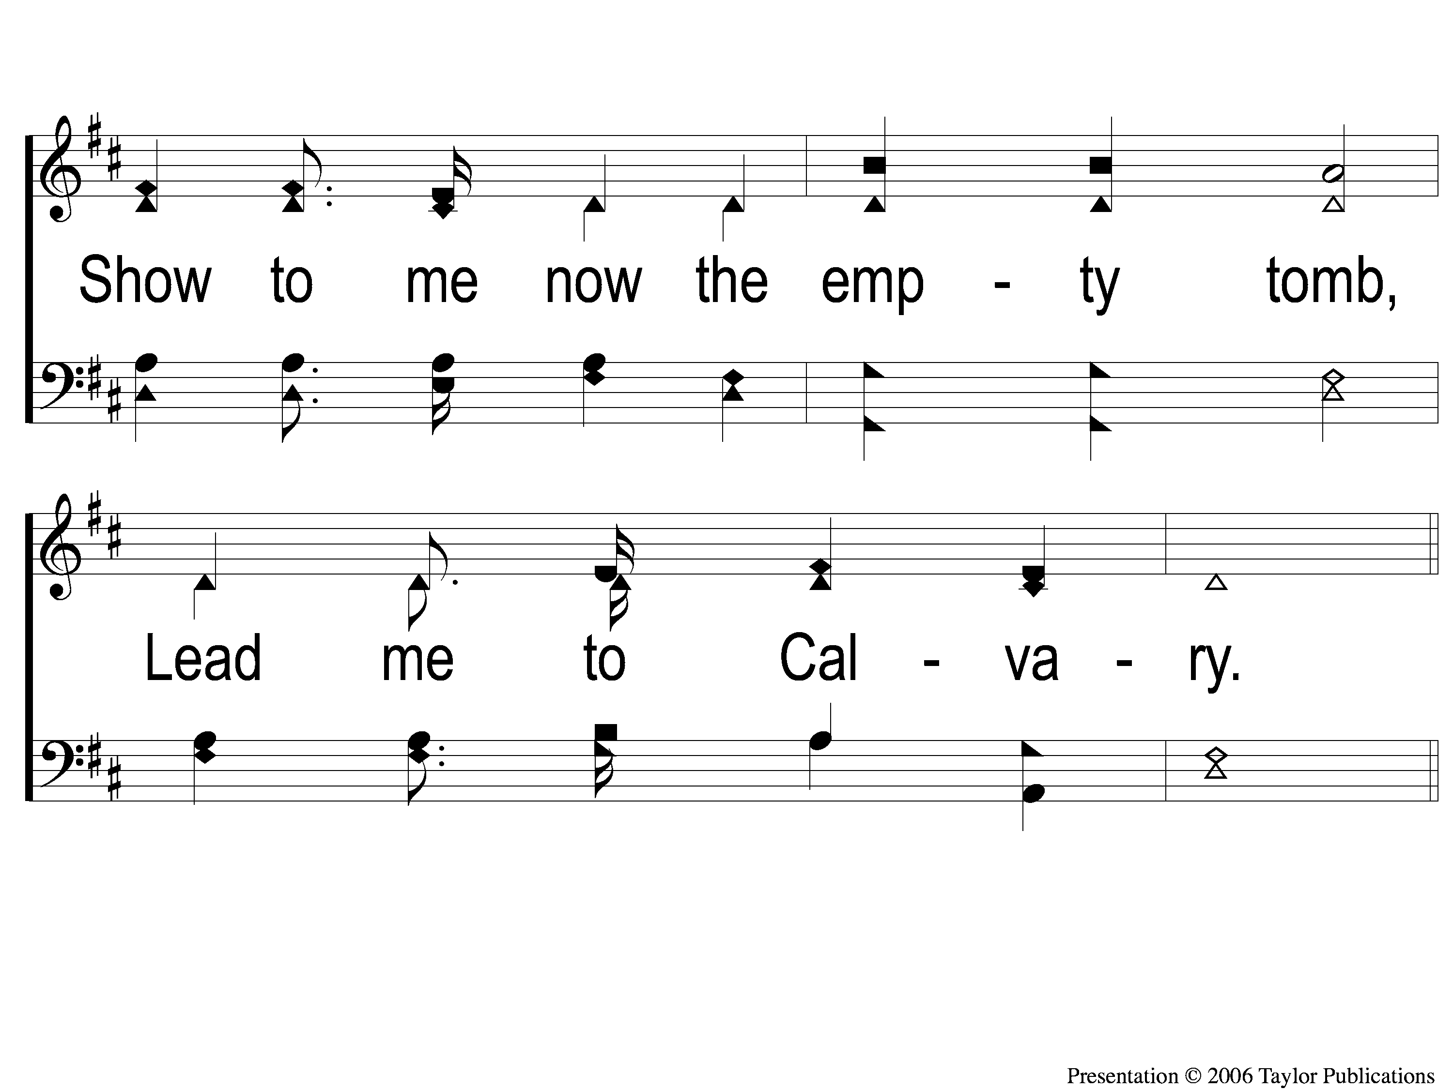
3-2 Lead Me To Calvary
Lead Me To Calvary
332

Slide 104
C-1 Lead Me To Calvary
Lead Me To Calvary
332

Slide 105
C-2 Lead Me To Calvary
Lead Me To Calvary
332

Slide 106
4-1 Lead Me To Calvary
Lead Me To Calvary
332

Slide 107
4-2 Lead Me To Calvary
Lead Me To Calvary
332

Slide 108
C-1 Lead Me To Calvary
Lead Me To Calvary
332

Slide 109
C-2 Lead Me To Calvary
Lead Me To Calvary
332

Slide 110
LORD’S SUPPER
The
Acts 20:7

Slide 111
Unleavened Bread
LORD’S SUPPER
Who has believed our report?
And to whom has the arm of the Lord been revealed?
² For He shall grow up before Him as a tender plant,
And as a root out of dry ground.
He has no form or comeliness;
And when we see Him,
There is no beauty that we should desire Him.
³ He is despised and rejected by men,
A Man of sorrows and acquainted with grief.
And we hid, as it were, our faces from Him;
He was despised, and we did not esteem Him.
.
Isaiah 53:1-3

Slide 112
Fruit of the Vine
LORD’S SUPPER
Surely He has borne our griefs
And carried our sorrows;
Yet we esteemed Him stricken,
Smitten by God, and afflicted.
⁵ But He was wounded for our transgressions,
He was bruised for our iniquities;
The chastisement for our peace was upon Him,
And by His stripes we are healed.
Isaiah 53:4-5

Slide 113
2 Corinthians 8:12
OFFERING
¹² For if there is first a willing mind, it is accepted according to what one has, and not according to what he does not have.

Slide 114
Closing PRAYER

Slide 115
#875
SONG:
Home Of The Soul

Slide 116
1-1 Home of the Soul
Home of the Soul
875

Slide 117
1-2 Home of the Soul
Home of the Soul
875

Slide 118
C-1 Home of the Soul
Home of the Soul
875

Slide 119
C-2 Home of the Soul
Home of the Soul
875

Slide 120
C-3 Home of the Soul
Home of the Soul
875

Slide 121
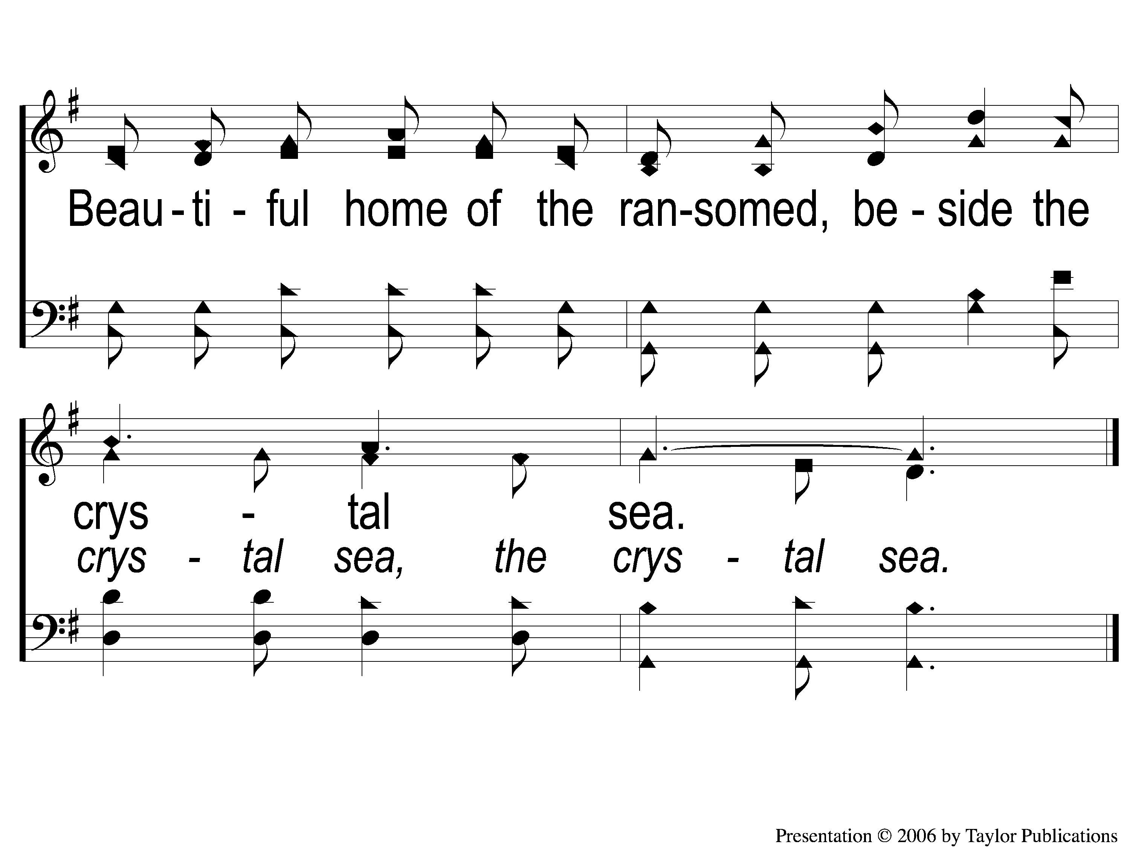
C-4 Home of the Soul
Home of the Soul
875

Slide 122
3-1 Home of the Soul
Home of the Soul
875

Slide 123
3-2 Home of the Soul
Home of the Soul
875

Slide 124
C-1 Home of the Soul
Home of the Soul
875

Slide 125
C-2 Home of the Soul
Home of the Soul
875

Slide 126
C-3 Home of the Soul
Home of the Soul
875

Slide 127
C-4 Home of the Soul
Home of the Soul
875

Slide 128
TONIGHT @ 6:00 pm
EVENING WORSHIP
HOPE TO SEE YOU THERE!

