Slide 1
PLEASE STANDBY
OUR LIVESTREAM
WILL BEGIN SOON

Slide 2
WELCOME
THANKS FOR JOINING US!

Slide 3
Opening Song

Slide 4
First PRAYER

Slide 5
Songs of
Praise to God

Slide 6
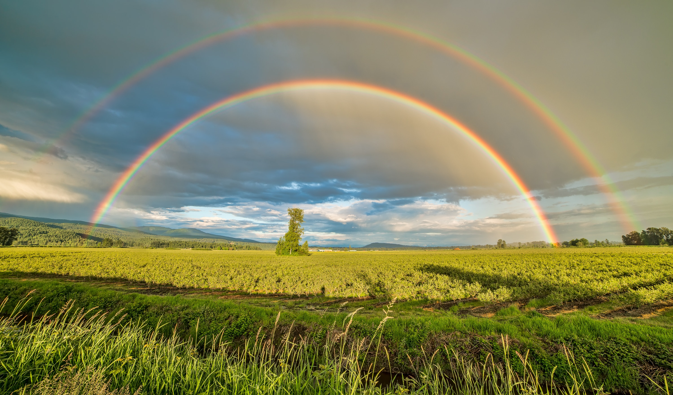
STANDING ON THE PROMISES

Slide 7
THE PROMISE OF PRESERVATION

Slide 8
1ST PETER
Letter to Jewish-Christians
Facing religious persecution
Written to Encourage!

Slide 9
1ST PETER
How to Endure Persecution:
Appreciate Your Salvation (1:1-2:2)
Remember Your Function (2:3-3:12)
Rejoice In Your Suffering (3:13-5:13)

Slide 10
1ST PETER
3 Motivations (Ch. 1)
Our Heavenly Inheritance (1:3-12)
Our Heavenly Father (1:13-21)
Our Heavenly Hope (1:22-2:2)

Slide 11
THE PROMISE OF PRESERVATION
The Word of God…
Existed Before Time

Slide 12
THE PROMISE OF PRESERVATION
The Word of God…
Existed Before Time
Jn. 1:1-5, Gen. 1:1, 26

Slide 13
THE PROMISE OF PRESERVATION
The Word of God…
Existed Before Time
Has Been Made Known & Complete

Slide 14
THE PROMISE OF PRESERVATION
The Word of God…
Has Been Made Known
Jn. 1:14-17
Eph. 1:7-9, 3:1-5

Slide 15
THE PROMISE OF PRESERVATION
The Word of God…
Has Been Made Known & Complete
Jn. 14:26, 16:13
2 Pet. 1:3, 2 Tim. 3:16-17

Slide 16
THE PROMISE OF PRESERVATION
The Word of God…
Existed Before Time
Has Been Made Known & Complete
Will Last Forever

Slide 17
THE PROMISE OF PRESERVATION
The Word of God…
Will Last Forever
1 Pet. 1:25, Isa. 40:6-8

Slide 18
Will Last Forever
Greek: μένω (Meno)
= to remain, to last
Psa. 19:10, 119:103

Slide 19
THE PROMISE OF PRESERVATION
The Word of God…
Will Last Forever
1 Pet. 1:25, Isa. 40:6-8
Matt. 24:35

Slide 20
DO YOU APPRECIATE GOD’S PRESERVATION OF HIS WORD?

Slide 21
Song of Invitation

Slide 22
LORD’S SUPPER
The
Acts 20:7

Slide 23
Closing PRAYER

Slide 24
Closing Song

Slide 25
WEDNESDAY @ 6:30 pm
JOIN US
HOPE TO SEE YOU THERE!

