Slide 1
WELCOME
THANKS FOR JOINING US!

Slide 2
1 Glorify Thy Name
Glorify Thy Name
77

Slide 3
C Glorify Thy Name
Glorify Thy Name
77

Slide 4
2 Glorify Thy Name
Glorify Thy Name
77

Slide 5
C Glorify Thy Name
Glorify Thy Name
77

Slide 6
3 Glorify Thy Name
Glorify Thy Name
77

Slide 7
C Glorify Thy Name
Glorify Thy Name
77

Slide 8
WELCOME
THANKS FOR JOINING US!

Slide 9
#166
SONG:
He’s My King

Slide 10
1-1 He’s My King
He’s My King
166

Slide 11
1-2 He’s My King
He’s My King
166

Slide 12
C-1 He’s My King
He’s My King
166

Slide 13
C-2 He’s My King
He’s My King
166

Slide 14
3-1 He’s My King
He’s My King
166

Slide 15
3-2 He’s My King
He’s My King
166

Slide 16
C-1 He’s My King
He’s My King
166

Slide 17
C-2 He’s My King
He’s My King
166

Slide 18
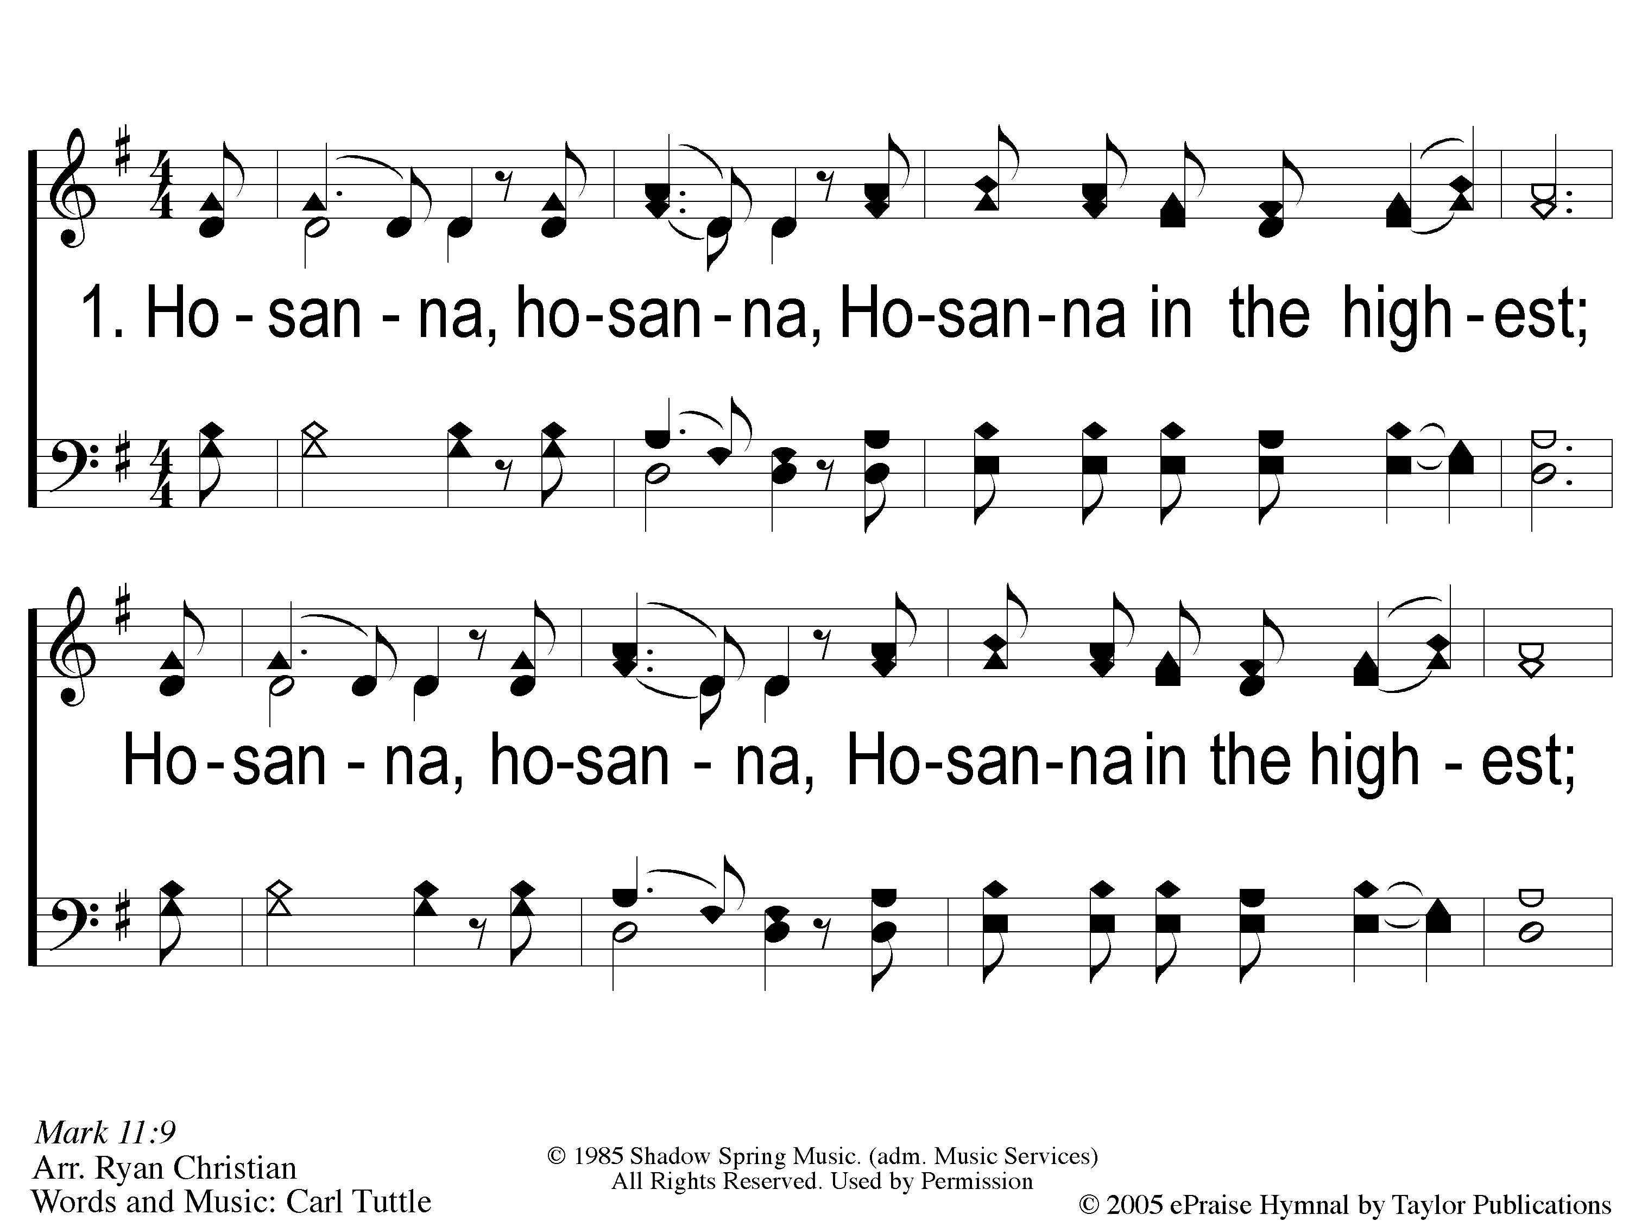
1 Hosanna
Hosanna
167

Slide 19
C-1 Hosanna
Hosanna
167

Slide 20
C-2 Hosanna
Hosanna
167

Slide 21
2 Hosanna
Hosanna
167

Slide 22
C-1 Hosanna
Hosanna
167

Slide 23
C-2 Hosanna
Hosanna
167

Slide 24
SONG:
Hosanna,
You’re My King

Slide 25
1-1 Hosanna you’re my King
Hosanna, You’re My King

Slide 26
1-2 Hosanna you’re my King
Hosanna, You’re My King

Slide 27
1-3 Hosanna you’re my King
Hosanna, You’re My King

Slide 28
1-1 Hosanna you’re my King
Hosanna, You’re My King

Slide 29
1-2 Hosanna you’re my King
Hosanna, You’re My King

Slide 30
1-3 Hosanna you’re my King
Hosanna, You’re My King

Slide 31
#550
SONG:
I Walk With The King

Slide 32
1-1 I Walk With the King
I Walk With The King
550

Slide 33
1-2 I Walk With the King
I Walk With The King
550

Slide 34
1-3 I Walk With the King
I Walk With The King
550

Slide 35
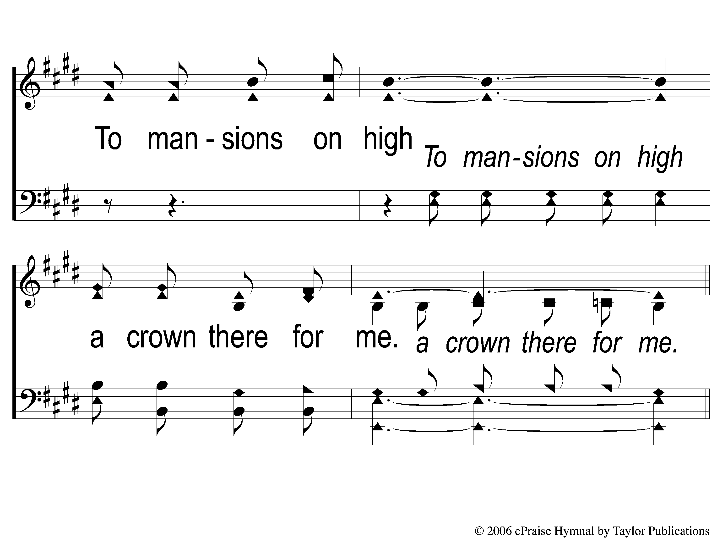
1-4 I Walk With the King
I Walk With The King
550

Slide 36
C-1 I Walk With the King
I Walk With The King
550

Slide 37
C-2 I Walk With the King
I Walk With The King
550

Slide 38
C-3 I Walk With the King
I Walk With The King
550

Slide 39
C-4 I Walk With the King
I Walk With The King
550

Slide 40
3-1 I Walk With the King
I Walk With The King
550

Slide 41
3-2 I Walk With the King
I Walk With The King
550

Slide 42
3-3 I Walk With the King
I Walk With The King
550

Slide 43
3-4 I Walk With the King
I Walk With The King
550

Slide 44
C-1 I Walk With the King
I Walk With The King
550

Slide 45
C-2 I Walk With the King
I Walk With The King
550

Slide 46
C-3 I Walk With the King
I Walk With The King
550

Slide 47
C-4 I Walk With the King
I Walk With The King
550

Slide 48
Opening PRAYER

Slide 49
SONG:
Ancient Words

Slide 50
1-1 Ancient Words
Ancient Words

Slide 51
1-2 Ancient Words
Ancient Words

Slide 52
1-3 Ancient Words
Ancient Words

Slide 53
C-1 Ancient Words
Ancient Words

Slide 54
C-2 Ancient Words
Ancient Words

Slide 55
2-1 Ancient Words
Ancient Words

Slide 56
2-2 Ancient Words
Ancient Words

Slide 57
2-3 Ancient Words
Ancient Words

Slide 58
C-1 Ancient Words
Ancient Words

Slide 59
C-2 Ancient Words
Ancient Words

Slide 60
Coda-1 Ancient Words
Ancient Words

Slide 61
Coda-2 Ancient Words
Ancient Words

Slide 62
tag Ancient Words
Ancient Words

Slide 63
SCRIPTURE:
2 Timothy 2:14-15

Slide 65
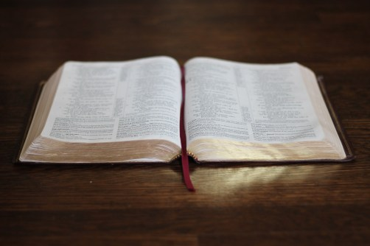
What Type Of Bible Do You Have?

Slide 68
…A STUDY BIBLE
Every Bible is…

Slide 69
A Study Bible
Acts 17:11
ἀνακρίνω = examine, search
2 Tim. 2:15
Σπουδάζω = “make every effort”

Slide 70
…A LIFE-APPLICATION BIBLE
Every Bible is…

Slide 71
A Life-Application Bible
Jms. 1:22-27
Rom. 2:13

Slide 72
…A SPIRIT-FILLED BIBLE
Every Bible is…

Slide 73
A Spirit-filled Bible
1 Pet. 1:10-12
2 Pet. 1:21
2 Sam. 23:2
2 Tim. 3:16-17

Slide 74
…FOR MEN, WOMEN, & CHILDREN
Every Bible is…

Slide 76
…For Men, Women,& Children
Gal. 3:26-29
Titus 2:1-8
Matt. 19:14
2 Cor. 5:10

Slide 77
…FOR JEWS & GENTILES
Every Bible is…

Slide 78
…For Jews & Gentiles
Gal. 3:26-29
Col. 3:11
Rom. 10:12

Slide 79
…A FOUNDER’S BIBLE
Every Bible is…

Slide 80
…A Founder’s Bible
Matt. 16:18
Eph. 2:19-20
Col. 1:18

Slide 81
…A ONE-BIG-STORY BIBLE
Every Bible is…

Slide 82
…A One-Big-Story Bible
Rom. 15:4, 16:26
1 Pet. 1:10-12
Acts 8:35

Slide 83
…AN OUTREACH BIBLE
Every Bible is…

Slide 84
…An Outreach Bible
Matt. 28:18-20
Jn. 7:42
Acts 17:2, 18:28
Rom. 1:16, 16:26

Slide 85
…A PASTOR’S BIBLE
Every Bible is…

Slide 86
…A Pastor’s Bible
Eph. 4:11
1 Tim. 3:1-3
Titus 1:5-6, 9

Slide 87
…A PREACHING BIBLE
Every Bible is…

Slide 88
…A Preaching Bible
1 Tim. 4:6
1 Thess. 3:2

Slide 89
What Kind Of
BIBLE
Is Yours?

Slide 90
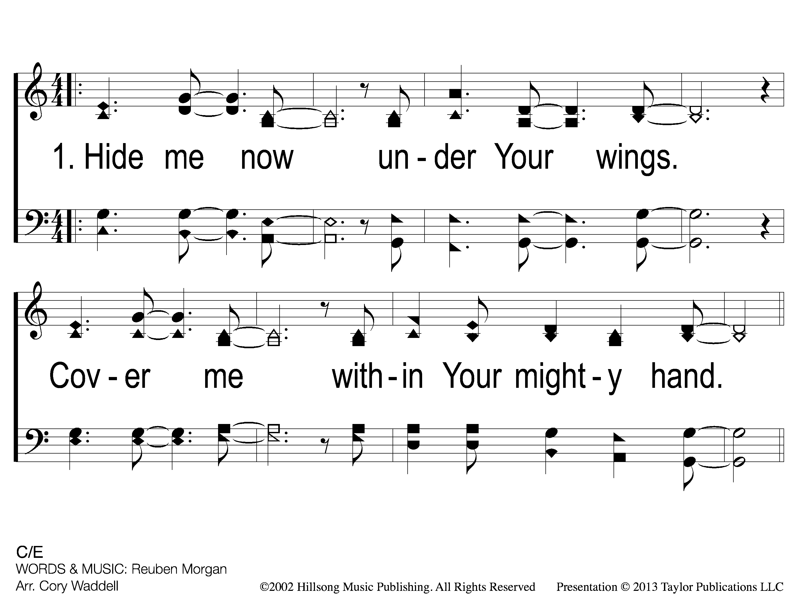
1 Still
Still

Slide 91
C-1 Still
Still

Slide 92
C-2 Still
Still

Slide 93
2 Still
Still

Slide 94
C-1 Still
Still

Slide 95
C-2 Still
Still

Slide 96
Bridge1 Still
Still

Slide 97
Bridge2 Still
Still

Slide 98
2c-1 Still
Still

Slide 99
2c-2 Still
Still

Slide 100
2c-3 Still
Still

Slide 101
SONG:
Break My Heart

Slide 102
1-1 Break My Heart
Break My Heart

Slide 103
1-2 Break My Heart
Break My Heart

Slide 104
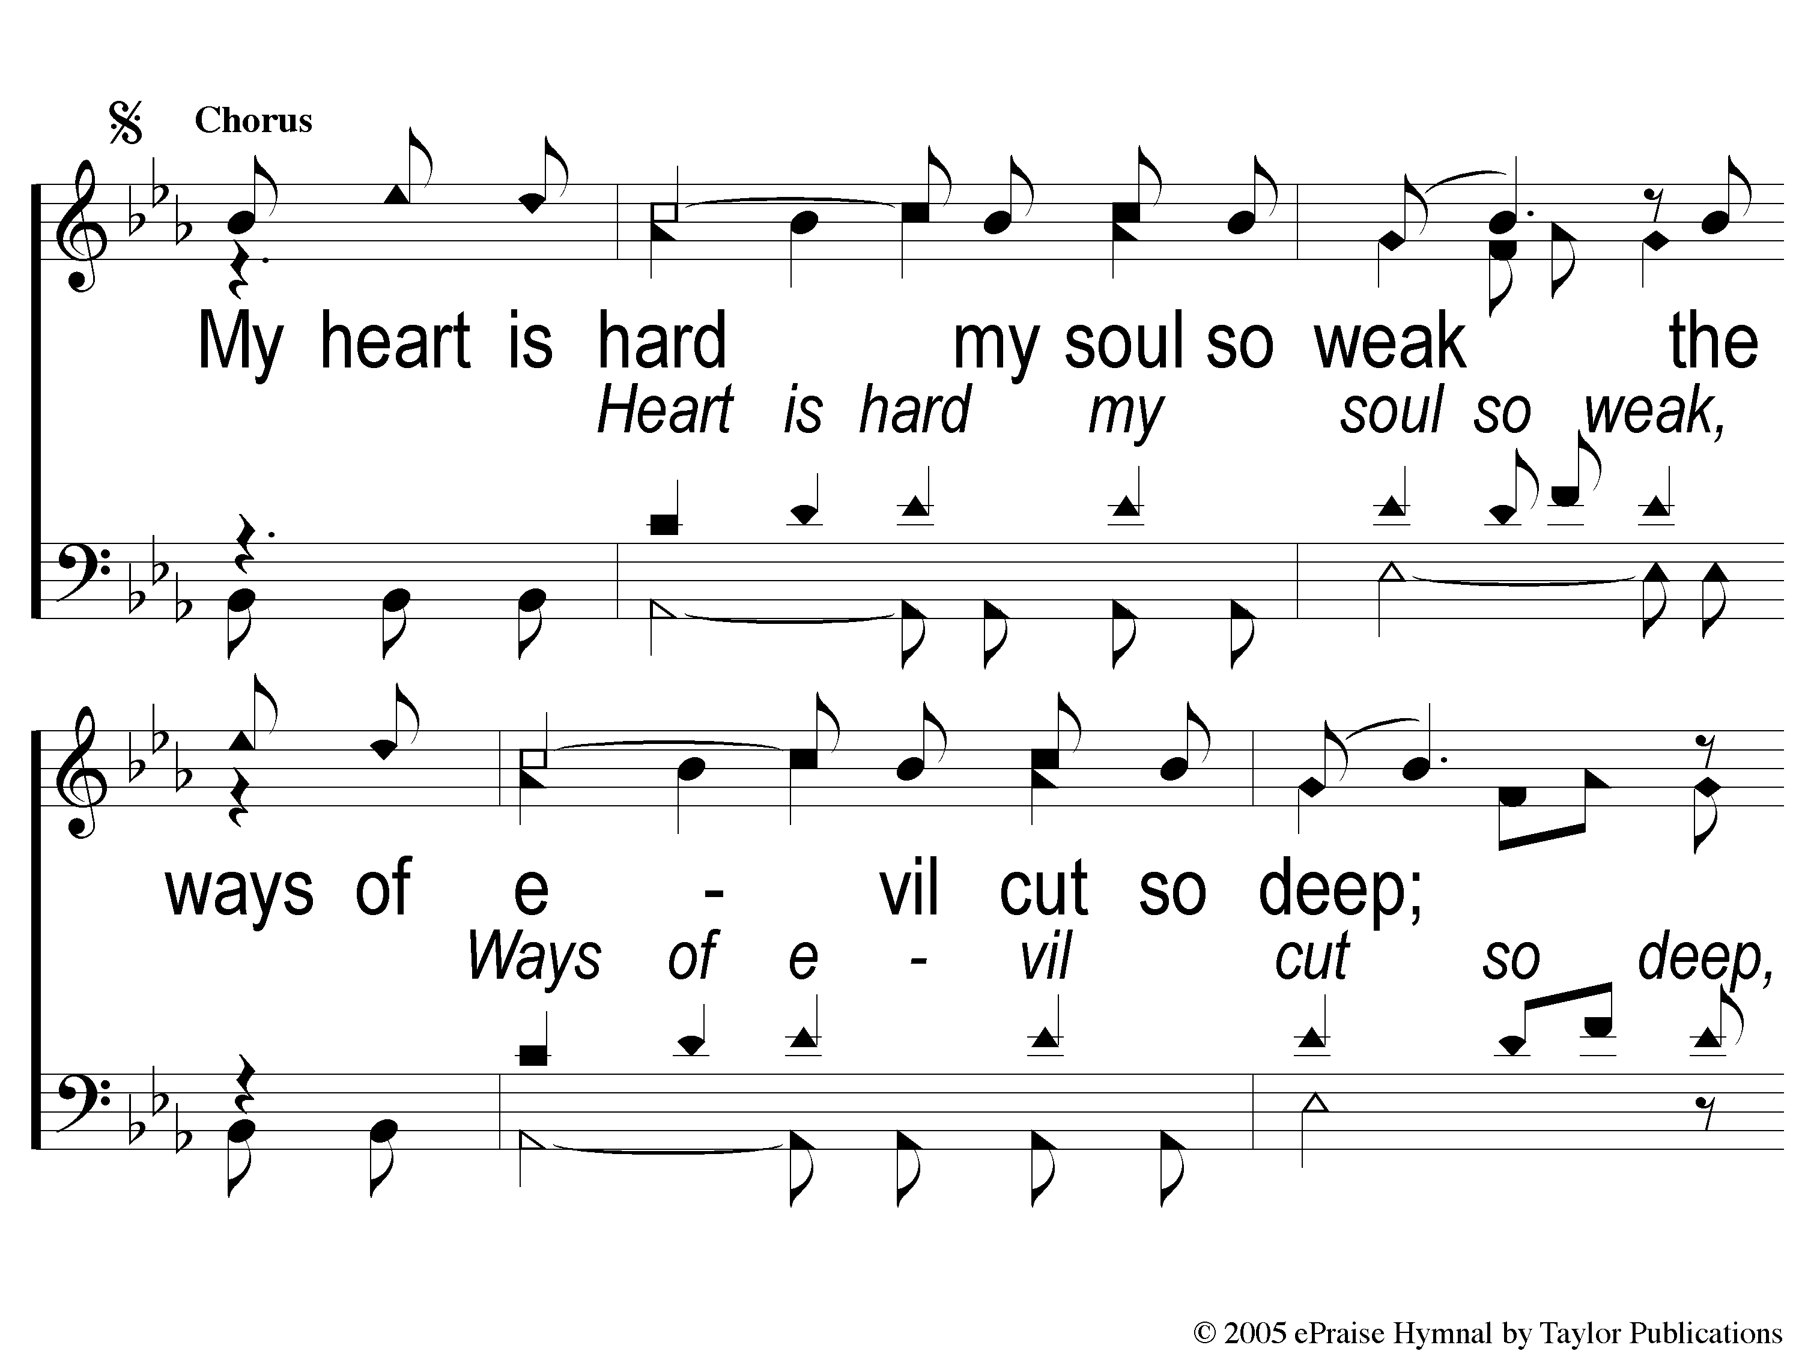
C-1 Break My Heart
Break My Heart

Slide 105
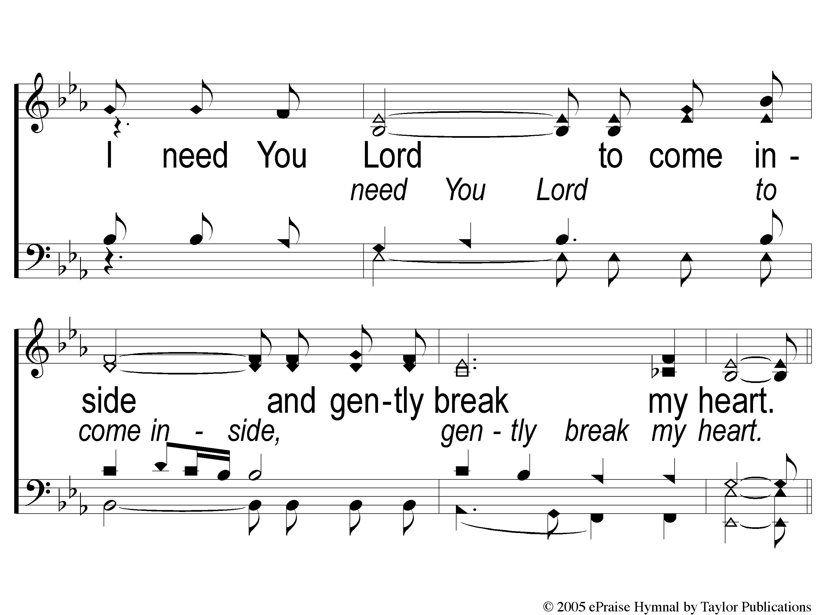
C-2 Break My Heart
Break My Heart

Slide 106
2-1 Break My Heart
Break My Heart

Slide 107
2-2 Break My Heart
Break My Heart

Slide 108
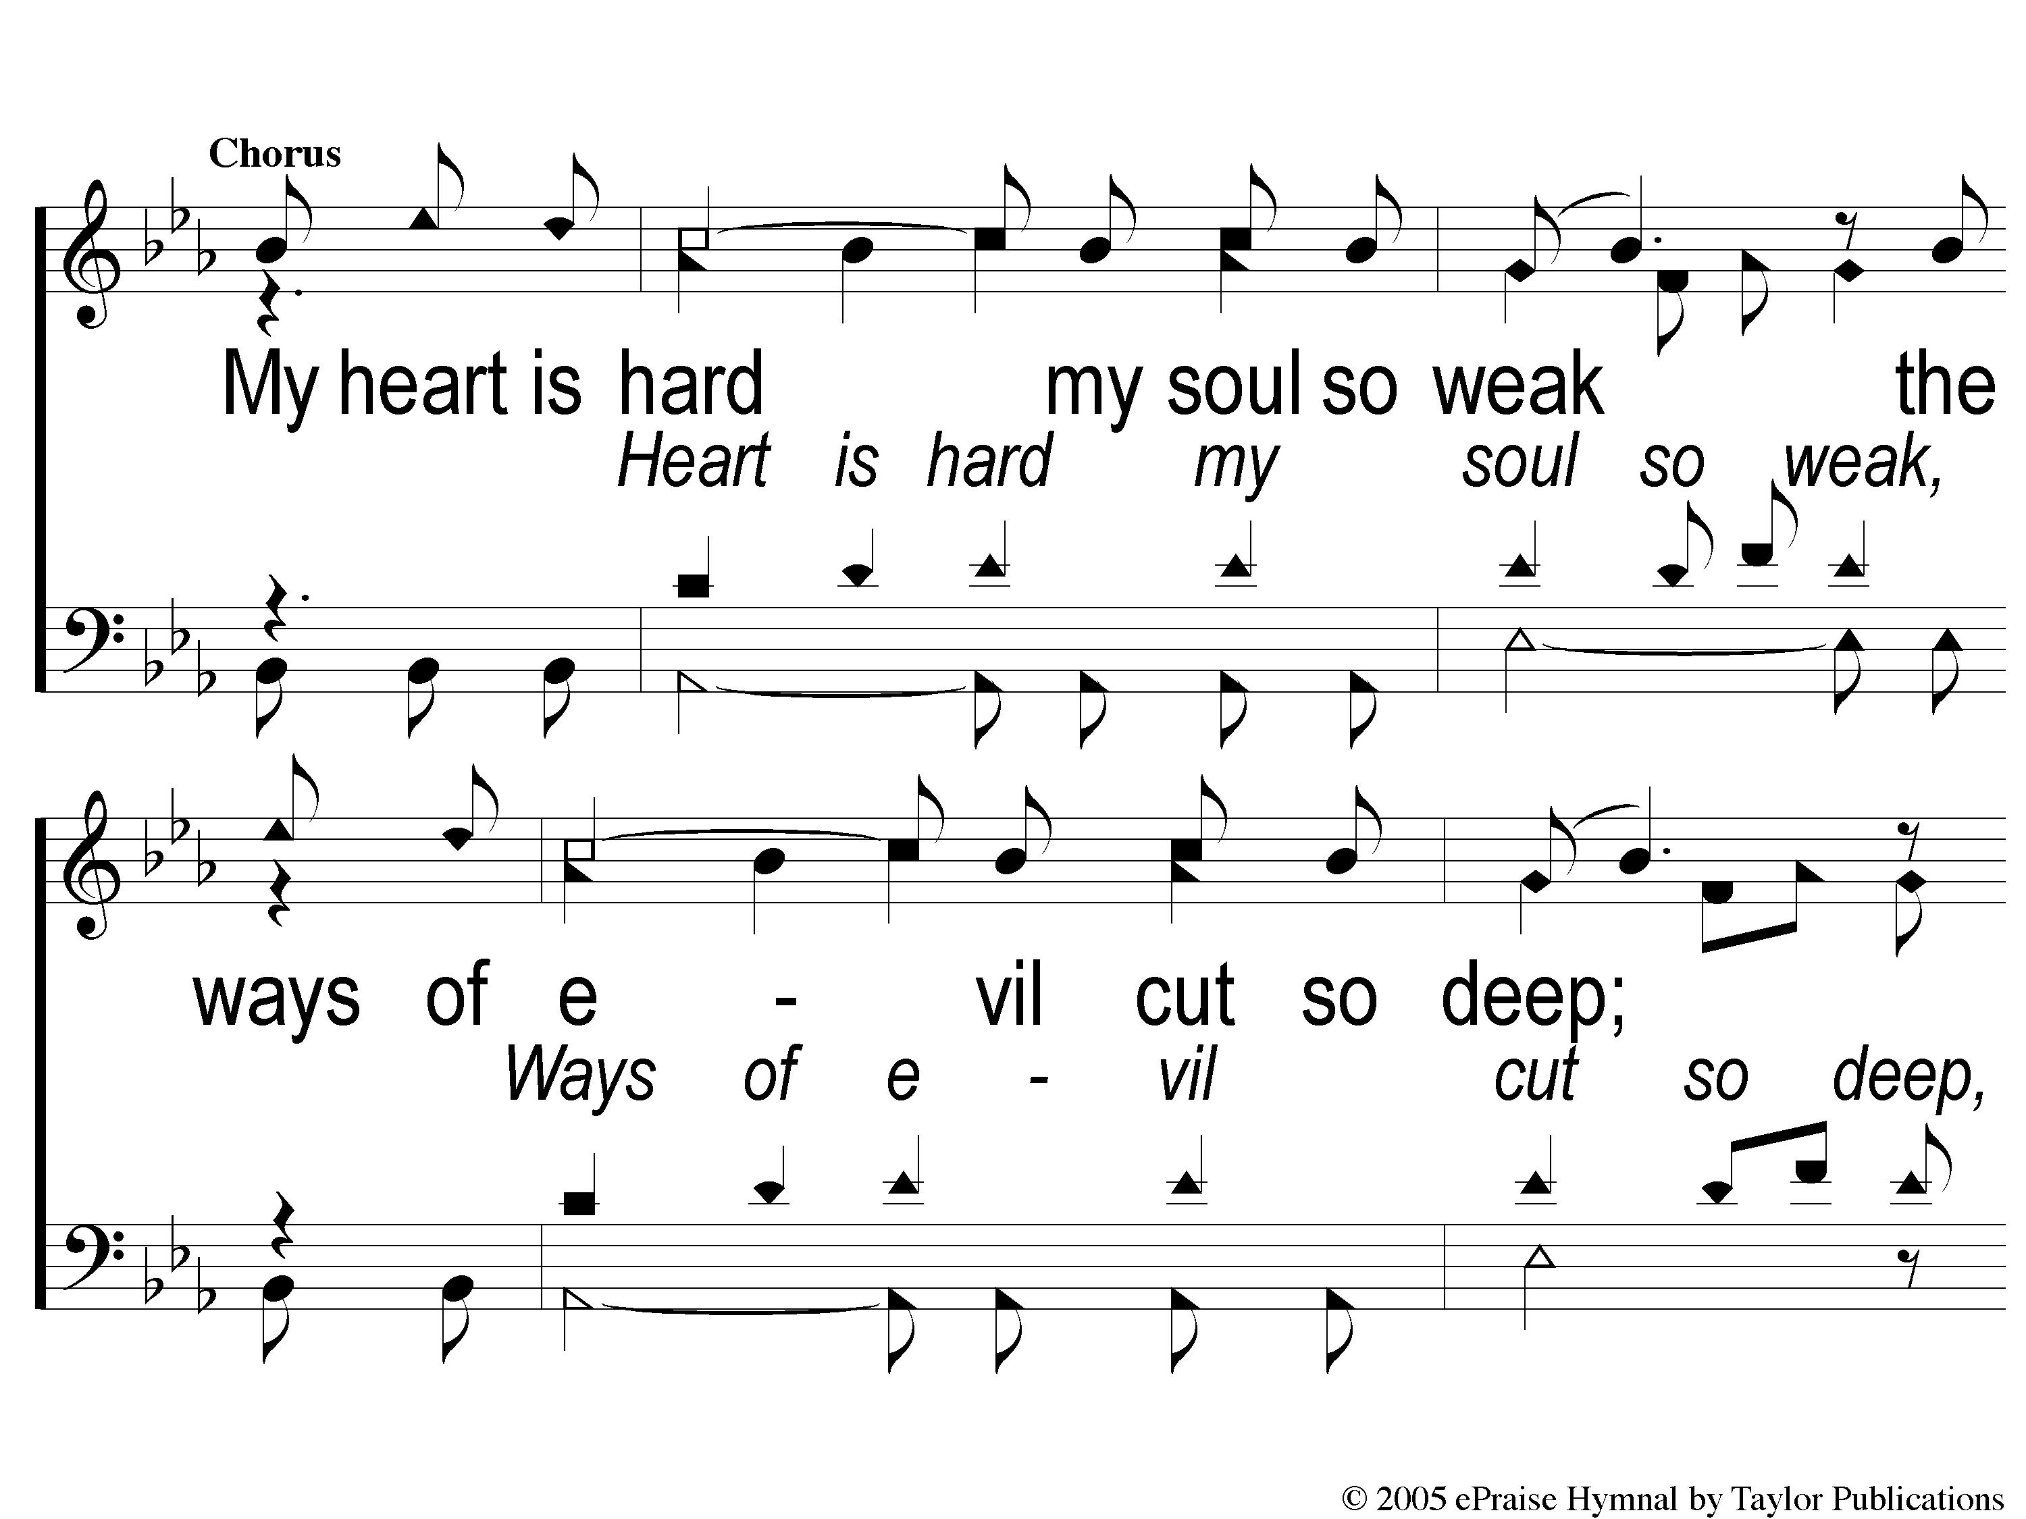
2c-1 Break My Heart
Break My Heart

Slide 109
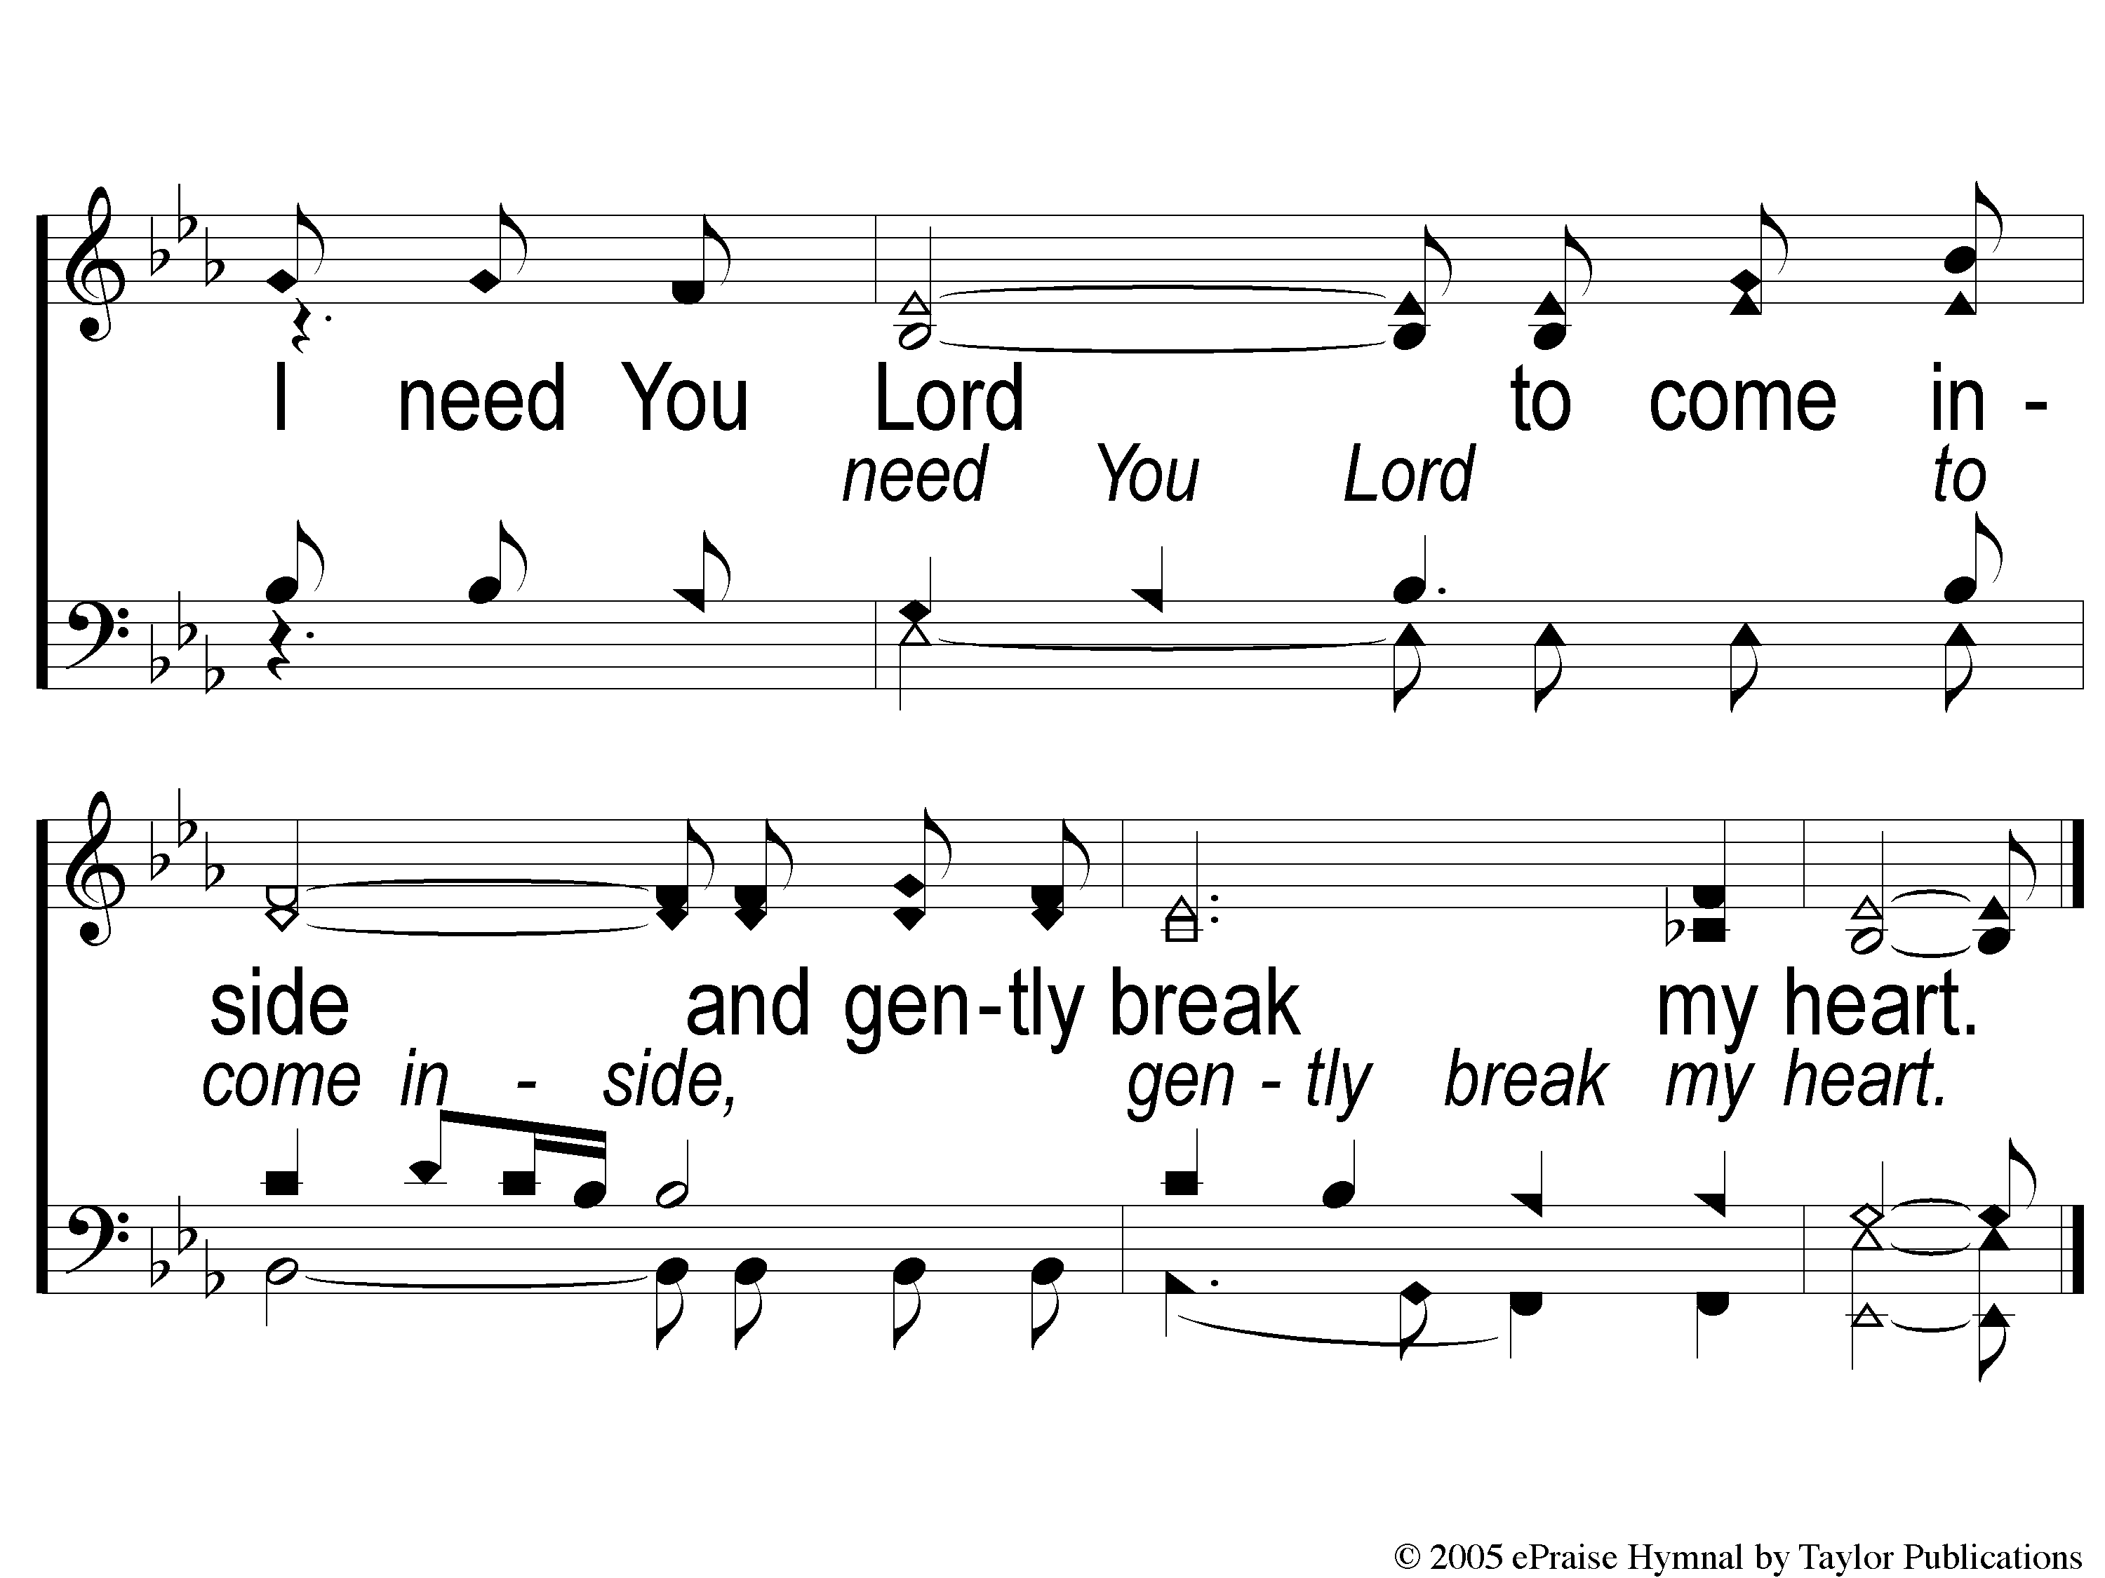
2c-2 Break My Heart
Break My Heart

Slide 110
LORD’S SUPPER
The
Acts 20:7

Slide 111
Unleavened Bread
LORD’S SUPPER
¹⁷ And when I saw Him, I fell at His feet as dead. But He laid His right hand on me, saying to me, “Do not be afraid; I am the First and the Last. ¹⁸ I am He who lives, and was dead, and behold, I am alive forevermore.
Revelation 1:17-18a

Slide 112
Fruit of the Vine
LORD’S SUPPER
9 And they sang a new song, saying:
“You are worthy to take the scroll,
And to open its seals;
For You were slain,
And have redeemed us to God by Your blood
Out of every tribe and tongue and people and nation,
10 And have made us kings and priests to our God;
And we shall reign on the earth.”
Revelation 5:9-10

Slide 113
1 John 3:16-17
OFFERING
¹⁶ By this we know love, because He laid down His life for us. And we also ought to lay down our lives for the brethren. ¹⁷ But whoever has this world’s goods, and sees his brother in need, and shuts up his heart from him, how does the love of God abide in him?

Slide 114
Closing PRAYER

Slide 115
#853
SONG:
When We All
Get To Heaven

Slide 116
1-1 When We All Get To Heaven
When We All Get To Heaven
853

Slide 117
1-2 When We All Get To Heaven
When We All Get To Heaven
853

Slide 118
C-1 When We All Get To Heaven
When We All Get To Heaven
853

Slide 119
C-2 When We All Get To Heaven
When We All Get To Heaven
853

Slide 120
3-1 When We All Get To Heaven
When We All Get To Heaven
853

Slide 121
3-2 When We All Get To Heaven
When We All Get To Heaven
853

Slide 122
C-1 When We All Get To Heaven
When We All Get To Heaven
853

Slide 123
C-2 When We All Get To Heaven
When We All Get To Heaven
853

Slide 124
MULTIPURPOSE BUILDING FOR A FELLOWSHIP MEAL
JOIN US IN THE

