Slide 1
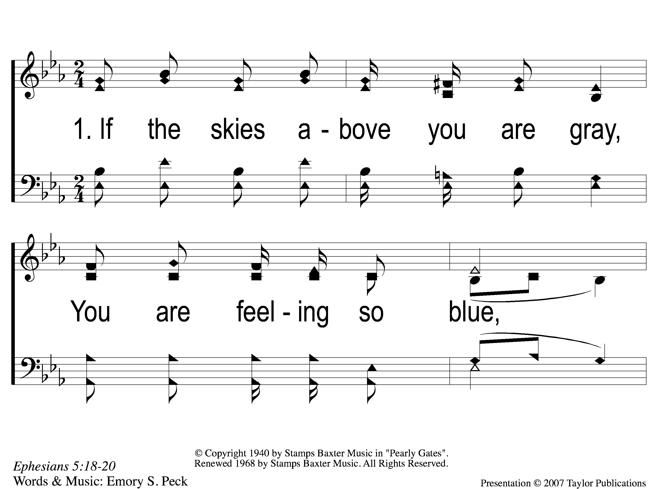
1-1 Sing and Be Happy
Sing and Be Happy
587

Slide 2
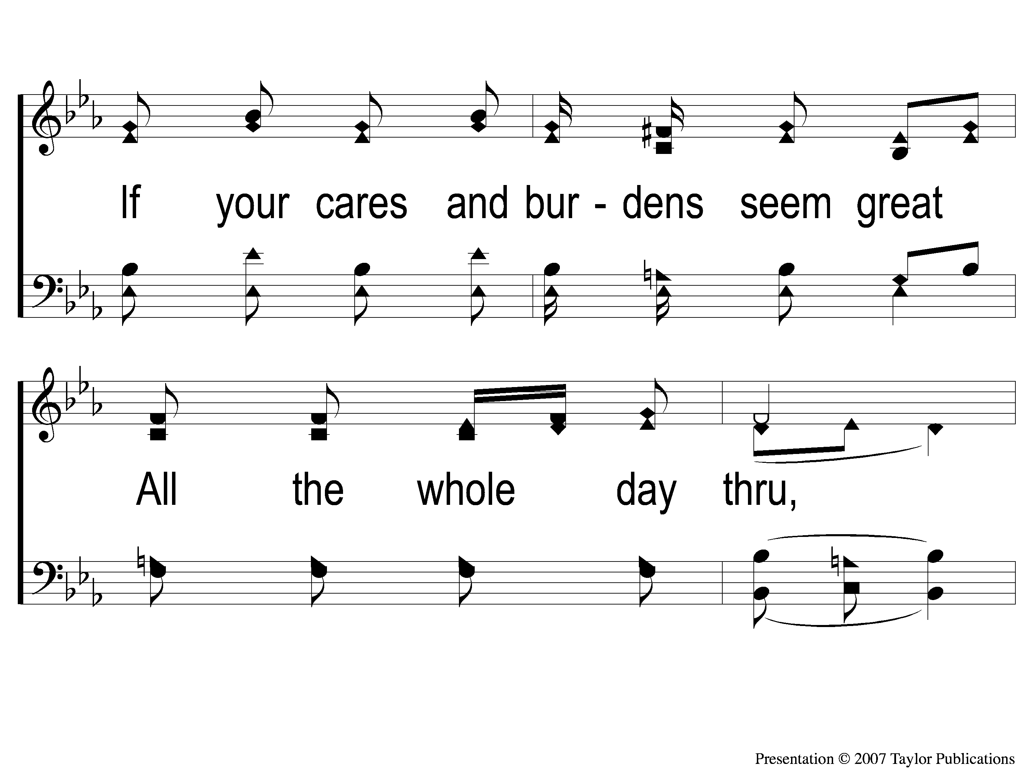
1-2 Sing and Be Happy
Sing and Be Happy
587

Slide 3
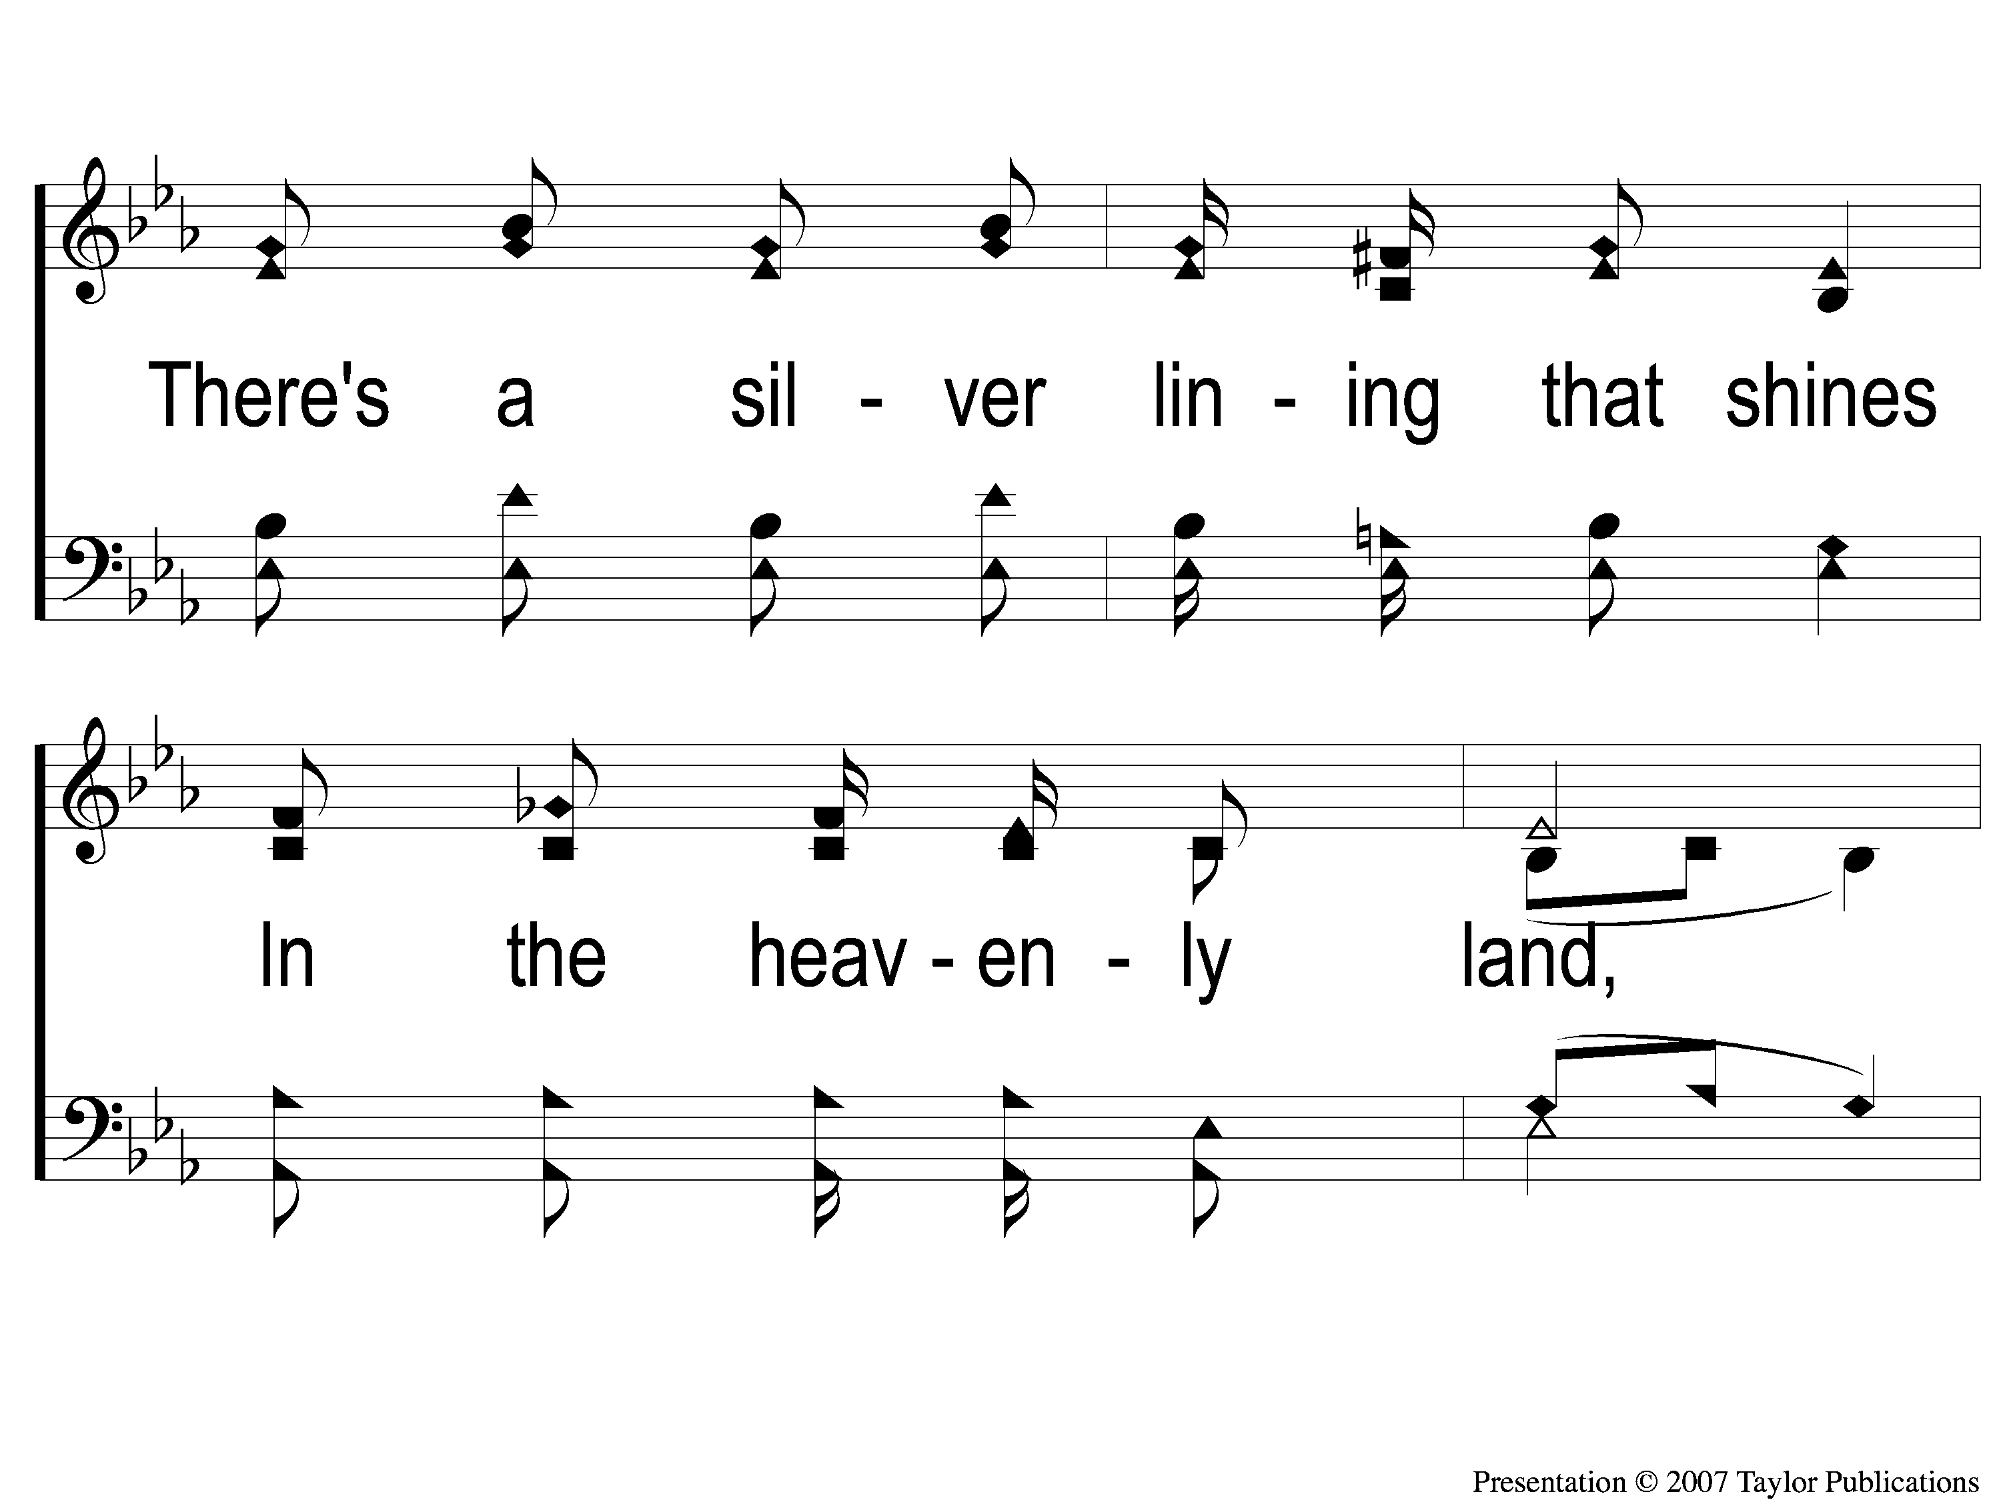
1-3 Sing and Be Happy
Sing and Be Happy
587

Slide 4
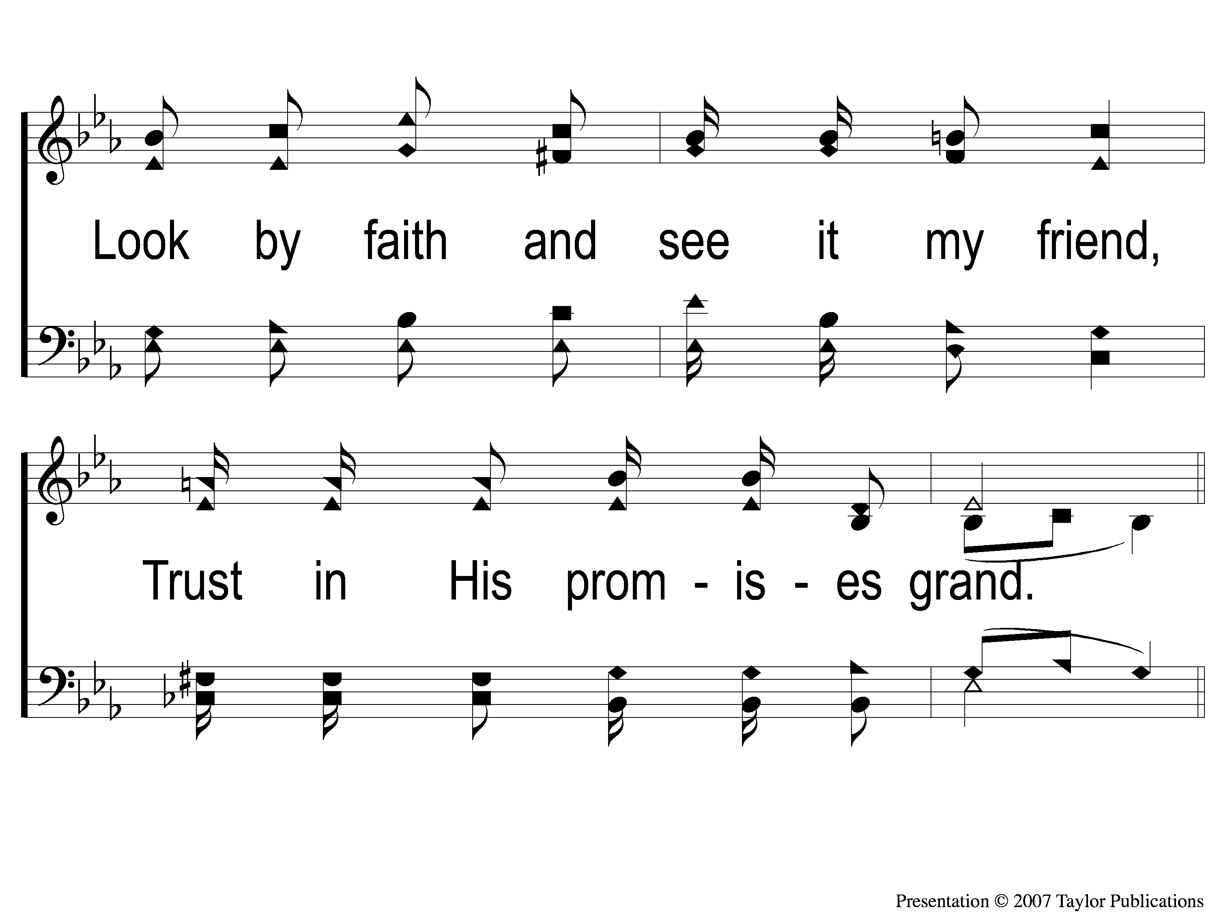
1-4 Sing and Be Happy
Sing and Be Happy
587

Slide 5
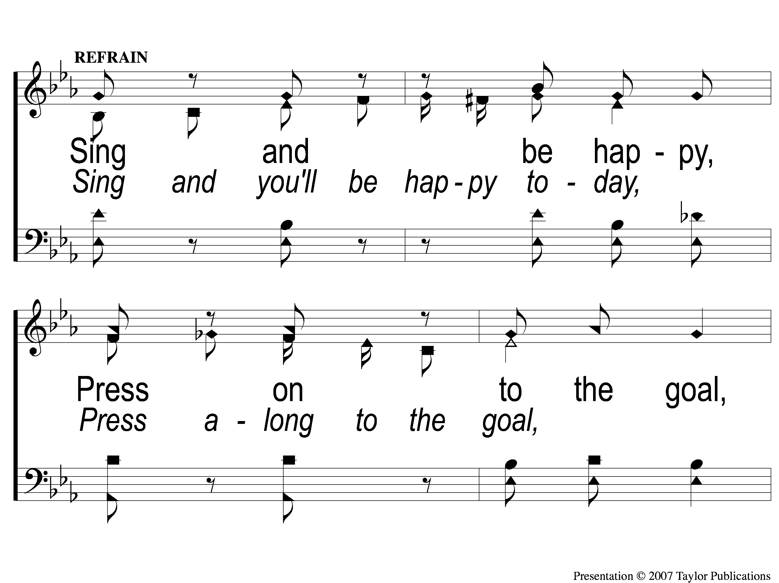
C-1 Sing and Be Happy
Sing and Be Happy
587

Slide 6
C-2 Sing and Be Happy
Sing and Be Happy
587

Slide 7
C-3 Sing and Be Happy
Sing and Be Happy
587

Slide 8
C-4 Sing and Be Happy
Sing and Be Happy
587

Slide 9
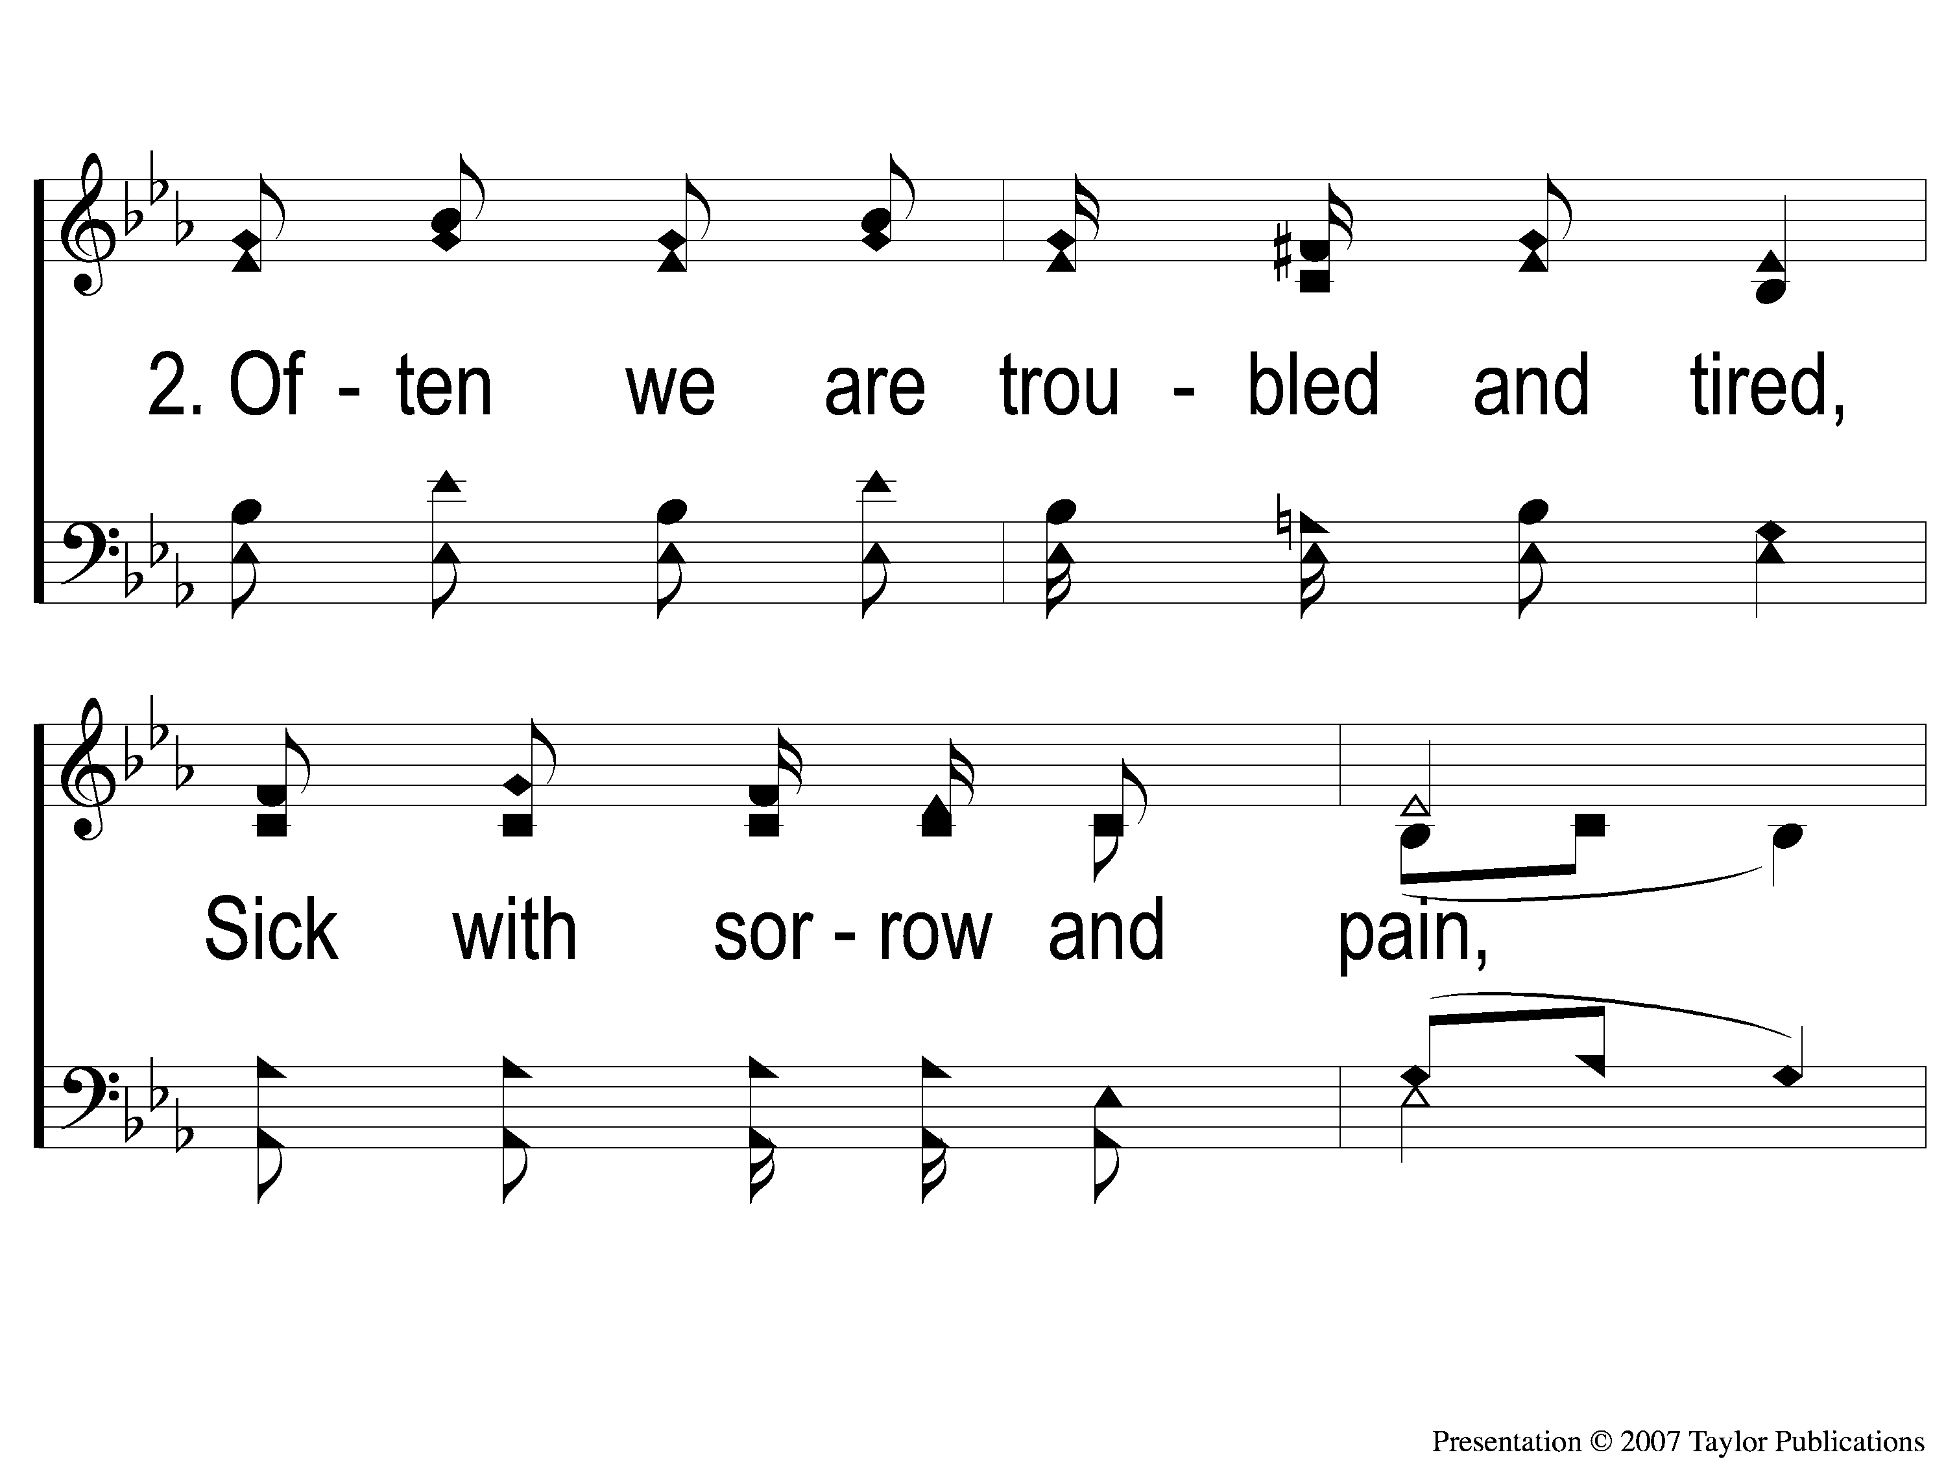
2-1 Sing and Be Happy
Sing and Be Happy
587

Slide 10
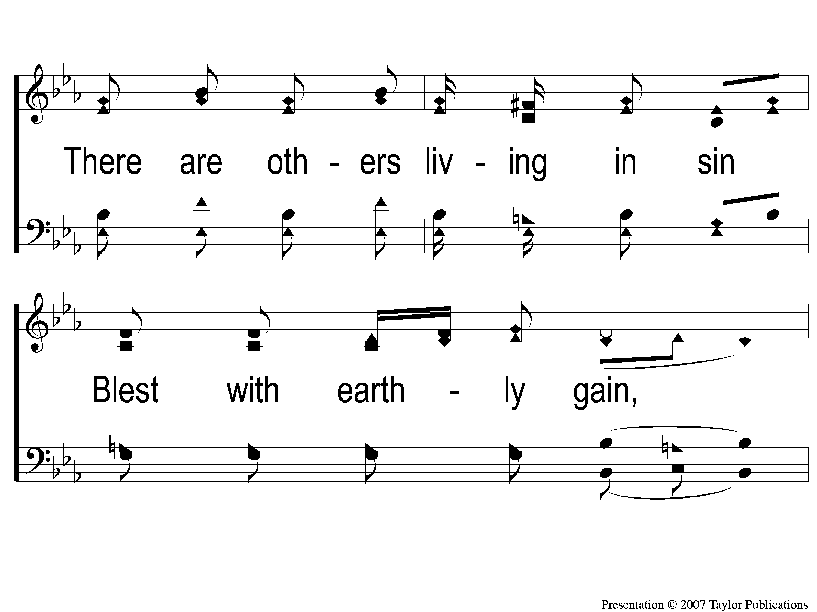
2-2 Sing and Be Happy
Sing and Be Happy
587

Slide 11
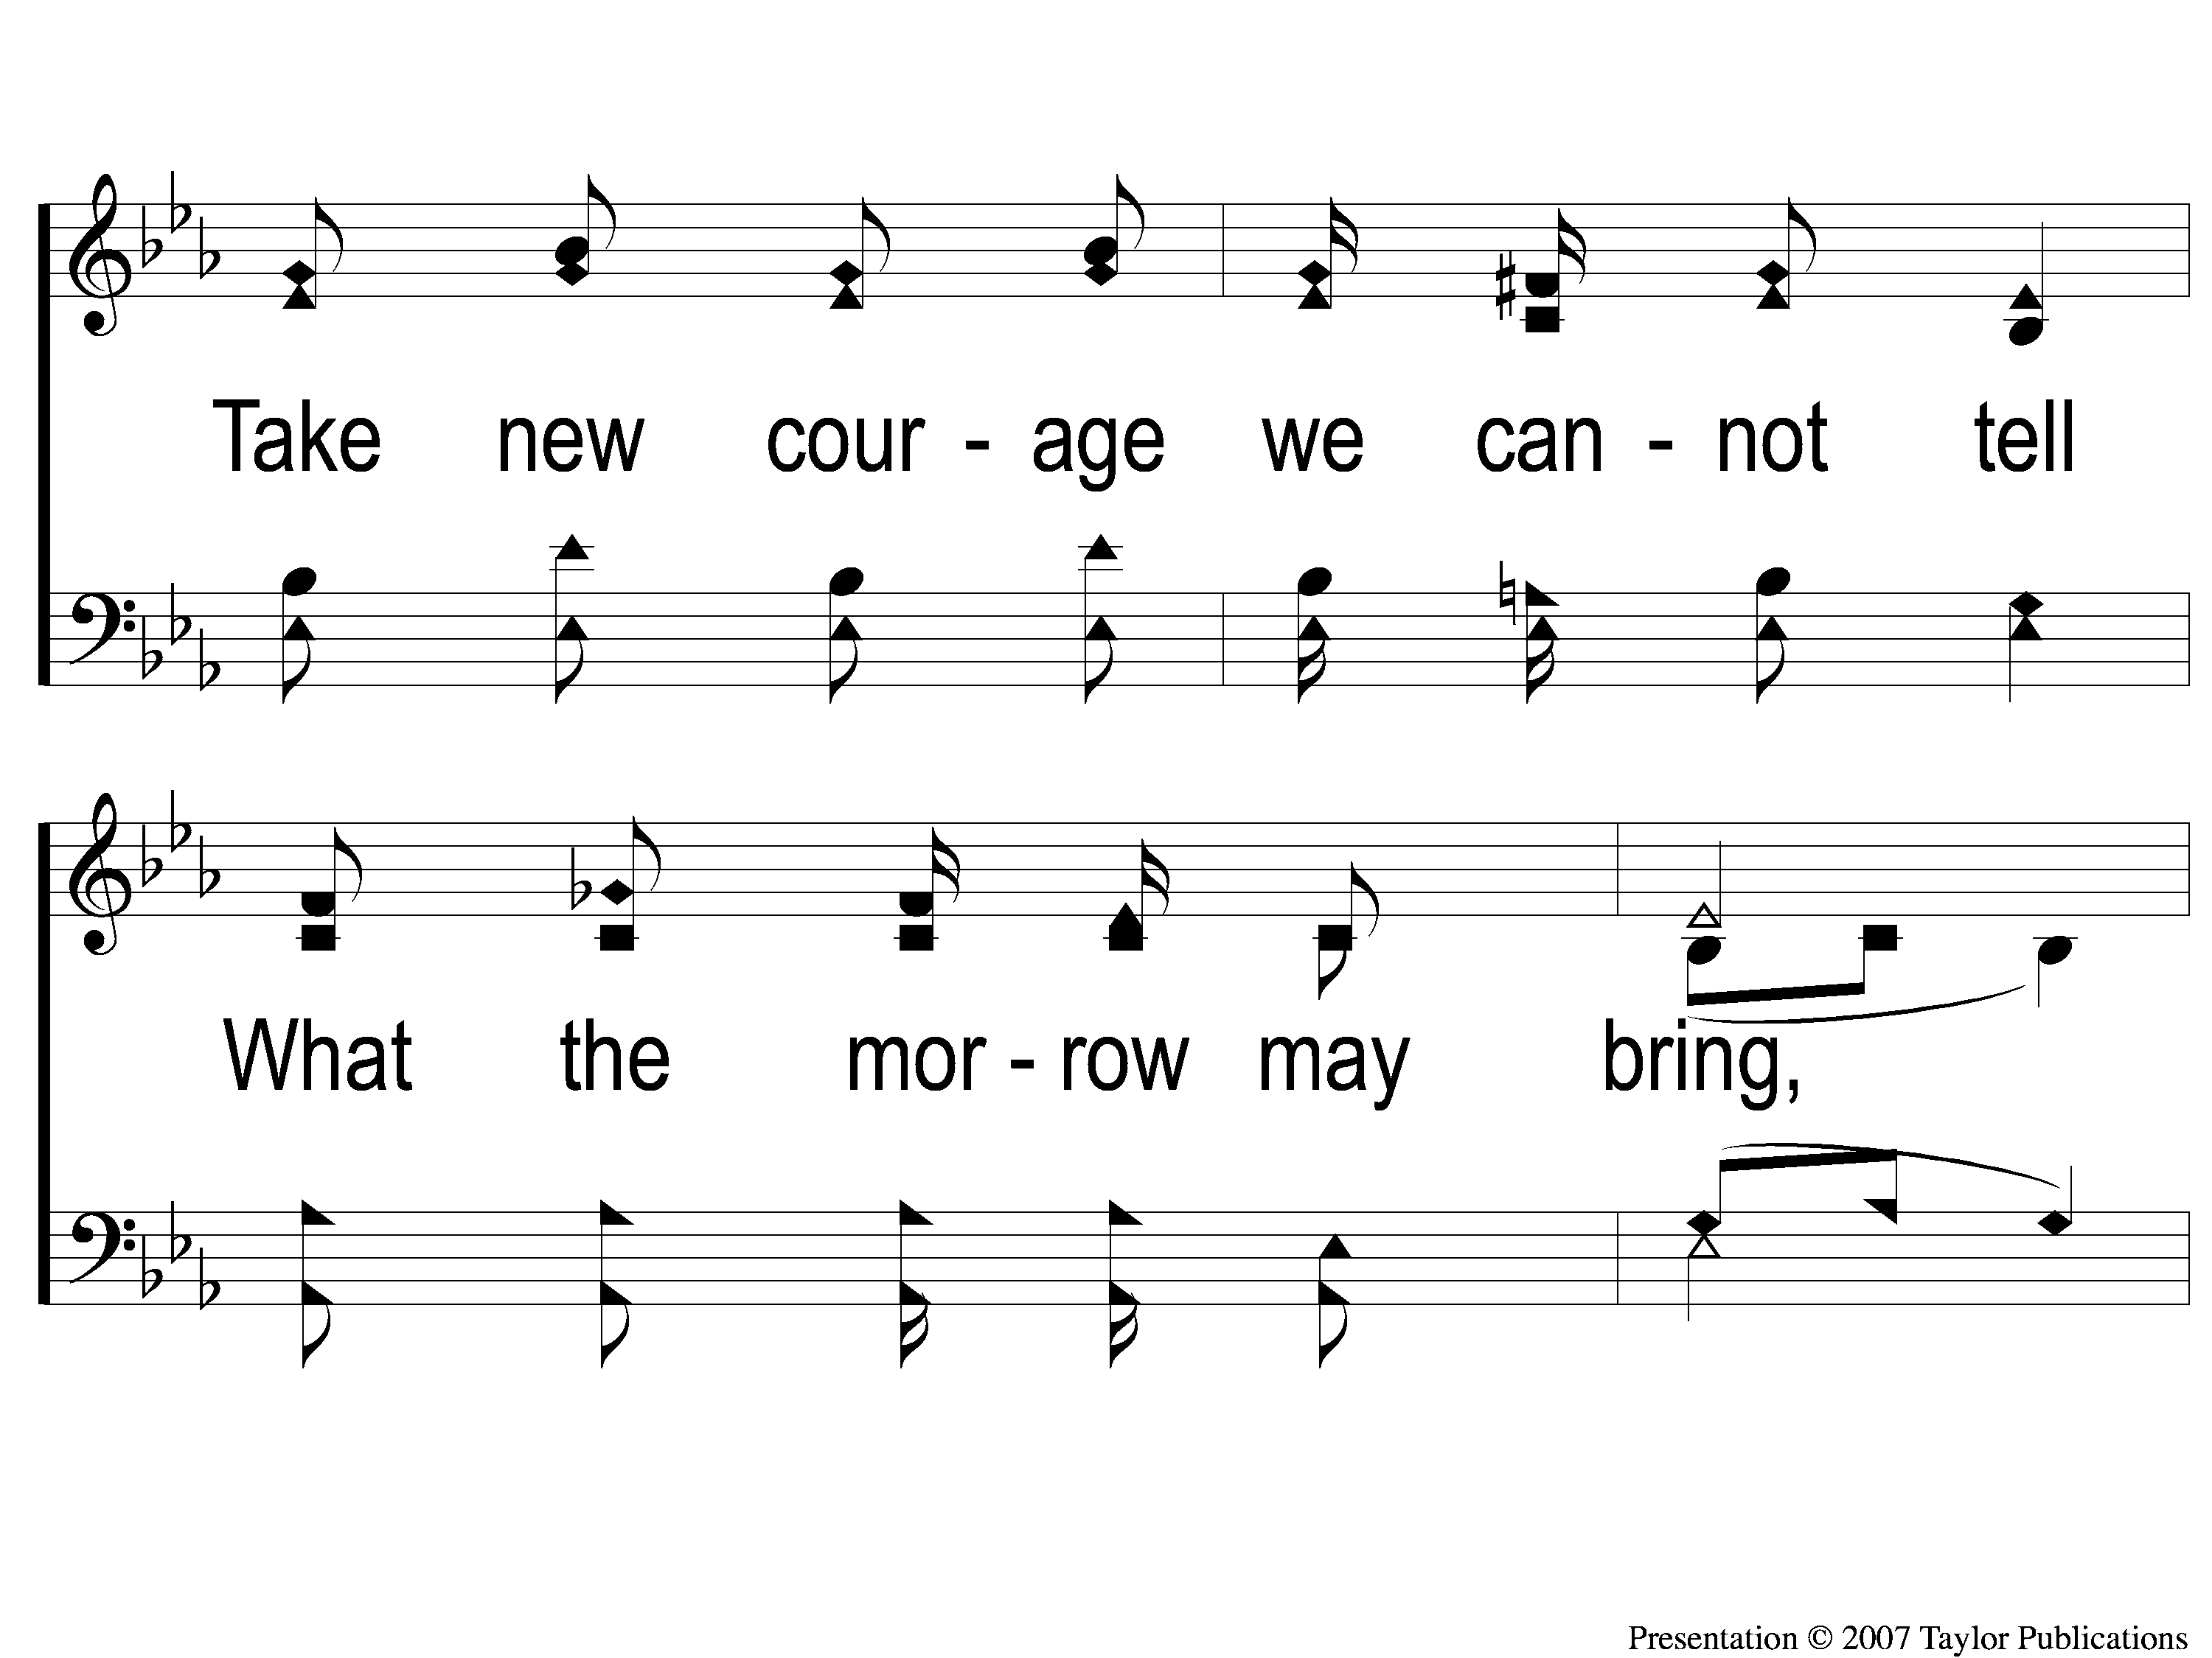
2-3 Sing and Be Happy
Sing and Be Happy
587

Slide 12
2-4 Sing and Be Happy
Sing and Be Happy
587

Slide 13
C-1 Sing and Be Happy
Sing and Be Happy
587

Slide 14
C-2 Sing and Be Happy
Sing and Be Happy
587

Slide 15
C-3 Sing and Be Happy
Sing and Be Happy
587

Slide 16
C-4 Sing and Be Happy
Sing and Be Happy
587

Slide 17
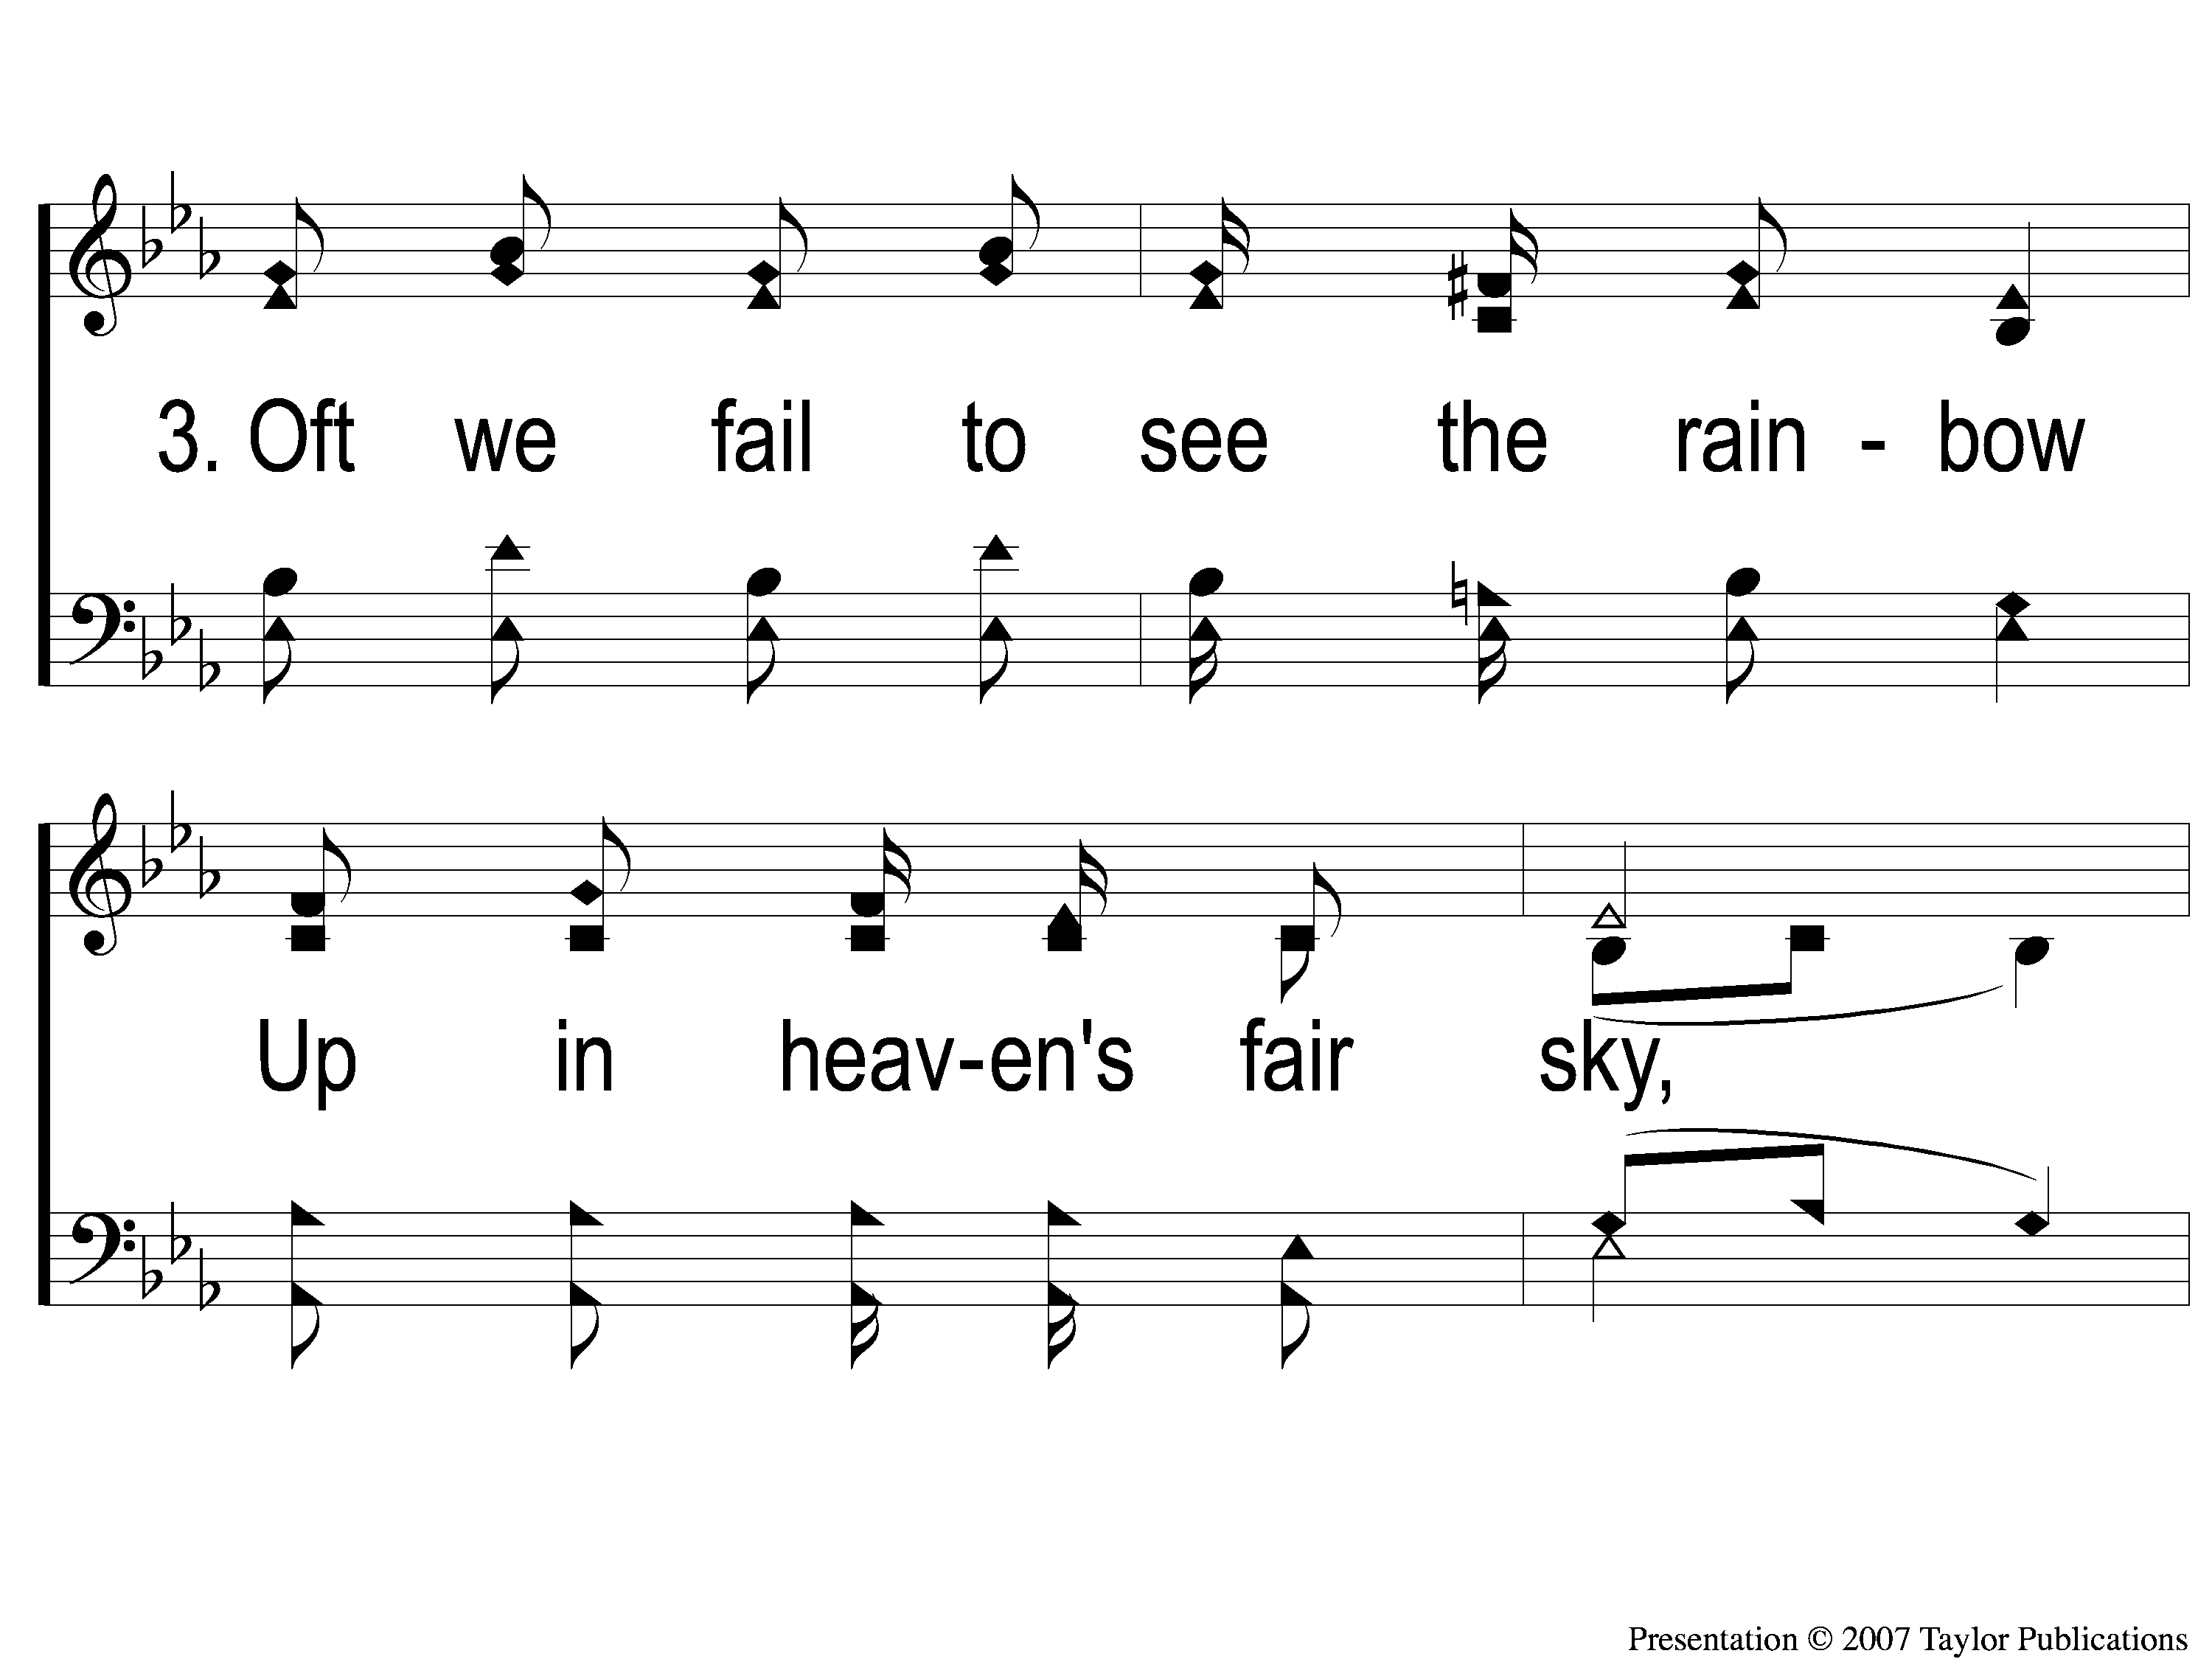
3-1 Sing and Be Happy
Sing and Be Happy
587

Slide 18
3-2 Sing and Be Happy
Sing and Be Happy
587

Slide 19
3-3 Sing and Be Happy
Sing and Be Happy
587

Slide 20
3-4 Sing and Be Happy
Sing and Be Happy
587

Slide 21
C-1 Sing and Be Happy
Sing and Be Happy
587

Slide 22
C-2 Sing and Be Happy
Sing and Be Happy
587

Slide 23
C-3 Sing and Be Happy
Sing and Be Happy
587

Slide 24
C-4 Sing and Be Happy
Sing and Be Happy
587

Slide 25
RESTORE REBUILD RENEW
welcome
we are glad to
Have you with us
IN 2022
WHEELER
CHURCH
OF
CHRIST

Slide 26
Song:
Shine, Jesus, Shine
#290

Slide 27
1-1 Shine Jesus Shine
Shine, Jesus, Shine
290

Slide 28
1-2 Shine Jesus Shine
Shine, Jesus, Shine
290

Slide 29
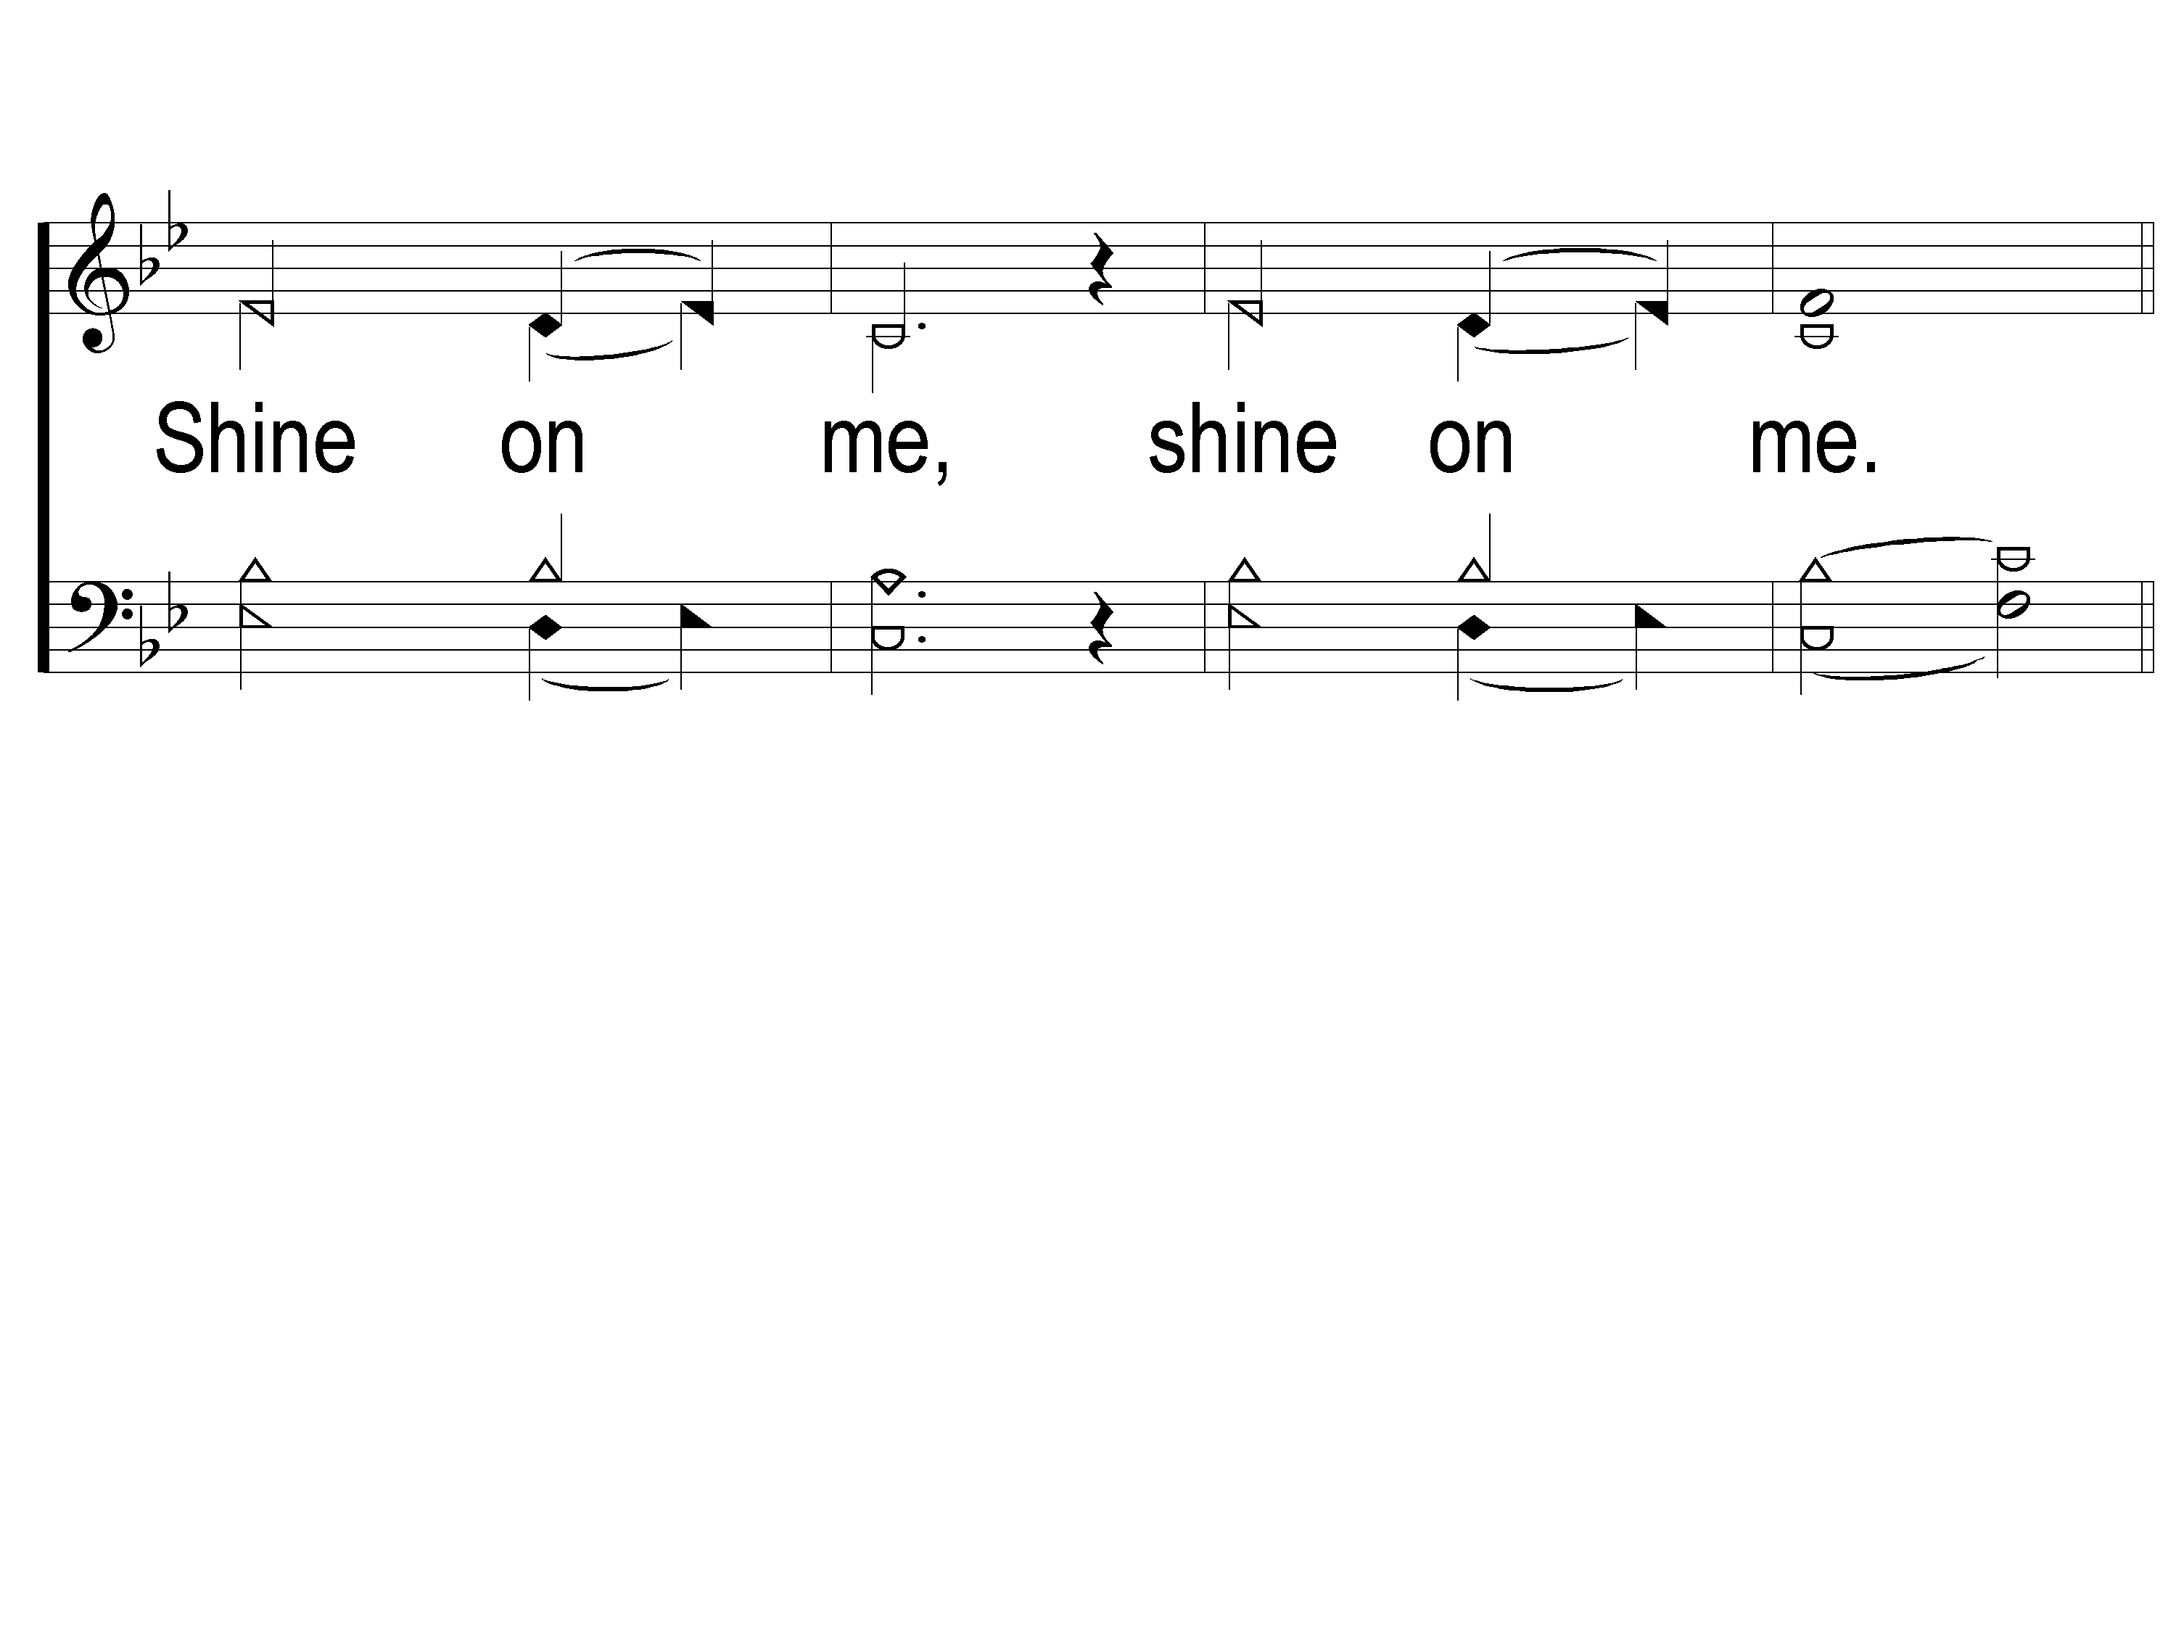
1-3 Shine Jesus Shine
Shine, Jesus, Shine
290

Slide 30
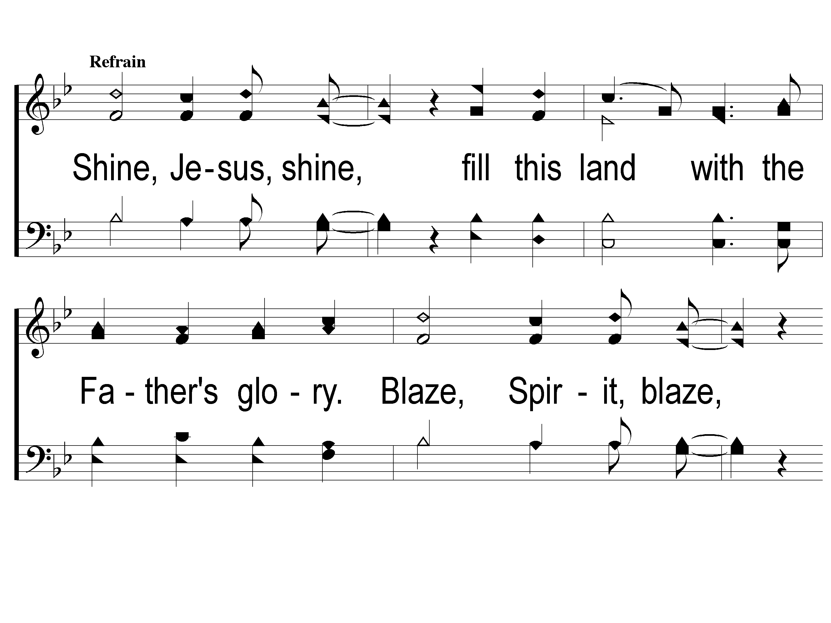
C-1 Shine Jesus Shine
Shine, Jesus, Shine
290

Slide 31
C-2 Shine Jesus Shine
Shine, Jesus, Shine
290

Slide 32
C-3 Shine Jesus Shine
Shine, Jesus, Shine
290

Slide 33
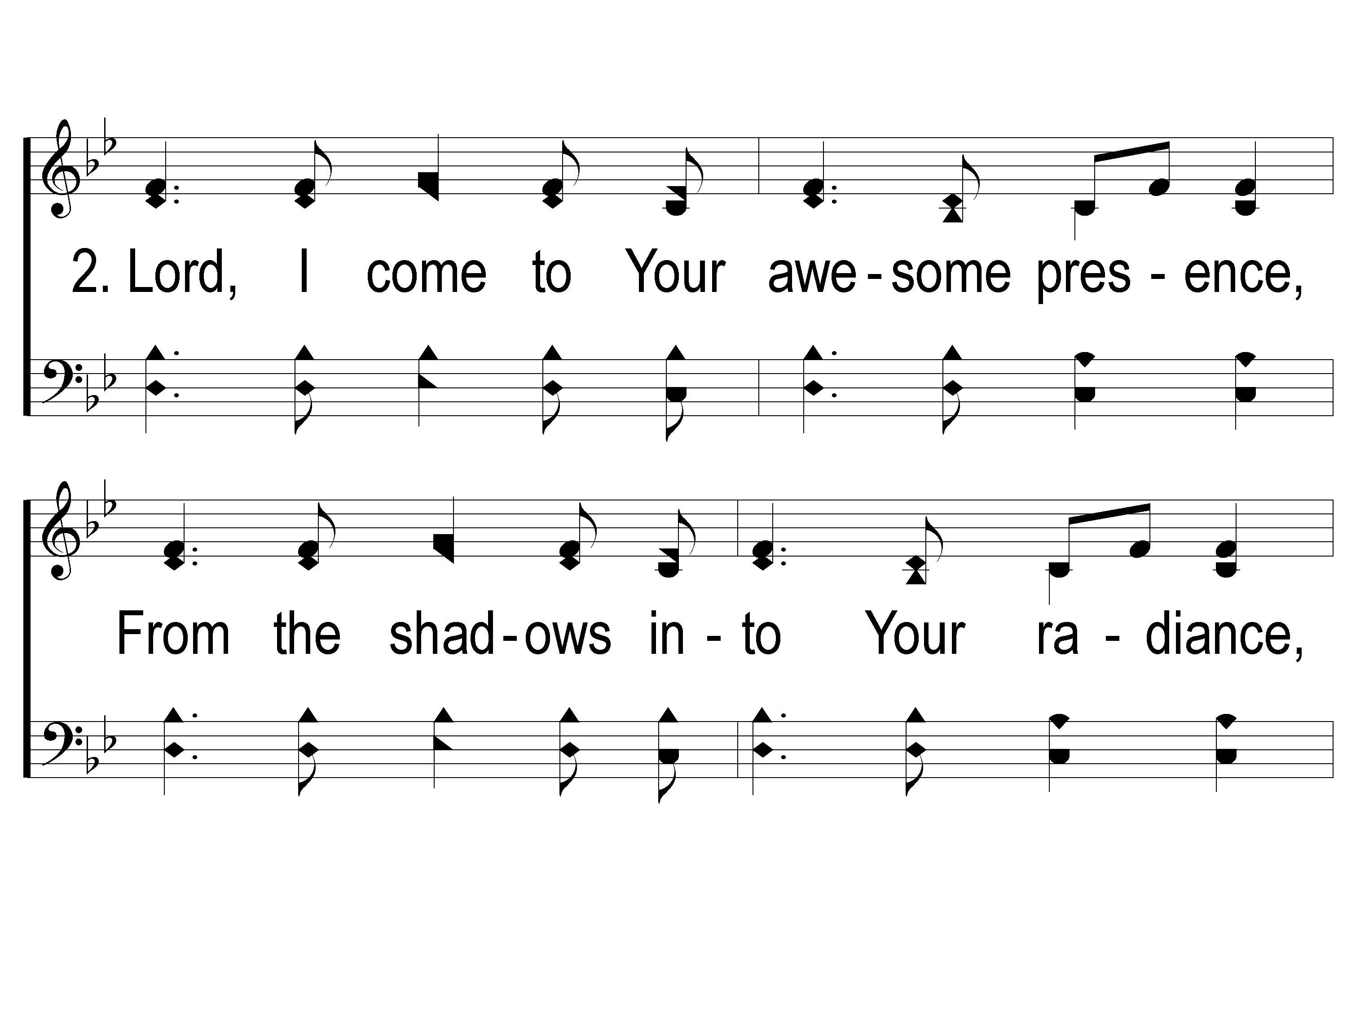
2-1 Shine Jesus Shine
Shine, Jesus, Shine
290

Slide 34
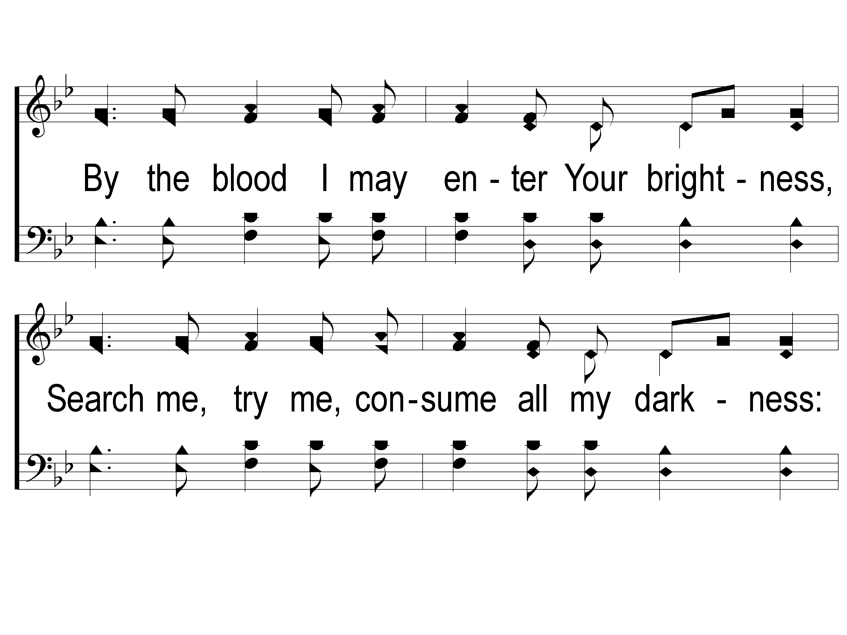
2-2 Shine Jesus Shine
Shine, Jesus, Shine
290

Slide 35
2-3 Shine Jesus Shine
Shine, Jesus, Shine
290

Slide 36
C-1 Shine Jesus Shine
Shine, Jesus, Shine
290

Slide 37
C-2 Shine Jesus Shine
Shine, Jesus, Shine
290

Slide 38
C-3 Shine Jesus Shine
Shine, Jesus, Shine
290

Slide 39
Song:
The Lily Of The Valley
#548

Slide 40
1-1 The Lily of the Valley
The Lily of the Valley
548

Slide 41
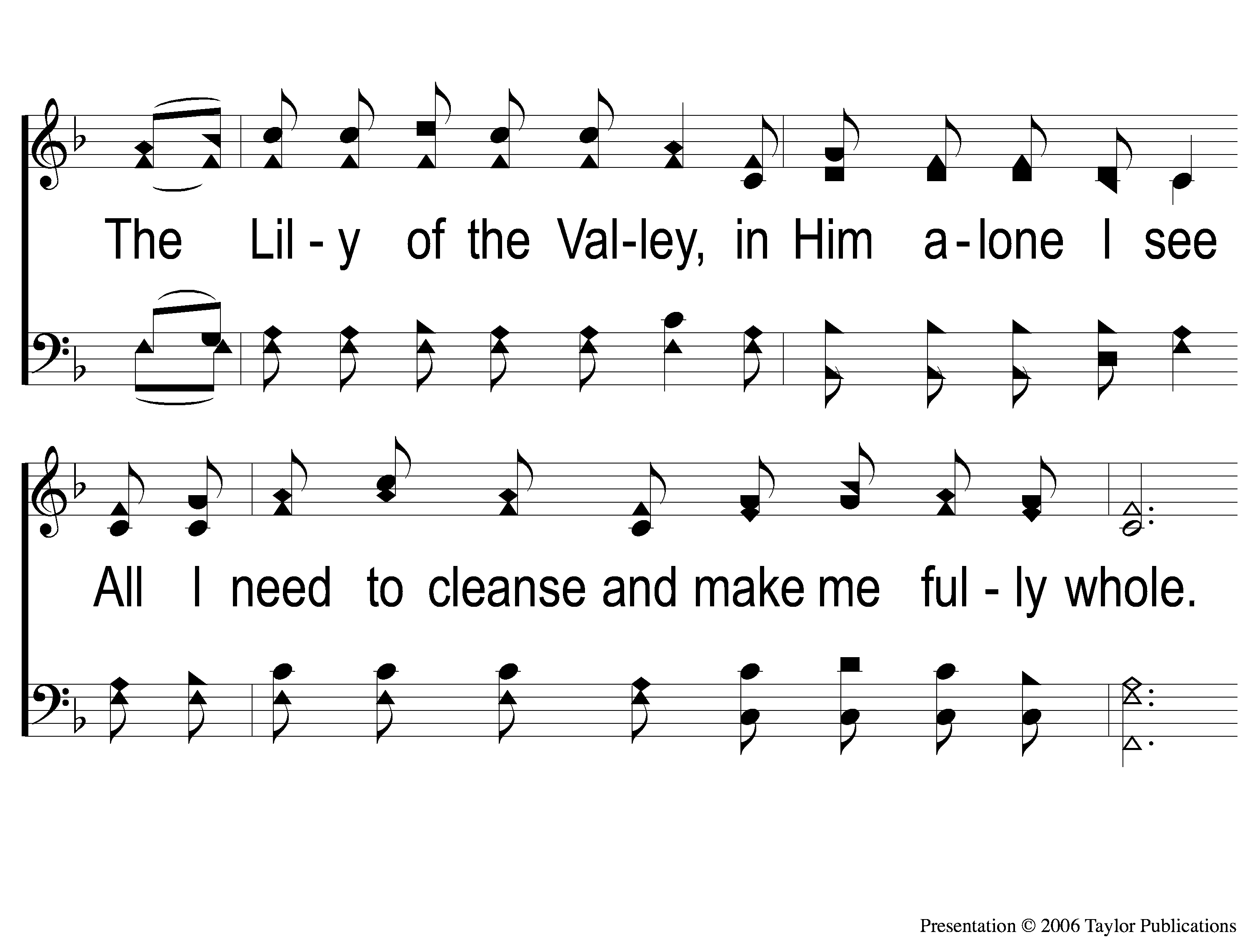
1-2 The Lily of the Valley
The Lily of the Valley
548

Slide 42
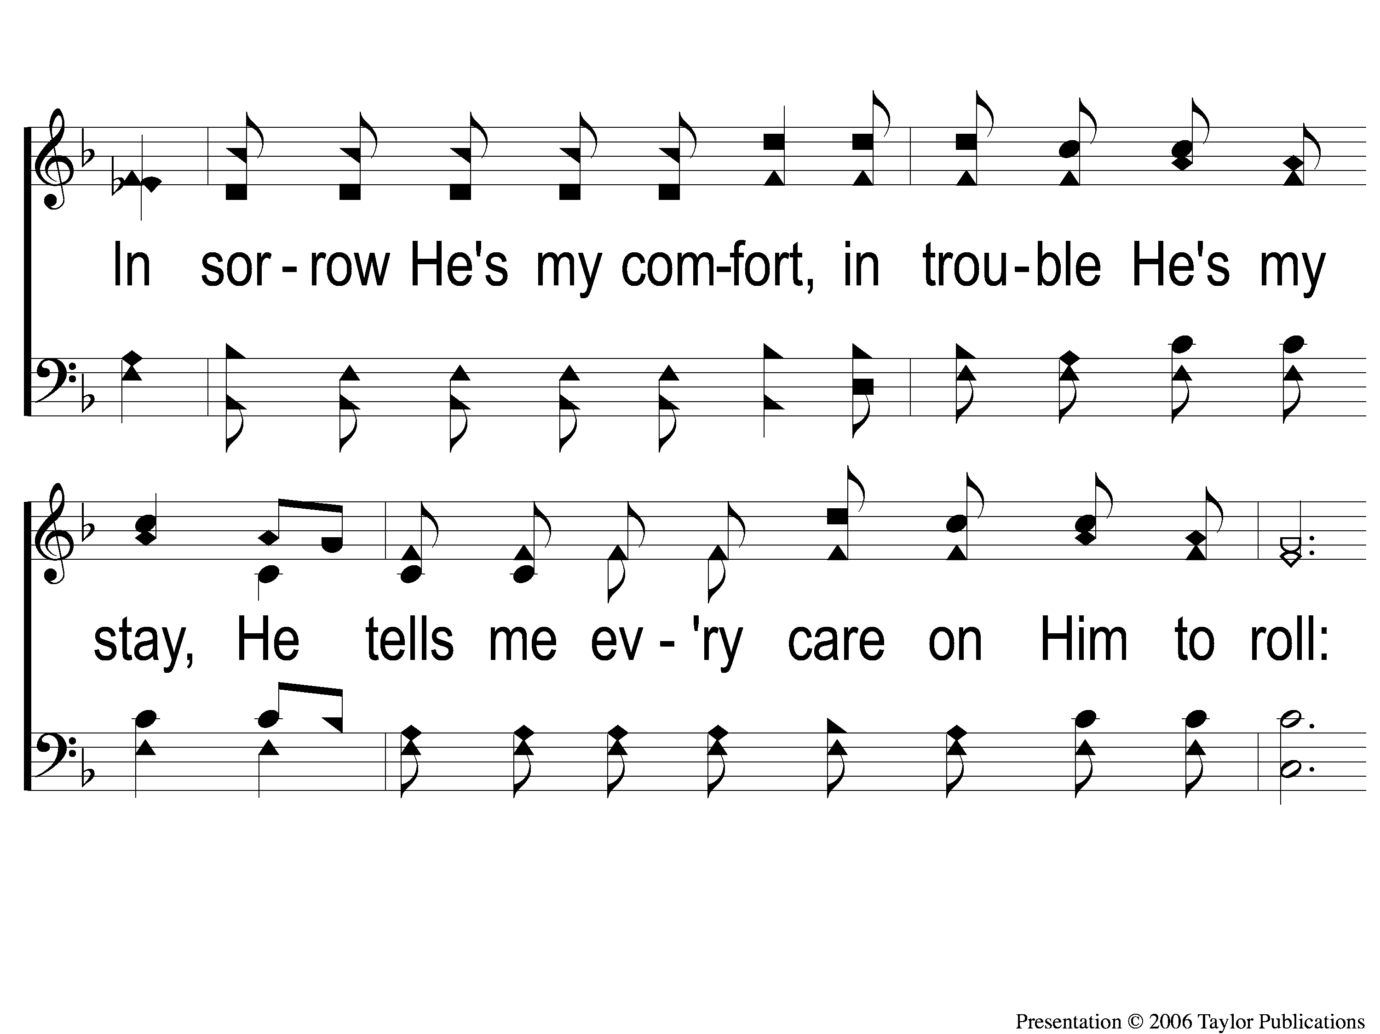
1-3 The Lily of the Valley
The Lily of the Valley
548

Slide 43
C The Lily of the Valley
The Lily of the Valley
548

Slide 44
2-1 The Lily of the Valley
The Lily of the Valley
548

Slide 45
2-2 The Lily of the Valley
The Lily of the Valley
548

Slide 46
2-3 The Lily of the Valley
The Lily of the Valley
548

Slide 47
C The Lily of the Valley
The Lily of the Valley
548

Slide 48
3-1 The Lily of the Valley
The Lily of the Valley
548

Slide 49
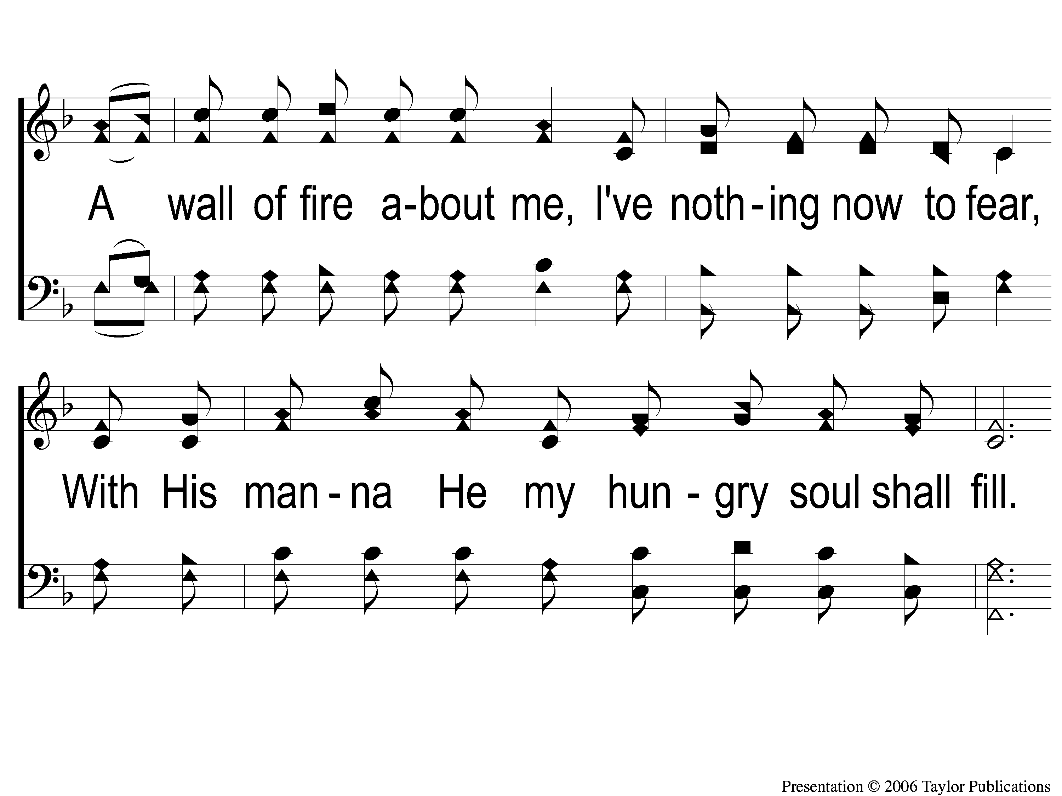
3-2 The Lily of the Valley
The Lily of the Valley
548

Slide 50
3-3 The Lily of the Valley
The Lily of the Valley
548

Slide 51
C The Lily of the Valley
The Lily of the Valley
548

Slide 52
Opening Prayer

Slide 53
Song:
There Is A Habitation
#860

Slide 54
1 There is a Habitation
There Is A Habitation
860

Slide 55
c There is a Habitation
There Is A Habitation
860

Slide 56
2 There is a Habitation
There Is A Habitation
860

Slide 57
c There is a Habitation
There Is A Habitation
860

Slide 58
3 There is a Habitation
There Is A Habitation
860

Slide 59
c There is a Habitation
There Is A Habitation
860

Slide 60
4 There is a Habitation
There Is A Habitation
860

Slide 61
c There is a Habitation
There Is A Habitation
860

Slide 62
Song:
I’ll Fly Away
#851

Slide 63
1-1 I’ll Fly Away
I’ll Fly Away
851

Slide 64
1-2 I’ll Fly Away
I’ll Fly Away
851

Slide 65
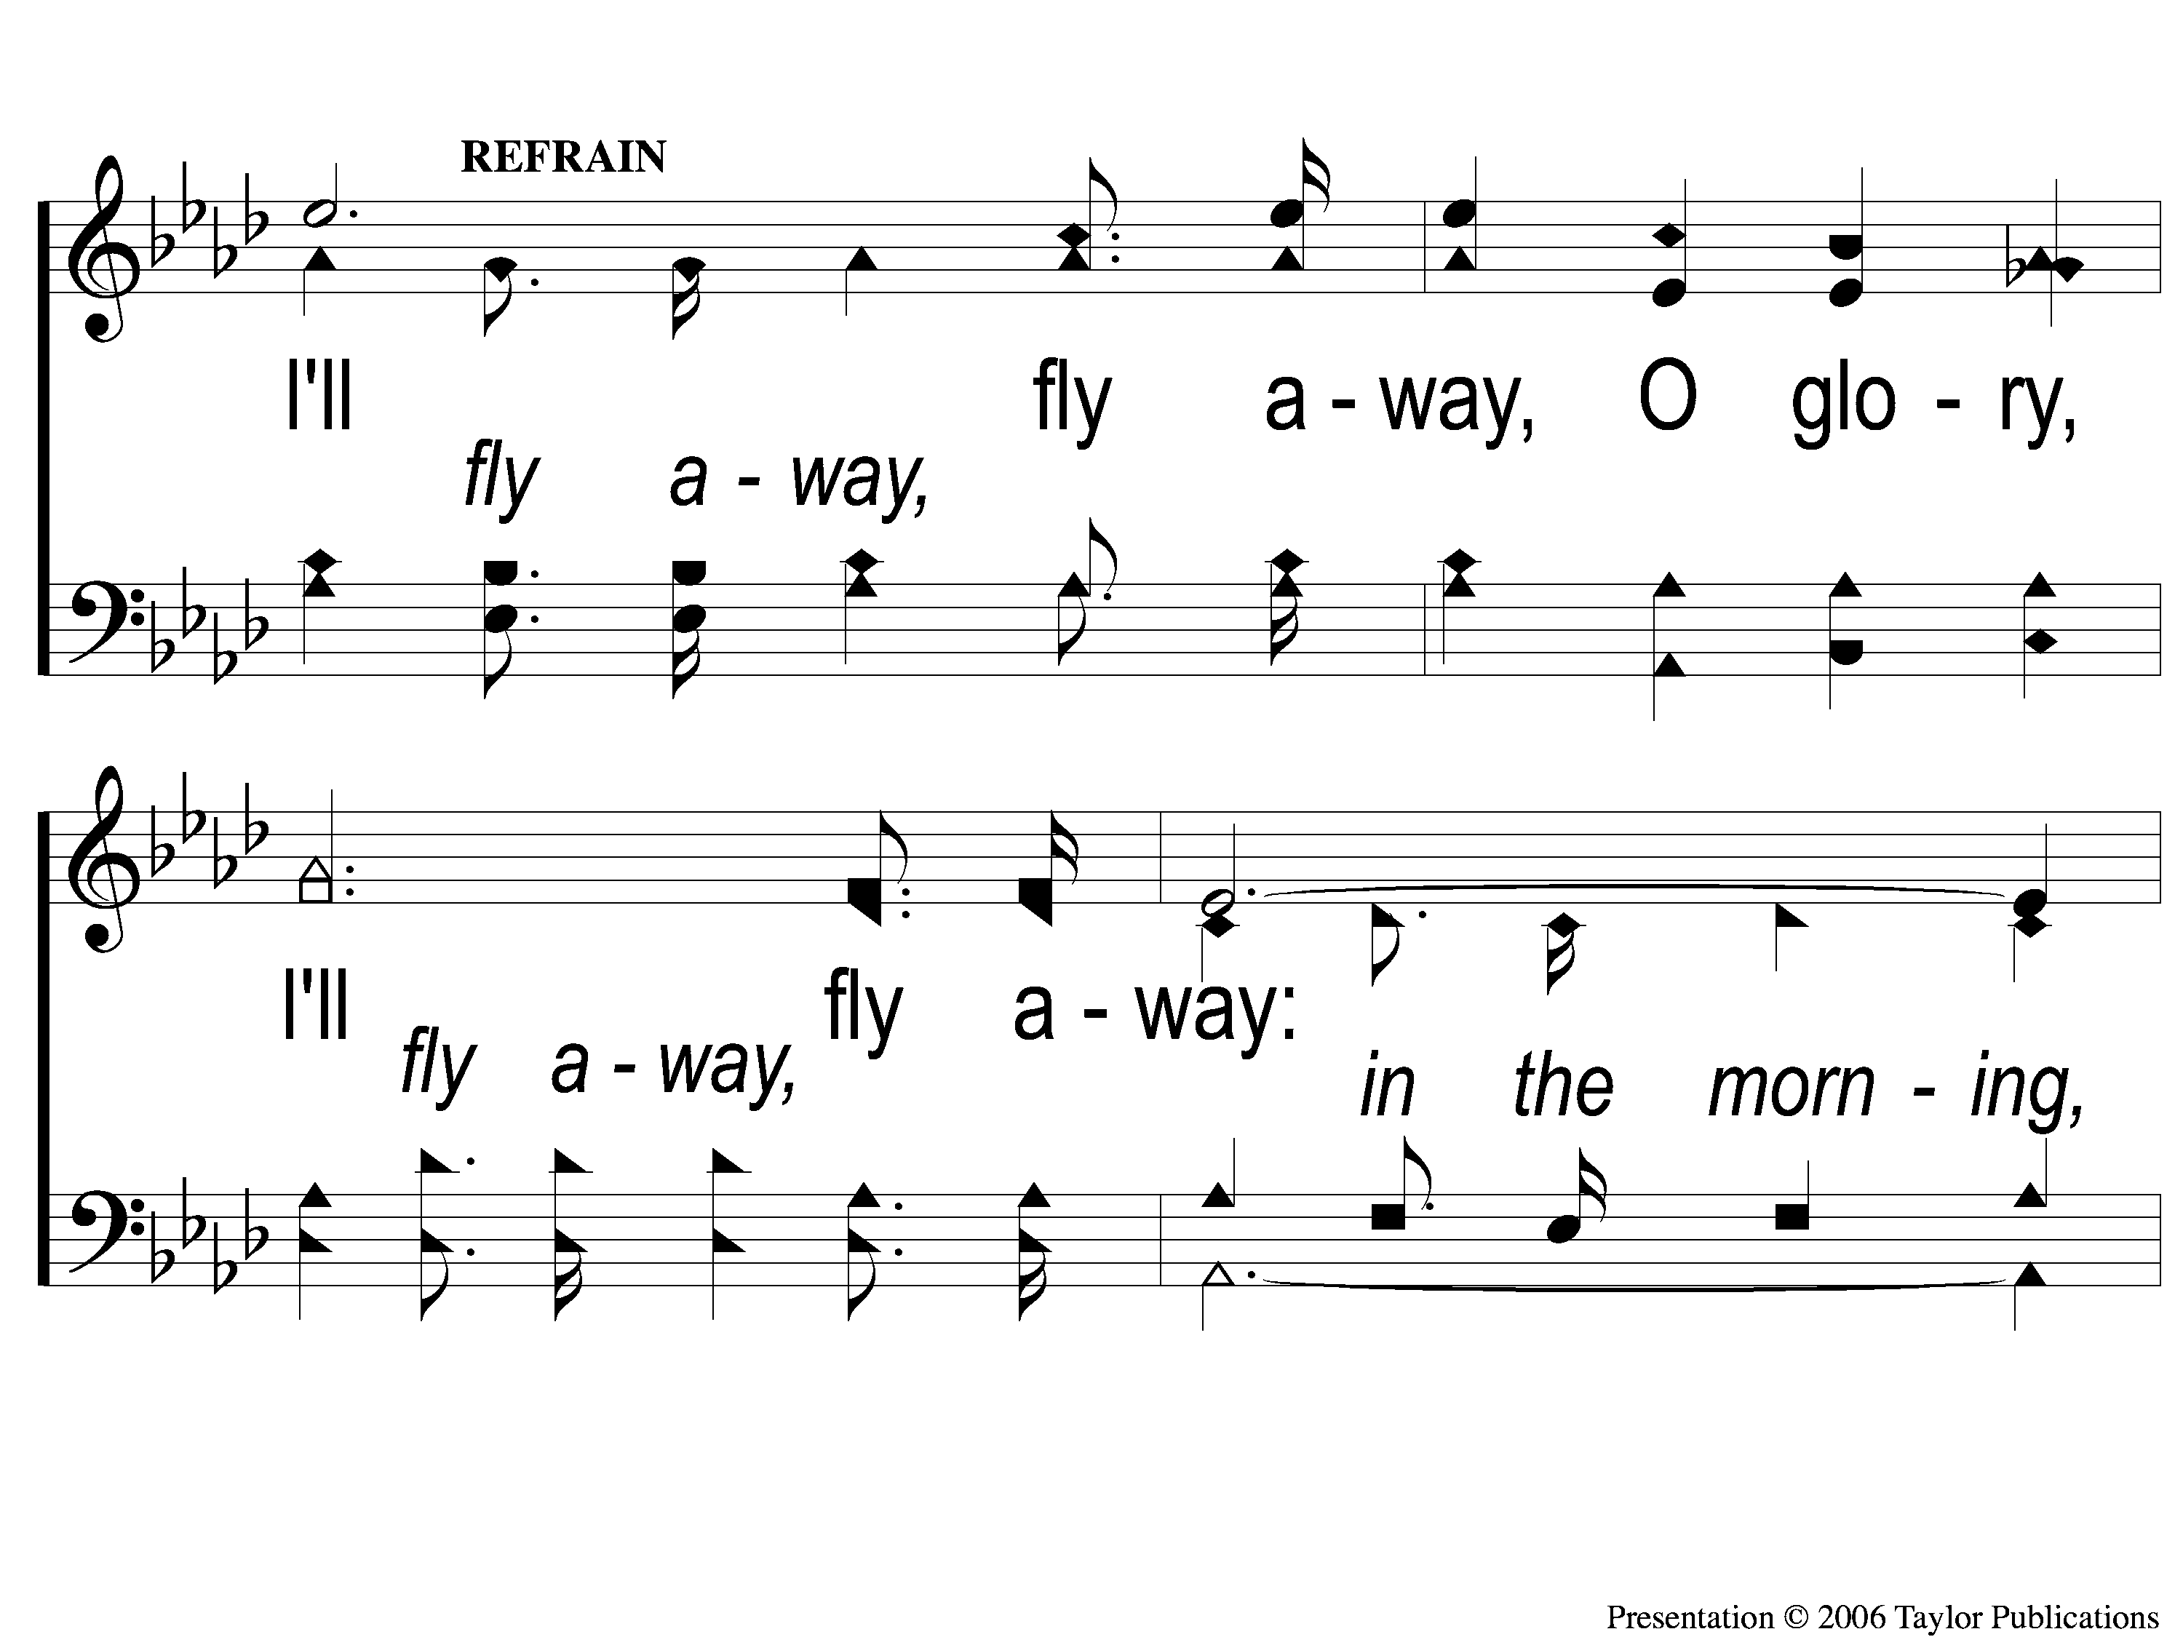
C-1 I’ll Fly Away
I’ll Fly Away
851

Slide 66
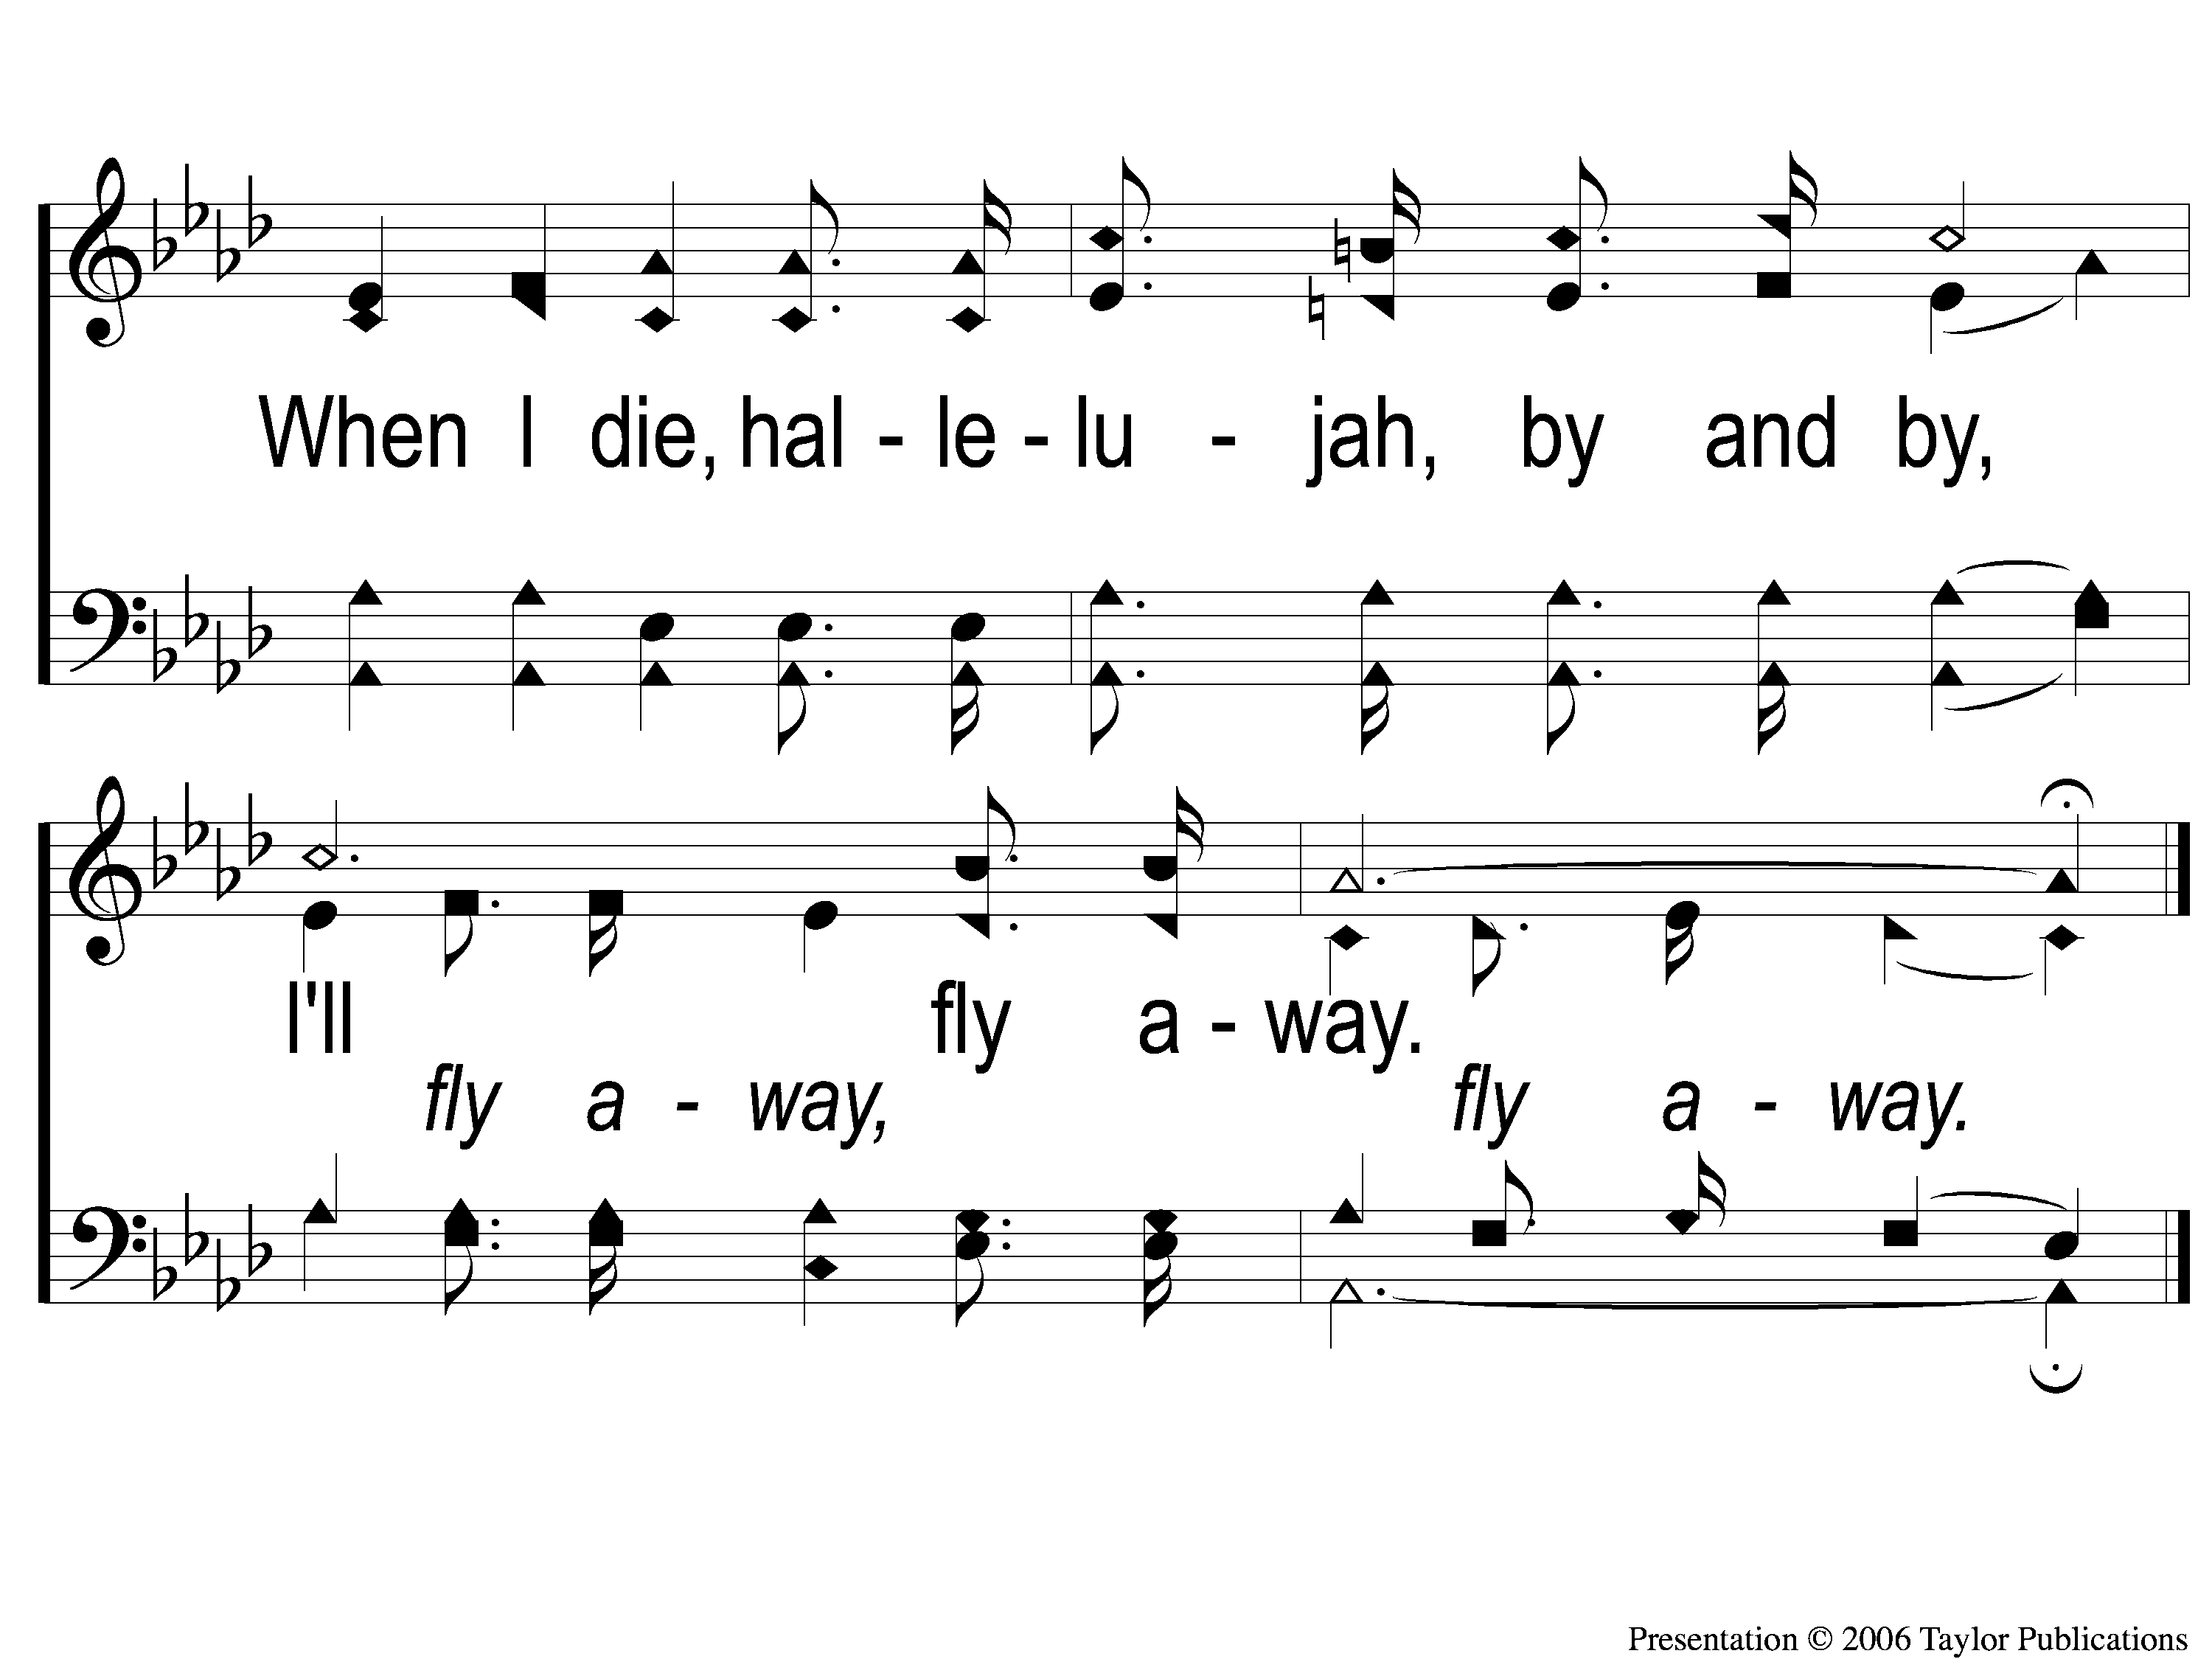
C-2 I’ll Fly Away
I’ll Fly Away
851

Slide 67
2-1 I’ll Fly Away
I’ll Fly Away
851

Slide 68
2-2 I’ll Fly Away
I’ll Fly Away
851

Slide 69
C-1 I’ll Fly Away
I’ll Fly Away
851

Slide 70
C-2 I’ll Fly Away
I’ll Fly Away
851

Slide 71
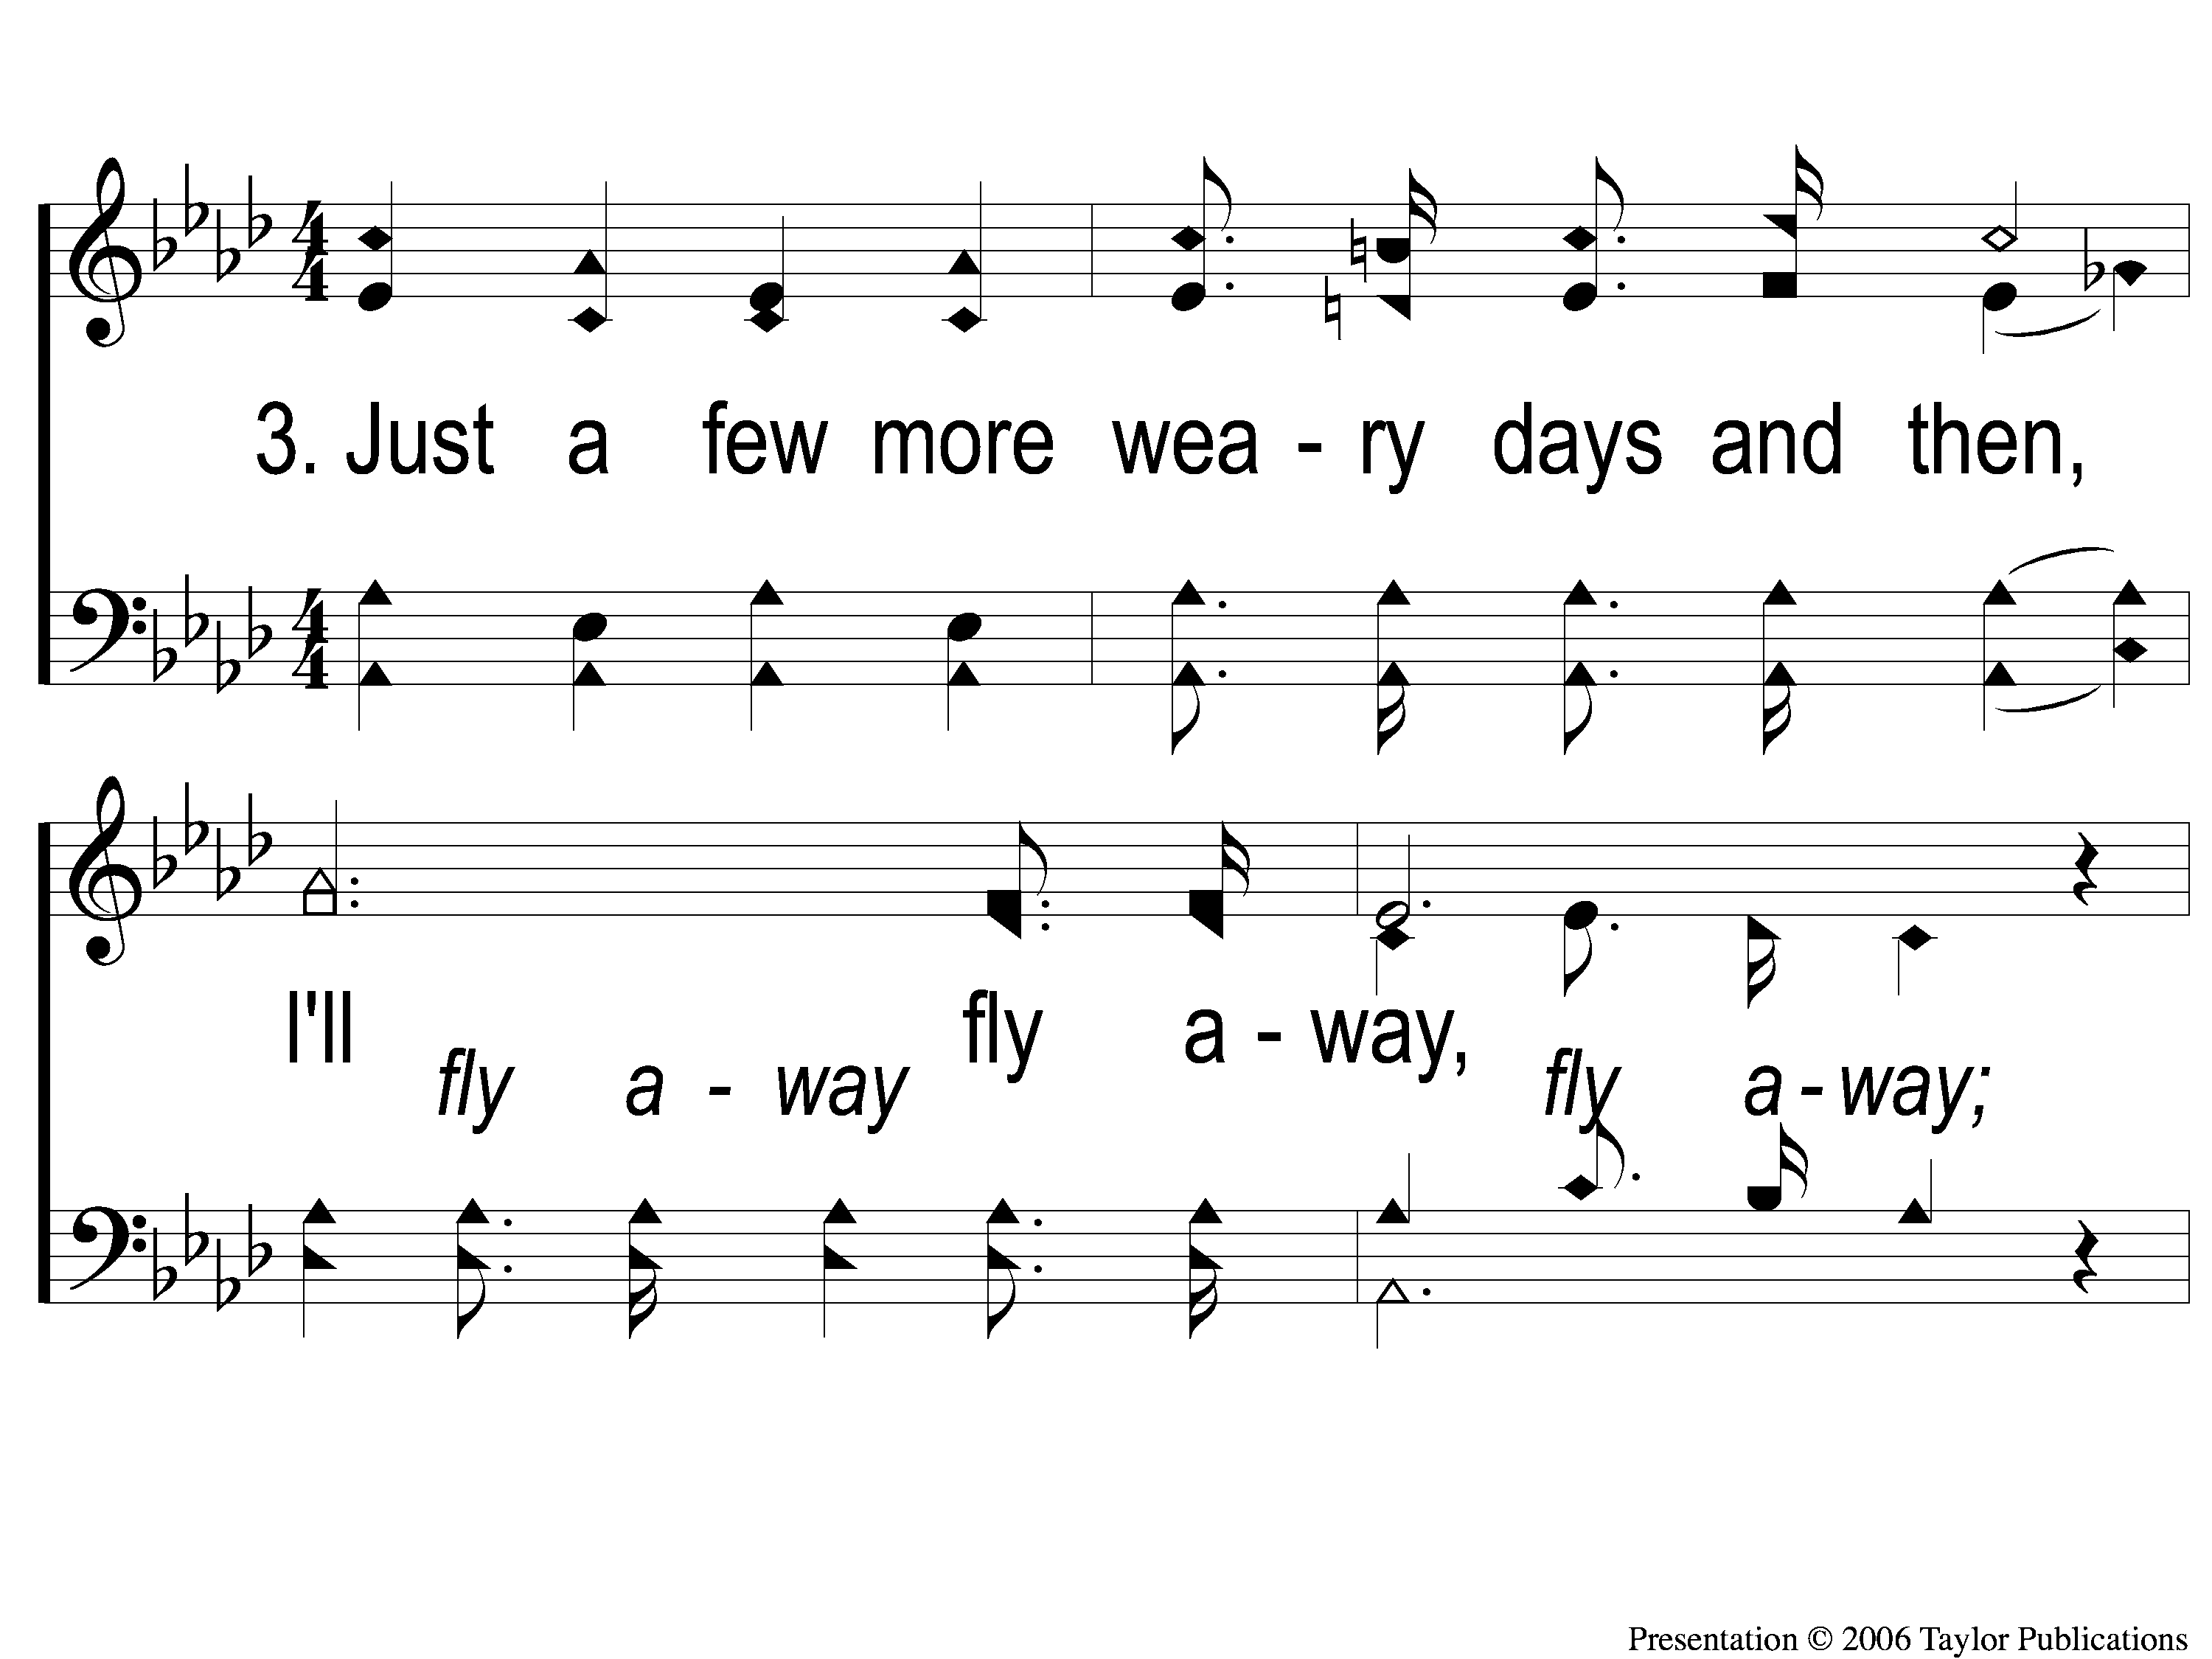
3-1 I’ll Fly Away
I’ll Fly Away
851

Slide 72
3-2 I’ll Fly Away
I’ll Fly Away
851

Slide 73
C-1 I’ll Fly Away
I’ll Fly Away
851

Slide 74
C-2 I’ll Fly Away
I’ll Fly Away
851

Slide 75
Scripture Reading:
Romans 9:6-13

Slide 77
THE REFORMATION MOVEMENT
Began October 31, 1517
With Martin Luther’s 95 Theses
“Disputation on the Power of Indulgences”

Slide 78
THE REFORMATION MOVEMENT
Continued With John Calvin in the 1500s
“Institutes of the Christian Religion”

Slide 80
CALVINISM: T-U-L-I-P

Slide 81
Total Hereditary Depravity Unconditional Election Limited Atonement Irresistible Grace Perseverance of the Saints

Slide 82
Unconditional Election

Slide 83
DEFINE TERMS
Unconditional = solely upon God’s grace

Slide 84
DEFINE TERMS
Unconditional = solely upon God’s grace
ELECTION = God’s choosing of individuals to be Saved

Slide 85
DEFINE TERMS
“God's eternal decree, by which He compacted with himself what he willed to become of each man. For all are not created in equal condition; rather, eternal life is foreordained for some, eternal damnation for others” – John Calvin in Inst. III, XXI, V

Slide 86
DEFINE TERMS
“The Reformed view of election, known as unconditional election, means that God does not foresee an action or condition on our part that induces Him to save us. Rather, election rests on God's sovereign decision to save whomever He is pleased to save.” – R. C. Sproul

Slide 87
DEFINE TEXTS
Romans 8:28-30; 9:10-13, 15, 18; 11:6
Ephesians 1:4-5, 9

Slide 88
DANGEROUS IMPLICATIONS
If Unconditional Election Is True…

Slide 89
DANGEROUS IMPLICATIONS
If Unconditional Election Is True…
Humans Have No Free Will
Lev. 19:5
Gen. 3:6

Slide 90
DANGEROUS IMPLICATIONS
If Unconditional Election Is True…
Faith Is Not Necessary
Jms. 2:14-17

Slide 91
DANGEROUS IMPLICATIONS
If Unconditional Election Is True…
Makes God A Respecter of Persons
Acts 10:34-35
Rom. 2:11

Slide 92
Conditional ELECTION
DOCTRINE OF THE BIBLE:

Slide 93
DOCTRINE OF THE BIBLE
God Elected A Place, Not Individuals
Rom. 3:24
Eph. 1:3

Slide 94
DOCTRINE OF THE BIBLE
Grace & Faith Save Together
Jms. 2:14-17
Matt. 7:21
1 Tim. 4:16

Slide 95
DOCTRINE OF THE BIBLE
Humans Have Free Will
Mk. 16:15
Rom. 10:17
Jn. 3:16

Slide 96
Have You CHOSEN
to be part of God’s ELECT?

Slide 97
What A Day That Will Be
#916
Invitation
Song:

Slide 98
1-1 What a Day That Will Be
What a Day That Will Be
916

Slide 99
1-2 What a Day That Will Be
What a Day That Will Be
916

Slide 100
1-3 What a Day That Will Be
What a Day That Will Be
916

Slide 101
C-1 What a Day That Will Be
What a Day That Will Be
916

Slide 102
C-2 What a Day That Will Be
What a Day That Will Be
916

Slide 103
C-3 What a Day That Will Be
What a Day That Will Be
916

Slide 104
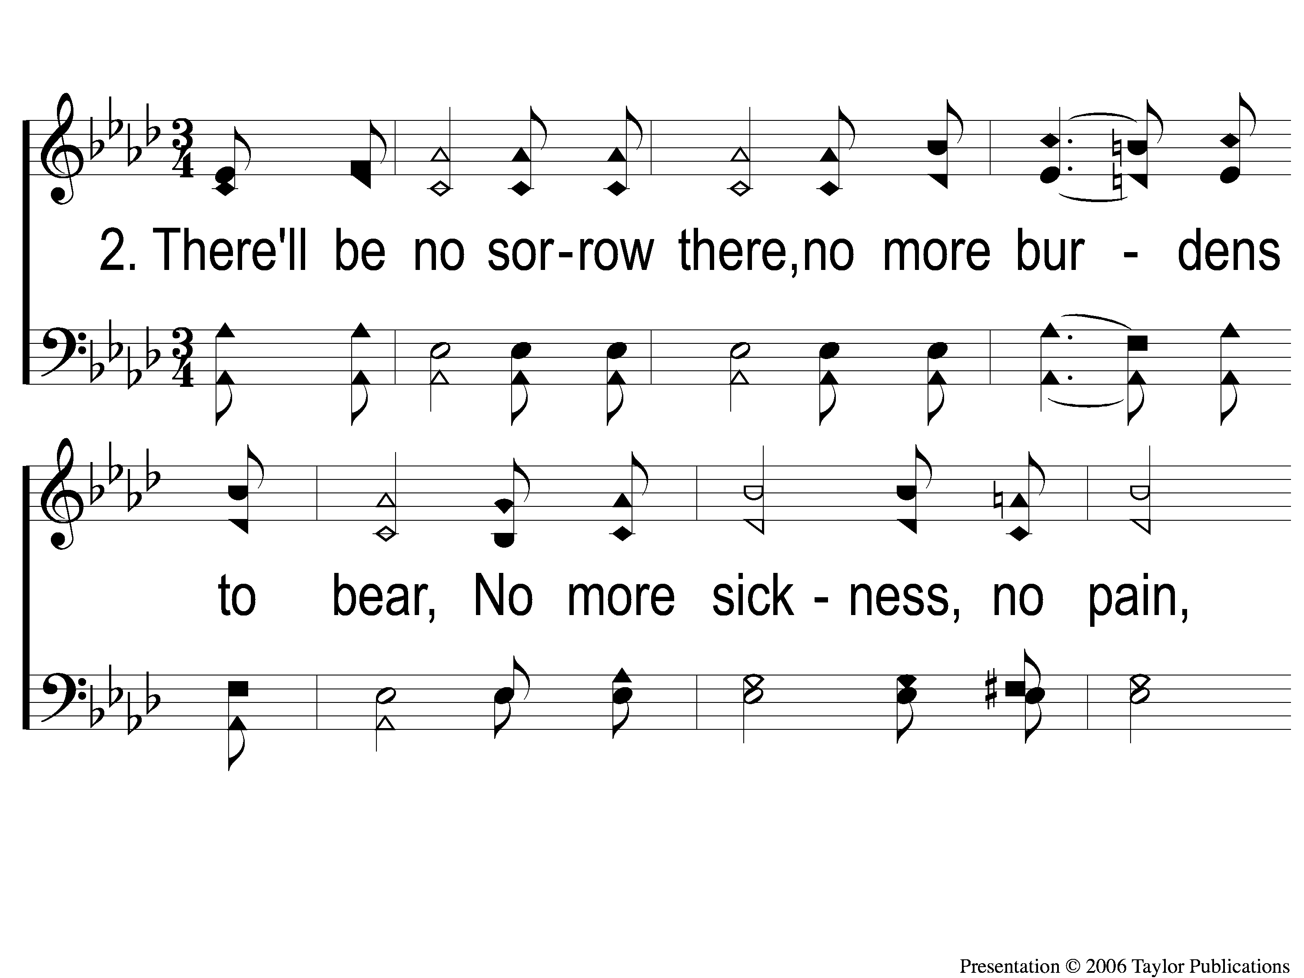
2-1 What a Day That Will Be
What a Day That Will Be
916

Slide 105
2-2 What a Day That Will Be
What a Day That Will Be
916

Slide 106
2-3 What a Day That Will Be
What a Day That Will Be
916

Slide 107
C-1 What a Day That Will Be
What a Day That Will Be
916

Slide 108
C-2 What a Day That Will Be
What a Day That Will Be
916

Slide 109
C-3 What a Day That Will Be
What a Day That Will Be
916

Slide 110
The Contribution:
1 John 3:16-17
“By this we know love, because He laid down His life for us. And we also ought to lay down our lives for the brethren. But whoever has this world’s goods, and sees his brother in need, and shuts up his heart from him, how does the love of God abide in him?”

Slide 111
Song:
Lamb Of God
#176

Slide 112
1-1 Lamb of God
Lamb of God
176

Slide 113
1-2 Lamb of God
Lamb of God
176

Slide 114
1-3 Lamb of God
Lamb of God
176

Slide 115
1-4 Lamb of God
Lamb of God
176

Slide 116
C-1 Lamb of God
Lamb of God
176

Slide 117
C-2 Lamb of God
Lamb of God
176

Slide 118
2-1 Lamb of God
Lamb of God
176

Slide 119
2-2 Lamb of God
Lamb of God
176

Slide 120
C-1 Lamb of God
Lamb of God
176

Slide 121
C-2 Lamb of God
Lamb of God
176

Slide 122
The Unleavened Bread
Hebrews 2:14-15
“Inasmuch then as the children have partaken of flesh and blood, He Himself likewise shared in the same, that through death He might destroy him who had the power of death, that is, the devil, and release those who through fear of death were all their lifetime subject to bondage.”

Slide 123
The Fruit
of the Vine
Hebrews 12:1-2
“Therefore we also, since we are surrounded by so great a cloud of witnesses, let us lay aside every weight, and the sin which so easily ensnares us, and let us run with endurance the race that is set before us, looking unto Jesus, the author and finisher of our faith, who for the joy that was set before Him endured the cross, despising the shame, and has sat down at the right hand of the throne of God.”

Slide 124
Closing Prayer

Slide 125
Song:
The Greatest Commands
#448

Slide 126
1-1 The Greatest Commands-SFP
The Greatest Commands
448

Slide 127
1-2 The Greatest Commands-SFP
The Greatest Commands
448

Slide 128
1-3 The Greatest Commands-SFP
The Greatest Commands
448

Slide 129
1-4 The Greatest Commands-SFP
The Greatest Commands
448

Slide 130
2-1 The Greatest Commands-SFP
The Greatest Commands
448

Slide 131
2-2 The Greatest Commands-SFP
The Greatest Commands
448

Slide 132
2-3 The Greatest Commands-SFP
The Greatest Commands
448

Slide 133
2-4 The Greatest Commands-SFP
The Greatest Commands
448

Slide 134
3-1 The Greatest Commands-SFP
The Greatest Commands
448

Slide 135
3-2 The Greatest Commands-SFP
The Greatest Commands
448

Slide 136
3-3 The Greatest Commands-SFP
The Greatest Commands
448

Slide 137
3-4 The Greatest Commands-SFP
The Greatest Commands
448

Slide 138
4-1 The Greatest Commands-SFP
The Greatest Commands
448

Slide 139
4-2 The Greatest Commands-SFP
The Greatest Commands
448

Slide 140
4-3 The Greatest Commands-SFP
The Greatest Commands
448

Slide 141
4-4 The Greatest Commands-SFP
The Greatest Commands
448

Slide 142
Today
Join us in the MPB for
A Fellowship Meal & Devo
Wednesday
Worship & Classes & 6:30 PM
RESTORE REBUILD RENEW
IN 2022
WHEELER
CHURCH
OF
CHRIST

Slide 143
tonight
Elders’ Meeting @ 5:30 PM
Worship @ 6:00 PM
Men’s Meeting After Worship
Wednesday
Worship & Classes & 6:30 PM
RESTORE REBUILD RENEW
IN 2022
WHEELER
CHURCH
OF
CHRIST

