Slide 1
WELCOME
THANKS FOR JOINING US!

Slide 2
1 We Shall Assemble
We Shall Assemble
718

Slide 3
2 We Shall Assemble
We Shall Assemble
718

Slide 4
3 We Shall Assemble
We Shall Assemble
718

Slide 5
4 We Shall Assemble
We Shall Assemble
718

Slide 6
WELCOME
THANKS FOR JOINING US!

Slide 7
#458
SONG:
Redeemed

Slide 8
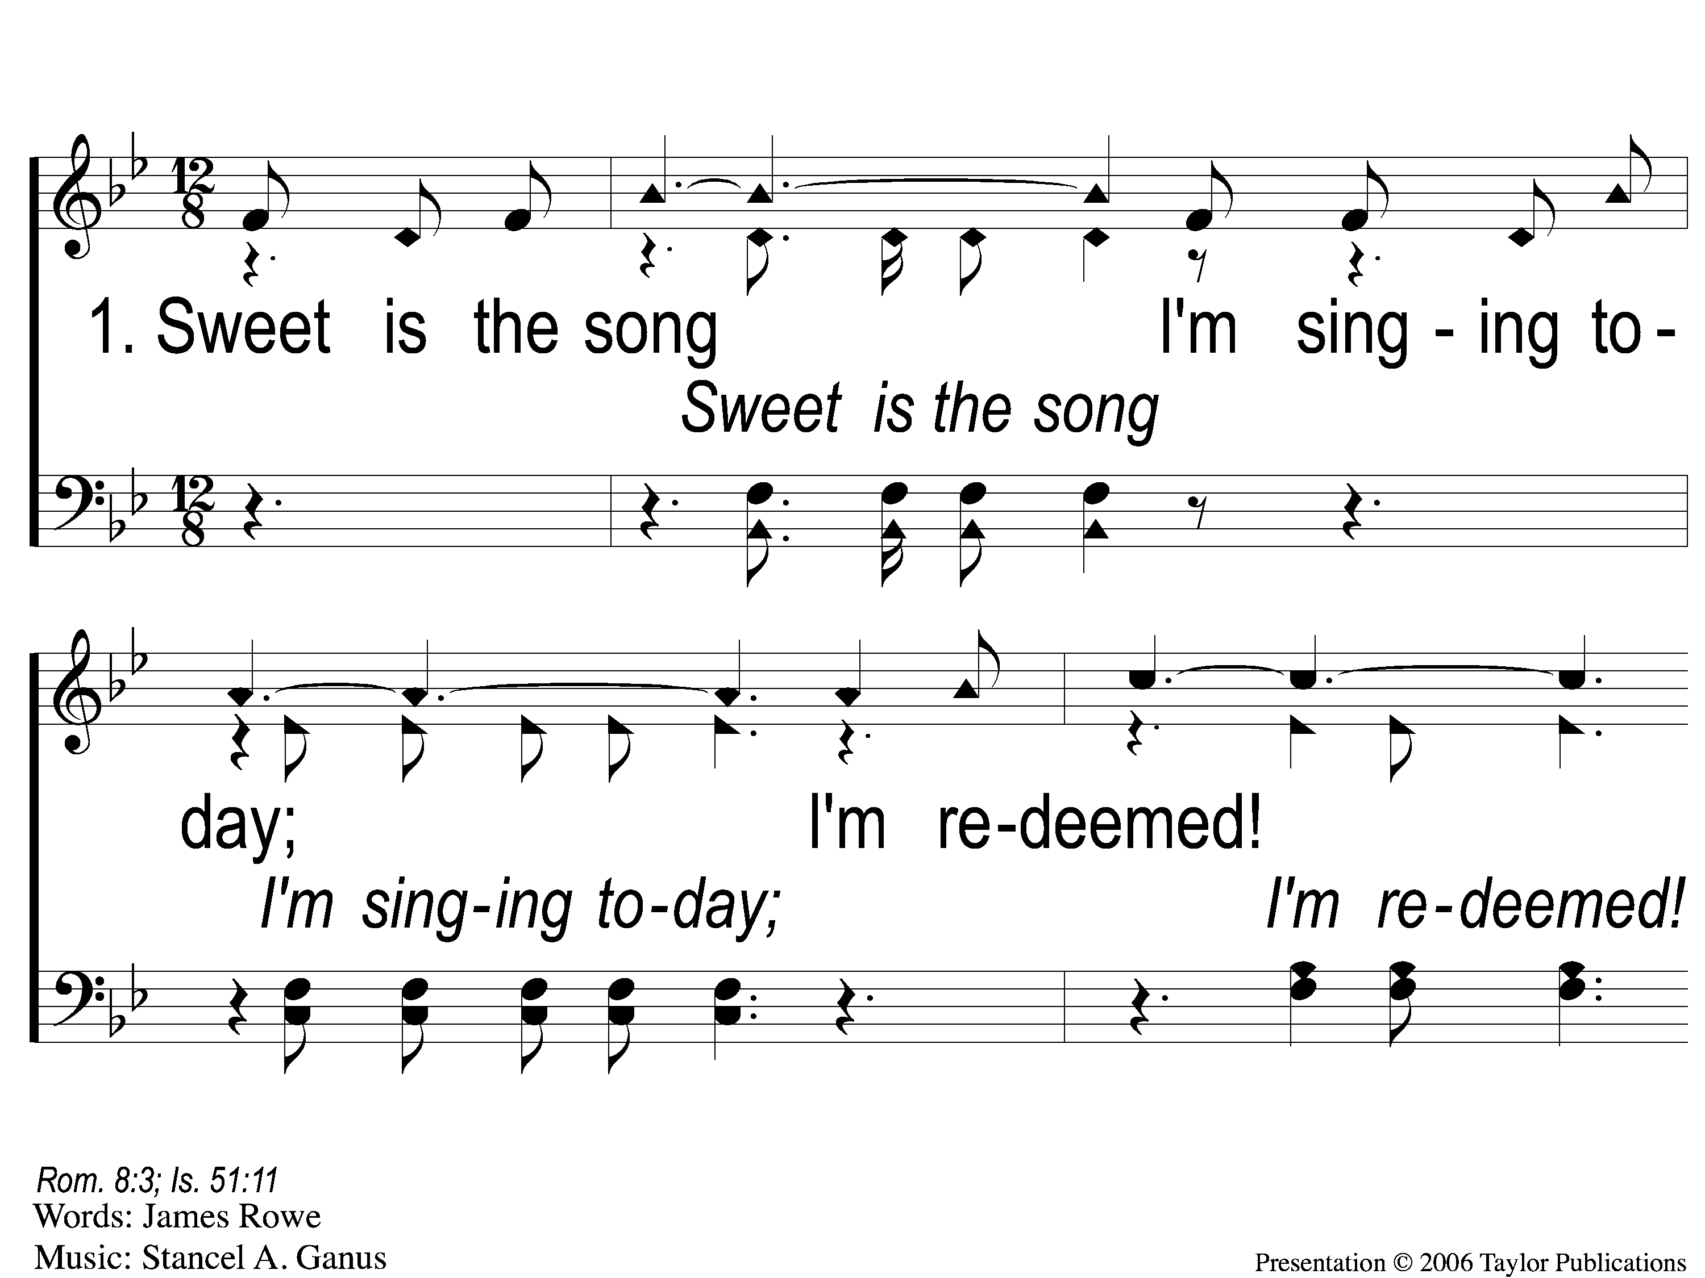
1-1 Redeemed - Sweet is the Song
Redeemed
458

Slide 9
1-2 Redeemed - Sweet is the Song
Redeemed
458

Slide 10
1-3 Redeemed - Sweet is the Song
Redeemed
458

Slide 11
C-1 Redeemed - Sweet is the Song
Redeemed
458

Slide 12
C-2 Redeemed - Sweet is the Song
Redeemed
458

Slide 13
3-1 Redeemed - Sweet is the Song
Redeemed
458

Slide 14
3-2 Redeemed - Sweet is the Song
Redeemed
458

Slide 15
3-3 Redeemed - Sweet is the Song
Redeemed
458

Slide 16
C-1 Redeemed - Sweet is the Song
Redeemed
458

Slide 17
C-2 Redeemed - Sweet is the Song
Redeemed
458

Slide 18
1 Blessed Jesus
Blessed Jesus
218

Slide 19
2 Blessed Jesus
Blessed Jesus
218

Slide 20
c Blessed Jesus
Blessed Jesus
218

Slide 21
3 Blessed Jesus
Blessed Jesus
218

Slide 22
c Blessed Jesus
Blessed Jesus
218

Slide 23
Opt tag Blessed Jesus
Blessed Jesus
218

Slide 24
273
SONG:
More Precious
Than Silver

Slide 25
1 More Precious Than Silver
More Precious Than Silver
273

Slide 26
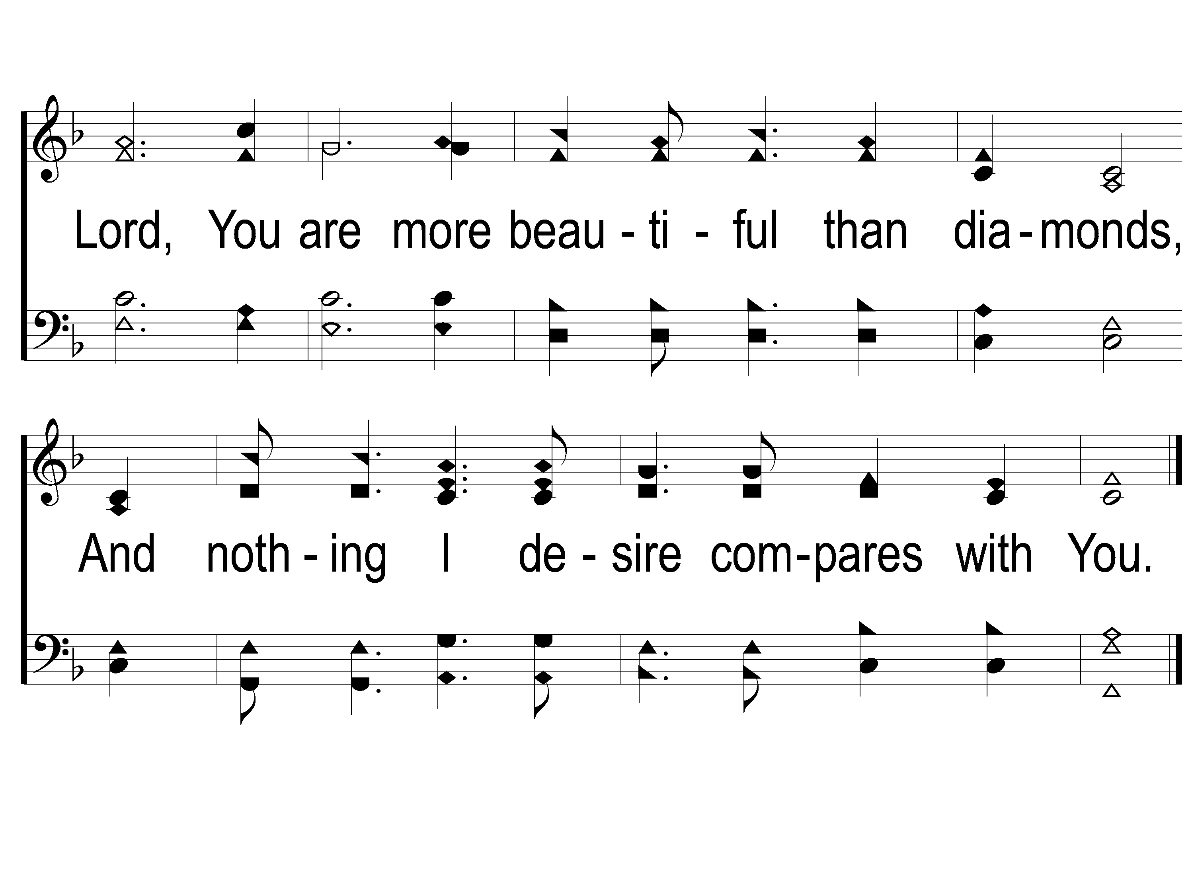
2 More Precious Than Silver
More Precious Than Silver
273

Slide 27
Opt Tag More Precious Than Silver
More Precious Than Silver
273

Slide 28
1 More Precious Than Silver
More Precious Than Silver
273

Slide 29
2 More Precious Than Silver
More Precious Than Silver
273

Slide 30
Opt Tag More Precious Than Silver
More Precious Than Silver
273

Slide 31
Opening PRAYER

Slide 32
SONG:
Create In Me
A Clean Heart

Slide 33
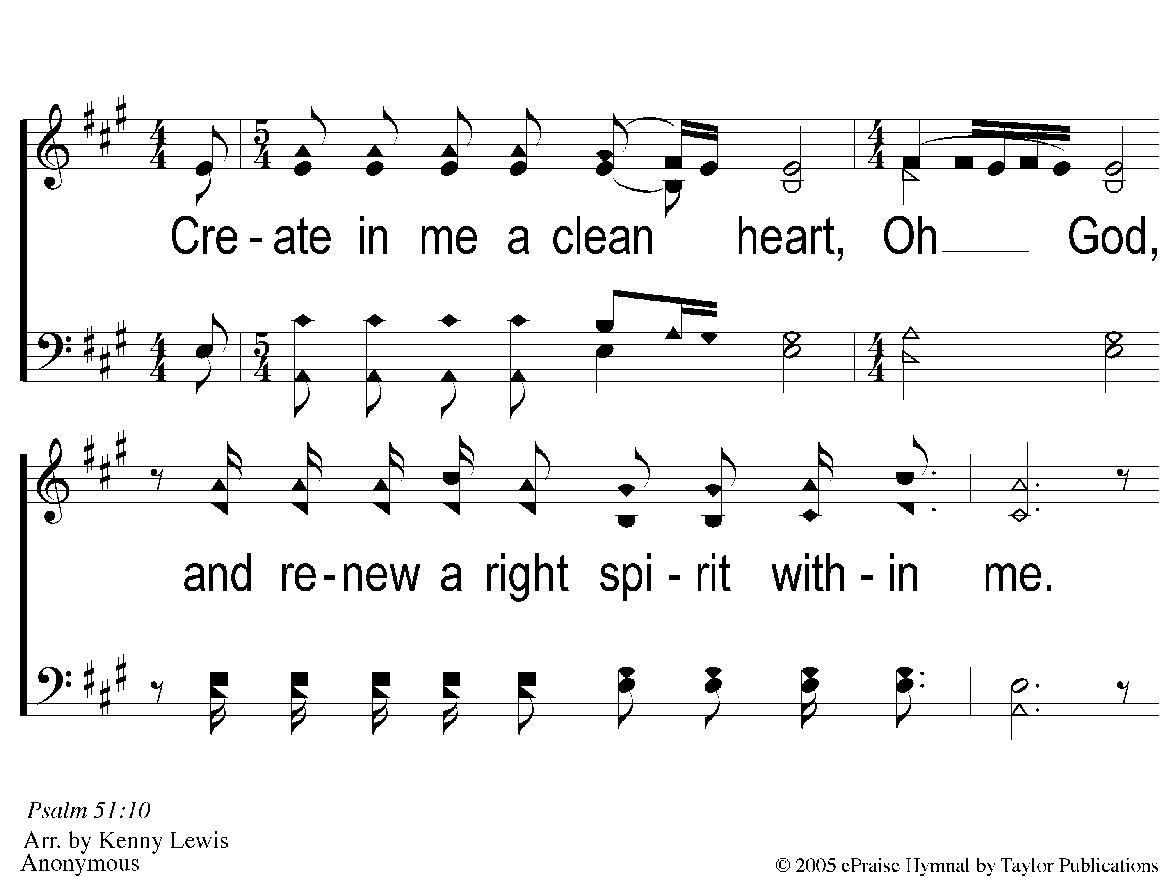
1 Create in Me
Create In Me A Clean Heart

Slide 34
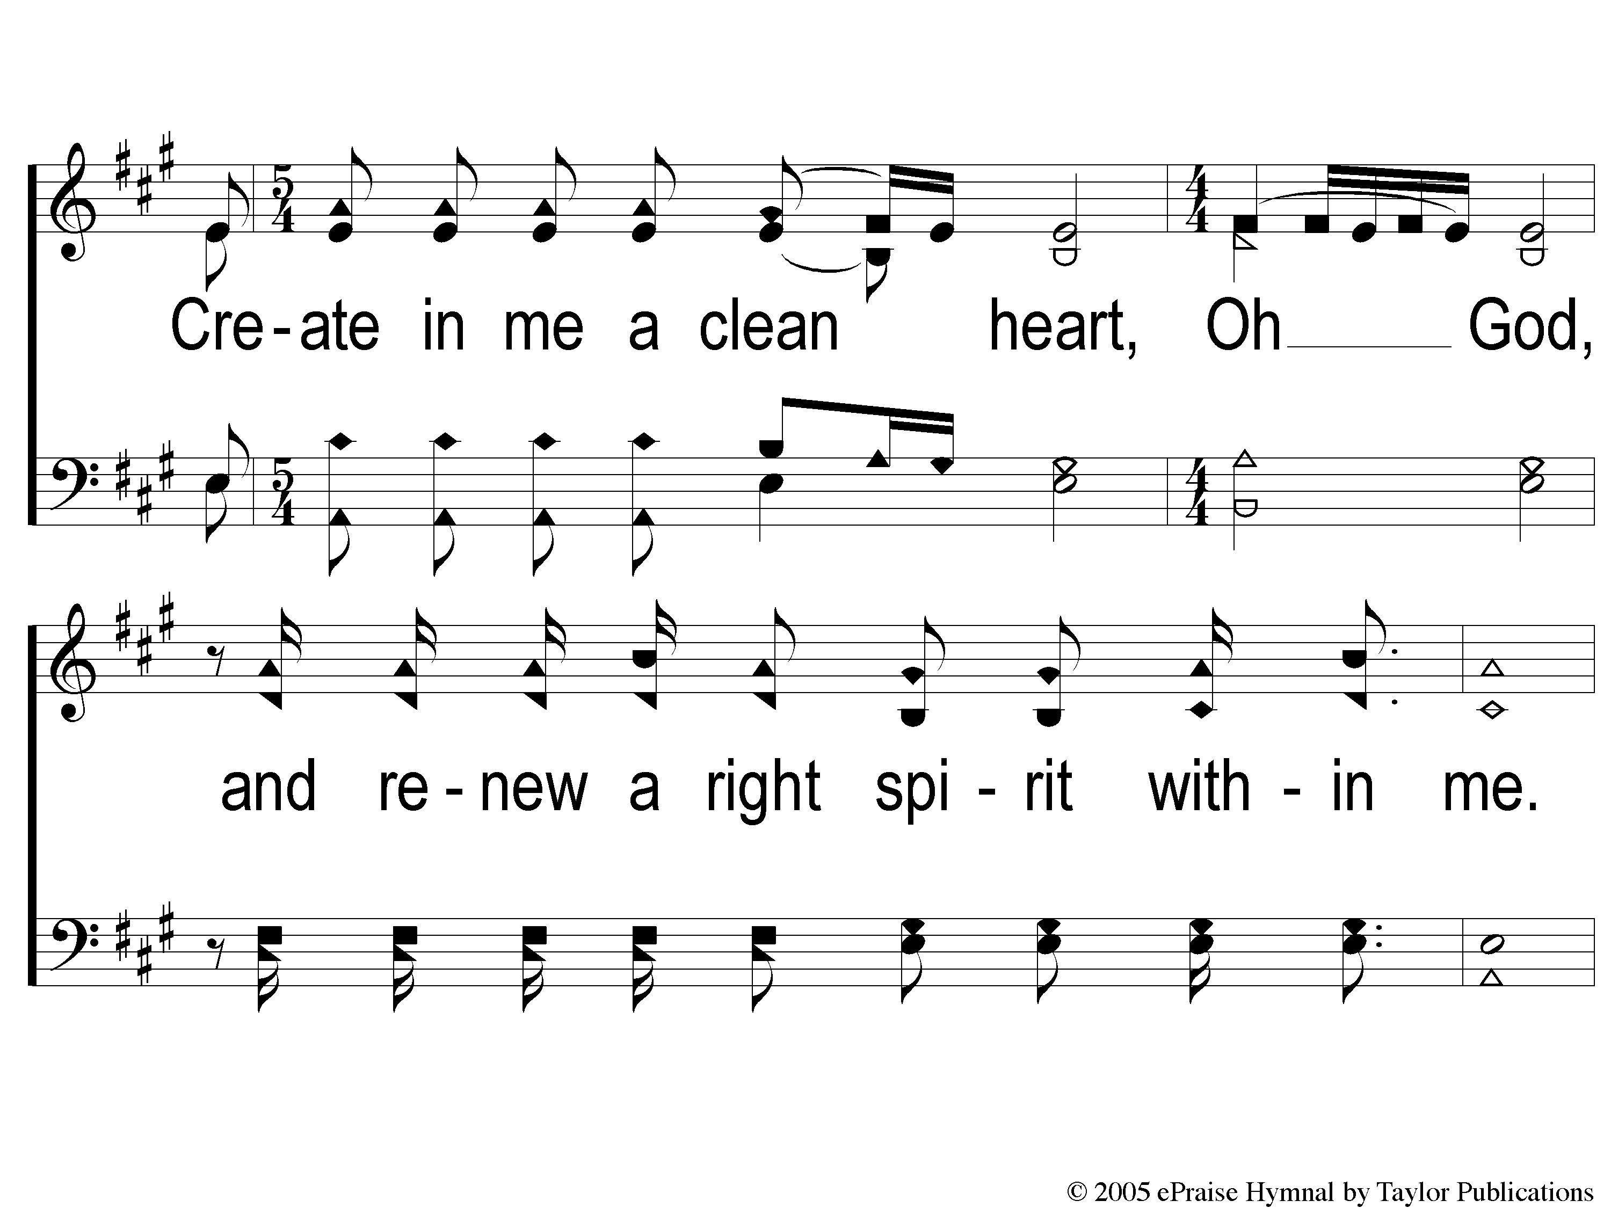
2 Create in Me
Create In Me A Clean Heart

Slide 35
3 Create in Me
Create In Me A Clean Heart

Slide 36
4 Create in Me
Create In Me A Clean Heart

Slide 37
#648
SONG:
Stand Up,
Stand Up For Jesus

Slide 38
1-1 Stand up Stand Up for Jesus
Stand Up, Stand Up For Jesus
648

Slide 39
1-2 Stand up Stand Up for Jesus
Stand Up, Stand Up For Jesus
648

Slide 40
2-1 Stand up Stand Up for Jesus
Stand Up, Stand Up For Jesus
648

Slide 41
2-2 Stand up Stand Up for Jesus
Stand Up, Stand Up For Jesus
648

Slide 42
2-3 Stand up Stand Up for Jesus
Stand Up, Stand Up For Jesus
648

Slide 43
4-1 Stand up Stand Up for Jesus
Stand Up, Stand Up For Jesus
648

Slide 44
4-2 Stand up Stand Up for Jesus
Stand Up, Stand Up For Jesus
648

Slide 45
SCRIPTURE:
John 18:1-5

Slide 47
WATCH WHERE YOU STAND

Slide 48
WATCH WHO YOU STAND
WITH

Slide 49
THE PLACE

Slide 50
THE PLACE
The Garden Of Gethsemane

Slide 51
THE PLACE
The Garden Of Gethsemane
Gethsemane = olive/oil press

Slide 52
THE PLACE
The Garden Of Gethsemane
Gethsemane = olive/oil press
On the “Mount of Olives” (Mt. 26:30)

Slide 53
THE PLACE
The Garden Of Gethsemane
Gethsemane = olive/oil press
On the “Mount of Olives” (Mt. 26:30)
Place of refuge, rest, & prayer

Slide 54
THE PEOPLE

Slide 55
THE PEOPLE
Judas Iscariot

Slide 56
THE PEOPLE
Judas Iscariot
One of “the twelve” chosen by Christ

Slide 57
THE PEOPLE
Judas Iscariot
One of “the twelve” chosen by Christ
Keeper of the treasury (Jn. 12:6)

Slide 58
THE PEOPLE
Judas Iscariot
One of “the twelve” chosen by Christ
Keeper of the treasury (Jn. 12:6)
Let sin ensnare him (Jn. 13:2)

Slide 59
THE PEOPLE
Those Whom Judas Was Among

Slide 60
THE PEOPLE
Those Whom Judas Was Among
Detachment of Troops = 600 Soldiers

Slide 61
THE PEOPLE
Those Whom Judas Was Among
Detachment of Troops = 600 Soldiers
Officers of the Chief Priests

Slide 62
THE PEOPLE
Those Whom Judas Was Among
Detachment of Troops = 600 Soldiers
Officers of the Chief Priests
With Weapons (Mt. 26:47)

Slide 63
THE PLOT
Jesus Is Betrayed

Slide 64
THE PLOT
Jesus Is Betrayed
Judas leads them to Jesus

Slide 65
THE PLOT
Jesus Is Betrayed
Judas leads them to Jesus
Jesus is put on trial

Slide 66
THE PLOT
Jesus Is Betrayed
Judas leads them to Jesus
Jesus is put on trial
Judas shows slight remorse

Slide 67
THE QUESTION
Who Are You
Standing With?

Slide 68
SONG:
Father God,
Just For Today

Slide 69
1-1 Father God
Father God, Just For Today

Slide 70
1-2 Father God
Father God, Just For Today

Slide 71
1C-1 Father God
Father God, Just For Today

Slide 72
1C-2 Father God
Father God, Just For Today

Slide 73
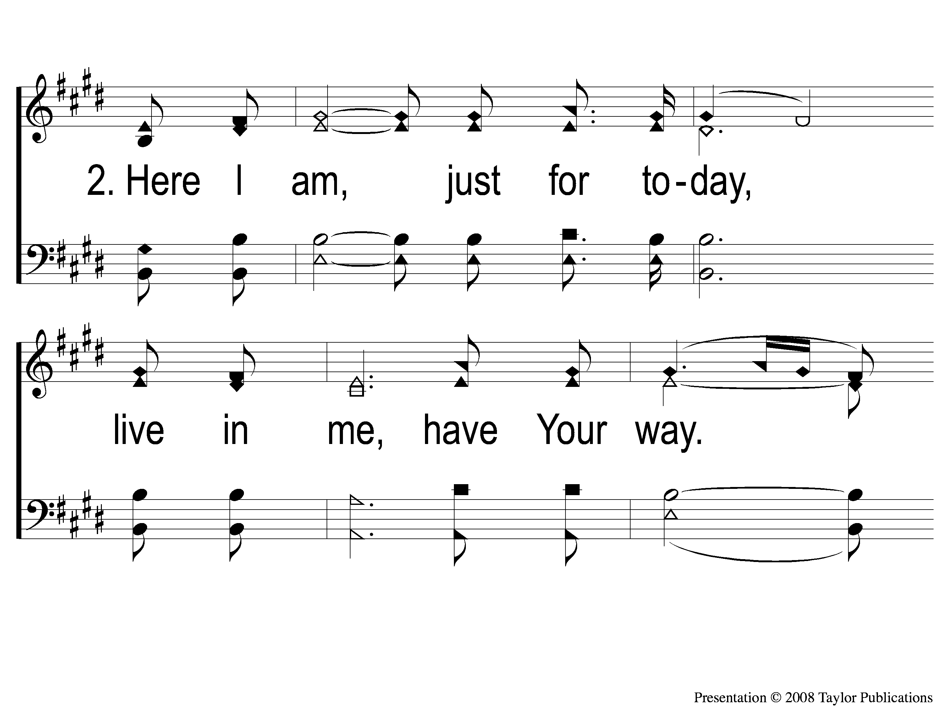
2-1 Father God
Father God, Just For Today

Slide 74
2-2 Father God
Father God, Just For Today

Slide 75
2C-1 Father God
Father God, Just For Today

Slide 76
2C-2 Father God
Father God, Just For Today

Slide 77
#176
SONG:
Lamb of God

Slide 78
1-1 Lamb of God
Lamb of God
176

Slide 79
1-2 Lamb of God
Lamb of God
176

Slide 80
1-3 Lamb of God
Lamb of God
176

Slide 81
1-4 Lamb of God
Lamb of God
176

Slide 82
C-1 Lamb of God
Lamb of God
176

Slide 83
C-2 Lamb of God
Lamb of God
176

Slide 84
2-1 Lamb of God
Lamb of God
176

Slide 85
2-2 Lamb of God
Lamb of God
176

Slide 86
C-1 Lamb of God
Lamb of God
176

Slide 87
C-2 Lamb of God
Lamb of God
176

Slide 88
LORD’S SUPPER
The
Acts 20:7

Slide 89
Unleavened Bread
LORD’S SUPPER
Therefore remember that you, once Gentiles in the flesh—who are called Uncircumcision by what is called the Circumcision made in the flesh by hands— that at that time you were without Christ, being aliens from the commonwealth of Israel and strangers from the covenants of promise, having no hope and without God in the world. But now in Christ Jesus you who once were far off have been brought near by the blood of Christ.
Eph. 5:11-13

Slide 90
Fruit of the Vine
LORD’S SUPPER
In Him we have redemption through His blood, the forgiveness of sins, according to the riches of His grace which He made to abound toward us in all wisdom and prudence, having made known to us the mystery of His will, according to His good pleasure which He purposed in Himself, that in the dispensation of the fullness of the times He might gather together in one ^{p}all things in Christ, ³both which are in heaven and which are on earth—in Him.
Eph. 1:7-10

Slide 91
1 Peter 4:10
OFFERING
As each one has received a gift, minister it to one another, as good stewards of the manifold grace of God.

Slide 92
Closing PRAYER

Slide 93
SONG:
Sweet Beulah Land

Slide 94
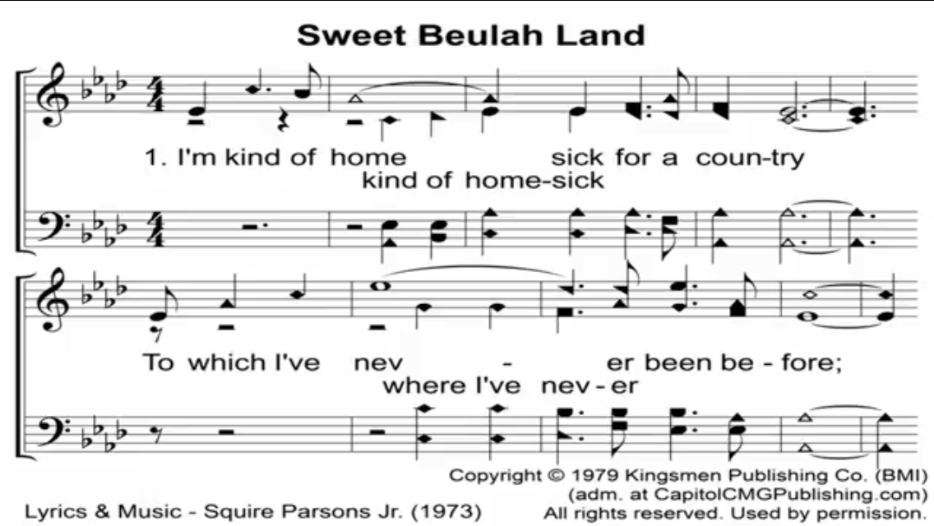

Slide 95
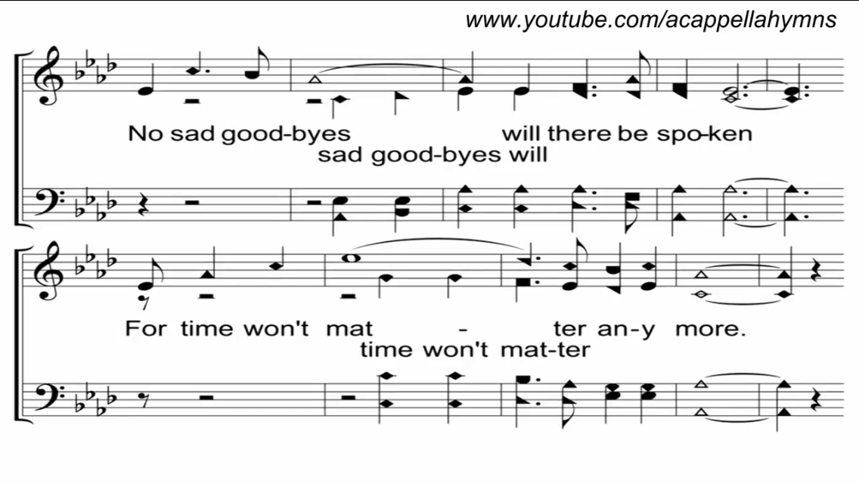

Slide 96
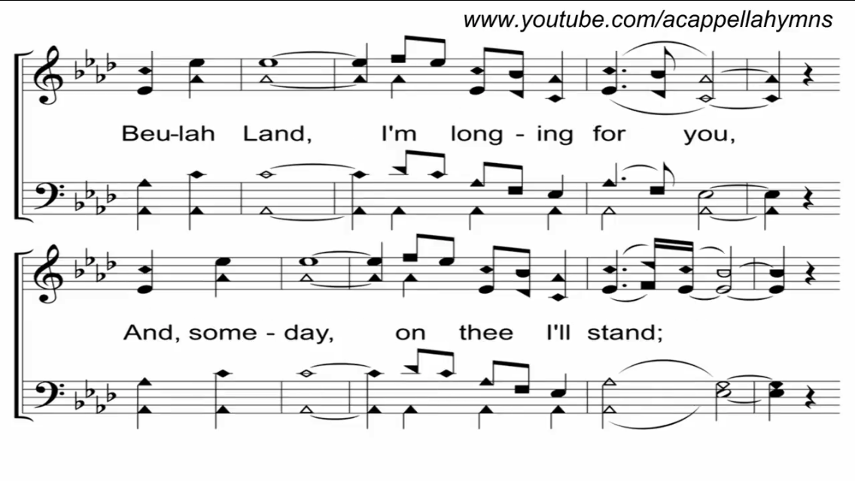

Slide 97
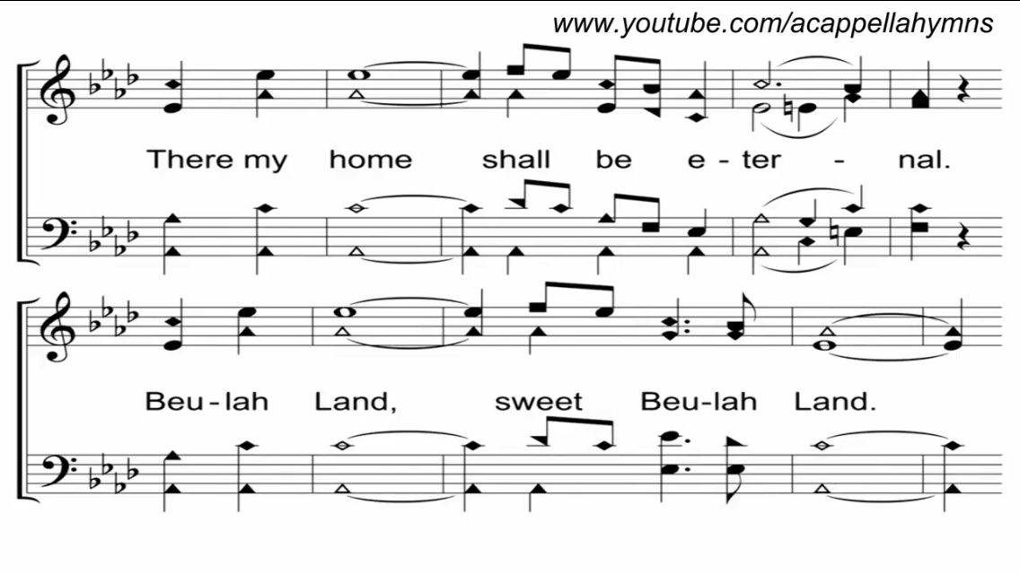

Slide 98
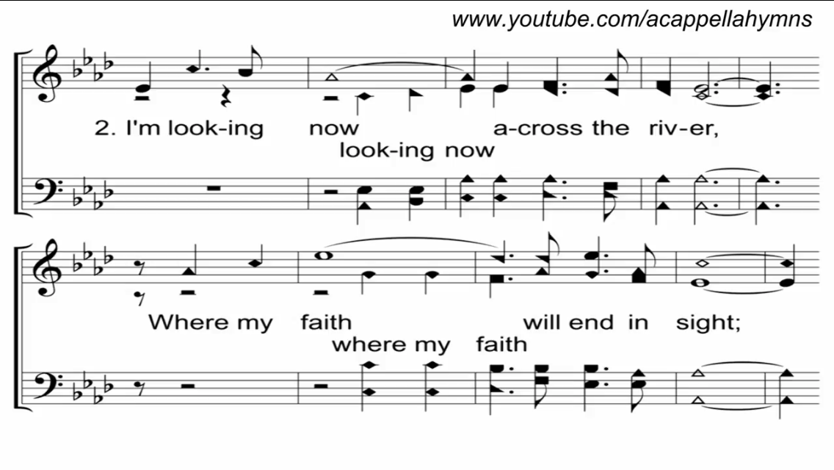

Slide 99
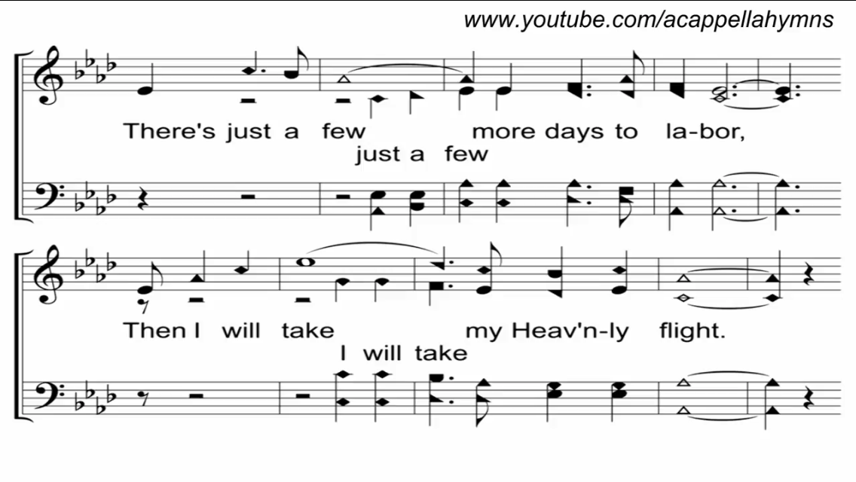

Slide 102
TONIGHT @ 6:00 pm
EVENING WORSHIP
HOPE TO SEE YOU THERE!

Slide 103
THE PRINCIPLE
God Condemns Idleness
Old Testament:
Eccl. 10:18
Prov. 14:23, 19:15, 31:27
Ezek. 16:49

Slide 104
THE PRINCIPLE
God Condemns Idleness
New Testament:
1 Tim. 1:6, 5:13, 6:20
2 Tim. 2:16
Titus 1:10
Matt. 20:3ff

Slide 105
THE APPLICATION
We Must Not Be Idle
In Works
Acts 1:11
Matt. 28:18-20

Slide 106
THE APPLICATION
We Must Not Be Idle
In Giving To Good Works
1 Tim. 6:18
Rom. 12:13

