Slide 1
WELCOME
THANKS FOR JOINING US!

Slide 2
Songs of
Praise to God

Slide 3
Opening PRAYER

Slide 4
Songs of
Praise to God

Slide 5
WATCH WHERE YOU STAND

Slide 6
WATCH
WHO YOU
STAND WITH
John 18:1-11

Slide 7
WATCH WHAT YOU STAND FOR
John 8:39-47

Slide 8
THE PLACE
From the Mount of Olives
Jn. 8:1

Slide 9
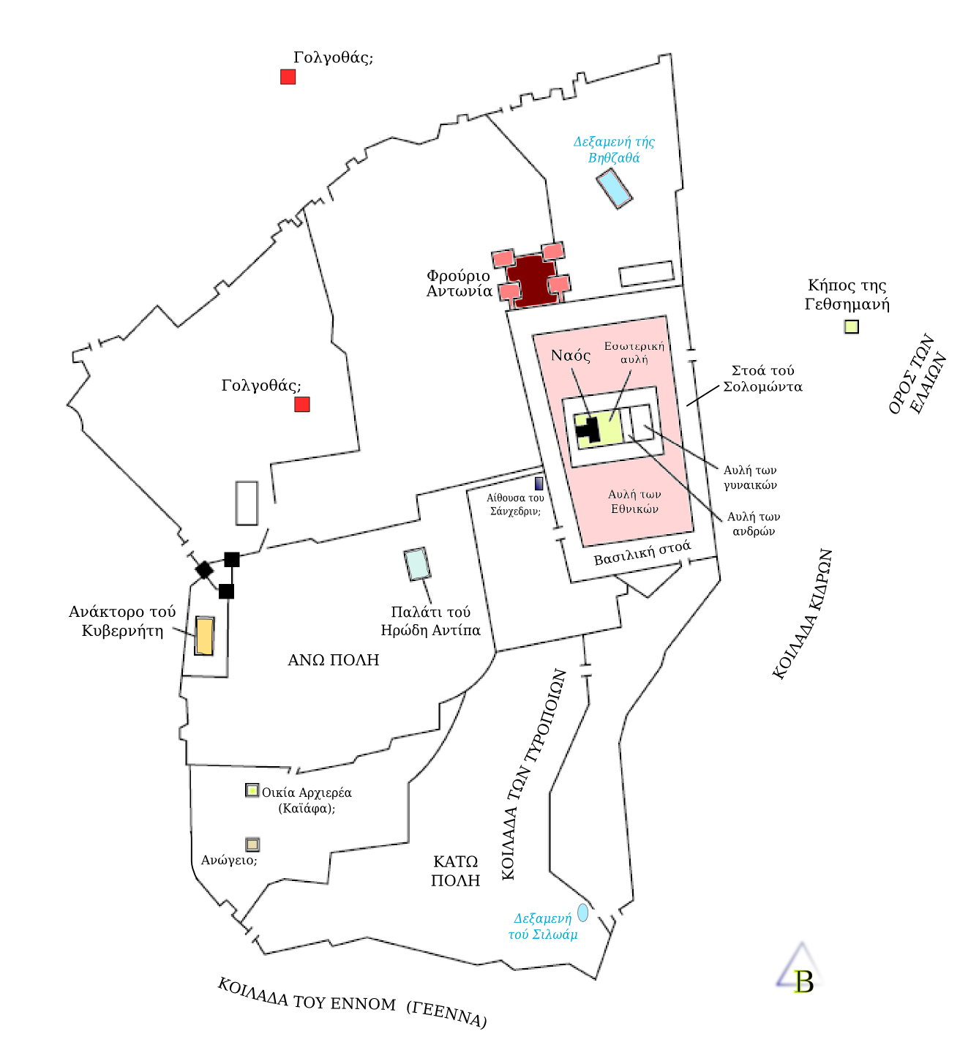

Slide 15
THE PLACE
The Temple

Slide 16
THE PLACE
The Temple
Jn. 2:14-15 – First Cleansing

Slide 17
THE PLACE
The Temple
Jn. 2:14-15 – First Cleansing
Jn. 7:14 – Teaching during Feast of Booths

Slide 18
THE PROVOKING
Pharisees Test Him (v. 3-11)
No intention to learn from Him

Slide 19
THE PROVOKING
Pharisees Test Him (v. 3-11)
No intention to learn from Him
“Test” = trap, cause to stumble

Slide 20
THE PROVOKING
Pharisees Test Him (v. 3-11)
No intention to learn from Him
“Test” = trap, cause to stumble
v. 11 – “go and sin no more”

Slide 21
THE PROBLEMS
A Question of Fatherhood (v. 12-59)

Slide 22
THE PROBLEMS
A Question of Fatherhood (v. 12-59)
Jesus’ Identity Questioned (v. 25)

Slide 23
THE PROBLEMS
A Question of Fatherhood (v. 12-59)
Jesus’ Identity Questioned (v. 25)
Jews’ Identity Questioned (v. 39)

Slide 24
THE QUESTION
What Are You
Standing For?

Slide 25
Invitation Song

Slide 26
Songs of
Praise to God

Slide 27
The Lord’s Supper

Slide 28
Closing PRAYER

Slide 29
Closing Song

Slide 30
Family Meal This WEDNESDAY @ 6:30 pm
JOIN US FOR OUR
In the MPB

