Slide 1
1-1 Just Over in the Glory Land
Just Over in the Glory Land

Slide 2
1-2 Just Over in the Glory Land
Just Over in the Glory Land

Slide 3
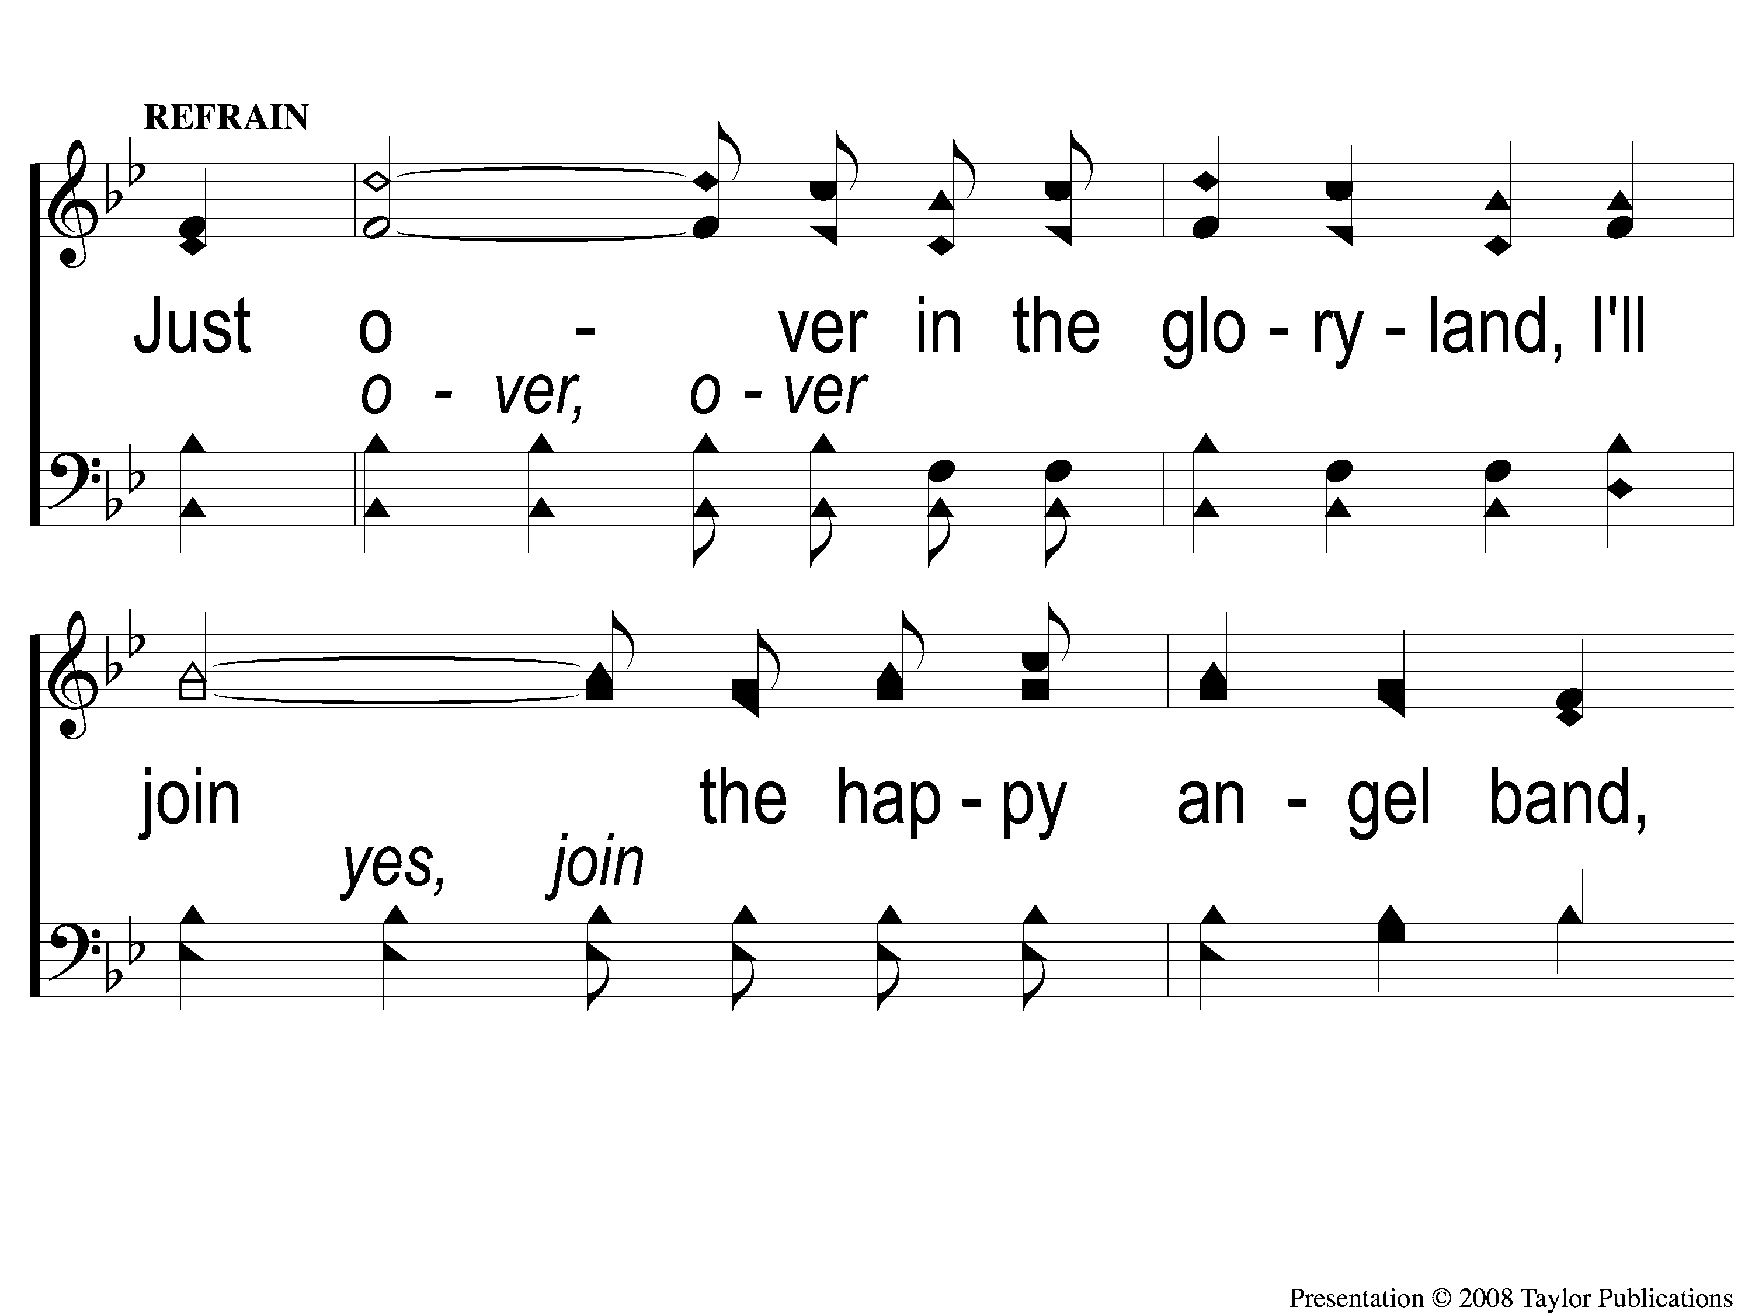
C-1 Just Over in the Glory Land
Just Over in the Glory Land

Slide 4
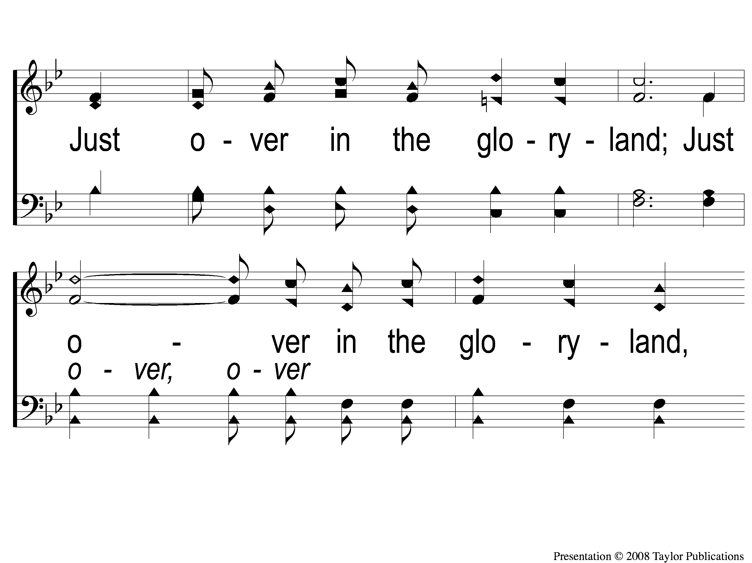
C-2 Just Over in the Glory Land
Just Over in the Glory Land

Slide 5
C-3 Just Over in the Glory Land
Just Over in the Glory Land

Slide 6
2-1 Just Over in the Glory Land
Just Over in the Glory Land

Slide 7
2-2 Just Over in the Glory Land
Just Over in the Glory Land

Slide 8
C-1 Just Over in the Glory Land
Just Over in the Glory Land

Slide 9
C-2 Just Over in the Glory Land
Just Over in the Glory Land

Slide 10
C-3 Just Over in the Glory Land
Just Over in the Glory Land

Slide 11
4-1 Just Over in the Glory Land
Just Over in the Glory Land

Slide 12
4-2 Just Over in the Glory Land
Just Over in the Glory Land

Slide 13
C-1 Just Over in the Glory Land
Just Over in the Glory Land

Slide 14
C-2 Just Over in the Glory Land
Just Over in the Glory Land

Slide 15
C-3 Just Over in the Glory Land
Just Over in the Glory Land

Slide 16
RESTORE REBUILD RENEW
welcome
we are glad to
Have you with us
IN 2022
WHEELER
CHURCH
OF
CHRIST

Slide 17
Song:
I Love To Tell The Story
#659

Slide 18
1-1 I Love to Tell the Story
I Love To Tell the Story
659

Slide 19
1-2 I Love to Tell the Story
I Love To Tell the Story
659

Slide 20
C-2 I Love to Tell the Story
I Love To Tell the Story
659

Slide 21
2-1 I Love to Tell the Story
I Love To Tell the Story
659

Slide 22
2-2 I Love to Tell the Story
I Love To Tell the Story
659

Slide 23
C-2 I Love to Tell the Story
I Love To Tell the Story
659

Slide 24
4-1 I Love to Tell the Story
I Love To Tell the Story
659

Slide 25
4-2 I Love to Tell the Story
I Love To Tell the Story
659

Slide 26
C-2 I Love to Tell the Story
I Love To Tell the Story
659

Slide 27
Song:
Sweet Hour Of Prayer
#827

Slide 28
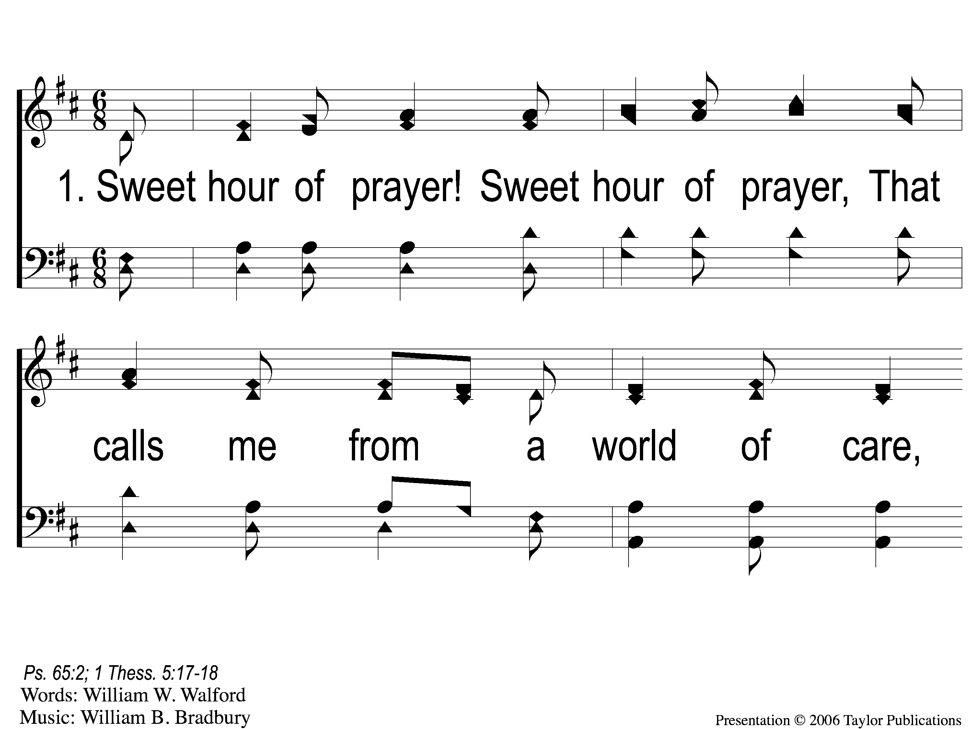
1-1 Sweet Hour of Prayer
Sweet Hour of Prayer
827

Slide 29
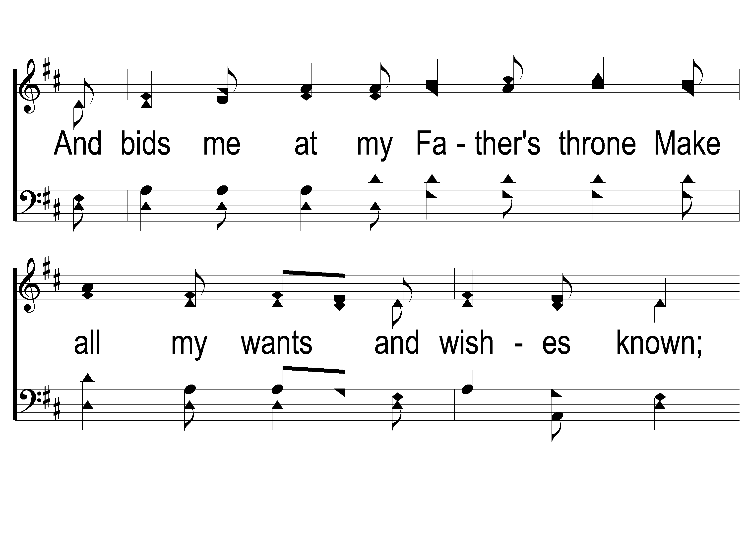
1-2 Sweet Hour of Prayer
Sweet Hour of Prayer
827

Slide 30
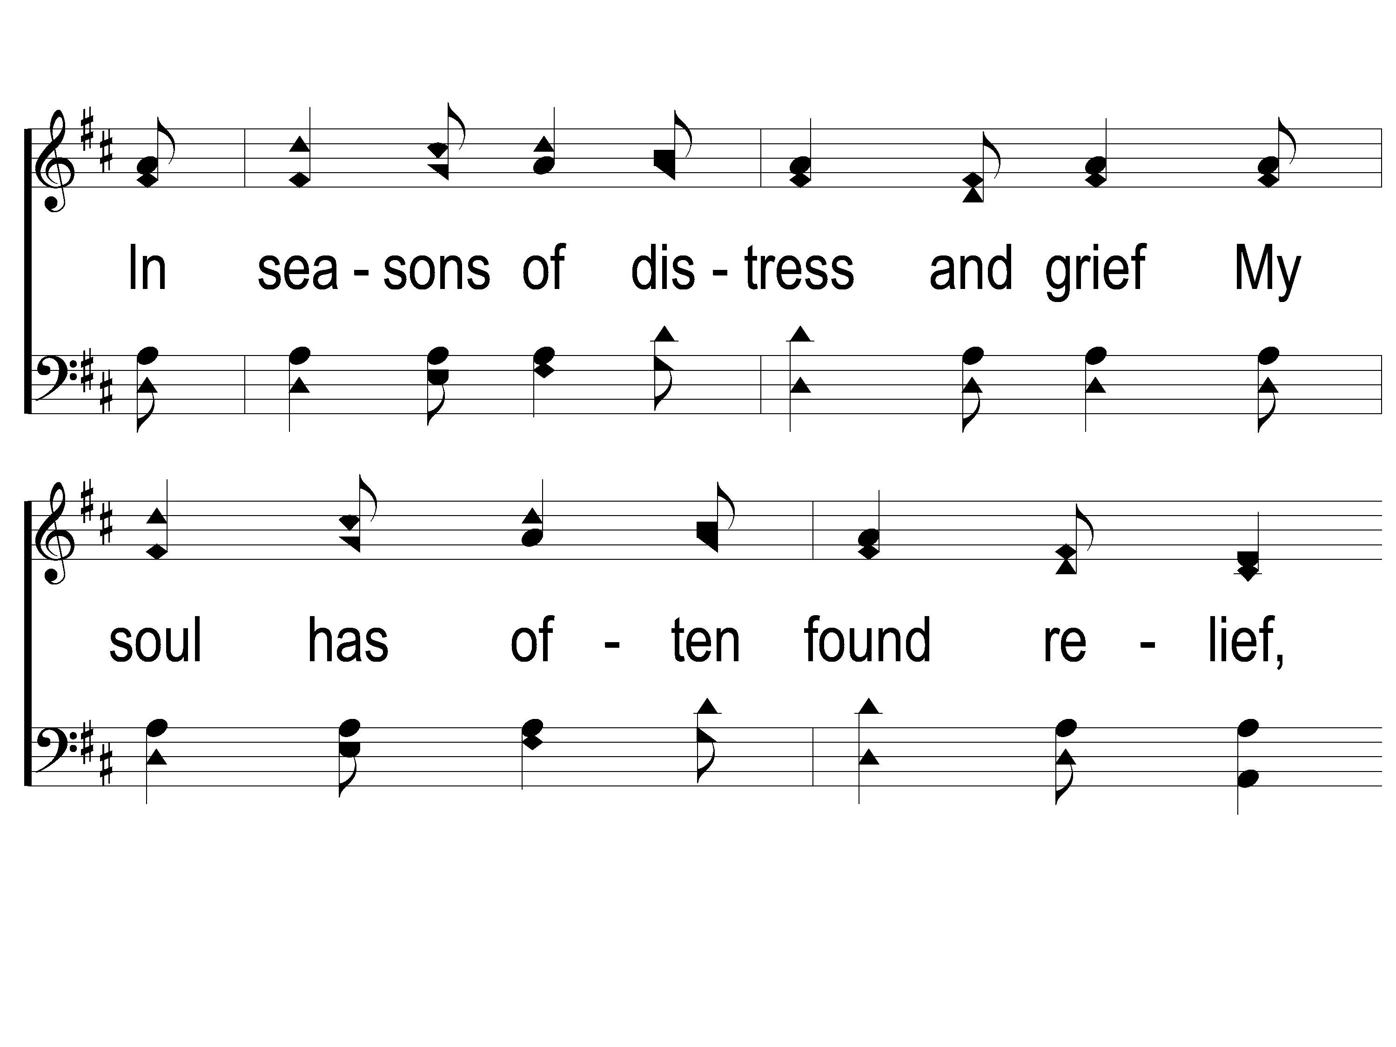
1-3 Sweet Hour of Prayer
Sweet Hour of Prayer
827

Slide 31
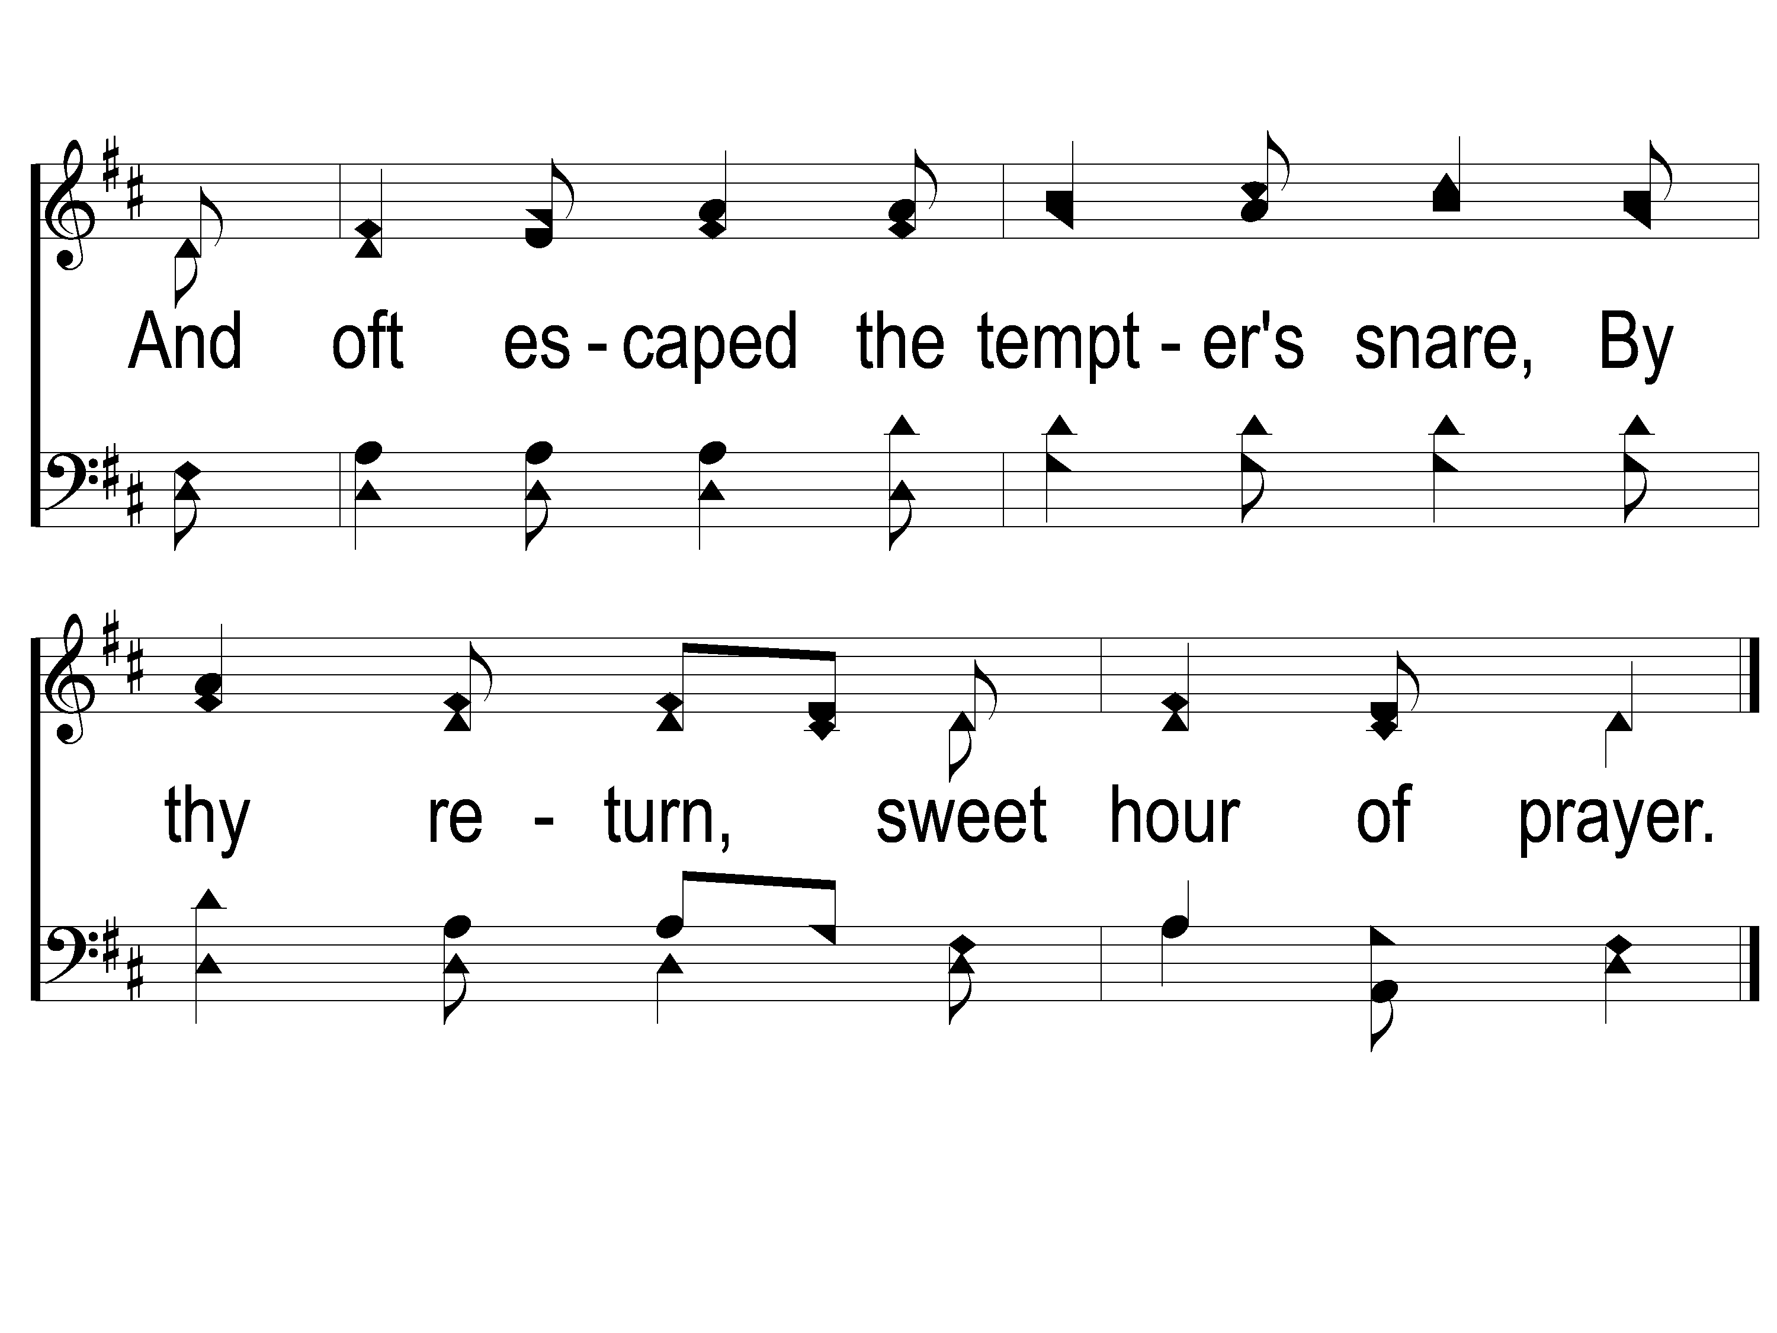
1-4 Sweet Hour of Prayer
Sweet Hour of Prayer
827

Slide 32
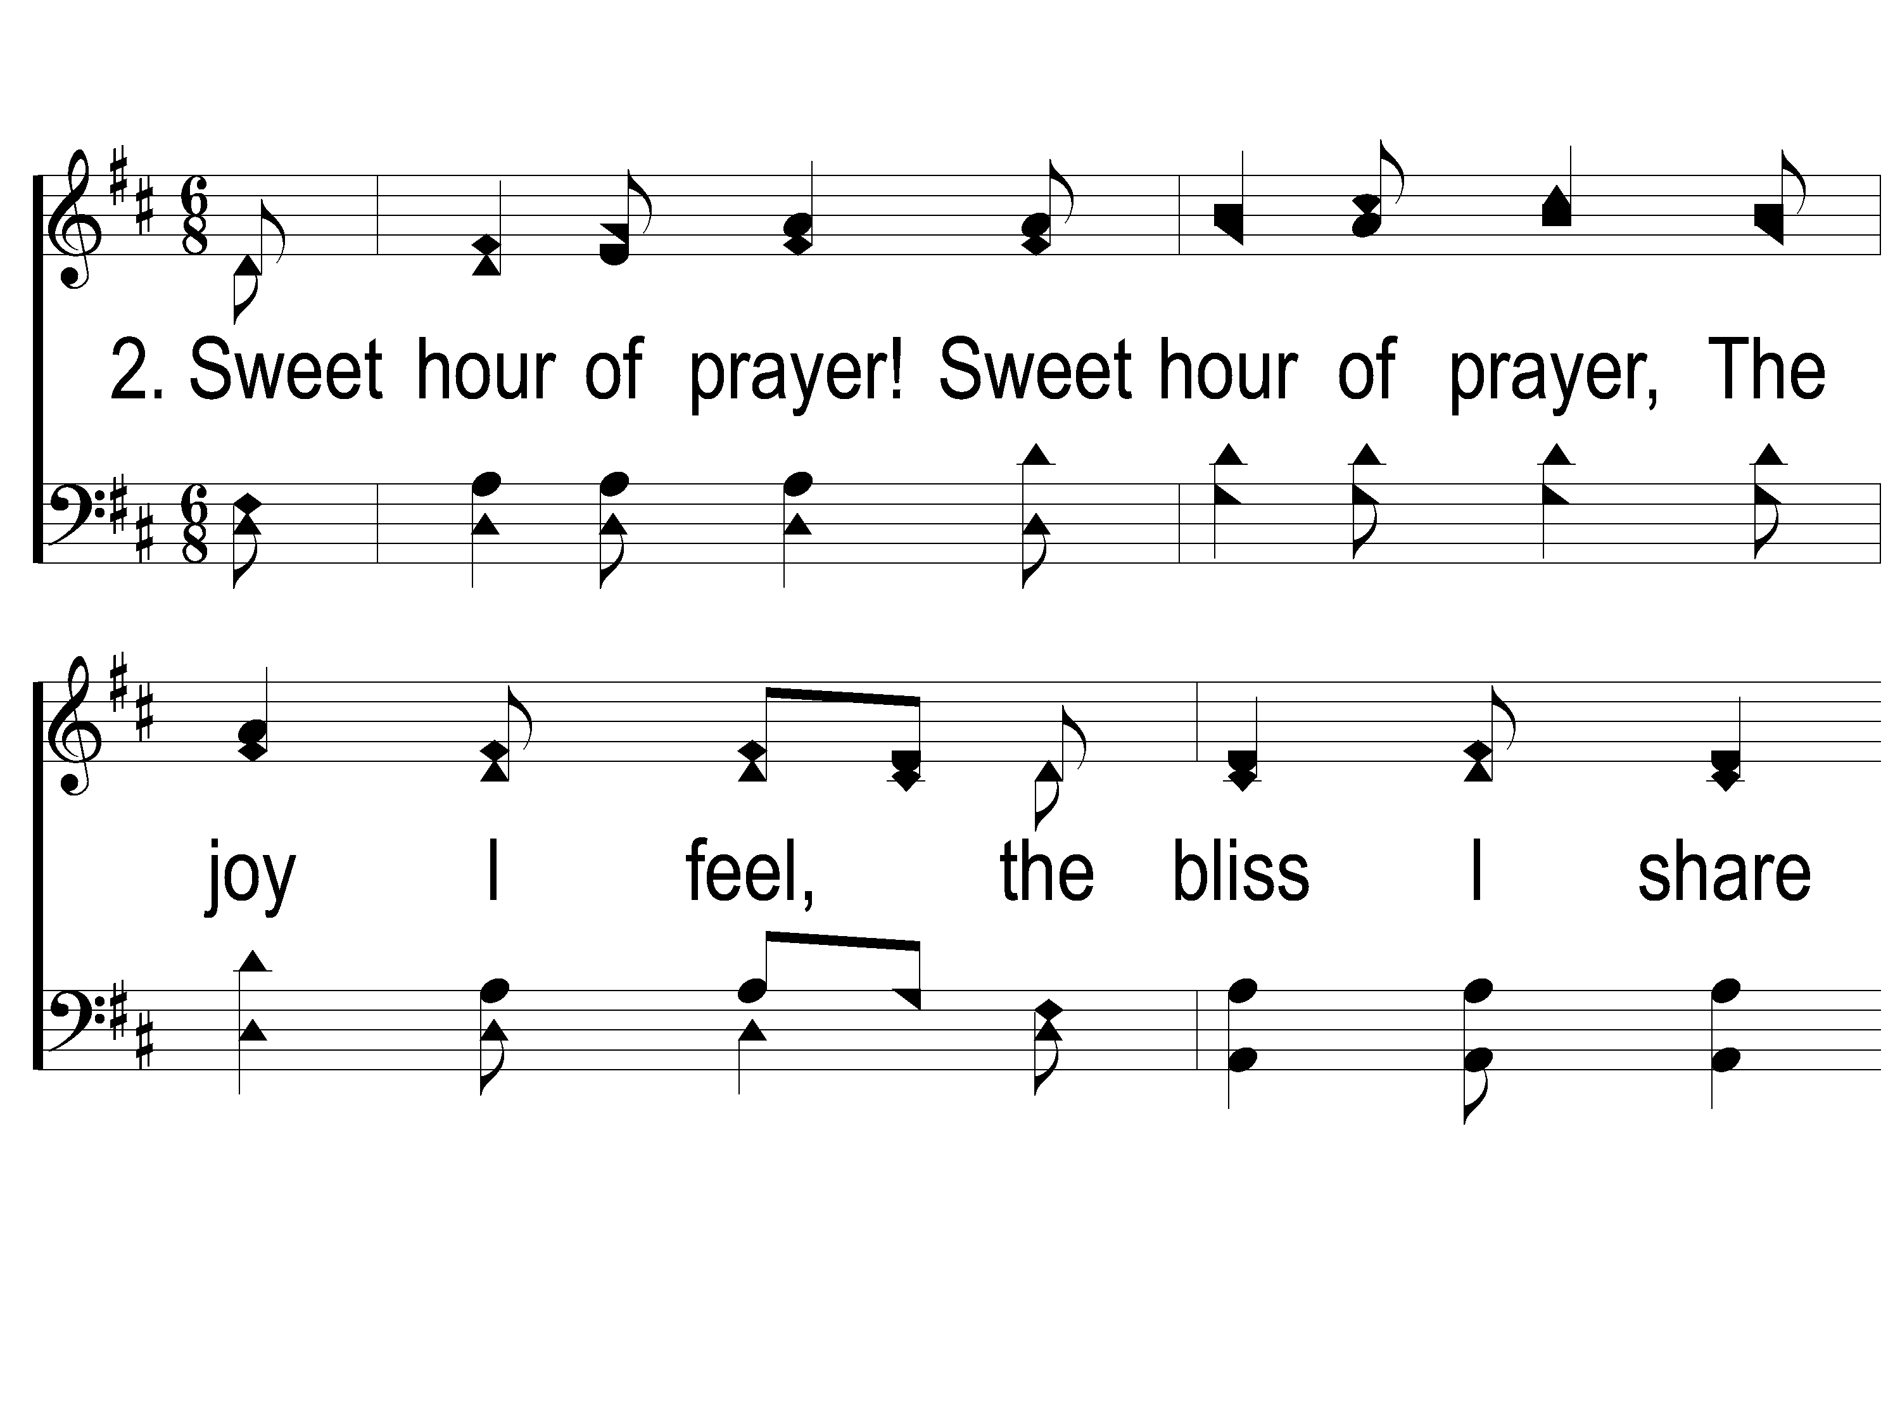
2-1 Sweet Hour of Prayer
Sweet Hour of Prayer
827

Slide 33
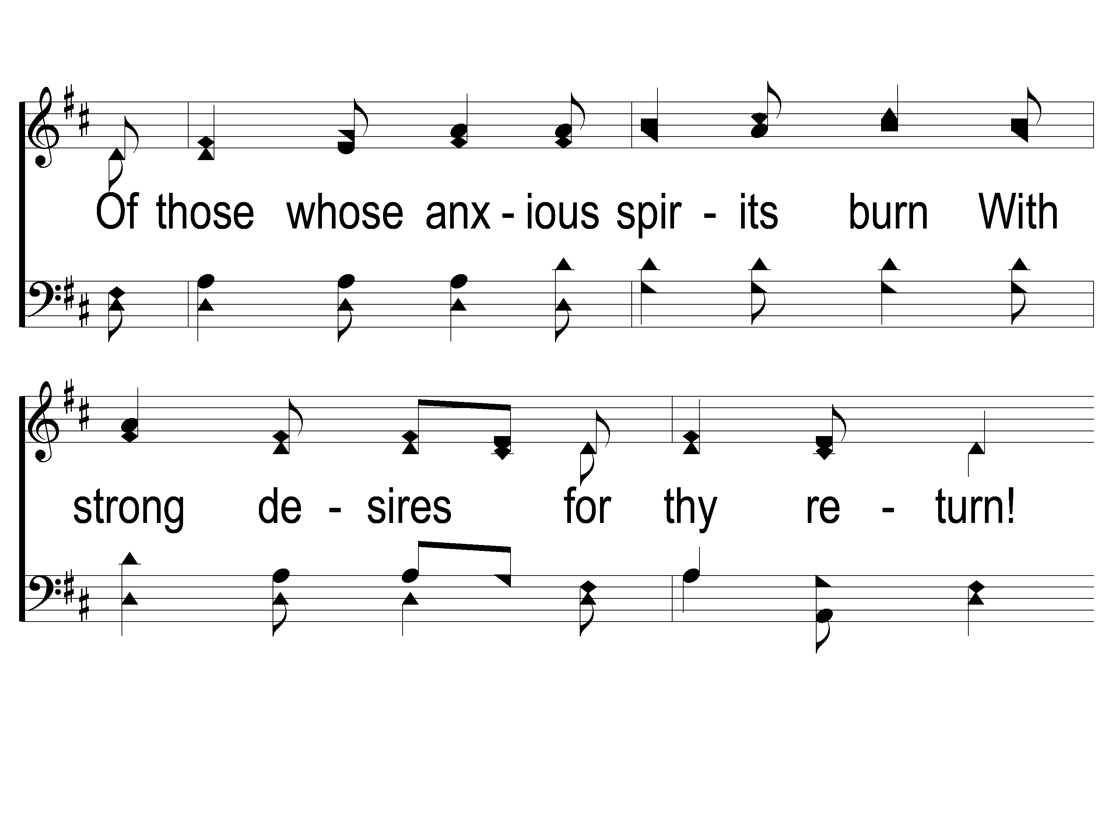
2-2 Sweet Hour of Prayer
Sweet Hour of Prayer
827

Slide 34
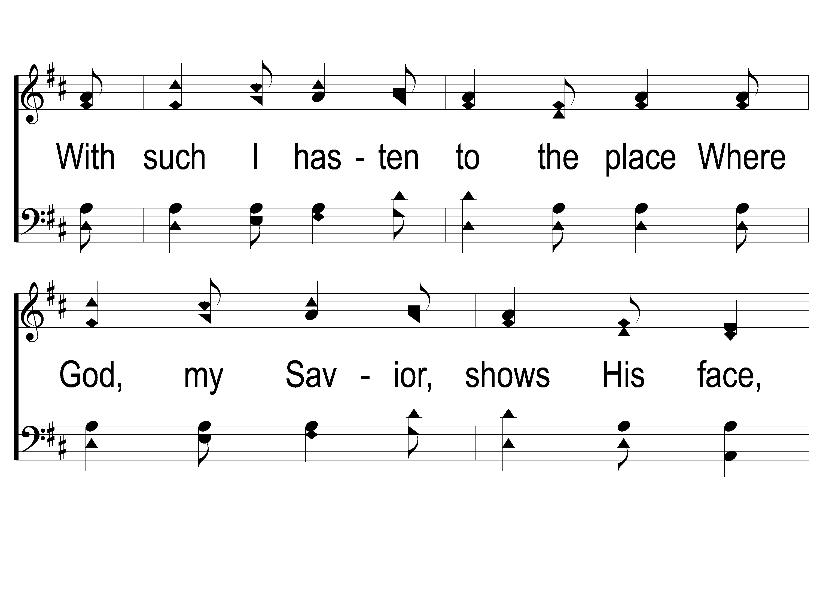
2-3 Sweet Hour of Prayer
Sweet Hour of Prayer
827

Slide 35
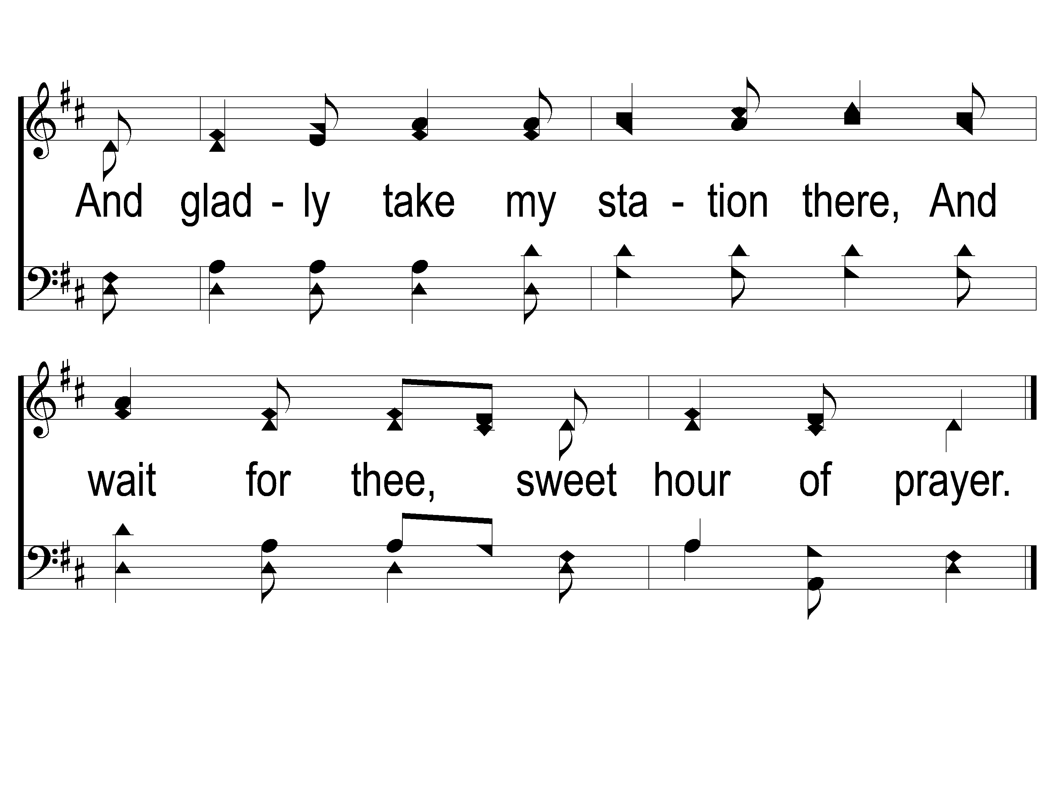
2-4 Sweet Hour of Prayer
Sweet Hour of Prayer
827

Slide 36
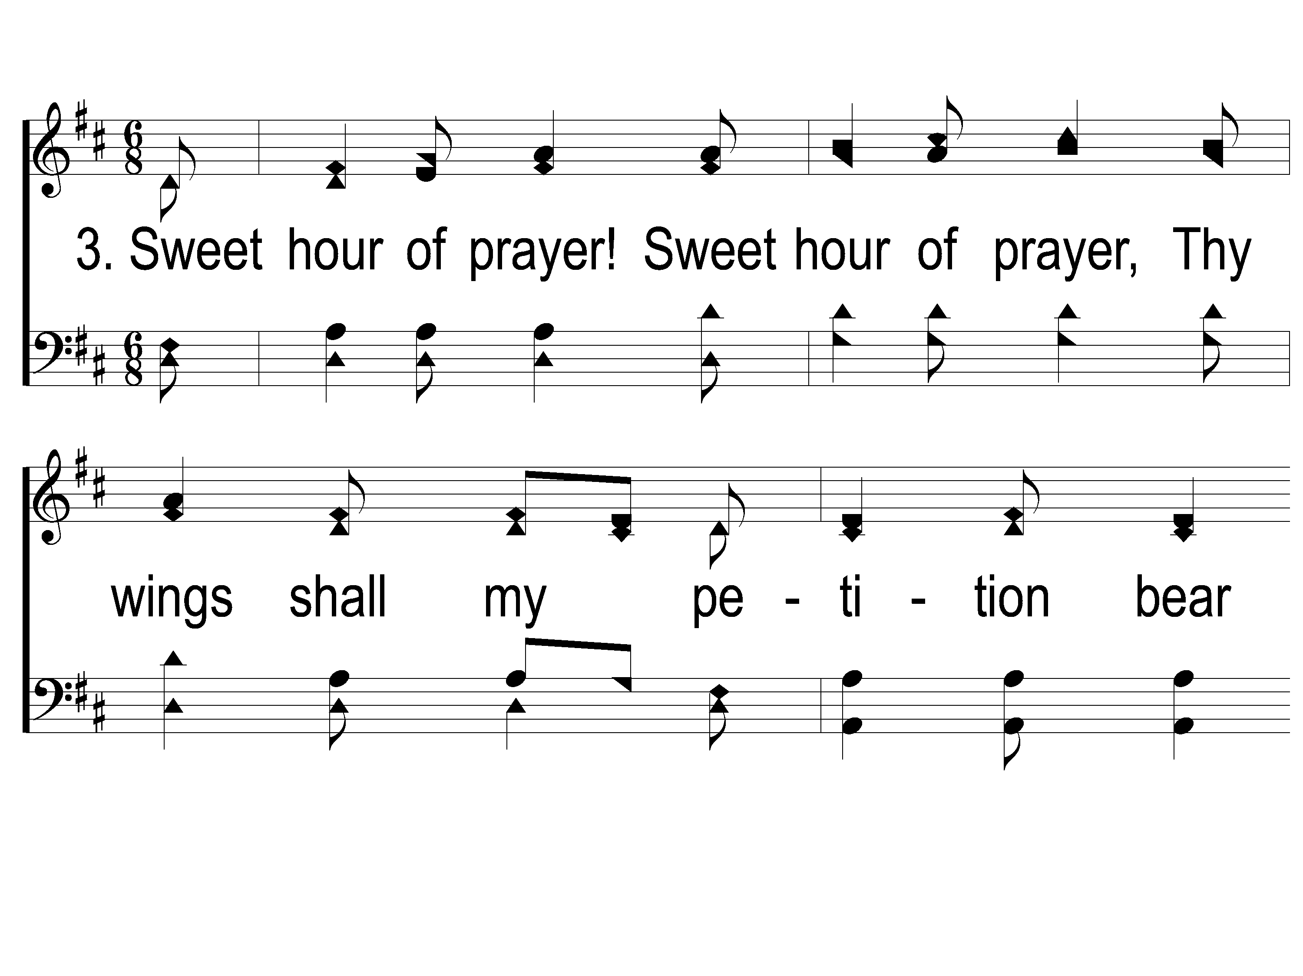
3-1 Sweet Hour of Prayer
Sweet Hour of Prayer
827

Slide 37
3-2 Sweet Hour of Prayer
Sweet Hour of Prayer
827

Slide 38
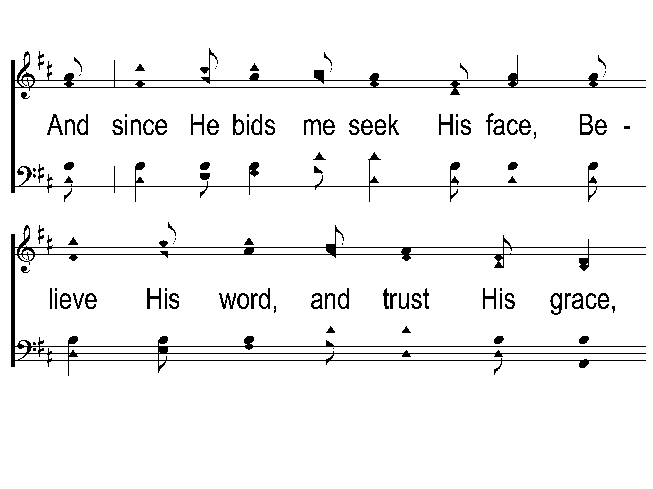
3-3 Sweet Hour of Prayer
Sweet Hour of Prayer
827

Slide 39
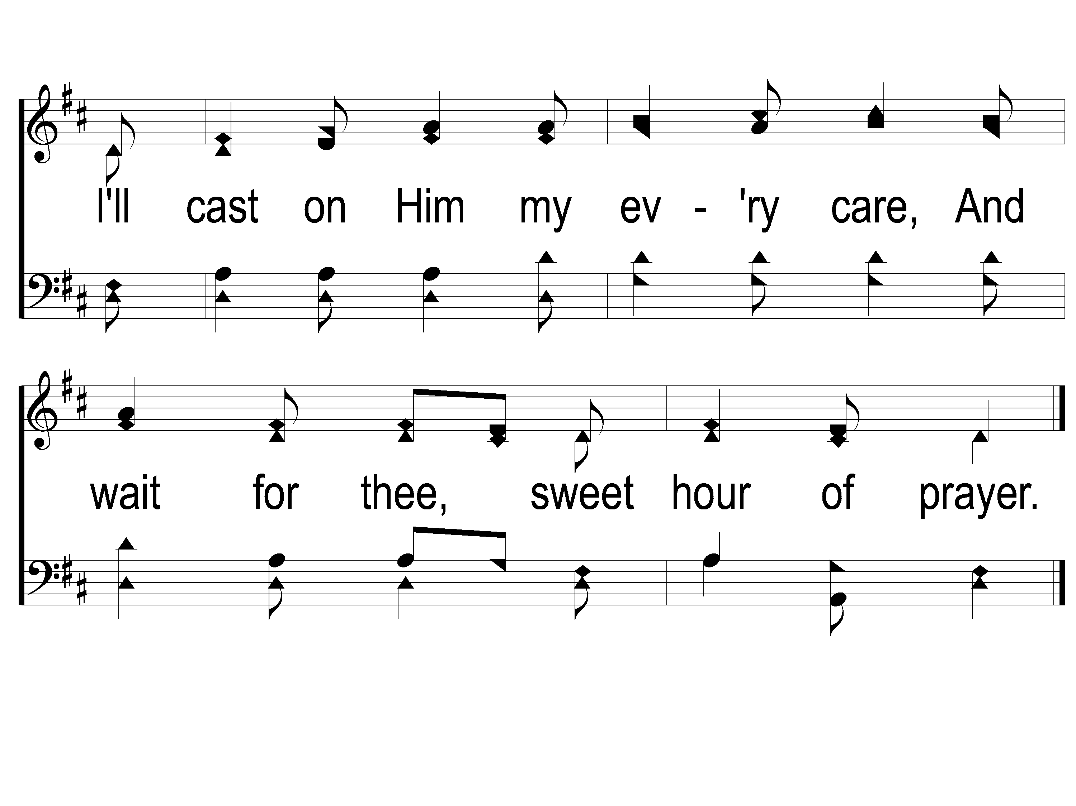
3-4 Sweet Hour of Prayer
Sweet Hour of Prayer
827

Slide 40
Opening Prayer

Slide 41
Song:
Tis So Sweet To Trust In Jesus
#679

Slide 42
1-1 ‘Tis so Sweet To Trust in Jesus
‘Tis So Sweet To Trust In Jesus
679

Slide 43
1-2 ‘Tis so Sweet To Trust in Jesus
‘Tis So Sweet To Trust In Jesus
679

Slide 44
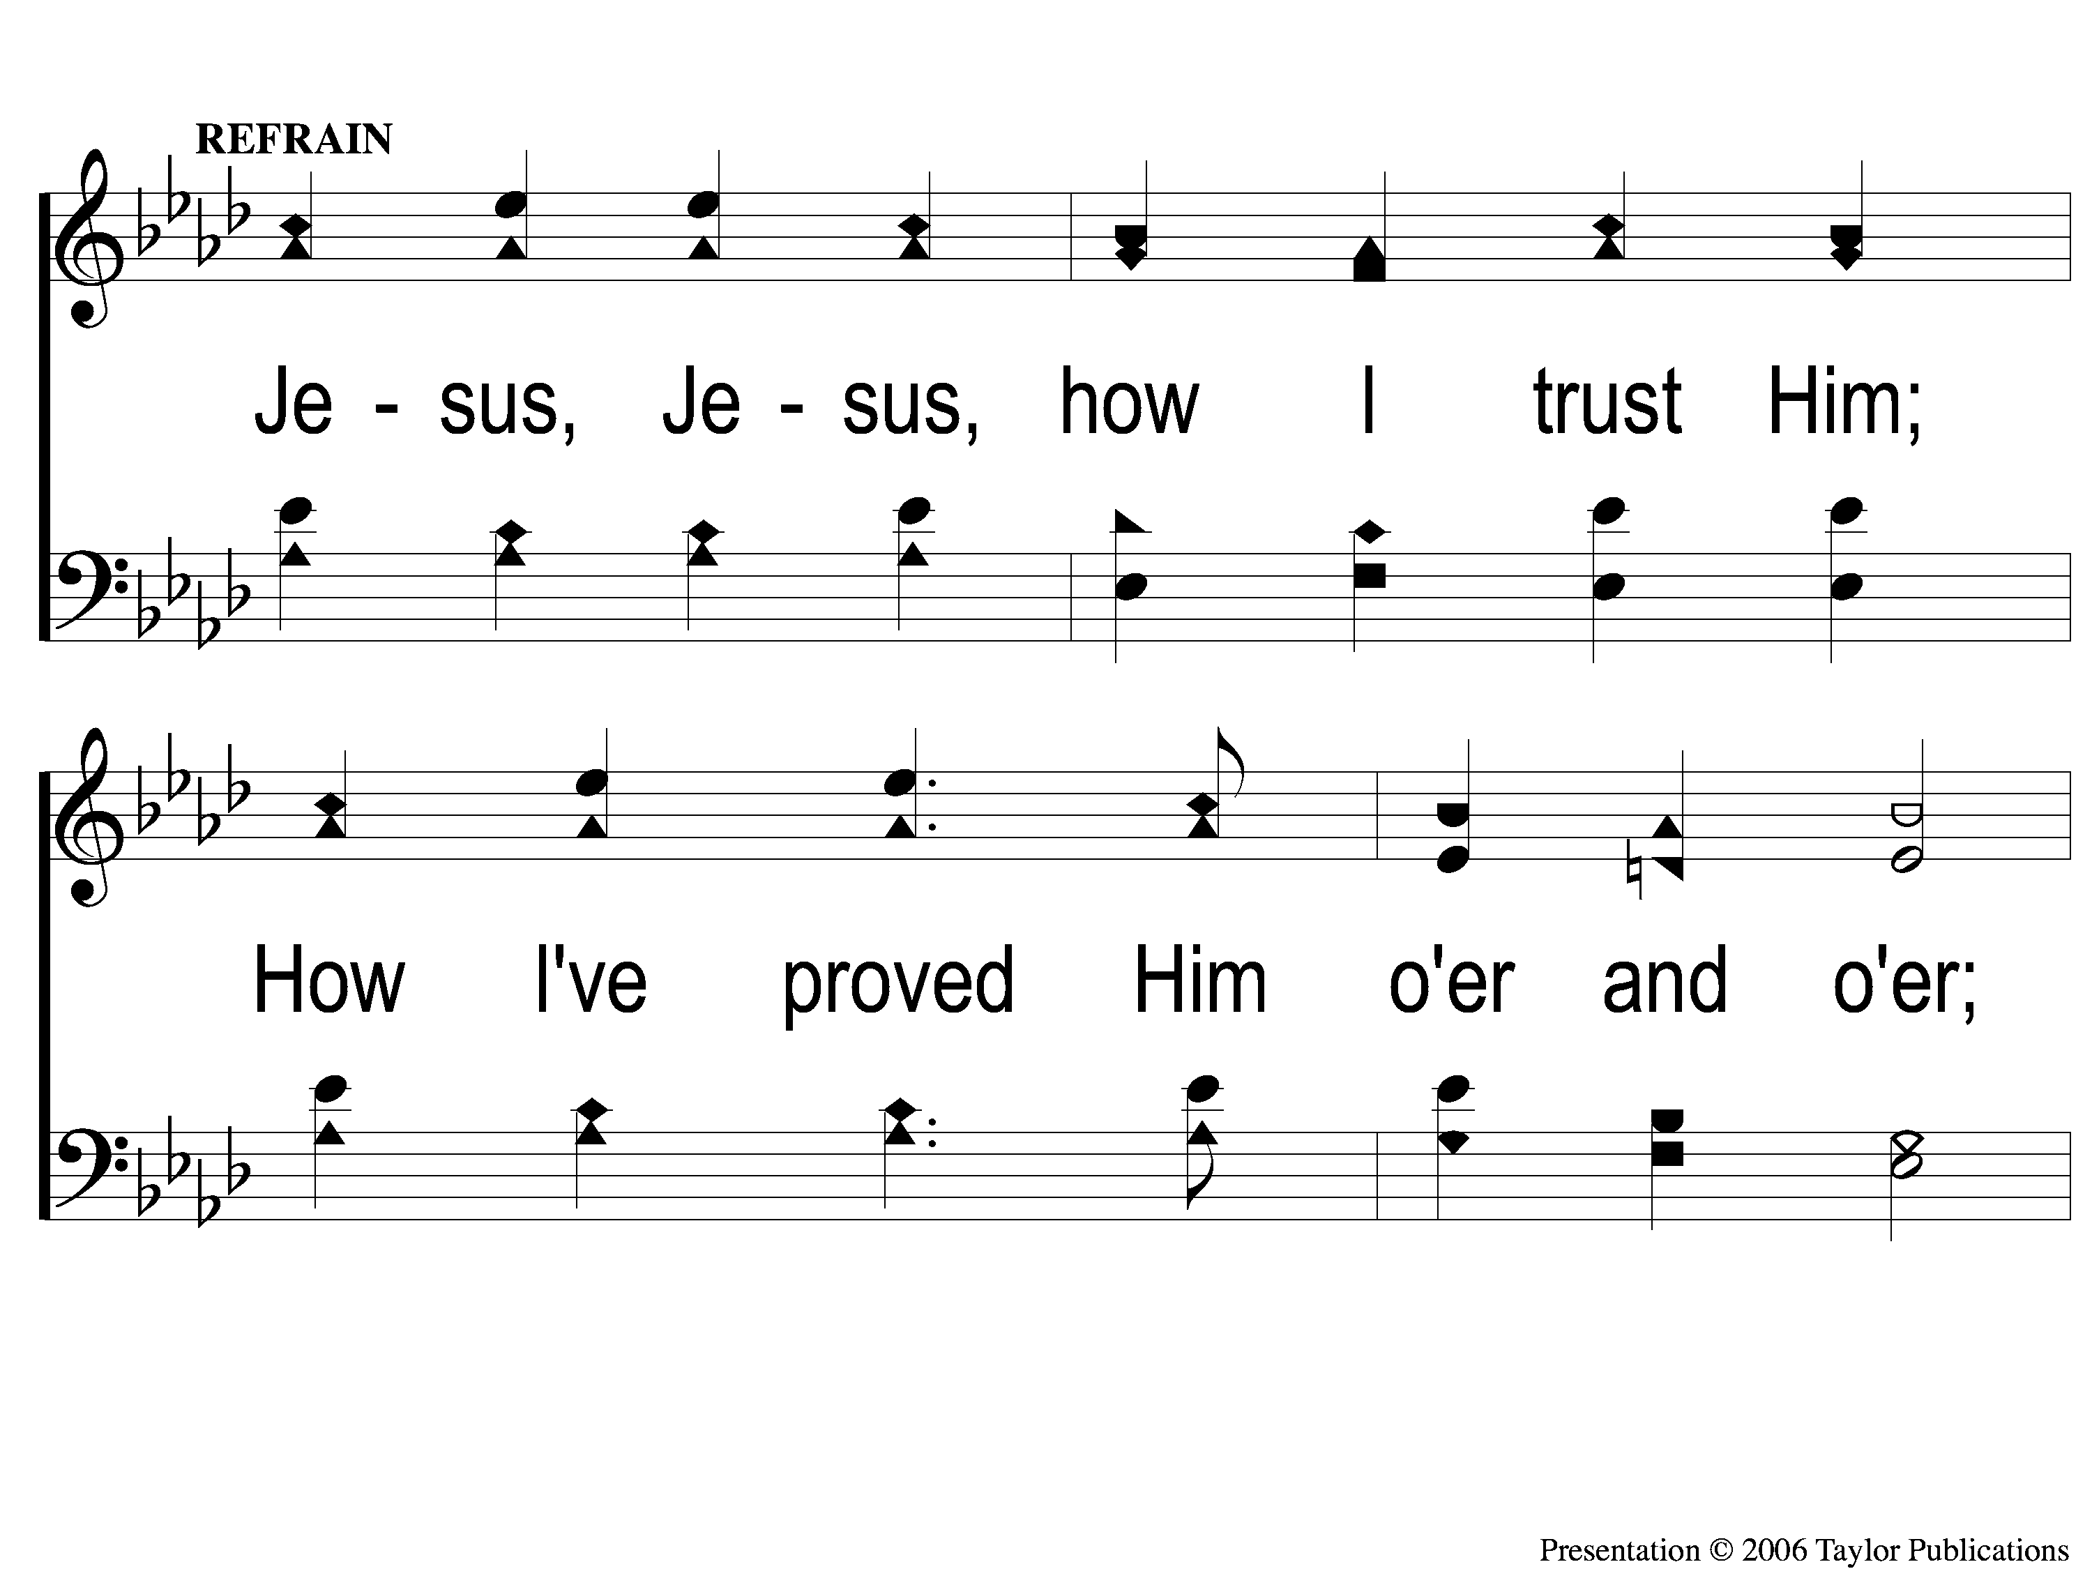
C-1 ‘Tis so Sweet To Trust in Jesus
‘Tis So Sweet To Trust In Jesus
679

Slide 45
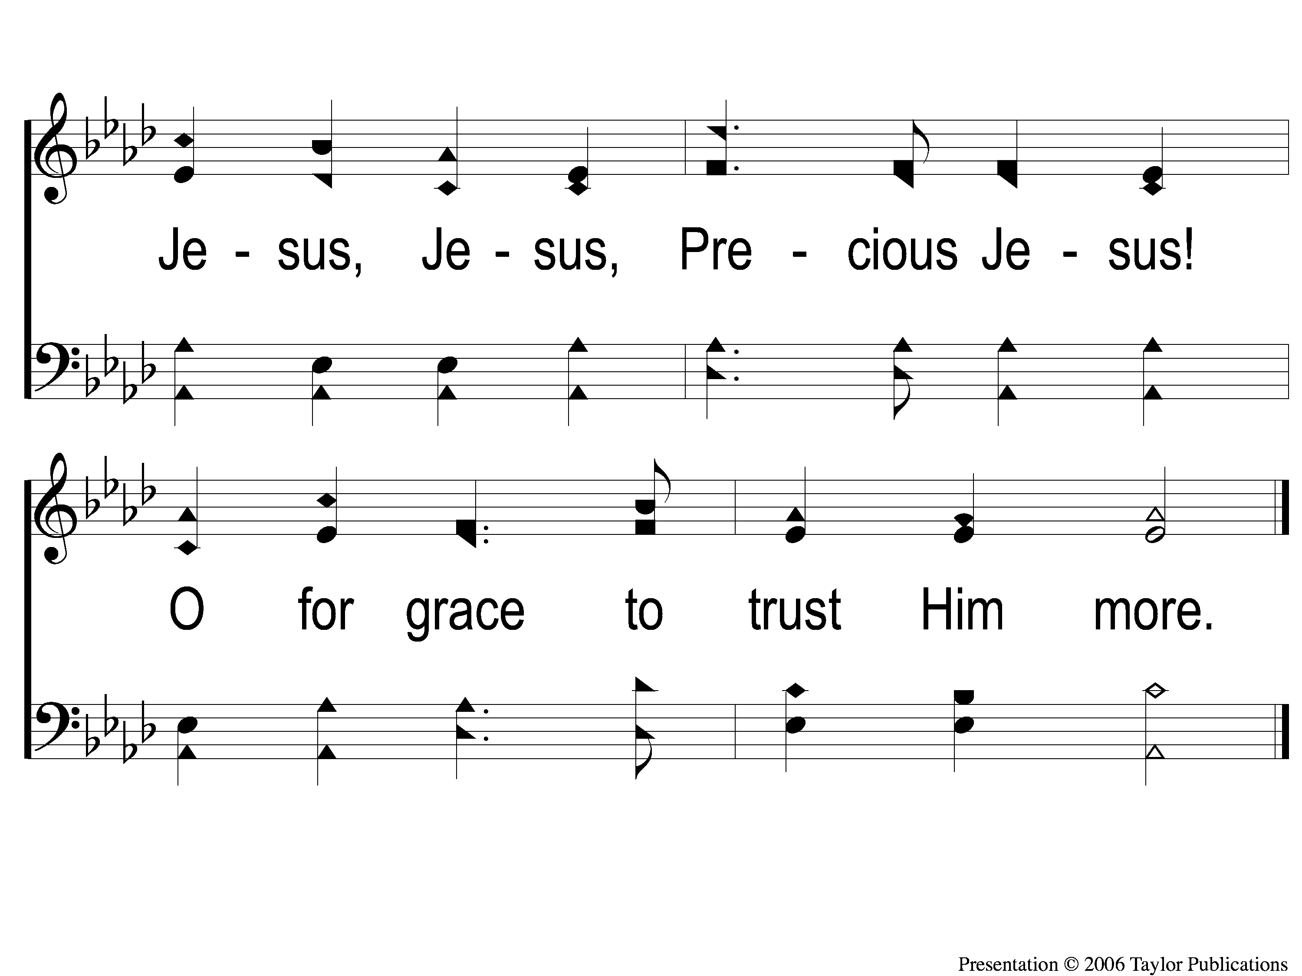
C-2 ‘Tis so Sweet To Trust in Jesus
‘Tis So Sweet To Trust In Jesus
679

Slide 46
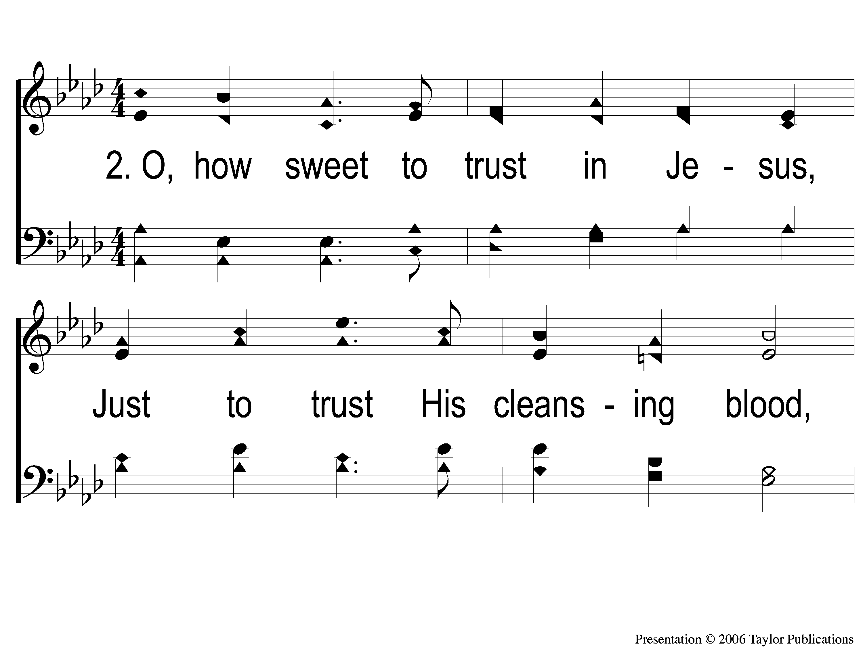
2-1 ‘Tis so Sweet To Trust in Jesus
‘Tis So Sweet To Trust In Jesus
679

Slide 47
2-2 ‘Tis so Sweet To Trust in Jesus
‘Tis So Sweet To Trust In Jesus
679

Slide 48
C-1 ‘Tis so Sweet To Trust in Jesus
‘Tis So Sweet To Trust In Jesus
679

Slide 49
C-2 ‘Tis so Sweet To Trust in Jesus
‘Tis So Sweet To Trust In Jesus
679

Slide 50
4-1 ‘Tis so Sweet To Trust in Jesus
‘Tis So Sweet To Trust In Jesus
679

Slide 51
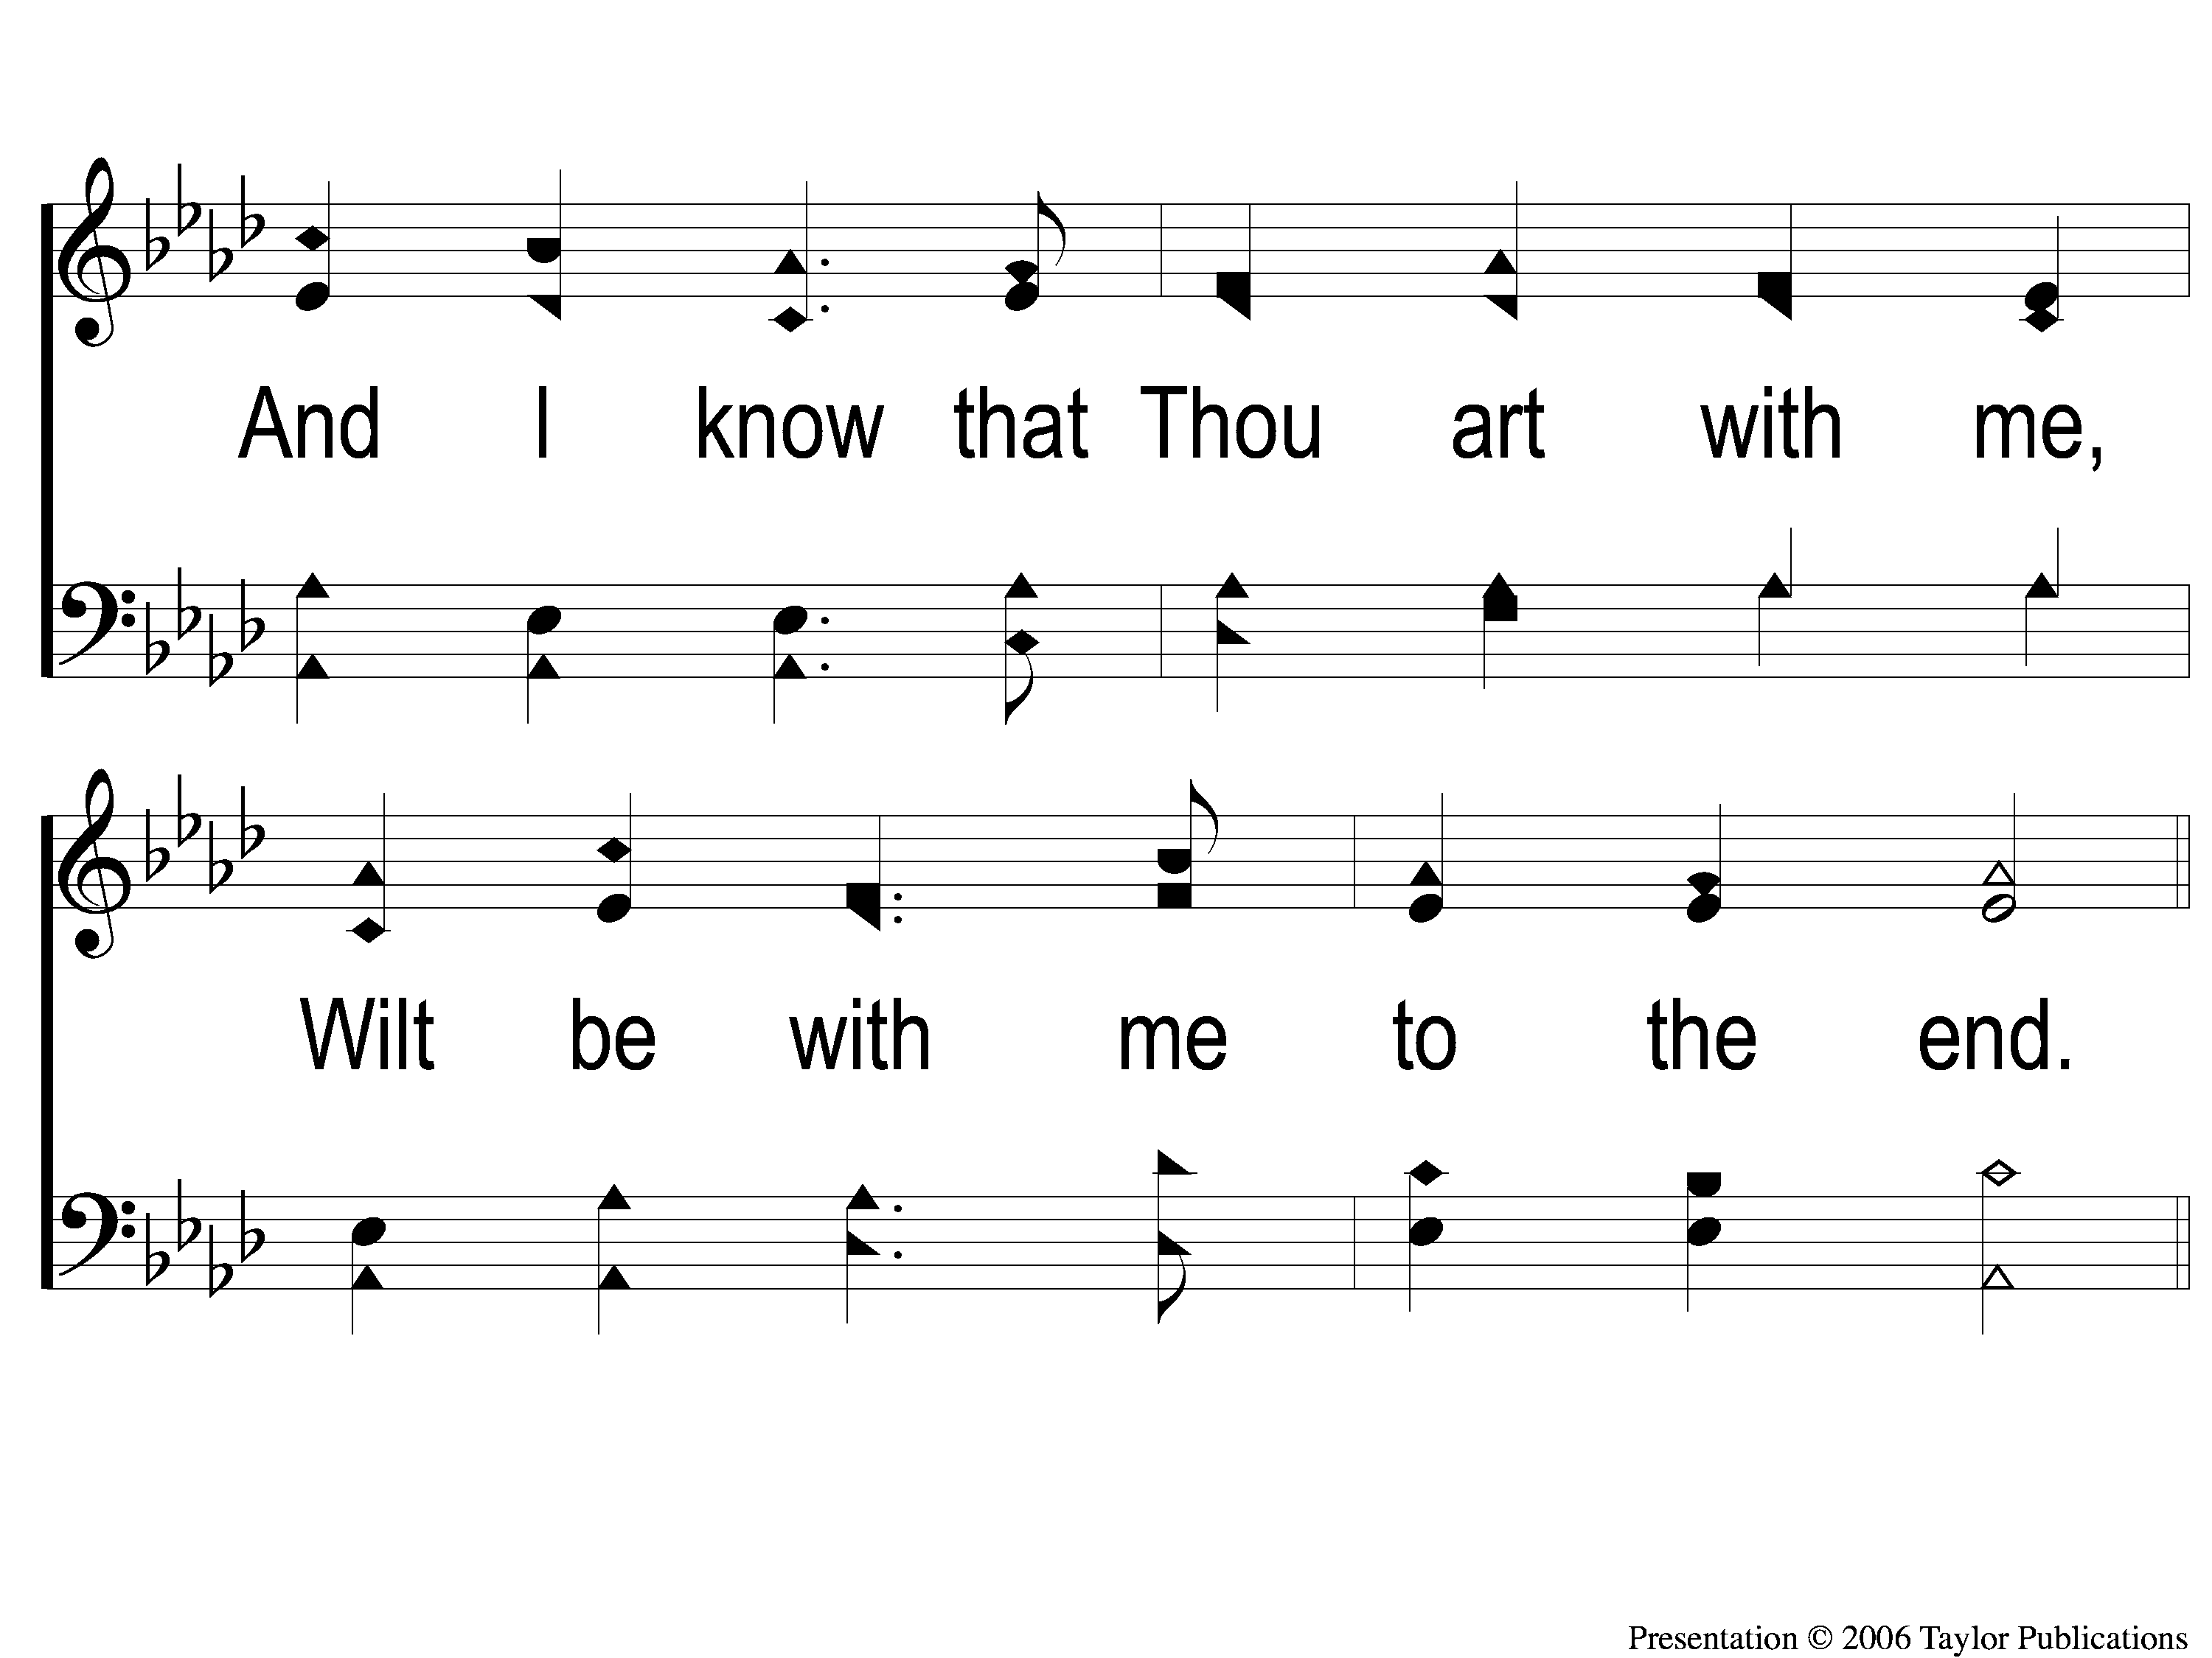
4-2 ‘Tis so Sweet To Trust in Jesus
‘Tis So Sweet To Trust In Jesus
679

Slide 52
C-1 ‘Tis so Sweet To Trust in Jesus
‘Tis So Sweet To Trust In Jesus
679

Slide 53
C-2 ‘Tis so Sweet To Trust in Jesus
‘Tis So Sweet To Trust In Jesus
679

Slide 54
Song:
Amazing Grace
#129

Slide 55
Scripture Reading:
Romans 8:35-39

Slide 57
THE REFORMATION MOVEMENT
Began October 31, 1517
With Martin Luther’s 95 Theses
“Disputation on the Power of Indulgences”

Slide 58
THE REFORMATION MOVEMENT
Continued With John Calvin in the 1500s
“Institutes of the Christian Religion”

Slide 60
CALVINISM: T-U-L-I-P

Slide 61
Total Hereditary Depravity Unconditional Election Limited Atonement Irresistible Grace Perseverance of the Saints

Slide 62
Irresistible Grace Perseverance of the Saints

Slide 63
DEFINE TERMS
Irresistible Grace
“These angels and men, thus predestined and foreordained, are particularly and unchangeably designed; and their number is so certain and definite, that it cannot be either increased or diminished.” - Westminster Confession of Faith III.IV

Slide 64
"The gospel invitation extends a call to salvation to every one who hears its message. It invites all men without distinction to drink freely of the water of life and live. It promises salvation to all who repent and believe. But this outward general call, extended to the elect and non-elect alike, will not bring sinners to Christ. Why? Because men are by nature dead in sin and are under its power. They are of themselves unable and unwilling to forsake their evil ways and to turn to Christ for mercy. Consequently, the unregenerate will not respond to the gospel call to repentance and faith. No amount of external threatenings or promises will cause blind, deaf, dead, rebellious sinners to bow before Christ as Lord and to look to Him alone for salvation. Such an act of faith and submission is contrary to the lost man's nature…”

Slide 65
"Therefore, the Holy Spirit, in order to bring God's elect to salvation, extends to them a special inward call in addition to the outward call contained in the gospel message. Through this special call the Holy Spirit performs a work of grace within the sinner which inevitably brings him to faith in Christ…”
– D. Steele and C. Thomas

Slide 66
“Irresistible grace does not mean that God's grace is incapable of being resisted. Indeed, we are capable of resisting God's grace, and we do resist it. The idea is that God's grace is so powerful that it has the capacity to overcome our natural resistance to it.” – R. C. Sproul

Slide 67
DEFINE TERMS
Perseverance of the Saints
“They whom God hath accepted in his Beloved, effectually called and sanctified by his Spirit, can neither totally nor finally fall away from the state of grace: but shall certainly persevere therein to the end and be eternally saved.”
– Westminster Confession of Faith, XIX, Sec. 1

Slide 68
DEFINE TERMS
Perseverance of the Saints
“They whom God hath accepted in his Beloved, effectually called and sanctified by his Spirit, can neither totally nor finally fall away from the state of grace: but shall certainly persevere therein to the end and be eternally saved.”
– Westminster Confession of Faith, XIX, Sec. 1

Slide 69
DEFINE TEXTS
Romans 8:35-39
John 10:28-29

Slide 70
DANGEROUS IMPLICATIONS
If True…
We Do Not Need God’s Word
2 Pet. 1:3
Gal. 5:4

Slide 71
DANGEROUS IMPLICATIONS
If True…
We Can Go On Sinning
Rom. 6:1-2

Slide 72
DOCTRINE OF THE BIBLE

Slide 73
P E A C E

Slide 74
Possible Depravity E Atonement For All Conditional Election E

Slide 75
Possible Depravity Escapable Grace Atonement For All Conditional Election Endurance Of The Saints

Slide 76
Freed by Grace Atonement for All Conditional Election Total Depravity Security in Christ

Slide 77
DOCTRINE OF THE BIBLE
We CAN Resist God’s Grace
Acts 7:51
2 Tim. 3:8, 16-17, 4:14-15

Slide 78
DOCTRINE OF THE BIBLE
We CAN Resist God’s Grace
Judas – Jn. 6:70, 15:16
Matt. 26:14-16, Jn. 13:2

Slide 79
DOCTRINE OF THE BIBLE
We CAN Fall From God’s Grace
Gal. 5:4
Heb. 2:1, 3, 6:3-5, 10:26-29
2 Pet. 2:20-22, Rev. 1:5

Slide 80
DOCTRINE OF THE BIBLE
We Must Be Transformed By Christ
Rom. 12:1-2
Col. 3:1-15

Slide 81
Possible Depravity Escapable Grace Atonement For All Conditional Election Endurance Of The Saints

Slide 82
Have You RECEIVED
God’s GRACE?

Slide 83
Jesus Is Tenderly Calling
#947
Invitation
Song:

Slide 84
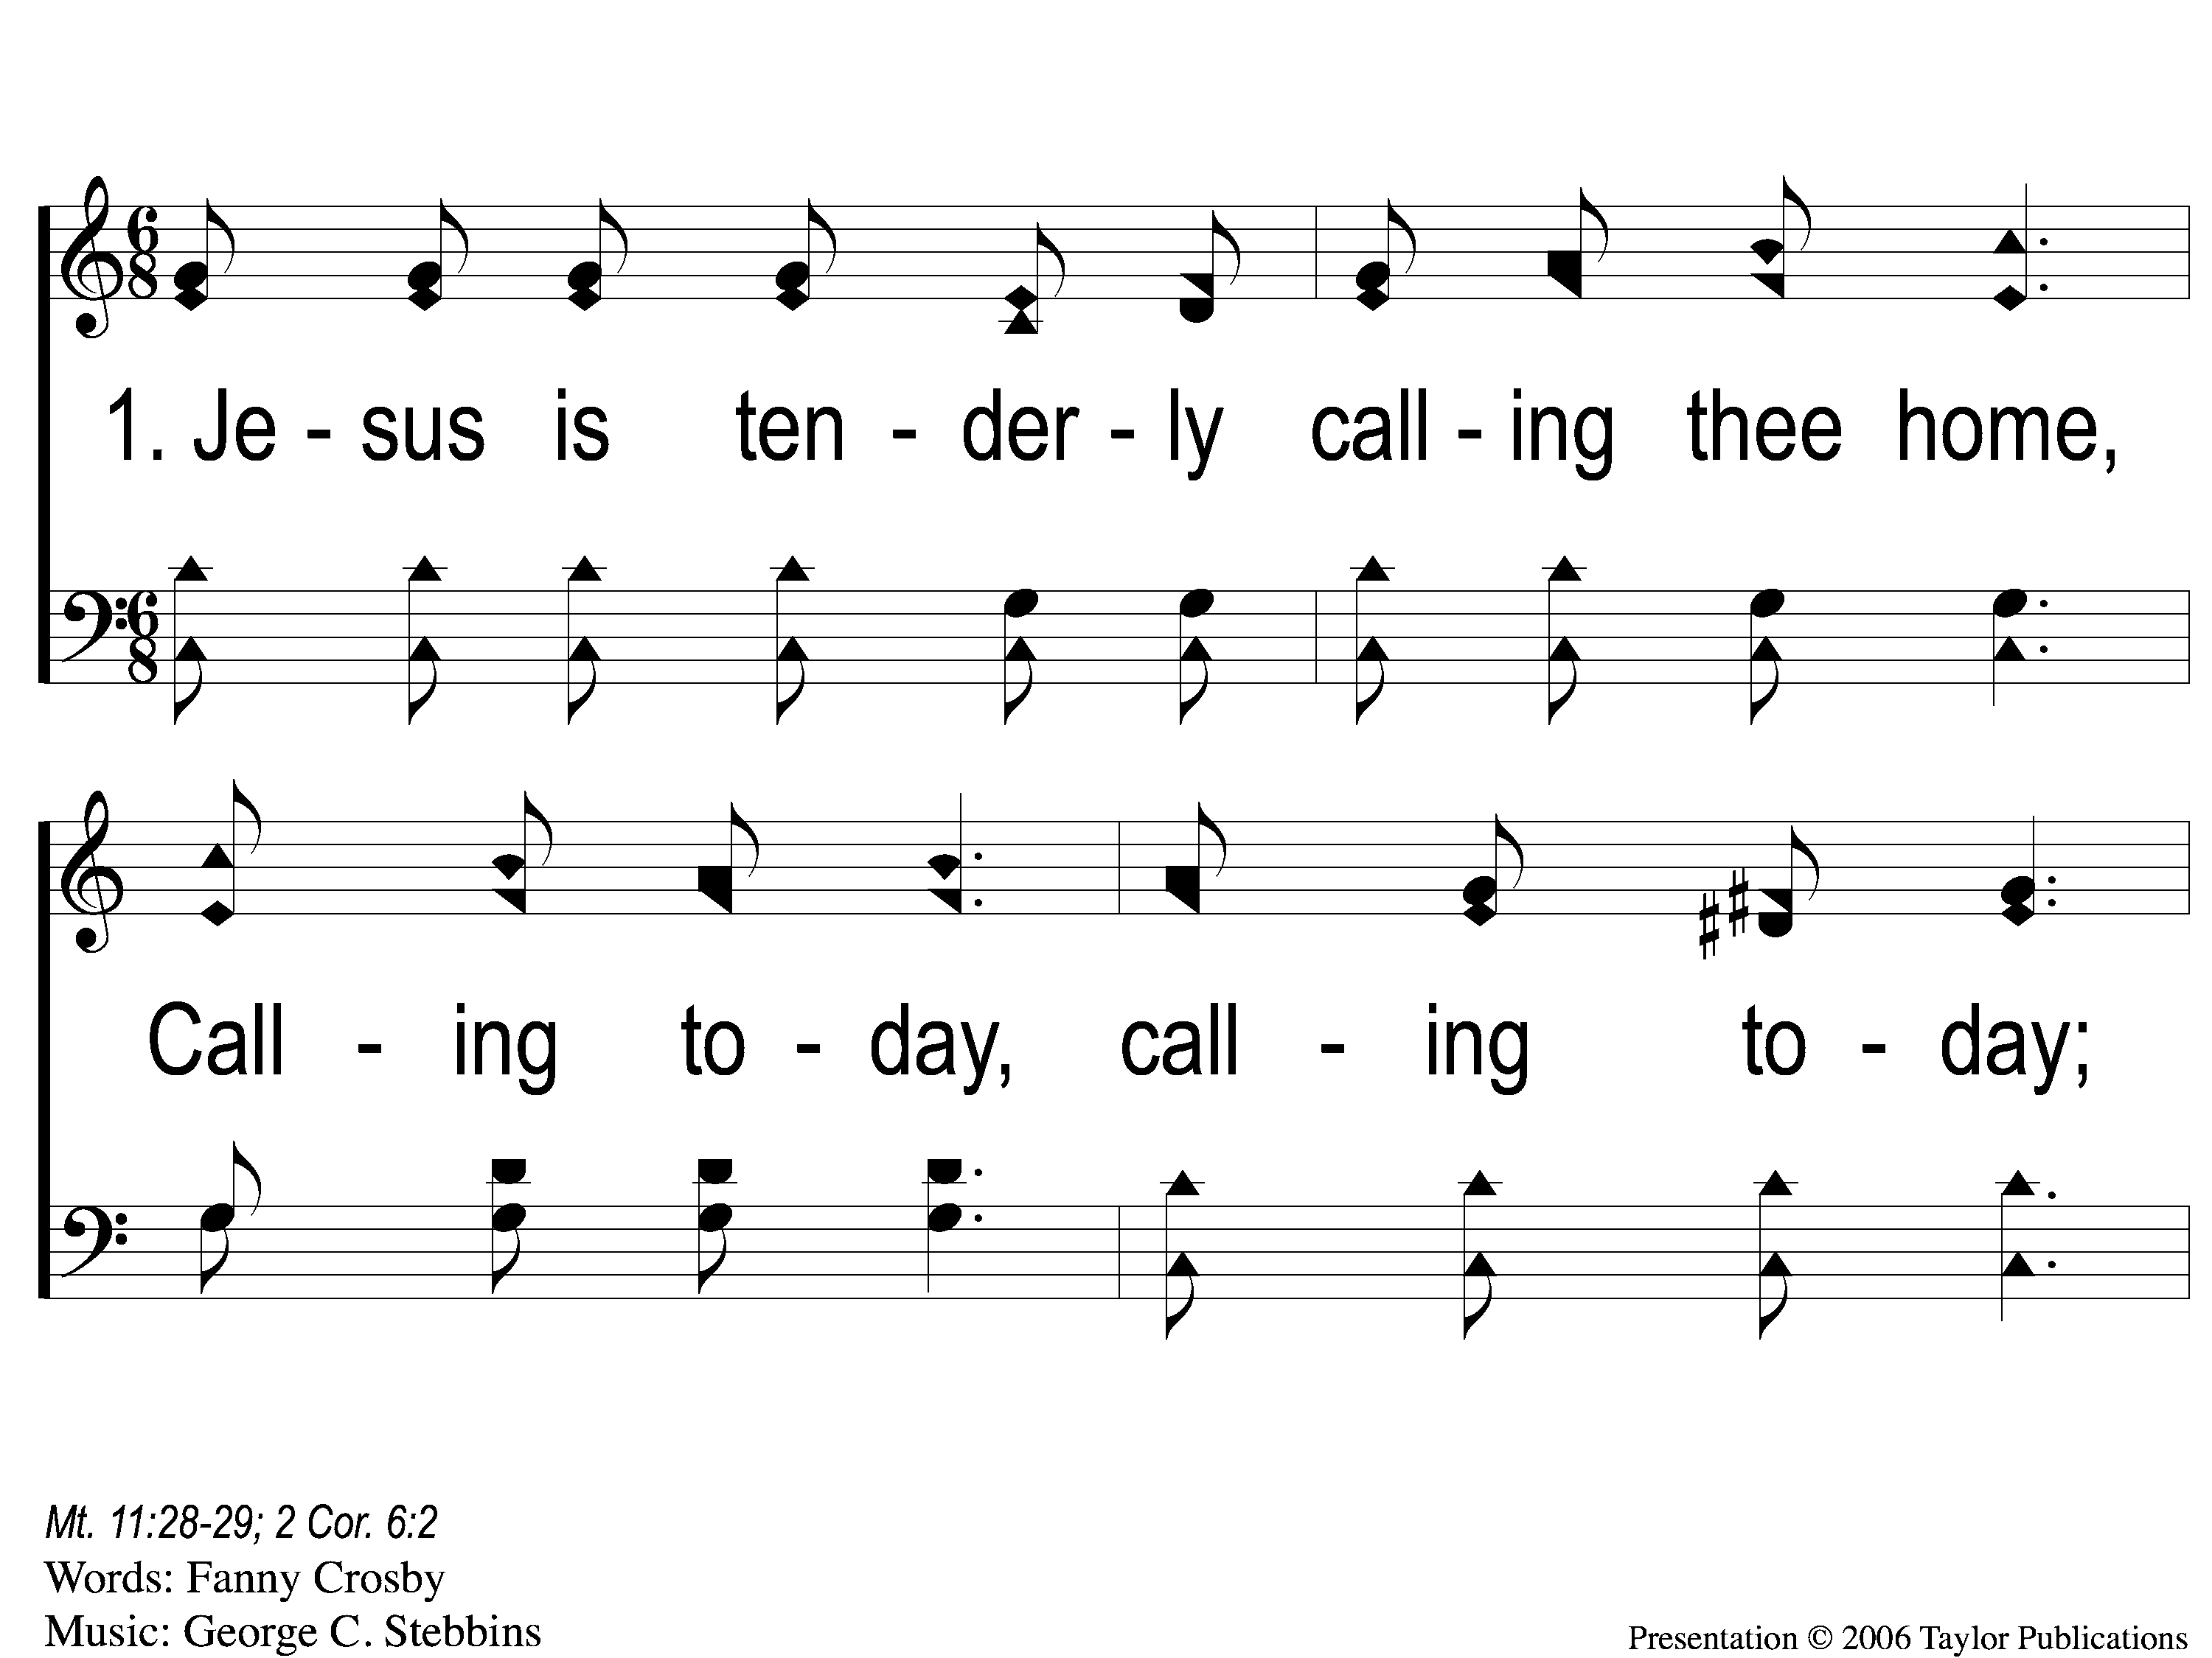
1-1 Jesus is Tenderly Calling
Jesus Is Tenderly Calling
947

Slide 85
1-2 Jesus is Tenderly Calling
Jesus Is Tenderly Calling
947

Slide 86
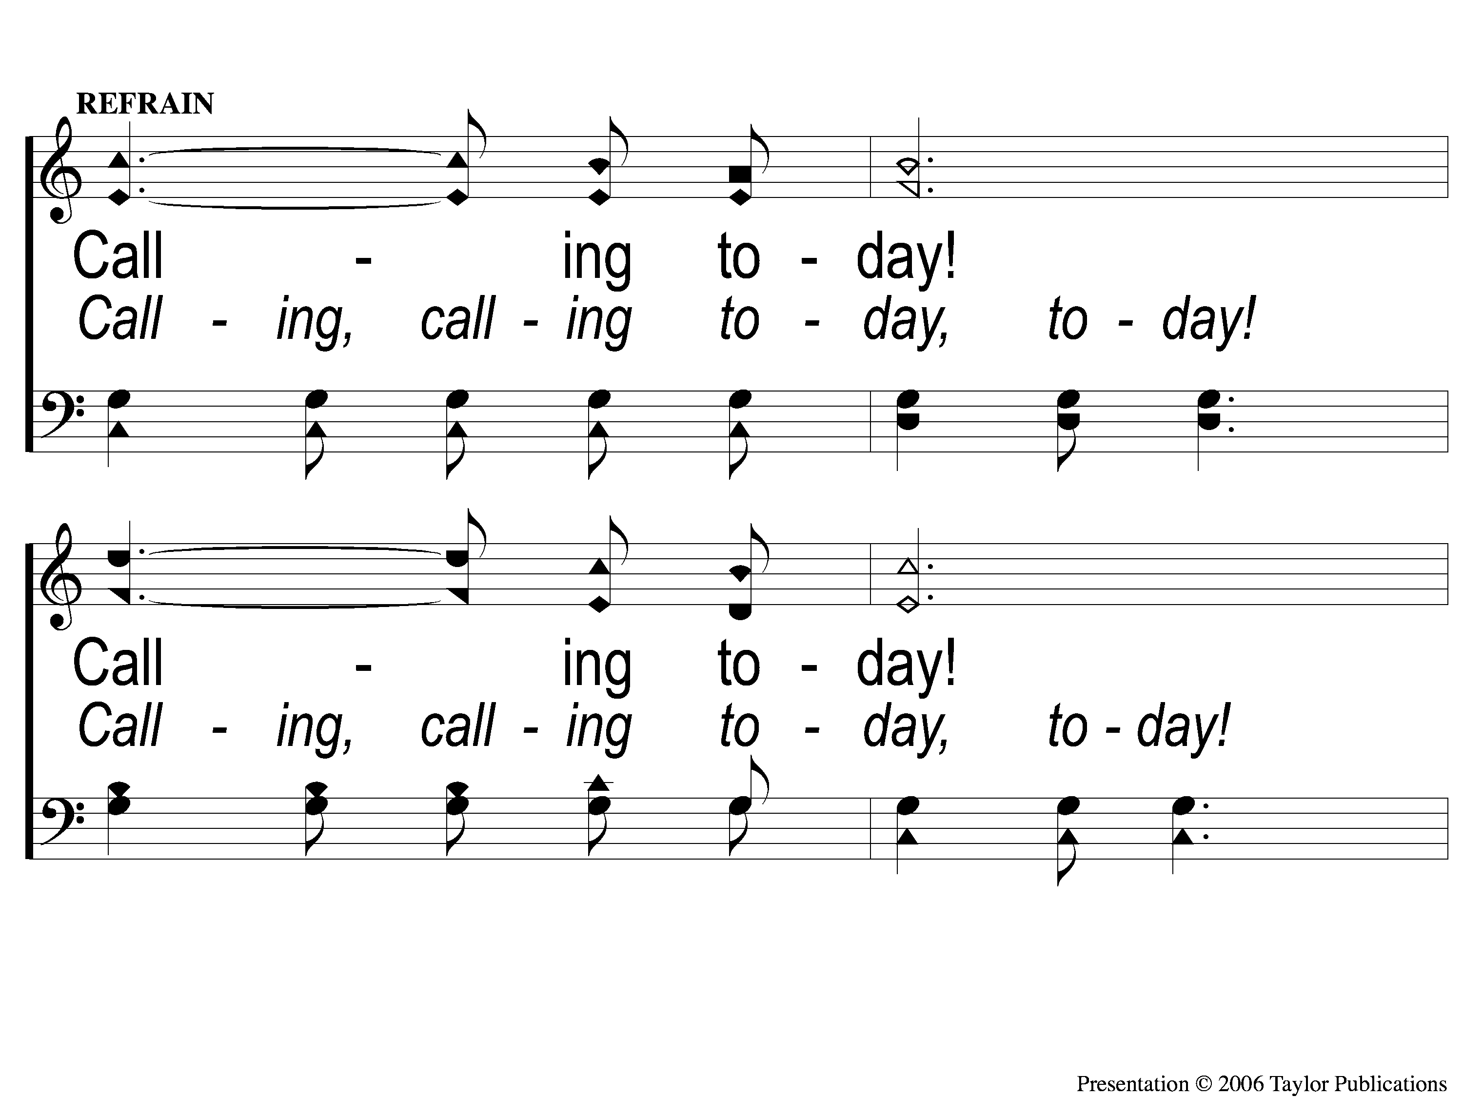
C-1 Jesus is Tenderly Calling
Jesus Is Tenderly Calling
947

Slide 87
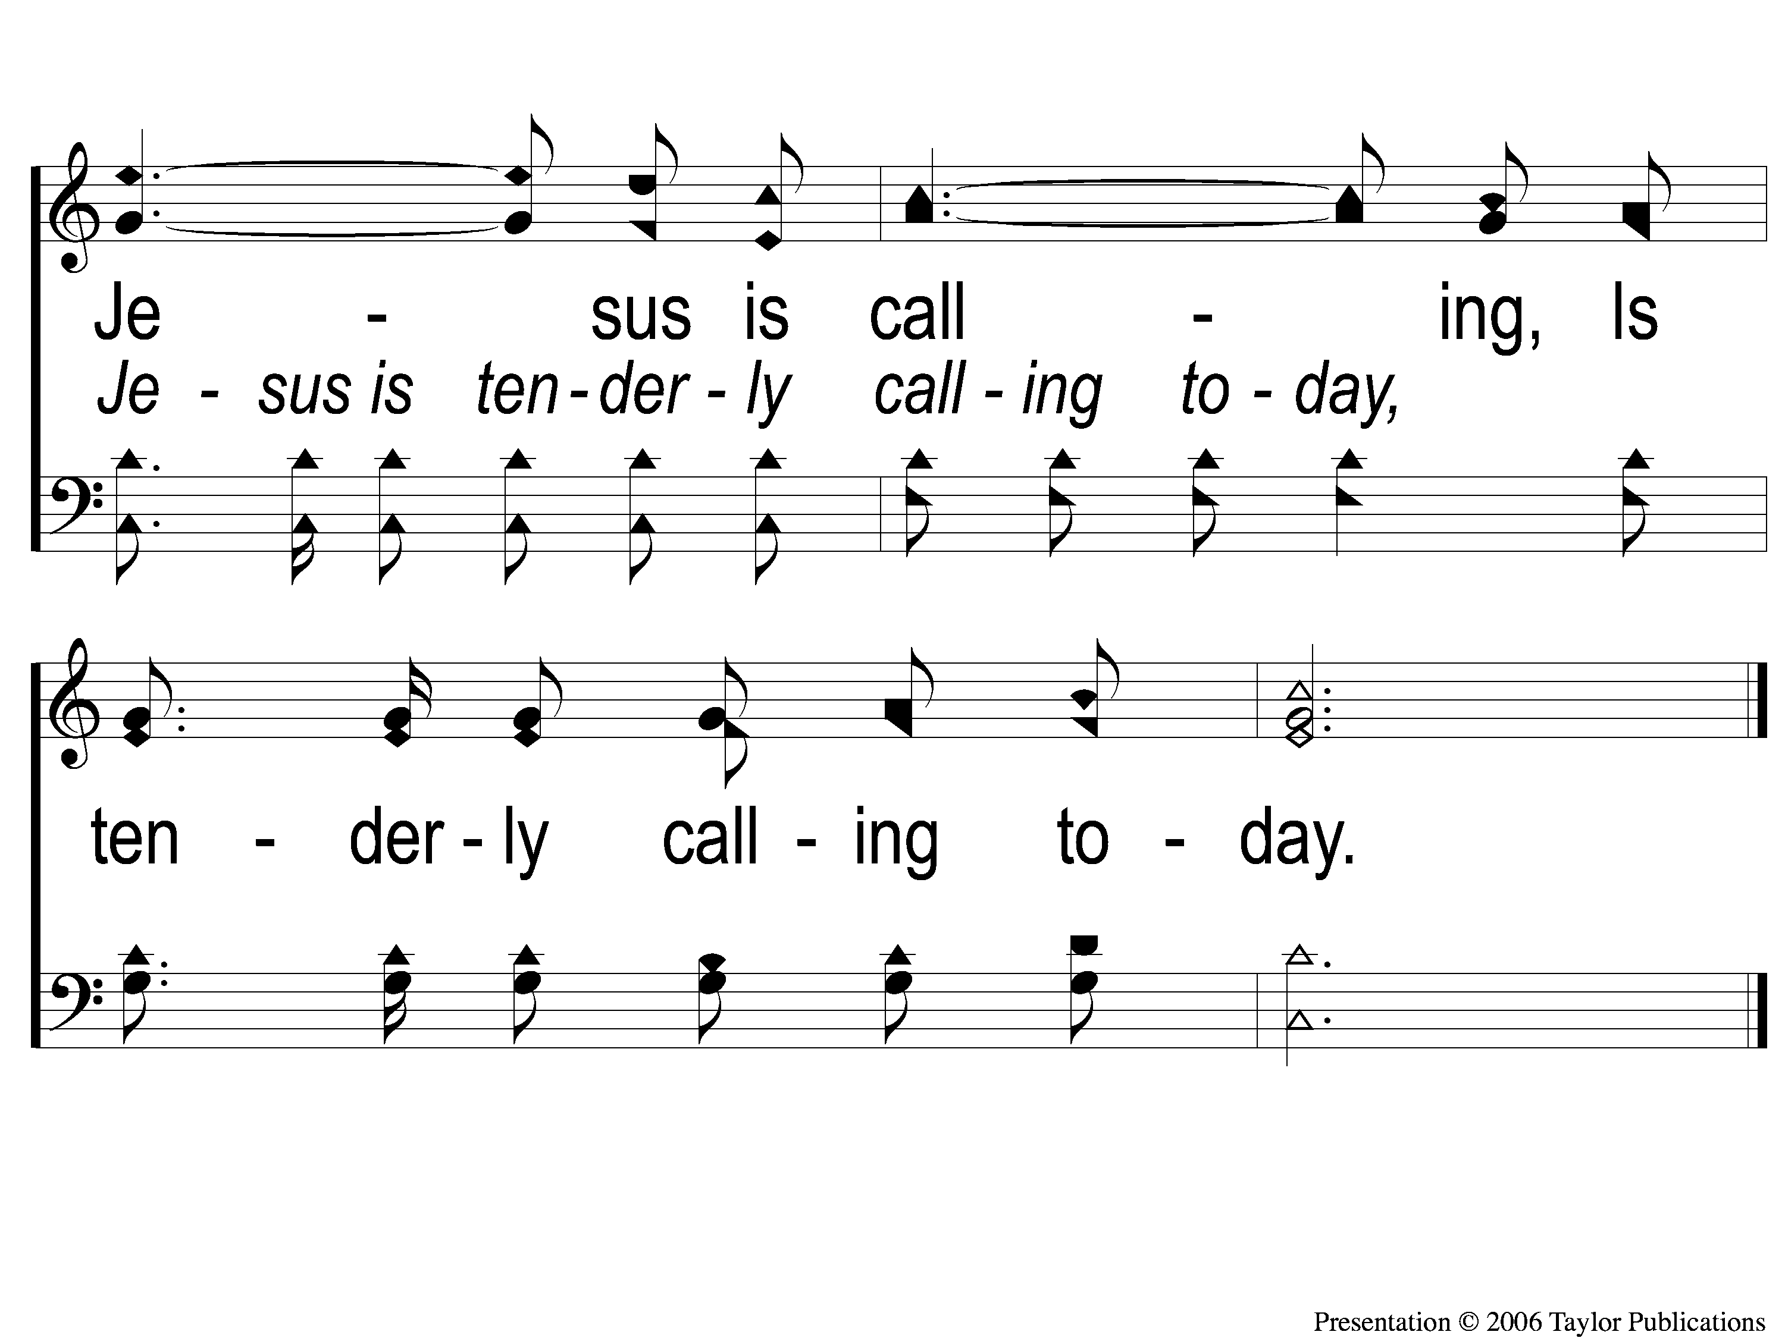
C-2 Jesus is Tenderly Calling
Jesus Is Tenderly Calling
947

Slide 88
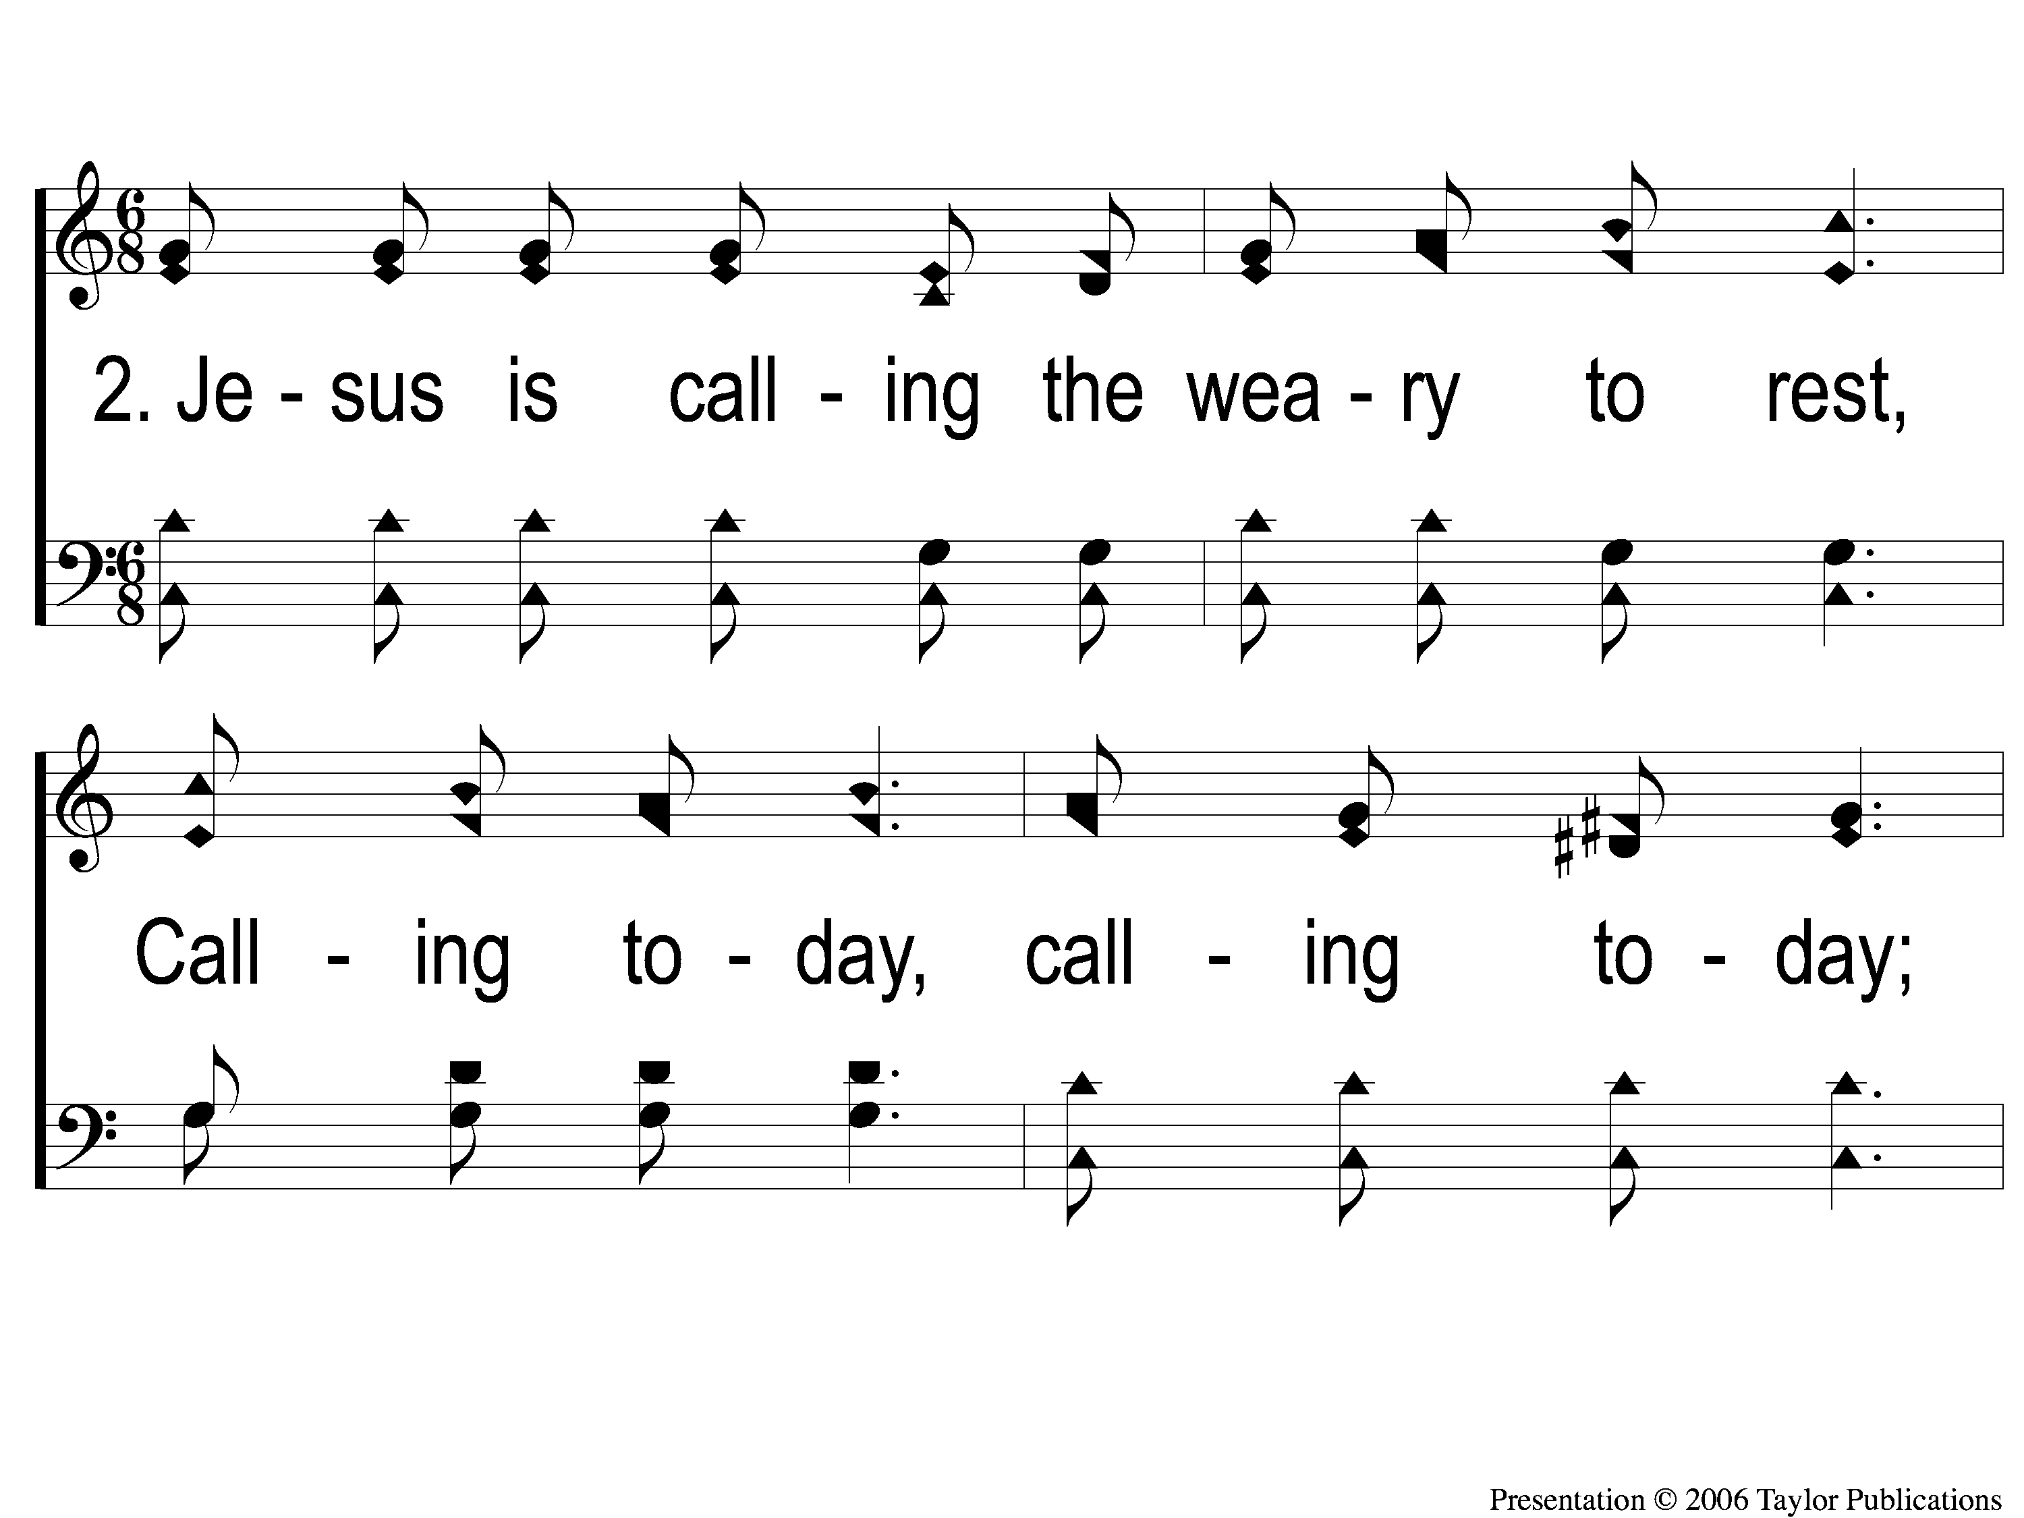
2-1 Jesus is Tenderly Calling
Jesus Is Tenderly Calling
947

Slide 89
2-2 Jesus is Tenderly Calling
Jesus Is Tenderly Calling
947

Slide 90
C-1 Jesus is Tenderly Calling
Jesus Is Tenderly Calling
947

Slide 91
C-2 Jesus is Tenderly Calling
Jesus Is Tenderly Calling
947

Slide 92
3-1 Jesus is Tenderly Calling
Jesus Is Tenderly Calling
947

Slide 93
3-2 Jesus is Tenderly Calling
Jesus Is Tenderly Calling
947

Slide 94
C-1 Jesus is Tenderly Calling
Jesus Is Tenderly Calling
947

Slide 95
C-2 Jesus is Tenderly Calling
Jesus Is Tenderly Calling
947

Slide 96
4-1 Jesus is Tenderly Calling
Jesus Is Tenderly Calling
947

Slide 97
4-2 Jesus is Tenderly Calling
Jesus Is Tenderly Calling
947

Slide 98
C-1 Jesus is Tenderly Calling
Jesus Is Tenderly Calling
947

Slide 99
C-2 Jesus is Tenderly Calling
Jesus Is Tenderly Calling
947

Slide 100
The Contribution:
Romans 9:6-8
“The point is this: whoever sows sparingly will also reap sparingly, and whoever sows bountifully will also reap bountifully. Each one must give as he has decided in his heart, not reluctantly or under compulsion, for God loves a cheerful giver. And God is able to make all grace abound to you, so that having all sufficiency in all things at all times, you may abound in every good work.”

Slide 101
Song:
Jesus, Keep Me Near The Cross
#383

Slide 102
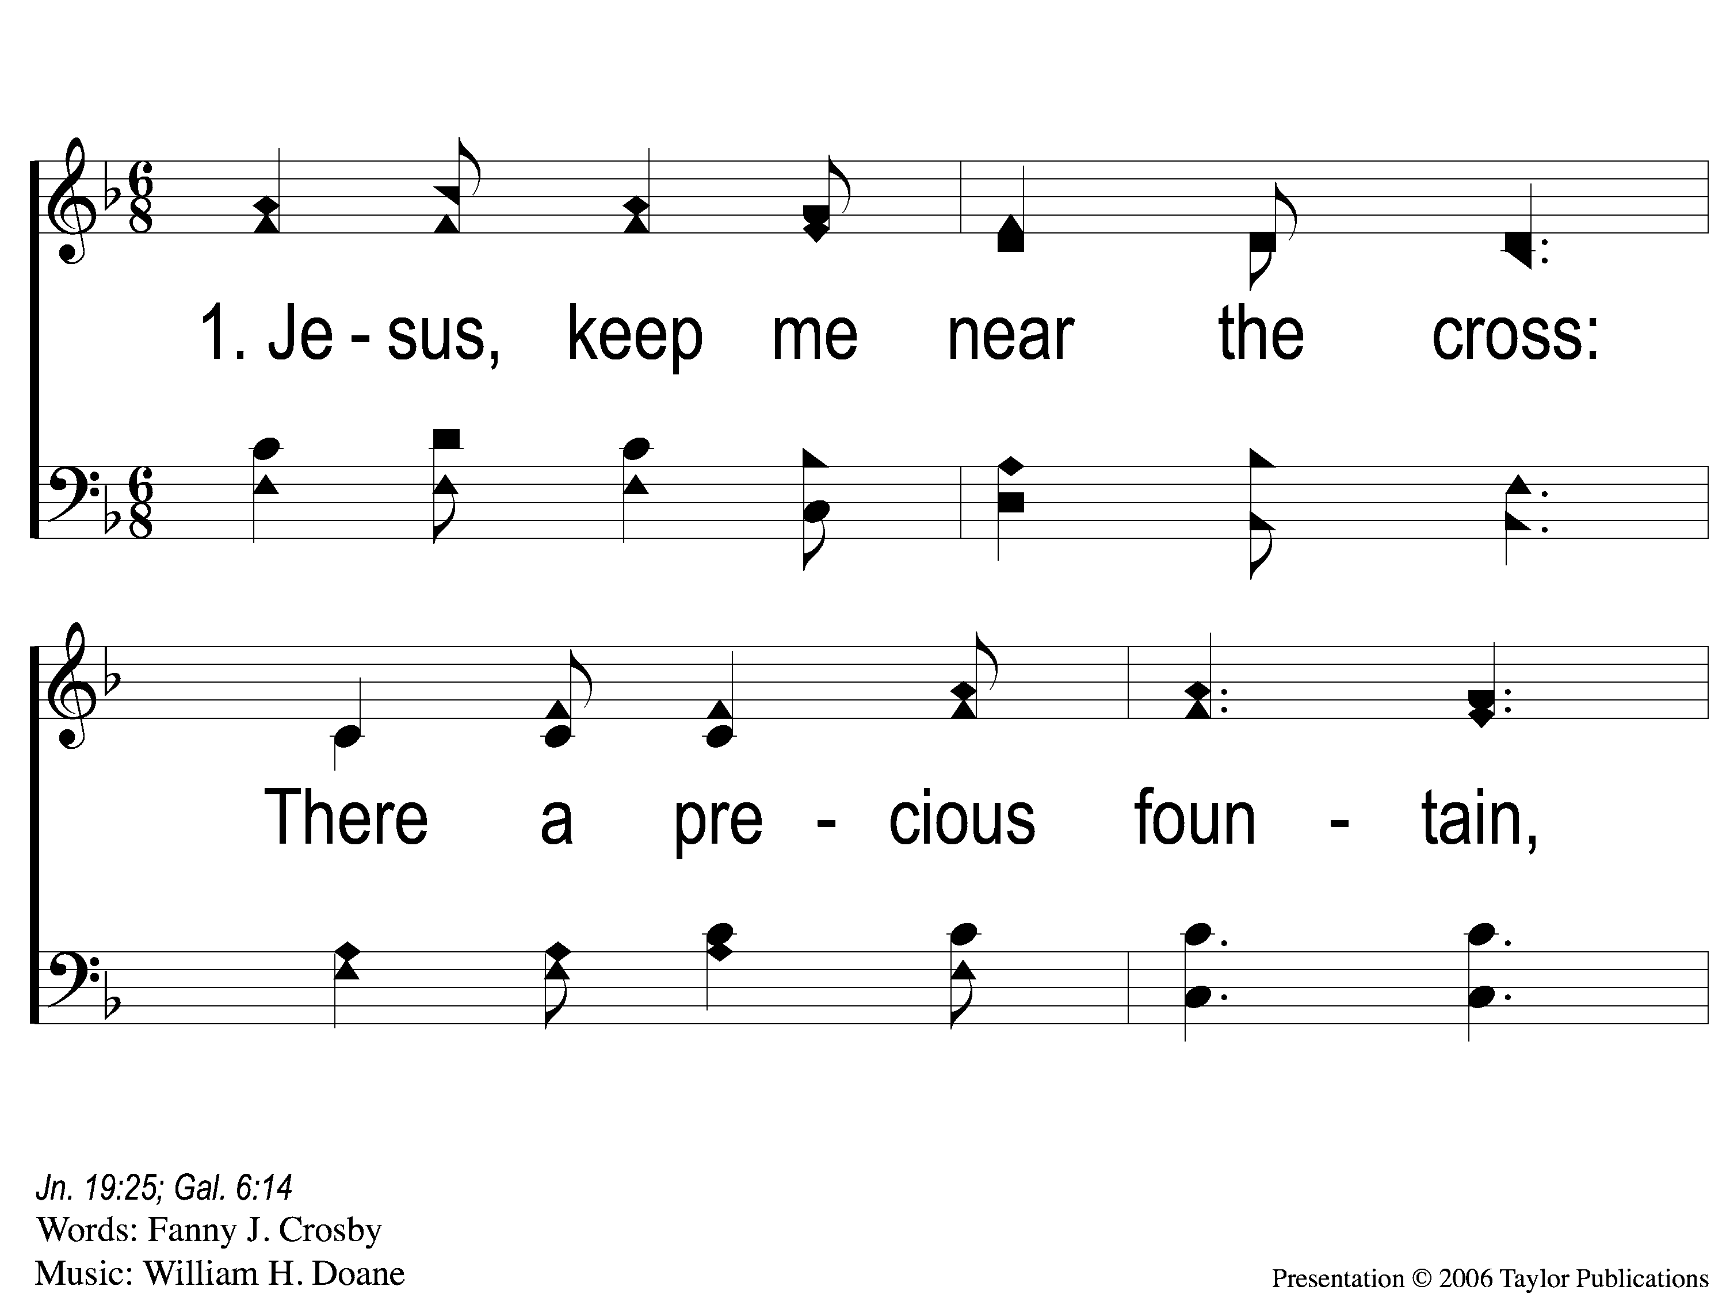
1-1 Jesus Keep Me Near the Cross
Jesus Keep Me Near The Cross
383

Slide 103
1-2 Jesus Keep Me Near the Cross
Jesus Keep Me Near The Cross
383

Slide 104
C Jesus Keep Me Near the Cross
Jesus Keep Me Near The Cross
383

Slide 105
3-1 Jesus Keep Me Near the Cross
Jesus Keep Me Near The Cross
383

Slide 106
3-2 Jesus Keep Me Near the Cross
Jesus Keep Me Near The Cross
383

Slide 107
C Jesus Keep Me Near the Cross
Jesus Keep Me Near The Cross
383

Slide 108
The Unleavened Bread
Romans 5:18-19
“Therefore, as through one man’s offense judgment came to all men, resulting in condemnation, even so through one Man’s righteous act the free gift came to all men, resulting in justification of life. For as by one man’s disobedience many were made sinners, so also by one Man’s obedience many will be made righteous.”

Slide 109
The Fruit
of the Vine
Romans 5:9-11
“Since, therefore, we have now been justified by his blood, much more shall we be saved by him from the wrath of God. For if while we were enemies we were reconciled to God by the death of his Son, much more, now that we are reconciled, shall we be saved by his life. More than that, we also rejoice in God through our Lord Jesus Christ, through whom we have now received reconciliation.”

Slide 110
Closing Prayer

Slide 111
Song:
We Praise Thee, O God
#2

Slide 112
1 We Praise Thee O God
We Praise Thee, O God
2

Slide 113
C We Praise Thee O God
We Praise Thee, O God
2

Slide 114
5 We Praise Thee O God
We Praise Thee, O God
2

Slide 115
C We Praise Thee O God
We Praise Thee, O God
2

Slide 116
Today
Join us in the MPB for
A Fellowship Meal & Devo
Wednesday
Worship & Classes & 6:30 PM
RESTORE REBUILD RENEW
IN 2022
WHEELER
CHURCH
OF
CHRIST

Slide 117
RESTORE REBUILD RENEW
tonight
Worship @ 6:00 PM
Wednesday
Worship & Classes & 6:30 PM
IN 2022
WHEELER
CHURCH
OF
CHRIST

