Slide 1
WELCOME
THANKS FOR JOINING US!

Slide 2
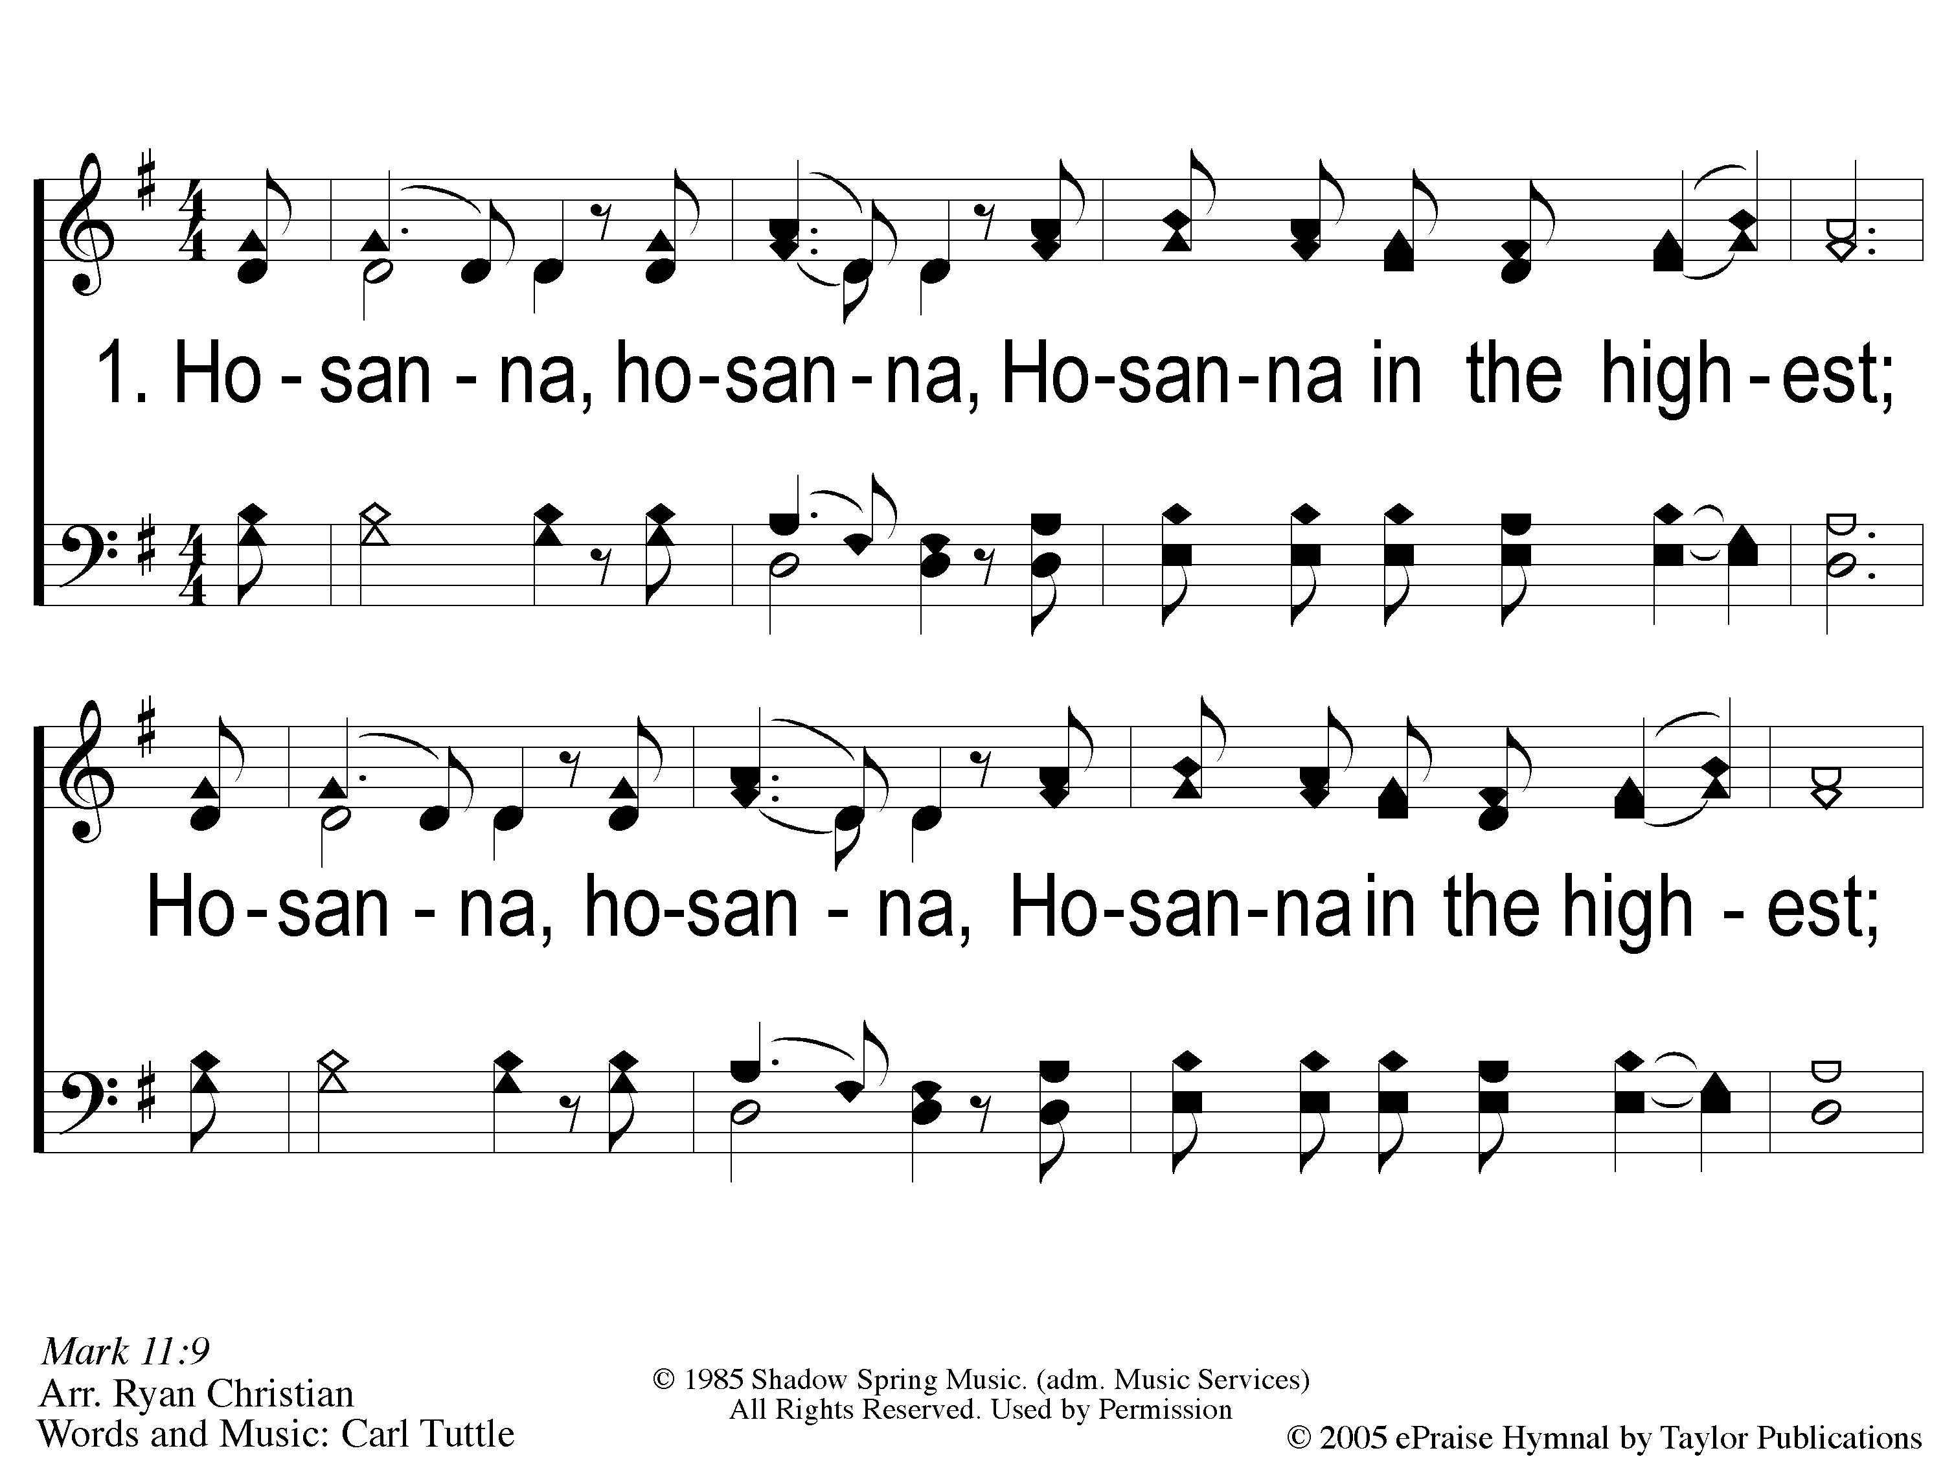
1 Hosanna
Hosanna
167

Slide 3
C-1 Hosanna
Hosanna
167

Slide 4
C-2 Hosanna
Hosanna
167

Slide 5
2 Hosanna
Hosanna
167

Slide 6
C-1 Hosanna
Hosanna
167

Slide 7
C-2 Hosanna
Hosanna
167

Slide 8
WELCOME
THANKS FOR JOINING US!

Slide 9
#290
SONG:
Shine, Jesus, Shine

Slide 10
1-1 Shine Jesus Shine
Shine, Jesus, Shine
290

Slide 11
1-2 Shine Jesus Shine
Shine, Jesus, Shine
290

Slide 12
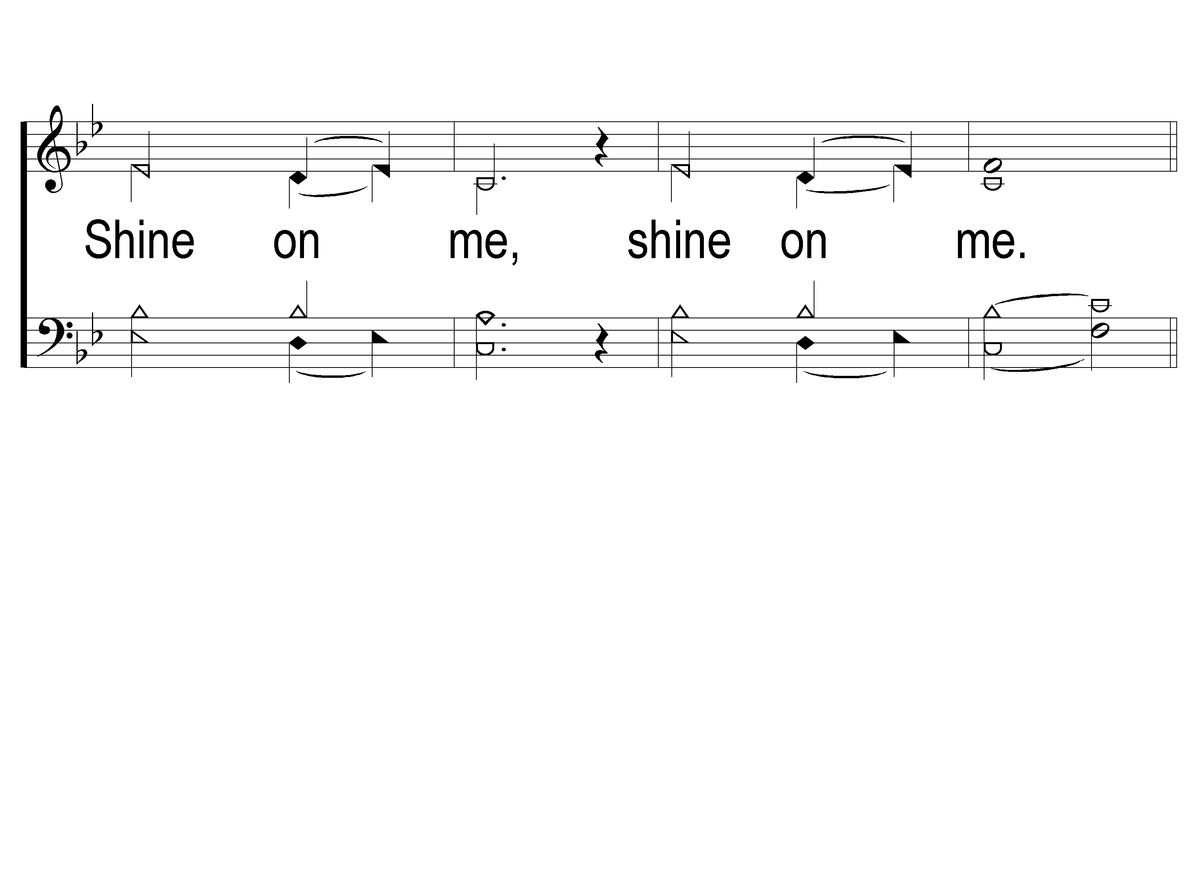
1-3 Shine Jesus Shine
Shine, Jesus, Shine
290

Slide 13
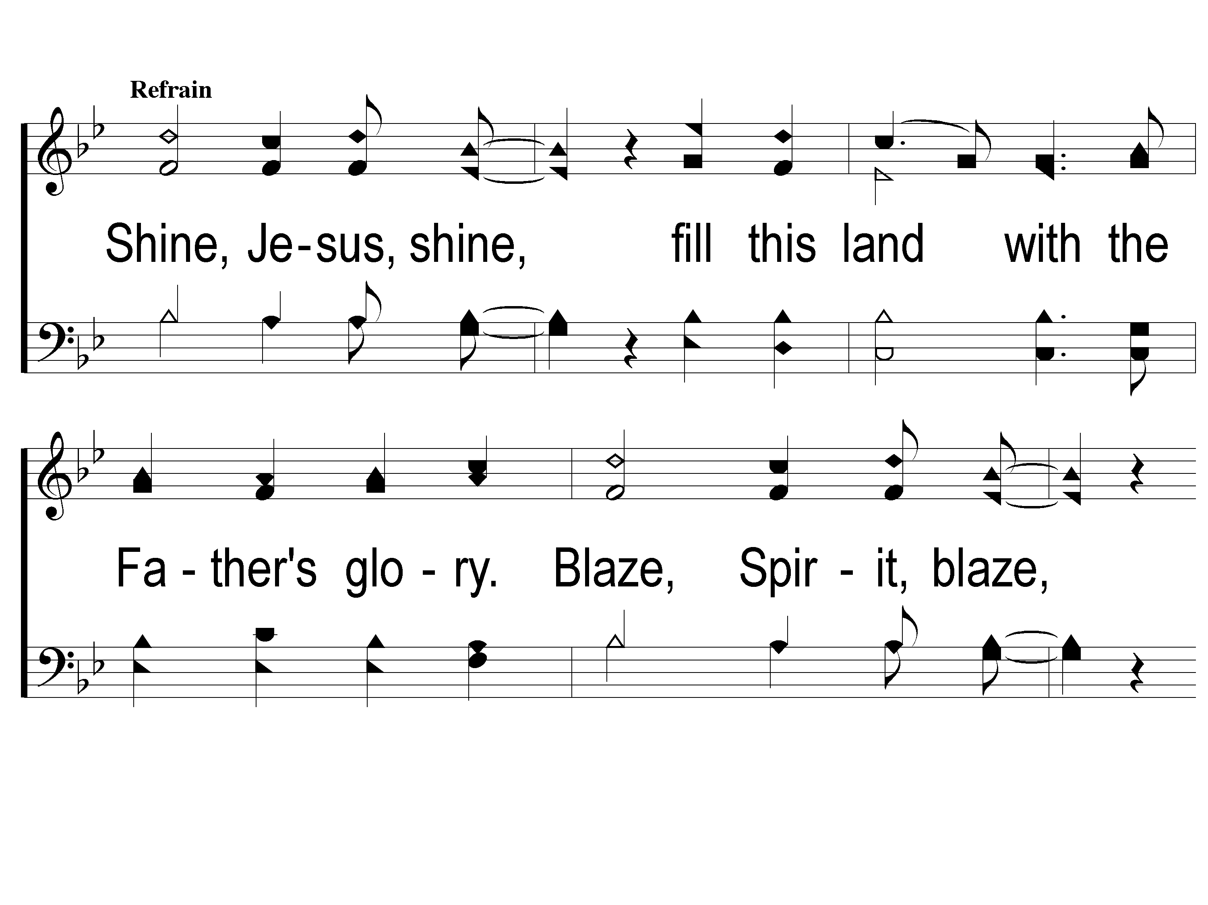
C-1 Shine Jesus Shine
Shine, Jesus, Shine
290

Slide 14
C-2 Shine Jesus Shine
Shine, Jesus, Shine
290

Slide 15
C-3 Shine Jesus Shine
Shine, Jesus, Shine
290

Slide 16
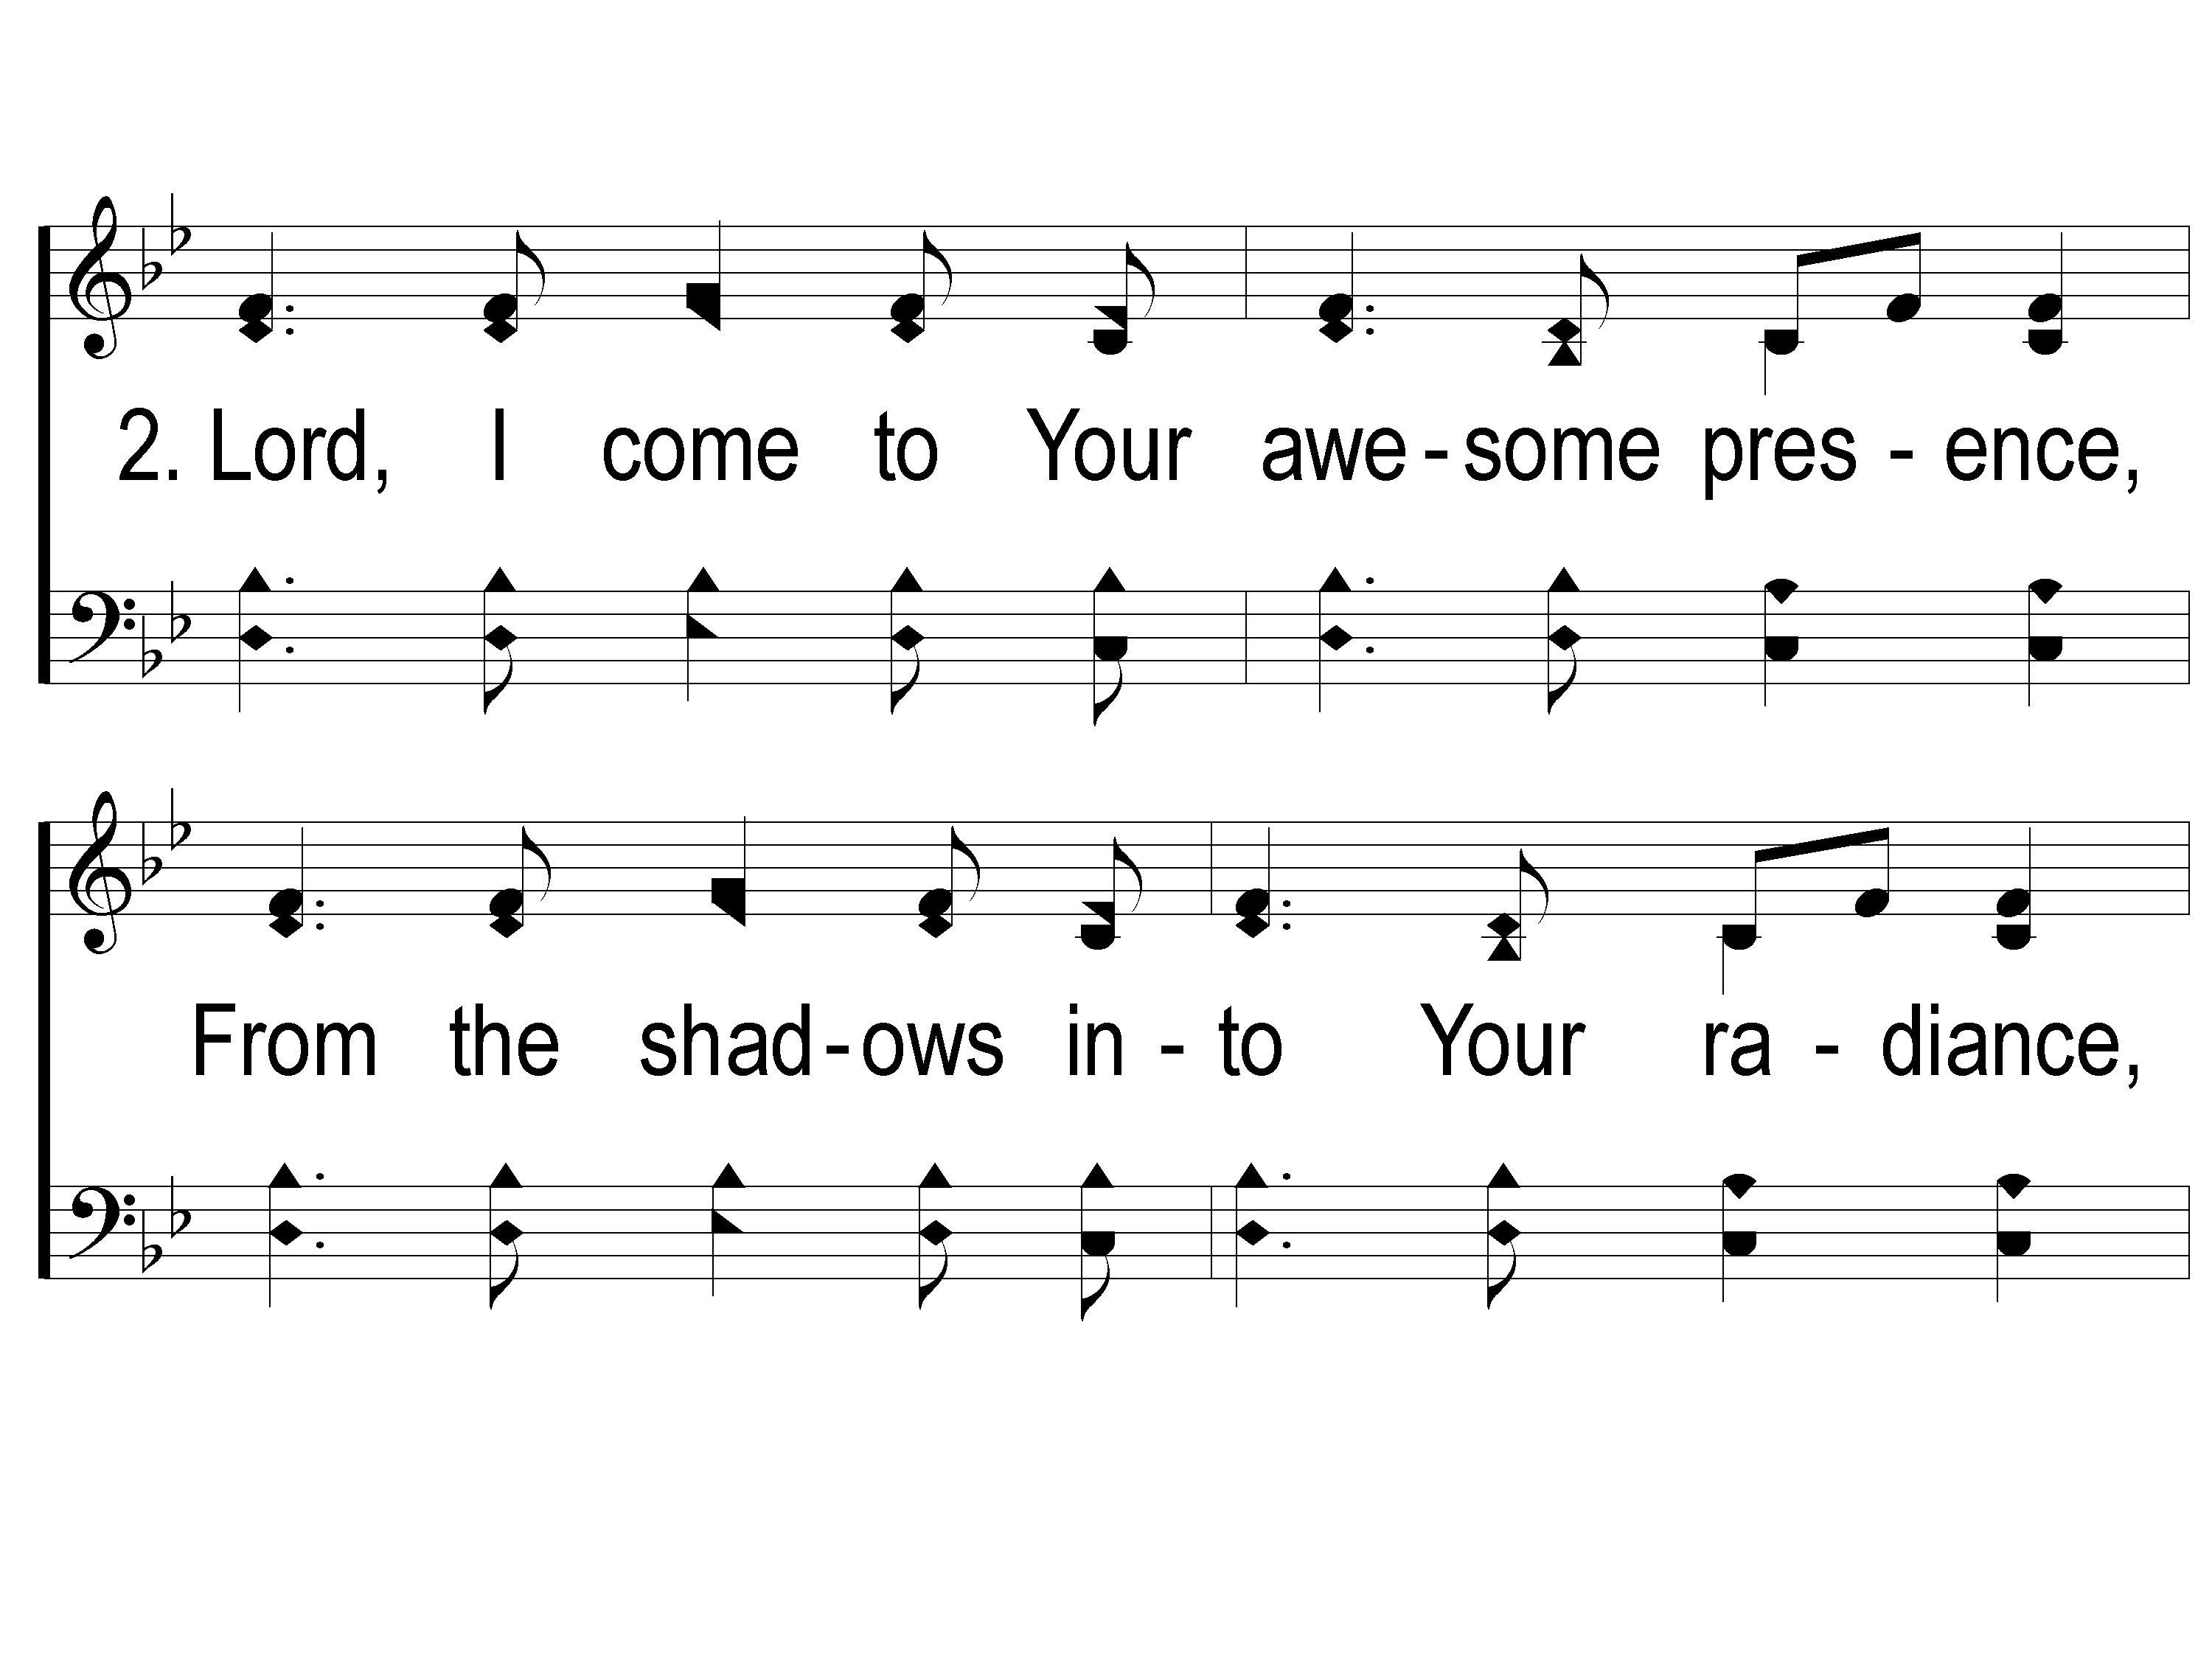
2-1 Shine Jesus Shine
Shine, Jesus, Shine
290

Slide 17
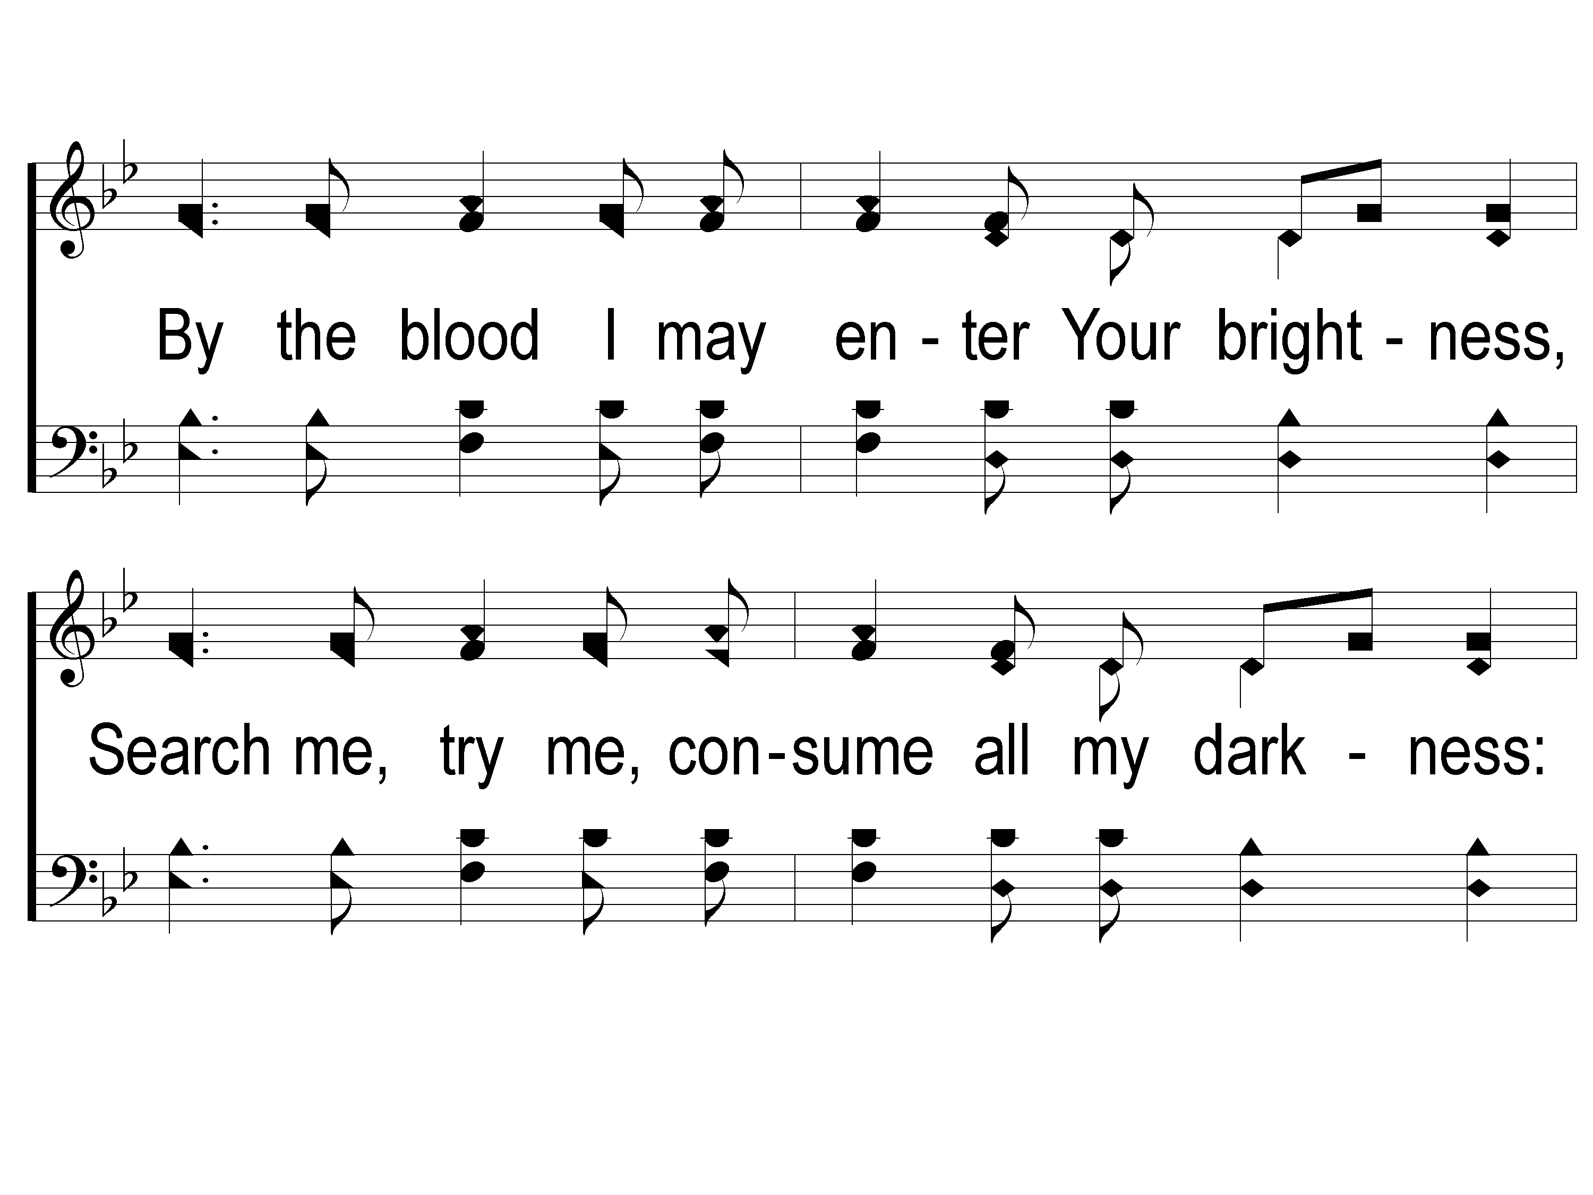
2-2 Shine Jesus Shine
Shine, Jesus, Shine
290

Slide 18
2-3 Shine Jesus Shine
Shine, Jesus, Shine
290

Slide 19
C-1 Shine Jesus Shine
Shine, Jesus, Shine
290

Slide 20
C-2 Shine Jesus Shine
Shine, Jesus, Shine
290

Slide 21
C-3 Shine Jesus Shine
Shine, Jesus, Shine
290

Slide 22
#578
SONG:
We Will Glorify

Slide 23
1-1 We Will Glorify
We Will Glorify
578

Slide 24
1-2 We Will Glorify
We Will Glorify
578

Slide 25
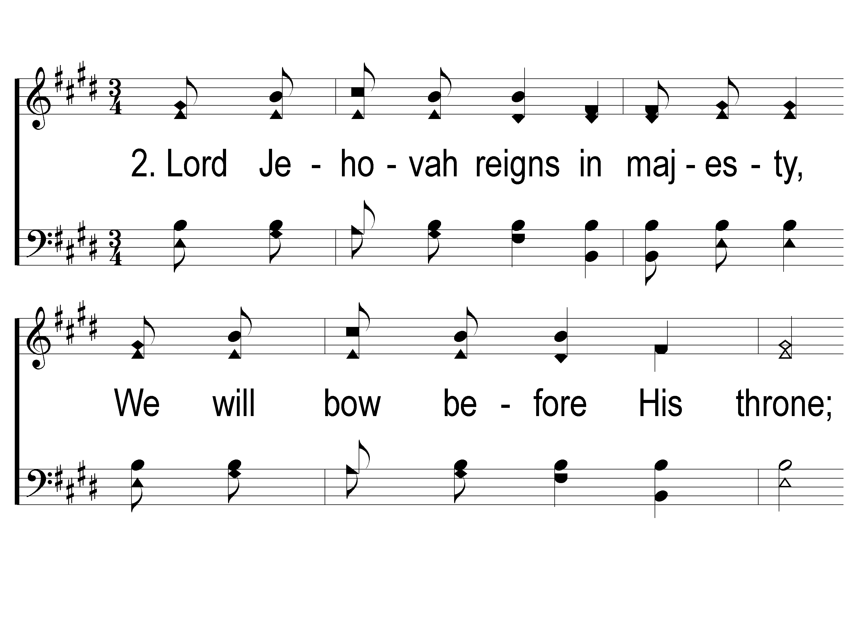
2-1 We Will Glorify
We Will Glorify
578

Slide 26
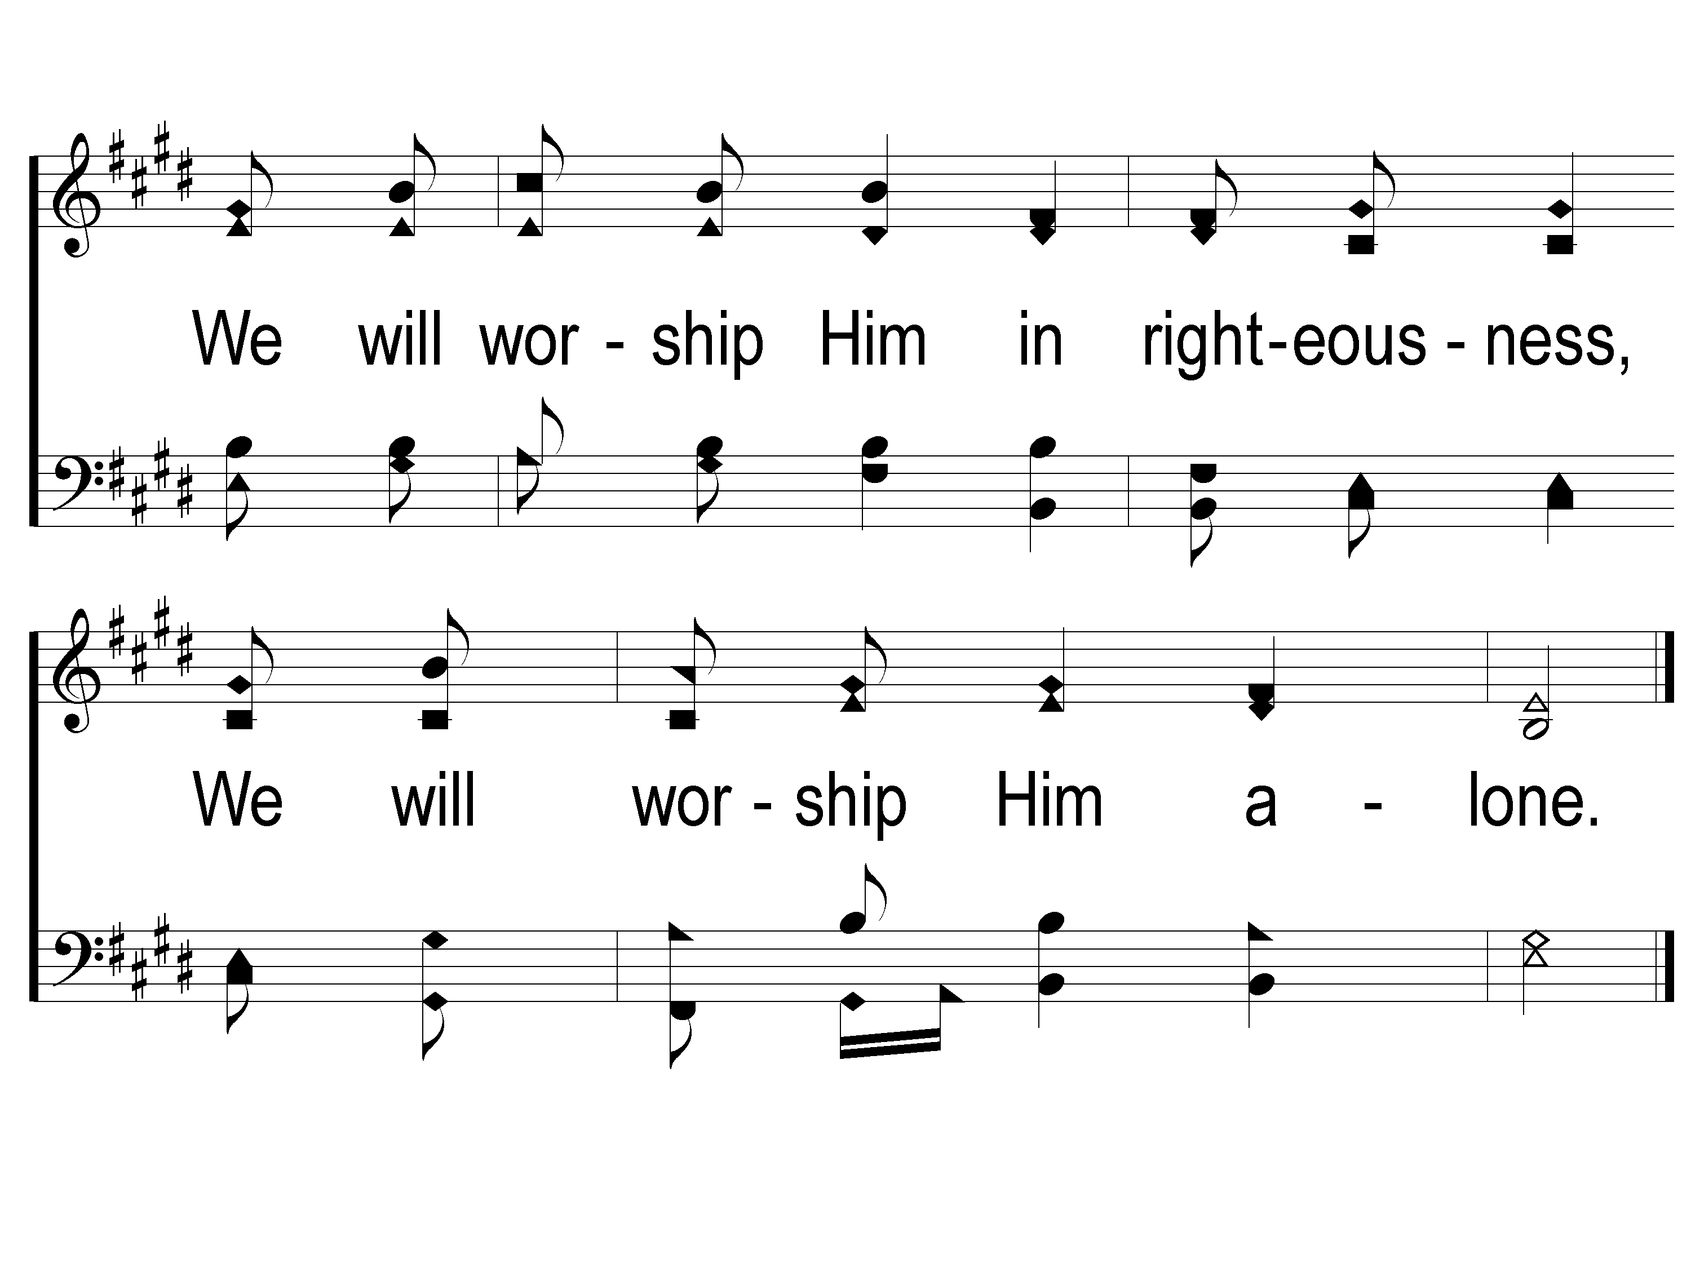
2-2 We Will Glorify
We Will Glorify
578

Slide 27
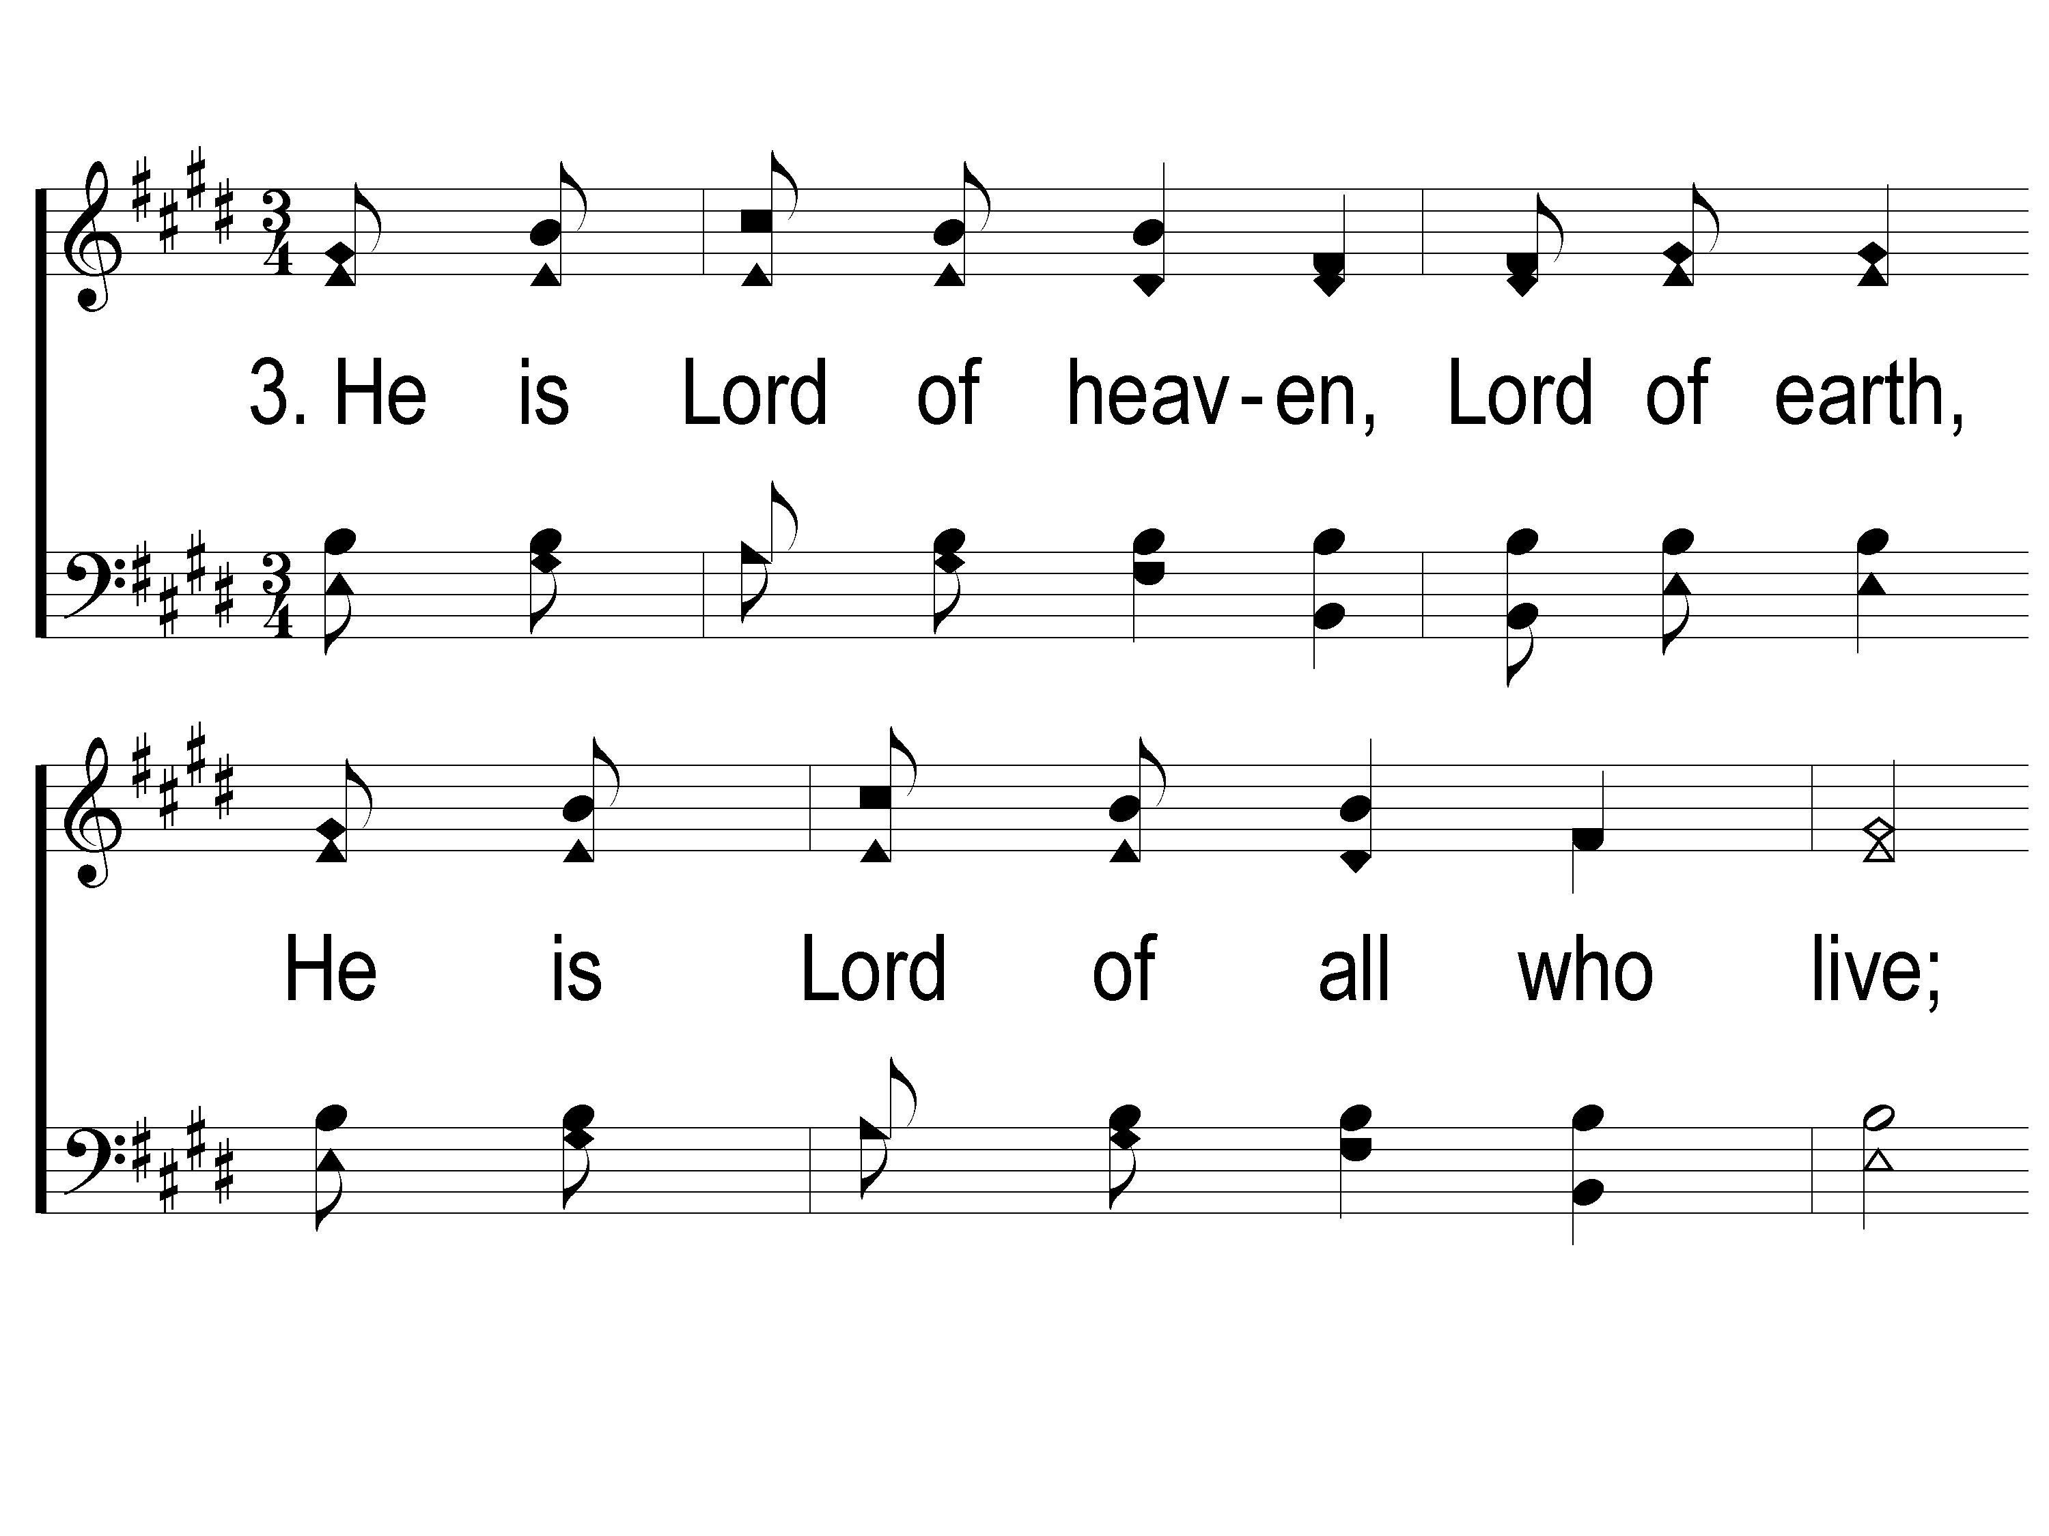
3-1 We Will Glorify
We Will Glorify
578

Slide 28
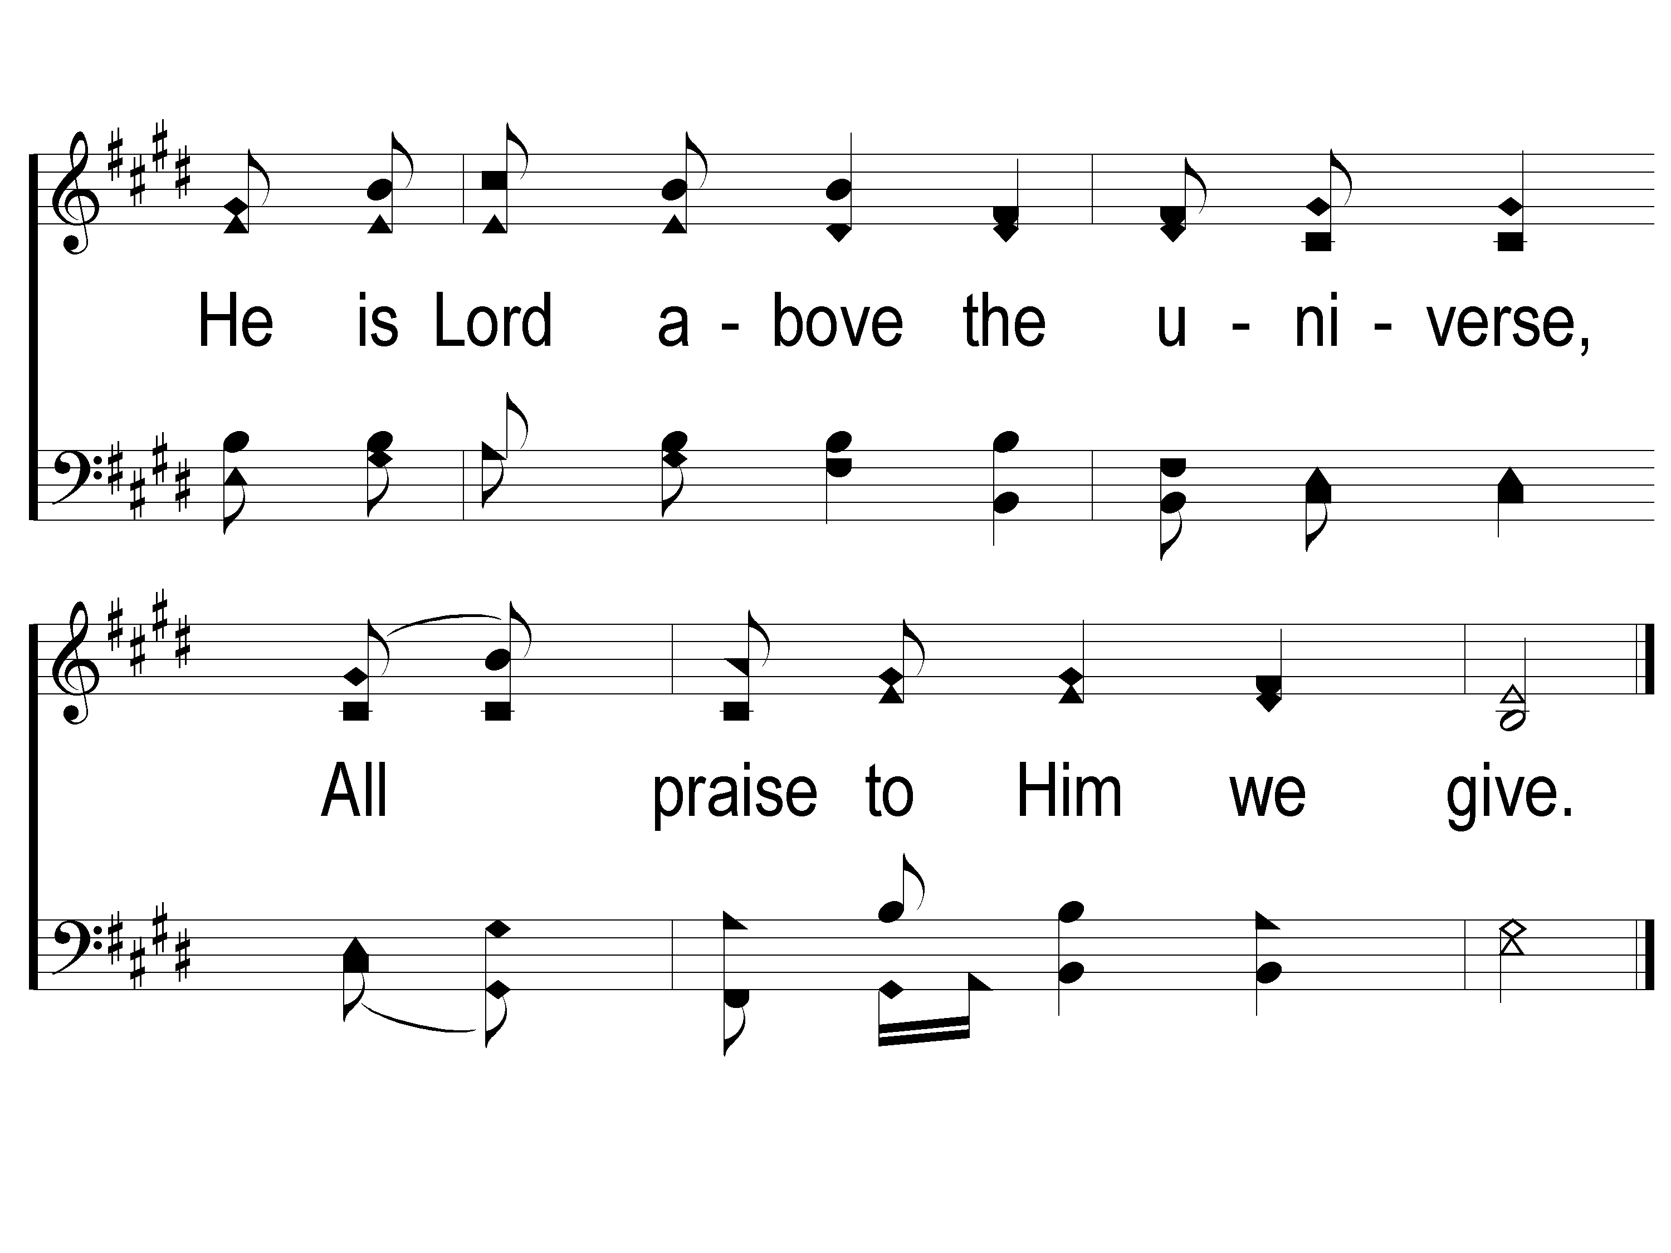
3-2 We Will Glorify
We Will Glorify
578

Slide 29
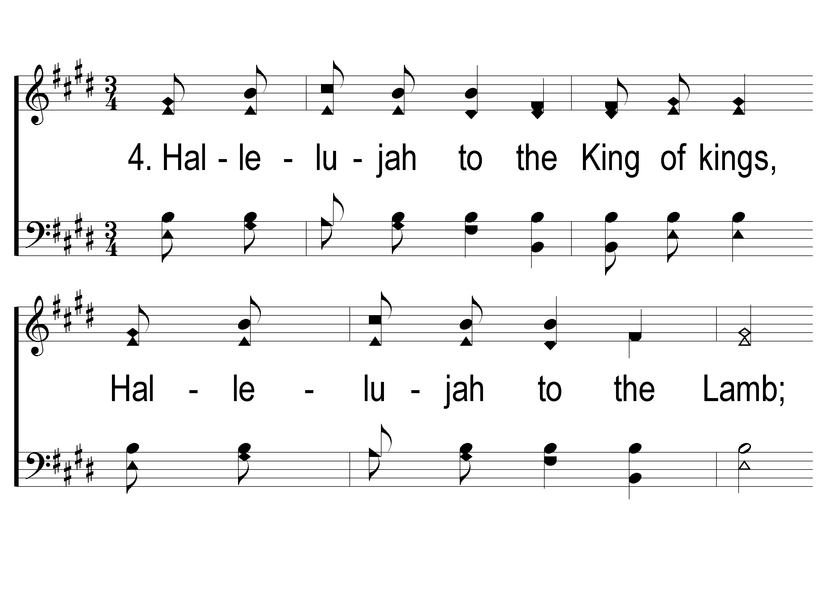
4-1 We Will Glorify
We Will Glorify
578

Slide 30
4-2 We Will Glorify
We Will Glorify
578

Slide 31
Opening PRAYER

Slide 32
#535
SONG:
The Glory Land Way

Slide 33
1-1 The Glory Land Way
The Glory Land Way
535

Slide 34
1-2 The Glory Land Way
The Glory Land Way
535

Slide 35
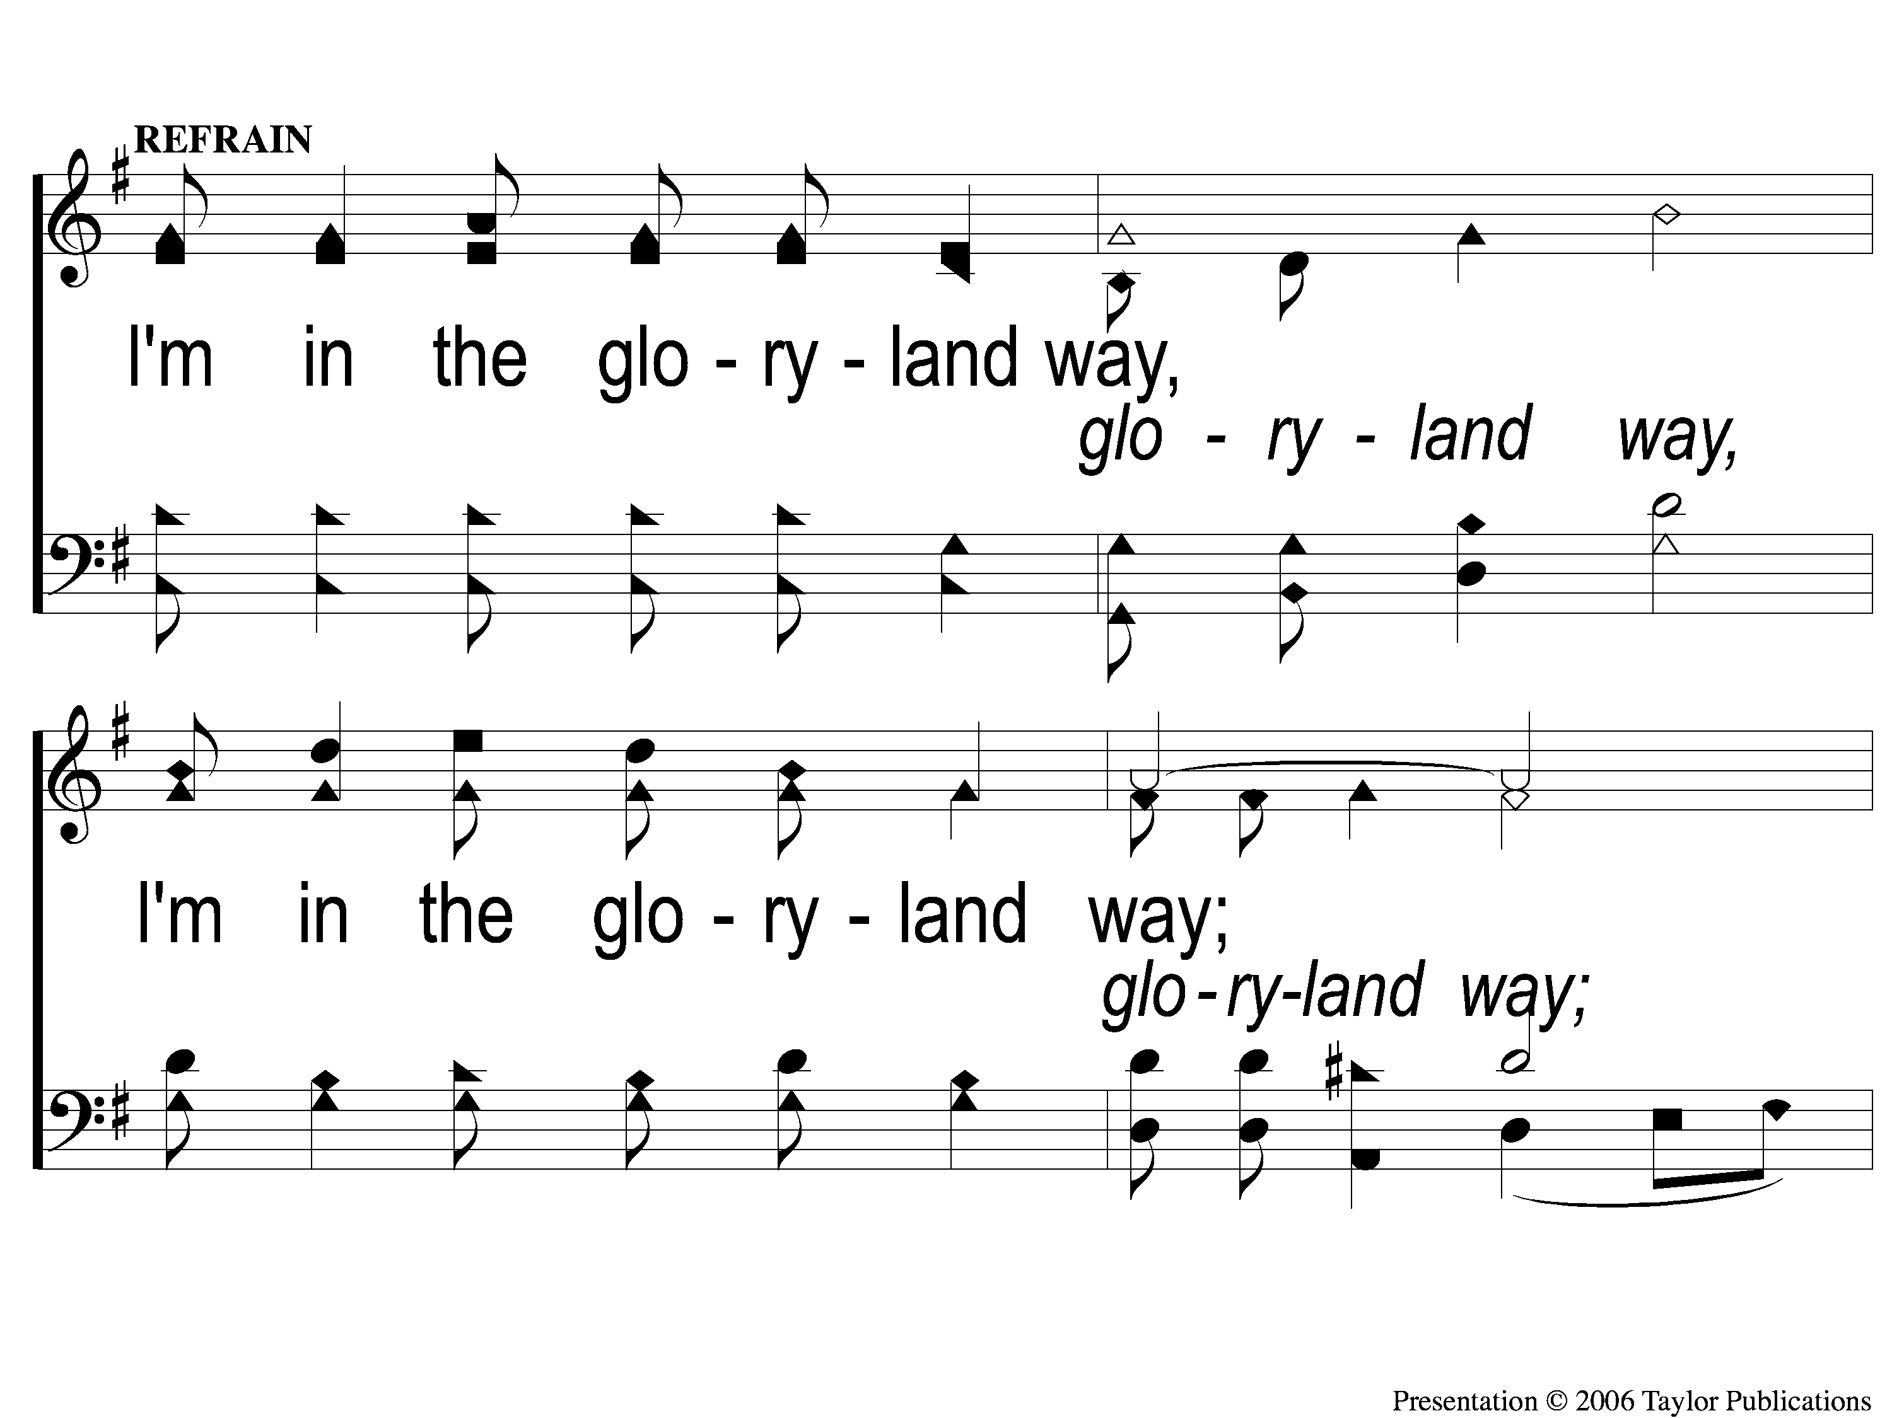
C-1 The Glory Land Way
The Glory Land Way
535

Slide 36
C-2 The Glory Land Way
The Glory Land Way
535

Slide 37
2-1 The Glory Land Way
The Glory Land Way
535

Slide 38
2-2 The Glory Land Way
The Glory Land Way
535

Slide 39
C-1 The Glory Land Way
The Glory Land Way
535

Slide 40
C-2 The Glory Land Way
The Glory Land Way
535

Slide 41
3-1 The Glory Land Way
The Glory Land Way
535

Slide 42
3-2 The Glory Land Way
The Glory Land Way
535

Slide 43
C-1 The Glory Land Way
The Glory Land Way
535

Slide 44
C-2 The Glory Land Way
The Glory Land Way
535

Slide 45
#718
SONG:
We Shall Assemble

Slide 46
1 We Shall Assemble
We Shall Assemble
718

Slide 47
2 We Shall Assemble
We Shall Assemble
718

Slide 48
3 We Shall Assemble
We Shall Assemble
718

Slide 49
4 We Shall Assemble
We Shall Assemble
718

Slide 50
SCRIPTURE:
1 Samuel 17:36-39

Slide 52
WATCH WHERE YOU STAND

Slide 53
KING DAVID

Slide 54
KING DAVID
His Courageous Youth

Slide 55
KING DAVID
His Courageous Youth
His Chaotic Kingship

Slide 56
KING DAVID
His Courageous Youth (1 Samuel)

Slide 57
KING DAVID
His Courageous Youth (1 Samuel)
His Caretaking (Ch .16)

Slide 58
KING DAVID
His Courageous Youth (1 Samuel)
His Caretaking (Ch .16)
His Companion (Ch. 18)

Slide 59
KING DAVID
His Courageous Youth (1 Samuel)
His Caretaking (Ch .16)
His Companion (Ch. 18)
His Craziness (Ch. 21)

Slide 60
KING DAVID
His Courageous Youth (1 Samuel)
His Caretaking (Ch .16)
His Companion (Ch. 18)
His Craziness (Ch. 21)
His Crowning (Ch. 16)

Slide 61
KING DAVID
His Courageous Youth (1 Samuel)
His Caretaking (Ch .16)
His Companion (Ch. 18)
His Craziness (Ch. 21)
His Crowning (Ch. 16)
His Conquering (Ch. 17)

Slide 62
THE FAMOUS STAGE
1 Samuel 17:1-3

Slide 63
THE FAMOUS STAGE
1 Samuel 17:1-3
Philistines gathered against Israel
Israel gathers in defense

Slide 64
THE FAMOUS STAGE
1 Samuel 17:1-3
Philistines gathered against Israel
Israel gathers in defense
Valley of Elah

Slide 65
THE PHILISTINE SOLDIER
1 Samuel 17:4-10

Slide 66
THE PHILISTINE SOLDIER
1 Samuel 17:4-10
A “Champion”

Slide 67
THE PHILISTINE SOLDIER
1 Samuel 17:4-10
A “Champion”
A Giant → at least 9’ 6”

Slide 68
THE PHILISTINE SOLDIER
1 Samuel 17:4-10
A “Champion”
A Giant → at least 9’ 6”
A Soldier with:
Armor – Helmet, chainmail, etc.

Slide 69
THE PHILISTINE SOLDIER
1 Samuel 17:4-10
A “Champion”
A Giant → at least 9’ 6”
A Soldier with:
Armor – Helmet, chainmail, etc.
Weapons – Spear, Sword, & Javelin

Slide 70
THE PHILISTINE SOLDIER
1 Samuel 17:4-10
A Defiant Attitude
Against God’s People
Against God

Slide 71
THE FEARFUL SOLDIERS
1 Samuel 17:11

Slide 72
THE FEARFUL SOLDIERS
1 Samuel 17:11
“Dismayed” = shattered

Slide 73
THE FEARFUL SOLDIERS
1 Samuel 17:11
“Dismayed” = shattered
“Greatly afraid” = frightened, in a state of deep concern

Slide 74
THE FIRST SOLUTION
1 Samuel 17:38-39a

Slide 75
THE FIRST SOLUTION
1 Samuel 17:38-39a
The Solution:
Wear Saul’s Armor

Slide 76
THE FIRST SOLUTION
1 Samuel 17:38-39a
The Solution:
Wear Saul’s Armor
The Result:
David Fell Short

Slide 77
THE FINAL SOLUTION
1 Samuel 17:39b-51

Slide 78
THE FINAL SOLUTION
1 Samuel 17:39b-51
The Solution:
No Armor

Slide 79
THE FINAL SOLUTION
1 Samuel 17:39b-51
The Solution:
No Armor
Take a Sling & 5 Stones

Slide 80
THE FINAL SOLUTION
1 Samuel 17:39b-51
The Solution:
No Armor
Take a Sling & 5 Stones
The Result:
Goliath Fell Instantly

Slide 81
WATCH WHERE YOUR FAITH COMES FROM

Slide 82
THE QUESTION
Where Does
Your Faith
Come From?

Slide 83
THE QUESTION
Is Your Faith
Truly Yours?

Slide 84
#214
SONG:
Have You Seen
Jesus My Lord?

Slide 85
1-1 Have You Seen Jesus My Lord
Have You Seen Jesus My Lord
214

Slide 86
1-2 Have You Seen Jesus My Lord
Have You Seen Jesus My Lord
214

Slide 87
C-1 Have You Seen Jesus My Lord
Have You Seen Jesus My Lord
214

Slide 88
C-2 Have You Seen Jesus My Lord
Have You Seen Jesus My Lord
214

Slide 89
2-1 Have You Seen Jesus My Lord
Have You Seen Jesus My Lord
214

Slide 90
2-2 Have You Seen Jesus My Lord
Have You Seen Jesus My Lord
214

Slide 91
C-1 Have You Seen Jesus My Lord
Have You Seen Jesus My Lord
214

Slide 92
C-2 Have You Seen Jesus My Lord
Have You Seen Jesus My Lord
214

Slide 93
4-1 Have You Seen Jesus My Lord
Have You Seen Jesus My Lord
214

Slide 94
4-2 Have You Seen Jesus My Lord
Have You Seen Jesus My Lord
214

Slide 95
C-1 Have You Seen Jesus My Lord
Have You Seen Jesus My Lord
214

Slide 96
C-2 Have You Seen Jesus My Lord
Have You Seen Jesus My Lord
214

Slide 97
#364
SONG:
Come, Share The Lord

Slide 98
1-1 Come Share the Lord
Come, Share The Lord
364

Slide 99
1-2 Come Share the Lord
Come, Share The Lord
364

Slide 100
C-1 Come Share the Lord
Come, Share The Lord
364

Slide 101
3-1 Come Share the Lord
Come, Share The Lord
364

Slide 102
3-2 Come Share the Lord
Come, Share The Lord
364

Slide 103
LORD’S SUPPER
The
Acts 20:7

Slide 104
Unleavened Bread
LORD’S SUPPER
For there is one God and one Mediator between God and men, the Man Christ Jesus, who gave Himself a ransom for all, to be testified in due time, for which I was appointed a preacher and an apostle—I am speaking the truth in Christ and not lying—a teacher of the Gentiles in faith and truth.
1 Tim. 2:5-7

Slide 105
Fruit of the Vine
LORD’S SUPPER
For God did not appoint us to wrath, but to obtain salvation through our Lord Jesus Christ, who died for us, that whether we wake or sleep, we should live together with Him. Therefore comfort each other and edify one another, just as you also are doing.
1 Thess. 5:9-11

Slide 106
2 Corinthians 8:12
OFFERING
For if there is first a willing mind, it is accepted according to what one has, and not according to what he does not have.

Slide 107
Closing PRAYER

Slide 108
#474
SONG:
Thank You, Lord

Slide 109
1 Thank You Lord
Thank You, Lord
474

Slide 110
1C Thank You Lord
Thank You, Lord
474

Slide 111
2 Thank You Lord
Thank You, Lord
474

Slide 112
1C Thank You Lord
Thank You, Lord
474

Slide 113
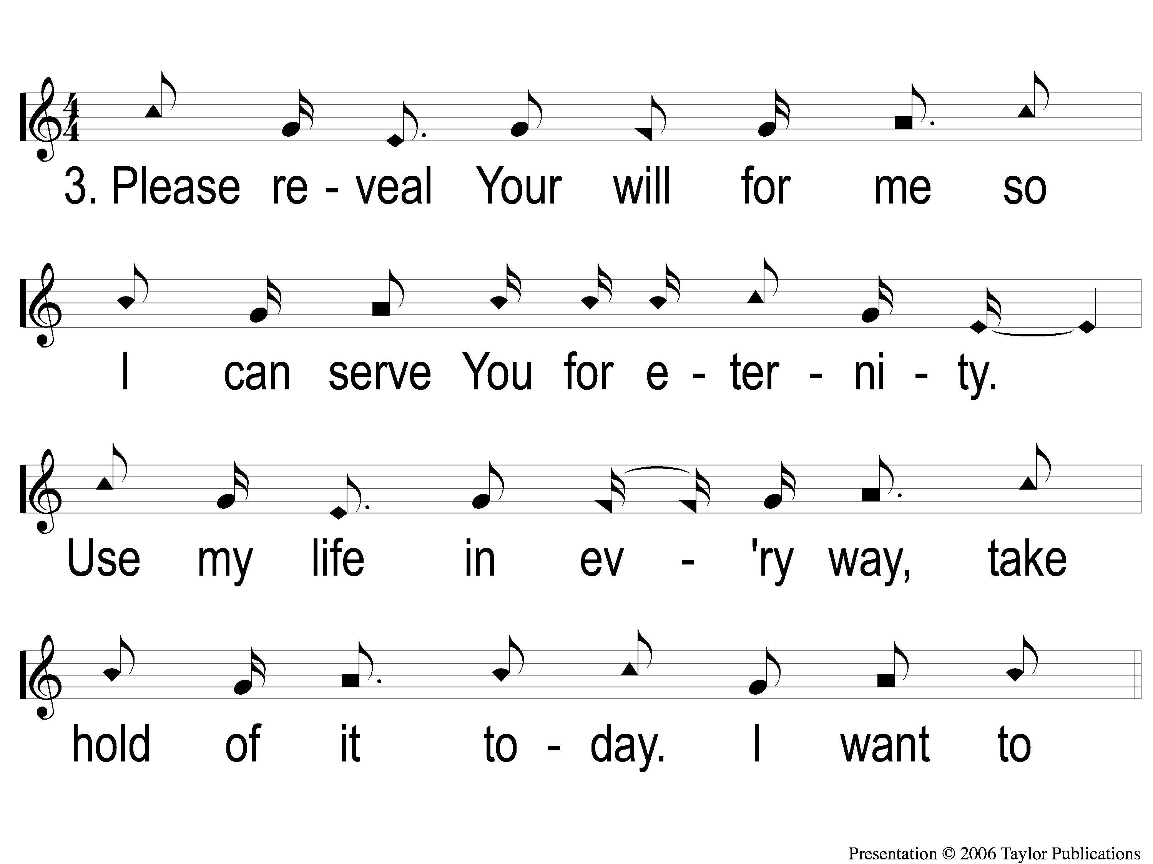
3 Thank You Lord
Thank You, Lord
474

Slide 114
2C-1 Thank You Lord
Thank You, Lord
474

Slide 115
2C-2 Thank You Lord
Thank You, Lord
474

Slide 116
TONIGHT @ 6:00 pm
EVENING WORSHIP
HOPE TO SEE YOU THERE!

