Slide 1
1-1 Wonderful Story of Love
Wonderful Story of Love
286

Slide 2
1-2 Wonderful Story of Love
Wonderful Story of Love
286

Slide 3
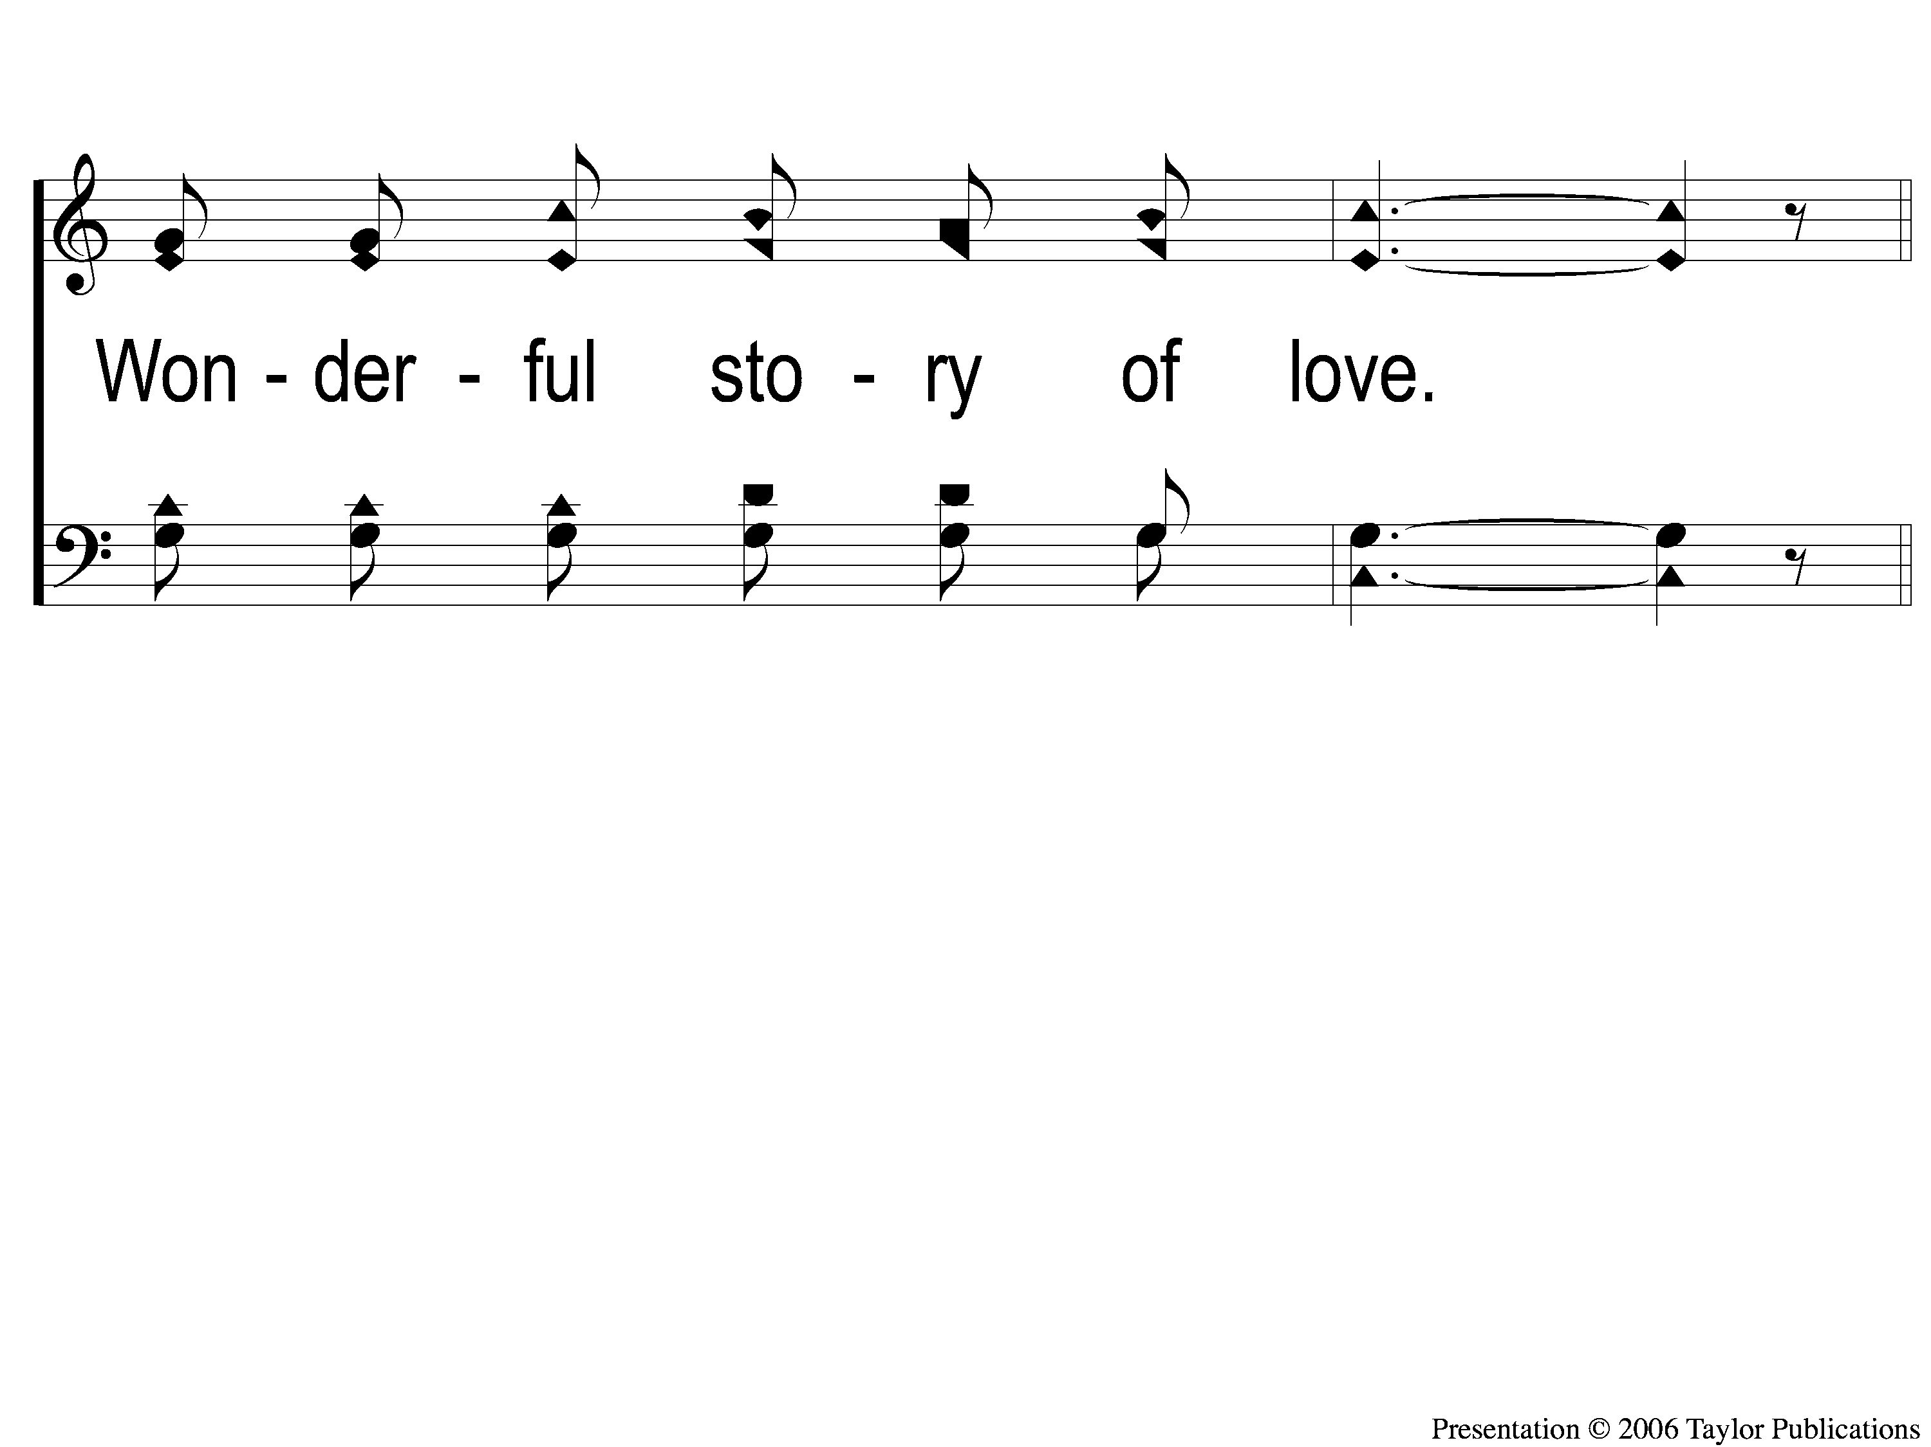
1-3 Wonderful Story of Love
Wonderful Story of Love
286

Slide 4
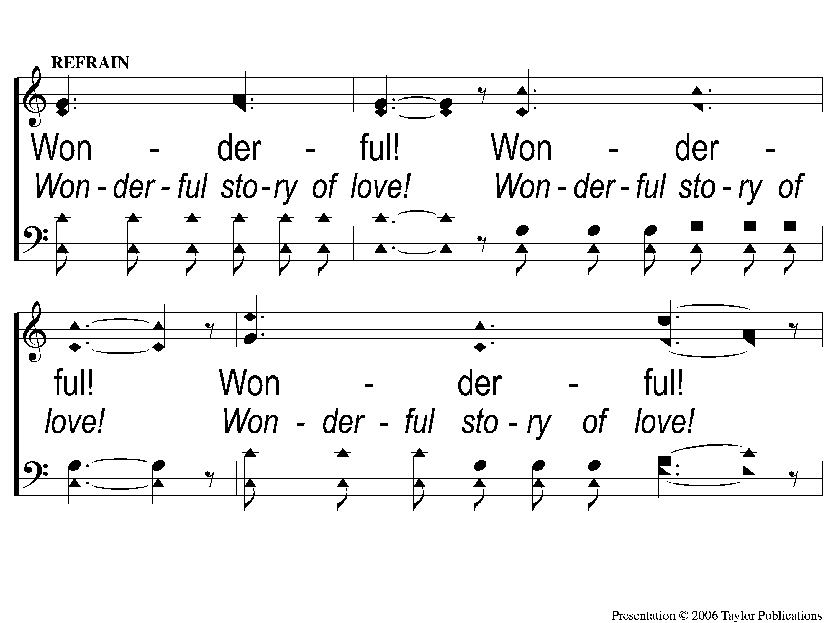
C-1 Wonderful Story of Love
Wonderful Story of Love
286

Slide 5
C-2 Wonderful Story of Love
Wonderful Story of Love
286

Slide 6
3-1 Wonderful Story of Love
Wonderful Story of Love
286

Slide 7
3-2 Wonderful Story of Love
Wonderful Story of Love
286

Slide 8
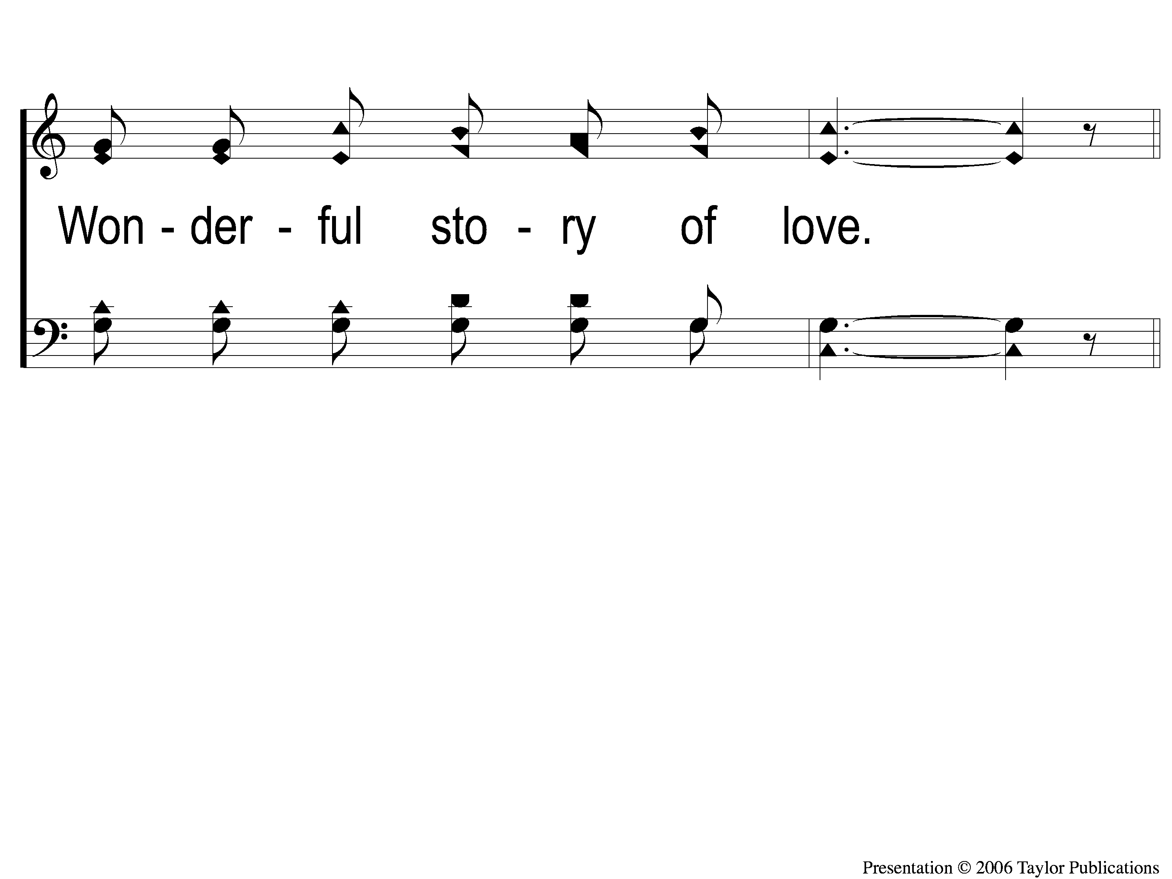
3-3 Wonderful Story of Love
Wonderful Story of Love
286

Slide 9
C-1 Wonderful Story of Love
Wonderful Story of Love
286

Slide 10
C-2 Wonderful Story of Love
Wonderful Story of Love
286

Slide 11
RESTORE REBUILD RENEW
welcome
we are glad to
Have you with us
IN 2022
WHEELER
CHURCH
OF
CHRIST

Slide 12
Song:
This World Is Not My Home
#957

Slide 13
1-1 This World is Not My Home
This World Is Not My Home
957

Slide 14
1-2 This World is Not My Home
This World Is Not My Home
957

Slide 15
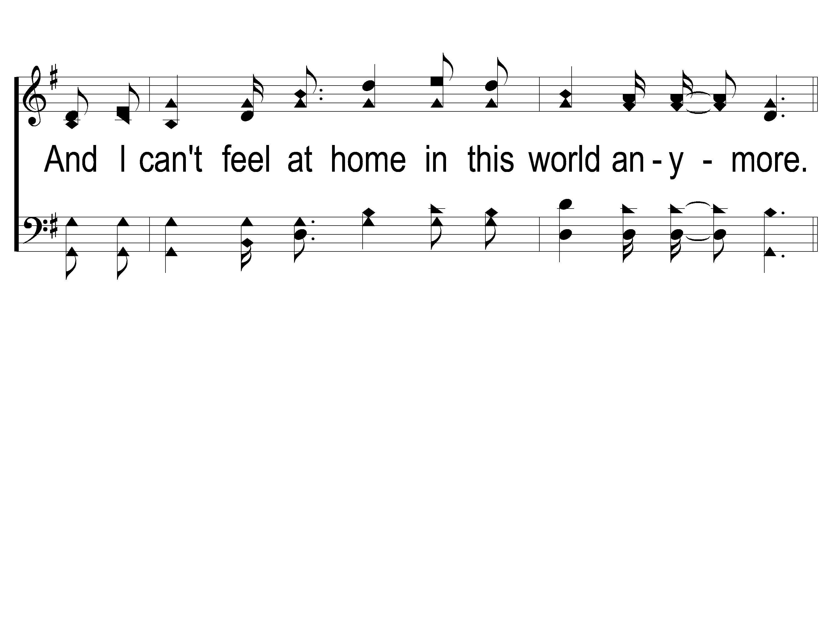
1-3 This World is Not My Home
This World Is Not My Home
957

Slide 16
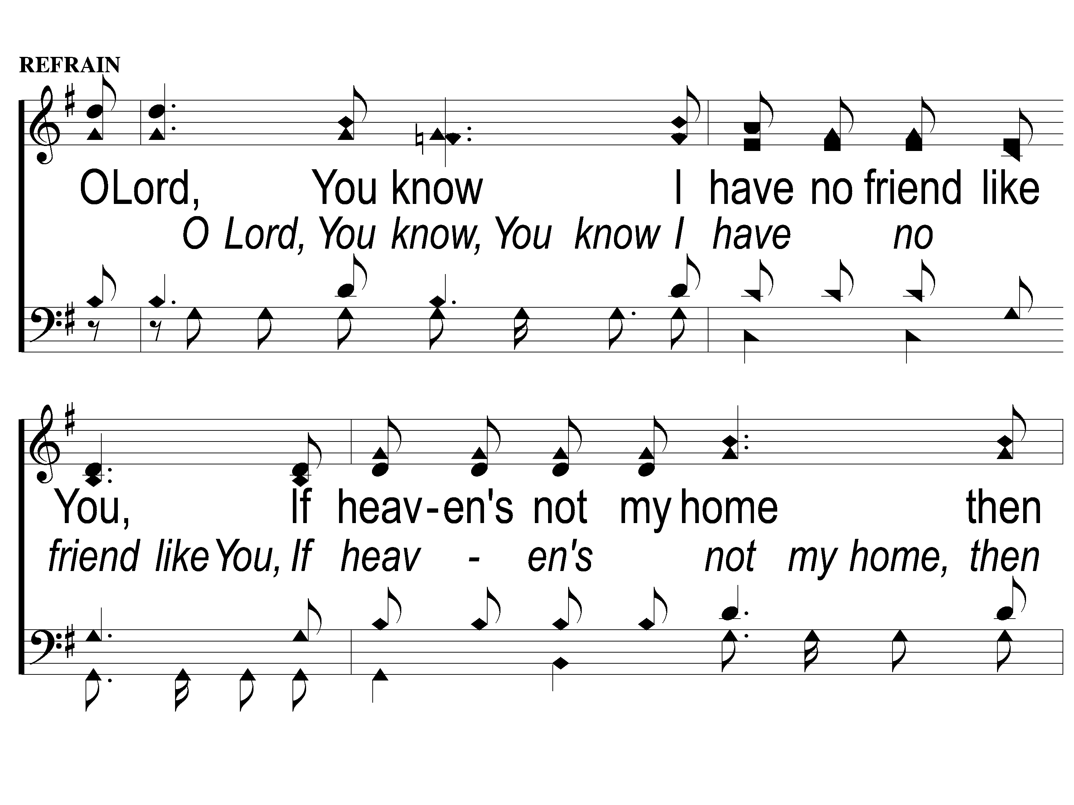
C-1 This World is Not My Home
This World Is Not My Home
957

Slide 17
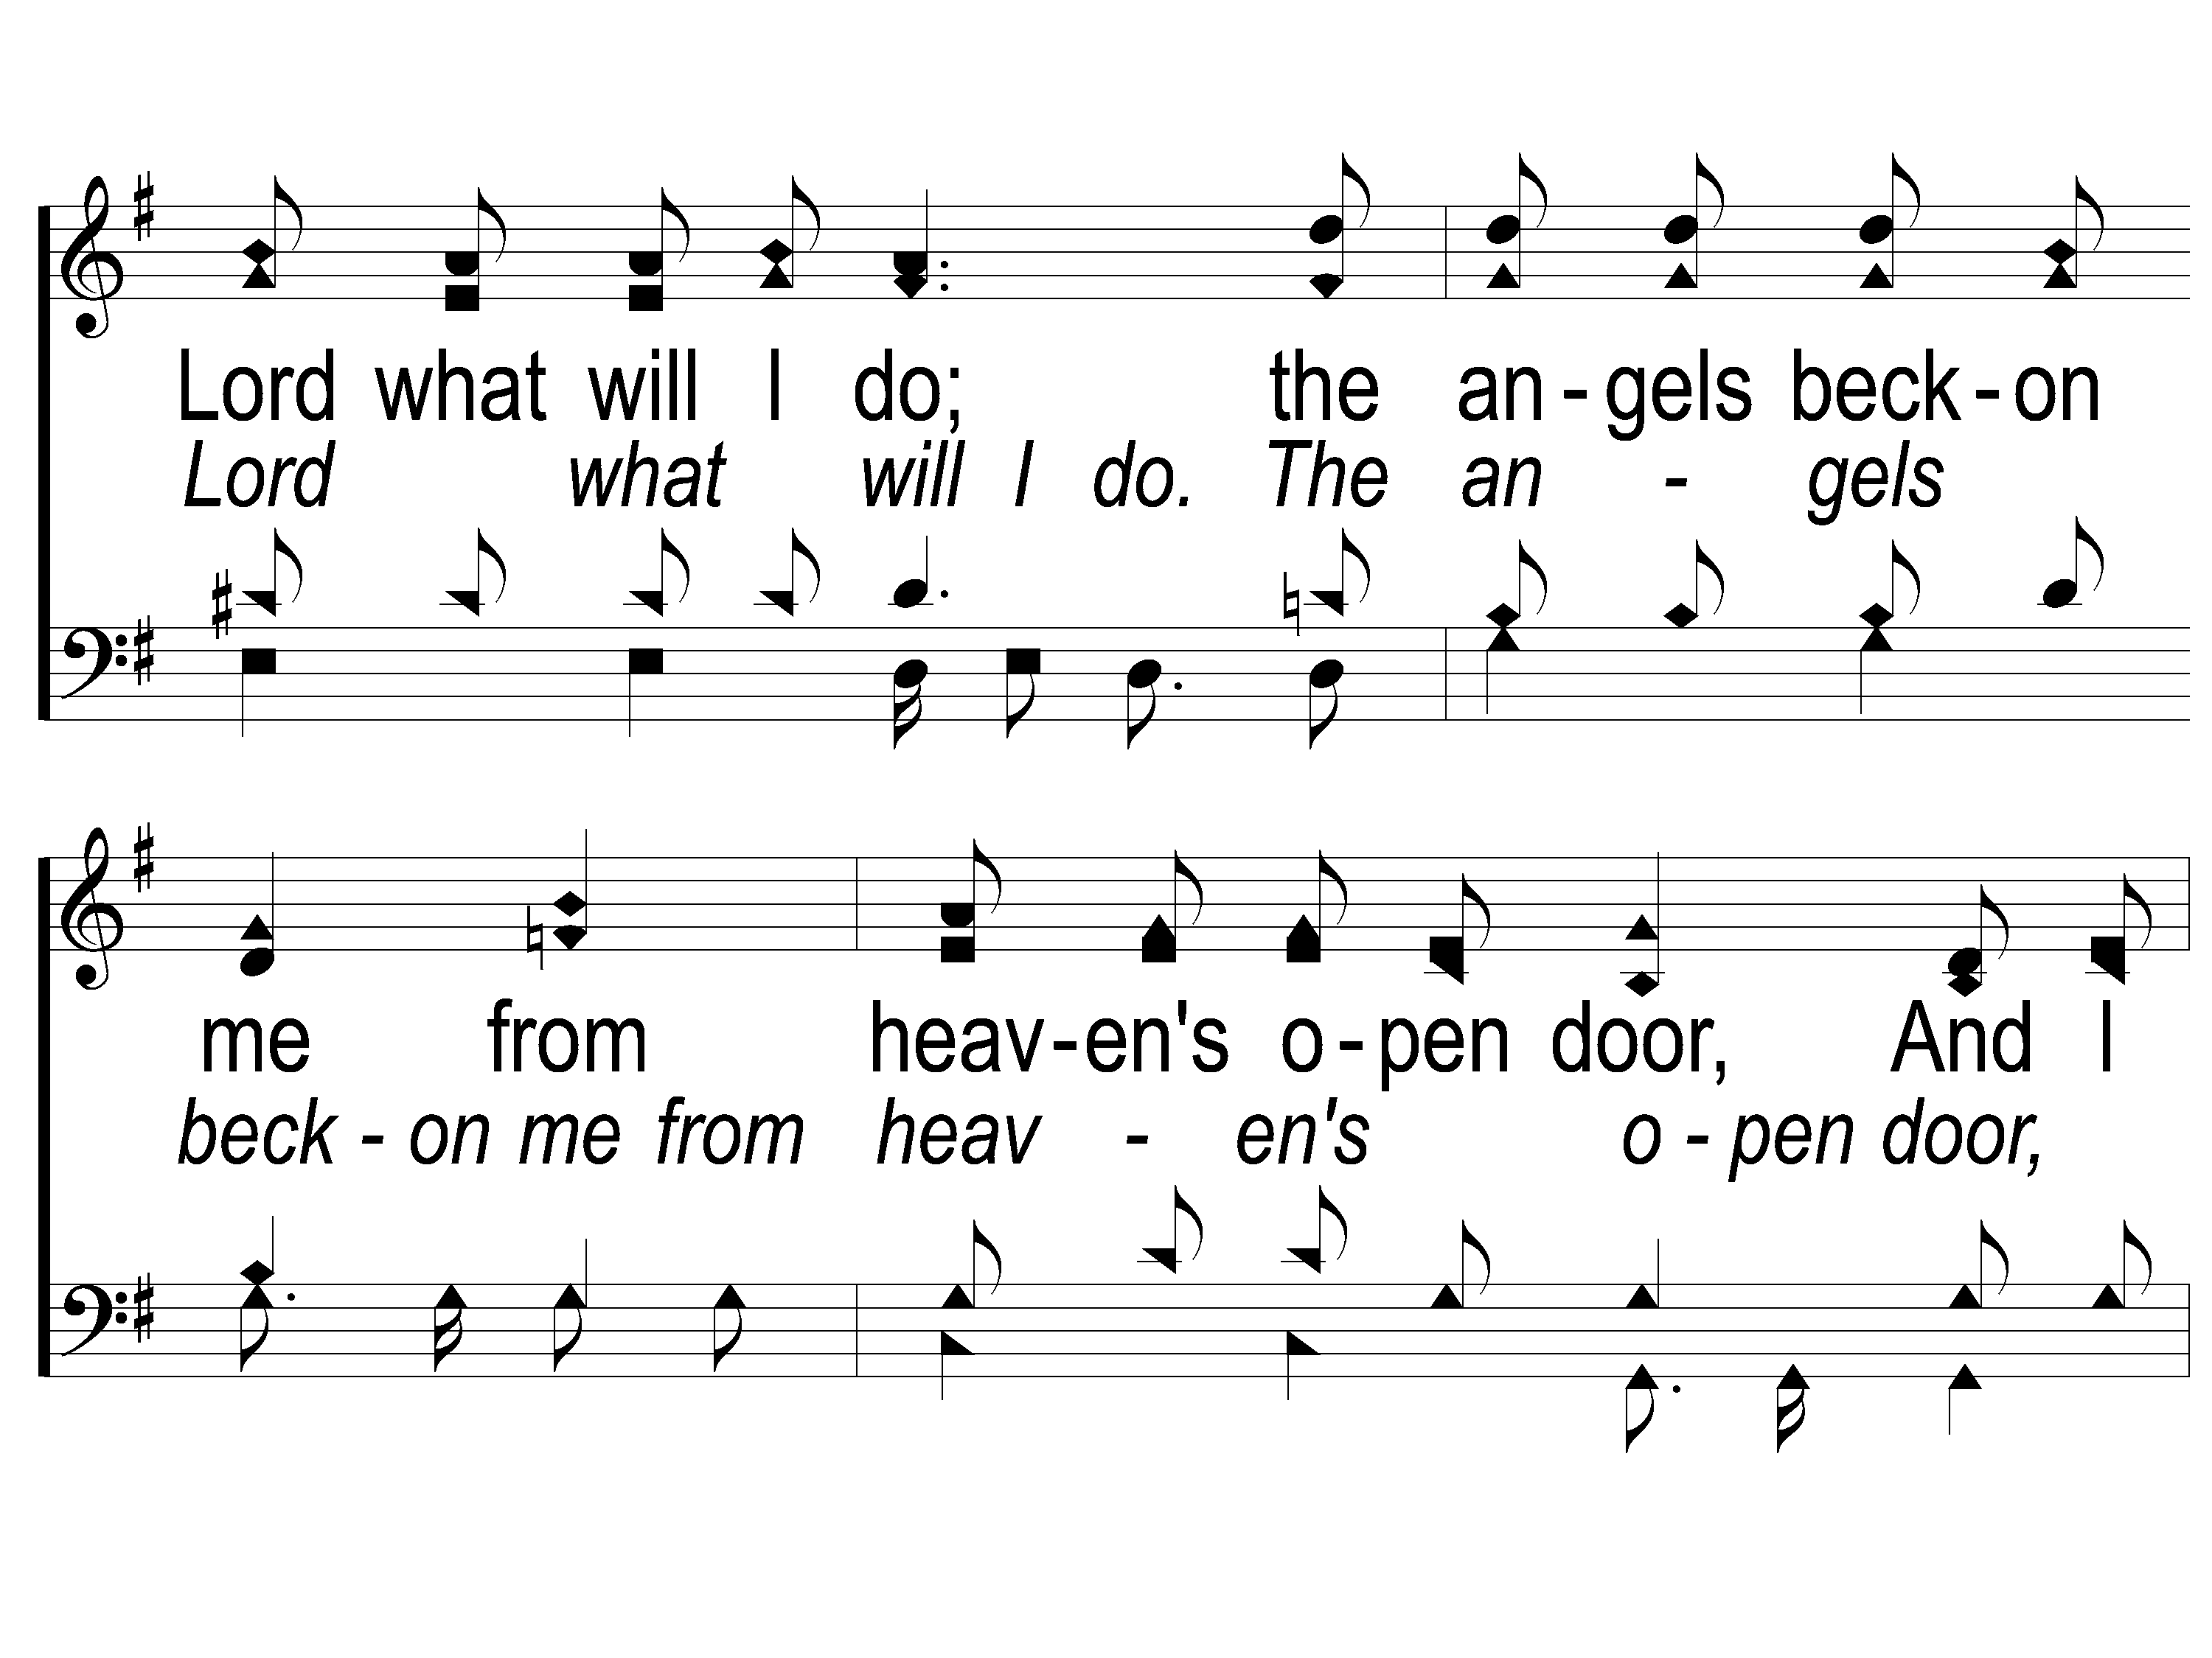
C-2 This World is Not My Home
This World Is Not My Home
957

Slide 18
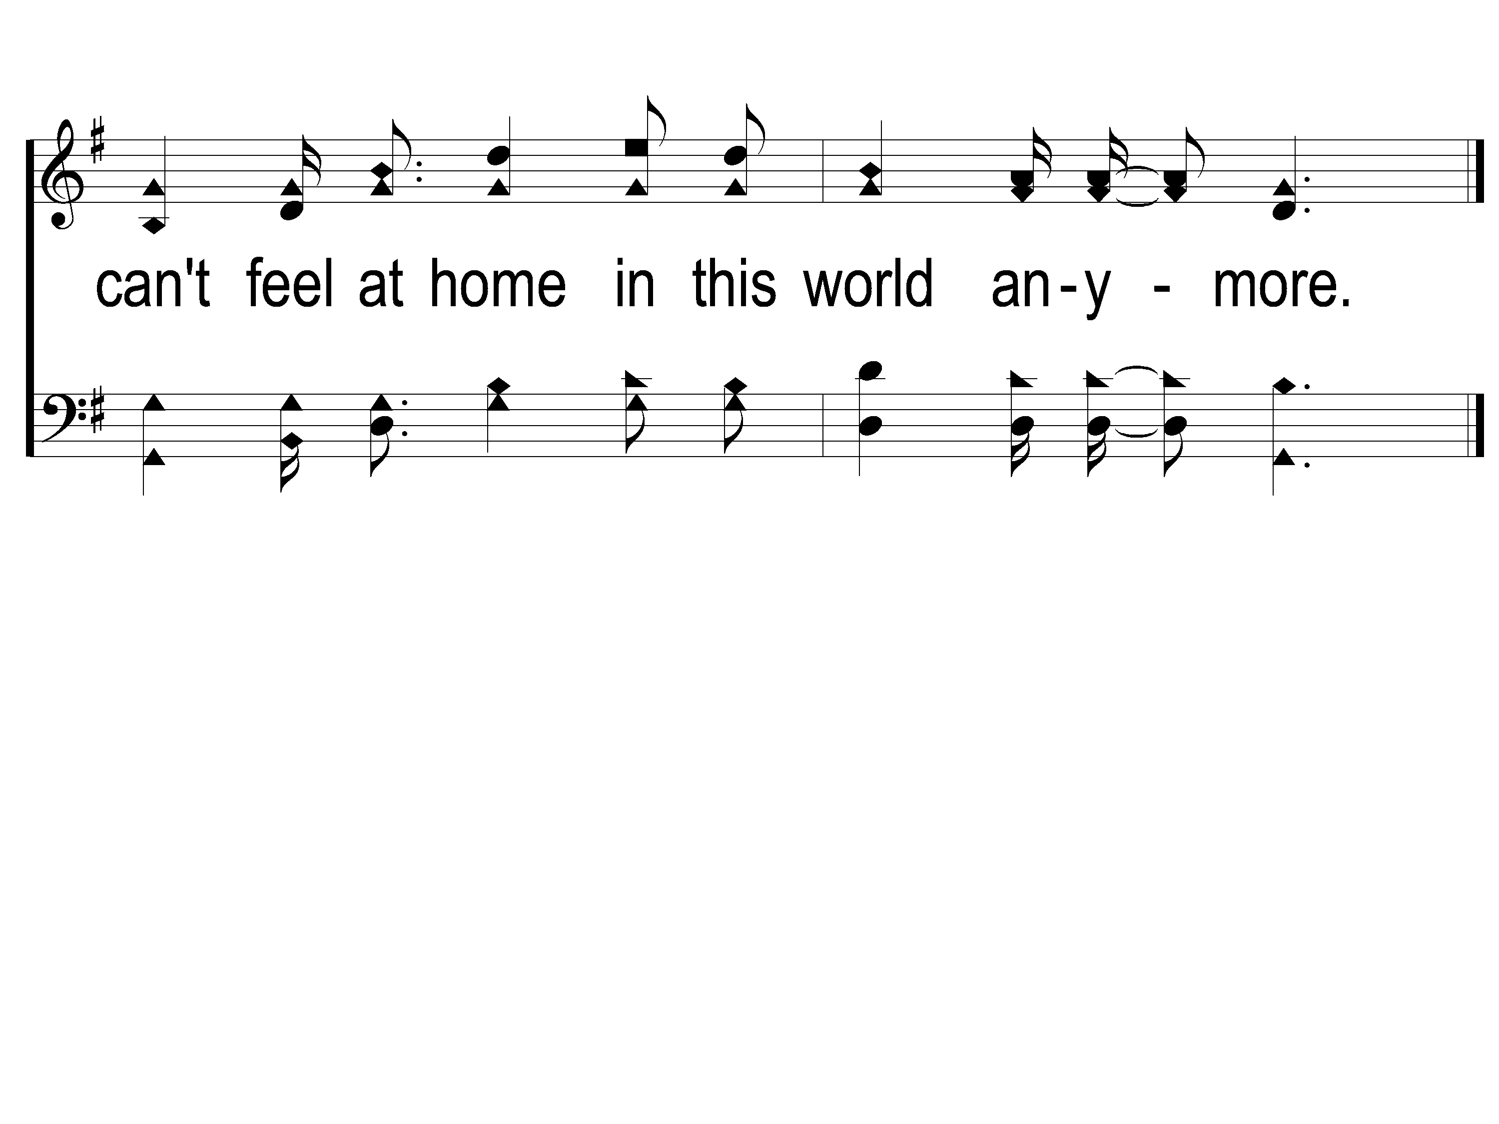
C-3 This World is Not My Home
This World Is Not My Home
957

Slide 19
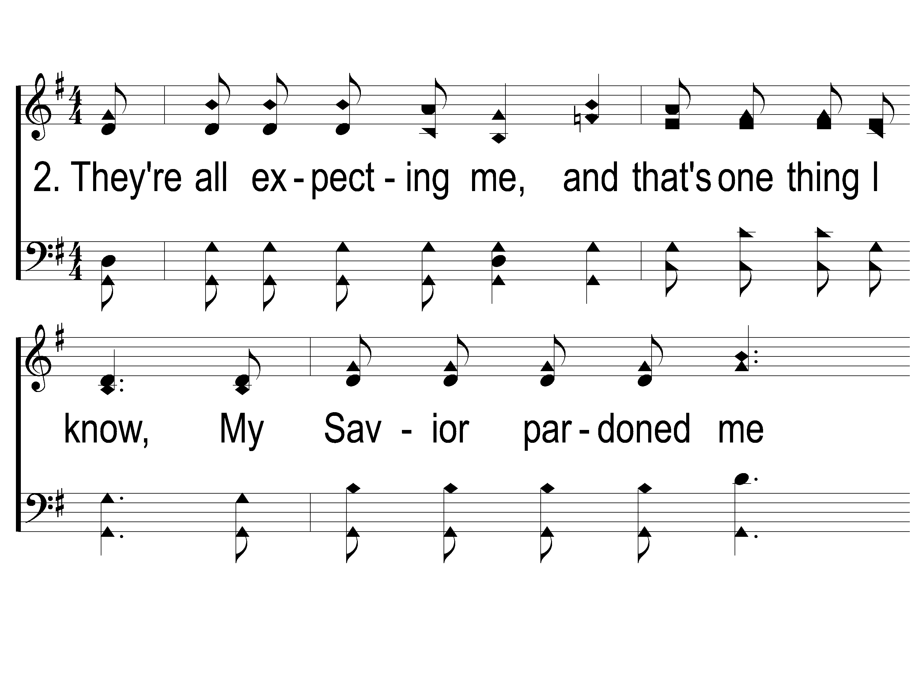
2-1 This World is Not My Home
This World Is Not My Home
957

Slide 20
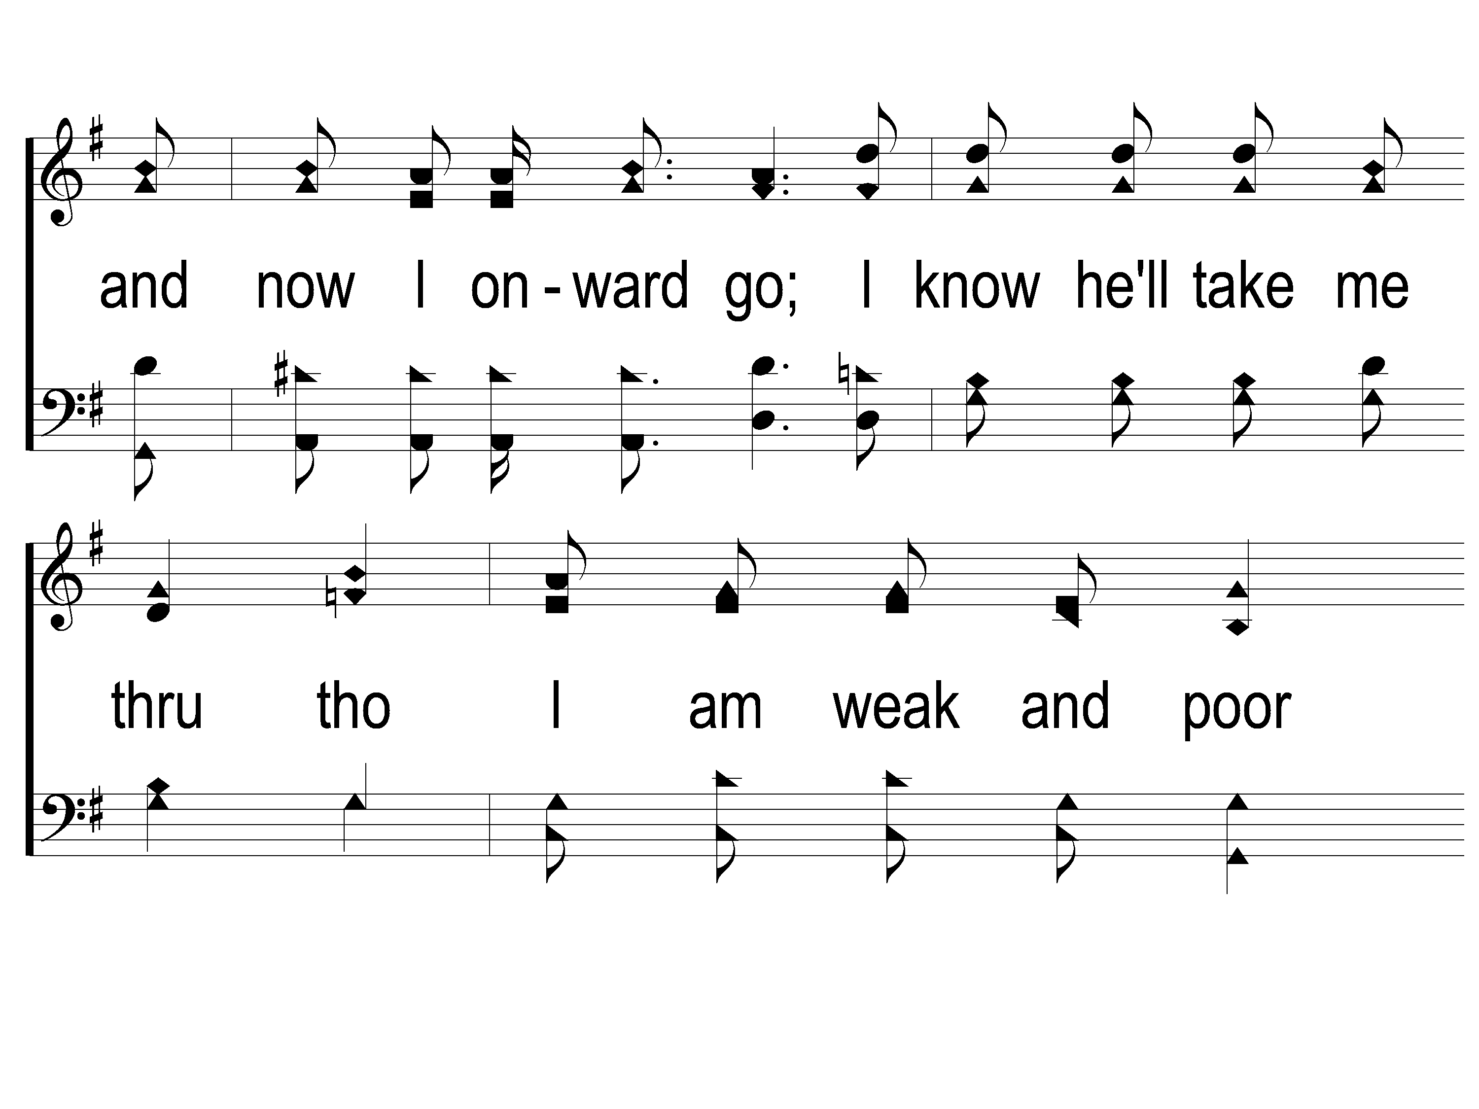
2-2 This World is Not My Home
This World Is Not My Home
957

Slide 21
2-3 This World is Not My Home
This World Is Not My Home
957

Slide 22
C-1 This World is Not My Home
This World Is Not My Home
957

Slide 23
C-2 This World is Not My Home
This World Is Not My Home
957

Slide 24
C-3 This World is Not My Home
This World Is Not My Home
957

Slide 25
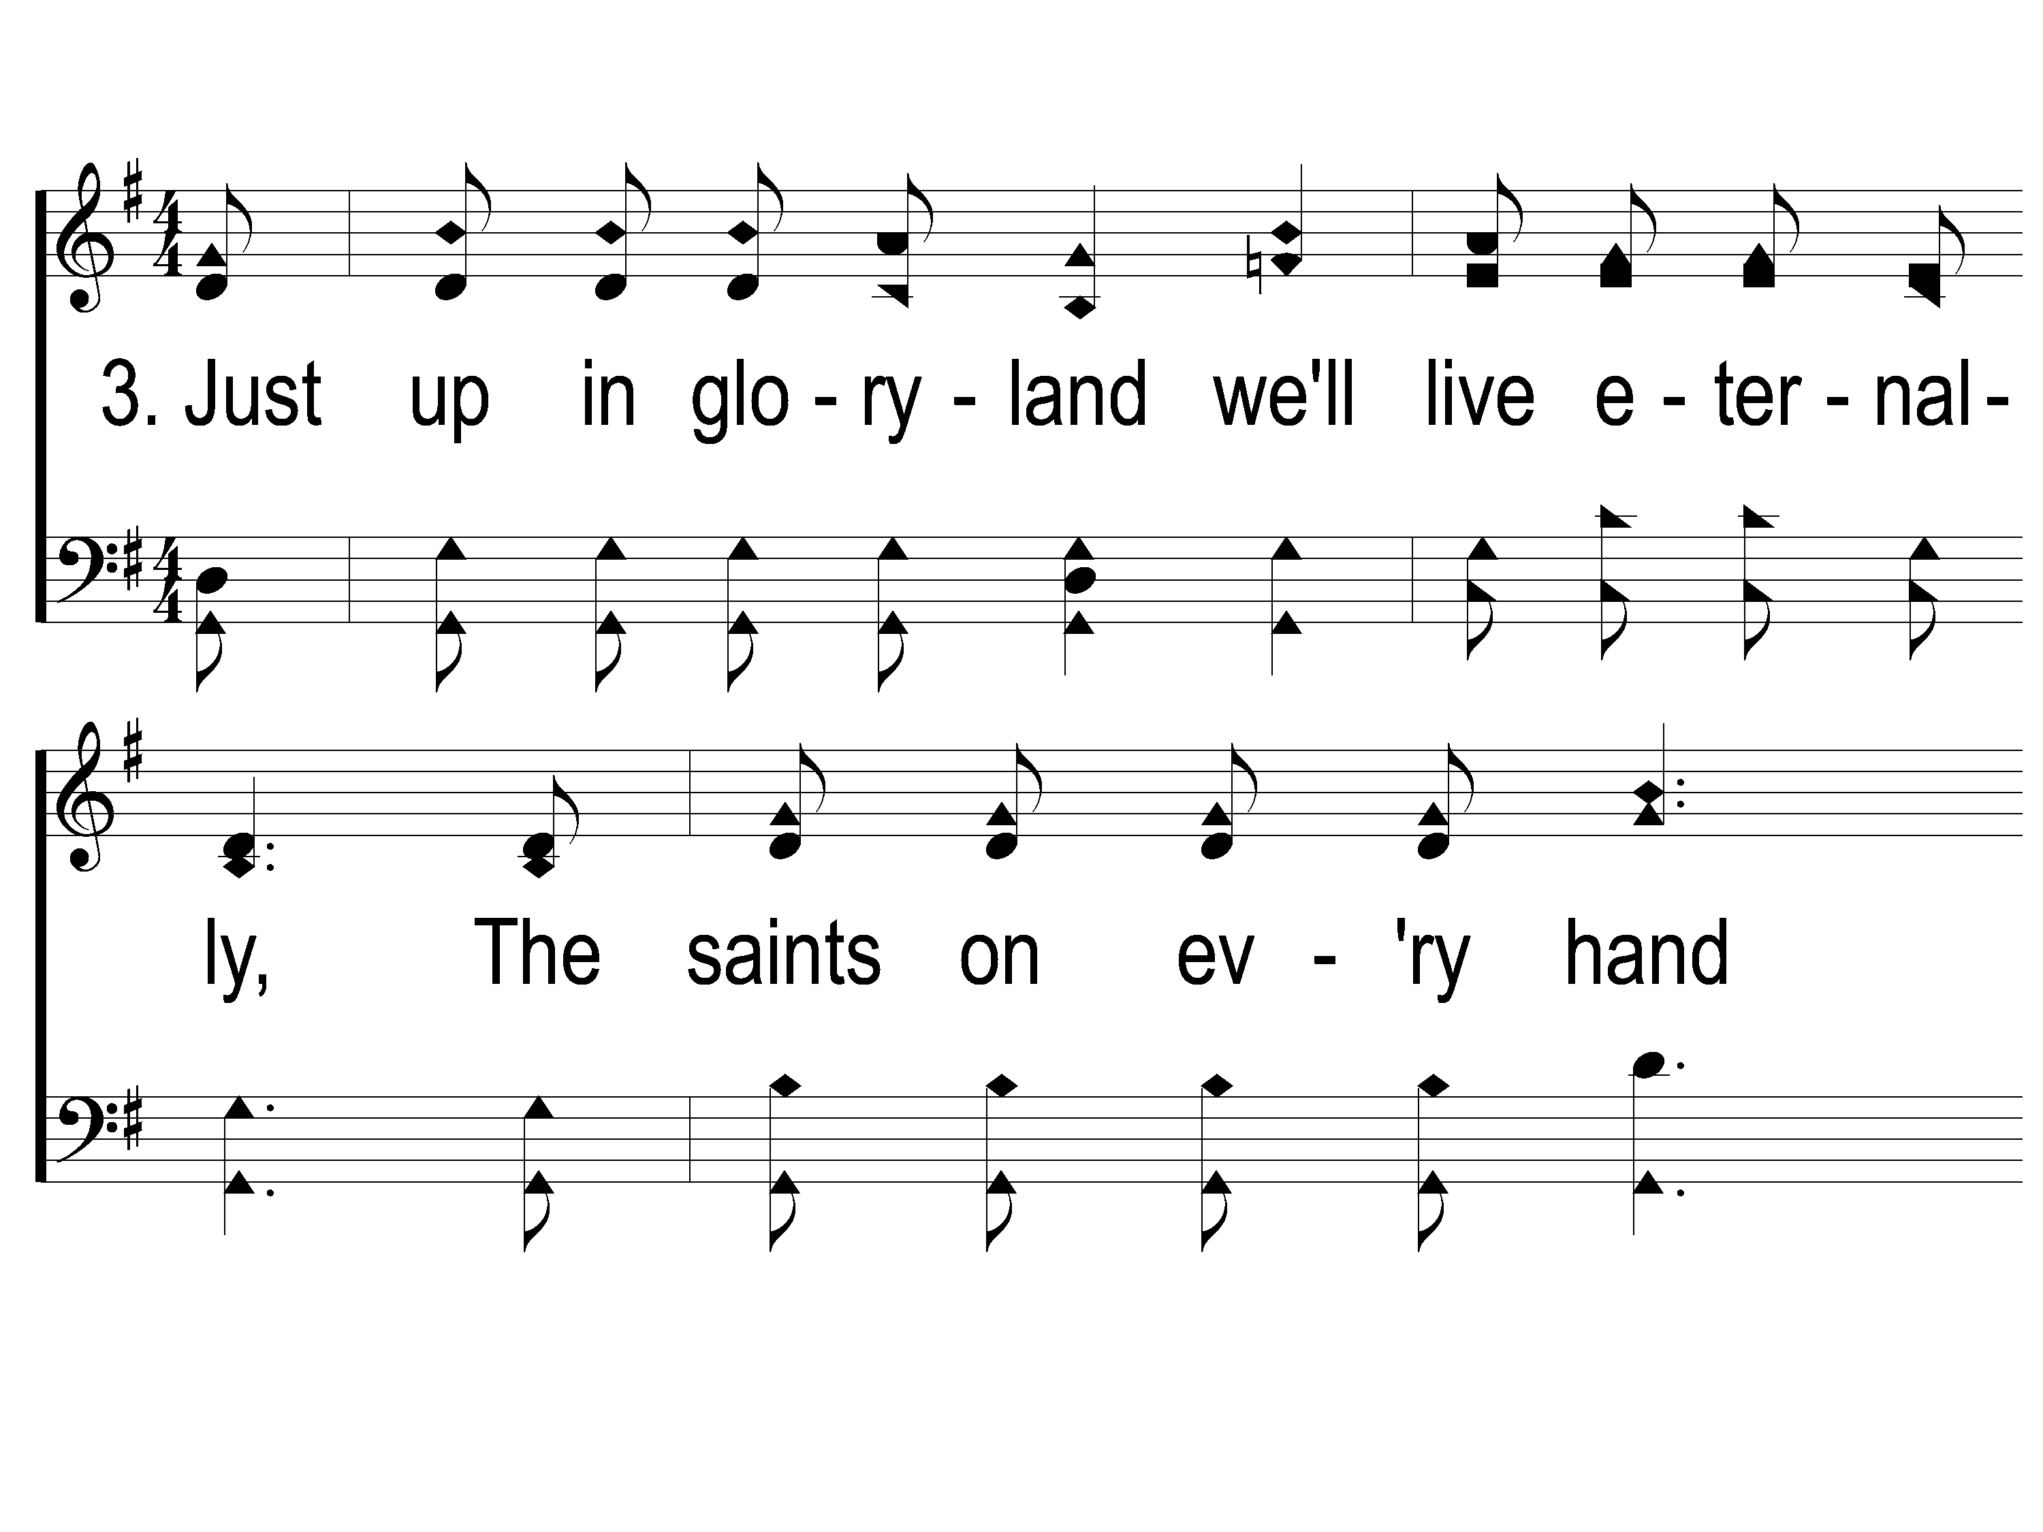
3-1 This World is Not My Home
This World Is Not My Home
957

Slide 26
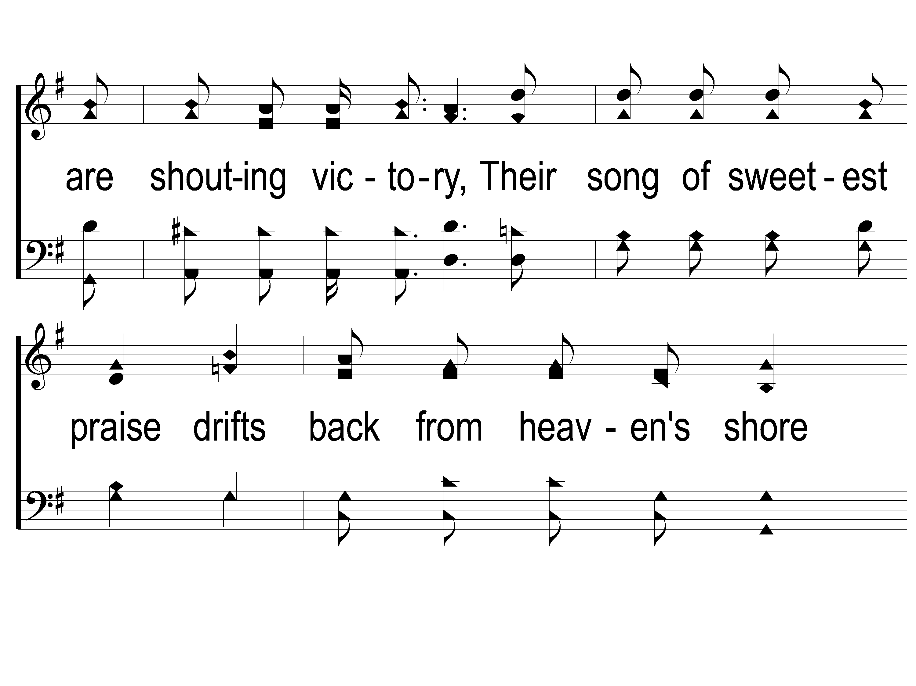
3-2 This World is Not My Home
This World Is Not My Home
957

Slide 27
3-3 This World is Not My Home
This World Is Not My Home
957

Slide 28
C-1 This World is Not My Home
This World Is Not My Home
957

Slide 29
C-2 This World is Not My Home
This World Is Not My Home
957

Slide 30
C-3 This World is Not My Home
This World Is Not My Home
957

Slide 31
Song:
Mansion Over The Hilltop
#881

Slide 32
1-1 Mansion Over the Hilltop
Mansion Over the Hilltop
881

Slide 33
1-2 Mansion Over the Hilltop
Mansion Over the Hilltop
881

Slide 34
C-1 Mansion Over the Hilltop
Mansion Over the Hilltop
881

Slide 35
C-2 Mansion Over the Hilltop
Mansion Over the Hilltop
881

Slide 36
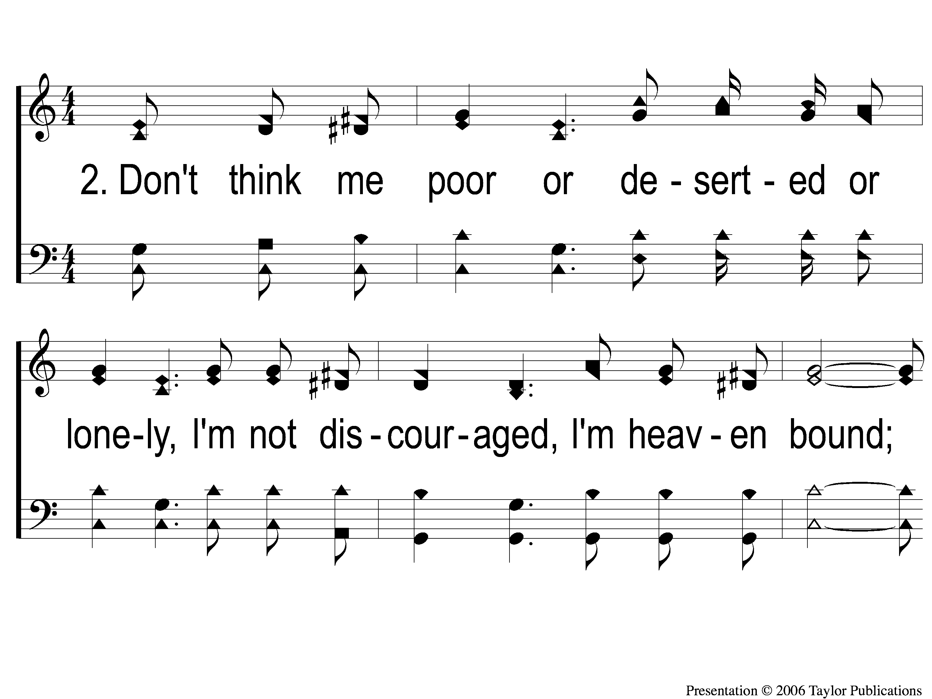
2-1 Mansion Over the Hilltop
Mansion Over the Hilltop
881

Slide 37
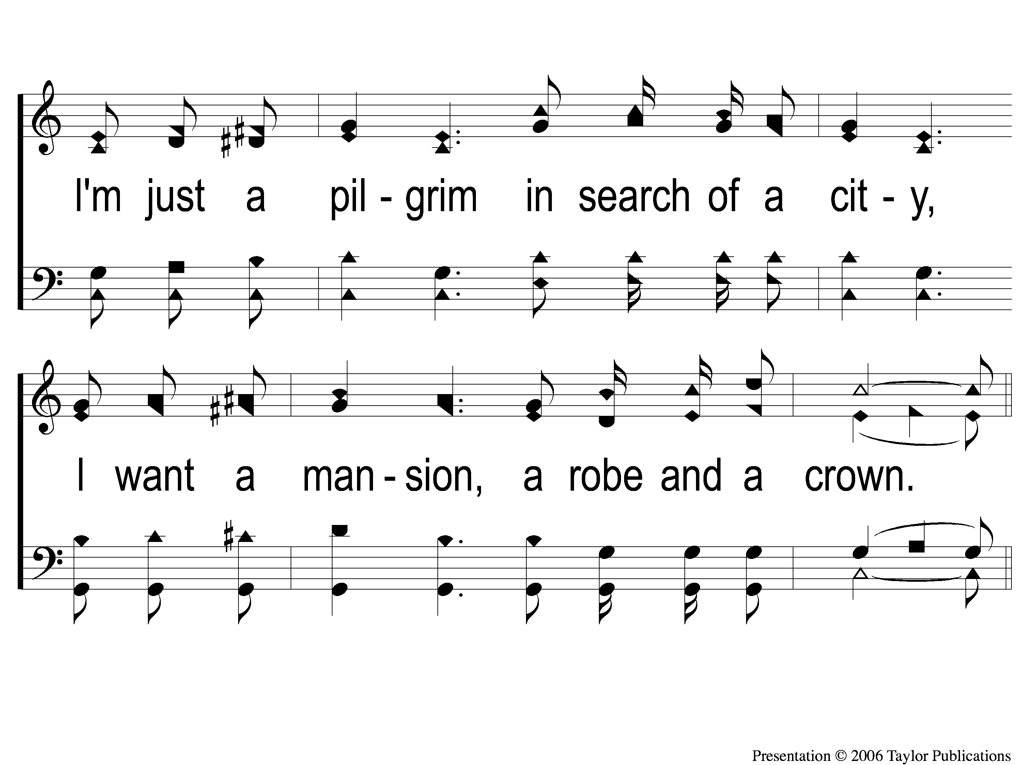
2-2 Mansion Over the Hilltop
Mansion Over the Hilltop
881

Slide 38
C-1 Mansion Over the Hilltop
Mansion Over the Hilltop
881

Slide 39
C-2 Mansion Over the Hilltop
Mansion Over the Hilltop
881

Slide 40
Opening Prayer

Slide 41
Song:
The Battle Belongs To The Lord
#749

Slide 42
1-1 The Battle Belongs to the Lord
The Battle Belongs to the Lord
749

Slide 43
1-2 The Battle Belongs to the Lord
The Battle Belongs to the Lord
749

Slide 44
C-1 The Battle Belongs to the Lord
The Battle Belongs to the Lord
749

Slide 45
C-2 The Battle Belongs to the Lord
The Battle Belongs to the Lord
749

Slide 46
2-1 The Battle Belongs to the Lord
The Battle Belongs to the Lord
749

Slide 47
2-2 The Battle Belongs to the Lord
The Battle Belongs to the Lord
749

Slide 48
C-1 The Battle Belongs to the Lord
The Battle Belongs to the Lord
749

Slide 49
C-2 The Battle Belongs to the Lord
The Battle Belongs to the Lord
749

Slide 50
3-1 The Battle Belongs to the Lord
The Battle Belongs to the Lord
749

Slide 51
3-2 The Battle Belongs to the Lord
The Battle Belongs to the Lord
749

Slide 52
C-1 The Battle Belongs to the Lord
The Battle Belongs to the Lord
749

Slide 53
C-2 The Battle Belongs to the Lord
The Battle Belongs to the Lord
749

Slide 54
Song:
Whispering Hope
#497

Slide 55
1-1 Whispering Hope
Whispering Hope
497

Slide 56
1-2 Whispering Hope
Whispering Hope
497

Slide 57
1-3 Whispering Hope
Whispering Hope
497

Slide 58
C-1 Whispering Hope
Whispering Hope
497

Slide 59
C-2 Whispering Hope
Whispering Hope
497

Slide 60
3-1 Whispering Hope
Whispering Hope
497

Slide 61
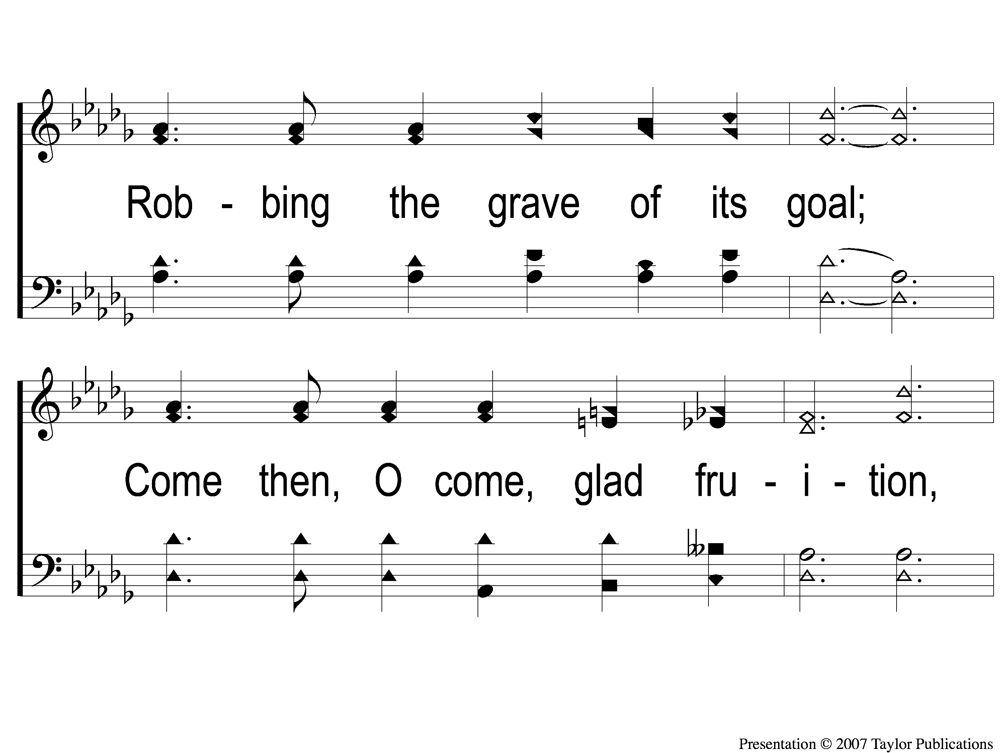
3-2 Whispering Hope
Whispering Hope
497

Slide 62
3-3 Whispering Hope
Whispering Hope
497

Slide 63
C-1 Whispering Hope
Whispering Hope
497

Slide 64
C-2 Whispering Hope
Whispering Hope
497

Slide 65
Scripture Reading:
Ephesians 4:1-6

Slide 67
“He shall be like a tree Planted by the rivers of water, That brings forth its fruit in its season, Whose leaf also shall not wither; And whatever he does shall prosper.”
PSALM 1

Slide 68
“The LORD is my shepherd; I shall not want. He makes me to lie down in green pastures; He leads me beside the still waters. He restores my soul; He leads me in the paths of righteousness For His name’s sake…”
Psalm 23

Slide 69
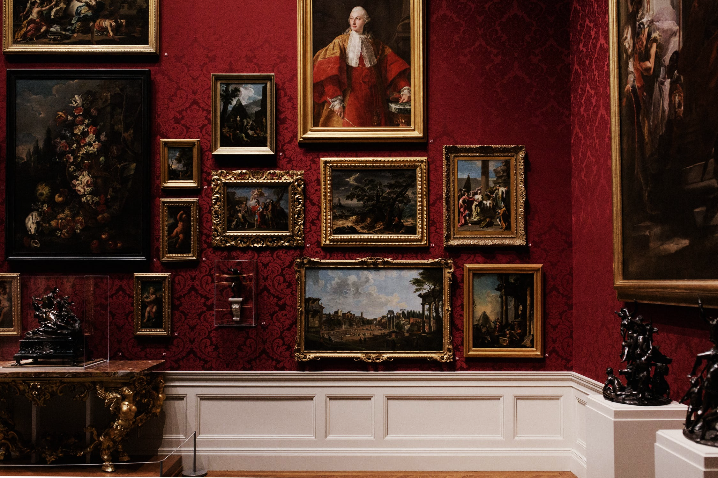
6
Portraits
of
The Church

Slide 70
The Church Is…
… The Body of Christ

Slide 71
The Body of Christ
The Portrait:
Eph. 1:22-23
2:14-16
3:1-6
4:4, 11-16
5:23-30

Slide 72
The Body of Christ
What Does It Imply?
The Head Controls the Body– 1: 22-23, 5: 23-30

Slide 73
The Body of Christ
What Does It Imply?
The Head Controls the Body– 1: 22-23, 5: 23-30
Access to the Body is through Christ– 2: 14-16, 5: 23

Slide 74
The Body of Christ
What Does It Imply?
The Head Controls the Body– 1: 22-23, 5: 23-30
Access to the Body is through Christ– 2: 14-16, 5: 23
Everyone Has Access– 3: 1-6

Slide 75
The Body of Christ
What Does It Imply?
The Head Controls the Body– 1: 22-23, 5: 23-30
Access to the Body is through Christ– 2: 14-16, 5: 23
Everyone Has Access– 3: 1-6
Every Part of the Body is Needed & Valued– 4: 4, 11-16

Slide 76
The Church Is…
… The Body of Christ
… The Bride of Christ

Slide 77
The Bride of Christ
The Portrait:
Jer. 31: 32-33– Isa. 62: 5

Slide 78
The Bride of Christ
The Portrait:
Jer. 31: 32-33– Isa. 62: 5
Eph. 5: 23-32
Rev. 21: 2, 9

Slide 79
The Bride of Christ
What Does It Imply?
Our Marriages should be Modeled after Christ & His Church

Slide 80
The Bride of Christ
What Does It Imply?
Our Marriages should be Modeled after Christ & His Church
Christ died so His Church would be Holy!

Slide 81
Are you married to Christ?

Slide 82
When We All Get To Heaven
#853
Invitation
Song:

Slide 83
1-1 When We All Get To Heaven
When We All Get To Heaven
853

Slide 84
1-2 When We All Get To Heaven
When We All Get To Heaven
853

Slide 85
C-1 When We All Get To Heaven
When We All Get To Heaven
853

Slide 86
C-2 When We All Get To Heaven
When We All Get To Heaven
853

Slide 87
3-1 When We All Get To Heaven
When We All Get To Heaven
853

Slide 88
3-2 When We All Get To Heaven
When We All Get To Heaven
853

Slide 89
C-1 When We All Get To Heaven
When We All Get To Heaven
853

Slide 90
C-2 When We All Get To Heaven
When We All Get To Heaven
853

Slide 91
The Contribution:
Romans 9:6-8
“The point is this: whoever sows sparingly will also reap sparingly, and whoever sows bountifully will also reap bountifully. Each one must give as he has decided in his heart, not reluctantly or under compulsion, for God loves a cheerful giver. And God is able to make all grace abound to you, so that having all sufficiency in all things at all times, you may abound in every good work.”

Slide 92
Song:
By Christ Redeemed
#366

Slide 93
1-1 By Christ Redeemed
By Christ Redeemed
366

Slide 94
1-2 By Christ Redeemed
By Christ Redeemed
366

Slide 95
2-1 By Christ Redeemed
By Christ Redeemed
366

Slide 96
2-2 By Christ Redeemed
By Christ Redeemed
366

Slide 97
3-1 By Christ Redeemed
By Christ Redeemed
366

Slide 98
3-2 By Christ Redeemed
By Christ Redeemed
366

Slide 99
The Unleavened Bread
Romans 5:18-19
“Therefore, as through one man’s offense judgment came to all men, resulting in condemnation, even so through one Man’s righteous act the free gift came to all men, resulting in justification of life. For as by one man’s disobedience many were made sinners, so also by one Man’s obedience many will be made righteous.”

Slide 100
The Fruit
of the Vine
Romans 5:9-11
“Since, therefore, we have now been justified by his blood, much more shall we be saved by him from the wrath of God. For if while we were enemies we were reconciled to God by the death of his Son, much more, now that we are reconciled, shall we be saved by his life. More than that, we also rejoice in God through our Lord Jesus Christ, through whom we have now received reconciliation.”

Slide 101
Closing Prayer

Slide 102
Song:
To Christ Be True
#736

Slide 103
1-1 To Christ Be True
To Christ Be True
736

Slide 104
1-2 To Christ Be True
To Christ Be True
736

Slide 105
C-1 To Christ Be True
To Christ Be True
736

Slide 106
C-2 To Christ Be True
To Christ Be True
736

Slide 107
3-1 To Christ Be True
To Christ Be True
736

Slide 108
3-2 To Christ Be True
To Christ Be True
736

Slide 109
C-1 To Christ Be True
To Christ Be True
736

Slide 110
C-2 To Christ Be True
To Christ Be True
736

Slide 111
Today
Join us in the MPB for
A Fellowship Meal & Devo
Wednesday
Worship & Classes & 6:30 PM
RESTORE REBUILD RENEW
IN 2022
WHEELER
CHURCH
OF
CHRIST

Slide 112
RESTORE REBUILD RENEW
tonight
New Hymns Class @ 4:45 PM
Worship @ 6:00 PM
Wednesday
Worship & Classes & 6:30 PM
IN 2022
WHEELER
CHURCH
OF
CHRIST

