Slide 1
RESTORE REBUILD RENEW
welcome
we are glad to
Have you with us
IN 2022
WHEELER
CHURCH
OF
CHRIST

Slide 2
Songs of Praise To God

Slide 3
Opening Prayer

Slide 4
Songs of Praise To God

Slide 5
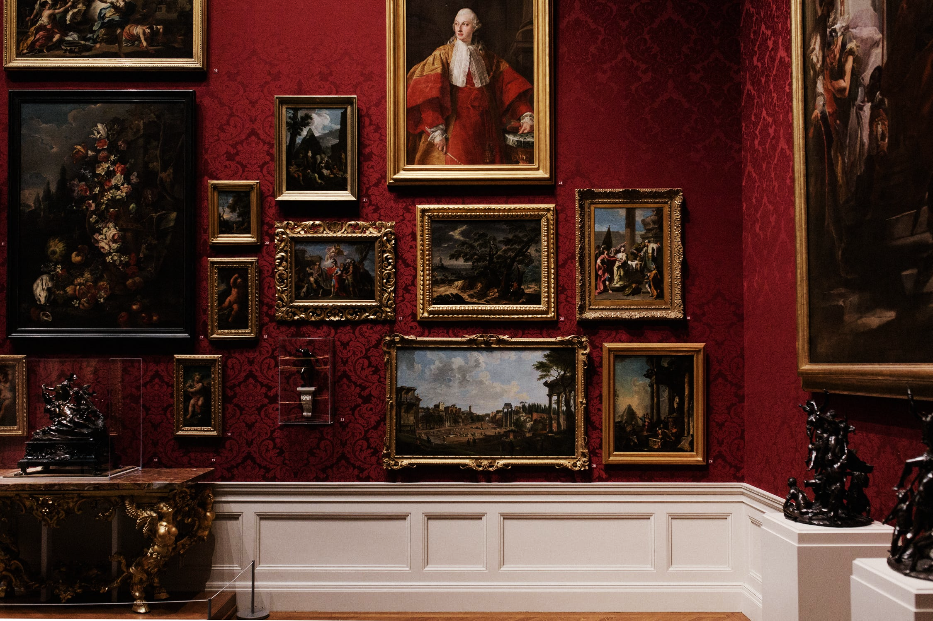
6
Portraits
of
The Church

Slide 6
The Church Is…
… the Body of Christ
… the Bride of Christ

Slide 7
The Church Is…
… the Body of Christ
… the Bride of Christ
… the Family of God

Slide 8
The Family of God
The Portrait:
Eph. 1: 2-6
2: 19
3: 15

Slide 9
The Family of God
What Does It Imply?
God is our Father– Matt. 6: 8, 25-26, 30-32, 7: 7-11

Slide 10
The Family of God
What Does It Imply?
God is our Father– Matt. 6: 8, 25-26, 30-32, 7: 7-11
We have Earthly Help– 2: 19-20, 1 Tim. 5: 1-2, Rom. 12: 18

Slide 11
The Family of God
What Does It Imply?
God is our Father– Matt. 6: 8, 25-26, 30-32, 7: 7-11
We have Earthly Help– 2: 19-20, 1 Tim. 5: 1-2, Rom. 12: 18
We have Heavenly Help– 3: 15, Heb. 12: 1

Slide 12
The Church Is…
… the Body of Christ
… the Bride of Christ
… the Family of God
… the Temple of God

Slide 13
The Temple of God
The Portrait:
Eph 2: 19-22
1 Cor. 3:16
2 Cor. 6:16

Slide 14
The Temple of God
What Does It Imply?
No other Foundation needed!– 2: 19-22, 1 Cor. 3: 10-11

Slide 15
The Temple of God
What Does It Imply?
No other Foundation needed!– 2: 19-22, 1 Cor. 3: 10-11
The Church must avoid Idolatry– 1 Jn. 5: 21, 2 Cor. 6: 16a

Slide 16
The Church Is…
… the Body of Christ
… the Bride of Christ
… the Family of God
… the Temple of God
… the Kingdom of God

Slide 17
The Kingdom of God
The Portrait:
Eph. 2: 19
5: 5

Slide 18
The Kingdom of God
What Does It Imply?
Jesus is King today and forever!– 1 Tim. 1: 17, 6: 15

Slide 19
The Kingdom of God
What Does It Imply?
Jesus is King today and forever!– 1 Tim. 1: 17, 6: 15
We are part of His Kingdom today– Col. 1: 13, 1 Cor. 15: 24

Slide 20
The Church Is…
… the Body of Christ
… the Bride of Christ
… the Family of God
… the Temple of God
… the Kingdom of God
… the Army of God

Slide 21
The Army of God
The Portrait:
Eph. 1: 21, 2: 1-3, 3: 10, 4: 11-16, 5: 5
Rev. 19: 19
Jn. 18: 36

Slide 22
The Army of God
What Does It Imply?
God has already Won!– Col. 2: 15, Heb. 2: 14, Rev. 5: 5

Slide 23
The Army of God
What Does It Imply?
God has already Won!– Col. 2: 15, Heb. 2: 14, Rev. 5: 5
Our Loyalty has Shifted– Col. 1: 13

Slide 24
The Army of God
What Does It Imply?
God has already Won!– Col. 2: 15, Heb. 2: 14, Rev. 5: 5
Our Loyalty has Shifted– Col. 1: 13
God’s Wisdom is Seen in Our Fighting for Him –

Slide 25
The Army of God
What Does It Imply?
God has already Won!– Col. 2: 15, Heb. 2: 14, Rev. 5: 5
Our Loyalty has Shifted– Col. 1: 13
God’s Wisdom is Seen in Our Fighting for Him –
We must Stand Firm– 1 Cor. 16: 13

Slide 26
The Army of God
What Does It Imply?
God has already Won!– Col. 2: 15, Heb. 2: 14, Rev. 5: 5
Our Loyalty has Shifted– Col. 1: 13
God’s Wisdom is Seen in Our Fighting for Him
We must Stand Firm– 1 Cor. 16: 13
We must Always be Ready!– 1 Pet. 5: 8

Slide 27
Are you fighting for God?

Slide 28
Songs of Praise To God

Slide 29
The Lord’s Supper
Acts 20:7

Slide 30
Closing Prayer

Slide 31
Songs of Praise To God

Slide 32
RESTORE REBUILD RENEW
Wednesday
Worship & Classes @ 6:30 pm
IN 2022
WHEELER
CHURCH
OF
CHRIST

