Slide 1
1-1 As the Deer
As The Deer
71

Slide 2
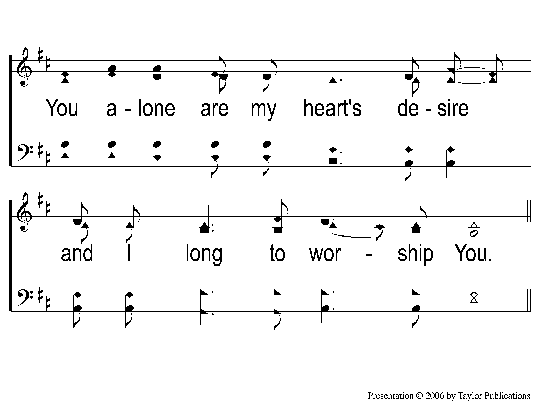
1-2 As the Deer
As The Deer
71

Slide 3
C-1 As the Deer
As The Deer
71

Slide 4
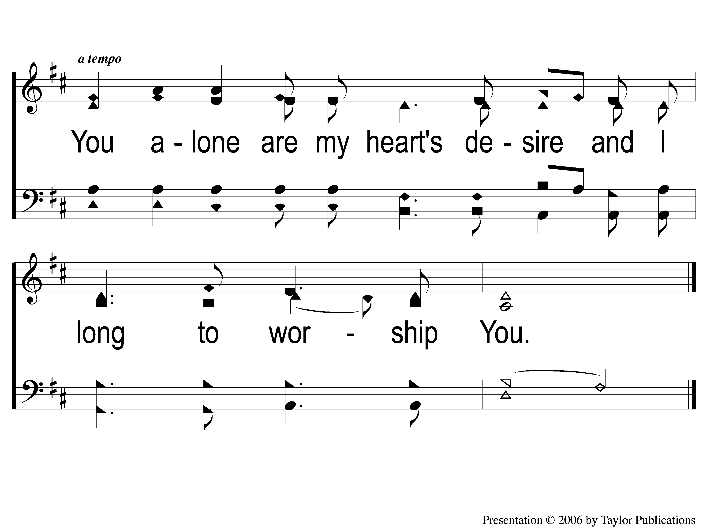
C-2 As the Deer
As The Deer
71

Slide 5
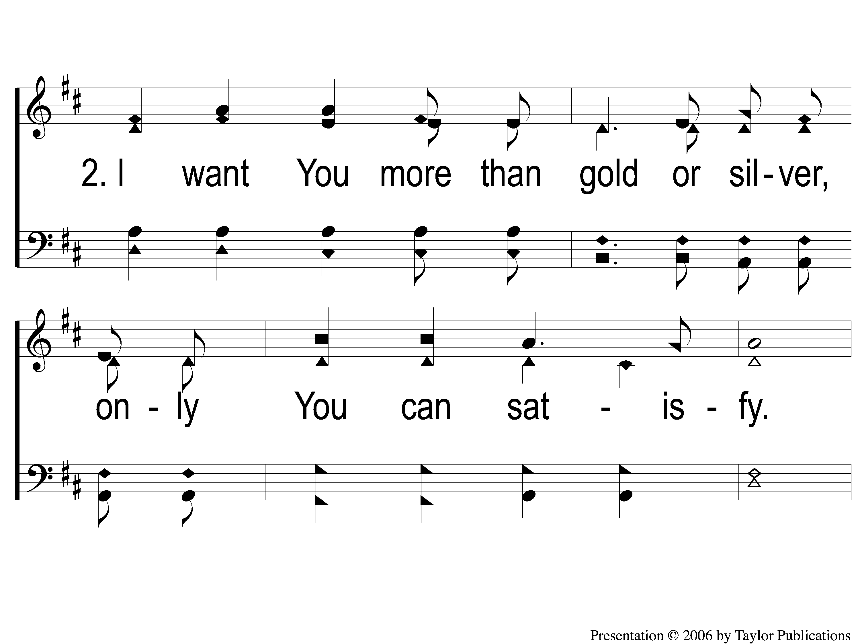
2-1 As the Deer
As The Deer
71

Slide 6
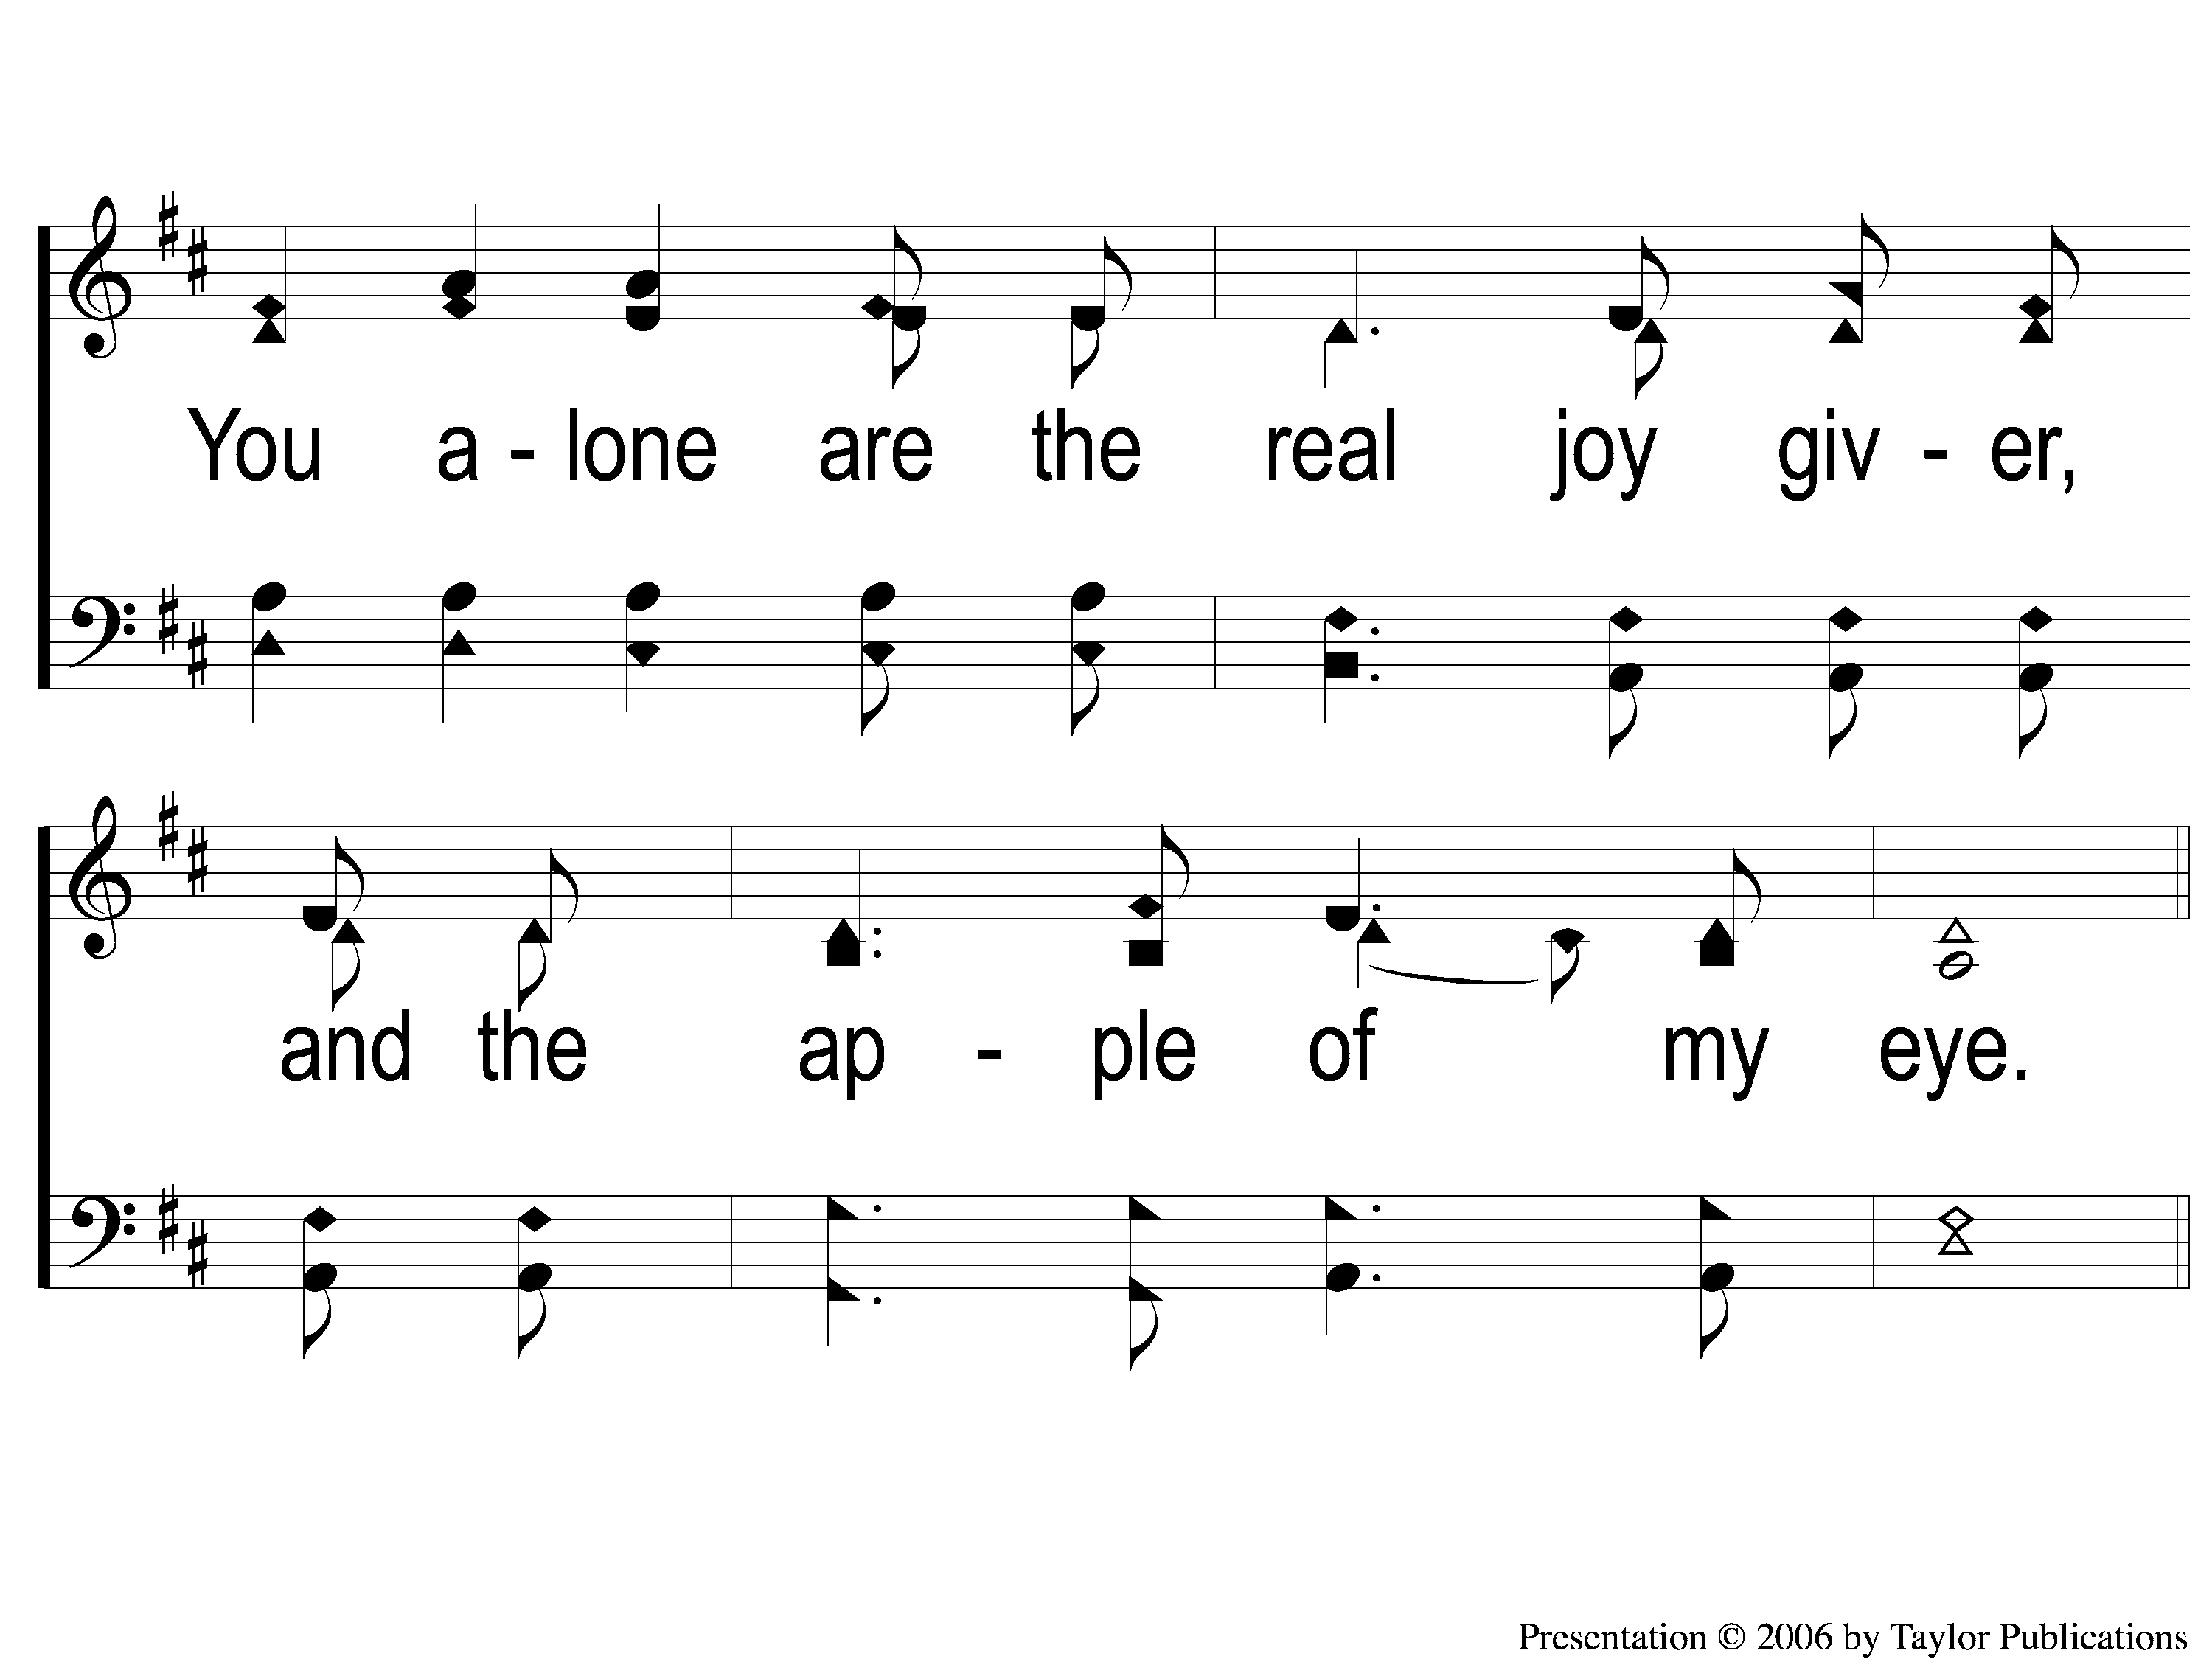
2-2 As the Deer
As The Deer
71

Slide 7
C-1 As the Deer
As The Deer
71

Slide 8
C-2 As the Deer
As The Deer
71

Slide 9
WELCOME
THANKS FOR JOINING US!

Slide 10
#611
SONG:
Walking In Sunlight

Slide 11
1-1 Walking in Sunlight
Walking In Sunlight
611

Slide 12
1-2 Walking in Sunlight
Walking In Sunlight
611

Slide 13
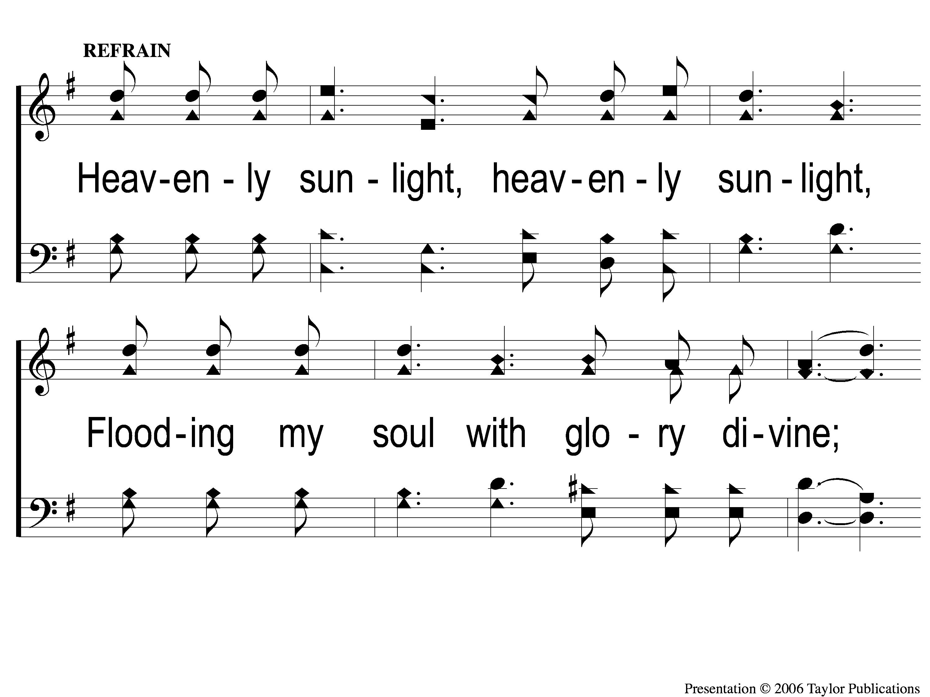
C-1 Walking in Sunlight
Walking In Sunlight
611

Slide 14
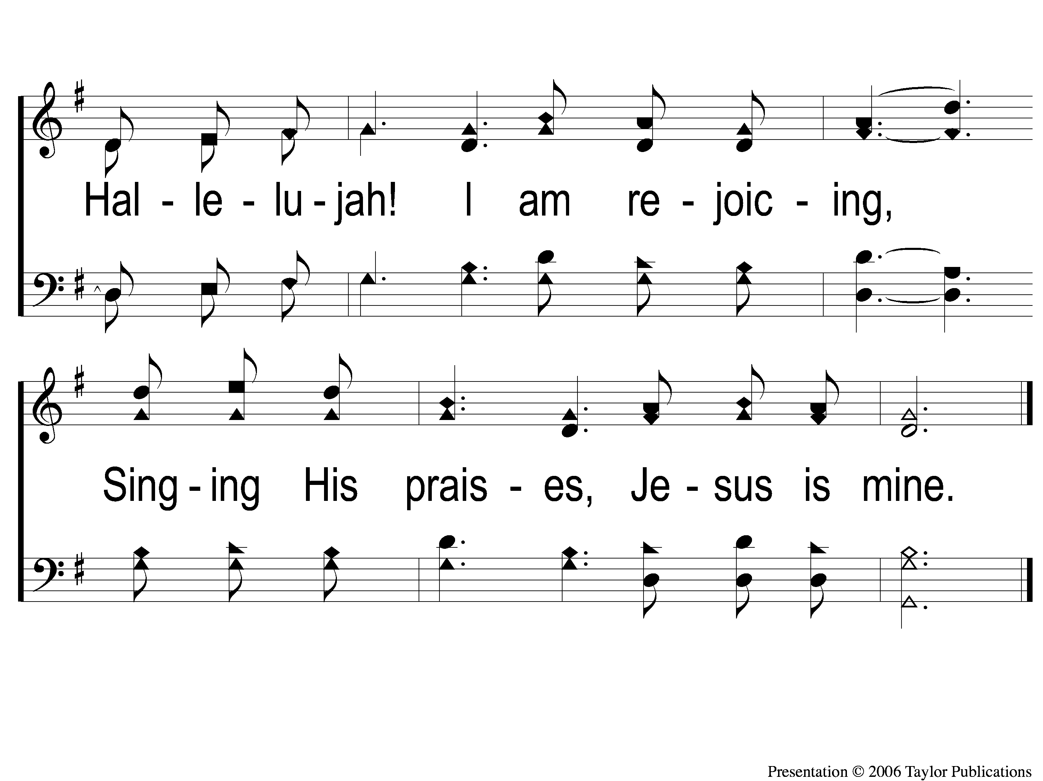
C-2 Walking in Sunlight
Walking In Sunlight
611

Slide 15
3-1 Walking in Sunlight
Walking In Sunlight
611

Slide 16
3-2 Walking in Sunlight
Walking In Sunlight
611

Slide 17
C-1 Walking in Sunlight
Walking In Sunlight
611

Slide 18
C-2 Walking in Sunlight
Walking In Sunlight
611

Slide 19
1-1 The Glory Land Way
The Glory Land Way
535

Slide 20
1-2 The Glory Land Way
The Glory Land Way
535

Slide 21
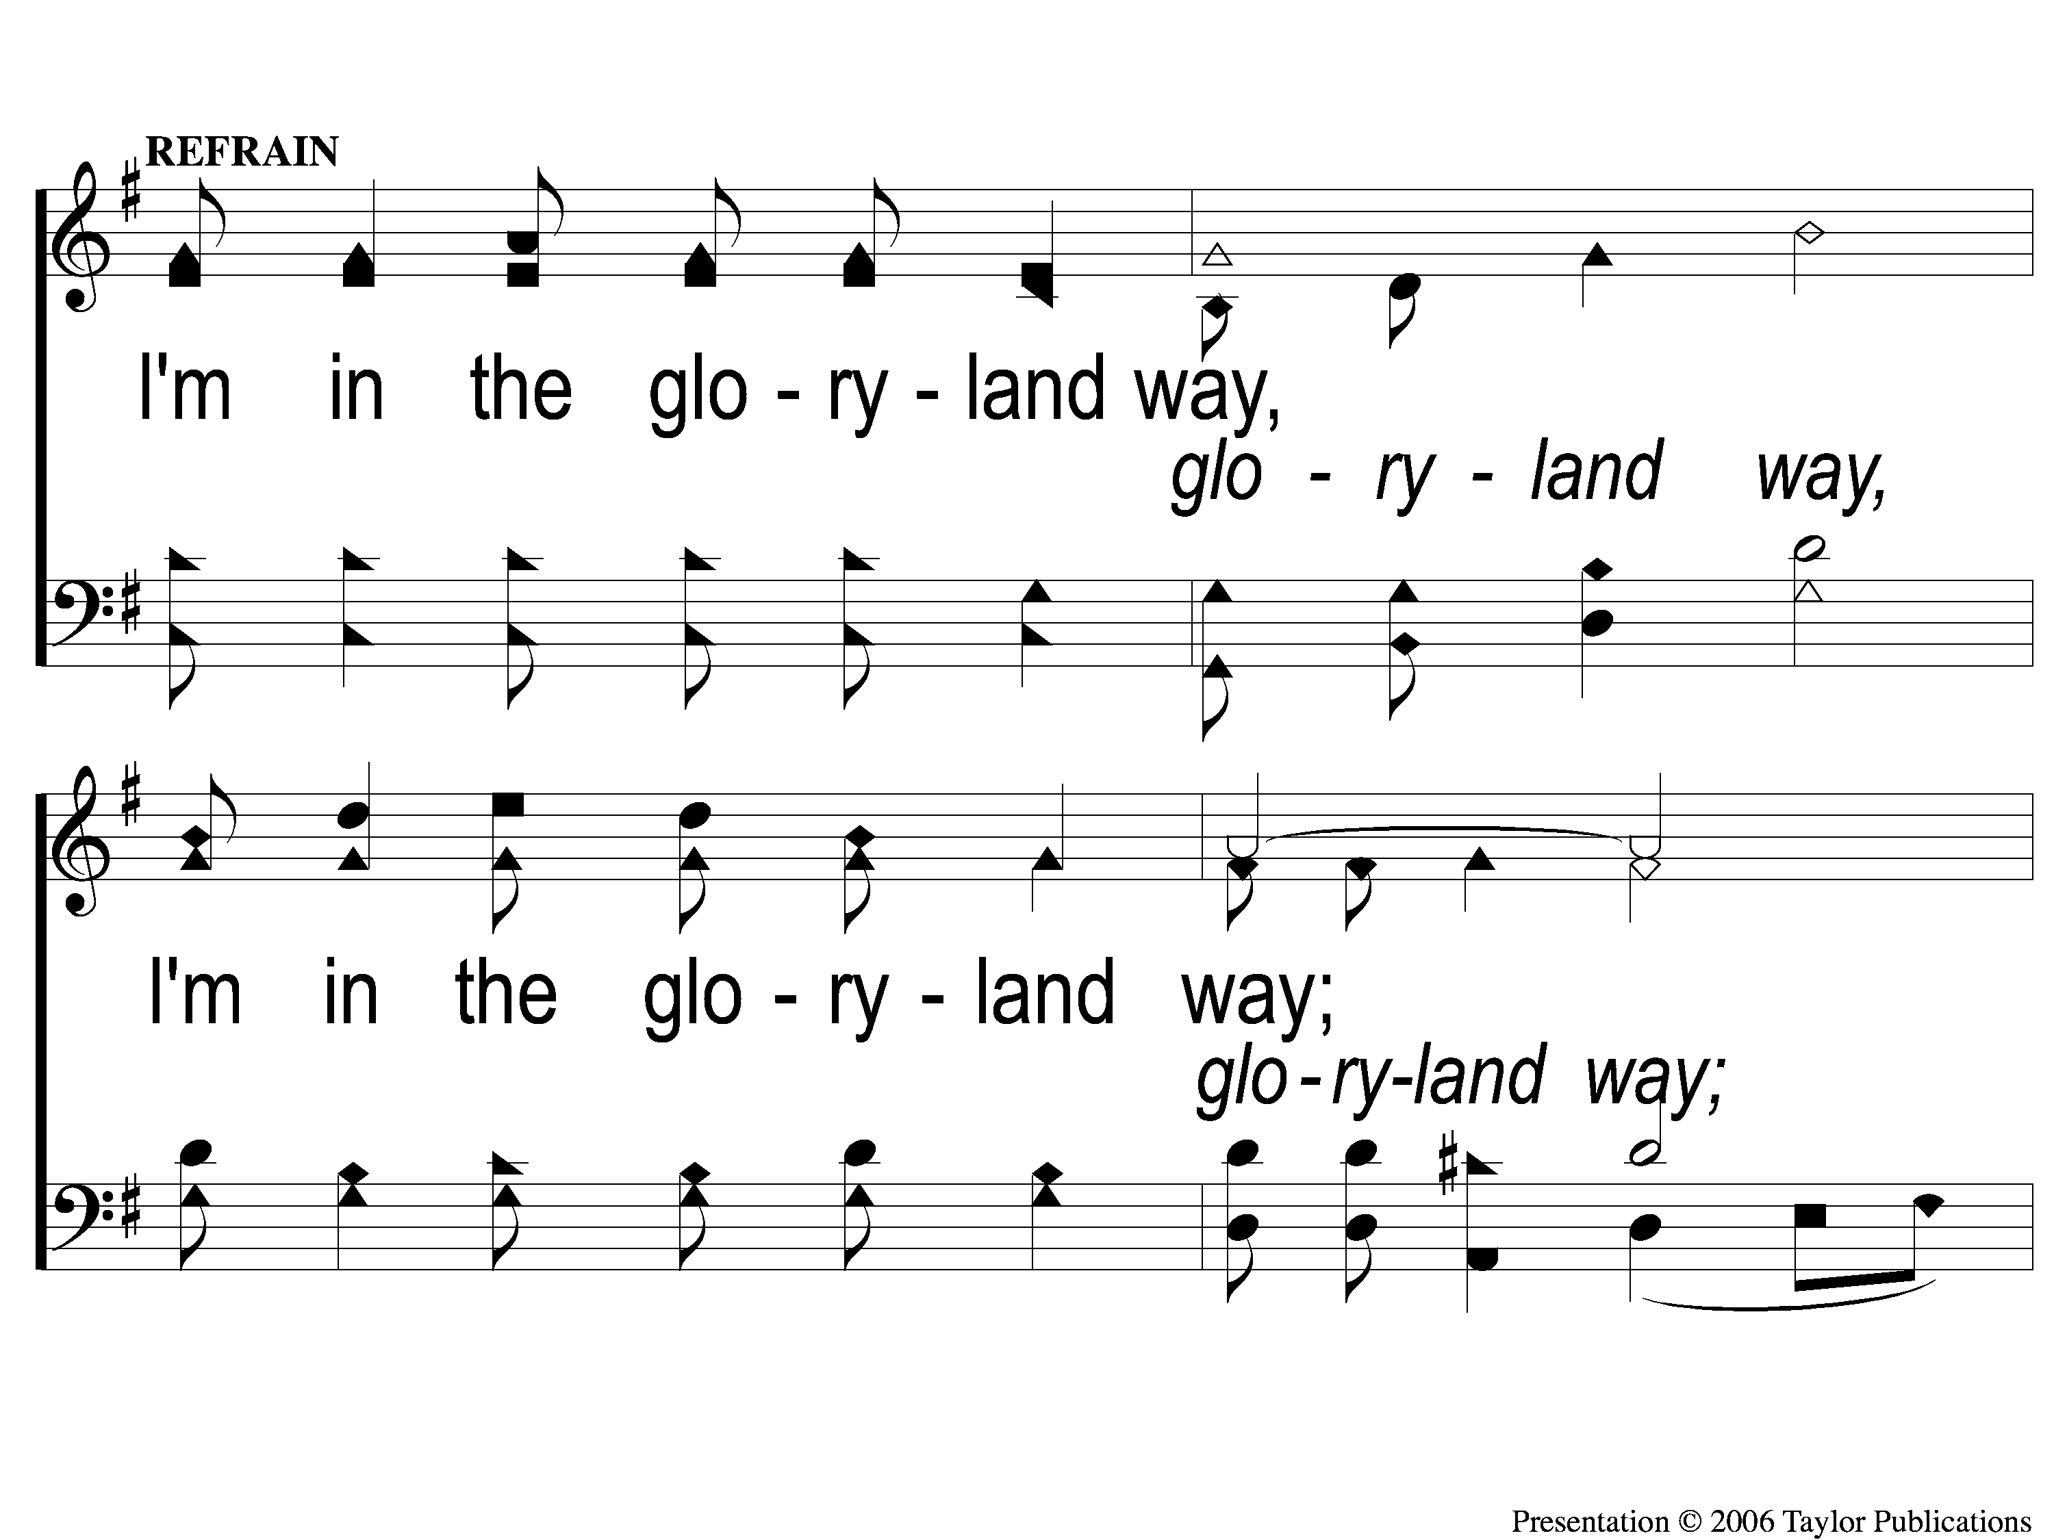
C-1 The Glory Land Way
The Glory Land Way
535

Slide 22
C-2 The Glory Land Way
The Glory Land Way
535

Slide 23
3-1 The Glory Land Way
The Glory Land Way
535

Slide 24
3-2 The Glory Land Way
The Glory Land Way
535

Slide 25
C-1 The Glory Land Way
The Glory Land Way
535

Slide 26
C-2 The Glory Land Way
The Glory Land Way
535

Slide 27
#578
SONG:
We Will Glorify

Slide 28
1-1 How Great Thou Art
How Great Thou Art
76

Slide 29
1-2 How Great Thou Art
How Great Thou Art
76

Slide 30
C-1 How Great Thou Art
How Great Thou Art
76

Slide 31
C-2 How Great Thou Art
How Great Thou Art
76

Slide 32
2-1 How Great Thou Art
How Great Thou Art
76

Slide 33
2-2 How Great Thou Art
How Great Thou Art
76

Slide 34
C-1 How Great Thou Art
How Great Thou Art
76

Slide 35
C-2 How Great Thou Art
How Great Thou Art
76

Slide 36
4-1 How Great Thou Art
How Great Thou Art
76

Slide 37
4-2 How Great Thou Art
How Great Thou Art
76

Slide 38
C-1 How Great Thou Art
How Great Thou Art
76

Slide 39
C-2 How Great Thou Art
How Great Thou Art
76

Slide 40
Opening PRAYER

Slide 41
#610
SONG:
I Love My Savior, Too

Slide 42
1-1 I Love My Savior
I Love My Savior, Too
610

Slide 43
1-2 I Love My Savior
I Love My Savior, Too
610

Slide 44
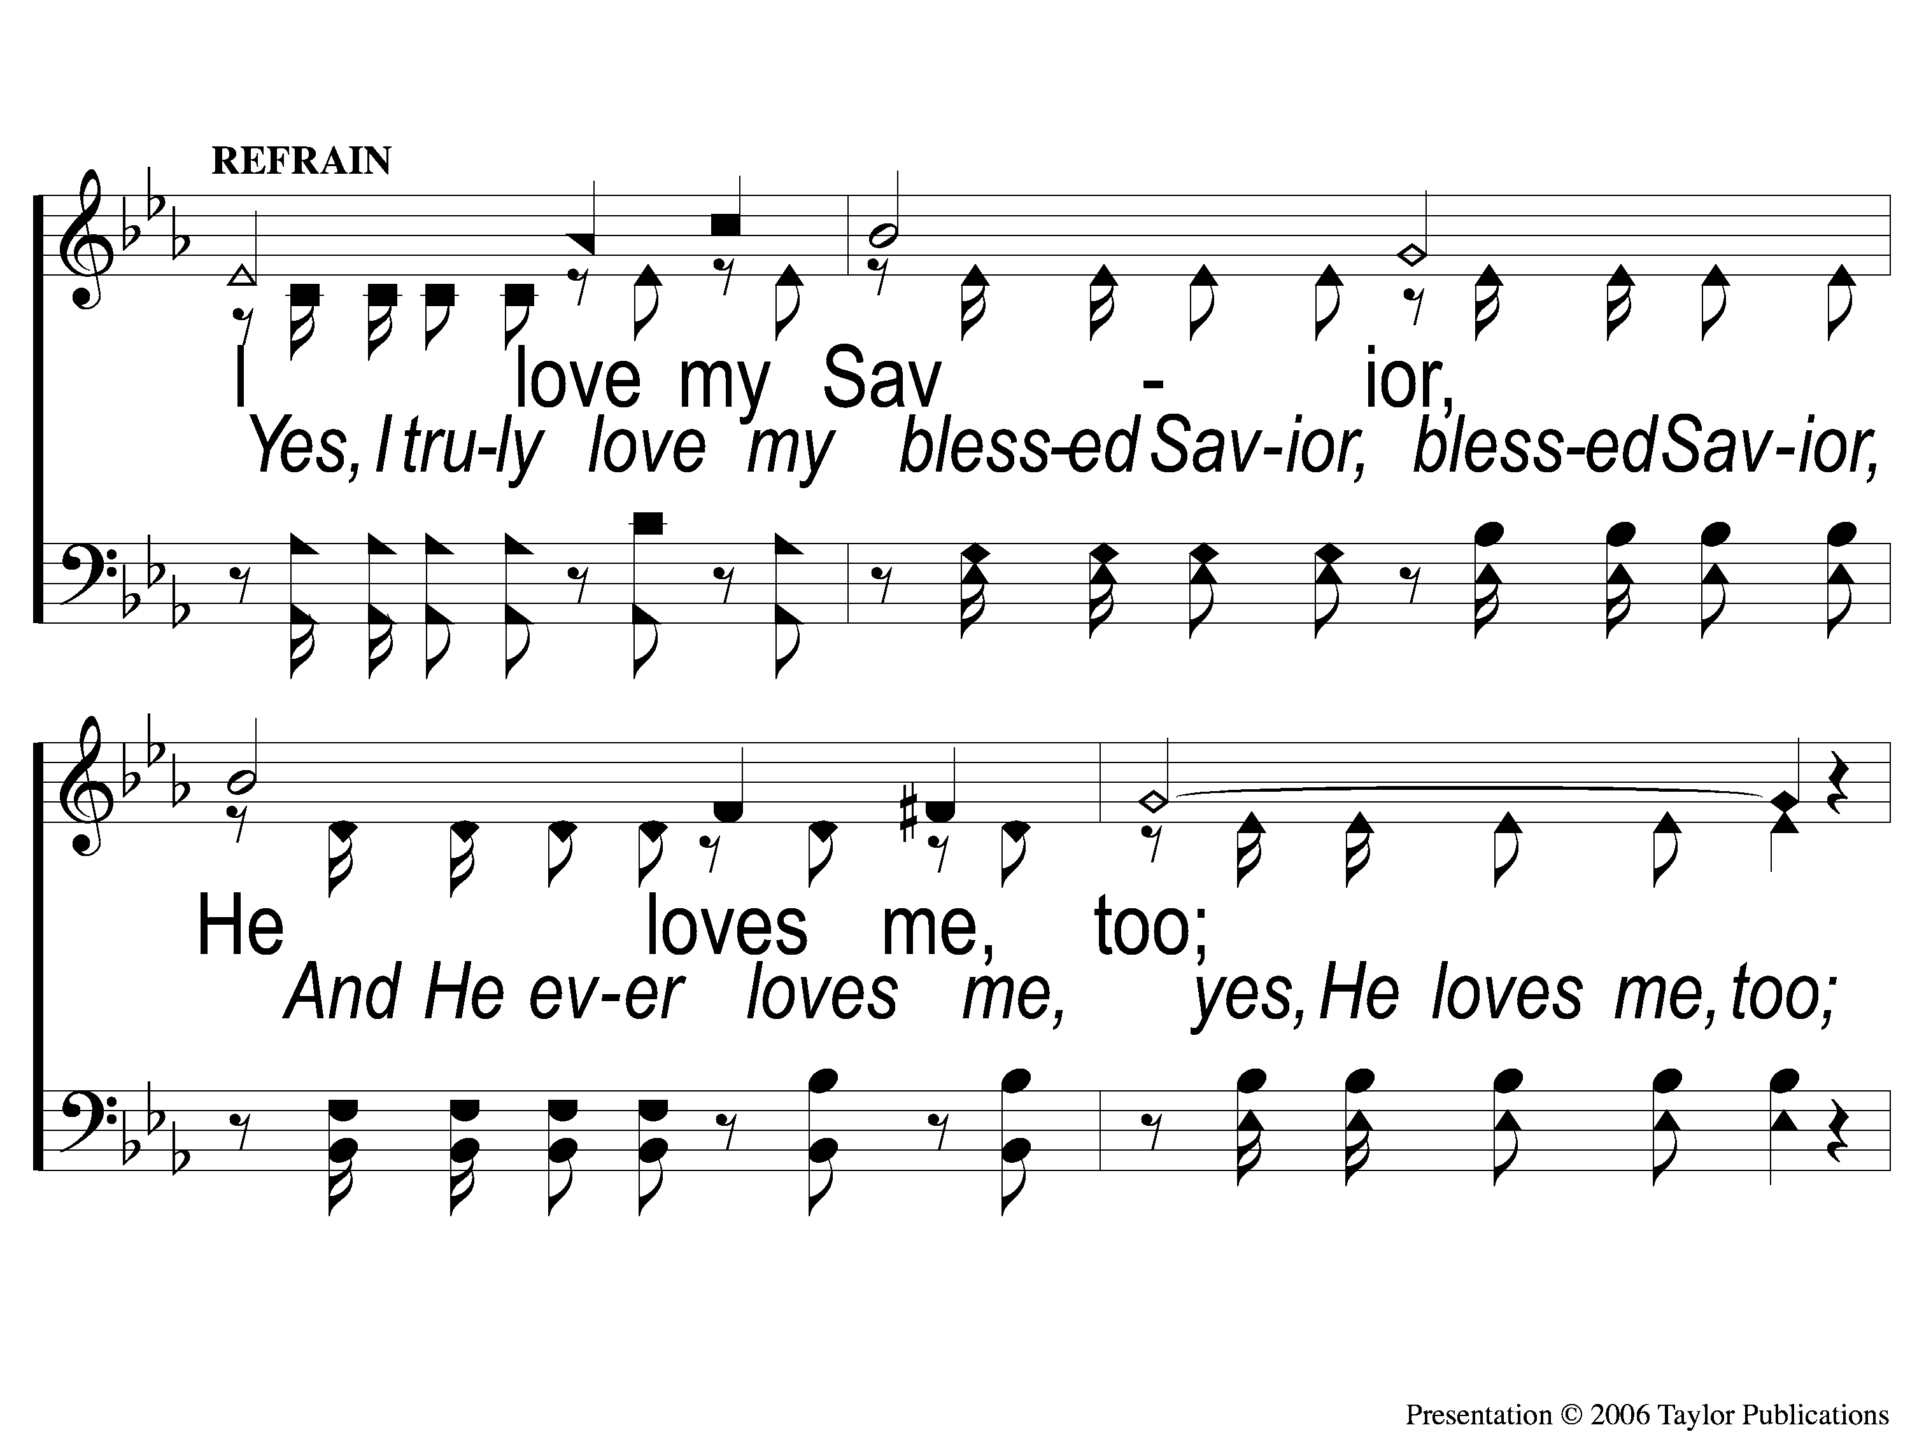
C-1 I Love My Savior
I Love My Savior, Too
610

Slide 45
C-2 I Love My Savior
I Love My Savior, Too
610

Slide 46
3-1 I Love My Savior
I Love My Savior, Too
610

Slide 47
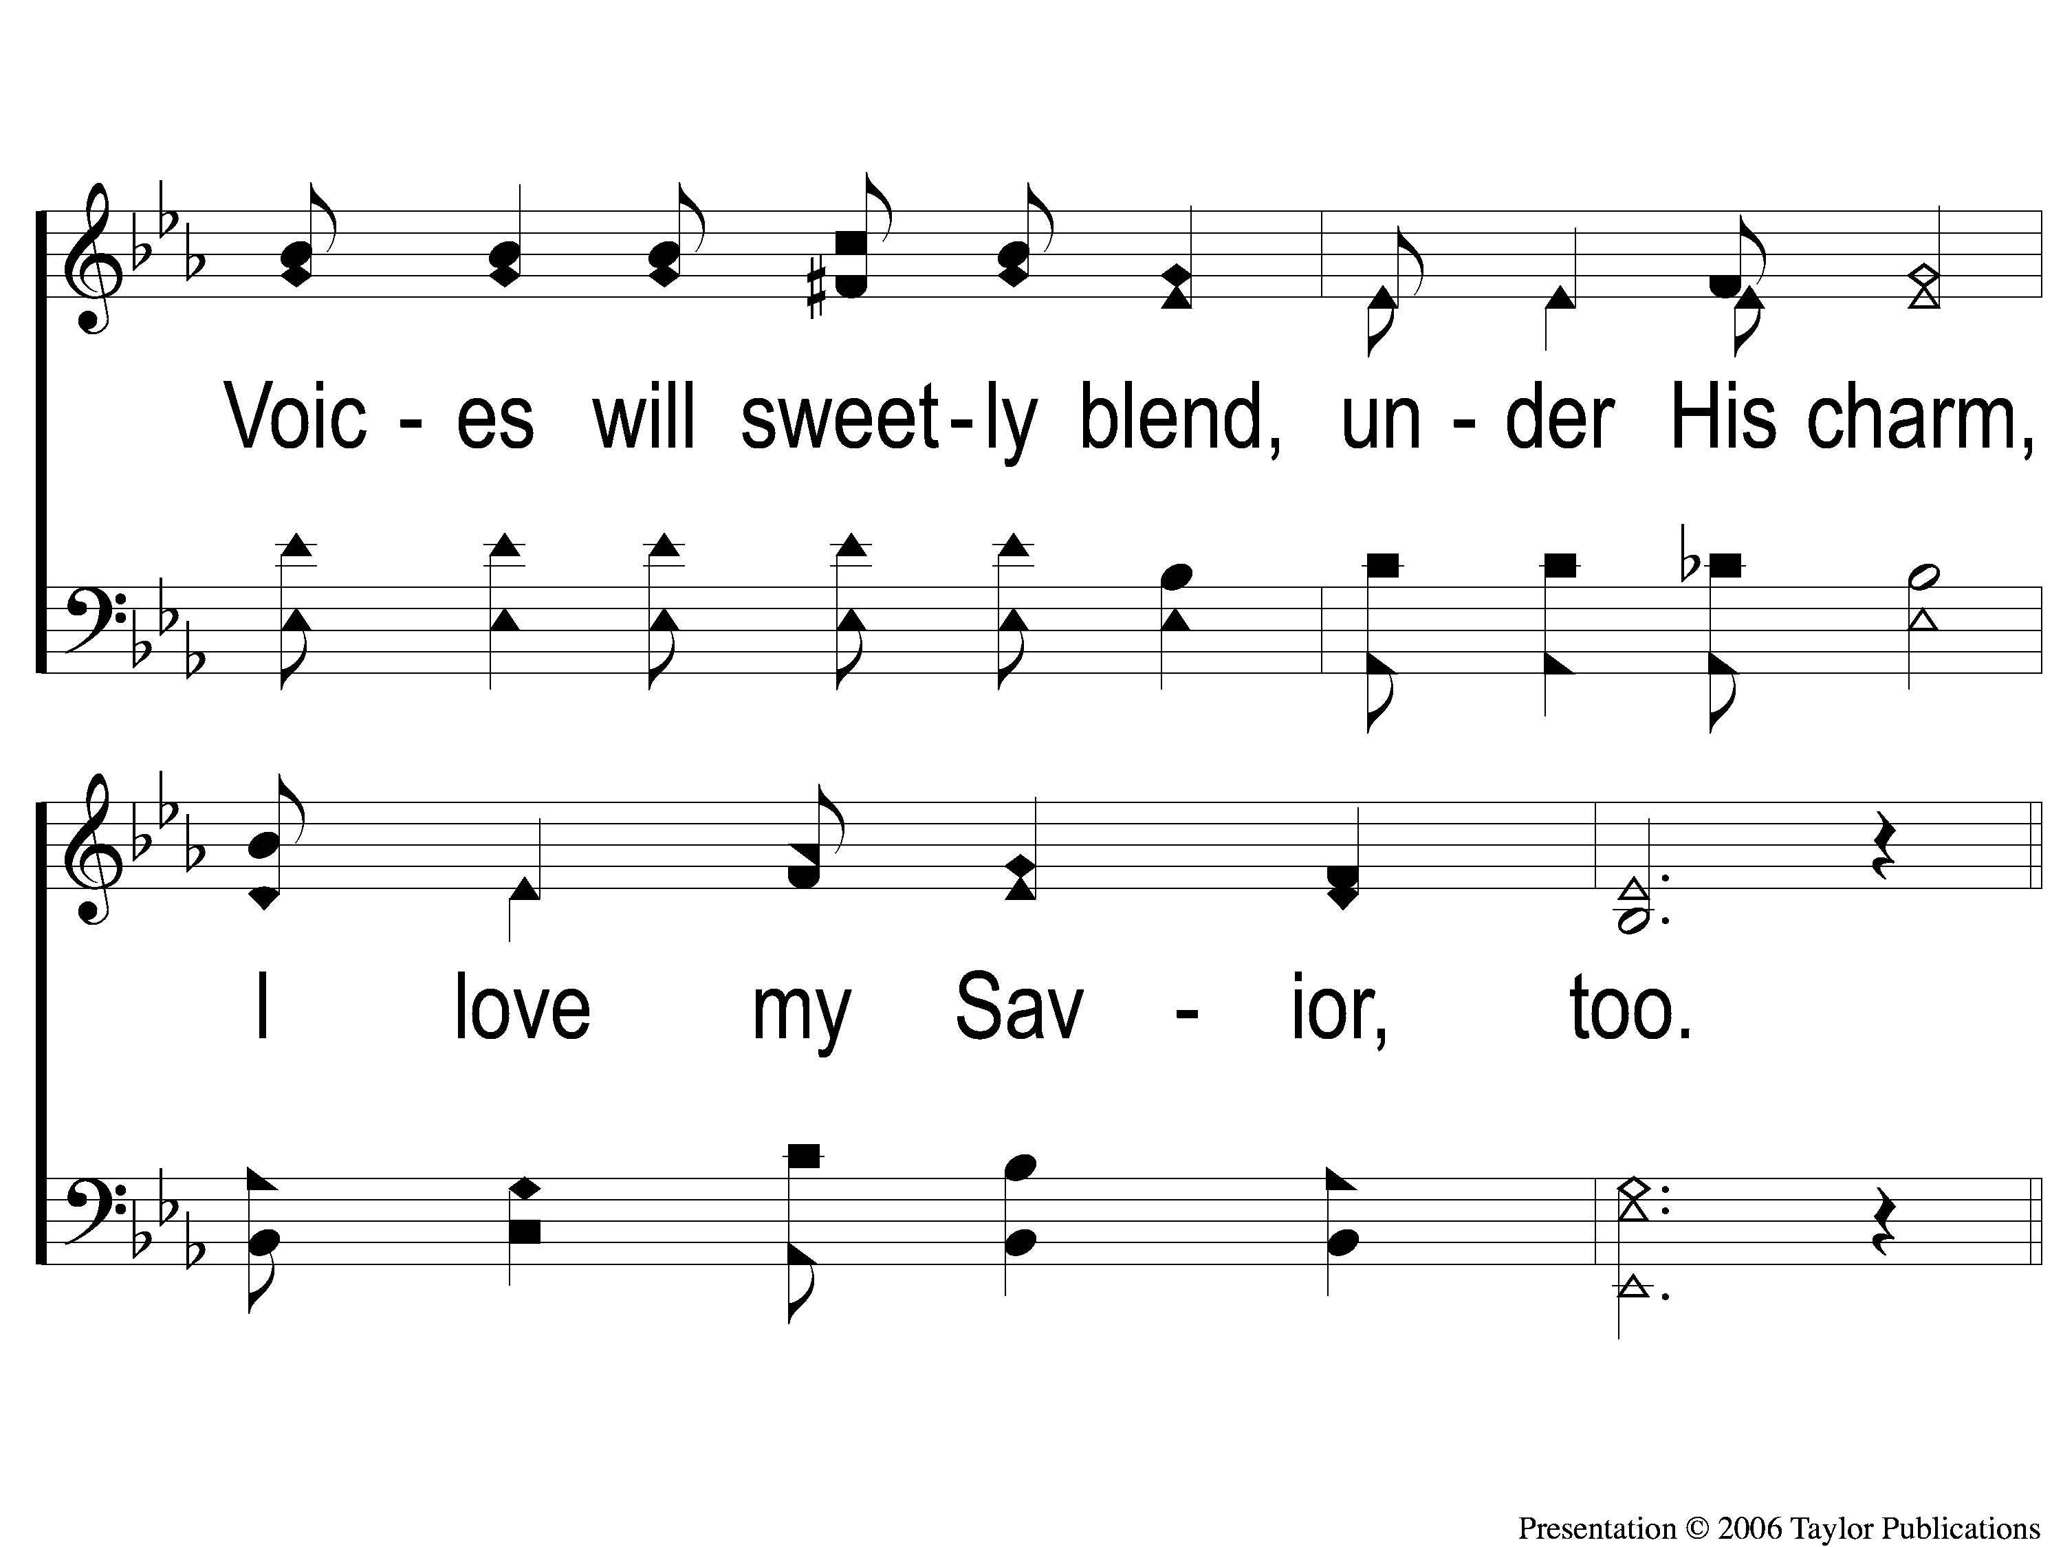
3-2 I Love My Savior
I Love My Savior, Too
610

Slide 48
C-1 I Love My Savior
I Love My Savior, Too
610

Slide 49
C-2 I Love My Savior
I Love My Savior, Too
610

Slide 50
#550
SONG:
I Walk With The King

Slide 51
1-1 I Walk With the King
I Walk With The King
550

Slide 52
1-2 I Walk With the King
I Walk With The King
550

Slide 53
1-3 I Walk With the King
I Walk With The King
550

Slide 54
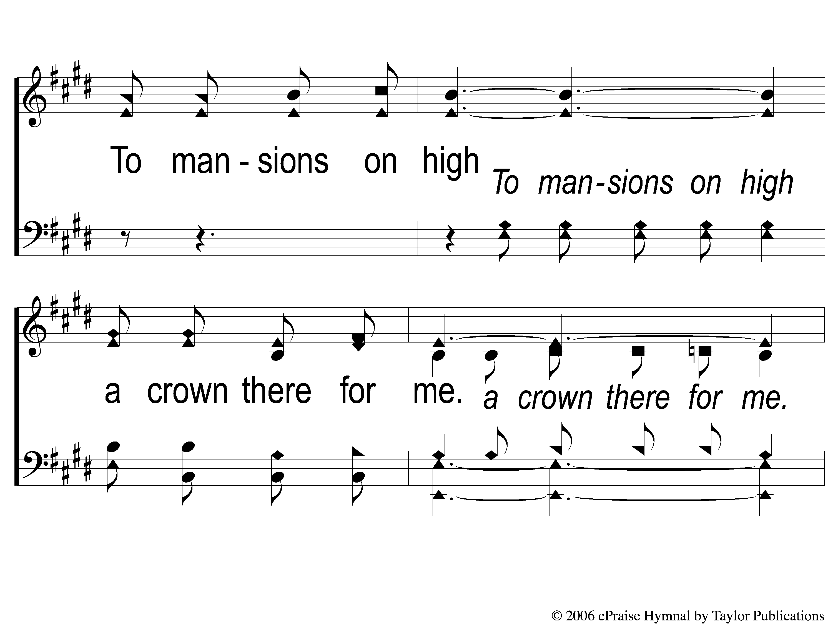
1-4 I Walk With the King
I Walk With The King
550

Slide 55
C-1 I Walk With the King
I Walk With The King
550

Slide 56
C-2 I Walk With the King
I Walk With The King
550

Slide 57
C-3 I Walk With the King
I Walk With The King
550

Slide 58
C-4 I Walk With the King
I Walk With The King
550

Slide 59
2-1 I Walk With the King
I Walk With The King
550

Slide 60
2-2 I Walk With the King
I Walk With The King
550

Slide 61
2-3 I Walk With the King
I Walk With The King
550

Slide 62
2-4 I Walk With the King
I Walk With The King
550

Slide 63
C-1 I Walk With the King
I Walk With The King
550

Slide 64
C-2 I Walk With the King
I Walk With The King
550

Slide 65
C-3 I Walk With the King
I Walk With The King
550

Slide 66
C-4 I Walk With the King
I Walk With The King
550

Slide 67
3-1 I Walk With the King
I Walk With The King
550

Slide 68
3-2 I Walk With the King
I Walk With The King
550

Slide 69
3-3 I Walk With the King
I Walk With The King
550

Slide 70
3-4 I Walk With the King
I Walk With The King
550

Slide 71
C-1 I Walk With the King
I Walk With The King
550

Slide 72
C-2 I Walk With the King
I Walk With The King
550

Slide 73
C-3 I Walk With the King
I Walk With The King
550

Slide 74
C-4 I Walk With the King
I Walk With The King
550

Slide 75
SCRIPTURE:
Acts 1:6-11

Slide 77
WATCH WHERE YOU STAND

Slide 78
WATCH OUT FOR
IDLENESS
ACTS 1:6-11

Slide 79
THE PRINCIPLE
Old Testament
Eccl. 10:18
Prov. 14:23, 19:15, 31:27
Ezek. 16:49

Slide 80
THE PRINCIPLE
New Testament
Matt. 20:1-16 – Parable of the Laborers & the Landowner

Slide 81
ARE YOU IDLE IN…
…Your Production?

Slide 82
ARE YOU IDLE IN…
…Your Production?
Acts 1:9-11
Matt. 28:18-20
Acts 26:16, 22

Slide 83
ARE YOU IDLE IN…
…Your Production?
Acts 1:9-11
Matt. 28:18-20
Acts 26:16, 22
Amos 6:1
Jer. 4:6, 21:8-9

Slide 84
ARE YOU IDLE IN…
…Your Communication?

Slide 85
ARE YOU IDLE IN…
…Your Communication?
1 Tim. 1:6, 5:13, 6:20
2 Tim. 2:16
Psa. 12:2
Prov. 14:23
Matt. 12:36

Slide 86
ARE YOU IDLE IN…
…Your Progression?

Slide 87
ARE YOU IDLE IN…
…Your Progression?
2 Cor. 8:7
Phili. 1:9
1 Thess. 3:12, 4:1
2 Pet. 1:5-8
Psa. 119:60

Slide 88
THE CONCLUSION
CHRISTIANS MUST BE PEOPLE WHO:

Slide 89
THE CONCLUSION
CHRISTIANS MUST BE PEOPLE WHO:
Actively Work

Slide 90
THE CONCLUSION
CHRISTIANS MUST BE PEOPLE WHO:
Actively Work
Gracefully Talk

Slide 91
THE CONCLUSION
CHRISTIANS MUST BE PEOPLE WHO:
Actively Work
Gracefully Talk
Faithfully Walk

Slide 92
THE QUESTION
Are You Active Or Idle?

Slide 93
THE INVITATION
Have You Decided
To Follow Jesus?

Slide 94
#674
SONG:
I Have Decided
To Follow Jesus

Slide 95
1-1 I Have Decided to Follow Jesus
I Have Decided to Follow Jesus
674

Slide 96
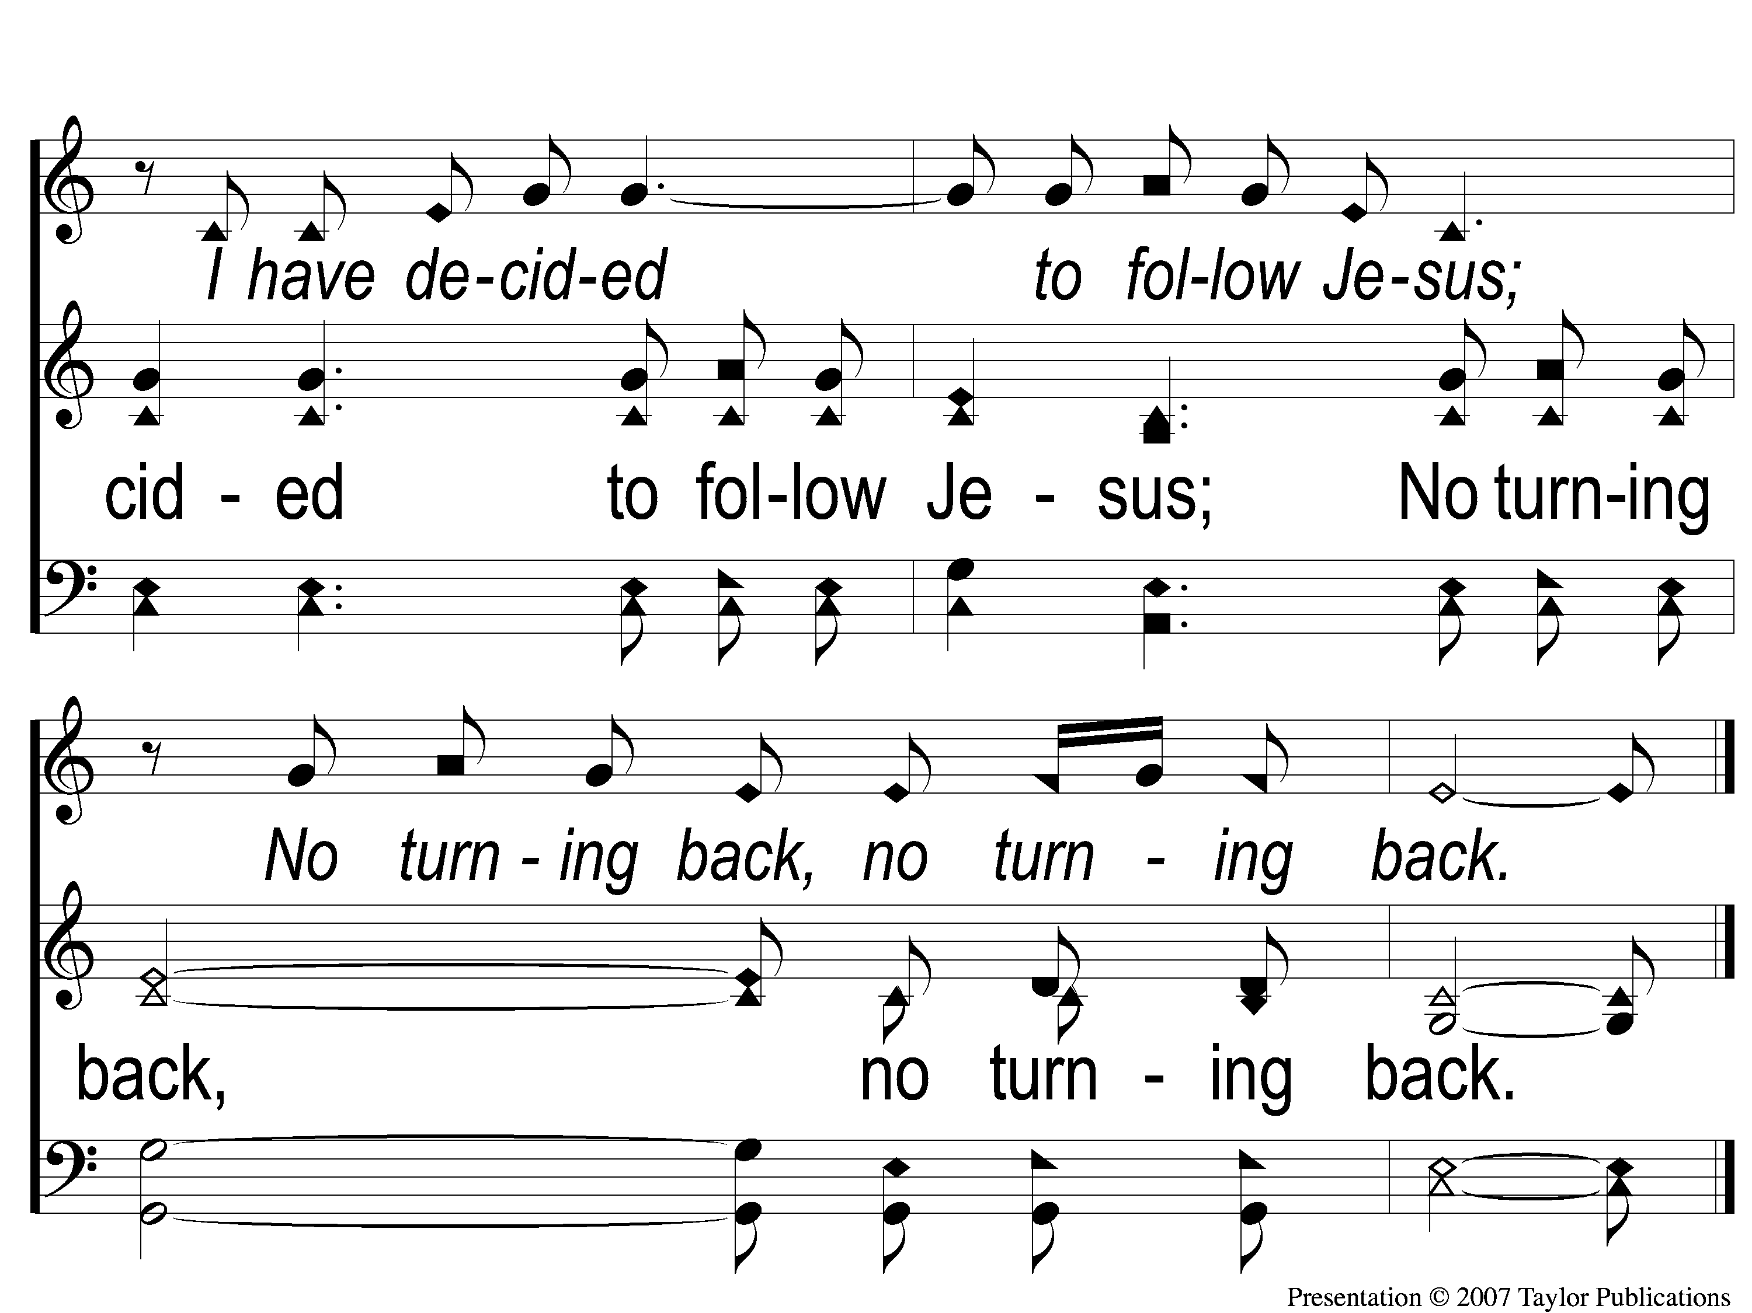
1-2 I Have Decided to Follow Jesus
I Have Decided to Follow Jesus
674

Slide 97
2-1 I Have Decided to Follow Jesus
I Have Decided to Follow Jesus
674

Slide 98
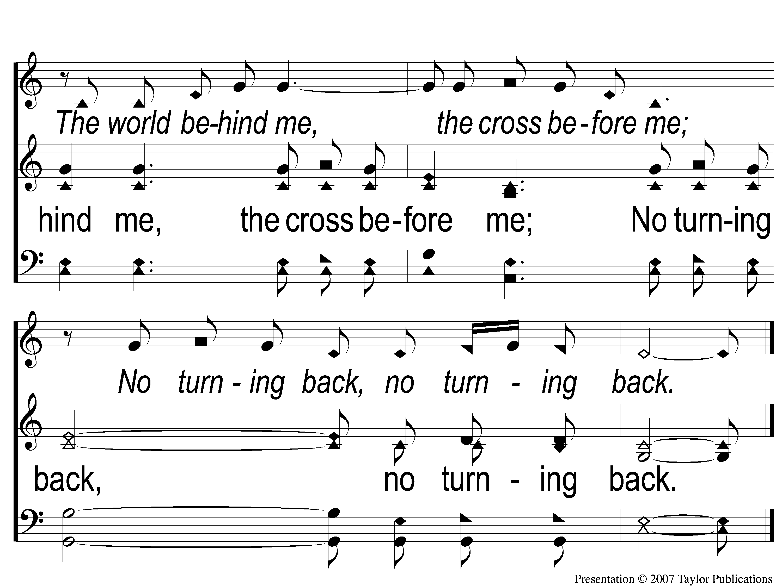
2-2 I Have Decided to Follow Jesus
I Have Decided to Follow Jesus
674

Slide 99
3-1 I Have Decided to Follow Jesus
I Have Decided to Follow Jesus
674

Slide 100
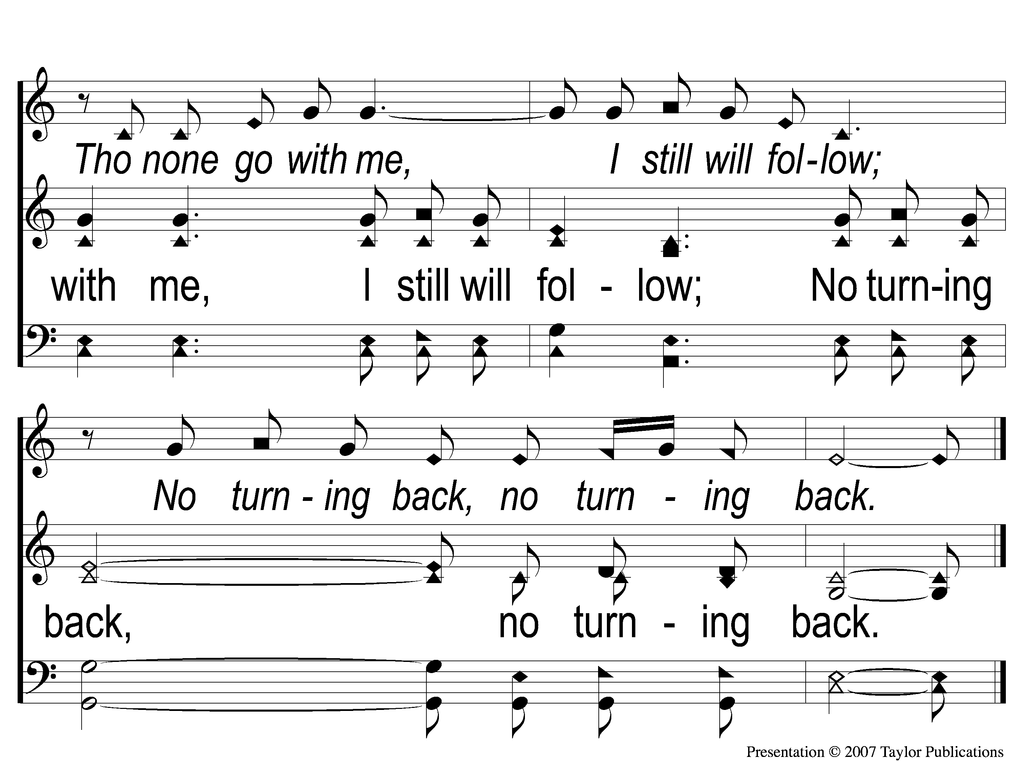
3-2 I Have Decided to Follow Jesus
I Have Decided to Follow Jesus
674

Slide 101
4-1 I Have Decided to Follow Jesus
I Have Decided to Follow Jesus
674

Slide 102
4-2 I Have Decided to Follow Jesus
I Have Decided to Follow Jesus
674

Slide 103
SONG:
In Christ Alone

Slide 104
1-1 In Christ Alone
In Christ Alone

Slide 105
1-2 In Christ Alone
In Christ Alone

Slide 106
1-3 In Christ Alone
In Christ Alone

Slide 107
1-4 In Christ Alone
In Christ Alone

Slide 108
2-1 In Christ Alone
In Christ Alone

Slide 109
2-2 In Christ Alone
In Christ Alone

Slide 110
2-3 In Christ Alone
In Christ Alone

Slide 111
2-4 In Christ Alone
In Christ Alone

Slide 112
3-1 In Christ Alone
In Christ Alone

Slide 113
3-2 In Christ Alone
In Christ Alone

Slide 114
3-3 In Christ Alone
In Christ Alone

Slide 115
3-4 In Christ Alone
In Christ Alone

Slide 116
LORD’S SUPPER
The
Acts 20:7

Slide 117
Unleavened Bread
LORD’S SUPPER
“I am the bread of life. Your fathers ate the manna in the wilderness, and are dead.This is the bread which comes down from heaven, that one may eat of it and not die. I am the living bread which came down from heaven. If anyone eats of this bread, he will live forever; and the bread that I shall give is My flesh, which I shall give for the life of the world.”
John 6:48-51

Slide 118
Fruit of the Vine
LORD’S SUPPER
“Then Jesus said to them, “Most assuredly, I say to you, unless you eat the flesh of the Son of Man and drink His blood, you have no life in you. Whoever eats My flesh and drinks My blood has eternal life, and I will raise him up at the last day. For My flesh is food indeed, and My blood is drink indeed. He who eats My flesh and drinks My blood abides in Me, and I in him. As the living Father sent Me, and I live because of the Father, so he who feeds on Me will live because of Me.”
John 6:53-57

Slide 119
Luke 12:15
OFFERING
“And He said to them, ‘Take heed and beware of covetousness, for one’s life does not consist in the abundance of the things he possesses.’”

Slide 120
Closing PRAYER

Slide 121
SONG:
Sweet Beulah Land

Slide 122
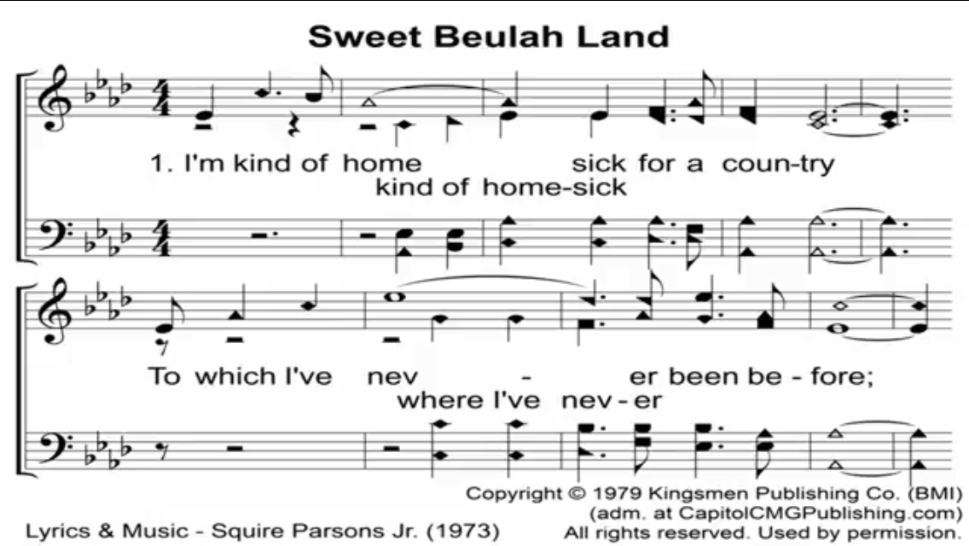

Slide 123
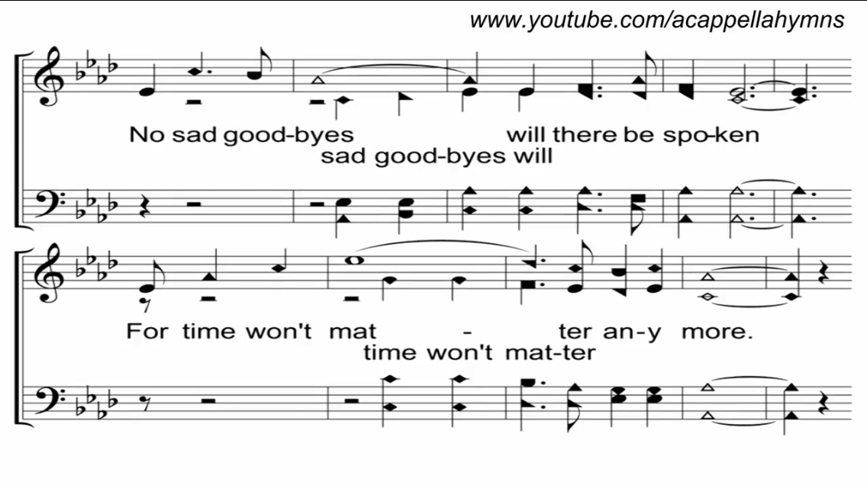

Slide 124
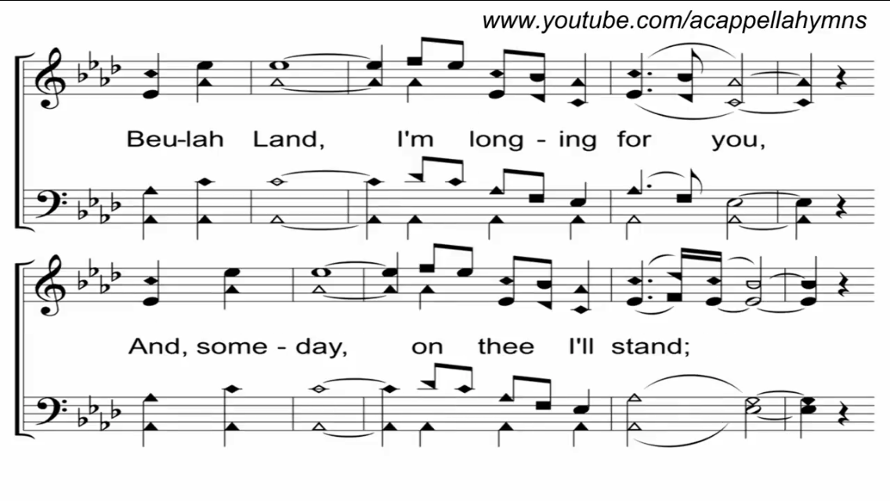

Slide 125
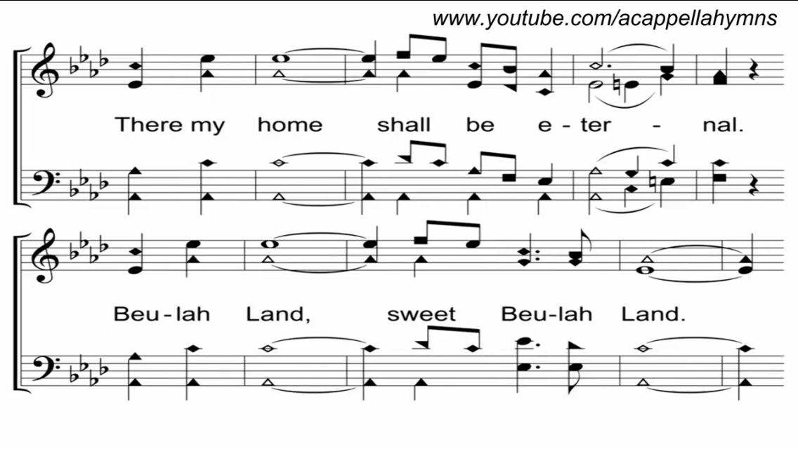

Slide 126
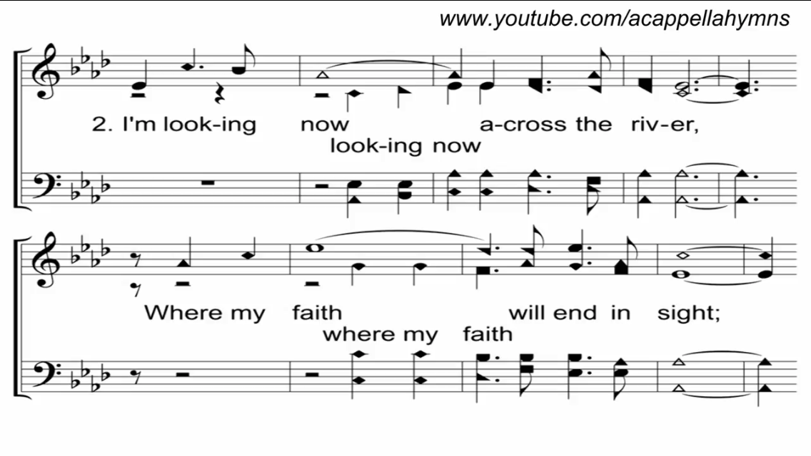

Slide 127
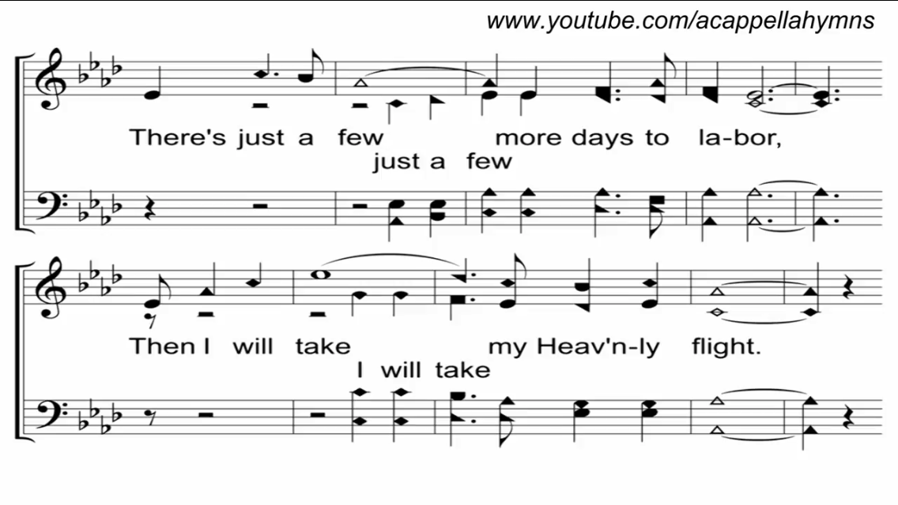

Slide 130
TONIGHT @ 6:00 pm
EVENING WORSHIP
HOPE TO SEE YOU THERE!

Slide 131
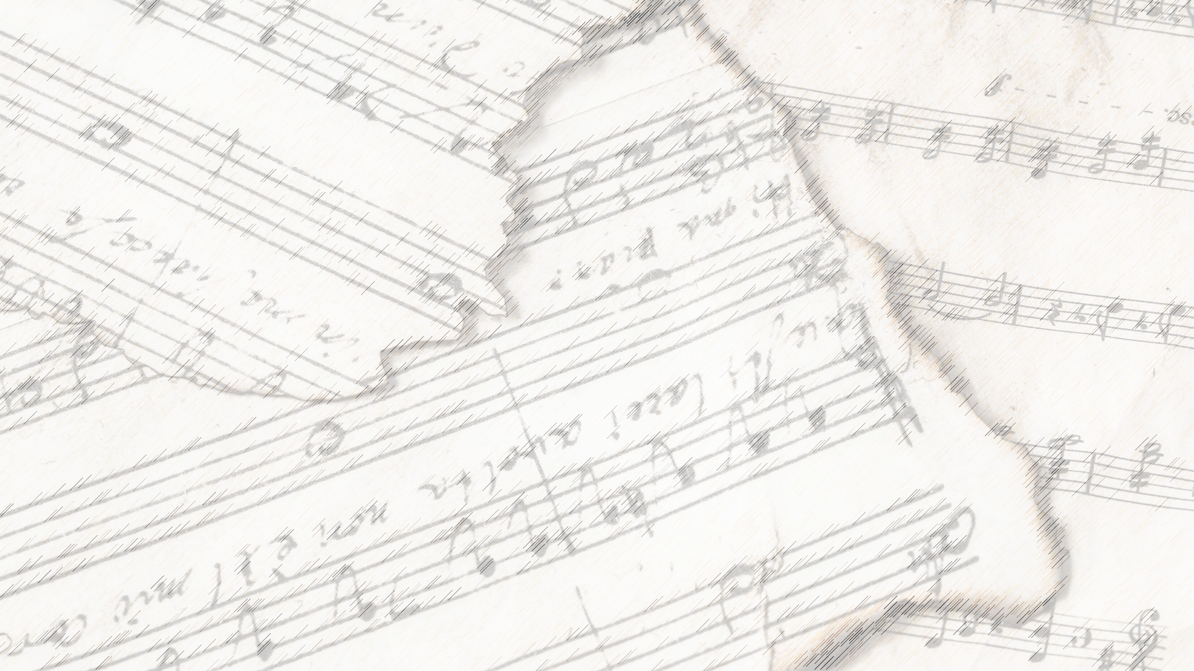
Songs
About
Standing

Slide 132
Songs about
Standing Firm

