Slide 1
WELCOME
THANKS FOR JOINING US!

Slide 2
Songs of
Praise to God

Slide 3
Opening PRAYER

Slide 4
Songs of
Praise to God

Slide 5
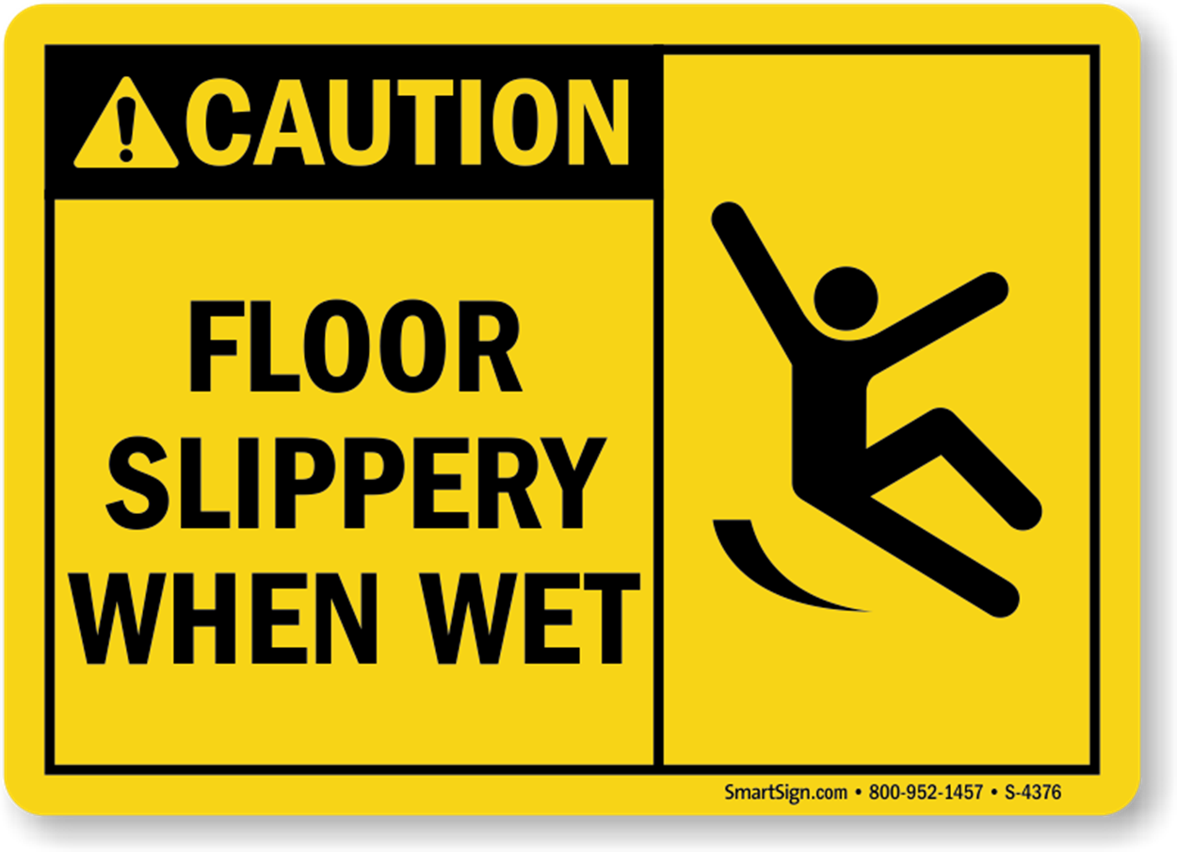
WATCH WHERE YOU STAND

Slide 6
WATCH OUT
FOR YOUR
FEELINGS
1 Cor. 10:12

Slide 7
THE PRINCIPLE
1 Cor. 10:12

Slide 8
THE PRINCIPLE
1 Cor. 10:12
“thinks” (δοκέω) = suppose, seem to be true

Slide 9
THE PRINCIPLE
1 Cor. 10:12
“thinks” (δοκέω) = suppose, seem to be true
= “to regard something as true, but without particular certainty”

Slide 10
THE PRINCIPLE
Our Thoughts Can Be Incorrect

Slide 11
THE PRINCIPLE
Our Thoughts Can Be Incorrect
Jn. 5:39, 20:15
1 Cor. 8:2
Gal. 6:3
Jms. 1:26

Slide 12
THE COMMAND
“Take Heed”

Slide 13
THE COMMAND
“Take Heed”
Βλέπω (Blepo) = see, look, watch

Slide 14
THE COMMAND
“Take Heed”
Βλέπω (Blepo) = see, look, watch
= be ready, alert, prepared to respond

Slide 15
THE COMMAND
“Take Heed”
Βλέπω (Blepo) = see, look, watch
= be ready, alert, prepared to respond
1 Thess. 5:6 – Col. 2:8 – Heb. 3:12

Slide 16
THE REASON
“Lest he fall”

Slide 17
THE REASON
“Lest he fall”
Πίπτω (Pipto) = to fall from a standing or upright position down to the ground surface

Slide 18
THE REASON
“Lest he fall”
Πίπτω (Pipto) = to fall from a standing or upright position down to the ground surface
Gal. 5:4 – 2 Pet. 3:17 – Heb. 11:30

Slide 19
THE QUESTION
Do you think you stand
or do you know?

Slide 20
THE QUESTION
Do you think you stand
or do you know?
1 John 2:3-4

Slide 21
Invitation Song

Slide 22
Songs of
Praise to God

Slide 23
The Lord’s Supper

Slide 24
Closing PRAYER

Slide 25
Closing Song

Slide 26
Join Us This WEDNESDAY @ 6:30 pm
Hope to see you there!

