Slide 1
WELCOME
THANKS FOR JOINING US!

Slide 2
1-1 On Bended Knee
On Bended Knee
791

Slide 3
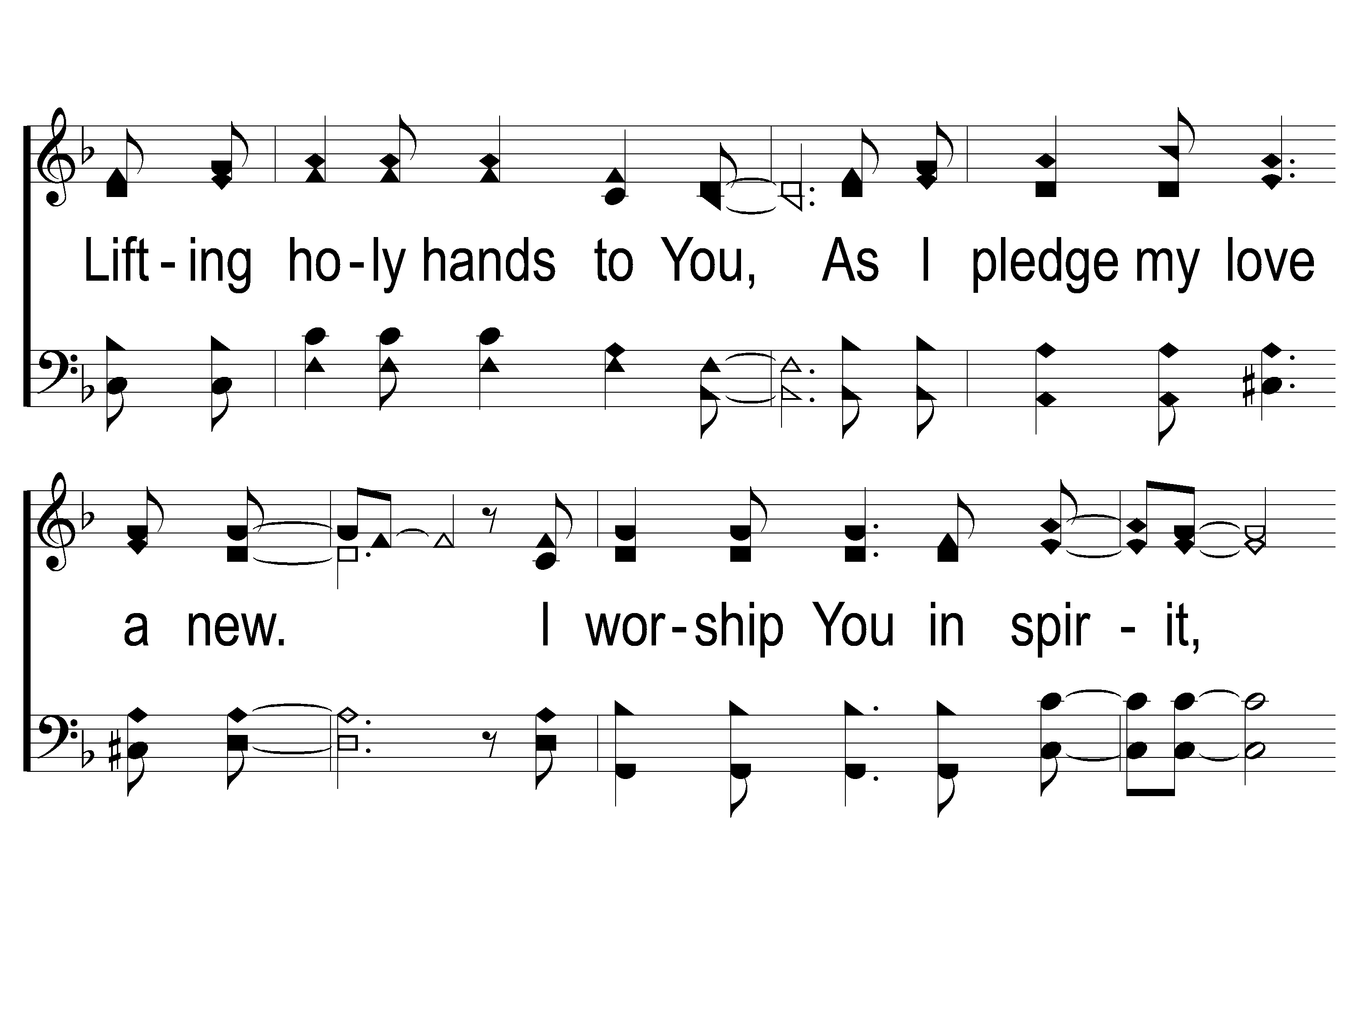
1-2 On Bended Knee
On Bended Knee
791

Slide 4
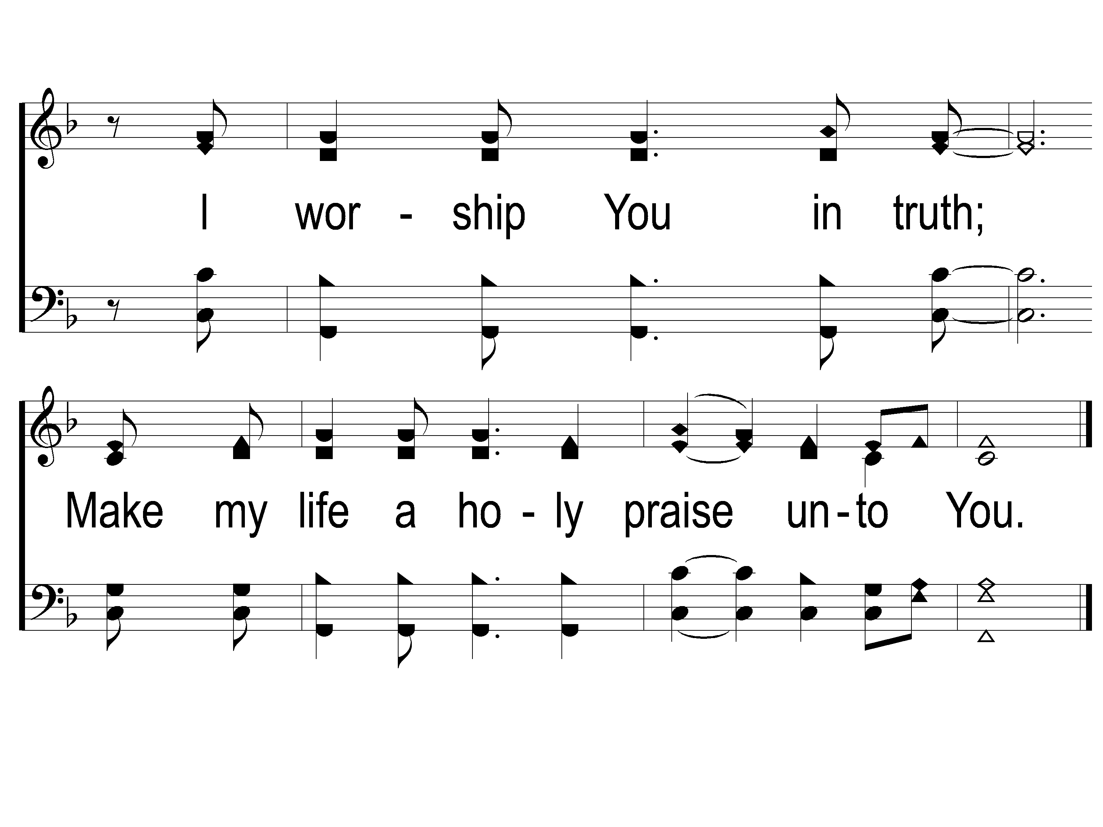
1-3 On Bended Knee
On Bended Knee
791

Slide 5
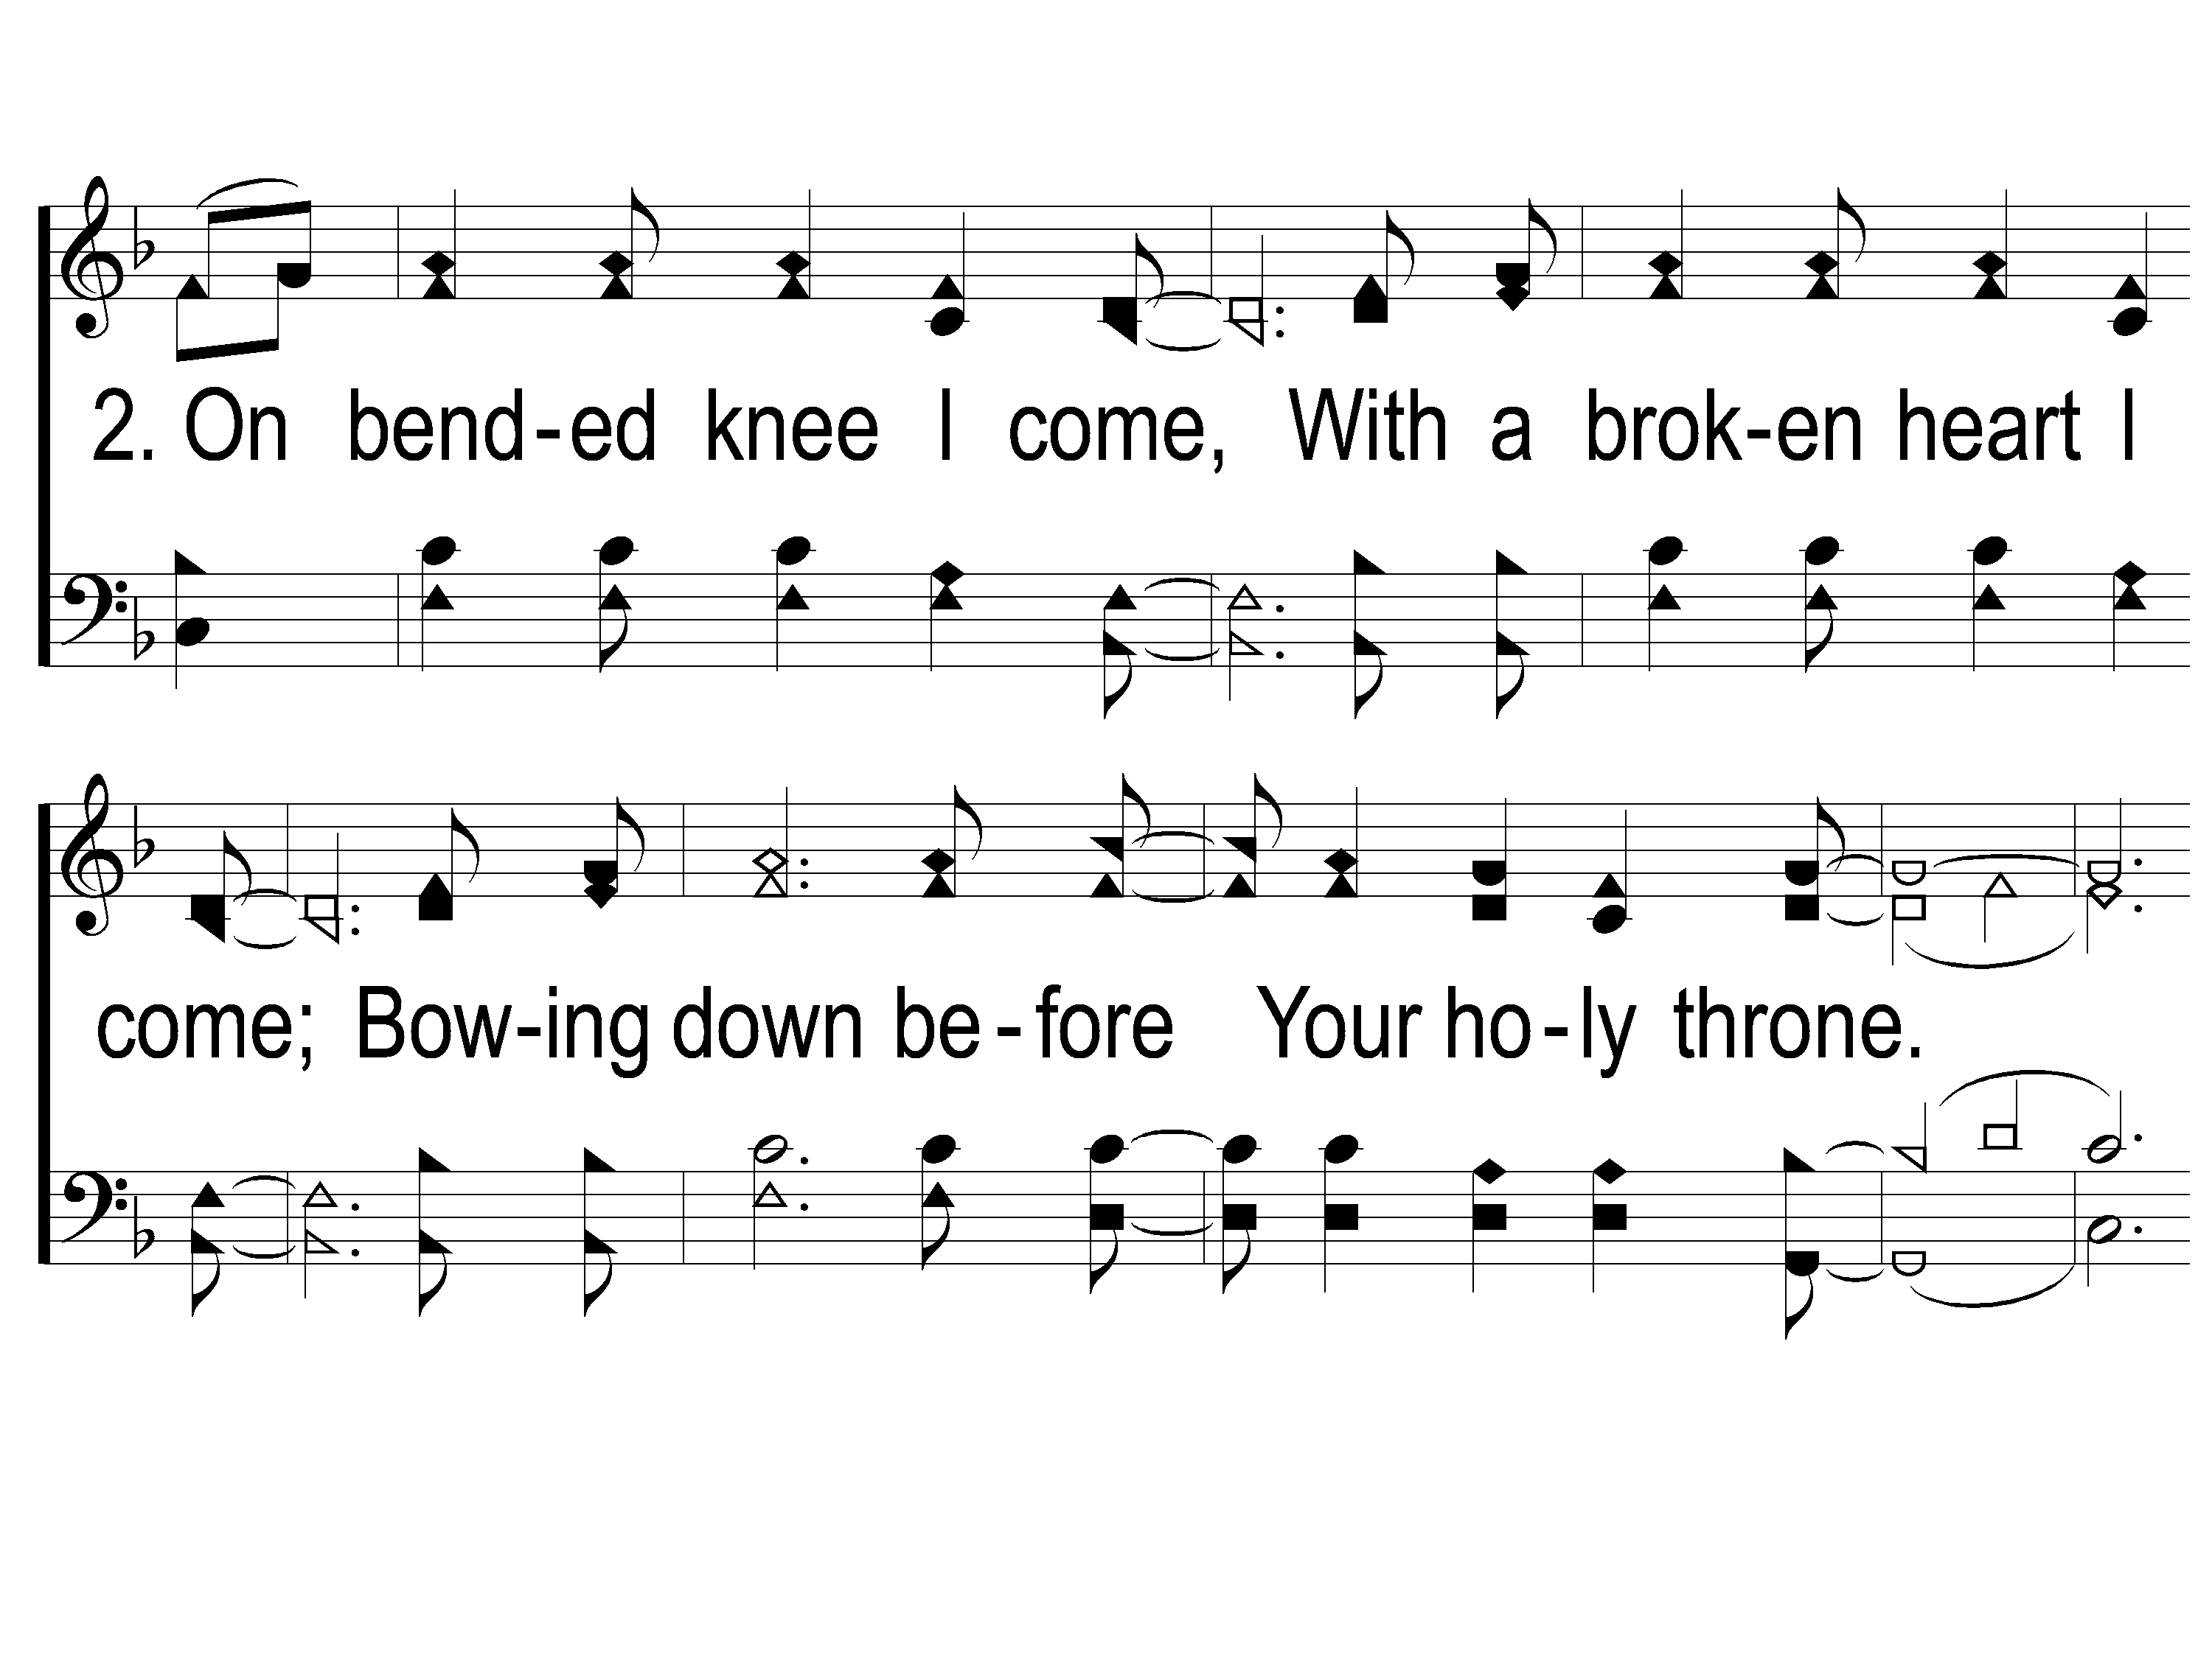
2-1 On Bended Knee
On Bended Knee
791

Slide 6
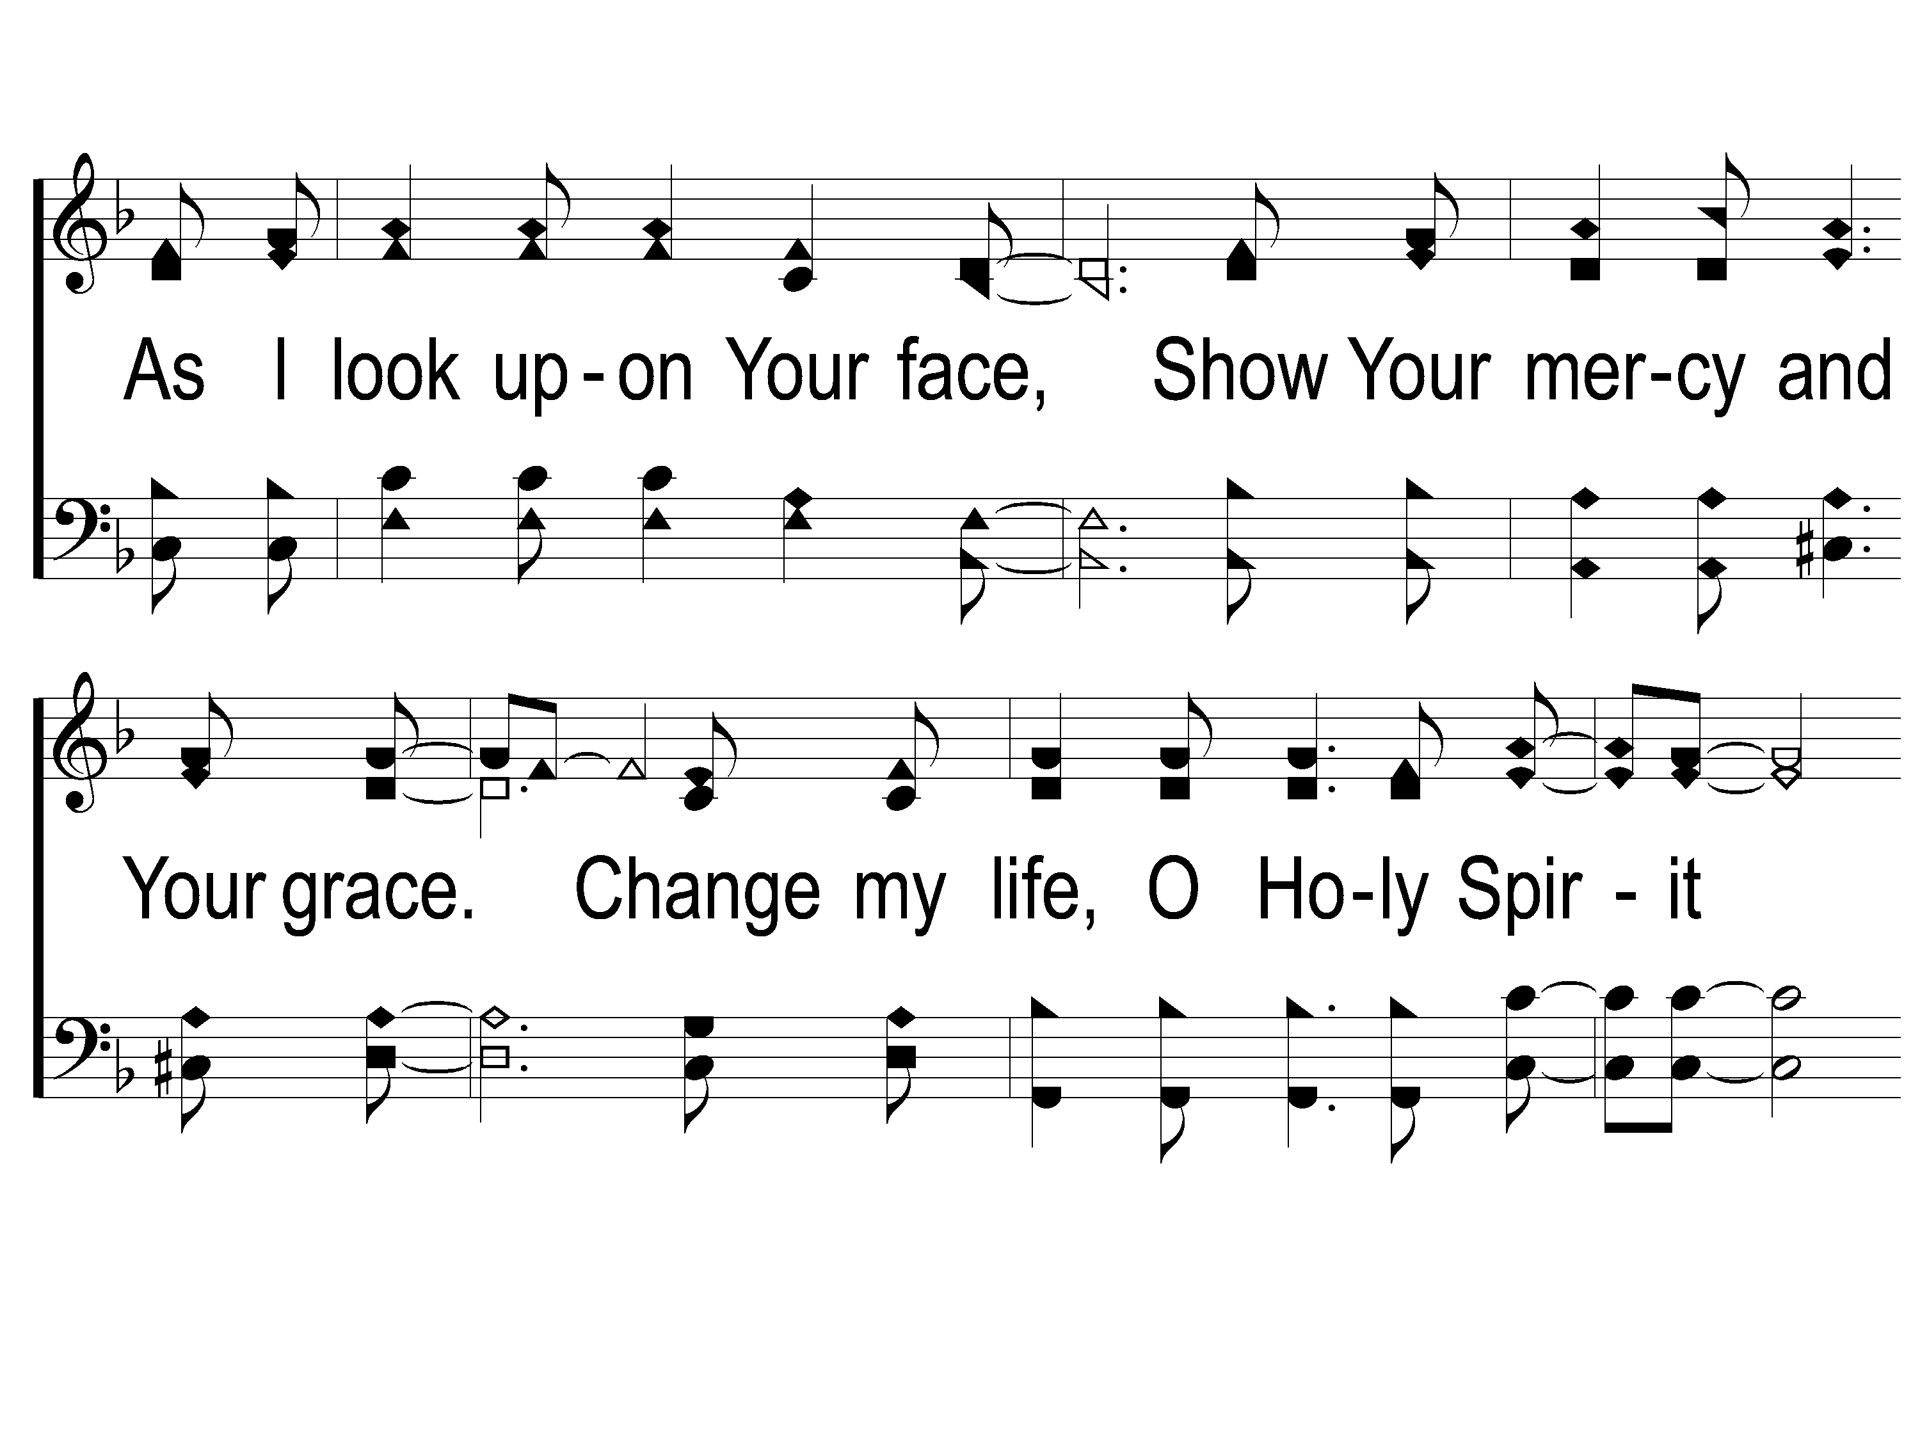
2-2 On Bended Knee
On Bended Knee
791

Slide 7
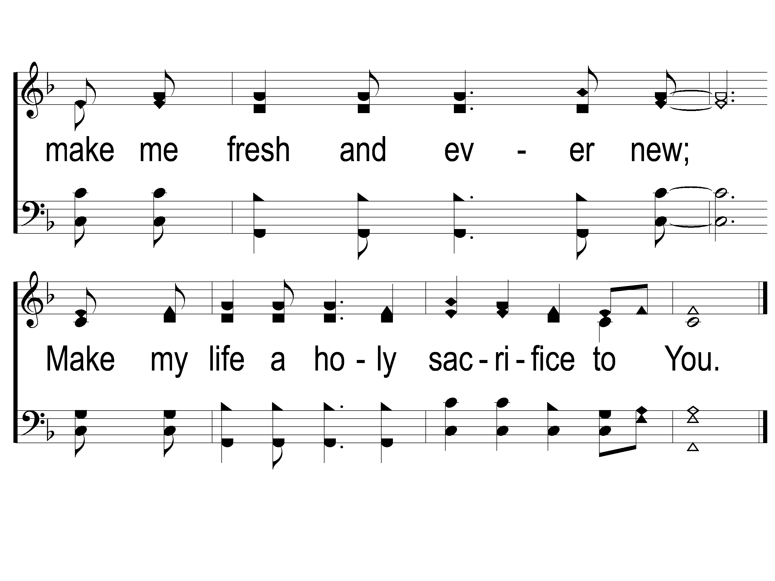
2-3 On Bended Knee
On Bended Knee
791

Slide 8
WELCOME
THANKS FOR JOINING US!

Slide 9
#234
SONG:
Worthy Is The Lamb

Slide 10
1-1 Worthy is the Lamb
Worthy Is the Lamb
234

Slide 11
1-2 Worthy is the Lamb
Worthy Is the Lamb
234

Slide 12
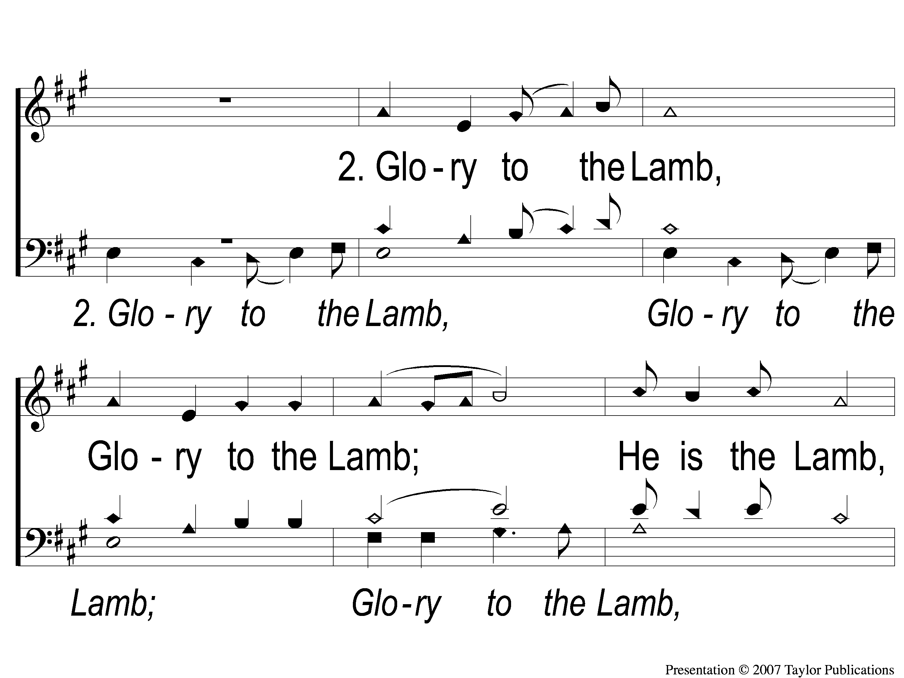
2-1 Worthy is the Lamb
Worthy Is the Lamb
234

Slide 13
2-2 Worthy is the Lamb
Worthy Is the Lamb
234

Slide 14
3-1 Worthy is the Lamb
Worthy Is the Lamb
234

Slide 15
3-2 Worthy is the Lamb
Worthy Is the Lamb
234

Slide 16
1 Highest Place
Highest Place
155

Slide 17
2 Highest Place
Highest Place
155

Slide 18
3 Highest Place
Highest Place
155

Slide 19
4 Highest Place
Highest Place
155

Slide 20
5 Highest Place
Highest Place
155

Slide 21
Tag Highest Place
Highest Place
155

Slide 22
3 Highest Place
Highest Place
155

Slide 23
4 Highest Place
Highest Place
155

Slide 24
5 Highest Place
Highest Place
155

Slide 25
Tag Highest Place
Highest Place
155

Slide 26
#100
SONG:
Holy Ground

Slide 27
1-1 Holy Ground
Holy Ground
100

Slide 28
1-2 Holy Ground
Holy Ground
100

Slide 29
2-1 Holy Ground
Holy Ground
100

Slide 30
2-2 Holy Ground
Holy Ground
100

Slide 31
Opening PRAYER

Slide 32
SONG:
The Lighthouse

Slide 33
There’s a lighthouse on the hillside
That overlooks life’s sea.
When I’m tossed…it sends out a light,
‘Tis a light that I might see.

Slide 34
And the light that shines in darkness now
Will safely lead us o’er.
If it wasn’t for the lighthouse,
My ship would be no more.

Slide 35
Chorus:
And I thank God for the lighthouse,
I owe my life to Him.
For Jesus is the lighthouse
And from the rocks of sin;

Slide 36
Chorus:
He has shone a light around me
That I could clearly see,
If it wasn’t for the lighthouse
Tell me where would this ship be?

Slide 37
#642
SONG:
Let The Lower
Lights Be Burning

Slide 38
1-1 Let the Lower Lights Be Burning
Let the Lower Lights Be Burning
642

Slide 39
1-2 Let the Lower Lights Be Burning
Let the Lower Lights Be Burning
642

Slide 40
C-1 Let the Lower Lights Be Burning
Let the Lower Lights Be Burning
642

Slide 41
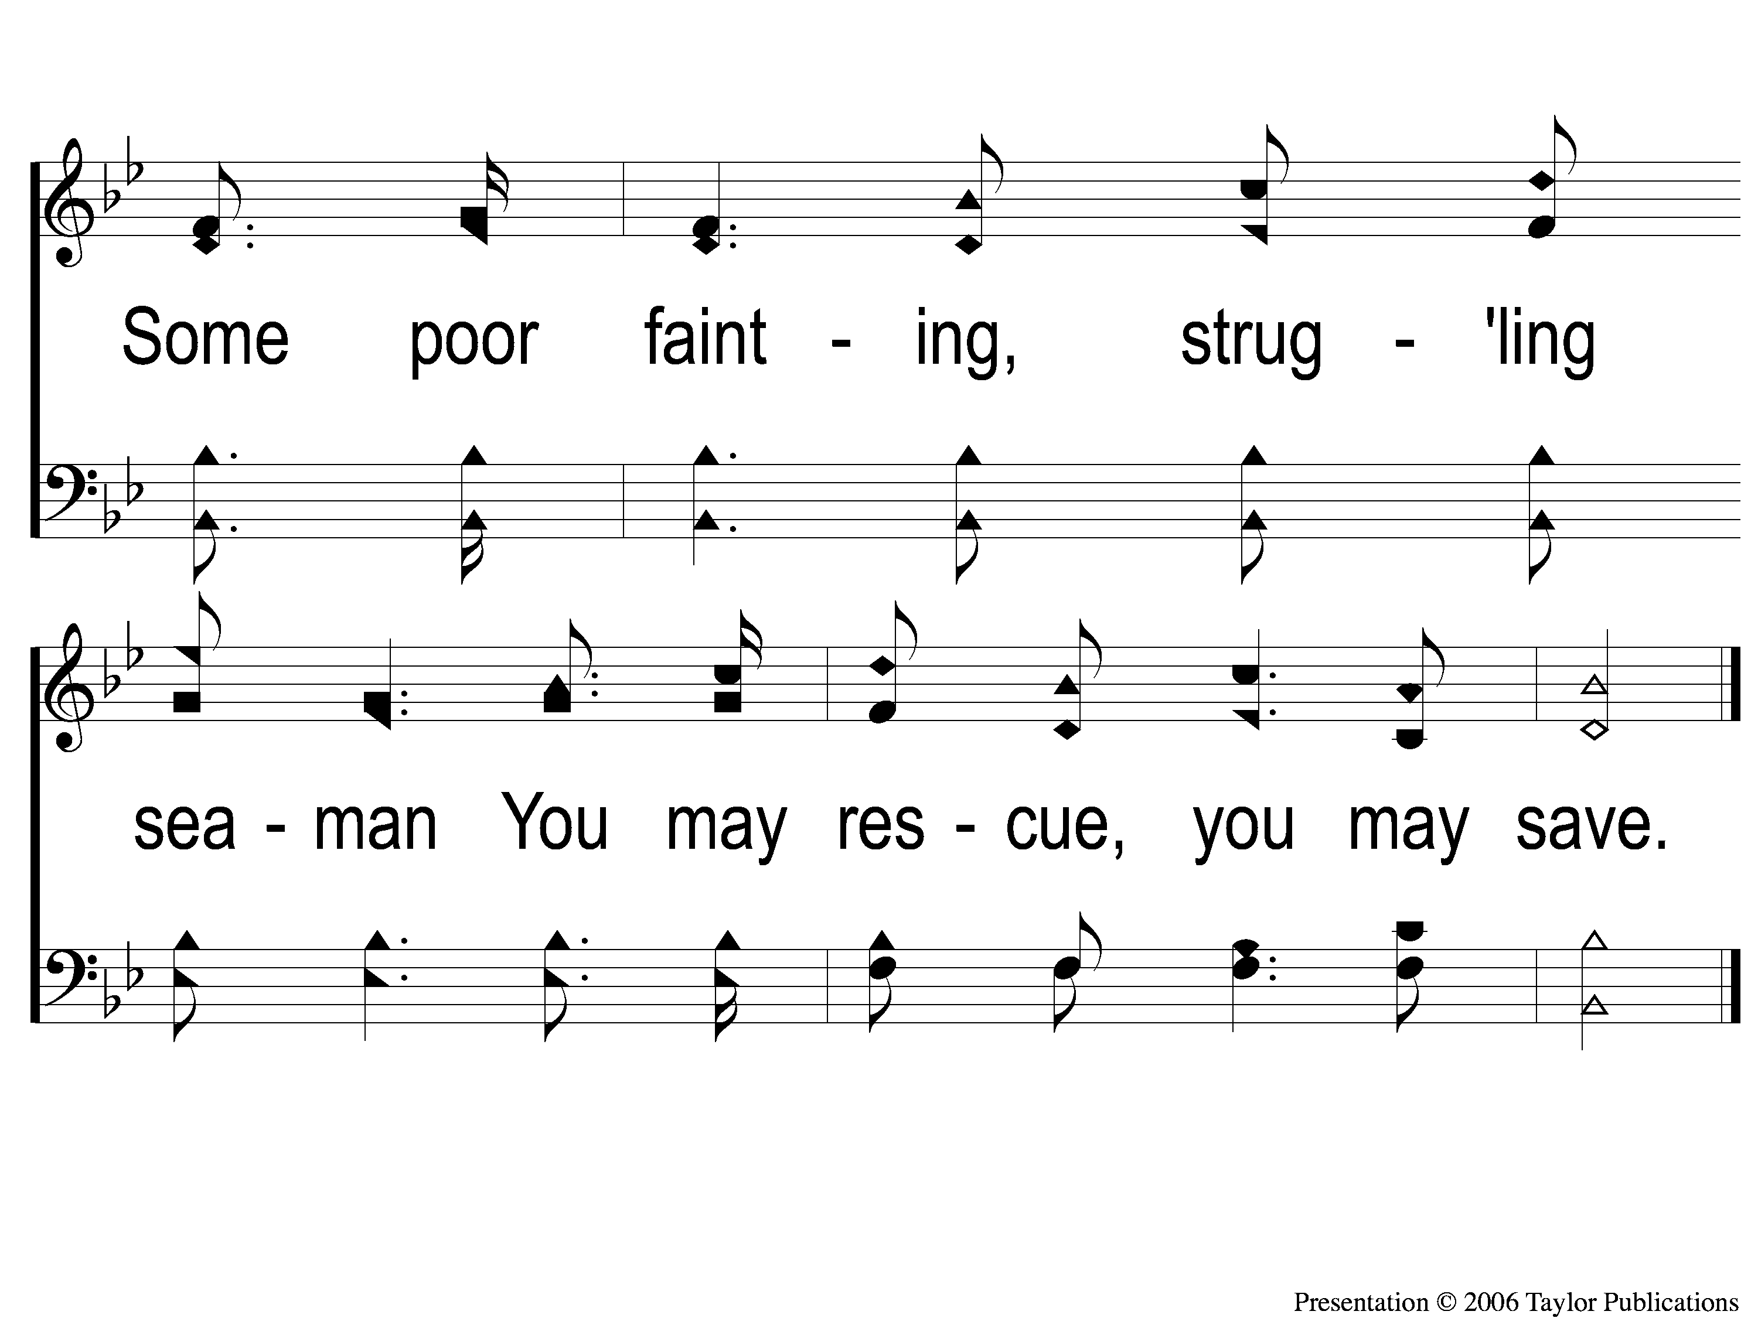
C-2 Let the Lower Lights Be Burning
Let the Lower Lights Be Burning
642

Slide 42
2-1 Let the Lower Lights Be Burning
Let the Lower Lights Be Burning
642

Slide 43
2-2 Let the Lower Lights Be Burning
Let the Lower Lights Be Burning
642

Slide 44
C-1 Let the Lower Lights Be Burning
Let the Lower Lights Be Burning
642

Slide 45
C-2 Let the Lower Lights Be Burning
Let the Lower Lights Be Burning
642

Slide 46
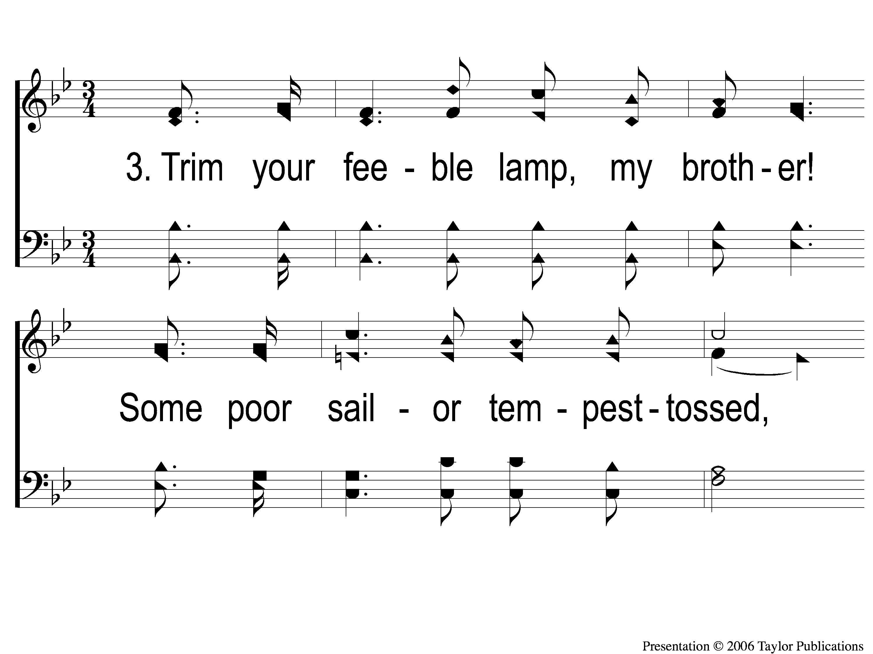
3-1 Let the Lower Lights Be Burning
Let the Lower Lights Be Burning
642

Slide 47
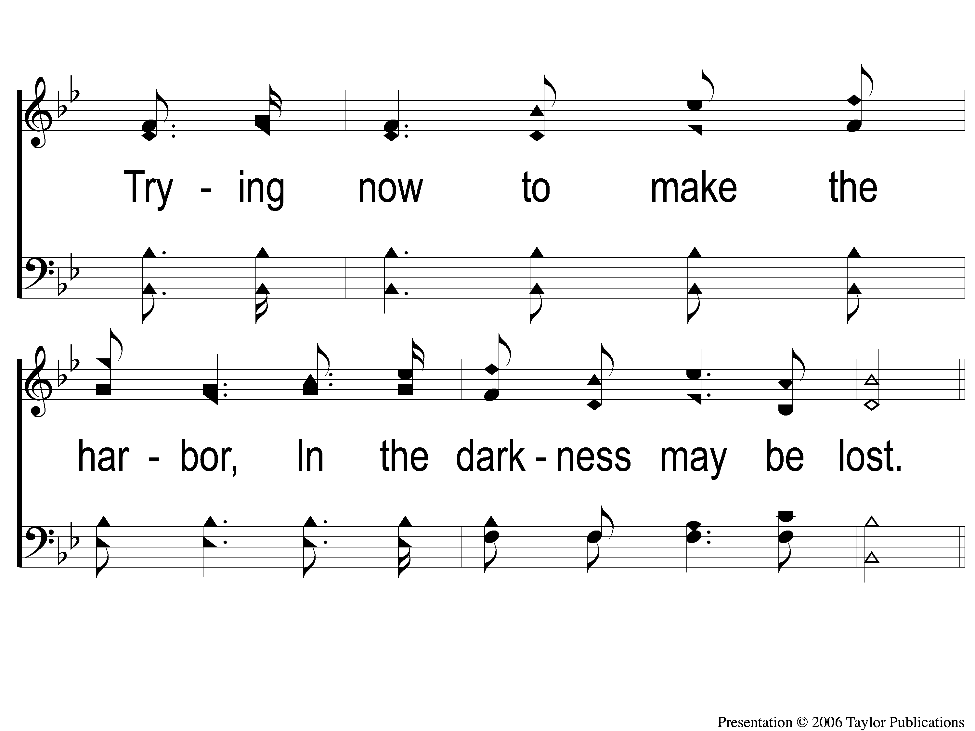
3-2 Let the Lower Lights Be Burning
Let the Lower Lights Be Burning
642

Slide 48
C-1 Let the Lower Lights Be Burning
Let the Lower Lights Be Burning
642

Slide 49
C-2 Let the Lower Lights Be Burning
Let the Lower Lights Be Burning
642

Slide 50
SCRIPTURE:
John 1:1-5

Slide 52
The Lighthouse & The Lower Lights
John 1:1-9

Slide 53
The lighthouse
Jesus: “The Light of the World”
John 1:1-9, 8:12, 9:5, 12:46

Slide 54
The LOWER LIGHTS
Christians: “The Light of the World”
Jn. 12:35-36
Matt. 5:14-16

Slide 55
Is Your Light Shining?

Slide 56
#932
SONG:
O Heart Bowed
Down With Sorrow

Slide 57
1-1 O Heart Bowed Down With Sorrow
O Heart Bowed Down With Sorrow
932

Slide 58
1-2 O Heart Bowed Down With Sorrow
O Heart Bowed Down With Sorrow
932

Slide 59
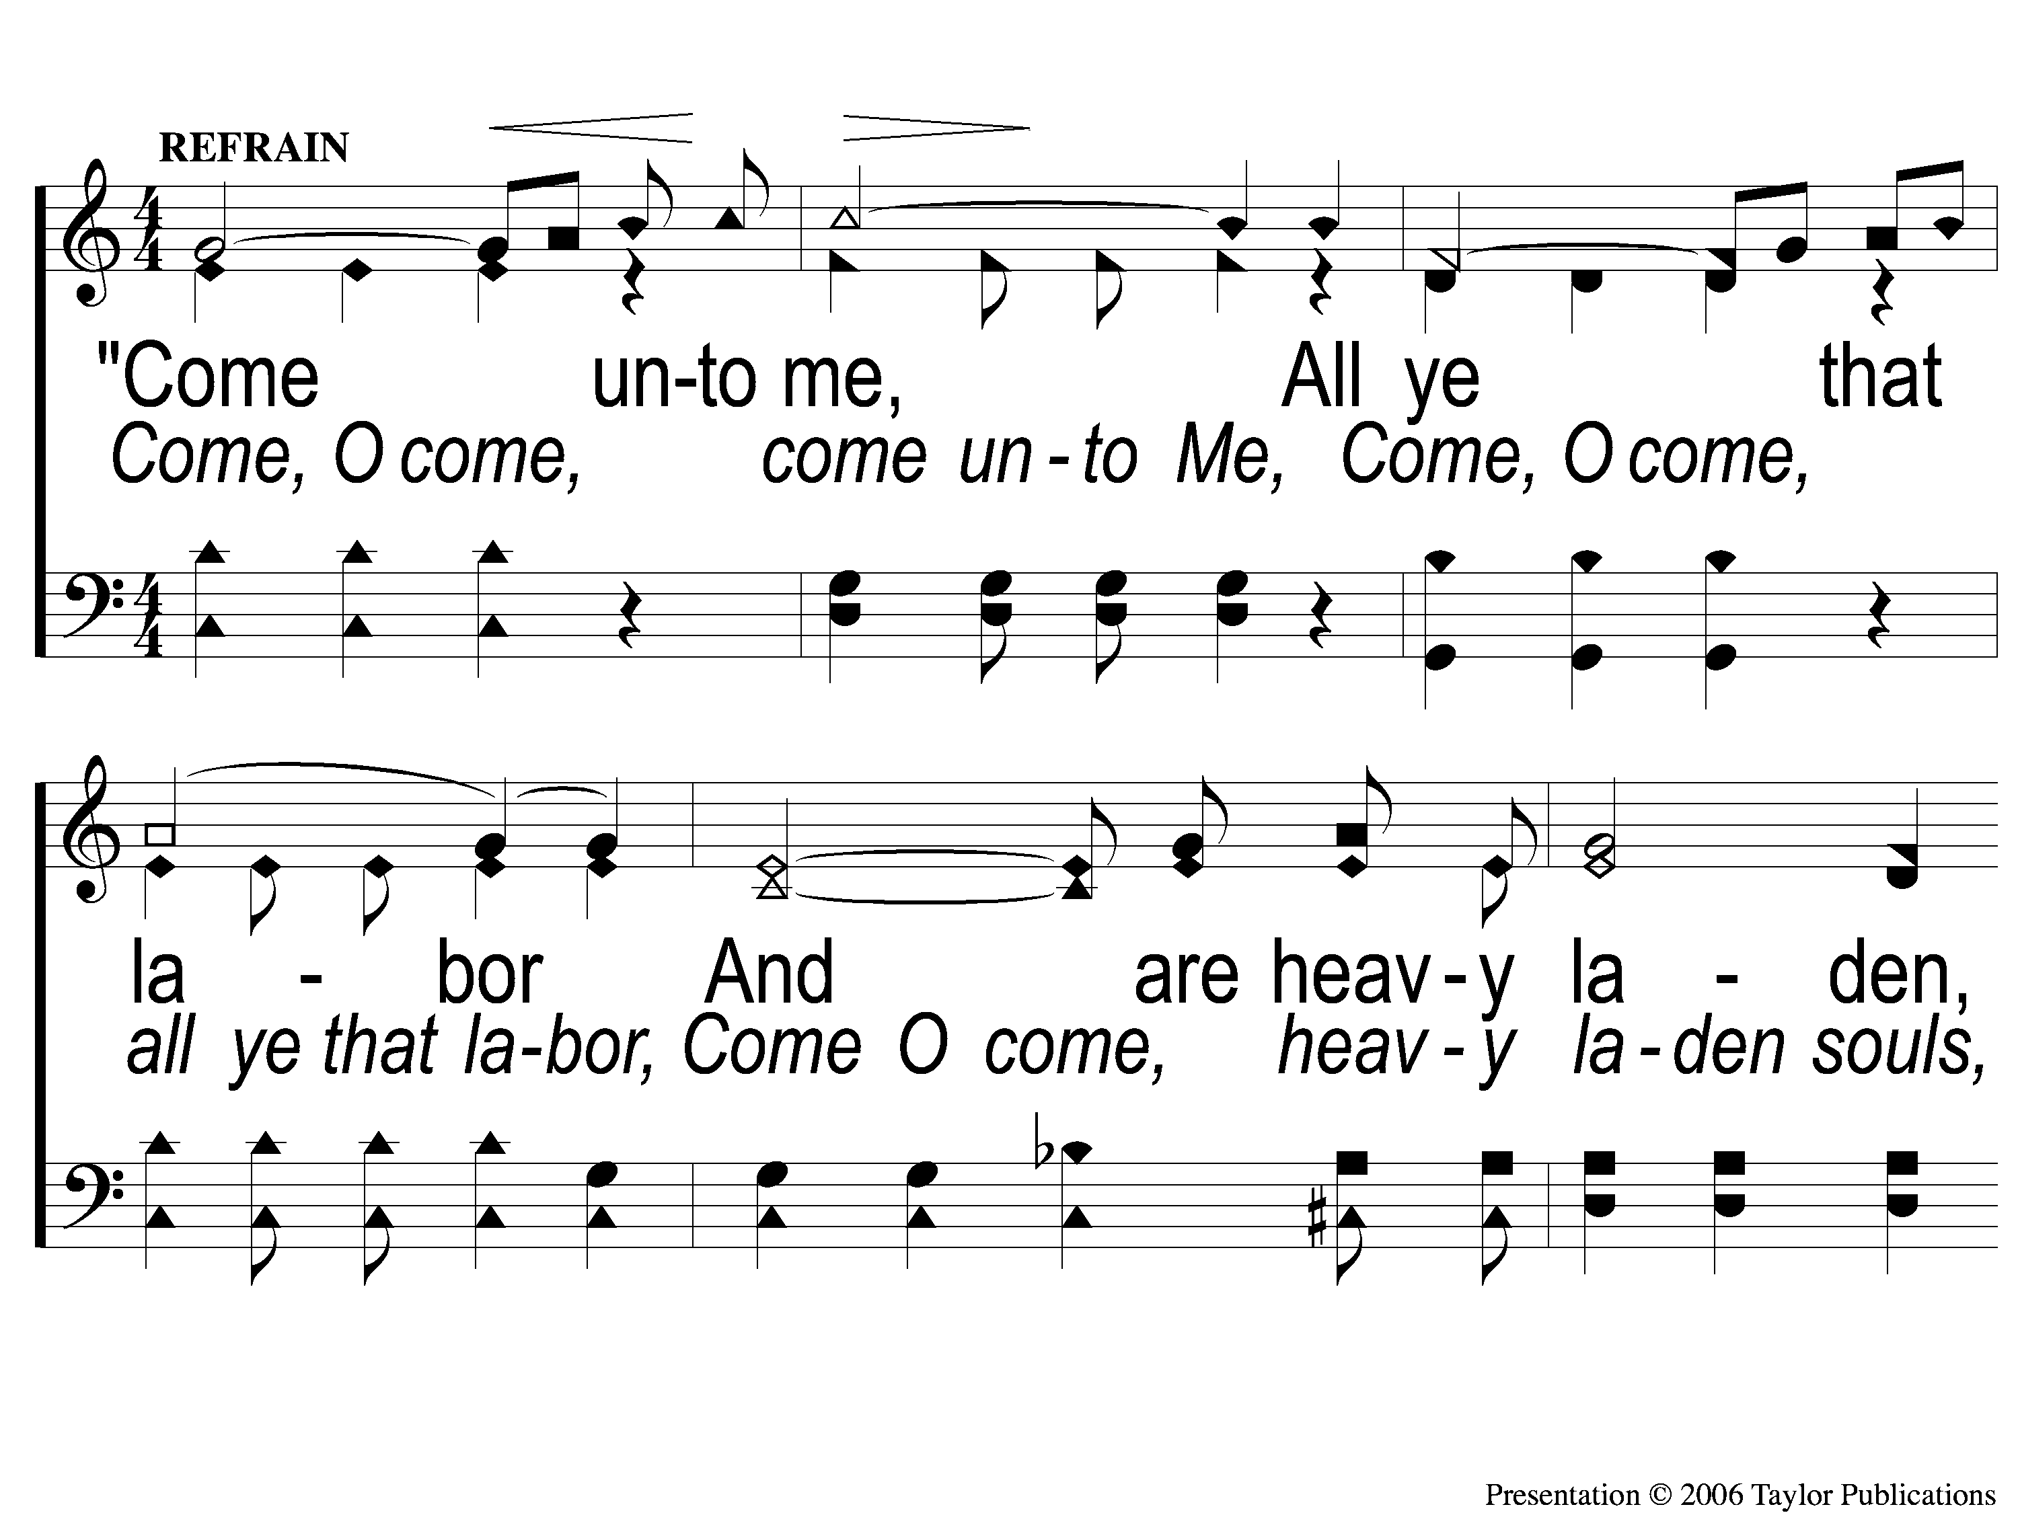
C-1 O Heart Bowed Down With Sorrow
O Heart Bowed Down With Sorrow
932

Slide 60
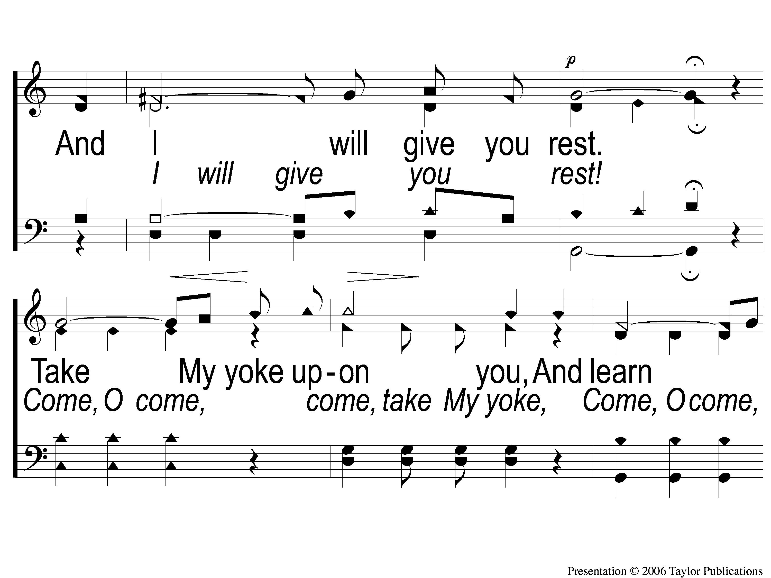
C-2 O Heart Bowed Down With Sorrow
O Heart Bowed Down With Sorrow
932

Slide 61
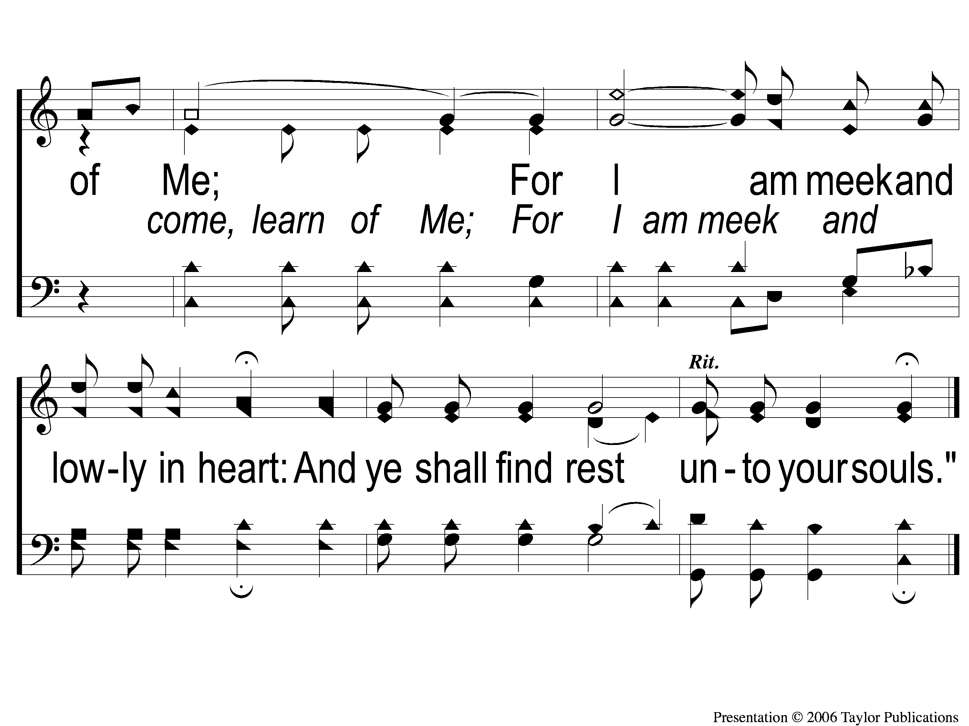
C-3 O Heart Bowed Down With Sorrow
O Heart Bowed Down With Sorrow
932

Slide 62
3-1 O Heart Bowed Down With Sorrow
O Heart Bowed Down With Sorrow
932

Slide 63
3-2 O Heart Bowed Down With Sorrow
O Heart Bowed Down With Sorrow
932

Slide 64
C-1 O Heart Bowed Down With Sorrow
O Heart Bowed Down With Sorrow
932

Slide 65
C-2 O Heart Bowed Down With Sorrow
O Heart Bowed Down With Sorrow
932

Slide 66
C-3 O Heart Bowed Down With Sorrow
O Heart Bowed Down With Sorrow
932

Slide 67
SONG:
Here I Am To Worship

Slide 68
1-1 Here I Am To Worship
Here I Am To Worship

Slide 69
1-2 Here I Am To Worship
Here I Am To Worship

Slide 70
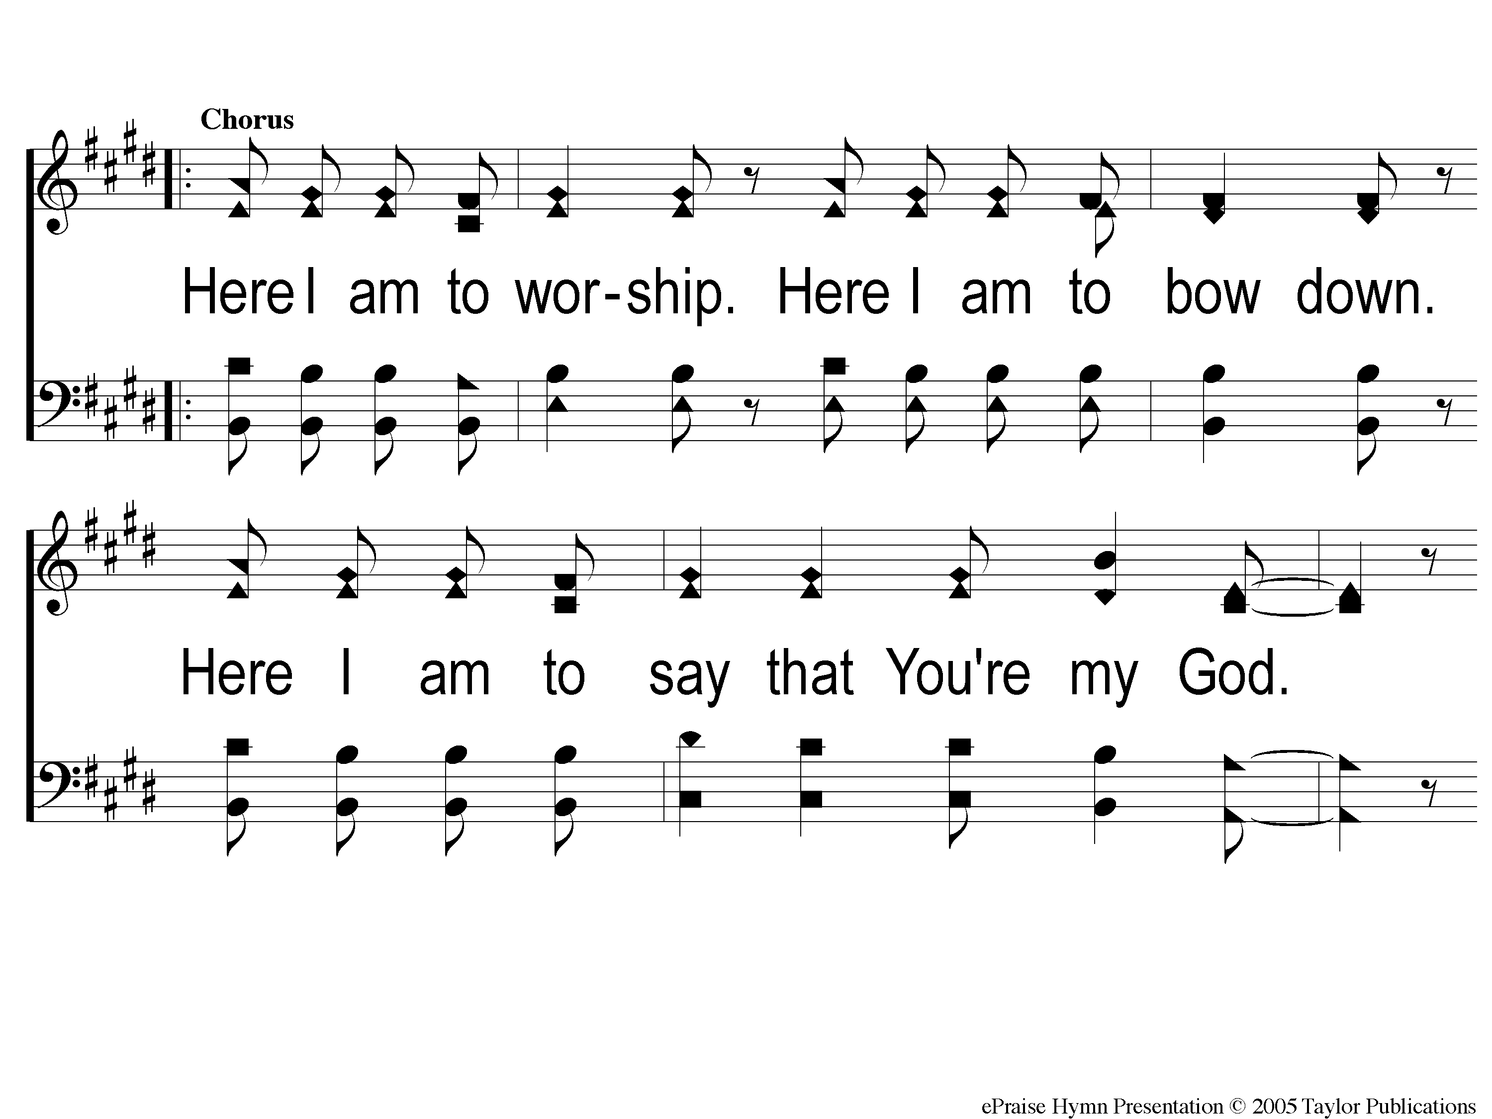
C-1 Here I Am To Worship
Here I Am To Worship

Slide 71
C-2 Here I Am To Worship
Here I Am To Worship

Slide 72
2-1 Here I Am To Worship
Here I Am To Worship

Slide 73
2-2 Here I Am To Worship
Here I Am To Worship

Slide 74
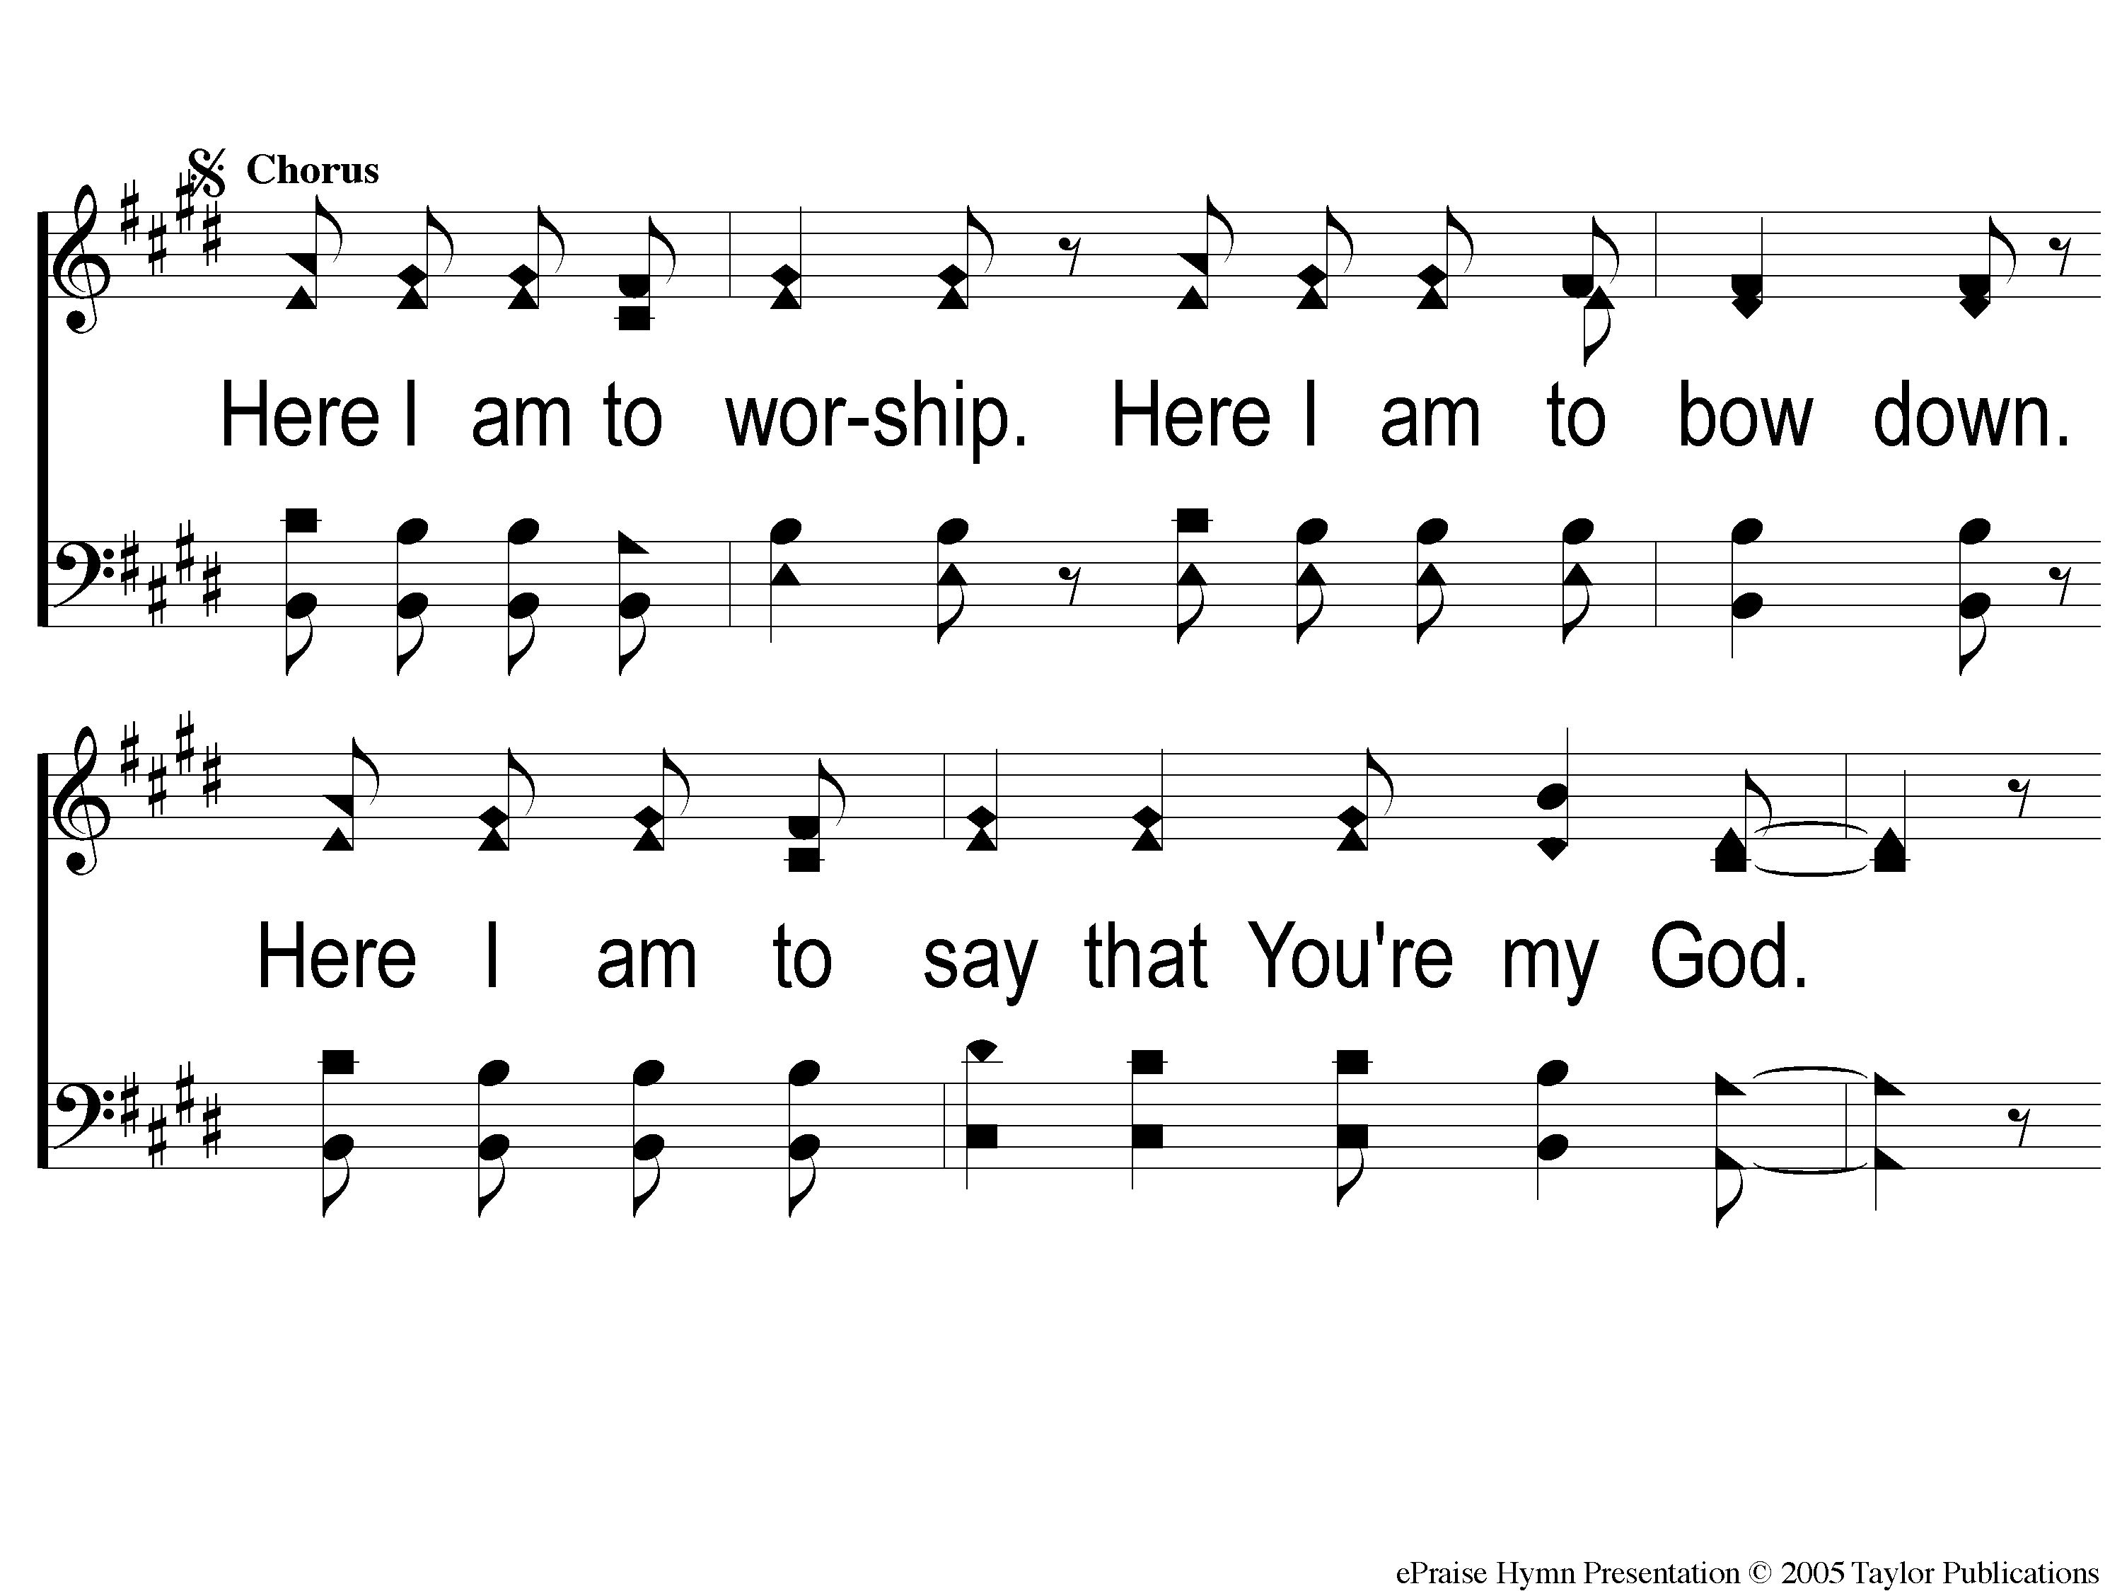
C2-1 Here I Am To Worship
Here I Am To Worship

Slide 75
C2-2 Here I Am To Worship
Here I Am To Worship

Slide 76
Bridge1 Here I Am To Worship
Here I Am To Worship

Slide 77
Bridge2 Here I Am To Worship
Here I Am To Worship

Slide 78
C2-1 Here I Am To Worship
Here I Am To Worship

Slide 79
C2-2 Here I Am To Worship
Here I Am To Worship

Slide 80
tag Here I Am To Worship
Here I Am To Worship

Slide 81
LORD’S SUPPER
The
Acts 20:7

Slide 82
Unleavened Bread
LORD’S SUPPER
Therefore, as through one man’s offense judgment came to all men, resulting in condemnation, even so through one Man’s righteous act the free gift came to all men, resulting in justification of life. For as by one man’s disobedience many were made sinners, so also by one Man’s obedience many will be made righteous.
Rom. 5:18-19

Slide 83
Fruit of the Vine
LORD’S SUPPER
Since, therefore, we have now been justified by his blood, much more shall we be saved by him from the wrath of God. For if while we were enemies we were reconciled to God by the death of his Son, much more, now that we are reconciled, shall we be saved by his life. More than that, we also rejoice in God through our Lord Jesus Christ, through whom we have now received reconciliation.
Rom. 5:9-11

Slide 84
Rom. 9:6-8
OFFERING
The point is this: whoever sows sparingly will also reap sparingly, and whoever sows bountifully will also reap bountifully. Each one must give as he has decided in his heart, not reluctantly or under compulsion, for God loves a cheerful giver. And God is able to make all grace abound to you, so that having all sufficiency in all things at all times, you may abound in every good work.

Slide 85
Closing PRAYER

Slide 86
#886
SONG:
On Jordan’s
Stormy Banks

Slide 87
1-1 On Jordan’s Stormy Banks
On Jordan’s Stormy Banks
886

Slide 88
1-2 On Jordan’s Stormy Banks
On Jordan’s Stormy Banks
886

Slide 89
C-1 On Jordan’s Stormy Banks
On Jordan’s Stormy Banks
886

Slide 90
C-2 On Jordan’s Stormy Banks
On Jordan’s Stormy Banks
886

Slide 91
4-1 On Jordan’s Stormy Banks
On Jordan’s Stormy Banks
886

Slide 92
4-2 On Jordan’s Stormy Banks
On Jordan’s Stormy Banks
886

Slide 93
C-1 On Jordan’s Stormy Banks
On Jordan’s Stormy Banks
886

Slide 94
C-2 On Jordan’s Stormy Banks
On Jordan’s Stormy Banks
886

Slide 95
TONIGHT @ 6:00 pm
EVENING WORSHIP
HOPE TO SEE YOU THERE!

