Slide 1
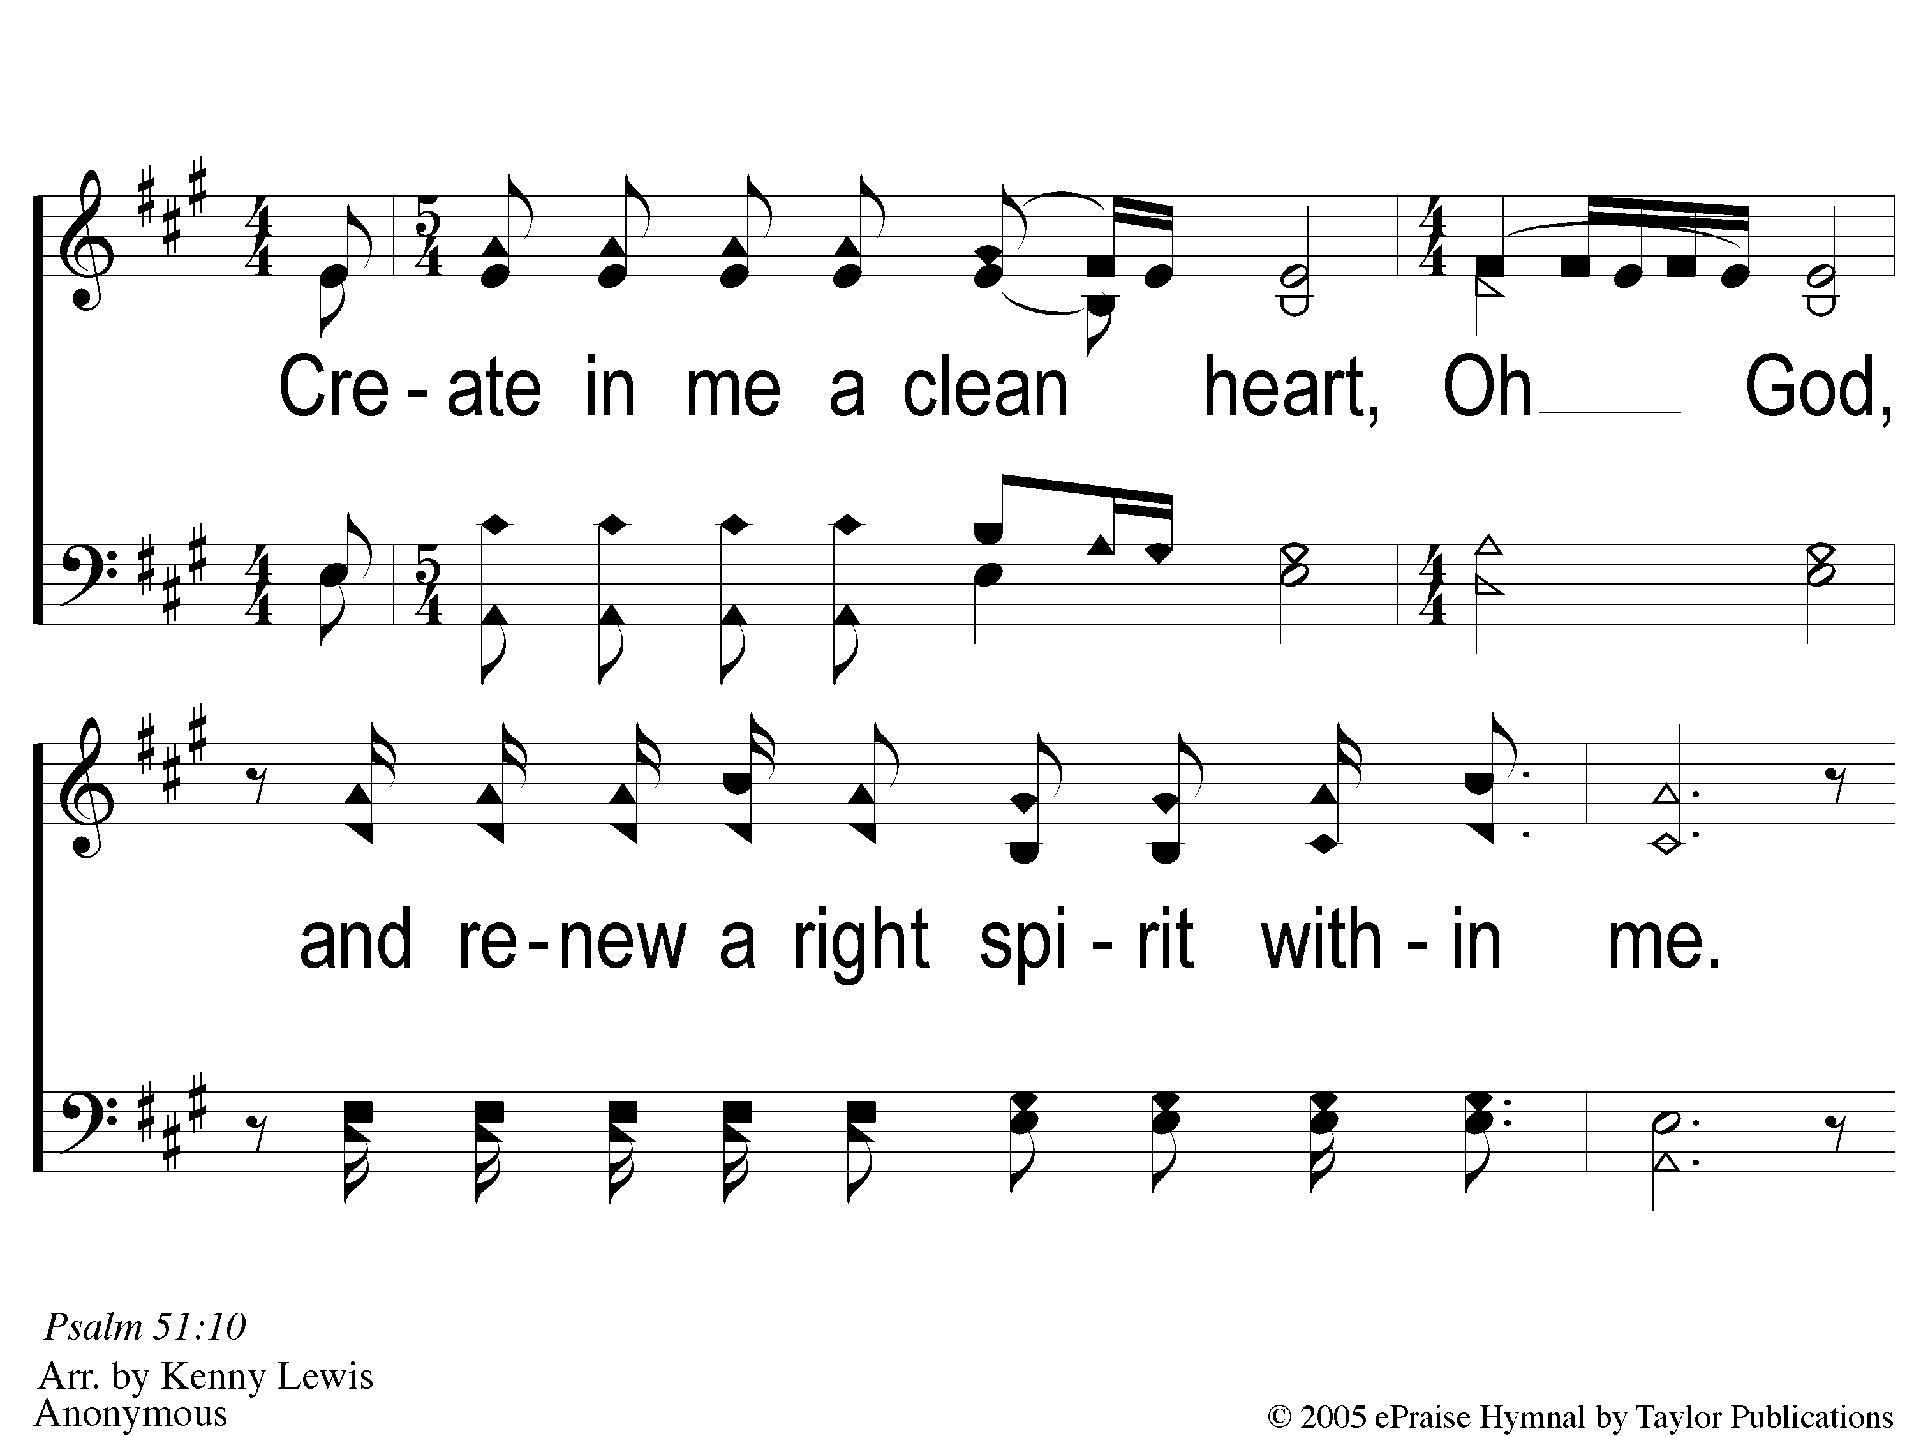
1 Create in Me
Create In Me A Clean Heart

Slide 2
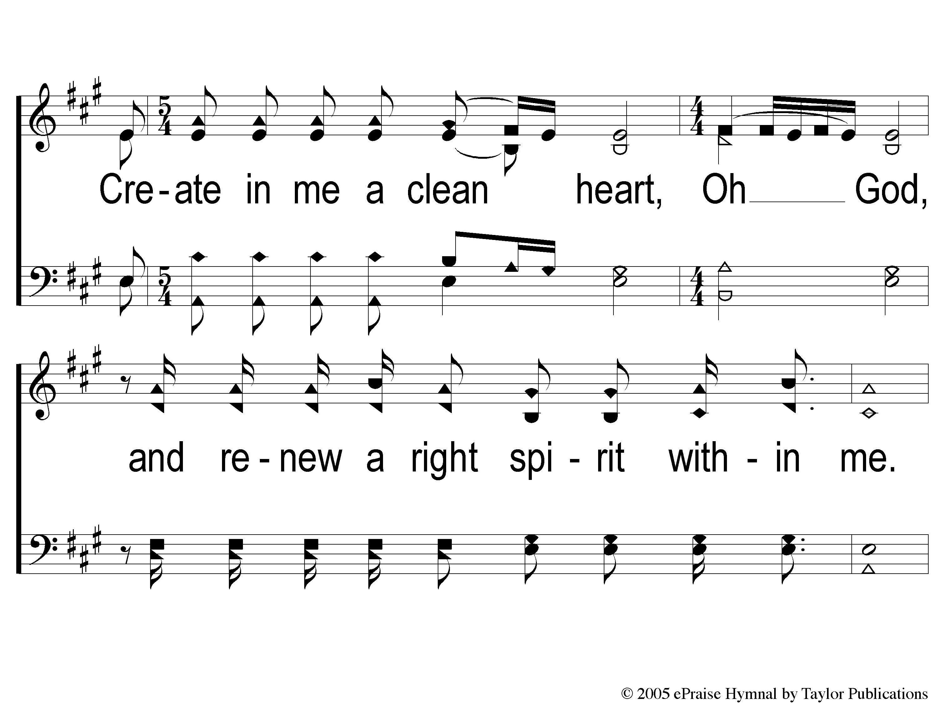
2 Create in Me
Create In Me A Clean Heart

Slide 3
3 Create in Me
Create In Me A Clean Heart

Slide 4
4 Create in Me
Create In Me A Clean Heart

Slide 5
RESTORE REBUILD RENEW
welcome
we are glad to
Have you with us
IN 2022
WHEELER
CHURCH
OF
CHRIST

Slide 6
Song:
Wonderful Words of Life
#543

Slide 7
1-1 Wonderful Words of Life
Wonderful Words of Life
543

Slide 8
1-2 Wonderful Words of Life
Wonderful Words of Life
543

Slide 9
C-1 Wonderful Words of Life
Wonderful Words of Life
543

Slide 10
C-2 Wonderful Words of Life
Wonderful Words of Life
543

Slide 11
3-1 Wonderful Words of Life
Wonderful Words of Life
543

Slide 12
3-2 Wonderful Words of Life
Wonderful Words of Life
543

Slide 13
C-1 Wonderful Words of Life
Wonderful Words of Life
543

Slide 14
C-2 Wonderful Words of Life
Wonderful Words of Life
543

Slide 15
Song:
What A Friend
We Have In Jesus
#800

Slide 16
1-1 What A Friend We Have in Jesus
What a Friend We Have in Jesus
800

Slide 17
1-2 What A Friend We Have in Jesus
What a Friend We Have in Jesus
800

Slide 18
1-3 What A Friend We Have in Jesus
What a Friend We Have in Jesus
800

Slide 19
1-4 What A Friend We Have in Jesus
What a Friend We Have in Jesus
800

Slide 20
3-1 What A Friend We Have in Jesus
What a Friend We Have in Jesus
800

Slide 21
3-2 What A Friend We Have in Jesus
What a Friend We Have in Jesus
800

Slide 22
3-3 What A Friend We Have in Jesus
What a Friend We Have in Jesus
800

Slide 23
3-4 What A Friend We Have in Jesus
What a Friend We Have in Jesus
800

Slide 24
Opening Prayer

Slide 25
Song:
God Will Take Care Of You
#461

Slide 26
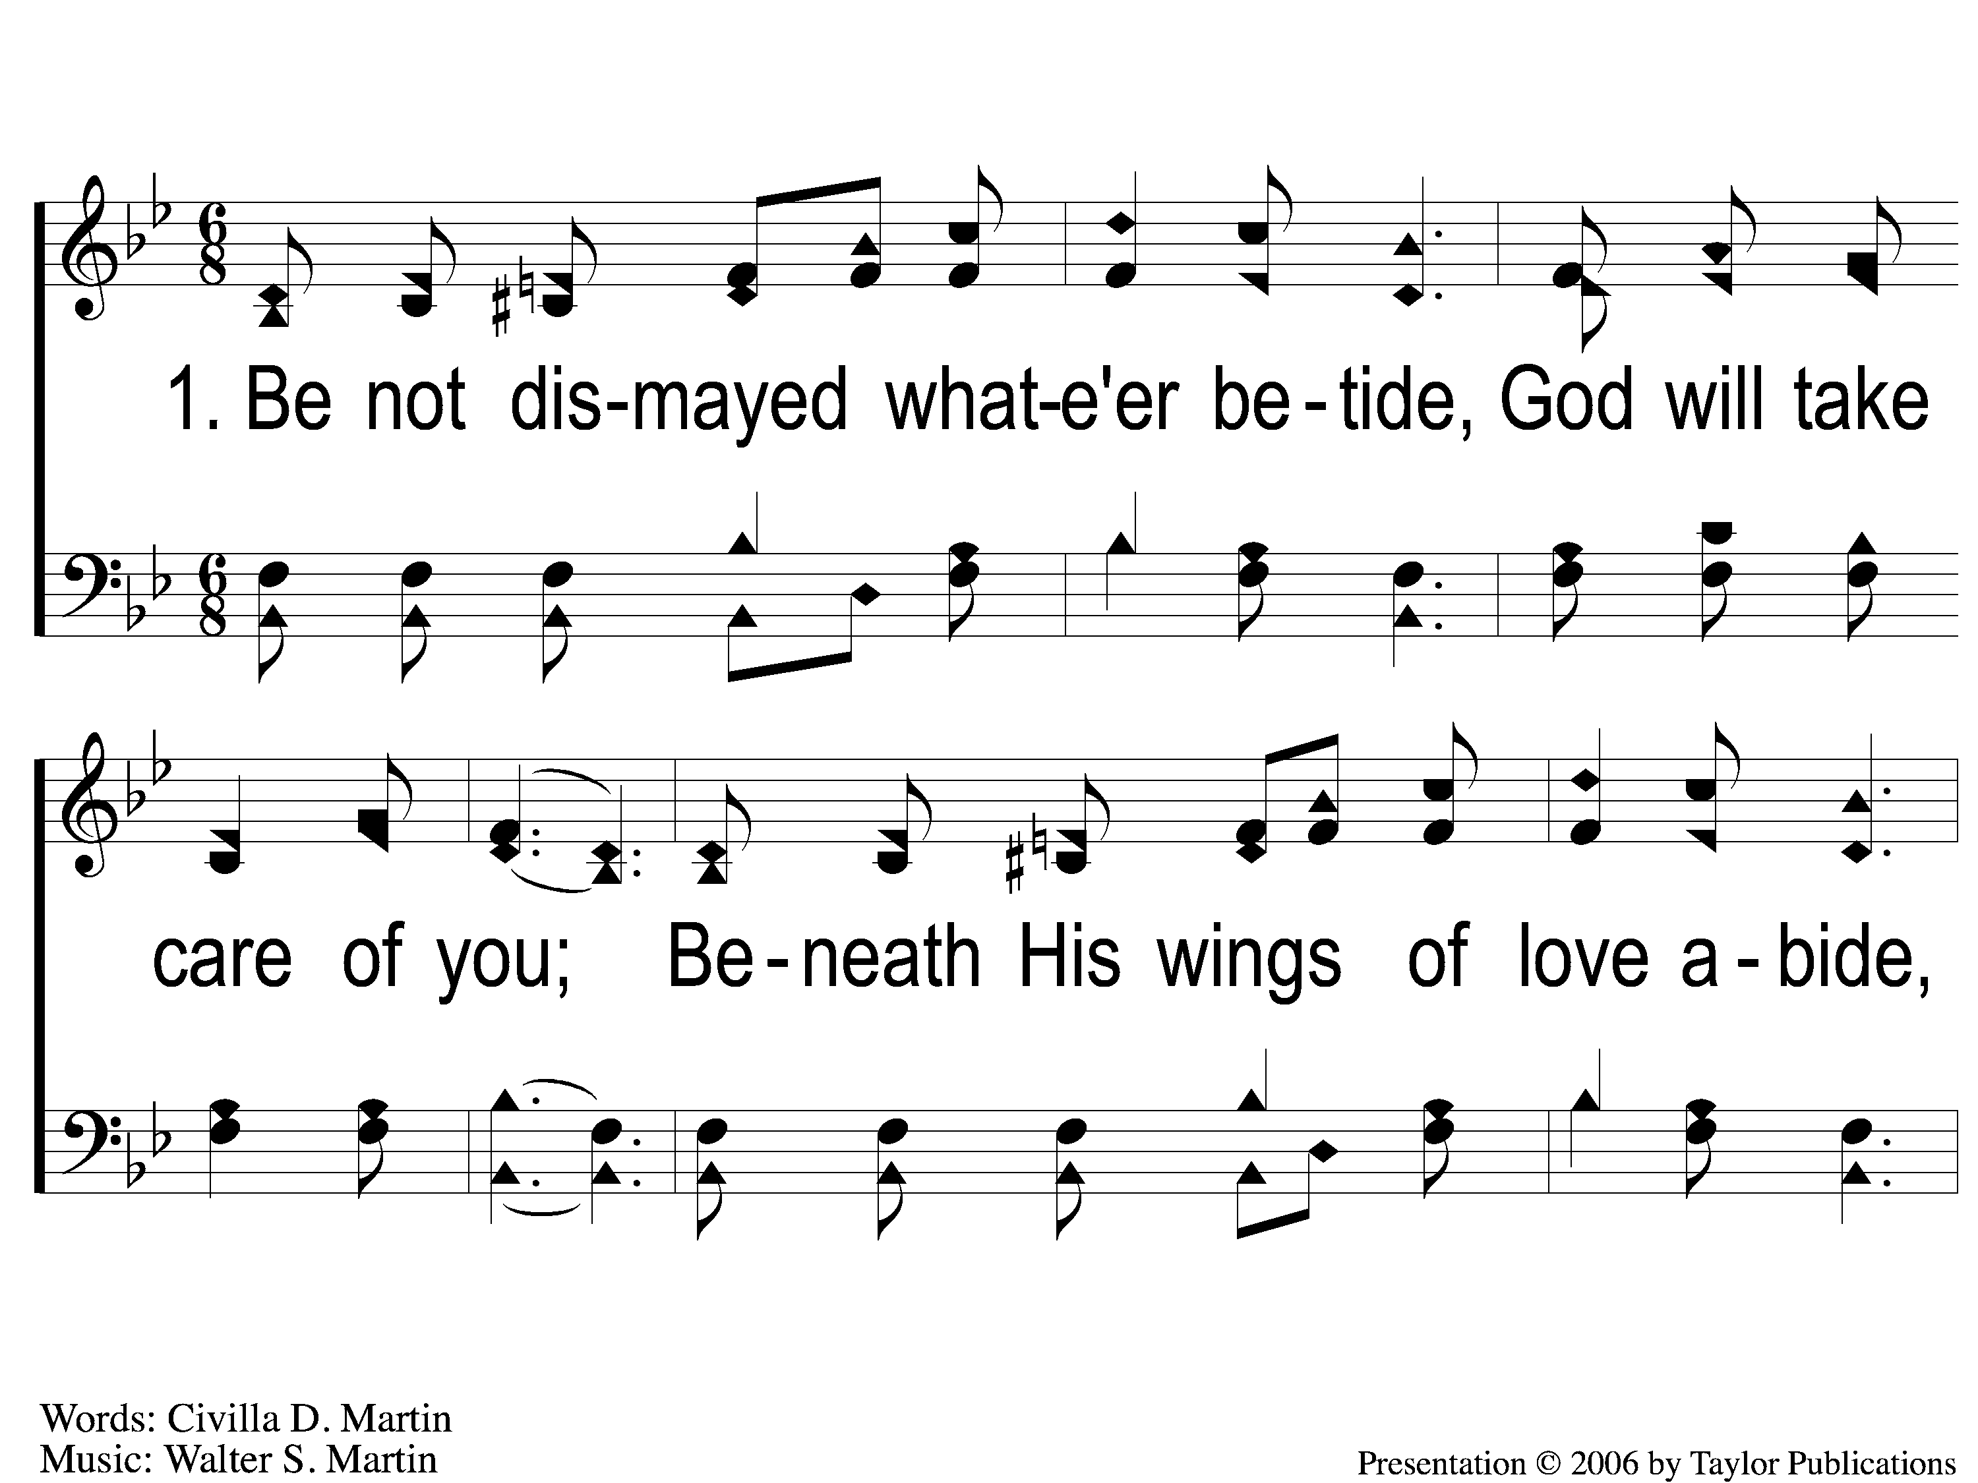
1-1 God Will Take Care Of You
God Will Take Care Of You
461

Slide 27
1-2 God Will Take Care Of You
God Will Take Care Of You
461

Slide 28
C-1 God Will Take Care Of You
God Will Take Care Of You
461

Slide 29
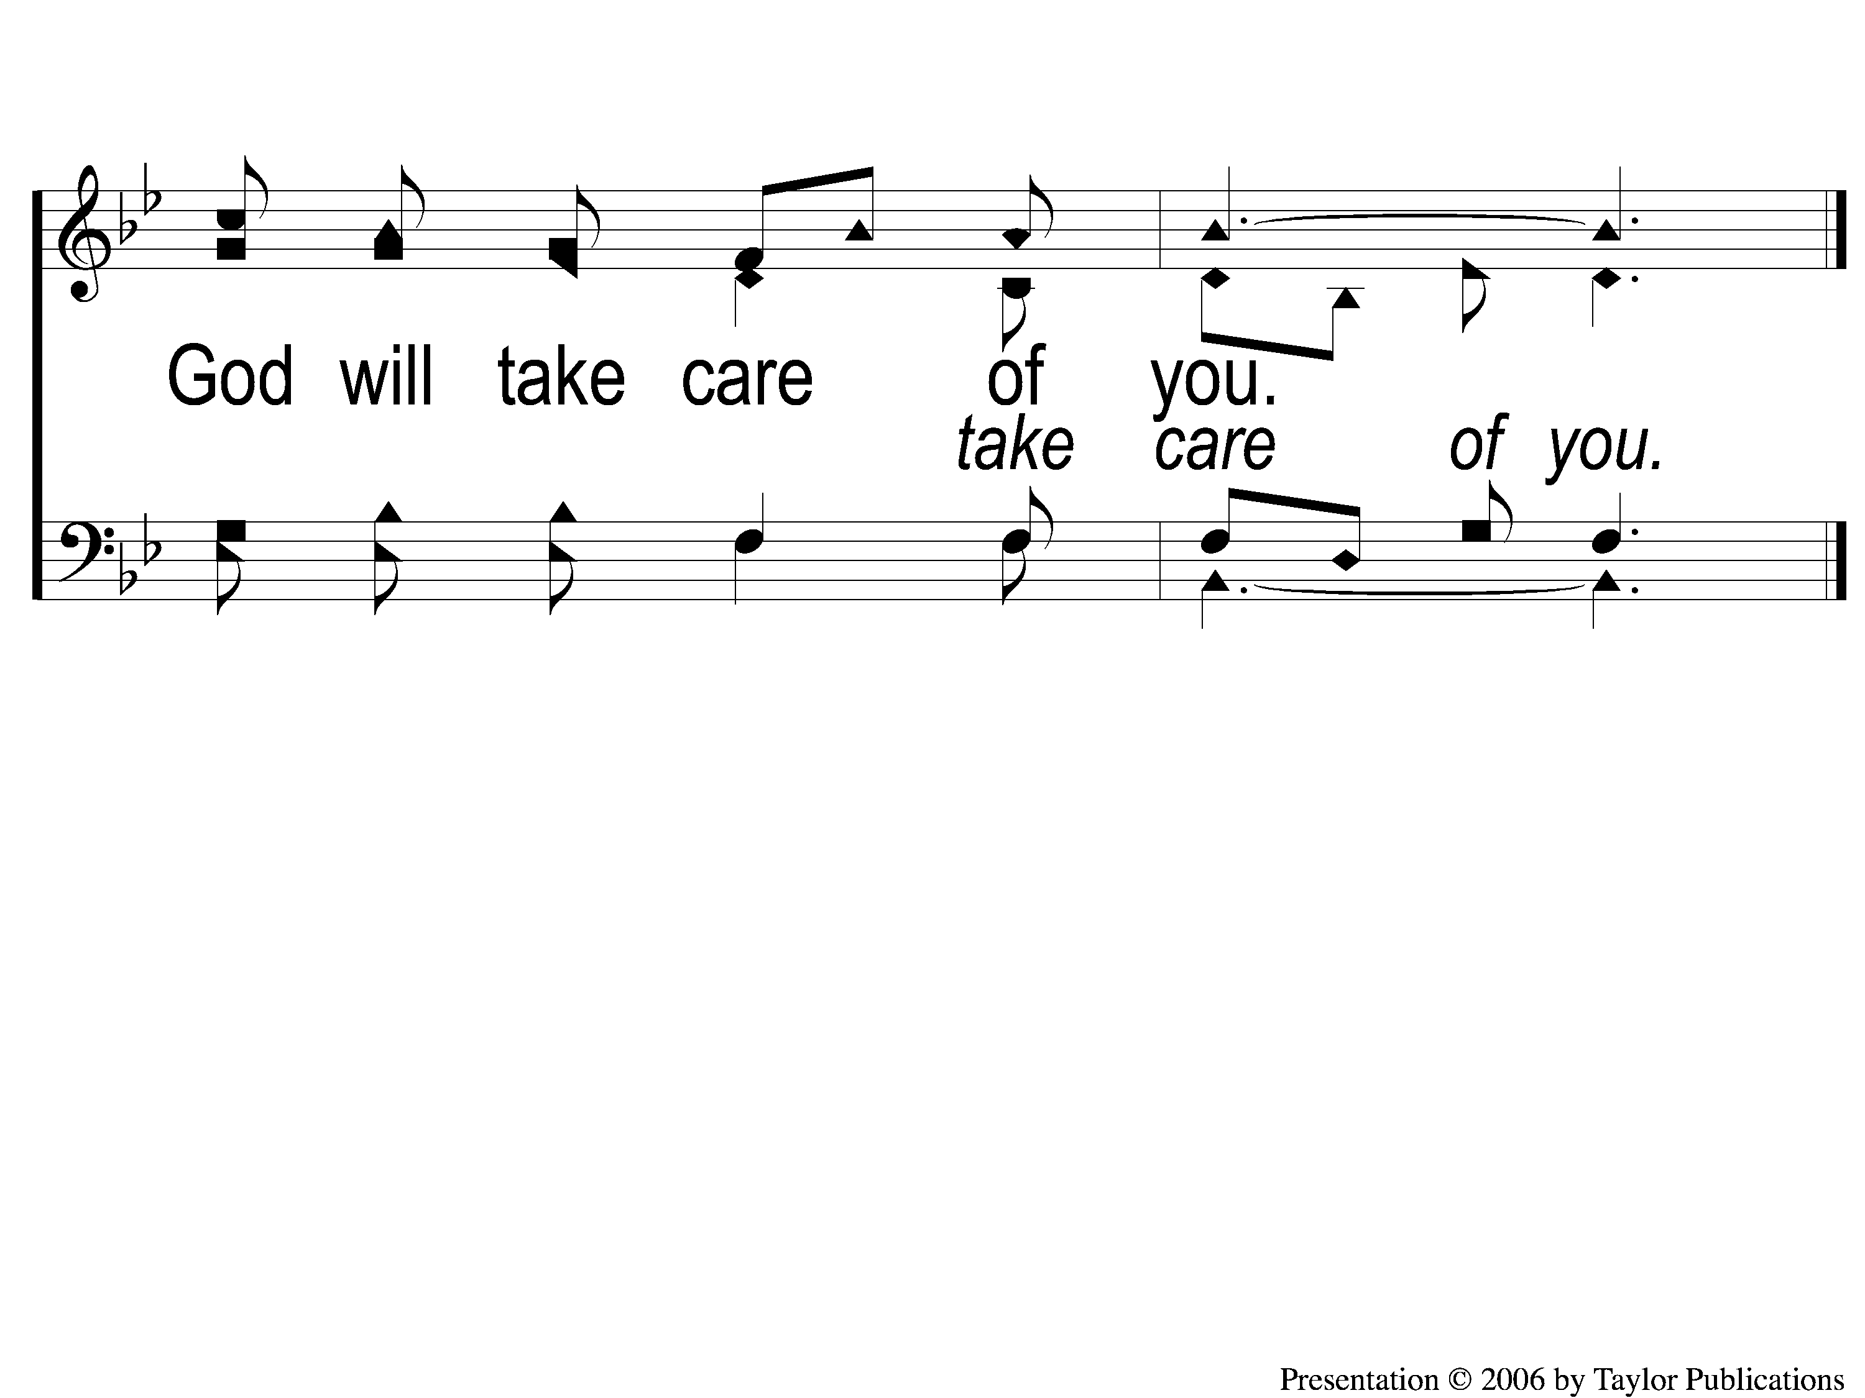
C-2 God Will Take Care Of You
God Will Take Care Of You
461

Slide 30
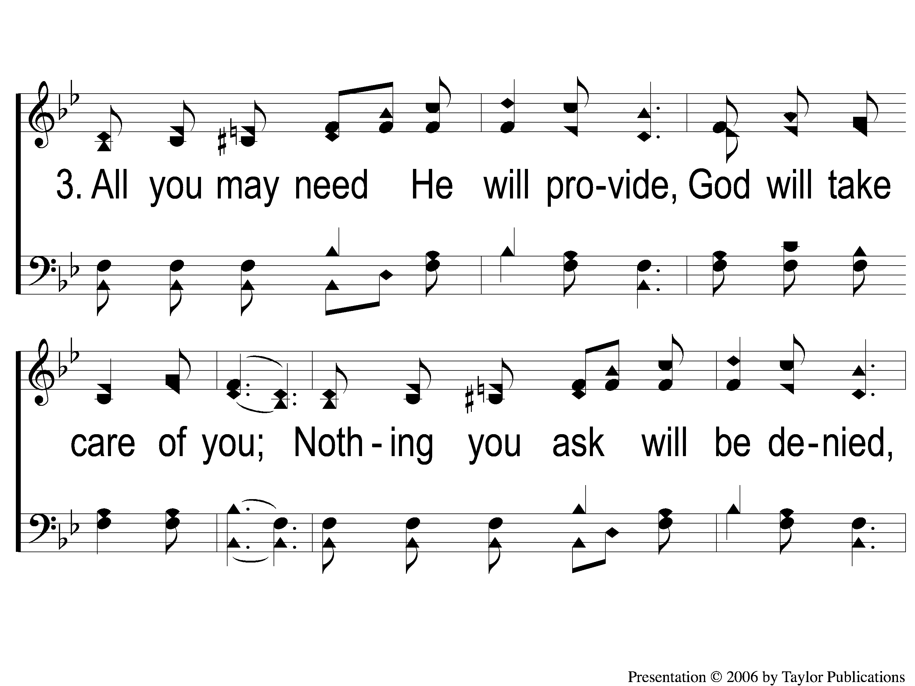
3-1 God Will Take Care Of You
God Will Take Care Of You
461

Slide 31
3-2 God Will Take Care Of You
God Will Take Care Of You
461

Slide 32
C-1 God Will Take Care Of You
God Will Take Care Of You
461

Slide 33
C-2 God Will Take Care Of You
God Will Take Care Of You
461

Slide 34
4-1 God Will Take Care Of You
God Will Take Care Of You
461

Slide 35
4-2 God Will Take Care Of You
God Will Take Care Of You
461

Slide 36
C-1 God Will Take Care Of You
God Will Take Care Of You
461

Slide 37
C-2 God Will Take Care Of You
God Will Take Care Of You
461

Slide 38
Song:
Have Thine Own Way, Lord
#552

Slide 39
1-1 Have Thine Own Way
Have Thine Own Way
552

Slide 40
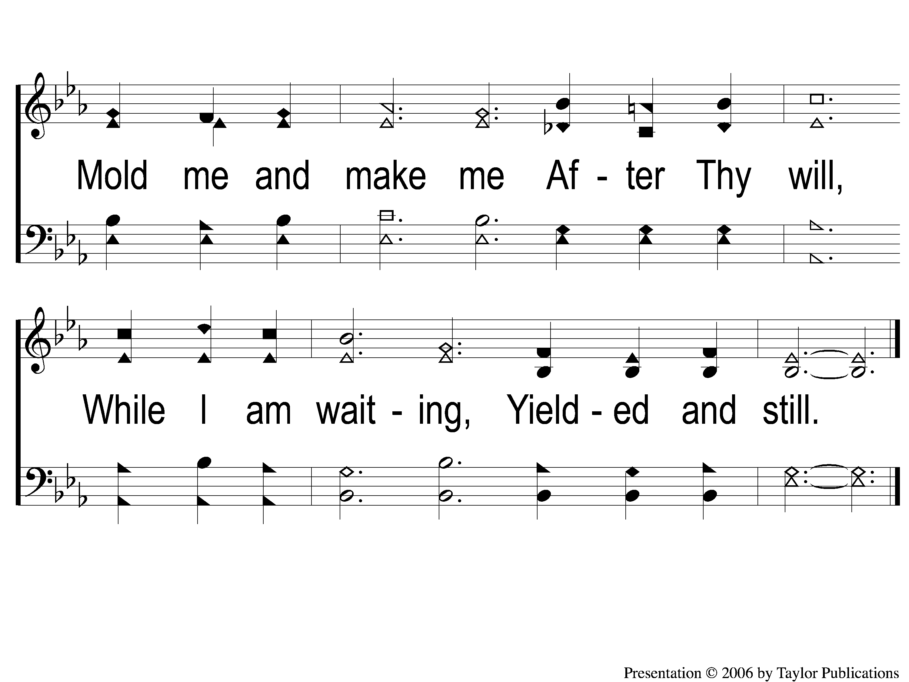
1-2 Have Thine Own Way
Have Thine Own Way
552

Slide 41
2-1 Have Thine Own Way
Have Thine Own Way
552

Slide 42
2-2 Have Thine Own Way
Have Thine Own Way
552

Slide 43
3-1 Have Thine Own Way
Have Thine Own Way
552

Slide 44
3-2 Have Thine Own Way
Have Thine Own Way
552

Slide 45
Scripture Reading:
Isaiah 64:1-8

Slide 46
RESTORE REBUILD RENEW
IN 2022

Slide 47
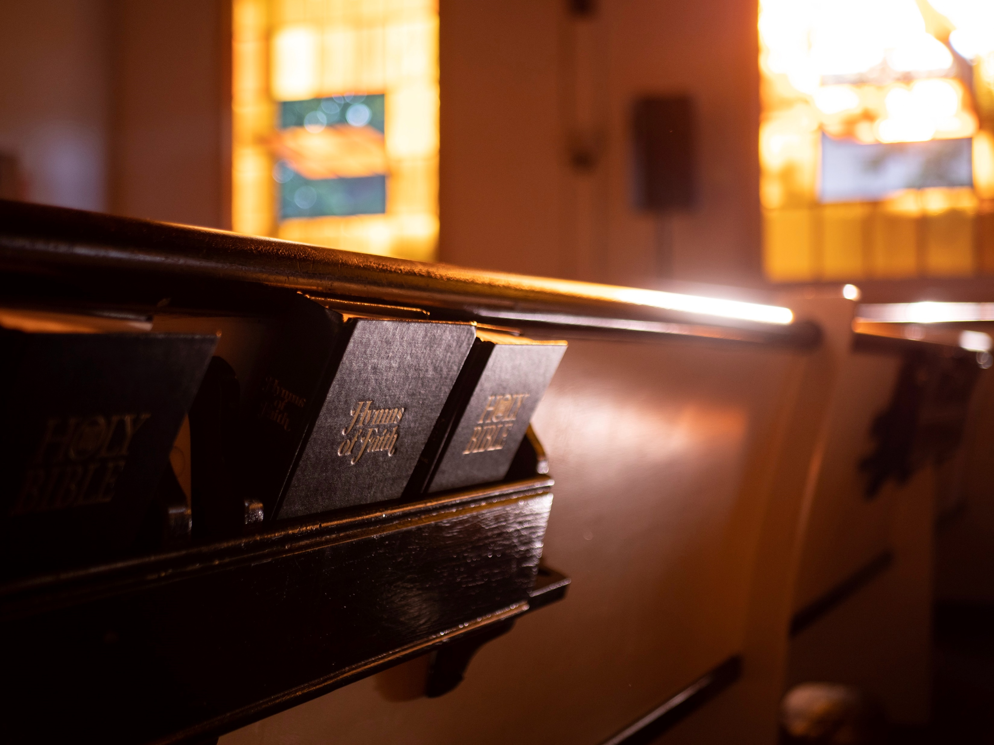
Renewed
by
Hymns

Slide 48
Have Thine Own Way,
Lord

Slide 49
Create In Me A Clean
Heart
Tonight @ 6pm

Slide 50
History of the Song
Author: Adelaide A. Pollard (1862-1934
Written: 1974
Occasion: A Prayer & Bible Study

Slide 51
In Order To Be Renewed…

Slide 52
In Order To Be Renewed…
Be Willing

Slide 53
Stanza #1:
"Have Thine own way, Lord, Have Thine own way! Thou art the Potter, I am the clay. Mold me and make me After Thy will, While I am waiting, Yielded and still.“

Slide 54
Be Willing To Change
God Will Not Change Unwilling Hearts
Isa. 29:16, 64:1-8
Jer. 18:4-6 – Lam. 4:2
Rom. 9:21

Slide 55
In Order To Be Renewed…
Be Willing
Be Transparent

Slide 56
Stanza #2:
"Have Thine own way, Lord, Have Thine own way! Search me and try me, Master, today! Whiter than snow, Lord, Wash me just now, As in Thy presence Humbly I bow."

Slide 57
Be Transparent
God Will Not Change Dishonest Hearts
Psa. 139:23-24 – Job 31:6
Eph. 4:25 – 1 Pet. 2:12
1 Jn. 1:6 – Rev. 21:8

Slide 58
In Order To Be Renewed…
Be Willing
Be Transparent
Be Prayerful

Slide 59
Be Prayerful
Prayer Is Transformative
Mk. 9:29
1 Pet. 5:6-7
Matt. 26:36, 39, 42, 44

Slide 60
Stanza #3:
Have Thine own way, Lord, Have Thine own way! Wounded and weary, Help me, I pray! Power, all power, Surely is Thine! Touch me and heal me, Savior divine."

Slide 61
Be Prayerful
Prayer Is Transformative
1 Pet. 5:6-7

Slide 62
Be Prayerful
Prayer Is Transformative
If we pray in faith (Mk. 9:29 – Jms. 5:16)

Slide 63
Be Prayerful
Prayer Is Transformative
If we pray in faith (Mk. 9:29 – Jms. 5:16)
If we pray humbly (Matt. 26:36, 39, 42, 44)

Slide 64
In Order To Be Renewed…
Be Willing
Be Transparent
Be Prayerful
Be Spirit-filled

Slide 65
Stanza #4:
"Have Thine own way, Lord, Have Thine own way! Hold o’er my being Absolute sway! Fill with Thy Spirit Till all shall see Christ only, always, Living in me."

Slide 66
Be Spirit-Filled
God’s Spirit is Transformative

Slide 67
Be Spirit-Filled
God’s Spirit is Transformative
If we are NOT self-filled
Eph. 4:23, 5:18
Gal. 5:16-26

Slide 68
Be Spirit-Filled
God’s Spirit is Transformative
If we are led by His Spirit
Rom. 8:4-5, 14
1 Cor. 2:13-15

Slide 69
Willing?
Are You

Slide 70
Let Him Have
His Way With Thee
Invitation
Song:

Slide 71
1-1 Let Him Have His Way With Thee
Let Him Have His Way With Thee

Slide 72
1-2 Let Him Have His Way With Thee
Let Him Have His Way With Thee

Slide 73
C-1 Let Him Have His Way With Thee
Let Him Have His Way With Thee

Slide 74
C-2 Let Him Have His Way With Thee
Let Him Have His Way With Thee

Slide 75
2-1 Let Him Have His Way With Thee
Let Him Have His Way With Thee

Slide 76
2-2 Let Him Have His Way With Thee
Let Him Have His Way With Thee

Slide 77
C-1 Let Him Have His Way With Thee
Let Him Have His Way With Thee

Slide 78
C-2 Let Him Have His Way With Thee
Let Him Have His Way With Thee

Slide 79
3-1 Let Him Have His Way With Thee
Let Him Have His Way With Thee

Slide 80
3-2 Let Him Have His Way With Thee
Let Him Have His Way With Thee

Slide 81
C-1 Let Him Have His Way With Thee
Let Him Have His Way With Thee

Slide 82
C-2 Let Him Have His Way With Thee
Let Him Have His Way With Thee

Slide 83
The Contribution:
Acts 20:35
“I have shown you in every way, by laboring like this, that you must support the weak. And remember the words of the Lord Jesus, that He said, ‘It is more blessed to give than to receive.’ ”

Slide 84
Song:
Alas! And Did
My Savior Bleed?
#324

Slide 85
1-1 Alas and Did My Savior Bleed
Alas! And Did My Savior Bleed?
324

Slide 86
1-2 Alas and Did My Savior Bleed
Alas! And Did My Savior Bleed?
324

Slide 87
C-1 Alas and Did My Savior Bleed
Alas! And Did My Savior Bleed?
324

Slide 88
C-2 Alas and Did My Savior Bleed
Alas! And Did My Savior Bleed?
324

Slide 89
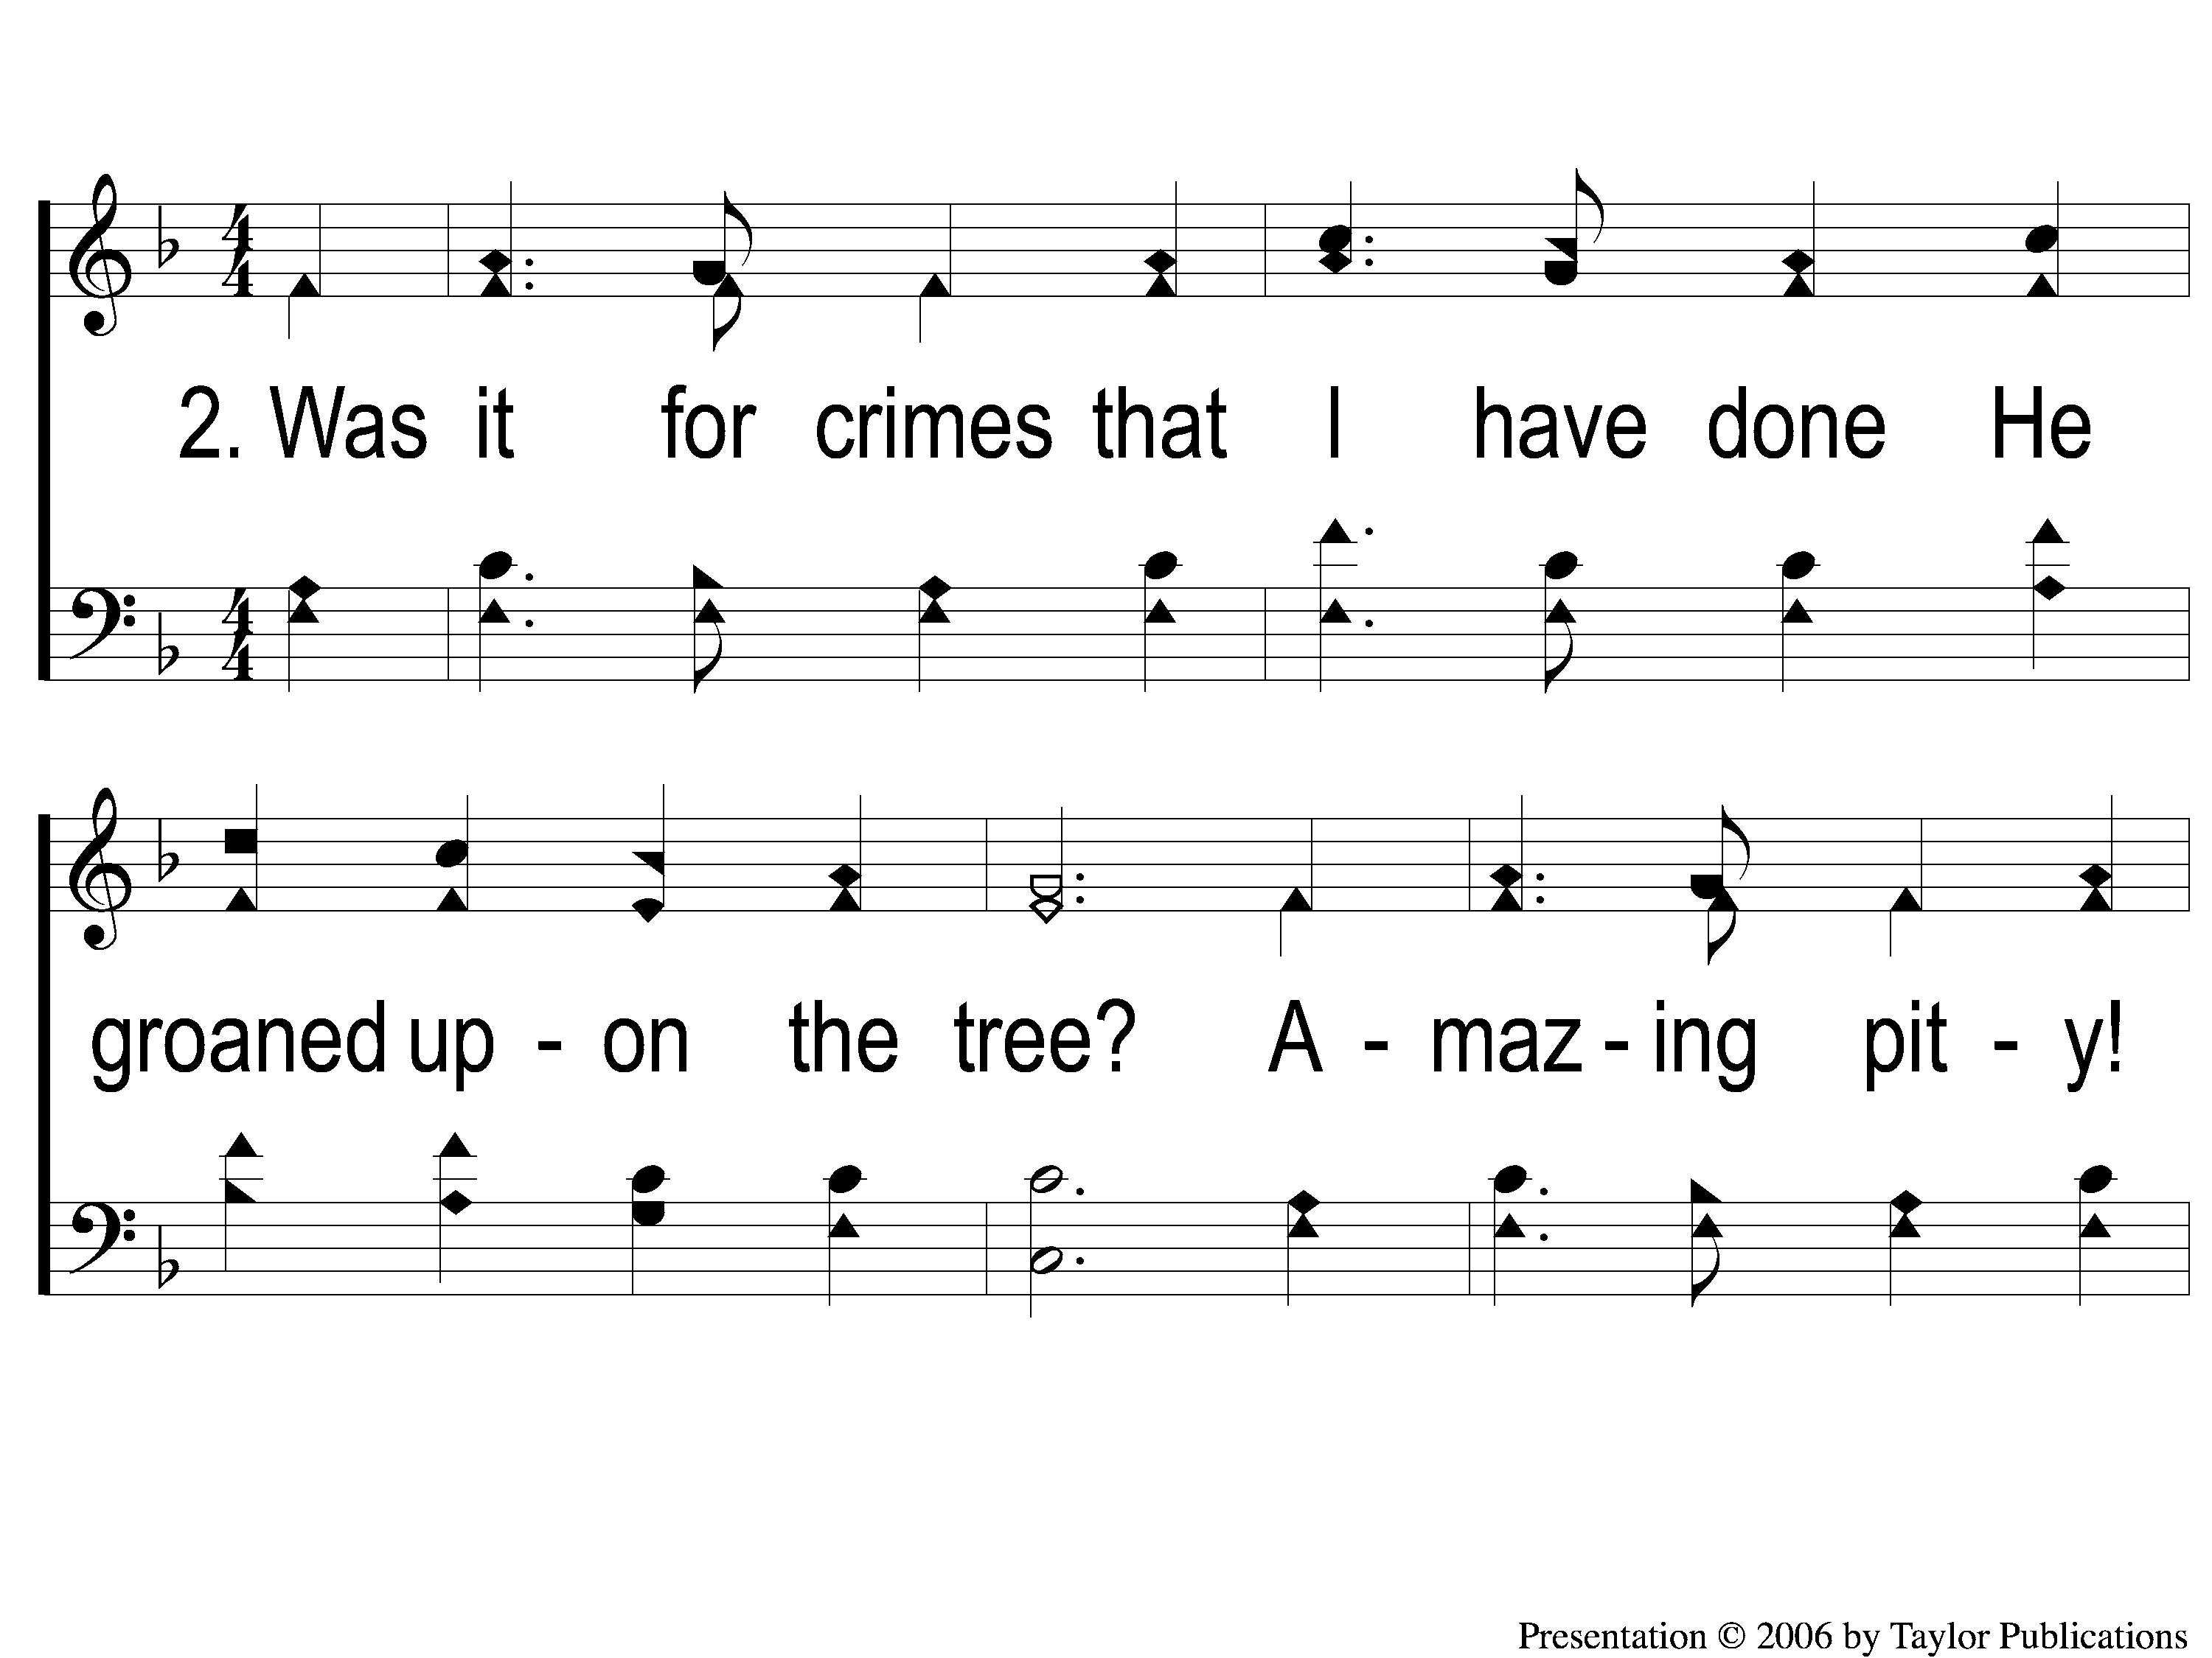
2-1 Alas and Did My Savior Bleed
Alas! And Did My Savior Bleed?
324

Slide 90
2-2 Alas and Did My Savior Bleed
Alas! And Did My Savior Bleed?
324

Slide 91
C-1 Alas and Did My Savior Bleed
Alas! And Did My Savior Bleed?
324

Slide 92
C-2 Alas and Did My Savior Bleed
Alas! And Did My Savior Bleed?
324

Slide 93
3-1 Alas and Did My Savior Bleed
Alas! And Did My Savior Bleed?
324

Slide 94
3-2 Alas and Did My Savior Bleed
Alas! And Did My Savior Bleed?
324

Slide 95
C-1 Alas and Did My Savior Bleed
Alas! And Did My Savior Bleed?
324

Slide 96
C-2 Alas and Did My Savior Bleed
Alas! And Did My Savior Bleed?
324

Slide 97
4-1 Alas and Did My Savior Bleed
Alas! And Did My Savior Bleed?
324

Slide 98
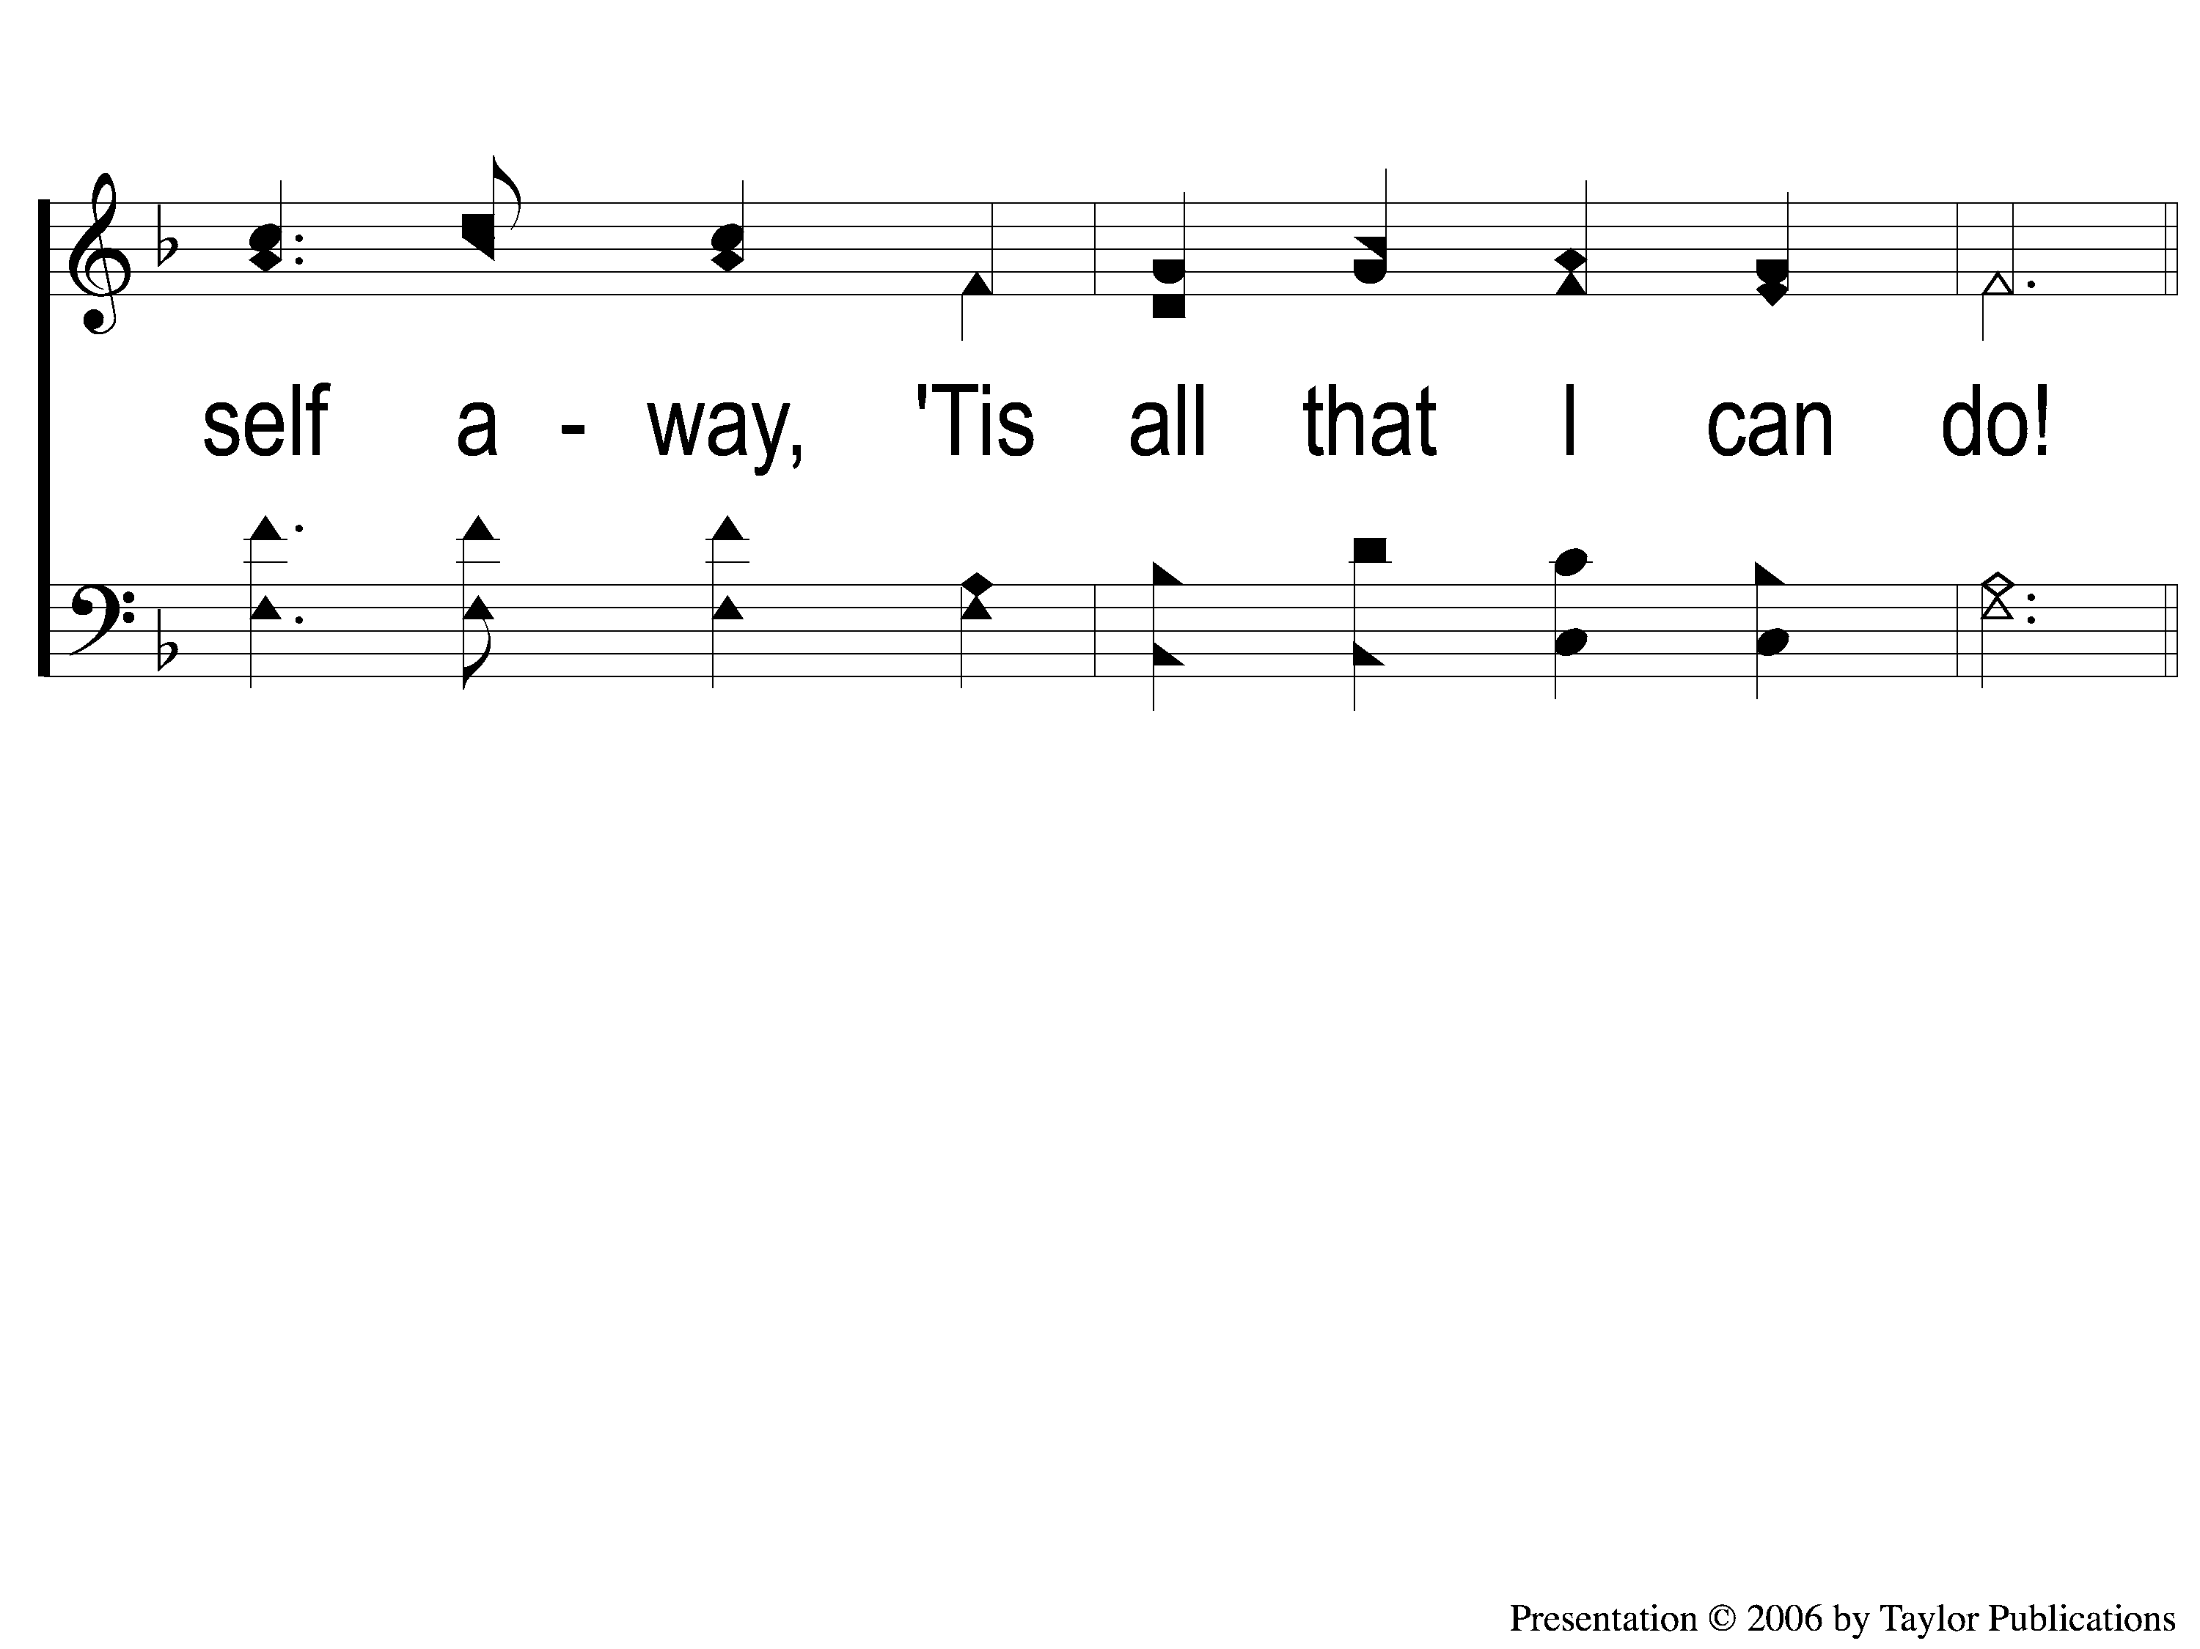
4-2 Alas and Did My Savior Bleed
Alas! And Did My Savior Bleed?
324

Slide 99
C-1 Alas and Did My Savior Bleed
Alas! And Did My Savior Bleed?
324

Slide 100
C-2 Alas and Did My Savior Bleed
Alas! And Did My Savior Bleed?
324

Slide 101
The Unleavened Bread
1 Corinthians 10:16b-17
“The bread which we break, is it not the communion of the body of Christ? For we, though many, are one bread and one body; for we all partake of that one bread.”

Slide 102
The Fruit
of the Vine
1 Corinthians 10:16a
“The cup of blessing which we bless, is it not the communion of the blood of Christ?...”

Slide 103
Closing Prayer

Slide 104
Song:
On Jordan’s Stormy Banks
#886

Slide 105
1-1 On Jordan’s Stormy Banks
On Jordan’s Stormy Banks
886

Slide 106
1-2 On Jordan’s Stormy Banks
On Jordan’s Stormy Banks
886

Slide 107
C-1 On Jordan’s Stormy Banks
On Jordan’s Stormy Banks
886

Slide 108
C-2 On Jordan’s Stormy Banks
On Jordan’s Stormy Banks
886

Slide 109
4-1 On Jordan’s Stormy Banks
On Jordan’s Stormy Banks
886

Slide 110
4-2 On Jordan’s Stormy Banks
On Jordan’s Stormy Banks
886

Slide 111
C-1 On Jordan’s Stormy Banks
On Jordan’s Stormy Banks
886

Slide 112
C-2 On Jordan’s Stormy Banks
On Jordan’s Stormy Banks
886

Slide 113
RESTORE REBUILD RENEW
tonight
Worship @ 6:00 PM
Wednesday
Worship & Classes & 6:30 PM
IN 2022
WHEELER
CHURCH
OF
CHRIST

Slide 114
Today
Join us in the MPB for
A Fellowship Meal & Devo
Wednesday
Worship & Classes & 6:30 PM
RESTORE REBUILD RENEW
IN 2022
WHEELER
CHURCH
OF
CHRIST

