Slide 1
RESTORE REBUILD RENEW
welcome
we are glad to
Have you with us
IN 2022
WHEELER
CHURCH
OF
CHRIST

Slide 2
Songs of Praise To God

Slide 3
Opening Prayer

Slide 4
Songs of Praise To God

Slide 5
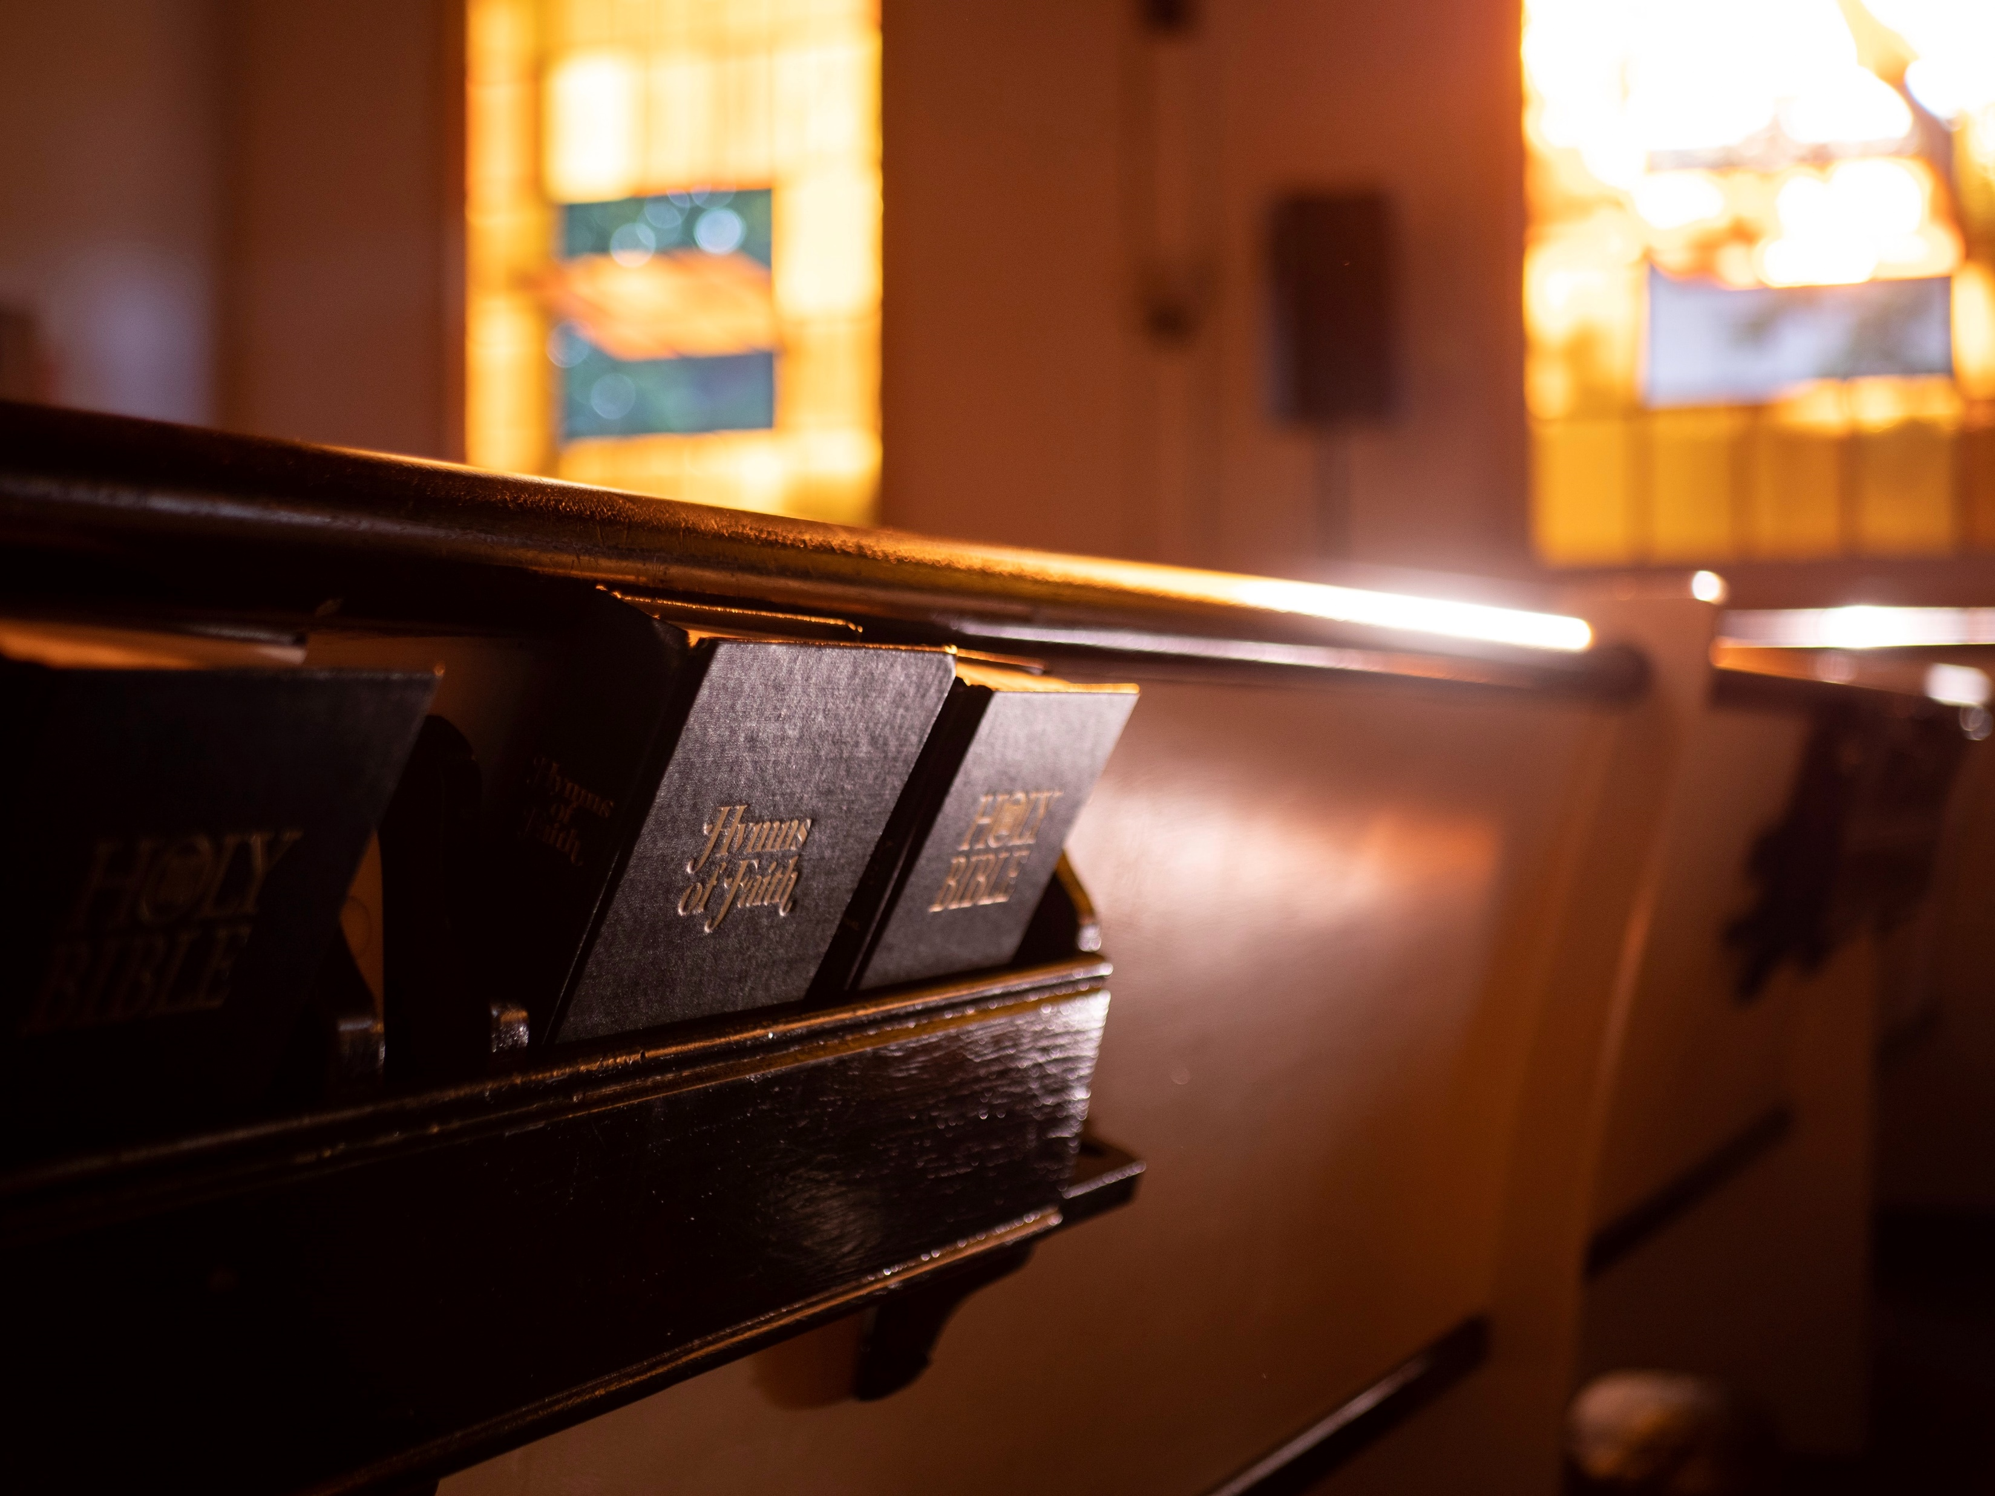
Renewed
by
Hymns

Slide 6
Create In Me A Clean
Heart

Slide 7
History of the Song
Author: Unknown
Published: 2012
Text: Psalm 51:10-13

Slide 8
Psalm 51
The Occasion: 2 Samuel 12:1-16
After David’s Sins
Against Bathsheba & Uriah

Slide 9
We Need To Understand…
How God Answers Prayer
How We Should React To God’s Answers

Slide 10
How God Answers Prayer
How Does God Answer Prayer in David’s Life?
2 Sam. 12:18

Slide 11
How God Answers Prayer
How Does God Answer Prayer in Our Lives?

Slide 12
How God Answers Prayer
How Does God Answer Prayer in Our Lives?
“Yes” “No” “Not Now”
Is this true?

Slide 13
How God Answers Prayer
How Does God Answer Prayer in Our Lives?
Jms. 1:5, 5:16
Lk. 21:36

Slide 14
In Order To Be Renewed…
Be Willing
Be Transparent
Be Prayerful
Be Spirit-filled

Slide 15
How God Answers Prayer
How Does God Answer Prayer in Our Lives?
Rom. 8:14
Deut. 6:6-9

Slide 16
How We Should React
How Did David React? 2 Sam. 12:18b-21

Slide 17
How We Should React
How Did David React? 2 Sam. 12:18b-21
Finished Mourning & Fasting
Cleaned Up
Worshiped God

Slide 18
How We Should React
How Should We React?

Slide 19
How We Should React
How Should We React?
Pray to God – Psalm 51

Slide 20
How We Should React
How Should We React?
Pray to God – Psalm 51
Clean Up Our Lives – Jn. 13:10, Lk. 11:39

Slide 21
How We Should React
How Should We React?
Pray to God – Psalm 51
Clean Up Our Lives – Jn. 13:10, Lk. 11:39
Worship God – Psa. 23:4, 34:18-19, 40:1-3

Slide 22
Do You Need
Renewal?

Slide 23
Songs of Praise To God

Slide 24
The Lord’s Supper
Acts 20:7

Slide 25
Closing Prayer

Slide 26
Songs of Praise To God

Slide 27
RESTORE REBUILD RENEW
Wednesday
Worship & Classes @ 6:30 pm
IN 2022
WHEELER
CHURCH
OF
CHRIST

