Slide 1
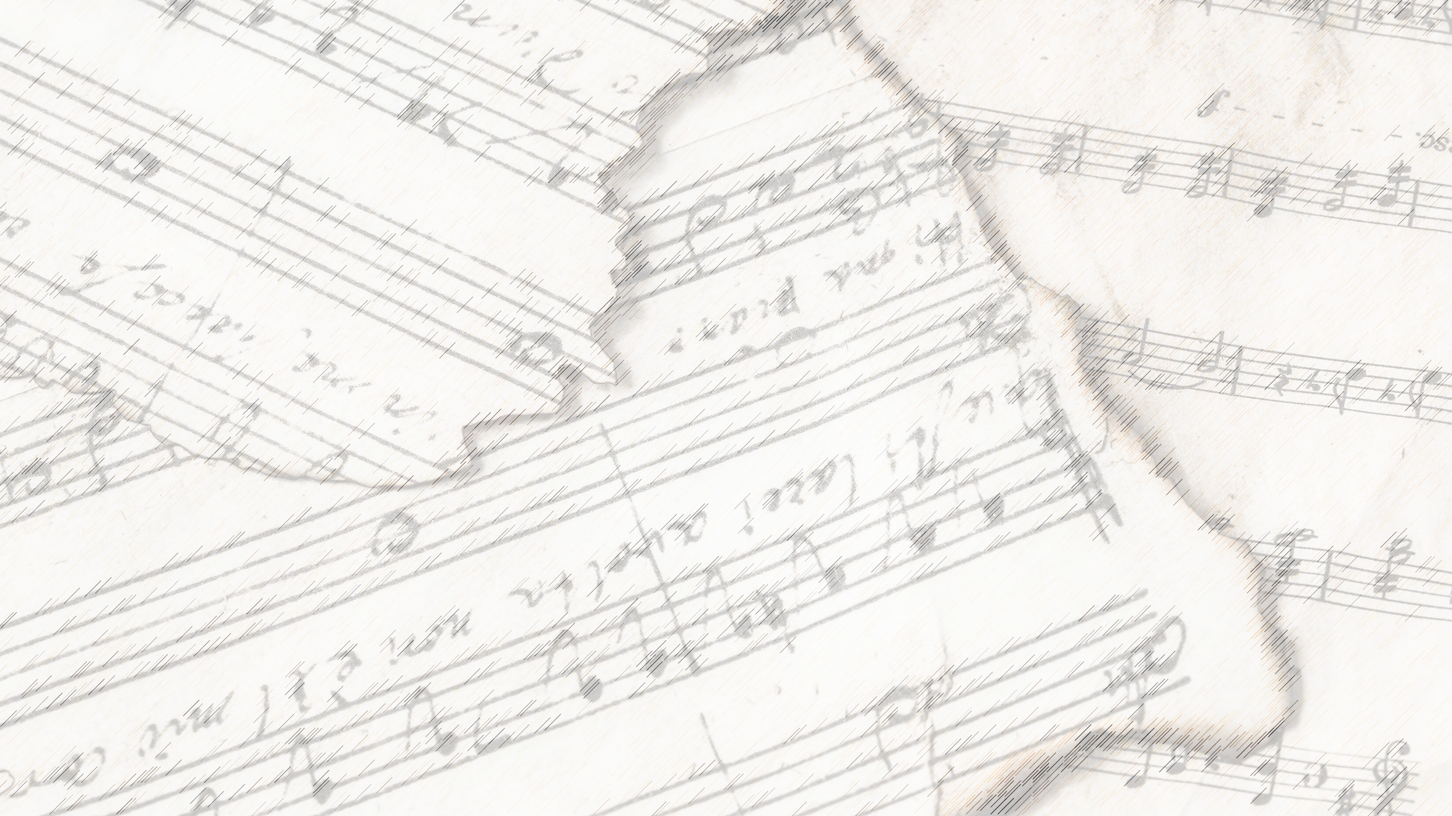
Welcome!
We Are Glad You Are Here

Slide 2
Sing Hallelujah
To The Lord
#242

Slide 3
There Is A Habitation
#860

Slide 4
Opening Prayer

Slide 5
Soldiers of Christ, Arise
#647

Slide 6
Stand Up,
Stand Up For Jesus
#648

Slide 7
Scripture Reading:
Exodus 3:1-5

Slide 9
Songs About
Standing Firm

Slide 10
Tonight:
Higher Ground

Slide 11
Holy Ground

Slide 12
Verse 1:
“This is Holy Ground.
We're standing on Holy Ground.
For the Lord is present and where He is, is holy.”

Slide 13
Two Leaders
Joshua– Josh. 5:15
Moses – Ex. 3:1-5

Slide 14
Verse 2:
You are holy, God, a Perfect and Holy God.
We will come before You with hearts
made clean by Jesus' blood.

Slide 15
Are You
Standing Up
For Jesus?

Slide 16
I Am A Poor,
Wayfaring Stranger
#979

Slide 17
The Lord’s Supper
Acts 20:7

Slide 18
The Unleavened Bread
“” – Jn. 6:48

Slide 19
The Fruit of the Vine
“” – Jn. 6:53-57

Slide 20
Our Offering
“” – Lk. 12:15

Slide 21
Closing Prayer

Slide 22
The Greatest Commands
#448

Slide 23
See You All
Tonight
@ 6:00pm!

