Slide 1
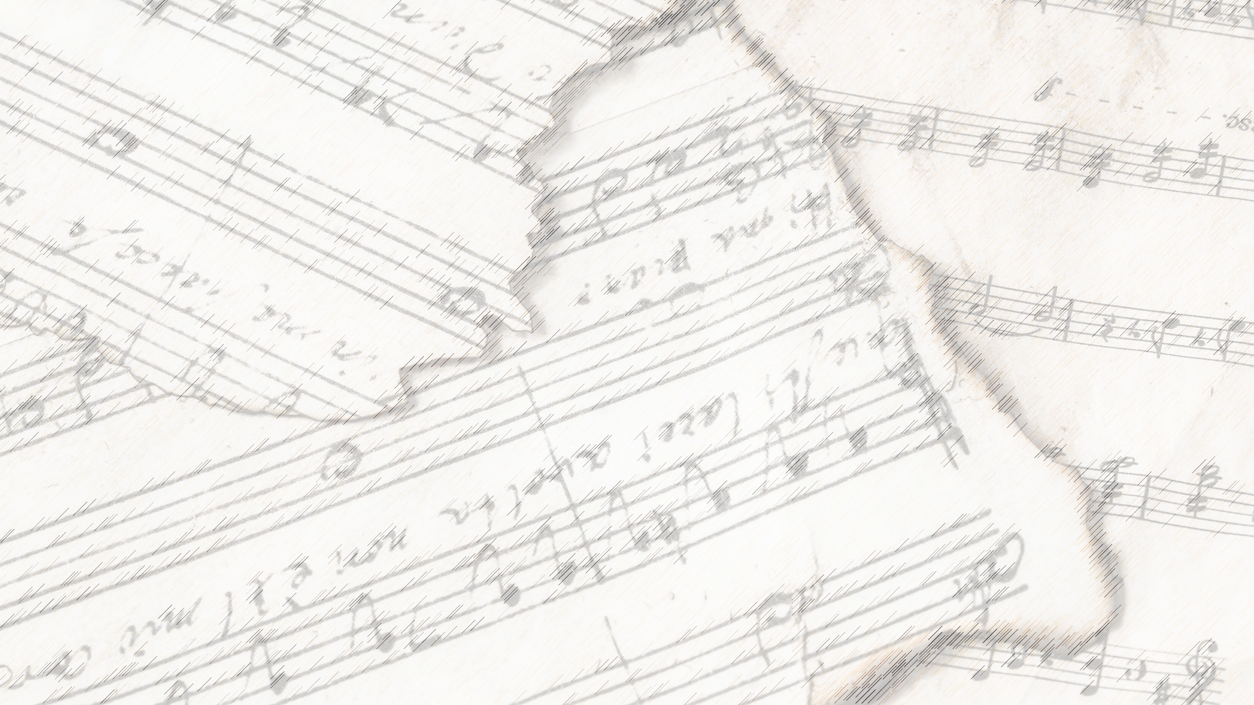
Welcome!
We Are Glad You Are Here

Slide 2
Songs of Praise

Slide 3
Opening Prayer

Slide 4
Songs of Praise

Slide 5
Songs About
Standing Firm

Slide 6
Holy Ground

Slide 7
Higher Ground

Slide 8
Verse 1:
“I’m pressing on the upward way,
New heights I’m gaining ev'ry day;
Still praying as I’m onward bound,
‘Lord, plant my feet on higher ground.’”

Slide 9
The Upward Way
Matt. 7:13-14
5:20, 48
Phili. 3:14

Slide 10
New Heights
2 Cor. 4:16
1 Cor. 15:31
Phili. 4:6-7

Slide 11
Verse 2:
“My heart has no desire to stay
Where doubts arise and fears dismay;
Though some may dwell where these abound,
My prayer, my aim, is higher ground.”

Slide 12
No Desire To Stay
Phili. 3:14
2 Cor. 5:2
Heb. 11:16, 4:11

Slide 13
New Aim
Ezek. 2:6
Jer. 23:4
1 Jn. 2:15-17
2 Pet. 1:5-8

Slide 14
Verse 3:
“I want to live above the world,
Though Satan’s darts at me are hurled;
For faith has caught a joyful sound,
The song of saints on higher ground.”

Slide 15
The World, Satan’s Domain
Eph. 2:1-3, 6:16
Jn. 12:31

Slide 16
The Song of Saints
Rev. 5: 8-10
14: 1-5

Slide 17
Verse 4:
“I want to scale the utmost height,
And catch a gleam of glory bright;
But still I’ll pray till heav’n I’ve found,
‘Lord, lead me on to higher ground.’”

Slide 18
A Glimpse of Glory
2 Cor. 4: 16-18, 5: 1-7, 12: 1-6

Slide 19
A Prayer for Glory
Matt. 6:13

Slide 20
Chorus:
“Lord, lift me up, and let me stand
By faith, on heaven’s tableland;
A higher plane than I have found,
Lord, plant my feet on higher ground.”

Slide 21
Standing By Faith
Rom. 3:28, 5:1-2, 11:20
Jms. 2:24

Slide 22
Standing By Faith
Eph. 2: 5, 8
1 Jn. 4:9-10

Slide 23
Are You Pressing On To
Higher Ground?

Slide 24
Invitation Song

Slide 25
Songs of Praise

Slide 26
The Lord’s Supper
Acts 20:7

Slide 27
Closing Prayer

Slide 28
Songs of Praise

Slide 29
See You All
Wednesday
@ 5: 30 pm
For our Family Meal

